Slide 1
Going Global: legal and business issues for international games development and distribution
Jas Purewal
Lecture to UBC Video Games Law course
30 January 2012

Slide 2
Overview
'Going Global'
Development
Distribution
Consumers
Q&A

Slide 3
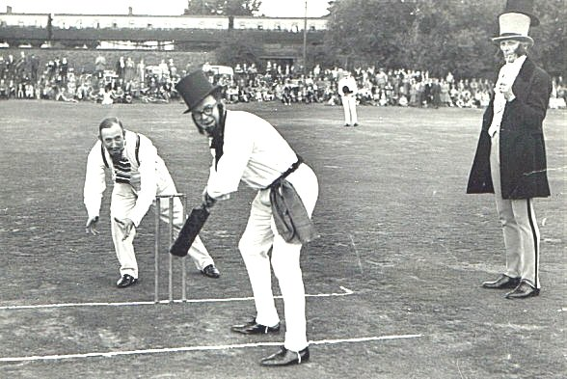
But first…
Hello from Merry Olde England!

Slide 4
About Osborne Clarke
About Osborne Clarke:
Osborne Clarke is an international law firm with over 550 lawyers working across 12 offices in the UK, Germany, Spain, Italy and Silicon Valley as well as a partner network worldwide
Our interactive entertainment practice:
Osborne Clarke is the leading interactive entertainment law firm in Europe
We advise the full range of interactive entertainment businesses from small developers to global publishers, platforms and distributors on all forms of interactive entertainment
We advise on legal issues in interactive entertainment including contracts, IP, privacy, regulation, employment, corporate/tax matters, financing and disputes
Clients include publishers and platforms such as Electronic Arts, Nintendo, Jagex, Gameforge and Facebook and developers including Team17, Ninja Theory, Stainless Games and Keen Games

Slide 5
About Jas
I'm an interactive entertainment and digital media lawyer at Osborne Clarke – I advise clients from independent developers to publishers on contracts, intellectual property, regulation and disputes
I write and speak regularly on legal issues in interactive entertainment and digital media, including on my blog: www.gamerlaw.co.uk
I like Twitter: @gamerlaw

Slide 6
Who are we talking about?
'International is a pretty big word
Example: 'Europe' comprises over 40 countries
The European Union only covers 27 of them
Some countries contain multiple legal systems, e.g. UK has 3!

Slide 7
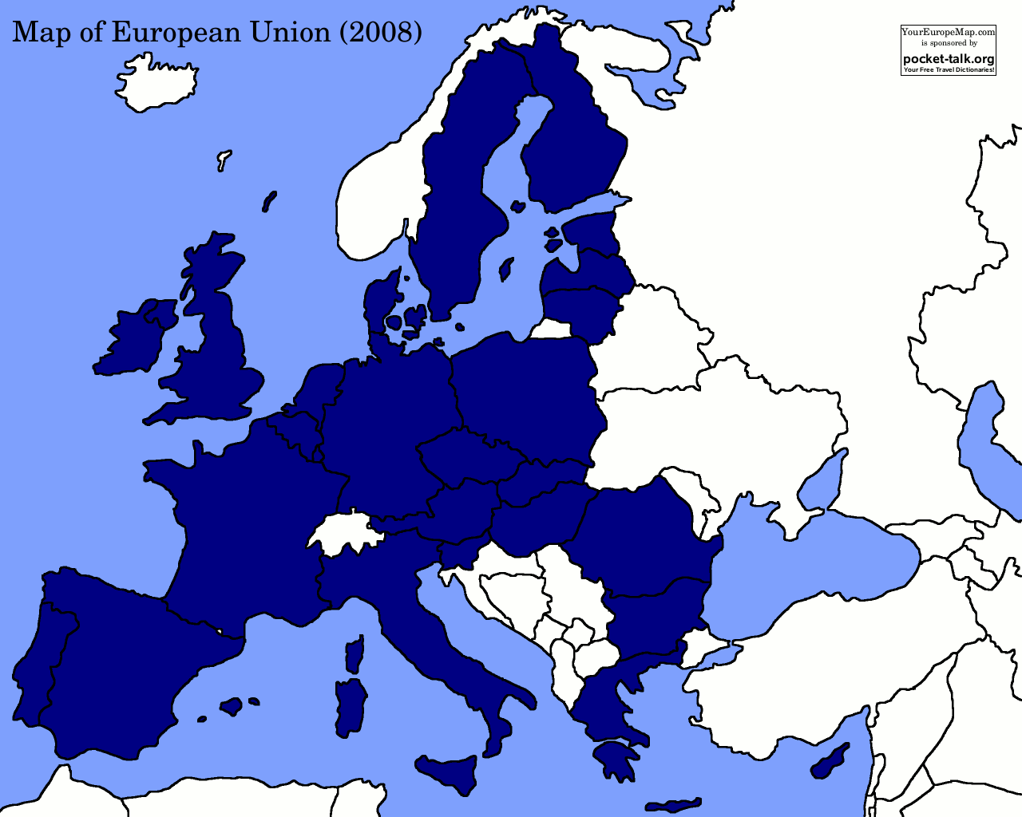
This isn’t the European Union...

Slide 8
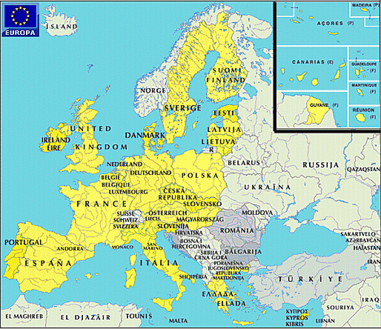
THIS is the European Union...

Slide 9
How big is the European games market?
2011 estimates:
UK: £3.6bn = ~ €4.5bn
Germany: €4.6bn
France: €3.2bn
Italy: €1.7bn
Spain: €1.6bn
Total UFIGS: €15.6bn = ~ €20.0bn
USA: €21.6bn
Source: Newzoo.com

Slide 10
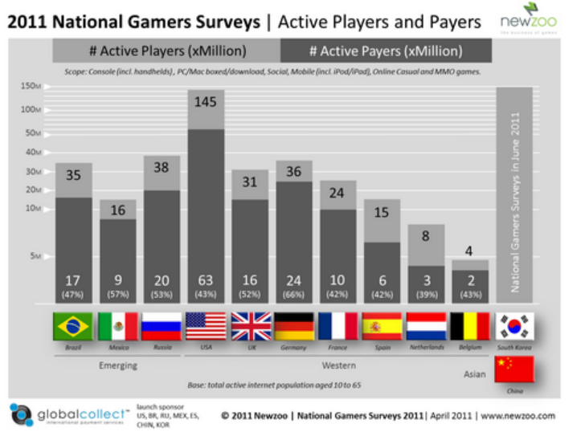
Different countries, different habits

Slide 11
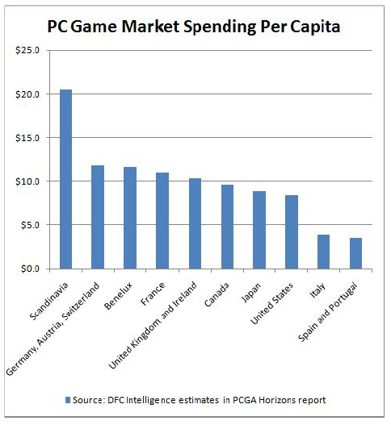
Different countries, different habits

Slide 12
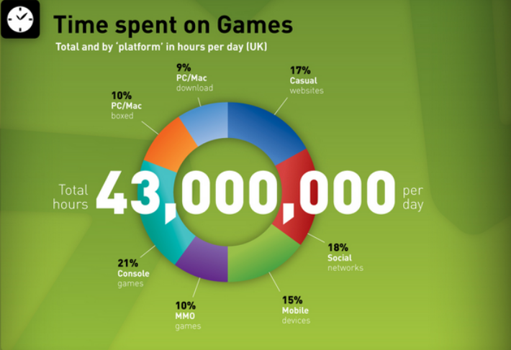
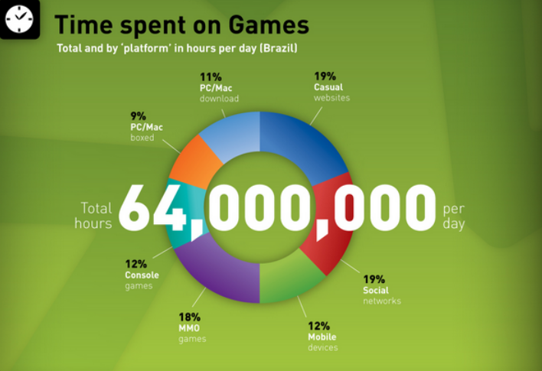
Different countries, similar habits
Source: www.Newzoo.com

Slide 13
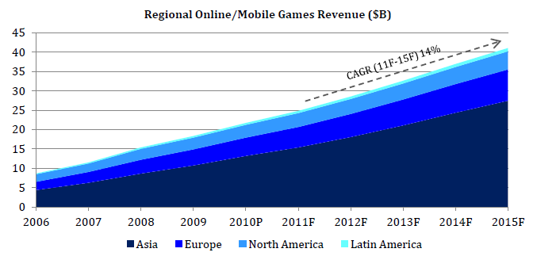
Growing at different rates...
Source: PwC, March 2011

Slide 14
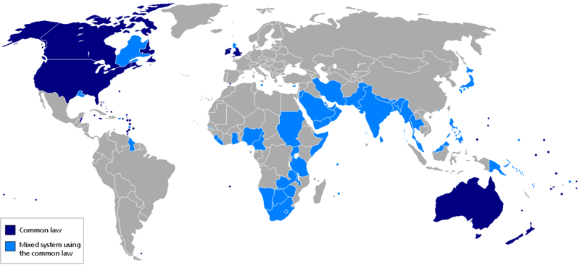
Development: contracts
Most countries don’t use a common law legal system
Source: DFC, March 2011
Source: Wikimedia

Slide 15
Development: contracts
Virtually no international harmonisation (and only very limited EU harmonisation)
Wide range of specific issues to consider under local law therefore
A few examples:
UK: Unfair Contract Terms Acts 1977 regulates unfair B2B contract terms in standard form contracts
Germany does not require consideration for contract validity; by default, USA and UK do (generally)
Several countries have signing formalities even extending to notarisation

Slide 16
Development: contracts
Governing law and jurisdiction
International treaties, e.g. WTO, Hague Convention
Supranational treaties, e.g. EU Brussels/Rome Regulations
Don't assume national laws are in place
Japanese law to amend certain parts of the Code of Civil Procedure and the Civil Provisional Remedies Act (No 36, 2011) – in force 1 April 2012 (source: Nishimura & Asahi)
A good rule of thumb is that any governing law and jurisdiction will take place in the country ‘most closely connected (complicated to work out and there exceptions even to that – e.g. e.g. China)

Slide 17
Development: intellectual property
Some international harmonisation via international treaties e.g. Berne Convention, Universal Copyright Convention, TRIPS.
But many differences in practice. Examples:
Copyright:
Different international approaches to e.g. registration requirements, moral rights, infringement, damages, fair use/dealing
What’s going on re cloning?
Tetris Holding Company LLC v Xio Interactive, Inc (Case 09-6115, USDC D. New Jersey)
SAS v World Programming (Case C‑406/10, CJEU)

Slide 18
Development: intellectual property
Trade Marks:
Trade marks are country-specific (although note Madrid Convention and Community Trade Marks)
Patents:
Patents are also country-specific
Software patents in EU

Slide 19
Development: intellectual property
Practical tips:
Consider IP protection/regulation formalities separately in each key market
Standard catch-all "worldwide" wording in IP clauses – does it work?
No direct authorities
Likely to provide at least some persuasive assistance
However, unlikely to evade any specific local requirements
IP issues are separate to questions of governing law or jurisdiction

Slide 20
Development and Distribution: Structure
Where is the best place for the development to take place legally?
By default, where the majority of development takes place physically
What about where the work is carried out internationally?
How easy/difficult is it to do business in a particular country…?

Slide 21
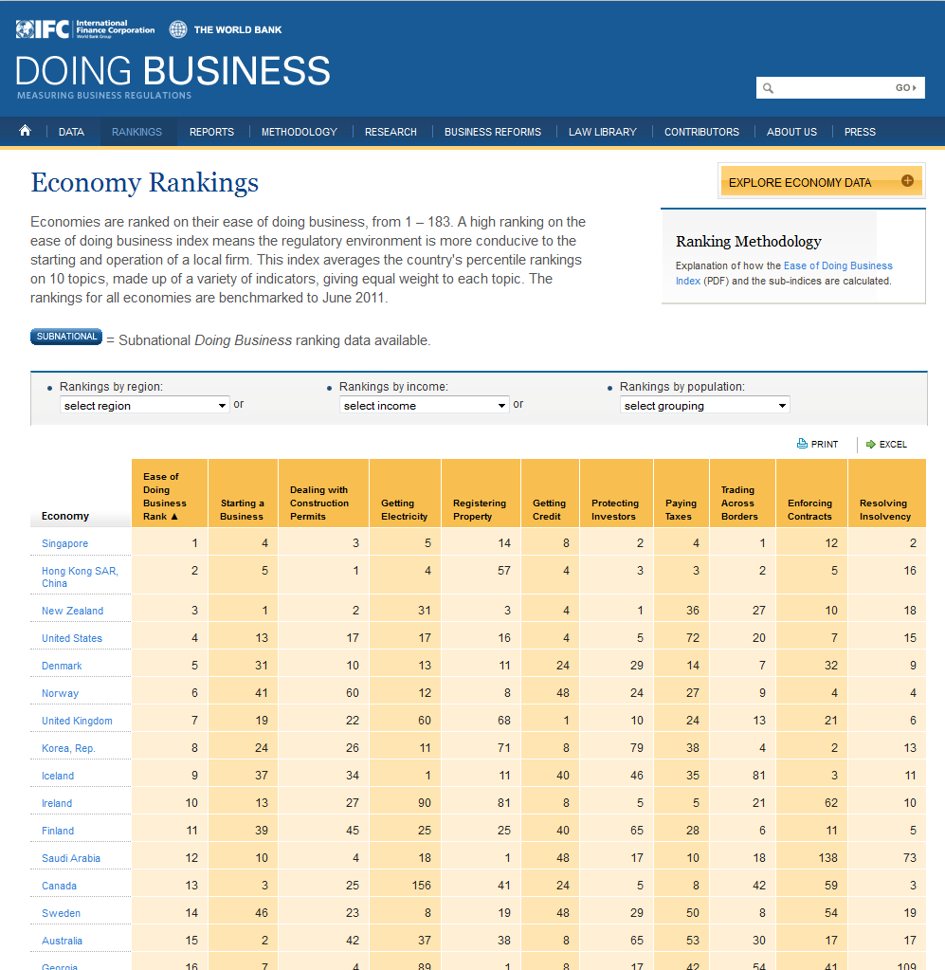
http://www.doingbusiness.org/rankings

Slide 22
Development and Distribution: Structure
Again, wide differences between corporate vehicles in different countries:
USA: LLC, LLP, Inc...
UK: LTD, LLP, Plc...
France, Switzerland… SARL, SA...
Australia, South Africa: Pty Ltd...
India: Pvt Ltd...
Is it useful/necessary, or unhelpful, to have a physical presence in a particular market? (Cf Yahoo! Nazi Memorabilia case)

Slide 23
Development and Distribution: Structure
What is the most tax efficient?
Highly complicated!
Key factors are local corporation tax, employment/social security/payroll contribution and sales tax/VAT
Tax breaks are another key consideration (e.g. Canada, France, soon UK)
Country examples:
Brazil: 34% corporation tax, sales tax 17-25%
Australia: 30% corporation tax, 4-6% payroll, 10% sales tax
Luxembourg: corporate tax 29.63% (BUT substantial IP savings), sales tax 15%
Offshoring game development and/or the IP can be very valuable – but tricky to obtain (and maintain)

Slide 24
Distribution: Contractual
Distribution deals can present their own contractual issues
In particular, watch out for the EU Commercial Agents Directive (86/653/EEC)
Grants 'commercial agents' wide powers during and after the agency
Directive can effectively also covers distributors… sometimes.
Among other things, makes termination for convenience terms significantly less useful

Slide 25
Distribution: Contractual
Some countries have their own local approaches, e.g. -
distributor right of return in Germany
use of standard software contracts in Sweden
some countries do not recognise the work for hire principle (and using governing law clauses doesn’t get around that)
Russian developers can demand a non-exclusive licence over their work
in China, software development or licensing are usually seen as ‘technology import arrangements’ – requires local government authority approval

Slide 26
Distribution: local best practice
Look for distribution rights in geographically proximate countries and/or countries with a common language:
e.g. 'Benelux', 'GAS', Malaysia & Singapore, Arabic-speaking countries
How are you actually going to distribute? Wheel or Hub?
e.g. Amsterdam/Europe, Kuala Lumpur/SE Asia, South Africa/Africa
Political niceties can prove important:
e.g. 'Cyprus', 'Korea'
Euro-collapse best practice:
Which countries are you dealing with? Are they at risk?
Do you have to use the Euro at all?
Consider using currency conversion/suspension/termination provisions

Slide 27
Distribution: local best practice
You monetisation model may be different in different territories:
e.g. Starcraft 2: traditional pricing in West; subscription in Russia, Brazil
Retain rights over as many revenue streams as you can, even if they do not seem important in your home territory
Watch out for local law problems:
e.g. Trade debtors' right of return under German law

Slide 28
Distribution: advertising and marketing
Advertising and marketing law vary widely from country to country – no one size fits all answer. Examples:
UK introduced regulation of advergaming in 2010 (virtually no other countries have)
France requires commercial advertising and packaging to be in French
Typically breach constitutes a civil offence (unless of content laws, e.g. in Middle East)
Advertising to children is particularly problematic
Patchily regulated around the world
Sometimes no rules at all, or a mix of legislation, cases and voluntary standards
High likelihood of reform (especially within EU – "A Safer Internet for Children")

Slide 29
Distribution: controlling your products
First sale/Exhaustion of rights issues – can you control release of your product in a particular territory?
Not often a substantial issue outside of US and EU
Oracle v UsedSoft (C-128/11, CJEU 3/07/12)
Price maintenance: can you control your product's price?
Complicated under EU competition law
Broadly: minimum or fixed prices bad, recommended prices ok
But that differs elsewhere
e.g. Chinese AntiMonopoly Law: resale price maintenance only illegal if it restricts or eliminates competition
More subtle position in US than in EU?
Your ability to control price maintenance is therefore heavily dependent on local law

Slide 30
Consumers: consumer protection
The European Union has probably the most advanced/prescriptive consumer protection system in the world:
e.g. Unfair Terms in Consumer Contracts Directive, Unfair Contract Terms Directive – make void any unreasonable consumer contract term (including in EULAs):
Mandatory Arbitration: X
Unilateral risk allocation: X
Liability limitation: X
Other consumer-facing legislation, e.g. Distance Selling Directive: do consumers have the right to return unwanted physical or digital products?

Slide 31
Consumers: consumer protection
Moves towards even stronger legislation –
Example #1 - new Consumer Rights Directive (?)
Originally intended to harmonise ALL EU consumer protection systems
Now watered down to a limited maximum harmonisation package
But work slowly continues to strengthen and harmonise EU consumer protection law – e.g. draft Common European Sales Law or virtual property/digital content proposed classification
Example #2 – proposed Direction on Consumer ADR / collective EU consumer redress

Slide 32
Consumers: consumer protection
Don’t overlook national law
Some countries have even stronger laws, e.g. Germany – absolute consumer right of goods return within 2 weeks
Other major games markets tend to have well-developed, activist consumer protection systems, e.g. Japanese Consumer Affairs Agency vs 'kompu gacha' game mechanic (2012)
Patchy record elsewhere
Few, or few enforceable, consumer protection laws in developing markets though definitely not missing altogether –
E.g. Indonesia: online T&CS only enforceable if fair and not misleading

Slide 33
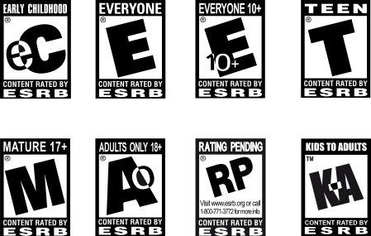
Consumers: age ratings
ESRB: USA
PEGI: 31 countries (European plus others including Canada and Israel); mix of voluntary and mandatory usage
Most countries; local standards
Australia: no 18+ rating at all (until August 2012) – Left4Dead 2, Aliens v Predator
Some countries stray into censorship allegations:
e.g. Iran/Battlefield 3
e.g. violent games legislation in Brazil, Venezuela, Switzerland
Age gating?
You need to know about the German system...

Slide 34
Distribution of indexed and non-indexed games in Germany
(Offline distribution only)
Game
USK rated?
no
Indexed?
yes
List A or B?
A
yes
no
B
18 rating?
Contents banned
by Criminial Code?
No distribution.
yes
no
yes
no
Contents "severely"
youth-endangering?
yes
Distribution
and advertising
OK, no sale to
minors under
the relevant
age
Distribution OK, but
restrictions apply,
including:
No over-the-counter sales
Restrictions on advertising
Restrictions on distance
selling
no
Distribution and
advertising OK,
but restrictions on
distance selling, and
no sale to minors

Slide 35
Consumers: privacy
Again, EU has an advanced/prescriptive system:
Series of statutes: Data Protection Directive, e-Privacy Directive, Cookie Directive...
Structured around 8 key data protection principles
Fundamentally focuses on the protection of ‘personal data’ / ‘sensitive personal data’
Particular focus on gathering of data from minors under 13
Strict prohibitions on third party data transfer
Range of national regulators with different enforcement powers
HUGE reform/change is incoming...

Slide 36
Consumers: privacy
Different approaches worldwide:
Examples -
Turkey: no meaningful data protection law at all yet
Japan: mixture of laws (applying to substantial use – e.g. Databases exceeding 5k users) and persuasive guidance. Broadly similar to EU approach – e.g. Use of ‘personal data’; limited use; requirement of explicit consent; limited transfer

Slide 37
Other issues
Examples of other matters to be aware of:
Gambling
Product liability
Fraud
Banking/financial services
Employment practices
Disputes

Slide 38
Thanks!
Marketing > Fotos > PP_Pitch > Kontakt 2
Jas Purewal
Senior Solicitor London, UK
T +44 (0) 207 105 7268
Jas.Purewal@osborneclarke.com Twitter: @gamerlaw www.osborneclarke.co.uk

