Slide 1
EULAs, TOUs, and NPEs: WTF?
@RochRipley
UBC VGL
September 11, 2013

Slide 2
Introduction
This talk
End User License Agreements
Terms of Use
Non-practising Entities (patent trolls)
Why these topics?
Paper Ideas
Consider the degree to which private law modifications and exceptions to statutory IP laws are beneficial
Notes:
EULAs & TOUs: Understand legal options for implementing business strategies. Can control/influence resale of games; how games are played.
NPEs: Timely.

Slide 3
EULAs & TOUs
Without EULAs & TOUs
Games are protected by copyright [Atari v. Oman [D.C. Cir 1992)]
Reverse Engineering okay [Atari v. Nintendo (Fed. Cir. 1992), Sega v. Accolade (9th Cir. 1992)]
Enhancements, which do not create a derivative work, okay [Lewis Galoob Toys v. Nintendo (9th Cir. 1992)]
Fair use exception to copyright infringement
Copyright exhaustion

Slide 4
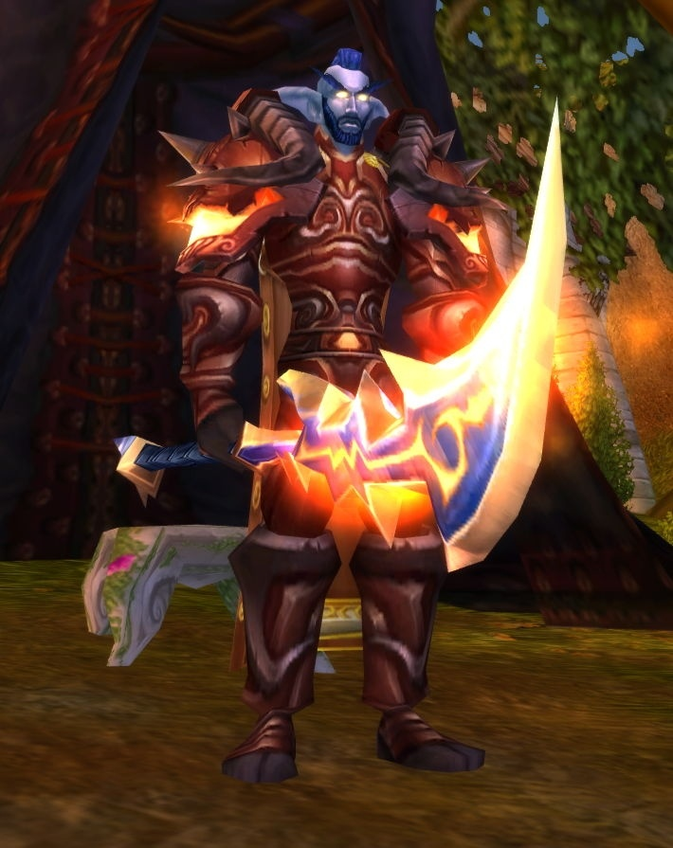
EULAs & TOUs
Davidson & Associates, Inc. v. Internet Gateway, 2004 U.S. Dist. LEXIS 20369 (E.D. Mo. 2004), aff’d 2005 U.S. App. LEXIS 18973 (8th Cir. 2005)
Established competing Battle.net service that did not require authentic copy of WOW → DMCA + EULA + TOU

Slide 5
EULAs & TOUs
“you may not, in whole or in part, copy, photocopy, reproduce, translate, reverse engineer, derive source code, modify, disassemble, decompile, create derivative works based on the Program”
“you shall not be entitled to … (iv) host or provide matchmaking services for any Blizzard software programs or emulate or redirect the communication protocols used by Blizzard as part of Battle.net”
Fair use (reverse eng) trumped by contract
Violation of DMCA: CD Key is an anti-circumvention device
Notes:
Also a DMCA issue; illustrate with next case

Slide 6
EULAs & TOUs
MDY Industries, LLC v. Blizzard Entertainment, Inc. (9th Cir. 2010)
Warden vs. Glider → DMCA + EULA + TOU

Slide 7
EULAs & TOUs
“All use of the Game Client is subject to this License Agreement and to the [TOU], both of which you must accept before you can use your Account to play the Game.”
“You agree that you will not (i) modify or cause to be modified any files that are a part of the Program or the Service; (ii) create or use cheats, bots, "mods," and/or hacks, or any other third-party software designed to modify the World of Warcraft experience”

Slide 8
EULAs & TOUs
Liable for breach of contract, violation of DMCA
No DMCA copy control breach b/c no © infringement
But, still DMCA access control breach
But breach of contract ≠ copyright infringement
No statutory damages & higher threshold for injunction

Slide 9
EULAs & TOUs
Vernor v. Autodesk, Inc., 2010 U.S. App. LEXIS 18957 (9th Cir.)
“YOU MAY NOT … (4) use . . . the Software outside of the Western Hemisphere; … [Y]ou must destroy the software previously licensed to you, including any copies resident on your hard disk drive . . . within sixty (60) days of the purchase of the license to use the upgrade or update ”

Slide 10
EULAs & TOUs
Vernor attempted software resale: exhaustion of rights if software was sold (vs. licensed)
“We hold today that a software user is a licensee rather than an owner of a copy where the copyright owner (1) specifies that the user is granted a license; (2) significantly restricts the user's ability to transfer the software; and (3) imposes notable use restrictions.”

Slide 11
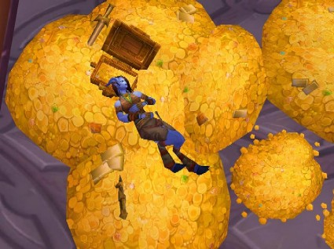
EULAs & TOUs
Blizzard Entertainment, Inc. v. In Game Dollar, LLC (2007), United States District Court for C.D. Cal., Case No. SACV07-0589-JVS
Notes:
Peons4hire: sell virtual currency for real currency; aggressive in game marketing

Slide 12
EULAs & TOUs
“… you shall not, under any circumstances, ... Exploit the Game or any of its parts, including without limitation the Game Client, for any commercial purpose”
“you may not:…Disrupt the normal flow of dialogue in Chat or otherwise act in a manner that negatively affects other users including without limitation posting commercial solicitations and/or advertisements for goods and services available outside of the World of Warcraft universe”
Notes:
Note Hernandez v. Internet Gaming Entertainment, Ltd., United States District Court Southern District of Florida, Case No. 07-21430-Civ-COHN/SNOW (Filed May 31, 2007, Settled August 26, 2008), in which a Battle.net user claimed to be a third party beneficiary of TOU and sued Internet Gaming Entertainment, Ltd. for selling virtual gold in a real world marketplace. Result was a settlement (although probably without teeth) in which IGE agreed to cease selling virtual gold.

Slide 13
EULAs & TOUs
Zynga Game Network, Inc. v. Labrasca, District Court for N.D. Cal., Case No. 5:09-cv-02958-PVT (2009)

Slide 14
EULAs & TOUs
Alleged Labrasca ran a number of websites that sold, for real world currency, virtual poker chips usable online in the game. Labrasca used the game to transfer the chips to purchasers.
“The Terms of Service that govern users' play of the Game provide that the "chips" used in the Game "are not redeemable for any sum of ‘real world' money or monetary value." The Terms of Service also prohibit sale of "chips" "for 'real world' money" and prohibit the use of the Game for unacceptable purposes, including activity in "conflict with the spirit or intent of' the Game.”
By consent judgment Zynga received $45,000 as well as fees and costs.

Slide 15
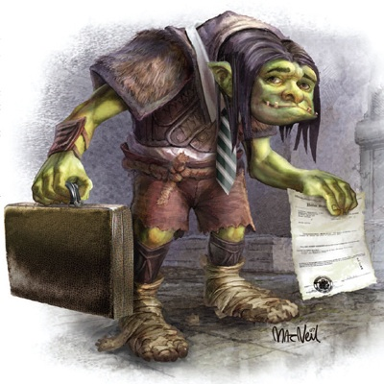
NPEs

Slide 16
NPEs
Have been around for decades; come into prominence over last 10 years, especially in IT industry
Why?
Emergence of the business method patent and State Street Bank v. Signature Financial Group decision
.com economic boom and bust
Top tier IP litigators working on contingency for NPEs

Slide 17
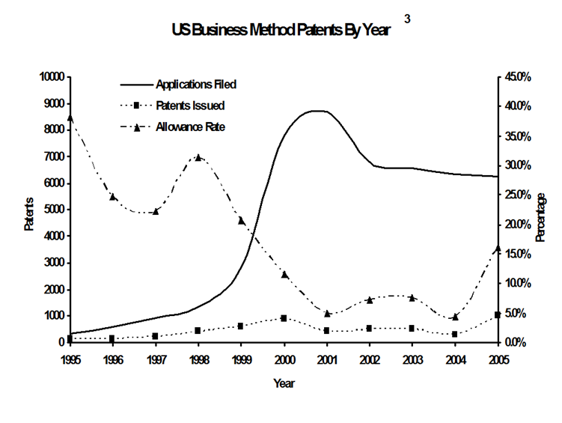
NPEs

Slide 18
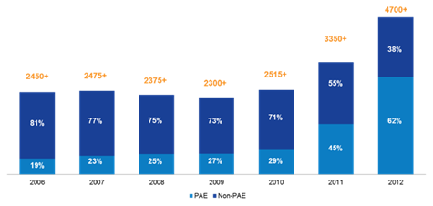
NPEs
PAE Suits (2005-2012)
Source: http://www.patentlyo.com/patent/2013/03/chien-patent-trolls.html

Slide 19
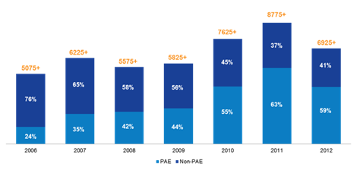
NPEs
PAE Defendants (2005-2012)
Source: http://www.patentlyo.com/patent/2013/03/chien-patent-trolls.html
Notes:
Drop in 2012 numbers from 2011: AIA Misjoinder rules

Slide 20
NPEs
Response
Law has evolved [at least partially] in response to NPEs
Jurisprudence
Easier to invalidate patents as obvious
Victor will not necessarily get permanent injunction
Statute
AIA: NPEs must start multiple suits, new ways to challenge patents
Proposed: SHIELD Act (NPE pays “full costs” and must post bond in advance; note Canada by default has loser [partially] pay system)
Executive
White House Task Force on High-Tech Patent Issues

Slide 21
NPEs
Gametek LLC v. [Everybody] (Facebook, Zynga, etc.) (2012)
“… the patent would seem to cover the common practice of using virtual currency to obtain items in a game.” http://paidcontent.org/2012/03/01/419-patent-troll-stalks-social-gaming-industry-over-virtual-payments/
Notes:
Lodsys also a high profile troll going after iOS and Android developers

Slide 22
NPEs
1. A method of managing the operation of a game which includes a game environment, and is programmed to control a gaming action for at least one of a plurality of users, said managing method using a programmed computer to effect the following steps:
a) tracking the activity of the at least one user in the course of the gaming action;
b) permitting the at least one user to create an account for receiving a consideration of the at least one user, the at least one user having a set of demographics;
c) determining the eligibility of the at least one user to purchase at least one of a plurality of game objects, said eligibility determining comprises the following sub steps:
i) permitting the at least one user to select the at least one game object,
ii) setting the purchase price of the at least one game object, and
iii) comparing the account balance of the at least one user's consideration with the set price of the at least one game object and, determining if the balance of the user's consideration is not less than the set price, determining the at least one user to be eligible to purchase the at least one game object;
d) displaying in the game environment a purchase price of the at least one game object;
e) presenting to the at least one user an offer to purchase the game object dependent upon a group of game parameters comprising the tracked activity of the at least one gaming action of the at least one user and, the one game environment or the one set of demographics of the least one user
f) permitting the at least one user to purchase the at least one game object at the set purchase price without interrupting the gaming action of the at least one user; and
g) supplying the at least one purchased game object to the at least one user without interrupting the gaming action of the at least one user and incorporating the game object into the game.

Slide 23
NPEs
Uniloc v. Mojang AB (Texas E.D., 2012)
“an online authentication system that enables users to verify and accesses their data on a portable ‘licensing medium.’”
“it was reported that the lawsuit has also been filed against other gaming companies including Halfbrick, Gameloft, Square Enix, Laminar Research, and Electronic Arts.” (http://www.digitaltrends.com/gaming/patent-troll-uniloc-sues-minecraft-maker-mojang-over-vague-patent/#ixzz2I7JrqiB8 )

Slide 24
NPEs
1. A system for preventing unauthorized access to electronic data on an electronic device, the system comprising:
a portable licensing medium configured to communicate with the electronic device and to store license data, the license data configured to be used by the electronic device to determine whether to allow access to the electronic data; and
a registration authority configured to communicate with the electronic device, the registration authority having verification data for verifying the license data stored on the licensing medium,
wherein the registration authority provides updated license data for the licensing medium.

Slide 25
Conclusion
Too much IP? Too much deference to K?
Was there ever a legal “sweet spot”?
What should be changed? How?
Courts reacting to the times. Have they kept up with technology?

Slide 26
Questions?
THANK YOU
@RochRipley
Roch.Ripley@gowlings.com
(604) 443-7632

