Slide 1

“Introduction”
Talk 1
Video Game Law - Fall 2013
UBC Law @ Allard Hall
Jon Festinger Q.C.
Centre for Digital Media
Festinger Law & Strategy
http://videogame.law.ubc.ca
@gamebizlaw
jon_festinger@thecdm.ca

Slide 2

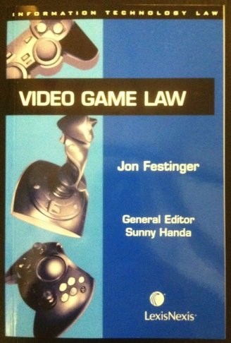
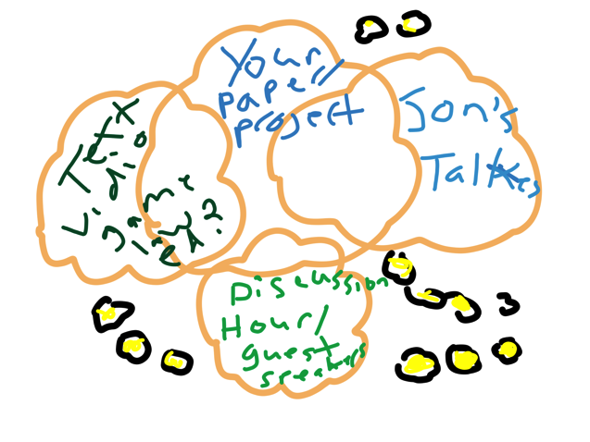
Origins
7th year being taught
Originally a book; but a course outline before a book..
2005/2006 UBC/UVic video experiment
Last year – started from scratch
iTunes U project (1st & last)
Last year – blogsite; This Year – website
http://videogame.law.ubc.ca Thanks to UBC CTLT

Slide 3

Pedagogic Goals
One word: ENGAGEMENT
Two words: CREATING PERSPECTIVE
Three words: APPRECIATING (LEGAL) COMPLEXITY

Slide 4
A Modest & Self Serving Pedagogic Theory
Engagement is interactivity
Most engaging form of goal-oriented interactivity requiring
skills growth, path choices & reflection……
…GAMES (of course)
So think of this as the “MMORPG” of law courses
(ok, it’s not massive)…
World of
LawyerCraft

Slide 5



Meaning what exactly?…
* “Quest” = Great paper, great contributions
* “Open World” = Vast terrain to be explored and navigated in your own way & on your unique(non-linear) path
Can be played from a “1st or 3rd person” perspective
* Provide tools for “user generated content”
Provide additional “downloadable content”
Encourage “multiplayer” engagement
In other words Skyrim (if it had multiplayer..)

Slide 6
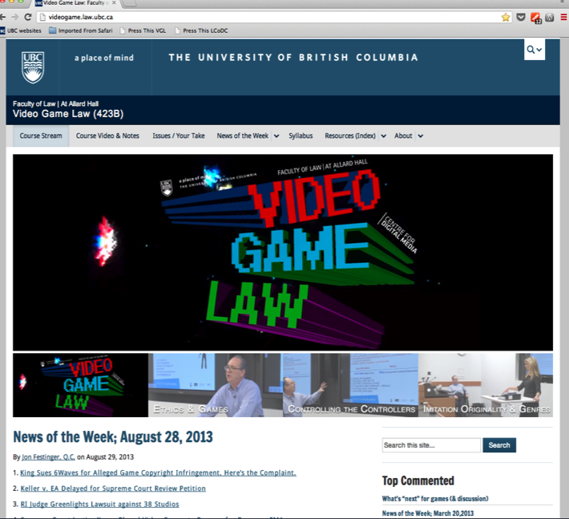

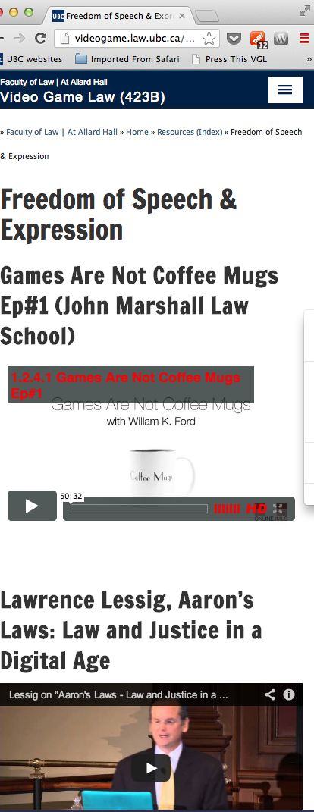
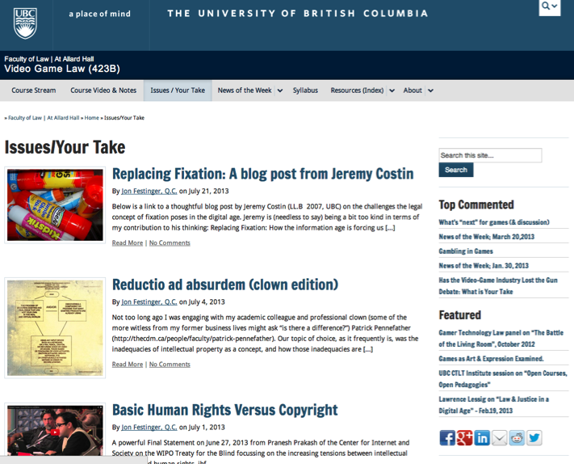

http://videogame.law.ubc.ca

Slide 7
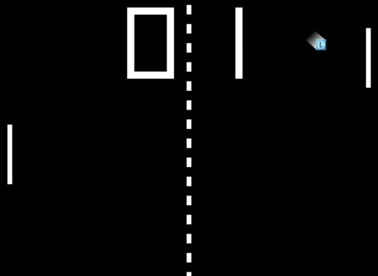
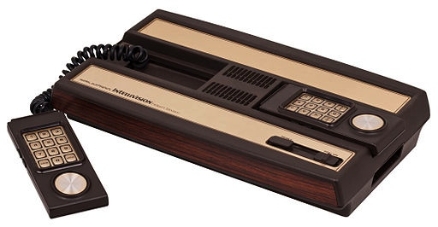
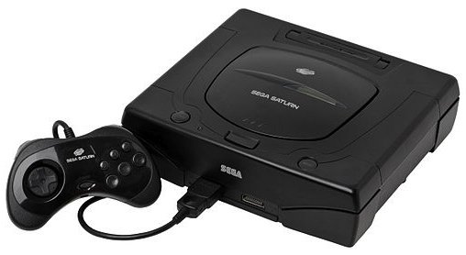

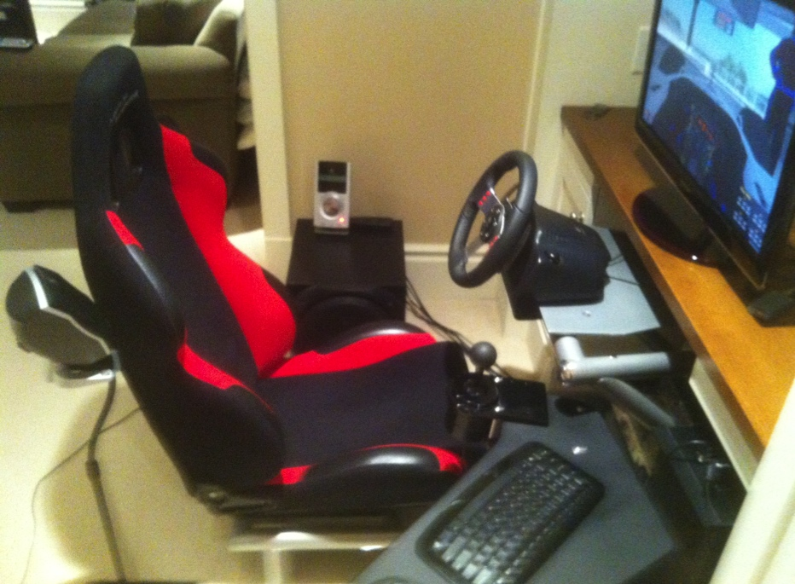
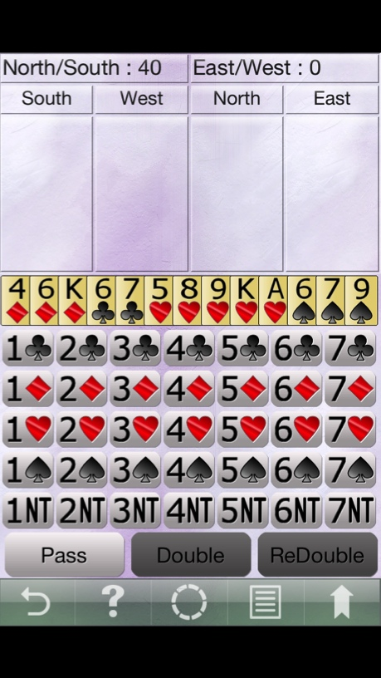
Gaming Bio

Slide 8


…From Form to Substance
Is Video Game Law a Unique area?
Is Digital Media catching-up?
Relationship to Media & Entertainment Law – analogy
– Newtonian physics to “string theory”

Slide 9
Video Game Leadership
Firsts & furthers, as well as barriers broken:
interactivity (multiplayer “Spacewar”)
“Control” – voice, mouse to Kinect to Google Glass
On-line “community”
social
voice over IP
open world
avatars (zeitgeist, memes, identity & equality)
3D
Virtual reality
Portability (handhelds)

Slide 10

What is a game?
Roots in play (fun)
+ Creativity
Always interactive
The digital journey “From documents to data“
Antecedents: comic books, pinball, D&D
Main metaphor: initiating content rather then receiving content (Television as “transmitter” to gamer as “transmitter’).
Strange thought: Gaming as Evolution (not the evolution of gaming). There must be a functional reason we are driven to play games…..Darwin was a gamer?
???

Slide 11
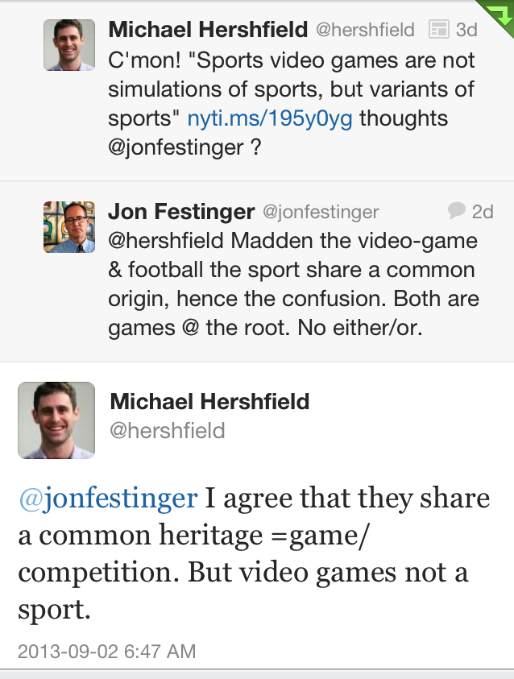
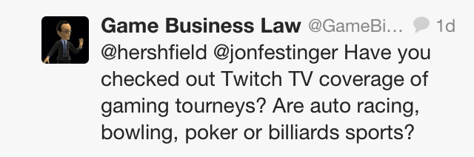
Is Madden NFL a Sport?
“Examined, the Virtual Life Is Worth Living: Madden NFL 25 Portrays ‘Real’ Football” New York Times, August 26, 2013 http://www.nytimes.com/2013/08/27/arts/video-games/madden-nfl-25-portrays-real-football.html
“And yet Madden NFL is largely ignored by the people who write about, and study, video games for a living; neither sport nor video game, And yet Madden NFL is largely ignored by the people who write about, and study, video games for a living; neither sport nor video game, I sit you out, they sneer. This quiet disdain for video game football is why it was shocking to so many, a decade ago when it emerged that National Football League players love to play Madden NFL. Why would real football players spend their time playing fake football?
Because it’s not fake. It’s football.”

Slide 12

WHY?
“Equally strange is our general addiction to games, both physical and mental. The profusion of games is truly startling: card games, board games, word games, ball games, electronic games….We even assemble in huge crowds to watch others playing games. What does all this mean? Do we simply get easily bored and cannot tolerate inactivity? I can find nothing in the literature of scientific psychology that helps me to understand such bizarre behavior.”
The Human Legacy (1982)
Leon Festinger

Slide 13

Play as Evolution
Does Gaming have an evolutionary purpose in the
Darwinian sense?
Dr. Kimberly Voll (CDM/UBC) – From “Game Design” – DMED 521:
1. “neurons that fire together, wire together” (Donald Hebb, aka “Hebbian Learning”)
2. “..so “fun” seems to be something our brains use to keep us doing something to the point of mastery…makes sense if it is something that will help us live better and get our genes out into the gene pool again…”

Slide 14

Stepping Up
* “5,000-year-old gaming tokens found in Turkey” (Aug. 15, 2013)
http://archaeologynewsnetwork.blogspot.ca/2013/08/5000-year-old-gaming-tokens-found-
in.html#.UibUSBbE9TM
* “We are all hardwired for play” (Oct. 18, 2012)
http://vgalt.com/2012/10/18/we-are-all-hardwired-for-play/
* “Jailed Megaupload Founder Falls From Top Spot In Modern
Warfare 3 Rankings” (Jan. 25, 2012)
https://www.gameinformer.com/b/news/archive/2012/01/25/jailed-megaupload-founder-falls-
from-top-spot-in-modern-warfare-3-rankings.aspx
*Playing With Life: Are Living Video Games Ethical? (Mashable
July 14, 2013)
http://mashable.com/2013/07/14/living-video-games/

Slide 15

Full Circle?
* “Largest space battle in history claims 2,900 ships, untold virtual lives:The combat is fake, but the emotions are real”
(The Verge July 28, 2013)
http://www.theverge.com/2013/7/28/4565558/eve-online-biggest-space-battle-in-history
http://www.youtube.com/watch?v=h9x8eYjUQzg
* “Game or be gamed: Douglas Rushkoff on prototyping democracy through play” (The Verge Dec. 12, 2012)
http://www.theverge.com/2012/12/12/3758576/douglas-rushkoff-gameplay-as-prototype
“By viewing our social, political, and economic structures through the lens of interactivity, Rushkoff says, we are beginning to "transition from the world of passively accepted narrative to one that invites our ongoing participation.”
EVOLUTION…

Slide 16

Next Week
Games are not IP;
Video Games are IP;
Explain?:….
Part A. Creating
“If Picasso had painted a round object…”

Slide 17
Our Academic Partners

