Slide 1
Building a franchise from your video game property
Don McGowan
Video Game Law, UBC Law 423B

Slide 2
Outline
The role of contracts in making your franchise
  What types of contracts are we talking about
  Some typical clauses in a non-video game contract
  What you need to watch out for in contracting
Other issues that arise when you build a franchise
  Product placement opportunities and pitfalls
  Fan interaction from different communities

Slide 3

Mandatory weasel words

Slide 4
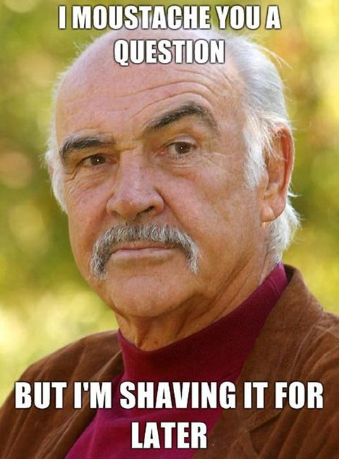
Feel free to ask questions whenever
Image source: www.reddit.com

Slide 5
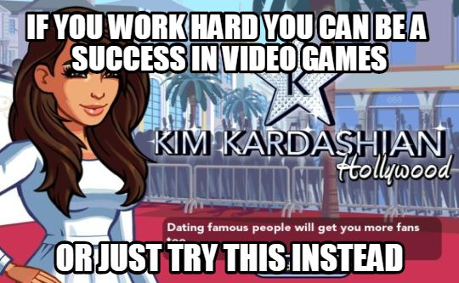
Building a franchise is the result of hard work. Unless it isn’t.

Slide 6
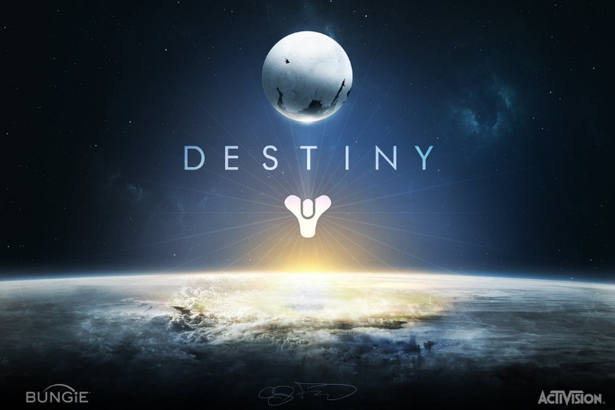
Designing a game property as a franchise requires proper consideration in the contract

Slide 7

Contracts can be a bit dull

Slide 8
The property and rights granted
“a series of entertainment software products currently being developed by Licensor entitled “Destiny”…”
Exclusive, non-transferable, non-sublicensable right to publish and distribute the Products on the Platforms, right to make Conversions (but not to make spinoffs), right to make localized versions
What does this tell you?
  Publishing rights deal
  They intend it to be more than just games

Slide 9
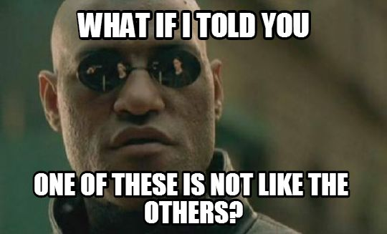
What the rights grant can tell you about relative negotiating power

Slide 10
Pre-release payments
Development advances
On-time, on-budget bonus: $2,500,000/year
Overage Penalties reduce royalty rates if the game is late:
  20 becomes 18
  24 becomes 21.6
  35 becomes 31.5

Slide 11
Post-release payments
Royalty:
  $0-$100,000,000 of Operating Income: 20%
  $100,000,001-$400,000,000: 24%
  $400,000,001+: 35%
  Note: Activision gets 25% of Net Revenue automatically
    Operating Income = about 75% of Net Revenue
    So 20% is actually on about $0-$125,000,000
Threshold bonuses: $25,000,000 at each of $750,000,000 and $1,000,000,000 of cumulative Operating Income
Ratings bonus: $2,500,000 if over 90 on gamerankings.com
  Doesn’t look like it’ll get there

Slide 12
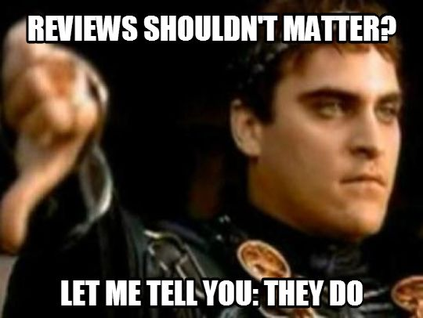
Why are reviews important?

Slide 13
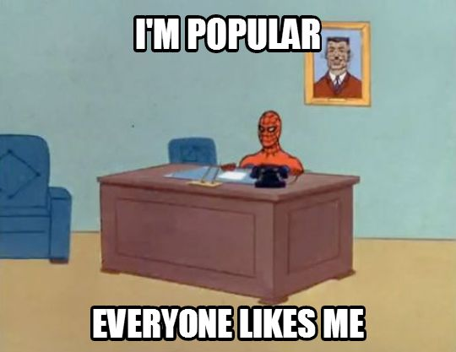
Why have franchises and sequels?

Slide 14
Option clauses and sequel rights
Option to pick up future works
Pretty much always exist in some format
  Destiny is a 4-game deal
Sometimes not found in adaptations of pre-existing content
  Many Hollywood studios insist on them even in those circumstances

Slide 15

Is this part over yet?

Slide 16
Ownership of copyrights and trademarks
Unless work-for-hire, copyright owned by creator
  Destiny contract specifically spells out that they’re owned by Bungie
Not always as obvious as you’d think
  Hollywood scripts are always works for hire
Trademarks not always dealt with
  Bungie retains them for Destiny

Slide 17
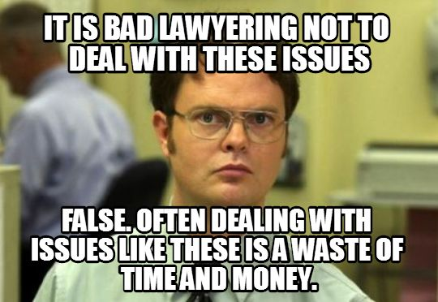
Why wouldn’t you address all of these issues?

Slide 18
Right to make derivative works without author involvement
At law, only creator can make them – 17 USC 106
  But publishers and especially Hollywood studios insist on having the right to continue if you don’t
Contractual commitments creators should get or keep
  Approval or at least consultation
  Ability to make derivatives themselves
Many contracts provide for this right, but not always
  If Bungie fails to produce games subject to the contract, Activision can make them

Slide 19
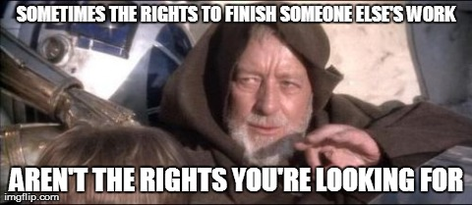
Why would some contracts give this right but not others?

Slide 20
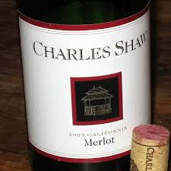
What issues arise when finishing someone else’s work?

Slide 21
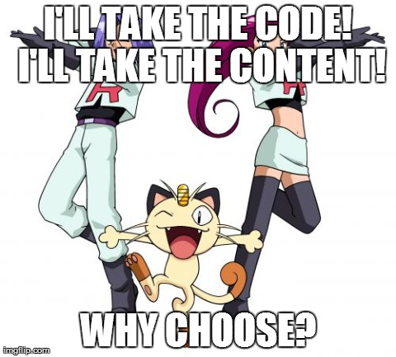
Code vs. content

Slide 22
Marketing and advertising
Two issues
  Obligation to market the product
  Permitted and non-permitted types of marketing
    Ashes 24: can’t advertise other products
Often raises issues of how hard the publisher has to work at marketing
  If possible, put this in the contract e.g. Bungie 7A.6, 13
PR is separate from marketing
  Reviews etc. are PR but work into marketing materials
  Dirty secret: blurbs and endorsements

Slide 23
A bit more on marketing
Activision must do marketing “consistent with the standard for other AAA caliber (or equivalent) titles published by Activision
  Mandatory spend: $1M over 2 years pre-beta
Bungie gets significant involvement in marketing
  Mutual approvals
  Activision must respect Bungie style guide
  Activision must include Bungie personnel in major events at Activision’s expense
  Both logos on all packaging with equal prominence

Slide 24
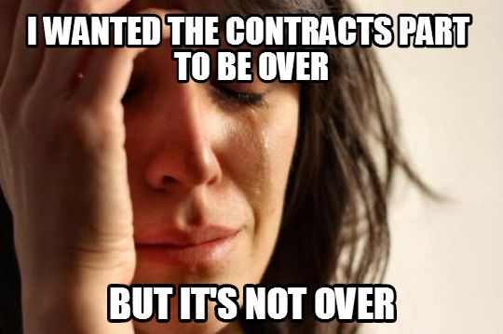
Options on future content

Slide 25

Okay, now it’s over

Slide 26
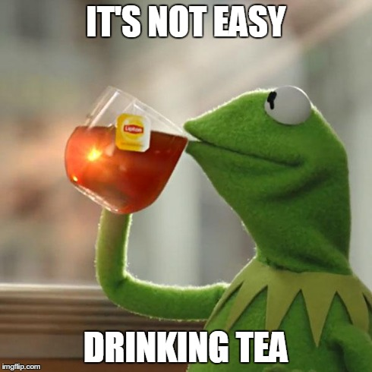
Using product placements to expand the brand isn’t always appropriate

Slide 27
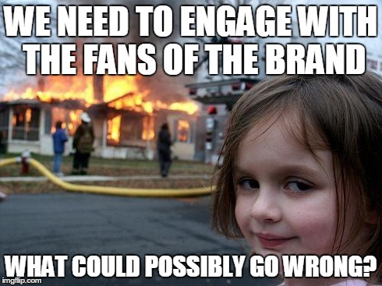
How should you encourage interaction with the brand?

Slide 28
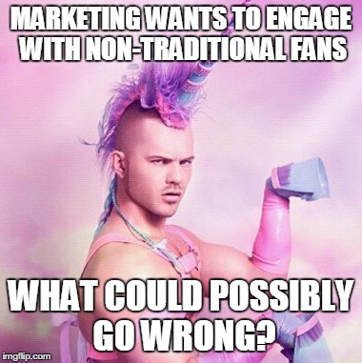
What about the kids?

Slide 29
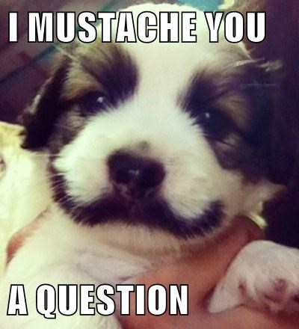
Unless you want to hear more, I’m done

