Slide 1
5 hot topics in international interactive entertainment law
Jas Purewal

Slide 2
What we’ll talk about
Data protection/privacy
Free to play regulation
First sale for digital games (?)
Let’s Play
Business models regulation

Slide 3
About me
I’m a digital entertainment and tech lawyer. 10 years in London, Silicon Valley, then founded my digital entertainment legal and business consultancy, Purewal & Partners, in London in 2014. I also write www.gamerlaw.co.uk.
Silicon Valley:
UK and EU:

Slide 4
(1) Data protection/privacy

Slide 5
(1) Data protection/privacy
Video games are subject to both US and EU regulation:
Disney/Playdom - $3m fine for COPPA breaches (2011)
SCEE - £250k fine by UK ICO for PSN data breaches (2012)
TinyCo - $300k fine for COPPA breaches (2014)
Investigations/lawsuits vs Google, Facebook, Amazon, Apple...

Slide 6
(1) Data protection/privacy
Regulatory interest is increasing…
FTC report on mobile kids' privacy (2012)
FTC report on mobile privacy disclosures (2013)
EU Article 29 Working Party opinion on mobile privacy (2013)
Updated/new privacy legislation in US (e.g. COPPA, state initiatives) and EU (Data Protection Regulation)

Slide 7
(1) Data protection/privacy
So what? Well…
Modern games are built on personal and non-personal data collection:
User accounts
Tracking user behaviour
Monetisation
Customer retention
User acquisition
Advertising
All of this requires intense use of data…often regulated.

Slide 8
(1) Key data protection/privacy issues
What data is regulated? Is analytics data regulated?
Which tracking technologies are regulated?
Which consents are required and how?
How best to make a privacy policy work on mobile?
Can a single global approach work?
No consistency across mobile or games industries on how to address these issues yet…

Slide 9
(2) First sale issues

Slide 10
The position in the EU: Oracle v UsedSoft (case C-128/11)
Oracle marketed software, mainly by download.
Customers received a non-exclusive, non-transferable license to use the software for an unlimited period.
UsedSoft resold software licences: its customers could buy Oracle software and download it directly from Oracle’s website.
Oracle sued UsedSoft in Germany.
Key questions in the litigation were referred up to the Court of Justice of the European Union (CJEU).
Required interpretation of Software and Copyright Directives.

Slide 11
The key questions in Usedsoft:
Does downloading software mean that the first sale right over it is exhausted?
Is a subsequent purchaser therefore permitted or banned from downloading and using that software?
Could Oracle use its IP rights to restrain second hand sales or use of its software?
Yes
Yes
Yes

Slide 12
Questions and caveats:
Does this case actively require publishers to permit second hand software sales? Probably not.
Does this case reflect existing EU law? No (see later).
Does this case apply equally to digital and physical copies of software? Not explicitly stated, but very likely yes.
What about the original purchaser's copy of the software? Only the right of distribution is exhausted – not the right of reproduction. The original purchaser must therefore make the copy "unusable" at the time of resale.
What can a publisher do to stop the first user continuing to use the game? Unclear, but CJEU did refer to measures such as "product keys" being permissible.

Slide 13
Questions and caveats:
Can non-copyright measures be taken to restrict second hand sales of a game? Unclear, but possibly yes if there is an objective justification (see also German developments, discussed below).
What can a publisher do to stop the first user continuing to use the game? Unclear, but CJEU did refer to measures such as "product keys" being permissible.
What about an online game or online aspects of a game? Unclear, but Copyright Directive provides that exhaustion does not apply to services and on-line services (Recital 28).

Slide 14
Questions and caveats:
What about virtual goods or IAP? Unclear, but in principle the same principles could apply (clearly problematic).
What about subscription- or service- based games? Same analysis would apply: is there in reality an ownership transfer?
Does this case ban DRM usage? Probably not, provided the DRM doesn't exist only to circumvent a user's ability to sell the software.

Slide 15
Test cases:
VZBW v Valve (2013): DE consumer protection authority sues Valve for refusing to permit second hand sales. Held: video games do not fall under UsedSoft (because it is not ‘computer software’, or at least not solely that).
Koch Media v CD key reseller (2014): effectively same result in DE.
?2+ cases going to CJEU may clarify.
How does all this stack up with the policy factors behind the CJEU decision?

Slide 16
The position in the US: the first sale doctrine
"[T]he owner of a particular copy or phonorecord lawfully made under [Title 17 of the United States Code]…is entitled, without the authority of the copyright owners, to sell or otherwise dispose of the possession of that copy or phonorecord" (17 USC § 109(a))

Slide 17
Vernor v Autodesk, Inc. (9th Circuit, 2010)
Timothy Vernor purchased used copies of AutoCAD from a business that had purchased them from Autodesk. Vernor then resold them on eBay. Autodesk sued.
Key question: could Autodesk restrain Vernor from selling the used software copies? Were first sale rights in the software copies exhausted?
Autodesk argued that the software was licensed, not sold, therefore its first sale rights were not exhausted.

Slide 18
Vernor v Autodesk, Inc. (9th Circuit, 2010)
Court focused on the form of the transaction:
Did the rights holder specify that only a license is granted?
Did it significantly restrict the user's ability to transfer the digital product?
Did it impose other notable use restrictions?
Court held that Autodesk licensed its direct purchasers and therefore Vernor could not purchase full software copies from those purchasers – there was no first sale.

Slide 19
The position in the US: other cases
UMG Recordings v Augusto (2008): ownership of promotional audio CDs (marked as being licensed not sold) – first sale rights were exhausted because CDs were sold not licensed.
MDY Industries v Blizzard Entertainment, Inc. (2008): ability of a bot maker to deploy an 'essential step' defence to deploy a bot in World of Warcraft – depended on whether the software was licensed or sold – court found it was licensed.
Kirtsaeng v John Wiley & Sons (2013): books manufactured outside US and imported/sold within the US protected by first sale doctrine.
Capitol Records, LLC v ReDigi, Inc. (2013): used music files distributed via a music locker - involved unauthorised reproduction – not protected by first sale doctrine.

Slide 20
Summary: the position in the US
Vernor proposes a three stage test to assess whether software has been licensed or sold, which includes assessment of the EULA terms.
Other US case law broadly supports this approach (but not Kirtsaeng?)
Movement so far seems to be against permitting second hand sales of physical or digital software, particularly where a well-drafted EULA is involved.

Slide 21
A recipe for confusion: the EU and US positions
The EU seems to be open (confusedly) to permitting second hand sales of digital and physical games.
The US is moving towards prohibiting them except in specific circumstances.
There is the real possibility of different systems in the two biggest Western markets in the medium term.

Slide 22
How important is this, practically?
Actual consumer demand for a digital second hand sales ability is unproven as yet (though see Green Man Gaming).
Major platforms (iOS, Google Play, Steam etc) are rumoured to be readying digital trading platforms.
Next generation consoles faced considerable consumer criticism over plans to restrict second hand software sales.
Growth markets (e.g. China, LatAm) generally do not have such issues with second hand sales.
Changes in distribution (cloud) and business model (F2P) may limit used games sales as a problem.
BUT, this is still for now a huge part of the market…

Slide 23
(3) Free to Play regulation

Slide 24
Scrutiny of F2P games
Two different matters are becoming linked in the eyes of the press, public and regulators:
Children's usage of new games platforms (esp mobile)
The rise of the free to play business model in the West
Partial regulation existed already, e.g. privacy law, advertising law restrictions, age ratings systems (?)
But question is now whether that existing regulation is enough, or whether new regulation is needed?

Slide 25
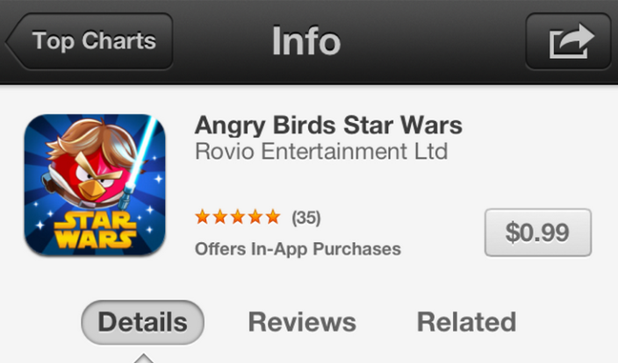
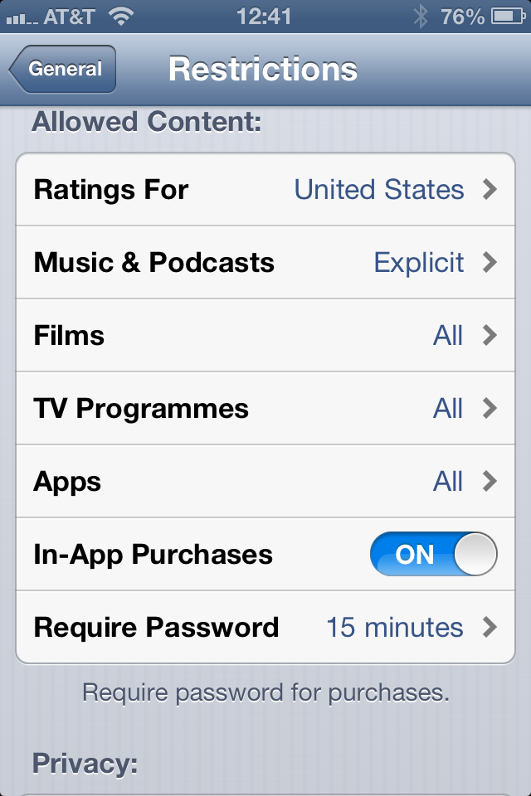
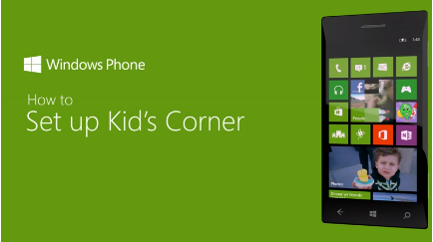
Industry self-regulation to date…

Slide 26
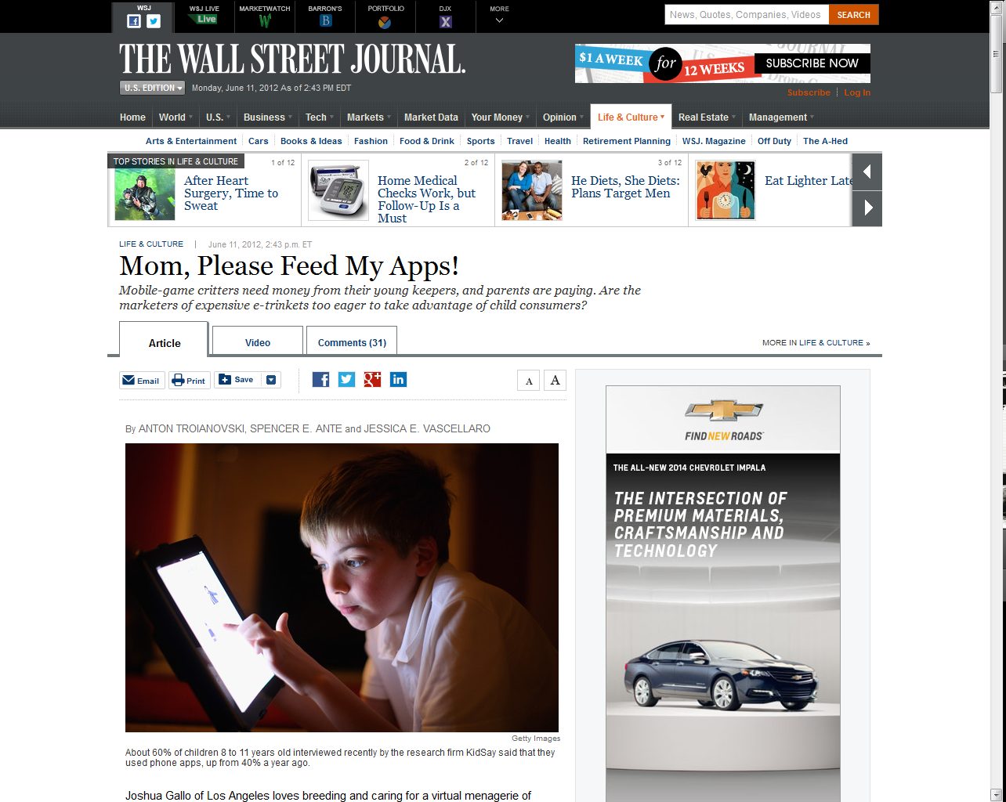
But scrutiny is still growing…

Slide 27
Recent developments
Japan: Ban of 'kompu gacha' mechanic (May 2012)
FTC investigation into kids' mobile privacy (but not F2P?) (2012)
ESRB and PEGI mobile age ratings being rolled out (2013 - )
F2P investigations in UK and EU (2013 – 2014…)

Slide 28
UK/EU F2P investigation: background
Late 2013: UK Office of Fair Trading (OFT) investigation begins
February 2013: European Commission announces investigation
March 2014: OFT investigation results in eight ‘Principles’ for free to play games
Summer 2014: European Commission completes investigation – wide changes to Google Play Store.

Slide 29
So what has happened?
EU consumer protection law is being applied more strictly for the first time in games:
Games cannot call themselves free if they are not
Games cannot be misleading, must provide material information to gamers, must help them to understand the purchases they are making
Must be very careful about marketing and/or selling to children
Must be T&Cs in place
Generally, games developers have to think about protecting consumers in F2P games, not just maximise game value/revenue.
What happens next…?

Slide 30
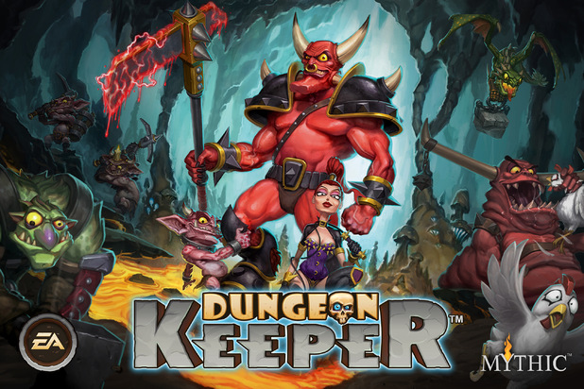
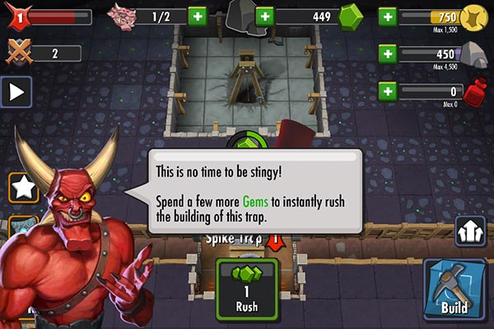
So that’s all sorted then?
Not quite...
The UK advertising regulator’s investigation of EA’s Dungeon Keeper’s F2P mechanics suggests a much more stringent, activist model of F2P regulation…

Slide 31
(4) T&Cs. Again.

Slide 32
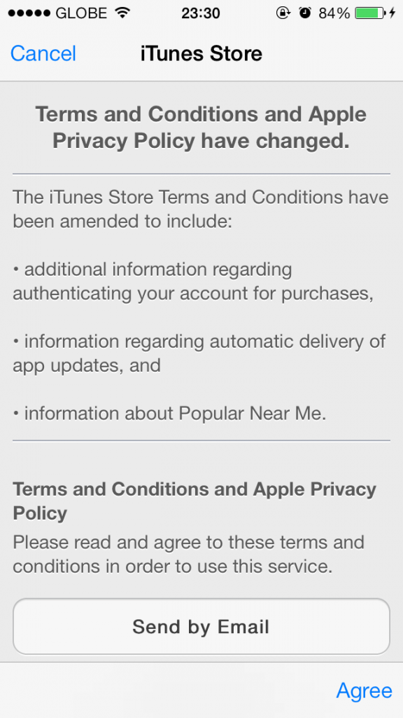
Is this OK?

Slide 33
Is this OK?

Slide 34
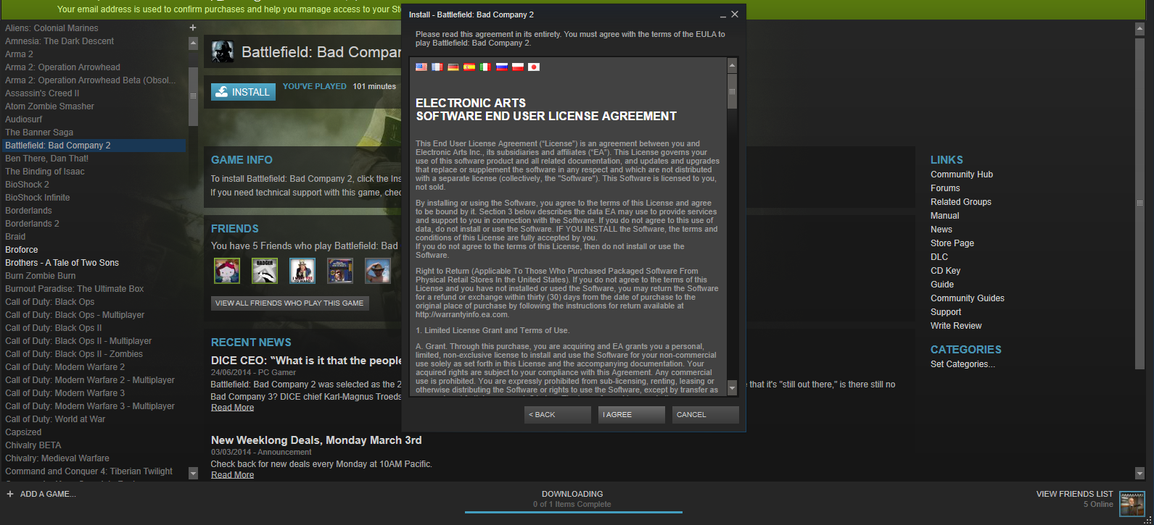
Is this OK?

Slide 35
T&Cs in games
Once upon a time we had lots of battles about boxwrap, clickwrap, browsewrap etc.
Many people thought that they were now resolved.
They aren’t.
Why?
Rise of mobile
Increasing consumer activism
Increasing pro-consumer legislation
We’re just waiting on a big test case…

Slide 36
(5) Let’s Play

Slide 37
Let’s Play
HUGE rise in the popularity of games-oriented video content
Legal questions:
Is this video games? Broadcast? VOD?
What regulation should apply to it?
How will you monetise?
Can you be paid to review someone’s game?
Can you run competitions?
Can you use third party content (with or without authorisation?)
…….

Slide 38
Thanks!
........................................................ E: jas@purewalandpartners.com W: www.purewalandpartners.com M: +44 774 760 3449 T: @gamerlaw ........................................................

