Slide 1
Freedom of Expression
GUILD OF CALAMITOUS INTENT

Slide 2
Topic
Freedom of expression in video game communities, its regulation and restriction by video game companies/creators, and its effects on video games and video game culture.
Violence in video games
Misogyny in video game communities
Limitations on freedom of expression
Issues

Slide 3
State of Ludological Research
Misogyny in "open based" Communities:

Slide 4
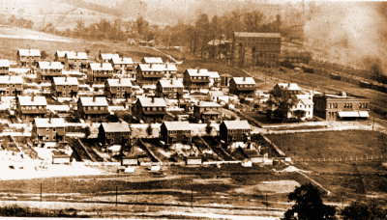
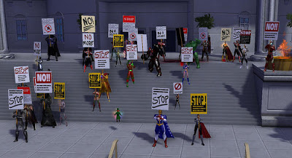
State of Ludological Research (2)
Peter Jenkins, The Virtual World as a Company Town: Freedom of Speech in Massively Multiple Online Role Playing Games
As many people spend more time (“live”) online in MMORPGs and other games, we should take the idea of protected speech seriously.
Analogized as the Company Town, as a private company owns or controls all of the resources players/citizens access
They should be considered “designated public forums,” or have areas protected as such

Slide 5
State of Legal Research (1)
“Violence in Video Games and Video Games as a Protected Form of Expression”
Salamanca's article follows the case law and judicial logic along the path video games took to gain recognition as a form of expression that should be protected by the First Amendment.
There are criticisms of the extension of this protection, predominantly that violence should be seen as “obscenity” with regard to children’s media
"Violence is a fact of life" - Salamanca

Slide 6
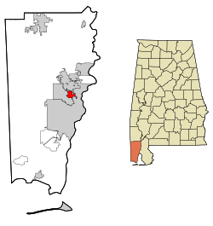
State of Legal Research (2)
Freedom of speech/expression limitations within virtual worlds?
“[I]f members of our society are uncomfortable with limitations upon speech in company towns and shopping malls, how will we feel about speech limitations placed on entire (virtual) worlds?” F Gregory Lastowka & Dan Hunter, “The Laws of the Virtual Worlds” (2004) 92:1 Cal L Rev 3
Marsh v Alabama, 326 US 501 (1946)
“I would say that the members of the public are privileged visitors whose privilege is revocable only upon misbehaviour . . . or by reason of unlawful activity. Such a view reconciles both the interests of the shopping centre owner and of members of the public” Harrison v Carswell, (1975), [1976] 2 SCR 200, Laskin CJC, dissenting

