Slide 1


Consumers & Users
As Creators & Connectors
Talk 5
Part B “Connecting”
Video Game Law - Fall 2015
UBC Law @ Allard Hall
Jon Festinger Q.C.
Centre for Digital Media
Festinger Law & Strategy
http://videogame.law.ubc.ca
@gamebizlaw
jon_festinger@thecdm.ca

Slide 2
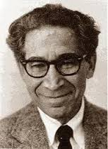
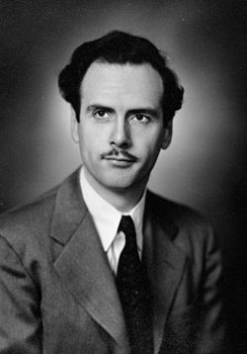

Connections (other than bad hair)?

Slide 3
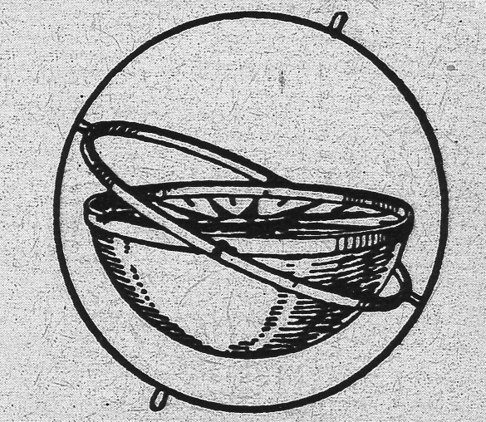
Where Are We?
*Last Week:…(How) Can a Right to CREATe (Mod) be established?
*TODAY – beginning of Part B:
“Connecting”
(Part C. “Controlling”, Part D. “Conciliation”)

Slide 4
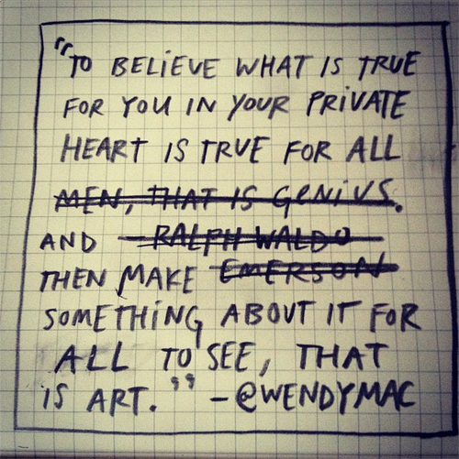
Reconciling Creating & Connecting
(sort of)…
From “Exp.lore.com”
http://exp.lore.com/post/41546671840/the-ever-brilliant-wendy-macnaughton-you-know

Slide 5
Mode(s) of Connecting
(& Legal Consequences)
TWO TRICKY QUESTIONS
1. Are “Creators, Consumers & Users” in fact the same? If so should they be treated equally in law?
2. Asymmetry or A Symmetry (?)
CREATION associated with COPYRIGHT/IP
CONNECTING goes with CONTRACT LAW ??

Slide 6
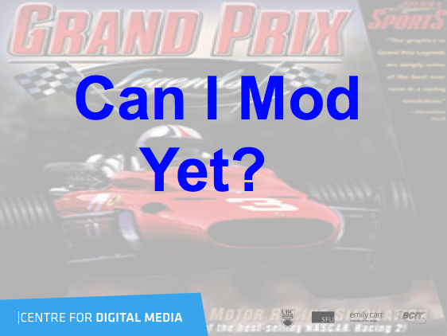
A Related Follow Up

Slide 7
The Fair Use Analysis (U.S.A.)

Slide 8
A. Threshold Questions: Is it even copyright material?
Wholly original creation?
Public domain material?
Creative Commons License (if so which)?
Licence or permissions granted (or obtainable)?
Does copyright apply? (clothing; games - Boyden; recipes etc.)

Slide 9
“Four Factors” Fair Use Test
Nature of the work (parody?)
Amount and substantiality of the portion used (in relation to the copyright work as a whole).
Purpose and character of the use (Is the use for a commercial purpose?).
Effect of the use on the work’s value in its potential market.

Slide 10
Practical factors indicative of fair use:
De minimis use.
Source acknowledgment.
Parody or satire.
Factual content.
News reporting, review, critique or commentary.
Non-commercial or educational purpose.
Sufficient transformation of the work through added meaning (rare and can be contentious) as opposed to being derivative.
Social usefulness/public interest (exceedingly rare).

Slide 11

Fair Dealing in Canada:
Enter User Rights…
Recent SCC “User” paradigm shifts
USERS ARE CREATORS TOO
August 2012 “Copyright Pentalogy” & previous cases
Moving from fair dealing as an exception to copyright infringement towards proactive “User Rights”
Right to Link (Crookes v. Newton)
Right to longer iTunes previews
Tech Neutrality
Fair dealing is to be assessed from the point of view of the purchaser/user
“Research” need not be associated with traditional intellectual pursuits

Slide 12
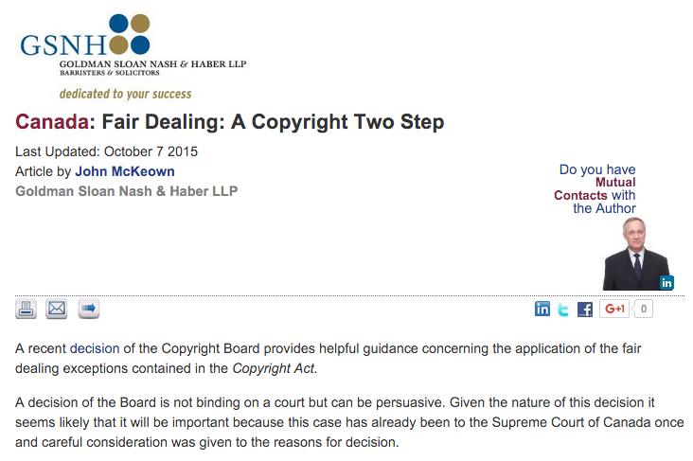
http://www.gsnh.com/2015/09/29/fair-dealing-a-copyright-two-step/

Slide 13
Step 1- Was the Dealing Done for an Allowable Purpose of Research, Private Study, Education, Parody or Satire?
Step 2- Was the Dealing Fair?
a) The Purpose of the Dealing
b) The Character of the Dealing
c) The Importance and Amount of the Work Taken
d) The Existence of Alternatives to the Dealing
e) The Nature of the Work
f) The Effect of the Dealing on the Work

Slide 14
Consumers:
Console & Gamer Stats
“Guardians of the Galaxy”
opening Weekend = $161M
“Destiny” opening five days = $325M (GTA V launch day = $800M; Jurassic World $209M)
Current Gen consoles sales: 9.1M Wii U; 11.3M Xbox One; 19.1M PS 4
Last gen console sales = 267M worldwide
Over 1.2 Billion “gamers”: 700M on-line
http://bgr.com/2015/02/18/ps4-vs-xbox-one-vs-wii-u-lifetime-console-sales/

Slide 15

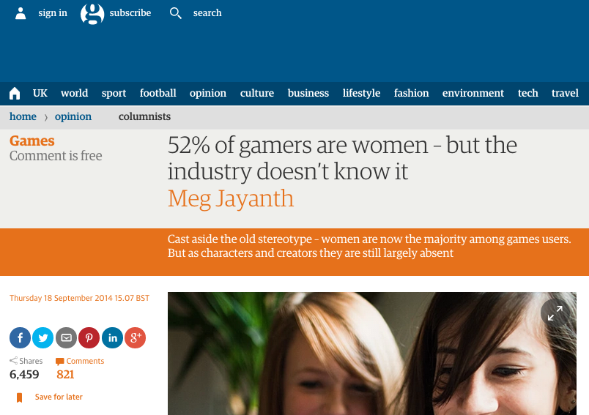
52% Women/48% Men

Slide 16

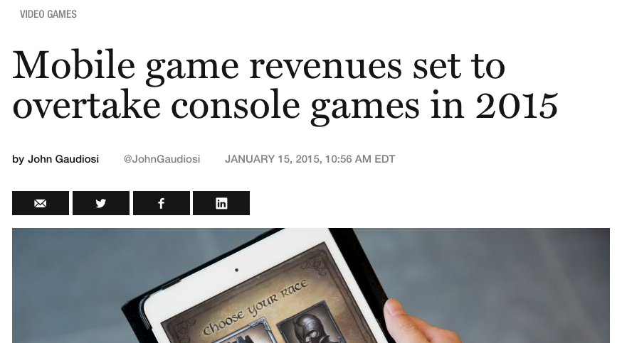
But…

Slide 17

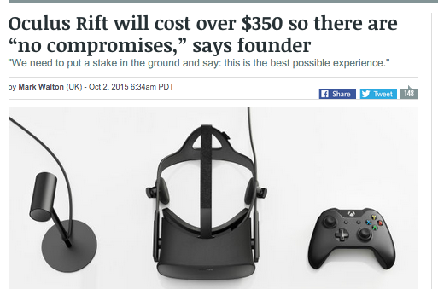
Other (Consumer?) Trend

Slide 18

Basic Thesis
If Copyright Law is reaching towards unity and equality of creators, consumers & users…
Contractual terms are tearing that utopian vision apart

Slide 19
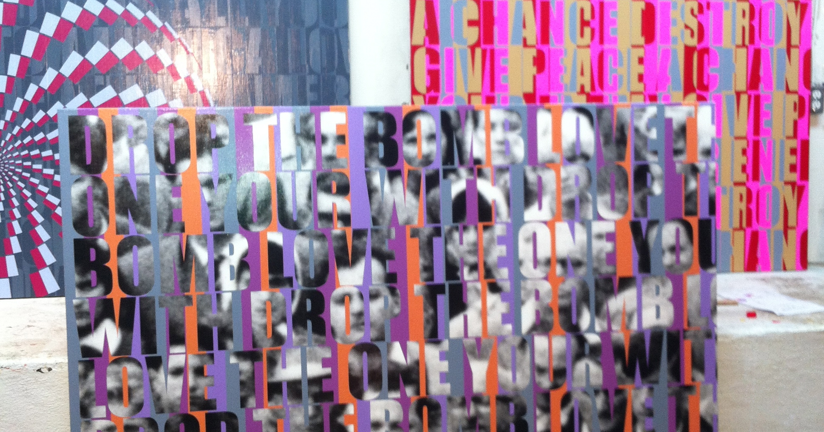
Beginning with…Where we left off
Sacredness of personal creativity -----SHARED.
Moral Rights (as opposed to economic property rights) as tool to protect the creative..
*
*Art by Allan Switzer

Slide 20
Word Alignments
Data
Game
Idea
Private
Interactive
Magic
Intellectual
Not IP
Documents
Video
Expression
Public
Environment
Circle
Property
IP

Slide 21

What does this list really mean?
It appears as an endless Yin/Yang dialectic between:
Nature & Nurture
Idea & Expression
Creativity & Connection
User & System
Gamer & Game
Magic & Circle
Human & Societal

Slide 22
Is this, in philosophical terms, really a hard choice?
“My life seemed like a glass tunnel, through which I was moving faster every year, and at the end of which there was darkness... [However] When I changed my view, the walls of my glass tunnel disappeared. I now live in the open air. There is still a difference between my life and the lives of other people. But the difference is less. Other people are closer. I am less concerned about the rest of my own life, and more concerned about the lives of others.”
Derek Parfit (1984) “Reasons and Persons” Oxford Clarendon Press

Slide 23
Back to…Connections?

Slide 24
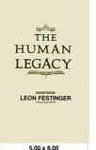
WHY GAMES?
“Equally strange is our general addiction to games, both physical and mental. The profusion of games is truly startling: card games, board games, word games, ball games, electronic games….We even assemble in huge crowds to watch others playing games. What does all this mean? Do we simply get easily bored and cannot tolerate inactivity? I can find nothing in the literature of scientific psychology that helps me to understand such bizarre behavior.”
The Human Legacy (1982)
Leon Festinger

Slide 25
McLuhan, 1964
(Games as social reaction)
Games, like institutions, are extensions of social man and the body politic, as technologies are extensions of the animal organism. Both games and technologies are counter-irritants or ways of adjusting to the stress of the specialized actions that occur in any social group. As extensions of the popular response to the workaday stress, games become faithful models of a culture. They incorporate both the action and the reaction of whole populations in a single dynamic image.

Slide 26
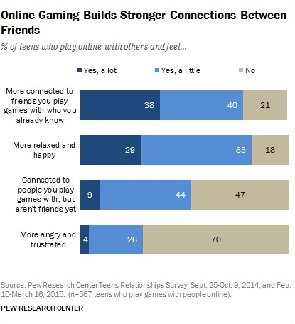
Evidence?

Slide 27
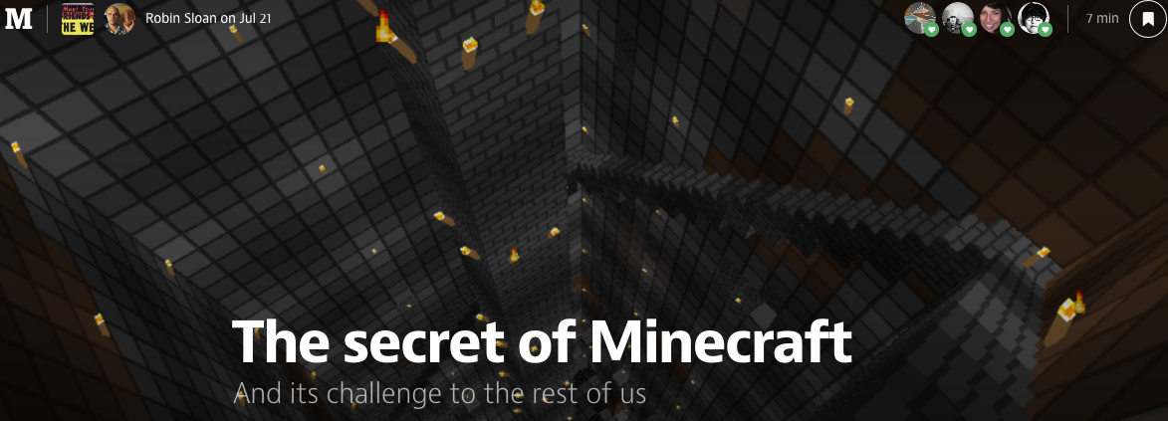
“What Are Video Games (today)?”
https://medium.com/message/the-secret-of-minecraft-97dfacb05a3c
“A generative, networked system laced throughout with secrets.”

Slide 28
Bruce Boyden
“In all of these situations, the owners of a copyright in a form, description, or set of instructions were attempting to extend their copyright to material for which the user of the work provided the essential content, not its author. That is what made them systems. They were, without that input, empty shells, waiting to be filled.”
“Games are systems in exactly the same way. A game, as sold, is only a game form; the content necessary for an instance of the game comes from the players. That is, the game form establishes the environment for play—the game space—and it defines permissible moves and the conditions for winning or drawing. But the game itself is supplied by the players.”
“Systems are shells into which users pour meaning. While they may contain expression themselves, that expression is there merely to facilitate the meaning added by the user.”

Slide 29

You decide…

Slide 30
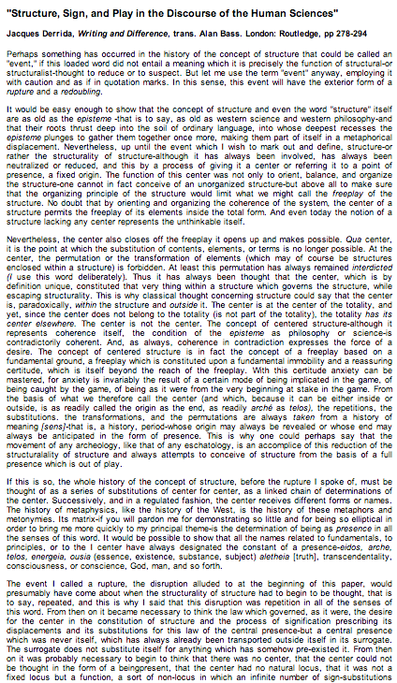
Jacques Derrida

Slide 31
Video-Games as Post-Structuralism
"Structure, Sign, and Play in the Discourse of the Human Sciences” Jacques Derrida
Structures as free-floating (or 'playing') sets of relationships. Structuralist discourses unfortunately hold on to a "center” which anchors the structure and “does not play”.
http://hydra.humanities.uci.edu/Derrida/sign-play.html

Slide 32
Post-Structuralist Concepts
Massively Multiplayer
Open World Playground
Content Creation Tools
Cooperative Mode
Public Gameplay Mode
Remote Play
Dynamic Gameplay Engine
WorldEditor (WED)
Scennery & Character Generators
A.I.

Slide 33
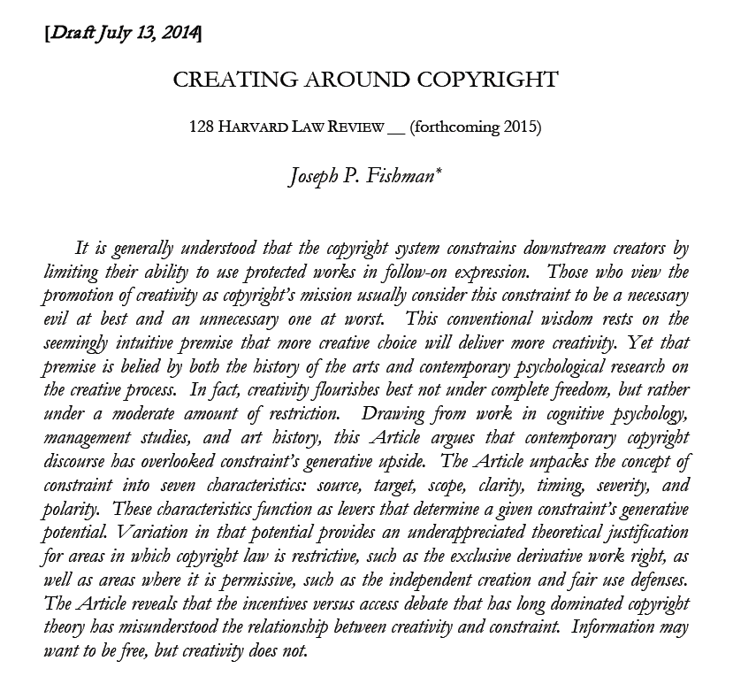
Structuralist???
http://papers.ssrn.com/sol3/papers.cfm?abstract_id=2465590

Slide 34
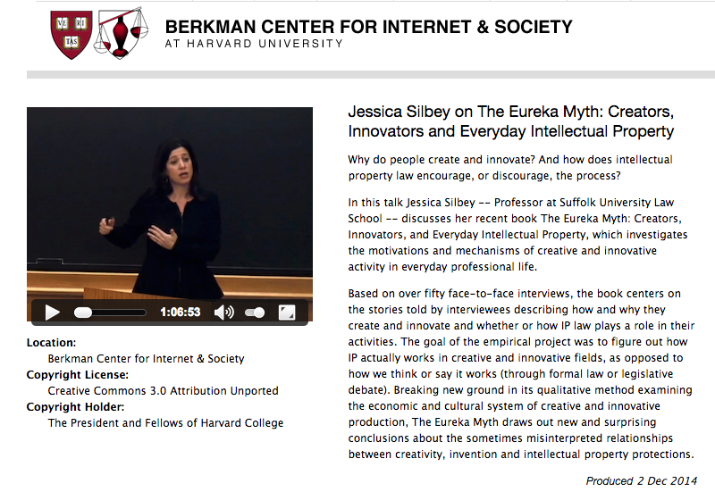
Creators do not need (nor want) additional constraints

Slide 35
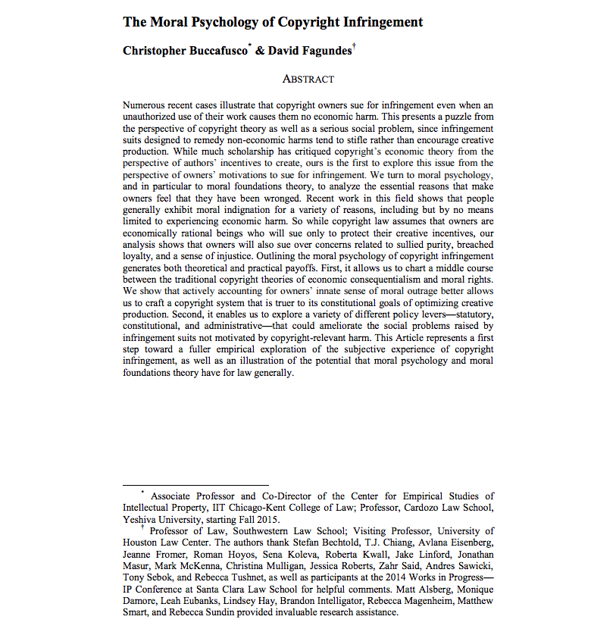
http://papers.ssrn.com/sol3/papers.cfm?abstract_id=2587339

Slide 36
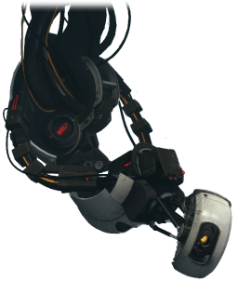
BUT EVEN IF YOU INSIST ON “RATIONALITY”
GLaDOS (Portal 2)

Slide 37
Measuring creative content in the context of mods and copyright ownership
Percentage of time gamers “create” in game versus time developers spent creating the game.
Percentage of pixels if you prefer, or lines of code…
Common denominator – effort in “framing experiences”

Slide 38


Eve Online
Minecraft

Slide 39
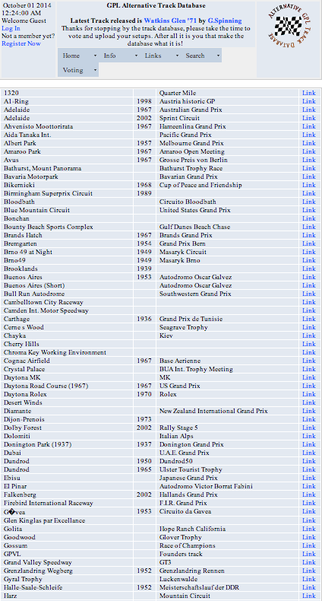
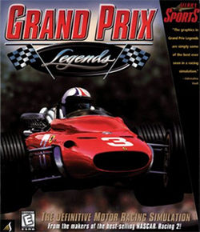
Not Even Close…

Slide 40
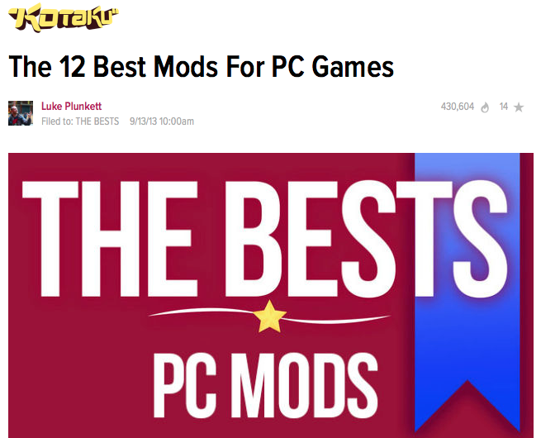
http://kotaku.com/5979860/the-12-best-mods-for-pc-games

Slide 41
Can I Mod
Yet?

Slide 42

“We cannot know how we would have acted, but we now know how we should have.”

Slide 43
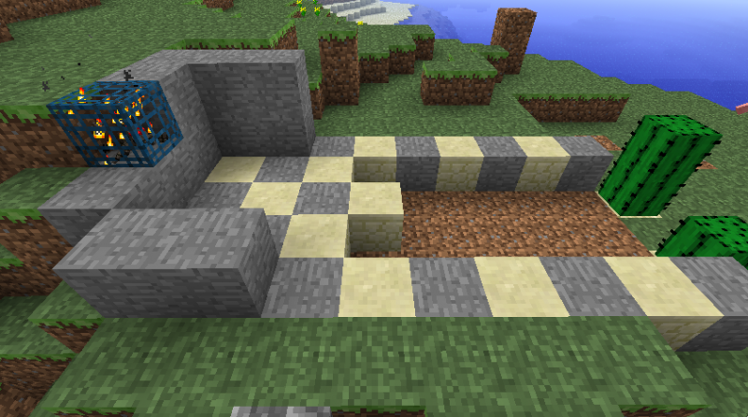
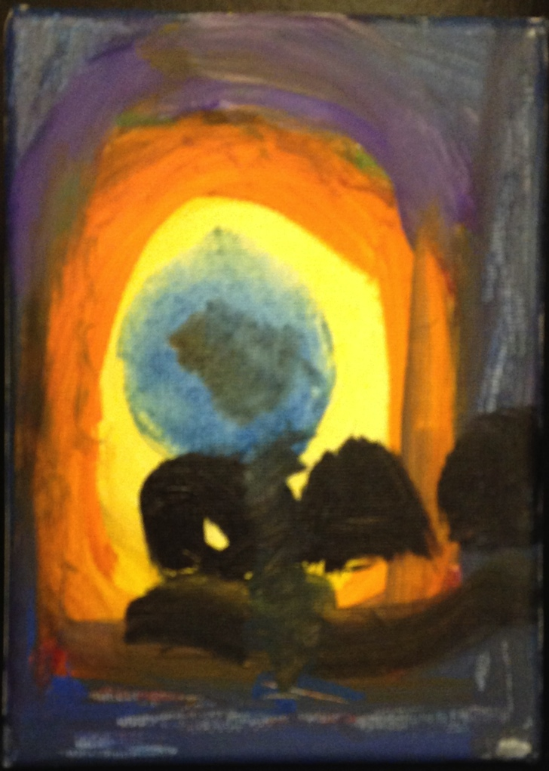
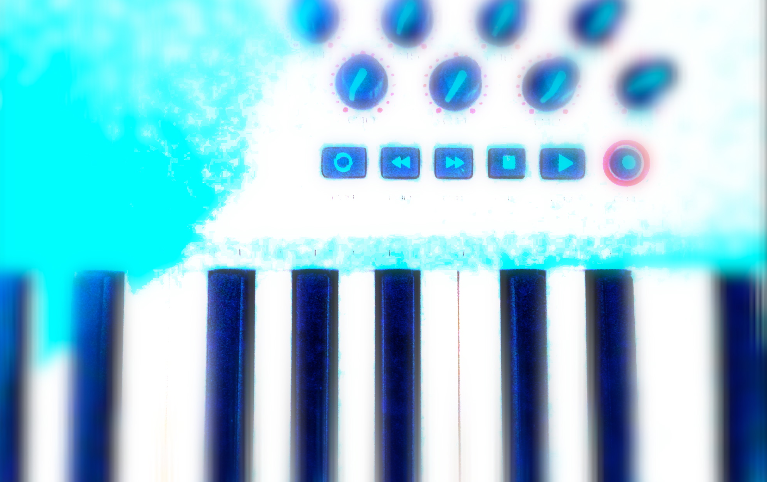
Creativity Rules
IP/Copyright as Property Right v. Right to Copy/Remix
TO BE RESOLVED IN FAVOUR OF “CREATIVITY” (not innovation, not commerce, not GNP, not the 1%)

Slide 44
Enter “Moral Rights”
Regime of ATTRIBUTION + INTEGRITY
IF TO IP = 1. commercial impact irrelevant;
2. right to be attributed
3. right to protect work’s integrity
Berne Convention for the Protection of Literary and Artistic
Works (1886):“(1) Independently of the author's economic
rights, and even after the transfer of the said rights, the author
shall have the right to claim authorship of the work and to object to
any distortion, mutilation or other modification of, or other
derogatory action in relation to, the said work, which would be
prejudicial to his honor or reputation.”

Slide 45

Snow v. Eaton Centre (1982)

Slide 46
Footnote: Universal v. Sony
(for the 2nd time)
Sony Corporation of America et al. v. Universal City Studios, Inc., et al. 464 U.S. 417 (1984) Supreme Court of the United States
http://scholar.google.ca/scholar_case case=5876335373788447272&hl=en&as_sdt=2&as_vis=1&oi=scholarr&sa=X&ei=hGYvUsjELay7jALQ9YHYBg&ved=0CEAQgAMoATAA
Time Shifting is Fair Use not Copyright infringement (see also Fox v. Dish Network USCA 9th (July 24,2013) upholding “ad skipping” http://www.scribd.com/doc/155719747/Hopper)
Weirdly similar to Moral Rights criteria:
1. Commercial impact of time-shifting irrelevant; 2. Attribution of content unaffected; 3. Work’s integrity unaffected.

Slide 47
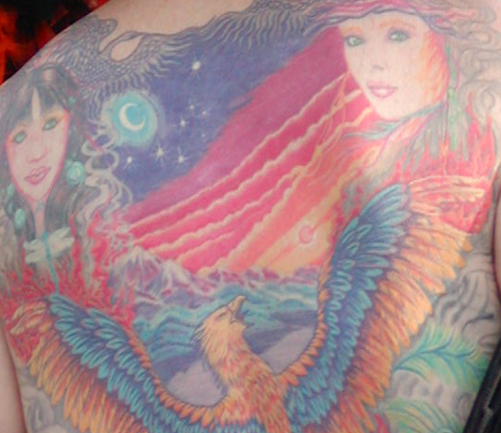
Testing Moral Rights…Thinking about Tatoos Again

Slide 48
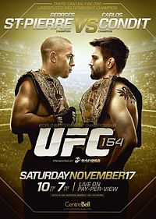
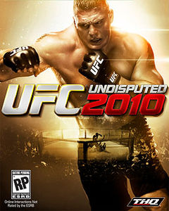
Escobedo v. THQ, Inc.
Tattoo artist sues THQ, makers of UFC
video game for copyright
infringement. Artist claims to have
tattooed an originally created lion
on Carlos Condit’s body. Escobedo
and Condit had no written agreement.
See: “Copyright in Tattoo Case”
http://www.dmlp.org/blog/2012/copyright-tattoo-
case-escobedo-v-thq-inc
"Tatoos and Copyright Infringement” by
C. Harkins (L&C Law Review)
http://www.brinksgilson.com/files/190.pdf

Slide 49
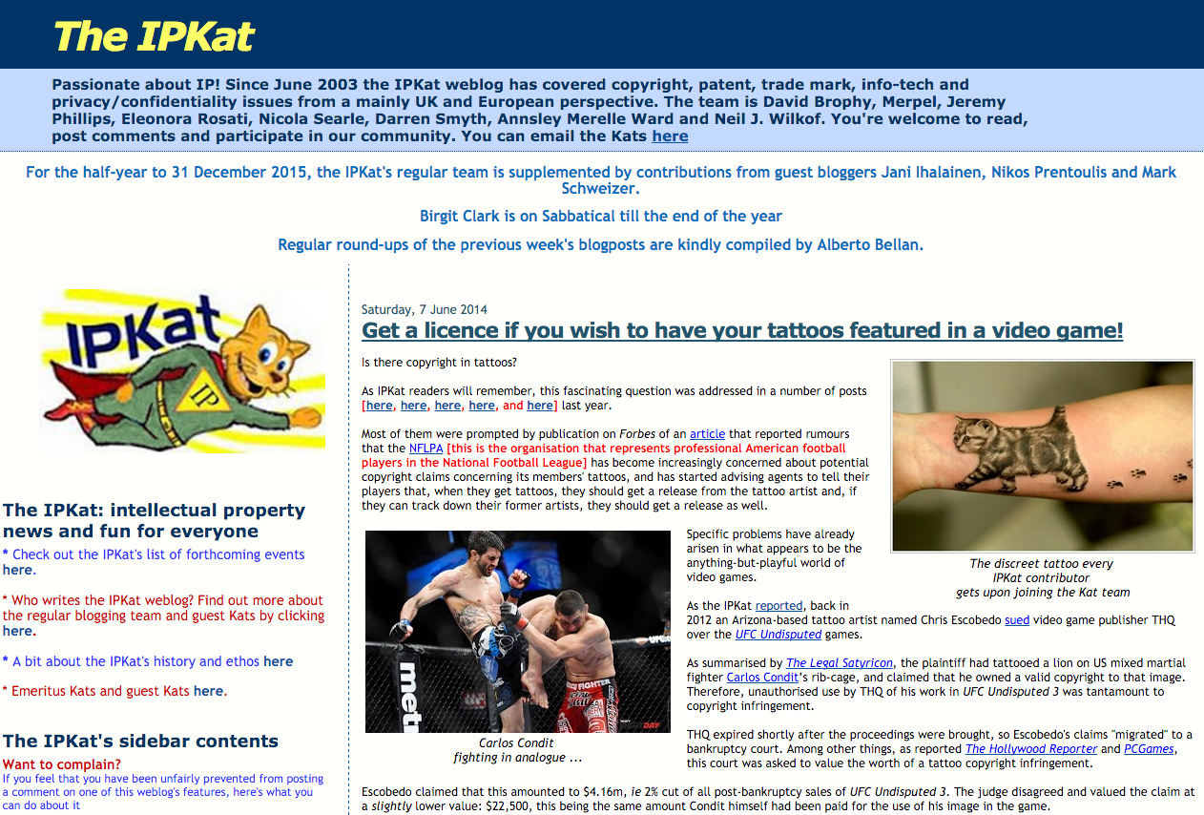
http://ipkitten.blogspot.ca/2014/06/get-licence-if-you-wish-to-have-your.html

Slide 50
Conventional legal wisdom…
"Tattoos and Copyright Infringement”
- C. Harkins (L&C Law Review - 2006) http://www.brinksgilson.com/files/190.pdf
“Before getting a tattoo, anyone with a reasonable expectation of fame should arm herself or himself with a work-made-for-hire contract, a joint work agreement specifying the customer’s contributions and expressing intent to make the customer a joint author, or some other written document transferring ownership from the tattooist and the tattoo business to the customer. As shown, many courts are fairly liberal on the specific wording. The would-be celebrity should seek legal advice or, if acting pro se, should ensure the written instrument uses the word “copyright” and states that all “ownership” in the tattoo and any drawing, sketch, and other work that becomes or embodies the tattoo vests in, belongs to, and is transferred in whole to the customer.”

Slide 51
Personal Rights Revisited
“More on copyright in tattoos: a Belgian precedent”
http://ipkitten.blogspot.ca/2013/08/more-on-copyright-in-tattoos-belgian.html
“The court held that copyright may subsist in a tattoo and that the person who realises it may be recognised as the author…
However, the reproduction right of the tattoo artist is limited to the actual design. This means that, while he/she may execute the same design on another person’s body, the tattoo artist may not interfere with the activities of the person bearing his/her tattoo…
The Court applied a similar reasoning with respect to the moral rights of the tattoo artist. It held that these are subordinated to the personality rights of the tattooed person. Because the tattoo is performed on a human being, as soon as the design is reproduced on one’s body, the author of the tattoo loses his/her right of disclosure and right of attribution to the tattoo, as well as his/her right of integrity.”

Slide 52
Enter “Moral Rights” Part 2
Regime of ATTRIBUTION + INTEGRITY
IF TO IP = 1. commercial impact irrelevant;
2. right to be attributed
3. right to protect work’s integrity
IF TO PRIVACY = Attribution & Integrity includes non-attribution (“right to be forgotten”)

Slide 53
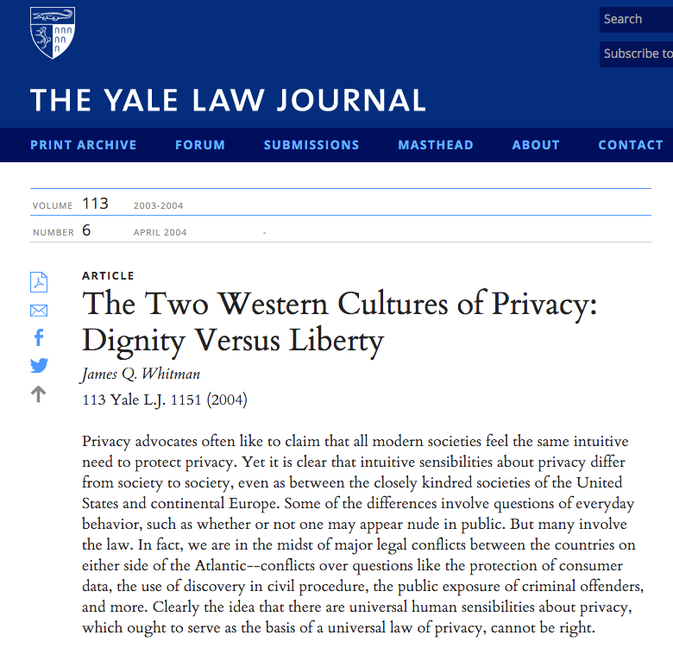
http://www.yalelawjournal.org/article/the-two-western-cultures-of-privacy-dignity-versus-liberty

Slide 54

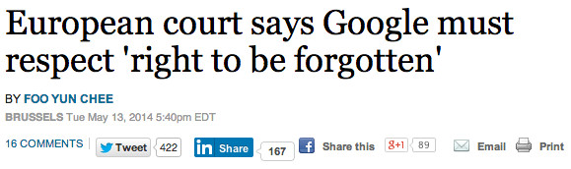
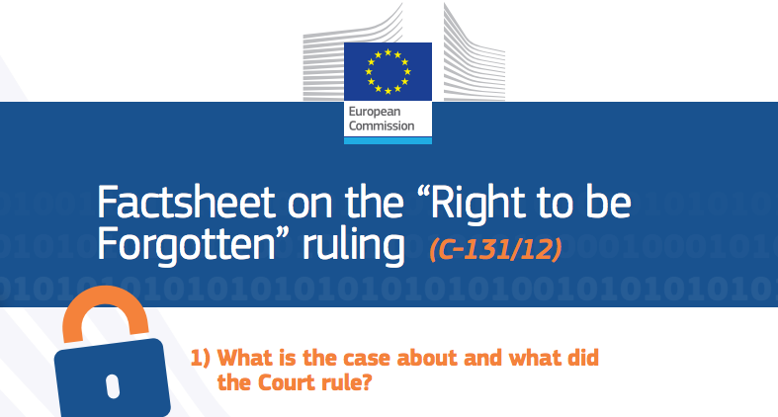
http://www.reuters.com/article/2014/05/13/us-eu-google-dataprotection-idUSBREA4C07120140513
http://ec.europa.eu/justice/data-protection/files/factsheets/factsheet_data_protection_en.pdf

Slide 55

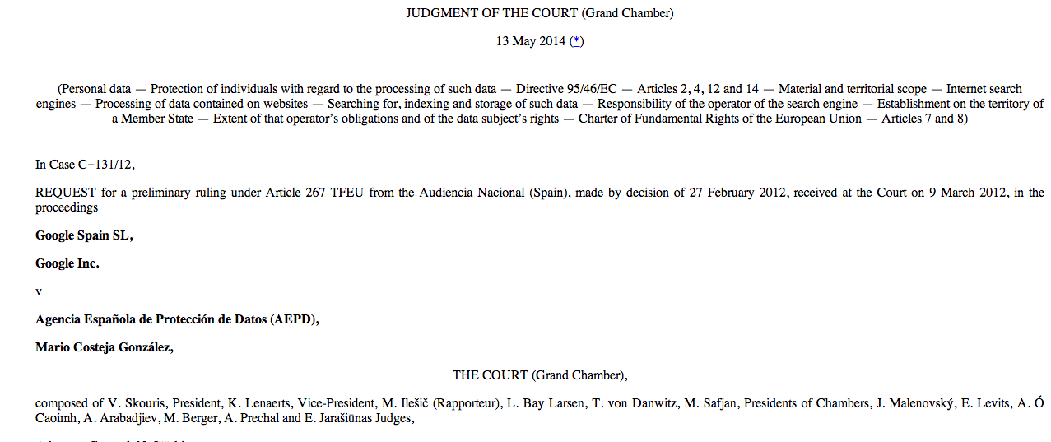
http://curia.europa.eu/juris/document/document_print.jsf?doclang=EN&text&pageIndex=0&part=1&mode=DOC&docid=152065&occ=first&dir&cid=437838

Slide 56
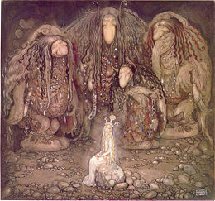
One more thing…
Why are there no trademark trolls?

Slide 57
What Trademark gets “right”
“USE IT OR LOSE IT”
All IP law could be “use it or lose it” per Trademark? Minimize trolling; encourage “connecting”.
* non-use for three consecutive years is prima facie evidence of abandonment in U.S.

Slide 58

Why Trademarks in
Canada get it “right”
“USE IT OR LOSE IT”
Trade-marks Act, RSC 1985, c T-13
“trade-mark” means (a) a mark that is used by a person for the purpose of distinguishing or so as to distinguish wares or services manufactured, sold, leased, hired or performed by him from those manufactured, sold, leased, hired or performed by others,..”
Declaration of Use
Cancellation for Non-use
Aligns with commerce NOT TROLLING

Slide 59
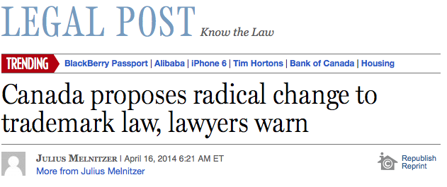
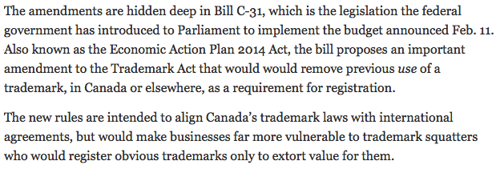
Concept somewhat weakened…
http://business.financialpost.com/2014/04/16/canada-proposes-radical-change-to-trademark-law-lawyers-warn/

Slide 60
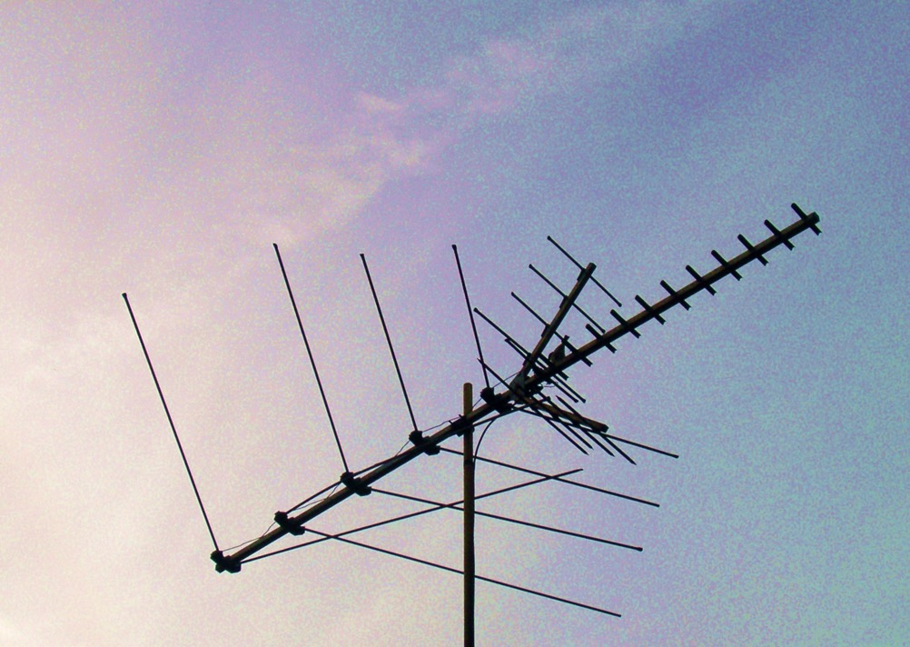
Next Week Back to Our Regularly Scheduled Programming…

Slide 61

Always include a cat picture

Slide 62
Quest De Integro Ludus (latin for “concerning the whole” Game)

Slide 63
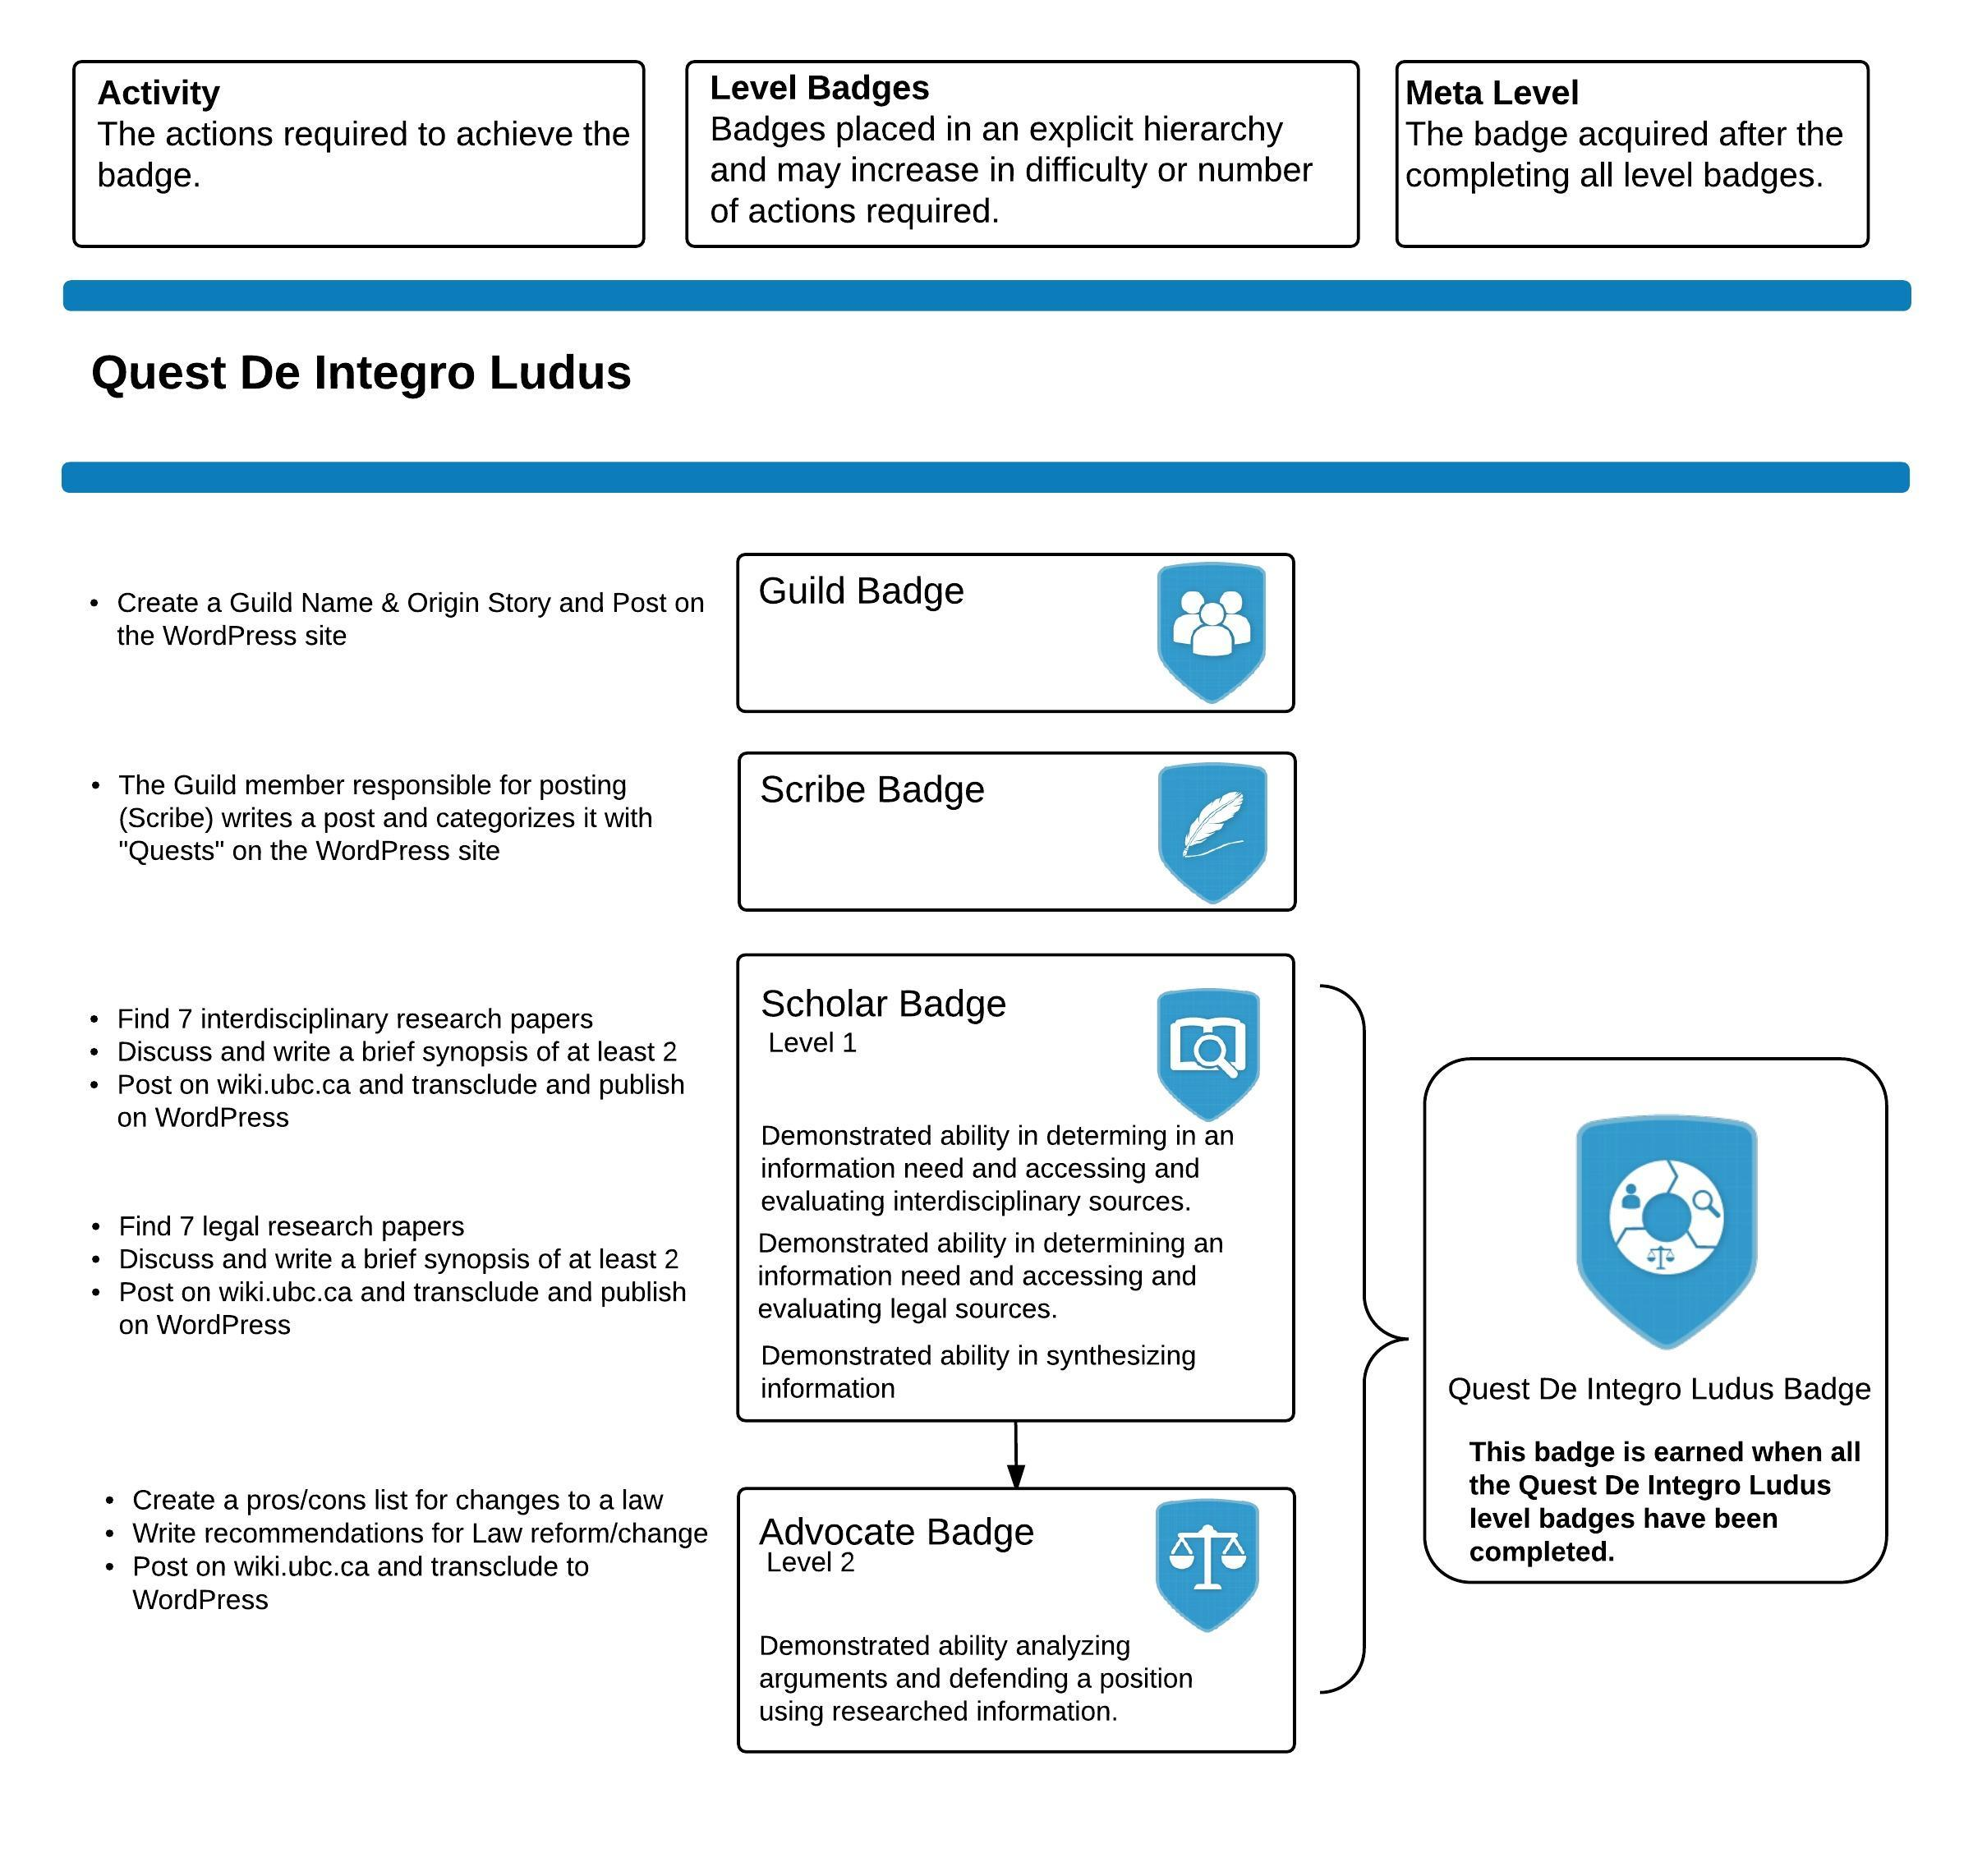

Slide 64
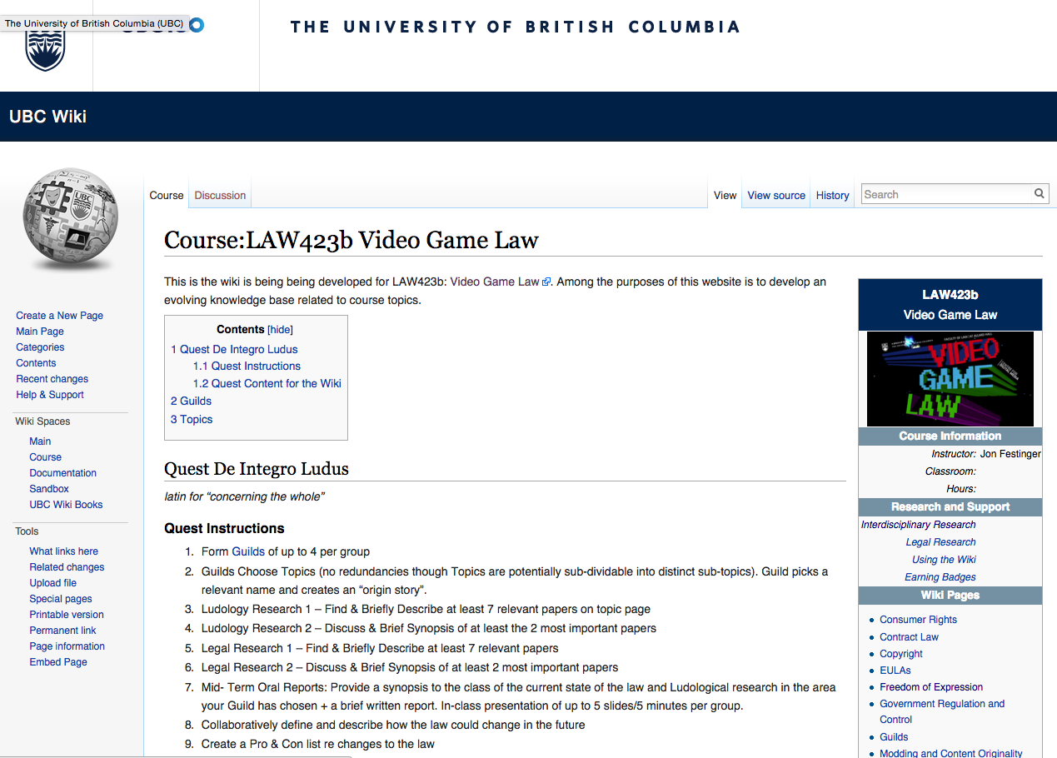

Slide 65
Topics (+Legal Aspects of + Video games)
Topic 1 (Class 2): Freedom of Expression
Topic 2 (Class 3): Copyright
Topic 3 (Classes 4 & 9): Modding & Content Originality
Topic 4 (Class 5): Consumer Rights
Topic 5 (Class 6): Contract Law
Topic 6 (Class 7): EULA’s - Good & Evil
Topic 7 (Class 8): Technology & Change
Topic 8 (Class 10): Violence, Misogyny & Social Issues
Topic 9 (Class 11): Privacy & Surveillance
Topic 10 (Class 11, 12 & 13): Government Regulation & Control

Slide 66
Class Activities
Class 1 Rules Explained: *Guilds of up to 4 per group; *All CC licensed and in Wiki.
Class 2 Guilds Formation Based on Topics (no redundancies though Topics are potentially sub-dividable into distinct sub-topics). Guild picks a relevant name and creates an “origin story”.
Class 3 Ludology Research 1 – Find & Briefly Describe at least 7 relevant papers
Class 4 Ludology Research 2 – Discuss & Brief Synopsis of at least the 2 most important papers
Class 5 Legal Research 1 – Find & Briefly Describe at least 7 relevant papers
Class 6 Legal Research 2 – Discuss & Brief Synopsis of at least 2 most important papers
Class 7 Mid- Term Oral Reports: Provide a synopsis to the class of the current state of the law and Ludological research in the area your Guild has chosen + a brief written report. In-class presentation of up to 5 slides/5 minutes per group.
Class 8 Collaboratively define and describe how the law could change in the future
Class 9 Create a Pro & Con list re changes to the law
Class 10 Recommendations for Law Reform/Change
Class 11 & 12 Oral Opinions/Presentation: 2 sub-groups of the same Guild present up to10 slides of alternating but responsible views on critical aspects of their legal quest in up to 10 minutes. This is not intended as a debate but rather as a technique to fairly illuminate different perspectives on a particular issue.

Slide 67
Our Academic Partners

