Slide 1

Legal Contradictions Manifest in the Digital World*
2015 Isaac Pitblado Lectures
Blackacre to BlackBerry:
Redefining Property & Ownership
Winnipeg, Manitoba
November 6, 2015
Jon Festinger Q.C.
Centre for Digital Media
Festinger Law & Strategy
http://videogame.law.ubc.ca
@gamebizlaw
jon_festinger@thecdm.ca
*Originally titled “Practical Contradictions in Intellectual Property”

Slide 2
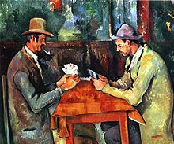
Think about playing a game
Cezanne – The Card Players

Slide 3
How important to the game is the game designer?
How important to the game are you?
How important to the game are the other people you are playing with?

Slide 4
Bruce Boyden: “Games and Other Uncopyrightable Systems”
“In all of these situations, the owners of a copyright in a form, description, or set of instructions were attempting to extend their copyright to material for which the user of the work provided the essential content, not its author. That is what made them systems. They were, without that input, empty shells, waiting to be filled.”
“Games are systems in exactly the same way. A game, as sold, is only a game form; the content necessary for an instance of the game comes from the players. That is, the game form establishes the environment for play—the game space—and it defines permissible moves and the conditions for winning or drawing. But the game itself is supplied by the players.”
“Systems are shells into which users pour meaning. While they may contain expression themselves, that expression is there merely to facilitate the meaning added by the user.”

Slide 5
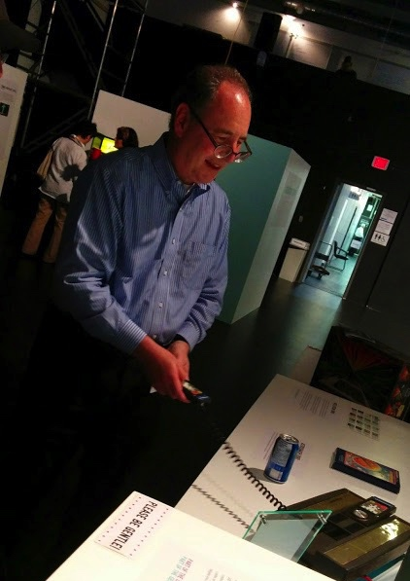
Videogames as most useful CONTEXT?

Slide 6
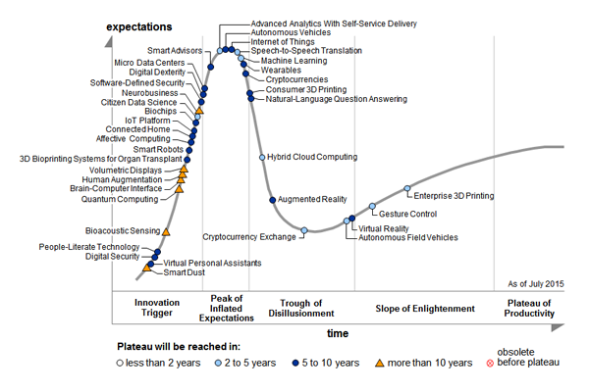
Gartner 2015 Hype Cycle for Emerging Technologies
http://www.gartner.com/newsroom/id/3114217

Slide 7
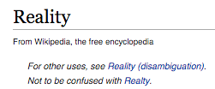
Practical Contradictions #1 + #2
There is no property in “intellectual property”, but that doesn’t matter anymore because it’s all about contracts (licenses) anyways.

Slide 8
But lets start at the beginning
“Once upon
a time…”

Slide 9
IP is not “Property”?
Copyright, trademark and patent law are very distinct disciplines.
Meme of WIPO?
Statute of Anne (aka the “Copyright Act 1709”) formally titled "An Act for the Encouragement of Learning, by Vesting the Copies of Printed Books in the Authors or Purchasers of Copies, during the Times therein mentioned".
In the Patent Act “a “patentee” means the person for the time being entitled to the benefit of a patent”
Property is “scarce” – digital good are not.

Slide 10
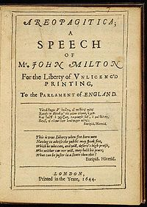
In fact the Statute of Anne (1709) can be interpreted as the apotheosis in a trajectory of authorial freedom from censorship.

Slide 11
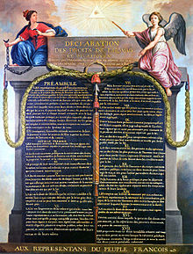
Perhaps the “property” was
in fact a “freedom”…
Article 11 Declaration of the Rights of Man and of the Citizen, 1789

Slide 12

Does that make you look at “digital rights” any differently?

Slide 13

Question applies to…
Fan Fiction

Slide 14
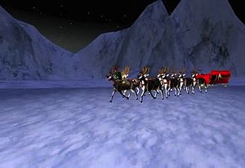
Machinima (in Second Life)

Slide 15

Remixing

Slide 16
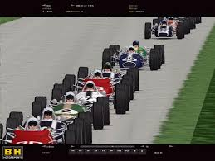
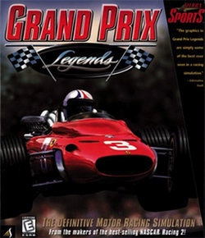

Video Game Mods

Slide 17
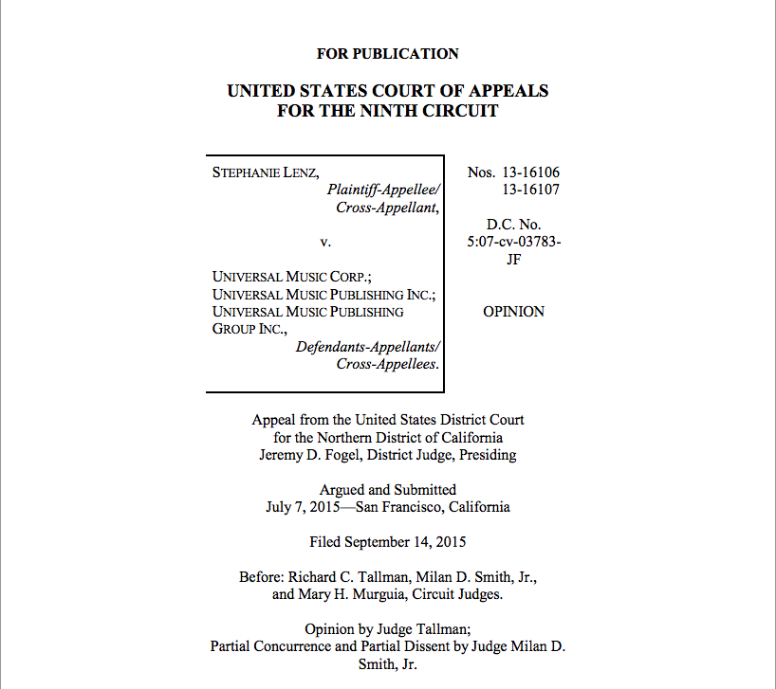
Evolving copyright law…
Who can resist a dancing baby?

Slide 18
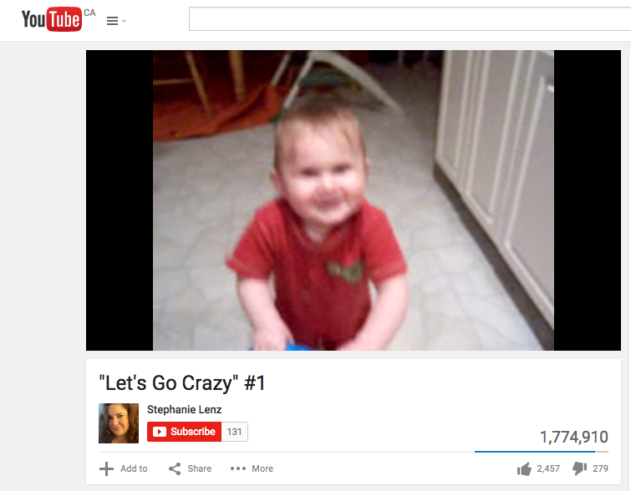
https://www.youtube.com/watch?v=N1KfJHFWlhQ

Slide 19

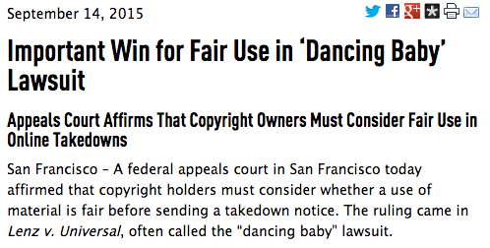
https://www.eff.org/press/releases/important-win-fair-use-dancing-baby-lawsuit

Slide 20
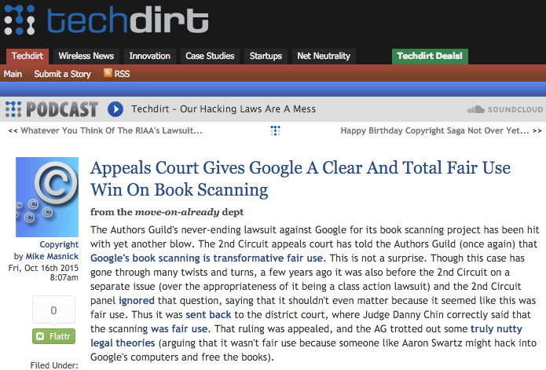
& even more recently…
https://www.techdirt.com/articles/20151016/08010632559/appeals-court-explains-yet-again-to-authors-guild-that-googles-book-scanning-is-fair-use.shtml

Slide 21
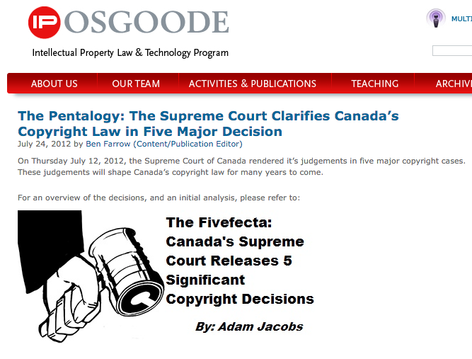
In Canada:
Fair Dealing/Users rights
http://www.iposgoode.ca/2012/07/the-pentalogy-the-supreme-court-clarifies-canadas-copyright-law-in-five-major-decision/

Slide 22
All clearly raising the question, if it’s “property”, whose property is it ???
Think about games (& Boyden)….

Slide 23
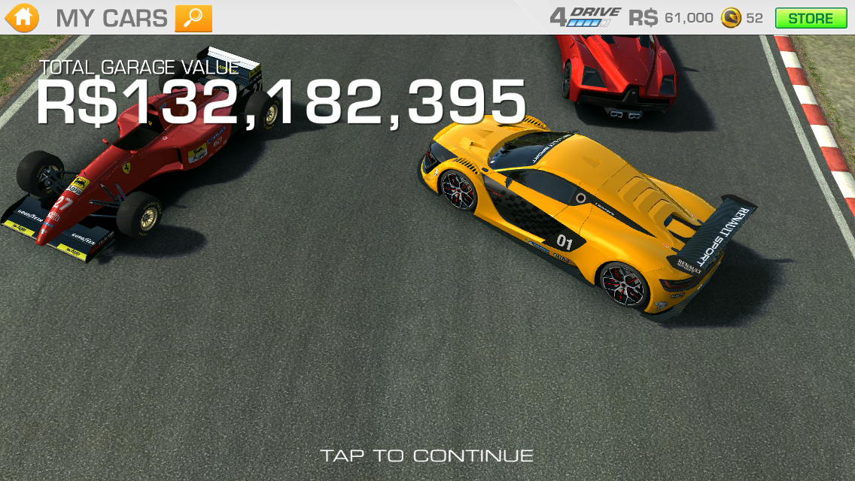
No doubt it can really
“feel” like “property”
Compulsion Loops in “freemium” games

Slide 24
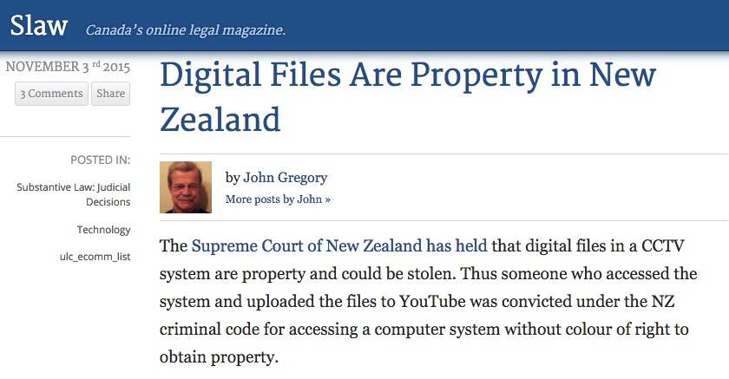
Very few cases
(& all over the map)

Slide 25


Slide 26

Why (do I) resist digital goods as property???

Slide 27
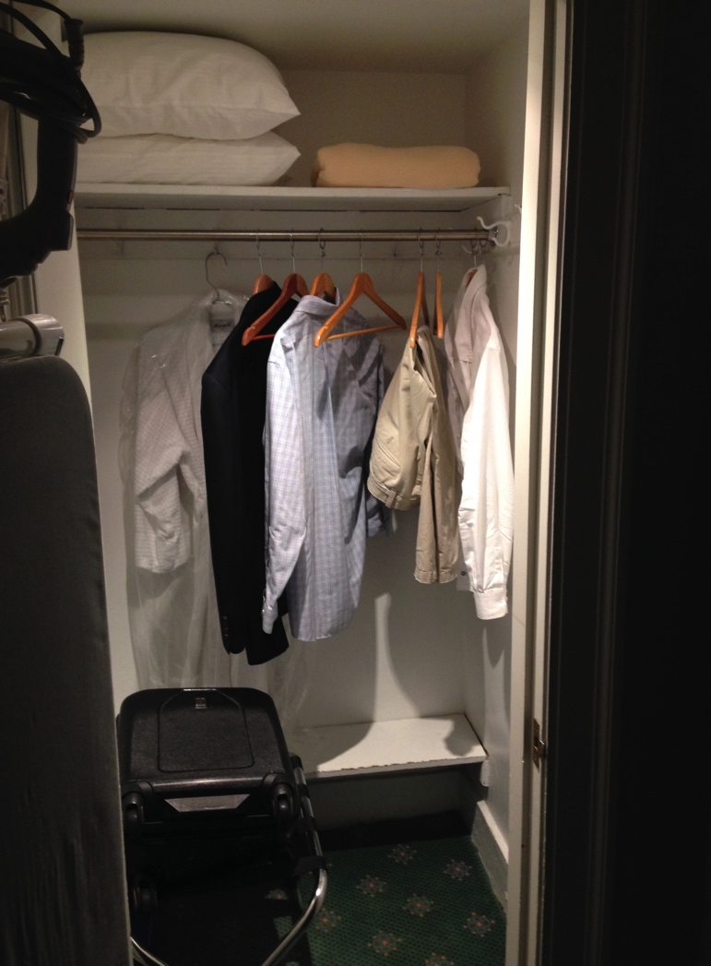
Fear #1
All or nothing? The exclusionary aspects of property law appear to be mostly binary, all or nothing, and not particularly accommodating of the interactive, often collaborative and always iterative post-structural nature of the Digital Media.

Slide 28
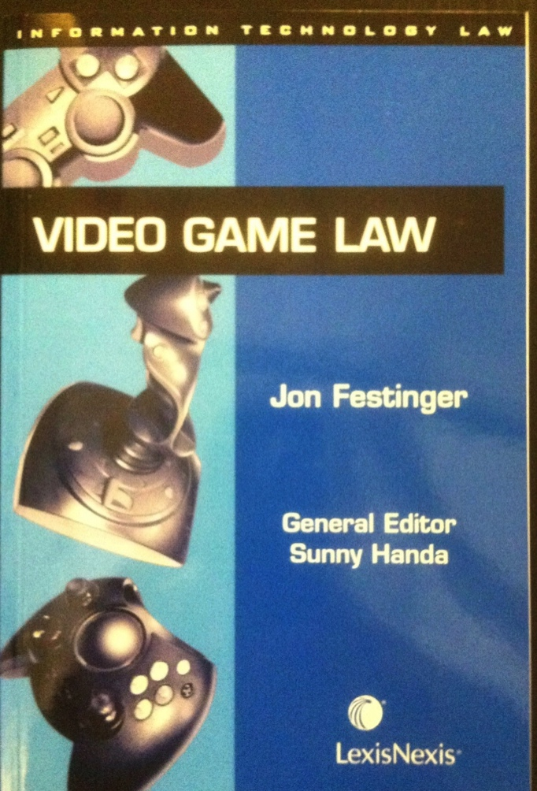
Fear #2: Lessons Learned
2005
Book-
Talk

Slide 29
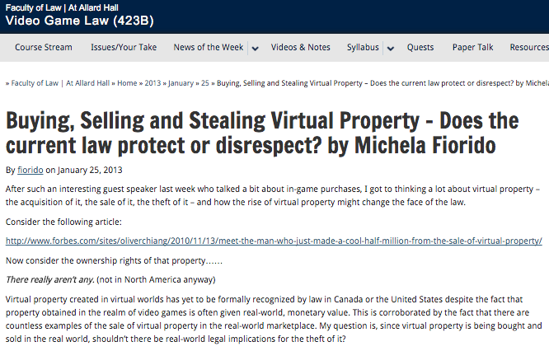
http://videogame.law.ubc.ca/2013/01/25/buying-selling-and-stealing-virtual-property-does-the-current-law-protect-or-disrespect-by-michela-fiorido/

Slide 30
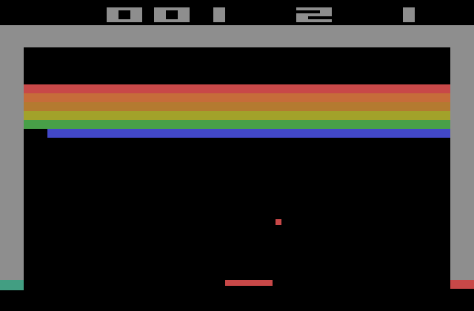
Respect…
Atari v. Oman 1992 USCA

Slide 31
Can Backfire
District court judge asked counsel for the Register:
"If Picasso had painted a round object on a canvas, would you say because it depicts a familiar subject--namely, something that's round--it can't be copyrighted?”

Slide 32

Raise Thresholds for IP Protection?
“The Innovation Dilemma: Intellectual Property and the Historical Legacy of Cumulative Creativity” Dutﬁeld & Suthersanen (U.K.)
http://www.academia.edu/860340/

Slide 33
Equally, it may seem tempting to have the legitimacy of digital goods being property…but is that really correct in law and/or is that really a good idea?

Slide 34
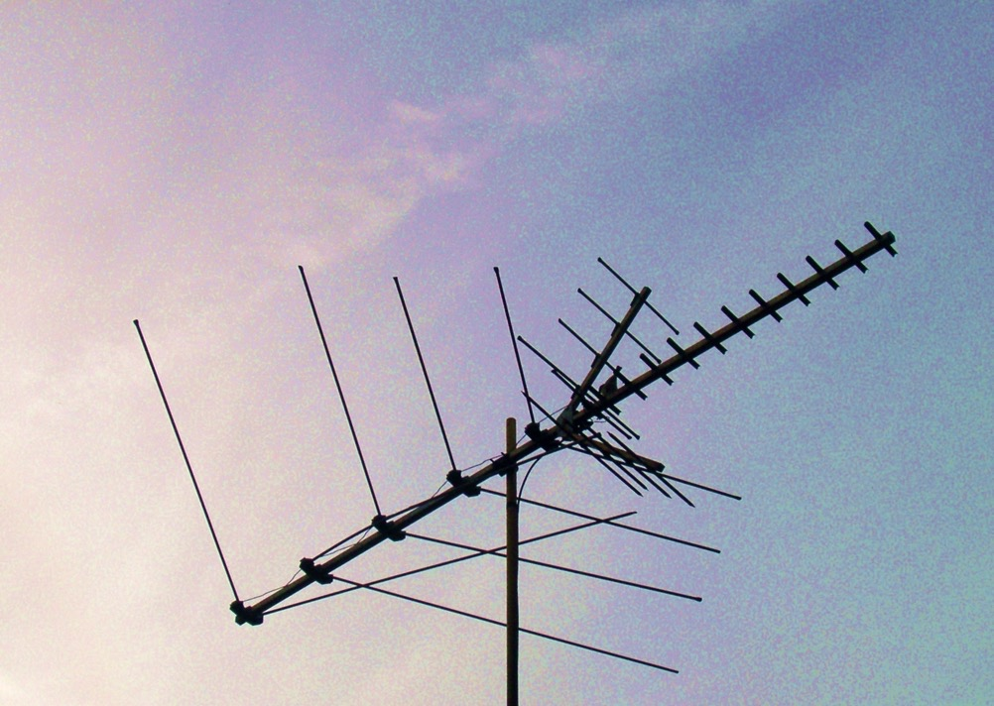
Now Back to Our Regularly Scheduled Programming…

Slide 35

…the real Legal Fly in the Copyright
Ointment

Slide 36
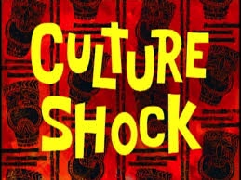

Slide 37
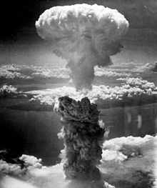
EULA’s, ToS & the Post (apocalyptic) IP World

Slide 38
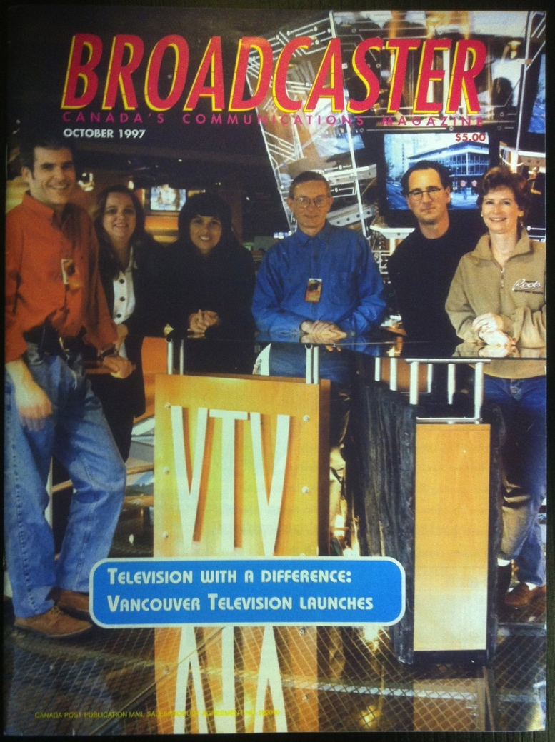

Digital 1.0 & 2.0

Slide 39
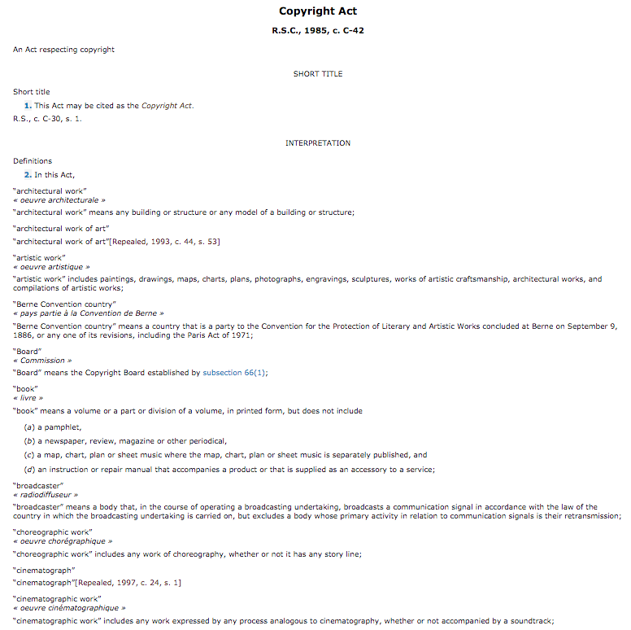
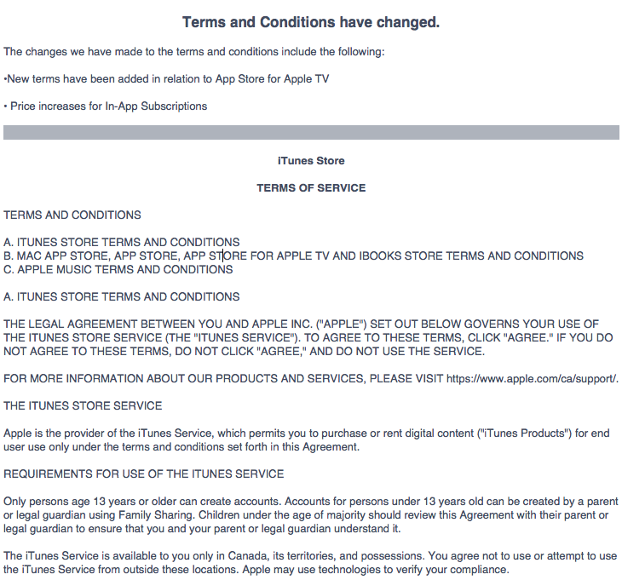
Digital 1.0 & 2.0

Slide 40
Repeat After Me…….
“I am agreeing. I am not reading what I am agreeing to. I am doing this thousands of times. Each document I am agreeing to & not reading is different, often quite different, from every other document I am agreeing to and not reading.”

Slide 41
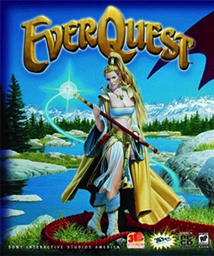

The Transition Point:
Networked multiplayer
1999

Slide 42
The chasm of contracting out
No one reads EULA’s, ToS’s & Privacy Policies:
“To Read All Of The Privacy Policies You Encounter, You’d Need to Take A Month Off From Work Every Year”http://www.techdirt.com/articles/20120420/10560418585/to-read-all-privacy-policies-you-encounter-youd-need-to-take-month-off-work-each-year.shtml
@gamerlaw: Amazing study by @nyulaw: "overall average rate of readership of EULAs is on the order of 0.1 percent to1 percent” http://t.co/DFcF0mx0
For review of “click-wrap” authorities see: Century 21 v. Rogers Communications 2011BCSC 1196 (upholding ToU) http://canlii.ca/en/bc/bcsc/doc/2011/2011bcsc1196/2011bcsc1196.html

Slide 43
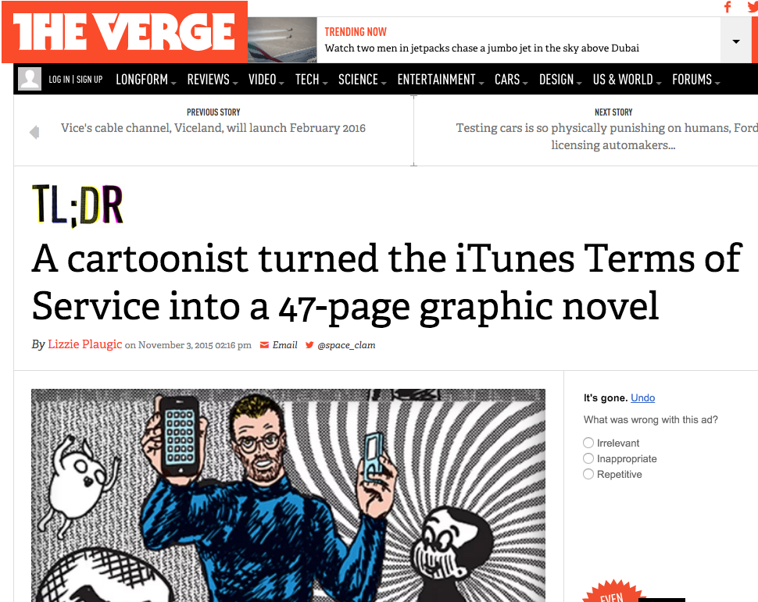

Slide 44
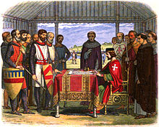
But surely the Rule of
Law will save us ?!!

Slide 45

The Common Law explains itself
“Every expression of a common intention arrived at by the parties is ultimately reducible to question and answer.” Anson, Principles of the English Law of Contract, 2nd Edn., p.15 (1882).
Common Law is “concerned not with the presence of an inward and mental assent but with its outward and visible signs.” Cheshire and Fifoot’s Law of Contract, 9th Edn. P.26 (1976).

Slide 46
The Joy of Tech:
“Support group for writers of end-user
license agreements” by Nitrozac & Snaggy
http://www.geekculture.com/joyoftech/joyarchives/2210.html

Slide 47
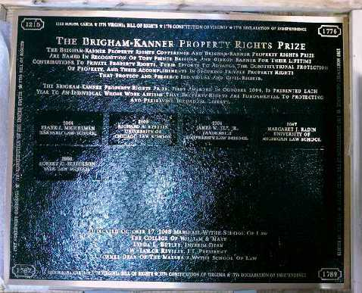
Re EULA’s etc.
“Boilerplate: The Fine Print, Vanishing
Rights, and the Rule of Law”
Princeton University Press
Margaret Jane Radin, Henry King Ransom Professor
of Law at the University of Michigan and the William
Benjamin Scott and Luna M. Scott Professor of Law,
emerita, at Stanford University

Slide 48
The Issue Stated
“Should We Allow the Overleveraging of IP Rights By Contract?”
http://ipkitten.blogspot.ca/2012/09/should-we-allow-overleveraging-of-ip.html
“Less appreciated, however, is the asymmetry that is created between the scope of the proprietary obligations that exist by virtue of the IP right and the potentially broader scope of contractual obligations that may be created under the licence, subject only to agreement by the two parties. Against that backdrop, an interesting question arises: how do we treat a contractual obligation that exceeds the scope of the IP right being licensed? ”

Slide 49

Davidson & Assoc. Inc. & Blizzard Enter. V. Internet Gateway, Bnetd 334 F.Supp.2d 1164 (E.D. Mo. 2004)
“BnetD” versus Blizzard’s own “Battle.net”
Amici Curiae Brief supporting defendants by teachers of IP Law in U.S. law schools argued unsuccessfully that insofar as they prohibit permissible “reverse engineering” Blizzard’s EULA’s should be preempted by copyright law. Alternatively argued that enforcement of the EULA’s should be denied under the Doctrine of Copyright Misuse (related to concept of “Copyright Monopoly”).

Slide 50
It is Contracts that
curtail “mods”…
Not Copyright Law

Slide 51
Unfairness?
Un-contract like uncertainty - Termination clauses that aren’t….eg. World of Warcraft EULA:
“This License Agreement is effective until terminated. You may terminate the License Agreement at any time by (i) permanently destroying all copies of the Game in your possession or control; (ii) removing the Game Client from your hard drive; and (iii) notifying Blizzard of your intention to terminate this License Agreement. Blizzard may terminate this Agreement at any time for any reason or no reason.”
Are we party to hundreds (thousands)
of contracts we don’t use?

Slide 52
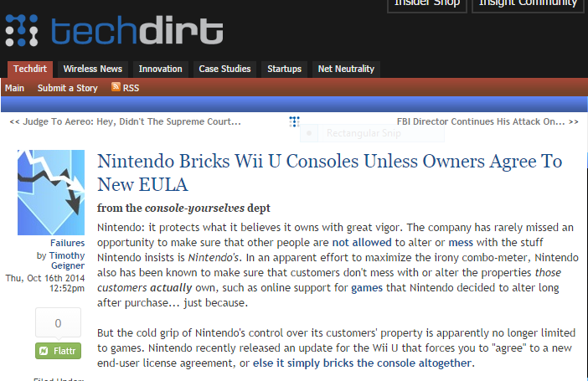
More Than Unfairness?
https://www.techdirt.com/articles/20141013/11010528810/nintendo-bricks-wii-u-consoles-unless-owners-agree-to-new-eula.shtml

Slide 53
EULA’s equally impact speech
Censorship controls effectively delegated to private interests (without free speech/expression overrides).
* “Apple rejects game based on Syrian civil war” http://killscreendaily.com/articles/news/apple-rejects-game-based-syrian-civil-war/
* “iOS games chafe under Apple's directions: 'If you want to criticize a religion, write a book’” http://www.theverge.com/2013/1/16/3879194/apple-app-store-guidelines-tell-game-developers-to-avoid-serious-themes
* “Turns Out Sexist Talk on Xbox Live Won't Earn You a Lifetime Ban” – but racist talk will. http://www.gamepolitics.com/2012/11/07/turns-out-sexist-talk-xbox-live-wont-earn-you-lifetime-ban#.URsttVpAR3c
* “Blizzard Bans 'Several Thousand' Diablo III Players for Cheating” – using bots (would “Notice” do?)
http://gamepolitics.com/2012/12/19/blizzard-bans-several-thousand-diablo-iii-players-cheating#.URswDFpAR3c

Slide 54
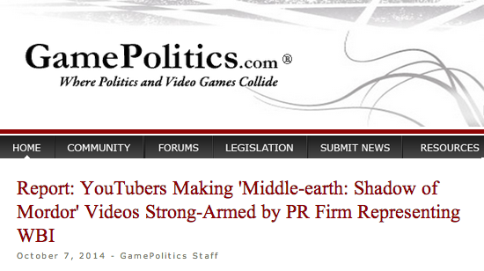
http://www.gamepolitics.com/2014/10/07/report-wb-strong-arms-shadow-mordor-reviewers#.VDxyXpRdX9Q

Slide 55
“YouTubers had to agree to do the following:
- Maximize awareness for the game during the ‘week of vengeance’
Persuade viewers to purchase game
Not show bugs or glitches that may exist
The agreement also notes that "videos will promote positive sentiment about the game.”
“…the company has final approval on the YouTube video at least 48 hours before any video goes live,”
Those who didn't sign the "branding agreement" and made their own found their videos taken down by a YouTube ContentID claim” (Now contrary to “Lenz”)

Slide 56
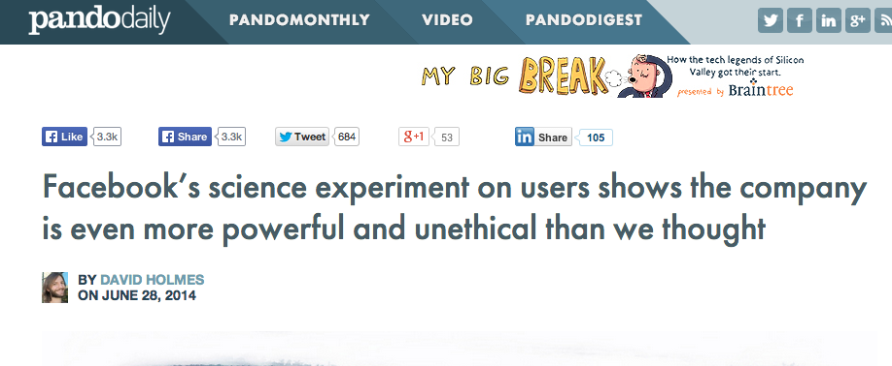
And impact privacy too…
http://pando.com/2014/06/28/facebooks-science-experiment-on-users-shows-the-company-is-more-even-powerful-and-unethical-than-we-thought/

Slide 57
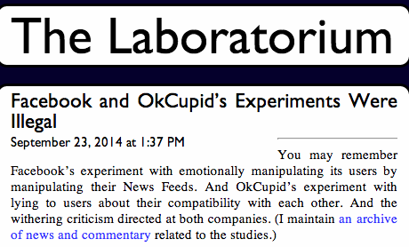
http://laboratorium.net/archive/2014/09/23/facebook_and_okcupids_experiments_were_illegal

Slide 58
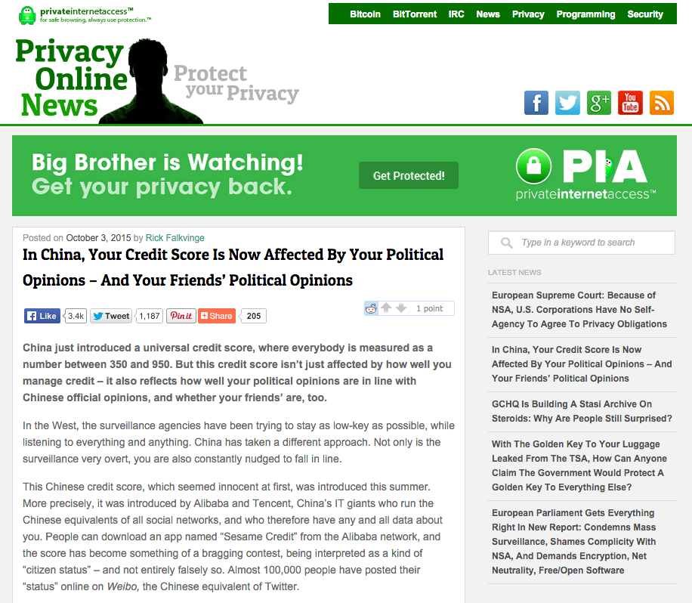
The Greatest Fear?
https://www.privateinternetaccess.com/blog/2015/10/in-china-your-credit-score-is-now-affected-by-your-political-opinions-and-your-friends-political-opinions/

Slide 59
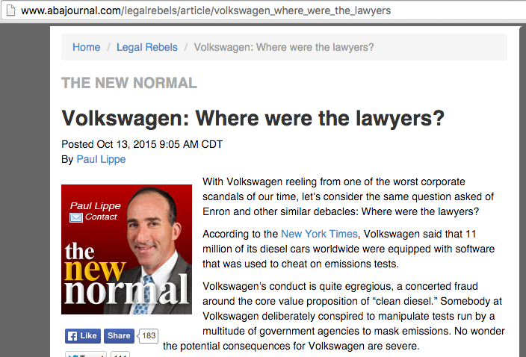
Where are the lawyers?

Slide 60
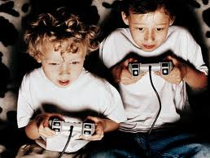
Related Issue
Contractual status of Minors

Slide 61

The Heretical Question…
Are EULA’s & ToS’ even necessary?

Slide 62
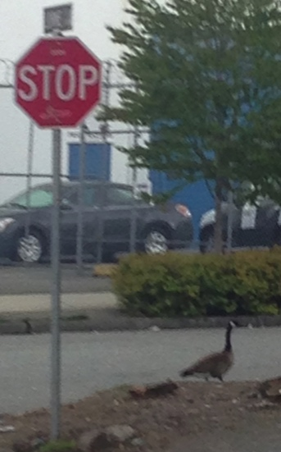
Roads to explore…
Ask the question: Are consumer contracts/license agreements redundant &/or unnecessary?
If EULA’s, ToS, & (non) Privacy Agreements disappeared suddenly would the gaps be filled by:
* Copyright
* Competition-antitrust law
* Privacy law
* Consumer protection laws
* International law/treaties
* Legislation & regulation
)

Slide 63
Fin Practical Contradictions #1 + #2
There is no property in “intellectual property”, but that doesn’t matter anymore because it’s all about contracts (licenses) anyways.

Slide 64
Practical Contradiction #3
Why is there a double standard of behavioral freedoms favoring patents over copyright in analogous circumstances (e.g. “modding”) with no explanation?

Slide 65
The Significance of Creativity v. Innovation
* With thanks to Andrew Ming-Lum

Slide 66

Creativity

Slide 67
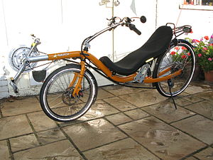
Innovation

Slide 68
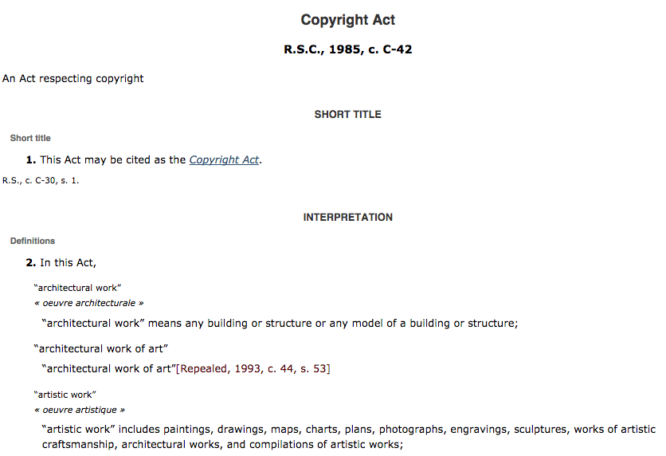
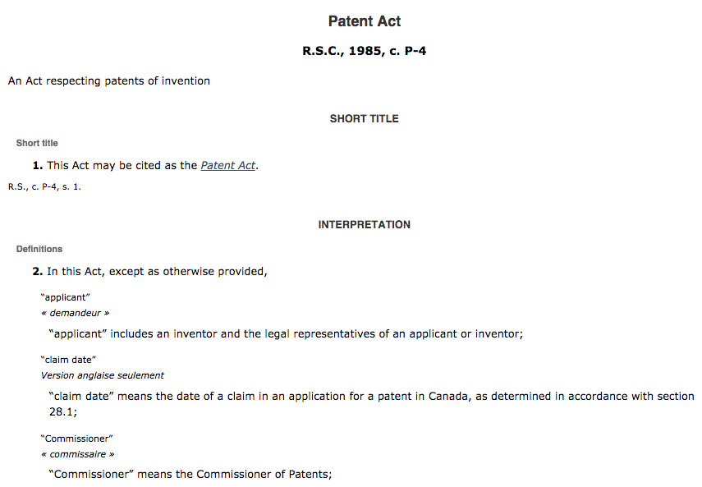
Significant that…
Creativity maps to Copyright Law
Innovation maps to Patent Law

Slide 69

But is the game rigged?
Industry > Art

Slide 70
Explains Patent Law double standards ?
Innovation in a patent law context effectively allows “mods”….So why doesn’t creativity in a copyright law context similarly allow mods.
Patent law allows free riding on both ideas and expression (through designing around). Copyright law allows free riding on ideas only. If free riding on ideas is ok, why is free riding on expression not ok?… (Tushnet)

Slide 71
Moreover…one more contradiction
Patent law recognizes “prior art” as a reason to invalidate a patent claim.
Copyright law, though recognizing “genre” in fair dealing/fair use terms, does not actually examine “prior art” per se. If it did almost no copyrights of creative works would be valid.

Slide 72
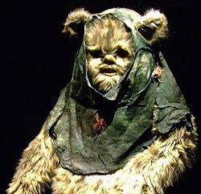

Preston v. 20th Century Fox Canada Ltd. (1991), 33 C.P.R. (3d) 242 (F.C.T.D.)

Slide 73
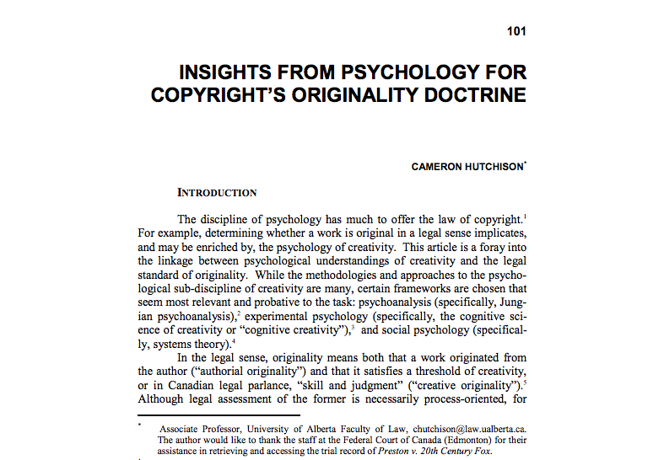
http://law.unh.edu/assets/images/uploads/publications/idea-vol52-no1-hutchison.pdf

Slide 74
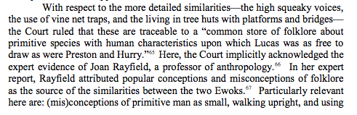
“common store of folklore”
= the “collective unconscious”

Slide 75
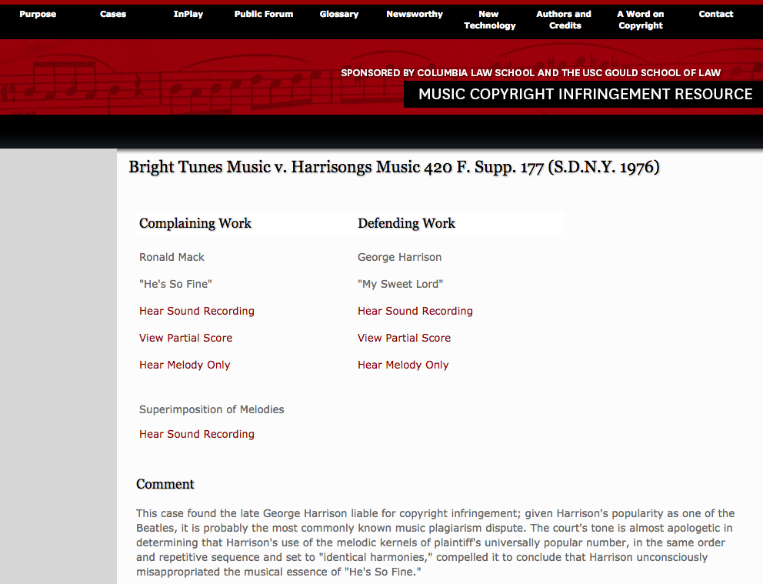
“Subconscious plagiarism”
http://mcir.usc.edu/cases/1970-1979/Pages/brightharrisongs.html

Slide 76
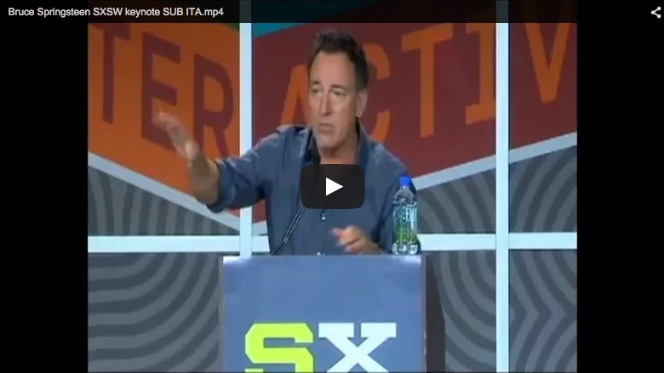
Conscious homage?
23:15 - 30:16

Slide 77
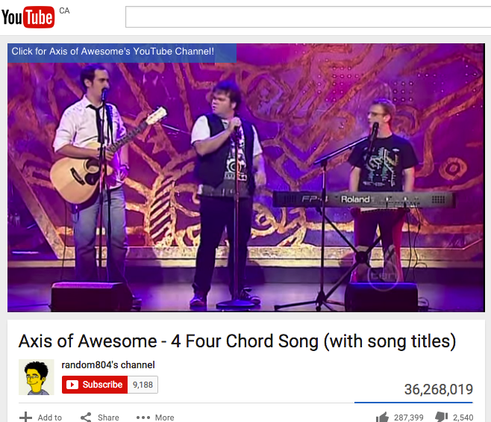
https://youtu.be/5pidokakU4I

Slide 78
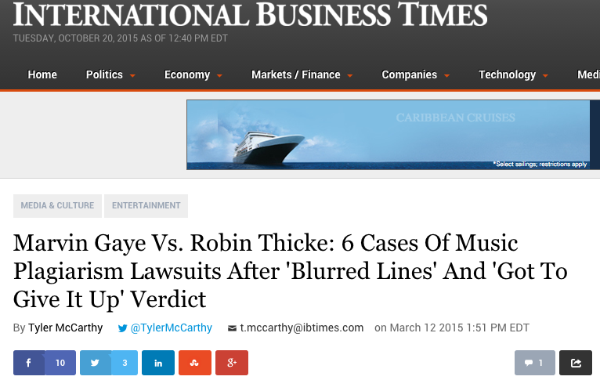

Slide 79

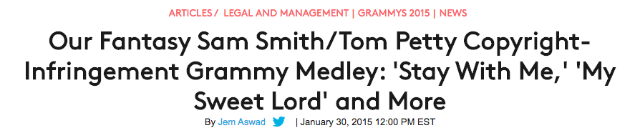
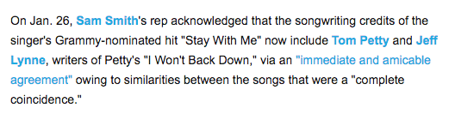
http://www.billboard.com/articles/events/grammys-2015/6457978/sam-smith-tom-petty-grammy-medley-mashups

Slide 80


Slide 81
Conclusion

Slide 82
Nasty Questions:
Has the trajectory of copyright freedoms/uncertainties led to a contractual backlash?
Does copyright matter in a “Post IP World”?
Do freedoms exist outside of contract in a “Post IP World”?

Slide 83

Is it property we are favoring?
Or is it commercialization?
To the detriment of creativity…
To the detriment of collaboration...

Slide 84

“We cannot know how we would have acted, but we now know how we should have.”

Slide 85
Common Denominator of
Practical Contradictions 1, 1.5 & 2
Points to the question: Have we got our values reversed?

Slide 86



Shouldn’t Creativity Be More Important Than Property ?

Slide 87


Slide 88
Radical reflections then…
Consider the cultural effects of these biases against creativity and storytelling:
Is it anti storytelling and expression?
Is it therefore inherently anti indigenous peoples?
Is it anti cultural diversity?
Is it cultural colonialism?
Is this why we are so pro-science where the message is that of uniform standards and cultural equality through assimilation rather then diversity (the “universal language of science”)?

Slide 89


A MATTER OF PERSPECTIVE

Slide 90
QUESTIONS? DISCUSSION?

Slide 91

Always include a cat picture

Slide 92
Our Academic Partners

Slide 93
Appendix 1
Views on EULA’s, ToS’ & Privacy Policies

Slide 94
1. “Empirical studies on software notices to inform policy makers and usability designers”; Jens Grossklags, Nathan Good (University of California Berkeley, 2007)
“Abstract: We evaluate the usability of End User License Agreements (EULAs) of popular consumer programs. Results from an empirical evaluation of 50 popular programs show the lack of accessibility and readability of notices. Our data from a recent study with 64 users involved in installation tasks confirms the public perception that notice to and consent by the user is not achieved.”
http://people.ischool.berkeley.edu/~jensg/research/usec.html
2. “Examination Of Privacy Policies Shows A Few Troubling Trends” (2011)
http://techcrunch.com/2011/11/30/examination-of-privacy-policies-shows-a-few-troubling-trends/

Slide 95
3. “Intellectual Property and Shrinkwrap Licenses”; Mark Lemley (1995)
http://papers.ssrn.com/sol3/papers.cfm?abstract_id=2126845##
4. “Terms Of Service, Terms Of Play In Children’s Online
Gaming”; Sara Grimes (2007)
http://www.academia.edu/183319/
Terms_Of_Service_Terms_Of_Play_In_Childrens_Online_Gaming
5. “Confess and protest against the Biggest Lie!”
http://www.biggestlie.com
6. “The Cost of Reading Privacy Policies”; A. McDonald, L.
Cranor. 4 ISJLP 543 (2008-2009)
http://lorrie.cranor.org/pubs/readingPolicyCost-authorDraft.pdf

Slide 96
7. “Re-Mediating Research Ethics: End-User License Agreements in Online Games”; Florence Chee, Nicholas Taylor, and Suzanne de Castell (2012) http://www.academia.edu/2976765/Re-Mediating_Research_Ethics_End-User_License_Agreements_in_Online_Games
8. “CLICK AND COPY: BREACH OF ONLINE LICENCE AGREEMENTS AND COPYRIGHT INFRINGEMENT”; Richard Stobbe (2012) 28 C.I.P.R. 227
http://www.ipblog.ca/wp-content/uploads/2013/01/cipr-28-2-click-and-copy-breach-of-
online-license-agreements-and-copyright-infringement-c1380000.PDF
9. “Top EULA Gotchas: Website Fine-Print Hall of Shame” (2012) http://www.pcworld.com/article/249396/top_eula_gotchas_website_fine_print_hall_of_shame.html
10. “Living and Dying in a Virtual World: Estate Planning or Digital Assets”; Greg Lastowka & Trisha Hall (2013) http://lastowka.rutgers.edu/files/2013/10/Lastowka.pdf
11. “Face value: digging through Google’s clumsy new terms of service” (2013) http://www.theverge.com/2013/10/17/4845828/digging-through-new-google-terms-of-service

Slide 97
Appendix 2
The legalities of the “Magic Circle”

Slide 98

Consider the “Magic Circle”
“All play moves and has its being within a play-ground marked off beforehand either materially or ideally, deliberately or as a matter of course. Just as there is no formal difference between play and ritual, so the ‘consecrated spot’ cannot be formally distinguished from the play-ground. The arena, the card-table, the magic circle, the temple, the stage, the screen, the tennis court, the court of justice, etc. are all in form and function play-grounds, i.e. forbidden spots, isolated, hedged round, hallowed, within which special rules obtain. All are temporary worlds within the ordinary world, dedicated to the performance of an act apart.”
Johan Huizinga (1872-1945) in “Homo Ludens: A Study of the Play-Element in Culture”. Applied to video games by Katie Salen & Eric Zimmerman in “Rules of Play: Game Design Fundamentals” (2003)

Slide 99

The “Magic Circle”
as a (theoretical) fence
keeping out real world laws
is probably untenable

Slide 100

http://remotedevice.net/ctcs-505/mia_2009.pdf

Slide 101




Why there is no “Magic Circle”
There is no virtual…
It’s all real…

Slide 102


Oops?...

Slide 103
The legalities of the “Magic Circle” 1
1. “The Laws of the Virtual Worlds” - Greg Lastowka & Dan Hunter (2003)
http://papers.ssrn.com/sol3/papers.cfm?abstract_id=402860
“No doubt there will be time and litigation enough to soon make further observations. However there is one point
that is worth making in conclusion. It is not going to be a sufficient answer, either for property or avatar rights, to
say, “It’s just a game”. Nor can the company creating the world simply intone that the world is theirs to do with as
they wish. The issues are more complex than that, and the users and community will have a say in the outcome
of these questions…We will have to recognize that these are separate places, with a separate community, separate laws,
and separate rights. Sometimes the inhabitants of these worlds will come down to our world, to have
recourse to our law, and gain protections against their gods. But more and more they will live out their lives in a different
world, and they will eventually come to create their own laws, just as they are building their own community. In time perhaps they won’t care what we think or what our laws say. They will live and love and law for themselves.”
2. “Virtual Liberty: Freedom to Design and Freedom to Play in Virtual Worlds” Jack Balkin (2004) http://papers.ssrn.com/sol3/papers.cfm?abstract_id=555683
“In the future, virtual worlds are likely to become important spaces for innovation and free expression. Properly
drafted interration statutes can help promote these values. To this end, legislatures should prominently state the
public values these statutes are designed to serve in the statutes themselves as guides to interpretation by
courts, and courts, in turn, should interpret these statutes liberally to promote free speech values. We should view
interration statutes as applications and extensions of the central values of individual creativity and democratic
participation that we associate with the First Amendment.⁹⁶ That is to say, we should view them as “First
Amendment extension acts” appropriate for a digital world in which many of the most important spaces for
creative expression are held in private hands.”
3. “The Right to Play” - Edward Castronova (2005)
http://papers.ssrn.com/sol3/papers.cfm?abstract_id=733486
“A legal framework for make-believe places will not be very fun to create either. It will require numerous creditors,
theft victims, tax collectors, protestors, defeated warriors and impoverished wizards to simply go home empty
handed, unsatisfied, perhaps distraught. But it will allow everyone, all of us, to spend time in worlds where magic
is real. Goodness, we haven’t done anything like that in hundreds of years. We miss it.”

Slide 104
The legalities of the “Magic Circle” 2
4. “Virtual Property” - Joshua Fairfield (2005) http://papers.ssrn.com/sol3/papers.cfm?abstract_id=807966
“I propose a different answer: cyberspace is neither a bad analogy nor a metaphor. Cyberspace is a
descriptive term. It describes the degree to which some kinds of code act like spaces or objects…And
while the place and space language is routinely used by the courts and lawyers, again, legal academics
have either supported the place metaphor as merely psychologically useful, or have completely
rejected it as a bad analogy.”
5. “Virtual Borders: The Interdependence of Real and Virtual worlds” – James
Grimmelmann (2006) http://papers.ssrn.com/sol3/papers.cfm?abstract_id=868824
“In the end, talking about the real-money trade points out the deep interdependence of the virtual and the real. It is possible only because of their interrelationship. If avatars in virtual worlds were not so profoundly linked to people in the real one, there would be no real-money trade. To the extent that the real-money trade is a problem, its solution also must recognize the interdependence of the real and the virtual.”
6. “The Magic Circle” - Joshua Fairfield (2008)
http://papers.ssrn.com/sol3/papers.cfm?abstract_id=1304234
“The implications for the future of virtual worlds are complex. On one hand, denizens of virtual worlds
should hope that the law that ultimately govern virtual worlds will not only take their interests into account
in some sort of paternalistic fashion, but that courts will give the actual solutions worked out by online
communities the force of law. On the other hand, players in virtual worlds should understand that their
behavior online is not entirely free from real-world scrutiny. This is a bit saddening. It was wonderful to live
in the cyber Wild West. But every new frontier has its civilizing moments. And virtual worlds are an
enormous phenomenon, one that law cannot afford to ignore.”

Slide 105
The legalities of the “Magic Circle” 2
4. “Virtual Property” - Joshua Fairfield (2005) http://papers.ssrn.com/sol3/papers.cfm?abstract_id=807966
“I propose a different answer: cyberspace is neither a bad analogy nor a metaphor. Cyberspace is a
descriptive term. It describes the degree to which some kinds of code act like spaces or objects…And
while the place and space language is routinely used by the courts and lawyers, again, legal academics
have either supported the place metaphor as merely psychologically useful, or have completely
rejected it as a bad analogy.”
5. “Virtual Borders: The Interdependence of Real and Virtual worlds” – James
Grimmelmann (2006) http://papers.ssrn.com/sol3/papers.cfm?abstract_id=868824
“In the end, talking about the real-money trade points out the deep interdependence of the virtual and the real. It is possible only because of their interrelationship. If avatars in virtual worlds were not so profoundly linked to people in the real one, there would be no real-money trade. To the extent that the real-money trade is a problem, its solution also must recognize the interdependence of the real and the virtual.”
6. “The Magic Circle” - Joshua Fairfield (2008)
http://papers.ssrn.com/sol3/papers.cfm?abstract_id=1304234
“The implications for the future of virtual worlds are complex. On one hand, denizens of virtual worlds
should hope that the law that ultimately govern virtual worlds will not only take their interests into account
in some sort of paternalistic fashion, but that courts will give the actual solutions worked out by online
communities the force of law. On the other hand, players in virtual worlds should understand that their
behavior online is not entirely free from real-world scrutiny. This is a bit saddening. It was wonderful to live
in the cyber Wild West. But every new frontier has its civilizing moments. And virtual worlds are an
enormous phenomenon, one that law cannot afford to ignore.”

Slide 106

News: There is a Magic Circle ?
http://arstechnica.com/tech-policy/2015/10/judge-losing-in-game-of-wars-virtual-casino-isnt-a-real-world-problem/

Slide 107

An issue that won’t go away…

Slide 108

And who can ever forget…
http://www.cnet.com/news/study-finds-online-gamers-arent-anti-social-basement-dwellers/

Slide 109
All Made More Complex By..
The complexities of virtual goods: “Can you actually own the Sword of Azeroth?” http://www.lexology.com/library/detail.aspx?g=34810a92-9fc4-41bb-8541-ca7ae2392dcf

