Slide 1


What’s it all about…EULA?
Talk 7
Part B “Connecting”
Video Game Law 2015
UBC Law @ Allard Hall
Jon Festinger Q.C.
Centre for Digital Media
Festinger Law & Strategy
http://videogame.law.ubc.ca
@gamebizlaw
jon_festinger@thecdm.ca

Slide 2
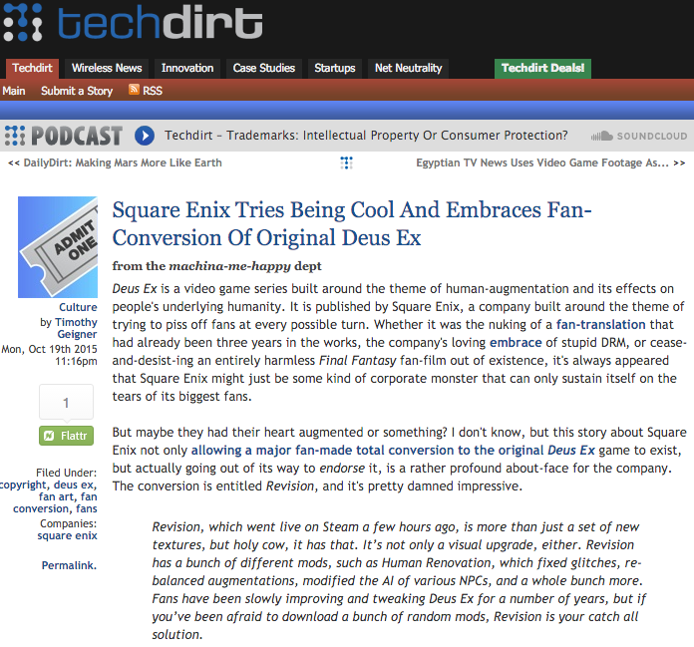
News of the Week

Slide 3
Taking Stock: Where Are We?
Part A: Memes of “Creating”
Meaning & purpose of creating (in a video game context)
Right to CREAte (mod)
Games as social reaction (McLuhan)
Games as empty vessels (Boyden)
Role of the “Magic Circle”?
Copyright as power & constraint

Slide 4
Taking Stock: Where Are We? (2)
Part B: Memes of “Connecting”
How connecting creativity transforms and restrains it
Creation as Connection: Connection as both the cause & the purpose of Creation = Games are post-structuralist
Video-games (like all creative works) as merger of Creativity & Connection of both Developer/Creator & Player/Creator
Connections→Creation→Greater Connections→Legal implications of post-structuralist nature of games

Slide 5
Leading to “THE POST IP WORLD”?
* Talks 5 & 6: Does the dominance of contracts mean we are already in a “The Post IP World”??
* Focus on contractual restraints (digital re-sale; transferability by will, contracting out of IP law permissions e.g. ToS prohibitions of reverse engineering)
CREATION goes with COPYRIGHT/IP LAW
CONNECTING goes with CONTRACT LAW

Slide 6
Nasty Questions:
Has the trajectory of copyright freedoms/uncertainties led to a contractual backlash?
Does copyright matter in a “Post IP World”?
Do freedoms exist outside of contract in a “Post IP World”?

Slide 7

Today
An assessment of the utility
of EULA’s (etc.)

Slide 8
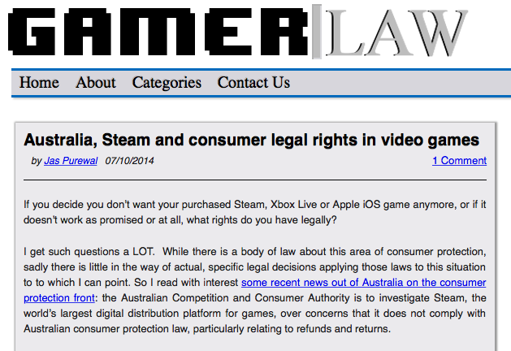
THINGS ARE CHANGING…
http://www.gamerlaw.co.uk/2014/australia-steam-and-consumer-legal-rights-in-video-games/

Slide 9
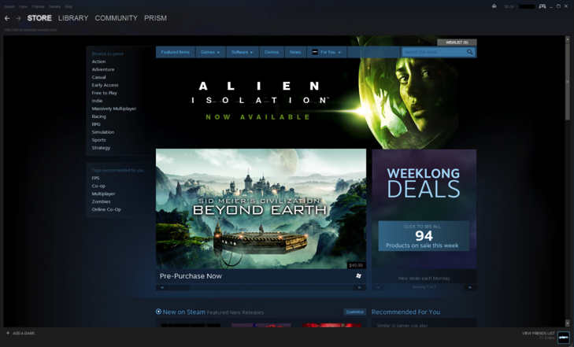
Jas Purewal: “This is a really interesting development to me for a few reasons: This is the first regulator to my knowledge which is specifically investigating the topic of digital distribution platforms’ compliance with consumer protection law, particularly regarding issues like refund rights and the extent to which platforms are bound by legal rules that products must always meet minimum quality standards (eg a requirement called called ‘satisfactory quality’ or ‘acceptable quality’ in the UK and Commonwealth countries or ‘merchantable quality’ in the US, among other requirements).”

Slide 10
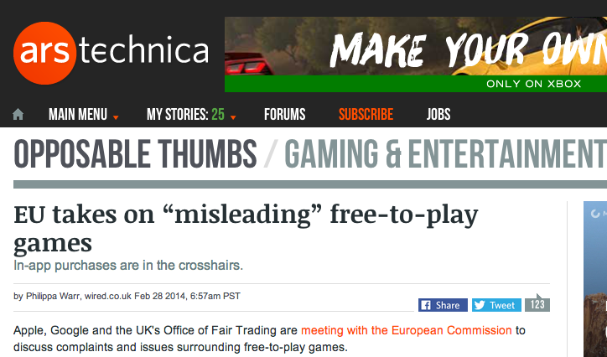
http://arstechnica.com/gaming/2014/02/eu-takes-on-misleading-free-to-play-games/

Slide 11

http://www.gamesindustry.biz/articles/2014-05-06-valve-refunding-earth-year-2066-customers

Slide 12
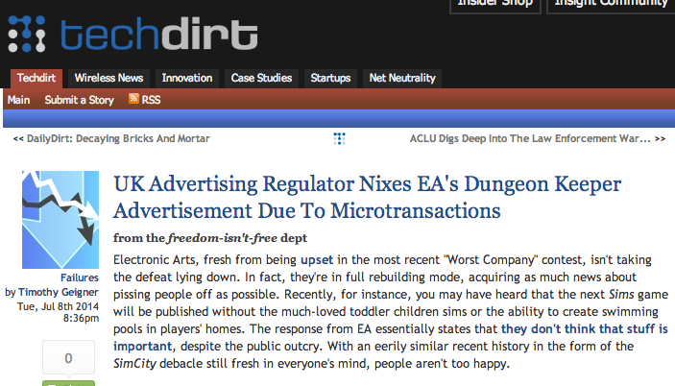
https://www.techdirt.com/articles/20140702/07443127757/uk-advertising-regulator-nixes-eas-dungeon-keeper-advertisement-due-to-microtransactions.shtml

Slide 13
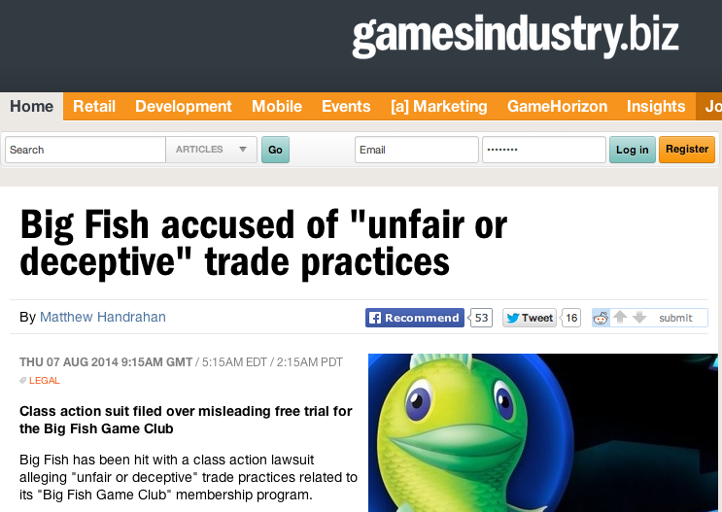
http://www.gamesindustry.biz/articles/2014-08-07-big-fish-accused-of-unfair-of-deceptive-trade-practices

Slide 14

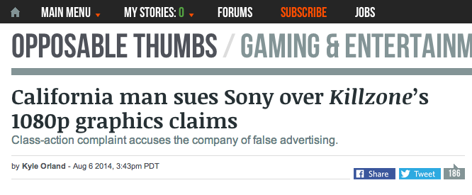
http://arstechnica.com/gaming/2014/08/california-man-sues-sony-over-killzones-1080p-graphics-claims/

Slide 15
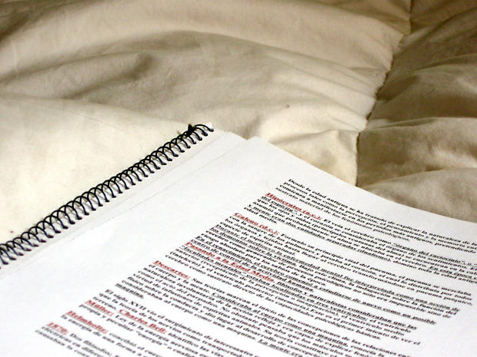
To more contractual issues…

Slide 16
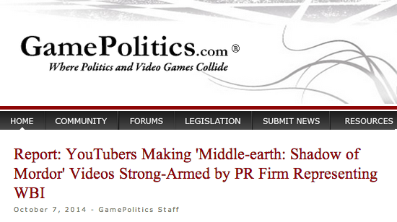
http://www.gamepolitics.com/2014/10/07/report-wb-strong-arms-shadow-mordor-reviewers#.VDxyXpRdX9Q

Slide 17
“YouTubers had to agree to do the following:
- Maximize awareness for the game during the ‘week of vengeance’
Persuade viewers to purchase game
Not show bugs or glitches that may exist
The agreement also notes that "videos will promote positive sentiment about the game.”
”…the company has final approval on the YouTube video at least 48 hours before any video goes live,”
Those who didn't sign the "branding agreement" and made their own found their videos taken down by a YouTube ContentID claim” (Abuse of copyright law?)

Slide 18

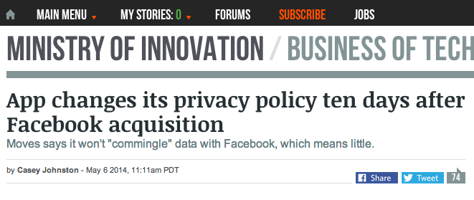
http://arstechnica.com/business/2014/05/app-changes-its-privacy-policy-ten-days-after-facebook-acquisition/

Slide 19

To understand EULA’s…

Slide 20
Constraint/Restraint - Coercion/Control
con·strain/kənˈstrān/Verb
Severely restrict the scope, extent, or activity of.
Compel or force (someone) toward a particular course of action.
Synonyms: force - compel - coerce - oblige - necessitate
re·strain/riˈstrān/Verb
Prevent (someone or something) from doing something; keep
under control.
Prevent oneself from displaying or giving way to a strong
urge or emotion.
Synonyms: curb - check - hold - repress - control - contain

Slide 21
A Pattern?
CREATION goes with COPYRIGHT/IP LAW
CONNECTING goes with CONTRACT LAW
BECOMES
COPYRIGHT/IP LAW CONSTRAINS/COERCES CREATION
CONTRACT LAW RESTRAINS/CONTROLS CONNECTING

Slide 22
Emerging from Talk 6 (“10 Cases -..”)
Considering:
1. Companies draft; consumers don’t
2. Click-wrap “fiction”
3. Lack of standardization (Industry Assoc./Treaty/Consumer Protection)
4. All cases had multiple causes of action, not just contract
Query: Morality of contracting out of:
a.) free speech/expression rights
b.) prevailing statutory copyright laws/rights
c.) privacy & surveillance protections

Slide 23
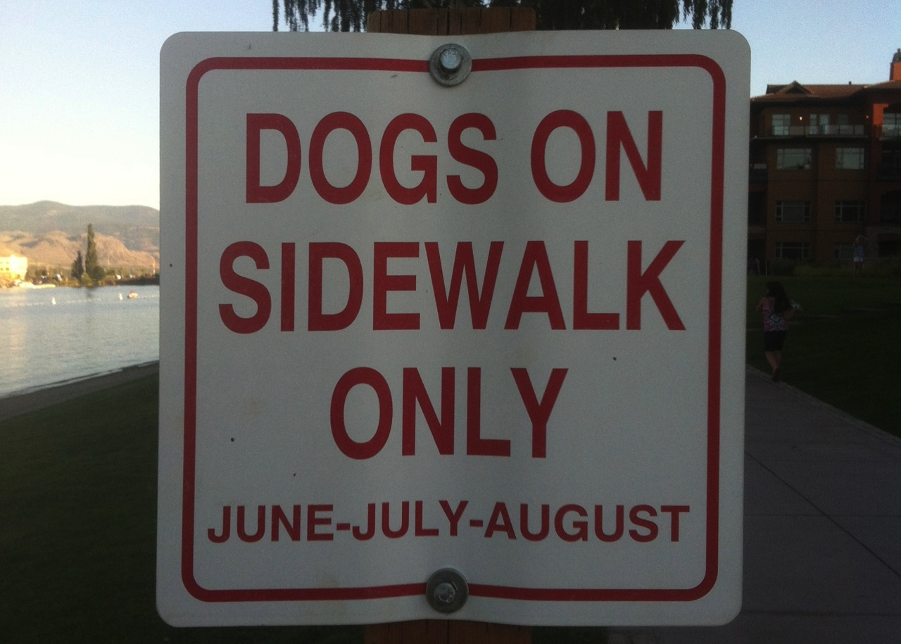
The problem with drafting…
(Where do the humans go?)

Slide 24
Trends in the Cases?
COPYRIGHT (constraint)
to
USER (COPY) RIGHTS
(e.g. reverse engineering, fair use, right to create {?})
to
CONTRACTING (restraint)
to
REMOVING USER RIGHTS
(no reverse engineering, no mods, no privacy?)
to
CONSUMER/GAMER PROTECTIONS ???
*Fairness of this process of moving from constraints to
additional restraints without user understanding?

Slide 25

Double Standard Tests
Core problem: EULA’s, ToS’ etc. we “agree to” are all different in specifics; yet apply to billions of people.
DOUBLE STANDARD Test #1: since digital developers Can (& do) customize your content, Why not YOUR EULA, TOS & Privacy agreements?
DOUBLE STANDARD Test #2: How many developers could survive the terms they impose on Consumers?
ETHICAL SOLUTION?: Embedding a “Do Unto
Others” algorithm rule-set which permits us to use the
digital bits of others if we share ours to the same
standard. Barter not infringement.

Slide 26
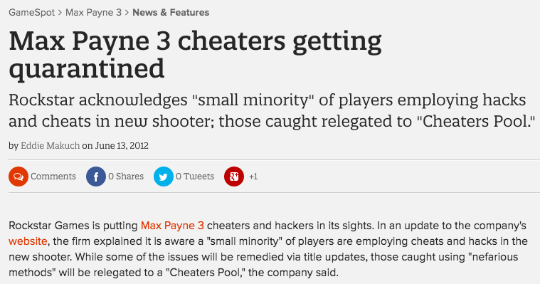
Why not tailor our rights in terms of how we deal with the rights of others?
http://www.gamespot.com/articles/max-payne-3-cheaters-getting-quarantined/1100-6382313/

Slide 27
Query: Developer’s Liability - Are not EULA/
ToS’ needed for the “really bad” stuff?
* Would a short legal notice would be as effective as EULA/ToS?
“Cheating, illegal &/or intolerant behavior is not acceptable. In such event we may take such legal or other actions we deem appropriate in our sole discretion.”
* EULA cases do tend to relate to commercial threats, not “really bad” stuff. See Davidson & iRacing for example.
* Bot/gold-mining cases more ambiguous, being about both;
a) gamer's experience; &
b) company possibly offering gamer same features.
* Consider: Blizzard Entertainment, Inc. v. In Game Dollar, LLC,
USDC Cal.2007 (gold-farming) followed by “Blizzard Introduces Buying in-Game WoW Items” (Nov/09)http://www.tomshardware.com/news/World-Warcraft-Blizzard-MMORPG-Microtransactions,9003.html

Slide 28
A More Insidious Result?
Censorship controls effectively delegated to private interests (without free speech/expression overrides).
“Apple rejects game based on Syrian civil war”http://killscreendaily.com/articles/news/apple-rejects-game-based-syrian-civil-war/
“iOS games chafe under Apple's directions: 'If you want to criticize a religion, write a book’”http://www.theverge.com/2013/1/16/3879194/apple-app-store-guidelines-tell-game-developers-to-avoid-serious-themes
& less insidiously: “Blizzard Bans 'Several Thousand' Diablo III Players for Cheating” – using bots (Would “Notice” do?)http://gamepolitics.com/2012/12/19/blizzard-bans-several-thousand-diablo-iii-players-cheating#.URswDFpAR3c

Slide 29
…but the “functional” answer may be…
Causes of action other then violation of EULA
& ToU available in ALL relevant cases…
1. Davidson & Associates, Inc. v. Internet Gateway:
Breach of Digital Millennium Copyright Act (DMCA) found.
2. Blizzard Entertainment, Inc. v. In Game Dollar, LLC:
Claims of intentional interference with contract; unfair competition & unjust enrichment. Case settled.
3. MDY Industries, LLC v. Blizzard Entertainment, Inc.:
Breach of DMCA found.
4. Blizzard Entertainment, Inc. v. Marshall:
Claims of copyright infringement, circumvention of copyright protection systems in violation of the DMCA & tortious interference with contract. Case dropped (settled).
5. iRacing Motorsports Simulations, LLC v. Tim Robinson: Copyright infringement claim.

Slide 30

iRacing redux
iRacing Motorsports Simulations, LLC v. Tim Robinson, District Court for the District of Massachusetts, Civil Action No. 05cv11639-NG (May, 2009)
EULA: “You may not, in whole or in part, copy, photocopy, reproduce, translate, reverse engineer, derive source code, modify, disassemble, decompile, create derivative works based on [NASCAR 2003], or remove any proprietary notices or labels on [NASCAR 2003] without the prior consent, in writing, of [iRacing].”
Mod community encouraged in past but line drawn?…

Slide 31
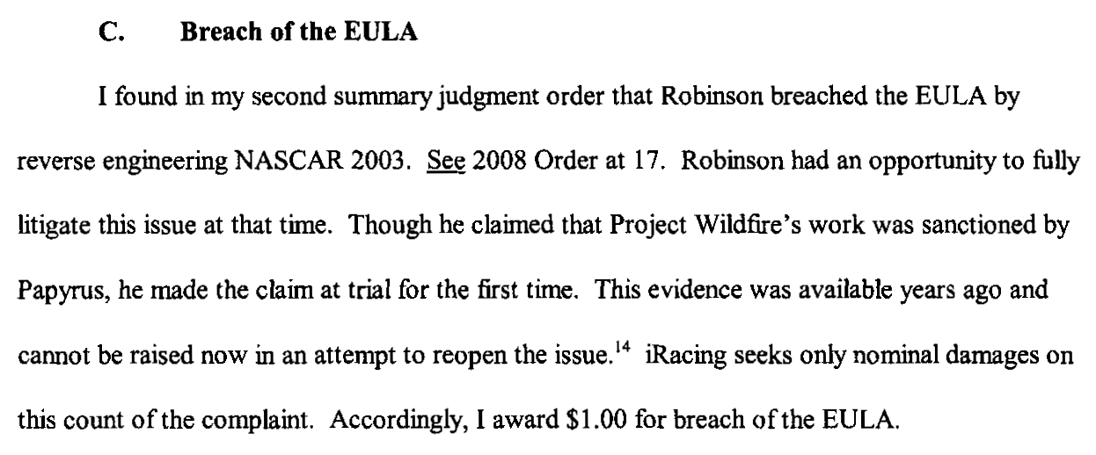
iRacing

Slide 32
Proof of non-EULA claims in EULA cases 2
6. Zynga Game Network, Inc. v. Labrasca: Claims of
trademark infringement, unfair competition, passing off, and
intentional interference with contractual relations. Consent
judgment.
7. Evony, LLC et. al. v. Holland:
Default judgment based on copyright infringement
(Copyright Act & DMCA), trademark & trade dress
infringements, tortious interference with contractual
relations & prospective economic advantage.
Footnotes - other cases not on-point
8. Vernor v. Autodesk, Inc.: Judgment for copyright infringement (non-game case).
9. Smallwood v. NCSOFT: EULA as defense in gaming addiction case not fully upheld
10. Hernandez v. Internet Gaming Entertainment, Ltd: Action by gamer against
gold farming company seeking to use ToU & EULA gold farming company must have
agreed to. Settled.

Slide 33

The Heretical Question…
Are EULA’s & ToS’ even necessary?

Slide 34
Unfairness?
1. Un-contract like uncertainty: Termination clauses that aren’t….eg. WoW EULA:
“This License Agreement is effective until terminated. You may terminate the License Agreement at any time by (i) permanently destroying all copies of the Game in your possession or control; (ii) removing the Game Client from your hard drive; and (iii) notifying Blizzard of your intention to terminate this License Agreement. Blizzard may terminate this Agreement at any time for any reason or no reason.”
Are we party to hundreds of contracts (or more) we don’t use?

Slide 35
Unfairness? (con’d)
2. Average Privacy Policy Reading Level is that of a College
Sophomore while Average U.S. Reading Level is 8th Grade.
“Examination Of Privacy Policies Shows A Few Troubling Trends”
http://techcrunch.com/2011/11/30/examination-of-privacy-policies-shows-a-few-troubling-trends/
3. “Microsoft Attacks Google on Gmail Privacy” | NY Times
“The ads will showcase research that shows most people don’t know that Web e-mail providers like Google scan the contents of their e-mail messages to deliver personalized ads to them — and when they do find out, they don’t like it.”
http://bits.blogs.nytimes.com/2013/02/06/microsoft-attacks-google-on-gmail-privacy/
4. “Terms of Service: Didn’t Read” (website) “I have read and agree to the Terms” is the biggest lie on the web. We aim to fix that.” http://tos-dr.info

Slide 36

The Common Law explains itself
“Every expression of a common intention arrived at by the parties is ultimately reducible to question and answer.” Anson, Principles of the English Law of Contract, 2nd Edn., p.15 (1882).
Common Law is ‘concerned not with the presence of an inward and mental assent but with its outward and visible signs.” Cheshire and Fifoot’s Law of Contract, 9th Edn. P.26 (1976).
…not much comfort…
…when there is an
obvious issue?

Slide 37
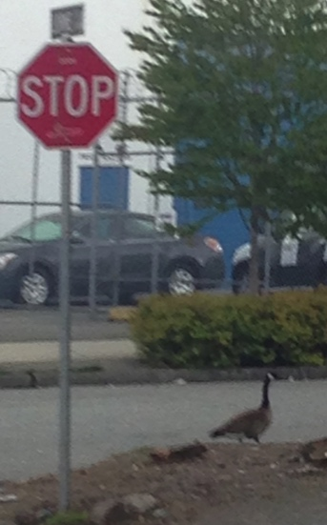
Roads to explore…
To Re-ask the question: Are consumer contracts/license agreements redundant &/or unnecessary?
If EULA’s, ToS, & (non) Privacy Agreements disappeared suddenly would the gaps be filled by:
* Copyright
* Competition-antitrust law
* Privacy law
* Consumer protection laws
* International law/treaties
* Legislation & regulation
)

Slide 38

Industry Association
Standard Form EULA?

Slide 39
Other Alternatives
1. Market uprising: e.g. “Instagram’s revised terms of use: Will the Facebook generation fight back?” http://www.lexology.com/library/detail.aspx?g=d3ce96bc-2b40-4c0c-8a36-c855e6f2207e
2. Technology (DRM+): e.g. “Examining Sony's Internet-free method for blocking used game sales”: “…patent application…outlines a content protection system that would use small RFID chips embedded on game discs to prevent used games from being played on its systems, all without requiring an online connection.” http://arstechnica.com/gaming/2013/01/examining-sonys-internet-free-method-for-blocking-used-game-sales/

Slide 40
The Future?
“The privacy policy required by this section shall be no more than 100 words and shall be written in clear and concise language at no greater than an eighth grade reading level. The privacy policy shall include a statement indicating whether the personally identifiable information may be sold or shared with others, and if line so, how and with whom the information may be shared.”
Context: Act amends Section 22575 of the Business and Professions Code, which requires that an operator of a commercial Web site or online service operators collecting personal information about consumers to make its privacy policy available.
California BILL No. 242; Assembly Member Ed Chau - February 6, 2013 (BILL No. 242 was 336 words per Techdirt) http://www.leginfo.ca.gov/pub/13-14/bill/asm/ab_0201-0250/ab_242_bill_20130206_introduced.pdf

Slide 41
Further Reading
1. “Empirical studies on software notices to inform policy makers and usability designers”; Jens Grossklags, Nathan Good (University of California Berkeley, 2007)
“Abstract: We evaluate the usability of End User License Agreements (EULAs) of popular consumer programs. Results from an empirical evaluation of 50 popular programs show the lack of accessibility and readability of notices. Our data from a recent study with 64 users involved in installation tasks confirms the public perception that notice to and consent by the user is not achieved.”
http://people.ischool.berkeley.edu/~jensg/research/usec.html
2. “Examination Of Privacy Policies Shows A Few Troubling Trends” (2011)
http://techcrunch.com/2011/11/30/examination-of-privacy-policies-shows-a-few-troubling-trends/

Slide 42
Further Reading 2
3. “Intellectual Property and Shrinkwrap Licenses”; Mark Lemley (1995)
http://papers.ssrn.com/sol3/papers.cfm?abstract_id=2126845##
4. “Terms Of Service, Terms Of Play In Children’s Online
Gaming”; Sara Grimes (2007)
http://www.academia.edu/183319/
Terms_Of_Service_Terms_Of_Play_In_Childrens_Online_Gaming
5. “Confess and protest against the Biggest Lie!”
http://www.biggestlie.com
6. “The Cost of Reading Privacy Policies”; A. McDonald, L.
Cranor. 4 ISJLP 543 (2008-2009)
http://lorrie.cranor.org/pubs/readingPolicyCost-authorDraft.pdf

Slide 43
Further Reading 3
7. “Re-Mediating Research Ethics: End-User License Agreements in Online Games”; Florence Chee, Nicholas Taylor, and Suzanne de Castell (2012) http://www.academia.edu/2976765/Re-Mediating_Research_Ethics_End-User_License_Agreements_in_Online_Games
8. “CLICK AND COPY: BREACH OF ONLINE LICENCE AGREEMENTS AND COPYRIGHT INFRINGEMENT”; Richard Stobbe (2012) 28 C.I.P.R. 227
http://www.ipblog.ca/wp-content/uploads/2013/01/cipr-28-2-click-and-copy-breach-of-
online-license-agreements-and-copyright-infringement-c1380000.PDF
9. “Top EULA Gotchas: Website Fine-Print Hall of Shame” (2012) http://www.pcworld.com/article/249396/top_eula_gotchas_website_fine_print_hall_of_shame.html
10. “Living and Dying in a Virtual World: Estate Planning or Digital Assets”; Greg Lastowka & Trisha Hall (2013) http://lastowka.rutgers.edu/files/2013/10/Lastowka.pdf
11. “Face value: digging through Google’s clumsy new terms of service” (2013) http://www.theverge.com/2013/10/17/4845828/digging-through-new-google-terms-of-service

Slide 44
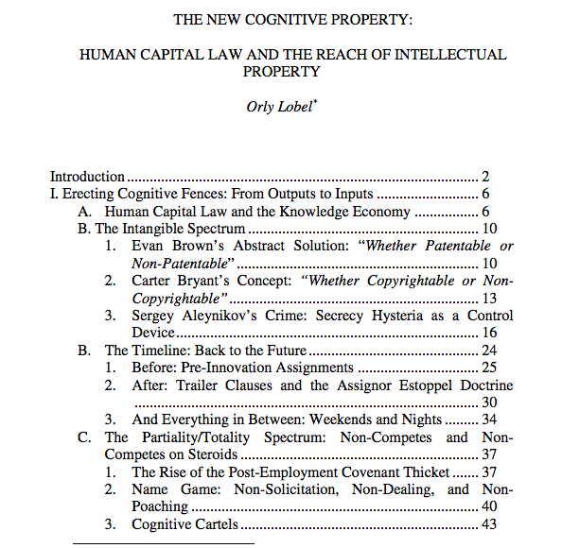
One last thought on contracts as restraints…
http://www.law.berkeley.edu/files/Lobel_Orly_IPSC_paper_2014.pdf

Slide 45


Silicon Valley, Boston &
Restrictive Covenants

Slide 46
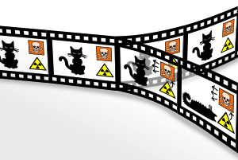

The Post IP World Considered
Two vastly different versions:
Post IP World A =
Contracts that super-cede rendering IP all but irrelevant {where we are?}
Post IP World B = User Rights + standard formatted, treaty based and/or consumer protected minimalist contracts {where we are not}

Slide 47
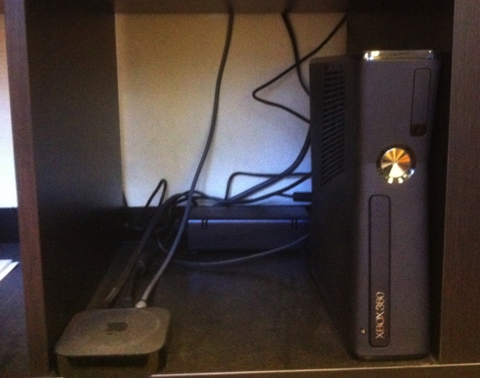
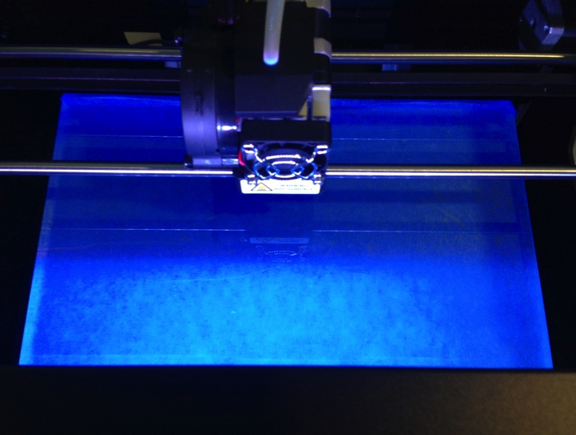

NEXT TIME….
FROM WHEELBARROWS TO HOLODECKS: “CONNECTING” LIVING ROOMS…THINGS…MOBILE DEVICES…EACH OTHER…AND WAY BEYOND…ON THE LEGAL IMPLICATIONS OF CONVERGEANCE…

Slide 48
In anticipation (1):
Consider the Question
WHY DOES LAW SEEM TO RESPOND SO SLOWLY TO TECHNOLOGICAL CHANGE?

Slide 49


“When Does Technology Change Enough That the Law Should Too?
Today's lower court ruling deferred to the Supreme Court's 1979 decision, Smith v. Maryland. Should that case still matter?
REBECCA J. ROSEN
DEC 27 2013, 5:39 PM ET”
“The Atlantic” on the
constitutionality of
NSA surveillance

Slide 50

In the coming of the Digital world
the Law often seems behind,
disconnected and confused,
incapable or too slow to do
Justice..
“[s]tealing is stealing whether you use a computer command
or a crowbar, and whether you take documents, data or
dollars. It is equally harmful to the victim whether you
sell what you have stolen or give it away.”*
*The United States Attorney’s Office, District of Massachusetts, Press Release, “Alleged Hacker Charged with
Stealing over Four Million Documents from MIT Network” (19 July 2011), online:
http://www.justice.gov/usao/ma/news/2011/July/SwartzAaronPR.html>

Slide 51
Consider the possibility...
…that concepts of Law & Justice
can never adequately resolve
issues related to communications
because…
communications memes
proactively define the future
meanings of Justice & the forms
Law will take.

Slide 52
Quest De Integro Ludus (latin for “concerning the whole” Game)

Slide 53
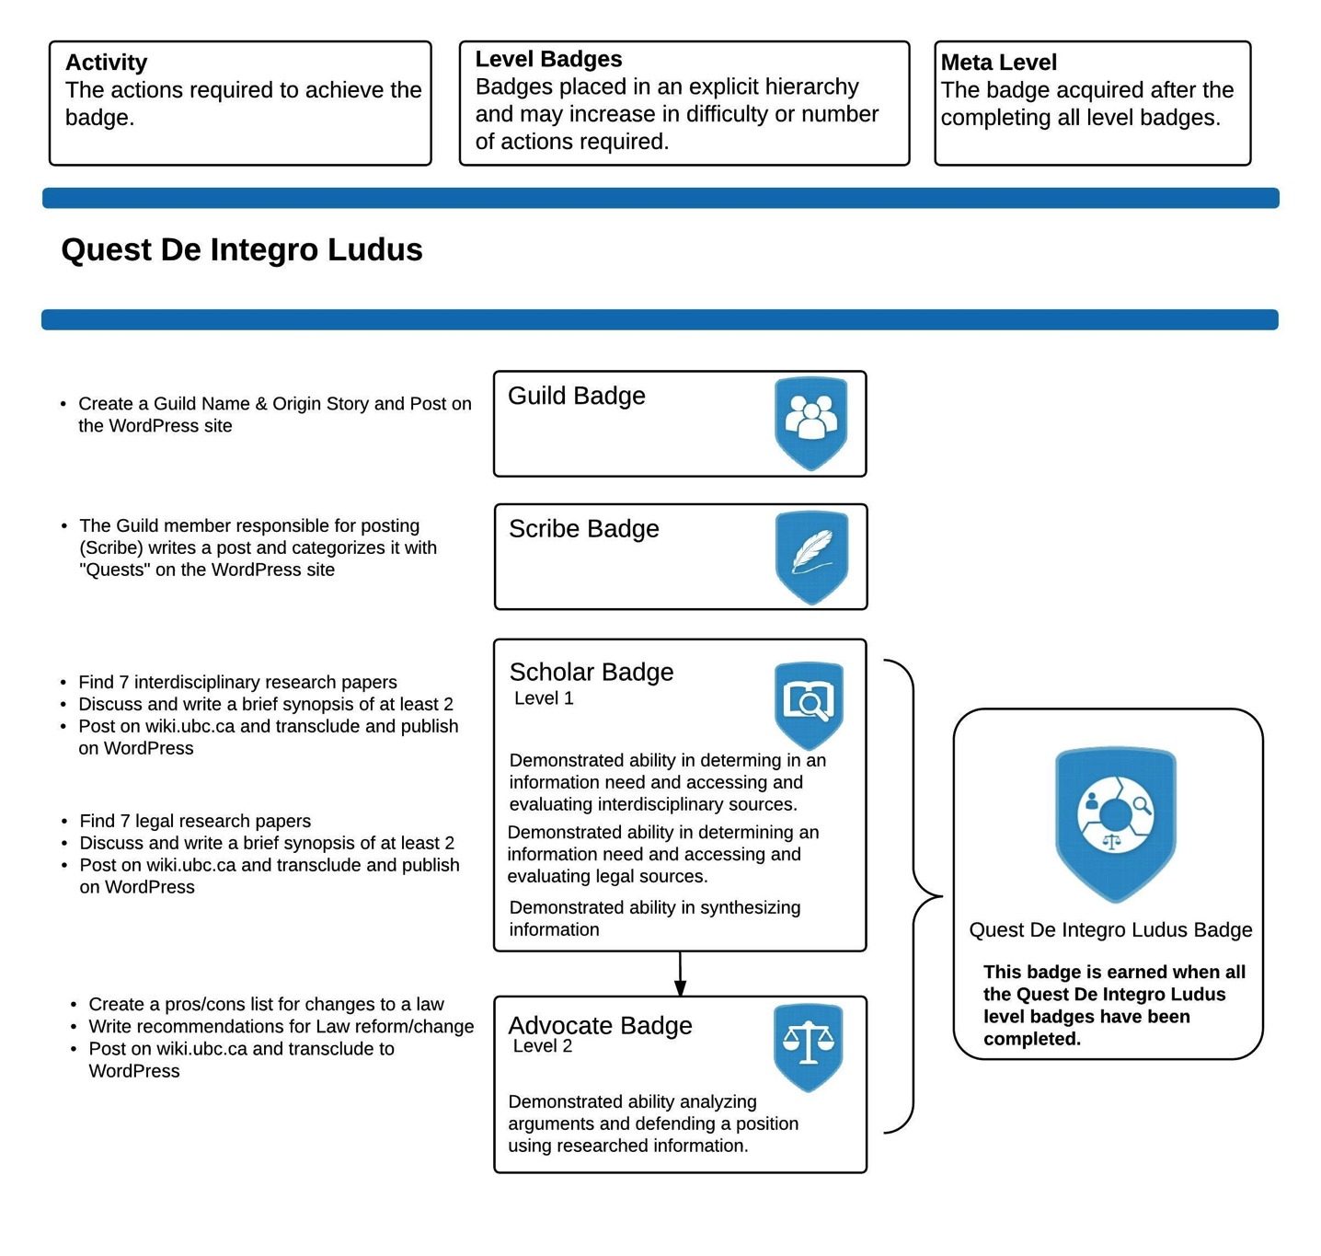

Slide 54
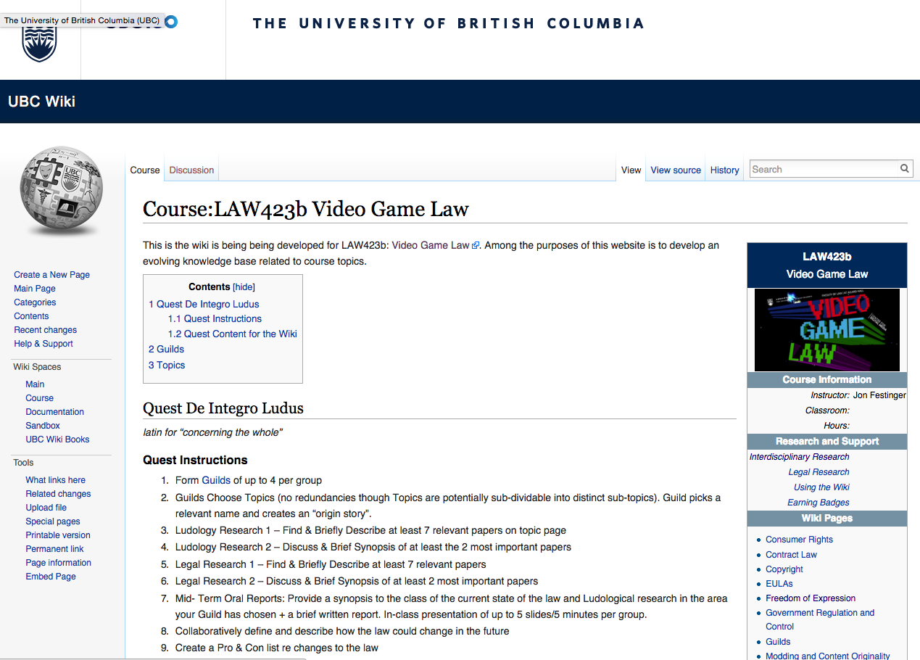

Slide 55
Topics (+Legal Aspects of + Video games)
Topic 1 (Class 2): Freedom of Expression
Topic 2 (Class 3): Copyright
Topic 3 (Classes 4 & 9): Modding & Content Originality
Topic 4 (Class 5): Consumer Rights
Topic 5 (Class 6): Contract Law
Topic 6 (Class 7): EULA’s - Good & Evil
Topic 7 (Class 8): Technology & Change
Topic 8 (Class 10): Violence, Misogyny & Social Issues
Topic 9 (Class 11): Privacy & Surveillance
Topic 10 (Class 11, 12 & 13): Government Regulation & Control

Slide 56
Class Activities
Class 1 Rules Explained: *Guilds of up to 4 per group; *All CC licensed and in Wiki.
Class 2 Guilds Formation Based on Topics (no redundancies though Topics are potentially sub-dividable into distinct sub-topics). Guild picks a relevant name and creates an “origin story”.
Class 3 Ludology Research 1 – Find & Briefly Describe at least 7 relevant papers
Class 4 Ludology Research 2 – Discuss & Brief Synopsis of at least the 2 most important papers
Class 5 Legal Research 1 – Find & Briefly Describe at least 7 relevant papers
Class 6 Legal Research 2 – Discuss & Brief Synopsis of at least 2 most important papers
Class 7 Mid- Term Oral Reports: Provide a synopsis to the class of the current state of the law and Ludological research in the area your Guild has chosen + a brief written report. In-class presentation of up to 5 slides/5 minutes per group.
Class 8 Collaboratively define and describe how the law could change in the future
Class 9 Create a Pro & Con list re changes to the law
Class 10 Recommendations for Law Reform/Change
Class 11 & 12 Oral Opinions/Presentation: 2 sub-groups of the same Guild present up to10 slides of alternating but responsible views on critical aspects of their legal quest in up to 10 minutes. This is not intended as a debate but rather as a technique to fairly illuminate different perspectives on a particular issue.

Slide 57
Today…
Class 7 Mid- Term Oral Reports: Provide a synopsis to the class of the current state of the law and Ludological research in the area your Guild has chosen + a brief written report. In-class presentation of up to 5 slides/5 minutes per group.
All in class (as originally advertised): Half hour prep + 5 groups x 5 minutes.

Slide 58
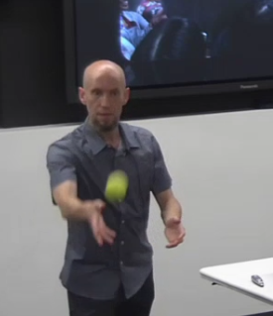
+
Short really means short. Will require collaboration…remember Patrick’s ball exercise…This is meant to be that with words.

Slide 59
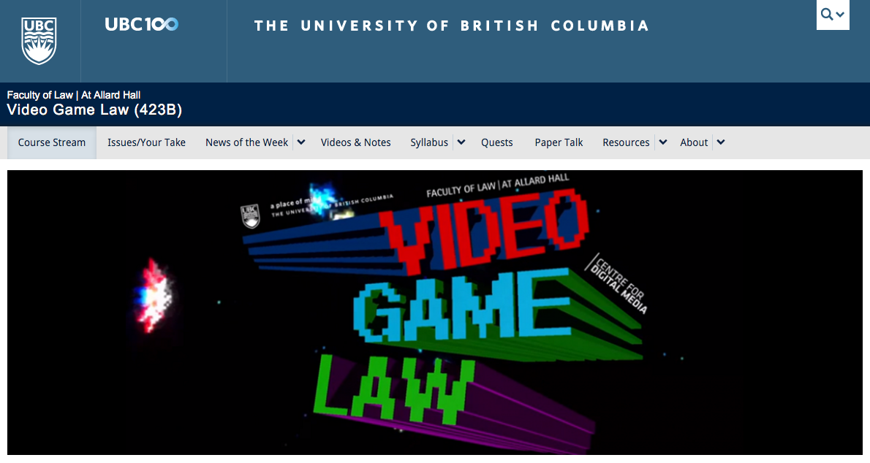
Side Quests?
The website post conundrum

Slide 60

Always include a cat picture

Slide 61
Our Academic Partners

