Slide 1
MODDING
*What is it?
Notes:
Modding is the creation of new game experiences created by the user. It includes a spectrum of possible changes, from the mere rearrangement of the game's art assets as seen in [Gabloob], to stripping the game down to nothing more than the game engine and using user-generated content.

Slide 2
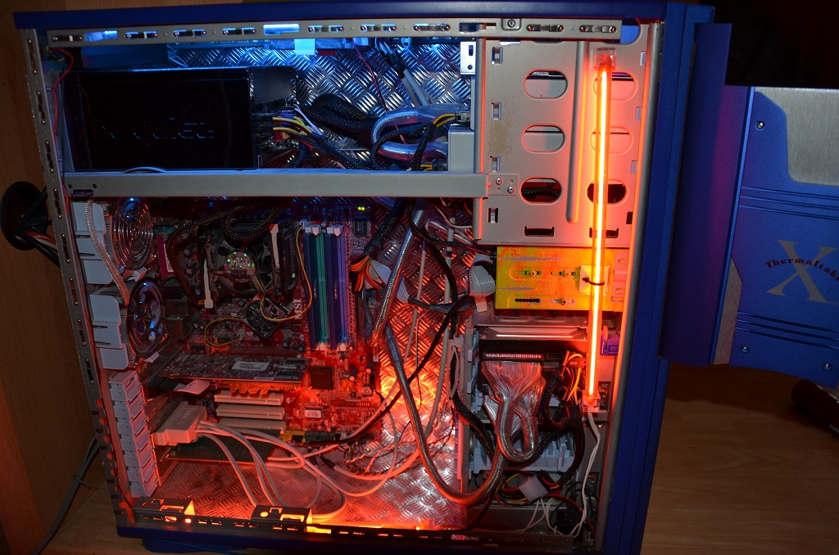
Types of Mods
User Interface Customizations,
Game Conversions,
Machimina, and
Hacking Closed Game Systems
Source: Walt Scacchi (UC Irvine)
Notes:
Mods can be categorized into user interface customizations, game conversions, machinima, and the hacking closed game system. User interface customizations are alterations to the user interface for convenience, display of more information, or better arrangements. Game conversions are the most common type of game mods, and entails changing either the game's assets or its rearrangements thereof. The creation of DotA from Warcraft or DayZ from ARMA II, as well as the common skin/voice/texture/lighting replacements fall into this category. Machinima is usually the creation of videos using in-game elements. The hacking of closed systems is the bypassing of game security and allowing non-authorized copies to be played.

Slide 3
Legal Issues in Modding Can’t we just game?
Copyright Law – CREATING
Classified as derivative works
Canada - Théberge v. Galerie d'Art du Petit Champlain Inc. [2002] S.C.C. 34 – reading in derivative works
US - Micro Star v. Formgen Inc., 154 F.3d 1107 (9th Cir. 1998)
Fair Use(US) – Fair Dealing(Canada)
Contract Law - CONNECTING
EULAs, ToS, Licensing…- iRacing, Davidson

Slide 4
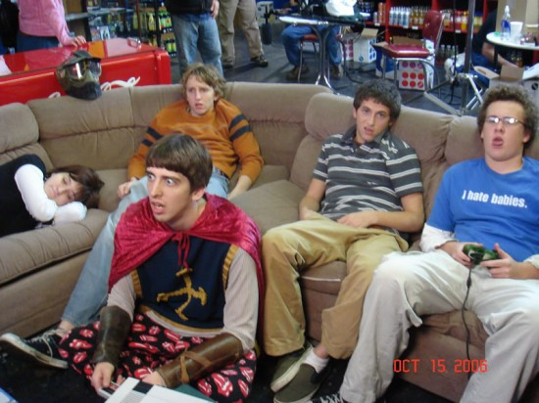
Attitudes
WHO
Game Developers
Users
Copyright Owners
Modders
ISPs? Google? YouTube?
IDEAS
Free Labor
Renew Interest
Social reasons
Enjoyment

Slide 5
Conclusion - Future
RIGHT TO CREATE? Lenz v. Universal Music Corp., Sept 14, 2015
Different Market Models
Berne Convention – International Norms?
Privacy issues
Non-commercial modding
Cultural Revolution??? Post-Structuralism
“Anyone who has lost track of time when using a computer knows the propensity to dream, the urge to make dreams come true and the tendency to miss lunch.” Tim Berners-Lee
Notes:
The Berne Convention requires the basic recognition of the moral rights of the author, and most of the signatories allow for protection of the author’s moral rights in the public sphere. However, with the drastic changes in how content is becoming distributed, the divide between private creations and public publications is rapidly shrinking, and may allow claims against what would previously be protected as private activities.

Slide 6
MODDING
*The Future
Notes:
Modding is the creation of new game experiences created by the user. It includes a spectrum of possible changes, from the mere rearrangement of the game's art assets as seen in [Gabloob], to stripping the game down to nothing more than the game engine and using user-generated content.

Slide 7
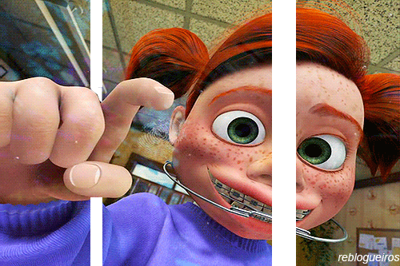
“LET ME OUTTA HERE!”

Slide 8
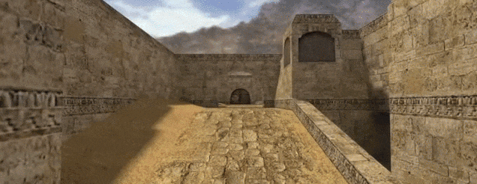
Who is The Creator (god)?

Slide 9
COPYRIGHT LAW
CONTRACT LAW
MORAL RIGHTS
INTERNATIONAL LAW
OTHER ISSUES
Solutions?

Slide 10
Copyright Law (US)
Protects:
Expression of ideas - not the ideas themselves
In games: overall look and feel; layout; game sequencing and progression; instructions/text (verbatim); storyline (not plot); developed characters; code; sounds; music
What it does not protect:
In games: general concepts, themes and genres; scenes a faire; method of play; stock characters; real life elements (e.g., sports moves); other elements “driven by genre”; functional aspects; content not original to the author
Original creator has exclusive rights to derivative works (s. 106)- with fair use exceptions

Slide 11
Copyright Law:
within the current law
Judicial interpretation: treating mods as non-derivative, original works
Micro Star only deals with partial conversion mods
Pros: Full rights of control for modders
Cons: Full conversion pie-in-the-sky, concerns about game engines
Fair use factor analysis:
Focus on transformative nature of user experience
Market impact analysis needs to be broader than Micro Star in the post-structuralist environment
Pros: Potential rights for a wider spectrum of mods, more consistent with other areas of fair dealing (e.g. Mattel)
Cons: Commercial factor may be a hurdle, contextual analysis-risky, could still deter creators, transformative purpose

Slide 12
Copyright Law: Changes
Alter the preamble relating to fair use (s.107) to include “non-commercial transformative works” (McKay)
Pros: Expands fair use defence for modders, does not detract from court’s discretion
Cons: Difficult, Narrow: likely does not save many mods, contextual analysis-risky, could still deter creators
New type of Ownership in Copyright Law

Slide 13
Copyright Law: Suitability?
What does copyright do?
Social Utility Theory
Lockean Theory
Personality Theory
Concerns:
Copyright moribund?
Poorly suited for the post-structuralist collaborative environment and diversity of mods
EULAs dominance

Slide 14
Contract Law
Current state of law
Use of EULAs and TOSs
Unfair to players
Player contributions to content not properly recognized
Lengthy contracts that players have to accept
Favours the game developers
Disparity in bargaining power
Terms tend to assign all rights to content within the game to developers

Slide 15
Contract Law
Possible changes
Changing the court’s approach to the construction of EULAs
Balancing test proposed by Jennifer Knight
User vs. developer
EULA unenforceable if it offends the overall goals of copyright
Pros
Allows greater scope for application of copyright law → better balance between rights of gamers and developers
Cons
Slower alternative to bringing about change as it requires relevant cases to be brought to court
What is the threshold for unconscionability?

Slide 16
Contract Law
Possible changes
Tailoring the terms of EULAs and TOSs to give users more (but not absolute) rights in creation
Pros
Encourages creativity and content creation
Allows the developer to maintain a desired level of control over the game
Cons
Change is dependent on the developers
Notes:
Examples
Second Life and Minecraft grants users rights in their creation
Microsoft and Blizzard updated their EULAs and TOSs to recognize users’ rights with regard to machinima - users are granted licenses to use and display derivative works based on the game’s content

Slide 17
Moral Rights
Can be claimed by the author against any derivative work
Considered infringing author’s moral rights if
distorted, mutilated, or otherwise modified
used in association with a product, service, cause or institution
Is a very wide potential cause of action/takedown notices
Théberge v Galerie d'Art du Petit Champlain Inc
moral right infringement ... the art is found to be prejudicial to the author
Snow v. the Eaton Centre Ltd. et al
'prejudicial to his honour or reputation' in s. 12(7) involve a certain subjective element or judgment on the part of the author so long as it is reasonably arrived at’

Slide 18
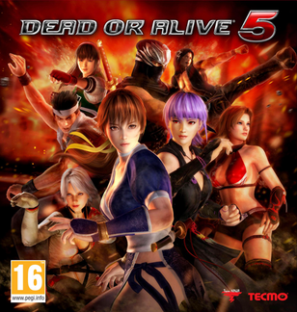
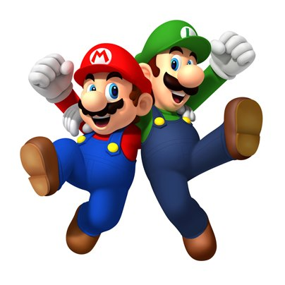
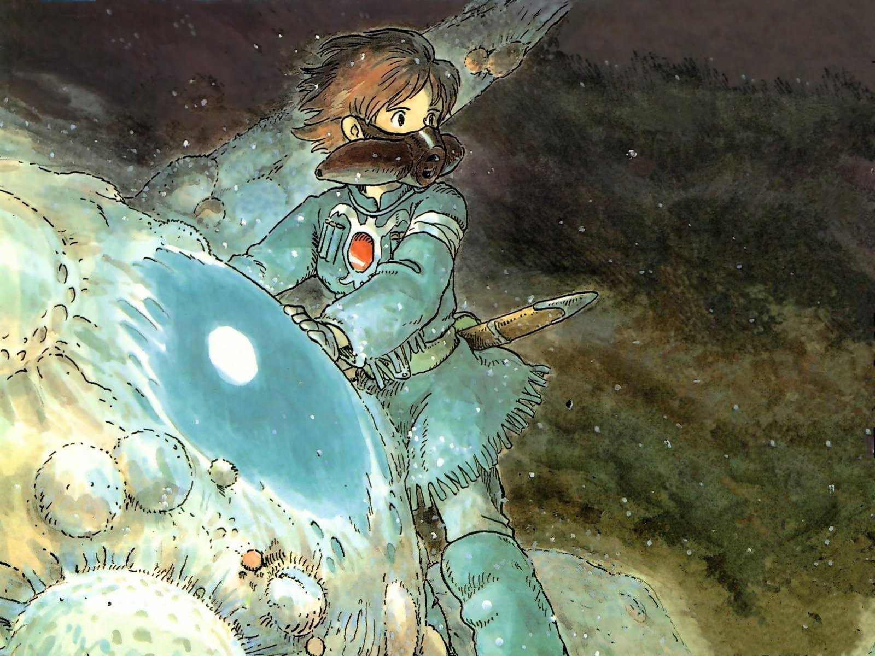
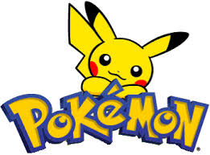
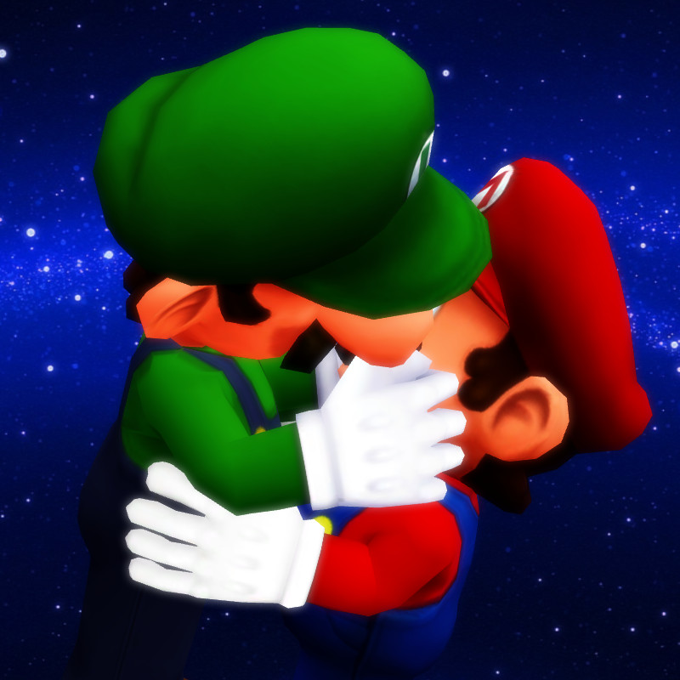
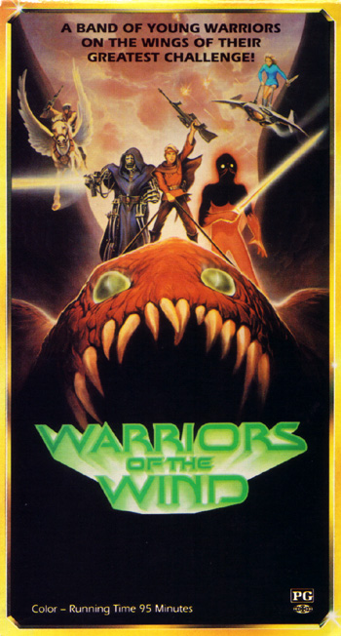
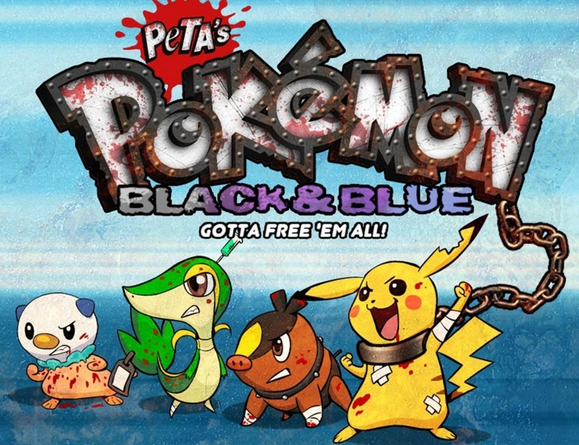
Moral Rights
Proposed change: Disallow the use of moral rights claims against non-commercial fan works
With mandatory labels if the fan work can be confused with the original or endorsed by the author
and usage for causes be seen as “parody” under fair use

Slide 19
International Law
Berne Convention:
Object to any distortion, mutilation or other modification of, or other derogatory action
PROPOSED CHANGE: similar to before, allowing fan works so long as they are not confused with the original or the original author’s intent
Trans Pacific Partnership
Knowingly, or having reasonable grounds to know, circumvents without authority any effective technological measure that controls access to a protected work...
PROPOSED CHANGE: allow for reverse engineering and modification, so long as the original work is not redistributed, nor aids in illegally obtaining the original work

Slide 20
Is there another way???
BC - Business Practices and Consumer Protection Act
Ontario - Consumer Protection Act
Canada - Competition Act
US - Federal Trade Commission Act - FTC
Net Neutrality = FREEDOM
Privacy?

Slide 21
Consumer Protection
What does it actually do?
How can it help?

Slide 22
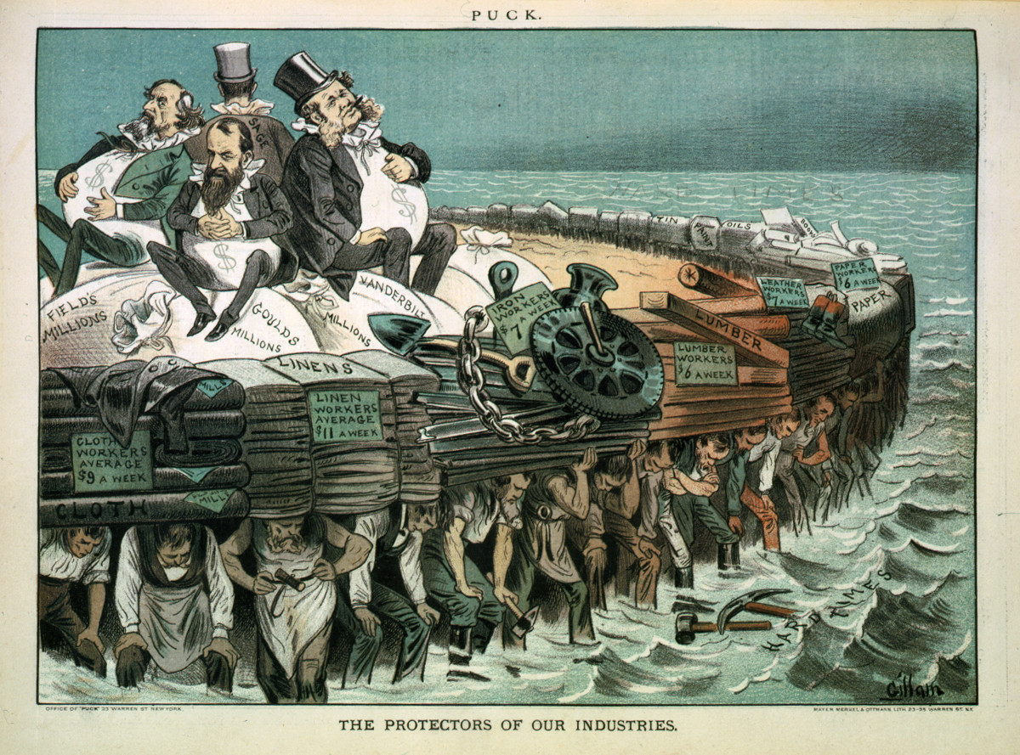
Anti-Trust
POWERS - unfair - redress - regulation - investigate - make recommendations for legislation
US telecoms - Comcast - Time Warner Merger
What about Canada? Canadian Telecoms - Competition Act

Slide 23
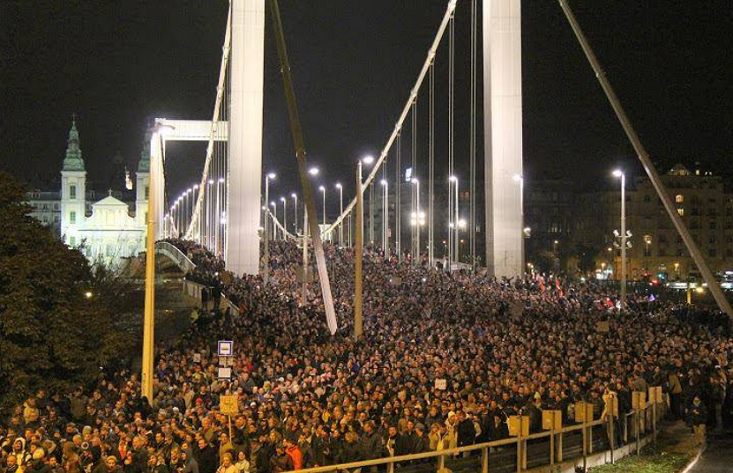
Internet Regulation
US - FCC
Canada - CRTC
Net Neutrality = FREEDOM
“Anyone who has lost track of time when using a computer knows the propensity to dream, the urge to make dreams come true and the tendency to miss lunch.” Tim Berners-Lee

Slide 24
What happens when we break the Internet?
*Who will fix it?
CAIP v Bell Canada (CRTC 2008-108)
Nat'l Cable & Telecommunications Ass'n v. Brand X Internet Services, 545 U.S. 967 (2005)
Comcast Corp. v. F.C.C., 600 F.3d 642 (2010)
Verizon v. F.C.C., 740 F.3d 623, 628 (D.C. Cir. 2014)

Slide 25
“Beware that, when fighting monsters, you yourself do not become a monster... for when you gaze long into the abyss, the abyss gazes also into you.”

