Slide 1
© 2015 ROADHOUSE HOLDINGS LIMITED
©2015 Roadhouse Interactive Limited - CONFIDENTIAL

Slide 2
Agenda
Intro
Roadhouse
Product
Business Models
Selected Legal Issues
Your QA
©2015 Roadhouse Interactive Limited - CONFIDENTIAL

Slide 3
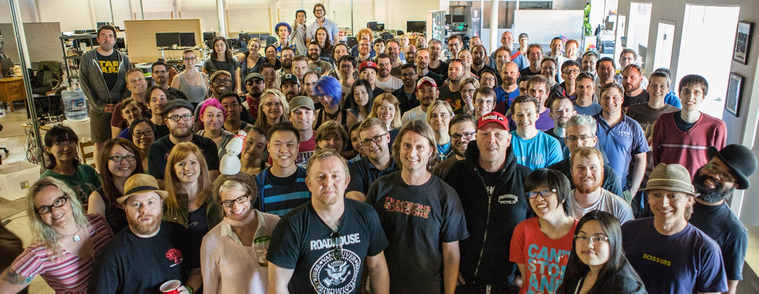
ROADHOUSE IS THE LARGEST INDEPENDENT MOBILE GAMES COMPANY IN VANCOUVER
150 people with 10+ years average industry experience.
We come from companies including Apple, DeNA, EA, Gameloft, Gree, Hothead, Kabam!, Microsoft, Namco Bandai, Ubisoft, Zynga, and others.
Developing and publishing mobile games since 2013.
© 2015 ROADHOUSE HOLDINGS LIMITED
©2015 Roadhouse Interactive Limited - CONFIDENTIAL

Slide 4
OUR LEADERSHIP
$4B in collective game sales.
A century of industry experience.
Business, creative and publishing.
© 2015 ROADHOUSE HOLDINGS LIMITED
©2015 Roadhouse Interactive Limited - CONFIDENTIAL

Slide 5
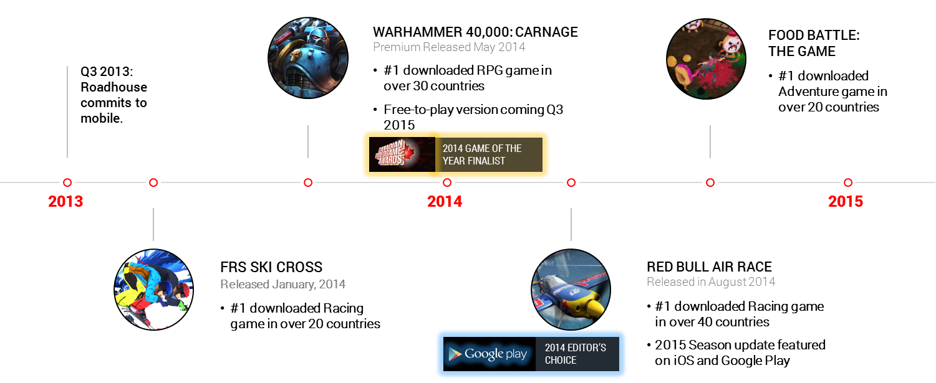
TIMELINE
© 2015 RADHOUSE HOLDINGS LIMITED
©2015 Roadhouse Interactive Limited - CONFIDENTIAL

Slide 6
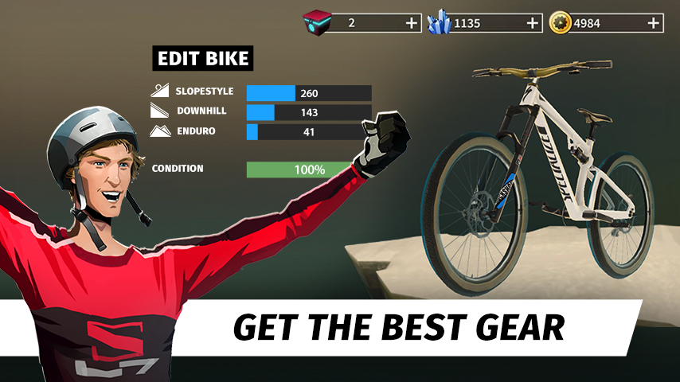
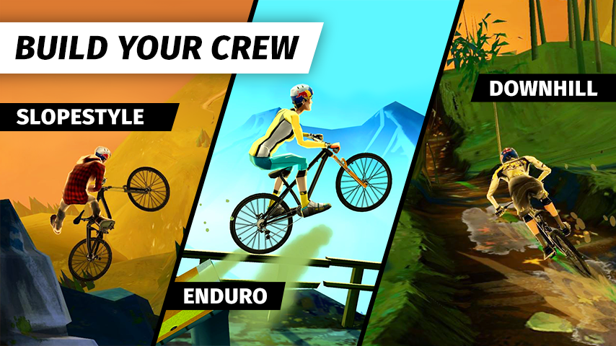
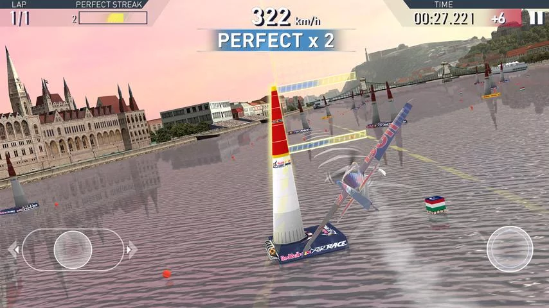
BIKE: UNCHAINED
Shred sweet trails, get the coolest bikes, build your crew and travel the world’s mountains riding against your ultimate rival - Team Praedor - as you battle for a top spot on the podium. Fearlessly ride your way through epic trails that combine Enduro, Downhill and Slopestyle Mountain Biking! Full of killer tricks, awesome freestyle action and insane stunts, Bike Unchained is a high paced racing adventure - it’s the evolution of mountain biking on mobile!
Development: Roadhouse Interactive
Publishing: Red Bull Media House
Wide Launch: November 2, 2015
Downloads: 2,000,000+ (So far…)
© 2015 ROADHOUSE HOLDINGS LIMITED
©2015 Roadhouse Interactive Limited - CONFIDENTIAL

Slide 7
Product
IP
Publisher
Product
Market
$
Developer
People
Tech
©2015 Roadhouse Interactive Limited - CONFIDENTIAL

Slide 8
Two Big Challenges For Aspiring Developers
Survive long enough to have a hit game (rinse, repeat)
Hiring model is mismatched to the Project model (Movie industry)
The longer you survive, the more opportunity to evolve away from chasing the next client
©2015 Roadhouse Interactive Limited - CONFIDENTIAL

Slide 9
Business Models: Pure Work for Hire
Publisher
Provides $ for Development (IP either developed or acquired)
Incurs 100% of Publishing Costs
Complete discretion in Publishing decisions
Developer
Conducts Development
Charges Fees sufficient to generate profit margin
Outcome
All risk lies with Publisher
All upside from product lies with Publisher
©2015 Roadhouse Interactive Limited - CONFIDENTIAL

Slide 10
Business Models: Modified Work for Hire
Publisher
Provides $ for Development (IP either developed or acquired)
Incurs 100% of Publishing costs
Complete discretion in Publishing decisions
Developer
Conducts Development
Charges Fees sufficient to cover costs, with a bit of cushion for the inevitable hiccup
Charges Royalty to provide share in upside (usually post-Publisher recoup)
Outcome
All risk lies with Publisher, except that Developer’s Royalty is subject to Publisher’s success
Upside from product is shared between Publisher & Developer
©2015 Roadhouse Interactive Limited - CONFIDENTIAL

Slide 11
Business Models: Hybrid Work for Hire
Publisher
Provides pre-agreed base $ for Development (IP either developed or acquired)
Additional Development costs are by mutual agreement
Expected to cover 100% of Publishing costs
Complete discretion in Publishing decisions
Developer
Conducts Development
Charges Fees sufficient to cover costs, with a bit of cushion for the inevitable hiccup
May contribute to Development & Publishing costs, if pre-agreed
Charges Royalty to provide share in upside
Outcome
Risks are shared based on relative investment into Development & Publishing
Both Parties recoup based on pro-rata investment, balance shared on agreed Royalty split
©2015 Roadhouse Interactive Limited - CONFIDENTIAL

Slide 12
Funding Models – If Developer wants to Blend in Non-Work for Hire
$ Needed To:
Develop; possibly acquire IP; publish the Game
$1-2M for development; Big IP can be similar; Publishing will scale but should budget same as Dev
How?
Raise Equity/Debt
Raise Project-based finance via SPV
Challenges
If little success so far, you may be too early and will be hugely diluted
Need a lot of sophistication beyond building games to convince investors (finance, modelling, etc…)
©2015 Roadhouse Interactive Limited - CONFIDENTIAL

Slide 13
Selected Legal Issues: Agile vs Waterfall
Creative Products vs Traditional Software
There is no script: you never know the details of where you’ll end up
Framework from which you learn as you go
Market environment can change markedly over a 12 month development period
So…
Many Developers recognize this and create products using Agile methodology
Problem:
Most Development contracts are structured to reflect Waterfall-style production (construction style)
Concern with long delay with product delivery, weak feedback cycles, big cost with stopping
Large companies (& their lawyers) tend to freak out about change
©2015 Roadhouse Interactive Limited - CONFIDENTIAL
Notes:
Termination – with Agile: 1. Customer has a working system each iteration, and 2: both parties will have a clear and up to date view on the state of the project.

Slide 14
Selected Legal Issues: Agile vs Waterfall
Possible Solutions:
There must be agreement that Agile is the method to create a better outcome for all parties
Product Success is primary priority: so enable rapid incrementally deployable deliverables and collaborative decision making to relive pressure on liability, warranty and similar issues.
Transparency & active collaboration must be built into the contract
Approvals process needs to be occur often (2-3 weeks) and issues fixed in subsequent Sprint
Termination Provisions need to accommodate a different way of working together while limiting risk for both sides
©2015 Roadhouse Interactive Limited - CONFIDENTIAL
Notes:
Ideally, Termination would be allowed without penalty after each sprint – but difficult if Developer has dedicated staff on project. Lower penalty as time goes on or X amount of days, allowing for staff reallocation.

Slide 15
Selected Legal Issues: Agile vs Waterfall – Milestones
Examples
Milestone 1: UI, Environments and gameplay confirmed. Prioritized features determined.
Milestone 3: 1st playable of core game play with operating environment, including multiplayer functionality.
Milestone 5: Testing and debugging have started and no major bugs (as defined) are in the deliverable.
©2015 Roadhouse Interactive Limited - CONFIDENTIAL

Slide 16
Selected Legal Issues: Agile vs Waterfall – Acceptance
Milestone details locked in during contract negotiation form the basis
Developer delivers build when due
Client has x days to review & either provide an Acceptance Certificate or a Defaults Notice
If Default Notice, need to spell out ways the build has fallen short
Developer has x period of time to fix, repeat Acceptance process
If fails again, Client has option to provide another Defects notice & repeat process or exercise Termination option
Challenge for Developer is that what happens with the development while all these approval processes are going on?
©2015 Roadhouse Interactive Limited - CONFIDENTIAL

Slide 17
Selected Legal Issues: Agile vs Waterfall – Milestone?
Implementation Plan (with Anticipated Timelines):
Business Framework (Target Audience; Target Platforms) – 1 month
Pre-Production (Concept, Vision, Game Design, Technical Design, Strategic Plan) – 2 months
Production Phase – 9 months
Release Phase (Alpha, Beta, Soft Launch) – 6 months
Live Operations (Commercial Launch) – Ongoing
Sprints:
Short development cycles (2-4 weeks) by a cross-functional team, repeatedly throughout the development
Plan – implement agreed targets/defs in Sprint Cycle – Review/Feedback – Approval – Plan Next Sprint
©2015 Roadhouse Interactive Limited - CONFIDENTIAL

Slide 18
Selected Legal Issues: Agile vs Waterfall – Acceptance
Definition:
Acceptance tests for each Sprint Cycle will be incrementally defined collaboratively by Client and Developer, both acting reasonably, and in the context of the overall development plan.
Process:
Deliverable passes all tests that were defined before the most recent Sprint Cycle and form part of the Specification for such Sprint Cycle;
Deliverable passes all prior tests, verifying that no regression has occurred; and
Deliverable conforms to the definition of “complete” that was defined before the most recent Sprint Cycle.
Then, the usual time periods for Acceptance (since changes are incremental, these are quick); if it fails, must be fixed by end of next Sprint Cycle; if fails again, Client can repeat cycle or exercise termination options.
©2015 Roadhouse Interactive Limited - CONFIDENTIAL
Notes:
Final Acceptance becomes a culmination of a number of acceptances along the way.

Slide 19
And….Finally….We’re Done….
Any wonderfully softball questions…..?
©2015 Roadhouse Interactive Limited - CONFIDENTIAL

Slide 20
Mark Devereux, CSO
mark@roadhouseinteractive.com
© 2015 ROADHOUS
©2015 Roadhouse Interactive Limited - CONFIDENTIAL
E HOLDINGS LIMITED

