Slide 1
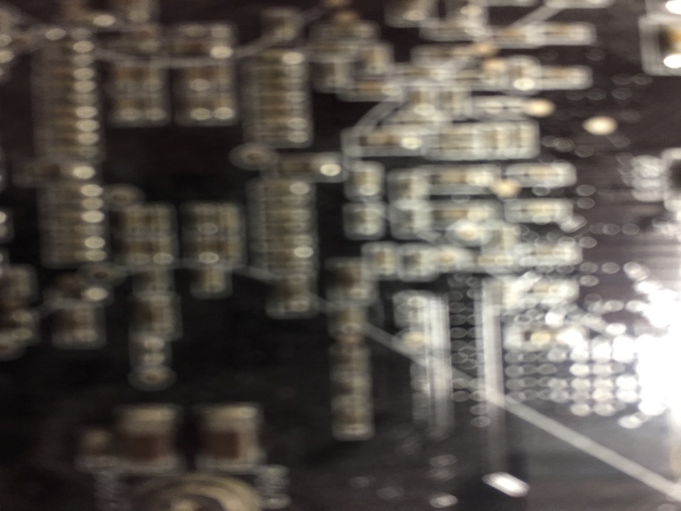

Acceleration to Authenticity:
Emerging Trends in Online Legal Education
Association of Canadian Legal Education Directors
2017 Annual Meeting
September 7, 2017
Vancouver, B.C.
Will Engle, MLIS
Strategist, Open Education Initiatives
Centre for Teaching, Learning and Technology
The University of British Columbia
http://ctlt.ubc.ca/
Twitter: @infology
will.engle@ubc.ca
Jon Festinger Q.C.
Centre for Digital Media
Allard Law of Law, UBC
QMUL School of Law (CCLS)
Festinger Law & Strategy
http://commlaw.allard.ubc
Twitter: @jonfestinger
jon_festinger@thecdm.ca

Slide 2
The most authentic thing about us is our capacity to create, to overcome, to endure, to transform, to love and to be greater than our suffering.
Ben Okri

Slide 3

Perspective

Slide 4
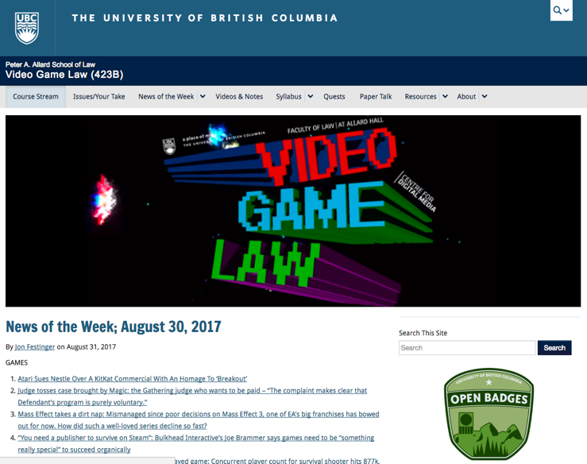
Notes:
Met Jon Working on this course in 2012
Traditional course; lectures + closed online LMS space
Several iterations; experiments: students doing public writing; open badges with potential industry endorsements, VR, live streaming, video blogging,
Results: teaching improves, students are exposed; UBC & Jon own video game law

Slide 5
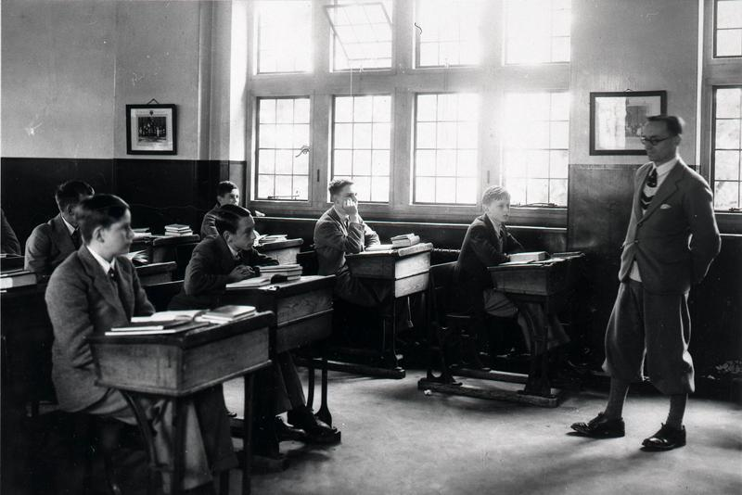
The Future of Education is…
Notes:
This is a question that a lot of people have been trying to answer for a very long time:

Slide 6
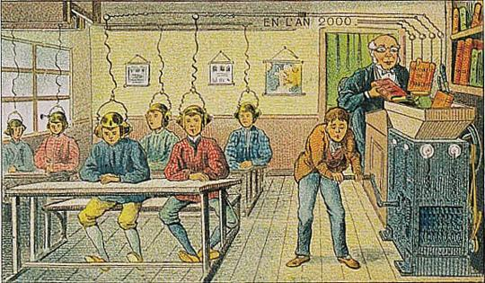
The Year 2000 (as seen in 1910):
Notes:
Villemard, 1910
Villemard postcards about the future from 1910
Books go into a machine; go straight into brains

Slide 7

The year 2034 (as seen in 2014):
Image Source: Mk2010, http://commons.wikimedia.org/wiki/File%3AMedication_potofen(Ibuprofen).JPG, CC-BY-SA
Notes:
“In 30 years…we’re going to be able to literally ingest information. Once information is in your bloodstream, some kind of mechanism could deposit the information in the brain. You could take a pill and learn English or the works of Shakespeare.”
-MIT Media Lab co-founder Nicholas Negroponte,
TED Vancouver, March 2014
Negroponte has been criticized as an extreme apologist for the “teachers don’t matter, kids + tech = MAGIC” view of ed tech.

Slide 8
Another view of 2020:
“All content can be easily digitized and made available on demand at very low cost.…the priority for teaching will have changed from information transmission and organization to knowledge management, where students have the responsibility for finding, analyzing, evaluating, sharing and applying knowledge, under the direction of a skilled subject expert.”
- Dr. Tony Bates
Notes:
Tony Bates was Director of Distance Education and Technology in Continuing Studies at UBC from 1995 to 2003, where he was responsible for many of the early developments in online learning at UBC. Prior to that, he was Professor of Educational Media Research at the Open University, where he worked for 20 years as one of the founding members of the staff.
All content can be easily digitalized and made available on demand at very low cost. Second, institutions will be making greater use of dynamic video (not talking heads) for demonstration, simulations, animations, etc. Thus most content modules will be multi-media. Third, open textbooks incorporating multi media components and student activities will provide the content, organization and interpretation that are the rationale for most lectures. Lastly, and most significantly, the priority for teaching will have changed from information transmission and organization to knowledge management, where students have the responsibility for finding, analyzing, evaluating, sharing and applying knowledge, under the direction of a skilled subject expert.

Slide 9
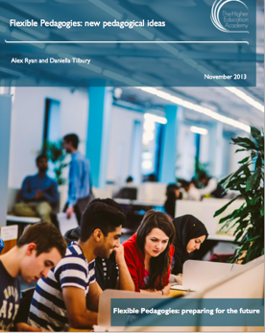
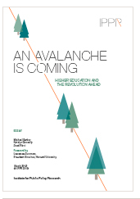
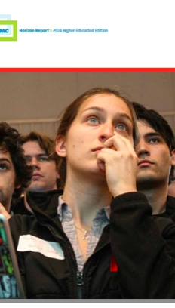
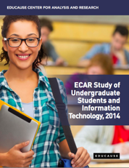
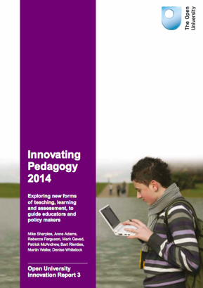
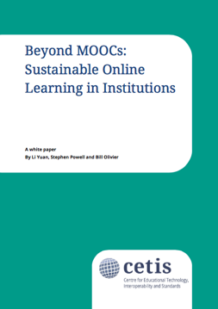
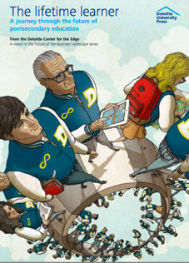
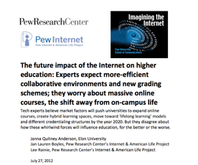
A View of Today From Today
Competency Based Learning
Learning Analytics
Modularization
Unbundling
Open Textbooks, OER
Digital Literacies
Student as Producer
Flexible Learning
Adaptive Learning
Flipped Classrooms
Blended components
Competition
NGDLE
Badging
Big Data/ Learning Analytics
Life Long Learning
MOOCs
Makerspaces

Slide 10
Pressure Point 1:
Educational Content is Ubiquitous
Notes:
• It’s becoming easier than ever to learn from the internet; YouTube is the largest University

Slide 11
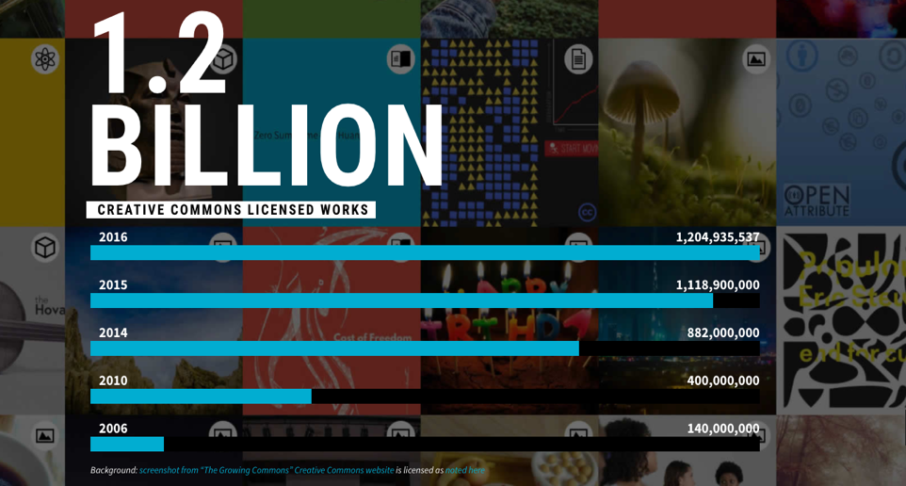
- 2016 State of the Commons: https://stateof.creativecommons.org/ CC-BYrg
Notes:
Openly licensed works (CC) - works other people can reuse
in 2010 it was 400 Million greatly increasing’
Live in a time of overabundance; changing from a time when learners took classes to get access to scarce knowledge to a time of the experts managing, evaluating, contextualizing the overabundance of knowledge.

Slide 12
Pressure Point 2:
Competition is Increasing
Notes:
online learning goes back decades and research proves it can be very effective;
Cheapness of in technology and internet make is easier to create online learning
Metaphor of the MOOC: Sebastien Thrun’s 2011 course Some 160,000 in more than 190 countries.

Slide 13
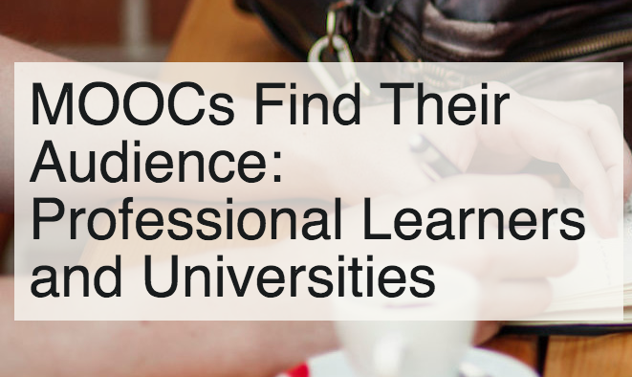
Notes:
MOOCs:
2012 NYTimes “Year of the MOOC”
UBC ran it’s first MOOC in 2013 (Game theory with Kevin Leyton Brown,) had over 100,000 people sign up to take it. (10,000 people completed it)
Today: a quick search indicates around over 200 open courses that touch upon law in a freemium model.
89% of Coursera learners are over the age of 22; lifelong and professional learning

Slide 14

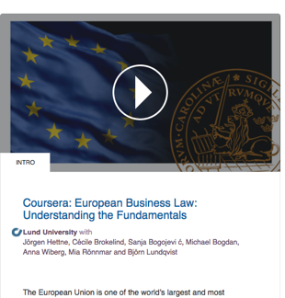
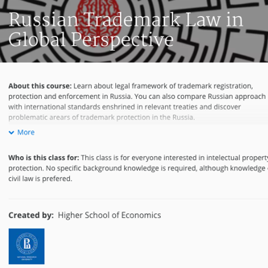
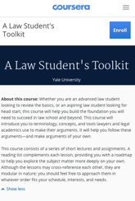

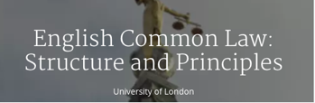
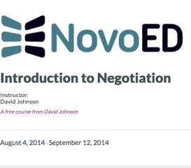




Notes:
Today: a quick search indicates around over 200 open courses that touch upon law in a freemium model.
From Harvard’s Contract Law Course to University of North Carolina’s Environmental law course

Slide 15
Pressure Point 3:
Education is an investment
Notes:
2015 was a record-setting year for ed-tech investment, here were 225 funding deals totalling $4 billion.

Slide 16
As of August 2017:
Tutoring – $606.5 million raised so far this year
Private student loans – $580.5 million raised so far this year
Online education – $320.9 million raised so far this year
Behavior management – $150 million raised so far this year
Language learning – $148.2 million raised so far this year
Test prep – $80 million raised so far this year
Coding bootcamps – $40.6 million raised so far this year (In addition, learn-to-code apps have raised $6.8 million)
Source: http://funding.hackeducation.com/2017/09/01/august.html
Notes:
“Those building educational apps, those offering online tutoring or test prep, those promising “skills” training, and those offering student loans were the most well funded and most frequently funded types of ed-tech companies.” - Audrey Watters

Slide 17
“Jon’s Law” (Will’s version):
What we’re teaching and the tools we are teaching with are in dialogue; how we teach can be an example of of what we are teaching.
Difference between teachers, technologists, and students is less than you think it is.
Notes:
What we’re teaching and the tools we are teaching with are in dialogue; how we teach can be an example of of what we are teaching.
Difference between teachers, technologists, and students is less than you think it is.

Slide 18
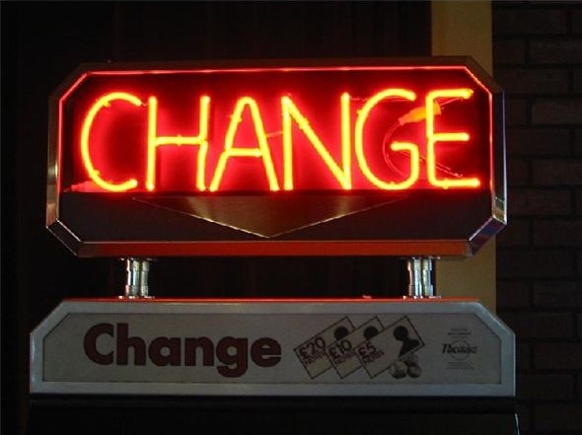
Coping with…

Slide 19
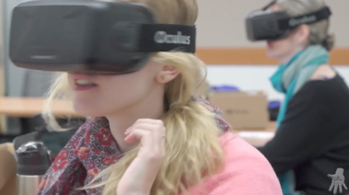
Today’s Educational Orthodoxies
Learning is increasingly personal
On-line can be used to make it even more personal
https://vimeo.com/112215004
http://videogamelaw.allard.ubc.ca/2014/11/12/oculus-alternate-classroom-is-114/

Slide 20
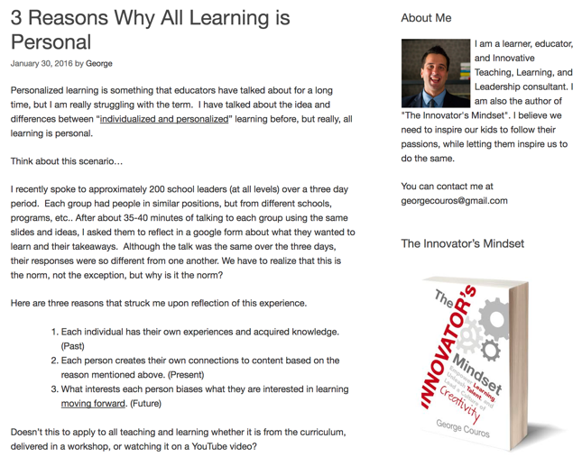
Why “Personal”?

Slide 21
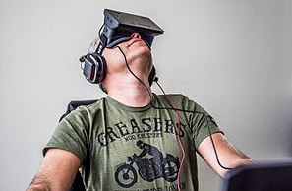
An AR/VR Interlude

Slide 22
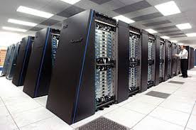
On-line/Digital serves “individuation”
Future of learning is customized and automated; personal learning environments/platforms based on:
  big data/learning analytics + AI
  machine-readable tagged content

Slide 23


Courses not classes
  No start (or end) date
  No set class times
  Open ended self directed academic explorations

Slide 24

History of the MOOC…
Notes:
2012 – MOOCs will disrupt higher ed
2012 – year of the mooc; 2013 year of the anti mooc
Started off full semester courses; mirrored the university
Became more modulular; shorter (6 weeks, 4 weeks)
From scheduled to open, self paced.

Slide 25
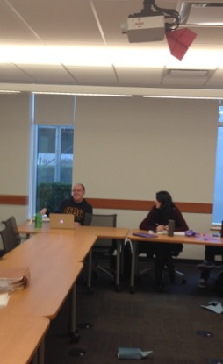
Horizontal as much (?) as Vertical
Communities of learners (horizontal) are as, or more important, to learning than are Professors (vertical) in actualizing knowledge & wisdom…

Slide 26
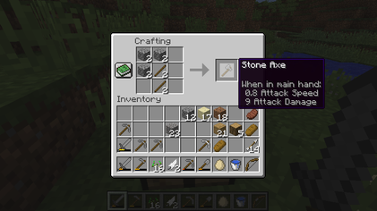
Just like a Video Game 1
Minecraft

Slide 27

Just like a Video Game 2

Slide 28
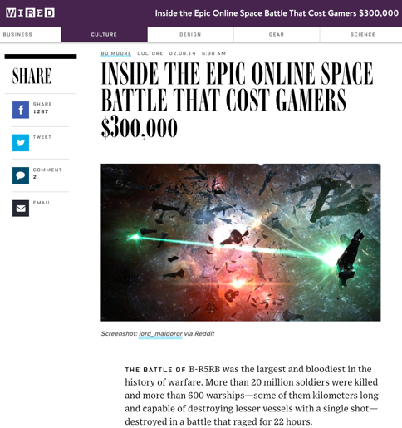
Just like a Video Game 3

Slide 29
“Sandbox” often is the most effective teaching/learning mode.
Just like a video game helps you learn how to play the game and adapts to your personal experiences to keep you in the game, online learning in the future will adapt and be customized to individual levels.
Multi-player (multi-learner) is among the most effective methods of engagement. Peer to peer: Curiosity → Play → Engagement → Learning.

Slide 30
Law is different?

Slide 31
Opposing Forces ????????
Personal Learning
Professional Standards

Slide 32
Learning to Think v. Subject Knowledge
On-line does both (but differently)
Learning to think requires: 1. community/collaboration; 2. personalized goal setting; 3. individualized follow-up; 4. personalized feedback; 5. open-ended materials; 6. longer term investment.
Knowledge requires: 1. Correct answers (to be measurable); 2. Immediate feedback loops; 3. Ability to repeat, and repeat, and repeat…; 4. Limitless numbers of exercises, quizzes, practice tests, corrective tests, final tests.
Both require: 1. Materials formatted and presented in multiple and redundant ways (because people learn differently); 2. challenge and reward loops.

Slide 33
Challenges of “Subject Knowledge” in Law
The Internet & Google are competition
Not particularly valuable without learning to think
Never “Reminds me of what I loved about law school”
Jacques Derrida

Slide 34

Reconciliation 1?
Minimum Bar: Learning outcomes of knowledge can to an be standardized (i.e. what knowledge and competencies you need to practice law will still be standard) but pathway to master those competencies will be completely unique based on what works best for you, the learner.

Slide 35
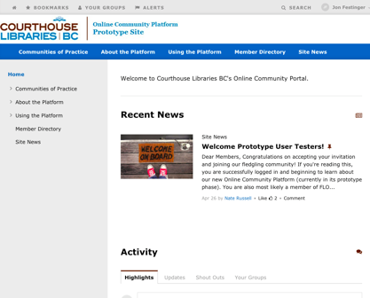
Reconciliation 2?
Ongoing communities of subject area learning and exploration can be constructed.

Slide 36
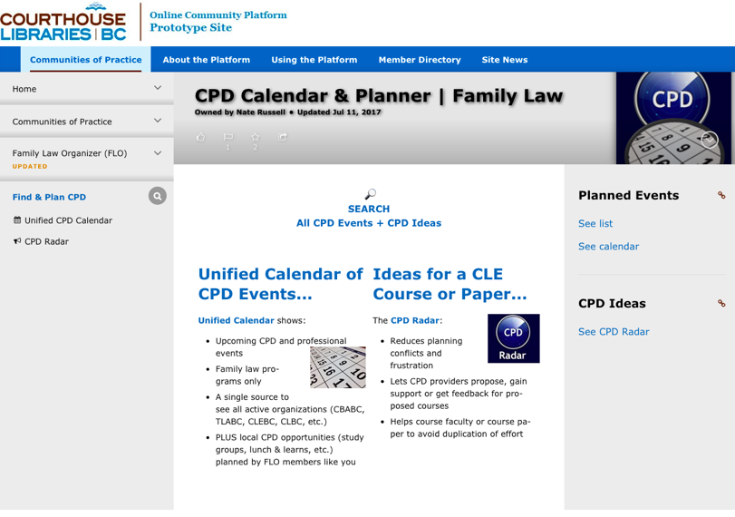

Slide 37
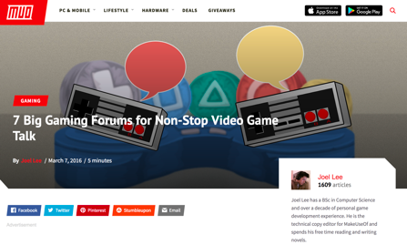
Making on-line personal
MOOC’s have limited success
Yup, the key is community
Again learn from gaming

Slide 38
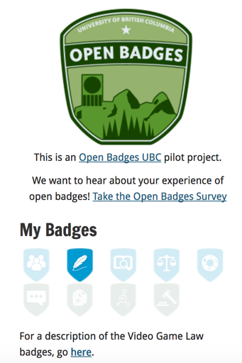
Badging/Certification

Slide 39
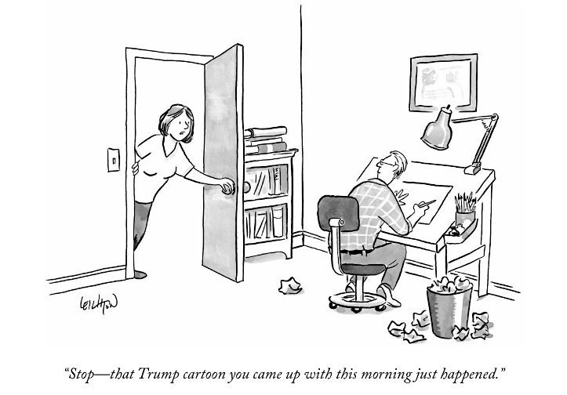
Grounding learning in the Real World

Slide 40
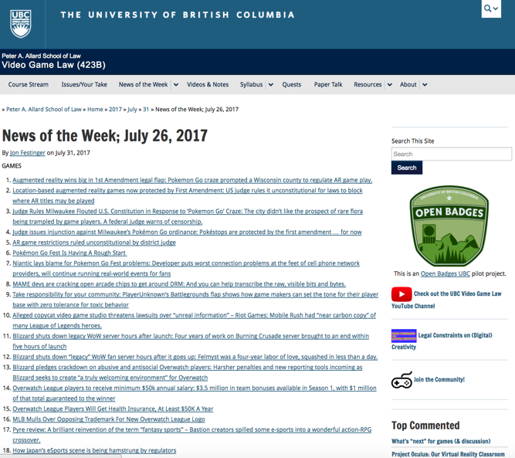

Slide 41
Law should be “Open”: Three words…
ACCESS TO JUSTICE

Slide 42
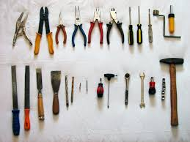
Tools to Consider

Slide 43
Collaborative exercises for learning to think
Test writing for “knowledge”
Self assessment (path reflections for “learning to think”; effort/blockage reflections for “knowledge”)
Wikipedia entry exercises (explicitly for “knowledge” but implicitly for “learning to think”)
Intentionally transformative “EXPERIENCE”
Simulations (Virtual Reality)
Augmented Reality (Clinical Work)

Slide 44
“[Ed Tech that fuels maker culture] recognizes that learning is messy. It recognizes that small and local still matters…[It] is personal learning.
….
Educational practices that we know work well: small group discussion, collaboration, participatory, project-based, and peer-to-peer learning, experimentation, inquiry, curiosity, play. “
-Audrey Watters
http://hackeducation.com/2013/02/06/the-case-for-a-campus-makerspace
Notes:
“[Ed Tech that fuels maker culture] recognizes that learning is messy. It recognizes that small and local still matters…[It] is personal learning.
….
Educational practices that we know work well: small group discussion, collaboration, participatory, project-based, and peer-to-peer learning, experimentation, inquiry, curiosity, play. “

Slide 45

Notes:
Student as Producer is a development of the University of Lincoln’s policy of research-informed teaching to research-engaged teaching. Research-engaged teaching involves more research and research-like activities at the core of the undergraduate curriculum… In this way students become part of the academic project of the University and collaborators with academics in the production of knowledge and meaning.
Dean of Teaching and Learning, University of Nebraska

Slide 46
Mike Neary:
...emphasises the role of the student as collaborators in the production of knowledge. The capacity for Student as Producer is grounded in the human attributes of creativity and desire, so that students can recognize themselves in a world of their own design.
Notes:
According to Derek Bruff: (Neary) argues students should move from being the object of the educational process to its subject. Students should not be merely consumers of knowledge but producers, engaged in meaningful, generative work...
http://cft.vanderbilt.edu/2013/09/students-as-producers-an-introduction/

Slide 47

Education either functions as an instrument which is used to facilitate integration of the younger generation into the logic of the present system and bring about conformity or it becomes the practice of freedom, the means by which men and women deal critically and creatively with reality and discover how to participate in the transformation of their world.
Notes:
1968, portugeuse
Into the logic of the present system and bring about conformity or it becomes the practice of freedom
Critical pedagogy, with theorists like Paulo Frerie, build off of this notion by expanding the idea that education should be meaningful but also that curriculum should connect to the local culture
Further to this is the idea that education should empower learners to move from what is real or known to what is possible (thinking outside of predefined answers)
and to support the development of alternatives to a variety of “problems” and that these problems should be meaningful to the community itself

Slide 48
Questions?

Slide 49
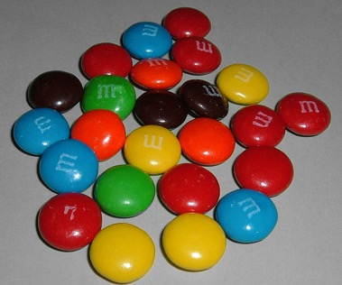

A MATTER OF PERSPECTIVE

Slide 50
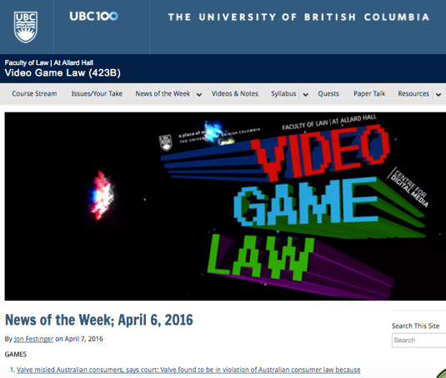
Please come visit…
http://videogame.law.ubc.ca

Slide 51

Always include a cat picture

Slide 52
Our Academic Partners

