Slide 1


What’s it all about…EULA?
Talk 7 Part 3
Part B “Connecting”
Video Game Law 2018
UBC Law @ Allard Hall
Jon Festinger Q.C.
Centre for Digital Media
Allard Law of Law, UBC
QMUL School of Law (CCLS)
Festinger Law & Strategy
http://videogamelaw.allard.ubc.ca/
Twitter: @jonfestinger
jon_festinger@thecdm.ca

Slide 2
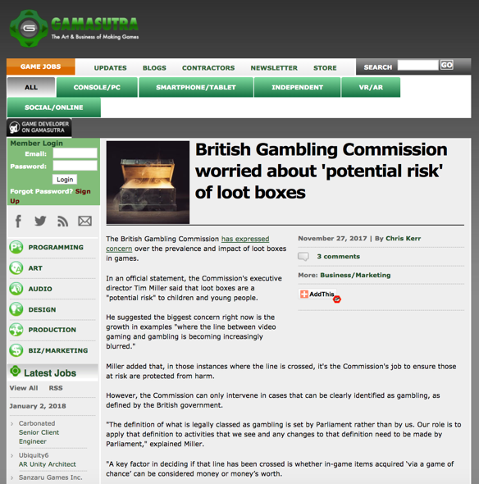

Slide 3
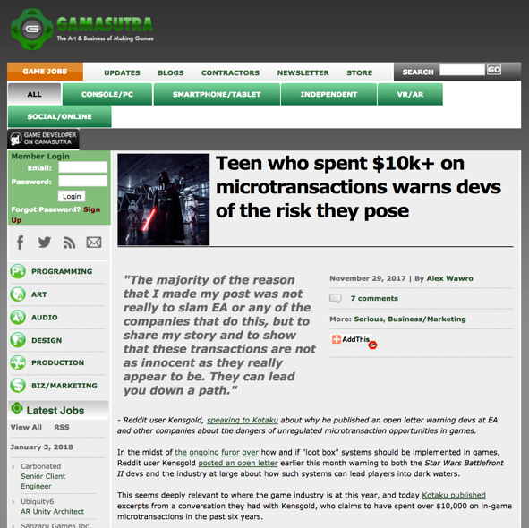

Slide 4
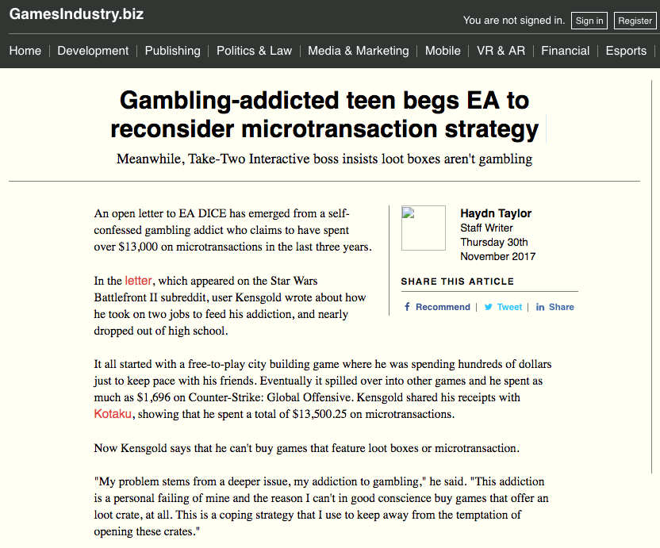

Slide 5
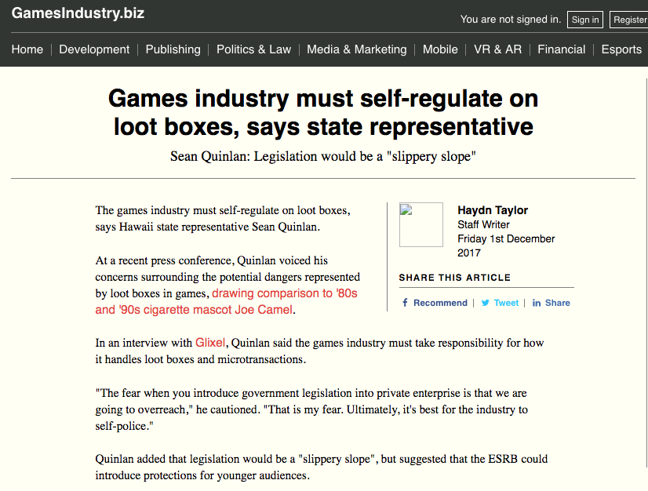

Slide 6
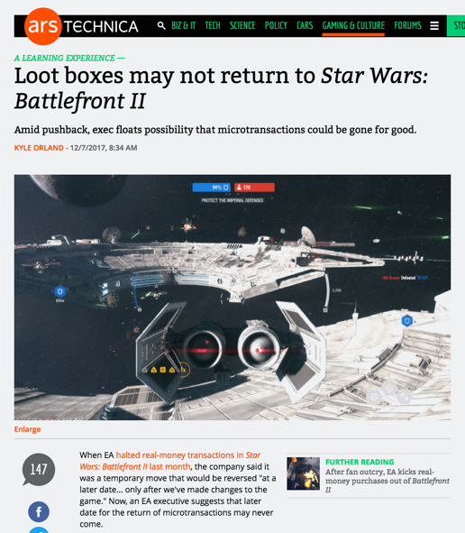

Slide 7
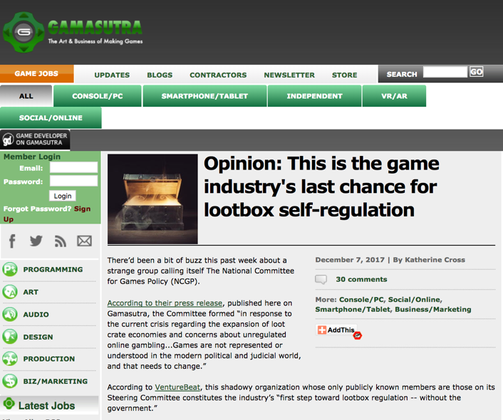

Slide 8
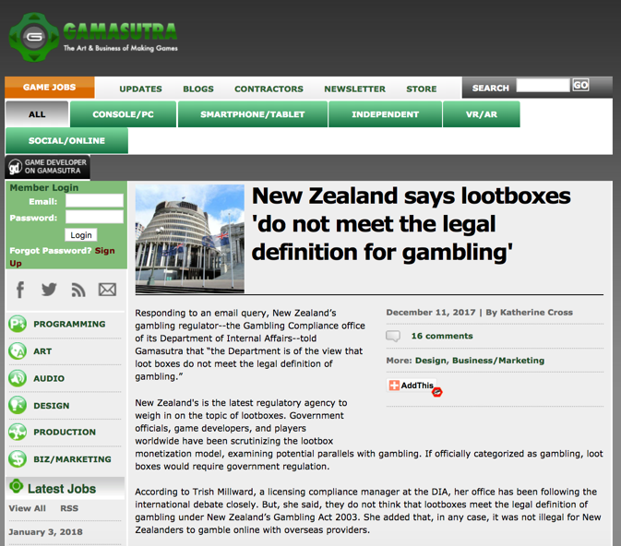

Slide 9
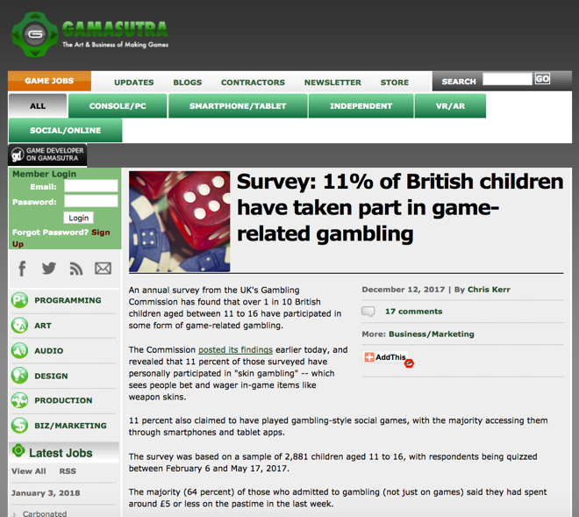

Slide 10
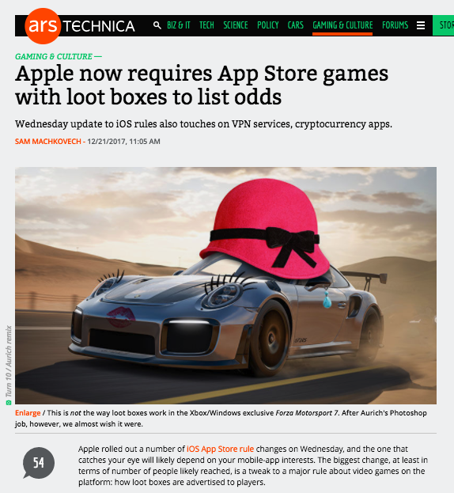

Slide 11
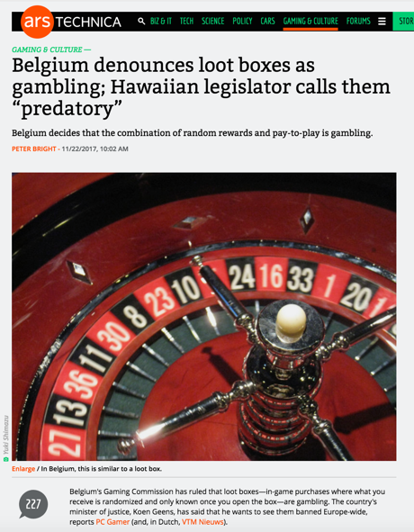

Slide 12
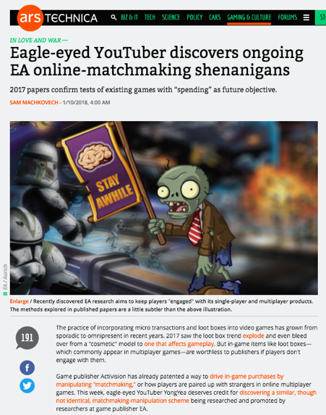

Slide 13
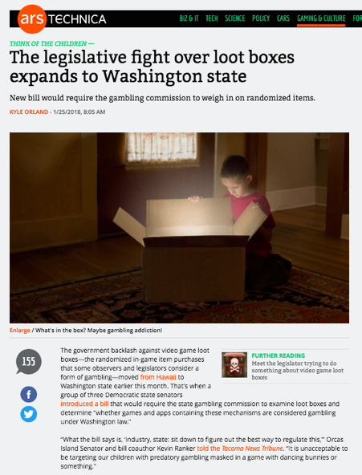

Slide 14
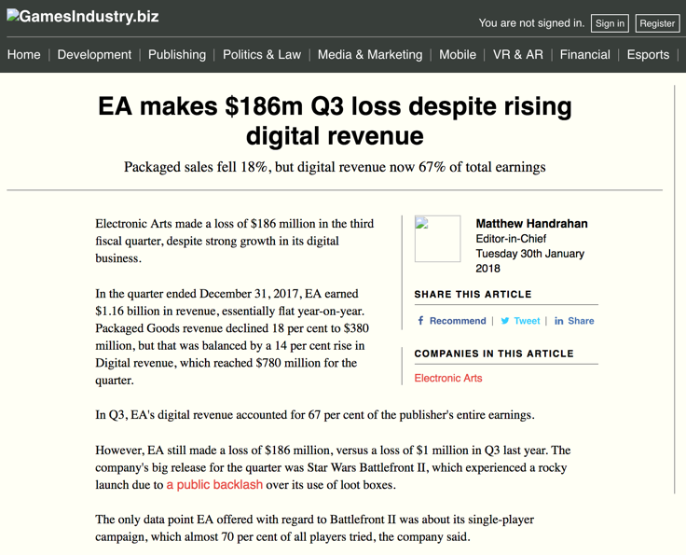

Slide 15
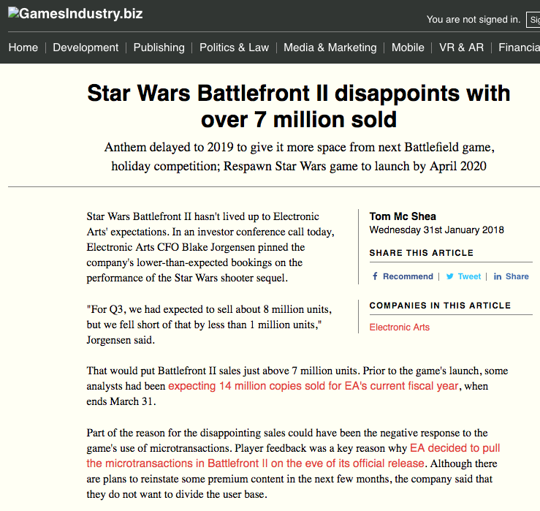

Slide 16
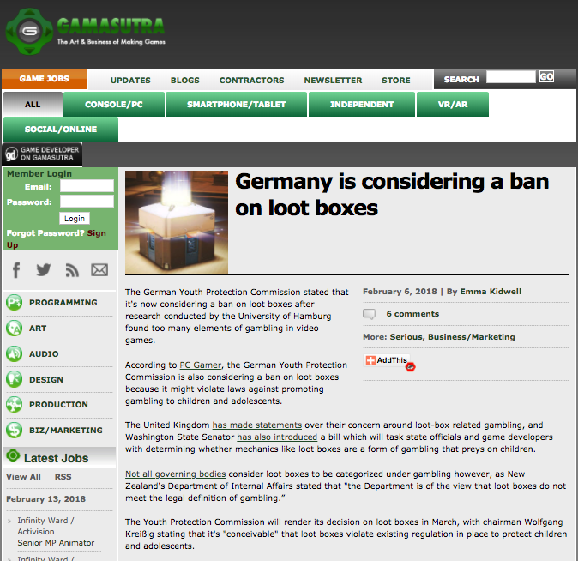

Slide 17
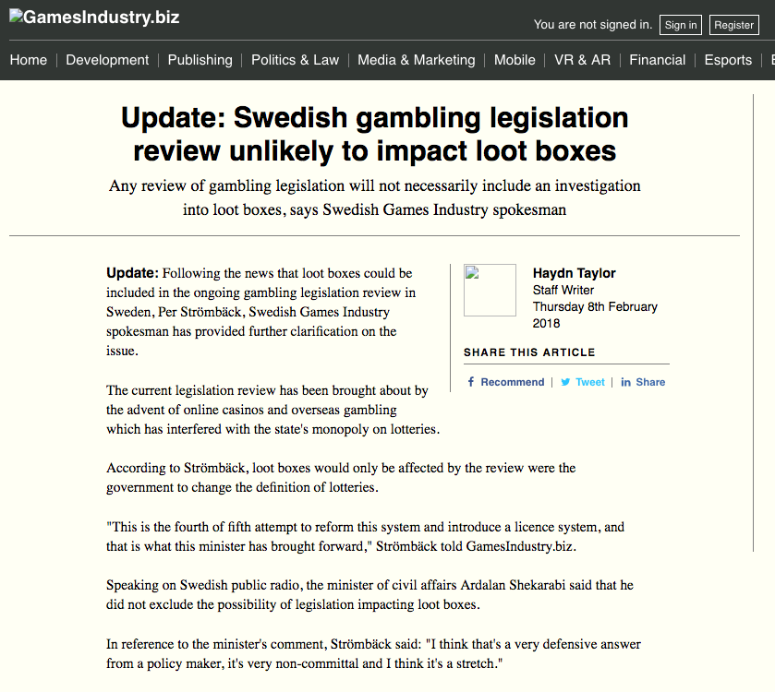

Slide 18
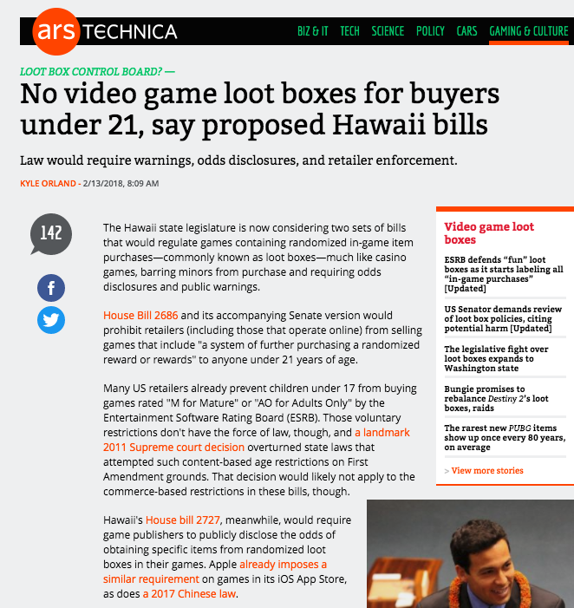

Slide 19
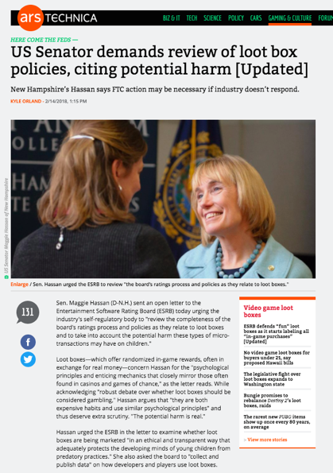

Slide 20
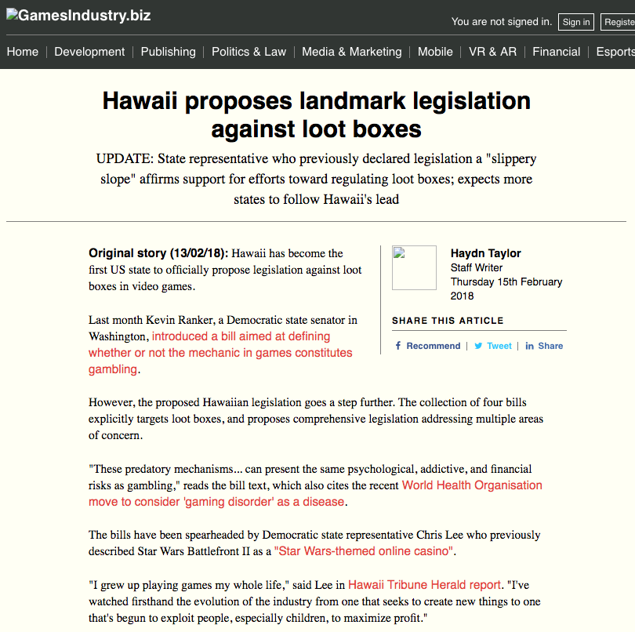

Slide 21
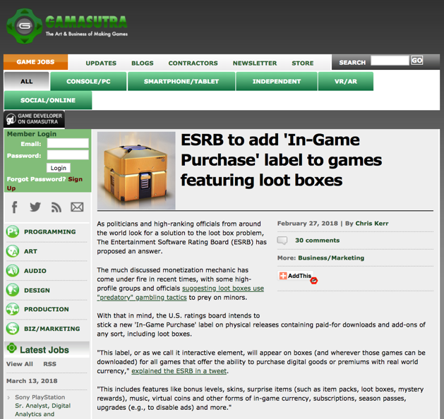

Slide 22
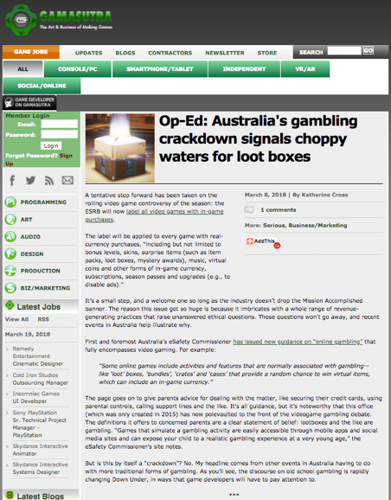

Slide 23
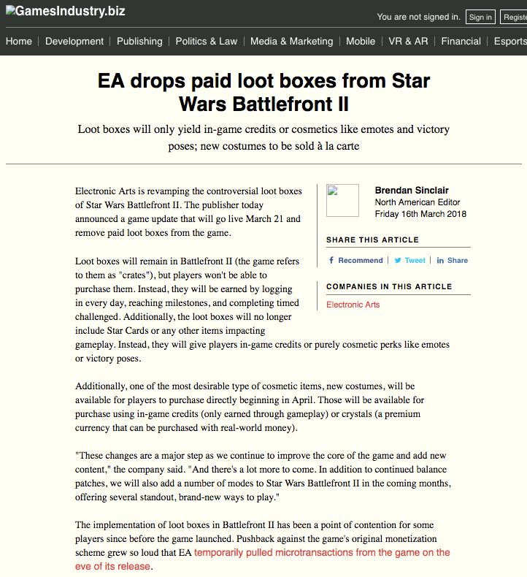

Slide 24
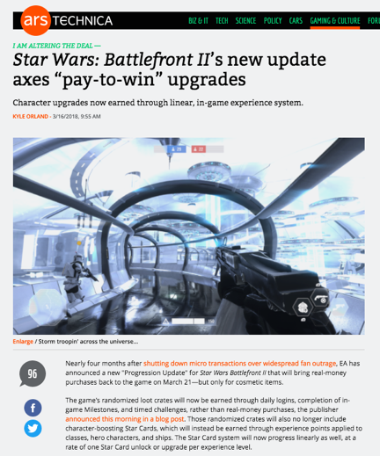

Slide 25
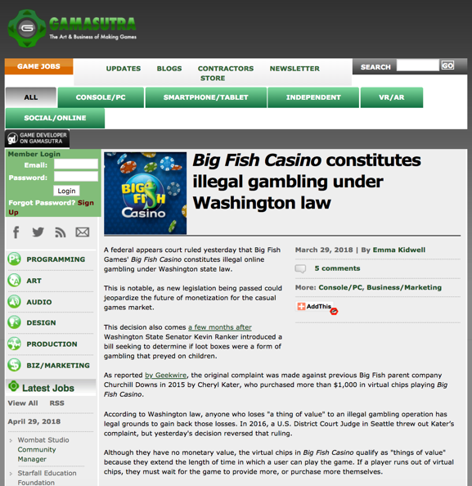

Slide 26
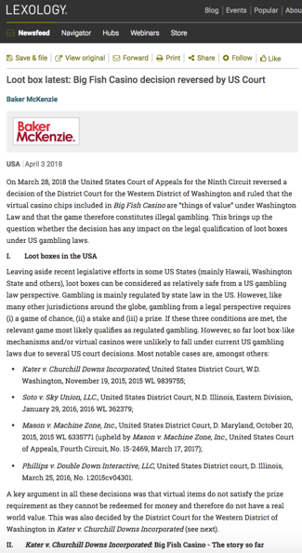

Slide 27
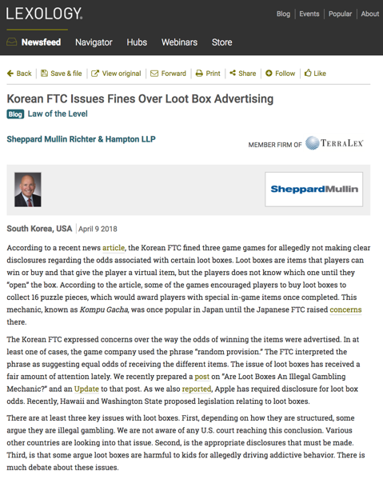

Slide 28
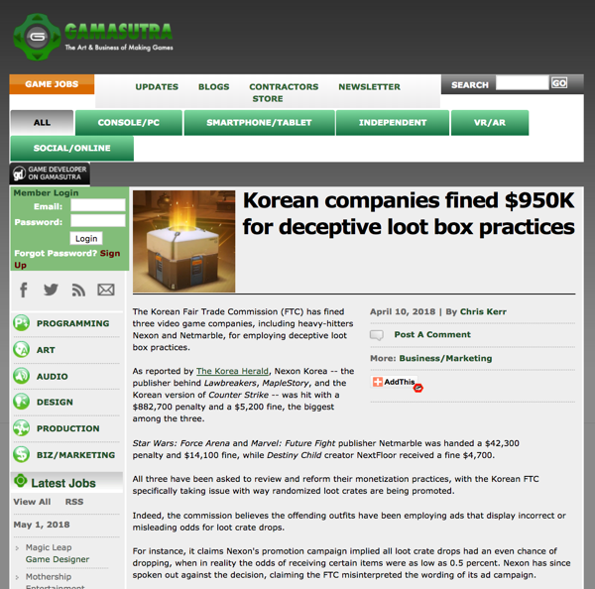

Slide 29
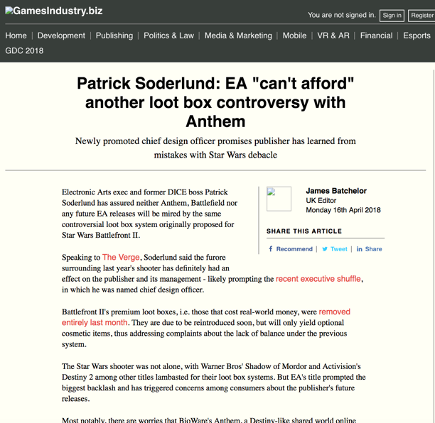

Slide 30
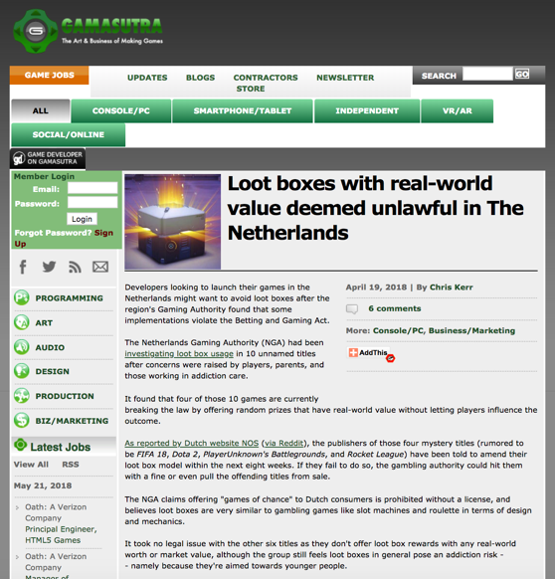

Slide 31
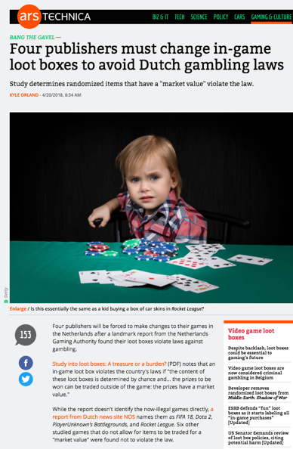

Slide 32
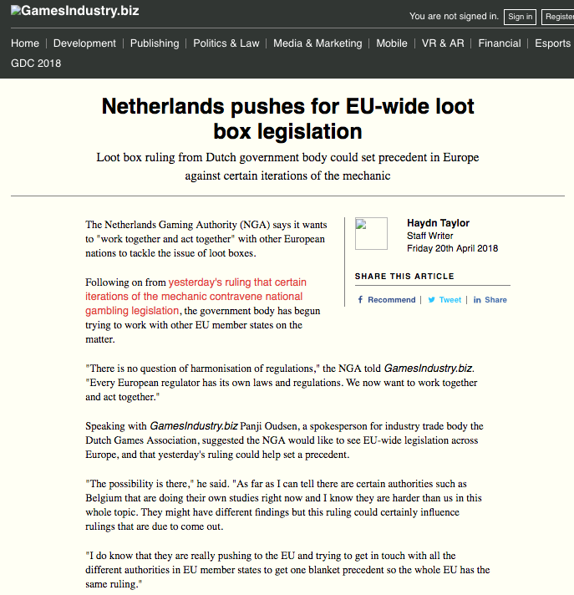

Slide 33
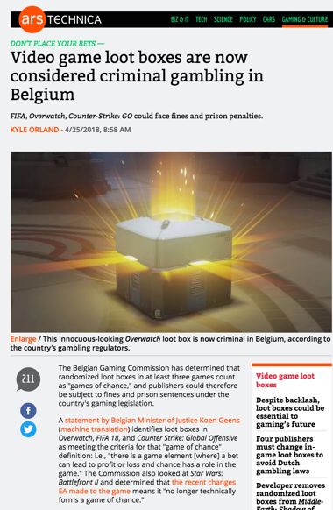

Slide 34
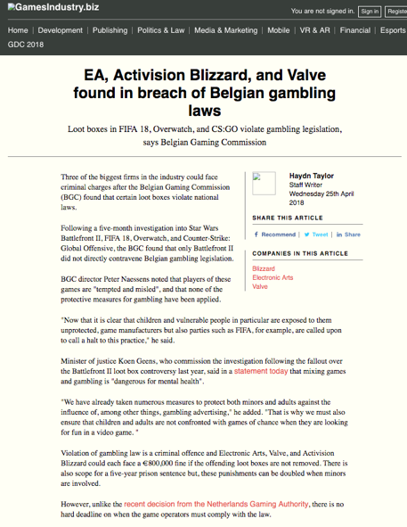

Slide 35
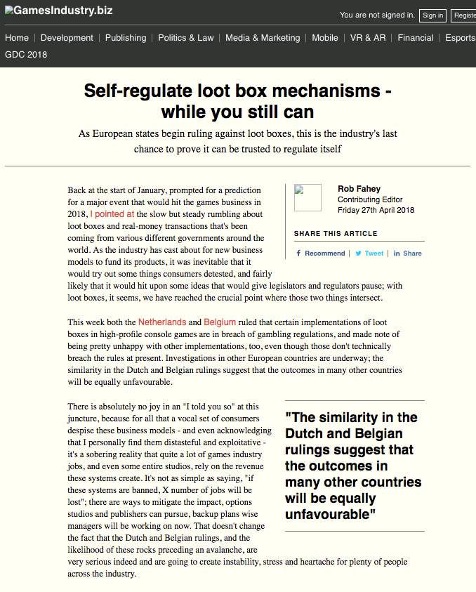

Slide 36
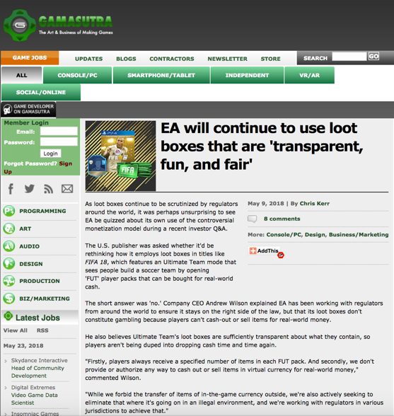

Slide 37
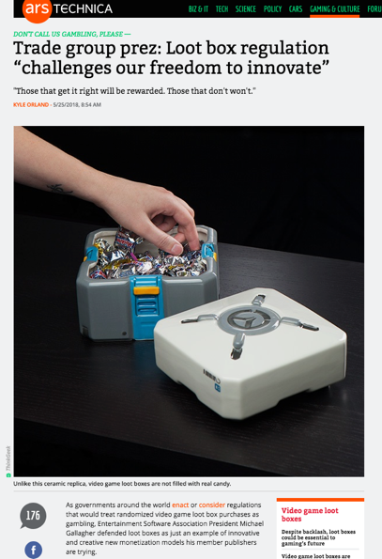

Slide 38
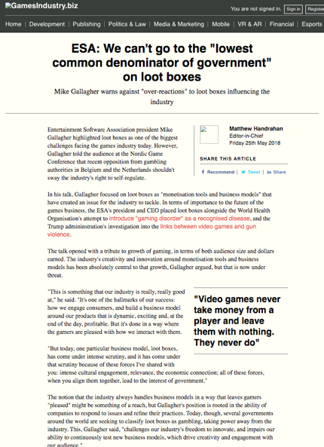

Slide 39
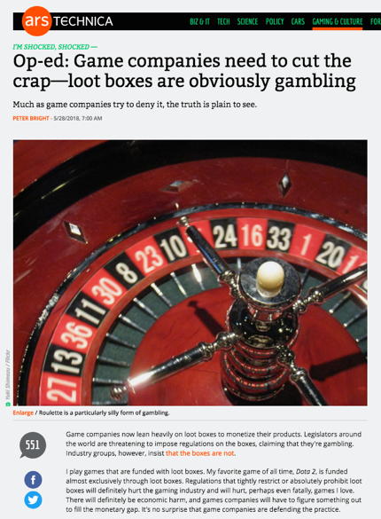

Slide 40
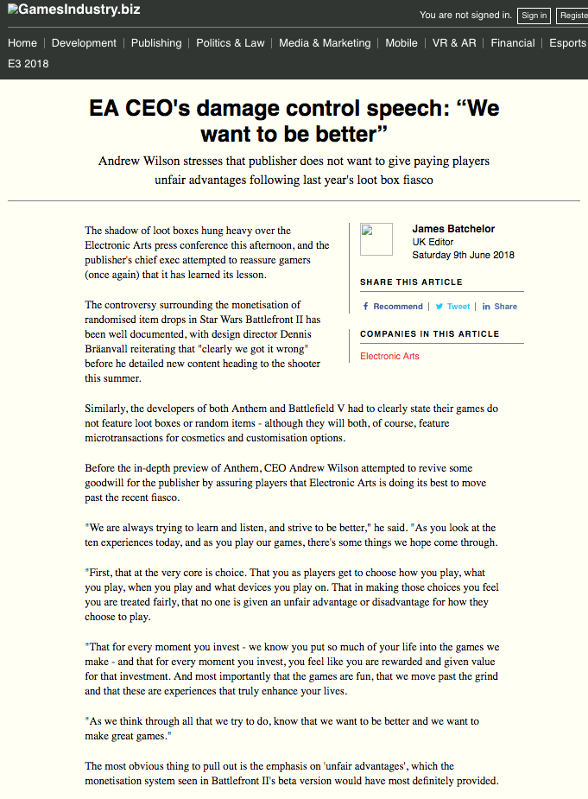

Slide 41
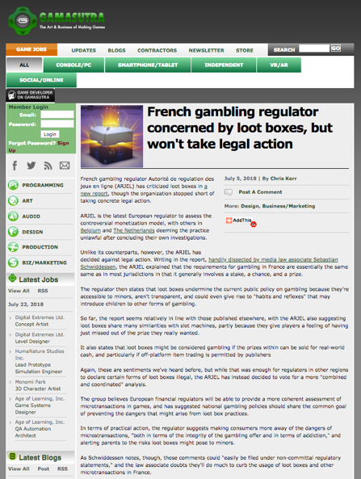

Slide 42
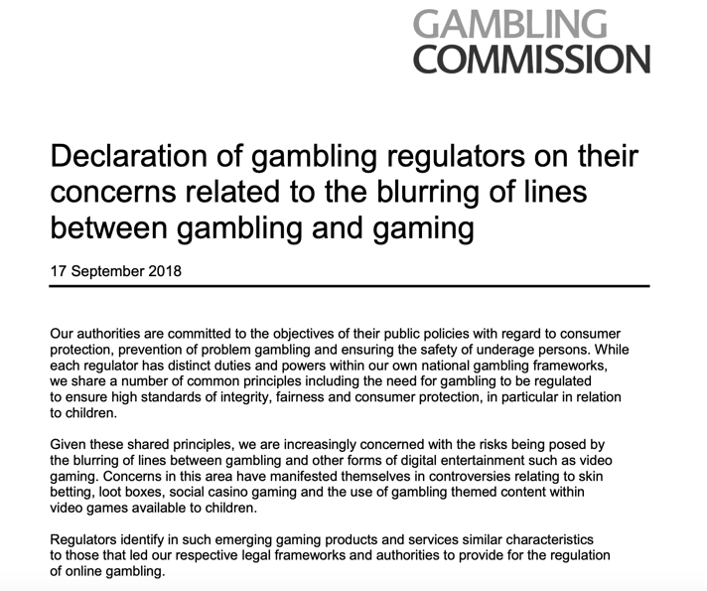

Slide 43
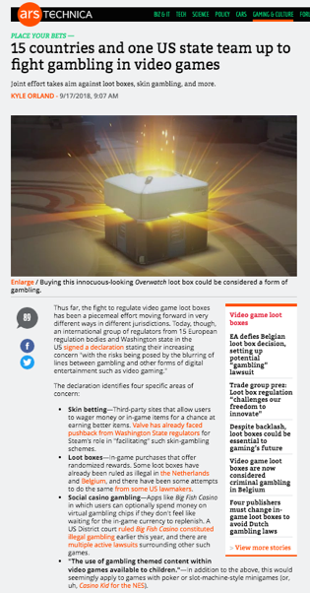

Slide 44
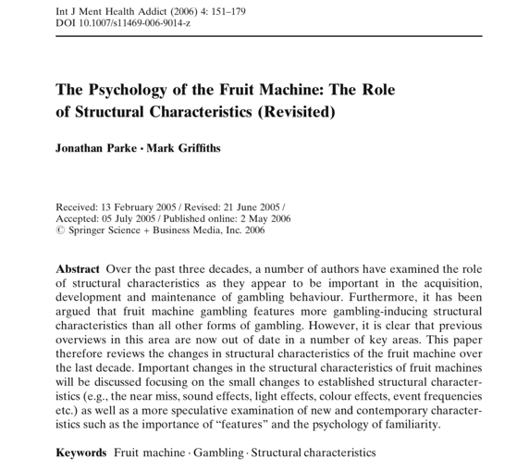
Academic & Industry Research

Slide 45
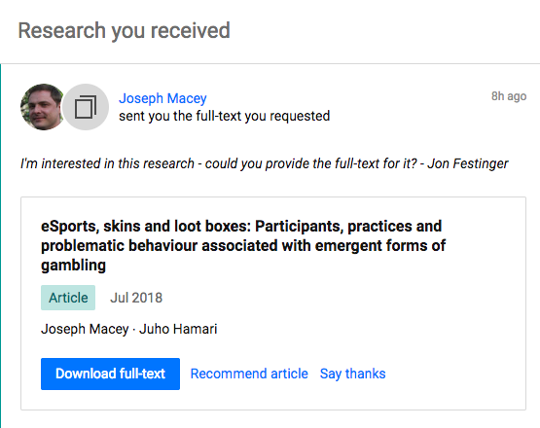

Slide 46
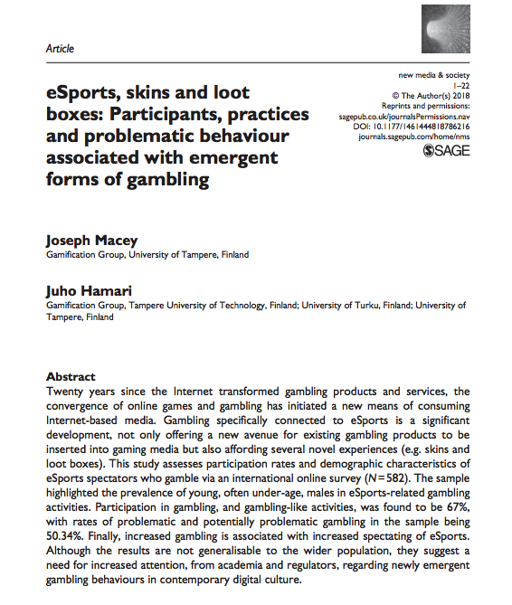

Slide 47
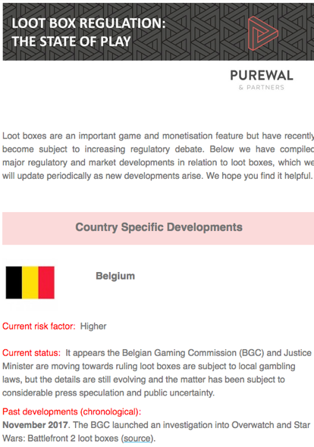

Slide 48
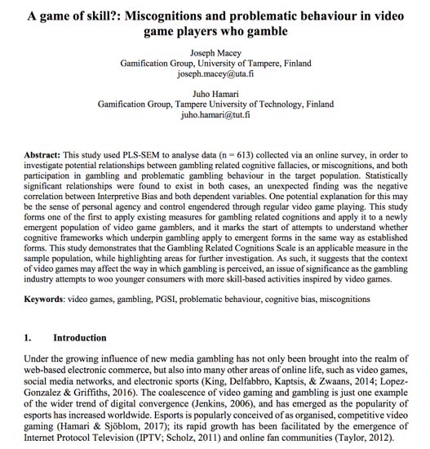

Slide 49
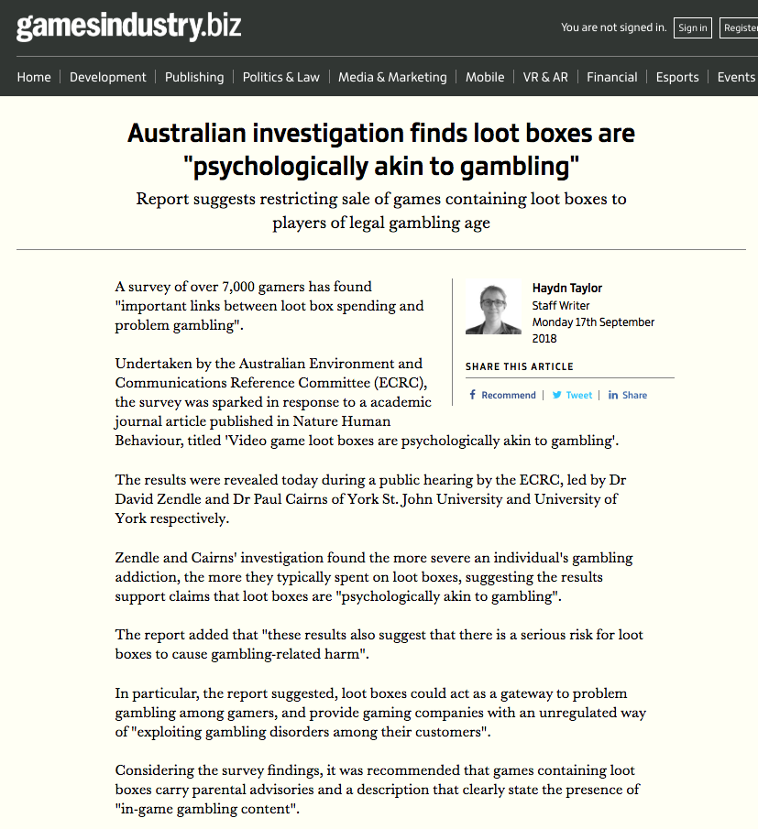

Slide 50
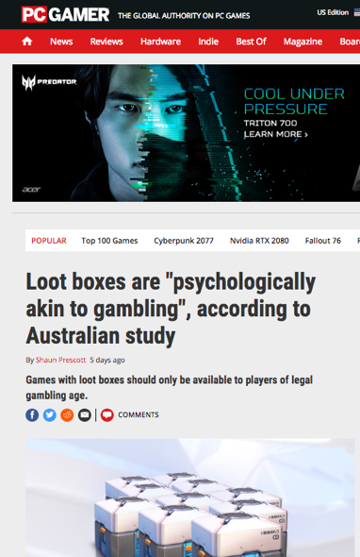

Slide 51
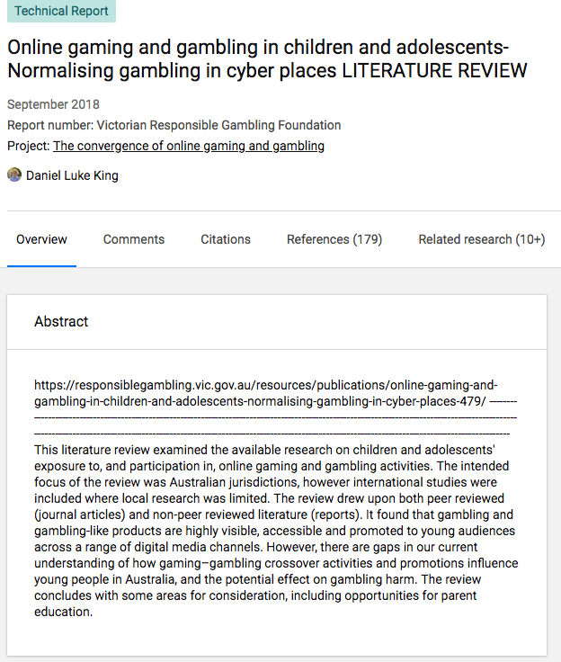

Slide 52


Slide 53

Canadian Analysis

Slide 54

Criminal Code of Canada

Slide 55
COMPETION ACT R.S.C., 1985, c. C-34
53(1): “No person shall, for the purpose of promoting, directly or indirectly, any business interest or the supply or use of a product, send or cause to be sent by electronic or regular mail or by any other means a document or notice in any form, if the document or notice gives the general impression that the recipient has won, will win, or will on doing a particular act win, a prize or other benefit, and if the recipient is asked or given the option to pay money, incur a cost or do anything that will incur a cost.

Slide 56
53(2) Subsection (1) does not apply if the recipient actually wins the prize or other benefit and the person who sends or causes the notice or document to be sent
(a) makes adequate and fair disclosure of the number and approximate value of the prizes or benefits, of the area or areas to which they have been allocated and of any fact within the person’s knowledge that materially affects the chances of winning;
(b) distributes the prizes or benefits without unreasonable delay; and
(c) selects participants or distributes the prizes or benefits randomly, or on the basis of the participants’ skill, in any area to which the prizes or benefits have been allocated.

Slide 57
QUESTIONS? DISCUSSION?

Slide 58



NEXT TIME….
FROM WHEELBARROWS TO HOLODECKS: “CONNECTING” LIVING ROOMS…THINGS…MOBILE DEVICES…EACH OTHER…AND WAY BEYOND…ON THE LEGAL IMPLICATIONS OF CONVERGEANCE…

Slide 59


All A MATTER OF PERSPECTIVE

Slide 60

Always include a cat picture

Slide 61
Our Academic Partners

