Slide 1


What’s it all about…EULA?
Talk 7 Part 1
Part B “Connecting”
Video Game Law 2018
UBC Law @ Allard Hall
Jon Festinger Q.C.
Centre for Digital Media
Allard Law of Law, UBC
QMUL School of Law (CCLS)
Festinger Law & Strategy
http://videogamelaw.allard.ubc.ca/
Twitter: @jonfestinger
jon_festinger@thecdm.ca

Slide 2

Another Wonderful Wednesday

Slide 3
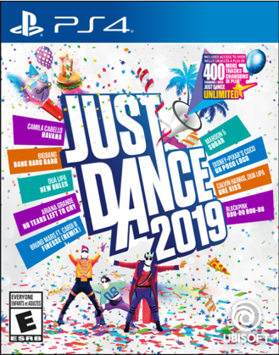
Happy Release Date(s)

Slide 4


Slide 5


Slide 6
Logistics?

Slide 7
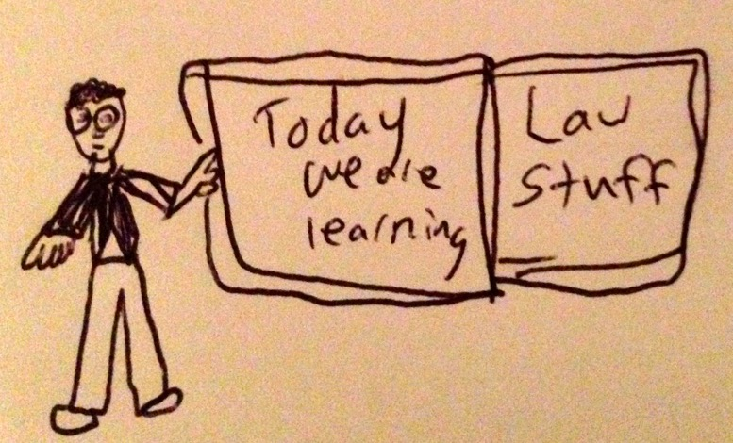

Slide 8
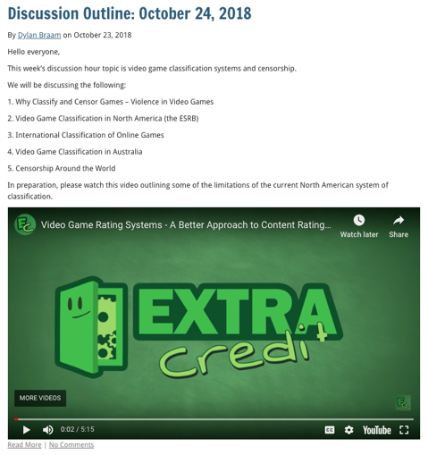

Slide 9
http://videogame.law.ubc.ca

Slide 10


Embedded Self-Socratic A.I.(ish)

Slide 11
Did you try?
Reactions?
Thoughts?

Slide 12
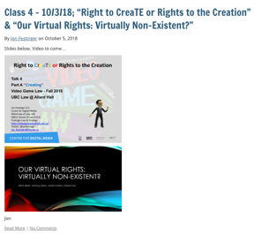
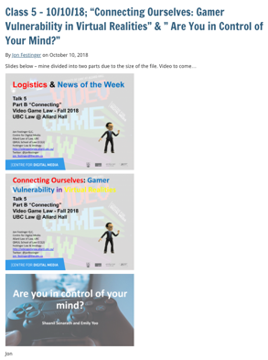
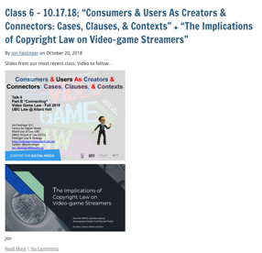
Video edits are in !

Slide 13
Questions on..
Papers ?
Participation ?
Class Presentations ?

Slide 14
Evaluation
A. Participation = 25% includes any or all of:
attendance;
class, website, forum contributions;
following “Journey” and/or “Self-Socratic” protocols.
B. Group presentation during “Discussion Hour” = 25%. Grade will be based on group preparation of their presentation & discussion outline.
C. Term Paper/Major Project (18 to 20 pages or equivalent – 5000 words – any font but comic sans) = 50%.

Slide 15
Evaluation Tips
Term paper topics need not be discussed with me, but often helpful to you if you do.
Term paper can be on your presentation topic.
Participation: In-class or other contributions, including attendance.
Group presentation need not be on that week’s topic (20 minute per student multiplier suggested 2-4 per group to 60 minute max).

Slide 16
Paper Confessional
Legal/normative reasoning/argument including footnote/bibliography support & Contribution/Move forward → 60%
Presentation including layout, headings, grammar, language/writing skills, “tightness” → 25%
Topic/Originality/Degree of Difficultly → 15%
THIS IS NOT A RUBRIC. IT IS A SELF ASSESSMENT.

Slide 17
Grades (primarily)
Paper → Quality
Participation → Effort

Slide 18

Happy to be home from speaking at MTJAG Frankfurt

Slide 19
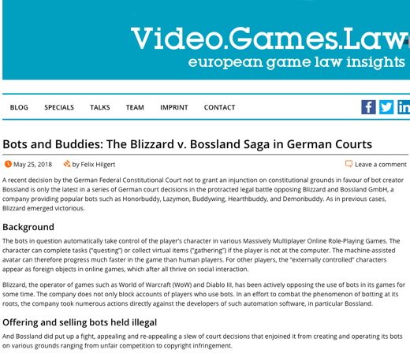
What I learned…

Slide 20
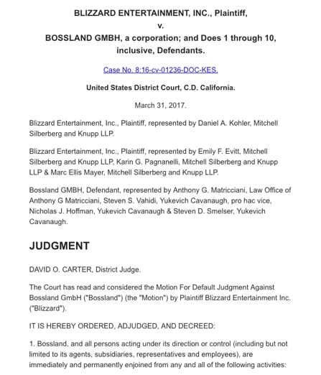

Slide 21
News of the Week

Slide 22
Yours?

Slide 23
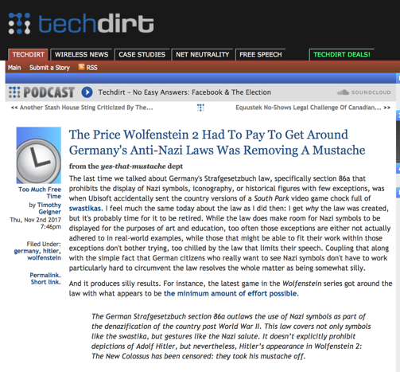
Last Year (roughly)this time

Slide 24
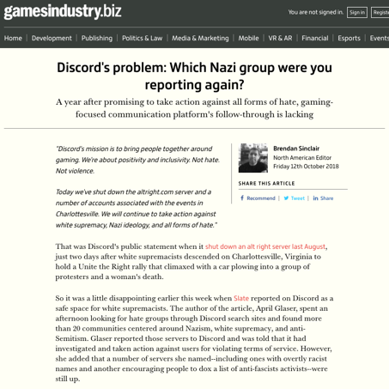
This year…

Slide 25
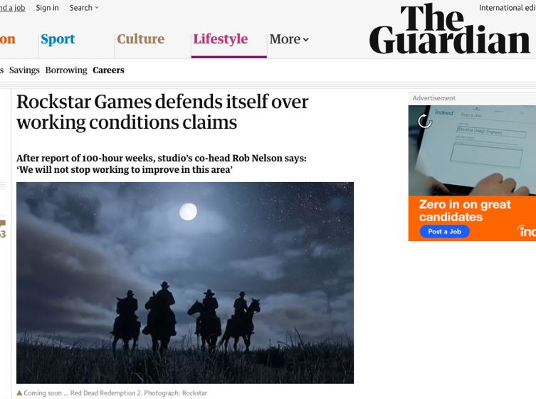

Slide 26
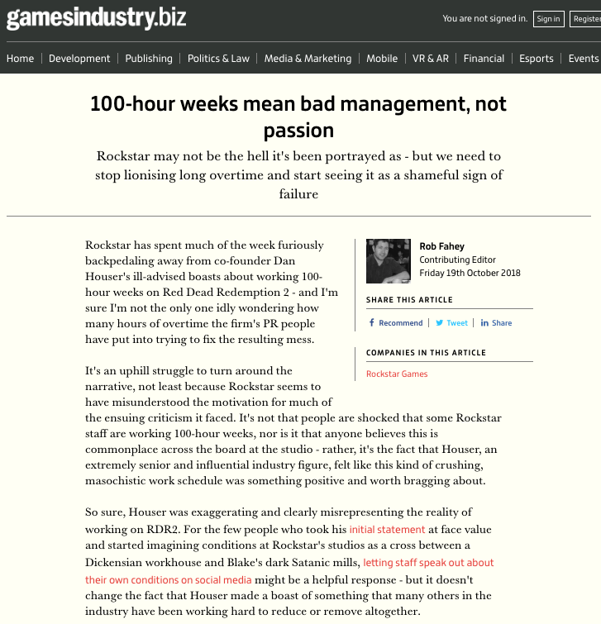

Slide 27
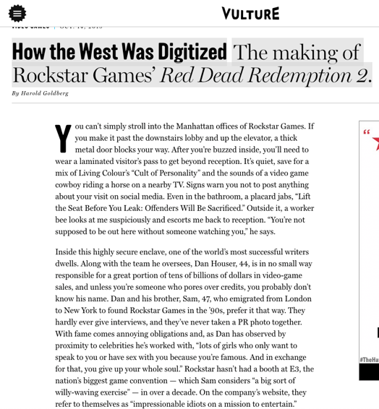

Slide 28
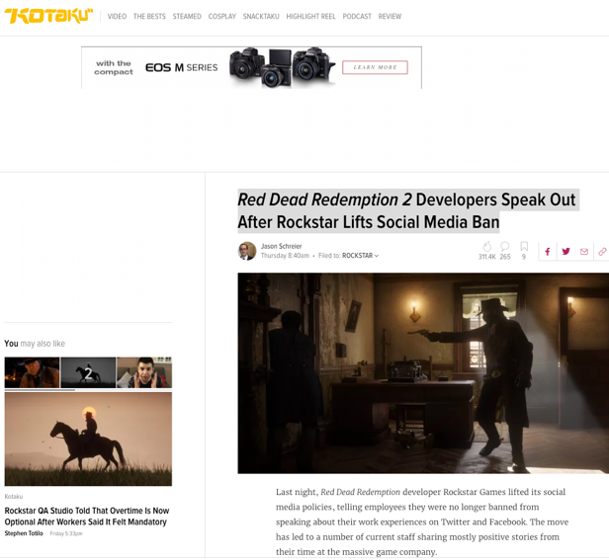

Slide 29
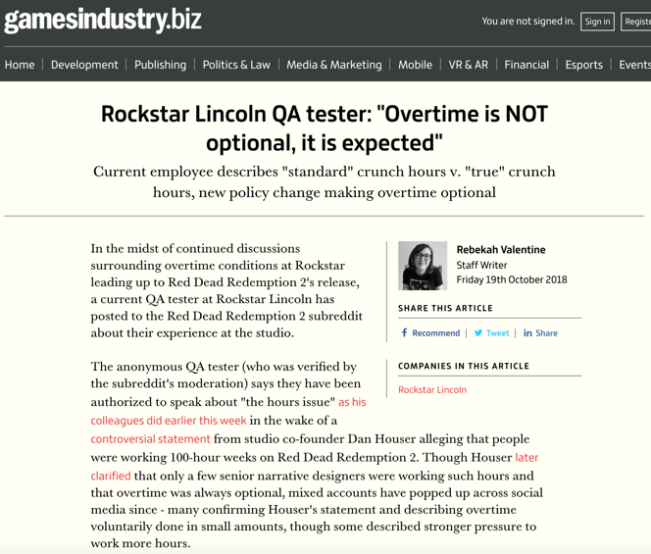

Slide 30
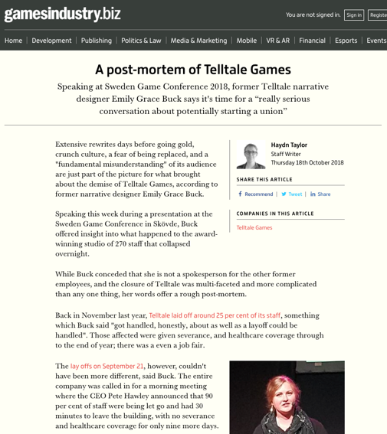

Slide 31
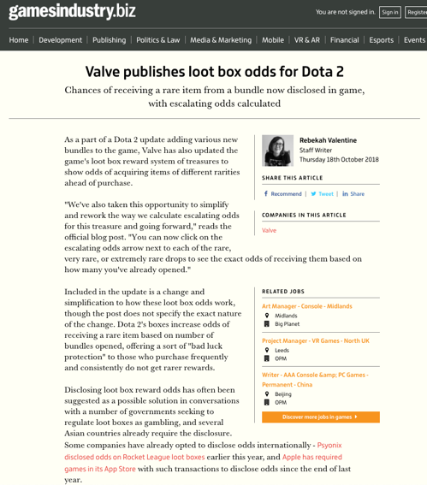

Slide 32
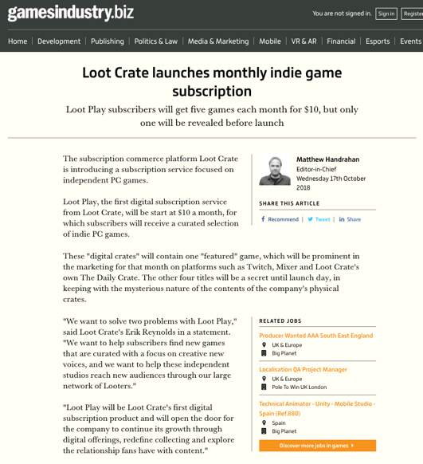
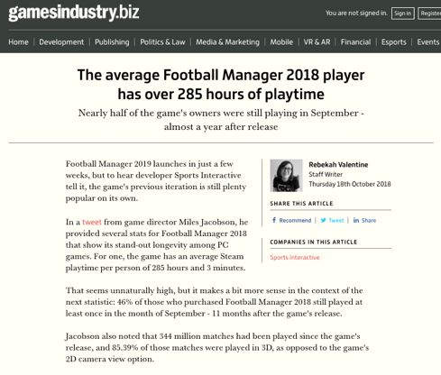

Slide 33
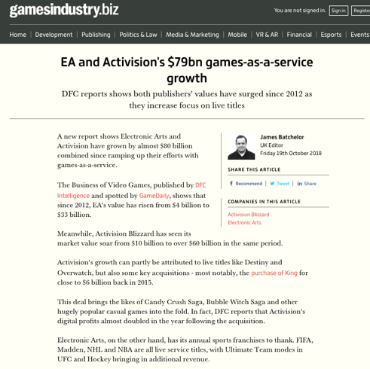

Slide 34


Slide 35


Slide 36
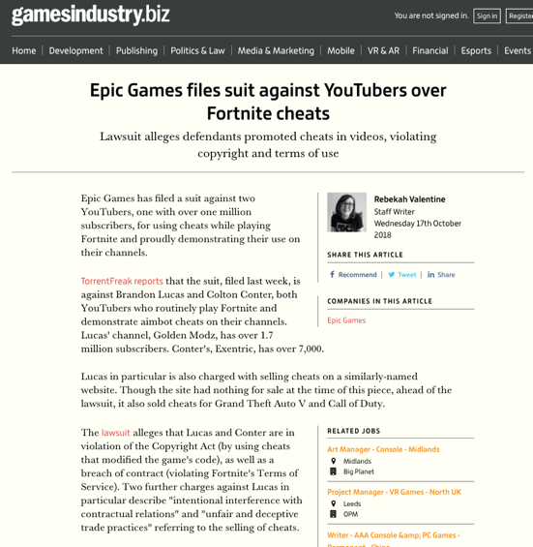

Slide 37


Slide 38
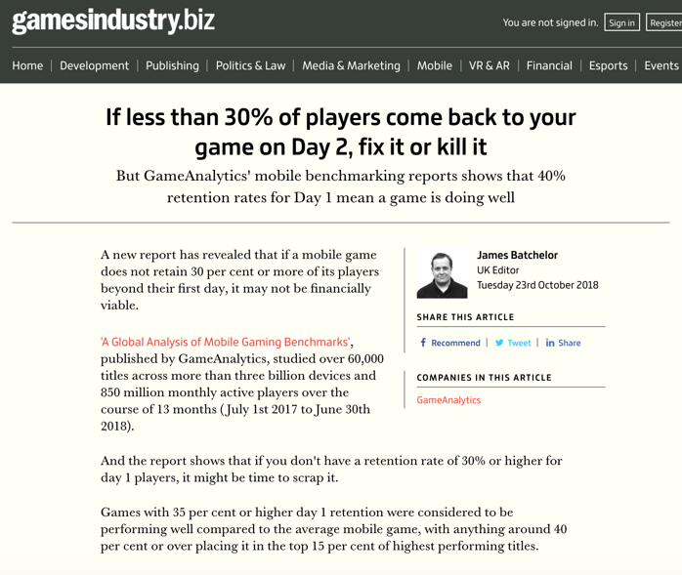

Slide 39
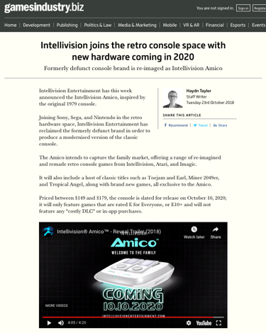
And most importantly…

Slide 40

Now Back to Our Regularly Scheduled Programming…

Slide 41

Starting Point

Slide 42
Taking Stock: Where Are We?
Part A: Memes of “Creating”
Meaning & purpose of creating (in a video game context)
Right to CREAte (mod)
Games as social reaction (McLuhan)
Games given meaning by the gamer (Boyden)
Games as Post-Structural
Copyright as constraint

Slide 43
Taking Stock: Where Are We? (2)
Part B: Memes of “Connecting”
How connecting creativity transforms and restrains i
Creation as Connection: Connection as both the cause & the purpose of Creation = Games are post-structuralist
Video-games (like all creative works) as merger of Creativity & Connection of both Developer/Creator & Player/Creator
Connections→Creation→Greater Connections→Legal implications of post-structuralist nature of games

Slide 44
Leading to “THE POST IP WORLD”?
* Does the dominance of contracts mean we are already in a “The Post IP World”??
* Focus on contractual restraints (digital re-sale; transferability by will, contracting out of IP law permissions e.g. ToS prohibitions of reverse engineering)
CREATION goes with COPYRIGHT/IP LAW
CONNECTING goes with CONTRACT LAW

Slide 45
Nasty Questions:
Does copyright even matter in a “Post IP World”?
Do freedoms (e.g. rights of free expression/speech/thought) exist outside of contract in a “Post IP World”?

Slide 46

Today
An assessment of the utility
of EULA’s (etc.)

Slide 47
The Joy of Tech:
“Support group for writers of end-user
license agreements” by Nitrozac & Snaggy
http://www.geekculture.com/joyoftech/joyarchives/2210.html

Slide 48
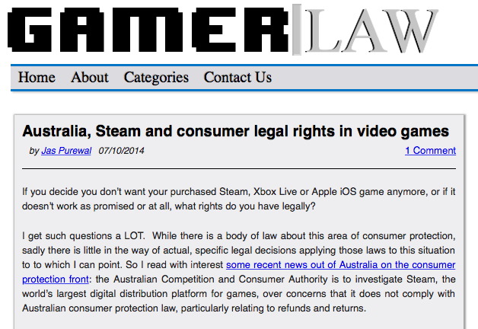
THINGS ARE CHANGING…
http://www.gamerlaw.co.uk/2014/australia-steam-and-consumer-legal-rights-in-video-games/

Slide 49
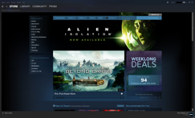
Jas Purewal: “This is a really interesting development to me for a few reasons: This is the first regulator to my knowledge which is specifically investigating the topic of digital distribution platforms’ compliance with consumer protection law, particularly regarding issues like refund rights and the extent to which platforms are bound by legal rules that products must always meet minimum quality standards (eg a requirement called called ‘satisfactory quality’ or ‘acceptable quality’ in the UK and Commonwealth countries or ‘merchantable quality’ in the US, among other requirements).”

Slide 50
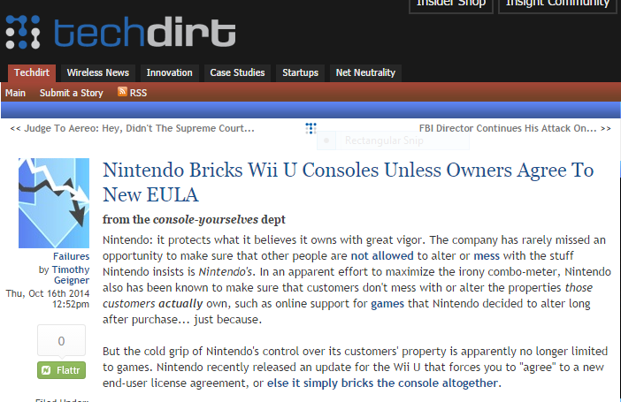
More EULA Unfairness
https://www.techdirt.com/articles/20141013/11010528810/nintendo-bricks-wii-u-consoles-unless-owners-agree-to-new-eula.shtml

Slide 51
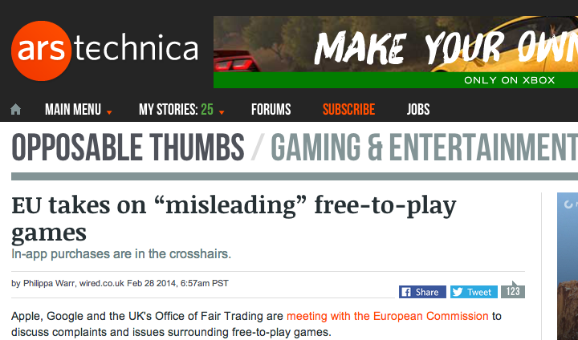
http://arstechnica.com/gaming/2014/02/eu-takes-on-misleading-free-to-play-games/

Slide 52
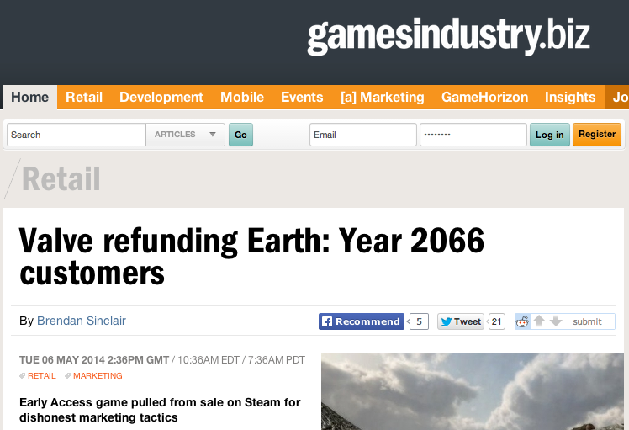
http://www.gamesindustry.biz/articles/2014-05-06-valve-refunding-earth-year-2066-customers

Slide 53
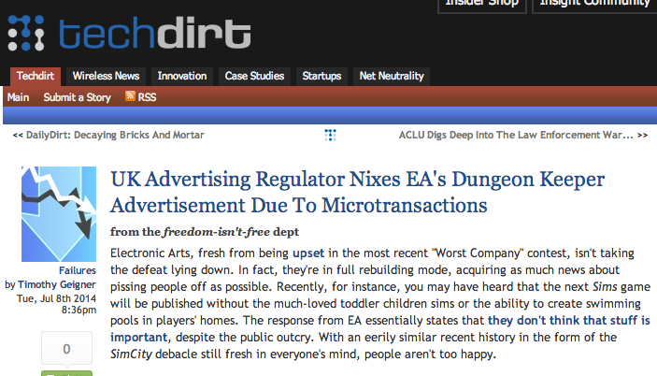
https://www.techdirt.com/articles/20140702/07443127757/uk-advertising-regulator-nixes-eas-dungeon-keeper-advertisement-due-to-microtransactions.shtml

Slide 54
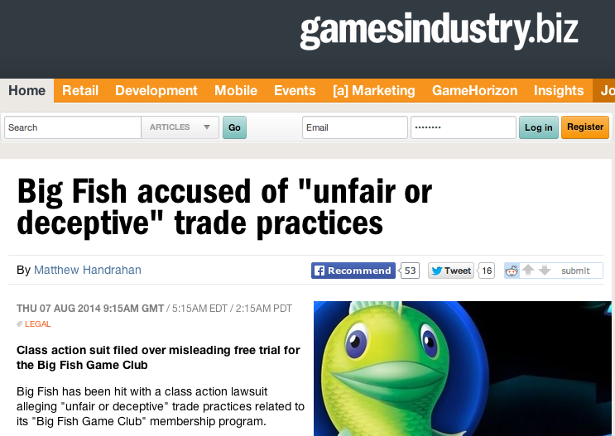
http://www.gamesindustry.biz/articles/2014-08-07-big-fish-accused-of-unfair-of-deceptive-trade-practices

Slide 55

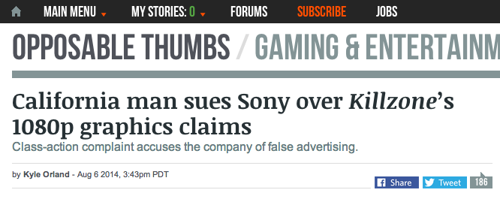
http://arstechnica.com/gaming/2014/08/california-man-sues-sony-over-killzones-1080p-graphics-claims/

Slide 56
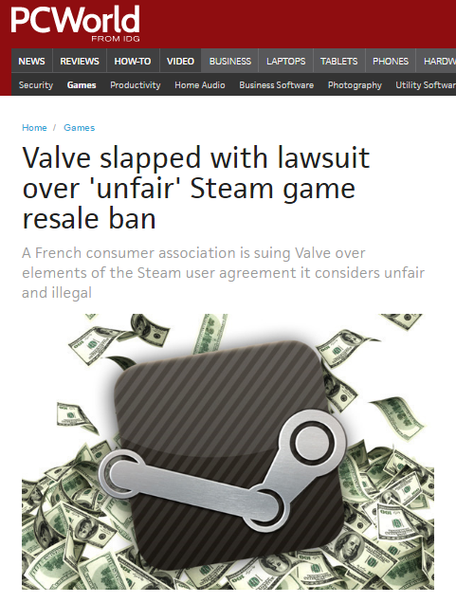

Slide 57
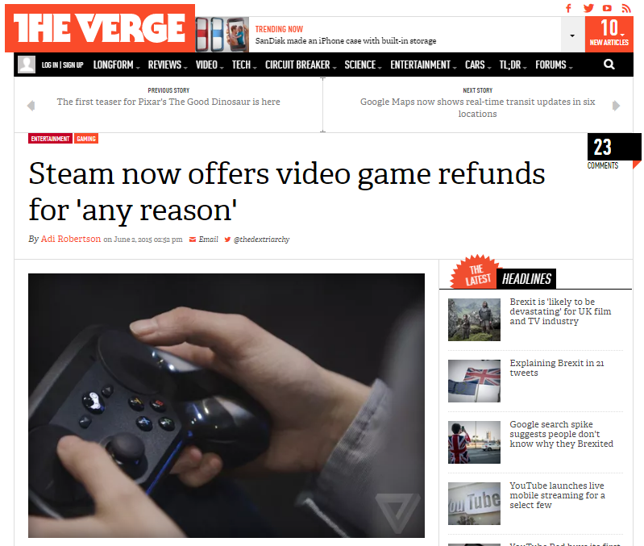

Slide 58


Slide 59
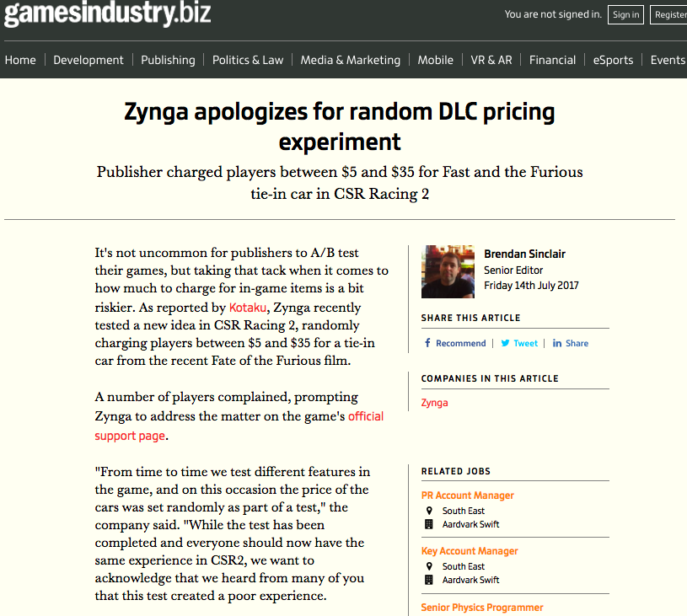

Slide 60
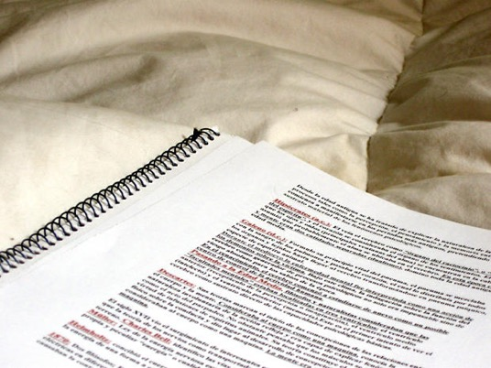
Weird contractual issues…

Slide 61
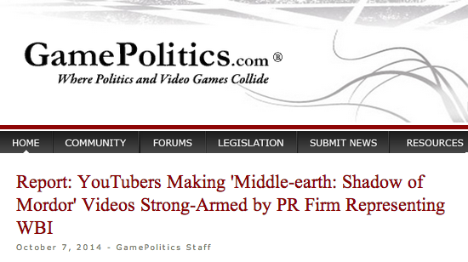
http://www.gamepolitics.com/2014/10/07/report-wb-strong-arms-shadow-mordor-reviewers#.VDxyXpRdX9Q

Slide 62
“YouTubers had to agree to do the following:
- Maximize awareness for the game during the ‘week of vengeance’
Persuade viewers to purchase game
Not show bugs or glitches that may exist
The agreement also notes that "videos will promote positive sentiment about the game.”
”…the company has final approval on the YouTube video at least 48 hours before any video goes live,”
Those who didn't sign the "branding agreement" and made their own found their videos taken down by a YouTube ContentID claim” (Abuse of copyright law?)

Slide 63
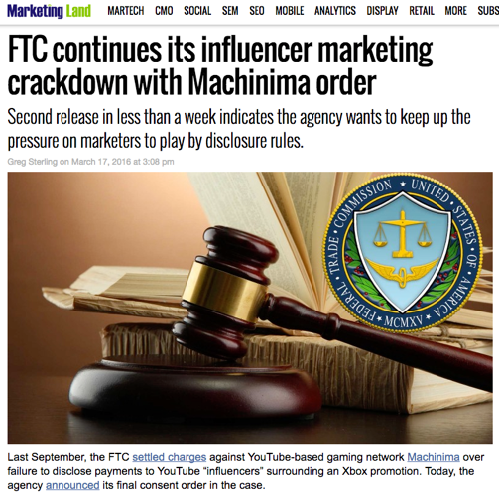
A Cautionary Tale

Slide 64
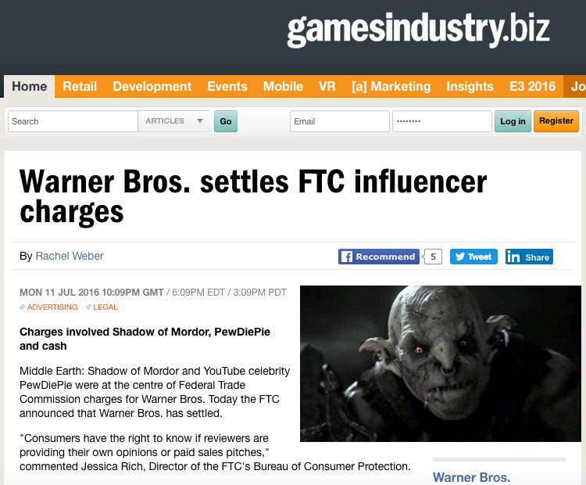

Slide 65
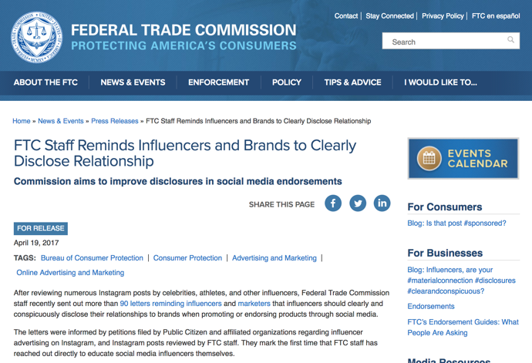
Led to…

Slide 66
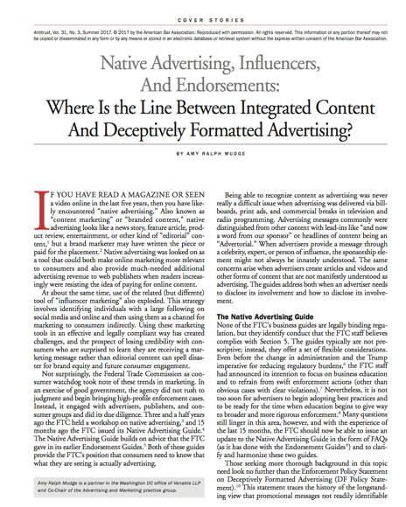

Slide 67
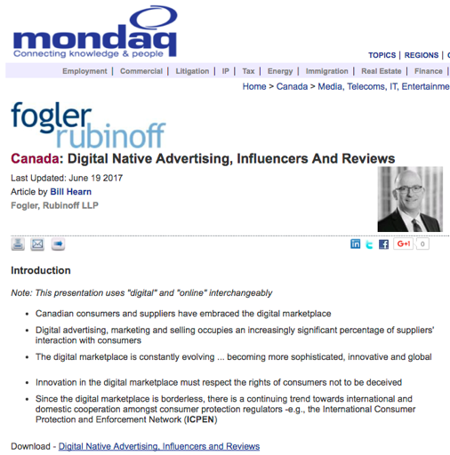
Canada

Slide 68

To understand EULA’s…

Slide 69
Constraint Restraint
Coercion Control
Statute Contract
con·strain/kənˈstrān/Verb
Severely restrict the scope, extent, or activity of.
Compel or force (someone) toward a particular course of action.
Synonyms: force - compel - coerce - oblige - necessitate
re·strain/riˈstrān/Verb
Prevent (someone or something) from doing something; keep
under control.
Prevent oneself from displaying or giving way to a strong
urge or emotion.
Synonyms: curb - check - hold - repress - control - contain

Slide 70
A Pattern?
CREATION goes with COPYRIGHT/IP LAW
CONNECTING goes with CONTRACT LAW
BECOMES
COPYRIGHT/IP LAW CONSTRAINS/COERCES CREATION
CONTRACT LAW RESTRAINS/CONTROLS CONNECTING

Slide 71
Emerging from Talk (“10 Cases -..”)
Considering:
1. Companies draft; consumers don’t
2. Click-wrap “fiction”
3. Lack of standardization (Industry Assoc./Treaty/Consumer Protection)
4. All cases had multiple causes of action, not just contract
Query: Morality of contracting out of:
a.) free speech/expression rights
b.) prevailing statutory copyright laws/rights
c.) privacy & surveillance protections

Slide 72
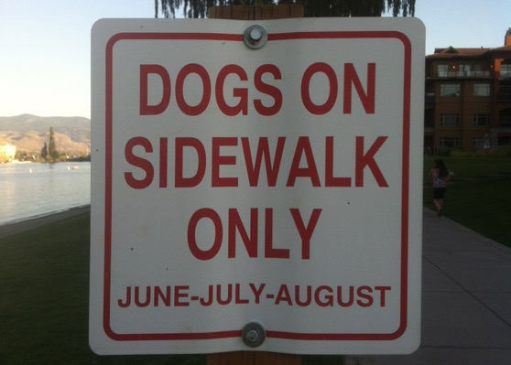
The problem with drafting…
(Where do the humans go?)

Slide 73
Trends in the Cases?
COPYRIGHT (constraint)
to
USER (COPY) RIGHTS
(e.g. reverse engineering, fair use, right to create {?})
to
CONTRACTING (restraint)
to
REMOVING USER RIGHTS
(no reverse engineering, no mods, no privacy?)
to
CONSUMER/GAMER PROTECTIONS ???
*Fairness of this process of moving from constraints to
additional restraints without user understanding?

Slide 74

Double Standard Tests
Core problem: EULA’s, ToS’ etc. we “agree to” are all different in specifics; yet apply to billions of people.
DOUBLE STANDARD Test #1: since digital developers Can (& do) customize your content, Why not YOUR EULA, TOS & Privacy agreements?
DOUBLE STANDARD Test #2: How many developers could survive the terms they impose on Consumers?
ETHICAL SOLUTION?: Embedding a “Do Unto
Others” algorithm rule-set which permits us to use the
digital bits of others if we share ours to the same
standard. Barter not infringement.

Slide 75
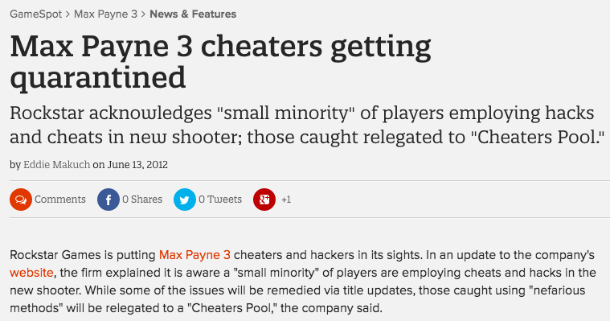
Why not tailor our rights in terms of how we deal with the rights of others?
http://www.gamespot.com/articles/max-payne-3-cheaters-getting-quarantined/1100-6382313/

Slide 76
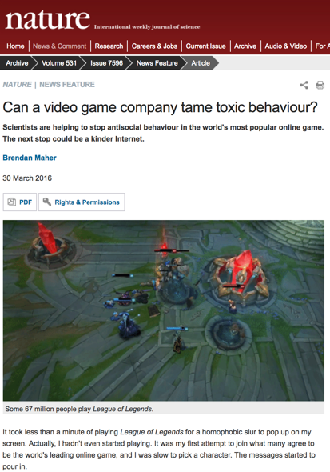

Slide 77
Query: Developer’s Liability - Are not EULA/
ToS’ needed for the “really bad” stuff?
* Would a short legal notice would be as effective as EULA/ToS?
“Cheating, illegal &/or intolerant behavior is not acceptable. In such event we may take such legal or other actions we deem appropriate in our sole discretion.”
* EULA cases do tend to relate to commercial threats, not “really bad” stuff. See Davidson & iRacing for example.
* Bot/gold-mining cases more ambiguous, being about both;
a) gamer's experience; &
b) company possibly offering gamer same features.
* Consider: Blizzard Entertainment, Inc. v. In Game Dollar, LLC,
USDC Cal.2007 (gold-farming) followed by “Blizzard Introduces Buying in-Game WoW Items” (Nov/09)http://www.tomshardware.com/news/World-Warcraft-Blizzard-MMORPG-Microtransactions,9003.html

Slide 78
A More Insidious Result?
Censorship controls effectively delegated to private interests (without free speech/expression overrides).
“Apple rejects game based on Syrian civil war”http://killscreendaily.com/articles/news/apple-rejects-game-based-syrian-civil-war/
“iOS games chafe under Apple's directions: 'If you want to criticize a religion, write a book’”http://www.theverge.com/2013/1/16/3879194/apple-app-store-guidelines-tell-game-developers-to-avoid-serious-themes
& less insidiously: “Blizzard Bans 'Several Thousand' Diablo III Players for Cheating” – using bots (Would “Notice” do?)http://gamepolitics.com/2012/12/19/blizzard-bans-several-thousand-diablo-iii-players-cheating#.URswDFpAR3c

Slide 79
…but the “functional” answer may be…
Causes of action other then violation of EULA
& ToU available in ALL relevant cases…
1. Davidson & Associates, Inc. v. Internet Gateway:
Breach of Digital Millennium Copyright Act (DMCA) found.
2. Blizzard Entertainment, Inc. v. In Game Dollar, LLC:
Claims of intentional interference with contract; unfair competition & unjust enrichment. Case settled.
3. MDY Industries, LLC v. Blizzard Entertainment, Inc.:
Breach of DMCA found.
4. Blizzard Entertainment, Inc. v. Marshall:
Claims of copyright infringement, circumvention of copyright protection systems in violation of the DMCA & tortious interference with contract. Case dropped (settled).
5. iRacing Motorsports Simulations, LLC v. Tim Robinson: Copyright infringement claim.

Slide 80

iRacing redux
iRacing Motorsports Simulations, LLC v. Tim Robinson, District Court for the District of Massachusetts, Civil Action No. 05cv11639-NG (May, 2009)
EULA: “You may not, in whole or in part, copy, photocopy, reproduce, translate, reverse engineer, derive source code, modify, disassemble, decompile, create derivative works based on [NASCAR 2003], or remove any proprietary notices or labels on [NASCAR 2003] without the prior consent, in writing, of [iRacing].”
Mod community encouraged in past but line drawn?…

Slide 81
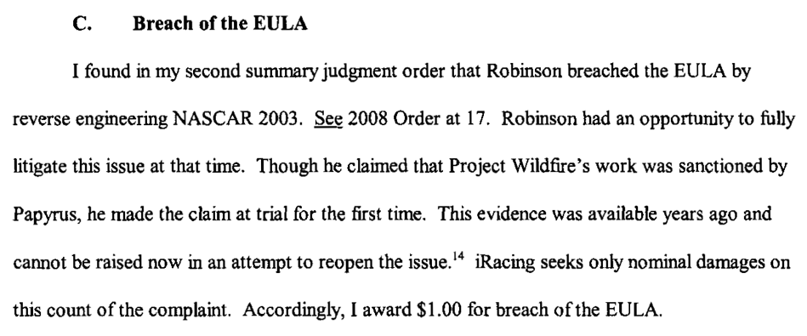
iRacing

Slide 82
Proof of non-EULA claims in EULA cases 2
6. Zynga Game Network, Inc. v. Labrasca: Claims of
trademark infringement, unfair competition, passing off, and
intentional interference with contractual relations. Consent
judgment.
7. Evony, LLC et. al. v. Holland:
Default judgment based on copyright infringement
(Copyright Act & DMCA), trademark & trade dress
infringements, tortious interference with contractual
relations & prospective economic advantage.
Footnotes - other cases not on-point
8. Vernor v. Autodesk, Inc.: Judgment for copyright infringement (non-game case).
9. Smallwood v. NCSOFT: EULA as defense in gaming addiction case not fully upheld
10. Hernandez v. Internet Gaming Entertainment, Ltd: Action by gamer against
gold farming company seeking to use ToU & EULA gold farming company must have
agreed to. Settled.

Slide 83

The Heretical Question…
Are EULA’s & ToS’ even necessary?

Slide 84
Other unfairness?
1. Un-contract like uncertainty: Termination clauses that aren’t….eg. WoW EULA:
“This License Agreement is effective until terminated. You may terminate the License Agreement at any time by (i) permanently destroying all copies of the Game in your possession or control; (ii) removing the Game Client from your hard drive; and (iii) notifying Blizzard of your intention to terminate this License Agreement. Blizzard may terminate this Agreement at any time for any reason or no reason.”
Are we party to hundreds of contracts (or more) we don’t use?

Slide 85
Unfairness? (con’d)
2. Average Privacy Policy Reading Level is that of a College
Sophomore while Average U.S. Reading Level is 8th Grade.
“Examination Of Privacy Policies Shows A Few Troubling Trends”
http://techcrunch.com/2011/11/30/examination-of-privacy-policies-shows-a-few-troubling-trends/
3. “Microsoft Attacks Google on Gmail Privacy” | NY Times
“The ads will showcase research that shows most people don’t know that Web e-mail providers like Google scan the contents of their e-mail messages to deliver personalized ads to them — and when they do find out, they don’t like it.”
http://bits.blogs.nytimes.com/2013/02/06/microsoft-attacks-google-on-gmail-privacy/
4. “Terms of Service: Didn’t Read” (website) “I have read and agree to the Terms” is the biggest lie on the web. We aim to fix that.” http://tos-dr.info

Slide 86

The Common Law explains itself
“Every expression of a common intention arrived at by the parties is ultimately reducible to question and answer.” Anson, Principles of the English Law of Contract, 2nd Edn., p.15 (1882).
Common Law is ‘concerned not with the presence of an inward and mental assent but with its outward and visible signs.” Cheshire and Fifoot’s Law of Contract, 9th Edn. P.26 (1976).
…not much comfort…
…when there is an
obvious issue?

Slide 87

Roads to explore…
To Re-ask the question: Are consumer contracts/license agreements redundant &/or unnecessary?
If EULA’s, ToS, & (non) Privacy Agreements disappeared suddenly would the gaps be filled by:
* Copyright
* Competition-antitrust law
* Privacy law
* Consumer protection laws
* International law/treaties
* Legislation & regulation
)

Slide 88

Industry Association
Standard Form EULA?

Slide 89
Another alternative:
Technology (DRM+): e.g. “Examining Sony's Internet-free method for blocking used game sales”: “…patent application…outlines a content protection system that would use small RFID chips embedded on game discs to prevent used games from being played on its systems, all without requiring an online connection.” http://arstechnica.com/gaming/2013/01/examining-sonys-internet-free-method-for-blocking-used-game-sales/

Slide 90
The Future?
“The privacy policy required by this section shall be no more than 100 words and shall be written in clear and concise language at no greater than an eighth grade reading level. The privacy policy shall include a statement indicating whether the personally identifiable information may be sold or shared with others, and if line so, how and with whom the information may be shared.”
Context: Act amends Section 22575 of the Business and Professions Code, which requires that an operator of a commercial Web site or online service operators collecting personal information about consumers to make its privacy policy available.
California BILL No. 242; Assembly Member Ed Chau - February 6, 2013 (BILL No. 242 was 336 words per Techdirt) http://www.leginfo.ca.gov/pub/13-14/bill/asm/ab_0201-0250/ab_242_bill_20130206_introduced.pdf

Slide 91
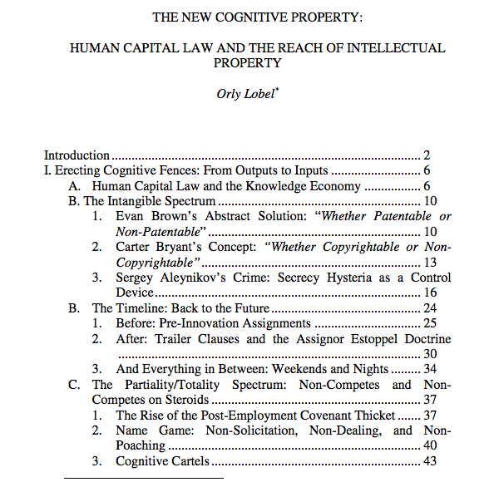
One last thought on contracts as restraints…
http://www.law.berkeley.edu/files/Lobel_Orly_IPSC_paper_2014.pdf

Slide 92


Silicon Valley, Boston &
Restrictive Covenants

Slide 93
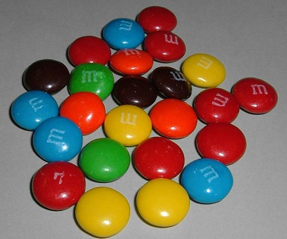

All A MATTER OF PERSPECTIVE

Slide 94

Always include a cat picture

Slide 95
Our Academic Partners

