Slide 1

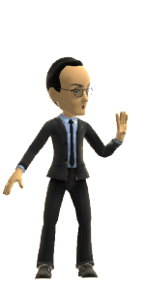
Controlling the Controllers: Privacy & Cultures 1
Talk 11
Part C “Controlling”
Video Game Law 2018
UBC Law @ Allard Hall
Jon Festinger Q.C.
Centre for Digital Media
Allard Law of Law, UBC
QMUL School of Law (CCLS)
Festinger Law & Strategy
http://videogamelaw.allard.ubc.ca/
Twitter: @jonfestinger
jon_festinger@thecdm.ca

Slide 2
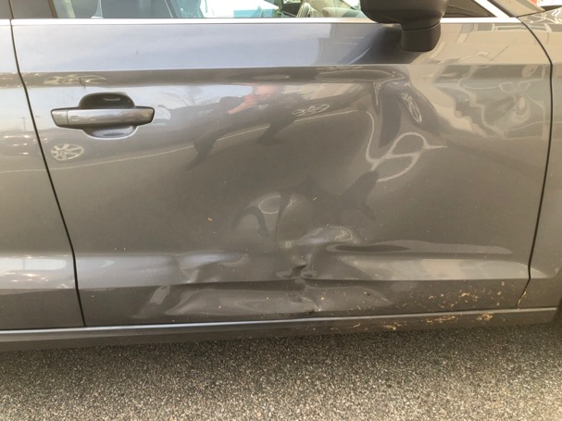
^{Last Week…}

Slide 3
Course Evaluations
“Students will be able to access the online course evaluation website beginning at 12:00 a.m. on Wednesday, November 21, and will be able to complete evaluations until 11:59 pm on Monday, December 3. Students will receive an email from support@SEOT.ubc.ca on November 21 that will direct the students to the teaching evaluation site”.

Slide 4
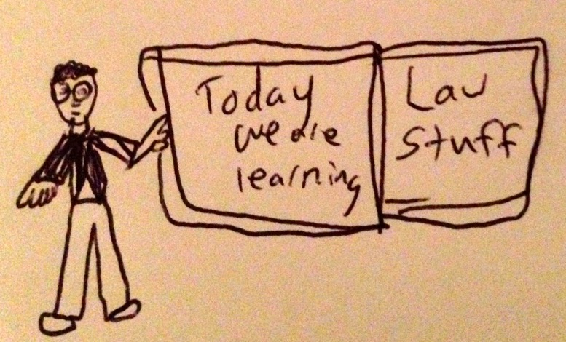

Slide 5

Happy Release Date(s)

Slide 6
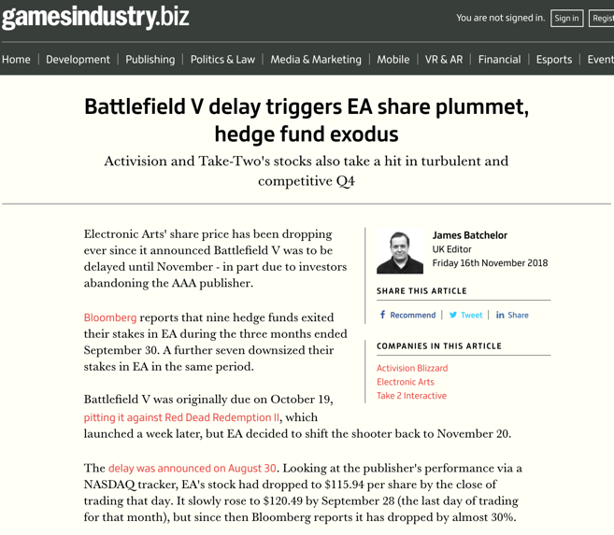

Slide 7
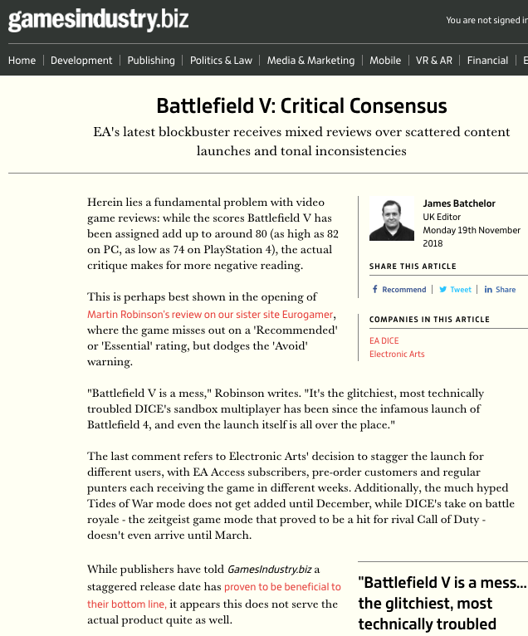

Slide 8
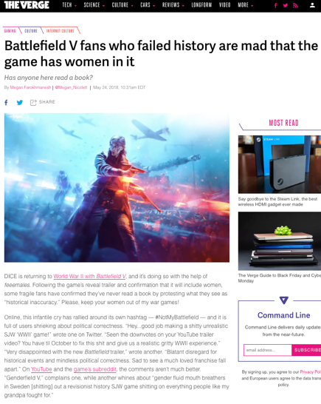

Slide 9
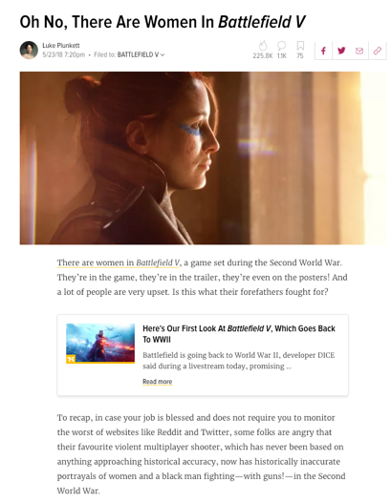

Slide 10
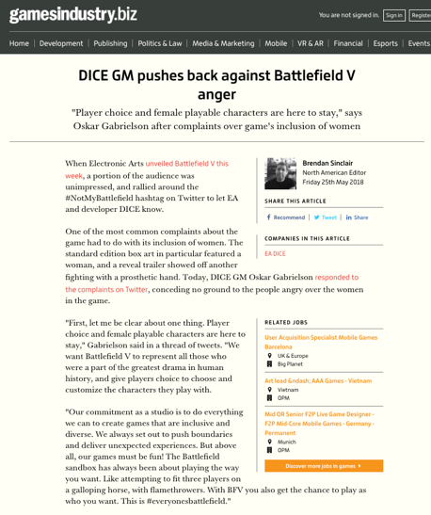

Slide 11
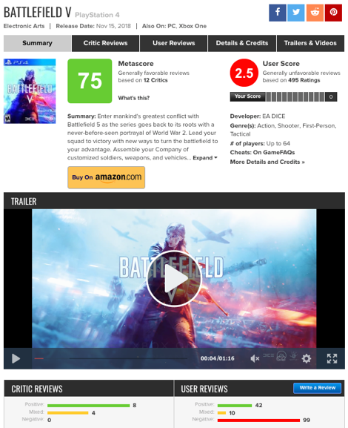

Slide 12

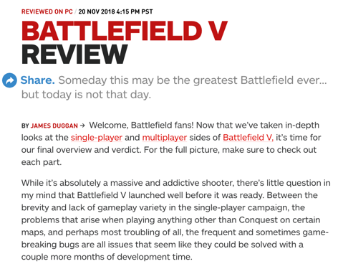


Slide 13
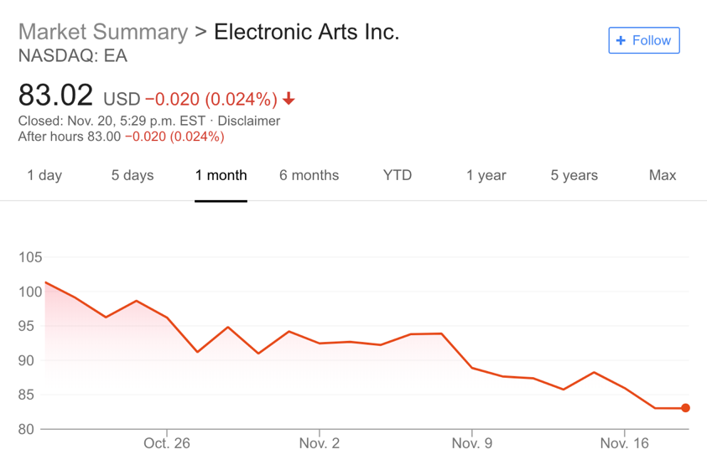

Slide 14

Other games…

Slide 15



Slide 16
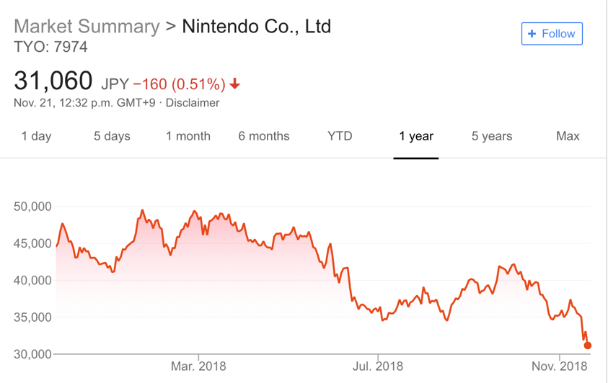

Slide 17
Logistics?

Slide 18
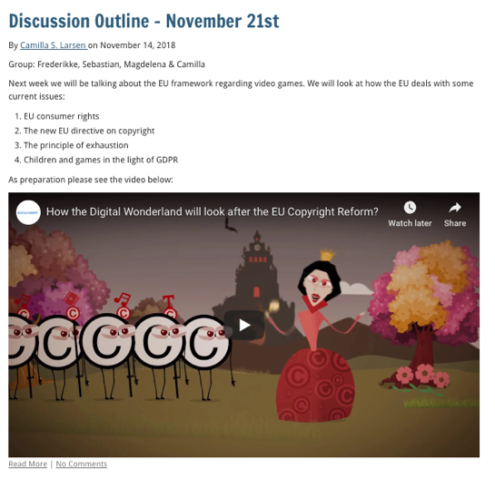

Slide 19
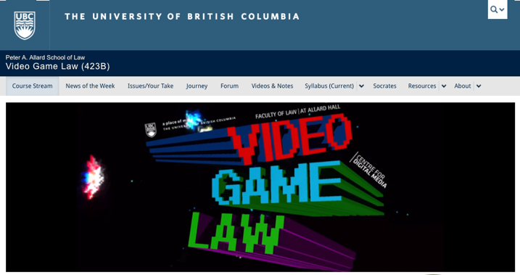
http://videogame.law.ubc.ca

Slide 20
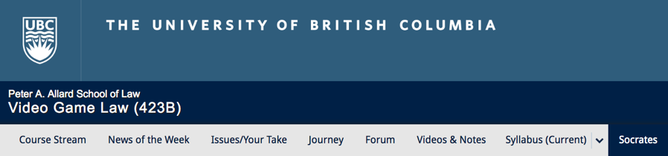

Embedded Self-Socratic A.I.(ish)

Slide 21
Questions on..
Papers ?
Participation ?
Class Presentations ?

Slide 22
Evaluation
A. Participation = 25% includes any or all of:
attendance;
class, website, forum contributions;
following “Journey” and/or “Self-Socratic” protocols.
B. Group presentation during “Discussion Hour” = 25%. Grade will be based on group preparation of their presentation & discussion outline.
C. Term Paper/Major Project (18 to 20 pages or equivalent – 5000 words – any font but comic sans) = 50%.

Slide 23
Evaluation Tips
Term paper topics need not be discussed with me, but often helpful to you if you do.
Term paper can be on your presentation topic.
Participation: In-class or other contributions, including attendance.
Group presentation need not be on that week’s topic (20 minute per student multiplier suggested 2-4 per group to 60 minute max).

Slide 24
Paper Confessional
Legal/normative reasoning/argument including footnote/bibliography support & Contribution/Move forward → 60%
Presentation including layout, headings, grammar, language/writing skills, “tightness” → 25%
Topic/Originality/Degree of Difficultly → 15%
THIS IS NOT A RUBRIC. IT IS A SELF ASSESSMENT.

Slide 25
Grades (primarily)
Paper → Quality
Participation → Effort

Slide 26
Will read: drafts…outlines…synopsis……abstracts…etc.
As late as I can…
Due last day of exams by 4:00 PM.
Hand in papers to front desk & send by email.
If email only, make sure you get acknowledgment of receipt.

Slide 27
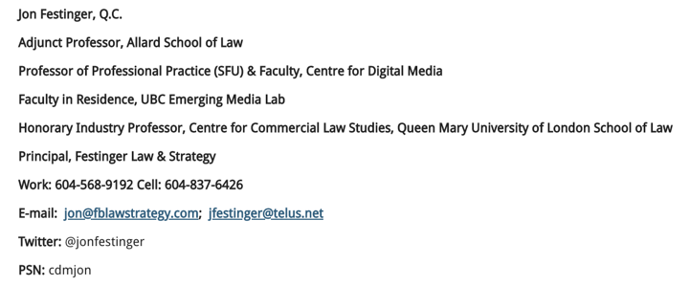
Receipt for Term Papers
Please hand in too – if not ensure you
get email confirmation from me!

Slide 28
6. WORD COUNT IS A (SORT OF) MINIMUM – NOT A MAXIMUM.

Slide 29
News of the Week

Slide 30
Yours?

Slide 31
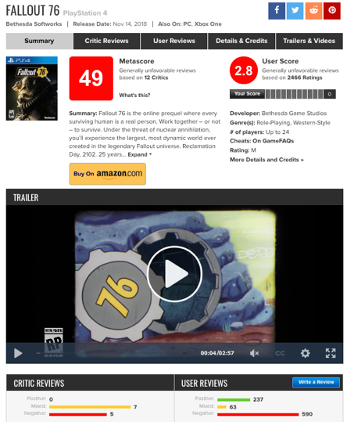

Slide 32

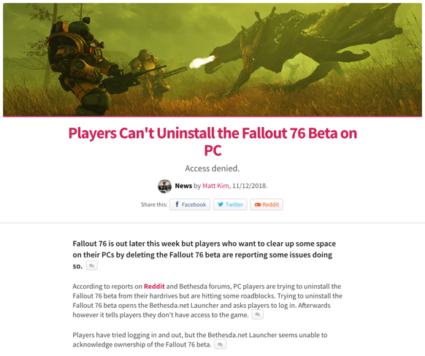

Slide 33
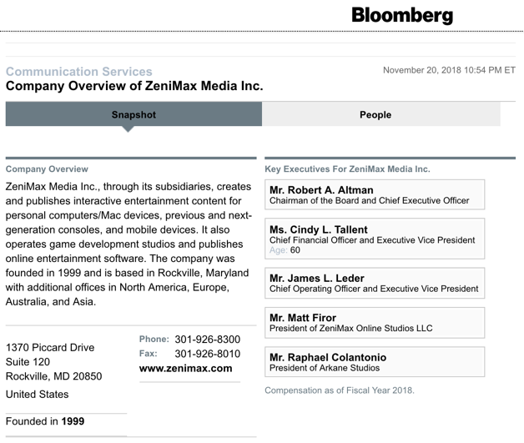

Slide 34
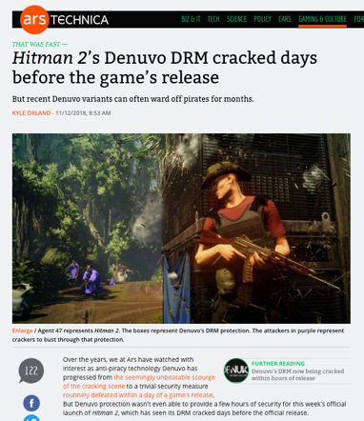

Slide 35
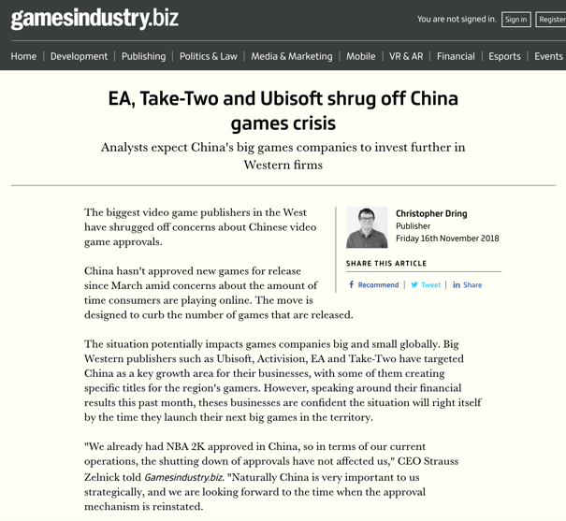

Slide 36
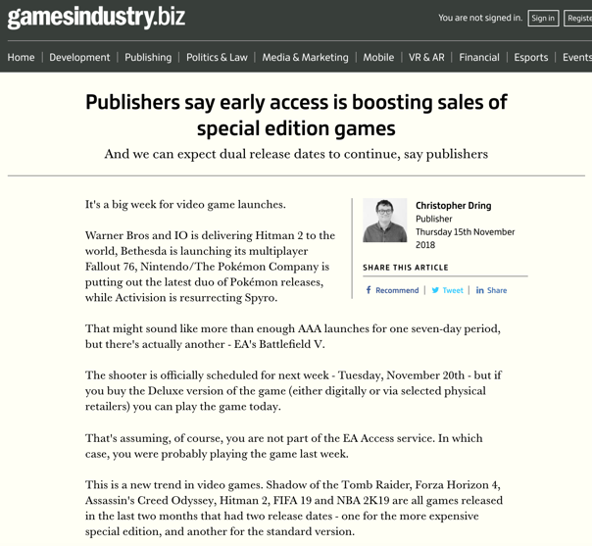

Slide 37
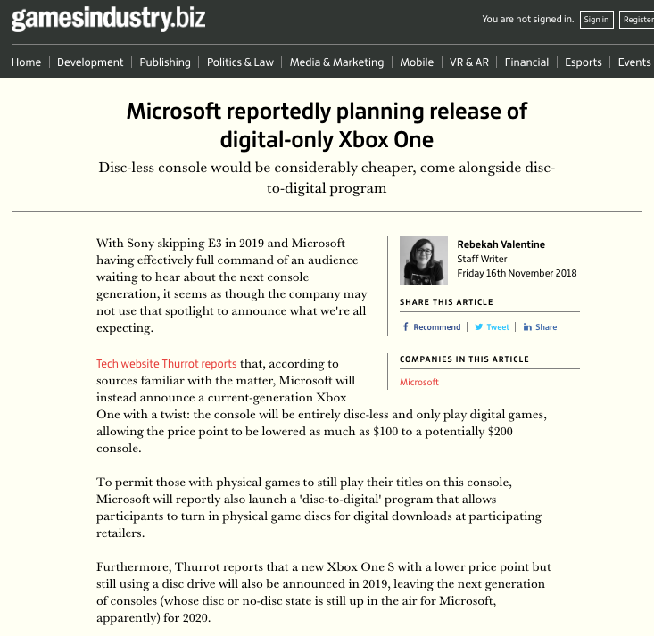

Slide 38
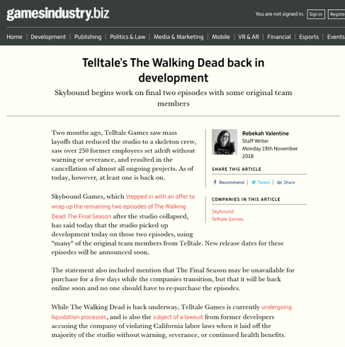

Slide 39
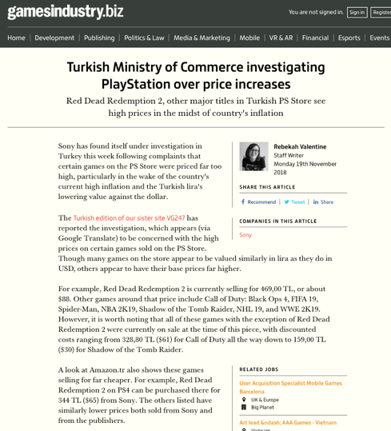

Slide 40
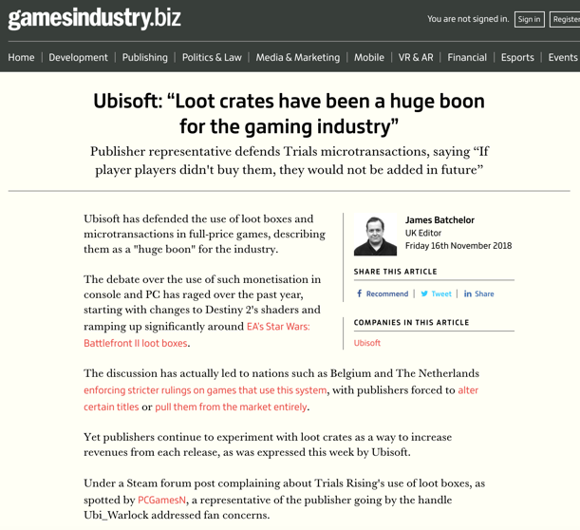

Slide 41
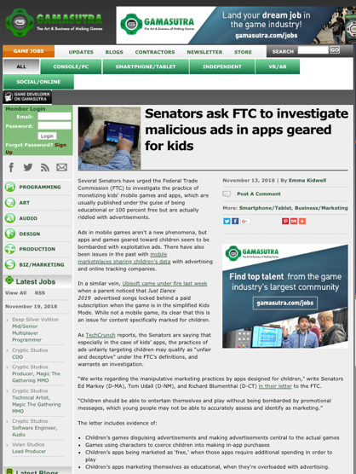

Slide 42
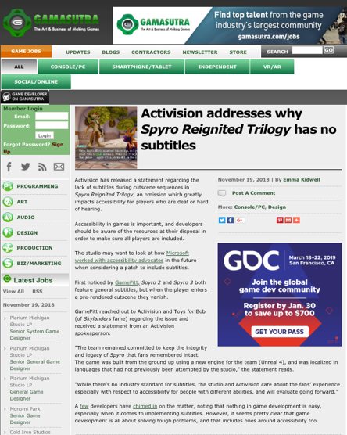

Slide 43
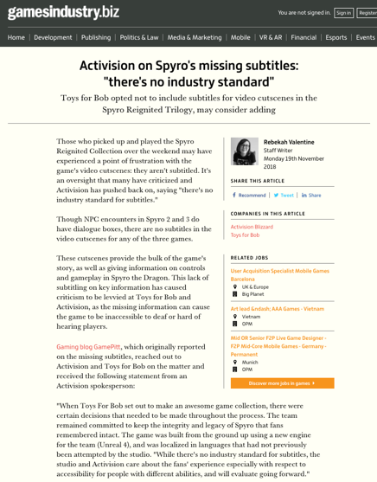

Slide 44
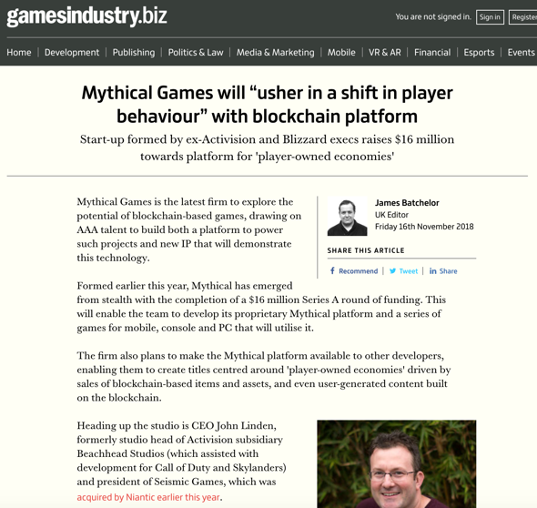

Slide 45
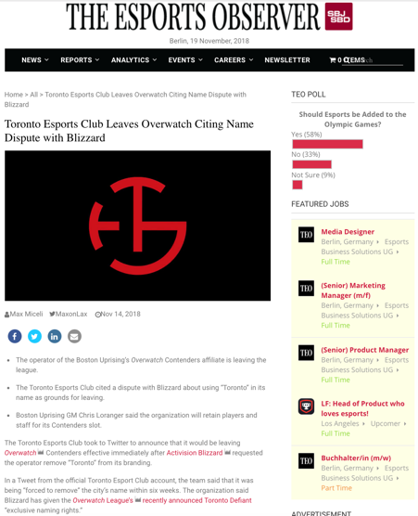

Slide 46
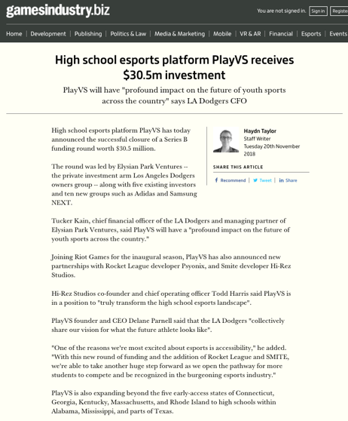

Slide 47
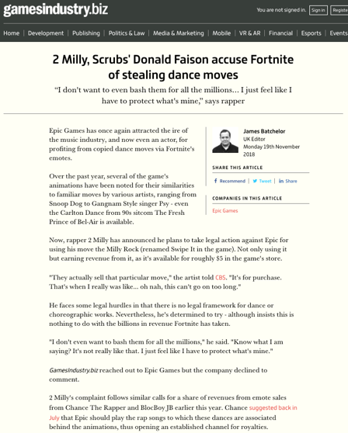

Slide 48
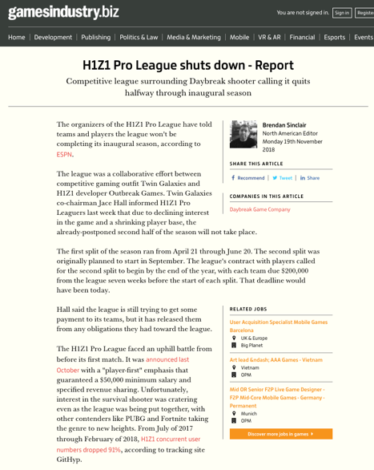

Slide 49
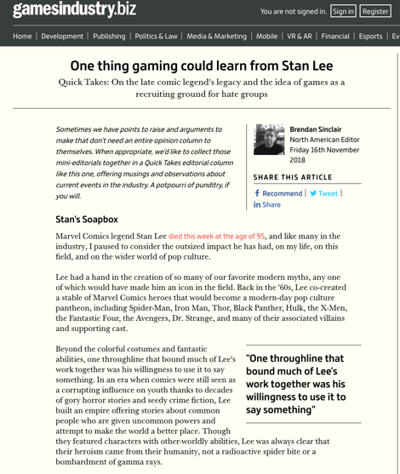

Slide 50
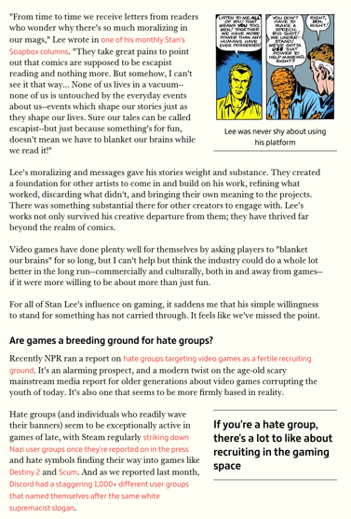

Slide 51
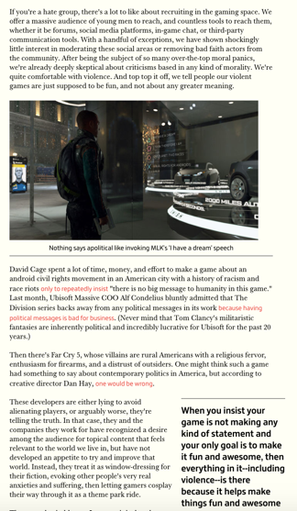

Slide 52
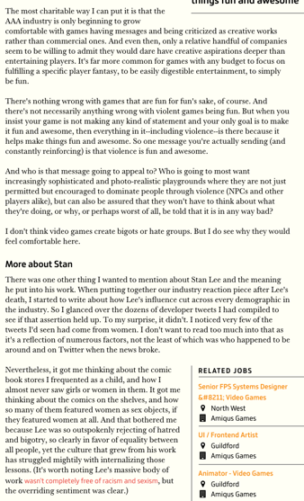

Slide 53
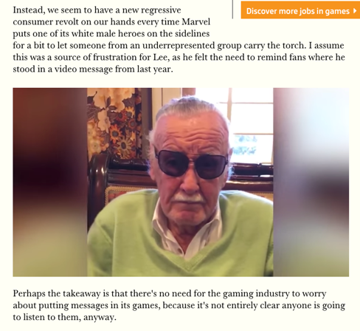

Slide 54


Slide 55

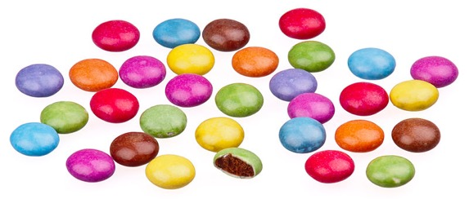
A MATTER OF PERSPECTIVE

Slide 56

Just auditing the course…

Slide 57
In learning you will teach
And in teaching you will learn
Phil Collins' Son of Man (1999)

Slide 58
Our Academic Partners

