Slide 1

From Wheelbarrows to Holodecks
Part B “Connecting” | Talk 7
Video Game Law 2013
UBC Law @ Allard Hall
Jon Festinger Q.C.
Centre for Digital Media
Festinger Law & Strategy LLP
@gamebizlaw
jon_festinger@thecdm.ca

Slide 2
Paper topics as Exam Questions
For Example:
“Both Sony & Microsoft have apparently developed used-game blocking mechanisms for their upcoming consoles. Please advise the on the legalities of their possible implementations, paying particular attention to Video Game Law cases involving interoperability as well as competition law/anti-trust questions. Consider also the law relating to hardware and software mods, as well as such freedom of expression/speech issues as you may be able to identify.”
“Sony patents tech to block used games”:
http://www.gamespot.com/news/sony-patents-tech-to-block-used-games-6401992
“GameStop warns Microsoft on rumored used game-blocking console”: http://arstechnica.com/gaming/2013/02/gamestop-warns-microsoft-on-rumored-used-game-blocking-console/

Slide 3
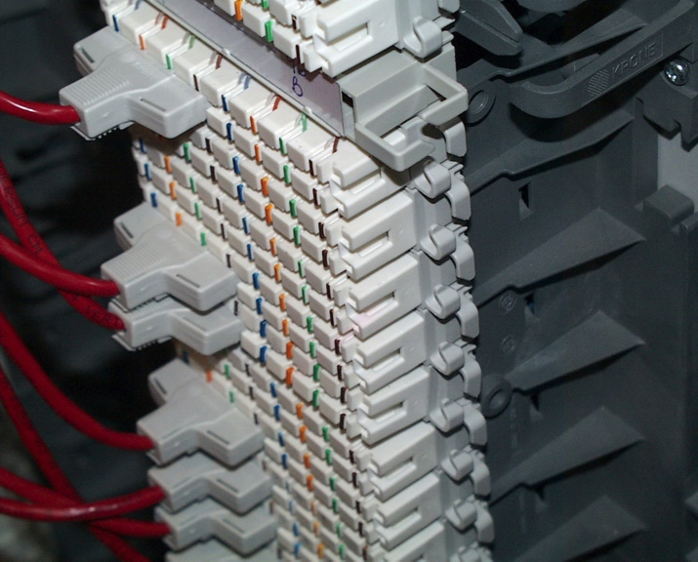
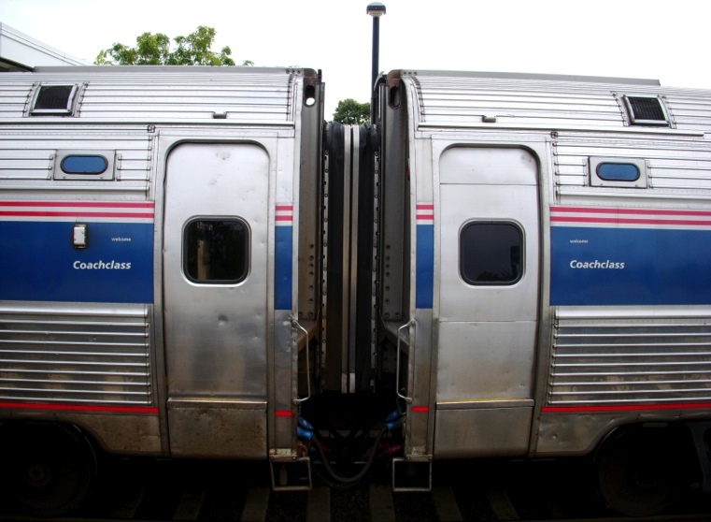
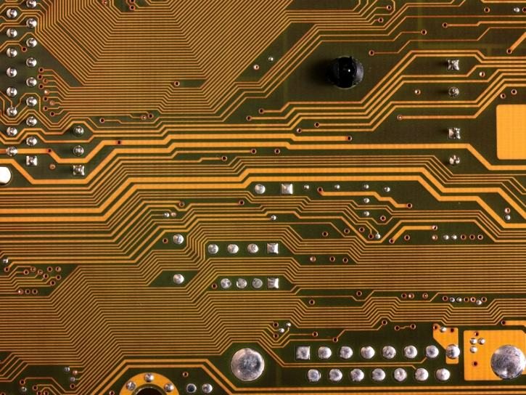
Where we are…(in the course)
4th & final talk under the “Connecting” rubric…
Creating>>>Connecting>>>Controlling>>>Conciliation
Today we focus on the technology that connects…

Slide 4
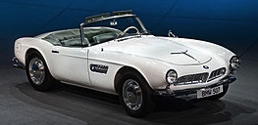
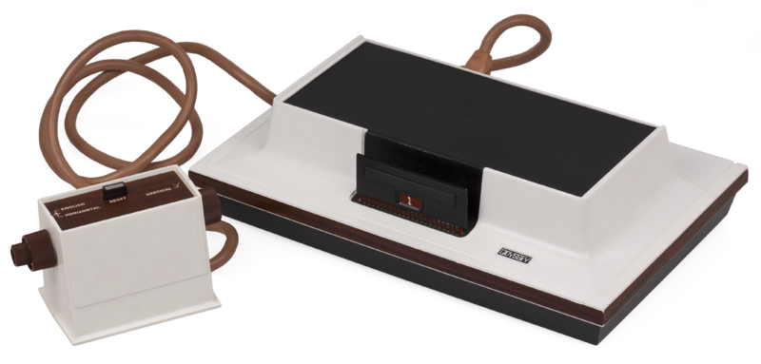
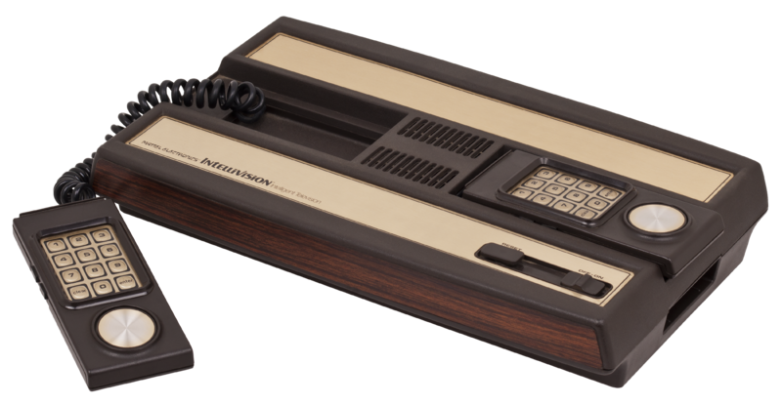
George Santayana played video-games?
“Those who cannot remember history are doomed to repeat it”
So we begin with the “507 patent”
No, not that 507…..
…“U.S. Reissue Patent No. 28507”
Our tale begins with Magnavox v. Mattel 1982 U.S. Dist. LEXIS 13773 (N.D. Ill.)

Slide 5
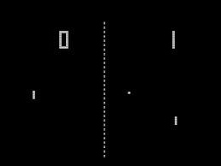
The Magnavox “apparatus”…
“The apparatus generated a display on the screen comprising a television picture including a symbol on the right side of the screen representing a first player, a symbol on the left side of the screen representing a second player, and a symbol which moved across the screen representing a ball. Player controls were provided so that each human player could move his corresponding player symbol on the face of the television screen. Each human player manipulated his corresponding player symbol to intercept the path of the ball as it moved across the screen. When the player symbol intercepted the ball symbol, i.e., two symbols appeared to be coincident on the screen, the motion of the ball was changed.”
Sounds like…??

Slide 6
Chronology
1962: Spacewar! released on DEC PDP-1 mainframe @ MIT
...’507 from experiments done by Rusch, employee of Sanders Associates in 1967/68
1971: Sanders & Magnavox enter into exclusive license
1972: Magnavox Odyssey introduced (analog circuitry)
1975: Atari introduces Pong game console for home use (analog)
1976 General Instruments introduces TV game microprocessor (digital circuitry)
Magnavox sues Atari for patent violation & infringing concept of electronic ping pong (settled by Atari becoming Magnavox exclusive licensee)
1978 Magnavox Odyssey 2 has a microprocessor (digital)
1979 Mattel introduces Intellivision with General Instruments microprocessor (digital). Magnavox sues Mattel.

Slide 7
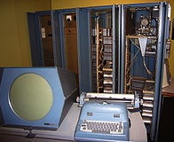
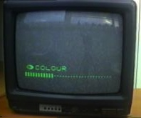
Court decision…
No distinction between analog and digital: “I regard analog and digital circuitry as two means which are interchangeable largely, which are equivalent, and which are, therefore, essentially the same means for achieving substantially the same results in substantially the same way.”
Mattel argued its console was not based on ’507 but on computer prior art, Space War!
Court noted PDP-1 was 6’ tall by 7’ wide, & cost approximately $120K. Court found for Magnavox: “…it is clear from the evidence that Mattel did not in fact follow the prior art but, instead, followed developments in the television game industry, an industry which was created because of the work done at Sanders in developing the first television games and an industry which expanded and developed and become economically viable largely because of television games which followed the teachings of the ’507 Patent.”

Slide 8
So…what might we be missing? Part 1
Legal bifurcation of Computer Games & Console Games
Consequences?
“Those who cannot remember history are doomed to repeat it”
Console/TV v. Computer v. Telephone/Mobile
…Easy to trip up?
Broadcasting Act: “broadcasting” means any transmission of programs…by …means of telecommunication for reception by the public by means of broadcasting receiving apparatus…“program” means sounds or visual images…intended to inform, enlighten or entertain…”

Slide 9
An Example: So…what is W.O.W.?
Is “it” Broadcasting?
International issue
Gatekeeper political/legal reality
Canadian example:
“broadcasting” means any transmission of programs…by…means of telecommunication for reception by the public by means of broadcasting receiving apparatus…
“program” means sounds or visual images, or a combination of sounds and visual images, that are intended to inform, enlighten or entertain…
(Note: 1. CRTC exemption order; & 2. SCC has held ISP’s are not broadcasting. Is W.O.W. an ISP or something else? See SCC in Rogers v. SOCAN – streaming on demand = communication to the public)

Slide 10
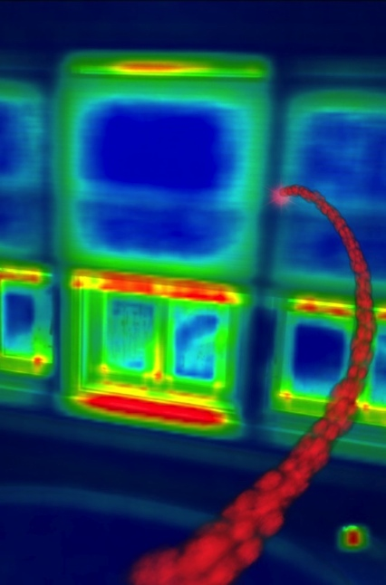
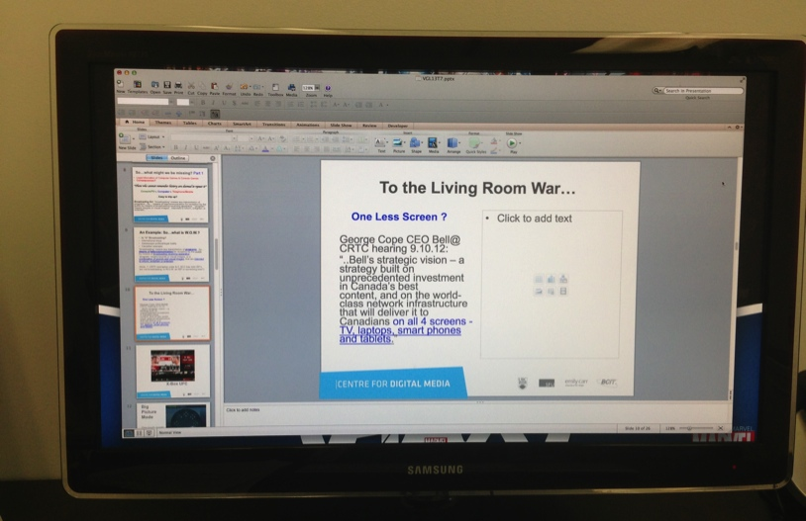
To the Living Room War…
One Less Screen ?
George Cope CEO Bell@ CRTC hearing 9.10.12:
“..Bell’s strategic vision – a strategy built on unprecedented investment in Canada’s best content, and on the world-class network infrastructure that will deliver it to Canadians on all 4 screens - TV, laptops, smart phones and tablets.”

Slide 11

The Salvos
X-Box: Netflix (1st); UFC; “720”
Steam-Valve: Big Picture Mode (1touch toggle game to browser; Steam Box – see “How Valve’s Steam Box will reinvent the game console as you know it”http://www.theverge.com/2013/2/6/3958162/valve-steam-box-cake
Apple (ecosystem): App store; Apple TV; Airplay
Ouya: Android game-box
Sony: PlayStation 4; cloud-gaming
Google: Glass + “Ingress”?

Slide 12
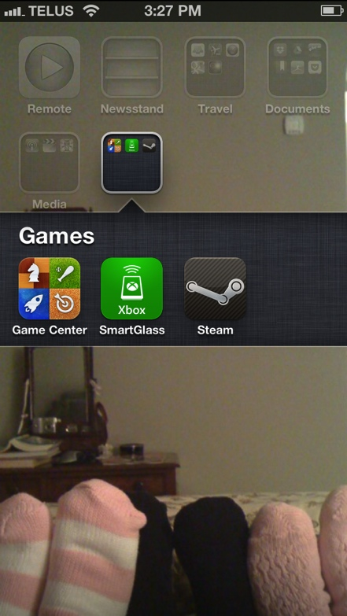
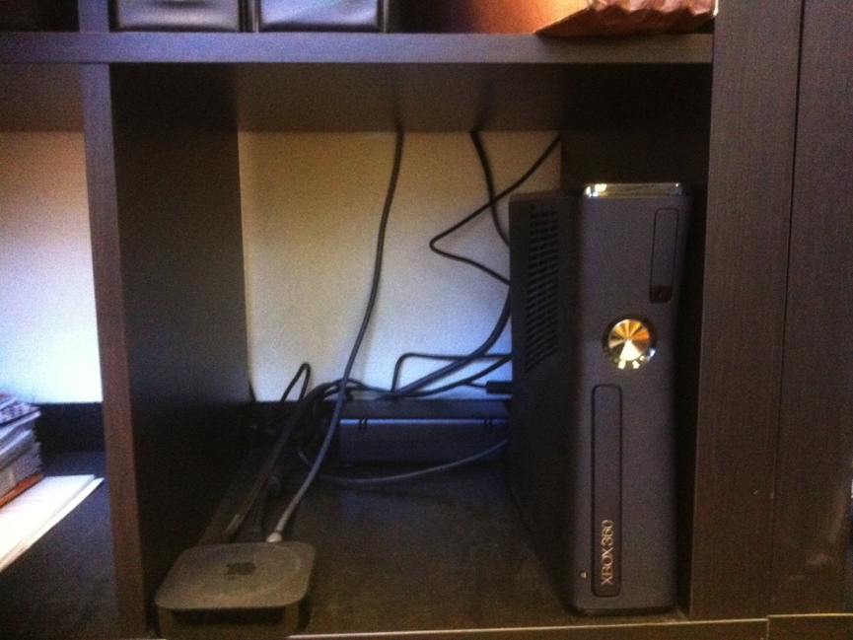
Ecosystem v. Inter-op: My Surprising Reality
Home
Telco IPTV
Windows PC w/Steam
Xbox 360
Apple TV
Mobile
iPhone (Game Center)
Steam App
Xbox App
WIFI anywhere
iPad
Office
Cord cutter
MacBook Pro w/Steam
Xbox 360
Apple TV
Killer app wish = TiVo functionality

Slide 13
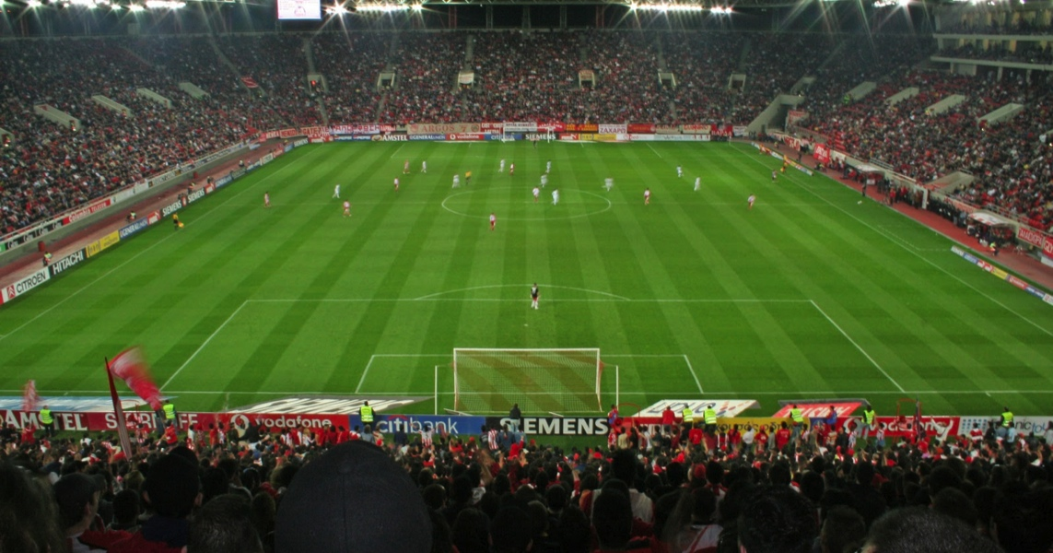

Test Case: Y-Sports?
Most compelling & accessible measure of living room interactivity
LIVE
Communal/tribal
Family embedded
Loyalty/passion/meaning/connection based
Infinite information/data & limitless appetite for it

Slide 14

Sports & Media
1939 New York Worlds Fair
August 26, 1939: first televised major league baseball game on
W2XBS (later WNBC). Red Barber called the game.
“..the World's Fair became the catalyst for the historic broadcast. The television was one of fair’s prize exhibits, and organizers believed that the Dodgers-Reds doubleheader…. was the perfect event to showcase America’s grasp on the new technology.” (Source History.com)
Footnote: Canadian Admiral v. Reddifusion Inc. [1954] Ex. CR 382: Live rebroadcast through cable of a Montreal Allouetes football game. Was showcase for sale of cable service to consumers. Court held no fixation in live feed of game

Slide 15
Sports Example Wish-list
1. VIRTUAL ARENA EXPERIENCE
“Who is in the crowd?”
“Pick your seat”: view the game from any any seat/any angle (emulated?).
Live Shared experience (Hangout). Friend and rival group options.
Scalability of closed to contact ranging to fully open (E.g. game v. between periods).
Fully interactive: voice, text, content sharing, search & content creation.
Play crowd games, trivia.
Infinite inputs including alternate audio feeds (plus “do your own”) & bonus video feeds (E.g. USTREAM’s and/or extra broadcast cameras – “you compose your own “broadcast”).
Live feedback (Twitter, text, Skype etc.) loops to teams, leagues, (players), (coaches) - the “techno heckle”.
2. “I KNOW SPORTS BETTER, LET ME PROVE IT.”
Infinite replays from infinite inputs.
Coaching tools (virtual Telestrator ).
Library of games & plays (by team, year & player).
Recreate or watch the game live in EA NHL 14 (watch replays in 1st person as any player).
3. SECOND SCREEN STUFF (Sx3)
Useable live in-arena on a tablet.
Full live stats including distance skated, shot-speeds, goalie.
Gamification for every possible challenge/bet.
Create your own sports music-video.

Slide 16
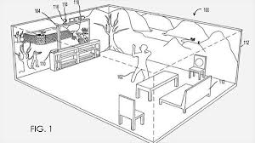
Advanced Wish List
Holographic immersive viewing
Remote audio crowd feedback fed back into arena (If Porsche can enhance engine sounds, why not crowd sounds as determined by fair standards by the Leagues)
Microsoft “Holodeck” Patent

Slide 17
Selected Issues…
Sponsor conflicts & exclusivities (rights-holder) especially audience/crowd - sourced input
Legal Ratatouille: the small version
Second screen - non-rights holder IP strategies and limits
Screen merge issues: Expression rights v. safe harbor/takedown - To edit or not to edit? – Who is the ISP?; Who is the content provider?
Multiple input dilemma = split legal approach for split screens?; lowest common denominator?
Idea/expression dichotomy “threshold problem”: Stating the obvious – the amount of protected expression is directly proportional to the accessibility of digital tools.
& “Why Johnny can’t stream: How video copyright went insane” issues - awesome James Grimmelmann article: http://arstechnica.com/tech-policy/2012/08/why-johnny-cant-stream-how-video-copyright-went-insane

Slide 18

THAT WAS THE EASY STUFF…
* 1st Blog post: What’s next for games?...Per Tyler - synthetic (as opposed to artificial) reality…with sophisticated inputs/outputs.
* “Are You Living in a Computer Simulation?” Nick Bostrom http://www.simulation-argument.com/simulation.html
Are we are turning life into a game(gamification)
*ARG’s e.g. EA’s 2001game “Majestic”: tagline = “It Plays You”; by phone, email, instant messaging, fax, and dedicated websites.
* Film Meme: “Inside the Game”
Tron (1982) & Tron Legacy (2010); Wargames (1983);
eXistenZ (1999); The Thirteenth Floor (1999);
The Matrix (1999);Avalon (2001); Gamer (2009);
Surrogates (2009); Wreck-It-Ralph (2012).

Slide 19
WHERE ARE WE NOW? A
3D Printing:
“What's the Deal with Copyright and 3D Printing?” (Public Knowledge) http://publicknowledge.org/Copyright-3DPrinting
Virtual Reality:
“Virtual reality is going to be a platform…” says Palmer Luckey “Oculus Rift and the Virtual Reality Revolution”http://www.gamesindustry.biz/articles/2012-12-18-oculus-rift-and-the-virtual-reality-revolution
Virtual Currency:
“Acquisition, retention and monetization in social and virtual spaces”http://vili.lehdonvirta.com/files/pbuc8001/ARMSFinalReport2012.pdf
“FarmVille 2 Ain’t No Game, It’s the Ultimate Perpetual-Motion Money Machine” http://www.wired.com/gamelife/2012/09/farmville-2/

Slide 20
WHERE ARE WE NOW? B
Augmented Reality:
“Sony's EyePad patent shows off a controller that can bring real-world items into games”http://www.theverge.com/2013/2/19/4005890/sony-eyepad-controller-patent-shows-off-3d-mapping-cameras
Google Glass:
“I used Google Glass: the future, but with monthly updates”http://www.theverge.com/2013/2/22/4013406/i-used-google-glass-its-the-future-with-monthly-updates
Neurogaming:
“Throw Trucks With Your Mind using this Kickstarter project” http://indiegames.com/2013/02/throw_trucks_with_your_mind_us.html

Slide 21
WHERE ARE WE NOW? C
Lifestream:
“The End of the Web, Search, and Computer as We Know It”http://www.wired.com/opinion/2013/02/the-end-of-the-web-computers-and-search-as-we-know-it/
Wifi v. Cellular Telephony:
“Open Wireless vs. Licensed Spectrum: Evidence from Market Adoption” Yochai Benkler (Harvard Journal of Law and Technology)
http://cyber.law.harvard.edu/publications/2012/unlicensed_wireless_v_licensed_spectrum
The “Cloud”:
“International Jurisdiction over Copyright Infringements in the Cloud”
http://papers.ssrn.com/sol3/papers.cfm?abstract_id=2181671
Google “self-driving” cars:
“Google expects its self-driving cars to be ready in three to five years”http://www.theverge.com/2013/2/11/3975988/google-expects-its-self-driving-cars-in-three-to-five-years

Slide 22
Made More Complex By…
The challenges of anonymity:
“The problems with anonymous trolls and accountability in the digital age”http://thenextweb.com/insider/2012/10/27/the-problems-with-anonymous-trolls-and-accountability-in-the-digital-age/
The complexities of virtual goods:
“Can you actually own the Sword of Azeroth?” http://www.lexology.com/library/detail.aspx?g=34810a92-9fc4-41bb-8541-ca7ae2392dcf
The (Software) Patent Problem:
“Let’s Go Back to Patenting the ‘Solution,’ Not the ‘Problem’ by Mark Lemley http://www.wired.com/opinion/2012/10/mark-lemley-functional-claiming/
“The Patent, Used as a Sword” http://www.nytimes.com/2012/10/08/technology/patent-wars-among-tech-giants-can-stifle-competition.html?pagewanted=all&_r=0

Slide 23
Made More Complex By…(con’d)
Authorship Issues (of course): “Whose Game Is This Anyway? - Negotiating Corporate Ownership in a Virtual World” by T.L. Taylor (N.C. State) http://www.digra.org/dl/db/05164.58571.pdf
All contributing to…
Legal Ratatouille:
THE BIG VERSION

Slide 24


Slide 25
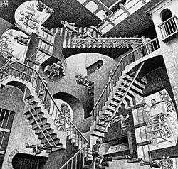
The Escher Conundrum
Escobedo v. THQ, Inc.
Tattoo artist sues THQ, makers of UFC video game for copyright infringement. Artist claims to have tattooed an originally created lion on Carlos Condit’s body. Escobedo and Condit had no written agreement.
See: “Copyright in Tattoo Case”
http://www.citmedialaw.org/blog/2012/copyright-tattoo-case-escobedo-v-thq-inc

Slide 26


Eve Online
“Due to the game's focus on freedom, consequence, and autonomy, many behaviours that are considered griefing inmost MMOs are allowed in Eve. This includes stealing from other players, extorting, and causing other players to be killed by large groups of NPCs.” (source: Wikipedia)
“In An Age of Free-to-Play, EVE Online Sets Records”http://www.forbes.com/sites/insertcoin/2012/12/17/in-an-age-of-f2p-eve-online-sets-records/
“EVE Online Workshop Submission Deadline Extended” http://eveonline.gamescholarship.org/
“How the Battle of Asakai Became One of the Largest Space Battles in Video Game History”http://io9.com/5980387/how-the-battle-of-asakai-became-one-of-the-largest-space-battles-in-video-game-history

Slide 27

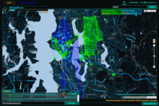
“Ingress” (Majestic2?)
“Inside Ingress, Google’s Augmented Reality Android Game” http://www.geekosystem.com/google-ingress-review/
“Augmented Reality Game Gets Player Busted: The First Of Many?”http://readwrite.com/2012/12/11/augmented-reality-game-gets-player-arrested-the-first-of-many
“Why Google's Ingress game is a data gold mine”
http://www.newscientist.com/article/mg21628936.200-why-googles-ingress-game-is-a-data-gold-mine.html

Slide 28
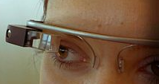
Add it up….
Ingress + Google Glass + Google Car
= Merger of real & virtual worlds
Notion that real laws shouldn’t apply to virtual world seem antiquated…where is that “magic circle” now?
But which laws & how to apply them???

Slide 29


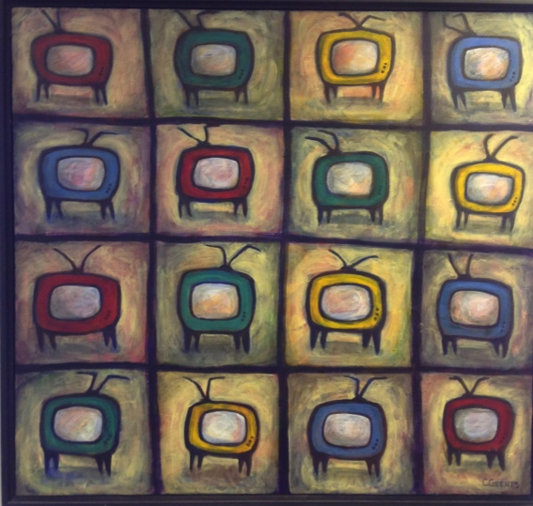
The Wheelbarrow & the Screens:
Direction reversal - bringing digital fantasy to reality?

Slide 30
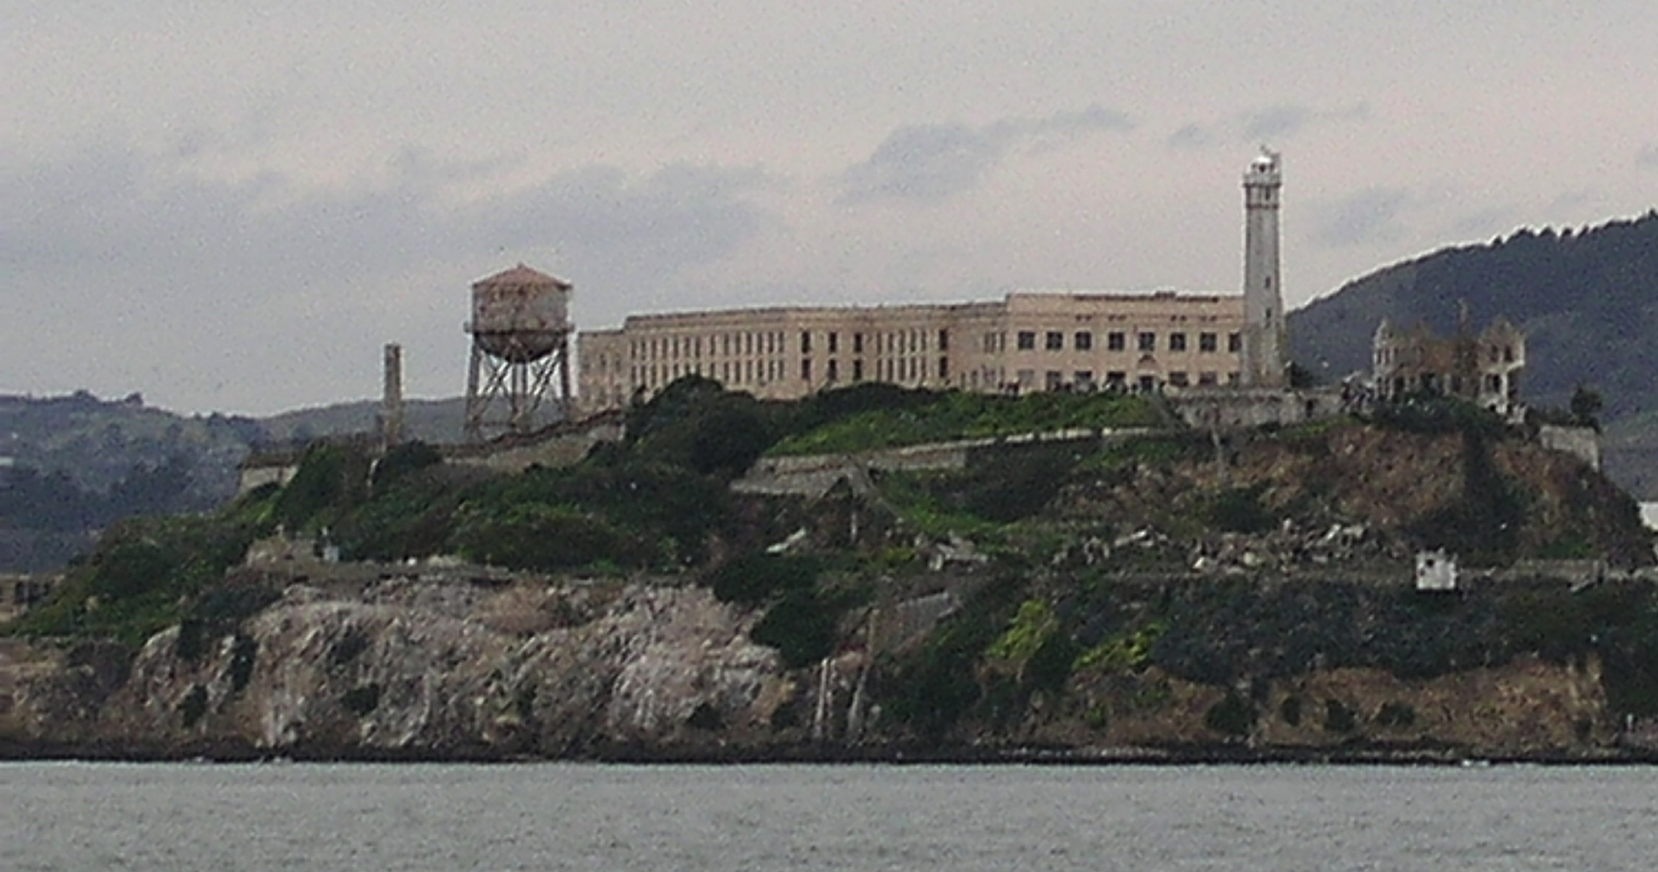
Next Class: “Part C. Controlling” begins

Slide 31
Our Academic Partners

