Slide 1

Game Development & Modification Panel
Gaming Panel
“Creation Nation: IP & The Rise of Prosumerism”
6th Annual Symposium
Penn Law Intellectual Property Group
March 29, 2013
Jon Festinger Q.C.
Centre for Digital Media
Festinger Law & Strategy LLP
@gamebizlaw
http://blogs.ubc.ca/videogamelaw/
jon_festinger@thecdm.ca

Slide 2

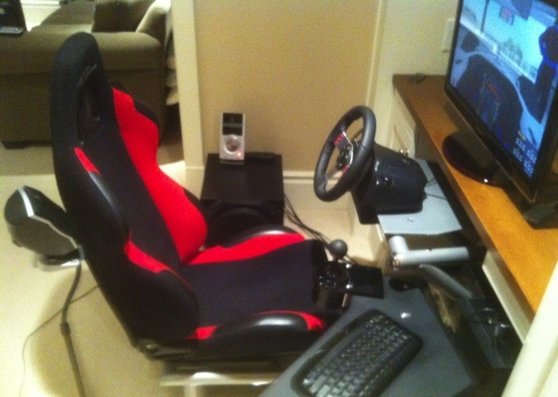
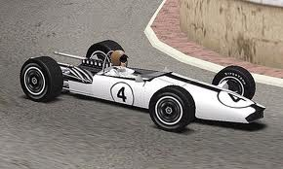
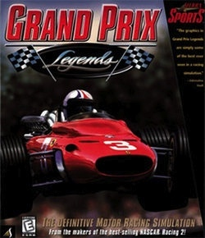
Grand Prix Legends & mods:
A personal history…

Slide 3
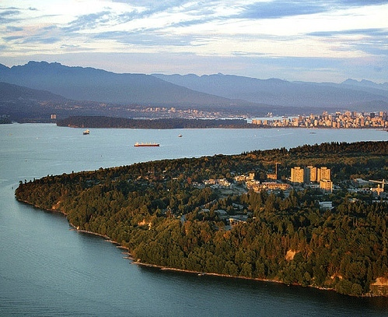

Education as modding
Building on &
citing the work
of others

Slide 4
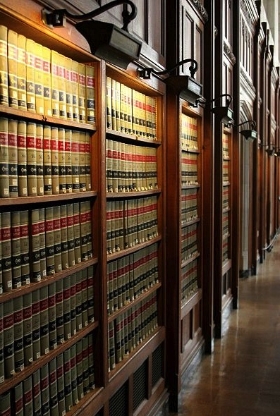
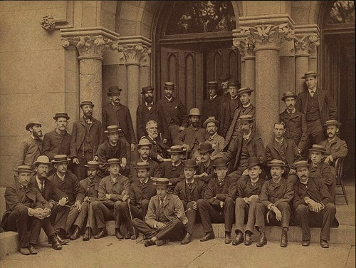
The Common Law as Modding

Slide 5
Conundrum 1: Memes of “CREATIVITY”
A. The Unique Gift (aka “Hollywood”)
* “The creative is the place where no one else has ever been. You have to leave the city of your comfort and go into the wilderness of your intuition. What you’ll discover will be wonderful. What you’ll discover is yourself.”
* Creativity as uniquely personal (or not) impacts beliefs about copyright & IP – consequences of “specialness”
Copyright literalists’ adopt “self” generated model of creativity? “Connection-ists” adopt open source model?
* Personal creation mythology deeply rooted’: “And G-d said: ‘Let us make man in our image, after our likeness;”(Genesis, Chap. 1 Verse 26)

Slide 6
Conflicting memes of “CREATIVITY” (con’d)
B. “Everything is a ReMix”
“If you wish to make an apple pie from scratch, you must first
invent the universe.” – Carl Sagan
“There is no doubt that creativity is the most important human resource of all.
Without creativity, there would be no progress, and we would be forever
repeating the same patterns.” - Edward de Bono
“The great driver of scientific and technological innovation [in the last 600 years
has been] the increase in our ability to reach out and exchange ideas with other
people, and to borrow other people’s hunches and combine them with our
hunches and turn them into something new.” – Steven Johnson “Where Good
Ideas Come From: The Natural History of Innovation”(book)..also see:
http://www.youtube.com/watch?feature=player_embedded&v=0af00UcTO-c#!
“All Creative Work is Derivative” – Nina Paley
http://blog.ninapaley.com/2010/02/09/all-creative-work-is-derivative/
“Creativity is just connecting things.” - Steve Jobs in a Wired Magazine
interview (Feb. 1996) http://www.wired.com/wired/archive/4.02/jobs_pr.html

Slide 7
Conundrum 2: Idea/Expression Dichotomy
Once upon a time…a long time ago……
Private Public
Idea Expression

Slide 8
(TODAY) IN THE DIGITAL WORLD
idea
private
EXPRESSION
PUBLIC

Slide 9
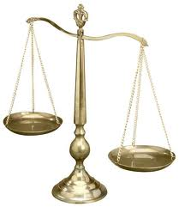
Not Failure of Law – Failure of Balance
Way to Rebalance:
BY acknowledging Creative Rights….
Mod
Use
Share
AS PRIVATE RIGHTS OF INDIVIDUALS

Slide 10
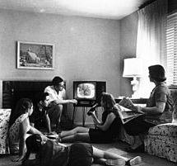
Conundrum 3: “Mrs. Smith” revisited
THE “MRS. SMITH” PRINCIPLE
Human Instinct to Censor?
“What matters is not what Canadians think is right for themselves to see. What matters is what Canadians would not abide other Canadians seeing because it would be beyond the contemporary Canadian Standard of tolerance to allow them to see it.” (1985 SCC Dickson CJ Towne Cinema v. The Queen )
THE “MRS. SMITH” PRINCIPLE REVISITED
WE DON’T ACTUALLY ACCEPT EACH OTHERS CREATIVITY & ABILITIES (or at least not easily; at least not that tolerantly)

Slide 11
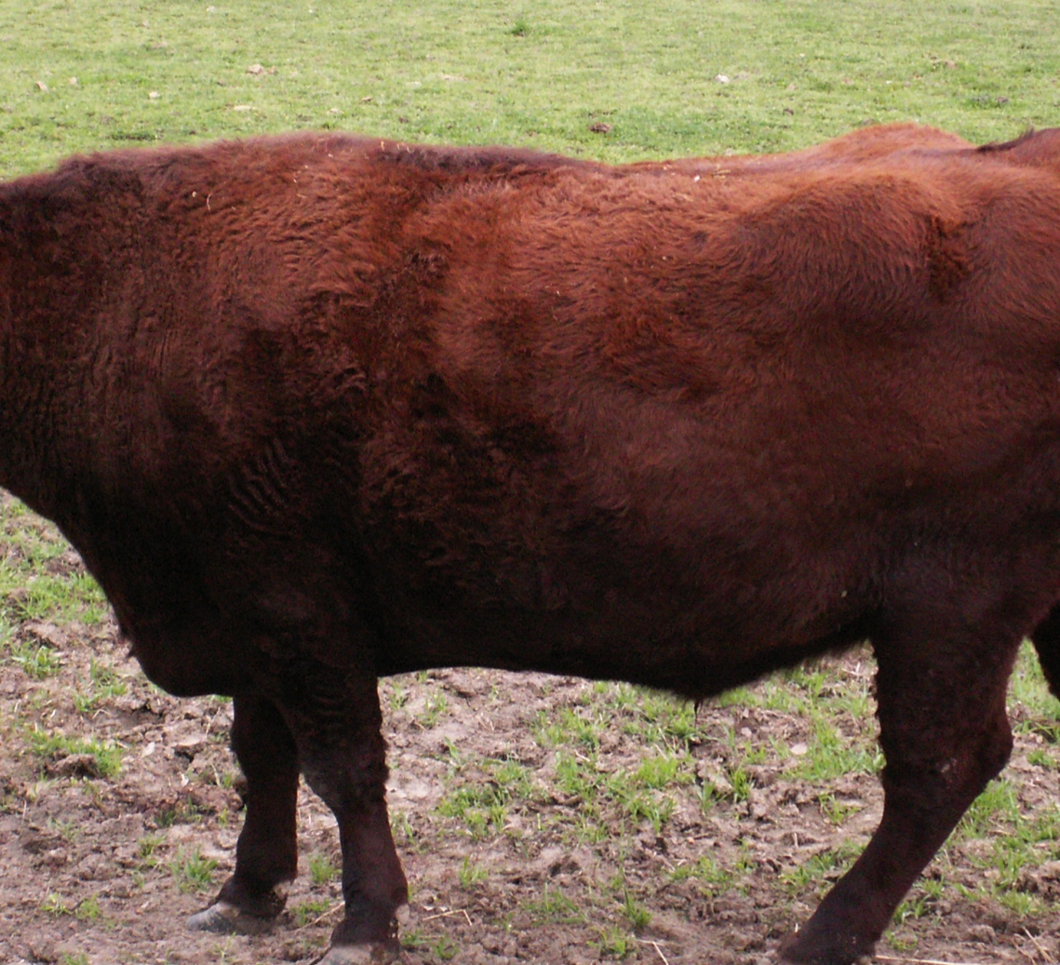
AND SO WE HAVE ARRIVED AT….

Slide 12
Finding Answers: Copyright as part of the trajectory of creative freedoms?
* Star Chamber (UK) abolished July 1641 - de facto cessation of censorship;
replacement of Royal with Parliamentary censorship.
*Licensing Order of 1643: Parliament required authors to have a government
license before a work could be published.
* “Areopagitica”: “A speech of Mr. John Milton for the Liberty of
Unlicensed Printing to the Parliament of England”; 1644.
“Licensing of the Press Act 1662”; "An Act for preventing the
frequent Abuses in printing seditious treasonable and unlicensed Bookes
and Pamphlets and for regulating of Printing and Printing Presses.”
Restrictions enforced by the Stationers' Company, a printers guild with the
exclusive power to print—and the responsibility to censor—literary works.
Then “The Statute of Anne” 1710 moved control to the publishers/
authors….and there we more or less have stayed until now.

Slide 13
Finding Answers:
The Cases Neither Allow Nor Prohibit Modding
Micro Star v. FormGen 1998 USCA
2. Davidson & Associates, Inc. v. Internet Gateway 2005 USCA (D&A = Blizzard):
3. iRacing v. Robinson (2007 Mass. Dist. Ct.)
4. MDY Industries, LLC v. Blizzard Entertainment, Inc. (2010 USCA):

Slide 14
Cases Neither Allow Nor Prohibit Modding (con’d)
Creativity is never in issue in any of the cases
Copyright Law directly relevant in Microstar (& Galoob “Game Genie”) only - no contractual nexus - sole “copyright only” case.
“Fair Use” to create mods question avoided by:
Contract Law (Davidson, iRacing & MDY all involved EULA, ToS or ToU terms & obligations, or DMCA).
Nothing creative in what Micro Star did – they did not create a mod – they usurped mod creators without permission
Conclusion: No current precedent that game mods are not “Fair Use”.
Cases can be interpret/edunderstood/rationalized with a pro User Rights/Gamer Rights lens (not pro-developer)

Slide 15

The truth in ‘tone’…
Audio of the June 20, 2005 oral argument in 8th Circuit Court of Appeal in Blizzard v. BnetD (Davidson) @ 32:40 – 33:05: “This case does not involve new creation. There may be a case that does. This isn’t it…”

Slide 16
Possible Right to Mod Methods (A):
Revert to No Protection for Games
“Games and Other Uncopyrightable Systems” by Bruce Boyden
http://www.georgemasonlawreview.org/docBoyden_18-2_2011.pdf
“Games therefore pose a number of challenges for copyright and patent law. Yet to date, intellectual property doctrine and scholarship has not really grappled with the slippery nature of games. Indeed, copyright has developed a very simple black-letter rule to handle them: games are not copyrightable. That rule begins to fall apart on close examination, however. It turns out that while games per se are not copyrightable, most of their constituent elements are: the board, pieces, cards, and even the particular expression of the rules. What could be the purpose of such a rule?”
Was Atari v. Oman (“Breakout” - 1992 USCA) wrong???

Slide 17
Possible Right to Mod Methods (B):
Raise Thresholds for IP Protection
“Personal Genius” theory of creativity undermined by low level of originality in copyright ?
See “The Innovation Dilemma: Intellectual Property and the Historical Legacy of Cumulative Creativity” - Graham M. Dutﬁeld and Uma Suthersanen (U.K.): “The downside of having a wide capacity to protect, however, is that copyright law does manage to ensnare essential information and elements that form a part of the knowledge base, which in turn impedes the progress of follow-on innovators who must build upon such vital building blocks.” http://www.academia.edu/860340/

Slide 18
Possible Right to Mod Methods (C):
Fair Use/Dealing – “User Rights”
Recent SCC “User” paradigm shifts
USERS ARE CREATORS TOO
“The August “Copyright Pentalogy” & previous cases
Moving from fair dealing as an exception to copyright infringement
towards proactive “User Rights”
Right to longer iTunes previews
Tech Neutrality
Fair Dealing is to be assessed from the point of view of the purchaser/user
“Research” need not be associated to traditional intellectual pursuits

Slide 19
Possible Right to Mod - Methods (D):
“Context Shifting”
WHAT WOULD THE WORLD LOOK LIKE WITHOUT Sony v. Universal ???
U.S. Supreme Court 464 U.S. 417 (1984)
Why can’t everything (digital) be seen as a form of tool enabled “time-shifting”?
Key Factors: a. enlarged audience; b. did not impair copyright value

Slide 20
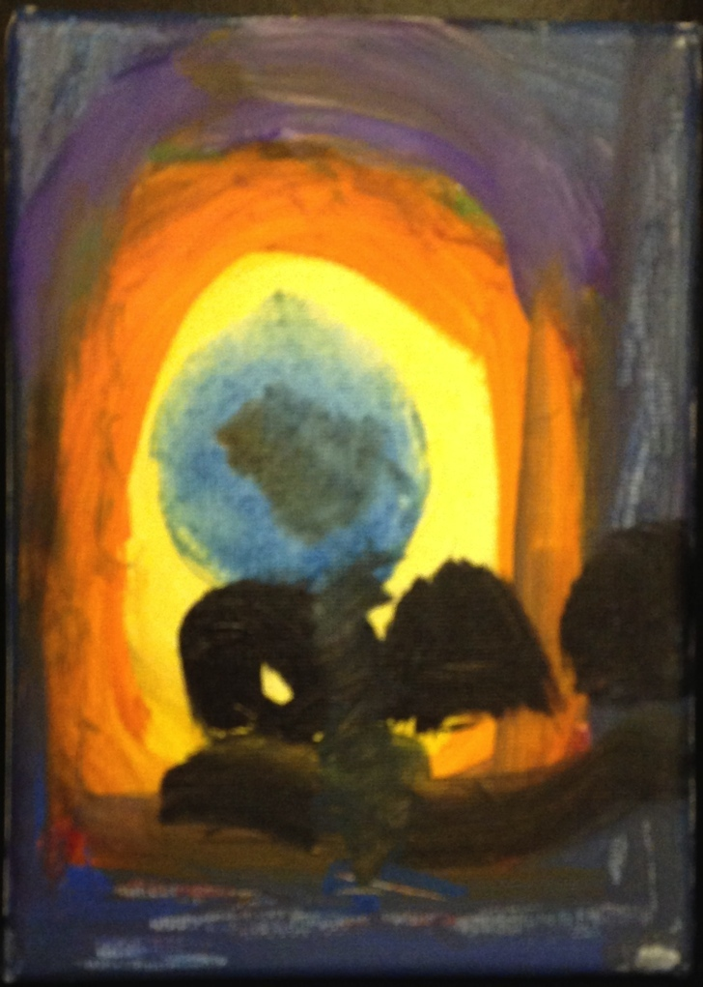
Possible Right to Mod Methods (E):
Right to Mod/CREATe
Right to CREATe-Mod as a creative/expressive right rather than an IP right/protection?
Can we...evolve a single standard:
For CREATORS as USERS, &
For USERS as CREATORS
…….to match reality…..
“Right to CREATe”
Not “Right in the Creation”

Slide 21
Our Academic Partners

