Slide 1

Video Game Law (423B) (Prof. Jon Festinger, Q.C. )
Presented by Anoop Desai, Director Business Affairs
October 23, 2013
Notes:
Work experience?
Theory is covered
I Live btwn the 2
Differences btwn 2 create some interesting business challenges

Slide 2

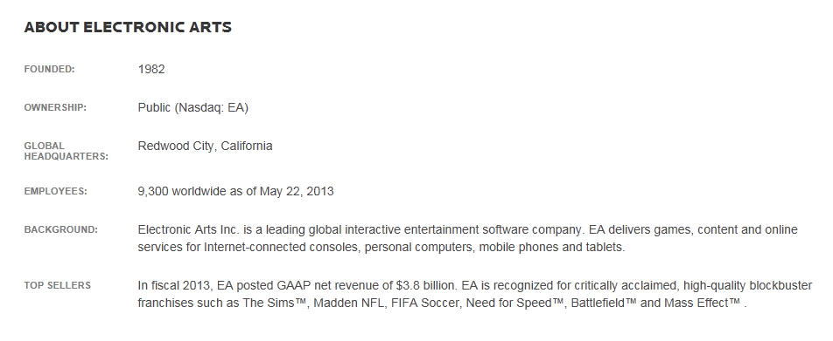

Slide 3






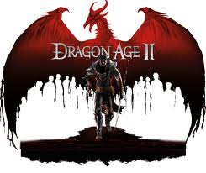



Slide 4
Anoop Desai, BComm LLB
Called to the Bar in 2002
Practiced a mid-sized full service law firm for 4 years specializing in the areas of general corporate commercial, M&A, securities and IP law.
Main areas of responsibility:
  Structure and negotiate strategic partnerships
  Source and manage partner relationships
  Work closely with client groups to shape digital future while preserving existing business interests
http://www.linkedin.com/in/anoopdesai

Slide 5

Business Affairs Mission Statement
Provide a central organization for the structuring, negotiation and execution of key third party relationships which span multiple EA business units and, where appropriate, source and manage such relationships. Work closely with client groups to shape EA’s digital future while preserving our existing business interests.

Slide 6
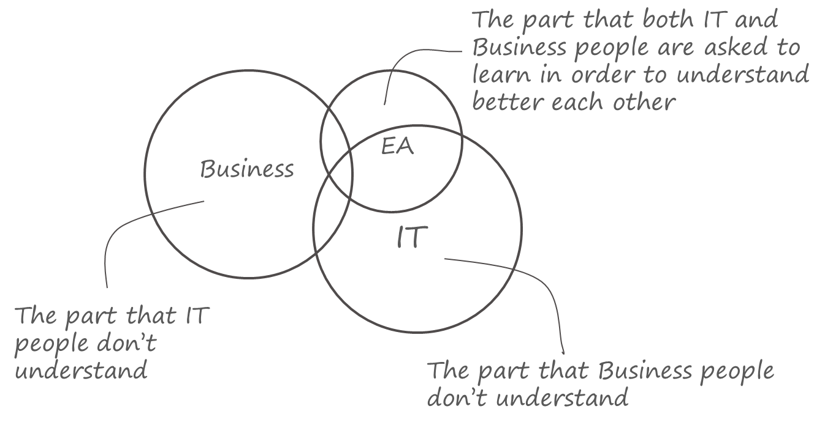
Reference: http://www.strategicstructures.com/

Slide 7


Legal
Business Affairs

Slide 8

Balancing Risk Against Reward
  Managing risk vs eliminating risk
  2 guiding principles:
      Retain control over IP
      Enable the business
Image source: http://digitalphotopix.com/funny/balancing-acts/

Slide 9

Licensing
Content licensing
  Sports Leagues/Players Association https://www.eff.org/files/brown_v._ea_-_ninth_circuit.pdf
  Car and parts manufacturers
  Music
Technology Licensing
    Games require third party software either in game or as part of development
Platform Licensing
    MS, Sony, Android, iOS, Facebook etc.
Outbound licensing
    Game assets from back catalogue
    Media channels (YouTube, Machinima, Twitch.tv)
      User generated content issues
      Music
Image source: http://www.exceedgulf.com/site/?page_id=90

Slide 10

Intellectual Property
Patents
    Patent Infringement – The Trolls
    http://www.forbes.com/sites/ericgoldman/2012/11/28/the-problems-with-software-patents/
  Copyright Infringement
  Digital Mellinium Copyright Act
  https://www.eff.org/cases/viacom-v-youtube
Trademarks
  http://docs.justia.com/cases/federal/district-courts/california/candce/3:2011cv04184/244555/13

Slide 11

Developer/Distribution Agreements
Developer Agreements
  Product Development agreements
    Full development agreements
    Asset or Content outsourcing – art, tech or any other part of a game may be developed by third party companies
Distribution and Publishing Agreements
  EA is both a developer and a publisher – will partner with other developers and use EA resources to distribute/publish their games

Slide 12
Crowdfunding
  Fiduciary Duties
  Securities Regulation
http://www.theglobeandmail.com/report-on-business/economy/economy-lab/daily-mix/crowdfunding-why-canada-is-far-behind-the-us/article2420066/
  http://www.entertainmentmedialawsignal.com/crowdfunding-for-canadian-entertainment-projects/
  http://www.forbes.com/sites/ericsavitz/2012/10/22/crowdfunding-potential-legal-disaster-waiting-to-happen/

Slide 13
QUESTIONS?

