Slide 1
I’ve Returned from the IP Dystopia
@RochRipley
UBC VGL
October 16, 2013

Slide 2
Introduction
Contrast collective vs. individual rights.
The IP Dystopia is a straw man. The difficulty in the real world is crafting laws that are enforceable and balanced. In practice, how different are the alternatives you’re discussing from what we have?
Review specific examples with a view to piecing together a larger picture.
Notes:
EULAs & TOUs: Understand legal options for implementing business strategies. Can control/influence resale of games; how games are played.
NPEs: Timely.

Slide 4
Happens with countries. US in the 19th century. Japan after WW2. Korea after Korean War. China now. Countries start as copiers and then become innovators. Unsurprising if same happens with companies.
What is incentive to get into the industry in the first place? Cannot consider creation in isolation.
The same development is possible within an IP framework. Consider mandatory licensing instead of injunctions.

Slide 6
Copyright law exemptions for fair use.
Brand is incredible valuable.
Apple: US$98bil
Google: US$93bil
Coca-cola: US$79bil [Interbrand 2013 survey]
Why should someone be allowed to jeopardize this?
What are the damages?
Practical issues re: access to justice and defending against claims, but these are systemic to justice system as a whole and not limited to IP.

Slide 8
No.
Both privacy and IP “literalists” understand the value of private information, and work at establishing systems and processes to facilitate use of that information in accordance with an individual’s wishes.
Privacy policies
Terms of use
Licensing of confidential information
Synergistic, not antagonistic.

Slide 10
Comparing GDP growth of BRIC economies to those of advanced economies like Canada and the US is comparing apples to oranges.
Taken to an extreme, can IP protection be prejudicial for economic growth?
I think so – e.g. current volume of patent troll litigation
Does this mean a world without IP is more productive than a world with IP?
No.

Slide 11
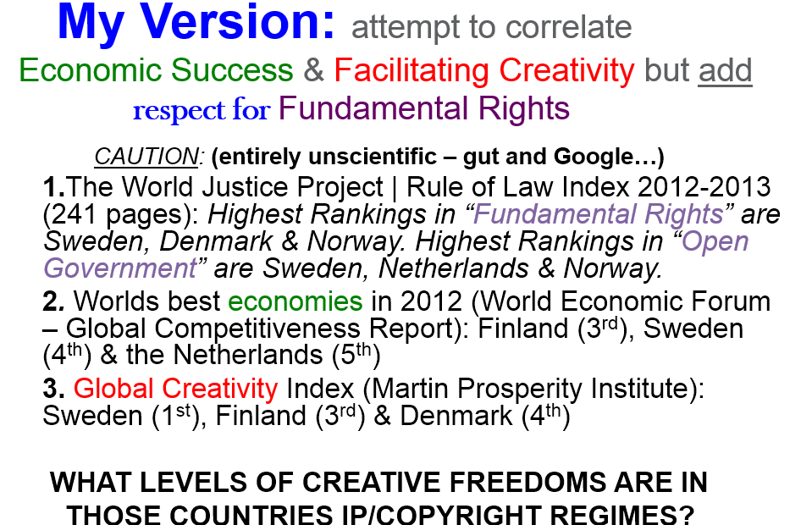

Slide 12
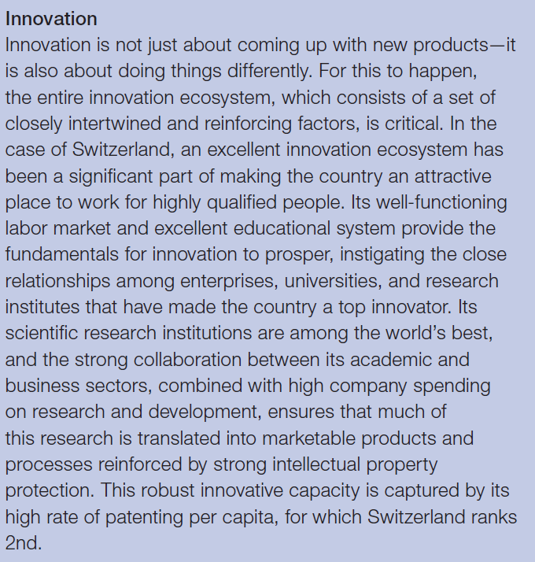
Switzerland: #1
Lots of other reasons for success
!!!
Source: 2013 World Economic Forum Global Competitiveness Report

Slide 14
What we call IP doesn’t matter. The underlying principle is that people should have an incentive to create and disseminate creations of the mind.
Cf. real or personal property
Aboriginal title is relatively new concept. Does that make real property rights less “real”?
There is public real property on which all may pass. An expired copyright allows all to copy. Does this undermine the property nature of real property?
Real and personal property rights serve a “larger purpose”: promote investment, security, economic growth. Again, undermine nature?

Slide 16
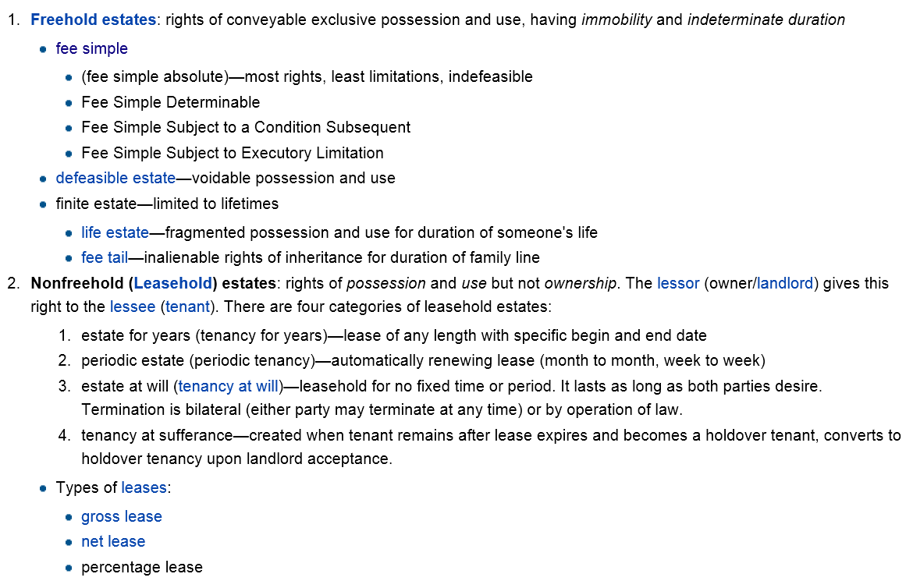

Slide 17
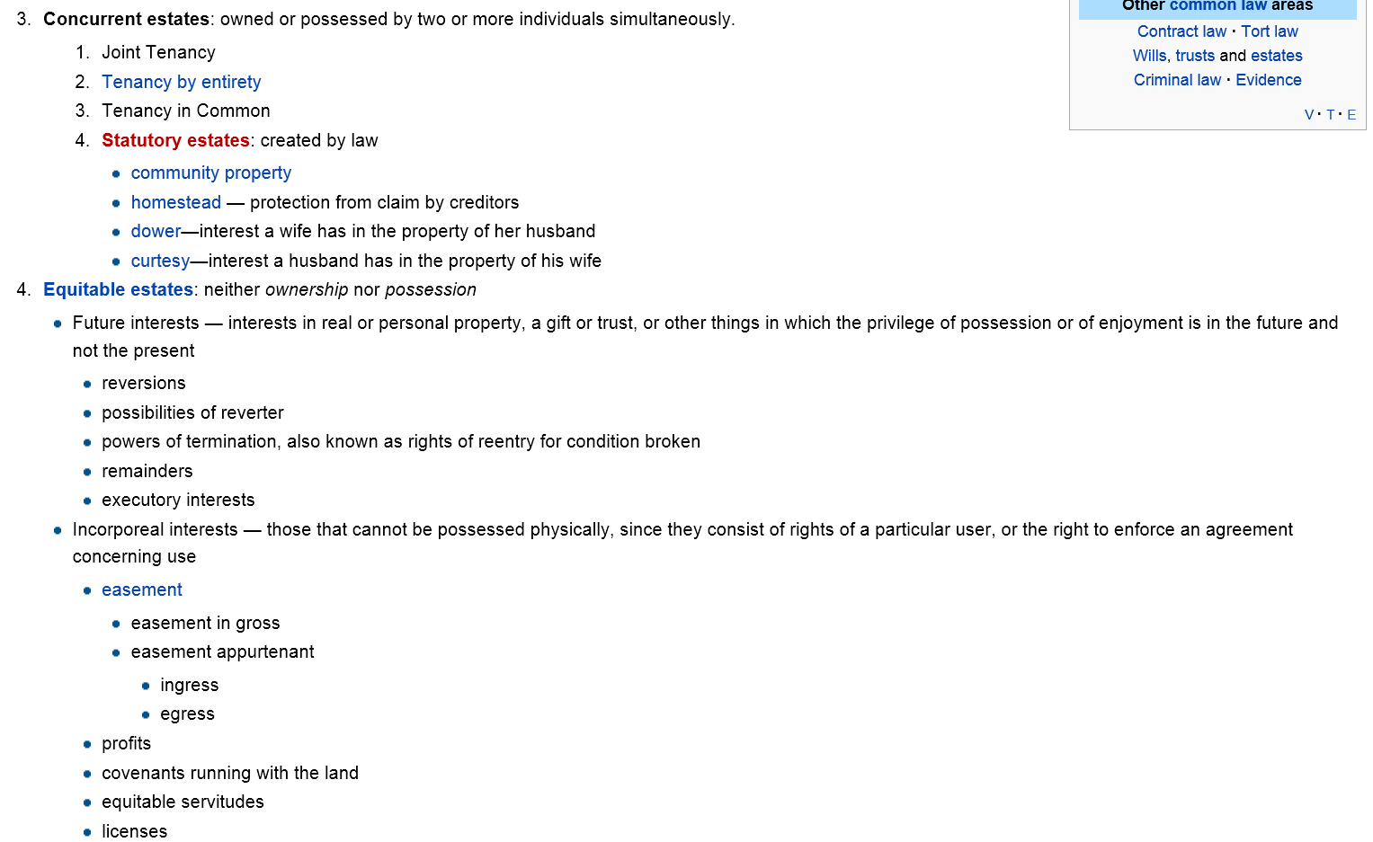
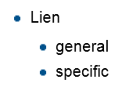

Slide 18
Don’t conflate property rights with the stuff you can hold and touch
Stuff I can touch: Computer
Real property rights: none
Personal property rights: owned by me
Intellectual property rights: software owned by Microsoft and licensed to me
Jon is equating the stuff you can touch with real/personal property rights. This is incorrect.
The Legislature could strip you of all your real and personal property rights tomorrow. Does this make them less real?

Slide 19
Many places, relatively little disagreement
Canadian law on fair dealing/user’s rights acceptable
User content provisions in new Copyright Act acceptable
Open to discussion re: raising thresholds for IP protection
Would the world end if the standard for copyright went from “skill & judgment” to “creativity”?
US patent law re: obviousness and final injunctions has changed significantly over past 10 years
Term of IP rights also up for debate (copyright term extensions in US; query adequacy/appropriateness of 20 yr patent term)

Slide 20
Conclusion

Slide 21
You can do this in the existing IP system
GPL, Creative Commons, cross-licensing, “defensive” patent licensing
GTA V (created under our current IP laws to “universal acclaim” [Metacritic 97/100])
Development & marketing: US $265 mil
Gross > US$1 bil to date
What do you have that’s equivalent to this to barter for?
Why should this system be forced on everyone? Should individuals have the right to choose how their work is used, as per the current system?

Slide 22
What if people refuse to barter? What will you do?
Make them pay?
Damages
Stop them from using?
Injunction
How will you figure out if bartering is even required?
Infringement-type analysis
→ Devil is in the details. How different would this “possible way forward” be from what we have?

Slide 23
Conclusion
If you believe in the right to create, you should believe in the right to protect creation.
IP is not an all or nothing approach. It can be crafted and adapted to suit a changing society. That is where the real debate is.

Slide 24
Questions?
THANK YOU
@RochRipley
Roch.Ripley@gowlings.com
(604) 443-7632

