Slide 1


Right to CreaTE or Rights of Creation
Part A “Creating” | Talk 4
Video Game Law 2013
UBC Law @ Allard Hall
Jon Festinger Q.C.
Centre for Digital Media
Festinger Law & Strategy
http://videogame.law.ubc.ca
@gamebizlaw
jon_festinger@thecdm.ca

Slide 2

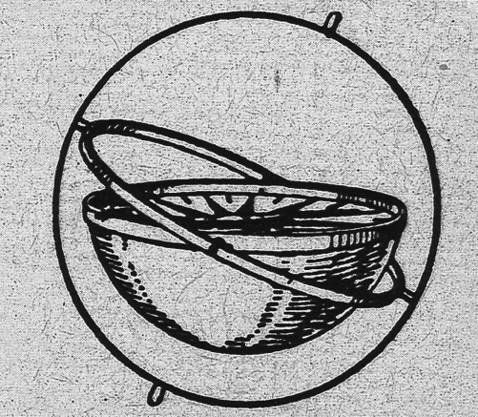
Where Are We?
*3rd and final Talk in Part A of the course under “Creating”
*Today:…(How) Can a Right to CREATe (Mod) be established?
*Next class – beginning of Part B: “Connecting”
(Part C. “Controlling”, Part D. “Conciliation”)

Slide 3
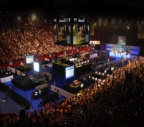
An Emergent Theme Evolves
What constitutes a “VIDEOGAME” & how is it to be differentiated?
Is Madden NFL a Sport?
“Examined, the Virtual Life Is Worth Living: Madden NFL 25 Portrays ‘Real’
Football” New York Times, August 26, 2013 http://www.nytimes.com/2013/08/27/arts/video-games/madden-nfl-25-portrays-real-football.html
Sport, or not a sport… By mattcharleton on September 9, 2013
& “Are Video Games a Sport?” (NYTimes video) http://nyti.ms/17cJXTO
2. “Game or be gamed: Douglas Rushkoff on prototyping democracy through play” (The Verge Dec. 12, 2012)
http://www.theverge.com/2012/12/12/3758576/douglas-rushkoff-gameplay-as-prototype
“By viewing our social, political, and economic structures through the lens of interactivity, Rushkoff says, we are beginning to "transition from the world of passively accepted narrative to one that invites our ongoing participation.”

Slide 4
An Emergent Theme Evolves 2
VIDEO GAME
IP NOT IP
“Games and Other Uncopyrightable Systems” Bruce Boyden (2011) http://www.georgemasonlawreview.org/doc/Boyden_18-2_2011.pdf
“Games are systems in exactly the same way. A game, as sold, is only a game form; the content necessary for an instance of the game comes from the players. That is, the game form establishes the environment for play

Slide 5
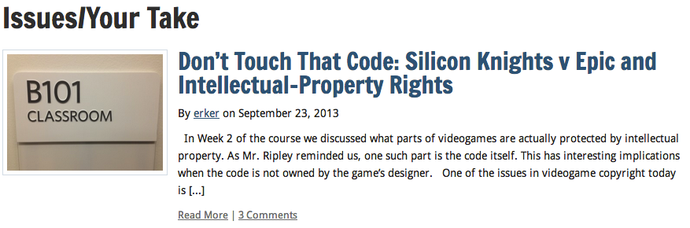

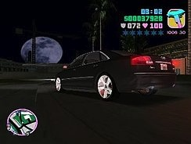
Mods (today’s topic)
Part of the evolution of
this Emergent Theme

Slide 6
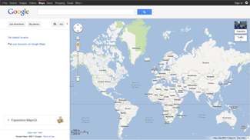
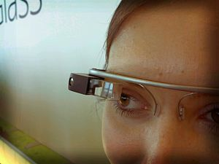
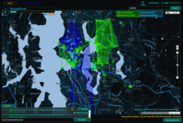
WHAT ABOUT?

Slide 7

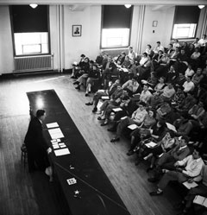
Starting Point Conundrum:
IDEA/EXPRESSION DICHOTOMY
Paradoxical Thesis: The problem with “the Law” may not have anything to do with the Law
IDEA/EXPRESSION DICHOTOMY:
No IP in an idea.
Becomes IP as (fixated) expression.
Contrast this “talk” to 70 years ago:

Slide 8
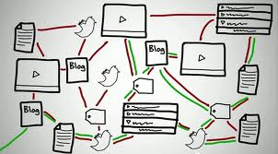
Now happens @ the speed of digital light….

Slide 9

...SO WHAT>>>>????
Conundrum A (Literalist Dichotomy) = Private v. Public
Conundrum B = Idea v. Expression
Once upon a time…a long time ago……
Private Public
Idea Expression

Slide 10

IN THE DIGITAL UNIVERSE
idea
private
EXPRESSION
PUBLIC

Slide 11
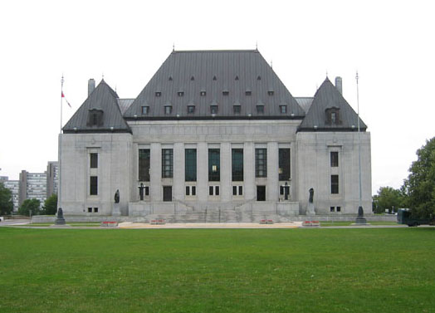
Not Failure of Law: Failure of Balance
Some Ways to Rebalance:
BY acknowledging the Right to CREATe….
Mod
Use
Share
AS PRIVATE RIGHTS OF INDIVIDUALS
User Rights = S.C.C. “Pentalogy”
Right to Hyperlink = Crookes v. Newton (2011 SCC 47)

Slide 12

Threshold to MODS - The DIGI-SHIFT
Other Precedents for “use”
ISP immunity v. expressive freedoms protection
When a carrier/provider? v. When a publisher/creator?
--------------------------------------------------------------------------------------
Right to republish: S. 230 Communications Decency Act (U.S.):
“No provider or user of an interactive service shall be treated as the publisher or speaker of any information provided by another another information content provider.”
-----------------------------------------------------------------------------------------------
“First Amendment Protection for Search Engine Search Results”: Eugene Volokh/Donald Falk (Google White Paper)http://papers.ssrn.com/sol3/papers.cfm?abstract_id=2055364
Right to Hyperlink = Crookes v. Newton (2011 SCC 47)

Slide 13
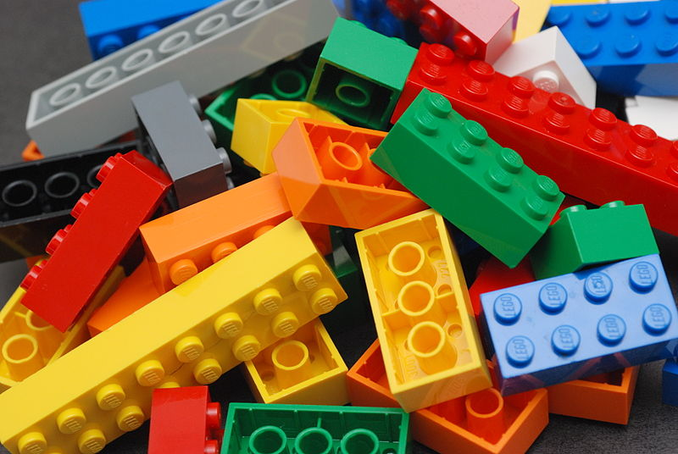
An Un-enumerated Right?
Where is the
FREEDOM TO
MOD/
CREAtE ?

Slide 14


Right to Mod/Right to CreaTe
Topic: Can these “right(s)” be established;
& if so through which legal pathways?
Core of anti-mod sentiment + attitude to overcome:
“[W]e believe it is our duty to uphold the integrity of our work.”
Statement by general manager of Tecmo Inc. re action against online forum members who released mod “skins” for (among other games) “Dead or Alive Xtreme Beach Volleyball”.

Slide 15

Concepts to Reflect On (for the next while..)
PERSONAL CREATiVITY
as part of an
INTERACTIVE ENVIRONMENT
Same or different from books, TV, Film etc?
Same or different from sports, music etc?

Slide 16
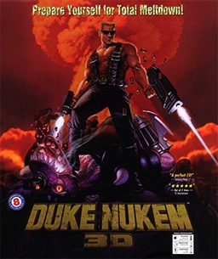

Cases to overcome*…
Micro Star v. FormGen 1998 USCA:
Micro Star commercially sold “Nuke It” – CD Rom
collection of 300 user created levels for Duke Nukem 3D
Did so without permission of community creators who had
previously released those levels for free.
EULA allowing “non-commercial” mods existed between
FormGen & Duke Nukem 3D purchasers.
Micro Star’s fair use argument failed.
2. Davidson & Associates, Inc. v. Internet Gateway
2005 USCA (D&A = Blizzard):
Free Battle.net community created competitor “bnetd”
EULA & TOU prohibited “reverse engineering”
“Blizzard” succeeds
* & one not to: Lewis Galoob Toys v. Nintendo of America 1992 USCA: “Game Genie” device allowed gameplay features to be modified (e.g. # of lives) but did not change data in Nintendo cartridge. Court found “fair use” in alternative to “no use”.

Slide 17
Cases to overcome (con’d)
3. iRacing v. Robinson (2007 Mass. Dist. Ct.):
“Nascar 2003” mod which modified the “.exe” source code file contrary to EULA.
“No CD” patch also made available by Robinson.
iRacing “wins” but Court found: “A defendant may successfully raise a fair use defense against a copyright infringement claim while still being found in breach of a contract not to copy.”
4. MDY Industries, LLC v. Blizzard Entertainment, Inc. (2010 USCA):
Blizzard used technological protection measure (“TPM” to prevent “bots” in “WoW” and effectively prohibited them by TOU.
MDY developed & sold “Glider” which circumvented the TPM and allowed bots into the game.
USCA affirmed Dist. Ct. finding that MDY violated DMCA’s copy control (anti-circumvention) provisions…

Slide 18
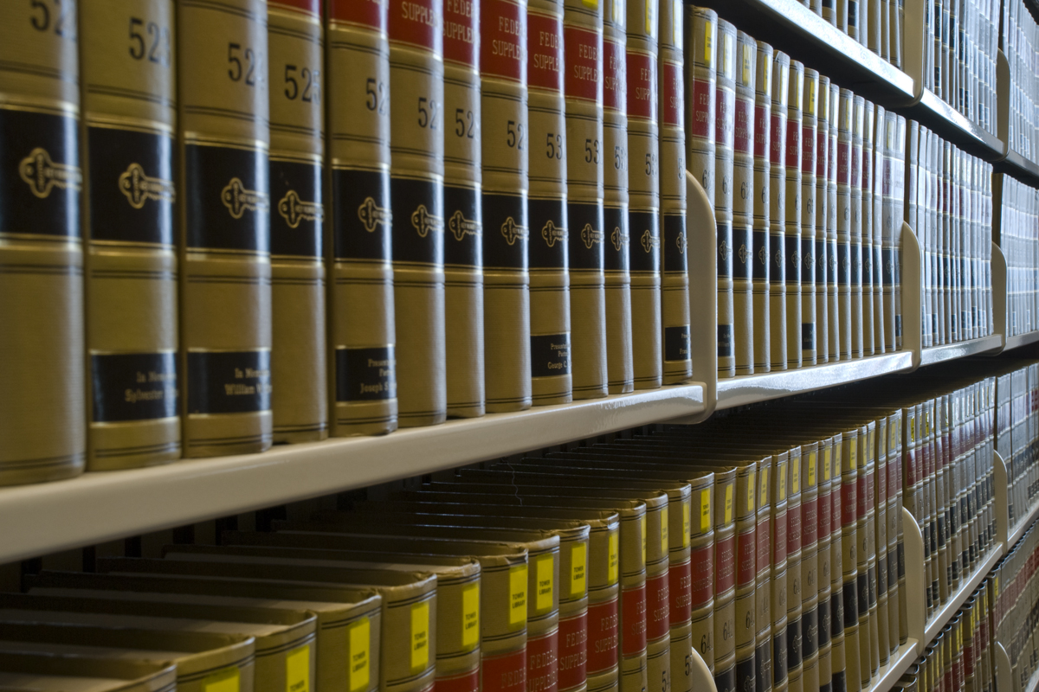
MDY (con’d): Contract not Copyright
Court in MDY reaffirmed copyright/contract distinction:
“…A Glider user violates the covenants with Blizzard, but does not thereby commit copyright infringement because Glider does not infringe any of Blizzard’s exclusive rights. For instance, the use does not alter or copy WoW software…
We conclude that for a licensee’s violation of a contract to constitute copyright infringement, there must be a nexus between the condition and the licensor’s exclusive rights of copyright. Here, WoW players do not commit copyright infringement by using Glider in violation of the ToU. MDY is thus not liable for secondary copyright infringement, which requires the existence of direct copyright infringement. Grokster, 545 U.S. at 930.”
* EFF: “A Mixed Ninth Circuit Ruling in MDY v. Blizzard: WoW Buyers Are Not Owners – But Glider Users Are Not Copyright Infringers” https://www.eff.org/deeplinks/2010/12/mixed-ninth-circuit-ruling-mdy-v-blizzard-wow

Slide 19
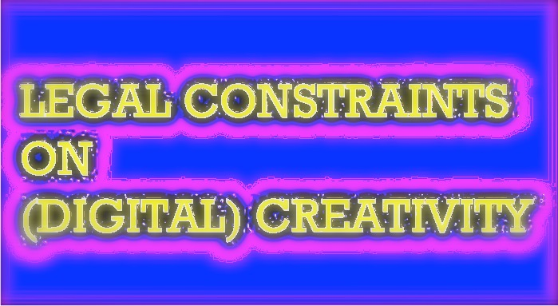
Notice any common denominators?
Creativity is never in issue in any of the cases
Copyright Law is only directly relevant in Microstar (& Galoob “Game Genie”)- no contractual nexus, so sole “copyright only” case.
“Fair Use” to create mods question avoided by:
Contract Law (Davidson, iRacing & MDY all decided on EULA, ToS or ToU terms & obligations).
Nothing creative in what Micro Star did – they did not create a mod – they usurped mod creators without permission
Conclusion: No current precedent that game mods are not “Fair Use”.

Slide 20
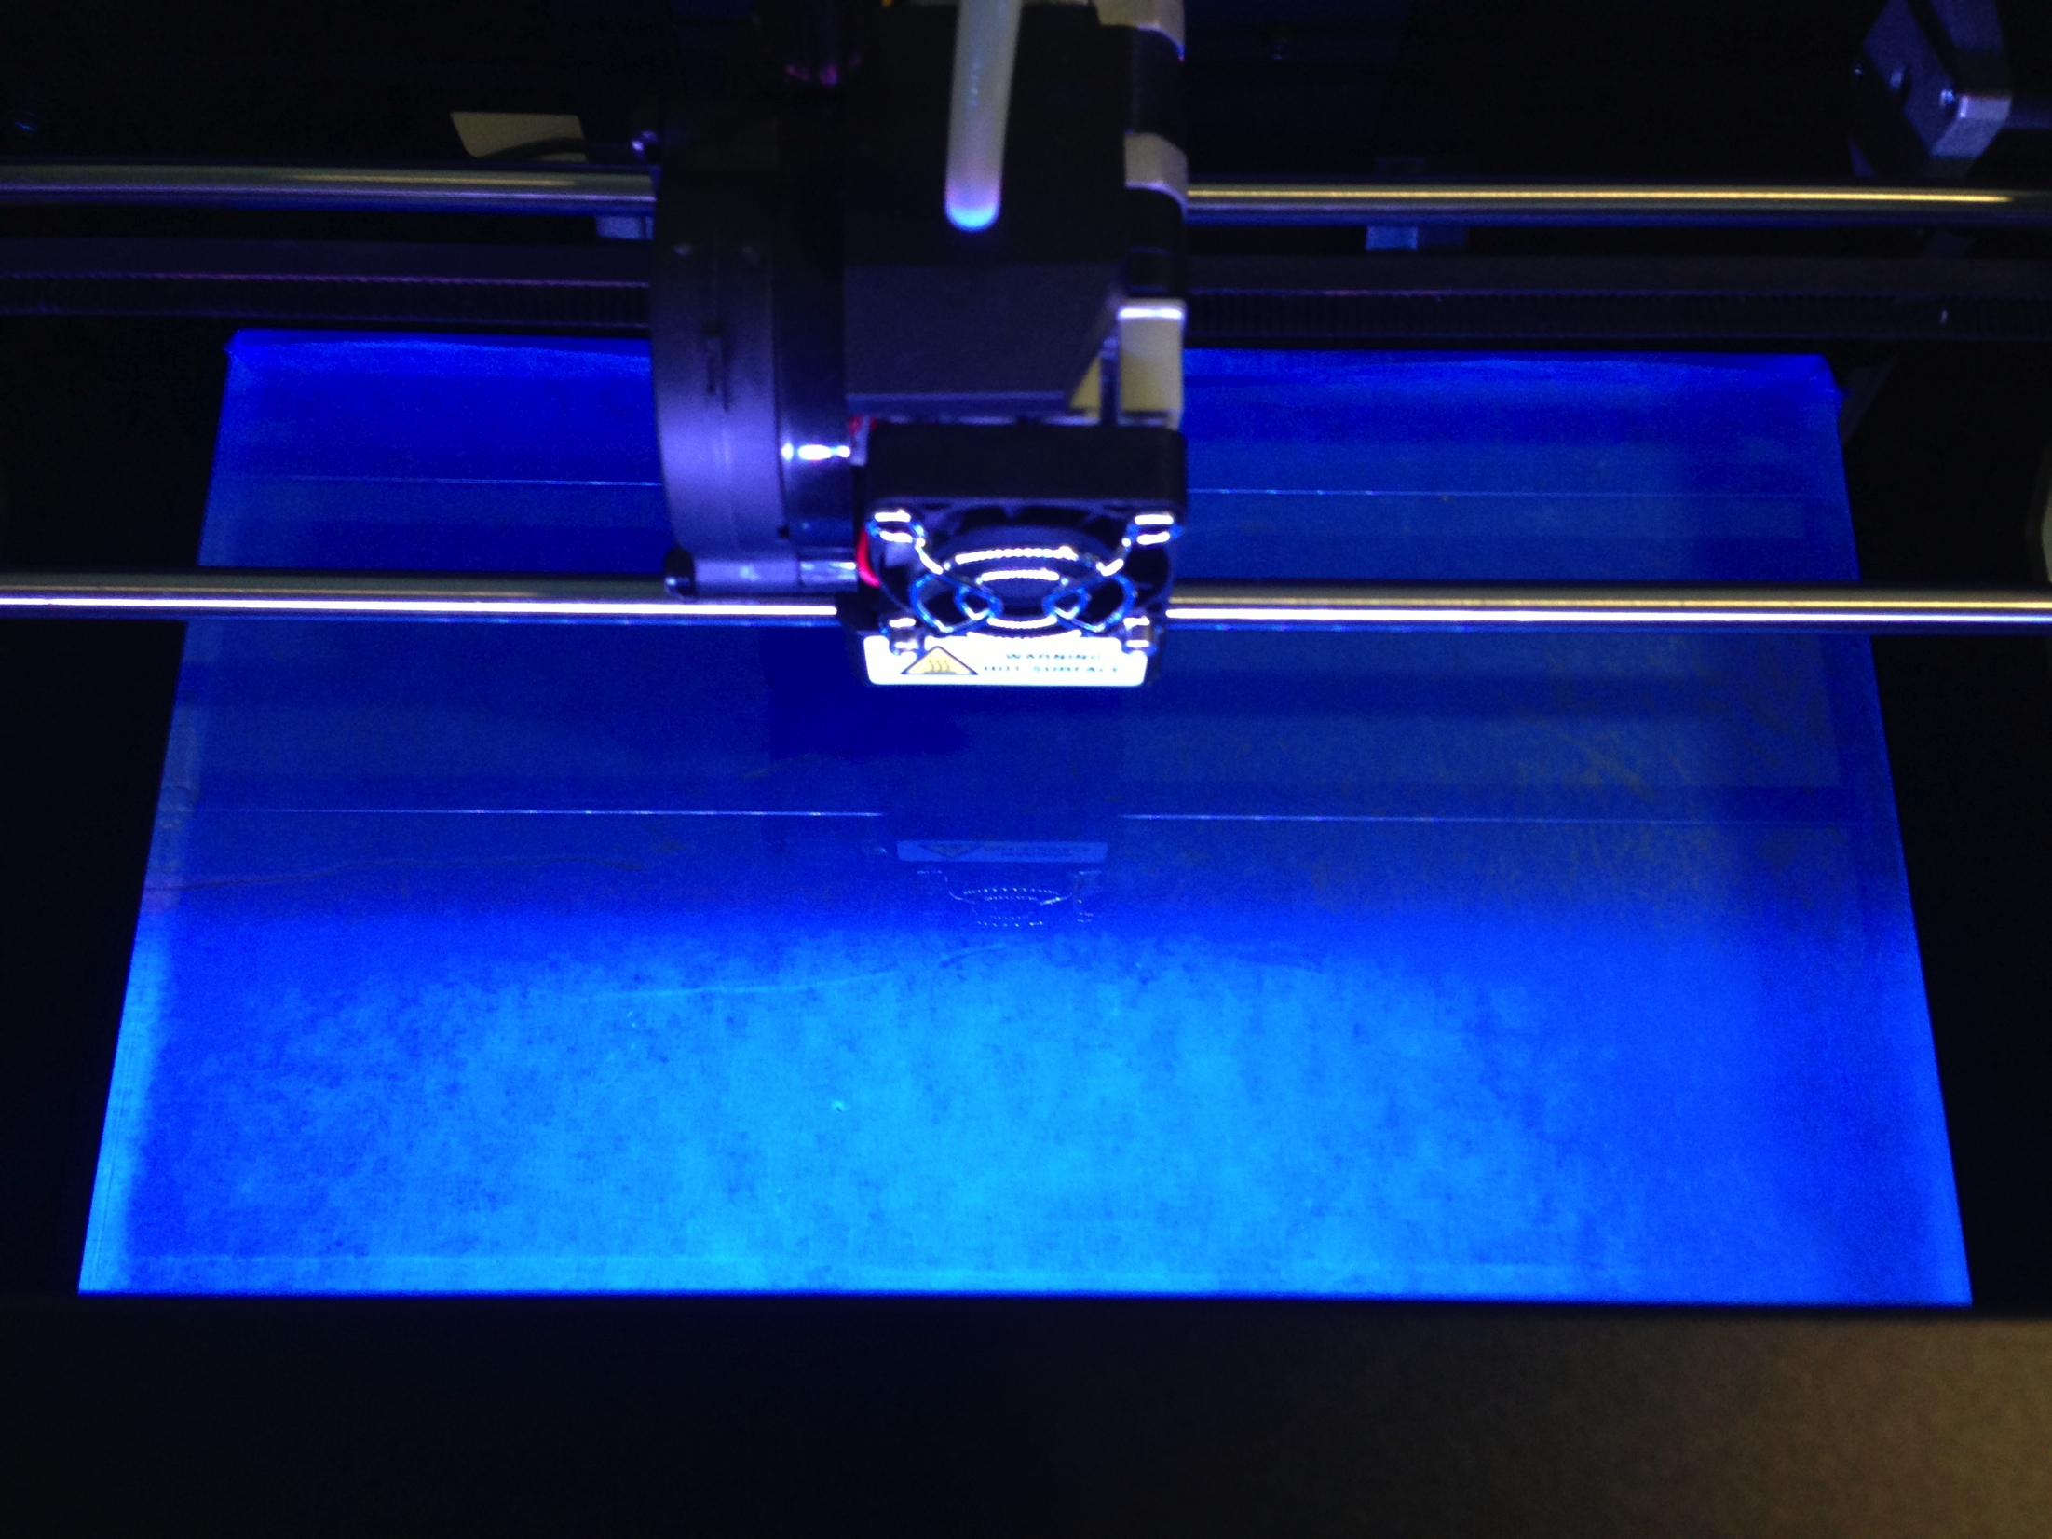
Does not mean Mods ARE “Fair Use”..
What’s at stake?
Mods
Machinima
Fan Fiction
Re-mix
Multi-source content
3D Printing
& (of course) Freedom to CREatE

Slide 21
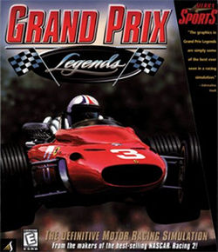
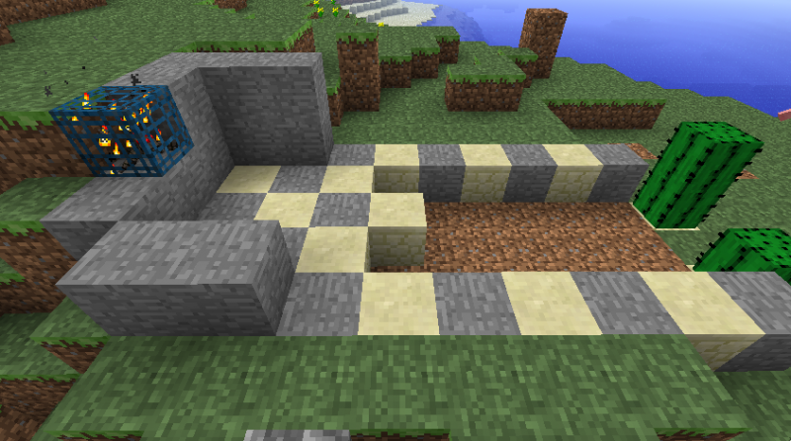
Establishing the Right to Mod: Questions of perspective
Does facilitating “true” INTERACTIVITY set Mods apart from other (one-way) art?
Does it make a difference in law that mods/games are a tool of other/further creativity?
Who owns SHARED CREATIVITY?
Is modding a “Right to CreaTE” (expression/speech) or a “Creator’s Right” (part of/defense to: copyright)?
Are Users Rights a “Right of Creation” or “Right to CreaTe”?
M
I
N
E
C
R
A
F
T

Slide 22
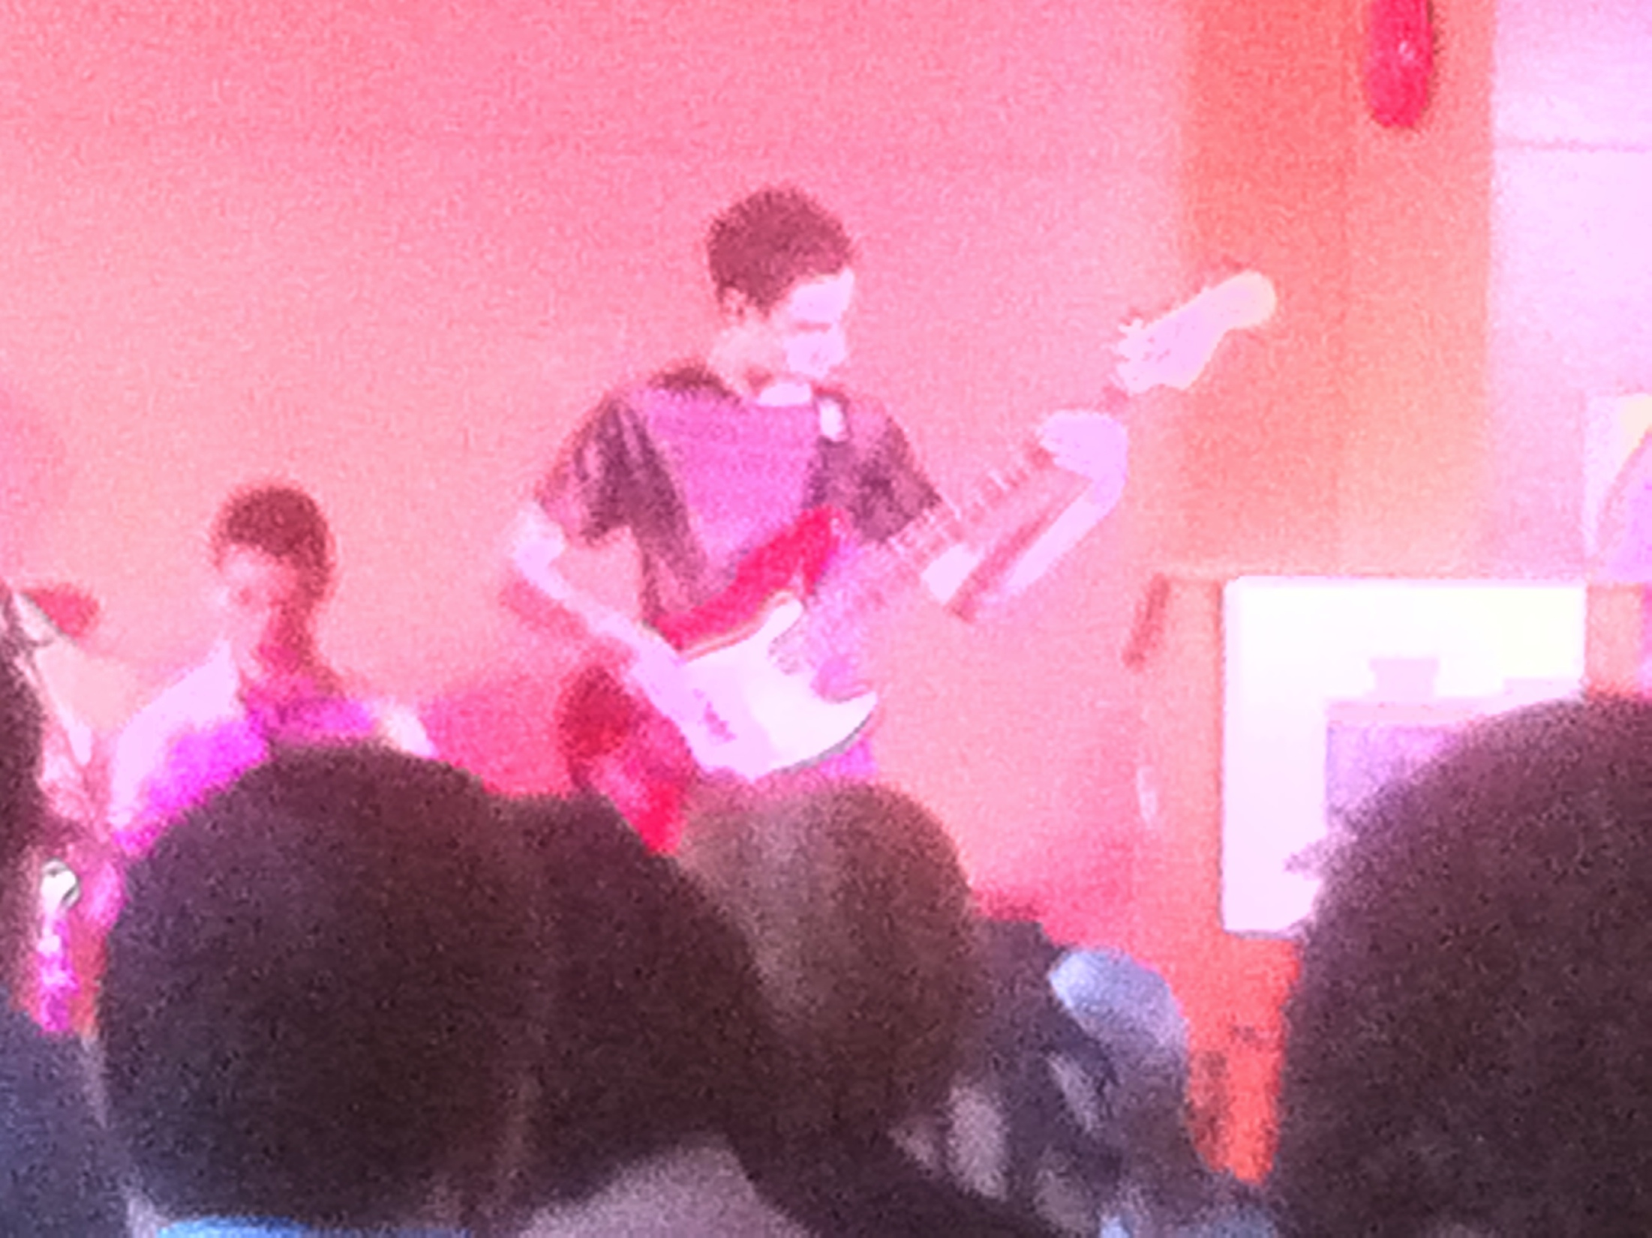
“Right to CreaTE” v. “Rights to Creation”
Right to CreaTe is a persons (inalienable) right to
Create. Think Freedom of Speech/Expression.
PERSONAL RIGHT (not a product right)
* “Creators Right” is a “right to the creation” which attaches to content – not a right to create but a “benefit” post facto
creation. Think IP/copyright – attaches to the product,
not the person (alienable by contract).
Which is to be preferred?
* Double Standards Test suggests perhaps “Right to Mod/
CREATe”: See “Freedom for Users, Not for Software” by
Benjamin Mako Hill http://mako.cc/writing/hill-freedom_for_users.html
*& “Bob Dylan: People Claiming I Plagiarized Them Are...”
http://www.techdirt.com/articles/20120923/23005020495/bob-dylan-people-claiming-i-plagiarized-them-are-pussies.shtml

Slide 23
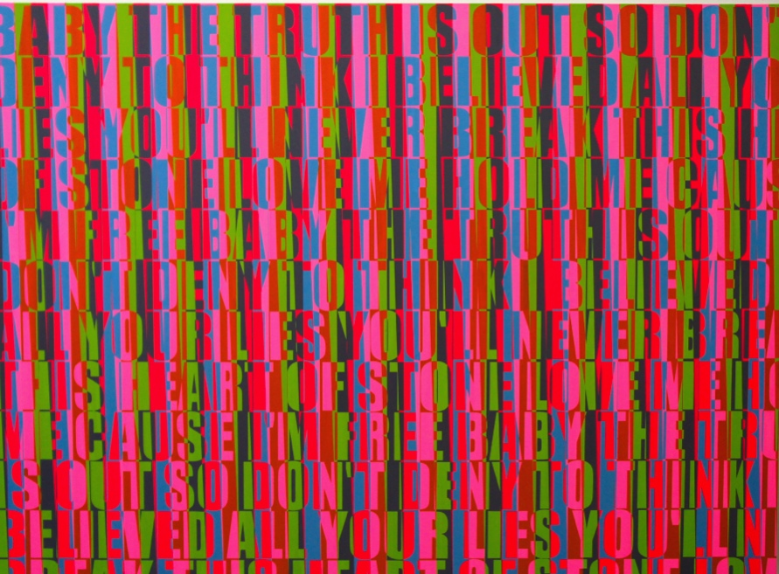
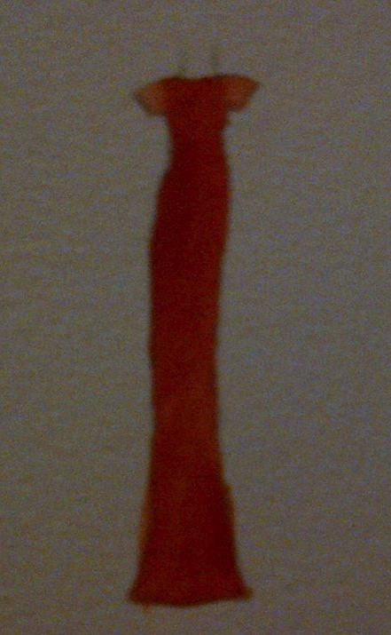
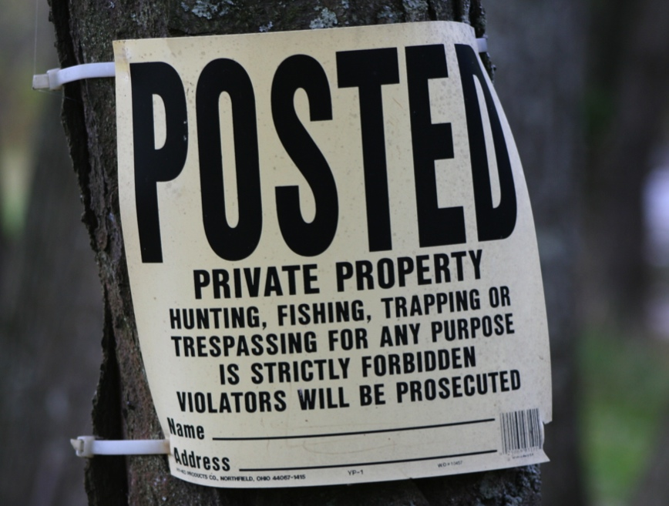
IS Creativity More
Important than Property?

Slide 24

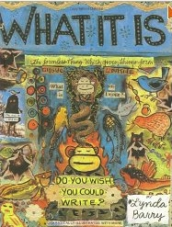
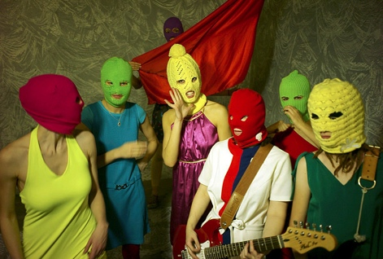
Cores of the Creative
The Personal Journey: “We don’t create a fantasy world to escape reality, we create it to be able to stay. I believe we have always done this, used images to stand and understand what otherwise would be intolerable.” Lynda Barry in “What It Is”.
Not Being Chilled: “The Creative Act requires not only freedom but also this assumption of freedom. If the creative artist worries if he will still be free tomorrow, then he will not be free today.” Salman Rushdie “On Censorship” http://www.newyorker.com/online/blogs/books/2012/05/on-censorship-salman-rushdie.html

Slide 25

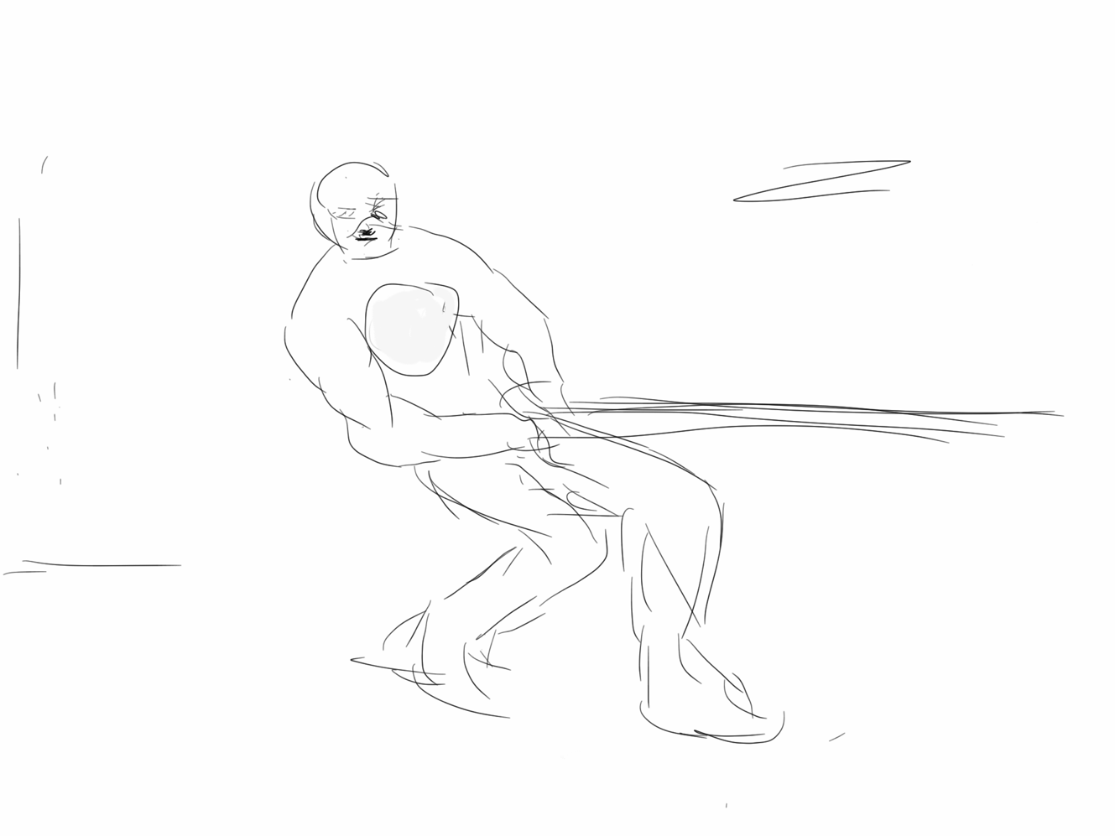
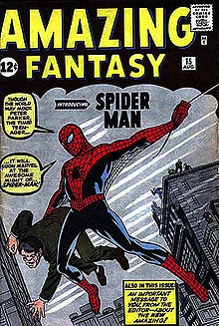
My (personal) moment…
“Kreyo”….…sworn enemy of “The Trolls”…..

Slide 26
“Intellectual Property” Paradoxes?
“Intellectual” + “Property”: Misnomer, contradiction, odd, oxymoronic?
Printing press invented circa 1440; term “intellectual property arose in 1860’s.
Word “Intellectual” undermined by legal requirements of fixation/“actual-ness”?
Word “Property” somewhat undermined by statutory limitations of impermanence: Property which expires?
Word “Property” undermined by statutory statements of “larger purpose.” Whose property is it if ultimately it belongs to us all in order to serve “progress”?
Is copyright “property” or “right”? Copyright Act: “property” appears in ways unrelated to a “built in” right. Appears several times in true ownership context in Trade-marks Act and Patent Act.

Slide 27
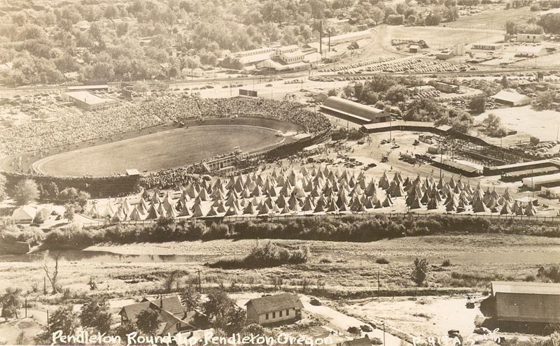
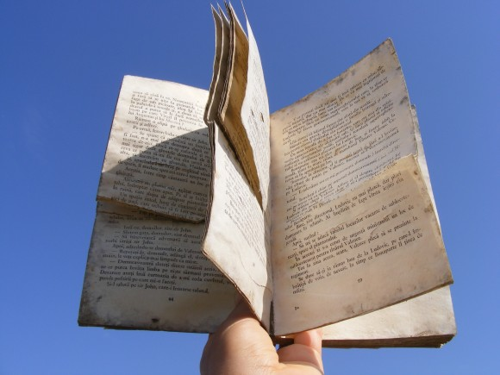
More reasons Copyright are not “Property”
Infinite slice-ability & dice-ability of IP makes it much less property like
Higher Purpose = To increase the knowledge of mankind:
* Statute of Anne, 1710: “An Act for the Encouragement of Learning”
* U.S. Constitution (Article 1, Section 8, Clause 8) – “To promote the Progress of Science and useful Arts, by securing for limited Times to Authors and Inventors the exclusive Right to their respective Writings and Discoveries;”

Slide 28
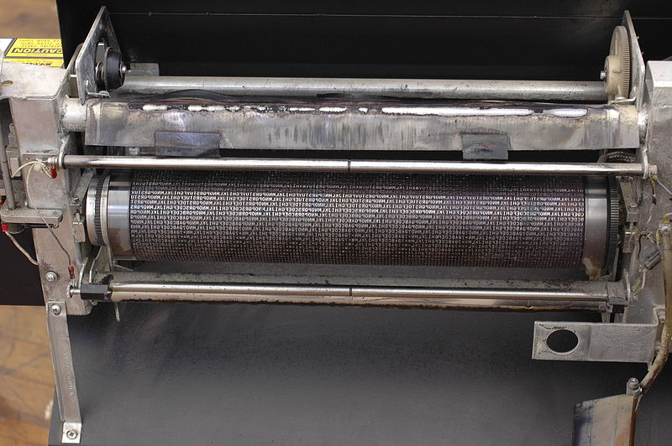
SHOULD…
“COPY”
in“Copyright”
just mean
“copy”?

Slide 29
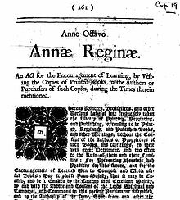

From Literal to Historical:
Copyright within trajectory of creative freedoms
* {KING..} Star Chamber (UK) abolished July 1641 - de facto cessation of
censorship; {TO PARLIAMENT..} replacement of Royal with Parliamentary censorship.
* {TO REGULATOR/EXCLUSIVE GUILD..} Licensing Order of 1643: Parliament
required authors to have a government license before a work could be published.
Restrictions enforced by the Stationers’ Company, a printers guild with the
exclusive power to print - and the responsibility to censor - literary works – in return
for monopoly on the printing trade.
* “Areopagitica”: “A speech of Mr. John Milton for the Liberty of
Unlicensed Printing to the Parliament of England”; 1644.
* “Licensing of the Press Act 1662”; "An Act for preventing the
frequent Abuses in printing seditious treasonable and unlicensed Bookes
and Pamphlets and for regulating of Printing and Printing Presses.”
* Then {TO PUBLISHERS/AUTHORS..} “The Statute of Anne” 1710 moved
control to the publishers/authors…

Slide 30
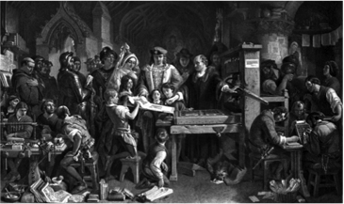
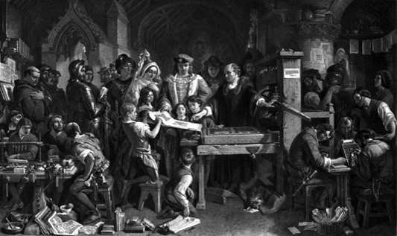
Understanding Copyright as part of the democratization of thought?
Strange then that Copyright constrains Speech???
Right to /RemixMod/CREATE perhaps the legitimate child of both
Free Speech & Copyright Laws
Meaning perhaps our understanding of copyright should prioritize the creative freedoms associated with content creation & use in preference to the “private ownership” aspects?
LEADING US BACK TO >>

Slide 31

…the Creator (author) & some serious questions…
Has anything of conceptual consequence happened since this TRAJECTORY OF LIBERALIZATION & FREEDOM vested power over media in the creator/author which was a HUGE STEP towards the freedom/democratization of media (pretty good for 1710)?
Did the evolution of a separate right to freedom of speech/expression result in the recasting of “authors rights” into a property right?
Note: Not much new to be created from a book in 1710? Little or no new creativity out of old creativity? Only unauthorized printing of the same work distributed at a lower cost…

Slide 32
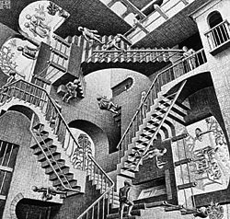
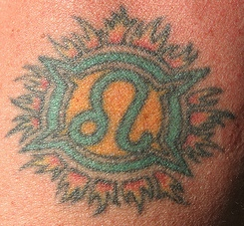
Think about: Tatoos
(The Escher Conundrum)
Escobedo v. THQ, Inc.
Tattoo artist sues THQ, makers of UFC video game for copyright infringement. Artist claims to have tattooed an originally created lion on Carlos Condit’s body. Escobedo and Condit had no written agreement.
See: “Copyright in Tattoo Case”
http://www.citmedialaw.org/blog/2012/copyright-tattoo-case-escobedo-v-thq-inc

Slide 33
IS LAW “AGILE”(enough)?
POSSIBLE
WAYS
FORWARD

Slide 34
POSSIBLE WAYS FORWARD:
Are we evading the deeper question?
SHOULD NOT
User Rights/Right to Remix really be a
independent creative/expressive right
rather than an IP right/protection/defense?
* Part of Freedoms of Thought/Conscience?
* Part of Free Speech/Expression (criticism & review/news reporting)?
* Or merely…an expanded “public interest” based Fair Dealing/Fair Use?
...NOT NOW..NOT YET?

Slide 35
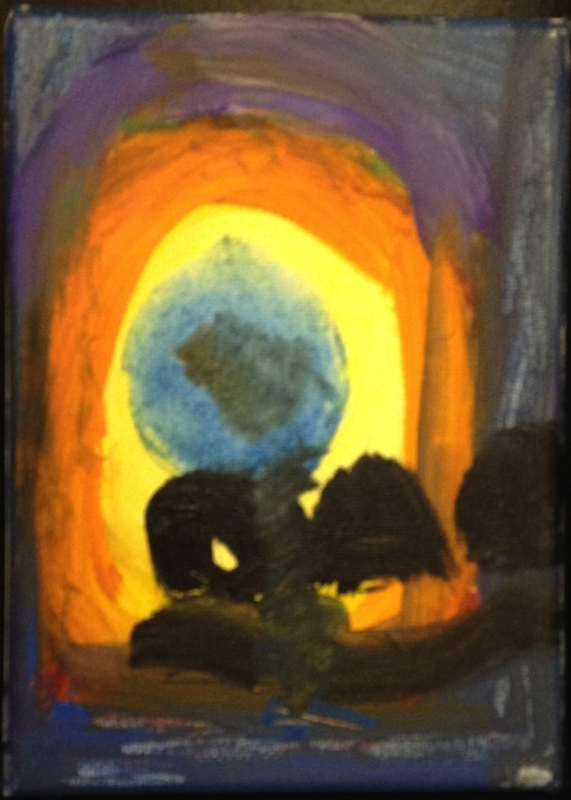
POSSIBLE WAYS FORWARD
Right to Remix/Mod/CREATE ?
Right to Remix-CREATe-Mod as a creative/expressive right rather than an IP right/protection?
“Right to CreaTe” v. “Right in the Creation”
Can we...evolve a single standard:
For CREATORS as USERS, &
For USERS as CREATORS
…….to match reality…..
“Right to CREATe”
Not “Right in the Creation”

Slide 36
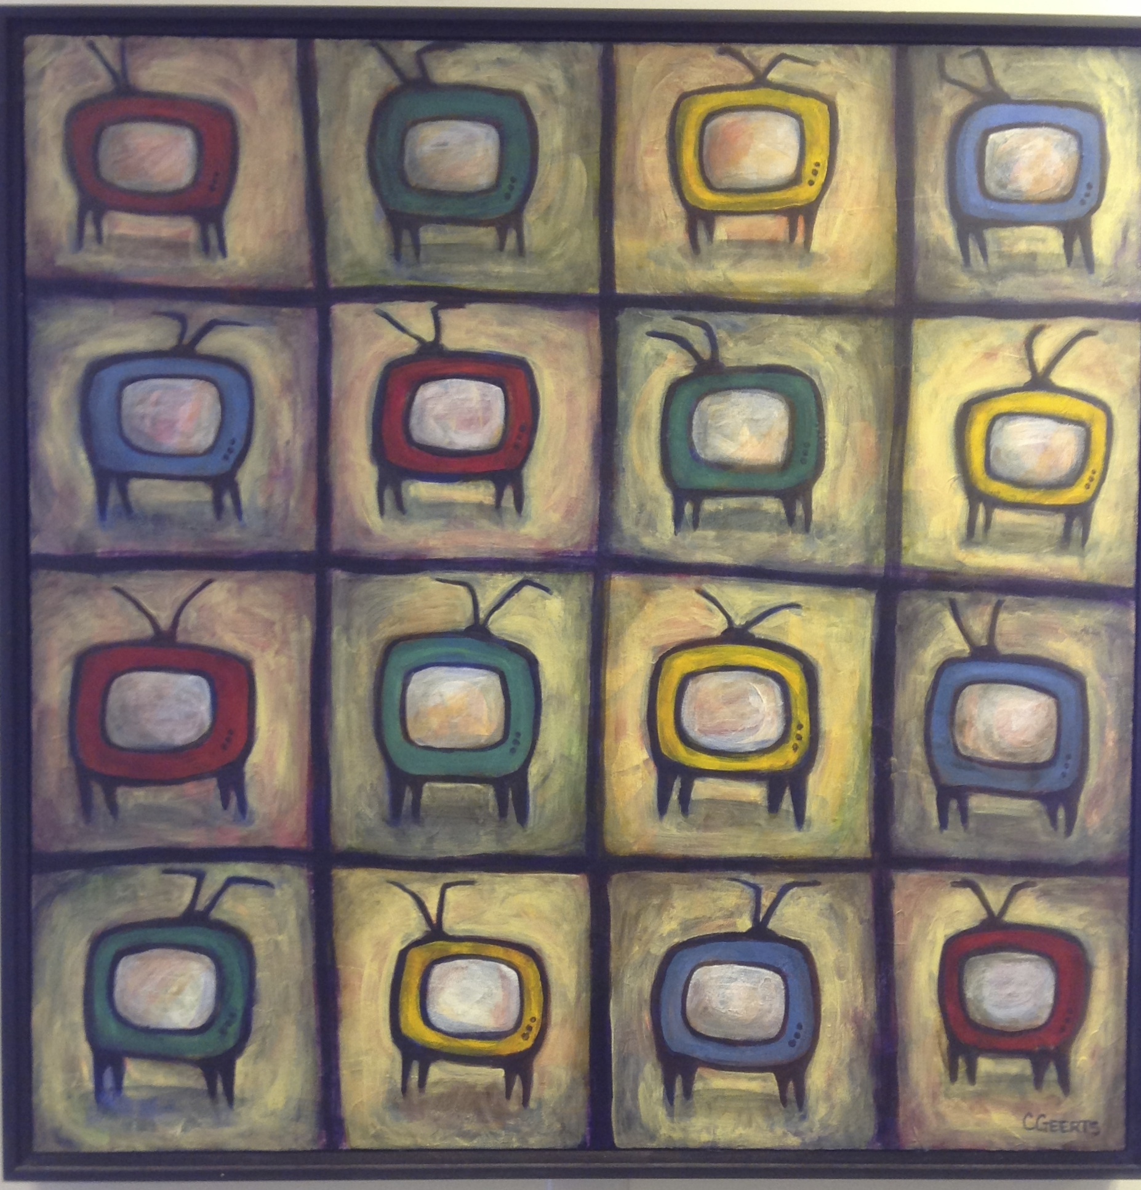
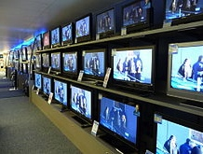
Re-enter Sony v. Universal (& sequels)
* Sony Corporation of America et al. v. Universal City Studios, Inc., et al. 464 U.S. 417 (1984) Supreme Court of United Stateshttp://scholar.google.ca/scholar_case?case=5876335373788447272&hl=en&as_sdt=2&as_vis=1&oi=scholarr&sa=X&ei=tspbUeHmOerJiwLsy4DQAg&ved=0CCoQgAMoADAA
“If vicarious liability is to be imposed on Sony in this case, it must rest on the fact that it has sold equipment with constructive knowledge of the fact that its customers may use that equipment to make unauthorized copies of copyrighted material. There is no precedent in the law of copyright for the imposition of vicarious liability on such a theory.”
*Veoh: 9th Circuit U.S.C.A. rejects Universal Music Group challenge that video-sharing site was not eligible for safe harbor from copyright claims (March 2013)
* Aereo: 2nd Circuit U.S.C.A refuses injunction to Comcast, NBC etc. (July 2013)
* Dish Network (“Hopper” ad-skip DVR)
9th Circuit U.S.C.A. rejects Fox action (July 2013)

Slide 37
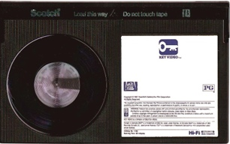
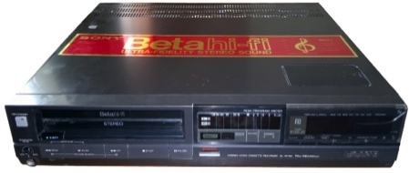
POSSIBLE WAYS FORWARD
“Context Shifting”
Imagine a world without Sony v. Universal SCOTUS
464 U.S. 417 (1984) (Betamax) time-shifting” fair use?
Why isn’t everything in digital world not a form
of tool enabled “time-shifting”
= “context shifting”
Key Factors in Sony:
a. enlarged audience; b. did not impair copyright value
Jumping off point to Fair Use discussion - Isn’t digital “todays tool”
=== “Context shifting”

Slide 38


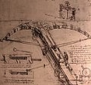
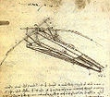
Fair Dealing in Canada:
Enter User Rights…
Recent SCC “User” paradigm shifts
USERS ARE CREATORS TOO
August 2012 “Copyright Pentalogy” & previous cases
Moving from fair dealing as an exception to copyright infringement towards proactive “User Rights”
Right to Link (Crookes v. Newton)
Right to longer iTunes previews
Tech Neutrality
Fair dealing is to be assessed from the point of view of the purchaser/user
“Research” need not be associated with traditional intellectual pursuits

Slide 39


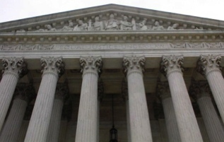
SCC Penatalogy...words
Abella J. for the majority in Alberta (Education) v. Canadian Copyright Licensing Agency (Access Copyright) 2012 SCC 37
“…fair dealing is a “user’s right”, and the relevant perspective when considering whether the dealing is for an allowable purpose…is that of the user…”
Abella J. for the Court in Society of composers, Authors and Music Publishers of Canada v. Bell Canada 2012 SCC 36
“Further, given the ease and magnitude with which digital works are disseminated over the Internet, focusing on the “aggregate” amount of the dealing in cases involving digital works could well lead to disproportionate findings of unfairness when compared with non-digital works.”
See also: “Copyright Fair Use Cases of the United States Supreme Court” http://www.ipwatchdog.com/2012/10/05/copyright-fair-use-cases-of-the-united-states-supreme-court/id=26225/
Abella J. for the majority in Alberta (Education) v. Canadian Copyright Licensing Agency (Access Copyright) 2012 SCC 37
“…fair dealing is a “user’s right”, and the relevant perspective when considering whether the dealing is for an allowable purpose…is that of the user…”
Abella J. for the Court in Society of composers, Authors and Music Publishers of Canada v. Bell Canada 2012 SCC 36
“Further, given the ease and magnitude with which digital works are disseminated over the Internet, focusing on the “aggregate” amount of the dealing in cases involving digital works could well lead to disproportionate findings of unfairness when compared with non-digital works.”
See also: “Copyright Fair Use Cases of the United States Supreme Court” http://www.ipwatchdog.com/2012/10/05/copyright-fair-use-cases-of-the-united-states-supreme-court/id=26225/

Slide 40
Non-commercial user-generated content
(Copyright Act, Canada)
29.21 (1) It is not an infringement of copyright for an individual to use an
existing work or other subject-matter or copy of one, which has been
published or otherwise made available to the public, in the creation of a
new work or other subject-matter in which copyright subsists and for the
individual — or, with the individual’s authorization, a member of their
household — to use the new work or other subject-matter or to authorize an
intermediary to disseminate it, if
(a) the use of, or the authorization to disseminate, the new work or other
subject-matter is done solely for non-commercial purposes;
(b) the source — and, if given in the source, the name of the author, performer,
maker or broadcaster — of the existing work or other subject-matter or copy of
it are mentioned, if it is reasonable in the circumstances to do so;
(c) the individual had reasonable grounds to believe that the existing work or
other subject-matter or copy of it, as the case may be, was not infringing
copyright; and
(d) the use of, or the authorization to disseminate, the new work or other
subject-matter does not have a substantial adverse effect, financial or
otherwise, on the exploitation or potential exploitation of the existing work or
other subject-matter — or copy of it — or on an existing or potential market for
it, including that the new work or other subject-matter is not a substitute for the
existing one.

Slide 41
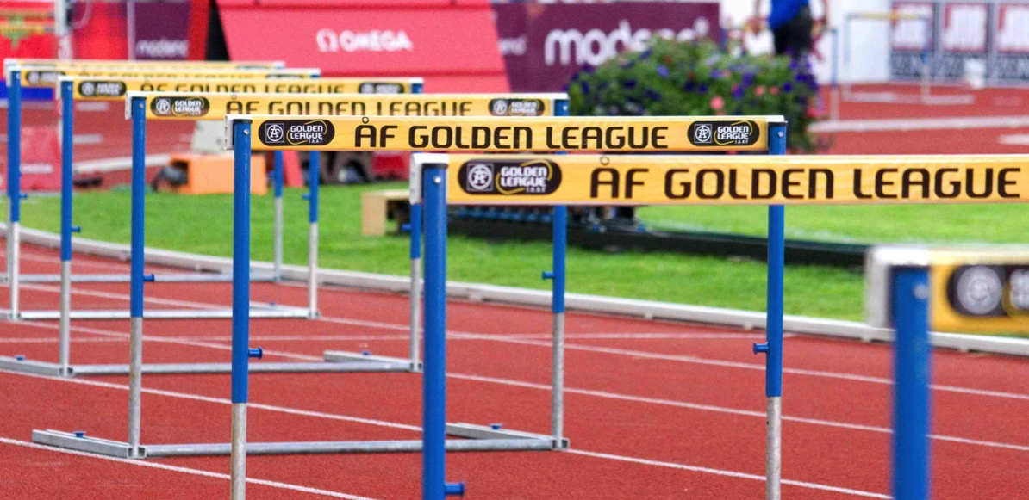
PWF: Raise Thresholds for IP Protection
“The Innovation Dilemma: Intellectual Property and the Historical Legacy of Cumulative Creativity” Dutﬁeld & Suthersanen (U.K.)
http://www.academia.edu/860340/

Slide 42
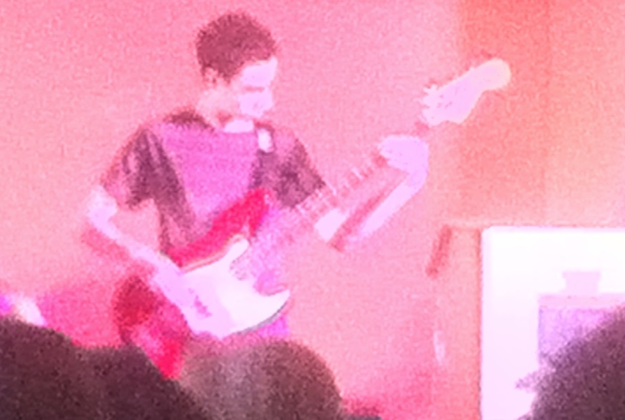
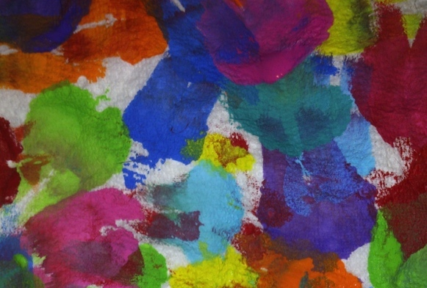
POSSIBLE WAYS FORWARD
Isn’t it Barter Not Theft
(Piracy) IF We Are All
Creators?

Slide 43

POSSIBLE WAYS FORWARD
Double Standard Test Yields Solution?
ETHICAL SOLUTION?: Embedding a “Do Unto
Others” algorithm rule-set which permits us to use the
digital bits of others if we share ours to the same
standard.
Barter not infringement.

Slide 44
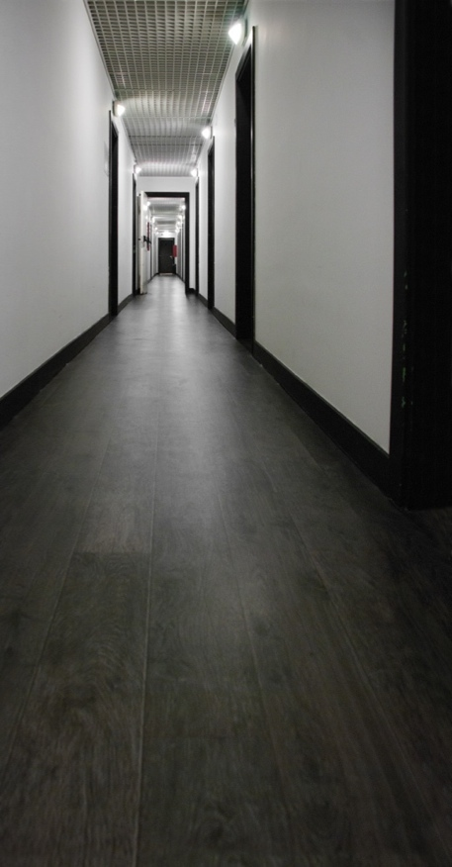
POSSIBLE WAYS FORWARD
Enter “Moral Rights”
Regime of ATTRIBUTION + INTEGRITY
IF TO IP = 1. commercial impact test irrelevant;
2. right to be attributed
3. right to protect work’s integrity
IF TO PRIVACY = Attribution & Integrity
includes non-attribution (“right to be forgotten”)
Berne Convention for the Protection of Literary and Artistic
Works (1886):“(1) Independently of the author's economic
rights, and even after the transfer of the said rights, the author
shall have the right to claim authorship of the work and to object to
any distortion, mutilation or other modification of, or other
derogatory action in relation to, the said work, which would be
prejudicial to his honor or reputation.”

Slide 45
Useful Authorities
Cariou v. Prince U.S.C.A. 2nd Circuit 2013 http://scholar.google.ca/scholar_case?case=5189514988129057173&hl=en&as_sdt=2&as_vis=1&oi=scholarr&sa=X&ei=RJxLUrzoHYaOigKinoGIAw&ved=0CCoQgAMoATAA
Seltzer v. Green Day, Inc. U.S.C.A. 9th Circuit 2013http://cdn.ca9.uscourts.gov/datastore/opinions/2013/08/07/11-56573.pdf
Acknowledging Copyright’s Illegitimate Offspring: User-Generated Content and Canadian Copyright Law - Teresa Scassahttp://www.press.uottawa.ca/sites/default/files/9780776620848_14.pdf
Copyright in Ideas: Equitable Ownership of Copyright - Robert Tomkowicz http://papers.ssrn.com/sol3/papers.cfm?abstract_id=2213601
The Remixing Dilemma: The Trade-off Between Generativity and Originality - Benjamin Mako Hill, Andrés Monroy-Hernándezhttp://mako.cc/academic/hill_monroy-remixing_dilemma-DRAFT.pdf
Is Data Speech? - Jane Bambauerhttp://papers.ssrn.com/sol3/papers.cfm?abstract_id=2231821
Magic Modders: Alter Art, Ambiguity, and the Ethics of Prosumption - Aaron Trammell http://journals.tdl.org/jvwr/index.php/jvwr/article/view/7040
Computer game modders’ motivations and sense of community: A mixed-methods approach - Nathanial Poor

Slide 46
Can I Mod
Yet?

Slide 47
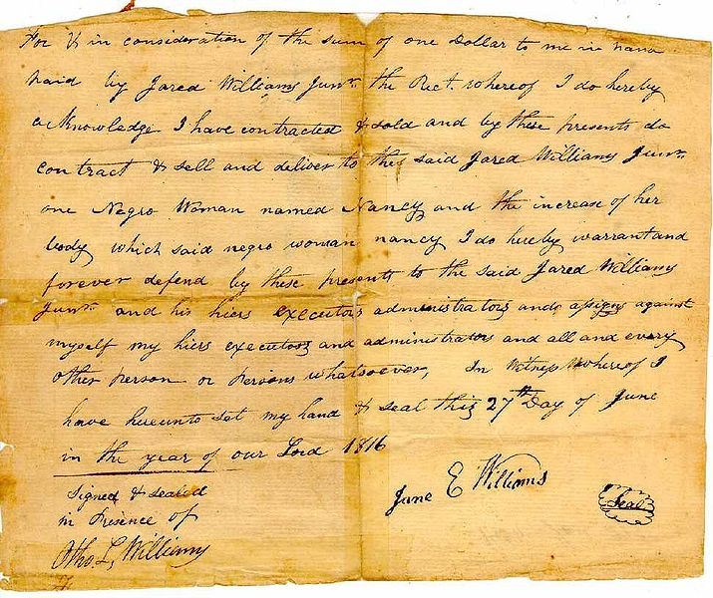
Next Class
We now done Part A (meme # 1): “Creating”
Entering into (drumroll please…)
Part B (meme#2) of the course:
>>>>>>>>>>>>>>>“CONNECTING”>>>>>>>>>>>>>>>>>
Talk: Creators, Consumers & Users
(sub-nom: intro to contractual conundrums)

Slide 48
Our Academic Partners

