Slide 1


What’s it all about…Beta?
Part B “Connecting” | Talk 7
Video Game Law 2013
UBC Law @ Allard Hall
Jon Festinger Q.C.
Centre for Digital Media
Festinger Law & Strategy
http://videogame.law.ubc.ca
@gamebizlaw
jon_festinger@thecdm.ca

Slide 2
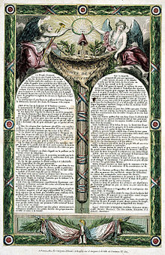
UPDATE 1: “Copyright Within TRAJECTORY
OF LIBERALIZATION & FREEDOM”
Did the evolution of a separate right to freedom of speech/
expression result in the recasting of “authors rights” into a
property right?
*Statute of Anne (copyright) 1710.
*Declaration of the Rights of Man (French Revolution
providing for free speech for the common man) 1789/1793.
“Timeline: a history of free speech”
http://www.theguardian.com/media/2006/feb/05/religion.news
THESIS STATED:
1. FREE SPEECH TO AUTHORS WAS COPYRIGHT!
2. THEN COPYRIGHT BECAME MORE INFUSED BY
“PROPERTY” TO GIVE IT MEANING AS FREEDOM
OF EXPRESSION EVOLVED.

Slide 3
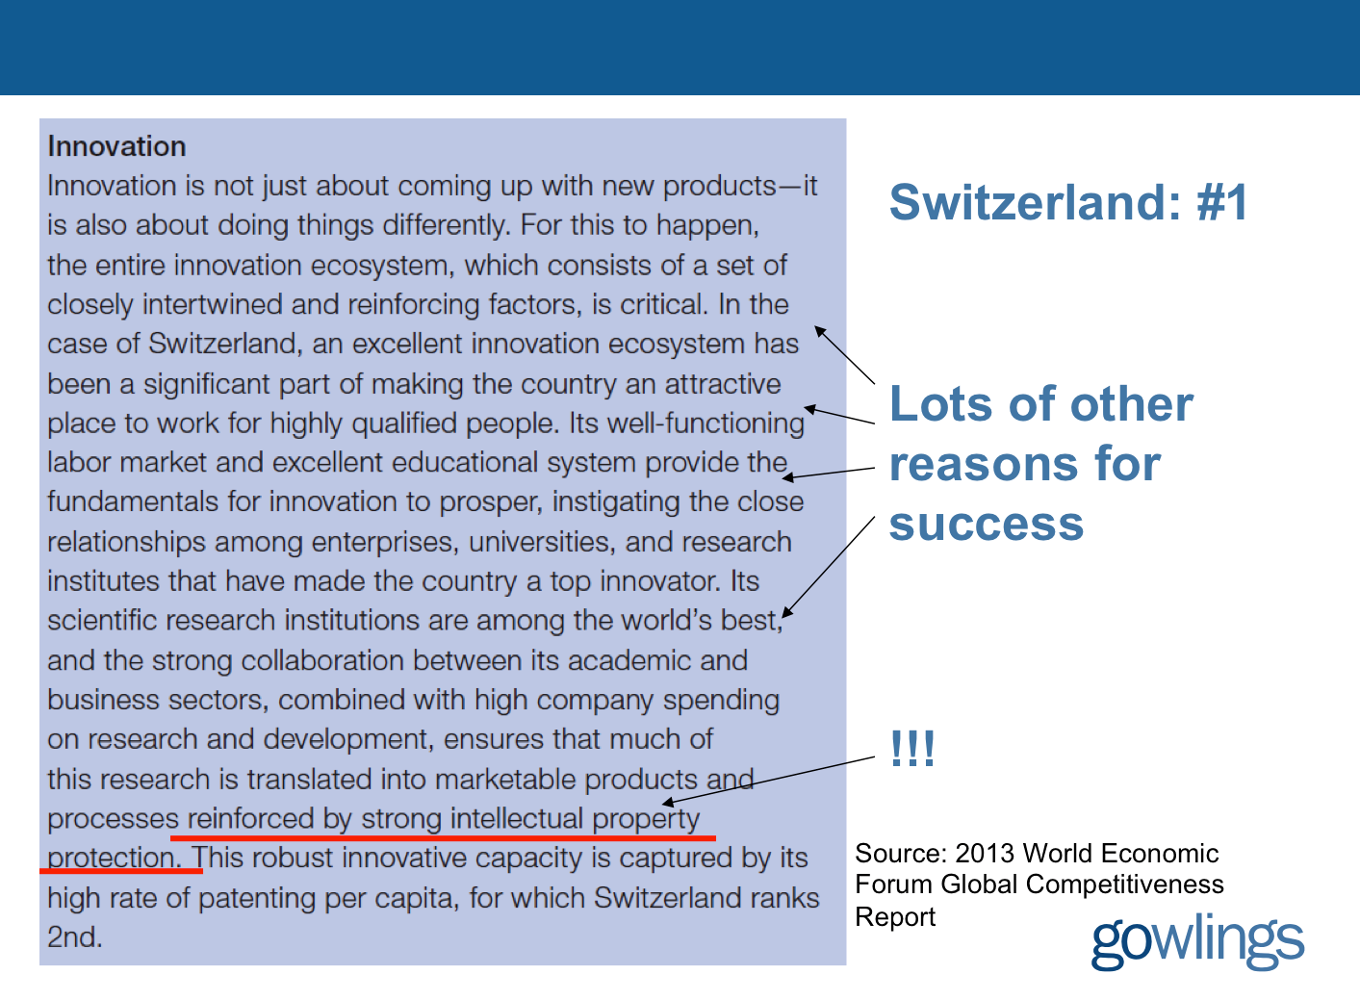

UPDATE 2: R^3 (Roch Ripley Response)
Switzerland

Slide 4


Not many video game companies..
“indexmundi” http://www.indexmundi.com/switzerland/industries.html
“Industries: machinery, chemicals, watches,
textiles, precision instruments, tourism, banking,
and insurance”

Slide 5
& two more things
1.“..why utilitarianism – the traditional standard-
bearer in the IP field – has failed as a viable
foundation.”
Foundations & Principles Redux: A Reply to Professor
Blankfein-Tabachnick by Robert P. Merges
California Law Review [Vol. 101:1361 2013]
http://papers.ssrn.com/sol3/papers.cfm?abstract_id=2332975
2. On the other hand…
Property as Platform: Coordinating Standards for Technological Innovation by Henry E. Smith
Journal of Competition Law & Economics (forthcoming)
http://papers.ssrn.com/sol3/papers.cfm?abstract_id=2321365

Slide 6
UPDATE 3: “11 Cases...”
Blizzard Entertainment Inc. v. Ceiling Fan Software LLC et al U.S. District Ct. (Central Dist. Of Calif.) Sept. 23, 2013
*Plaintiff’s Motion for liability Summary Judgment granted
“Defendants are in the business of selling and distributing two
pieces of computer software—Pocket Gnome and Shadow Bot
(collectively, the “Bots”), which are software “bots” that, when
installed on a player’s computer, permit the player to “automate”
his or her WoW game play on Apple Mac computers and
Windows PCs, respectively…
At all times since they began operating their business,
Defendants have known that the WoW ToU and EULA prohibited
users from using bot software, including Shadow Bot and Pocket
Gnome.”
http://legal.ceilingfansoftware.com/docs/147%20Order%20Granting%20Blizzard's%20Motion%20for%20Summary%20judgment%20and%20Denying%20Defendants'%20Motion%20for%20Summary%20Judgment%20(2013-09-24).pdf

Slide 7
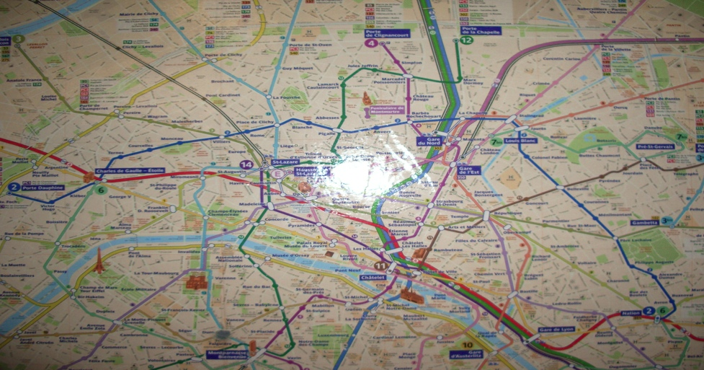
Taking Stock: Where Are We?
Part A: Memes of “Creating”
* Meaning & purpose of creating (in a video game context)
* Right to CREAte (mod)
* Copyright as power & constraint
Part B: Memes of “Connecting”
* How connecting creativity transforms and restrains it
* Creation as Connection: Connection as both the cause & the purpose of Creation
* Connections>>>Creation>>>Greater Connections
* Video-games (like all creative works) as merger of Creativity &
Connection of both Developer/Creator & Player/Creator

Slide 8
Leading to “THE POST IP WORLD”
* Talks 5 & 6: Does the dominance of contracts mean we are already in a “The Post IP World”??
* Focus on contractual restraints (digital re-sale; transferability by will, contracting out of IP law permissions e.g. ToS prohibitions of reverse engineering)
CREATION goes with COPYRIGHT/IP LAW
CONNECTING goes with CONTRACT LAW

Slide 9

Today
An 2nd stage assessment of the utility of EULA’s (etc.)

Slide 10
Constraint/Restraint - Coercion/Control
con·strain/kənˈstrān/Verb
Severely restrict the scope, extent, or activity of.
Compel or force (someone) toward a particular course of action.
Synonyms: force - compel - coerce - oblige - necessitate
re·strain/riˈstrān/Verb
Prevent (someone or something) from doing something; keep
under control.
Prevent oneself from displaying or giving way to a strong
urge or emotion.
Synonyms: curb - check - hold - repress - control - contain

Slide 11
A Pattern?
CREATION goes with COPYRIGHT/IP LAW
CONNECTING goes with CONTRACT LAW
BECOMES
COPYRIGHT/IP LAW CONSTRAINS CREATION
CONTRACT LAW RESTRAINS CONNECTING

Slide 12
Emergent from Talk 6 (“10 Cases -..”)
Copyright - serious consequences (injunctions, fines)/serious defenses
(fair use/dealing) = constraint oriented
Contract - less serious/few defenses (generally damages only)
= restraint oriented
Cases – (vaguely) consumer/user rights (constraint) oriented
Considering:
1. Companies draft; consumers don’t
2. Click-wrap “fiction”
3. Lack of standardization (Industry Assoc./Treaty/Consumer Protection)
4. All cases had multiple causes of action, not just contract
Query:
Morality of contracting out of:
a.) free speech/expression rights
b.) prevailing statutory copyright laws/rights
c.) {& we have not even mentioned privacy yet}

Slide 13
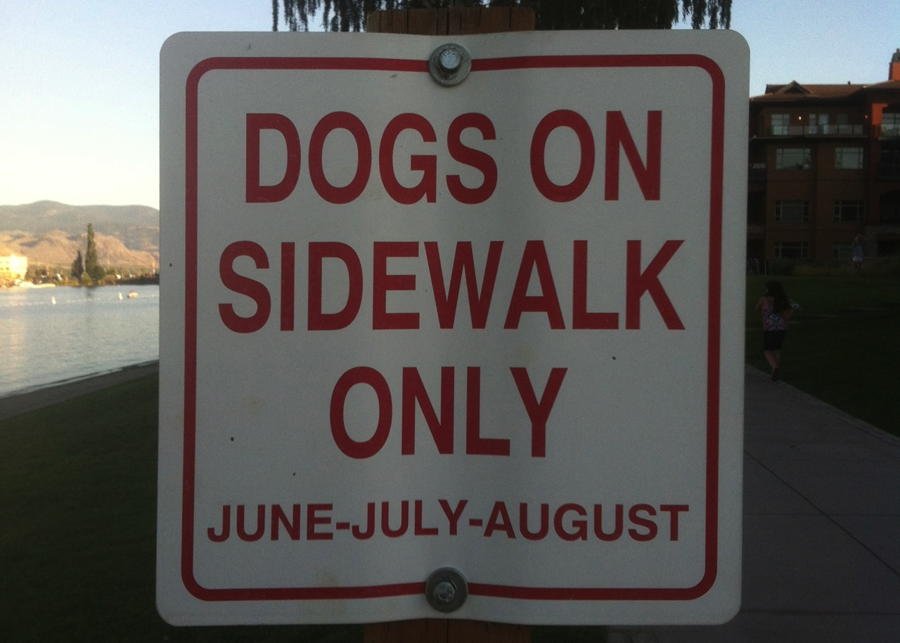
The problem with drafting…
(where do the humans go?)

Slide 14
Trends in the Cases?
COPYRIGHT (constraint)
to
USER RIGHTS
(e.g. reverse engineering, fair use, right to create {?})
to
CONTRACTING (restraint)
to
REMOVING USER RIGHTS
(no reverse engineering, no mods)
to
RE-EMERGEANCE OF USER RIGHTS ?
(same user rights as copyright?)
*Fairness of this process of moving from constraints to
additional restraints without user understanding?

Slide 15

Double Standard Tests
Core problem: EULA’s, ToS’ etc. we “agree to” are all different in specifics; yet apply to billions of people.
`
DOUBLE STANDARD Test #1: since digital developers Can (& do) customize your content, Why not YOUR EULA, TOS & Privacy agreements?
DOUBLE STANDARD Test #2: How many developers could survive the terms they impose on Consumers?
ETHICAL SOLUTION?: Embedding a “Do Unto
Others” algorithm rule-set which permits us to use the
digital bits of others if we share ours to the same
standard. Barter not infringement.

Slide 16
Query: Developer’s Liability -
Are not EULA/ToS’ needed for the “really bad” stuff?
* Would a short legal notice would be as effective as EULA/ToS?
“Cheating, illegal &/or intolerant behavior is not acceptable. In such event we may take such legal or other actions we deem appropriate in our sole discretion.”
* EULA cases do tend to relate to commercial threats, not “really bad” stuff. See Davidson & iRacing for examples.
* Bot/gold-mining cases more ambiguous, being about both;
a) gamer's experience; &
b) company possibly offering gamer same features.
* Consider: Blizzard Entertainment, Inc. v. In Game Dollar, LLC,
USDC Cal.2007 (gold-farming) followed by “Blizzard Introduces Buying in-Game WoW Items” (Nov/09)http://www.tomshardware.com/news/World-Warcraft-Blizzard-MMORPG-Microtransactions,9003.html

Slide 17
A More Insidious Result?
Censorship controls effectively delegated to private interests (without free speech/expression overrides).
* “Apple rejects game based on Syrian civil war”http://killscreendaily.com/articles/news/apple-rejects-game-based-syrian-civil-war/
* “iOS games chafe under Apple's directions: 'If you want to criticize a religion, write a book’”http://www.theverge.com/2013/1/16/3879194/apple-app-store-guidelines-tell-game-developers-to-avoid-serious-themes
* “Turns Out Sexist Talk on Xbox Live Won't Earn You a Lifetime Ban” – but racist talk will.http://www.gamepolitics.com/2012/11/07/turns-out-sexist-talk-xbox-live-wont-earn-you-lifetime-ban#.URsttVpAR3c
* & less insidiously: “Blizzard Bans 'Several Thousand' Diablo III Players for Cheating” – using bots (would “Notice” do?)http://gamepolitics.com/2012/12/19/blizzard-bans-several-thousand-diablo-iii-players-cheating#.URswDFpAR3c

Slide 18
…but the “functional” answer may be…
Causes of action other then violation of EULA
& ToU available in ALL relevant cases…
1. Davidson & Associates, Inc. v. Internet Gateway:
Breach of Digital Millennium Copyright Act (DMCA) found.
2. Blizzard Entertainment, Inc. v. In Game Dollar, LLC:
Claims of intentional interference with contract; unfair competition & unjust enrichment. Case settled.
3. MDY Industries, LLC v. Blizzard Entertainment, Inc.:
Breach of DMCA found.
4. Blizzard Entertainment, Inc. v. Marshall:
Claims of copyright infringement, circumvention of copyright protection systems in violation of the DMCA & tortious interference with contract. Case dropped (settled).
5. iRacing Motorsports Simulations, LLC v. Tim Robinson: Copyright infringement found.

Slide 19
Proof of non-EULA claims in EULA cases 2
6. Zynga Game Network, Inc. v. Labrasca: Claims of
trademark infringement, unfair competition, passing off, and
intentional interference with contractual relations. Consent
judgment.
7. Evony, LLC et. al. v. Holland:
Default judgment based on copyright infringement
(Copyright Act & DMCA), trademark & trade dress
infringements, tortious interference with contractual
relations & prospective economic advantage.
Footnotes - other cases not on-point
8. Vernor v. Autodesk, Inc.: Judgment for copyright infringement (non-game case).
9. Smallwood v. NCSOFT: EULA as defense in gaming addiction case not fully upheld
10. Hernandez v. Internet Gaming Entertainment, Ltd: Action by gamer against
gold farming company seeking to use ToU & EULA gold farming company must have
agreed to. Settled.

Slide 20
Unfairness?
1. Un-contract like uncertainty: Termination clauses that aren’t….eg. WoW EULA:
“This License Agreement is effective until terminated. You may terminate the License Agreement at any time by (i) permanently destroying all copies of the Game in your possession or control; (ii) removing the Game Client from your hard drive; and (iii) notifying Blizzard of your intention to terminate this License Agreement. Blizzard may terminate this Agreement at any time for any reason or no reason.”
Are we party to hundreds of contracts (or more) we don’t use?

Slide 21
Unfairness? (con’d)
2. Average Privacy Policy Reading Level is that of a College
Sophomore while Average U.S. Reading Level is 8th Grade.
“Examination Of Privacy Policies Shows A Few Troubling Trends”http://techcrunch.com/2011/11/30/examination-of-privacy-policies-shows-a-few-troubling-trends/
3. “Microsoft Attacks Google on Gmail Privacy” | NY Times
“The ads will showcase research that shows most people don’t know that Web e-mail providers like Google scan the contents of their e-mail messages to deliver personalized ads to them — and when they do find out, they don’t like it.”
http://bits.blogs.nytimes.com/2013/02/06/microsoft-attacks-google-on-gmail-privacy/
4. “Terms of Service: Didn’t Read” (website) “I have read and agree to the Terms” is the biggest lie on the web. We aim to fix that.” http://tos-dr.info

Slide 22

The Common Law explains itself
“Every expression of a common intention arrived at by the parties is ultimately reducible to question and answer.” Anson, Principles of the English Law of Contract, 2nd Edn., p.15 (1882).
Common Law is ‘concerned not with the presence of an inward and mental assent but with its outward and visible signs.” Cheshire and Fifoot’s Law of Contract, 9th Edn. P.26 (1976).
…not much comfort…
…when there is an
obvious issue?

Slide 23
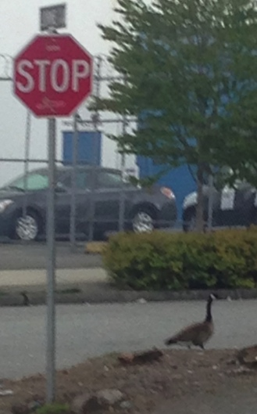
Roads to explore…
A leading question: Are consumer contracts/license agreements redundant &/or unnecessary?
If EULA’s, ToS, & (non) Privacy Agreements disappeared suddenly would the gaps be filled by:
* Copyright
* Competition-antitrust law
* Privacy law
* Consumer protection laws
* International law/treaties
* Legislation & regulation
See: “Peer Progress and Regulation 2.0” Nick Grossman on principles of regulation in the digital networked age
https://citp.princeton.edu/event/grossman/ (video)
http://www.avc.com/a_vc/2013/02/peer-progress-and-regulation-20.html (slides)

Slide 24
Other Alternatives
1. Market uprising: e.g. “Instagram’s revised terms of use: Will the Facebook generation fight back?”http://www.lexology.com/library/detail.aspx?g=d3ce96bc-2b40-4c0c-8a36-c855e6f2207e
2. Technology (DRM+): e.g. “Examining Sony's Internet-free method for blocking used game sales”:
“…patent application…outlines a content protection system that would use small RFID chips embedded on game discs to prevent used games from being played on its systems, all without requiring an online connection.”http://arstechnica.com/gaming/2013/01/examining-sonys-internet-free-method-for-blocking-used-game-sales/

Slide 25
The Future?
“The privacy policy required by this section shall be no more than 100 words and shall be written in clear and concise language at no greater than an eighth grade reading level. The privacy policy shall include a statement indicating whether the personally identifiable information may be sold or shared with others, and if line so, how and with whom the information may be shared.”
Context: Act amends Section 22575 of the Business and Professions Code, which requires that an operator of a commercial Web site or online service operators collecting personal information about consumers to make its privacy policy available.
California BILL No. 242; Assembly Member Ed Chau - February 6, 2013 (BILL No. 242 was 336 words per Techdirt)http://www.leginfo.ca.gov/pub/13-14/bill/asm/ab_0201-0250/ab_242_bill_20130206_introduced.pdf

Slide 26
Further Reading
1. “Empirical studies on software notices to inform policy makers and usability designers”; Jens Grossklags, Nathan Good (University of California Berkeley, 2007)
“Abstract: We evaluate the usability of End User License Agreements (EULAs) of popular consumer programs. Results from an empirical evaluation of 50 popular programs show the lack of accessibility and readability of notices. Our data from a recent study with 64 users involved in installation tasks confirms the public perception that notice to and consent by the user is not achieved.”
http://people.ischool.berkeley.edu/~jensg/research/usec.html
2. “Examination Of Privacy Policies Shows A Few Troubling Trends” (2011)
http://techcrunch.com/2011/11/30/examination-of-privacy-policies-shows-a-few-troubling-trends/

Slide 27
Further Reading 2
3. “Intellectual Property and Shrinkwrap Licenses”; Mark Lemley (1995)
http://papers.ssrn.com/sol3/papers.cfm?abstract_id=2126845##
4. “Terms Of Service, Terms Of Play In Children’s Online
Gaming”; Sara Grimes (2007)
http://www.academia.edu/183319/
Terms_Of_Service_Terms_Of_Play_In_Childrens_Online_Gaming
5. “Confess and protest against the Biggest Lie!”
http://www.biggestlie.com
6. “The Cost of Reading Privacy Policies”; A. McDonald, L.
Cranor. 4 ISJLP 543 (2008-2009)
http://lorrie.cranor.org/pubs/readingPolicyCost-authorDraft.pdf

Slide 28
Further Reading 3
7. “Re-Mediating Research Rthics: End-User License Agreements in Online Games”; Florence Chee, Nicholas Taylor, and Suzanne de Castell (2012) http://www.academia.edu/2976765/Re-Mediating_Research_Ethics_End-User_License_Agreements_in_Online_Games
8. “CLICK AND COPY: BREACH OF ONLINE LICENCE AGREEMENTS AND COPYRIGHT INFRINGEMENT”; Richard Stobbe (2012) 28 C.I.P.R. 227
http://www.ipblog.ca/wp-content/uploads/2013/01/cipr-28-2-click-and-copy-breach-of-
online-license-agreements-and-copyright-infringement-c1380000.PDF
9. “Top EULA Gotchas: Website Fine-Print Hall of Shame” (2012) http://www.pcworld.com/article/249396/top_eula_gotchas_website_fine_print_hall_of_shame.html
10. “Living and Dying in a Virtual World: Estate Planning or Digital Assets”; Greg Lastowka & Trisha Hall (2013) http://lastowka.rutgers.edu/files/2013/10/Lastowka.pdf
11. “Face value: digging through Google’s clumsy new terms of service” (2013) http://www.theverge.com/2013/10/17/4845828/digging-through-new-google-terms-of-service

Slide 29
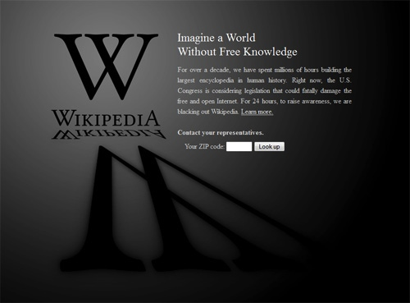
The Post IP World Considered
Two vastly different versions:
Post IP World A = Superseding Contracts rendering IP all but irrelevant {where we are?}
Post IP World B = User Rights + standard formatted, treaty based and/or consumer protected minimalist contracts {where we are not}

Slide 30
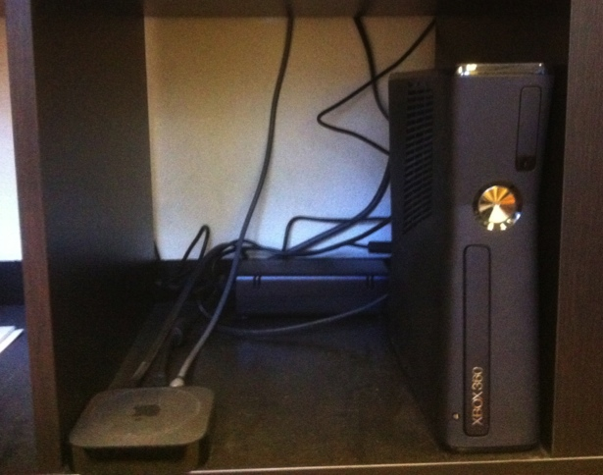
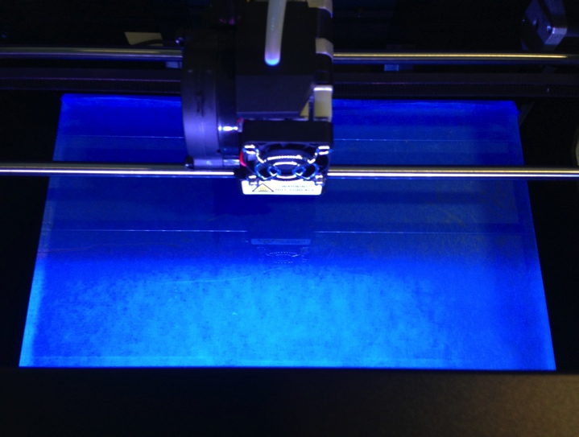

NEXT TIME….
FROM WHEELBARROWS TO HOLODECKS: “CONNECTING” LIVING ROOMS…AND WAY BEYOND… ON THE LEGAL IMPLICATIONS OF TRUE CONVERGEANCE

Slide 31
& just so you have something to ponder in anticipation (1)..
“Parallels of Technology & Justice”
1. Pre-literate
2. Writing Instruments
3. Printing Press
4. Digital
5. Data Cloud ?
Retribution as Justice
Privileged Justice
Rights (equality)
Dispute Resolution
Individuation ?

Slide 32

& just so you have something to ponder in anticipation (2)…
“ARE YOU LIVING IN A COMPUTER
SIMULATION?” Nick Bostrom – Faculty of
Philosophy, Oxford University. http://www.simulation-argument.com/simulation.html
“Physicists devise test to see if we're living in
'The Matrix”http://www.theverge.com/2012/10/11/3487710/computer-simulation-silas-beane-university-bonn
WE ARE ?

Slide 33
Our Academic Partners

