Slide 1
Taking Games Literally
IAN VERCHERE
X 5
SCORE
450 001
TIME
Oct 09, 2013
Games As Semiotic Domain.
UBC Law

Slide 2
Before I Proceed...
Going to next slide means you agree.
Note: Privileged/Confidential information may be contained in this message and may be subject to legal privilege. Access to this e-mail by anyone other than the intended is unauthorized. If you are not the intended recipient (or responsible for delivery of the message to such person), you may not use, copy, distribute or deliver to anyone this message (or any part of its contents ) or take any action in reliance on it. In such case, you should destroy this message, and notify us immediately. If you have received this email in error, please notify us immediately by e-mail or telephone and delete the e-mail from any computer. If you or your employer does not consent to internet e-mail messages of this kind, please notify us immediately. All reasonable precautions have been taken to ensure no viruses are present in this e-mail. As our company cannot accept responsibility for any loss or damage arising from the use of this e-mail or attachments we recommend that you subject these to your virus checking procedures prior to use. The views, opinions, conclusions and other information expressed in this electronic mail are not given or endorsed by the company unless otherwise indicated by an authorized representative independent of this message.

Slide 3
Email Disclaimers…
Prohibited by who?
Why is this at the end of the email?
US Courts have ruled for legal effect when disclaimer is before the text of the email or in the body itself.
In the EU, there is a directive that strikes down legal obligations that have been imposed, and thus disclaimers are unenforceable.

Slide 4
Demo/Attract Mode
Who plays games?
What consoles do you own, if any?
What was the last game that you actually finished?
Have you ever spent money in a free-to-play game?
How many of you Androids have spent money on IAP?

Slide 5
Current Events!

Slide 6
ROADHOUSE INTERACTIVE

Slide 7
Front End
Mid-core ‘free-to-play’ games for smartphones, tablets and browsers.
Amidst the doom and gloom of the Vancouver game industry, we started Roadhouse with 3 people, in December of 2009.
We have grown since then to 55 staff.
We have lots of projects in development.

Slide 8
Front End
Warhammer 40K CARNAGE

Slide 9
Front End
Elemental Power

Slide 10
FREERIDE SKI CROSS
Notes:
Freeride Ski Cross

Slide 11
Front End

Slide 12
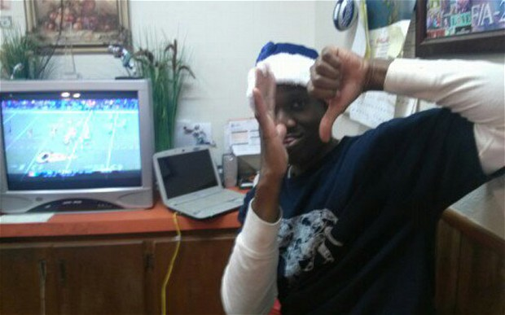
Current Events!
"Like other best-selling games today, Grand Theft Auto V trains millions of young Americans to walk into public places and shoot innocent people...”
- Fox News Commentary
Aaron Alexis: Washington navy yard gunman 'obsessed with violent video games'
- Headline in The Telegraph, UK

Slide 13
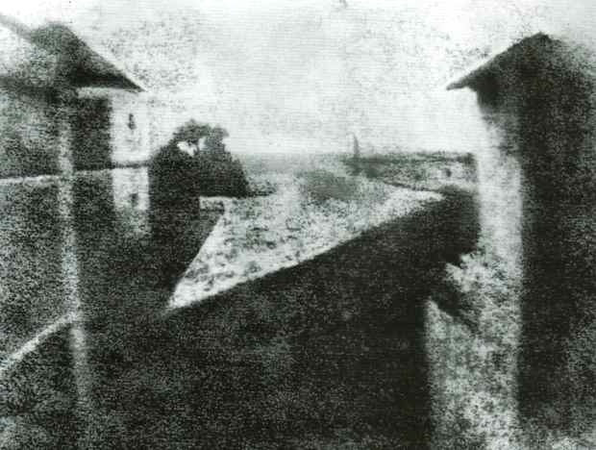
Video games are the end of civilization
Notes:
Photography was the end of painting

Slide 14
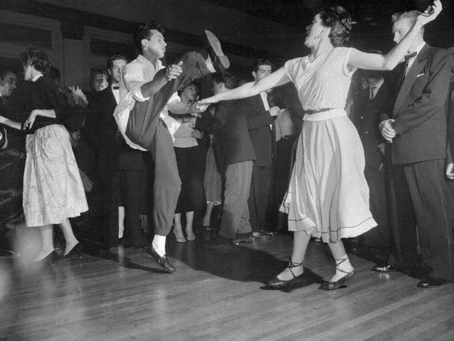
Video games are the end of civilization
Notes:
Swing, Jazz and rock and roll were the end of civilization

Slide 15
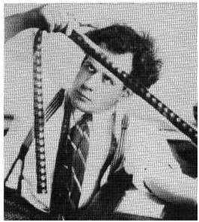
From tech to art

Slide 16
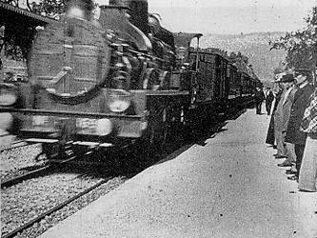
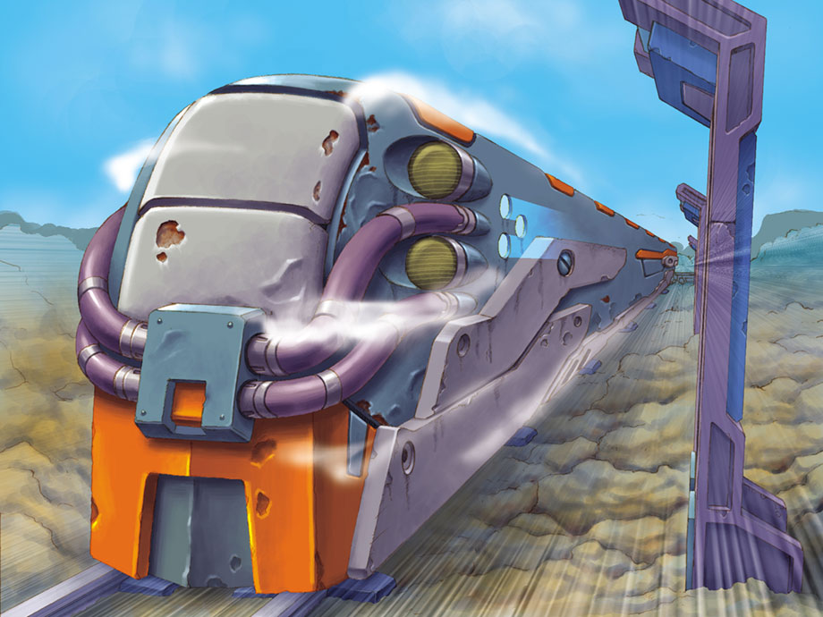
Precedent

Slide 17
Emergence
Average age of gamers now 37
Games are part of the suburban landscape.
It is a first language for people who are 40 and younger.
Moving past the Lumiere phase and into the critical realm where The Art will emerge.

Slide 18
Domains
A domain is the realm of something – sports, music, cinema, food, and of course, games.
Literacy is the ability to *read* or *write* about something – to be a producer and a consumer of texts.

Slide 19
Literacy
Literacy has been traditionally perceived as the ability to read and to write texts in print form.
There are other forms of literacy if the perception of texts are expanded into other domains.

Slide 20
Literacy
You are literate in the domain of law.
In a media rich environment, people need to be literate in multiple domains.
As technology evolves, people have to learn to be literate in new and emerging domains.

Slide 21
Semiotic Domains
Semiotic being the signs and symbols of things that take on meaning.
Domains being the realm of something, VIDEO GAMES are a SEMIOTIC DOMAIN in which people are either literate or they are not.

Slide 22
Domain Case Study
“Mario is Missing” is a fun edu-tainment title that is aimed at educating kids ages 8-12 about the world's geography and history”
- Marketing materials

Slide 23
Domain Case Study
Bonk100's Rating: 1.5
the plot is good and the game would have been better if they didnt throw ONE thing in.... and that is EDUCATION!!! last i checked, VIDEO GAMES ARE FUN! this is NOT fun, it's like a SCHOOL game! if this game had smoother controls, if it made more sense, and if it did NOT have education it would have been A LOT BETTER!!! DO NOT PLAY THIS GAME.....

Slide 24
Domain Case Study
“Mario Is Missing can only exist because Nintendo was forced by hordes of rampaging mothers of underachieving kids to make some game that would stimulate their brains (or at least not rot them out.) The Mommies must have held Nintendo headquarters under siege for months for a game this horrible to have been produced.”
- Reviews of the game

Slide 25
Domain Case Study
This was not a problem of literacy, but of domain.
The gamers were visually and agency literate.
The semiotic domain of video games and that of education were incongruous circa 1992

Slide 26
Domain Case Study
Understanding game literacy can lead to success cross-domain:
Classroom obesity has doubled over past 5 years.
One in five high school students are overweight or obese*
Easy to blame electronics and entertainment media as enablers of “The New Sedentary Childhood.”
Could games offer a possible solution?

Slide 27
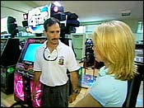
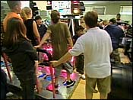
Domain Case Study
Teen cliques: Jocks, Goths, Nerds, Punks
Alienation and performance anxiety lead to decreased participation in physical activity and withdrawal.
A school in Los Angeles brought in DDR machines:

Slide 28
Domain Case Study
Outcome: weight loss, increased attendance, interest in physical activity and positive feedback from health benefits from teens otherwise marginalized from PE.
“The use of video games in P.E. is a departure from traditional P.E. classes, which largely had students teaming up and playing competitive sports. That method of teaching P.E. catered to students who naturally gravitate to sports … so we're moving toward really trying to catch those kids who are nontraditional athletes.”
Fairview Elementary School - PE Teacher Joe Rardin

Slide 29
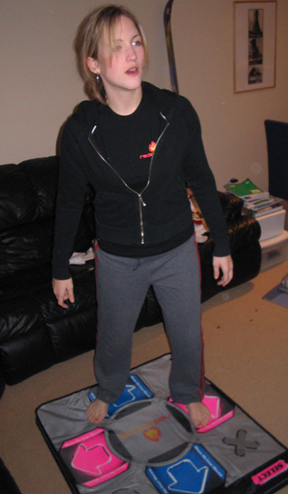
Domain Case Study
Tania lost 95 pounds playing DDR - one hour of DDR burns 100 calories more than jogging.

Slide 30
Ironic Illiteracy
The course would have included one day of classroom instruction in football, baseball and basketball, two days of physical activity and two days of PlayStation tournaments.
Superintendent Don Gaetz halted registration for the course, calling it "an idea whose time will never come."

Slide 31
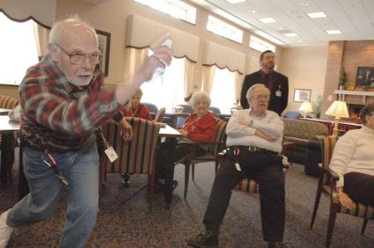
Domain shift

Slide 32
YOU WIN!
The intersection of the domain of law and the domain of games.
Notes:
Being released in North America on October 24th!

Slide 34
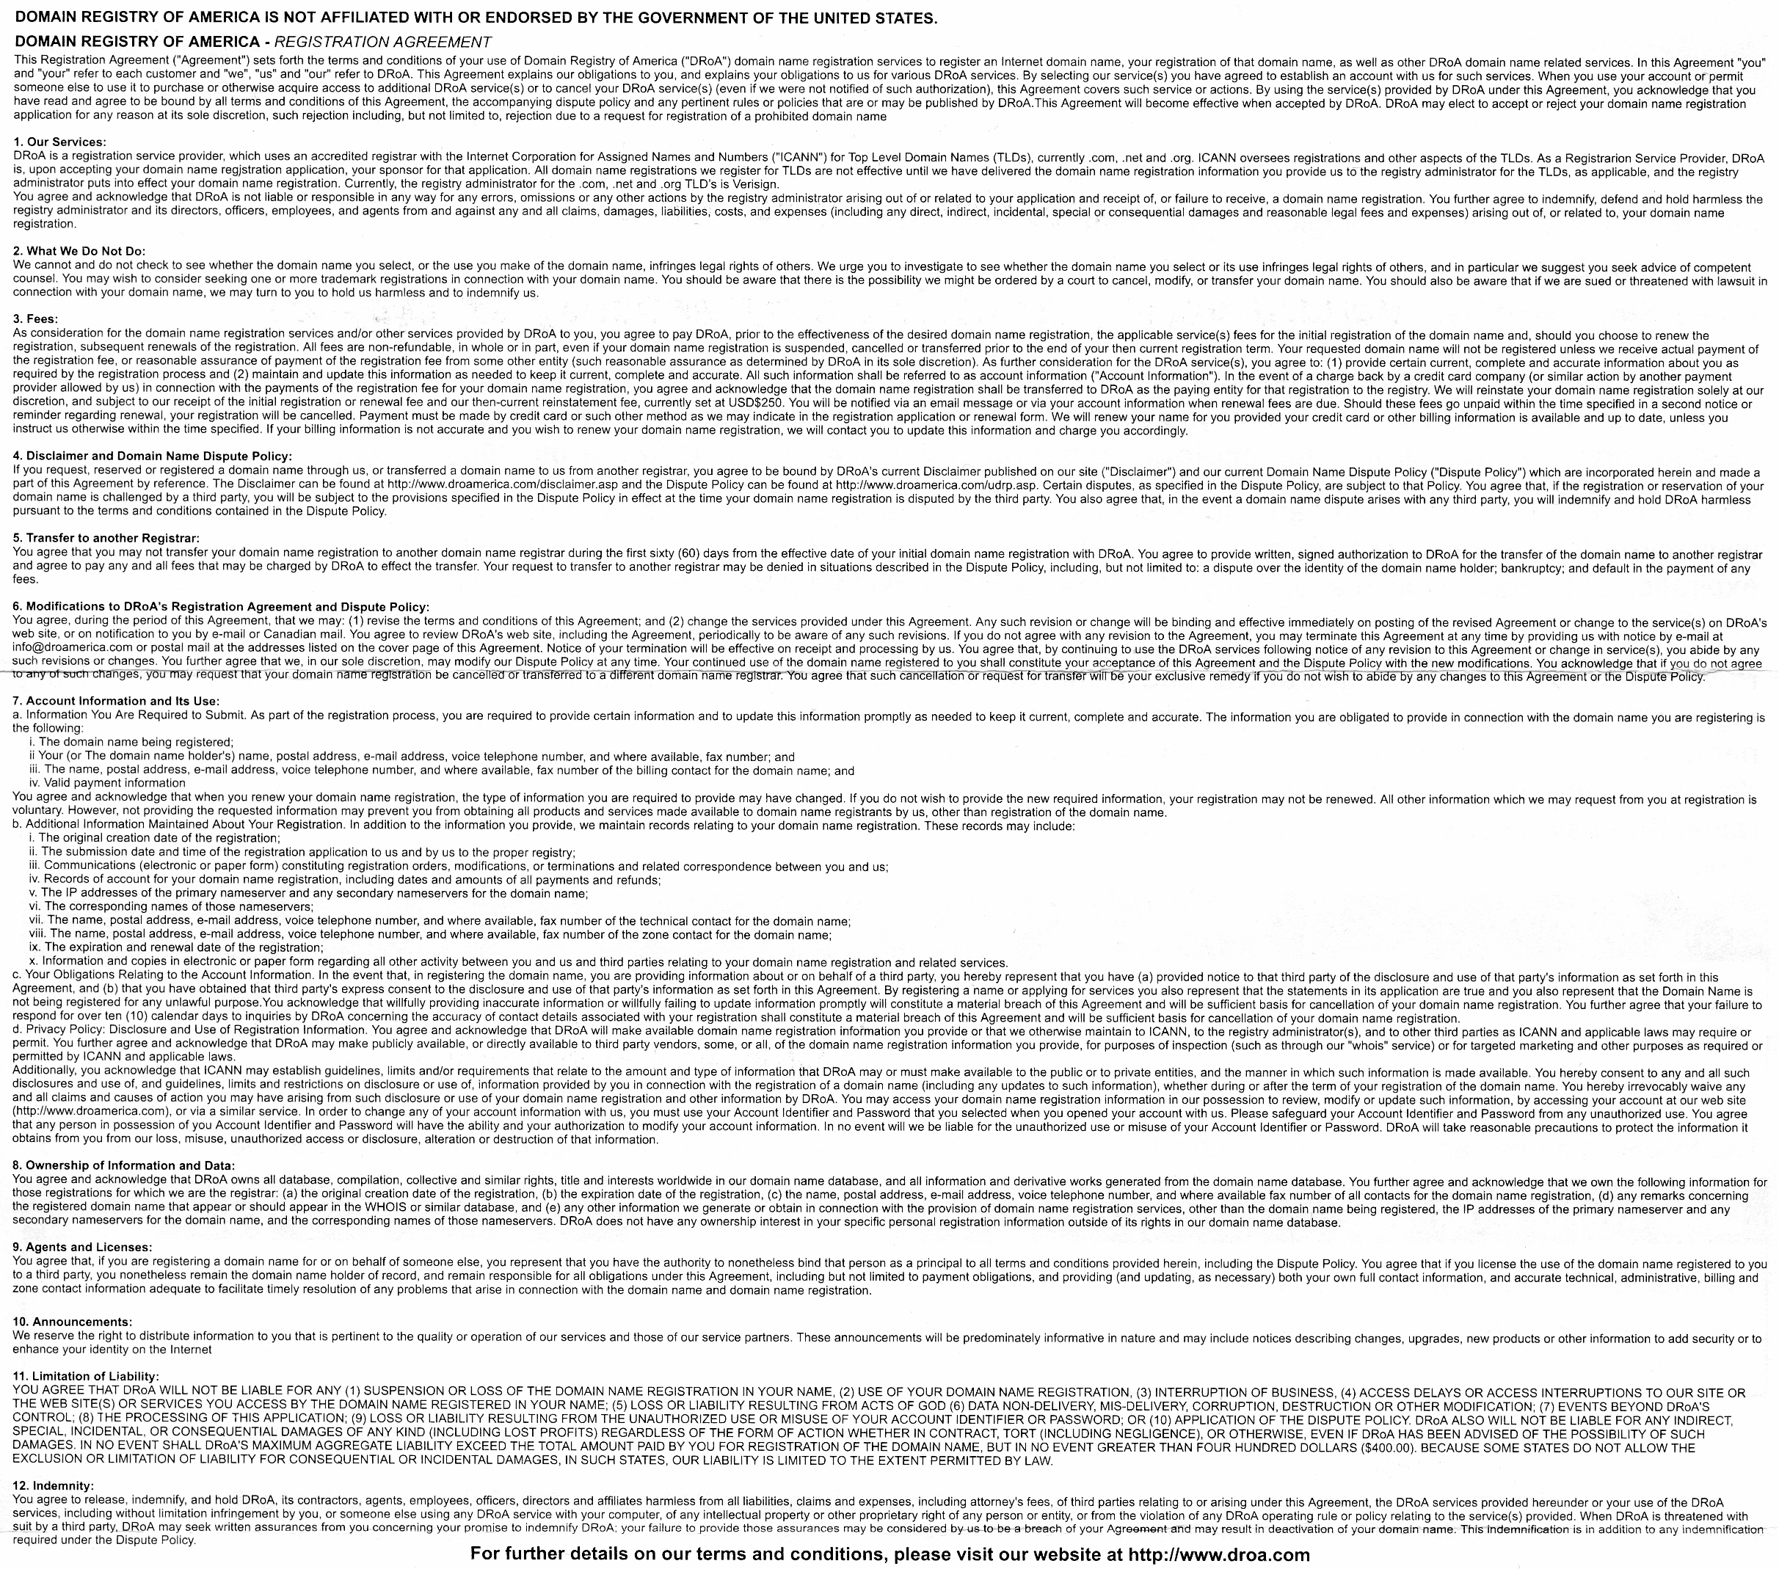
Thanks and QA
What, this? It’s nothing.

