Slide 1


Ethics & Games
Part D “Conciliation” | Talk 12
Video Game Law 2013
UBC Law @ Allard Hall
Jon Festinger Q.C.
Centre for Digital Media
Festinger Law & Strategy
http://videogame.law.ubc.ca
@gamebizlaw
jon_festinger@thecdm.ca

Slide 2

Now at Part D: Conciliation (final leg of journey)
Part A = Creating
Part B = Connecting
Part C = Controlling

Slide 3
Any Questions on 1st Three memes
Part A = Creating
Part B = Connecting
Part C = Controlling
????????????????????

Slide 4


(How) do these (cases) resemble each other?
The Terminator & the Orc
Brown v. Entertainment Merchants Association, 131 S. Ct. 2729 (2011)
(originally VSDA v. Schwarzenegger)
http://www.wneclaw.com/firstamendment/brown.pdf
Davidson & Associates, Inc. v. Internet Gateway, 2005 U.S. App. LEXIS 18973 (8th Cir. 2005) http://cyber.law.harvard.edu/people/tfisher/2005%20Blizzard%20Abridged.pdf

Slide 5

BnetD case “seems to be about”…
* “BnetD” versus Blizzard’s “Battle.net”
* Amici Curiae Brief supporting defendants by teachers of IP Law in U.S. law schools
https://www.eff.org/sites/default/files/filenode/Blizzard_v_bnetd20040221_law_professor_brief.pdf
* Argued unsuccessfully that insofar as they prohibit permissible “reverse engineering” Blizzard’s EULA’s should be preempted by copyright law. Alternatively argued that enforcement of the EULA’s should be denied under the Doctrine of Copyright Misuse (related to concept of “Copyright Monopoly”).
*Attempted unsuccessfully to preserve Sega Enterprises v. Accolade, Inc. statement of the application of Fair Use to to reverse Engineering
* HARSHEST MOD CASE

Slide 6
Schwarzenegger case “seems to be about”…
California Statute defined “violent video
game” as:
“(d)(1) “Violent video game” means a video game in
which the range of options available to a player
includes killing, maiming, dismembering, or
sexually assaulting an image of a human being, if
those acts are depicted in the game in a manner
that ...: A) Comes within all of the following
descriptions:
A reasonable person, considering the game as a whole, would find appeals to a deviant or morbid interest of minors.
It is patently offensive to prevailing standards in the community as to what is suitable for minors.
It causes the game, as a whole, to lack serious literary, artistic, political, or scientific value for minors.”

Slide 7

on ‘Correlation not Causation’…
“In sum, the evidence presented by the State does not support the Legislature’s purported interest in preventing psychological or neurological harm. Nearly all of the research is based on correlation, not evidence of causation, and most of the studies suffer from significant, admitted flaws in methodology as they relate to the State’s claimed interest. None of the research establishes or suggests a causal link between minors playing violent video games and actual psychological or neurological harm, and inferences to that effect would not be reasonable. In fact, some of the studies caution against inferring causation. Although we do not require the State to demonstrate a “scientific certainty,” the State must come forward with more than it has. As a result, the State has not met its burden to demonstrate a compelling interest.”

Slide 8

on Comparative Literature
“California's argument would fare better if there were a
longstanding tradition in this country of specially restricting
children's access to depictions of violence, but there is none.
Certainly the books we give children to read -- or read to them
when they are younger -- contain no shortage of gore. Grimm's
Fairy Tales, for example, are grim indeed. As her just deserts
for trying to poison Snow White, the wicked queen is made to
dance in red hot slippers "till she fell dead on the floor, a sad
example of envy and jealousy." Cinderella's evil stepsisters have
their eyes pecked out by doves. And Hansel and Gretel kill their
captor by baking her in an oven.
High-school reading lists are full of similar fare. Homer's
Odysseus blinds Polyphemus by grinding out his eye with a heated
stake. In the Inferno, Dante and Virgil watch corrupt politicians
struggle to stay submerged beneath a lake of boiling pitch. And
Lord of the Flies recounts how a schoolboy is savagely murdered
by other children while marooned on an island.
This is not to say that minors' consumption of violent
entertainment has never encountered resistance. In the 1800's,
dime novels depicting crime and "penny dreadfuls" were blamed in
some quarters for juvenile delinquency. When motion pictures came
along, they became the villains instead. Radio dramas were next, and then came comic books. And, of course, after comic books came
television and music lyrics.”

Slide 9
on the impact of ‘Interactivity’
“California claims that video games present special
problems because they are “interactive,” in that the
player participates in the violent action on screen and
determines its outcome. The latter feature is nothing new:
Since at least the publication of The Adventures of You:
Sugarcane Island in 1969, young readers of choose-your-
own-adventure stories have been able to make decisions
that determine the plot by following instructions about
which page to turn to. As for the argument that video
games enable participation in the violent action, that
seems to us more a matter of degree than of kind.” (Justice
Scalia delivering the opinion of the Court)
Versus
“When all of the characteristics of video games are taken
into account, there is certainly a reasonable basis for
thinking that the experience of playing a video game may be
quite different from the experience of reading a book,
listening to a radio broadcast, or viewing a movie. And if
this is so, then for at least some minors, the effects of
playing violent video games may also be quite different. The
Court acts prematurely in dismissing this possibility out of
hand.” (Justice Alito, concurring in the result)

Slide 10


Truth in ‘tone’…
Audio of the June 20, 2005 oral argument in 8th Circuit Court of Appeal in Blizzard v. BnetD (Davidson) @ 32:40 – 33:05: “This case does not involve new creation. There may be a case that does. This isn’t it…”
Audio of the November 2, 2010 oral argument in the U.S. Supreme Court in Brown v. Entertainment Merchants Association @ 1:13 - 7:20 + 11:25 - 14:04: “What’s a deviant violent video game?...Some of the Grimm’s Fairy Tales are quite grim…” + “I’m not concerned with the jury judging, I’m concerned with the producer of the game…”

Slide 11
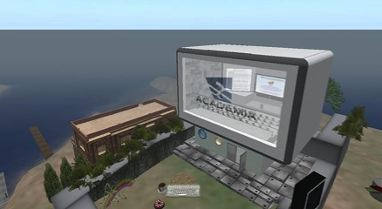
Common Denominator 1
The word: CREATIVITY
Problem is not in asserting creativity (of
Blizzard/game makers); it is in both cases
the denial of the creativity of others
(modders, children, the child in all of us)
Recall uniquely personal “Hollywood Model” of
creation (‘It’s all about ME & MY UNIQUE TALENT’)
In Swartzenegger the Court was protecting the
implications of creativity no matter how
extreme (in terms of violence, not sex) so the
creator can create (& the user can ‘benefit’)
In Davidson argument was that BnetD was anything
but creative (because it all changes if user
creativity is implicated???)
Never mentioned: USERS ARE CREATORS

Slide 12
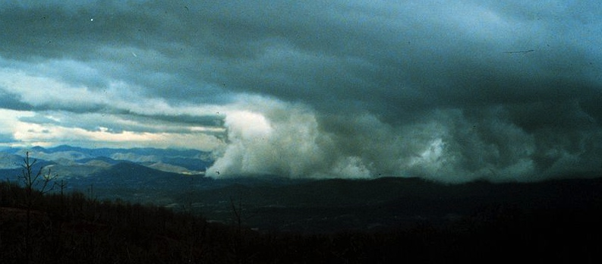
Common Denominator 2: “Chill”
Censorship = Libel Chill
Copyright Infringement
fears = uncertainties =
“Creative Chill”

Slide 13

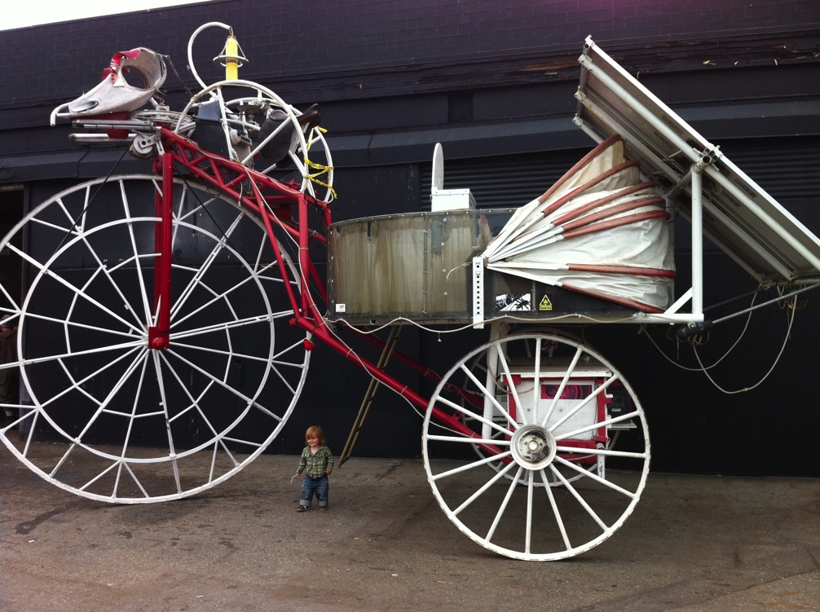
Application of all this…
TO MODS

Slide 14
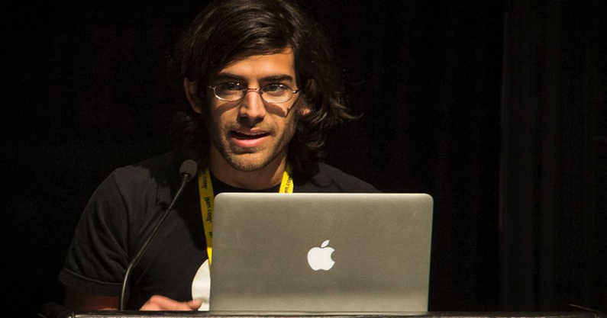
In the coming of the Digital world
the Law often seems behind,
disconnected and confused,
incapable or too slow to do
Justice..
“[s]tealing is stealing whether you use a computer command
or a crowbar, and whether you take documents, data or
dollars. It is equally harmful to the victim whether you
sell what you have stolen or give it away.”*
*The United States Attorney’s Office, District of Massachusetts, Press Release, “Alleged Hacker Charged with
Stealing over Four Million Documents from MIT Network” (19 July 2011), online: <
http://www.justice.gov/usao/ma/news/2011/July/SwartzAaronPR.html>

Slide 15
We are disappointed by this.
Should we be?
Perhaps the effect of an inevitable cause?

Slide 16
Concepts of law & justice
do not shape
communications
technologies
nearly as much as they
are shaped by them.

Slide 17
Technology /Justice (Parallels)?
Before Justice was Revenge
1. Pre-literate => Justice as Retribution
2. Writing Instruments => Justice as Truth
3. Printing Press => Justice as(Privileged)
Rights
4. Mass Media=>Justice as (Equality) Rights
5. Digital => Justice as Resolution
6. Big Data =>
-----FUTURE----
=> 6. Justice as Boundaries
7. Virtual reality => ???

Slide 18
Cases Neither Allow Nor Prohibit (Creative) Modding
Micro Star v. FormGen (1998 USCA)
2. Davidson & Associates, Inc. v. Internet Gateway 2005 USCA (D&A = Blizzard):
Audio of the June 20, 2005 oral argument in 8th Circuit Court of Appeal in Blizzard v. BnetD (Davidson) @ 32:40 – 33:05: “This case does not involve new creation. There may be a case that does. This isn’t it…”
3. iRacing v. Robinson (2007 Mass. Dist. Ct.)
4. MDY Industries, LLC v. Blizzard Entertainment, Inc. (2010 USCA)

Slide 19
WHICH
LEADS TO…

Slide 20
WE CAN……
……evolve a single standard:
For CREATORS as USERS, &
For USERS as CREATORS……
to match reality…
Facilitating “true”
INTERACTIVITY set Mods apart
from other (one-way) art
It make a difference that mods/
games are a tool of other/
further creativity.
Who owns SHARED CREATIVITY?
Is modding a “Right to
CREAtE” (expression/speech) or a
“Creator’s Right” (part of/defense
to: copyright)?
Users Rights ought to be a “Right
to CREAtE” not “Rights of Creation”

Slide 21
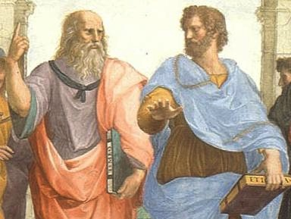
IF WE
EVOLVE
CERTAIN
(ETHICAL)
PRINCIPLES

Slide 22


1st Principles: A. Ethics Before Law
Ethics Must Dictate Law;
Law Must Not Dictate Ethics;
Where Law Dictates Ethics, that is Repression.
Unlike the chicken and an egg, we can
determine what comes first…

Slide 23
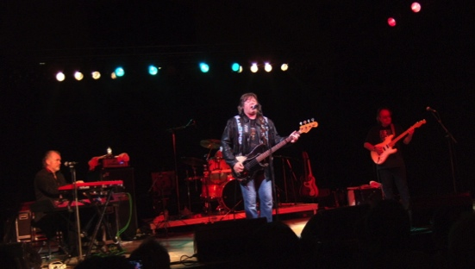

1st Principles: B. Everything is Connected (including creativity/identity)
“We are the sum of all the people we have ever met; you change the tribe and the tribe changes you.” Fierce People by Dirk Wittenborn
“Neurologist Oliver Sacks on Memory, Plagiarism, and the necessary Forgetting's of Creativity”: “We, as human beings, are landed with memory systems that have fallibilities, frailties, and imperfections — but also great flexibility and creativity. Confusion over sources or indifference to them can be a paradoxical strength: if we could tag the sources of all our knowledge, we would be overwhelmed with often irrelevant information”.http://www.brainpickings.org/index.php/2013/02/04/oliver-sacks-on-memory-and-plagiarism/
Bruce Springsteen SXSW keynote @ 24:27 - 26:40 & 27:35 - 30:00 http://www.youtube.com/watch?v=JWbv0SUVQjM&list=PLEqpzAExPV-xr9gIhSqLMxTSXrimGF6pA&index=2
Playing Computer Games Together Makes Brains Feel and Think Alikehttp://www.sciencedaily.com/releases/2013/11/131121091439.htm

Slide 24
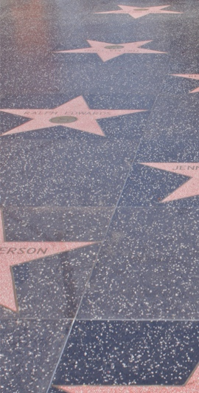
1st Principles: B. Everything is Connected Another Take on Original-ism
“More then ever, the narcissistic interests of those who make art count for more than the human needs of those who desire and supposedly benefit from it – and how much they benefit from it is the contemporary question about art.” Donald Kuspit, “Signs of Psyche in Modern and Post Modern Art” (1994)
* Is there a game without the gamer?
* Mods through objective content measurement??
* Personal creation mythology appears unsound by research, less sound still from a human perspective

Slide 25

1st Principles: C. Preponderance of
Human Creativity - Test of “Good”
Derek Parfit 1: “My life seemed like a glass tunnel, through which I was moving faster every year, and at the end of which there was darkness... [However] When I changed my view, the walls of my glass tunnel disappeared. I now live in the open air. There is still a difference between my life and the lives of other people. But the difference is less. Other people are closer. I am less concerned about the rest of my own life, and more concerned about the lives of others.” Reasons and Persons (1984)
Derek Parfit 2: Objective v. Subjective Theories of “(Non-Religious) Ethics” On What Matters (2011)
* Demonstrate through GPL & other mods that preponderance of creativity lies with the co-creators
* Add in players playing as co-creators then every creative work is comprised mostly of others creativity/work/effort
* With respect to art, music, TV, film add in viewing, dancing, fan fiction & “fan-ish behavior” (tougher then games but same result)

Slide 26
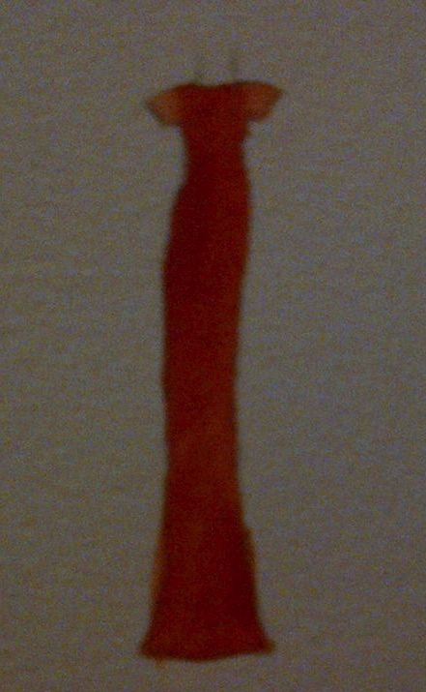

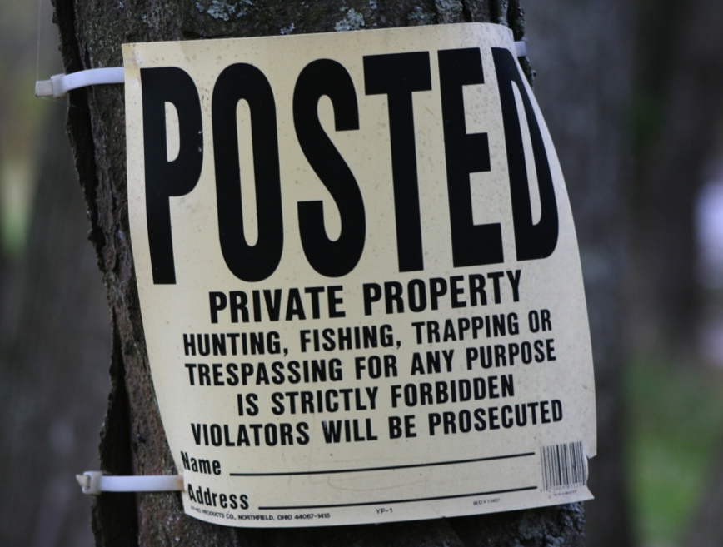
1st Principles D:
Creativity is More
Important Than Property

Slide 27

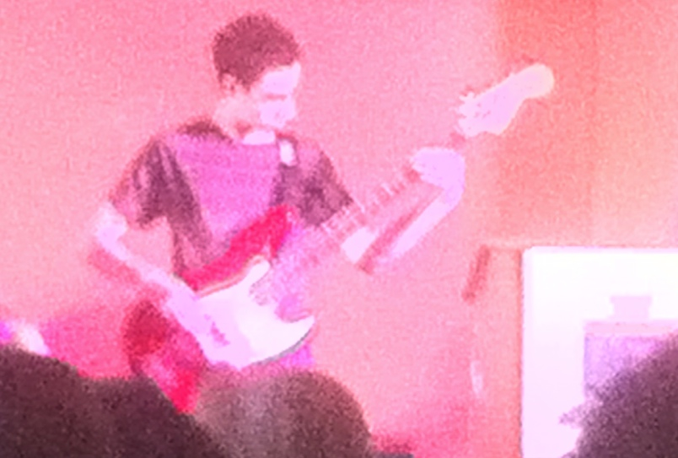
Consequence of 1st Principles D:
Is It Barter Not Theft(Piracy)IF We Are All Creators?

Slide 28

1st Principles E:
Prior Restraints Are A Problem
Blackstone: “Every freeman has an undoubted right to lay what sentiments he pleases before the public; to forbid this, is to destroy the freedom of the press; but if he publishes what is improper, mischievous or illegal, he must take the consequence of his own temerity.” (4 Bl. Com. 151, 152.)
*IP as “Prior Restraint” to Creativity?
*EULA’s & ToS’ as even greater
“Prior Restraint” to Creativity

Slide 29
Constraints Distort Creativity
11. Internet Governance & Surveillance (International Law)
10. Criminal & Obscenity Laws.
9. Taxation/Currency/Gambling (regulatory; quasi-criminal)
8. Misleading promises/advertising, physical or
psychological harm, unfair competition/anti-trust
(consumer protection)
7. Industry self regulation (delegated authority) & medium
specific regulation (constitutional)
Out of the Creation Norms (Censorship) ----------------------------------------------------------
In the Creation (Magic Circle) Ethics (of Originality, Creativity & Expression)
6. Privacy, Defamation & Personality law (tort, IP)
5. EULA/ToS & Contracts (contractual, private)
4. Trademark, Patents & the IP Business
3. Copyright & Users Rights (statutory)
2. Technology (quasi extra-legal)
1. Community (extra-legal)

Slide 30
OK THEN…

Slide 31
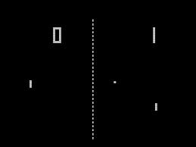

Right to Mod Argument - Method A:
Revert to No Protection for Games
“Games and Other Uncopyrightable Systems” Bruce Boyden 2011 http://www.georgemasonlawreview.org/doc/Boyden_18-2_2011.pdf
“Games therefore pose a number of challenges for copyright and patent law. Yet to date, intellectual property doctrine and scholarship has not really grappled with the slippery nature of games. Indeed, copyright has developed a very simple black-letter rule to handle them: games are not copyrightable. That rule begins to fall apart on close examination, however. It turns out that while games per se are not copyrightable, most of their constituent elements are: the board, pieces, cards, and even the particular expression of the rules. What could be the purpose of such a rule?”

Slide 32
Right to Mod Argument - Method A:
Revert to No Protection for Games
“Games and Other Uncopyrightable Systems” Bruce Boyden (2011) http://www.georgemasonlawreview.org/doc/Boyden_18-2_2011.pdf
“Games therefore pose a number of challenges for copyright and patent law. Yet to date, intellectual property doctrine and scholarship has not really grappled with the slippery nature of games. Indeed, copyright has developed a very simple black-letter rule to handle them: games are not copyrightable.
…What could be the purpose of such a rule?”
Two possibilities emerge from the cases. First, several cases describe games, and game rules, as unprotectable ideas… The other possible explanation that emerges from the case law is that games are uncopyrightable systems or processes.

Slide 33
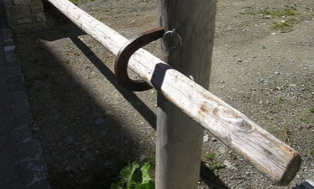

Right to Mod Argument – Method B:
Raise Thresholds for IP Protection
* “Personal Genius” theory of creativity undermined by low level of originality in copyright and ease of differentiation in patent. See “The Innovation Dilemma: Intellectual Property and the Historical Legacy of Cumulative Creativity” - Graham M. Dutﬁeld and Uma Suthersanen (U.K.): “The downside of having a wide capacity to protect, however, is that copyright law does manage to ensnare essential information and elements that form a part of the knowledge base, which in turn impedes the progress of follow-on innovators who must build upon such vital building blocks.” http://www.academia.edu/860340/

Slide 34
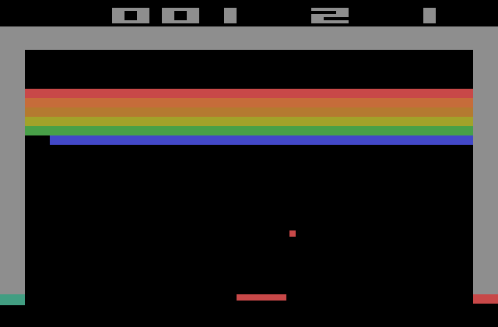
Right to Mod Argument –
Methods A + B Combined
Not the game..
Not the
Interactivity..
But the “art”
that attracts
copyright protection

Slide 35
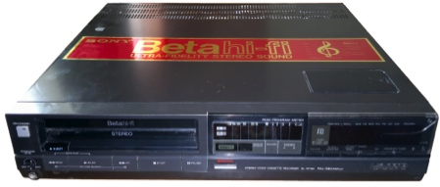
Right to Mod Argument – Method C:
“Context Shifting”
*Imagine a world without Sony v.
Universal SCOTUS 464 U.S. 417 (1984)
(Betamax) time-shifting” fair use
*Isn’t everything digital a form of tool
enabled “time- shifting”
= “context shifting”
Key Factors in Sony:
a. enlarged audience b. copyright value not impaired
Jumping off point for Fair Use: –
Digital is “todays tool”
= “Context shifting”

Slide 36
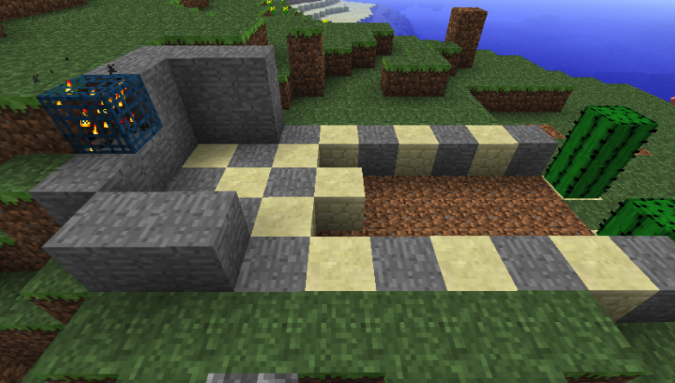

Right to Mod Argument – Method D:
Right to Mod/CREAtE
SHOULD NOT User Rights/Right to CREAtE-Mod really be a creative/expressive right rather than an IP right/protection?
Part of Freedoms of Thought/Conscience?
Part of Free Expression (criticism & review/news reporting)
An expanded “public interest” based Fair Dealing/Fair Use?
As an independent “right”

Slide 37
Right to Mod Argument – Method E:
Fair Use/Dealing – “User Rights”
Recent SCC “User” paradigm shifts
USERS ARE CREATORS TOO
August 2012 “Copyright Pentalogy” & previous
From fair dealing as an exception to
infringement towards proactive “User Rights”
Right to Link (Crookes v. Newton)
Right to longer iTunes previews
Tech Neutrality
Fair dealing is to be assessed from the point of view of the purchaser/user
“Research” need not be associated with traditional intellectual pursuits

Slide 38
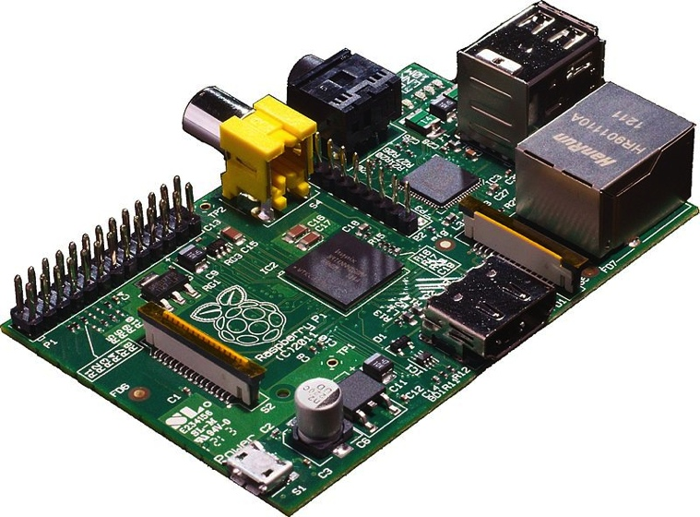
‘Pentalogy’ as harbinger..
User’s Rights
Creator’s Rights:
Same thing?
(individual rights
& responsibilities)

Slide 39
In this context: SCC “User” paradigm shifts
August 2012 “Copyright Pentalogy” & previous cases
Moving from fair dealing as an exception to copyright infringement towards proactive “User Rights”
Right to Link (Crookes v. Newton)
Right to longer iTunes previews
Tech Neutrality
Fair dealing is to be assessed from the point of view of the purchaser/user
“Research” need not be associated with traditional intellectual pursuits
See: “Reflections on the Supreme Court of Canada 2012 Copyright Decisions” (IP Osgoode) Nov. 29,2012http://www.iposgoode.ca/2012/11/ip-osgoode-speaker-series-the-honourable-mr-justice-marshall-rothstein-%E2%80%93-reflections-on-the-supreme-court-of-canada-2012-copyright-decisions/

Slide 40

SCC Penatalogy Quotes
Abella J. for the majority in Alberta (Education)
v. Canadian Copyright Licensing Agency (Access
Copyright) 2012 SCC 37:
“…fair dealing is a “user’s right”, and the
relevant perspective when considering whether the
dealing is for an allowable purpose…is that of the
user…”
Abella J. for the Court in Society of composers,
Authors and Music Publishers of Canada v. Bell
Canada 2012 SCC 36:
“Further, given the ease and magnitude with which
digital works are disseminated over the Internet,
focusing on the “aggregate” amount of the dealing in
cases involving digital works could well lead to
disproportionate findings of unfairness when compared
with non-digital works.”
See also: “Copyright Fair Use Cases of the
United States Supreme Court” http://www.ipwatchdog.com/2012/10/05/copyright-fair-use-cases-of-the-united-states-supreme-court/id=26225/

Slide 41
Non-commercial User-generated
Content, S.29.21 Copyright Act
Non-commercial user-generated content
29.21 (1) It is not an infringement of copyright for an individual to use
an existing work or other subject-matter or copy of one, which has been
published or otherwise made available to the public, in the creation of a
new work or other subject-matter in which copyright subsists and for the
individual — or, with the individual’s authorization, a member of their
household — to use the new work or other subject-matter or to authorize an
intermediary to disseminate it, if
(a) the use of, or the authorization to disseminate, the new work
or other subject-matter is done solely for non-commercial purposes;
(b) the source — and, if given in the source, the name of the author,
performer, maker or broadcaster — of the existing work or other subject-
matter or copy of it are mentioned, if it is reasonable in the
circumstances to do so;
(c) the individual had reasonable grounds to believe that the existing work
or other subject-matter or copy of it, as the case may be, was not
infringing copyright; and
(d) the use of, or the authorization to disseminate, the new work or other
subject-matter does not have a substantial adverse effect, financial or
otherwise, on the exploitation or potential exploitation of the existing
work or other subject-matter — or copy of it — or on an existing or
potential market for it, including that the new work or other subject-
matter is not a substitute for the existing one.

Slide 42

A Related Path: Moral Rights
Regime of ATTRIBUTION + INTEGRITY
IF TO IP = 1. commercial impact test
irrelevant;
2. right to be attributed
3. right to protect work’s
integrity
IF TO PRIVACY = Attribution & Integrity
includes non-attribution
(“right to be forgotten”)
IF TO CONTRACTS = ??? (but cannot assign –
only waive)
NOTE: Copyright Act (Canada) now extends
moral rights to “performers” in their
“performances”.

Slide 43
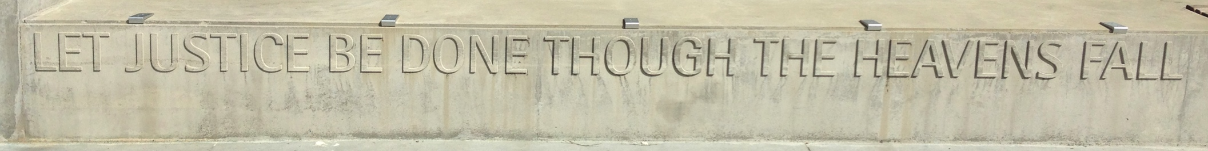
"The world as we have created it is a process of our thinking. It cannot be changed without changing our thinking”
Albert Einstein

Slide 44

The Truth About Video Game IP?
1. Games are inherently creative & interactive
2. Games have a larger evolutionary purpose
3. Video games are “evolved” games
4. In context the “art” though wonderful is
incidental to the game…
5. The experience, the evolving narrative
& playing (creation) is the key…
6 …& player as co-creator of the game…
The “Red Herring”?:
IP in the game is
more incidental then core ???

Slide 45
(TODAY) IN THE DIGITAL WORLD
idea
private
EXPRESSION
PUBLIC

Slide 46
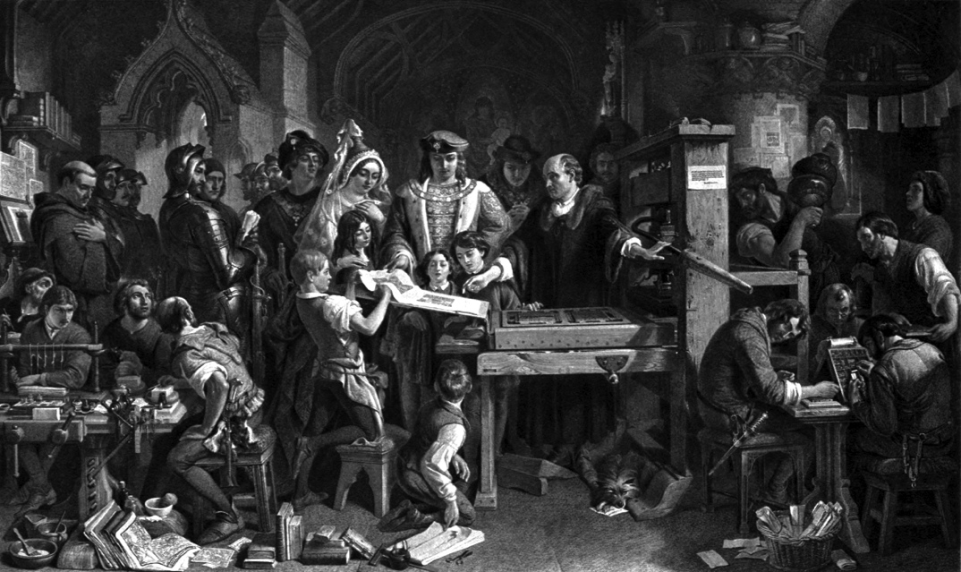
Understanding Copyright as part of the democratization of thought? As part of a trajectory of creative freedoms?
From King…to Parliament…to Government
Regulator…to Industry Self Regulation…to Author…
to User..
Have we stopped @ 1710 Statute of Anne?
= Right to Mod/CREATE?

Slide 47
The Academic Battleground
“The Illegal Process: Basic Problems in the Making
and Application of Censorship” by James
Grimmelmann: http://lawreview.uchicago.edu/sites/lawreview.uchicago.edu/files/uploads/Dialogue/Grimmelmann%20Online.pdf
In response to:
1A. “Orwell’s Armchair” by Derek Bambauer: http://lawreview.uchicago.edu/sites/lawreview.uchicago.edu/files/uploads/79_3/01%20Bambauer%20ART.pdf
(Re indirect v. direct internet censorship – Bambauer argues
direct preferable)
2. “Collateral Censorship and Freedom of the Press”
by Christina Mulligan http://papers.ssrn.com/sol3/papers.cfm?abstract_id=2224058
(Net intermediaries need near-complete immunity to avoid chill
of gov’t effectively censoring creators)
3. “The Regulatory Turn in IP” by Mark Lemley
http://papers.ssrn.com/sol3/papers.cfm?abstract_id=2172440
4. “A Case for the Public Domain” by Clark Asay
https://papers.ssrn.com/sol3/papers.cfm?abstract_id=2201066
5. “Error Costs & IP Law” by Joseph Miller
http://papers.ssrn.com/sol3/papers.cfm?abstract_id=2212256

Slide 48
Battleground 2
6. Does copyright law work? New and ongoing empirical research suggests: not always
http://www.cjr.org/cloud_control/empirical_ip.php?page=all
7. Copyright & Creation: A case for Promoting Inclusive Online Sharing
http://www.lse.ac.uk/media@lse/documents/MPP/LSE-MPP-Policy-Brief-9-Copyright-and-Creation.pdf
8. How Intellectual Property Reinforces Inequality
http://opinionator.blogs.nytimes.com/2013/07/14/how-intellectual-property-reinforces-inequality/?_r=0
9. Fan Communities and the Self-Regulation of Digital Creative Space
http://script-ed.org/?p=1165

Slide 49
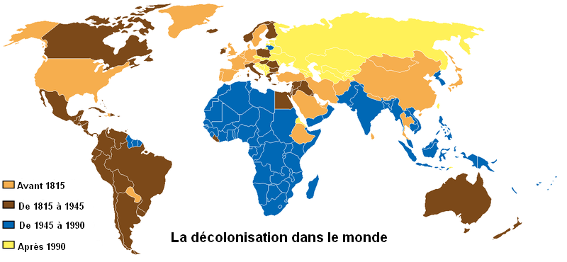
Also: Original-ism (the “Hollywood Model”) as Neo-colonialism
See “Intellectual Property: The Global
Spread of a Legal Concept” Alexander Peukert http://papers.ssrn.com/sol3/papers.cfm?abstract_id=2218292

Slide 50

The buck stops here…
“Judges as Bad Reviewers:
Fair Use and
Epistemological Humility”
Rebecca Tushnet,
Georgetown University Law
Center
“…the future of fair use as
a formal doctrine in the
United States depends on
whether judges act like bad
reviewers on Amazon.com, or
whether they behave
differently in interpreting
challenged works than they do
in almost every other aspect
of judging.”

Slide 51
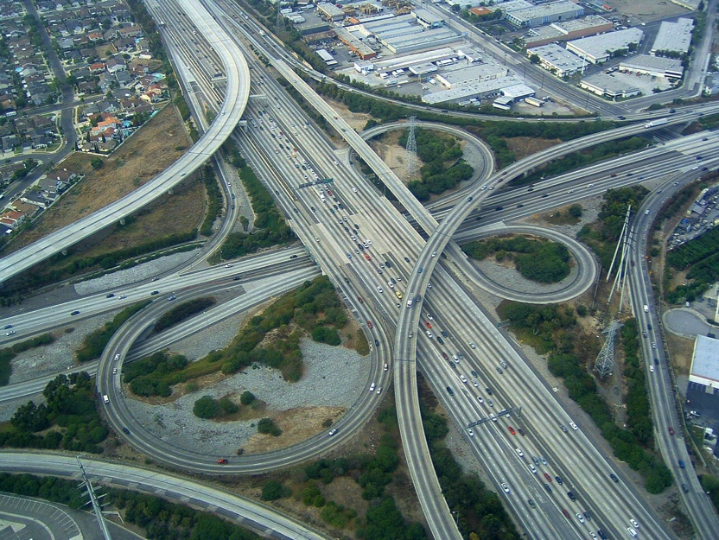
CONCLUSION
EVERYTHING IS A VIDEO-GAME:
GAMES ARE AND REMAIN AT THE
CUTTING EDGE CROSS-ROADS OF
FREEDOM OF SPEECH/
EXPRESSION, COPYRIGHT/IP &
CONTRACTS. NO LENS FOR THE
LAW IS CLEARER OR LESS
FORGIVING BECAUSE VIDEO
GAMES IMPLICATE CREATIVITY,
INTERACTIVITY & CUTTING EDGE
TECHNOLOGY LIKE NOTHING ELSE
DOES.

Slide 52

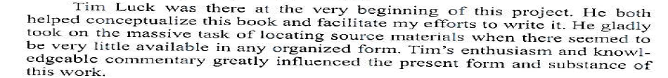
Tim Luck…(in memory)
…

Slide 53

Finis
“I have learned much from my teachers, more from my peers, but from my students most of all” (Ta'anit 7a)
THANK YOU…

Slide 54

Stay in touch…

Slide 55
Our Academic Partners

