Slide 1
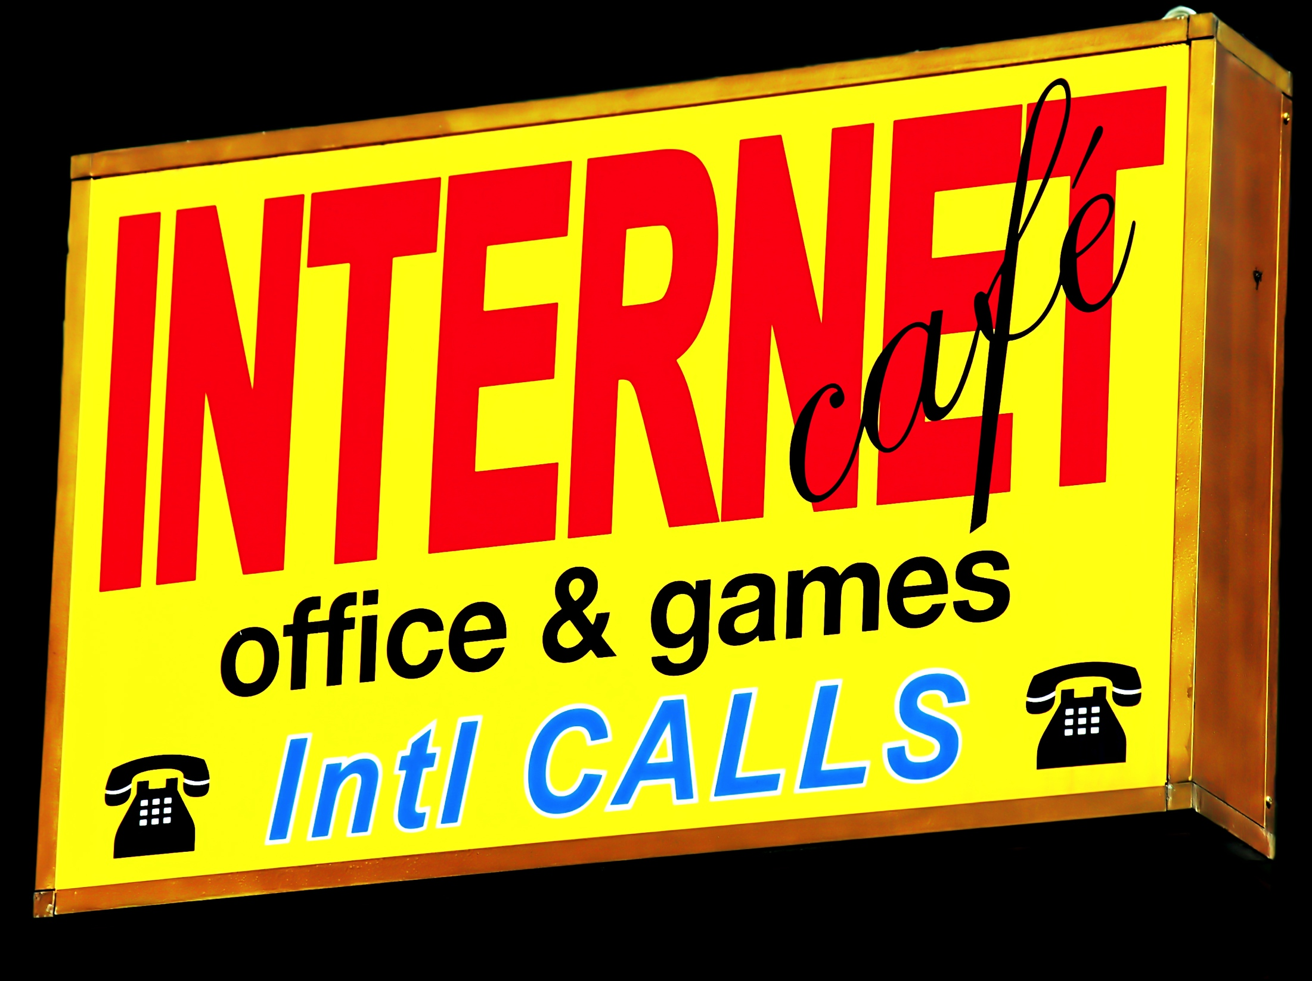

Social Media Memes
& Legal Realities
“And Now For a Word…FROM
the Audience. Social Media:
Disruption and Opportunity”
The Law Society of Upper Canada
17th Biennial National Conference
New Developments in Communications
Law and Policy, May 1 2014
PRESENTATION NOTES
Jon Festinger Q.C.
Festinger Law & Strategy
Centre for Digital Media
UBC Faculty of Law
TRU Faculty of Law
http://videogame.law.ubc.ca
@jonfestinger
jon_festinger@thecdm.ca

Slide 2
What is
“Social Media”?

Slide 3
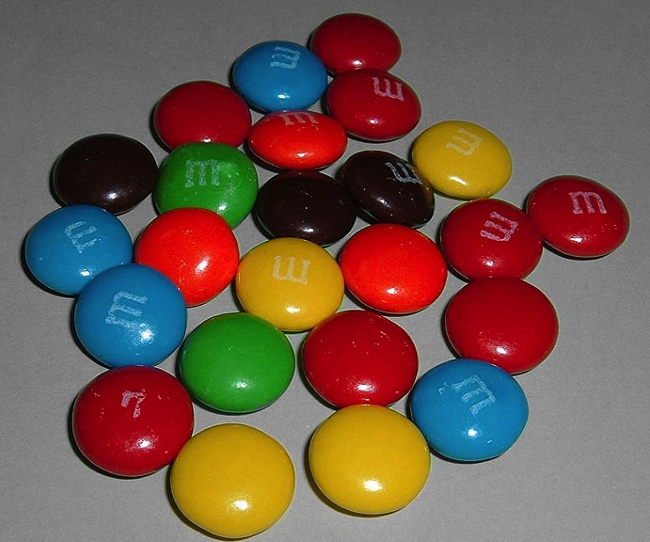

All A MATTER OF PERSPECTIVE

Slide 4
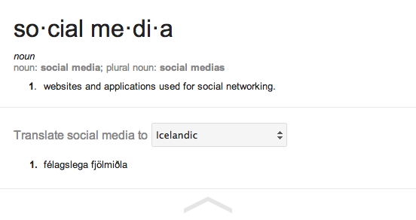
A Definition of Social Media
My definition: “ Social media uses interactive platforms for distributing (digital) communications incorporating user created, modified or shared content.”

Slide 5
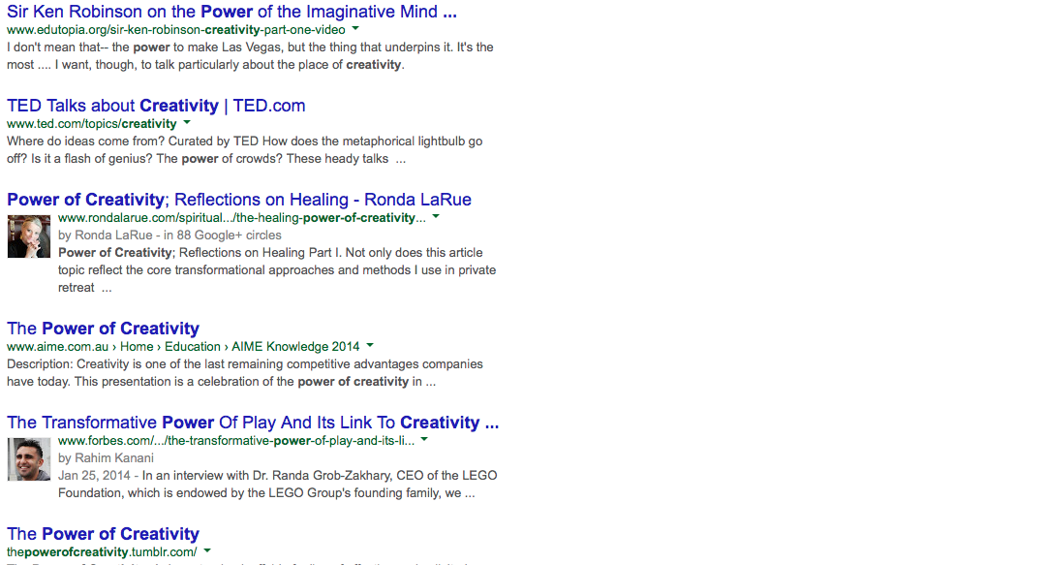
Do not underestimate the transformative nature of empowering personal creativity
& resulting human connection

Slide 6
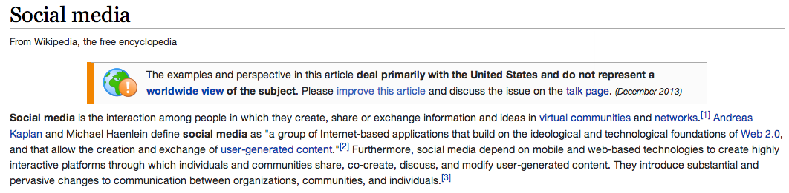










Slide 7
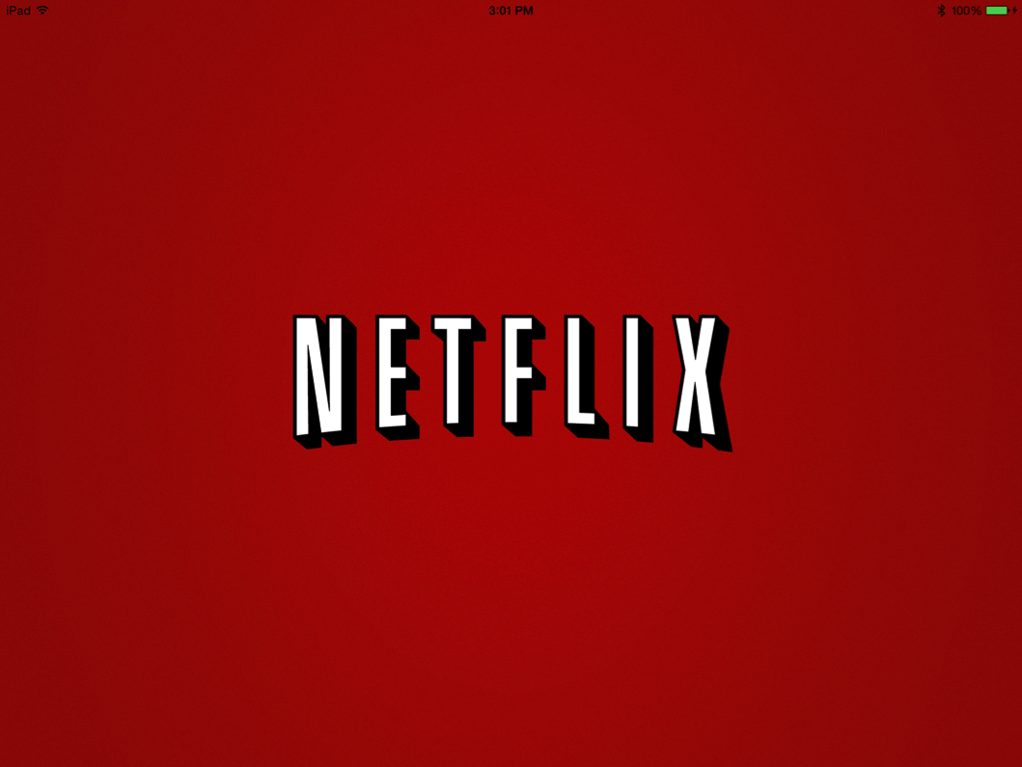





What About ?????

Slide 8
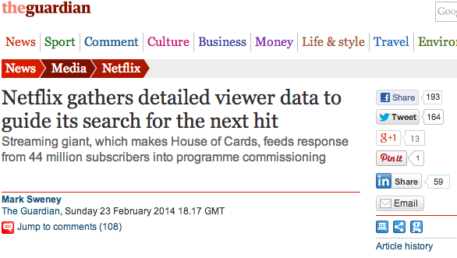
Using “It’s” Data

Slide 9
The Real Issue?
Could it be that for
the first time ever,
the national pop
culture conversation,
is happening outside of
“traditional” media?
Adapted from “The Opt-Out Economy” by Daniel Gross, The Daily Beast 12.16.2013
http://www.thedailybeast.com/articles/2013/12/16/the-opt-out-economy.html

Slide 10
Social Media:
Direct competitor
to Broadcasters?

Slide 11
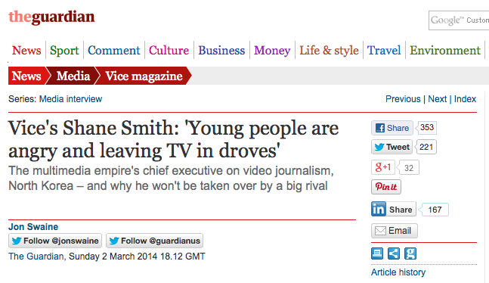

Slide 12
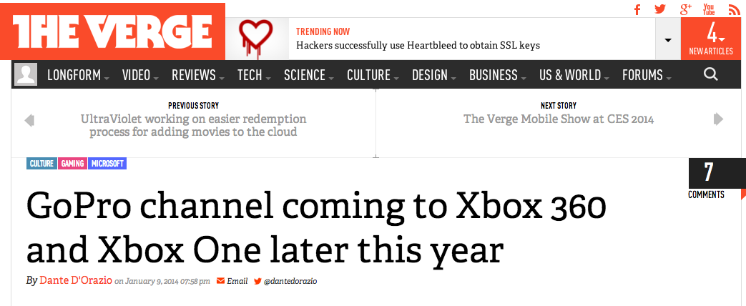

Slide 13
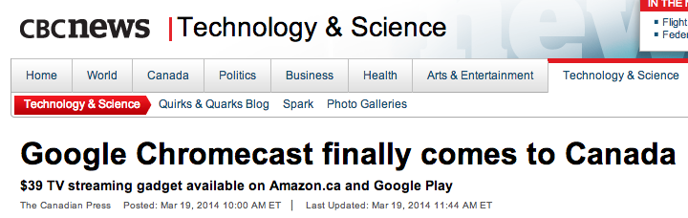
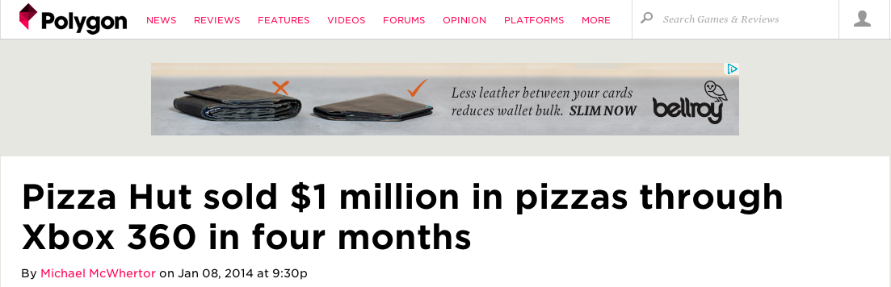

Slide 14

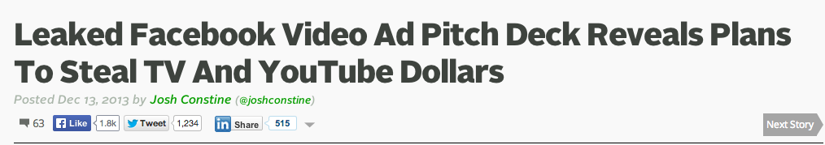
Selling Facebook
http://techcrunch.com/2013/12/13/facebook-vs-tv-and-youtube/

Slide 15
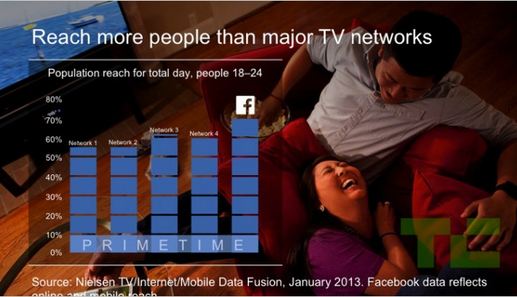
Some sample slides

Slide 16
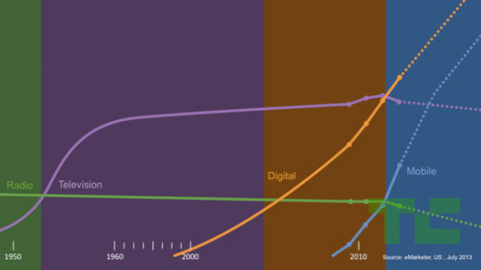
History of time spent on media…(per Facebook)

Slide 17

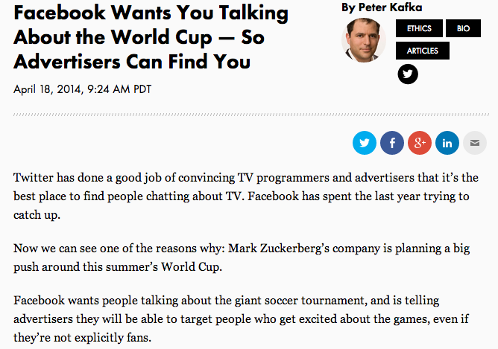

Slide 18
Social Media:
Does it help
broadcasters?

Slide 19

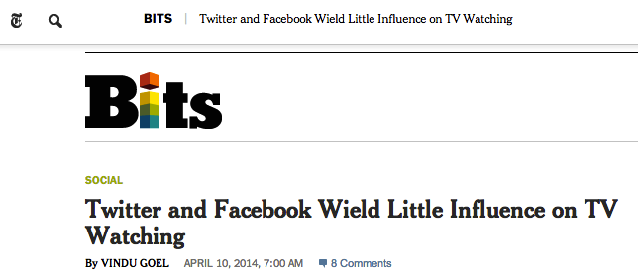
http://bits.blogs.nytimes.com/2014/04/10/twitter-and-facebook-wield-little-influence-on-tv-watching/?_php=true&_type=blogs&hpw&rref=technology&_r=0

Slide 20

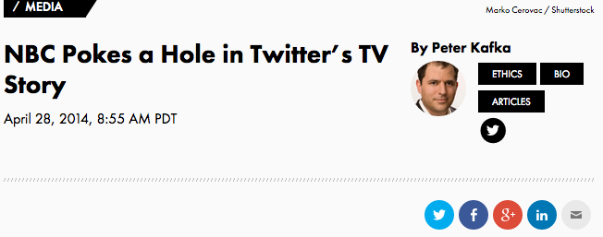

Slide 21

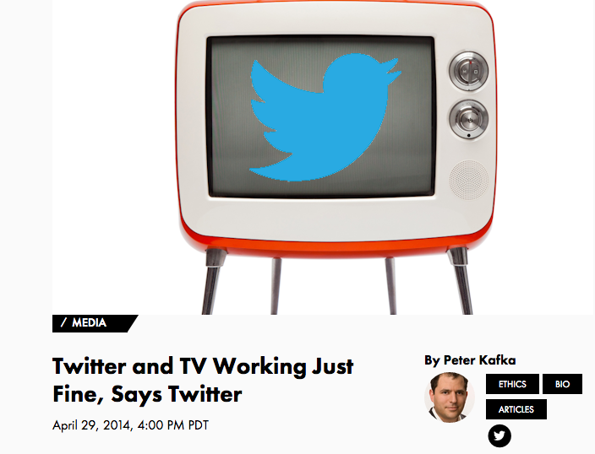

Slide 22
The quotes…
NBC Universal’s Alan Wurtzel commenting on the fact that during the 18-day period of coverage just 19% of Olympic viewers posted about the games on social media: “I am saying the emperor wears no cloths. It is what it is. These are the numbers”
Twitter CEO Dick Costello replied: “Fox research has produced research that shows 92 percent of Twitter users have taken immediately some action like either tuning into the TV show, or searching for the TV show after seeing a tweet about the show. Symphony highlighted that using Twitter while watching TV decreases an audience member’s likelihood to change the channel. And then Nielsen found a causal relationship between Twitter activity and tune-in.”

Slide 23
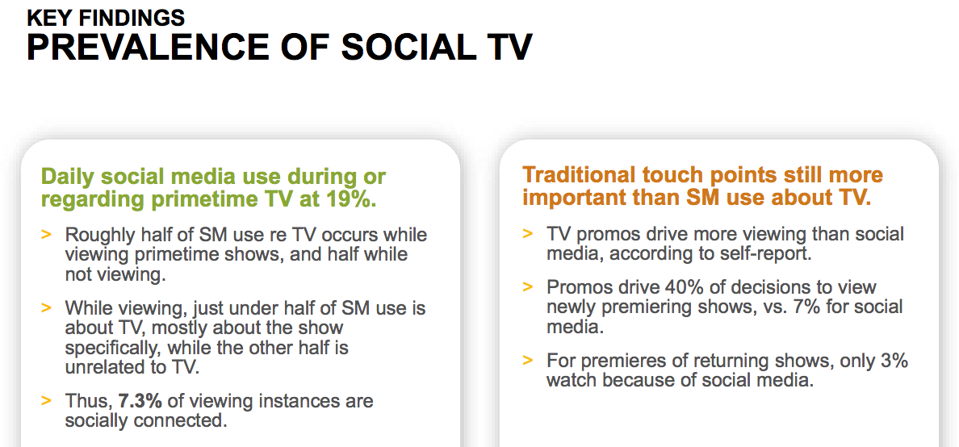
Council for Research Excellence
(April 10, 2014 Report)
http://www.researchexcellence.com/documents/misc/
CRE_Talking_Social_TV_2_Clients_Meeting_FINAL_04092014.pdf

Slide 24
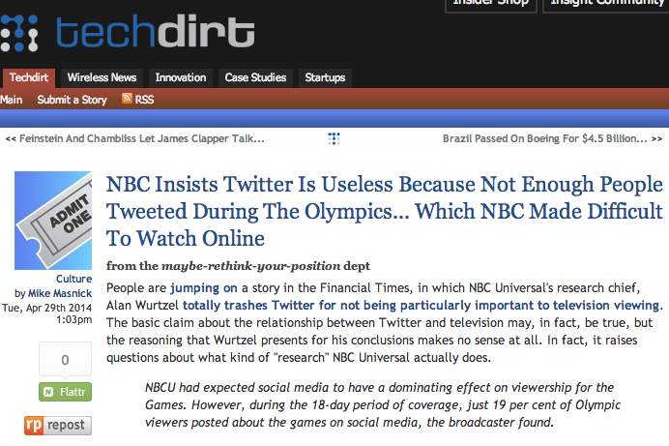
A reconciliation?

Slide 25
Is Social Media a
“new” medium?

Slide 26
A Brief Historical
Digression

Slide 27
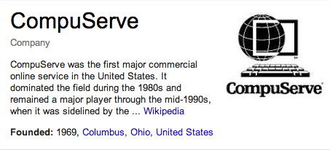
A personal CompuServe moment
(circa 1994-95)

Slide 28
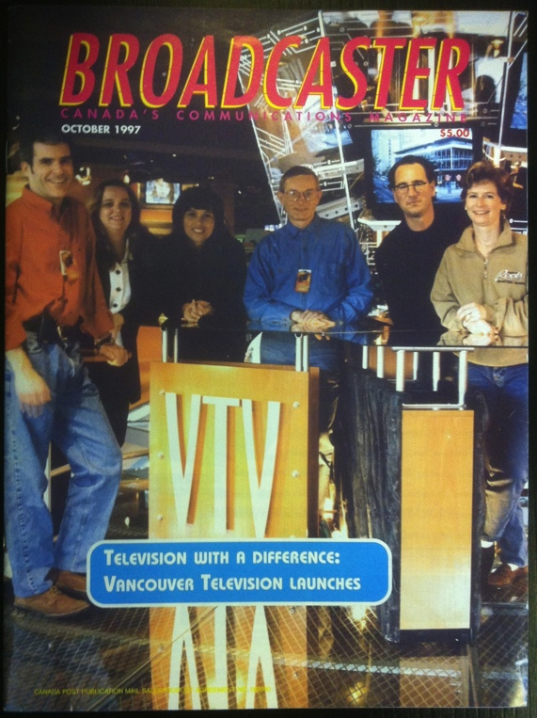
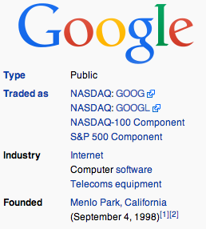
VTV versus Google
VTV (now CTV British Columbia:
*1st all digital conventional station in
N.A.
*Award Winning
*Owned by CTV
*(first?) regular web-segment on 6PM
news.
*Launched Sept. 22, 1997
Google founded Sept. 4, 1998
(google.com registered Sept. 15, 1997)

Slide 29
Connects to the Shaw Doctrine
D.L Shaw, “The Rise and Fall of American Mass Media: Roles of Technology and Leadership”, April 1991 “Roy W. Howard Lecture” Indiana University.
“No medium, once it has lost it’s dominant position has ever returned to the top”
“Audience choice, made possible by modern technologies, has made the concept of “mass media” obsolete; and audiences are not necessarily loyal, exercising choices when available to obtain information and entertainment in the most efficient way possible.”

Slide 30
History of time spent on media…(per Facebook)

Slide 31
Some
Answers for
‘Conventional’
Media?

Slide 32

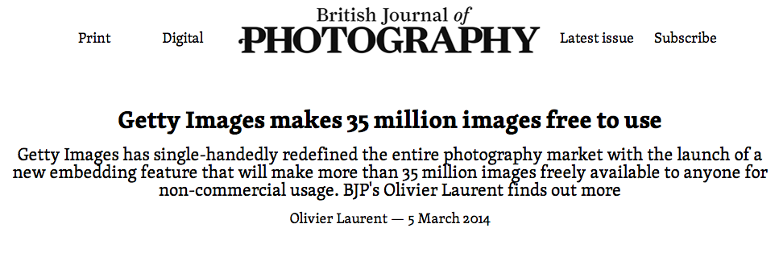
Innovative response to Social Media?
http://www.bjp-online.com/2014/03/getty-images-makes-35-million-images-free-in-fight-against-copyright-infringement/

Slide 33
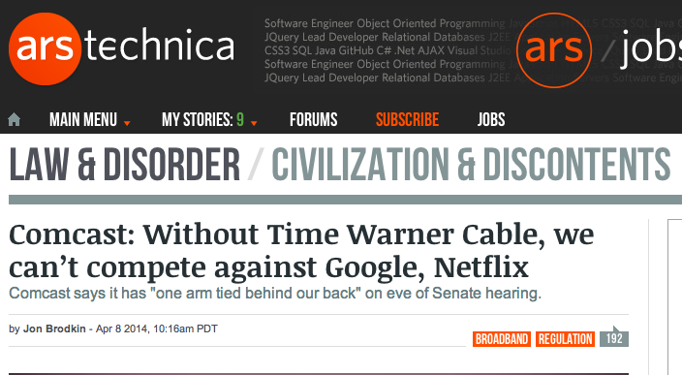
Non-innovative response to Social Media?
http://arstechnica.com/tech-policy/2014/04/comcast-without-time-warner-cable-we-cant-compete-against-google-netflix/

Slide 34
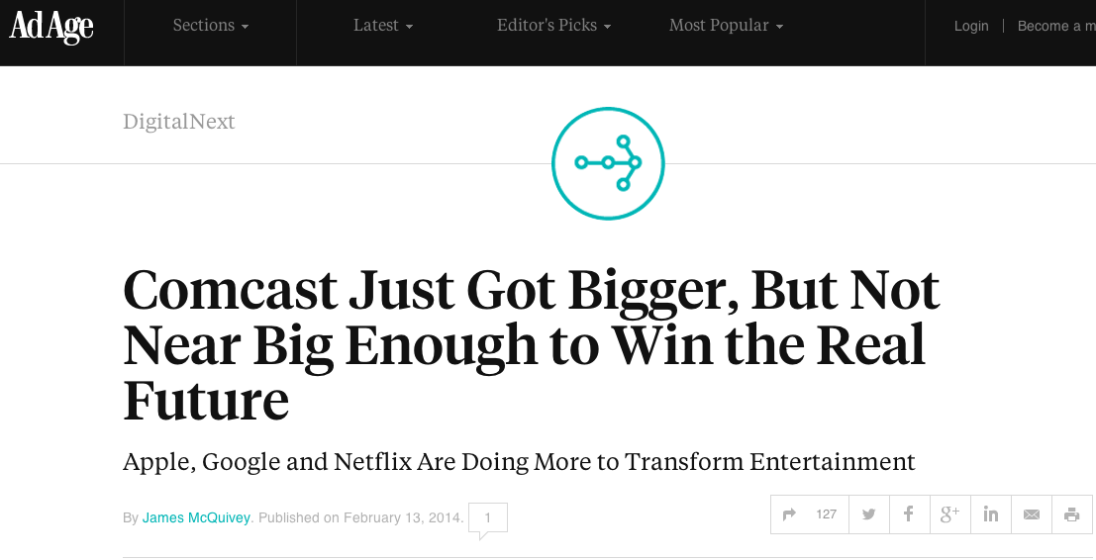
Also, may just not work…

Slide 35
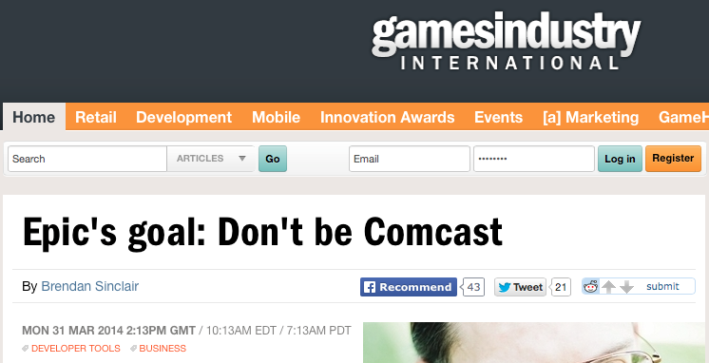
And the unkindest cut of all

Slide 36

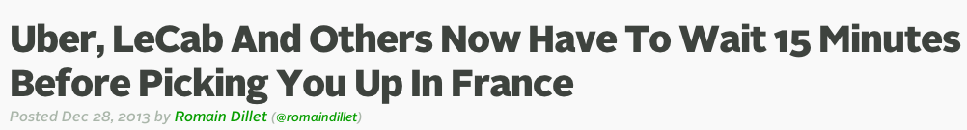
In the “face-palm” department..
France legislated that urban transportation services like Le Cab & Uber had to make consumers wait 15 minutes before letting them in the car in order to “protect” traditional taxis…

Slide 37

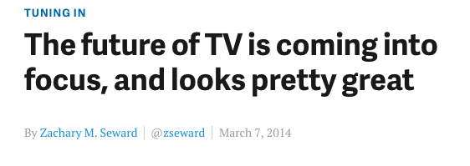
Conventional strategies…
It will be cheaper
2. Limited channel lineup
3. Organized by subject
4. Personal subscriptions
Viewable on any screen
5. A better remote
6. No more switching inputs
6. Netflix is just another channel
7. HBO gets more accessible
8. On-demand that’s not awful
9. New channels emerging all the time
10. (Internet TV is) not as reliable
11. (Internet TV is) Not as cheap
http://qz.com/184378/the-future-of-tv-is-coming-into-focus-and-looks-pretty-great/

Slide 38
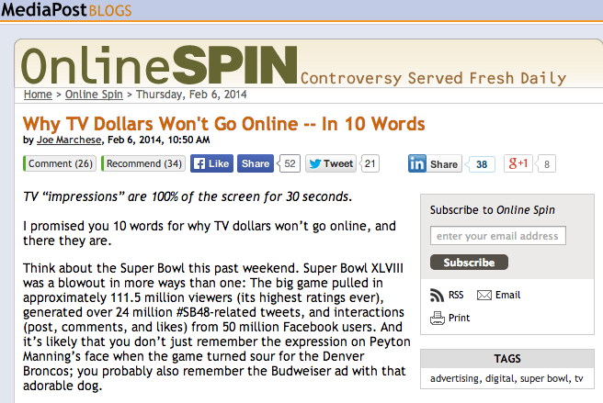
http://www.mediapost.com/publications/article/218961/why-tv-dollars-wont-go-online-in-10-words.html

Slide 39

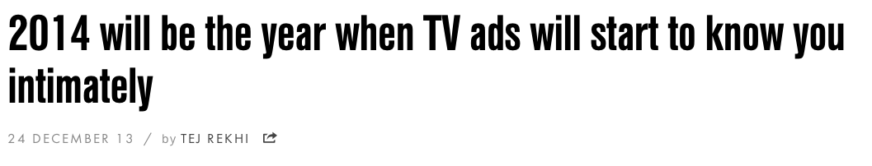
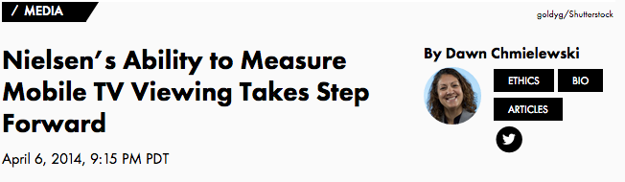
http://www.wired.co.uk/magazine/archive/2013/12/wired-world-2014/tv-ads-that-know-you-intimately
http://recode.net/2014/04/06/nielsens-ability-to-measure-mobile-tv-viewing-takes-step-forward/

Slide 40
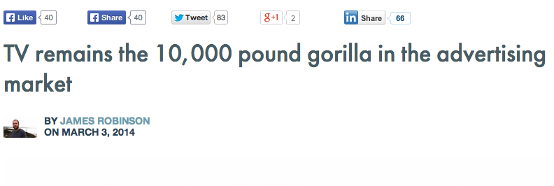
http://pando.com/2014/03/03/tv-remains-the-10000-pound-gorilla-in-the-advertising-market/

Slide 41
Another Possible Strategy?:
Embrace User/Consumer Privacy
Broadcasters have a long and proud history (notably in their newsrooms) of legal resistance to search warrants, prior restraints and the like…
Does this represent a profound vulnerability of social media/digital media that “conventional” media might take advantage of?

Slide 42
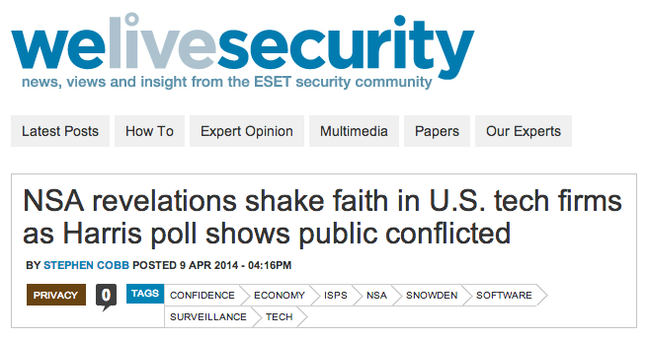
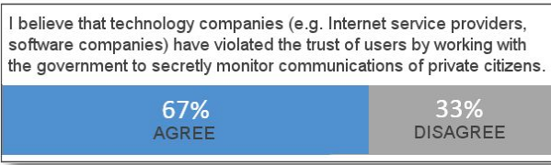
An Example

Slide 43
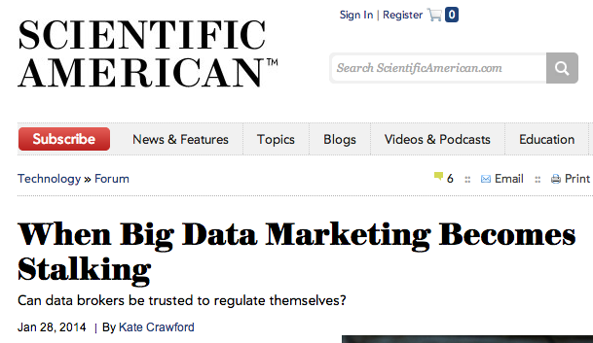
But avoid the pitfall
http://www.scientificamerican.com/article/when-big-data-marketing-becomes-stalking/

Slide 44
The most unorthodox of ideas… the oddest of ironies
Would broadcaster/cable-
co/distributers be best
advised to work with
Netflix?
WHY IN THE WORLD?

Slide 45
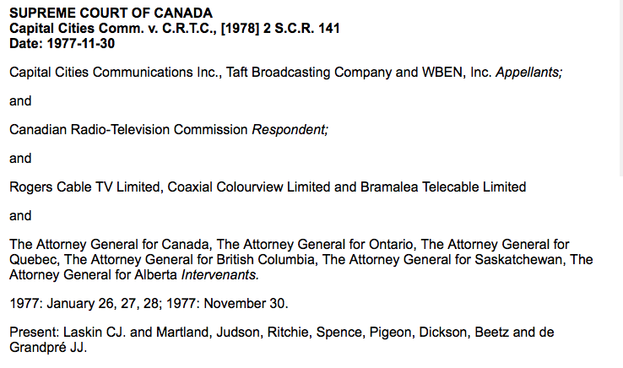
Consider the application of…
https://scc-csc.lexum.com/scc-csc/scc-csc/en/item/2586/index.do

Slide 46
Simply put…
What are the
consequences if
Netflix is seen
as part of the
“Broadcasting
System”?

Slide 47
Future
Directions

Slide 48
1. The obvious (perhaps)…
* On-line entertainment streaming that is
social (watch shows “together”)
* User control of on-screen graphic assets
* Lock-screen on mobile as “gatekeeper”
* From “friends” (Facebook) to
“followers” (Twitter)
* “Location” means people more than
places
* Ads that follow you geographically (see
“Minority Report”)
* Social networks go “peer-to-peer”

Slide 49

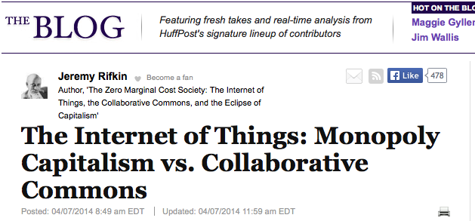
2. Social Media meets The Internet of Things

Slide 50
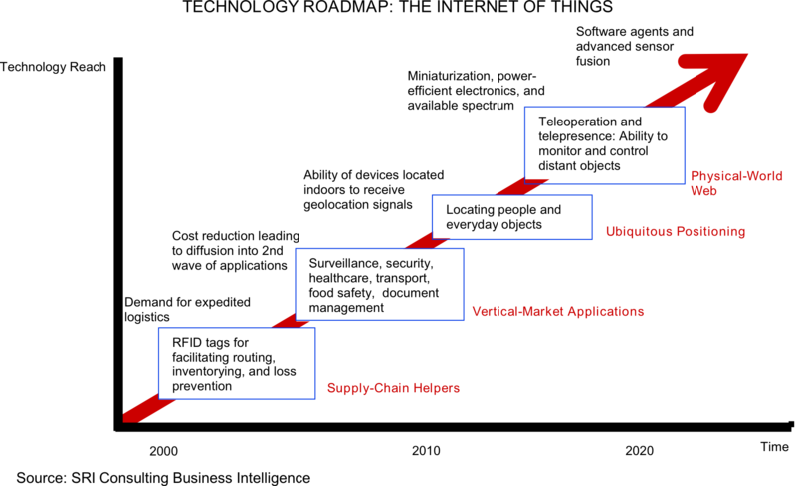
2. Social Media meets the
“Internet of Things”

Slide 51
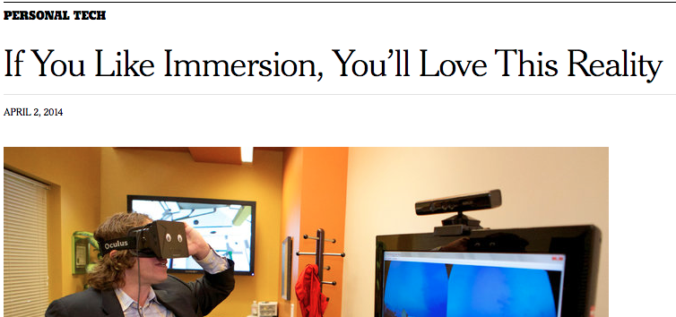
3. Facebook + Virtual Reality
http://www.nytimes.com/2014/04/03/technology/personaltech/virtual-reality-perfect-for-an-immersive-society.html?_r=0

Slide 52
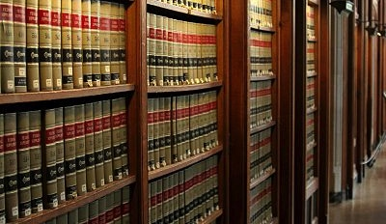
The
Challenge of
“The Law”

Slide 53



Are Legal Responses Useful?
“15 Technologies The Legacy Content Companies Have Sued In The Past 15 Years” http://www.techdirt.com/blog/innovation/articles/20131008/11072724796/15-technologies-legacy-content-companies-have-sued-past-15-years.shtml

Slide 54

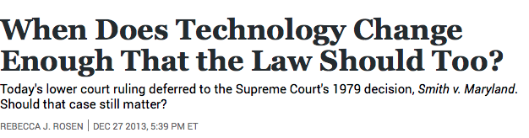
A Common Question:
Why is it that law inevitably lags technology?

Slide 55

The Law often seems behind,
disconnected and confused,
incapable or too slow to do
Justice..
“[s]tealing is stealing whether you use a computer command
or a crowbar, and whether you take documents, data or
dollars. It is equally harmful to the victim whether you
sell what you have stolen or give it away.”*
*The United States Attorney’s Office, District of Massachusetts, Press Release, “Alleged Hacker Charged with
Stealing over Four Million Documents from MIT Network” (19 July 2011), online: <
http://www.justice.gov/usao/ma/news/2011/July/SwartzAaronPR.html>

Slide 56
“I may be one of very few people in this room who actually makes his living personally by creating what these gentlemen are pleased to call “intellectual property.” I don’t regard my expression as a form of property. Property is something that can be taken from me. If I don’t have it, somebody else does.
Expression is not like that. The notion that expression is like that is entirely a consequence of taking a system of expression and transporting it around, which was necessary before there was the internet, which has the capacity to do this infinitely at almost no cost.”
John Perry Barlow, May 2011

Slide 57
Consider the possibility...
…that Law (& Justice) can never
adequately resolve
communications based issues
precisely because…
communications memes
proactively define the future
meanings of Justice & the forms
Law will take.
(breathing hard…sweat falling off brow…this can’t
be right…can it?)

Slide 58
Less Bravely
Concepts of law & justice do not shape communications technologies nearly as much as they are shaped by the memes and meanings arising from communications technologies.

Slide 59
Technology /Justice (Parallels)?
Before Justice was Revenge
1. Pre-literate => Justice as Retribution
2. Writing Instruments => Justice as
Compensation
3. Printing Press => Justice as Rights
4. Mass Media => Justice as Truth
5. Digital => Justice as Resolution
6. Big Data =>
-----FUTURE----
=> 6. Justice as Boundaries
7. Virtual reality => ???

Slide 60
Concluding
Thoughts:

Slide 61
Questions
1. In a digital world which appears relatively borderless from a social media user/creator/consumer perspective, is being a Canadian creator/broadcaster/distributor less significant then it was?
2. Are we increasingly moving away from “Branded Entertainment” and towards “Branded Audiences”?
3. Moving towards “EXPERIENCES” over “entertainment”
4. Innovation/disruption as a key (public policy) meme?

Slide 62

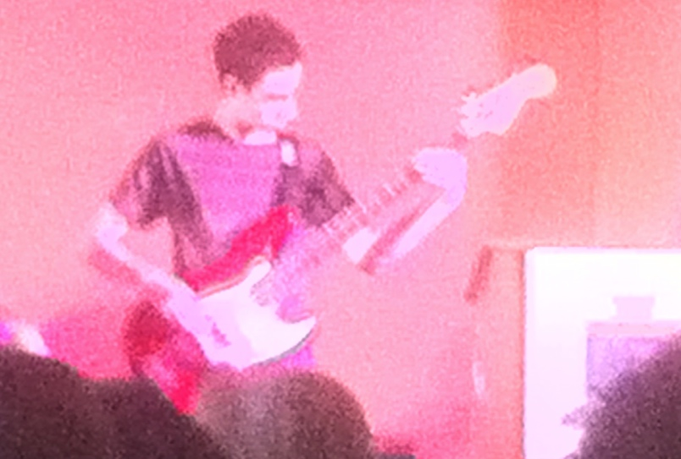
One more question:
Is It Barter Not Theft(Piracy)IF We Are All Creators?

Slide 63

Always include a cat picture

Slide 64
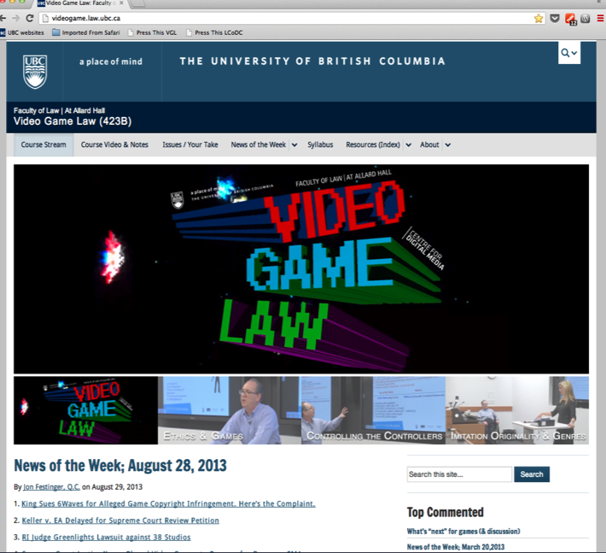
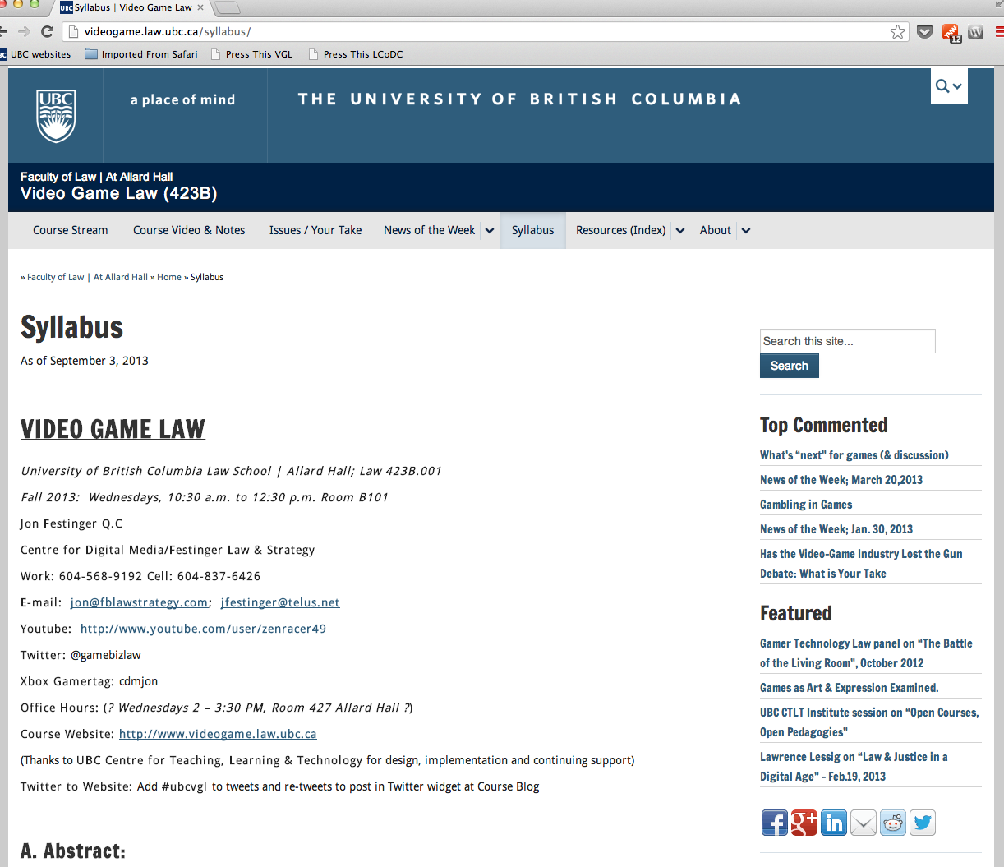
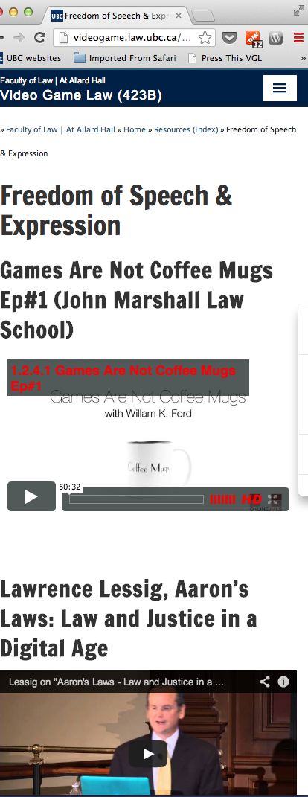
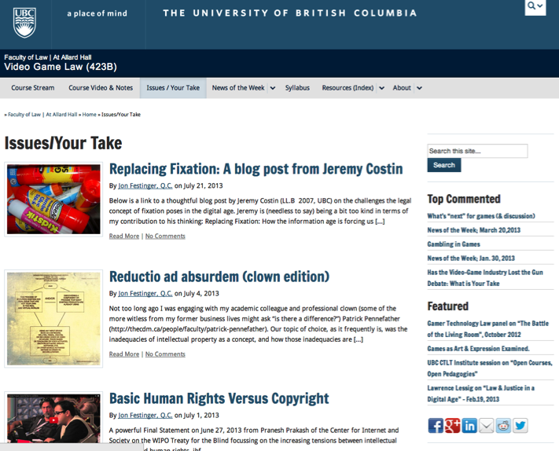
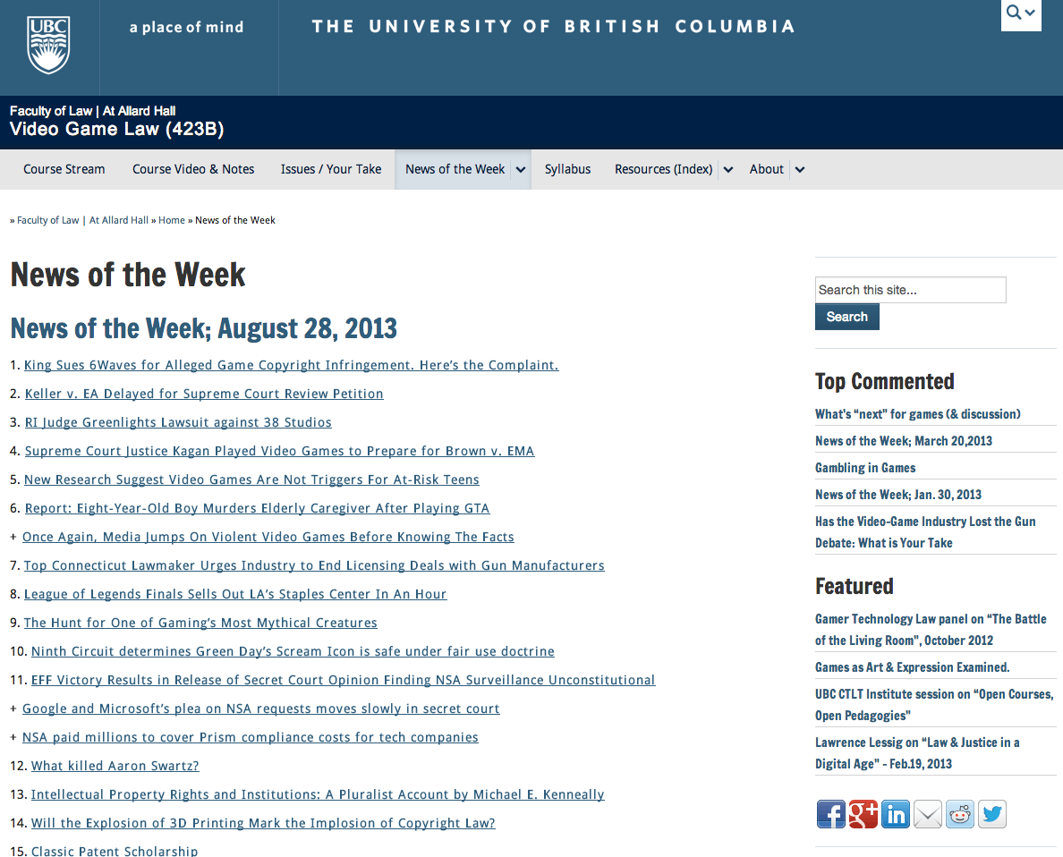
http://videogame.law.ubc.ca

Slide 65
Our Academic Partners

