Slide 1


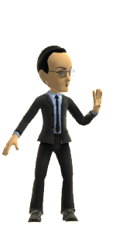
Candy Crushing on Flappy Birds
Full Indie - Vancouver
April 29,2014
Jon Festinger Q.C.
Centre for Digital Media
Festinger Law & Strategy
http://videogame.law.ubc.ca
@gamebizlaw
jon_festinger@thecdm.ca

Slide 2
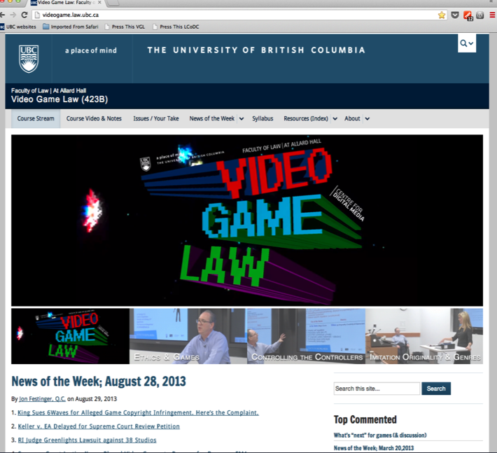
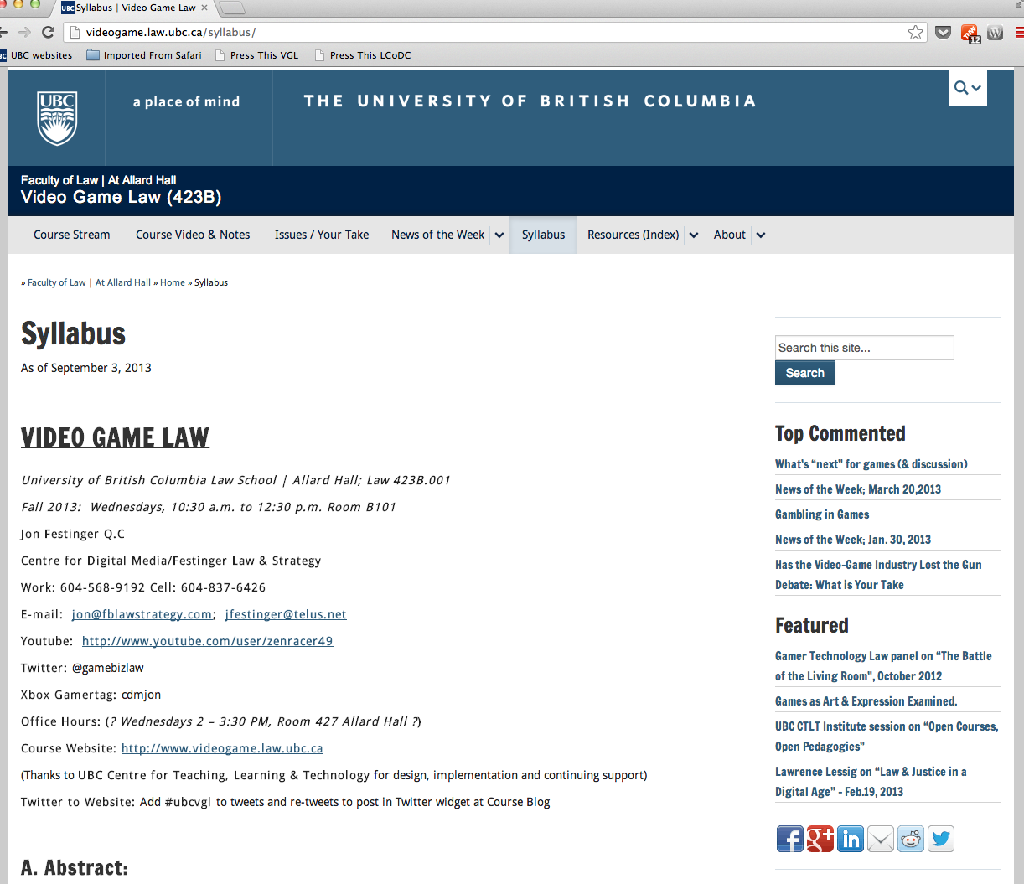
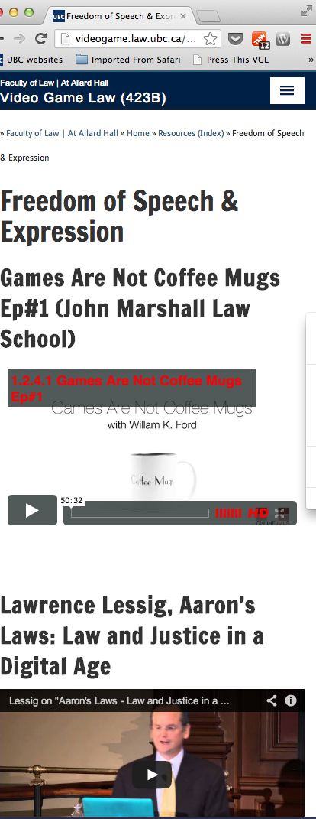
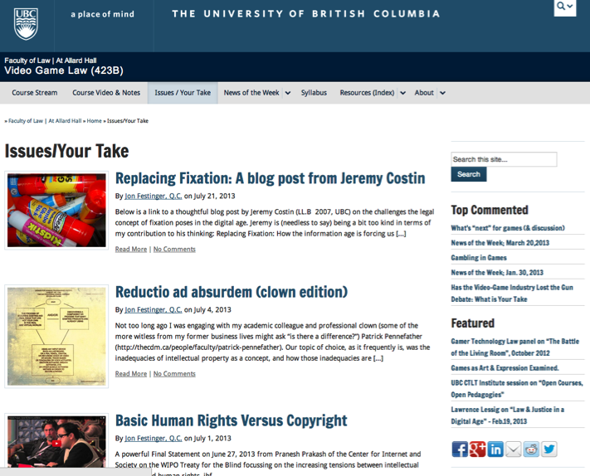
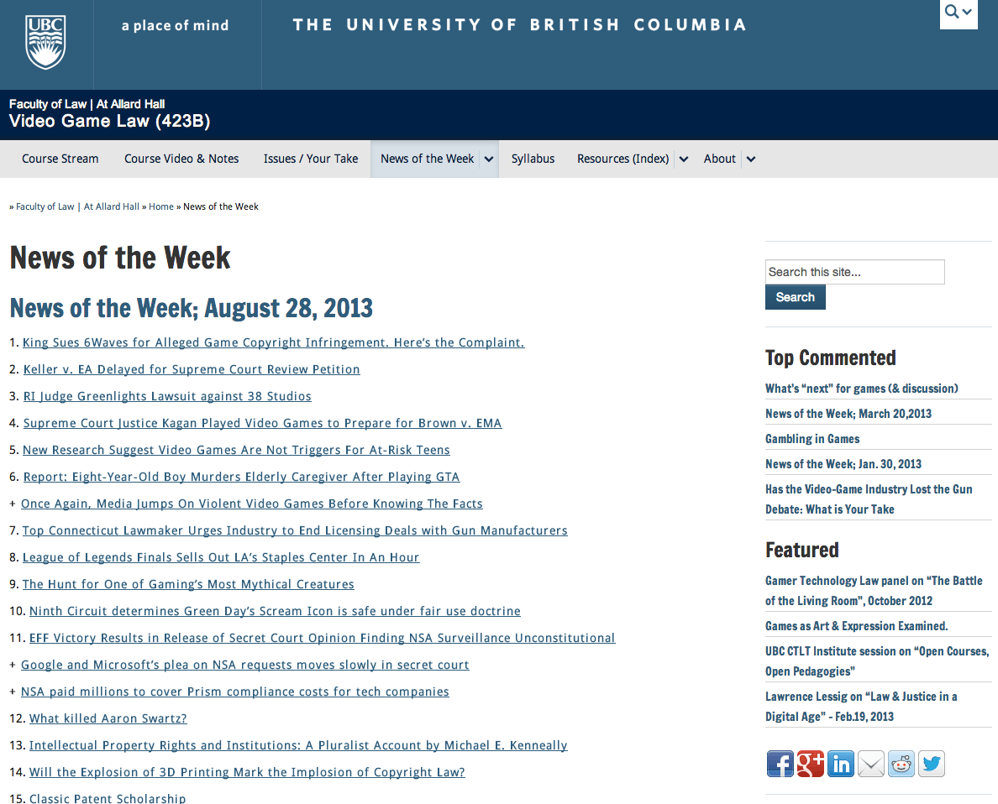
http://videogame.law.ubc.ca

Slide 3
WHAT IS AN
“ORIGINAL”
GAME (IN
Law)?

Slide 4
STEP 1

Slide 5
First key is the…
IDEA/
EXPRESSION
DICHOTOMY

Slide 6
STEP 2

Slide 7
THE IP
THRESHOLD
FOR GAMES

Slide 8
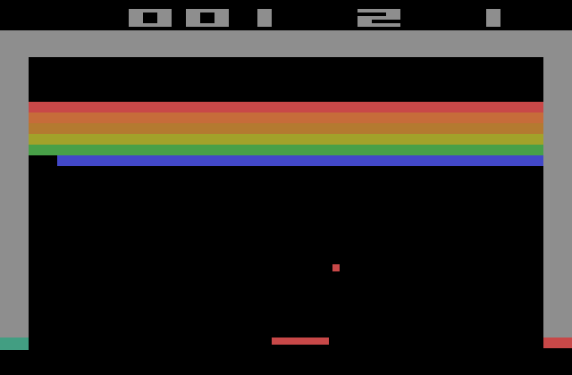
BREAKOUT
Issue: The “creativity standard” in copyright.

Slide 9
Atari v. Oman - 1989/1992 USCA DC Cir.
* “BREAKOUT's audiovisual display features a wall formed by red, amber, green, and blue layers of rectangles representing bricks. A player maneuvers a control knob that causes a rectangular-shaped representation of a paddle to hit a square-shaped representation of a ball against the brick wall. When the ball hits a brick, that brick disappears from its row, the player scores points, and a brick on a higher row becomes exposed. A "breakout" occurs when the ball penetrates through all rows of bricks and moves into the space between the wall and the top of the screen; the ball then ricochets in a zig-zag pattern off the sides of the screen and the top layer of the wall, removing bricks upon contact and adding more points to the player's score. Various tones sound as the ball touches different objects or places on the screen. The size of the paddle diminishes and the motion of the ball accelerates as the game is played.”
District court judge asked counsel for the Register, "If Picasso had painted a round object on a canvas, would you say because it depicts a familiar subject--namely, something that's round--it can't be copyrighted?”
Atari Games Corp. v. Oman, 979 F. 2d 242 - 1992 - ‎Court of Appeals, Dist. of Columbia Circuit
Atari Games Corp. v. Oman, 888 F. 2d 878 - 1989 - ‎Court of Appeals, Dist. of Columbia Circuit
Atari Games Corp. v. Oman, 693 F. Supp. 1204 - 1988 - ‎Dist. Court, Dist. of Columbia

Slide 10
STEP 3
Copyright

Slide 11
    No protection for:
    general concepts, plots,
    themes and genres;
    scenes a faire, ideas
    “merged” with
    expression; content not
    original to the author

Slide 12
Meaning no protection for:
    basic game concept, rules, method of play, stock characters, common sports moves, other aspects of games “driven by genre”

Slide 13
STEP 4
What is protectable…

Slide 14
      “look and feel”, game
      progression, graphics,
      instructions
      (verbatim), underlying
      code, storyline,sounds
      can be protected

Slide 15
STEP 5
Defenses:
Copyright invalidity;
Independent creation;
Fair dealing/ use.

Slide 16
Summary of Copyright Analysis
Step 1: Identify game’s genre and others that fall into it
Step 2: Identify un-protectable aspects of such games
Step 3: Compare the games

Slide 17
THE EXAM:

Slide 18
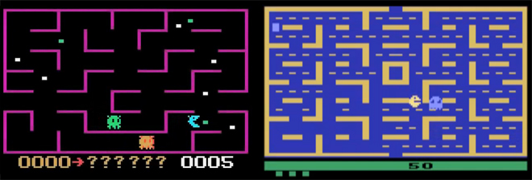
K.C. Munchkin & Pac-Man

Slide 19
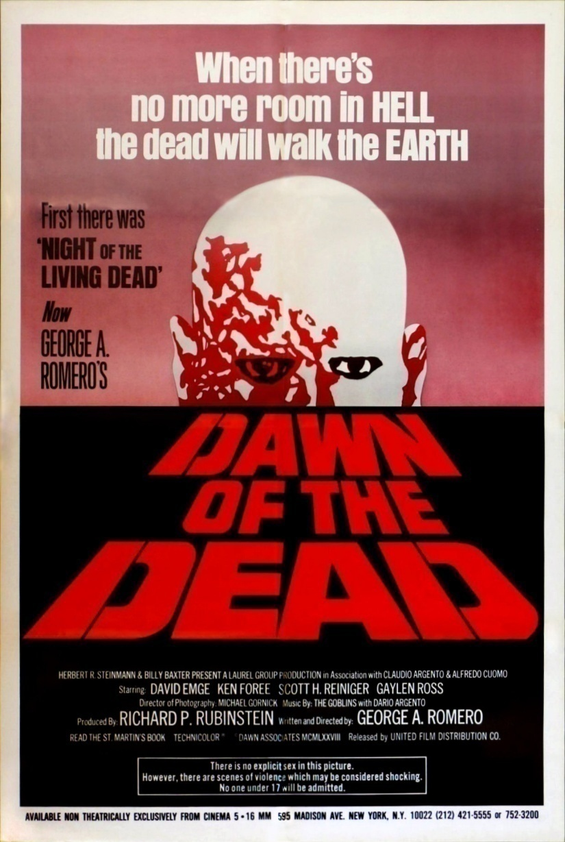
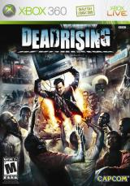
Dawn of the Dead & Dead Rising

Slide 20
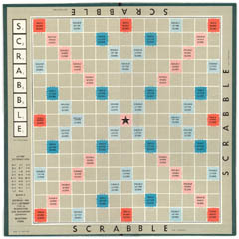
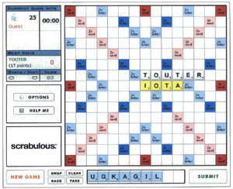
Scrabble & Scrabulous

Slide 21
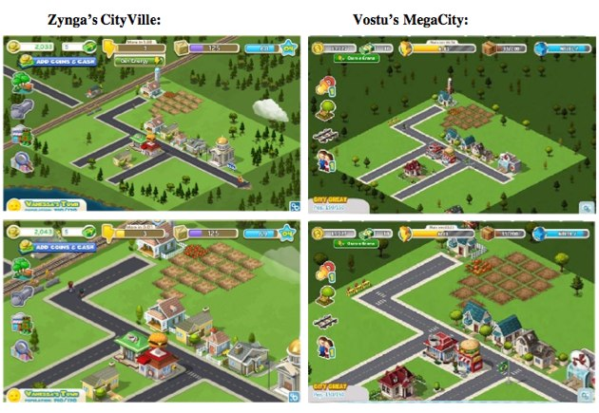
Cityville & MegaCity

Slide 22
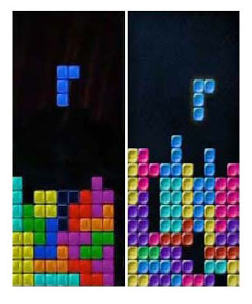
Tetris & Mino

Slide 23
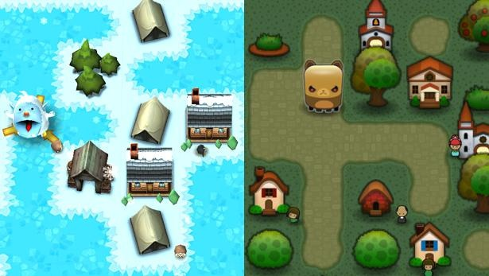
Triple Town & Yeti Town

Slide 24
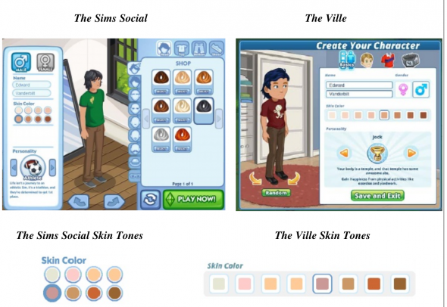
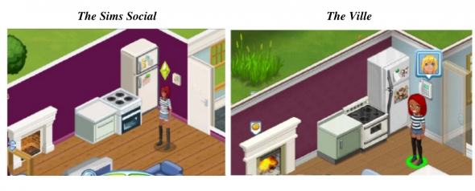
Sims Social & The Ville

Slide 25
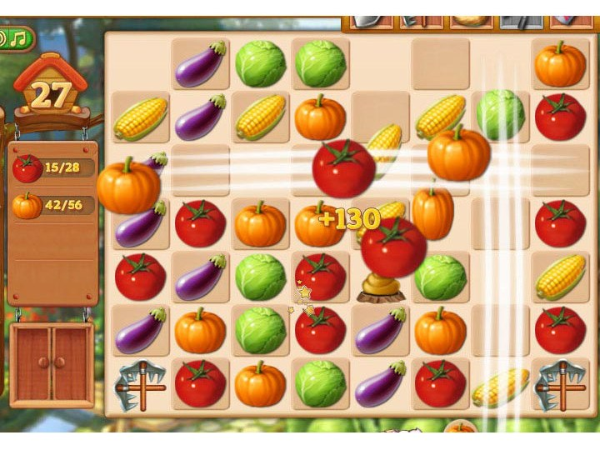
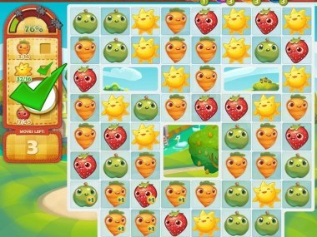
Farm Heroes Saga & Farm Epic

Slide 26
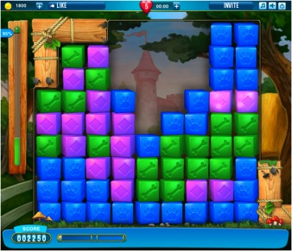
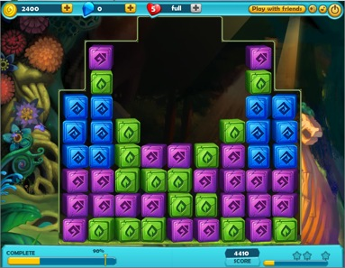
Pet Rescue Saga & Treasure Epic

Slide 27
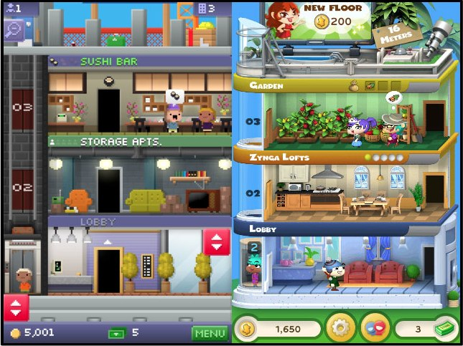
Tiny Tower & Dream Heights

Slide 28
STEP 6
Trademark

Slide 29

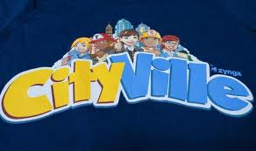
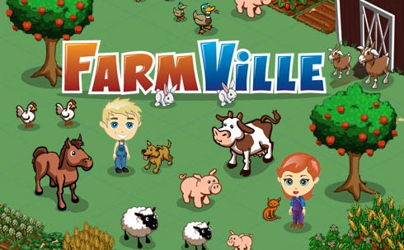

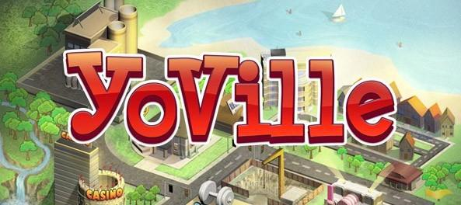

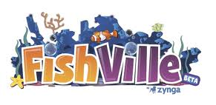
Blingville & Zynga

Slide 30
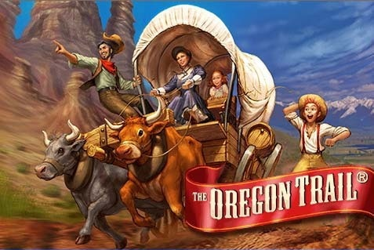
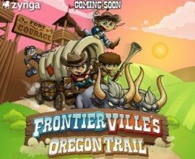
The Learning Co. & Zynga

Slide 31
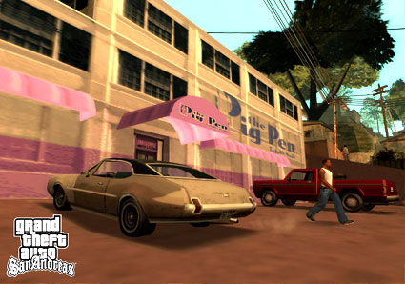
ESS Entertainment & Rock Star
The Play Pen & The Pig Pen

Slide 32
STEP 7
Personality Rights

Slide 33
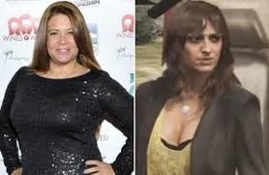
Karen Gravano & GTA V

Slide 34
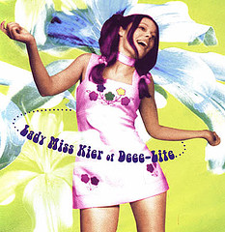
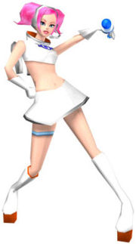
Lady Miss Kier & Space Channel 5

Slide 35
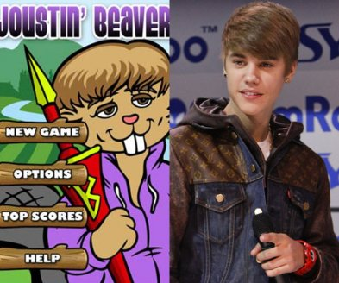
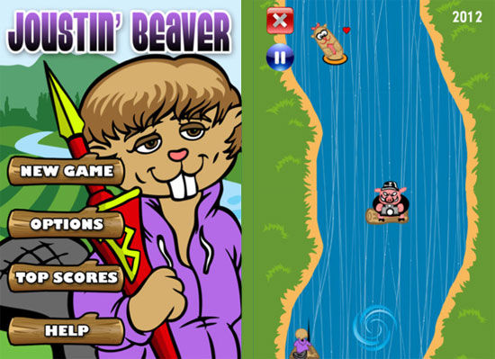
Beaver & Bieber

Slide 36
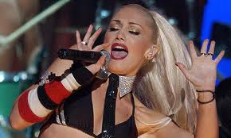
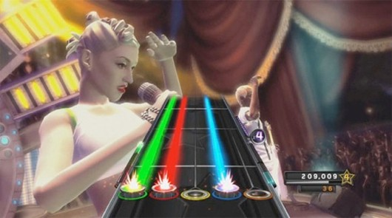
No Doubt & Activision Publishing, Inc.
(No Doubt & Band Hero)

Slide 37
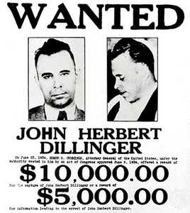
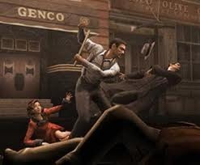
Dillinger & Electronic Arts
John Dillinger & “Dillinger Tommy Gun”

Slide 38
STEP 8
Patent Rights

Slide 39
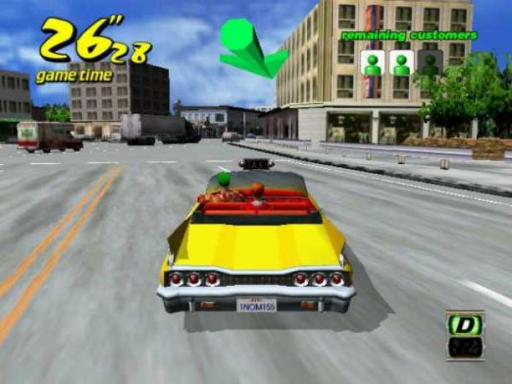
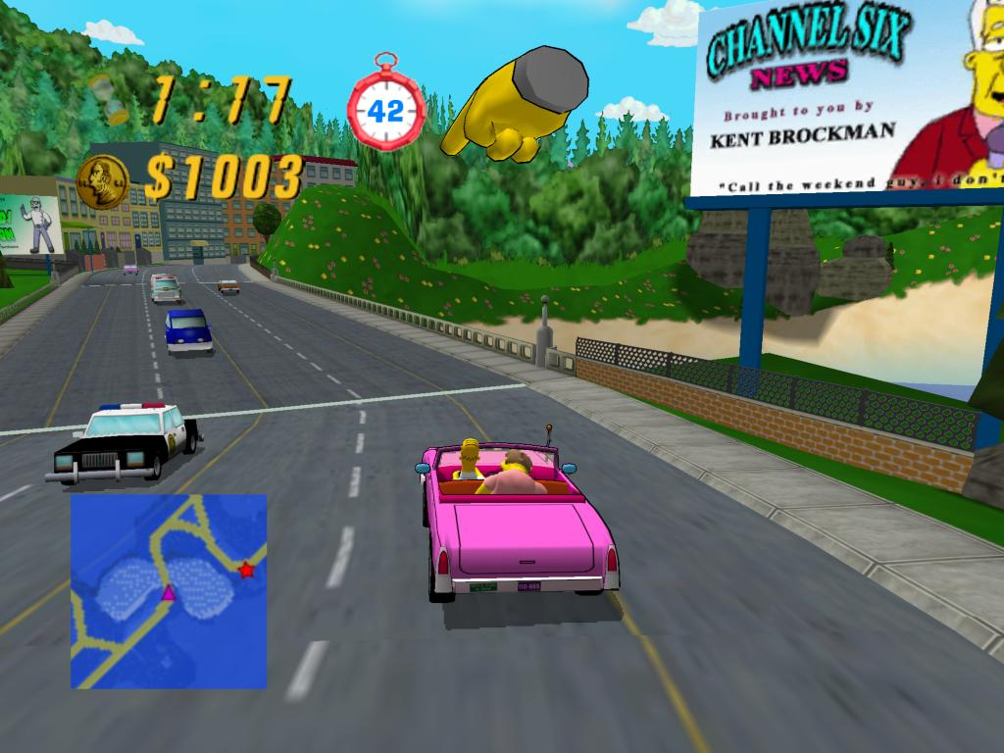
Crazy Taxi v. Simpsons Road Rage

Slide 40
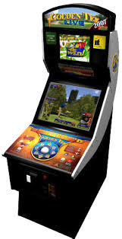
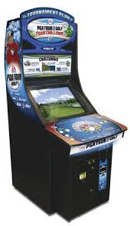
Golden Tee v. PGA Tour Golf

Slide 41
STEP 8
Now YOU
decide…

Slide 42
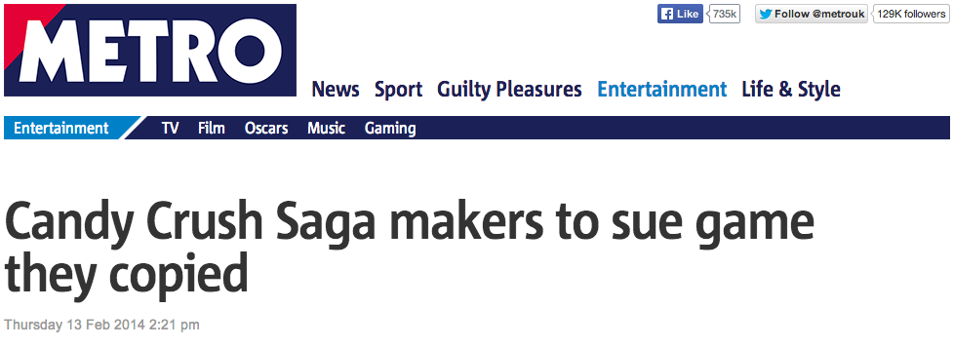
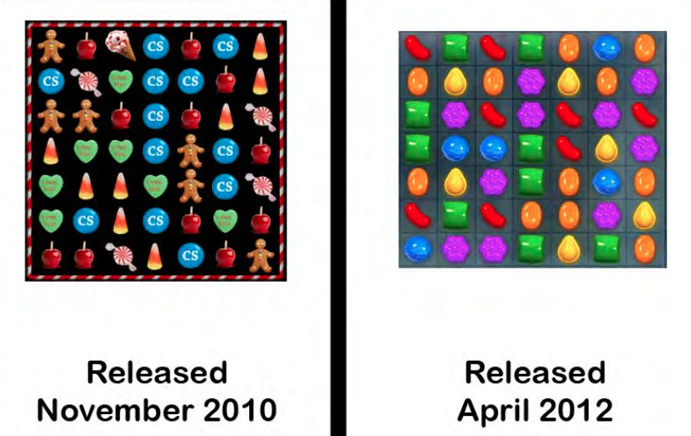
Candy Crush 1

Slide 43
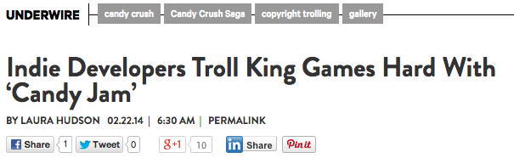
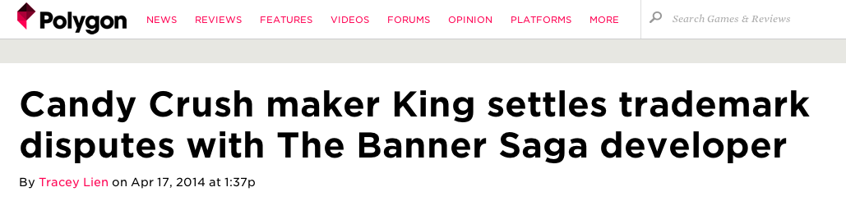
Candy Crush 2

Slide 44
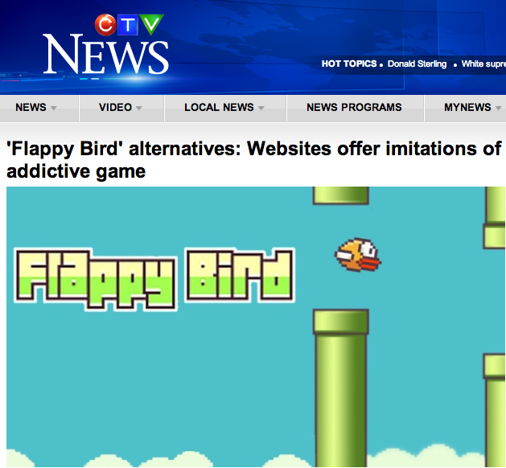

Slide 45
& just to confuse your
feelings...

Slide 46
don’t forget
FREEDOM TO
MOD/
CREAtE ?

Slide 47
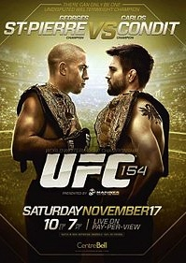
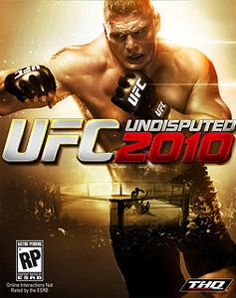
Think about Tatoos
Escobedo v. THQ, Inc.
Tattoo artist sues THQ, makers of UFC
video game for copyright
infringement. Artist claims to have
tattooed an originally created lion
on Carlos Condit’s body. Escobedo
and Condit had no written agreement.
See: “Copyright in Tattoo Case”
http://www.dmlp.org/blog/2012/copyright-tattoo-
case-escobedo-v-thq-inc
"Tatoos and Copyright Infringement” by
C. Harkins (L&C Law Review)
http://www.brinksgilson.com/files/190.pdf

Slide 48
Resolving the conflict?

Slide 49
Please Self Identify
CREATOR
or
CONNECTOR

Slide 50
Who is a CREATOR?
“The creative is the place where no one else has ever been. You have to leave the city of your comfort and go into the wilderness of your intuition. What you’ll discover will be wonderful. What you’ll discover is yourself.”

Slide 51
Who is a CONNECTOR?
“Creativity is just connecting things. When you ask creative people how they did something, they feel a little guilty because they didn't really do it, they just saw something. It seemed obvious to them after a while. That's because they were able to connect experiences they've had and synthesize new things.”

Slide 52
Please Self Identify
CREATOR
or
CONNECTOR

Slide 53
THANK
YOU

Slide 54
AND…
Special thanks to Jennifer
Kelly of Fenwick West for
allowing me to “remix”
some of her materials…

Slide 55

Always include a cat picture

Slide 56
Our Academic Partners

