Slide 1


Video Game Law:
A Common(wealth) perspective?
May 20/21,2014
University of Auckland
Jon Festinger Q.C.
Centre for Digital Media
Festinger Law & Strategy
http://videogame.law.ubc.ca
@gamebizlaw
jon_festinger@thecdm.ca

Slide 2
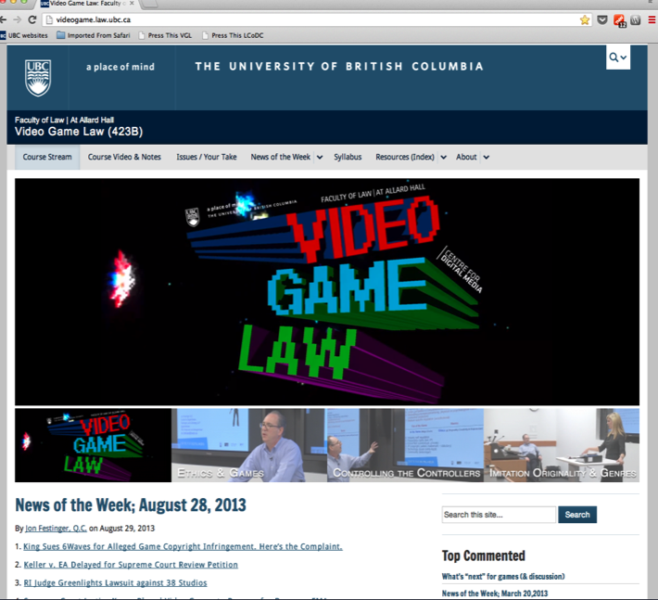
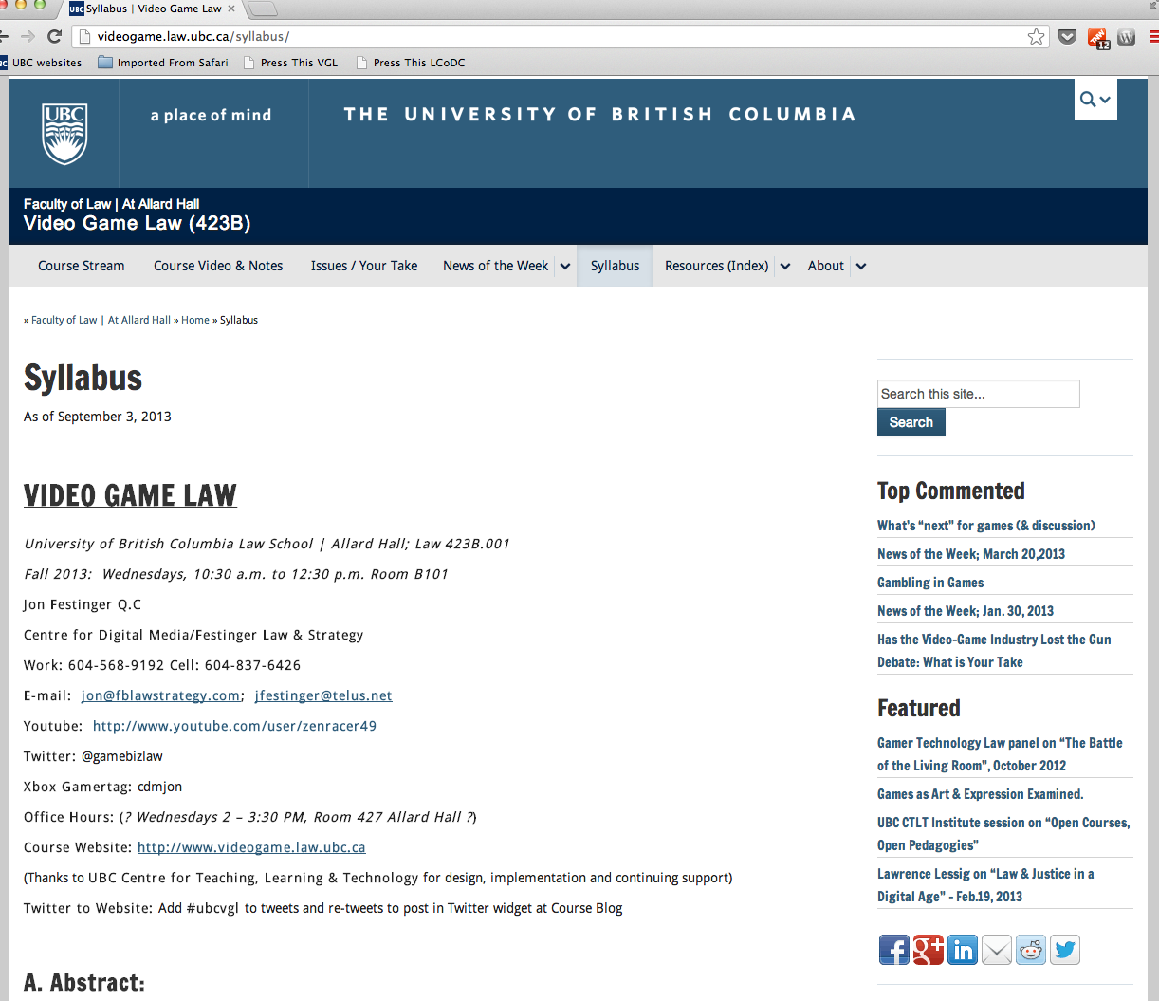
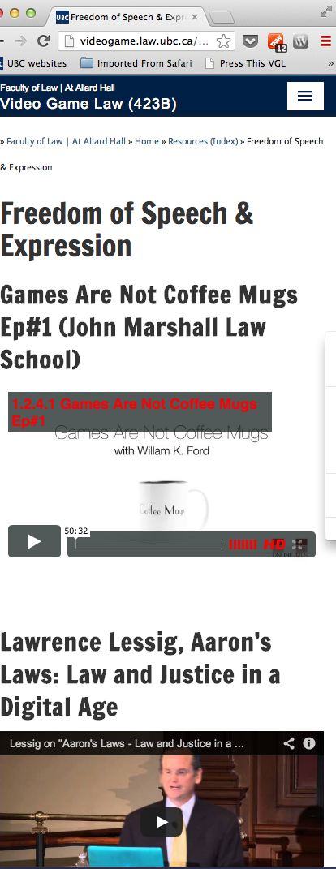
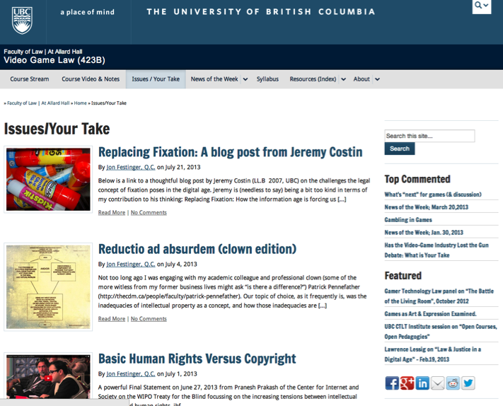
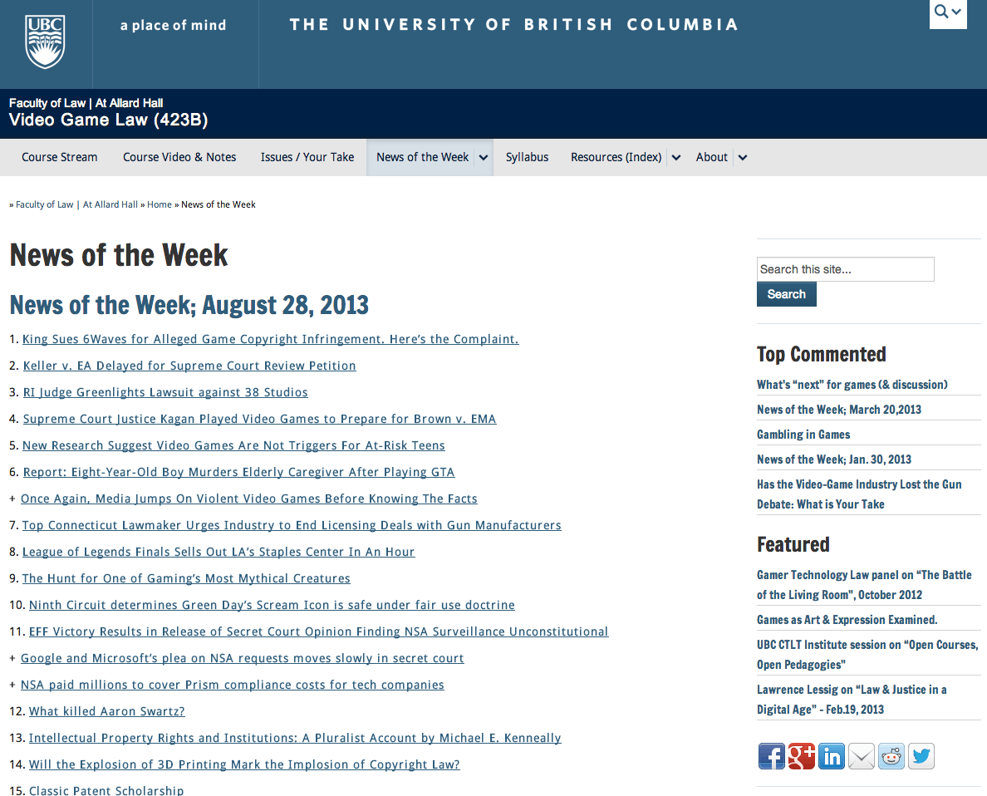
http://videogame.law.ubc.ca

Slide 3
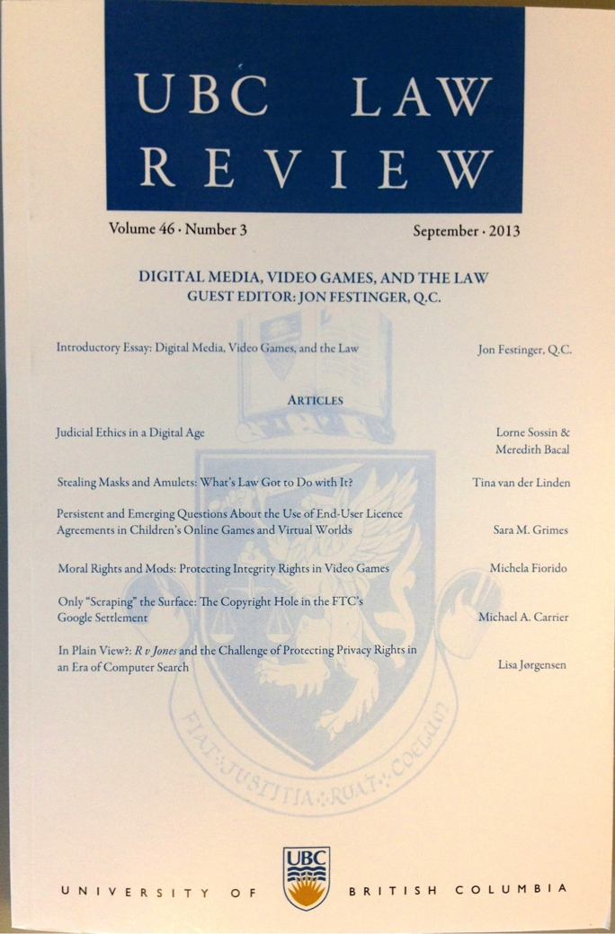
Special Issue of the UBC Law Review on “Digital Media, Video Games, And the Law” available…
http://ubclawreview.ca/issues/no3sept/

Slide 4

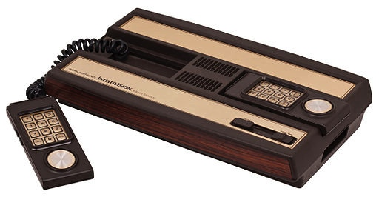
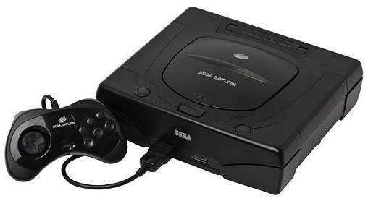

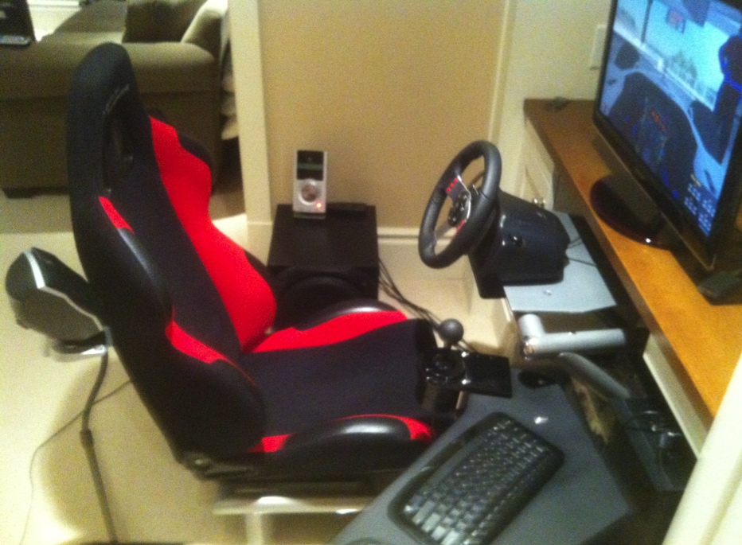
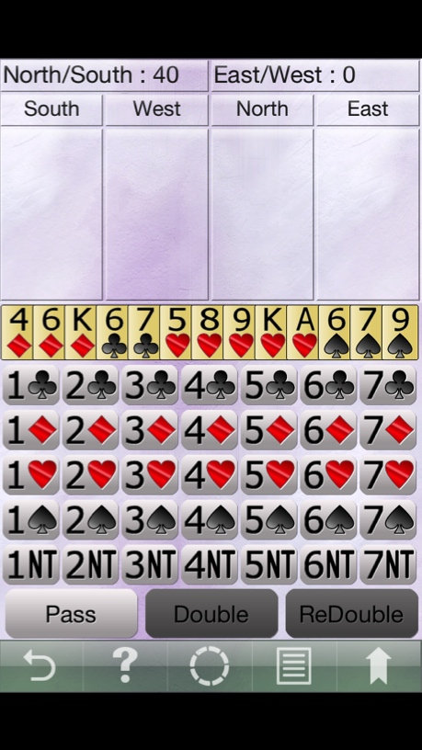
Gaming Bio

Slide 5
Video Game Leadership
Firsts & furthers, as well as barriers broken:
interactivity (multiplayer “Spacewar”)
“Control” – voice, mouse to Kinect to Google Glass
On-line “community”
social
voice over IP
open world
avatars (zeitgeist, memes, identity & equality)
3D
Virtual reality
Portability (handhelds)

Slide 6
WHAT IS A
(VIDEO)
GAME ?

Slide 7
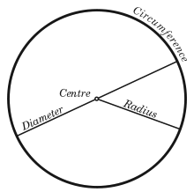
Key seems to be in the…
The “Magic Circle”
“All play moves and has its being within a play-ground marked off
beforehand either materially or ideally, deliberately or as a matter of course.
Just as there is no formal difference between play and ritual, so the
‘consecrated spot’ cannot be formally distinguished from the play-ground.
The arena, the card-table, the magic circle, the temple, the stage, the
screen, the tennis court, the court of justice, etc. are all in form and
function play-grounds, i.e. forbidden spots, isolated, hedged round,
hallowed, within which special rules obtain. All are temporary worlds
within the ordinary world, dedicated to the performance of an act apart.”
Johan Huizinga (1872-1945) in “Homo Ludens: A Study of the Play-Element in
Culture”. Applied to video games by Katie Salen & Eric Zimmerman in “Rules
of Play: Game Design Fundamentals” (2003)

Slide 8
Which leads to: Application of real world laws to virtual environments
Is there a virtual world?
Is WoW its own country?
Ben Duranske “Virtual Law” (2008): “This chapter will argue that the law needs to acknowledge and provide protection for virtual property, but that it must do so in a way that preserves virtual worlds and games as play spaces, at least to the extent that the developers desire their worlds to remain pure play spaces. On one hand, many game and virtual world providers seek to avoid real-life implications in their social and play spaces. Where providers take reasonable steps to draw a line between the real and the virtual, the world or game should be protected by the “magic circle” that protects other play spaces (from theme parks to family Monopoly games) from taking on inadvertent real-world implications. On the other hand, it is both inevitable and desirable that some game and virtual world designers will seek to include real money trade (RMT) and offer a real cash economy (RCE) in their platforms. Users of these platforms need the protection of virtual property law.”http://www.amazon.com/Benjamin-Tyson-Duranske/e/B001JP104A
EULA/ToS: The “real world law” is the law of contracts.

Slide 9
When is it a game (in IP terms)?
“Games and Other Uncopyrightable Systems” Bruce Boyden (2011) http://www.georgemasonlawreview.org/doc/Boyden_18-2_2011.pdf
“Games therefore pose a number of challenges for copyright and patent law. Yet to date, intellectual property doctrine and scholarship has not really grappled with the slippery nature of games. Indeed, copyright has developed a very simple black-letter rule to handle them: games are not copyrightable. …What could be the purpose of such a rule?”
Two possibilities emerge from the cases. First, several cases describe games, and game rules, as unprotectable ideas… The other possible explanation that emerges from the case law is that games are uncopyrightable systems or processes.”

Slide 10
Boyden - Conclusion
“Games are systems in exactly the same way. A game, as sold, is only a game form; the content necessary for an instance of the game comes from the players. That is, the game form establishes the environment for play—the game space—and it defines permissible moves and the conditions for winning or drawing. But the game itself is supplied by the players. Games are systems in the same way that the excluded schemes in the cases above were systems.”
“For systems, the rule against the copyrightability of games demonstrates why systems are generally uncopyrightable and why that term has special significance. The term is not merely a synonym for “idea,” or “process.” Systems are shells into which users pour meaning. While they may contain expression themselves, that expression is there merely to facilitate the meaning added by the user. Copyright properly excludes them.”

Slide 11
2. THE IP
THRESHOLD
FOR GAMES

Slide 12

BREAKOUT
Issue: The “creativity standard” in copyright.

Slide 13
Atari v. Oman - 1989/1992 USCA DC Cir.
* “BREAKOUT's audiovisual display features a wall formed by red, amber, green, and blue layers of rectangles representing bricks. A player maneuvers a control knob that causes a rectangular-shaped representation of a paddle to hit a square-shaped representation of a ball against the brick wall. When the ball hits a brick, that brick disappears from its row, the player scores points, and a brick on a higher row becomes exposed. A "breakout" occurs when the ball penetrates through all rows of bricks and moves into the space between the wall and the top of the screen; the ball then ricochets in a zig-zag pattern off the sides of the screen and the top layer of the wall, removing bricks upon contact and adding more points to the player's score. Various tones sound as the ball touches different objects or places on the screen. The size of the paddle diminishes and the motion of the ball accelerates as the game is played.”
District court judge asked counsel for the Register: "If Picasso had painted a round object on a canvas, would you say because it depicts a familiar subject--namely, something that's round--it can't be copyrighted?”
Atari Games Corp. v. Oman, 979 F. 2d 242 - 1992 - ‎Court of Appeals, Dist. of Columbia Circuit
Atari Games Corp. v. Oman, 888 F. 2d 878 - 1989 - ‎Court of Appeals, Dist. of Columbia Circuit
Atari Games Corp. v. Oman, 693 F. Supp. 1204 - 1988 - ‎Dist. Court, Dist. of Columbia

Slide 14
FREEDOM TO
MOD/
CREAtE ?

Slide 15

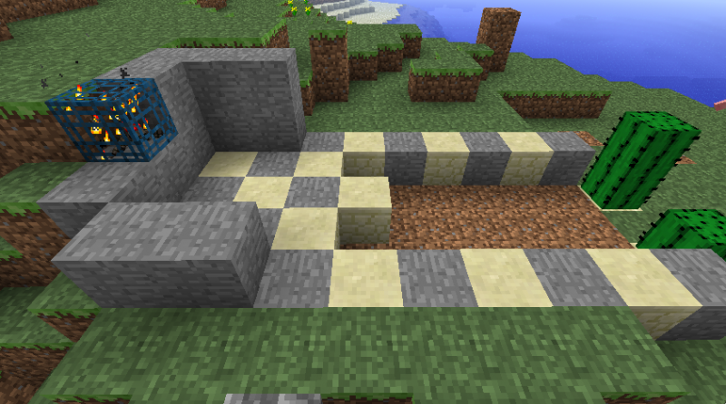
Videogames as Proof
Video Games as proof of mutually reliant and merged creativity?
Player’s creative input is necessary to the game & game designer. Game designer’s creativity is (obviously) necessary for the game to exist.
Video-games: Either exception where all creativity is connected (by design) or more proof that all creativity is connected generally???

Slide 16



……. Evolving a single standard:
For CREATORS as USERS, &
For USERS as CREATORS

Slide 17
Blizzard v. Internet Gateway - (Battle.net clone)
“BnetD” versus Blizzard’s own “Battle.net”
Amici Curiae Brief supporting defendants by teachers of IP Law in U.S. law schoolshttps://www.eff.org/sites/default/files/filenode/Blizzard_v_bnetd/20040221_law_professor_brief.pdf
Argued unsuccessfully that insofar as they prohibit permissible “reverse engineering” Blizzard’s EULA’s should be preempted by copyright law. Alternatively argued that enforcement of the EULA’s should be denied under the Doctrine of Copyright Misuse (related to concept of “Copyright Monopoly”).
Attempted unsuccessfully to preserve Sega Enterprises v. Accolade, Inc. statement of the application of Fair Use to to reverse Engineering

Slide 18
Blizzard v. Internet Gateway - con’d
Davidson & Associates, Inc. v. Internet Gateway, 2004 U.S. Dist. LEXIS 20369 (E.D. Mo. 2004), aff’d 2005 U.S. App. LEXIS 18973 (8th Cir. 2005)
EULA: “… subject to the grant of license hereinabove, you may not, in whole or in part, copy, photocopy, reproduce, translate, reverse engineer, derive source code, modify, disassemble, decompile, create derivative works based on the Program, or remove any proprietary notices or labels on the program without the prior consent, in writing, of Blizzard.”
TOU: “You are entitled to use Battle.net for your own personal use, but you shall not be entitled to … (ii) copy, photocopy, reproduce, translate, reverse engineer, modify, disassemble, or de-compile, in whole or in part, any Battle.net software; (iii) create derivative works based on Battle.net; (iv) host or provide matchmaking services for any Blizzard software programs or emulate or redirect the communication protocols used by Blizzard as part of Battle.net, through protocol emulation, tunneling, modifying, or adding components to the Program, use of a utility program, or any other technique now known or hereafter developed for any purpose, including, but not limited to, network play over the Internet, network play utilizing commercial or non-commercial gaming networks, or as part of content aggregation networks without the prior written consent of Blizzard or exploit Battle.net or any of its parts for any commercial purpose …”

Slide 19
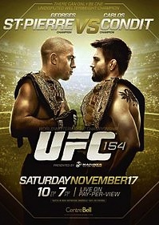

Think about Tatoos
Escobedo v. THQ, Inc.
Tattoo artist sues THQ, makers of UFC
video game for copyright
infringement. Artist claims to have
tattooed an originally created lion
on Carlos Condit’s body. Escobedo
and Condit had no written agreement.
See: “Copyright in Tattoo Case”
http://www.dmlp.org/blog/2012/copyright-tattoo-
case-escobedo-v-thq-inc
"Tatoos and Copyright Infringement” by
C. Harkins (L&C Law Review)
http://www.brinksgilson.com/files/190.pdf

Slide 20



IS Creativity More
Important than Property?

Slide 21

Can I Mod
Yet?

Slide 22
4. EULA’s, ToS & the Post IP World

Slide 23

Are we already IN THE POST IP WORLD?
In todays world….In real terms….Is it possible that…
IP has become VIRTUALLY* MEANINGLESS?
mean·ing·less/ˈmēniNGlis/
Adjective: Having no meaning or significance.
Having no purpose or reason.
Synonyms: pointless - senseless - unmeaning - insignificant – inane
*no pun intended

Slide 24
Related Issue 1: The chasm of contracting out
No one reads EULA’s, ToS’s & Privacy Policies:
“To Read All Of The Privacy Policies You Encounter, You’d Need to Take A Month Off From Work Every Year”http://www.techdirt.com/articles/20120420/10560418585/to-read-all-privacy-policies-you-encounter-youd-need-to-take-month-off-work-each-year.shtml
@gamerlaw: Amazing study by @nyulaw: "overall average rate of readership of EULAs is on the order of 0.1 percent to1 percent” http://t.co/DFcF0mx0
For review of “click-wrap” authorities see: Century 21 v. Rogers Communications 2011BCSC 1196 (upholding ToU) http://canlii.ca/en/bc/bcsc/doc/2011/2011bcsc1196/2011bcsc1196.html

Slide 25
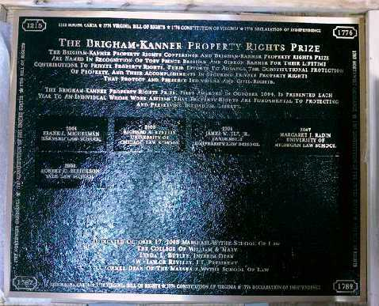
Re EULA’s etc.
“Boilerplate: The Fine Print, Vanishing
Rights, and the Rule of Law”
Princeton University Press
Margaret Jane Radin, Henry King Ransom Professor
of Law at the University of Michigan and the William
Benjamin Scott and Luna M. Scott Professor of Law,
emerita, at Stanford University

Slide 26
Insidious Results?
Censorship controls effectively delegated to private interests (without free speech/expression overrides).
* “Apple rejects game based on Syrian civil war”http://killscreendaily.com/articles/news/apple-rejects-game-based-syrian-civil-war/
* “iOS games chafe under Apple's directions: 'If you want to criticize a religion, write a book’”http://www.theverge.com/2013/1/16/3879194/apple-app-store-guidelines-tell-game-developers-to-avoid-serious-themes
* “Turns Out Sexist Talk on Xbox Live Won't Earn You a Lifetime Ban” – but racist talk will.http://www.gamepolitics.com/2012/11/07/turns-out-sexist-talk-xbox-live-wont-earn-you-lifetime-ban#.URsttVpAR3c
* & less insidiously: “Blizzard Bans 'Several Thousand' Diablo III Players for Cheating” – using bots (would “Notice” do?)http://gamepolitics.com/2012/12/19/blizzard-bans-several-thousand-diablo-iii-players-cheating#.URswDFpAR3c

Slide 27
5. The Future of Video Games
{& PRIVACY}

Slide 28


Start with “Identities”
Avatar v. real names – what should be disclosed & to whom? “Google's Vint Cerf explains why Facebook's real-name requirement is flawed” http://www.theverge.com/2013/3/5/4066546/vint-cerf-real-name-authentication-useful-but-anonymity-necessary
“Facebook wins legal battle to force Europeans to use real names online”
http://www.theverge.com/2013/2/15/3991458/german-court-rules-in-facebooks-favor-europeans-must-use-real-names
Avatars deeply embedded in history of gaming - core to play - suspension of disbelief - “magic circle”
Anonymity also deeply embedded in history of
the “web”
Extra Legal Measures (“Doxxing” – outing real identities)
“Do trolls have privacy rights” http://www.technollama.co.uk/do-trolls-have-privacy-rights
State Action: “Five More Game Companies Join New York State’s ‘Operation Game Over’ Initiative, 2100 More Accounts Purged”http://www.theverge.com/2013/2/15/3991458/german-court-rules-in-facebooks-favor-europeans-must-use-real-names
“State Laws Restricting Social media Use by Sex Offenders Are Failing in Court” http://blog.ericgoldman.org/archives/2013/01/state_laws_rest.htm

Slide 29

WHERE ARE WE NOW?
3D Printing:
Virtual Reality (Occulus Rift)
Complexities of virtual goods
Virtual Currencies (Bitcoin)
Augmented Reality
Google Glass
Kinnect/voice/motion control
Neurogaming
Wifi overtakes Cellular
The “Cloud”
“Self-driving” vehicles
The (Software) Patent Problem:
Patent Trolls
Fingerprint passwords

Slide 30


The new video game (hypothetical)
Real-world “play” (“Ingress” – Capture the Flag mechanic)
+ Immersive control mechanism (Google Glass)
+ Anywhere/any device capability (the “cloud”)
+ “Open World” design (literally & Google Earth)
+ Tools/weapons (AR Drone Quadra Copter; Google Car)
IS THIS REALLY A GAME?
+

Slide 31

Now Ponder This…
“ARE YOU LIVING IN A COMPUTER
SIMULATION?” Nick Bostrom – Faculty of
Philosophy, Oxford University. http://www.simulation-argument.com/simulation.html
“Physicists devise test to see if we're living in
'The Matrix”http://www.theverge.com/2012/10/11/3487710/computer-simulation-silas-beane-university-bonn
WE ARE ?

Slide 32

So now you are ready for what is next…
TELEPATHIC GAMING

Slide 33
Truly Immersive Virtual Reality
Start With Occulus Rift or MS Illumiroom
Add Physical Player Response Measurements
Add Neurogaming
Add Brain to Brain Interfaces
Add Big Data
Add “Lifestream”
Add 3D Printing
Add Smart Remote Control Vehicles (Anki)
Add (virtual?) monetization
Wrap it all into Augmented Reality (Google Glass/real- world interface)

Slide 34
SEE ANY LEGAL ISSUES?

Slide 35
MAIN ISSUES WILL BE
PRIVACY
PRIVACY
PRIVACY
PRIVACY
PRIVACY
PRIVACY
CONSUMER PROTECTION
(DIGITAL MANIPULATION) – “Calo”

Slide 36



Layers of Privacy in Video Games
9. Access to law enforcement by Search Warrant
8. Access by law enforcement to information where gamer does not have a
“reasonable expectation of privacy” (highly interpretive)
7. Aggregated Gamer/Game information available to advertisers/sponsors/
purchasers having relationships with game/developer/game network/social
network/ (ISP-carrier?) as permitted by EULA/ToS
6. Gamer/Game information available to ISP/network carrier/mobile carrier
(often includes location information)
5. Gamer/Game information useable by game network/social network
(permissions)/ISP (Steam, XBLive, Facebook) per ToS (often
includes location information)
4. Gamer information useable by developer/publisher per EULA
3B. Audio gaming layer – quasi-public (through game)
3A. Audio gaming layer – private (Ventrilo)
2. Gamer shares information for “magic circle” purposes (multiplayer; forums)
1. Gamer creates information

Slide 37

Video Game Privacy Breaches
“UK regulators fine Sony for 'preventable' 2011 PSN
hack” (Sony dropped appeal re 2011 hack)http://www.theverge.com/2013/1/24/3910538/uk-government-fines-sony-for-preventable-psn-data-breach
“Blizzard Faces Class Action Over Battle.net
Security”
http://www.gamepolitics.com/2012/11/09/blizzard-faces-class-action-over-battlenet-security#.UUl0jqXR1Lw
“Data Breach Class Action against Popular Video Game
Developer Dismissed for Failure to Plead Adequate
Damages” (Valve/STEAM)http://www.dataprivacymonitor.com/data-breaches/data-breach-class-action-against-popular-video-game-developer-dismissed-for-failure-to-plead-adequat/
+ “Steam’s Sub Agreement Prohibits Class-Action
Lawsuit
http://www.rockpapershotgun.com/2012/08/01/steams-sub-agreement-prohibits-class-action-lawsuits/
“FTC fines Path mobile social networking app $800,000
for privacy breaches”
http://www.lexology.com/library/detail.aspx?g=6f2cc64a-755d-4cbf-a57e-b1ee458280f6
“Bug in EA’s Origin game platform allows attackers to
hijack player PC’s”
http://arstechnica.com/security/2013/03/bug-on-eas-origin-game-platform-allows-attackers-to-hijack-player-pcs/

Slide 38
& Can the Magic Circle
EVEN SURVIVE?
NO QUESTION IT’S SHRINKINg

Slide 39
6. Social Issues:
Violence
&
Sexism

Slide 40

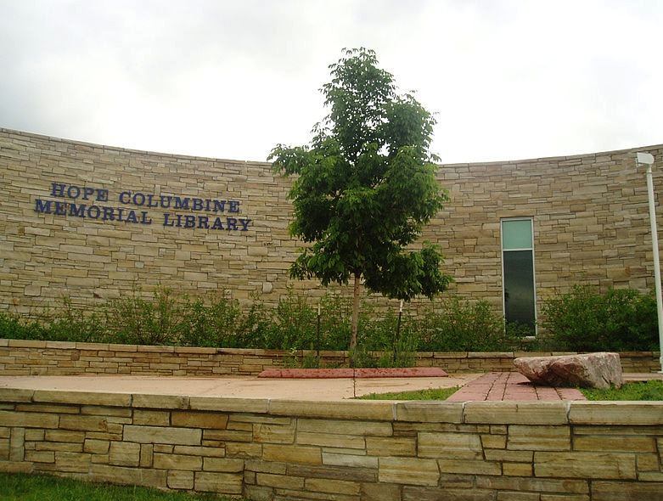
Assaults on Videogames
Assaults by Videogames
REMIXING VIOLENCE, SEXISM
& CIVIL SOCIETY

Slide 41
Violent Games, Liability & Regulation: Cases
Watters v. TSR (D&D) 1990 USCA
James v. Meow (Heath High, Kentucky) 2002 USCA
Sanders v. Acclaim (Columbine) 2002 US Dist.
Wilson v. Midway (Mortal Kombat) 2002 US Dist.
----------------------------------------------------------
American Amusement v. Kendrick 2001 USCA
(protecting minors)
IDSA v. St. Louis 2003 USCA (protecting minors)
VSDA v. Maleng 2004 US Dist. (regulate games
depicting violence against law enforcement)
ESA v. Blagojevich 2006 USCA (protecting minors)
EMA v. Henry 2007 US Dist. (protecting minors)
ESA v. Swanson 2008 USCA (purchase contrary to
“rating”)
ESA v. Chicago Transit 2010 US Dist. (restricted
“M” game ads on CTA vehicles)
ESA v. Schwarzenegger 2011 SCOTUS (prohibited violent
video games) - Class 12 upcoming

Slide 42
Violent Games, Liability & Regulation: Rationales
Proximate cause (civil) not demonstrated - not
foreseeable - studies ambiguous re “actual harm”
Products liability claims inapplicable
Duty to exercise ordinary care
-----------------------------------------------------
Link of violent games to violence unproven – causality not demonstrated; correlation not cause
Thought control = totalitarianism = family
responsibility
Drafting not narrowly tailored to objective
Vague & ambiguous definitions/provisions
Classic literature/film, Bible, fairy-tale
comparisons

Slide 43


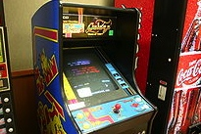
Canada - potentially quite different (if tested)
Montreal v. Arcade Amusements 1985 SCC – City By-Law 5156 (1977) cannot discriminate based on age (under 18) prohibiting entry to video arcade (narrowly construed decision)
Irwin Toy v. Quebec 1989 SCC - constitutionality of ban on commercial advertising directed at children under 13 upheld (no evidence or discussion of direct harm)
R. v. Sharpe 2001 SCC - reasoned apprehension of harm to children is sufficient (child pornography)

Slide 44
The Painful Truth…
Watters v. TSR, Inc., 904 F. 2d 378 - Court of Appeals, 6th Circuit 1990 (Dungeons & Dragons):
“But if Johnny's suicide was not foreseeable to his own mother, there is no reason to suppose that it was foreseeable to defendant TSR…
…The fact is, unfortunately, that youth is not always proof against the strange waves of despair and hopelessness that sometimes sweep seemingly normal people to suicide, and we have no way of knowing that Johnny would not have committed suicide if he had not played Dungeons & Dragons…
…As far as the record discloses, no one had any reason to know that Johnny Burnett was going to take his own life. We cannot tell why he did so or what his mental state was at the time. His death surely was not the fault of his mother, or his school, or his friends, or the manufacturer of the game he and his friends so loved to play. Tragedies such as this simply defy rational explanation, and courts should not pretend otherwise.”

Slide 45


Virtual v. Real GUNS: the obvious distinction
Guns are not the cause of violence
They are actually a part of the
violence.
It is for that reason guns are different from media influences, video-games and the rest.
Related: difference between ACTIONS (e.g. rampage killing) & INFLUENCES (video-games, movies). Between them lies INTERPRETATION
(which is about education)

Slide 46

Women Gamers – Women in Games
“Video Games and Aestheticising Sexual Violence” http://gamingbolt.com/video-games-and-aestheticising-sexual-violence
“A Feminist Reviews Tomb Raider's Lara Croft” http://www.forbes.com/sites/carolpinchefsky/2013/03/12/a-feminist-reviews-tomb-raiders-lara-croft/
“Hitman Absolution: Trailer causes outrage”http://www.pocket-lint.com/news/45874/hitman-absolution-trailer-causes-outrage-io-games-producer-talks-violence-and-content
“In Virtual Play, Sex Harassment Is All Too Real” http://www.nytimes.com/2012/08/02/us/sexual-harassment-in-online-gaming-stirs-anger.html
“Image Based Harassment and Visual Misogyny”http://www.feministfrequency.com/2012/07/image-based-harassment-and-visual-misogyny/
“Fear of a Woman Warrior”http://www.gamespot.com/features/fear-of-a-woman-warrior-6404142/
“On being a girl in computer science - a confession” by Dr. Kimberly Vollhttp://zanytomato.tumblr.com/post/44978912674/on-being-a-girl-in-computer-science-a-confession

Slide 47
Something(s) utopian to reflect on..
Razing the virtual glass ceiling: Gendered economic disparity in two massive online games – Ratan, Lehdonvirta, Kennedy, Williams (2012) http://vili.lehdonvirta.com/files/wmtr2821/Ratan-2012-gender-virtual-wealth-gap.pdf
Online dating study shows racial prejudices can be easily altered
http://www.boston.com/news/science/blogs/science-in-mind/2013/11/04/online-dating-study-shows-racial-prejudices-can-easily-altered/UsN6Rc6oOEIQQTsUQFLdxM/blog.html
Modifying player behavior in League of Legends using positive reinforcement
http://www.gamasutra.com/view/news/184806/
You and Your Videogame Avatar Are More Moral Than You Realize
http://www.forbes.com/sites/carolpinchefsky/2012/11/28/you-and-your-videogame-avatar-are-more-moral-than-you-realize/
Computer Games Save Norwegian Youth
http://www.tnp.no/norway/panorama/3904-computer-games-save-norwegian-youth
Strong-female protagonist game jam kicks off in Vancouver to fight industry sexism
http://business.financialpost.com/2013/07/12/strong-female-protagonist-game-jam-kicks-off-in-vancouver-to-fight-industry-sexism/?__lsa=9ee1-db35
And a concern: Sexualized avatars affect the real
world, Stanford researchers find
http://news.stanford.edu/news/2013/october/virtual-female-avatars-100913.html

Slide 48
9 Ways Video Games Can Actually Be Good For You
1. 'Mario' Is Like Steroids For Your Brain
2. 'Starcraft' May Make You Smarter
3. Video Games May Slow The Aging Process
4. They May Help Dyslexic Kids Read Better
5. Teen Gamers End Up Better At Virtual Surgery
Than Real Medical Residents
6. Video Games Can Be A Pain Reliever
7. 'Call Of Duty' Can Improve Your Eyesight
8. Video Games Can Be As Effective As One-On-One
Counseling
9. They Can Help Stroke Victims More Fully
Recover http://www.huffingtonpost.com/2013/11/07/video-games-good-for-us_n_4164723.html

Slide 49

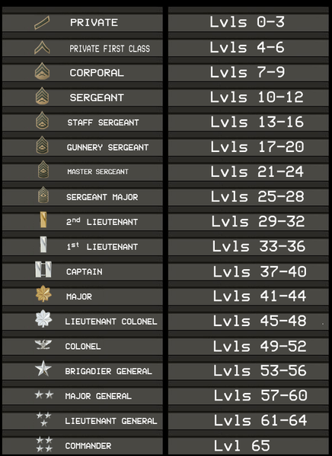

What’s Your Take?
“Gamers committing war crimes should suffer ‘virtual consequences,’ says Red Cross”
http://www.theverge.com/2013/10/8/4815090/gamers-committing-war-crimes-should-suffer-virtual-consequences-says

Slide 50
THANK
YOU

Slide 51

Required cat pic..

Slide 52
Our Academic Partners

