Slide 1
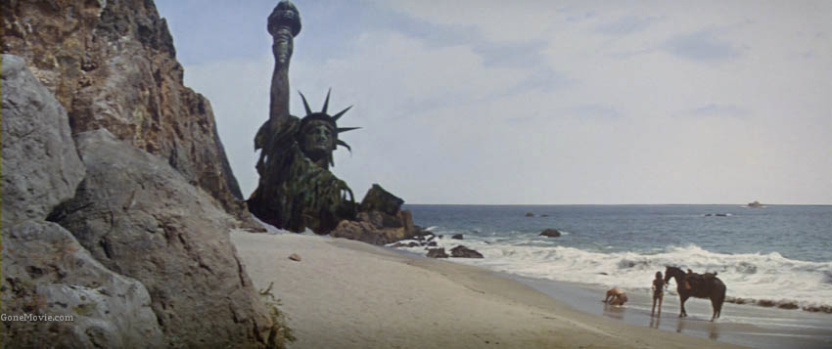
THE FUTURE

Slide 2
ANDY MOORE
Founder and Captain of Radial Games
Game Developer, Programmer, Designer, Producer
Community Developer, Teacher, Mentor
SteamBirds, Monster Loves You!, ROCKETSROCKETSROCKETS

Slide 3
TOPICS
Ethics
The future of the video game industry
Augmented reality
Virtual reality

Slide 4
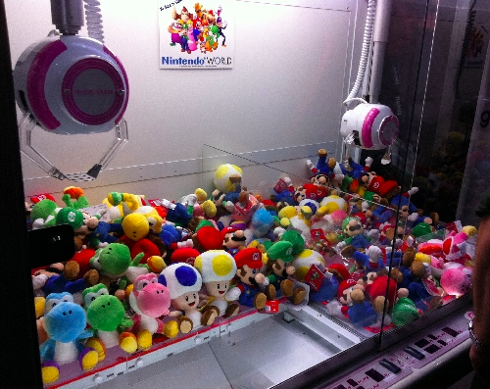
CHANGING ECOSYSTEM
Notes:
Marketplaces used to be gated
Self publishing more popular (books, films, video games)
Discoverability dropping
Publisher value dropping
Studio risk very high (no support, no backup, gabe newell death threats)

Slide 5
SOCIAL ACCOUNTABILITY
Notes:
to stand out, developers need to speak up
speaking up may now cost you your business
or your life

Slide 6
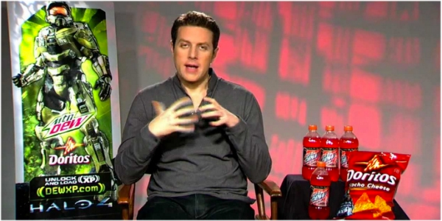
JOURNALISTIC INTEGRITY
Notes:
hardly able to exist right now

Slide 7
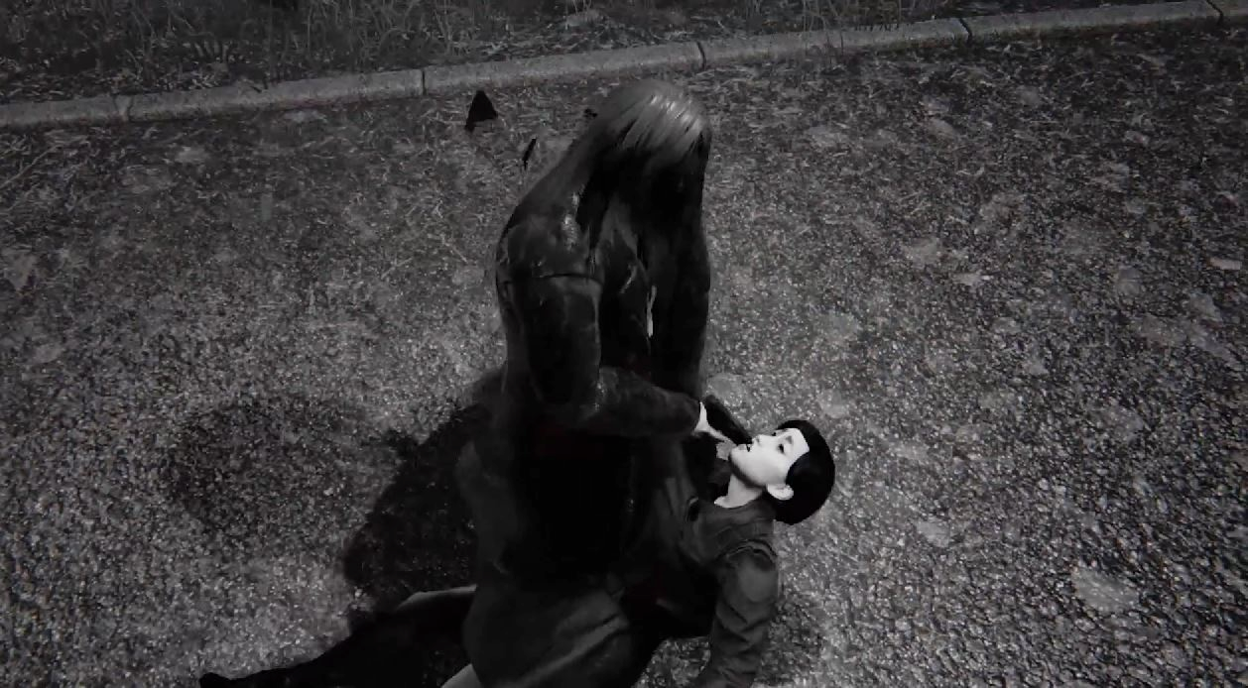
CULTURAL RESPONSIBILITY
Notes:
Shock culture is dead.
Try watching an old marilyn manson or alice cooper music video and be “outraged”

Slide 8
RESPECTING PLAYER’S TIME

Slide 9
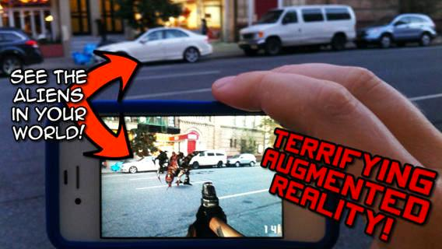
AUGMENTED REALITY
Notes:
occlusion problem is too hard to solve

Slide 10
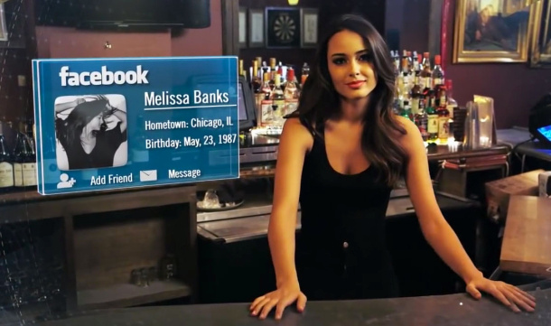
AUGMENTED REALITY
Notes:
Google glass banned in many locales, more than cameras
conspicuous use?

Slide 11
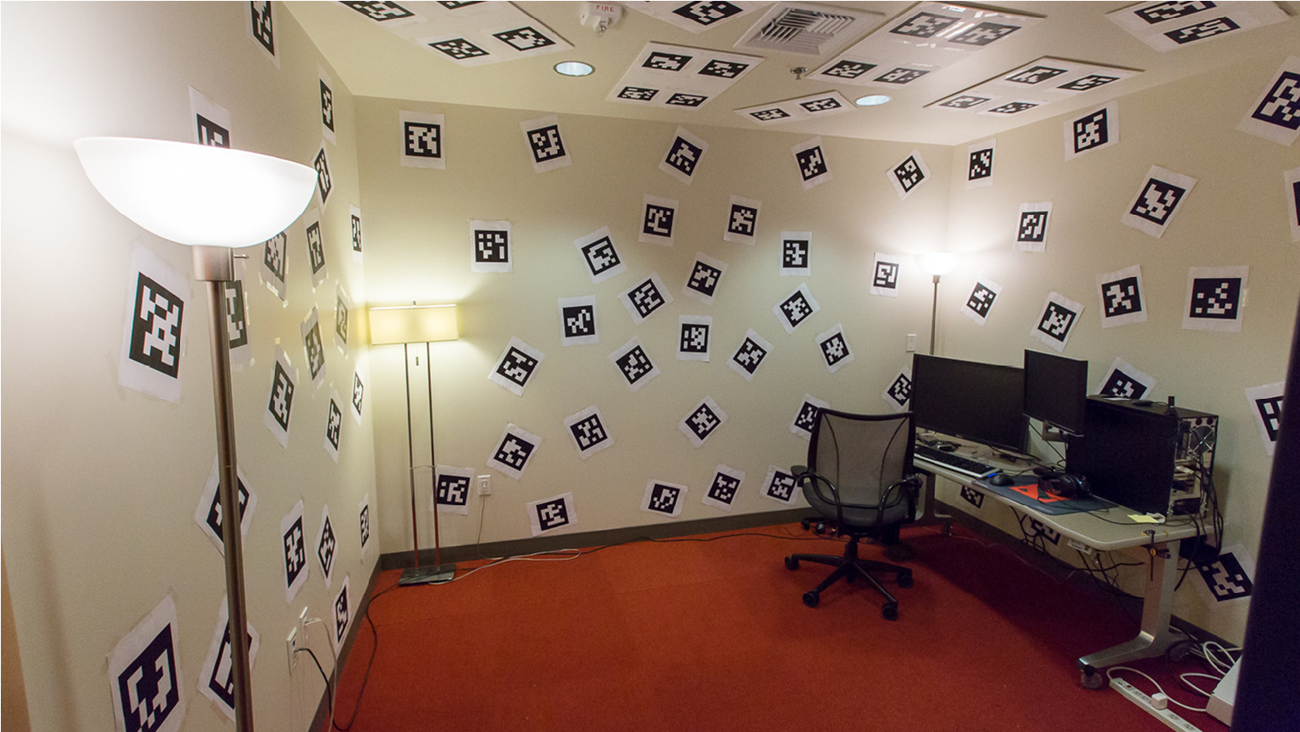
VIRTUAL REALITY
Notes:
cliff story

Slide 12
ANDY MOORE

