Slide 1
From Games to Change
Connecting the dots between Behavioural Psychology, Games and Persuasive-design Principles
to show how real change can happen in health care.
August 9, 2014 Full Indie SummitMorning Session

Slide 2
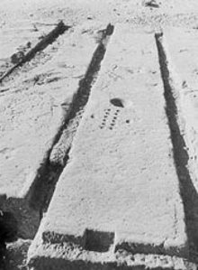
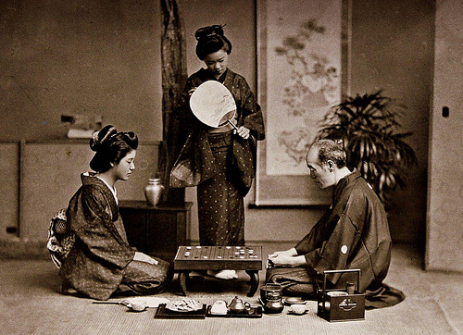
Ayo+Go: two of the world’s oldest symbolic games
Ayo
Go
Notes:
A game board similar to Mancala was found on the roof of the temple of Seti I in Egypt. The Temple of Seti I was completed by Ramses II for his father, Seti I, likely within the first 5 years of his reign. It was used as part of the Abydene pilgrimages for over 1000 years, and was eventually closed down during the Roman period. Since roofs of temples were often used by priests to observe the stars, they would spend hours in these locations. When waiting for the stars to come out, or for the sky to clear, they apparently played games. There are numerous game boards are hollowed out in the sandstone blocks of the temple.
Royal Game of Ur
Go – most difficult strategy game in the world. Two pixels. The best AI computer games can be beaten by junior competitor.
The ancient Oriental board game “Go” is a game of unfathomable complexity given rise to by a set of elegantly simple rules. It has played a key role in the Eastern societies and cultures of which it has been a part over the last thousands of years, and is rapidly gaining popularity in the West as well. At the same time, Go provides a fascinating tableau for mathematical and scientific research, in particular artificial intelligence and cognition…” Myers and Chatterjee, 2003.

Slide 3
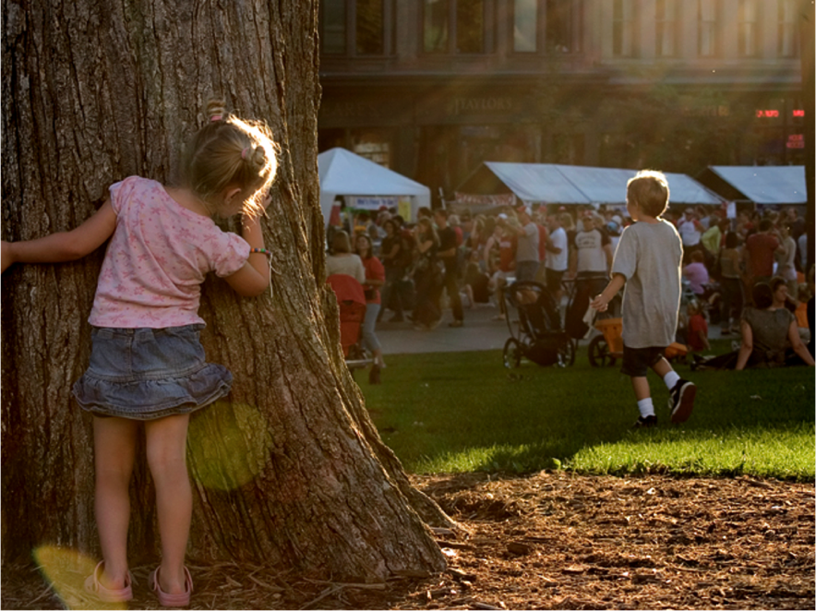
Notes:
First – let’s start with Play…

Slide 4
Bridge from Play to Games
Games structure and intensification play by adding:
Goal/Win State
Rules
Feedback System
Voluntary participation

Slide 5
Playing a game is the voluntary attempt to overcome unnecessary obstacles. -Bernard Suits

Slide 6
Video games use the science of telemetry, data mining and analytics to perfect their understanding of how players experience play and formalize that into repeatable game components.

Slide 7
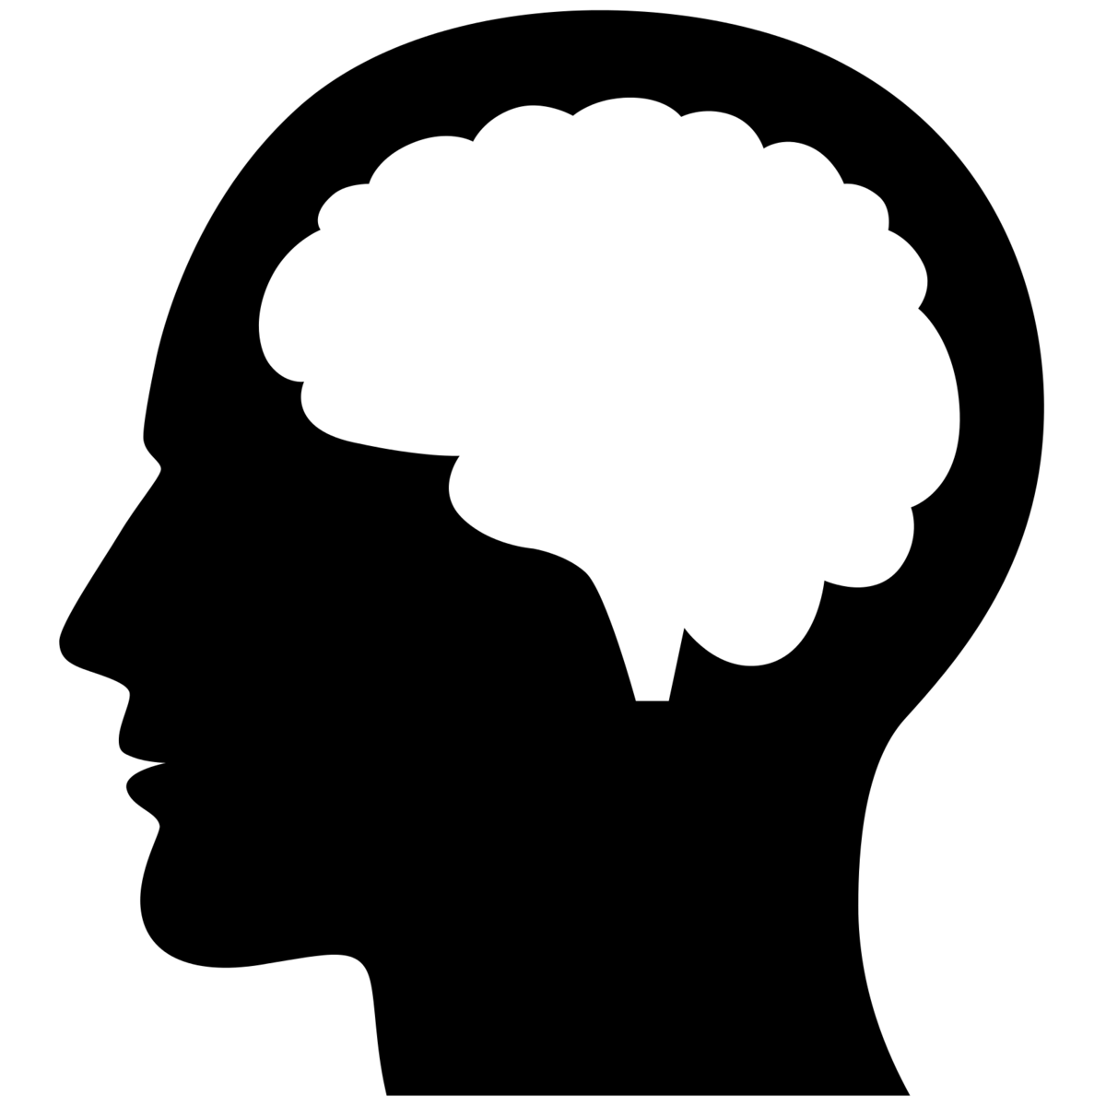
Dopamine
Stimulus
Action
Feedback
Notes:
Games elicit controlled releases of dopamine that fuel an Engagement Loop:
the brain is alerted to pay attention with the promise of fun (think of the trigger words associated with the behaviours listed above: win! collect! unlock the mystery! play with friends!);
the player crosses the “activitation threshold” and takes action;
the player receives feedback (You won! You’re almost there. 2 out of 3 complete. Your friends are playing too - share with them! etc).
This feedback motivates the player to continue, therefore continuing the loop.

Slide 8
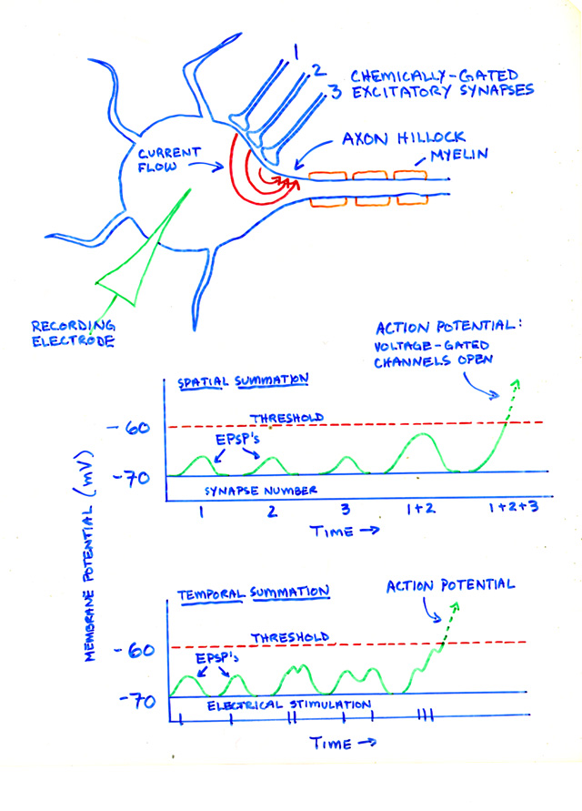
Big Fat Caveat
I think you’ll find it is more complicated than that.
-Ben Goldacre
Bad Science

Slide 9
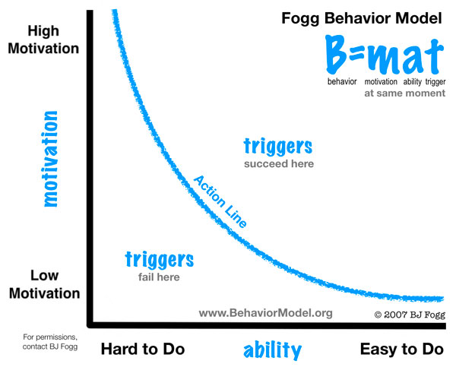
Habit Loop
Trigger
Action
Feedback
Flow
Habit
Notes:
Games elicit controlled releases of dopamine that fuel an Engagement Loop:
the brain is alerted to pay attention with the promise of fun (think of the trigger words associated with the behaviours listed above: win! collect! unlock the mystery! play with friends!);
the player crosses the “activitation threshold” and takes action;
the player receives feedback (You won! You’re almost there. 2 out of 3 complete. Your friends are playing too - share with them! etc).
This feedback motivates the player to continue, therefore continuing the loop.

Slide 10
There are nine component states of achieving flow (Fullagar & Kelloway):
challenge-skill balance,
merging of action and awareness,
immediate and unambiguous feedback,
concentration on the task at hand,
paradox of control,
transformation of time,
loss of self-consciousness,
autotelic [intrinsically-rewarding] experience.”
Flow: The Psychology of Optimal Experience, Csíkszentmihályi

Slide 11
DOSE: Four Chemicals that Activate Happiness & Engagement
Engagement
Dopamine
Anticipation
Oxytocin
Social bonding
Serotonin
Good gut
Tryptophan
Endorphins
Power-through
Source: Nicole Lazarro, XeoDesign

Slide 12
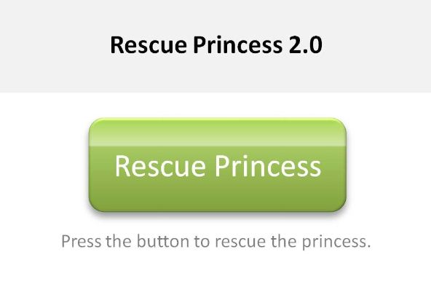
Notes:
No effortful thought required.

Slide 13
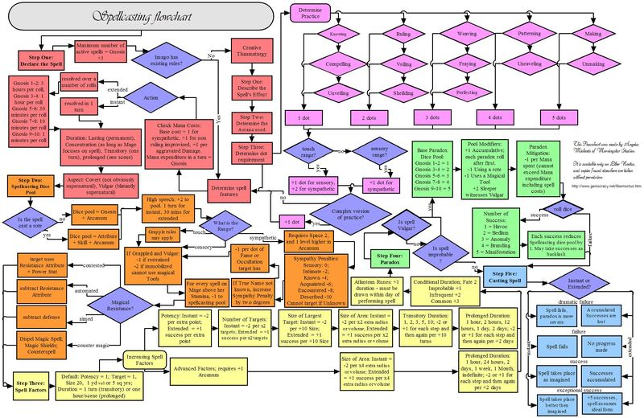
vs.
Notes:
Effortful - but the complexity is voluntary.
The complexity has progress, rules, and win states or resolution.
The complexity deepens engagement with the material

Slide 14
There are nine component states of achieving flow (Fullagar & Kelloway):
challenge-skill balance,
merging of action and awareness,
immediate and unambiguous feedback,
concentration on the task at hand,
paradox of control,
transformation of time,
loss of self-consciousness,
autotelic [intrinsically-rewarding] experience.”
Flow: The Psychology of Optimal Experience, Csíkszentmihályi

Slide 15
Video games use the science of telemetry, data mining and analytics to perfect their understanding of how players experience play and formalize that into repeatable game components.

Slide 16
When do serious games make sense?
There’s time to play
There’s a reason to deepen engagement
There’s a discrete player behaviour to motivate
There’s risk to overcome in experimenting with the new
Rote learning is ineffective
Context counts
When fun matters….

Slide 17
Behavioral Psychology & Cognitive Behavioural Therapy
Motivation underlies Change Games
What is motivating:
Cognitive biases (Behavioural Psychology)
The 90% Success Threshold (CBT- Motivational Interviewing)
the Zone of Proximal control; Goal Gradient (CBT)
Agency: voluntary, autonomous, personalized, choice
Goal setting (CBT)
Commitment, reciprocal social obligation
Novelty, changing cues and triggers
Feedback on incremental progress (CBT)
Challenge interspersed with easy delight

Slide 18
Four Keys to Fun
Hard Fun
Endorphins, dopamine
Easy Fun
People Fun
Oxytocin
Serious Fun
Dopamine
Creativity
Exploration
Fantasy
Relief
Fiero \o/
Frustration, obstacles
Moving together, gestures
Amusement
Control
Teasing, Encouraging
Completion
Feedback
Meaningful
Progress
Source: Nicole Lazarro, XEO design
“The best games have at least 3 out of 4 keys.”

Slide 19
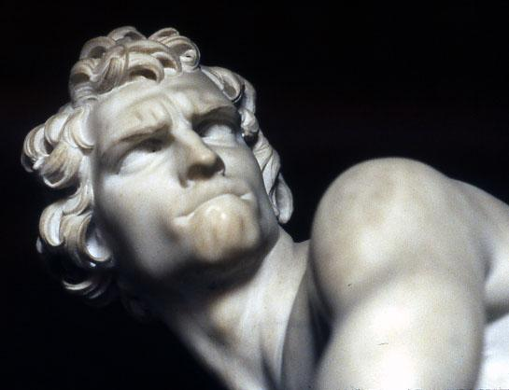
Hard Fun: Frustration, Fiero, Relief
Challenge & Strategy
Uncertain Outcomes
Mastery
Feelings of Accomplishment
Focused attention
Intensified play via Goal, Constraints, Timebox
Eustress not distress
Dopamine
Epinephrine, Cortisol-CRH
Endorphins
Bernini’s David

Slide 20
Easy Fun: Curiosity, Surprise, Wonder
Exploration
Discovery
Fantasy
Creativity
Distractability
Receptive
Framing changes perception
Agency, off track play
Easter Eggs. Haptics & controls
Dopamine
Serotonin
Utagawa Kunisada
Notes:
Serotonin helps regulate mood, sexual desire and function, appetite, sleep, memory and learning, temperature regulation, and some social behavior

Slide 21
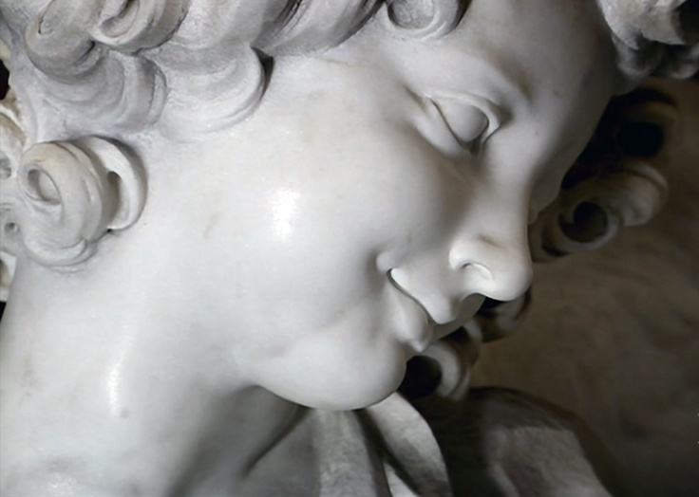
People Fun: Amici, Amusement, Admiration, Schadenfreude
Communicate
Cooperate
Compete
Mimic
Hang out
Social interaction
Gesture & touch(screen)
Gifting
Teasing
Oxytocin
Serotonin
Bernini’s St. Theresa

Slide 22
Serious Fun: Excitement, Focus, Purpose
Meaning
Repetition
Rhythm
Collecting & arranging
Purposeful Play
Act upon and within the world
Andy Goldsworthy
Nils Udo
Dopamine
Serotonin
Bernini’s St. Theresa

Slide 23
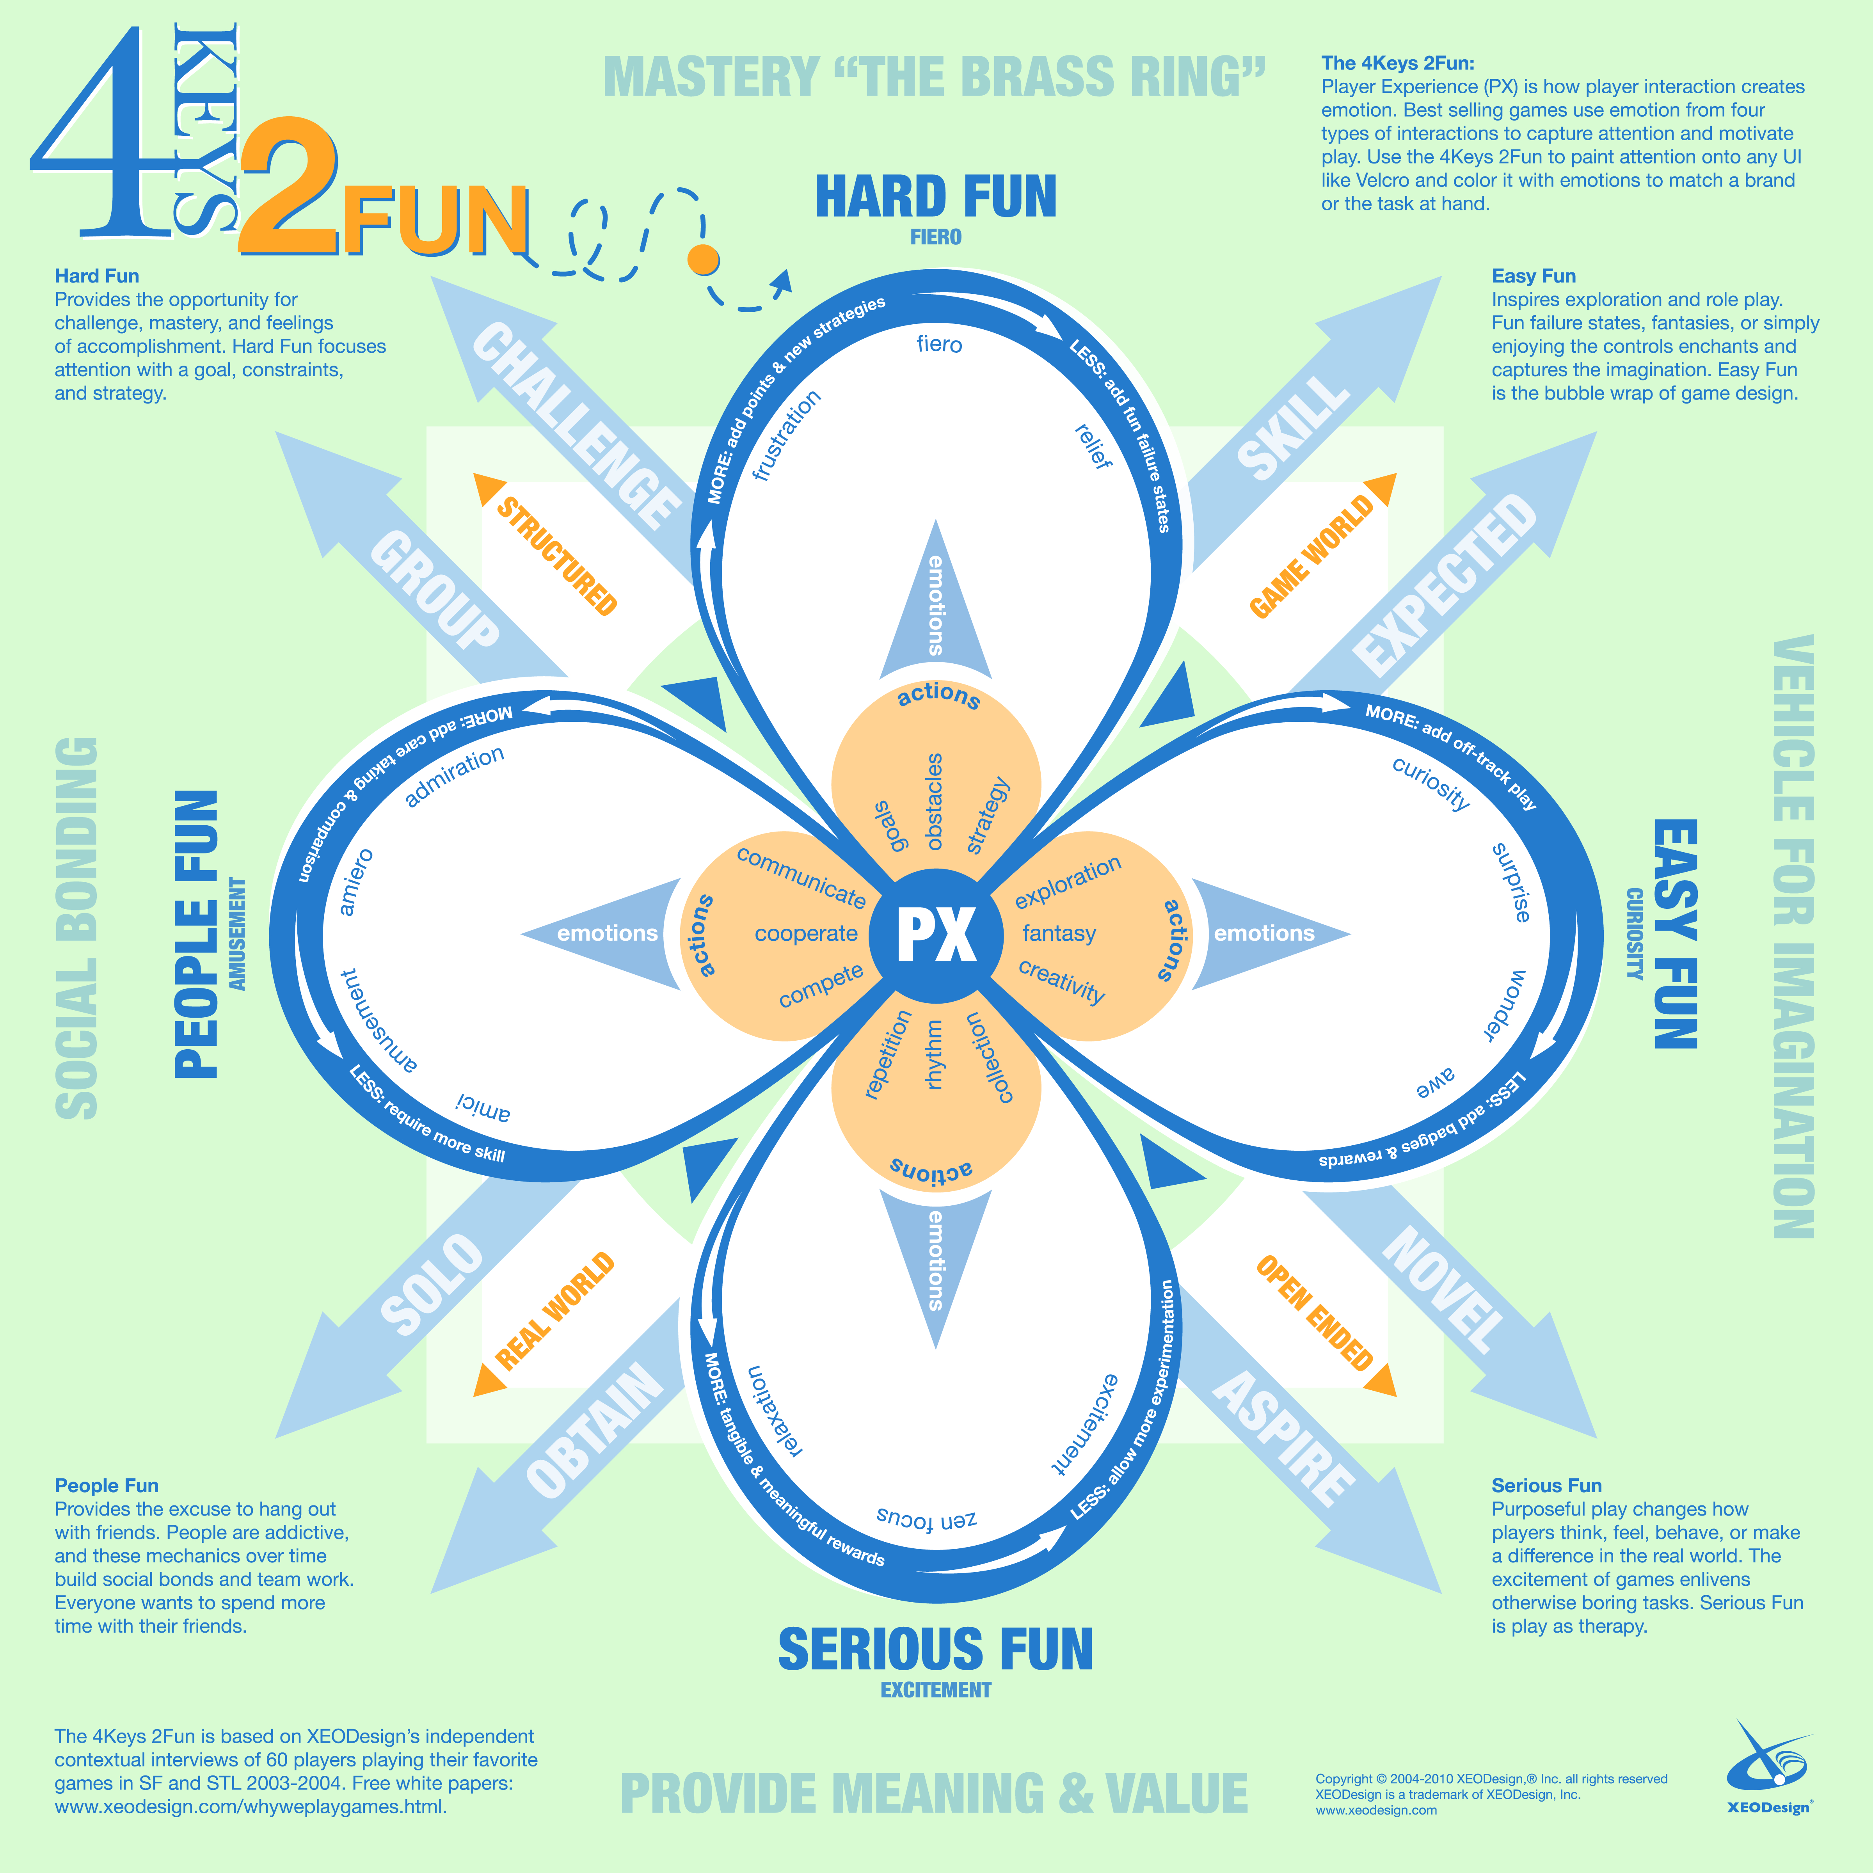

Slide 24
Addiction: yes, for some, it’s real
Computer Game playing may lead to long-term changes in the reward circuitry that resemble the effects of substance dependence, showing reduced dopamine response to stimuli associated with their addiction, due to sensitization.
Weinstein, Aviv Malkiel. "Computer and video game addiction-a comparison between game users and non-game users." The American journal of drug and alcohol abuse 36.5 (2010): 268-276.
DRD2 Taq1A1 allele seems to be associated with reward dependence in excessive internet video game play adolescents.
Han, Doug Hyun, et al. "Dopamine genes and reward dependence in adolescents with excessive internet video game play." Journal of addiction medicine 1.3 (2007): 133-138.
4% of Norwegian adults experience problematic video game addiction; higher % of Massively Multiplayer Online Role-Playing Games (MMORPG, MMO).
Mentzoni, Rune Aune, et al. "Problematic video game use: estimated prevalence and associations with mental and physical health."Cyberpsychology, behavior, and social networking 14.10 (2011): 591-596.
Some ADHD Kids more vulnerable to “dependence” on VG
Notes:
Healthy control subjects had reduced dopamine D2 Receptor occupancy of 10.5% in the caudate after playing a motorbike riding computer game, completed with baseline levels of binding consistent with increased release and binding to its receptors. Ex-chronic ecstasy users showed no change in levels of dopamine D2 receptors occupancy after playing the same game. Cinclusiong
Psycho-stimulant users have decreased sensitivity to natural reward.

Slide 25
Persuasive Technology
Behavioural Psychology:
Defaults
Choice Complexity
Loss Aversion
Heuristics as basis of decision making (Attribute substitution)
Temporal Discounting
Gamification:
Agency
Challenge
Uncertainty
Rules
Outcomes
Points
Badges
Leaderboards

Slide 26
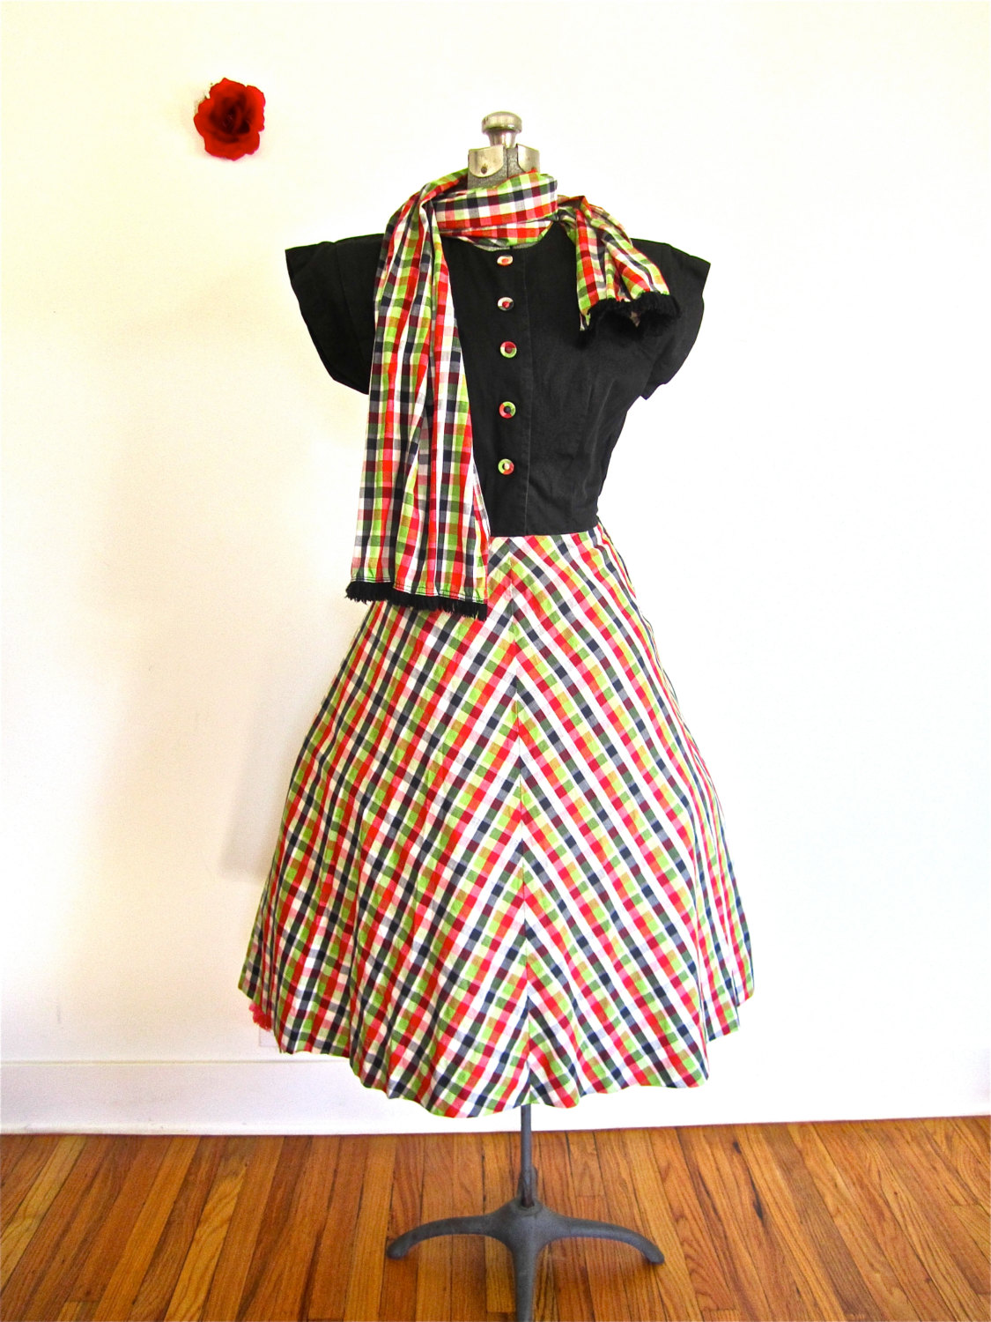
Manipulation? Or Accessibility Issue?
=$110
A dress and a scarf together cost $110.
The dress costs $100 more than the scarf.
How much does the scarf cost?
Notes:
Kahnemann & Tversky
System 1 & System 2: Thinking Fast & Slow

Slide 27
Framing
Here’s an easy question…
Vs
Because lawyers pay close attention to qualifying words such as “more”, they are 90% more likely than other students to get the correct answer to a trick question that requires simple math…
Notes:
Kahnemann & Tversky
System 1 & System 2: Thinking Fast & Slow

Slide 28
The Answer
$10
The Scarf costs
$5
$105 is $100 more than $5.
$105+$5= $110

Slide 29
Discuss: Persuasive or Manipulative?
“Put hot triggers in the path of motivated people.”
BJ Fogg
Confound people with effortful thinking then surprise them with a question where an incorrect but accessible answer is expected.

Slide 30
Notes:
Positive reinforcement: motivating with moments of joy.

Slide 31
Thank you!
Connect with me on LinkedIn
linkedin.com/in/mavisdixon
mavis@ayogo.com

