Slide 1


Creators, Consumers & Users
Talk 5
Part B “Connecting”
Video Game Law - Fall 2014
UBC Law @ Allard Hall
Jon Festinger Q.C.
Centre for Digital Media
Festinger Law & Strategy
http://videogame.law.ubc.ca
@gamebizlaw
jon_festinger@thecdm.ca

Slide 2
…and now…Mode(s) of Connecting
(& Legal Consequences)
TWO TRICKY QUESTIONS
1. Are “Creators, Consumers & Users” in fact the same? If so should they be treated equally in law?
2. Asymmetry or A Symmetry (?)
CREATION associated with COPYRIGHT/IP
CONNECTING goes with CONTRACT LAW ??

Slide 3
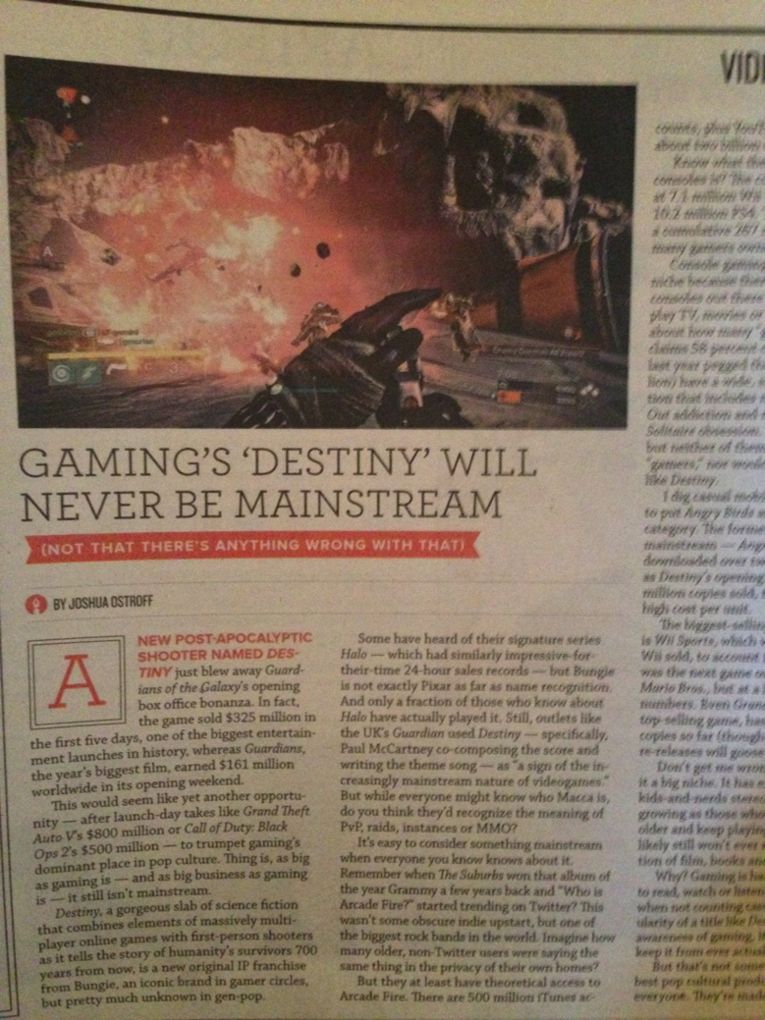
Console Stats v. Gamer Stats
“Guardians of the Galaxy” opening Weekend = $161 million
“Destiny” opening five days = $325 million (GTA V launch day = $800 million)
Current Gen consoles sales: 7.1M Wii U; 5.1M Xbox One; 10.2M PS 4 (Last gen = 267M worldwide)
1.2 Billion “gamers”
Source: “Gaming’s Destiny Will Never Be Mainstream” by Joshua Ostroff in October 2014 “Exclaim!*’#”

Slide 4

Basic Thesis
If Copyright Law is reaching towards unity and equality of creators, consumers & users…
Contractual terms are tearing that utopian vision apart

Slide 5
Beginning with…Where we left off
Bait: Right to Mod/Right to CreaTe
Switch:
Copyright’s relationship to (derived from?) free speech rights.
2. LEVELLING UP: Video game interactivity a “level” beyond other remix’s/uses owing to fundamental nature of gamer as contributor. Also community based “social reaction” (McLuhan). Closest analogy not remix rap, but fan fiction?
3. Symmetry of personal interactivity in a creative environment (VIDEO-GAMES) with personal creativity in an interactive environment (WEB, SOCIAL MEDIA) ought to equal right to mod, machinima & remix?
4. Perhaps copy “right” regime makes more sense for non-interactive mediums – e.g. records, film, television?

Slide 6

Leading to ….
Sacredness of personal creativity -----SHARED.
Moral Rights (as opposed to economic property rights) as tool to protect the creative..
*
*Art by Allan Switzer

Slide 7
Word Alignments
Data
Game
Idea
Private
Interactive
Magic
Intellectual
Not IP
Documents
Video
Expression
Public
Environment
Circle
Property
IP

Slide 8

What does this list really mean?
It appears as an endless Yin/Yang dialectic between:
Nature & Nurture
Idea & Expression
Creativity & Connection
User & System
Gamer & Game
Magic & Circle
Human & Societal

Slide 9
Is this, in philosophical terms, really a hard choice?
“My life seemed like a glass tunnel, through which I was moving faster every year, and at the end of which there was darkness... [However] When I changed my view, the walls of my glass tunnel disappeared. I now live in the open air. There is still a difference between my life and the lives of other people. But the difference is less. Other people are closer. I am less concerned about the rest of my own life, and more concerned about the lives of others.”
Derek Parfit (1984) “Reasons and Persons” Oxford Clarendon Press

Slide 10

“What Are Video Games (today)?”
https://medium.com/message/the-secret-of-minecraft-97dfacb05a3c
“A generative, networked system laced throughout with secrets.”

Slide 11
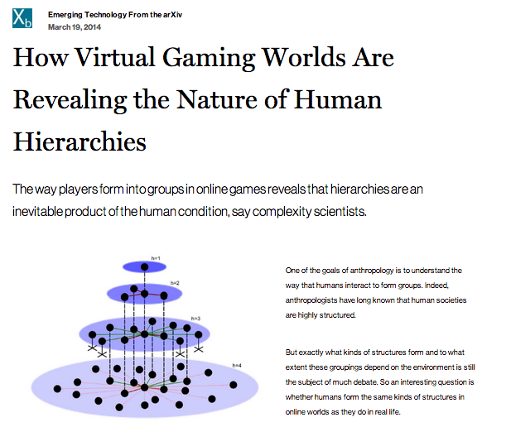

More Evidence
http://www.technologyreview.com/view/525696/how-virtual-gaming-worlds-are-revealing-the-nature-of-human-hierarchies/

Slide 12
Boyden
“In all of these situations, the owners of a copyright in a form, description, or set of instructions were attempting to extend their copyright to material for which the user of the work provided the essential content, not its author. That is what made them systems. They were, without that input, empty shells, waiting to be filled.”
“Games are systems in exactly the same way. A game, as sold, is only a game form; the content necessary for an instance of the game comes from the players. That is, the game form establishes the environment for play—the game space—and it defines permissible moves and the conditions for winning or drawing. But the game itself is supplied by the players.”
“Systems are shells into which users pour meaning. While they may contain expression themselves, that expression is there merely to facilitate the meaning added by the user.”

Slide 13
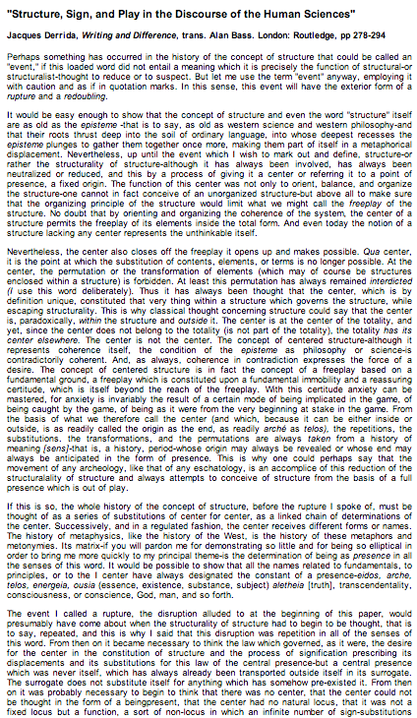
Video-Games as Post-Structuralism
"Structure, Sign, and Play in the Discourse of the Human Sciences” Jacques Derrida
Structures as free-floating (or 'playing') sets of relationships. Structuralist discourses unfortunately hold on to a "center” which anchors the structure and “does not play”.
http://hydra.humanities.uci.edu/Derrida/sign-play.html

Slide 14
Post-Structuralist Concepts
Massively Multiplayer
Open World Playground
Content Creation Tools
Cooperative Mode
Public Gameplay Mode
Remote Play
Dynamic Gameplay Engine
WorldEditor (WED)
Scennery & Character Generators
A.I.

Slide 15
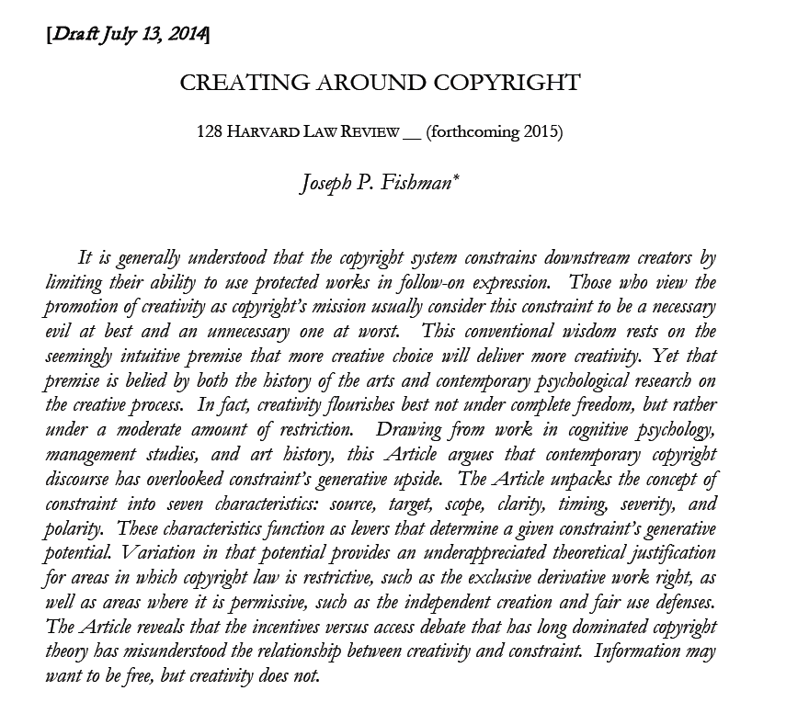
Otherwise…
http://papers.ssrn.com/sol3/papers.cfm?abstract_id=2465590

Slide 16

BUT EVEN IF YOU INSIST ON “RATIONALITY”
GLaDOS (Portal 2)

Slide 17
Measuring creative content in the context of mods and copyright ownership
Percentage of time gamers “create” in game versus time developers spent creating the game.
Percentage of pixels if you prefer, or lines of code…
Common denominator – effort in “framing experiences”

Slide 18


Eve Online
Minecraft

Slide 19
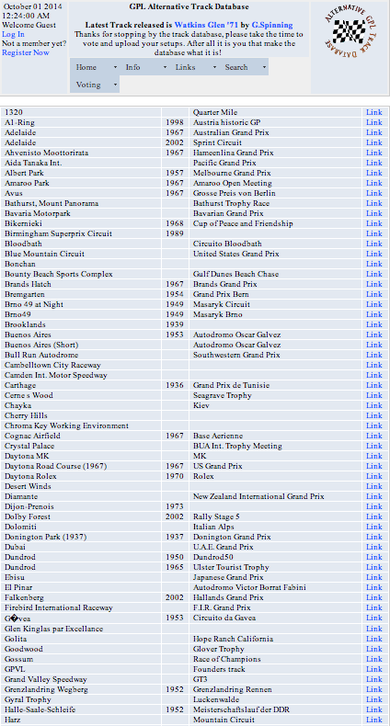
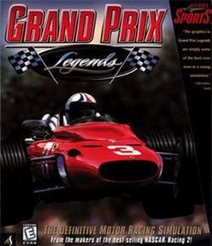
Not Even Close…

Slide 20

http://kotaku.com/5979860/the-12-best-mods-for-pc-games

Slide 21
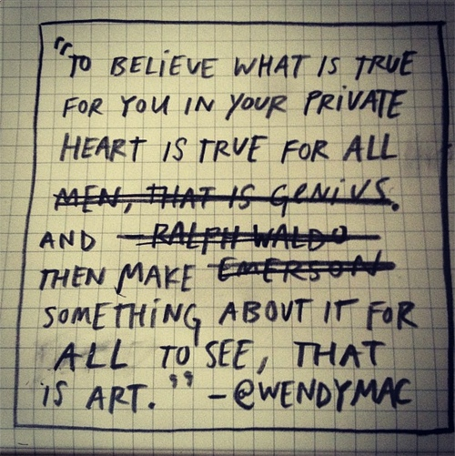
Reconciling Creating & Connecting
(sort of)…
From “Exp.lore.com”
http://exp.lore.com/post/41546671840/the-ever-brilliant-wendy-macnaughton-you-know

Slide 22
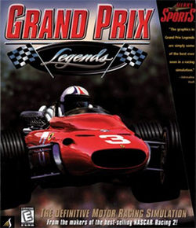
Can I Mod
Yet?

Slide 23

“We cannot know how we would have acted, but we now know how we should have.”

Slide 24
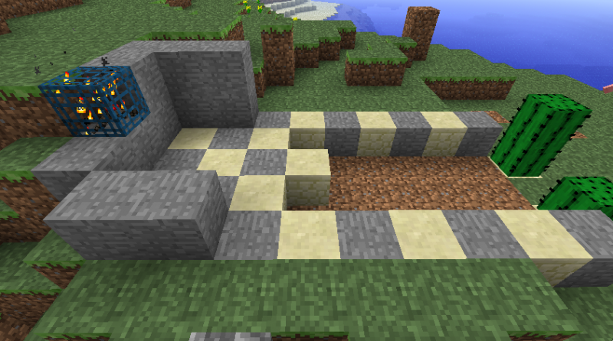


Creativity Rules
IP/Copyright as Property Right v. Right to Copy/Remix
TO BE RESOLVED IN FAVOUR OF “CREATIVITY” (not innovation, not commerce, not GNP, not the 1%)

Slide 25
POSSIBLE WAYS FORWARD
Enter “Moral Rights”
Regime of ATTRIBUTION + INTEGRITY
IF TO IP = 1. commercial impact irrelevant;
2. right to be attributed
3. right to protect work’s integrity
Berne Convention for the Protection of Literary and Artistic
Works (1886):“(1) Independently of the author's economic
rights, and even after the transfer of the said rights, the author
shall have the right to claim authorship of the work and to object to
any distortion, mutilation or other modification of, or other
derogatory action in relation to, the said work, which would be
prejudicial to his honor or reputation.”

Slide 26
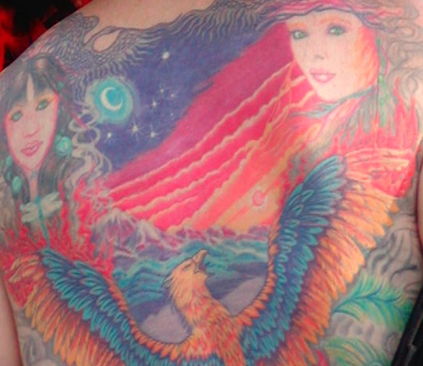
Testing Moral Rights…Thinking about Tatoos Again

Slide 27
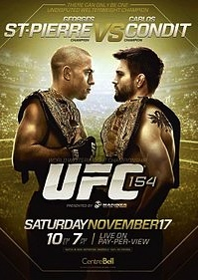
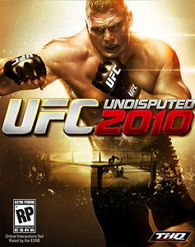
Escobedo v. THQ, Inc.
Tattoo artist sues THQ, makers of UFC
video game for copyright
infringement. Artist claims to have
tattooed an originally created lion
on Carlos Condit’s body. Escobedo
and Condit had no written agreement.
See: “Copyright in Tattoo Case”
http://www.dmlp.org/blog/2012/copyright-tattoo-
case-escobedo-v-thq-inc
"Tatoos and Copyright Infringement” by
C. Harkins (L&C Law Review)
http://www.brinksgilson.com/files/190.pdf

Slide 28
Conventional legal wisdom…
"Tattoos and Copyright Infringement” by C. Harkins (L&C Law Review - 2006) http://www.brinksgilson.com/files/190.pdf
“Before getting a tattoo, anyone with a reasonable expectation of fame should arm herself or himself with a work-made-for-hire contract, a joint work agreement specifying the customer’s contributions and expressing intent to make the customer a joint author, or some other written document transferring ownership from the tattooist and the tattoo business to the customer. As shown, many courts are fairly liberal on the specific wording. The would-be celebrity should seek legal advice or, if acting pro se, should ensure the written instrument uses the word “copyright” and states that all “ownership” in the tattoo and any drawing, sketch, and other work that becomes or embodies the tattoo vests in, belongs to, and is transferred in whole to the customer.”

Slide 29
Personal Rights Revisited
“More on copyright in tattoos: a Belgian precedent”
http://ipkitten.blogspot.ca/2013/08/more-on-copyright-in-tattoos-belgian.html
“The court held that copyright may subsist in a tattoo and that the person who realises it may be recognised as the author…
However, the reproduction right of the tattoo artist is limited to the actual design. This means that, while he/she may execute the same design on another person’s body, the tattoo artist may not interfere with the activities of the person bearing his/her tattoo…
The Court applied a similar reasoning with respect to the moral rights of the tattoo artist. It held that these are subordinated to the personality rights of the tattooed person. Because the tattoo is performed on a human being, as soon as the design is reproduced on one’s body, the author of the tattoo loses his/her right of disclosure and right of attribution to the tattoo, as well as his/her right of integrity.”

Slide 30

Testing Moral Rights 2:
Copyright’s Privacy Problem
The Symptom: Seemingly opposite positioning between privacy literalists and IP literalists – Double Standards Test
Privacy literalists tend to be more “open source” / “free info”
“IP literalists” tend to be more comfortable with commercial exploitation of personal data
IS THERE A Core Common Denominator?
"Feeling" those 1's and 0's "belong" to me.
= Common approach therefore possible?
Personality Rights (tort) + moral Rights

Slide 31
POSSIBLE WAYS FORWARD
“Moral Rights”
Regime of ATTRIBUTION + INTEGRITY
IF TO IP = 1. commercial impact irrelevant;
2. right to be attributed
3. right to protect work’s integrity
IF TO PRIVACY = Attribution & Integrity includes non-attribution (“right to be forgotten”)

Slide 32

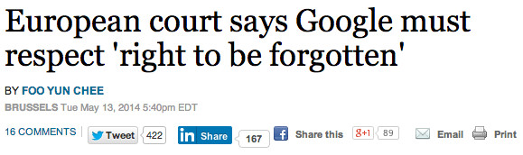
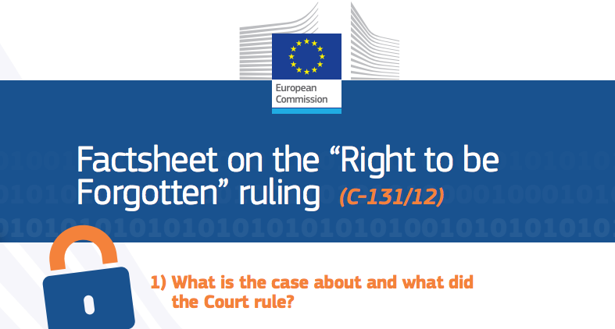
http://www.reuters.com/article/2014/05/13/us-eu-google-dataprotection-idUSBREA4C07120140513
http://ec.europa.eu/justice/data-protection/files/factsheets/factsheet_data_protection_en.pdf

Slide 33

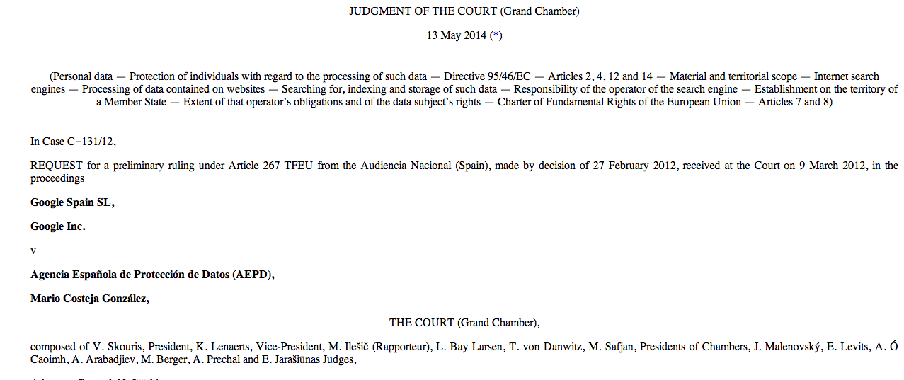
http://curia.europa.eu/juris/document/document_print.jsf?doclang=EN&text&pageIndex=0&part=1&mode=DOC&docid=152065&occ=first&dir&cid=437838

Slide 34
POSSIBLE WAYS FORWARD
What Trademark gets “right”
“USE IT OR LOSE IT”
All IP law could be “use it or lose it” per Trademark? Minimize trolling; encourage “connecting”.
* non-use for three consecutive years is prima facie evidence of abandonment in U.S.

Slide 35

Why Trademarks in Canada used to get it “right”
“USE IT OR LOSE IT”
Trade-marks Act, RSC 1985, c T-13
“trade-mark” means (a) a mark that is used by a person for the purpose of distinguishing or so as to distinguish wares or services manufactured, sold, leased, hired or performed by him from those manufactured, sold, leased, hired or performed by others,..”
Declaration of Use
Cancellation for Non-use
Aligns with commerce NOT TROLLING

Slide 36
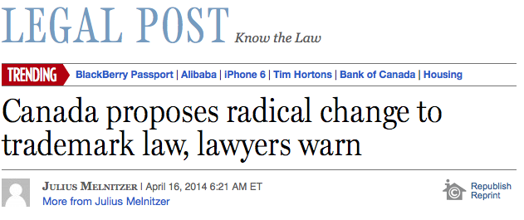
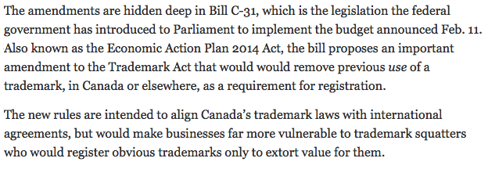
Oh well…
http://business.financialpost.com/2014/04/16/canada-proposes-radical-change-to-trademark-law-lawyers-warn/

Slide 37

…and now…
the Legal Fly
in the
Ointment

Slide 38

EULA’s, ToS & the Post (apocalyptic) IP World

Slide 39

Are we already IN THE POST IP WORLD?
In todays world….In real terms….Is it possible that…
IP has become VIRTUALLY* MEANINGLESS?
mean·ing·less/ˈmēniNGlis/
Adjective: Having no meaning or significance.
Having no purpose or reason.
Synonyms: pointless - senseless - unmeaning - insignificant – inane
*no pun intended

Slide 40
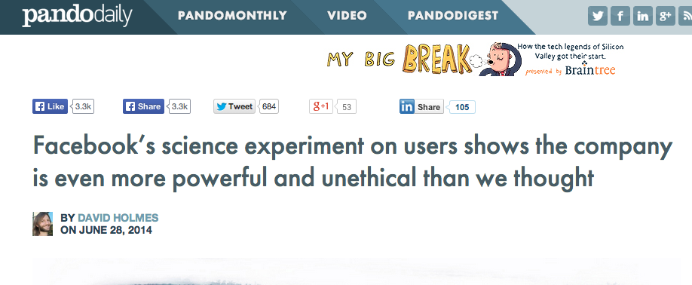
Some very poor judgment
…care of Facebook
http://pando.com/2014/06/28/facebooks-science-experiment-on-users-shows-the-company-is-more-even-powerful-and-unethical-than-we-thought/

Slide 41
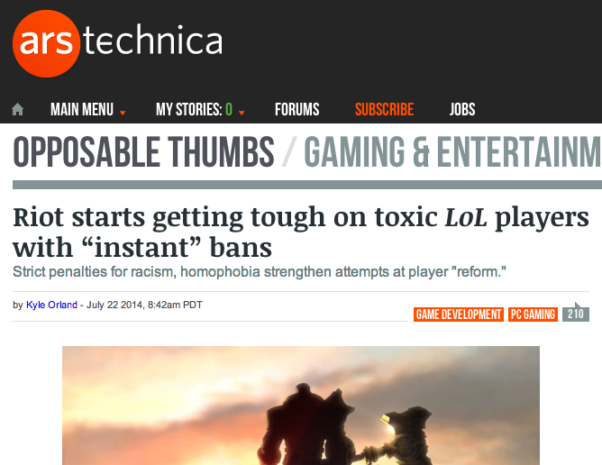
On the + side
http://arstechnica.com/gaming/2014/07/riot-starts-getting-tough-on-toxic-players-with-instant-bans/

Slide 42

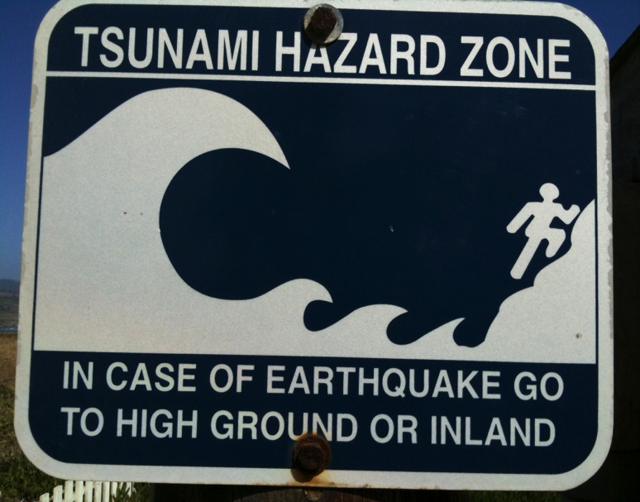
IP Law Swept Away By?
Privity of Contract; AKA Licensing Agreements (EULA’s, ToS etc.)
Privacy Agreements
Broadcast & Telecom Regulation
Competition/Anti -Trust Law
Consumer Protection
Fair Use/Dealing (SCC)

Slide 43
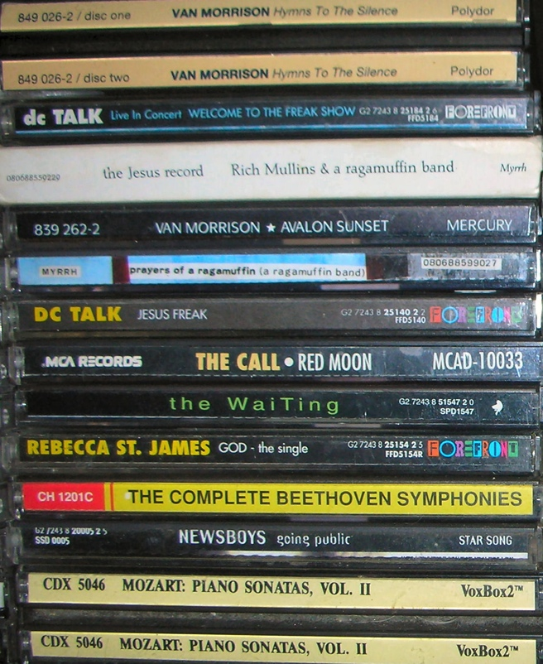

A Question….
Why no EULA when you store-buy an album
but EULA when you buy the same
album on iTunes???

Slide 44

Some reasons…
1: Evolution of Software:
Licensing grew out of the early computer software consulting (e.g. enterprise accounting)…never intended for mass entertainment. Originally motivated by “sovereignty”?
2: Slicing & Dicing IP:
*IP is infinitely slice-able & dice-able: Allows for rights to be given based on geography, time, character of right AND any other variable you can think of. As long as rights are NOT DUPLICATED
* “You may copy this work only in Moncton N.B. between 7 & 9 P.M. on the 2nd Tuesday of every odd numbered month and only distribute it for $346 per copy between 8 & 10 AM on the 1st Monday of every even month in Detroit Michigan.”
Note: EA for years followed the CD model…no EULA…just Copyright Law default….Online seemed to galvanize the industry to licensing by contract EXCLUSIVELY….

Slide 45

Result: All of which makes IP...
….very, very CONTRACT FRIENDLY.
And thus we get → → →
End User License Agreements & Terms of Service & all the rest…

Slide 46
Related Issue 1:
The chasm of contracting out
No one reads EULA’s, ToS’s & Privacy Policies:
“To Read All Of The Privacy Policies You Encounter, You’d Need to Take A Month Off From Work Every Year”http://www.techdirt.com/articles/20120420/10560418585/to-read-all-privacy-policies-you-encounter-youd-need-to-take-month-off-work-each-year.shtml
@gamerlaw: Amazing study by @nyulaw: "overall average rate of readership of EULAs is on the order of 0.1 percent to1 percent” http://t.co/DFcF0mx0
For review of “click-wrap” authorities see: Century 21 v. Rogers Communications 2011BCSC 1196 (upholding ToU) http://canlii.ca/en/bc/bcsc/doc/2011/2011bcsc1196/2011bcsc1196.html

Slide 47
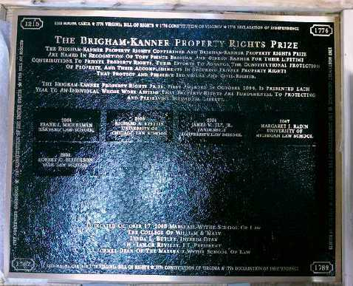
Re EULA’s etc.
“Boilerplate: The Fine Print, Vanishing
Rights, and the Rule of Law”
Princeton University Press
Margaret Jane Radin, Henry King Ransom Professor
of Law at the University of Michigan and the William
Benjamin Scott and Luna M. Scott Professor of Law,
emerita, at Stanford University

Slide 48
Insidious Results?
Censorship controls effectively delegated to private interests (without free speech/expression overrides).
* “Apple rejects game based on Syrian civil war”http://killscreendaily.com/articles/news/apple-rejects-game-based-syrian-civil-war/
* “iOS games chafe under Apple's directions: 'If you want to criticize a religion, write a book’”http://www.theverge.com/2013/1/16/3879194/apple-app-store-guidelines-tell-game-developers-to-avoid-serious-themes
* “Turns Out Sexist Talk on Xbox Live Won't Earn You a Lifetime Ban” – but racist talk will.http://www.gamepolitics.com/2012/11/07/turns-out-sexist-talk-xbox-live-wont-earn-you-lifetime-ban#.URsttVpAR3c
* & less insidiously: “Blizzard Bans 'Several Thousand' Diablo III Players for Cheating” – using bots (would “Notice” do?)http://gamepolitics.com/2012/12/19/blizzard-bans-several-thousand-diablo-iii-players-cheating#.URswDFpAR3c

Slide 49

Related Issue 2: Digital re-sale
First Sale Doctrine v. EULA prohibition of re-sale
First Sale Doctrine limits right of copyright holder – enables distribution chain of reselling books, CD’s etc.
BUT how does it apply to the digital world?
“EU court rules it's legal to resell digital games, software” http://www.joystiq.com/2012/07/03/eu-court-rules-its-legal-to-resell-digital-games-software/
“A Setback for Resellers of Digital Products” http://www.nytimes.com/2013/04/02/business/media/redigi-loses-suit-over-reselling-of-digital-music.html?_r=0
Capitol Records, LLC v. ReDigi Inc.
(being appealed)

Slide 50
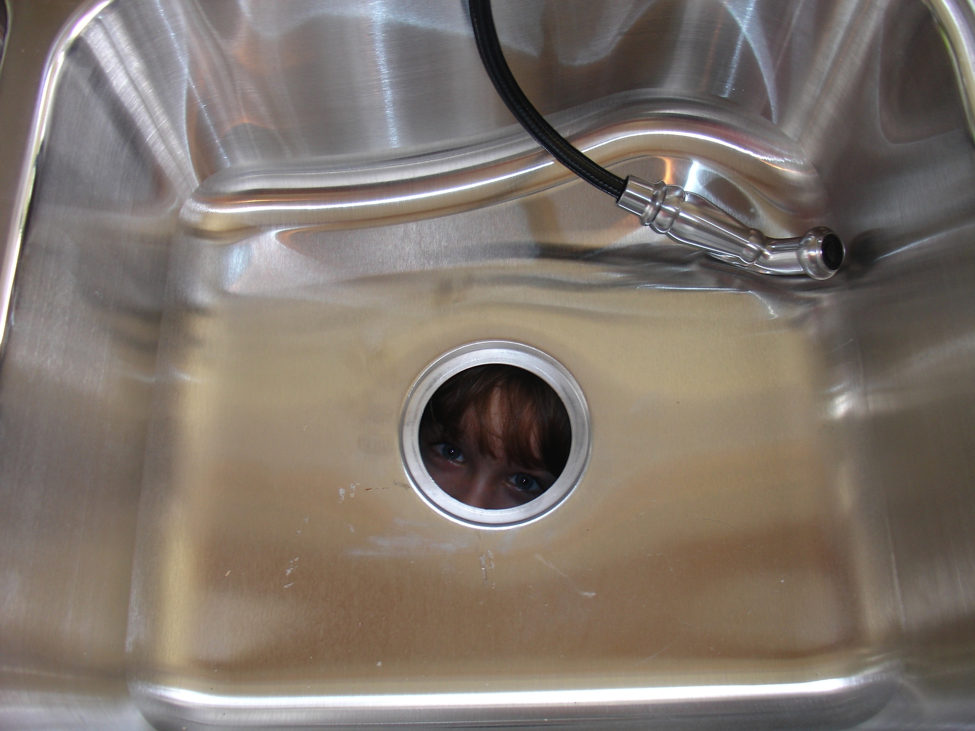
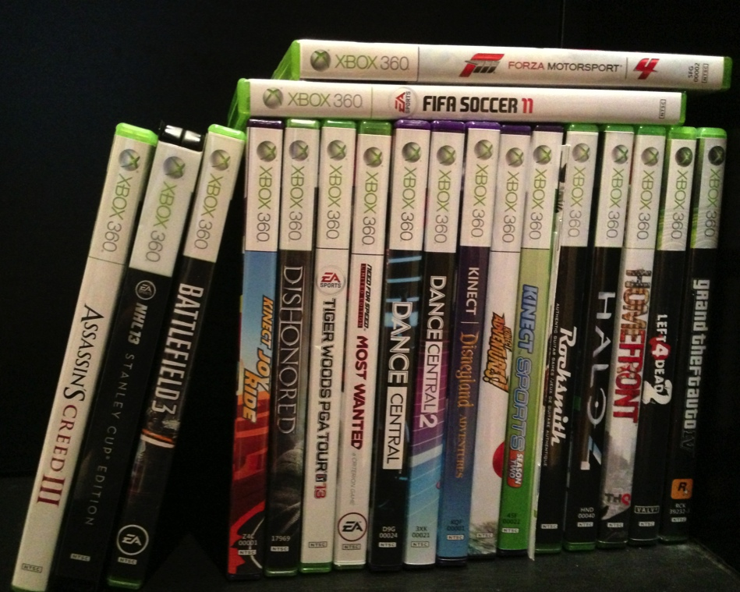
Related Issue 3:
The “kitchen sink” effect
“You may not purchase, sell, gift or trade any Account, or offer to purchase, sell, gift or trade any Account, and any such attempt shall be null and void. Blizzard owns, has licensed, or otherwise has rights to all of the content that appears in the Game. You agree that you have no right or title in or to any such content, including without limitation the virtual goods or currency appearing or originating in the Game, or any other attributes associated with any Account. Blizzard does not recognize any purported transfers of virtual property executed outside of the Game, or the purported sale, gift or trade in the “real world” of anything that appears or originates in the Game. Accordingly, you may not sell in-game items or currency for “real” money, or exchange those items or currency for value outside of the Game.”

Slide 51

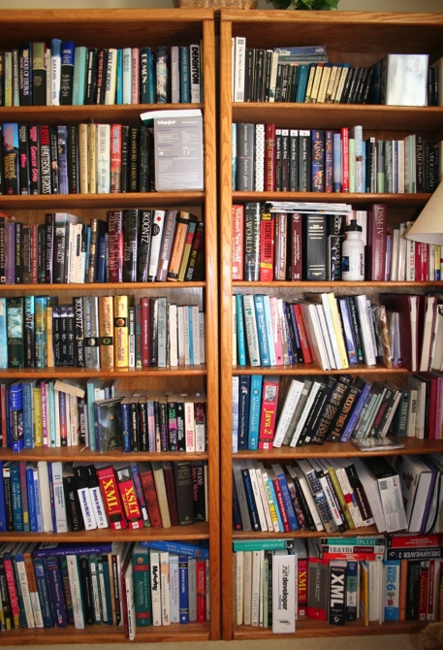

Related Issue 4: Death
What happens to your digital library of games when you die?
Real library is bequeathed as property…digital property tends to be personal license to user only.

Slide 52
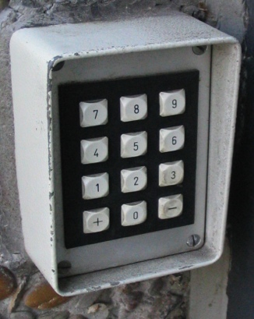
Related Issue 5:
Non-circumvention
EULA’s usually prohibit of reverse engineering
Remember “Blizzard/BnetD”
“Digital Locks” v. IP right to “reverse engineer”
U.S.A. DMCA non-circumvention provisions
New Copyright Act (Canada) criticized for too broad empowerment of “Technological Protection Mechanisms” …“ Unlocking Bill C-11: What are Digital locks, and Why Should You Care?” http://thefulcrum.ca/2012/02/unlocking-bill-c-11-what-are-digital-locks-and-why-should-you-care/#.UKVU4-Oe-OU

Slide 53

Related Issue 5
Backlash?
SDK’s
Creative Commons
Open Source
Crowdsourcing
But all are Contracts!

Slide 54

Other Possible Answers
Consumer protection laws
International Law “standard forms”
“Anonymous”
“Hacktivism”
“Changing the Rules of the Game: How Video Game Publishers are Embracing User-Generated Derivative Works” – re. Machinima http://jolt.law.harvard.edu/articles/pdf/v21/21HarvJLTech567.pdf
But ref. Isabelle Arvers http://www.isabellearvers.com
Machinima still living in a complex
contractuallyrestricted world
[your suggestions here]

Slide 55

Next Class: “Frictions & Fictions”
10 Contractual CLAUSES
10 Digital Law CASES
10 Unique CONTEXTS
Digging into contracts in digital space...

Slide 56

Always include a cat picture

Slide 57
Our Academic Partners

