Slide 1
From Farmville to Fallow Fields
Opportunities & cycles in the game industry

Slide 2
About Adrian Crook
Founder of Adrian Crook + Associates
Consulting Services: Design Audits, Game Design, Leadership
Focus in social & mobile games, including:
Some of our clients:
Notes:
About Adrian - AC+A, games worked on, specialties, clients

Slide 3
Presentation Overview
Explosion in game reach and popularity
Timeline of where the industry has been, where it is now, and where it’s headed
Analysis of new market forces and their impact on the future of the industry
Notes:
Overview of talk
Games have now entered mainstream culture
New types of games and innovations coming in the next 5-10 years
--Definition of a “gamer” has been completely overhauled in recent years (went from “teenage boy with a console” to “grandma with an iPad”). --Traditional game industry business models, delivery platforms and revenue streams are all being reinvented as games enter mainstream culture.
--Talk is focused on the industry in the US

Slide 4
Where the Game Industry Has Been
Business models
distribution
Popular platforms

Slide 5
Where We’ve Been: Business Models
Publishers funded development of games, which were created by game development studios
Players purchased a final packaged game
Notes:
Publishers fund, publish and market games which are created by game development studios.
Common business model: Game developer makes the game, game publisher markets and distributes the game.
The users pay the initial license fee upfront and own the right to obtain the service in perpetuity.
Game might have been patched a couple times, but there was rarely new content in these updates. New content would have been released as expansion packs.
Other biz models existed, but this was the most common.

Slide 6
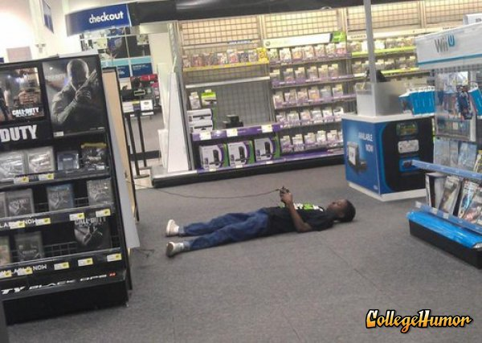
Where We’ve Been: Distribution
Physical copies of games purchased from retailers
Notes:
Games purchased from box stores because internet was still new (and slower) and digital downloads hadn’t quite taken off.

Slide 7
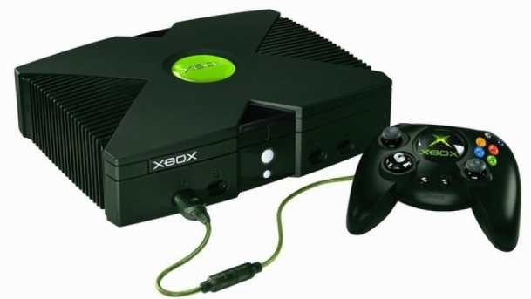
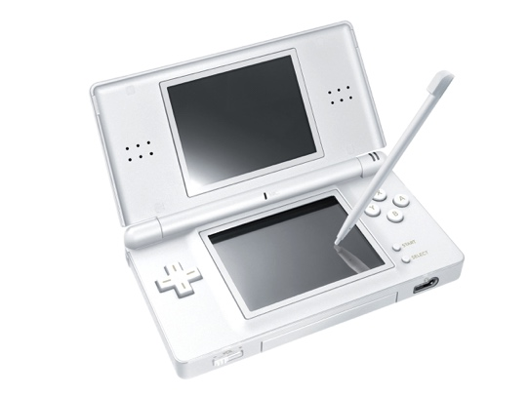
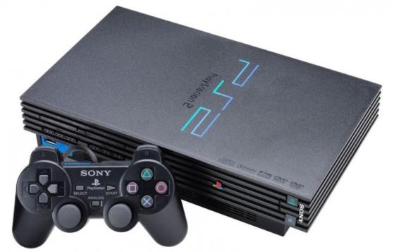
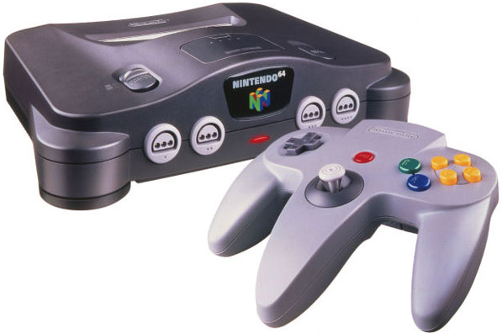
Where We’ve Been: Popular Platforms
PCs, Consoles, handhelds
Notes:
PC and console games were very popular.

Slide 8
What changed everything?
Notes:
What led to such a drastic change in the industry in just a few short years?

Slide 9
Answer: The Internet
Notes:
Or smartphones, or whatever you think the answer is. ☺

Slide 10
After the Internet exploded…
It increased access to games, made piracy easier (warez) while also promising an end to it (Steam)
Smartphones became popular; everyone had a gaming device in their pocket
More people started playing games
New players meant demands for different genres and pricing models
Notes:
“The Internet has not changed what games are, but it has made them vastly more effective at what they do. ”
Source: http://www.technologyreview.com/view/532331/games-and-the-internet-fertile-ground-for-cultural-change/
“The iPhone created a “wide-open” market for third-party titles, where the barrier to entry for developers is low and games cost relatively little money for consumers.” (Sorry, I know you’re an Android guy ☺)
Source: http://www.theesa.com/games-improving-what-matters/mobile-games.asp
“half of American smartphone owners will spend close to 200 hours per year playing mobile games”
Source: http://www.insidemobileapps.com/2013/11/25/smashing-ideas-50-of-smartphone-users-spend-close-to-200-hours-per-year-playing-games/
“Before the Internet, gaming companies usually had one point of transactional contact with a consumer: the sale of the game itself, unless the company released merchandise or an official guide. Now, taking advantage of consumers’ ability and desire to buy things online, gaming companies have found seemingly limitless ways to entice them to buy things to enhance their experience with a particular game.”
Source: http://highspeedinternet.com/blog/technology/how-the-internet-changed-the-gaming-industry
Rise of the internet/WWW increased access to games
Increased access meant more people could play
New players meant demands for different genres (casual and social became more popular)
When smartphones became widely available, new mechanics had to be developed for touchscreens and games meant to be played ‘on the go’ or in short bursts
All of these changes also meant that available methods of developing and financing games expanded beyond the traditional publisher/developer model.
Also changed how games could be developed

Slide 11
Major Game Industry Changes
Smartphones and tablets spawned the massive mobile game market
Casual social games skyrocketed in popularity as “gamer” demographics changed
Increased broadband Internet speeds opened up new options for cloud gaming, streaming, and “always on”
Growing library of tools, engines and services helped streamline the game development process
Notes:
Will come back to these new market forces later in the presentation in more detail.
Smartphone/tablet as new platforms
“Shifting mobile game market to hit $9 billion in 2016. Smartphones will remain the primary device which users make in-app purchases on, with more than $6 billion spent on them in 2016, over double the amount spent on tablets.”
Source: http://www.juniperresearch.com/viewpressrelease.php?id=534&pr=364
Article: http://www.gamesindustry.biz/articles/2013-04-30-mobile-to-be-primary-hardware-for-gaming-by-2016
“Video game industry grew 4 times faster than US economy in 2012, study says”
http://www.cnet.com/news/video-game-industry-grew-4-times-faster-than-us-economy-in-2012-study-says/
Casual/social games and player demographics
“Casual/social game play on mobile devices and online has increased significantly over the past year. Among most frequent gamers, social games are now the most popular genre, increasing in popularity by 55%from 2012 to 2013.”
“The average game player is 31 years old” 52% male and 48% female.
Source for both: http://www.theesa.com/facts/pdfs/ESA_EF_2014.pdf
Ease of development
“The lower barriers to entry mean developers can experiment with more innovative and creative games. If it isn't successful, they can quickly start developing a new game for a small cost and try again and again.
Source: http://www.businessinsider.com/10-ways-modern-technology-has-changed-video-games-forever-in-just-five-years-2011-11?op=1

Slide 12
Where the Game Industry Is Now
Business models
distribution
Popular platforms

Slide 13
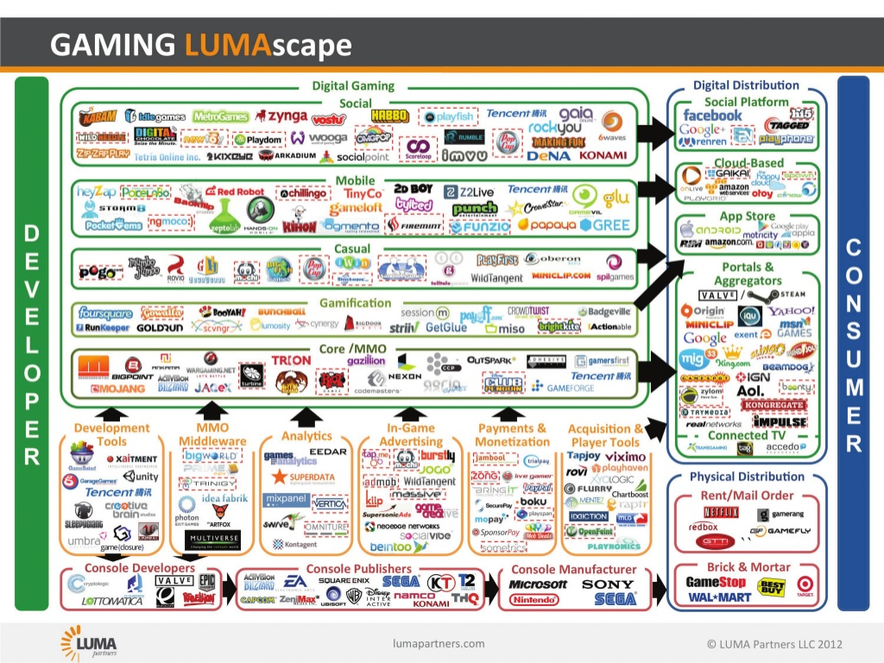

Slide 14
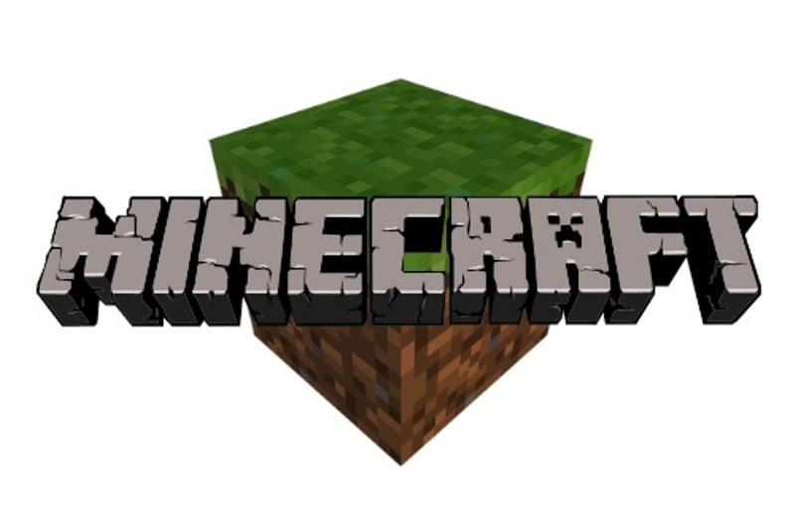
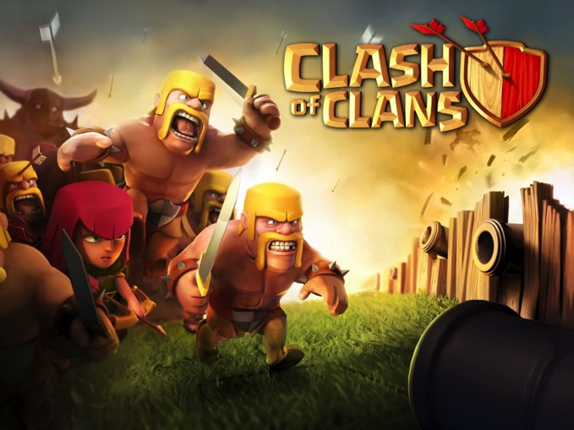
Where We Are Now: Business Models
Premium
I.e. Developer releases a game on their website or third party platform player purchase and download
Freemium
I.e. Developer releases a game for free, offers items for IAP and makes continuous updates to retain players
Notes:
Traditional games publishers no longer have a monopoly on mainstream game distribution and development (except for AAA games).
Industry power has shifted to smaller, innovative studios who self-finance and publish, run Kickstarters, and often have a deeper connection to their playerbase.
Games are often updated with new, free content after their official release/launch.
Common business model 1: Indie developer releases a game on their website for direct consumer purchase and download.
Example: The alpha version of Minecraft was publicly released for PC in 2009, and after gradual updates, the full version was released in 2011.
Biz model 2: Game developer releases a freemium mobile game and makes continuous updates to retain players
Example: Clash of Clans by Supercell was released in 2012 and has been consistently updated with new features ever since. http://clashofclans.wikia.com/wiki/Version_History
Other new biz models: Crowdfunding (Kickstarter)
“In fact, purchases of digital game content accounted for 40 percent of all game content sales in 2012, and generated $5.92 billion in revenue.”
Source: http://www.theesa.com/games-improving-what-matters/mobile-games.asp

Slide 15
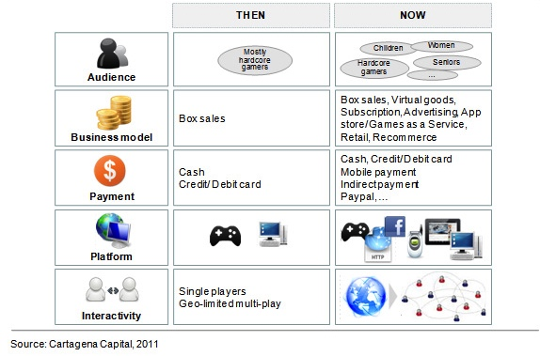
Comparison of Then & Now
Now
Notes:
Then
Business Model: Publisher pays developer to make the game
Distribution: Players buy a boxed game from a retail store like Best Buy
Popular Platforms: PC, Consoles like N64, Xbox and PlayStation 2
Now
Business Model: Developer self-publishes game
Distribution: Player downloads the game from a digital storefront like the App Store
Popular Platforms: Mobile devices, the Internet

Slide 16
Variations on Premium/Freemium
Premium
Episodic
Subscription
Freemium
Ad supported
Virtual items
Hybrid
DLC
Gated Progression
MTX in Premium

Slide 17
Freemium is a radical change
Freemium is to games as SaaS is to enterprise
Launching a freemium game is “tip of iceberg” for development effort
Cost/complexity of operating freemium much higher than premium – see many devs failing to gauge this properly
Legal issues around “sunsetting” freemium games, what happens to player purchases, etc

Slide 18
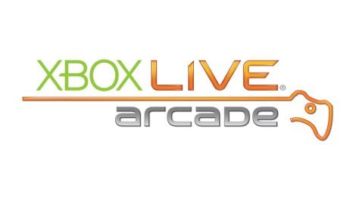
Where We Are Now: Distribution
Games downloaded from digital storefronts, or accessed in a browser
Usually a 70/30 rev split with platform owner
Issues around discovery
Notes:
How/where games are purchased: Digital storefronts such as Steam, Steam Greenlight, iOS app store, Google Play, Xbox Arcade, Wii Ware, Playstation storefront.
Browser games, Facebook app center.

Slide 19
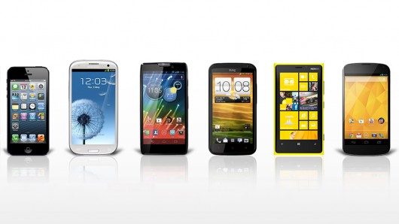
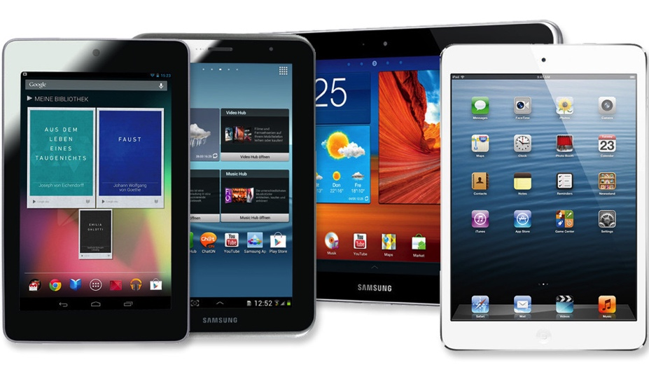
Where We Are Now: Platforms
Mobile/Tablets
“HD” Console/PCs
Facebook/browser
Handheld (Vita, DS)
VR, AR, emergent
Notes:
Popular platforms: Smartphones and tablets, Facebook games
Android used to be 25% ARPU of iOS, not closer to 2/3rds
Cross platform game development is aim for most, iOS first is the reality due to fragmentation of Android market

Slide 20
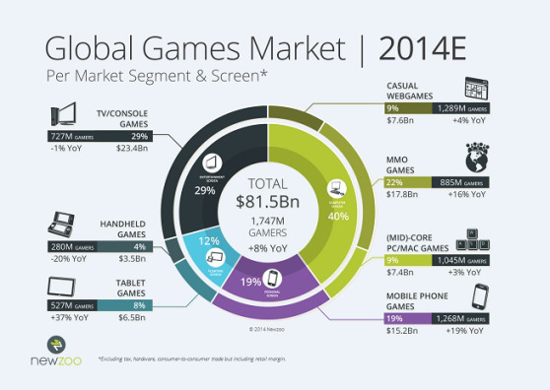

Slide 21
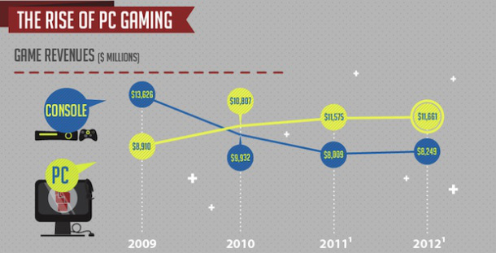
PC Gaming Growth at Expense of Console

Slide 22
Console Product Consolidation
Fewer big budget console games being made
Greater share of revenue going to fewer titles
Fewer traditional AAA publishers
“Winner takes all” market at the top
High end AAA game budgets are 000s of $M

Slide 23
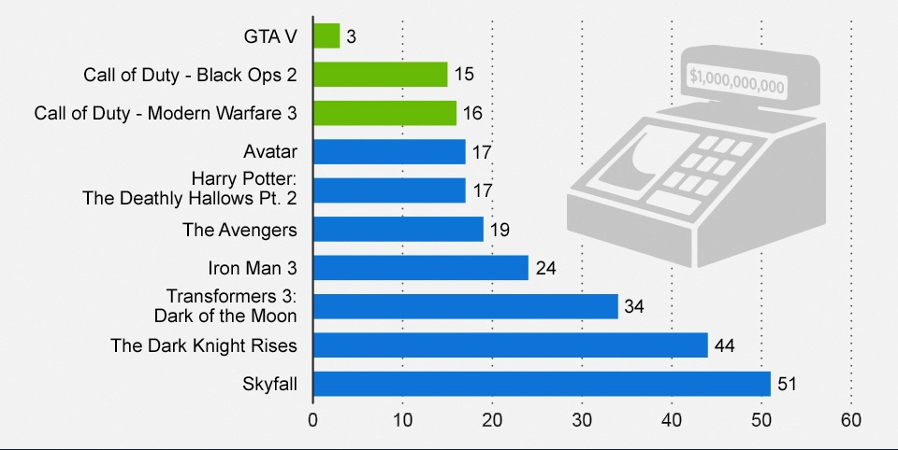
GTA V Fastest to Reach $1B in Sales

Slide 24
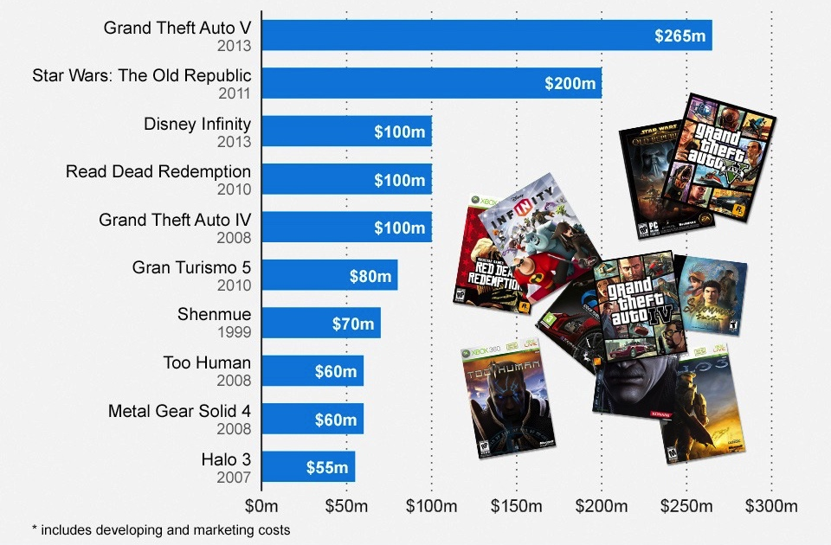
GTA V Most Expensive Game Ever

Slide 25
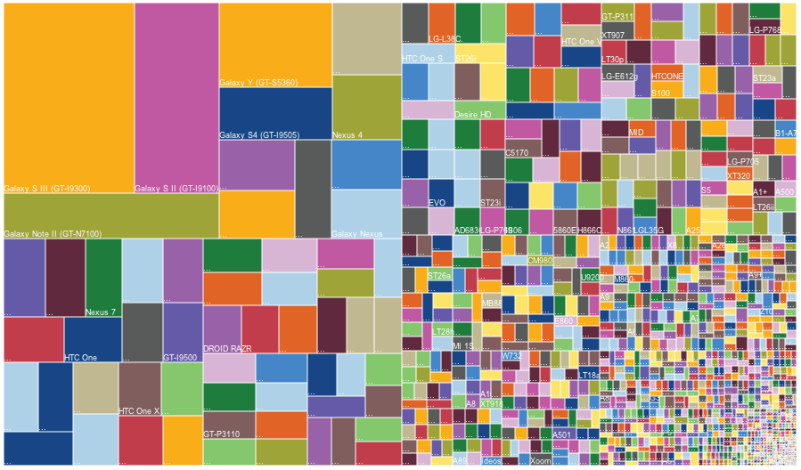
Platform Fragmentation (Android)
Notes:
Android device fragmentation as of 2013
This is why it’s iOS first for many game/app devs
However, some devs, like Kiwi, have made a good business going Android only/first, as there’s more blue ocean there for games because of this fragmentation issue

Slide 26
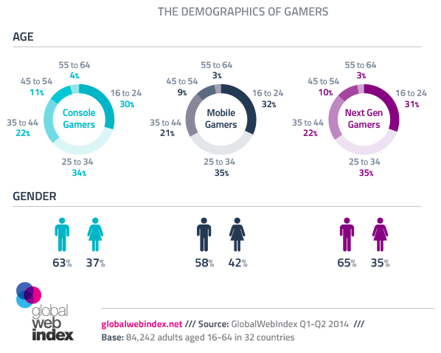
Gamer Demographics

Slide 27
Rise of New Market Forces
Lower Barrier to Entry
Growth of Mobile & Internet, Saas
Metrics and Data Tracking

Slide 28
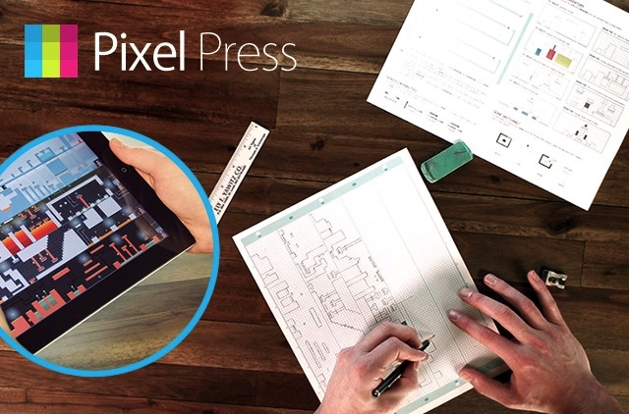
Lower Barrier to Entry Into Industry
Game development is getting easier (in some ways)
Developers have access to more types of middleware, content libraries, analytics services, and self-publishing platforms than ever before.
Game creation software and engines are widely available.
Notes:
Game development is getting easier (in some ways)
Middleware, content libraries, engines, self publishing

Slide 29
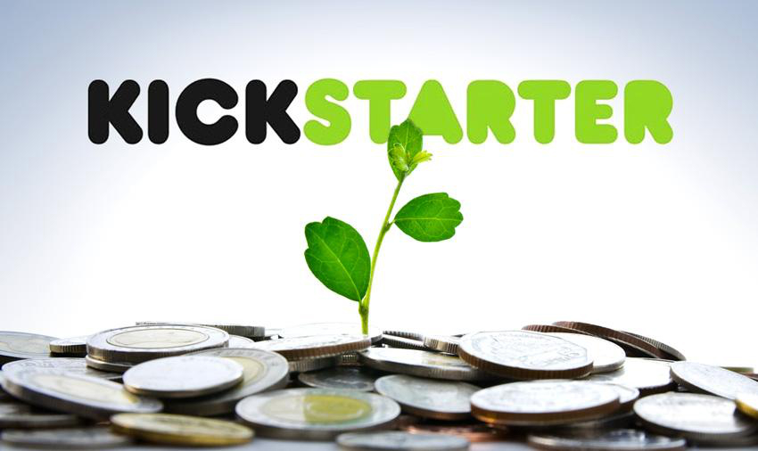
Lower Barrier to Entry Into Industry
Crowdfunding is providing alternate ways to fund game development
Unclear legal landscape for projects that are not delivered to their backers
Equity crowdfunding is now possible as well
Notes:
Crowdfunding
Kickstarter etc providing alternate path to funding
legal issues around game completion, or failure to complete
Kickstarter has issued new guidelines on projects that fail to be completed: http://www.gamespot.com/articles/as-kickstarter-failures-continue-new-legal-terms-a/1100-6422484/
Neal Stephenson and Clang: http://venturebeat.com/2014/09/19/neal-stephenson-kills-clang/
“Backers looking for refunds will need to take note of Kickstarter’s terms, which don’t offer protection for a project that doesn’t make it: “Kickstarter does not guarantee projects or investigate a creator’s ability to complete their project. However, before they launch on Kickstarter, all creators agree that failure to fulfill backer rewards may result in legal action.”
https://www.kickstarter.com/blog/accountability-on-kickstarter
crowdfunding in exchange for equity (look this up)
Gambitious: https://gambitious.com/pages/howitworks
http://www.forbes.com/sites/ericwagner/2014/03/18/equity-crowdfunding-101-is-it-right-for-your-startup/

Slide 30
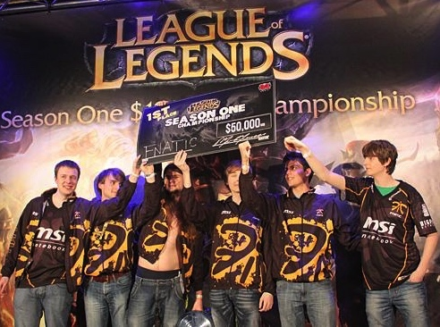
Lower Barrier to Entry Into Industry
Players are getting more involved in the industry, and even making money from it, such as:
Creating (and selling) game mods & content
Making money streaming games on Twitch.tv ($800K/year for one)
Competing in eSports for games like DotA, LoL, and others
Notes:
Slide incomplete (players taking ownership of games)
Players use existing game content and author their own content in interesting ways.
Mods/Content
Valve’s Virtual item store for TF2 and Dota 2 has paid out $10 mil to community creators in 2013 alone: http://venturebeat.com/2014/01/17/dota-2-and-team-fortress-2-item-creators-get-10-2-million-payout-from-valve-in-2013/
Sony does the same thing with their Player Studio: https://www.sony.com/SCA/company-news/press-releases/sony-online-entertainment/2014/sony-online-entertainment-to-launch-player-studio-.shtml?icid=pr-newswire-feed#sony-skip-nav, https://player-studio.soe.com/
http://www.gamasutra.com/view/news/179493/Usergenerated_content_When_game_players_become_developers.php
Twitch
Twtch and audio copyright: http://www.gameskinny.com/zh0f3/5-things-the-twitchtv-audio-copyright-fiasco-teaches-gamers, http://www.forbes.com/sites/insertcoin/2014/08/08/twitch-muting-further-demonstrates-copyright-law-needs-to-relax-for-its-own-good/
Discussion about which games are legal to stream. Interesting because games with nudity are allowed if they have an ESRB rating, and since SecondLife characters can sometimes have nudity but the game doesn’t have an ESRB rating, it’s in a gray area. Fourth comment down: http://help.twitch.tv/customer/portal/questions/4115542-all-games-allowed
https://games.yahoo.com/blogs/plugged-in/-league-of-legends--champ-retires%E2%80%A6to-earn--800-000-a-year-streaming-games-185102018.html

Slide 31
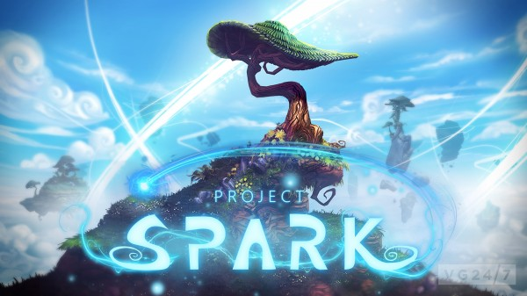
We even have games that help players make games

Slide 32
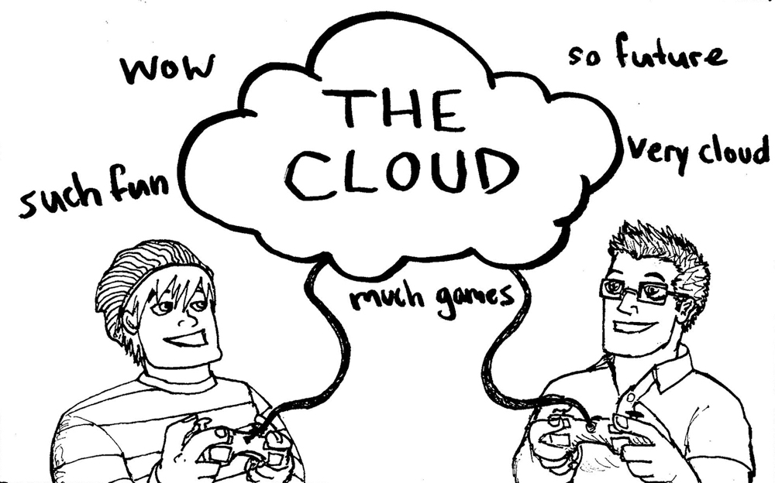
Growth of the Internet
Cloud gaming slowly becoming a reality as Internet speeds increase and stabilize.
Legal problems abound: regulation, data protection and security, and net neutrality to name a few.
Notes:
Cloud Gaming
“This report estimates that the online games market will more than double and downloading/ streaming will grow nine-fold by 2017, reaching $30bn and $8bn sales respectively. In contrast, the traditional boxed-games market is expected to remain stagnant at around $25bn. The trend is very clear, video games are leaning more and more towards the Cloud and those companies who are not quick to learn and adapt will be left behind.”
Source: http://www.cgconfusa.com/report/
Lots of charts if you want to use them instead of pictures: http://www.alistdaily.com/news/cloud-gaming-report-2012
Cloud Gaming Services:
Playstation Now info: http://www.playstation.com/en-us/explore/psnow/faq/
Nvidia Grid: http://www.gamespot.com/articles/nvidia-s-cloud-gaming-service-rolling-out-next-wee/1100-6423567/
OnLive: https://www.onlive.com/ http://time.com/13304/onlives-second-act-cloud-gaming-that-piggybacks-on-steam/
Steam has an interesting twist on this with In-Home Streaming service: http://store.steampowered.com/streaming/
“Cloud Gaming: Legal Update” – Definitely read this
Key Problems: Regulation, data protection and security, net neutrality
Sourec: http://www.slideshare.net/jaspurewal/jp-ie-presentation-cloud-gaming-the-key-legal-issues-may-2014

Slide 33
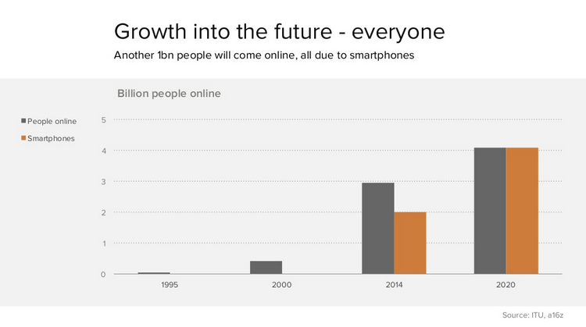
Growth of Mobile
Number of people globally who own a smartphone continues to increase
Notes:
Mobile use expected to continue to grow
Note: Following two links are by the same author, so they share some information/stats.
http://ben-evans.com/benedictevans/2014/10/28/presentation-mobile-is-eating-the-world
Benefits of smartphones:
Personal
Taken everywhere
Frictionless access
Sensors, cameras
Location
Payment
Social platform
Easy to use
“Smartphones combined the Technology and Mobile worlds, and internet, media and TV are being dragged along.”
Source: http://www.slideshare.net/bge20/2014-02-incontext

Slide 34
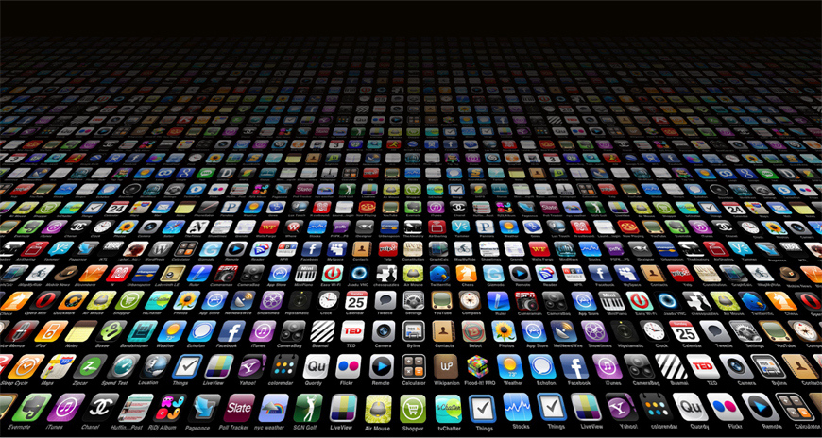
BUT… all of this has created a crowded market
Notes:
BUT… that's led to a crowded market… SO
Traditional gatekeepers (publishers) are trying to remake themselves to offer devs differentiation (cross-promo, marketing, PR, publisher services like localisation, etc)

Slide 35
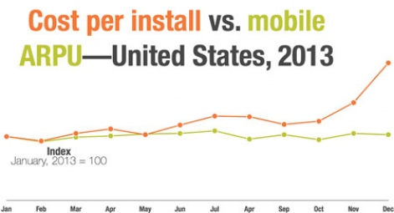
User Acquisition Costs Extremely High
Notes:
UA costs have increased to very high levels
Necessity being mother of invention, this has spurred many efforts to build new UA methods, or discover low cost channels

Slide 36
New Console Introductions Slow
Console release cycles lengthening – used to be every 4/5 years, now as long as 7 or 8.
Current gen may be “last” consoles released, marginal upgrades from here
Sales still driven by hit games, but other features such as streaming and home device connectivity playing larger role

Slide 37
Opportunities in the game industry

Slide 38
Gold Rush Opportunity
In the old model, the biggest opportunity was to be a “launch title”
Established your franchise’s position on the platform for coming 4 years
Huge up-front investment, massive risk
But competition was less and spotlight was on you, meaning co-marketing with platform owner
This opportunity still exists in the console space

Slide 39
Game platform growth curve

Slide 40
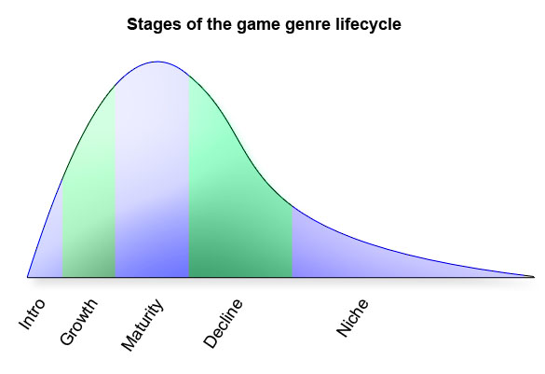
Game Genre Growth Curve
Notes:
The genre life cycle is useful for garnering insight but is not foolproof:
Some genres, such as match-3 games, experience strong resurgences when new platforms or business models arrive on the scene.
Others, such as console RPGs, trundle on into the maturity phase with little evidence of decline.
Other genres are simply hard to track because they are still in the introduction or expansion phase and there is no commonly understood definition of the genre. For example, is there yet a Katamari Damacy genre? Alternatively, the data is simply poor. “Action” or “Strategy” tells very little about the core mechanics that ground a quality genre classification.

Slide 41
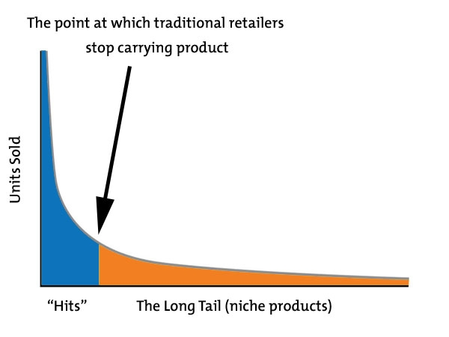
The Fallow Field Opportunity

Slide 42
Fallow Fields, Explained
Game platforms are cyclical in popularity, but new net based platforms never cease to exist
Consumption drives platform refreshes – consumers believe they need “new”
In new’s wake are still-viable platforms, once saturated with product and high UA costs
PS2 had 155M unit install base when PS3 launched; PS3 80M when PS4 launched
Facebook is no dev’s first choice as a game platform anymore
Opportunities can be scaled to these legacy markets

Slide 43
Two Strategies For Opportunities
Find the Fallow Fields
Low risk
Low prestige
Value pricing
Low product investment
Large install base supports niche products
Stake a Gold Rush claim
High risk
High prestige
Premium pricing
High product investment
Small install base tolerates mostly mainstream products

Slide 44
Gaming & New Technologies
What’s here now
What’s on the horizon
Notes:
Transition to future cool tech used for gaming.

Slide 45
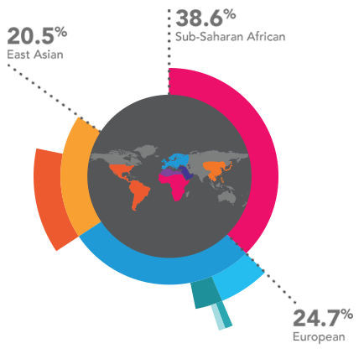
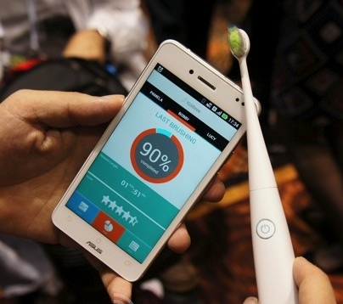
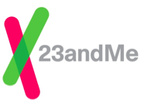
As game designers, our range of inputs we can leverage into our designs is expanding rapidly.
Notes:
From 23andme homepage https://www.23andme.com/
Your privacy and security.
The Genetic Information Nondiscrimination Act (GINA) is U.S. federal legislation that protects Americans from discrimination (in health insurance and employment decisions) on the basis of genetic information. Click here to learn about how GINA protects your genetic privacy. https://customercare.23andme.com/hc/en-us/articles/202907820-What-is-GINA-
Nest having some legal/device functionality trouble
http://www.triplepundit.com/2014/04/nest-freezes-sales-smoke-alarm-sued-thermostats-energy-savings-claims/

Slide 46
Metrics and Data Tracking: Game Analytics
Player data being tracked, stored and analyzed to improve and personalize player experiences (and increase game revenue).
Notes:
Backend tracking of user stats.
DeltaDNA is a company that uses these metrics to predict user behavior
Flurry, Kontagent (now Upsight?), GameAnalytics
A/B testing of everything from design to ecomm setup
Metrics being used to drive development
Services provided by Flurry: http://www.flurry.com/solutions/analytics
“According to reliable market reports, a large, video-game manufacturer has the potential to generate around 50 terabytes of data each day.”
“Benefits of Big Data: Sustained gamer engagement, Increased up-selling and cross-selling, Tailored game designs”
Source for both: http://www.experfy.com/blog/big-data-transformation-gaming-industry/
Game analytics and data tracking seems to be mostly done with the help of third-party analytics software/services, though some have in-house solutions
Possible legal issues (no sources, just brainstorming): data privacy, tracking data of children/minors, selling player data, using data in unfair ways (purchasing something in-game might cause prices to go up slightly because developers know you’ll buy more in the future) carry data from one game to the next in unfair ways (previous purchase history in other games means higher prices in a new game, or lack of history means lower prices to entice purchases).
http://www.huffingtonpost.com/2014/11/11/app-privacy_n_6139556.html
http://privacygrade.org/

Slide 47
Metrics and Data Tracking: Quantified Self
“Self knowledge through numbers”
Track health, fitness, diet, sleep, mood, energy levels
How will games protect data privacy?
Notes:
Quantified Self
http://www.slideshare.net/alanau/games-for-health-2013-quantified-self-games-gamification
http://www.bbc.com/future/story/20130102-self-track-route-to-a-better-life
Brings up potential issues of data privacy
Sleep patterns could be relevant, say, in a court case about a traffic accident.
People who post genetic information now are revealing things about their future children and grandchildren.
http://lifestreamblog.com/lifelogging/
“Lifelogging: The Most Miserable, Self-Aware 30 Days I've Ever Spent”
http://mashable.com/2014/03/20/lifelogging-experiment/

Slide 48
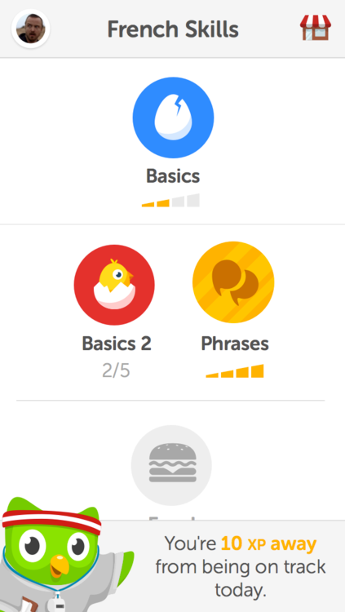
Metrics are already used in many games to provide a real-world benefit to the player
Fitness games
Educational games
Notes:
Delete slide? Trying to tie in fitness and education games under this topic but I don’t think it’s working.
EA Active 2
http://s1.hubimg.com/u/5064554_f260.jpg
http://image.jeuxvideo.com/images/wi/e/a/ea-sports-active-2-wii-1291648728-011.jpg
Rocksmith – learn to play guitar
http://imagery.playerattack.com/RocksmithInfographic.jpg

Slide 49
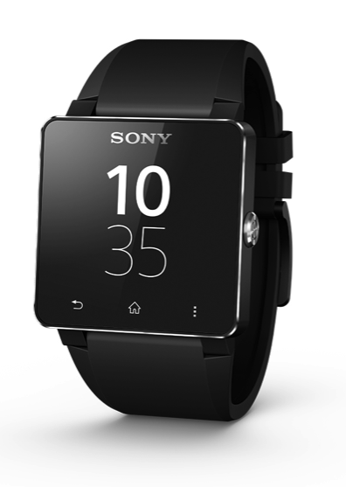
Wearable Technology
Smartwatches
Haptic feedback vest
Fitness trackers
Google Glass
E-wearables, Whole body games
Notes:
Wearable Technology/Computers
Google glass, Smartwatches, Fitness tracker
Connecting wearable tech to games:
Apple Smartwatch games: http://www.fool.com/investing/general/2014/09/12/can-ea-successfully-launch-mobile-games-for-apples.aspx
Pebble games: http://www.allpebble.com/index.asp?c=G
Kidizoom, a Smartwatch for kids: http://www.vtechkids.com/brands/brand_view/smartwatch
KOR Haptic Feedback vest: http://www.crunchwear.com/kor-haptic-feedback-vest-will-make-gaming-intense/
E-traces, ballet slippers that draw: http://makezine.com/2014/11/06/e-traces-ballet-slippers-that-make-drawings-from-the-dancers-movements/
Mental trackers that alter your mental state: http://www.techtimes.com/articles/17505/20141008/mood-changing-wearable-promises-make-thync.htm
Woven: http://www.wearablegames.eu/
Emotional Controller detects when you’re bored with a game: http://www.crunchwear.com/game-controller-reads-skin-tell-youre-bored/
Dexmo, a force feedback exoglove: http://www.cnet.com/news/hand-exoglove-lets-you-touch-a-virtual-world/
Legal implications:
http://www.washingtonpost.com/business/capitalbusiness/recalls-lawsuits-traffic-tickets--wearable-tech-is-starting-to-get-attention-from-legal-system/2014/02/28/034eb63a-9e5d-11e3-b8d8-94577ff66b28_story.html
http://www.washingtonpost.com/business/technology/wearable-technology-raise-privacy-concerns/2013/09/30/0a81a960-2493-11e3-ad0d-b7c8d2a594b9_story.html
Wearable Computer
As the name suggests, wearable computers are electronic devices which you can wear on you like an accessory or apparel. It can be a pair of gloves, eyeglasses, a watch or even a suit. The key feature of wearable UI is that it should keep your hands free and will not hinder your daily activities. In other words, it will serve as a secondary activity for you, as and when you wish to access it.
Think of it as having a watch that can work like a smartphone. Sony has already released an Android-powered SmartWatch earlier this year that can be paired with your Android phone via Bluetooth. It can provide notifications of new emails and tweets. As with all smartphones, you can download compatible apps into Sony SmartWatch for easy accessibility.
Expect more wearable UI in the near future as microchips bearing smart capabilities grow nano-smaller and be fitted into everyday wear.

Slide 50
Brain & Body Technology
Biofeedback gaming
Brain-computer interfaces to control games: Emotiv, 4DForce
Implanted computers, biohacks
Notes:
Brain & Body Technology
Biofeedback Gaming
http://www.gamasutra.com/blogs/ErinReynolds/20131029/203265/Quit_Playing_Games_with_My_Heart_Biofeedback_in_Gaming.php
“high tech mood rings”
“Rarely can players consciously control their physiological responses (which serve as a primary input when it comes to biofeedback gaming). This lack of intentional control is part of what makes biofeedback so powerful. However, it also limits the player’s ability to consciously decide what information is provided to the game. Biofeedback input grants us access to data that hasn’t been curated by the player, so establishing trust is key. If players don’t feel safe providing their biofeedback data, then the tech could be abandoned before it has a chance to flourish.”
Nevermind game: https://www.kickstarter.com/projects/reynoldsphobia/nevermind-biofeedback-horror-game
Stress management and peak performance games: https://www.somaticvision.com/products
http://www.livescience.com/24327-biofeedback-video-game-helps-kids-control-anger.html
Brain Computer Interfaces
http://www.crunchwear.com/4dforce-the-gaming-controller-that-reads-your-mind/
“Our brain generates all kinds of electrical signals with our thoughts, so much so that each specific thought has its own brainwave pattern. These unique electrical signals can be mapped to carry out specific commands so that thinking the thought can actually carry out the set command. In any case, envision a (distant) future where one could operate computer systems with thoughts alone. From the concept of a ‘smart home’ where one could turn lights on or off without having to step out of your bed in the morning, to the idea of immersing yourself in an ultimate gaming experience that response to your mood (via brainwaves), the potential for such an awesome UI is practically limitless.”
Implanted Computers
http://www.makeuseof.com/tag/plugging-brain-body-future-implanted-computers/
Implanted headphones, biostamps that track vitals like hydration and temperature, and more: http://www.cnn.com/2014/04/08/tech/forget-wearable-tech-embeddable-implants/

Slide 51
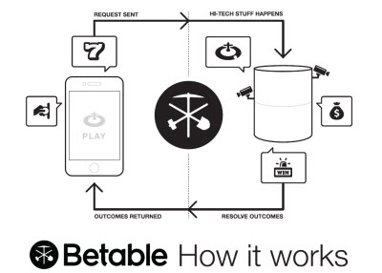
Real Money Gambling Legalized
US will legalize this across the board in coming years
Already big money elsewhere
Increasing middleware/APIs to enable real money wagering in “normal” mobile social games

Slide 52
Efforts Made to Unify Mobile Market
Game platforms (i.e. Unity, Unreal) that conquer fragmentation continue their rise
Samsung lightens up on TouchWiz, at Google’s request
iOS continues to be favoured platform due to vertical integration = more simple dev and UX

Slide 53
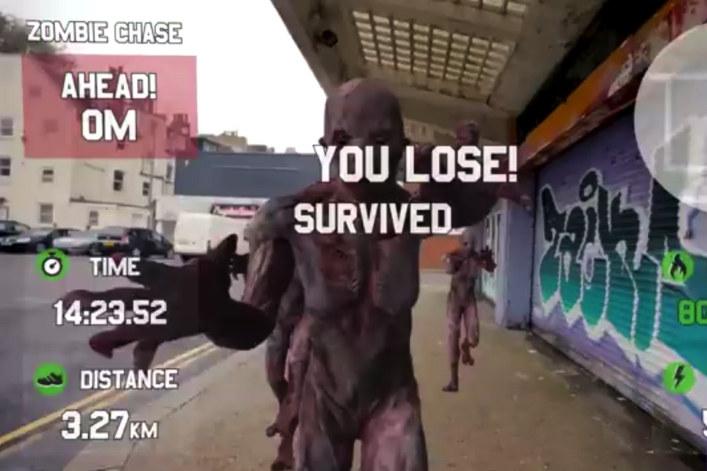
Augmented Reality
Two implementations:
Augmented reality combined with wearable tech, such as Google Glass games
Augmented reality games played on smartphones
Notes:
Augmented reality - real world game environments
Google Glass “Race Yourself” game: http://www.mirror.co.uk/news/technology-science/technology/google-glass-race-yourself-flesh-eating-3009010
Xbox One AR glasses: http://www.crunchwear.com/microsoft-files-patent-for-augmented-reality-glasses-to-be-used-with-xbox-one/
People playing Google’s ingress were detained by police on multiple occasions due to suspicious behavior: http://readwrite.com/2012/12/11/augmented-reality-game-gets-player-arrested-the-first-of-many
Another Ingress lawsuit (not a credible source, but interesting): http://uselectionatlas.org/FORUM/index.php?topic=197450.0
http://www.jaygarmon.net/2013/07/augmented-reality-advertising-why.html
“There will come a day in the not-so-distant future when Google Glass-like devices allow you to run an AdBlock-equivalent algorithm on real life, editing physical advertising out of your everyday experience.”
“The legal quagmire of deciding whether I, as an augmented reality user, have the right to control what appears in my field of view will be a big deal, one not resolved quickly or cheaply. A whole new set of opt-in and opt-out rights will need to be settled”
http://www.fastcompany.com/1495569/inevitable-augmented-reality-first-person-shooting-game-hits-iphone
“…uses the iPhone's camera to view the real world and is smart enough to work out when you've "shot" an enemy successfully (the phone vibrates when you make a kill).”

Slide 54
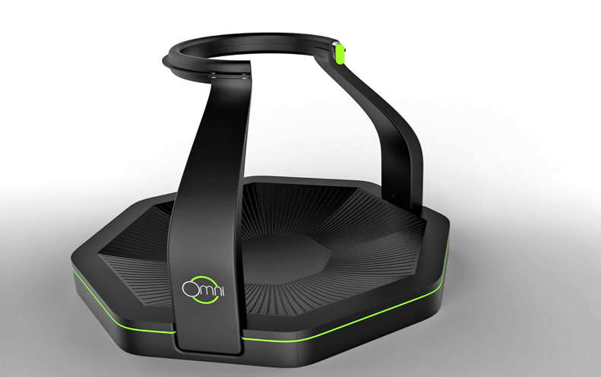
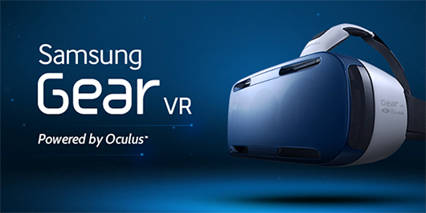
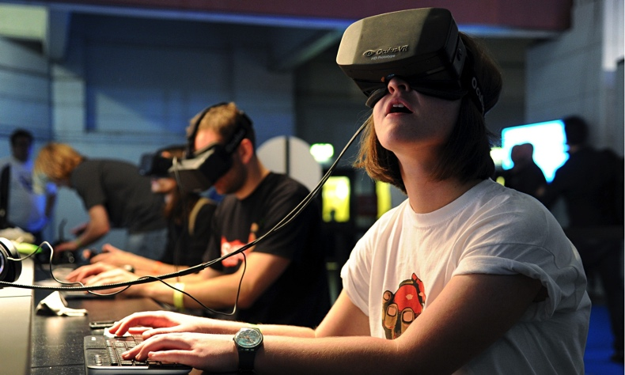
Virtual Reality
Samsung Gear VR (powered by Oculus) has early December release date
Oculus Rift release in 2015
Virtuix Omni also coming soon
Notes:
Virtual reality
Gear VR
http://www.joystiq.com/2014/11/15/oculus-releases-mobile-sdk-gear-vr-coming-in-december/
Oculus Rift
http://www.crunchwear.com/oculus-rift-launches-gaming-platform-for-vr-games/
https://share.oculus.com/
http://newsroom.fb.com/news/2014/03/facebook-to-acquire-oculus/
Virtuix Omni
https://www.kickstarter.com/projects/1944625487/omni-move-naturally-in-your-favorite-game
Interesting to note that both Oculus and Omni had very successful Kickstarter campaigns.

Slide 55
Industry Challenges
Cultural (GamerGate)
Lack of trust on both sides
Discoverability
“How do players find my game?)”
Economics
7 figure development budgets for mobile games
$10 CPA for some mobile genres
Winner-takes-all console market
Creative
Licenses and sequels have always been easy risk mitigation strategies
Notes:
Games have entered mainstream culture, leading to rapid changes in the industry
Timeline of where the industry has been, where it is now, and where it’s headed
Analysis of new market forces and their impact on the future of the industry
What kinds of legal battles will you be fighting in 2020?

Slide 56
Thank you!
Adrian Crook
Adrian Crook + Associates
adrian@adriancrook.com
@adriancrook

