Slide 1


Terminators, Orcs
& Other Anomalies
Talk 12
Part D “Conciliation”
Video Game Law 2014
UBC Law @ Allard Hall
Jon Festinger Q.C.
Centre for Digital Media
Festinger Law & Strategy
http://videogame.law.ubc.ca
@gamebizlaw
jon_festinger@thecdm.ca

Slide 2
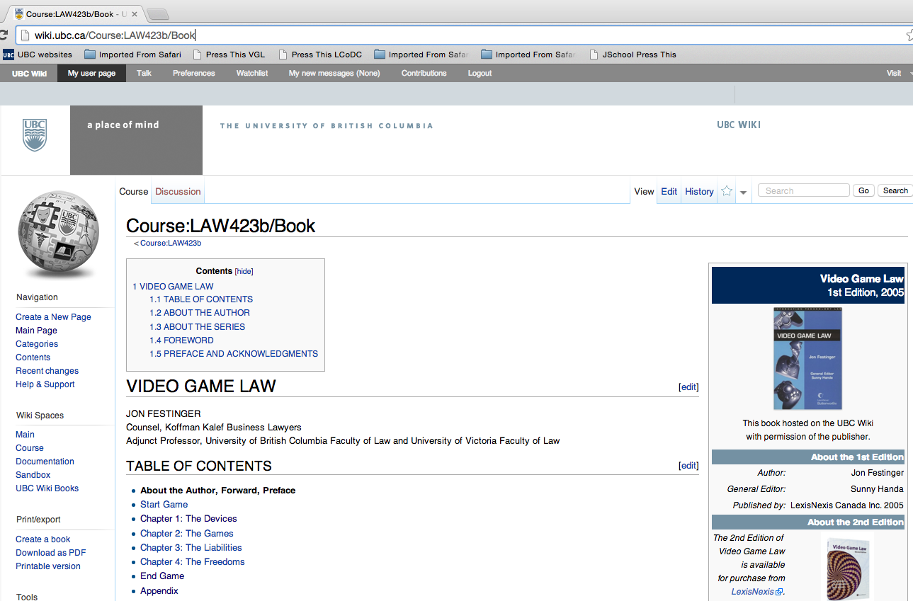
Wiki Update
Post/F.A.Q.
VGL (1st Ed.) IS MODABLE – it is a real Wiki
Wiki place for your papers (optional – after course)

Slide 3
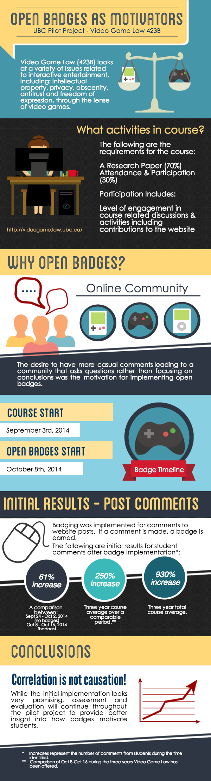

Online Survey Coming

Slide 4
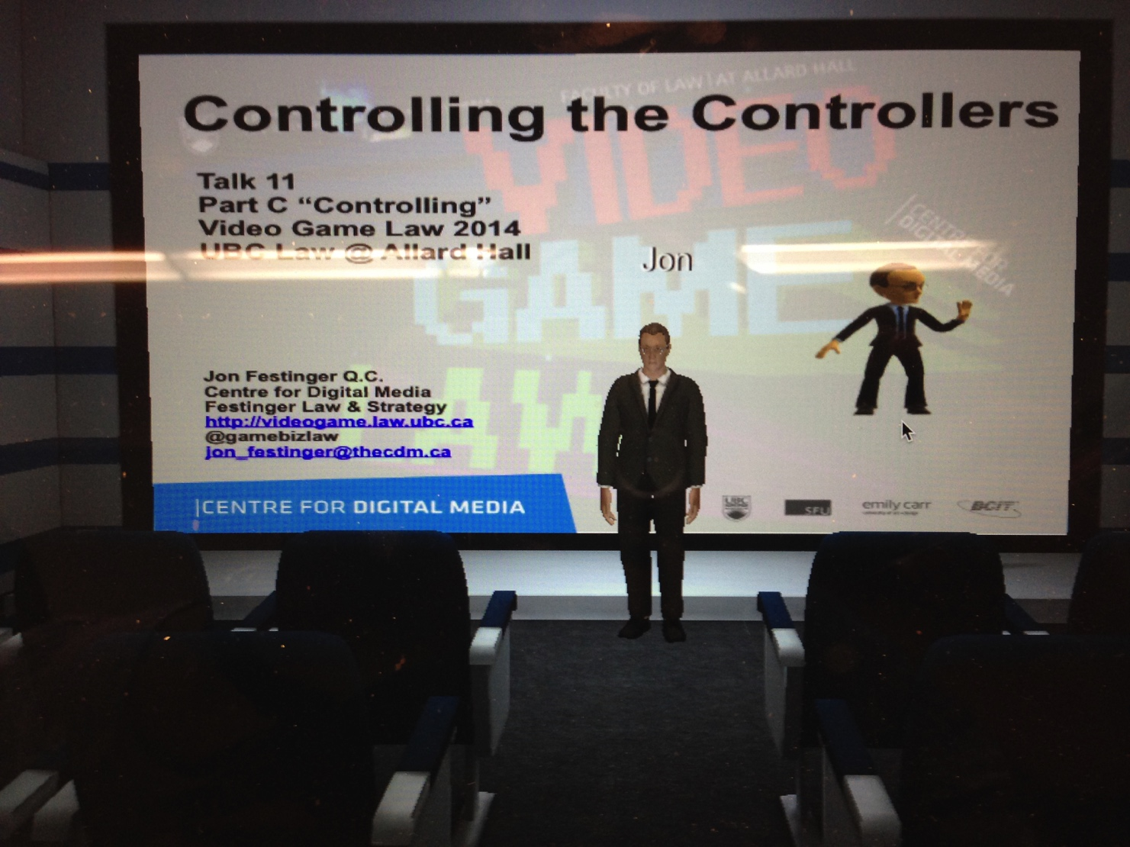
Project Oculus: Follow Up

Slide 5

Now at Part D: Conciliation (final leg of journey)
Part A = Creating
Part B = Connecting
Part C = Controlling

Slide 6
Any Questions on 1st Three memes
Part A = Creating
Part B = Connecting
Part C = Controlling
????????????????????

Slide 7


(How) do these (cases) resemble each other?
The Terminator & the Orc
Brown v. Entertainment Merchants Association, 131 S. Ct. 2729 (2011)
(originally VSDA v. Schwarzenegger)
http://www.wneclaw.com/firstamendment/brown.pdf
Davidson & Associates, Inc. v. Internet Gateway, 2005 U.S. App. LEXIS 18973 (8th Cir. 2005) http://cyber.law.harvard.edu/people/tfisher/2005%20Blizzard%20Abridged.pdf

Slide 8

BnetD case “seems to be about”…
* “BnetD” versus Blizzard’s “Battle.net”
* Amici Curiae Brief supporting defendants by teachers of IP Law in U.S. law schools
https://www.eff.org/sites/default/files/filenode/Blizzard_v_bnetd20040221_law_professor_brief.pdf
* Argued unsuccessfully that insofar as they prohibit permissible “reverse engineering” Blizzard’s EULA’s should be preempted by copyright law. Alternatively argued that enforcement of the EULA’s should be denied under the Doctrine of Copyright Misuse (related to concept of “Copyright Monopoly”).
*Attempted unsuccessfully to preserve Sega Enterprises v. Accolade, Inc. statement of the application of Fair Use to to reverse Engineering
* HARSHEST MOD CASE

Slide 9
Schwarzenegger case “seems to be about”…
California Statute defined “violent video
game” as:
“(d)(1) “Violent video game” means a video game in
which the range of options available to a player
includes killing, maiming, dismembering, or
sexually assaulting an image of a human being, if
those acts are depicted in the game in a manner
that ...: A) Comes within all of the following
descriptions:
A reasonable person, considering the game as a whole, would find appeals to a deviant or morbid interest of minors.
It is patently offensive to prevailing standards in the community as to what is suitable for minors.
It causes the game, as a whole, to lack serious literary, artistic, political, or scientific value for minors.”

Slide 10

on ‘Correlation not Causation’…
“In sum, the evidence presented by the State does not support the Legislature’s purported interest in preventing psychological or neurological harm. Nearly all of the research is based on correlation, not evidence of causation, and most of the studies suffer from significant, admitted flaws in methodology as they relate to the State’s claimed interest. None of the research establishes or suggests a causal link between minors playing violent video games and actual psychological or neurological harm, and inferences to that effect would not be reasonable. In fact, some of the studies caution against inferring causation. Although we do not require the State to demonstrate a “scientific certainty,” the State must come forward with more than it has. As a result, the State has not met its burden to demonstrate a compelling interest.”

Slide 11

on Comparative Literature
“California's argument would fare better if there were a longstanding tradition in this country of specially restricting children's access to depictions of violence, but there is none. Certainly the books we give children to read -- or read to them when they are younger -- contain no shortage of gore. Grimm's Fairy Tales, for example, are grim indeed. As her just deserts for trying to poison Snow White, the wicked queen is made to dance in red hot slippers "till she fell dead on the floor, a sad example of envy and jealousy." Cinderella's evil stepsisters have their eyes pecked out by doves. And Hansel and Gretel kill their captor by baking her in an oven.
High-school reading lists are full of similar fare. Homer's Odysseus blinds Polyphemus by grinding out his eye with a heated stake. In the Inferno, Dante and Virgil watch corrupt politicians struggle to stay submerged beneath a lake of boiling pitch. And Lord of the Flies recounts how a schoolboy is savagely murdered by other children while marooned on an island.
This is not to say that minors' consumption of violent entertainment has never encountered resistance. In the 1800's, dime novels depicting crime and "penny dreadfuls" were blamed in some quarters for juvenile delinquency. When motion pictures came along, they became the villains instead. Radio dramas were next, and then came comic books. And, of course, after comic books came television and music lyrics.”

Slide 12
on the impact of ‘Interactivity’
“California claims that video games present special problems because they are “interactive,” in that the player participates in the violent action on screen and determines its outcome. The latter feature is nothing new: Since at least the publication of The Adventures of You: Sugarcane Island in 1969, young readers of choose-your-own-adventure stories have been able to make decisions that determine the plot by following instructions about which page to turn to. As for the argument that video games enable participation in the violent action, that seems to us more a matter of degree than of kind.” (Justice Scalia delivering the opinion of the Court)
Versus
“When all of the characteristics of video games are taken into account, there is certainly a reasonable basis for thinking that the experience of playing a video game may be quite different from the experience of reading a book, listening to a radio broadcast, or viewing a movie. And if this is so, then for at least some minors, the effects of playing violent video games may also be quite different. The Court acts prematurely in dismissing this possibility out of hand.” (Justice Alito, concurring in the result)

Slide 13


Truth in ‘tone’…
Audio of the June 20, 2005 oral argument in 8th Circuit Court of Appeal in Blizzard v. BnetD (Davidson) @ 32:40 – 33:05: “This case does not involve new creation. There may be a case that does. This isn’t it…”
Audio of the November 2, 2010 oral argument in the U.S. Supreme Court in Brown v. Entertainment Merchants Association @ 1:13 - 7:20 + 11:25 - 14:04: “What’s a deviant violent video game?...Some of the Grimm’s Fairy Tales are quite grim…” + “I’m not concerned with the jury judging, I’m concerned with the producer of the game…”

Slide 14
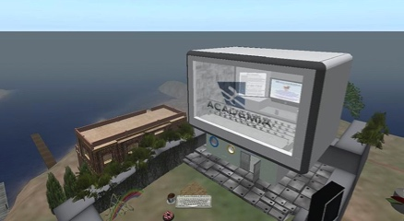
Common Denominator 1
In a word: CREATIVITY
Problem is not in asserting creativity (of Blizzard/game makers); it is in both cases the denial of the creativity of others (modders, children, the child in all of us)
Recall uniquely personal “Hollywood Model” of creation (‘It’s all about ME & MY UNIQUE TALENT’)
In Swartzenegger the Court was protecting the implications of creativity no matter how extreme (in terms of violence, not sex) so the creator can create (& the user can ‘benefit’)
In Davidson argument was that BnetD was anything but creative (because it all changes if user creativity is implicated???)
Never mentioned: USERS ARE CREATORS
TOO

Slide 15

Common Denominator 2: “Chill”
Censorship = Libel Chill
Copyright Infringement fears = uncertainties = “Creative Chill”

Slide 16
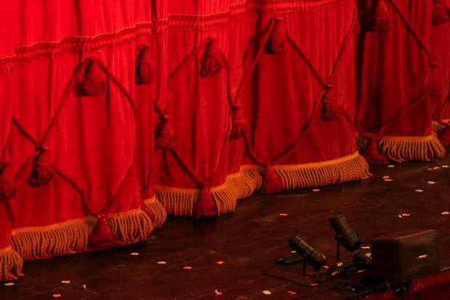
A Useful Intermission

Slide 17

REMEMBER:
WHY DOES LAW SEEM TO RESPOND SO SLOWLY TO TECHNOLOGICAL CHANGE?

Slide 18
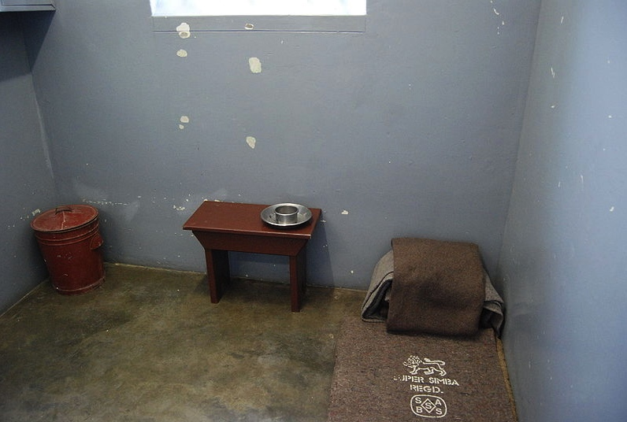
Justice Is…
Personal in
Experience,
General in Application.
Nelson Mandela’s cell

Slide 19

Consider the possibility...
Concepts of law & justice do not shape communications technologies nearly as much as they are shaped by the memes, concepts and meanings arising from communications technologies.

Slide 20

Put Another Way…
Communication tools iteratively alter and shape how and what we communicate, including (over time), how we formulate ethical concerns and legal frameworks…

Slide 21

Add to this…(a personal view)
Law can be inspired by order (social contract) and/or justice. Justice is only sometimes inspired by order. More often it is inspired by human potential.

Slide 22
Technology /Justice (Parallels)?
Before Justice was Revenge
1. Pre-literate → Justice as Retribution
2. Writing Instruments →Justice as Compensation
3. Printing Press → Justice as Rights
4. Mass Media → Justice as Truth
5. Digital → Justice as Resolution
6. Big Data → Justice as (Individual) Boundaries
7. Virtual reality → Freedom of Thought

Slide 23
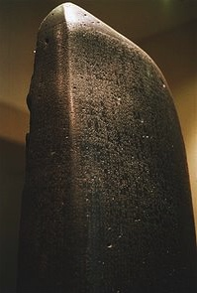
1. Pre-literate → Justice as Retribution
Speculation that Code of Hammurabi (Babylonia
1172 B.C.) imposed “eye for an eye”
punishments to limit uncontrolled revenge as
the prevailing principle.
* “Let the punishment fit the crime”
* Actually a limitation on
unlimited revenge though
we see it as barbaric today.
* Code of Hammurabi (1900 B.C.)
was a non-binding restatement
of Principles*
* Related to trial by ordeal?
* Driver and Miles via L. Festinger @ p.156 “The Human Legacy”

Slide 24
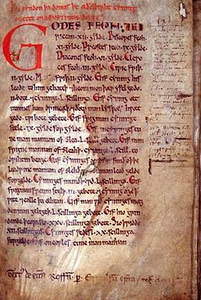
2. Writing Instruments → Justice as
Compensation
Law of Æthelberht
(early 7th
century) first
Germanic-language
law code sets out
compensations for
loss caused by
others.

Slide 25

3. Printing Press → Justice as Rights
Fascinating transition from Justice as a privileged right…
To Justice as egalitarian
right.
From “Declaration of the
Rights of Man and of the
Citizen” 1789…
to “Declaration of the
Rights of Man and Citizen”
1793.

Slide 26

4. Mass Media → Justice as (search for) Truth
Symptom: Huge increase in size of trials, discovery, documents & process.
Motivation: Evidence/facts as truth/justice (as opposed to reason, argument & persuasion yielding justice).
Result: 1. What could be “seen” more important then what is
believed; & 2. Bigger became “better”
Observation: All of the above happened
first in media, then in law. → Big Media/Big Law?
Newseum 9/12 headlines

Slide 27

5. Digital → Justice as Resolution
Mediation/Arbitration
Truth & Reconciliation Commissions
“Peace is Justice”???

Slide 28

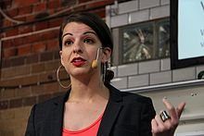
6. Big Data → Justice as Boundaries
Harassment/Privacy test
Also “user’s rights” in SCC pentalogy – Abella J. for the majority in “Access Copyright” case 2012 SCC 37
“…fair dealing is a “user’s right”, and the relevant perspective when considering whether the dealing is for an allowable purpose…is that of the user…”

Slide 29

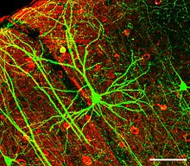

7. Virtual reality → Freedom of Thought
The Future is “Telepathic”

Slide 30
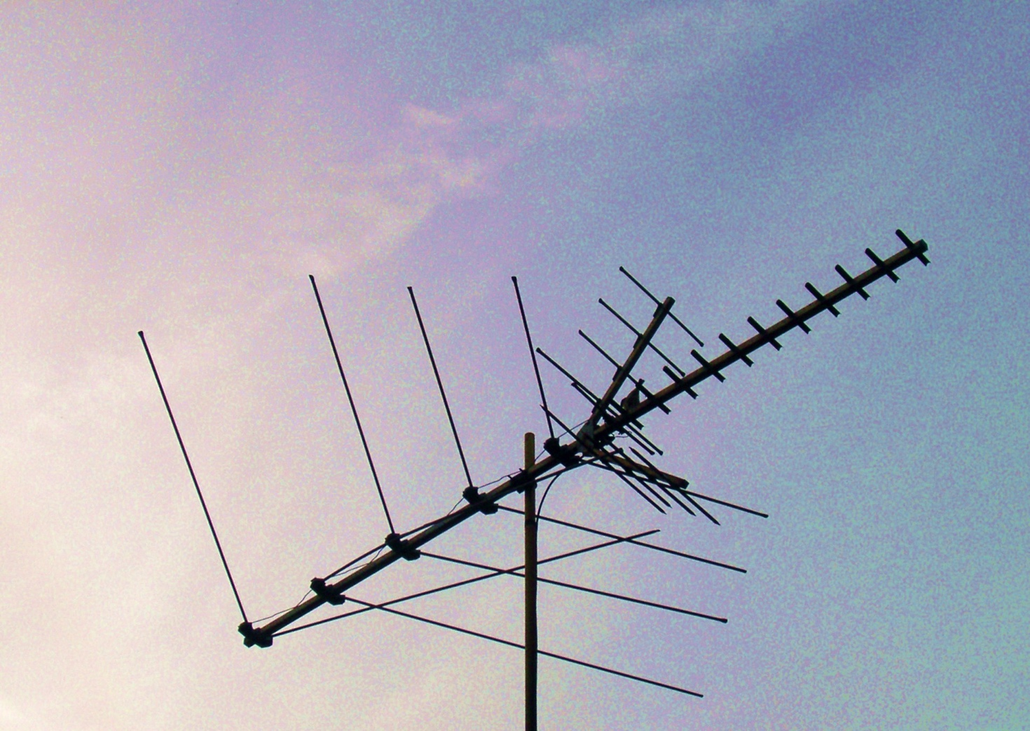
Now Back to Our Regularly Scheduled Programming…

Slide 31

We were talking about…
“chill”

Slide 32

Prior Restraints Are A Problem
Blackstone: “Every freeman has an undoubted right to lay what sentiments he pleases before the public; to forbid this, is to destroy the freedom of the press;…” (4 Bl. Com. 151, 152.)
*IP as “Prior Restraint” to Creativity?
*EULA’s & ToS’ as even greater
“Prior Restraint” to Creativity

Slide 33
Constraints Distort Creativity
11. Internet Governance & Surveillance (International Law)
10. Criminal & Obscenity Laws.
9. Taxation/Currency/Gambling (regulatory; quasi-criminal)
8. Misleading promises/advertising, physical or
psychological harm, unfair competition/anti-trust
(consumer protection)
7. Industry self regulation (delegated authority) & medium
specific regulation (constitutional)
Out of the Creation Norms (Censorship) ----------------------------------------------------------
In the Creation (Magic Circle) Ethics (of Originality, Creativity & Expression)
6. Privacy, Defamation & Personality law (tort, IP)
5. EULA/ToS & Contracts (contractual, private)
4. Trademark, Patents & the IP Business
3. Copyright & Users Rights (statutory)
2. Technology (quasi extra-legal)
1. Community (extra-legal)

Slide 34
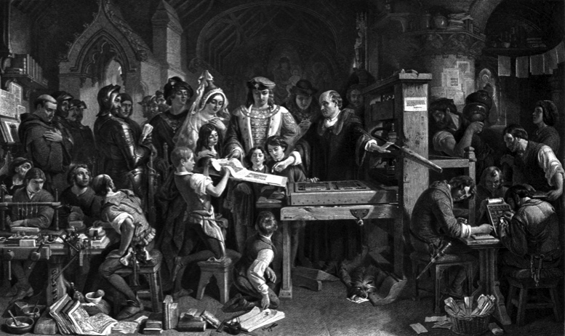
Understanding CREATIVITY as part of the democratization of thought? As part of a trajectory of freedoms?
From King…to Parliament…to Government
Regulator…to Industry Self Regulation…to Author…
…to User…
Did we stop @ 1710 Statute of Anne?
= Right to CREATE?

Slide 35


Breaking through creative chill …
IN MODS

Slide 36
Cases Neither Allow Nor Prohibit (Creative) Modding
1. Micro Star v. FormGen (1998 USCA) Duke Nukem levels
2. Davidson & Associates, Inc. v. Internet Gateway 2005 USCA (D&A = Blizzard):
Audio of the June 20, 2005 oral argument in 8th Circuit Court of Appeal in Blizzard v. BnetD (Davidson) @ 32:40 – 33:05: “This case does not involve new creation. There may be a case that does. This isn’t it…”
{3. iRacing v. Robinson (2007 Mass. Dist. Ct.) – direct commercial interference???}
4. MDY Industries, LLC v. Blizzard Entertainment, Inc. (2010 USCA) Glider “bot”

Slide 37
WE COULD…
……evolve a single standard:
For CREATORS as USERS, &
For USERS as CREATORS……
to match reality…
It makes a difference that mods/
games are tools of further creativity.
Modding ought to be a “Users Right to CREAtE”
What about “Rights in the Creation”?

Slide 38

Right to Mod Argument
Right to Mod/CREAtE
SHOULD NOT User Rights/Right to CREAtE-Mod really be a creative/expressive right rather than an IP right/protection?
Part of Freedoms of Thought/Conscience?
Part of Free Expression (criticism & review/news reporting)
An expanded “public interest” based Fair Dealing/Fair Use?
As an independent “right”
Limited EULA restrictions? HOW?

Slide 39
The Truth About Video Game IP ?!?
1. Games are inherently creative & interactive
2. Games have a larger evolutionary purpose
3. Video games are “evolved” games
4. In context the “art” though wonderful is incidental
to the game…
5. The experience, the evolving narrative & playing
(creation) is the key…
6. …& player as co-creator of the game…
Creativity & connection in gameplay is the core

Slide 40

Remember the PUZZLE…
“Equally strange is our general addiction to games, both physical and mental. The profusion of games is truly startling: card games, board games, word games, ball games, electronic games….We even assemble in huge crowds to watch others playing games. What does all this mean? Do we simply get easily bored and cannot tolerate inactivity? I can find nothing in the literature of scientific psychology that helps me to understand such bizarre behavior.”
The Human Legacy (1982)
Leon Festinger

Slide 41
Is this a video game?
“…the process of creating a model of the world using multiple feedback loops in various parameters (e.g., in temperature, space, time, and in relation to others), in order to accomplish a goal (e.g., find mates, food, shelter).”

Slide 42
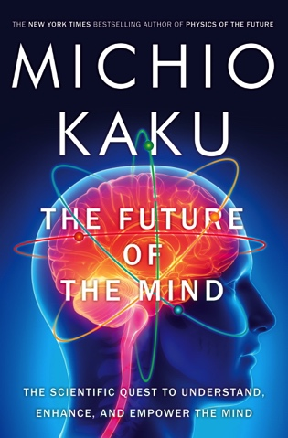
NO, IT IS YOU
“Consciousness is the process of creating a model of the world using multiple feedback loops in various parameters (e.g., in temperature, space, time, and in relation to others), in order to accomplish a goal (e.g., find mates, food, shelter).”

Slide 43
It really is YOU:
Jung on Games & Instinct
“One of the most difficult tasks men can perform, however much others may despise it, is the invention of good games and it cannot be done by men out of touch with their instinctive selves.”
Jung and the Story of Our Time, Laurens van der Post (1977)

Slide 44

“You & yours”: Play as Evolution
Does Gaming have an evolutionary purpose in the Darwinian sense?
Dr. Kimberly Voll (CDM/UBC) – From “Game Design” – DMED 521:
1. “neurons that fire together, wire together” (Donald Hebb, aka “Hebbian Learning”)
2. “..so “fun” seems to be something our brains use to keep us doing something to the point of mastery…makes sense if it is something that will help us live better and get our genes out into the gene pool again…”

Slide 45

GAMING AS A DARWINIAN EVOLUTION
“The role of self image in video game play”
James Madigan (Gamasutra Feb. 3, 2012)
http://www.gamasutra.com/view/news/40093 The_role_of_self_image_in_video_game_play.php
“In the article, Andrew Przybylski...and his co-
authors hypothesize that we’re motivated to play video
games to the extent that they allow us to sample our
“ideal self characteristics,” especially when there’s
a large gap between our ideal selves and who we actually
think we are. This could help explain why people are
attracted to games in a way that’s unique to the medium.”
Przybylski, A. K., Weinstein, N., Murayama, K., Lynch, M. F., & Ryan, R. M. (2012). The ideal self at play: The appeal of videogames that let you be all you can be. Psychological Science, 23, 69-76.
http://pss.sagepub.com/content/23/1/69.full.pdf+html

Slide 46
You & Others: McLuhan, 1964
(Games as social reaction)
Games are popular art, collective, social reactions to the main drive or action of any culture. Games, like institutions, are extensions of social man and the body politic, as technologies are extensions of the animal organism. Both games and technologies are counter-irritants or ways of adjusting to the stress of the specialized actions that occur in any social group. As extensions of the popular response to the workaday stress, games become faithful models of a culture. They incorporate both the action and the reaction of whole populations in a single dynamic image.

Slide 47
You as provider of meaning: Boyden
“In all of these situations, the owners of a copyright in a form, description, or set of instructions were attempting to extend their copyright to material for which the user of the work provided the essential content, not its author. That is what made them systems. They were, without that input, empty shells, waiting to be filled.”
“Games are systems in exactly the same way. A game, as sold, is only a game form; the content necessary for an instance of the game comes from the players. That is, the game form establishes the environment for play—the game space—and it defines permissible moves and the conditions for winning or drawing. But the game itself is supplied by the players.”
“Systems are shells into which users pour meaning. While they may contain expression themselves, that expression is there merely to facilitate the meaning added by the user.”

Slide 48
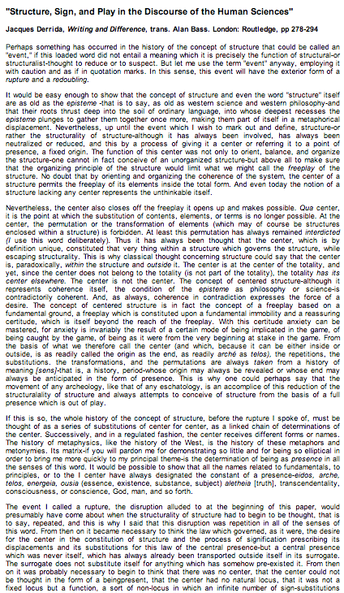
You as “author”: Video-Games as
Post-Structuralism
"Structure, Sign, and Play in the Discourse of the Human Sciences” Jacques Derrida
Structures as free-floating (or 'playing') sets of relationships. Structuralist discourses unfortunately hold on to a "center” which anchors the structure and “does not play”.
http://hydra.humanities.uci.edu/Derrida/sign-play.html

Slide 49
From “Post-Structuralism and Videogames
“Post-structuralism with respect to narratology can be said to focus on decentralization of the author and the replacement of them with the reader. What this means is that authorial intent is not the primary goal of a textual or narrative analysis of a work. Decentralizing the author allows the work to be open to new interpretations. The way a text is read by one person is not invalidated by another reading of it, but rather just another interpretation given a different situated perspective. So what does this mean for an individual reader and, more importantly, a videogame player?”

Slide 50

‘Pentalogy’ as harbinger..
User’s Rights
Creator’s Rights:
Same thing?
(individual rights
& responsibilities)

Slide 51

SCC Penatalogy Quotes
Abella J. for the majority in Alberta (Education) v. Canadian Copyright Licensing Agency (Access Copyright) 2012 SCC 37:
“…fair dealing is a “user’s right”, and the relevant perspective when considering whether the dealing is for an allowable purpose…is that of the user…”
Abella J. for the Court in Society of Composers, Authors and Music Publishers of Canada v. Bell Canada 2012 SCC 36:
“Further, given the ease and magnitude with which digital works are disseminated over the Internet, focusing on the “aggregate” amount of the dealing in cases involving digital works could well lead to disproportionate findings of unfairness when compared with non-digital works.”

Slide 52

Rationale A: Everything is Connected (including creativity/identity)
“We are the sum of all the people we have ever met; you change the tribe and the tribe changes you.” Fierce People by Dirk Wittenborn
“Neurologist Oliver Sacks on Memory, Plagiarism, and the necessary Forgetting's of Creativity”: “We, as human beings, are landed with memory systems that have fallibilities, frailties, and imperfections — but also great flexibility and creativity. Confusion over sources or indifference to them can be a paradoxical strength: if we could tag the sources of all our knowledge, we would be overwhelmed with often irrelevant information”.http://www.brainpickings.org/index.php/2013/02/04/oliver-sacks-on-memory-and-plagiarism/
Bruce Springsteen SXSW keynote @ 24:27 - 26:40 & 27:35 - 30:00
https://www.youtube.com/watch?v=NvaRKlKerZo
Playing Computer Games Together Makes Brains Feel and Think Alikehttp://www.sciencedaily.com/releases/2013/11/131121091439.htm

Slide 53
Rationale B: Everything is Connected Another Take on Original-ism
“More then ever, the narcissistic interests of those who make art count for more than the human needs of those who desire and supposedly benefit from it – and how much they benefit from it is the contemporary question about art.” Donald Kuspit, “Signs of Psyche in Modern and Post Modern Art” (1994)
* Is there a game without a gamer? (No per Boyden)
* Mods through objective content measurement??
* Personal creation mythology appears unsound by research, less sound still from a human perspective

Slide 54
Rationale C: Preponderance of
Human Creativity - Test of “Good”
Derek Parfit 1: “My life seemed like a glass tunnel, through which I was moving faster every year, and at the end of which there was darkness... [However] When I changed my view, the walls of my glass tunnel disappeared. I now live in the open air. There is still a difference between my life and the lives of other people. But the difference is less. Other people are closer. I am less concerned about the rest of my own life, and more concerned about the lives of others.” Reasons and Persons (1984)
Derek Parfit 2: Objective v. Subjective Theories of “(Non-Religious) Ethics” On What Matters (2011)
Demonstrate through GPL & other mods that preponderance of creativity lies with the co-creators. Add in players playing as co-creators then every creative work is comprised mostly of others creativity/work/effort

Slide 55



Rationale D:
Creativity is More
Important Than Property

Slide 56
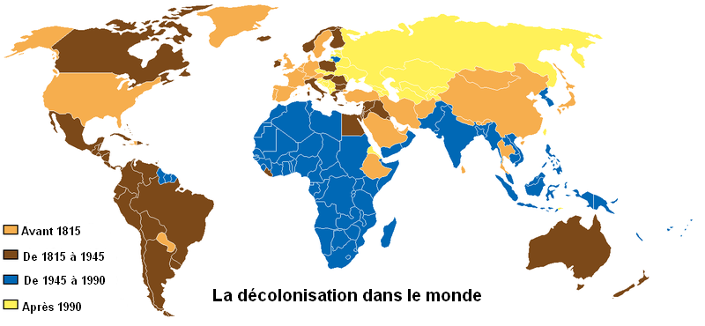
Also: Original-ism (the “Hollywood Model”) as Neo-colonialism
See “Intellectual Property: The Global
Spread of a Legal Concept” Alexander Peukert http://papers.ssrn.com/sol3/papers.cfm?abstract_id=2218292

Slide 57
OK THEN…

Slide 58

The buck stops here…
“Judges as Bad Reviewers: Fair Use and Epistemological Humility”
Rebecca Tushnet, Georgetown University Law Center
“…the future of fair use as a formal doctrine in the United States depends on whether judges act like bad reviewers on Amazon.com, or whether they behave differently in interpreting challenged works than they do in almost every other aspect of judging.”

Slide 59
Final Class: “The Ethical Underpinnings of Video-Games ”
Some legal concepts to consider in a post-
structuralist context as applied to video-games:
Copyright (e.g. mods)
Copyright as an author’s right
Trademarks
Patents
RIGHT TO CREAtE ?
Moral rights
Contracts
Browsewrap contracts
Clickwrap contracts
Privacy (e.g. gamer not system dictates)

Slide 60

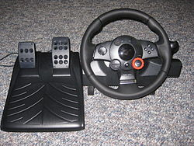
& Breaking through creative chill …
IN HARDWARE

Slide 61

“Actually, it’s about ethics in games journalism …”

Slide 62
Our Academic Partners

