Slide 1


“Legal, Normative & Cultural Perspectives on Mods and Modding of Japanese Video Games”
Jon Festinger Q.C.
Centre for Digital Media;
Festinger Law & Strategy
http://videogame.law.ubc.ca
@gamebizlaw
jon_festinger@thecdm.ca

Slide 2
Part A: “Press Now”
Current Modding Issues
In Japanese Games

Slide 3
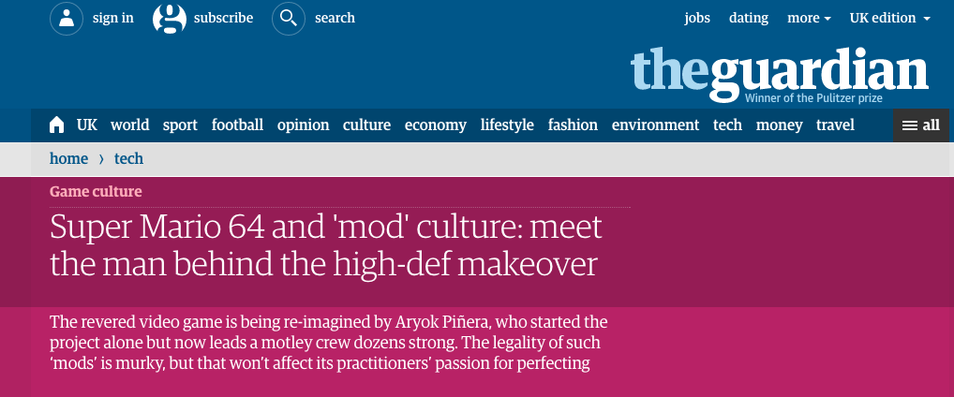
The “Western” View of Mods
http://www.theguardian.com/technology/2015/feb/18/super-mario-64-high-definition-mod

Slide 4
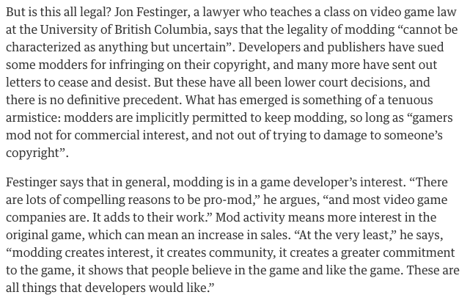

Slide 5


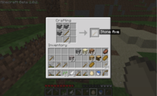

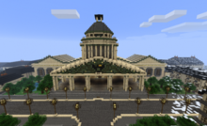

Video games today seem to be less about what the developer intended; more about what the player does…

Slide 6
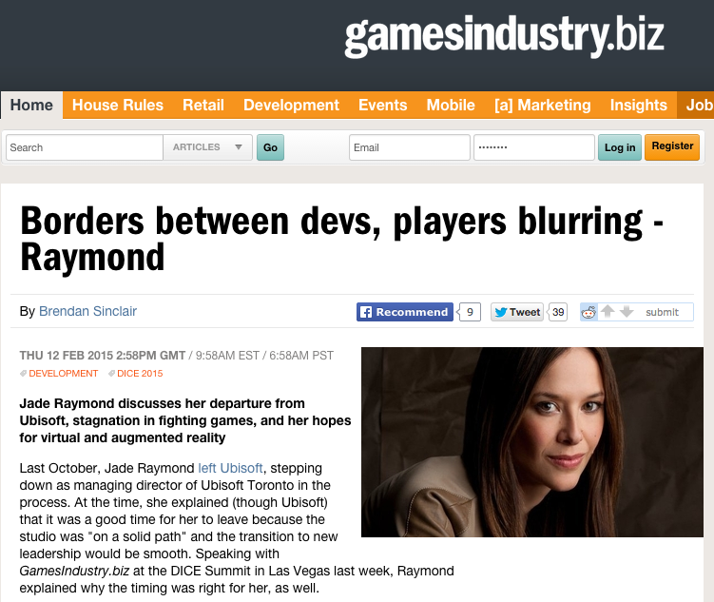
http://www.gamesindustry.biz/articles/2015-02-11-borders-between-devs-players-blurring-raymond

Slide 7
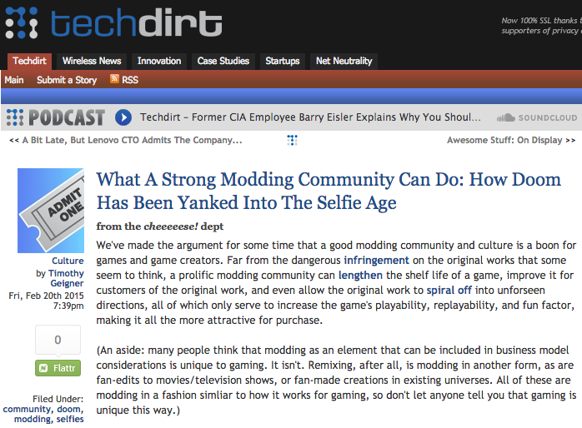
https://www.techdirt.com/articles/20150217/11265630058/what-strong-modding-community-can-do-how-doom-has-been-yanked-into-selfie-age.shtml

Slide 8
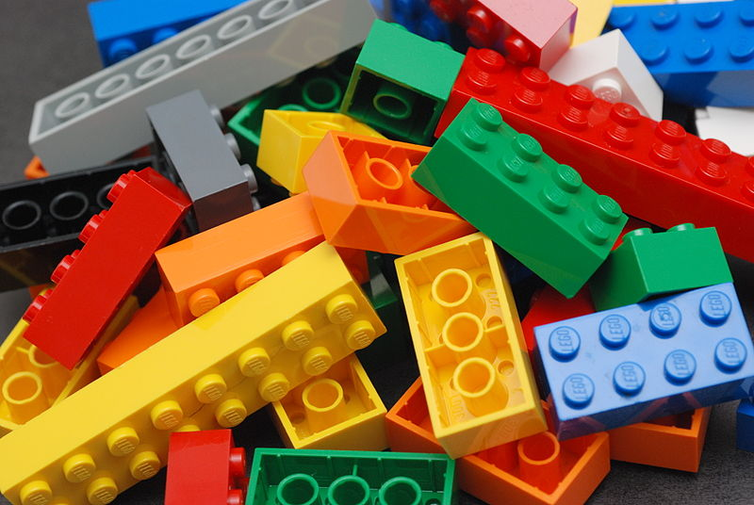
The Legal Question:
Is there a
FREEDOM TO
CREAtE
(MOD)?

Slide 9
Western conception re mods…
1. Really emphasizes the concept of “property” in “Intellectual Property” (even though the word “property” does not appear in that context even once in the Copyright Act or the Copyright Modernization Act).
2. Fair Use/Fair Dealing exist squarely within this “property” framework.
3. SCC Penatalogy (July 2012) reinforces “Users Rights”

Slide 10

SCC Penatalogy Quotes
Abella J. for the majority in Alberta (Education) v. Canadian Copyright Licensing Agency (Access Copyright) 2012 SCC 37:
“…fair dealing is a “user’s right”, and the relevant perspective when considering whether the dealing is for an allowable purpose…is that of the user…”

Slide 11

Non-commercial user-generated content
(Copyright Act, Canada)
29.21 (1) It is not an infringement of copyright for an individual to use an
existing work or other subject-matter or copy of one, which has been
published or otherwise made available to the public, in the creation of a
new work or other subject-matter in which copyright subsists and for the
individual — or, with the individual’s authorization, a member of their
household — to use the new work or other subject-matter or to authorize an
intermediary to disseminate it, if
(a) the use of, or the authorization to disseminate, the new work or other
subject-matter is done solely for non-commercial purposes;
(b) the source — and, if given in the source, the name of the author, performer,
maker or broadcaster — of the existing work or other subject-matter or copy of
it are mentioned, if it is reasonable in the circumstances to do so;
(c) the individual had reasonable grounds to believe that the existing work or
other subject-matter or copy of it, as the case may be, was not infringing
copyright; and
(d) the use of, or the authorization to disseminate, the new work or other
subject-matter does not have a substantial adverse effect, financial or
otherwise, on the exploitation or potential exploitation of the existing work or
other subject-matter — or copy of it — or on an existing or potential market for
it, including that the new work or other subject-matter is not a substitute for the
existing one.

Slide 12
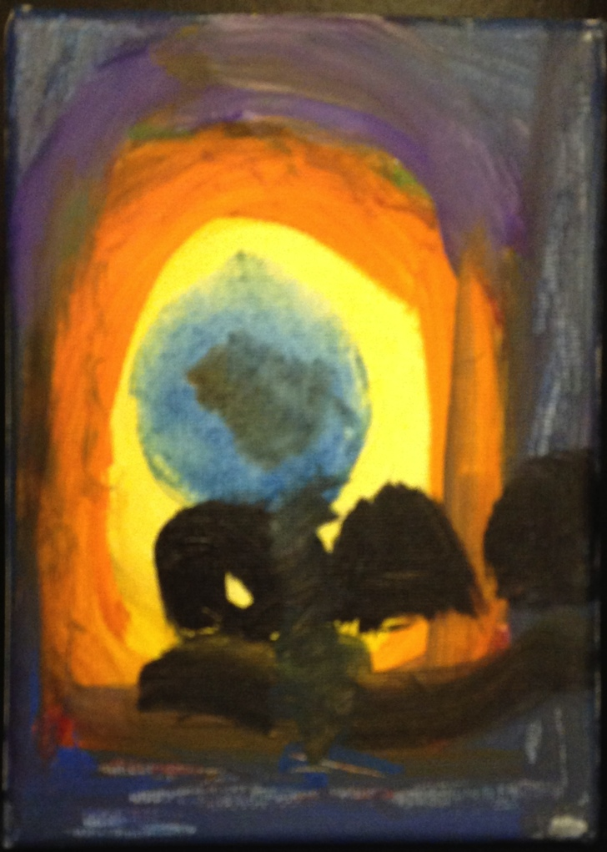
Right to Remix/Mod/CREAtE ?
“Right to CReAte”
Not “Property Right
in the Creation”

Slide 13
Can we find a “right to create” in the Charter?
2. Everyone has the following fundamental freedoms:
(a) freedom of conscience and religion;
(b) freedom of thought, belief, opinion and expression, including freedom of the press and other media of communication;

Slide 14

Now Back to Our Regularly Scheduled Programming…

Slide 15
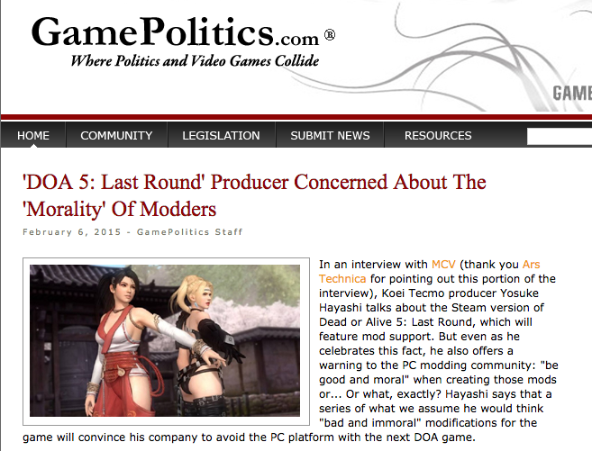
DOA 5: Last Round Controversy
http://gamepolitics.com/2015/02/06/doa-5-last-round-producer-concerned-about-morality-modders#.VOqdE1PF8Ws

Slide 16
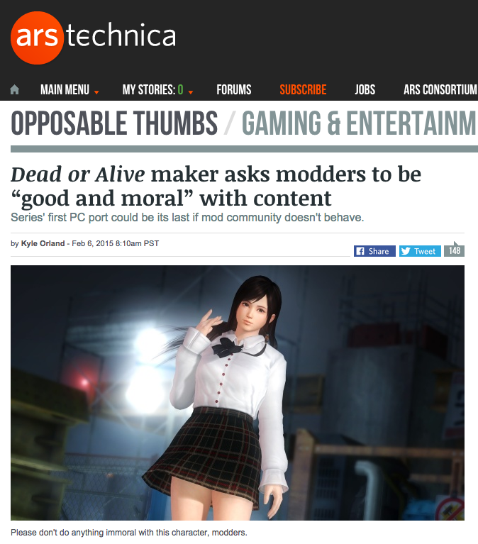
http://gamepolitics.com/2015/02/06/doa-5-last-round-producer-concerned-about-morality-modders#.VOqdE1PF8Ws

Slide 17
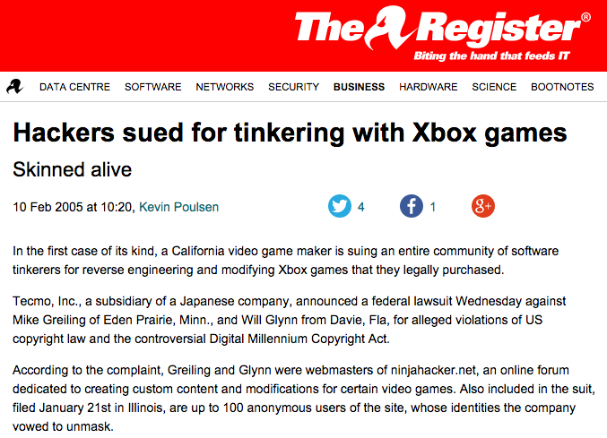
Not the first time…
http://www.theregister.co.uk/2005/02/10/tecmo_sues_xbox_game_hackers/

Slide 18
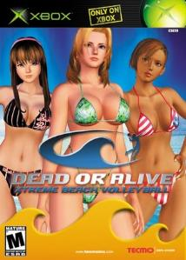
"[W]e believe it is our duty to uphold the integrity of our work," said John Inada, general manager for Tecmo, in a statement. "Hacking of this kind will not be tolerated and we intend to take all necessary measures…” (2005)

Slide 19
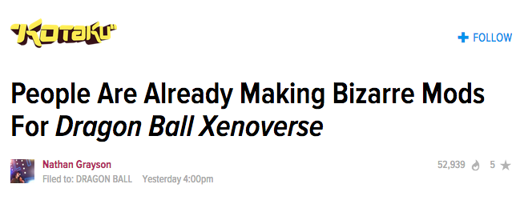
But modding Japanese games is hardly going away
http://kotaku.com/people-are-already-making-bizarre-mods-for-dragon-ball-1686912769

Slide 20
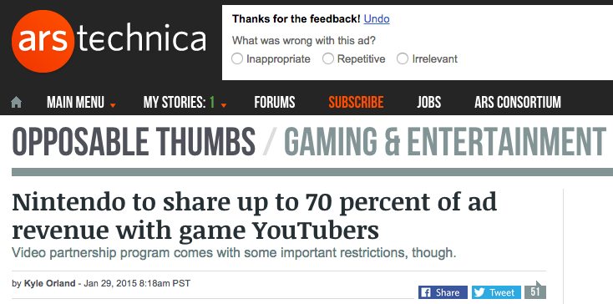
But the schisms multiply…
http://arstechnica.com/gaming/2015/01/nintendo-to-share-up-to-70-percent-of-ad-revenue-with-game-youtubers/

Slide 21
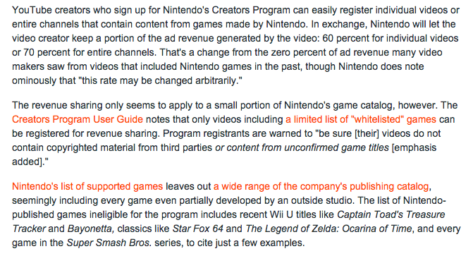
…and grow…

Slide 22
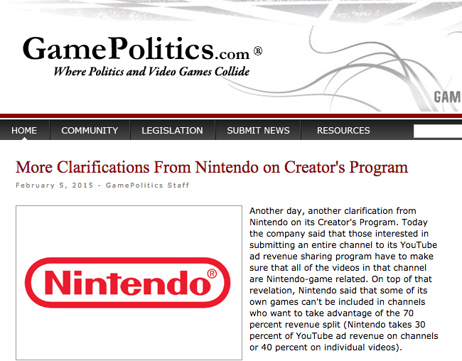
http://gamepolitics.com/2015/02/05/more-clarifications-nintendo-creators-program#.VOqwjVPF83s

Slide 23
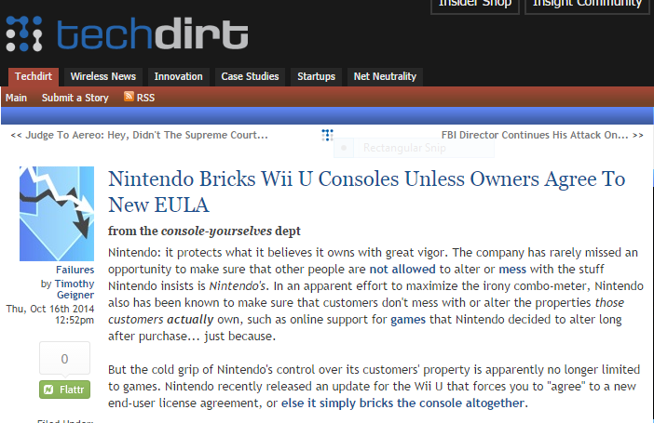
& perhaps most challenging of all...
https://www.techdirt.com/articles/20141013/11010528810/nintendo-bricks-wii-u-consoles-unless-owners-agree-to-new-eula.shtml

Slide 24
Part B: “Press Why”

Slide 25
So what is really going on here?

Slide 26
Is this really about I.P. from a Japanese gaming perspective?

Slide 27
“Respect” for…
Creative Integrity
& Quality

Slide 28
Versus “property”

Slide 29
Not inconsistent with (?)…
Sony v. Ball – Messiah 2 chip (2004); Sony v. Stevens – mod chip (2002)
Sony v. Connectix – Virtual Game Station emulation (2000)
Nintendo v. Computer & Entertainment – Super UFO cartridge copier (1996)
Sega v. Accolade – access to Genesis through reverse engineering (1992)
Nintendo/Game Genie case (1992)
Nintendo v. Elcon (1982)

Slide 30
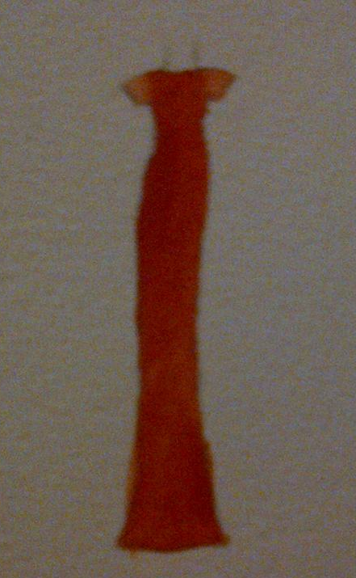
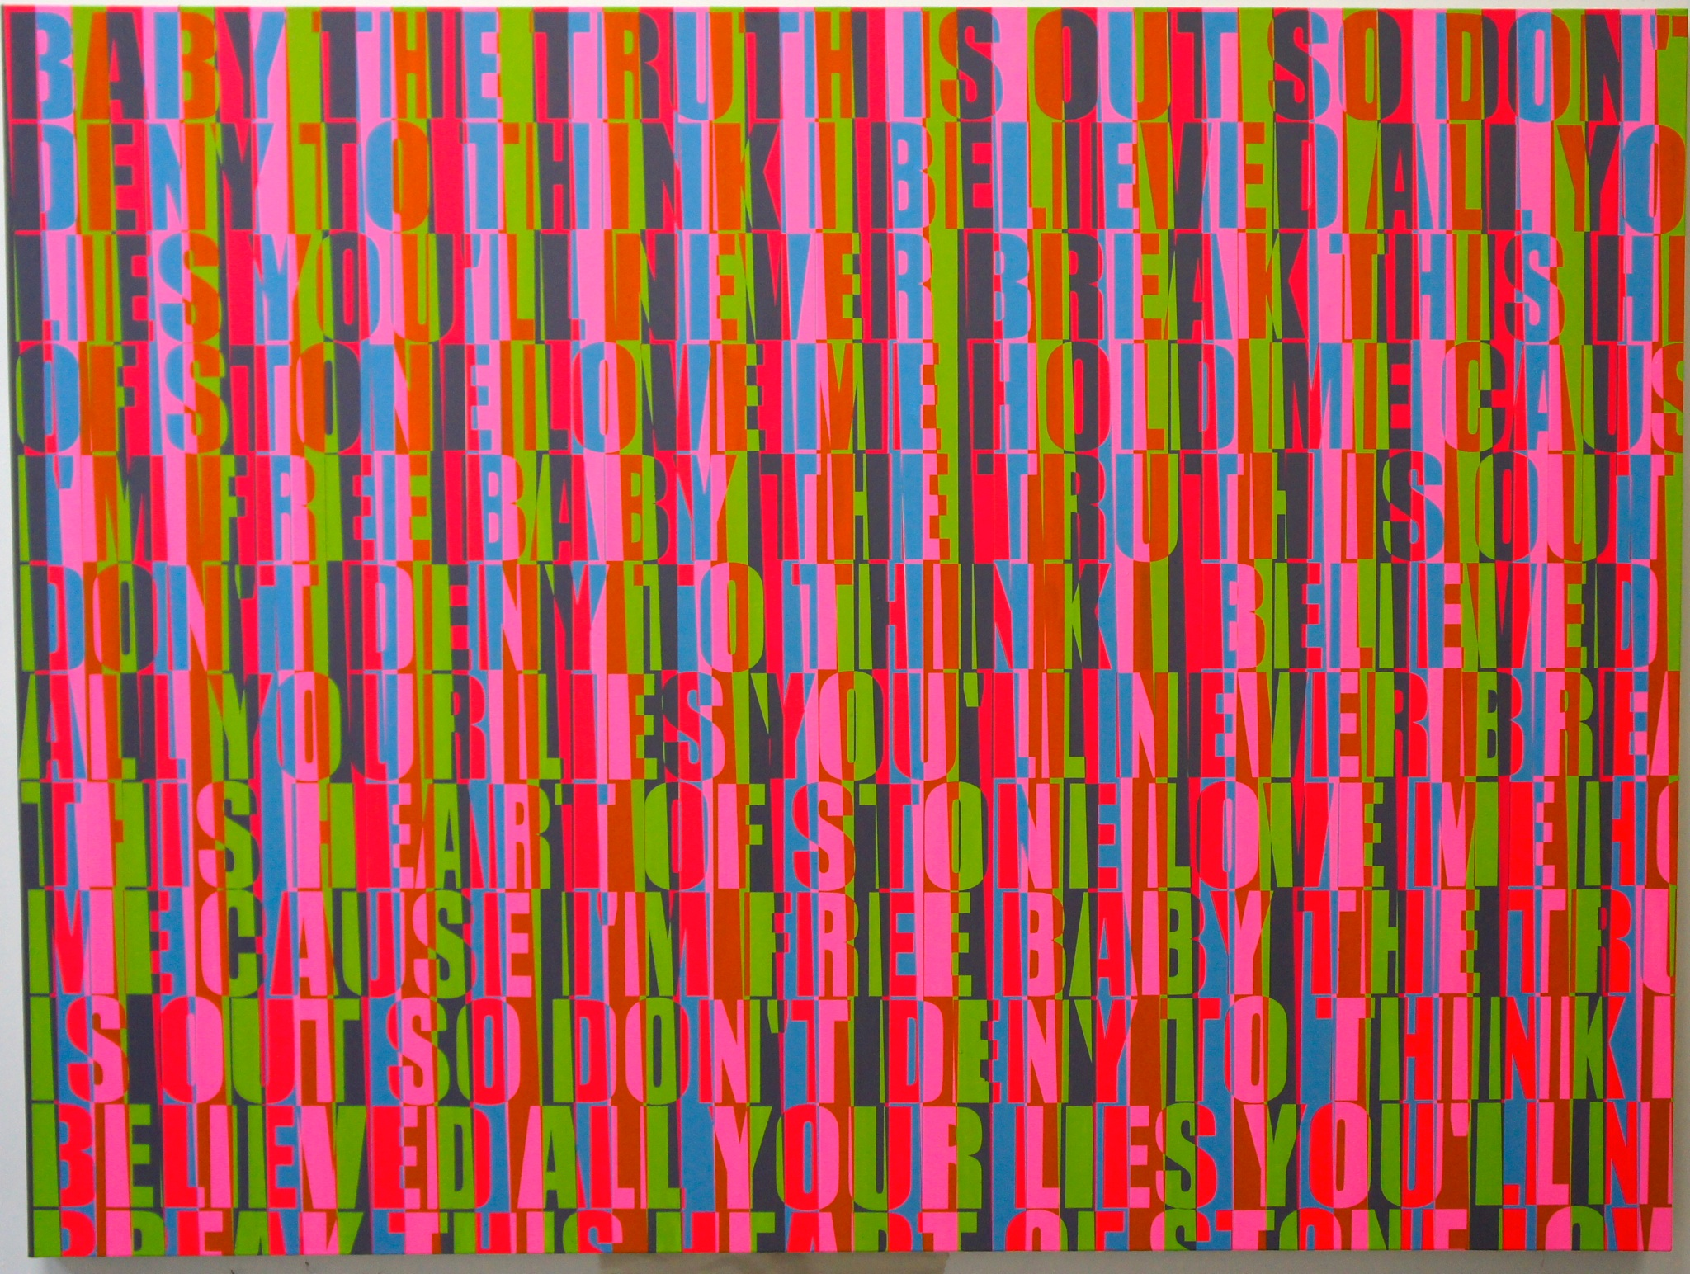
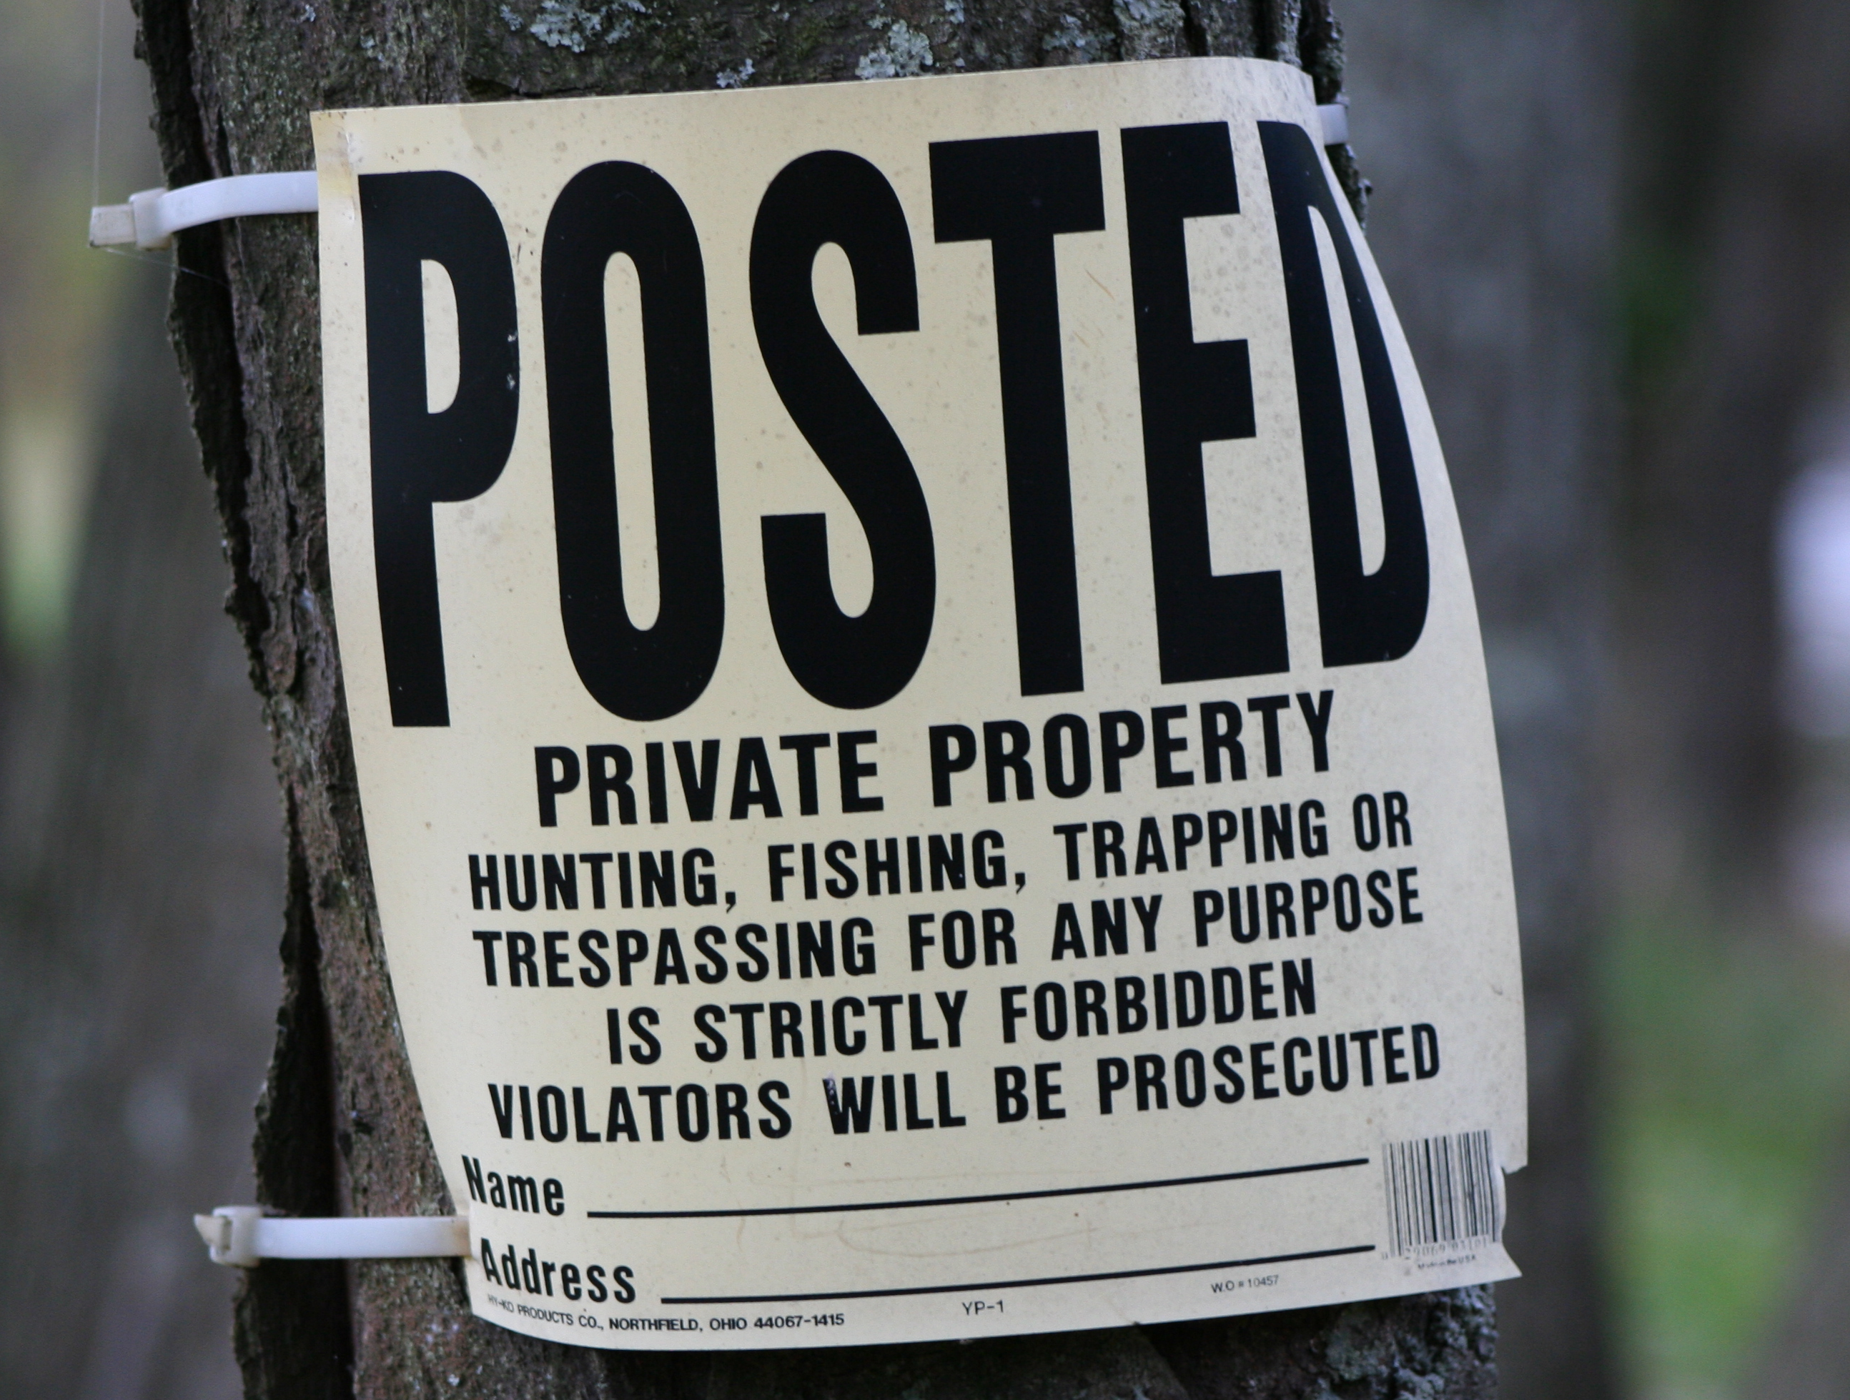
Perhaps Creative Integrity
Is More Important Than
(Intellectual) Property ?

Slide 31
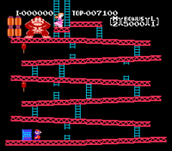
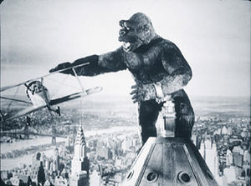
The Parable That Really Happened

Slide 32
“Monkey Business”
Universal v. Nintendo, 1985 USCA
(AKA King Kong v. Donkey Kong)
A morality tale where Hollywood asserted property rights and Nintendo defended creative integrity and independence. Donkey Kong wins. Universal didn’t have the rights. Punitive damages for Universal’s conduct awarded.

Slide 33
“An award of punitive damages was appropriate under the facts of this case. First, Universal knew that it did not have trademark rights in King Kong, yet it proceeded to broadly assert such rights anyway. This amounted to a wanton and reckless disregard of Nintendo’s rights.
Second, Universal did not stop after it asserted its rights to Nintendo. It embarked on a deliberate, systematic campaign to coerce all of Nintendo’s third party licensees to either stop marketing Donkey Kong products or pay Universal royalties.
Finally, Universal’s conduct amounted to an abuse of judicial process, and in that sense caused a larger harm to the public as a whole. Depending on the commercial results, Universal alternatively argued to the courts, first, that King Kong was part of the public domain, and then second, that King Kong was not part of the public domain, and that Universal possessed exclusive trademark rights in it. Universal’s assertions in court were based not on any good faith belief in their truth, but on the mistaken belief that it could use the courts to turn a profit.”

Slide 34
Part C: “Press What Now?”
Possible repercussions & outcomes

Slide 35
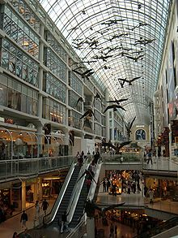
Understanding through the lens of “moral rights”
14.1 (1) The author of a work has…the right to the integrity of the work and, in connection with an act mentioned in section 3, the right, where reasonable in the circumstances, to be associated with the work as its author by name or under a pseudonym and the right to remain anonymous.
(2) Moral rights may not be assigned but may be waived in whole or in part.
(3) An assignment of copyright in a work does not by that act alone constitute a waiver of any moral rights…
Snow v. Eaton Centre Ltd.
(1982), 70 CPR (2d) 105.

Slide 36
What is perhaps most interesting about “moral rights” is that it is the (only) legal concept which directly incorporates the process of Creativity.

Slide 37
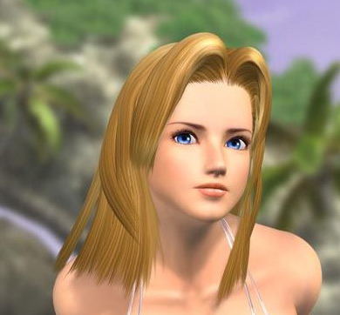
So back to DOA 5

Slide 38
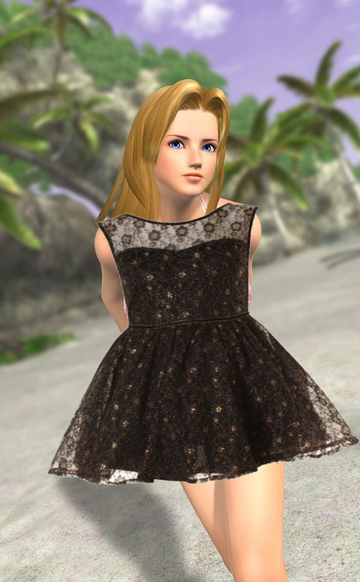
As modded by Patrick Pennefather

Slide 39
Quality or not?
You decide…

Slide 40

“We cannot know how we would have acted, but we now know how we should have.”

Slide 41
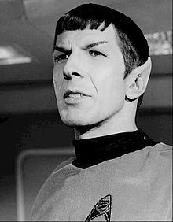
“The Needs of the Many Outweigh the Needs of the Few”
Leonard Nimoy 1931 - 2015

Slide 42
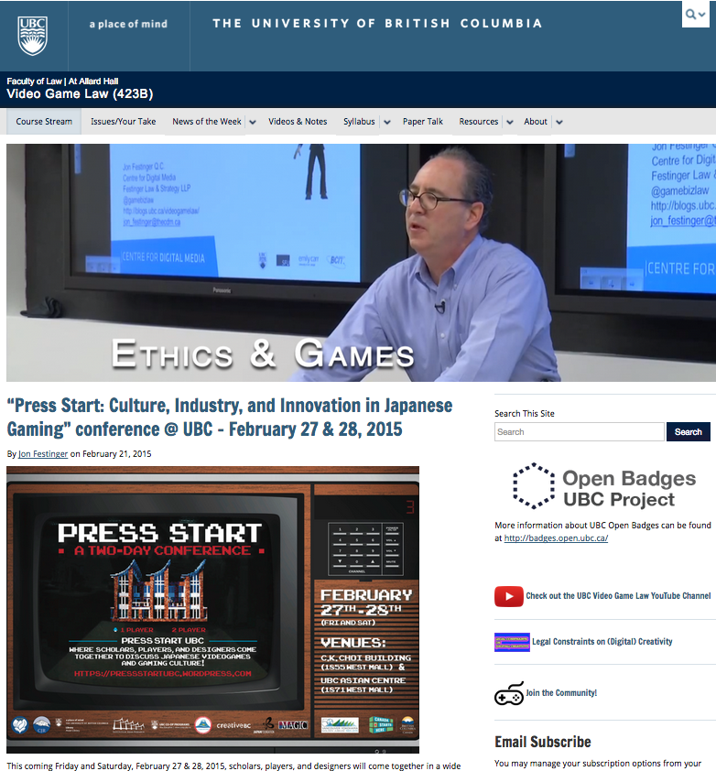
http:videogame.law.ubc.ca

Slide 43
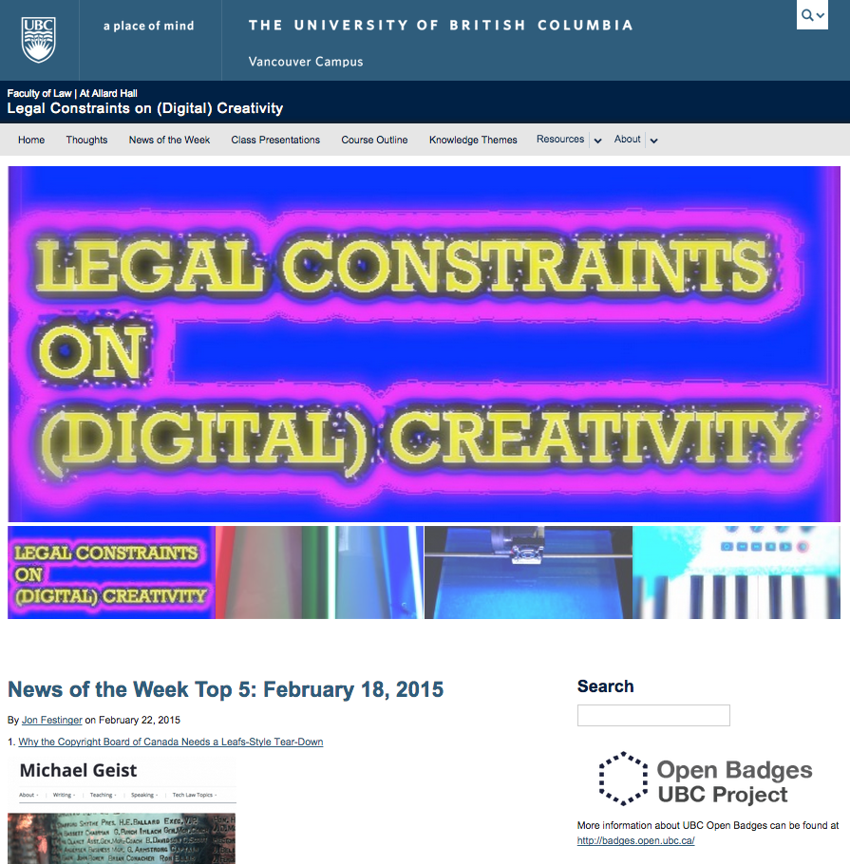
http://creativity.law.ubc.ca

Slide 44

Always include a cat picture

Slide 45
Our Academic Partners

