Slide 1


Relating Memes of
Justice & Technology
2015 TRU SLS Conference
Thursday, Feb. 5, 2015
Jon Festinger Q.C.
Centre for Digital Media
Festinger Law & Strategy
http://videogame.law.ubc.ca
@gamebizlaw
jon_festinger@thecdm.ca

Slide 2
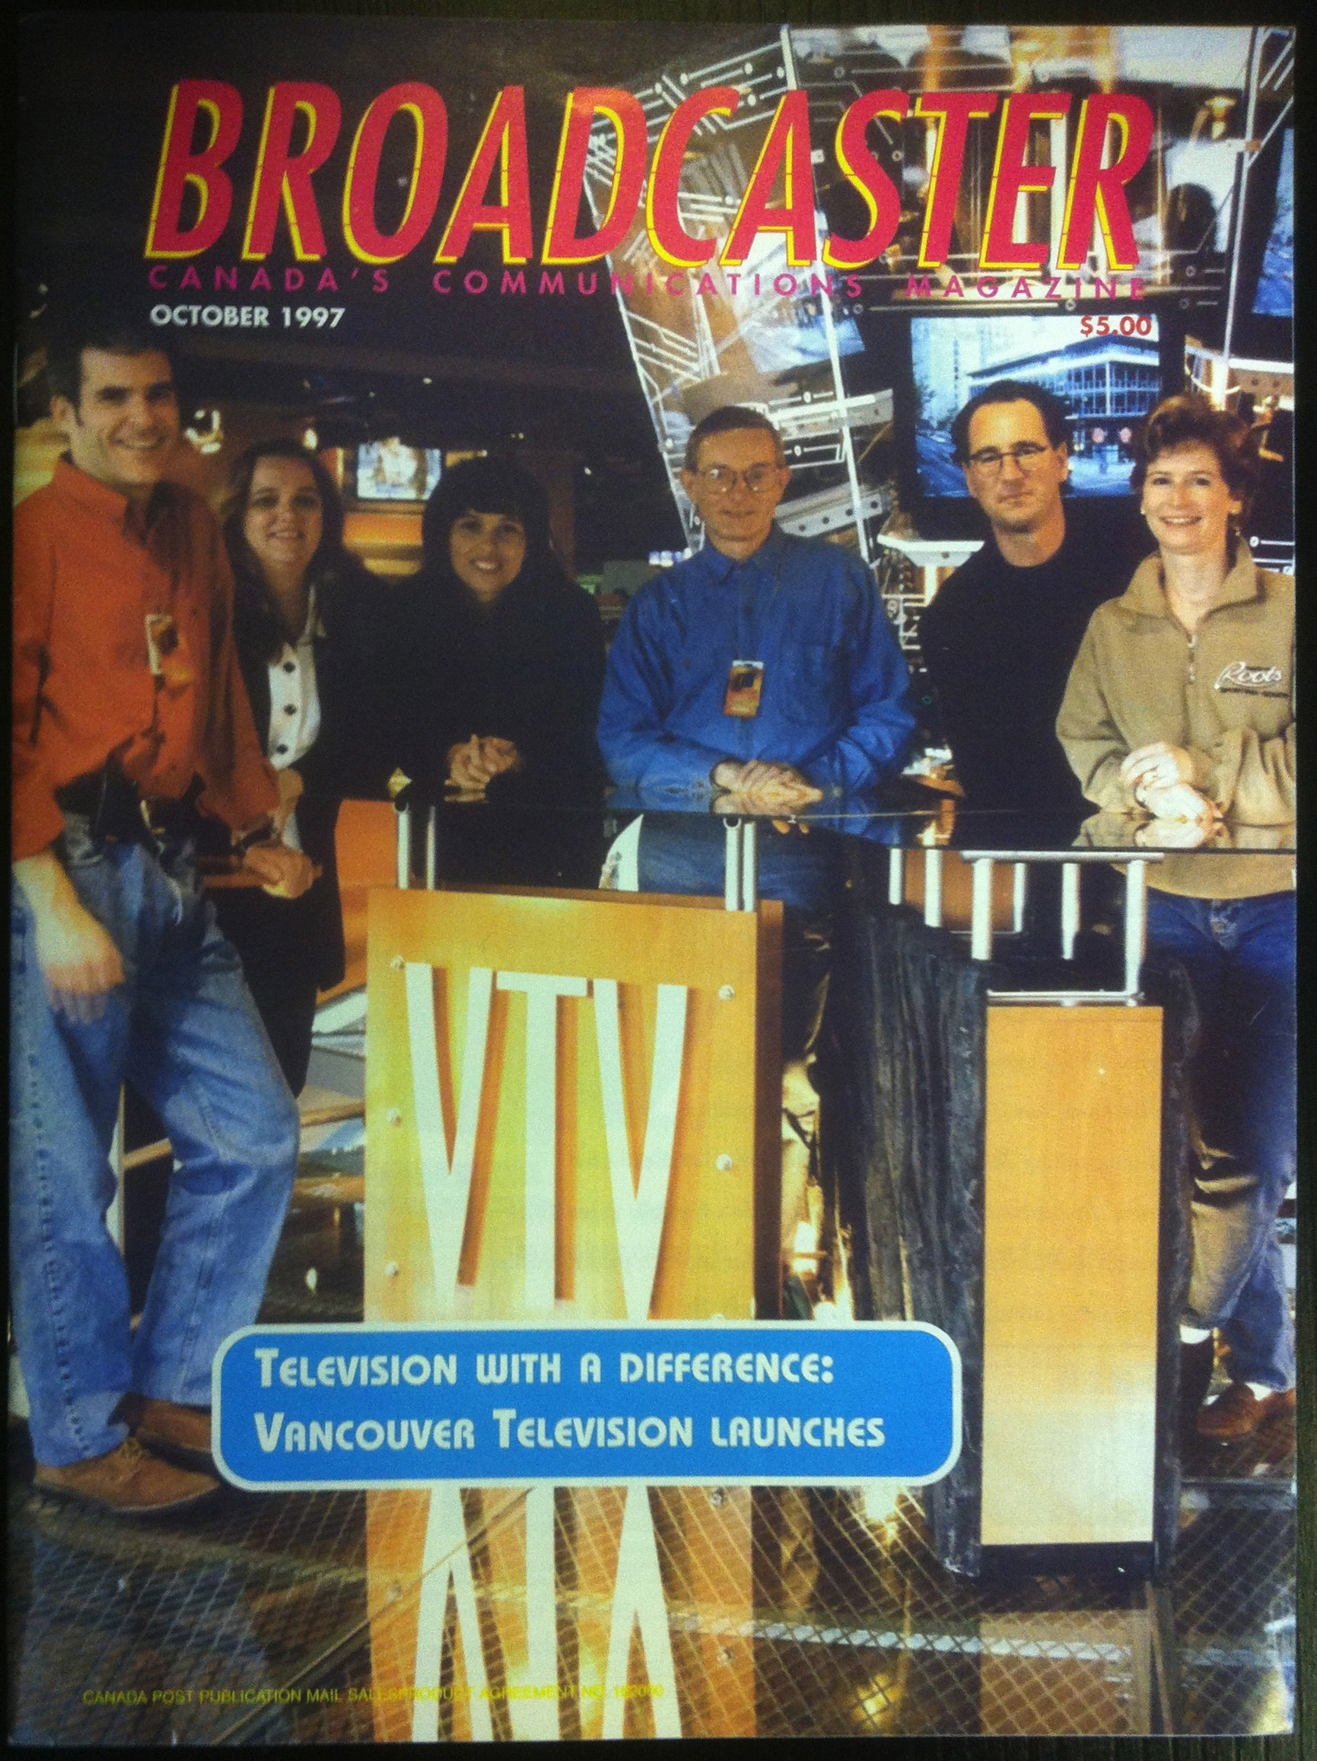
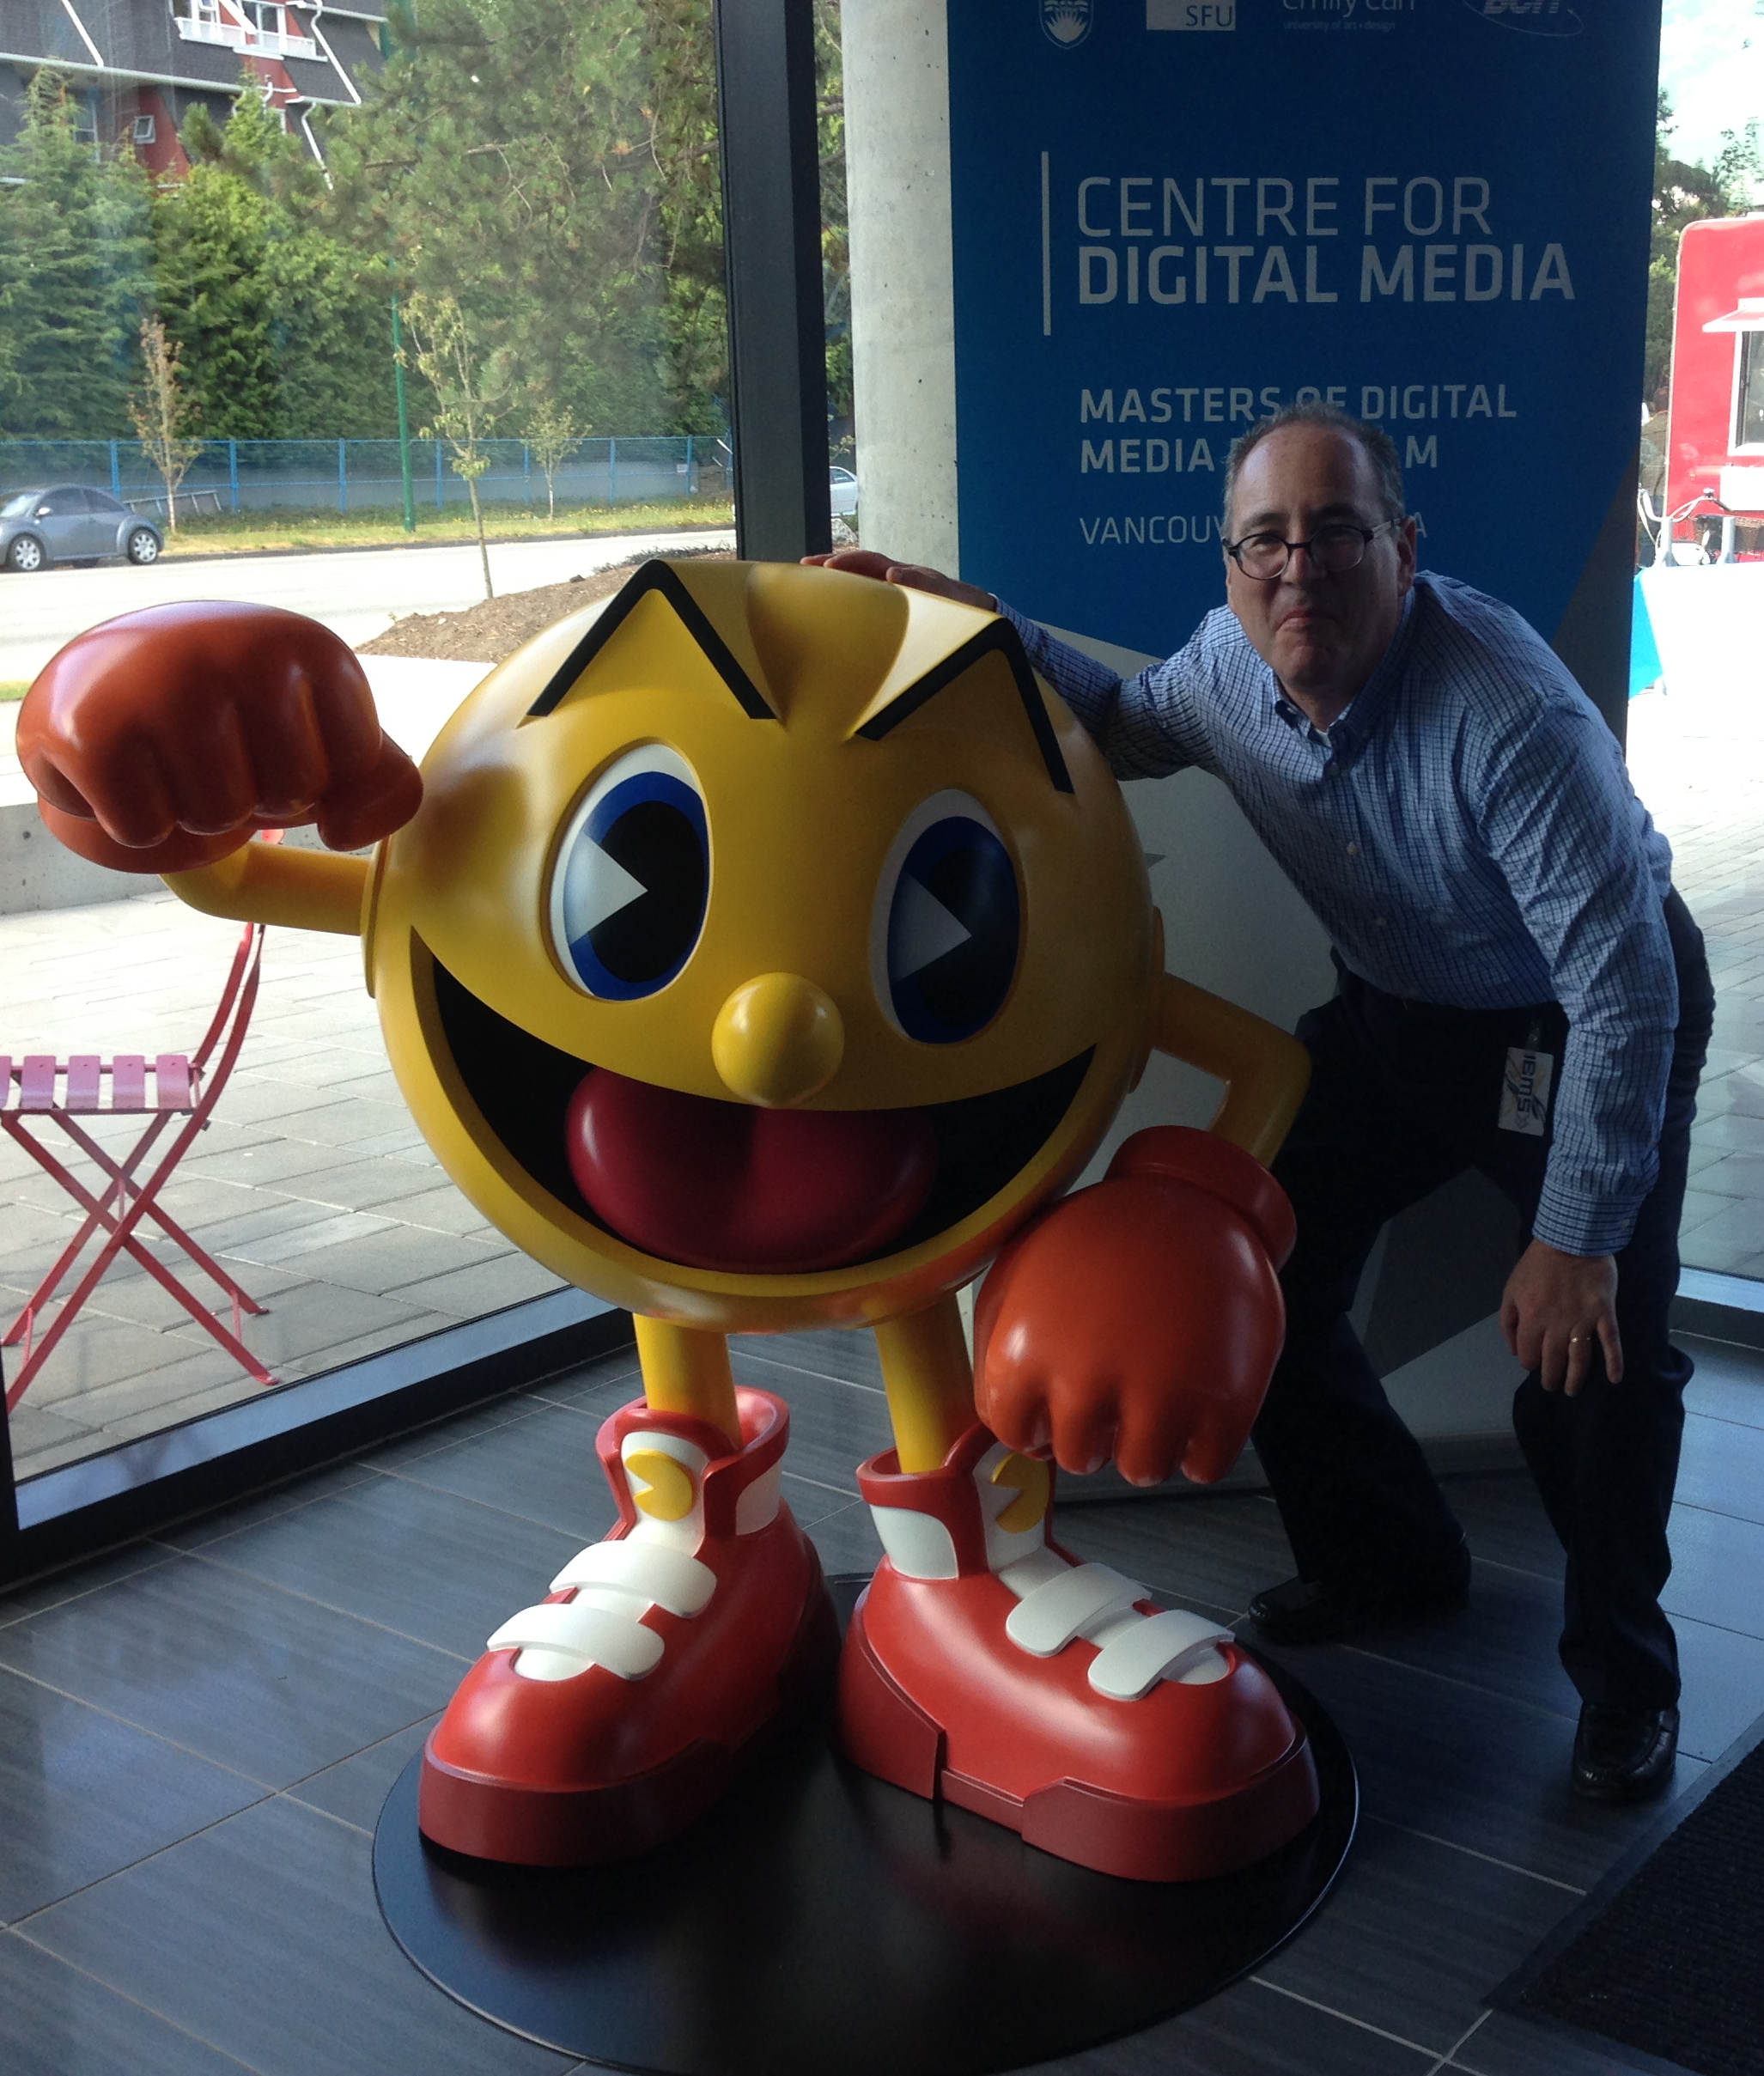
Why?

Slide 3
1. Defining the problem

Slide 4
Consider the Question
WHY DOES LAW SEEM TO RESPOND SO SLOWLY TO TECHNOLOGICAL CHANGE?

Slide 5
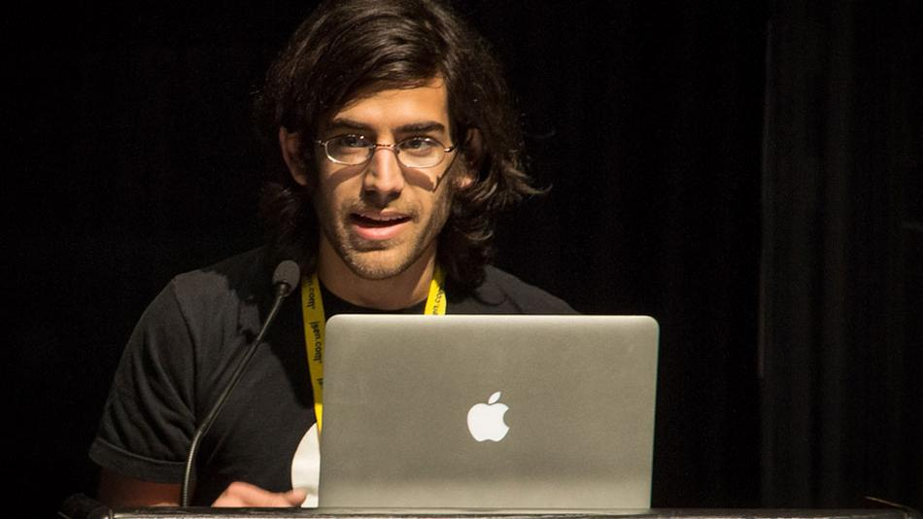
In the coming of the Digital world
the Law often seems behind,
disconnected and confused,
incapable or too slow to do
Justice..
“[s]tealing is stealing whether you use a computer command
or a crowbar, and whether you take documents, data or
dollars. It is equally harmful to the victim whether you
sell what you have stolen or give it away.”*
*The United States Attorney’s Office, District of Massachusetts, Press Release, “Alleged Hacker Charged with
Stealing over Four Million Documents from MIT Network” (19 July 2011), online:
http://www.justice.gov/usao/ma/news/2011/July/SwartzAaronPR.html>

Slide 6
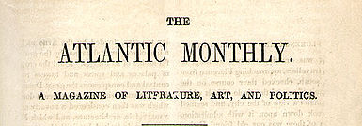

In other words…
“When Does Technology Change Enough That the Law Should Too?”
Today's lower court ruling deferred to the Supreme Court's 1979 decision, Smith v. Maryland. Should that case still matter?
REBECCA J. ROSEN
DEC 27 2013, 5:39 PM ET”
“The Atlantic” on the
constitutionality of
NSA surveillance

Slide 7

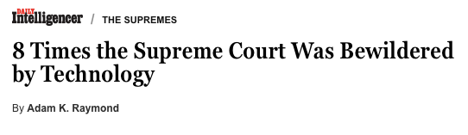

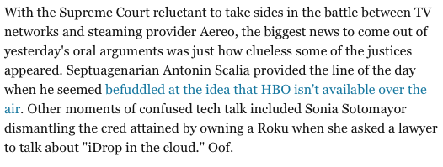
http://nymag.com/daily/intelligencer/2014/04/supreme-court-confused-technology.html

Slide 8
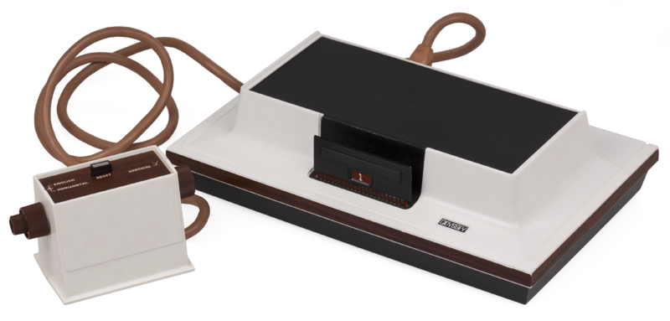

Another example…
Magnavox v. Mattel 1982 U.S. Dist. LEXIS 13773 (N.D. Ill.)

Slide 9
Creation of a meaningless
Computer Game/TV Console Divide
* Mattel argued its console was not based on ’507 but on computer prior art, Space War!
* Court noted PDP-1 was 6’ tall by 7’ wide, & cost approximately $120K. Court found for Magnavox: “…it is clear from the evidence that Mattel did not in fact follow the prior art but, instead, followed developments in the television game industry, an industry which was created because of the work done at Sanders in developing the first television games and an industry which expanded and developed and become economically viable largely because of television games which followed the teachings of the ’507 Patent.”

Slide 10
Today’s IP (Copyright) Disconnect
“I may be one of very few people in this room who actually makes his living personally by creating what these gentlemen are pleased to call “intellectual property.” I don’t regard my expression as a form of property. Property is something that can be taken from me. If I don’t have it, somebody else does.
Expression is not like that. The notion that expression is like that is entirely a consequence of taking a system of expression and transporting it around, which was necessary before there was the internet, which has the capacity to do this infinitely at almost no cost.”
John Perry Barlow, May 2011

Slide 11



Leading to Uncertainties,
Confusion & the Tech/Content Wars
“15 Technologies The Legacy Content Companies Have Sued In The Past 15 Years” http://www.techdirt.com/blog/innovation/articles/20131008/11072724796/15- technologies-legacy-content-companies-have-sued-past-15-years.shtml

Slide 12
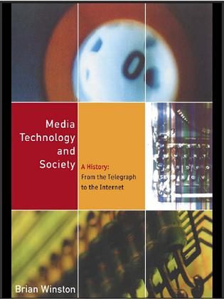
An answer?
Technologies evolve over time, with their 'invention’ mediated and controlled by society and societal factors which suppress the radical potential of any particular technology.

Slide 13
Is it what Brian Winston
(appears to) suggest
and/or the inevitable
effect of a less than
obvious cause?

Slide 14
2. Some tools & clues

Slide 15
Memes…
“Just as genes propagate themselves in the gene pool by leaping from body to body via sperms or eggs, so memes propagate themselves in the meme pool by leaping from brain to brain.”
Richard Dawkins “The Selfish Gene” (Oxford University Press 1976)

Slide 16
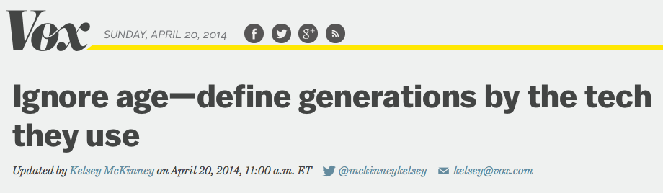
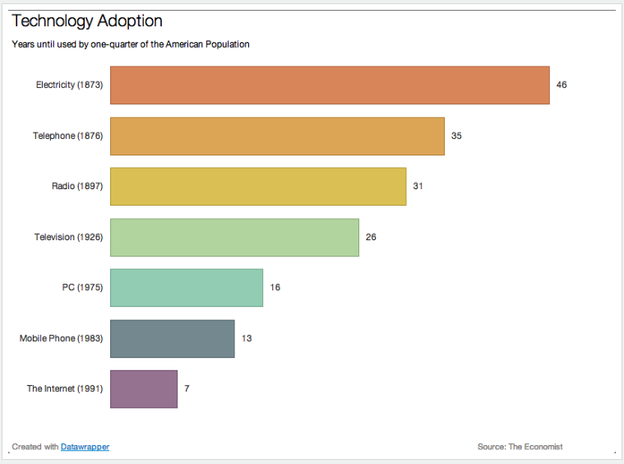
A Metaphor…

Slide 17
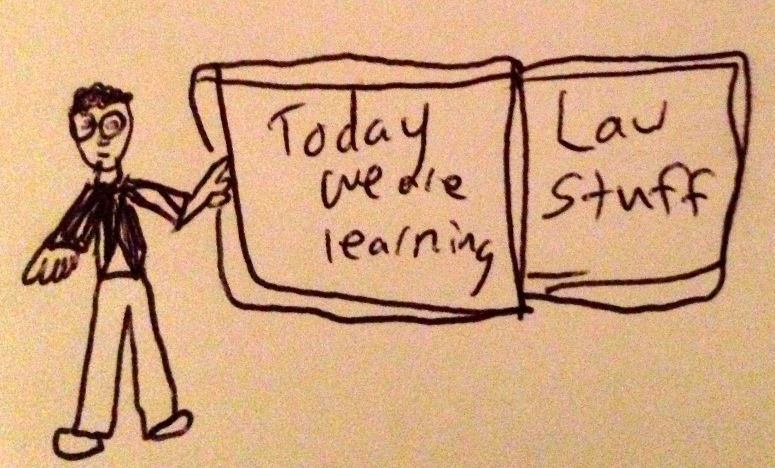
WHAT IS “JUSTICE”?
Is it Law?

Slide 18
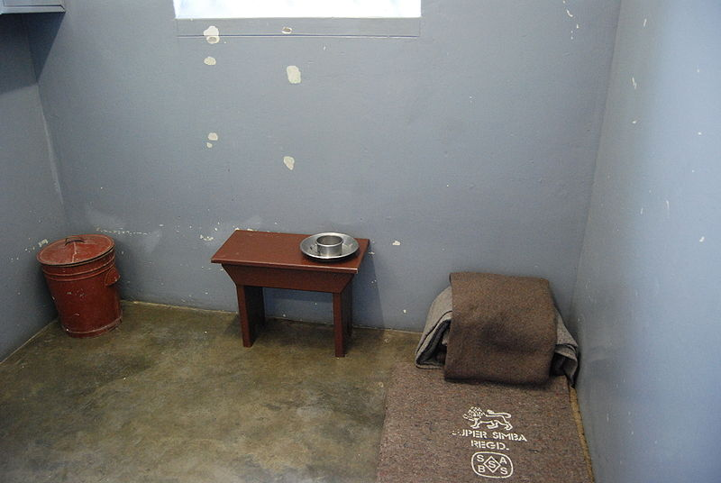
Justice Is…
Personal in
Experience,
General in
Application.
Nelson Mandela’s cell

Slide 19
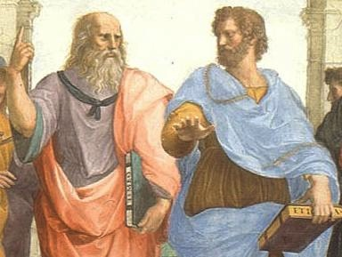


One Personal Conviction:
Ethics Before Law
Ethics Must Dictate Law;
Law Must Not Dictate Ethics;
Where Law Dictates Ethics, that is
Repression.
Unlike the chicken and an egg, we should know what comes first…

Slide 20
I.E. “Justice”
“The difficulty is that laws that attempt to enforce special forms of moral behavior breed disrespect for the law and for law-enforcing agencies among those who do not share the beliefs on which these regulations are based…
The more complex a society becomes, the more fully the law must take into account the diversity of the people who live in it. The approach to crime is not a matter for the police and the courts — or even the lawmakers — alone. It is a matter in which the whole society is involved.”
Margaret Mead (1968)

Slide 21
“It used to be said that the judges did not make law but merely declared what the law has always been. This is a view that has few, if any, adherents today…But cases are brought raising novel questions, and the judges have to answer them. Their answers will often make law, whatever answer they give, one way or another. So the judges do have a role in developing the law…”
Tom Bingham “The Rule of Law’ (Allen Lane 2010)

Slide 22

3. Originally a simple &
(academically sound) idea

Slide 23

Connecting Books?

Slide 24
Consider the possibility...
…that concepts of Law & Justice can never adequately resolve issues related to communications because…technologies have a role in proactively defining how we communicate…and therefore the future meanings of Justice & the forms Law will take.

Slide 25
In other words…
Concepts of law & justice do not shape communications technologies nearly as much as they are shaped by the memes, concepts and meanings arising from communications technologies.

Slide 26
Put Another Way…
Communication tools iteratively alter and shape how and what we communicate, including (over time) how we formulate ethical concerns and legal frameworks…

Slide 27

Point is IT WILL ALL WORK OUT
Communication tools iteratively alter and shape how and what we communicate, including (over time), how we formulate ethical concerns and legal frameworks…

Slide 28



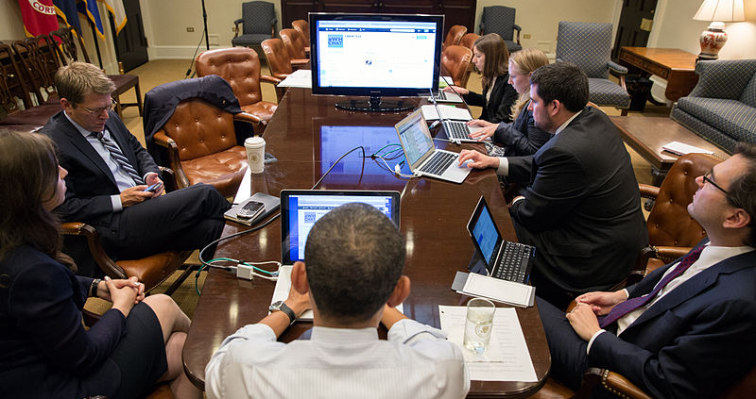
Communications technologies
often are disruptive …
Why would they not disrupt
concepts of justice?

Slide 29
4. An Explanation

Slide 30
Technology /Justice (Parallels)?
Before Justice was Revenge
1. Pre-literate => Justice as Retribution
2. Writing Instruments =>Justice as Compensation
3. Printing Press => Justice as Rights
4. Mass Media => Justice as Truth
5. Digital => Justice as Resolution
6. Big Data=>Justice as (Individual) Boundaries
7. Virtual reality => Freedom of Thought

Slide 31
Not Mutually Exclusive Phases…
Might work as suggested in:
D.L Shaw, “The Rise and Fall of American Mass Media: Roles of Technology and Leadership”, April 1991 “Roy W. Howard Lecture” Indiana University.
“No medium, once it has lost it’s dominant position has ever returned to the top”
Accordingly all forms of justice are present in some form even if superseded.

Slide 32
Not Only Memes of Justice…
Similar exercise can be tried with:
Technology & Education
Technology & Science
Technology & Politics
Technology & Communication
Technology & Media
Technology & Language
Technology & Philanthropy
Technology & Religion
Technology & Social Relationships
&…

Slide 33
5. It has always been thus…

Slide 34
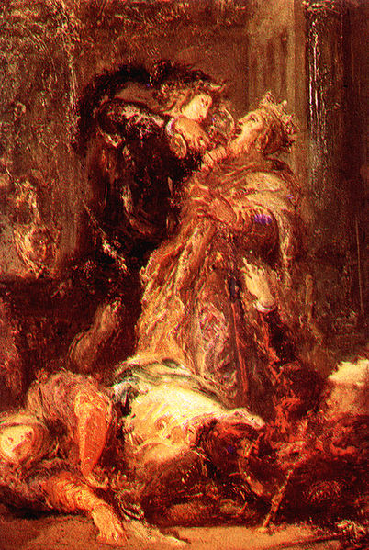
Before Justice was Revenge
“Revenge is a kind of wild
justice, which the more a man's
nature runs to, the more ought
law to weed it out.” - Francis
Bacon
“Haste me to know’t, that I,
with wings as swift
As meditation or the thoughts
of love,
May sweep to my revenge”
HAMLET (1.5.7)

Slide 35
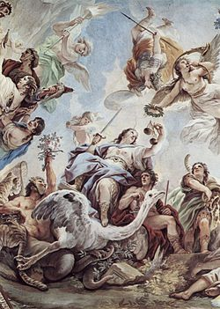
Anthropology of Justice
“So you might say that ancient theories of
justice start with virtue, while modern
theories start with freedom”
“Justice: What’s the Right Thing To Do”
@ p.9, Michael Sandel

Slide 36
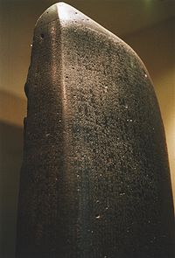
1. Pre-literate => Justice as Retribution
Speculation that Code of Hammurabi (Babylonia
1172 B.C.) imposed “eye for an eye”
punishments to limit uncontrolled revenge as
the prevailing principle.
* “Let the punishment fit the crime”
* Actually a limitation on
unlimited revenge though
we see it as barbaric today.
* Code of Hammurabi (1900 B.C.)
was a non-binding restatement
of Principles*
* Related to trial by ordeal?
* Driver and Miles via L. Festinger @ p.156 “The Human Legacy”

Slide 37
“An Eye For An Eye”
"And a man who inflicts an injury upon
his fellow man just as he did, so shall
be done to him [namely,] fracture for
fracture, eye for eye, tooth for tooth.
Just as he inflicted an injury upon a
person, so shall it be inflicted upon
him”
Leviticus 24:19-21
“An eye for an eye only ends up making
the whole world blind.”
Mahatma Gandhi

Slide 38

2. Writing Instruments => Justice as
Compensation
Law of Æthelberht
(early 7th
century) first
Germanic-language
law code sets out
compensations for
loss caused by
others.

Slide 39
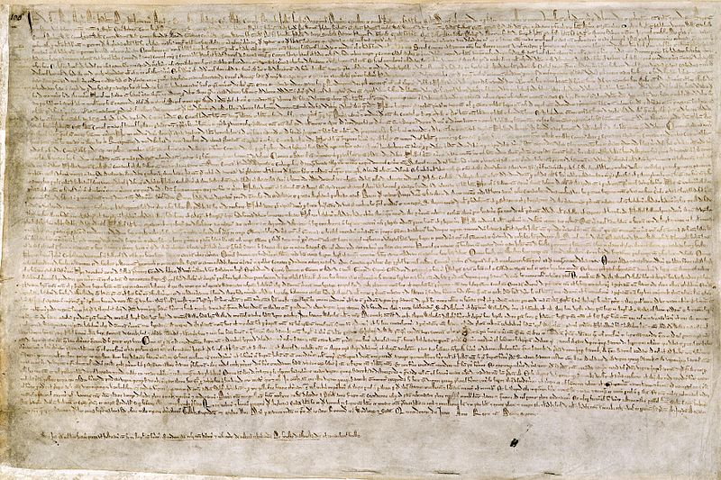
Moving towards Justice as Rights
*The Magna Carta
Limiting King’s
arbitrary
powers.
Established
principle of no
punishment
except by law.

Slide 40
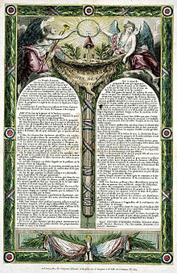
3. Printing Press => Justice as Rights
Fascinating transition from Justice as a privileged right…
To Justice as egalitarian
right.
From “Declaration of the
Rights of Man and of the
Citizen” 1789…
to “Declaration of the
Rights of Man and Citizen”
1793.

Slide 41
4. Mass Media => Justice as (search for) Truth
Symptom: Huge increase in size of trials, discovery, documents & process.
Motivation: Evidence/facts as truth/justice (as opposed to reason, argument & persuasion yielding justice).
Result: 1. What could be “seen” more
important then what is believed
2. Bigger became “better”
Observation: All of the above happened
first in media, then in law.
Big Media/Big Law?

Slide 42
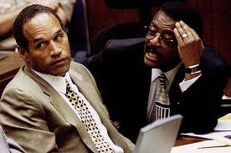
Mass Media → → → → → →
Justice as (search for) Truth

Slide 43
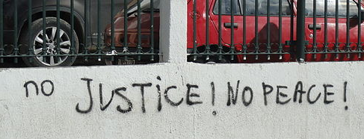
5. Digital => Justice as Resolution
Mediation/Arbitration
Truth & Reconciliation Commissions
“Peace is Justice”???

Slide 44
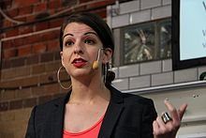

6. Big Data → Justice as Boundaries
Harassment/Privacy test is “reasonable expectation of..”
Similar to “user’s rights” in SCC pentalogy – Abella J. for the majority in “Access Copyright” case 2012 SCC 37
“…fair dealing is a “user’s right”, and the relevant perspective when considering whether the dealing is for an allowable purpose…is that of the user…”

Slide 45

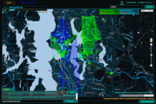
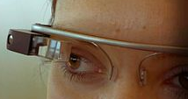
7. Virtual reality => Freedom of Thought
The Future is “Telepathic”

Slide 46
6. Implications

Slide 47
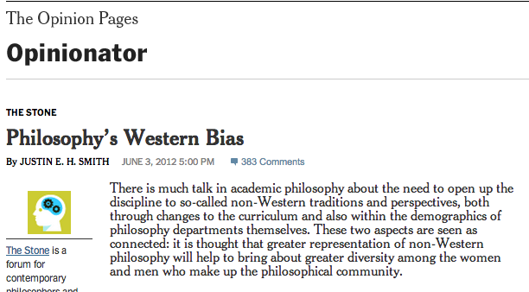
Self Critique
1. Hopelessly “Western”?

Slide 48
2. Beware:
Technological Determinism
“Technological determinism is a reductionist theory that presumes that a society's technology drives the development of its social structure and cultural values.”
(Wikipedia)

Slide 49
For Law
(& Legal Education)?
If indeed the evolution of justice is not “random” but (predictably) ongoing…If indeed justice is necessarily always catching up to the means of communication. Then “progressive” lawyering may not be flight of fancy but a practical necessity. If true then it becomes in fact the task of the lawyer to progress the law. Accordingly both academic and clinical approaches are necessary and work together.

Slide 50


A MATTER OF PERSPECTIVE

Slide 51
Thanks to:
Professor Joel Bakan, UBC Faculty of Law;
Professor Ryan Calo, University of Washington School of Law
Dr. Joe McIntyre, TRU Faculty of Law;
Dr. Richard Smith, Centre for Digital Media/SFU;
…for ideas, sources and inspiration.

Slide 52

Always include a cat picture

Slide 53
Our Academic Partners

