Slide 1
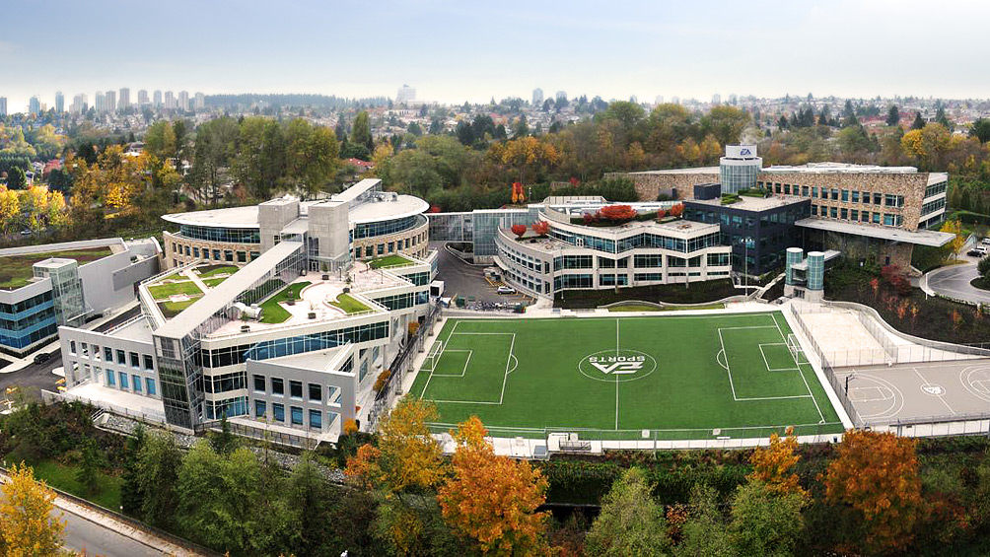
I have L:\Nadine
L:\Nadine

Slide 2
AGENDA
INTRODUCTION – EA AND BRIAN
VIDEO GAME LAWYER – AN EXPANDED DEFINITION!
QUESTIONS
Key theme – what you will cover in this class is actually a narrow slice of what legal does to support video game production

Slide 3
ABOUT EA
Founded in 1982
1991 merged with Distinctive Software (Burnaby Based company)
Global Headquarters is Redwood City, California
Last year reported 3.6 Billion in GAAP Net Revenue
Approximately 8500 full and part time employees
Studio locations are scattered around the globe

Slide 4
EA AND CANADA
Operate in 5 Provinces – BC, AB, ONT, QUE and PEI
Have over 2000 full time employees
Burnaby Studio is one of the largest game development studios in the world
Locally developed titles include FIFA; NHL; UFC and Plants v. Zombies Garden Warfare

Slide 5
WHAT BRIAN DOES ALL DAY
*As imagined by my family, friends, neighbours, and former law firm friends

Slide 6
WHAT BRIAN DOES ALL DAY

Slide 7
LEGAL NEEDS …
Video Game companies … are … companies
The legal needs of EA are in many respects no different than those at any large, publicly traded, multi-national corporation
Being a “video game lawyer” can mean many things …

Slide 8
Groups that make up EA Legal worldwide
EA Legal
IP Team
Global Compliance Team
Employment Law Team
Privacy Team
Mergers &
Acquisitions Team
Stock Administration
Team
Corporate Services Team
Immigration
Development Team

Slide 9
IP Team
Patents, Trademarks, IP Enforcement Issues, IP related litigation, Patent Infringement, Copyright Infringement
Trademark clearances
Launch readiness
Beta launches
Final product review
Promotional partnerships
Credits, notices, disclaimers
Content clearance (including UGC, employee performances)
Marketing and advertising material review
Promotions and promotional offers
Contests and sweepstakes (rules and materials; internal and external)
Copyright registrations
Permission requests

Slide 10
Development Teams
Typically a transactional lawyer and a IP Team member are partnered with each game development team
Draft, review, negotiate and interpret; technology licenses; sports league and athlete endorsements; third-party product development agreements; content licenses; marketing/promotion agreements; consulting agreements; and the list goes on …
In Canada the Transaction Team works with the following key franchises:
NHL, NBA, FIFA, UFC; Mass Effect; Dragon Age

Slide 11
Privacy Team Provide privacy policy compliance and data protection guidelines
This is rapidly becoming a major part of the legal team’s role within EA – focused on securing an protecting consumer information but also includes other types of data – employee data; confidential information; unauthorized system access
Privacy breaches or lapses can have devastating consequences for the business and the ability to provide rapid and accurate advice is critical
Happens in every industry - Sony’s PlayStation Network 2011 for gaming related issues

Slide 12
Employment Law Team
Closely partnered with EA’s HR organization to help manage all aspects of the employment life cycle
Hiring Employees
Managing Employees
Terminating Employees
Create and manage employment policies, conduct training and education, manage investigations and employment litigation

Slide 13
Global Compliance Team
Global Code of Conduct
Conflict of Interest Issues
Anti-Bribery and Anti-Corruption Training and Education
Export Control Laws
Anti-Harassment and Anti-Bullying Training and Education

Slide 14
Corporate Services Team
Support is provided to all EA Corporate Groups, including Corporate Services, Facilities (includes Real Estate), Finance, IT, Operations; and Retail Sales

Slide 15
Stock Administration Team
Responsible for processing stock option and ESPP transactions, SEC compliance including stock reporting and reconciliation.
Mergers & Acquisitions Team
Advice and counsel with respect to EA’s acquisitions, investments and other strategic corporate transactions.
Key acquisitions:
BioWare – 2008
PopCap – 2011
2 Strategtic Canadian acquisitions in PEI in 2011 and 2012

Slide 16
Immigration
EA sources and recruits top talent world wide
At any given time in Burnaby as many as 400+ employees will be foreign nationals working under work permits and/or actively seeking permanent residence status
The ability to easily access talent from abroad is critical and can often determine whether products are developed here or not
In Canada EA employs a full time Immigration lawyer to manage this function

Slide 17
Litigation
Primarily IP Litigation – Patent Trolls
Not generally a Canadian issue
Other

Slide 18
The bottom line…
Being a video game lawyer covers the entire legal spectrum – there is a need for just about every type of lawyer …

Slide 19
QUESTIONS?

