Slide 1


Frictions & Fictions: Consumer Contracts & Creative Constraints
Talk 6
Part B “Connecting”
Video Game Law - Fall 2015
UBC Law @ Allard Hall
Jon Festinger Q.C.
Centre for Digital Media
Festinger Law & Strategy
http://videogame.law.ubc.ca
@gamebizlaw
jon_festinger@thecdm.ca

Slide 2
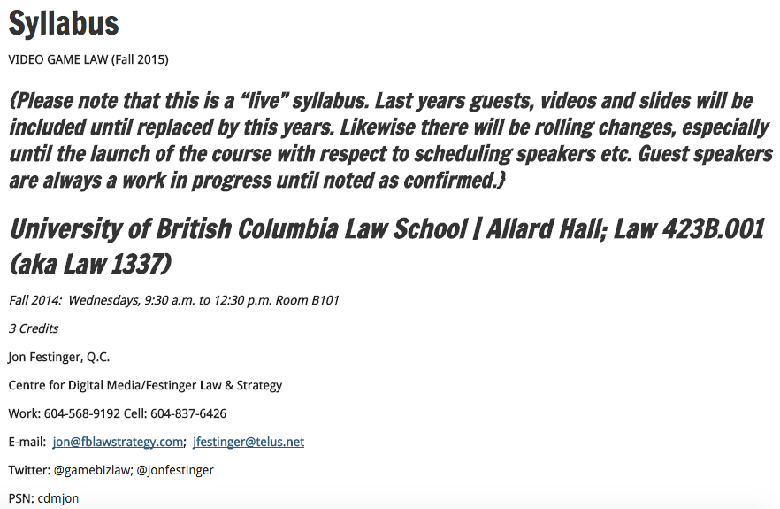
Housekeeping (+ more on way)

Slide 3
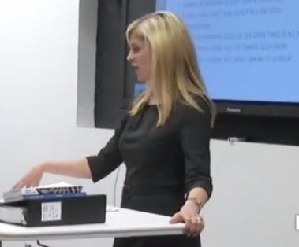
Remembrance Day
Wednesday Nov. 11
Jennifer Lloyd Kelly (Fenwick &
West) Wednesday Nov. 18

Slide 4
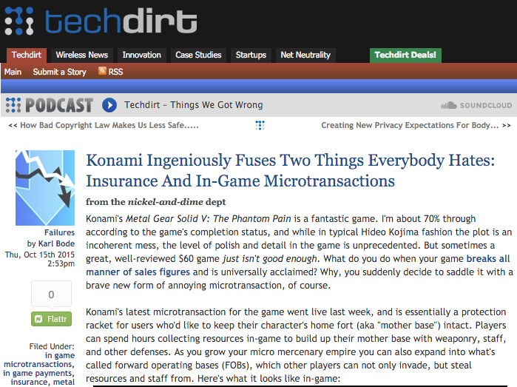
Follow up to Mavis Dixon
https://www.techdirt.com/articles/20151007/10540632468/konami-ingeniously-fuses-two-things-everybody-hates-insurance-in-game-microtransactions.shtml

Slide 5

& rather frighteningly…
https://www.privateinternetaccess.com/blog/2015/10/in-china-your-credit-score-is-now-affected-by-your-political-opinions-and-your-friends-political-opinions/

Slide 6

Now Back to Our Regularly Scheduled Programming…

Slide 7
Post-Structuralist Redux
Because in the dynamic of contract law is (perhaps) inherently post-structuralist…

Slide 8
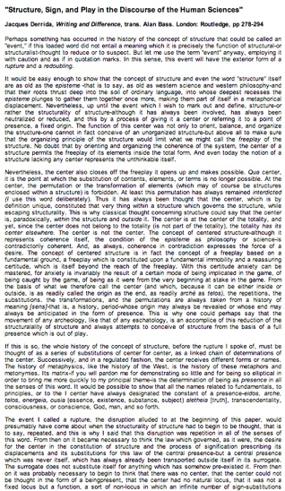
Video-Games as Post-Structuralism
"Structure, Sign, and Play in the Discourse of the Human Sciences” Jacques Derrida
Structures as free-floating (or 'playing') sets of relationships. Structuralist discourses unfortunately hold on to a "center” which anchors the structure and “does not play”.
http://hydra.humanities.uci.edu/Derrida/sign-play.html

Slide 9
Decentralizing Author & Replacing Them With Reader
=
Decentralizing Developer & Replacing Them With Gamer

Slide 10
Video Games as
Post-Structuralist
Real question is what are the legal implication of this?

Slide 11
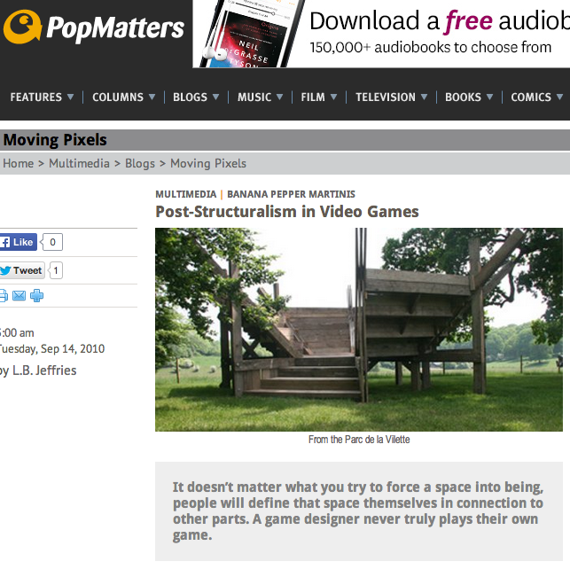
http://www.popmatters.com/post/130849-post-structuralism-in-video-games/

Slide 12
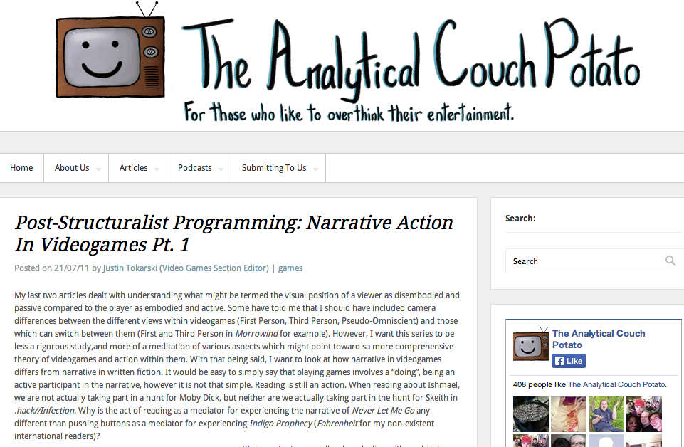
http://theanalyticalcouchpotato.org/wp/post-structuralist-programming-narrative-action-in-videogames-pt-1/
“Post-structuralism with respect to narratology can be said to focus on decentralization of the author and the replacement of them with the reader. What this means is that authorial intent is not the primary goal of a textual or narrative analysis of a work.”

Slide 13
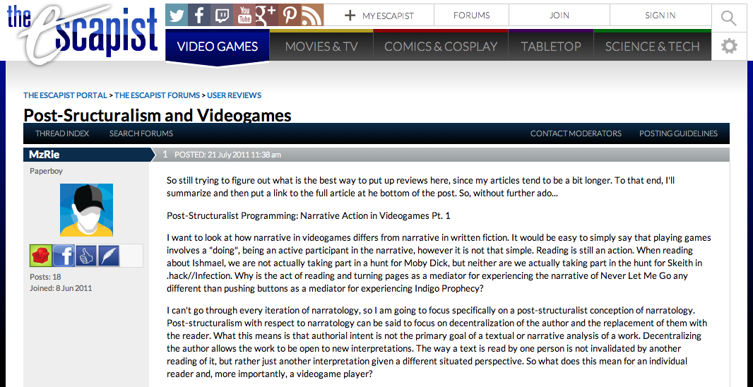
http://www.escapistmagazine.com/forums/read/326.302015-Post-Sructuralism-and-Videogames

Slide 14
From “Post-Structuralism and Videogames”
“Post-structuralism with respect to narratology can be said to focus on decentralization of the author and the replacement of them with the reader. What this means is that authorial intent is not the primary goal of a textual or narrative analysis of a work. Decentralizing the author allows the work to be open to new interpretations. The way a text is read by one person is not invalidated by another reading of it, but rather just another interpretation given a different situated perspective. So what does this mean for an individual reader and, more importantly, a videogame player?”

Slide 15


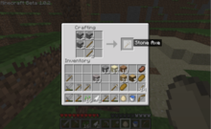



Meaning…
When you look at a video game it is not about what the developer intended…it’s about what the player does…

Slide 16
Boyden
“In all of these situations, the owners of a copyright in a form, description, or set of instructions were attempting to extend their copyright to material for which the user of the work provided the essential content, not its author. That is what made them systems. They were, without that input, empty shells, waiting to be filled.”
“Games are systems in exactly the same way. A game, as sold, is only a game form; the content necessary for an instance of the game comes from the players. That is, the game form establishes the environment for play—the game space—and it defines permissible moves and the conditions for winning or drawing. But the game itself is supplied by the players.”
“Systems are shells into which users pour meaning. While they may contain expression themselves, that expression is there merely to facilitate the meaning added by the user.”

Slide 17
Post-Structuralist Concepts
Massively Multiplayer
Open World Playground
Content Creation Tools
Cooperative Mode
Public Gameplay Mode
Remote Play
Dynamic Gameplay Engine
WorldEditor (WED)
Scennery & Character Generators
A.I.

Slide 18
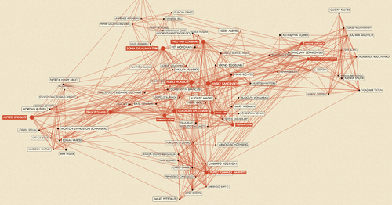
Post-Structuralist Proof?
For the exhibition “Inventing Abstraction 1910-1925” MoMA mapped how different abstract artists influenced each other http://exp.lore.com/post/41877532653/for-the-exhibition-inventing-abstraction

Slide 19

What are the legal implication of video-games being post stucturalist?
A (correct) ethical model informs what the better legal/policy choices might be?
We ought to be able to identify legal principles/solutions that are congruent/aligned with the ethical model.

Slide 20

…and now…
the Legal Fly
in the Copyright
Ointment

Slide 21

EULA’s, ToS & the Post (apocalyptic) IP World

Slide 22

Are we already IN THE POST IP WORLD?
In todays world….In real terms….Is it possible that…
IP has become VIRTUALLY* MEANINGLESS?
mean·ing·less/ˈmēniNGlis/
Adjective: Having no meaning or significance.
Having no purpose or reason.
Synonyms: pointless - senseless - unmeaning - insignificant – inane
*no pun intended

Slide 23

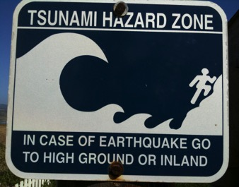
IP Law Swept Away By?
Privity of Contract; AKA Licensing Agreements (EULA’s, ToS etc.)
Privacy Agreements
Broadcast & Telecom Regulation
Competition/Anti -Trust Law
Consumer Protection
Fair Use/Dealing (SCC)

Slide 24
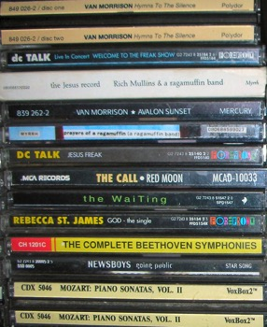

A Question….
Why no EULA when you store-buy an album
but EULA when you buy the same
album on iTunes???

Slide 25

Some reasons…
1: Evolution of Software:
Licensing grew out of the early computer software consulting (e.g. enterprise accounting)…never intended for mass entertainment. Originally motivated by “sovereignty”?
2: Slicing & Dicing IP:
*IP is infinitely slice-able & dice-able: Allows for rights to be given based on geography, time, character of right AND any other variable you can think of. As long as rights are NOT DUPLICATED
* “You may copy this work only in Moncton N.B. between 7 & 9 P.M. on the 2nd Tuesday of every odd numbered month and only distribute it for $346 per copy between 8 & 10 AM on the 1st Monday of every even month in Detroit Michigan.”
Note: EA for years followed the CD model…no EULA…just Copyright Law default….Online seemed to galvanize the industry to licensing by contract EXCLUSIVELY….

Slide 26

Result: All of which makes IP...
….very, very CONTRACT FRIENDLY.
And thus we get → → →
End User License Agreements & Terms of Service & all the rest…

Slide 27
Related Issue 1:
The chasm of contracting out
No one reads EULA’s, ToS’s & Privacy Policies:
“To Read All Of The Privacy Policies You Encounter, You’d Need to Take A Month Off From Work Every Year”http://www.techdirt.com/articles/20120420/10560418585/to-read-all-privacy-policies-you-encounter-youd-need-to-take-month-off-work-each-year.shtml
@gamerlaw: Amazing study by @nyulaw: "overall average rate of readership of EULAs is on the order of 0.1 percent to1 percent” http://t.co/DFcF0mx0
For review of “click-wrap” authorities see: Century 21 v. Rogers Communications 2011BCSC 1196 (upholding ToU) http://canlii.ca/en/bc/bcsc/doc/2011/2011bcsc1196/2011bcsc1196.html

Slide 28
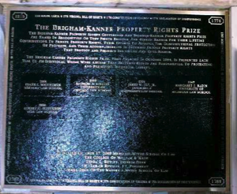
Re EULA’s etc.
“Boilerplate: The Fine Print, Vanishing
Rights, and the Rule of Law”
Princeton University Press
Margaret Jane Radin, Henry King Ransom Professor
of Law at the University of Michigan and the William
Benjamin Scott and Luna M. Scott Professor of Law,
emerita, at Stanford University

Slide 29
The Issue Stated
“Should We Allow the Overleveraging of IP Rights By Contract?”
http://ipkitten.blogspot.ca/2012/09/should-we-allow-overleveraging-of-ip.html
“Less appreciated, however, is the asymmetry that is created between the scope of the proprietary obligations that exist by virtue of the IP right and the potentially broader scope of contractual obligations that may be created under the licence, subject only to agreement by the two parties. Against that backdrop, an interesting question arises: how do we treat a contractual obligation that exceeds the scope of the IP right being licensed? ”

Slide 30
Insidious Results?
Censorship controls effectively delegated to private interests (without free speech/expression overrides).
* “Apple rejects game based on Syrian civil war” http://killscreendaily.com/articles/news/apple-rejects-game-based-syrian-civil-war/
* “iOS games chafe under Apple's directions: 'If you want to criticize a religion, write a book’” http://www.theverge.com/2013/1/16/3879194/apple-app-store-guidelines-tell-game-developers-to-avoid-serious-themes
* “Turns Out Sexist Talk on Xbox Live Won't Earn You a Lifetime Ban” – but racist talk will. http://www.gamepolitics.com/2012/11/07/turns-out-sexist-talk-xbox-live-wont-earn-you-lifetime-ban#.URsttVpAR3c
* & less insidiously: “Blizzard Bans 'Several Thousand' Diablo III Players for Cheating” – using bots (would “Notice” do?)
http://gamepolitics.com/2012/12/19/blizzard-bans-several-thousand-diablo-iii-players-cheating#.URswDFpAR3c

Slide 31
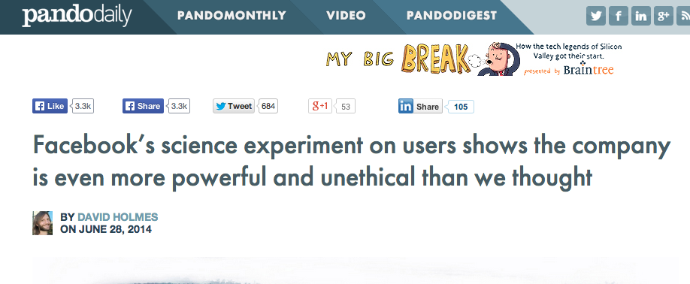
Some very poor judgment
…care of Facebook
http://pando.com/2014/06/28/facebooks-science-experiment-on-users-shows-the-company-is-more-even-powerful-and-unethical-than-we-thought/

Slide 32
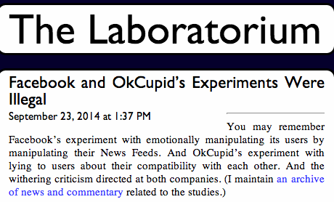
http://laboratorium.net/archive/2014/09/23/facebook_and_okcupids_experiments_were_illegal

Slide 33
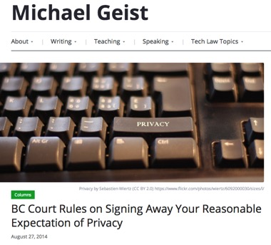
R. v. Godbut – Recipient of courier package deemed not to have “reasonable expectation of privacy” where courier company opens a package that had illegal drugs and then alerted RCMP. Reason was courier company’s contractual terms, which said “without notice, DHL may, at its sole discretion, open and inspect any shipment and its contents at any time. Customs authorities, or other governmental authorities, may also open and inspect any shipment and its contents at any time.” Only problem was that Godbut as recipient of the package was not a party to the contract.

Slide 34
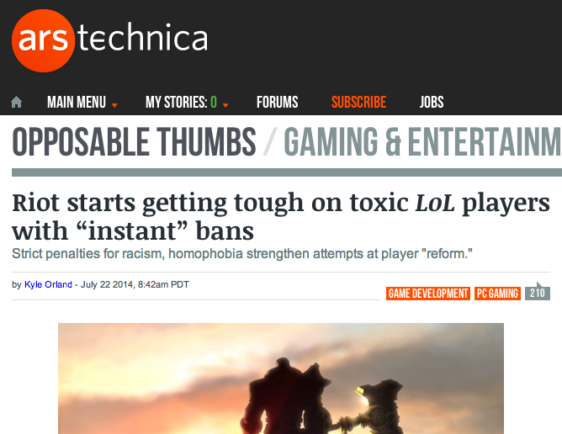
On the + side
http://arstechnica.com/gaming/2014/07/riot-starts-getting-tough-on-toxic-players-with-instant-bans/

Slide 35

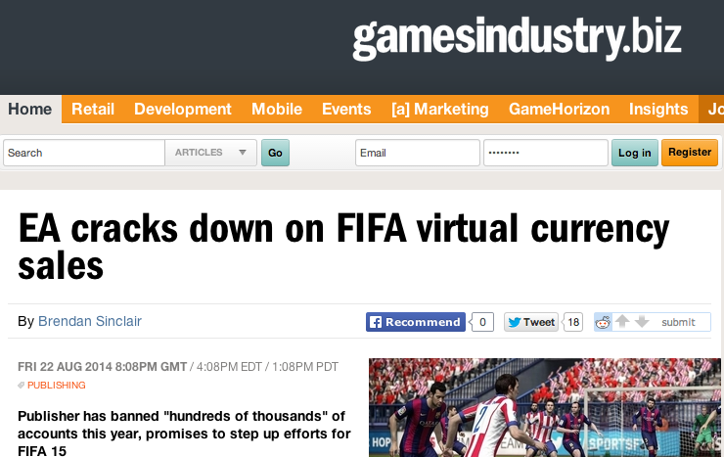
http://www.gamesindustry.biz/articles/2014-08-22-ea-cracks-down-on-fifa-virtual-currency-sales

Slide 36
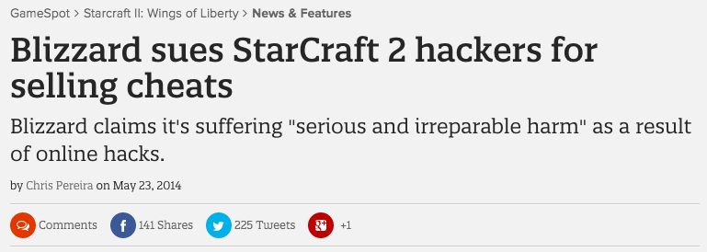
http://www.gamespot.com/articles/blizzard-sues-starcraft-2-hackers-for-selling-cheats/1100-6419854/

Slide 37

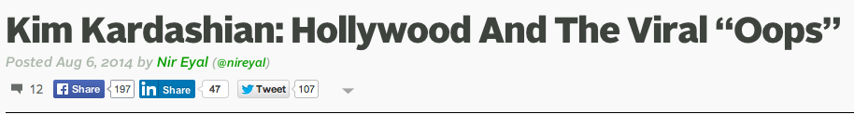
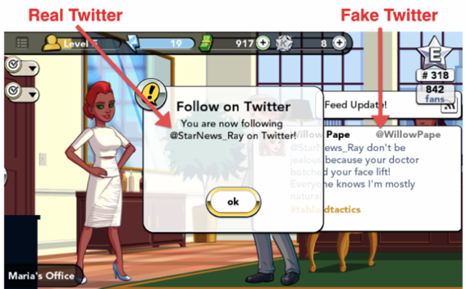

Slide 38

Related Issue: Digital re-sale
First Sale Doctrine v. EULA prohibition of re-sale
First Sale Doctrine limits right of copyright holder – enables distribution chain of reselling books, CD’s etc.
BUT how does it apply to the digital world?
“EU court rules it's legal to resell digital games, software” http://www.joystiq.com/2012/07/03/eu-court-rules-its-legal-to-resell-digital-games-software/
“A Setback for Resellers of Digital Products” http://www.nytimes.com/2013/04/02/business/media/redigi-loses-suit-over-reselling-of-digital-music.html?_r=0
Capitol Records, LLC v. ReDigi Inc.
(being appealed)

Slide 39
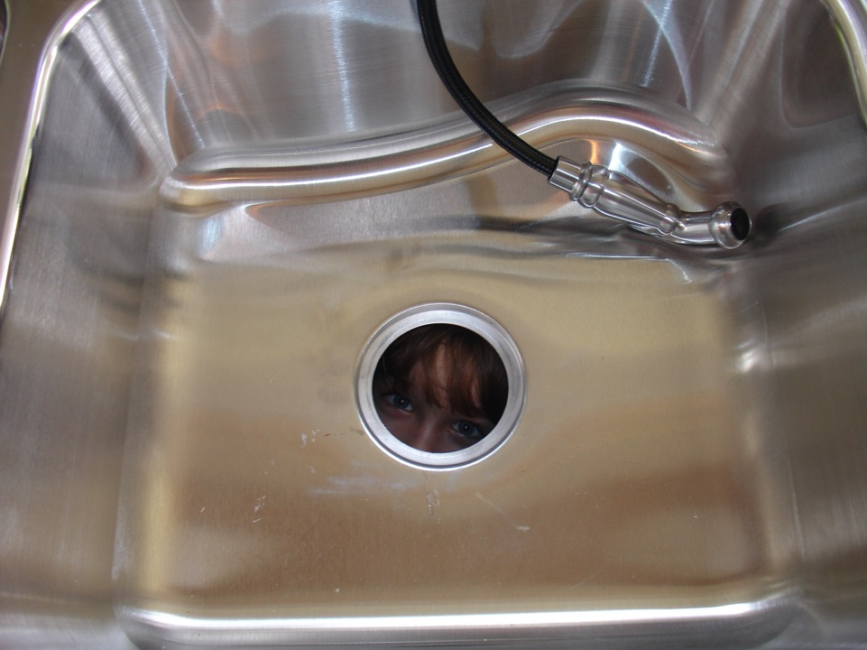
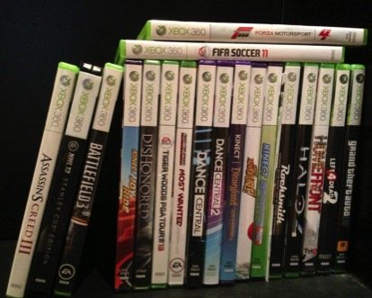
Related Issue:
The “kitchen sink” effect
“You may not purchase, sell, gift or trade any Account, or offer to purchase, sell, gift or trade any Account, and any such attempt shall be null and void. Blizzard owns, has licensed, or otherwise has rights to all of the content that appears in the Game. You agree that you have no right or title in or to any such content, including without limitation the virtual goods or currency appearing or originating in the Game, or any other attributes associated with any Account. Blizzard does not recognize any purported transfers of virtual property executed outside of the Game, or the purported sale, gift or trade in the “real world” of anything that appears or originates in the Game. Accordingly, you may not sell in-game items or currency for “real” money, or exchange those items or currency for value outside of the Game.”

Slide 40



Related Issue: Death
What happens to your digital library of games when you die?
Real library is bequeathed as property…digital property tends to be personal license to user only.

Slide 41
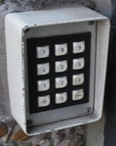
Related Issue:
Non-circumvention
EULA’s usually prohibit reverse engineering
Remember “Blizzard/BnetD”
“Digital Locks” v. IP right to “reverse engineer”
U.S.A. DMCA non-circumvention provisions
New Copyright Act (Canada) criticized for too broad empowerment of “Technological Protection Mechanisms” …“ Unlocking Bill C-11: What are Digital locks, and Why Should You Care?” http://thefulcrum.ca/2012/02/unlocking-bill-c-11-what-are-digital-locks-and-why-should-you-care/#.UKVU4-Oe-OU

Slide 42

The Future
Backlash?
SDK’s
Creative Commons
Open Source
Crowdsourcing
But all are contracts too!

Slide 43

Other Possible Answers
Consumer protection laws
International Law “standard forms”
“Anonymous”
“Hacktivism”
“Changing the Rules of the Game: How Video Game Publishers are Embracing User-Generated Derivative Works” – re. Machinima http://jolt.law.harvard.edu/articles/pdf/v21/21HarvJLTech567.pdf
But ref. Isabelle Arvers http://www.isabellearvers.com
Machinima still living in a complex
contractuallyrestricted world
[your suggestions here]

Slide 44
Continuing…
Connecting as/by Contracting
Ten Cases
Ten Clauses
Ten Contexts
& some lessons learned…

Slide 45

Things to Look For 1:
Collisions of CONTRACT (Law) &:
Copyright freedoms
Expressive freedoms
Creative freedoms
Connective freedoms
Preferences to gamer in game or developer outside of game
Implications of contracts as individual bargains &/or mass
agreement (contract of adhesion)
Contractual complexity as a consequence of infinite slice-
able &dice-able nature of IP.

Slide 46
Things to Look For 2:
1. Copyright Law
2. Terms of Contract
(EULA &/or ToS)
→ 2 SEPARATE STREAMS OF
ANALYSIS

Slide 47

WE HAVE ARRIVED AT….

Slide 48
Repeat After Me…….
“I am agreeing. I am not reading what I am agreeing to. I am doing this thousands of times. Each document I am agreeing to & not reading is different, often quite different, from every other document I am agreeing to and not reading.”

Slide 49
WARNING & NOTICE
The materials that follow are filled with often dense, repetitive and difficult to follow legal language. You will find yourself scrambling to understand what the quoted text says and why those particular words and concepts are being conveyed……..It will be difficult to understand…..
AND THAT IS THE POINT

Slide 50
Case 1: “Davidson”
“BnetD” versus Blizzard’s own “Battle.net”
Amici Curiae Brief supporting defendants by teachers of IP Law in U.S. law schools https://www.eff.org/sites/default/files/filenode/Blizzard_v_bnetd/20040221_law_professor_brief.pdf
Argued unsuccessfully that insofar as they prohibit permissible “reverse engineering”, Blizzard’s EULA’s should be preempted by copyright law. Alternatively argued that enforcement of the EULA’s should be denied under the Doctrine of Copyright Misuse (related to concept of “Copyright Monopoly”).
Attempted unsuccessfully to preserve Sega Enterprises v. Accolade, Inc. application of Fair Use to to reverse Engineering

Slide 51
Blizzard v. Internet Gateway - con’d
(Battle.net clone)
Davidson & Associates, Inc. v. Internet Gateway, 2004 U.S. Dist. LEXIS 20369 (E.D. Mo. 2004), aff’d 2005 U.S. App. LEXIS 18973 (8th Cir. 2005)
EULA: “… subject to the grant of license hereinabove, you may not, in whole or in part, copy, photocopy, reproduce, translate, reverse engineer, derive source code, modify, disassemble, decompile, create derivative works based on the Program, or remove any proprietary notices or labels on the program without the prior consent, in writing, of Blizzard.”
TOU: “You are entitled to use Battle.net for your own personal use, but you shall not be entitled to … (ii) copy, photocopy, reproduce, translate, reverse engineer, modify, disassemble, or de-compile, in whole or in part, any Battle.net software; (iii) create derivative works based on Battle.net; (iv) host or provide matchmaking services for any Blizzard software programs or emulate or redirect the communication protocols used by Blizzard as part of Battle.net, through protocol emulation, tunneling, modifying, or adding components to the Program, use of a utility program, or any other technique now known or hereafter developed for any purpose, including, but not limited to, network play over the Internet, network play utilizing commercial or non-commercial gaming networks, or as part of content aggregation networks without the prior written consent of Blizzard or exploit Battle.net or any of its parts for any commercial purpose …”

Slide 52
Case 2: Blizzard v. In Game (gold-farming)
In 2007 Blizzard sued In Game Dollar. IGD through a subsidiary offered power-leveling and virtual gold-selling services. IGD sent spam messages to players though WoW’s chat system to advertise its services.
Blizzard claimed all this effected a diminishment of gamer enjoyment and experience resulting in lost subscribers and lost revenue. Causes of action included: violation of Blizzard’s EULA and ToU; intentional interference with contract; unfair competition & unjust enrichment.
IGD shut down its business & the case settled in Jan. 2008 by consent order.

Slide 53
Blizzard v. In Game – con’d
Blizzard Entertainment, Inc. v. In Game Dollar, LLC,
United States District Court for C.D. Cal., Case No. SACV07-0589-JVS(2007)
TOU: “You agree that you shall not, under any circumstances, ... Exploit
the Game or any of its parts, including without limitation the Game
Client, for any commercial purpose, including without limitation use at a
cyber cafe, computer gaming center or any other location-based site
without the express written consent of Blizzard;”
EULA: “You may not share the Account or the Login Information with anyone
other than as expressly set forth herein.”
“When engaging in Chat in the Program, or otherwise utilizing the Program,
you may not:…Disrupt the normal flow of dialogue in Chat or otherwise act in
a manner that negatively affects other users including without limitation posting
commercial solicitations and/or advertisements for goods and services
available outside of the World of Warcraft universe;…Sending [sic] repeated
unsolicited or unwelcome messages to a single user or repeatedly posting
similar messages in a Chat area, including but not limited to continuous
advertisements to sell goods or services;”

Slide 54
Case 3: MDY (“Glider” bot)
Electronic Frontier Foundation VIEW:https://www.eff.org/deeplinks/2010/12/mixed-ninth-circuit-ruling-mdy-v-blizzard-wow
“The Ninth Circuit today issued its decision in the second of a trio of cases that raise the critical legal question of whether "magic words" in a end-user license agreement… slapped onto a consumer product can turn buyers…into mere licensees, rather than owners…
Ownership matters, because otherwise Blizzard and other software vendors can wipe away important consumer rights with legalese contained in license agreements.
In September, the Ninth Circuit held that buyers of software…are not owners as long as the vendor saddles the transfer with enough restrictions to transform what the buyer may think is sale into a mere license. Today, in yet another blow to user rights, the Ninth Circuit ruled that Blizzard’s license restrictions for WoW accomplish the same purpose.
However, the court also held that using Glider in WoW play in violation of Blizzard’s terms did not amount to copyright infringement…The license term that forbade WoW players from using Glider was a covenant a promise not to do something rather than a condition limiting the scope of the copyright license. And while violating "antibot" covenants might breach a contract, it does not violate any copyright. (By contrast, creating a derivative work might.)”

Slide 55
MDY v. Blizzard - con’d (WoW Glider/bot)
MDY Industries, LLC v. Blizzard Entertainment, Inc.,
2008 U.S. Dist. LEXIS 53988
EULA: “Grant of Limited Use License. If you agree to this License Agreement, computer software (hereafter referred to as the “Game Client”) will be installed on your hardware. If your hardware meets the minimum requirements, the installation of the Game Client will enable you to play the Game by accessing your account with the Service (your “Account”). Subject to your agreement to and continuing compliance with this License Agreement, Blizzard hereby grants, and you hereby accept, a limited, nonexclusive license to (a) install the Game Client on one or more computers owned by you or under your legitimate control, and (b) use the Game Client in conjunction with the Service for your non-commercial entertainment purposes only. All use of the Game Client is subject to this License Agreement and to the [TOU], both of which you must accept before you can use your Account to play the Game.”
TOU: “You agree that you will not (i) modify or cause to be modified any files that are a part of the Program or the Service; (ii) create or use cheats, bots, "mods", and/or hacks, or any other third-party software designed to modify the World of Warcraft experience; or (iii) use any third-party software that intercepts, "mines", or otherwise collects information from or through the Program or the Service. Notwithstanding the foregoing, you may update the Program with authorized patches and updates distributed by Blizzard, and Blizzard may, at its sole and absolute discretion, allow the use of certain third party user interfaces.”

Slide 56
Case 4: Blizzard v. Marshall
Blizzard alleged Justin Marshall led “StarCrack” a hacker group developing servers emulating Blizzard’s Battle.net (where have you heard this before?), allowing gamers with pirate copies of the StarCraft 2 (which was still in a closed beta) to play multiplayer online.
In April 2010, Blizzard sued Justin Marshall and unnamed defendants for breach of contract, copyright infringement, circumvention of copyright protection systems in violation of the DMCA and tortious interference with contract.
“The suit was dropped a week later, with Blizzard stating that the “matter had been resolved in a way that has allowed us to dismiss the lawsuit.””
http://mygaming.co.za/news/news/5840-blizzard-not-afraid-to-go-after-hackers.html
----------------------------------------------------------------------------------------------------------
TOU: Users may not "use ... unauthorized third-party software designed to modify the service, any Game or any Game experience," "host, provide, or develop matchmaking services for any Game or the service, or intercept, emulate or redirect the communication protocols used by Blizzard in any way, for any purpose, including without limitation unauthorized play over the internet ...

Slide 57
Blizzard v. Marshall – con’d (Battle.net clone)
Blizzard Entertainment, Inc. v. Marshall, District Court for the Central District of California, Case
No. 10-cv-00450-DOC-RNB (2010)
Beta Test Agreement: “Subject to the license granted hereunder, you may not, in whole
or in part, copy, photocopy, reproduce, translate, reverse engineer, derive source code
from, modify, disassemble, decompile, or create derivative works based on the Game...
Failure to comply with the restrictions and limitations contained in this Section 7 shall
result in the immediate, automatic termination of the license granted hereunder and
may subject you to potential civil and/or criminal liability.
Without limiting Blizzard's rights hereunder, you agree that you shall not, under any
circumstances:...
(iii) host, provide or develop matchmaking services for the Game or intercept, emulate
or redirect the communication protocols used by Blizzard in any way, including without
limitation through protocol emulation, tunneling, packet sniffing, modifying or adding
components to the Game, use of a utility program or any other techniques now known
or hereafter developed, for any purpose, including without limitation unauthorized network play
over the Internet, network play utilizing commercial or non-commercial gaming netWorks, or as
part of content aggregation networks;
(iv) Facilitate, create or maintain any unauthorized connection to the Game, including without
limitation any connection to any unauthorized server that emulates, or attempts to emulate, the
Game. All connections by or to the Game may only be made through methods and means
approved by Blizzard. Under no circumstances may you connect, or create tools that allow you
or others to connect, to the Game other than those expressly provided by Blizzard for use by
Beta Testers;...

Slide 58
Blizzard v. Marshall (con’d 2)
Consent to Monitor. WHEN RUNNING, THE GAME MAY MONITOR YOUR COMPUTER'S RANDOM ACCESS MEMORY (RAM) FOR UNAUTHORIZED THIRD PARTY PROGRAMS RUNNING CONCURRENTLY WITH THE GAME. AN "UNAUTHORIZED THIRD PARTY PROGRAM" AS USED HEREIN SHALL BE DEFINED AS ANY THIRD PARTY SOFTWARE, INCLUDING WITHOUT LIMITATION ANY "ADDON," "MOD," "HACK," "TRAINER," OR "CHEAT," THAT IN BLIZZARD'S SOLE DETERMINATION: (i) ENABLES OR FACILITATES CHEATING OF ANY TYPE; (ii) ALLOWS USERS TO MODIFY OR HACK THE GAME INTERFACE, ENVIRONMENT, AND/OR EXPERIENCE IN ANY WAY NOT EXPRESSLY AUTHORIZED BY BLIZZARD; OR (iii) INTERCEPTS, "MINES," OR OTHER WISE COLLECTS INFORMATION FROM OR THROUGH THE GAME. IN THE EVENT THAT THE GAME DETECTS AN UNAUTHORIZED THIRD PARTY PROGRAM, THE GAME MAY (a) COMMUNICATE INFORMATION BACK TO BLIZZARD, INCLUDING WITHOUT LIMITATION YOUR ACCOUNT NAME, DETAILS ABOUT THE UNAUTHORIZED THIRD PARTY PROGRAM DETECTED, AND THE TIME AND DATE THE UNAUTHORIZED THIRD PARTY PROGRAM WAS DETECTED;…”

Slide 59
Case 5:Vernor v. Autodesk
Decision: “Timothy Vernor purchased several used copies of Autodesk, Inc.'s AutoCAD Release 14 software ("Release 14") from one of Autodesk's direct customers, and he resold the Release 14 copies on eBay. Vernor brought this declaratory judgment action against Autodesk to establish that these resales did not infringe Autodesk's copyright…
We hold today that a software user is a licensee rather than an owner of a copy where the copyright owner (1) specifies that the user is granted a license; (2) significantly restricts the user's ability to transfer the software; and (3) imposes notable use restrictions. Applying our holding to Autodesk's SLA, we conclude that CTA was a licensee rather than an owner of copies of Release 14 and thus was not entitled to invoke the first sale doctrine or the essential step defense…”

Slide 60
Vernor v. Autodesk – con’d (re-sale)
Vernor v. Autodesk, Inc., 2010 U.S. App. LEXIS 18957
EULA: “YOU MAY NOT: (1) modify, translate, reverse-engineer, decompile, or disassemble the Software . . . (3) remove any proprietary notices, labels, or marks from the Software or Documentation; (4) use . . . the Software outside of the Western Hemisphere; (5) utilize any computer software or hardware designed to defeat any hardware copy-protection device, should the software you have licensed be equipped with such protection; or (6) use the Software for commercial or other revenue-generating purposes if the Software has been licensed or labeled for educational use only.
[Y]ou must destroy the software previously licensed to you, including any copies resident on your hard disk drive . . . within sixty (60) days of the purchase of the license to use the upgrade or update . . . . Autodesk reserves the right to require you to show satisfactory proof that previous copies of the software have been destroyed.”

Slide 61

Case 6: iRacing (Mods)
iRacing Motorsports Simulations, LLC v. Tim Robinson, District Court for the District of Massachusetts, Civil Action No. 05cv11639-NG (May, 2009)
EULA: “You may not, in whole or in part, copy, photocopy, reproduce, translate, reverse engineer, derive source code, modify, disassemble, decompile, create derivative works based on [NASCAR 2003], or remove any proprietary notices or labels on [NASCAR 2003] without the prior consent, in writing, of [iRacing].”
Mod community encouraged in past but line drawn?…

Slide 62
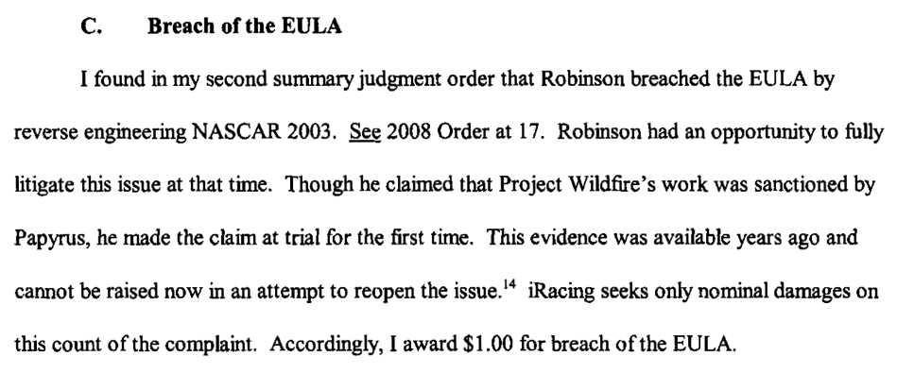
iRacing (con’d)

Slide 63
Case 7: Smallwood (addiction)
Decision:
http://scholar.google.ca/scholar_case?case=17471300131704032790&q=smallwood+v.+ncsoft+corp&hl=en&as_sdt=2,5&as_vis=1
“Plaintiff became psychologically dependent and addicted to playing Lineage
II. During the years that Plaintiff played Lineage II, the phenomena of psychological
dependence and addiction to playing computer games was recognized by and known to
Defendants. Defendants never gave Plaintiff any notice or warning of the danger of
psychological dependence or addiction from continued play…
The Court finds the agreement here valid. Plaintiff had notice of the User Agreement,
was required to affirmatively agree to it by clicking "I agree," and had an opportunity to
cease playing Lineage II if he disagreed with it…
Thus,…it appears that one cannot preemptively waive a gross negligence claim…
Accordingly, the Court finds that the waiver and limitation of liability in the User
Agreement is not valid as to the gross negligence claim…
Under Texas law, a party also may not waive its right to bring a fraud claim…
However, because Plaintiff's claim for defamation is based upon negligence, Plaintiff's
damages for such a claim are limited under the User Agreement…”

Slide 64
Smallwood v. NCSOFT – con’d
Smallwood v. NCSOFT, 730 F. Supp. 2d 1213 (Dist. Court. D. Hi. 2010)
EULA: “THE MAXIMUM AMOUNT OF NC INTERACTIVE'S (OR ANY OF ITS SHAREHOLDERS, PARTNERS, AFFILIATES, DIRECTORS, OFFICERS, SUBSIDIARIES, EMPLOYEES, AGENTS, SUPPLIERS, LICENSEES OR DISTRIBUTORS) LIABILITY TO YOU UNDER THIS AGREEMENT SHALL NOT EXCEED AN AMOUNT EQUAL TO THE LOWER OF THE (i) ACCOUNT FEES OR (ii) PURCHASE PRICE OF THE ADDITIONAL FEATURES EACH OF THE FOREGOING (i) OR (ii) AS PAID BY YOU TO NC INTERACTIVE IN THE PRECEDING SIX (6) MONTHS.
IN NO EVENT SHALL NC INTERACTIVE, NOR ANY OF ITS CONTENT PROVIDERS, SHAREHOLDERS, PARTNERS, AFFILIATES, DIRECTORS, OFFICERS, EMPLOYEES, AGENTS OR SUPPLIERS, BE LIABLE TO YOU OR TO ANY THIRD PARTY FOR ANY SPECIAL, INCIDENTAL, CONSEQUENTIAL, PUNITIVE OR EXEMPLARY DAMAGES, (INCLUDING, WITHOUT LIMITATION, LOSS OF BUSINESS PROFITS, BUSINESS INTERRUPTION, LOSS OF BUSINESS INFORMATION OR ANY OTHER PECUNIARY LOSS), REGARDLESS OF THE THEORY OF LIABILITY (INCLUDING CONTRACT, NEGLIGENCE, OR STRICT LIABILITY) ARISING OUT OF OR IN CONNECTION WITH THE SERVICE, THE SOFTWARE, YOUR ACCOUNT OR THIS AGREEMENT WHICH MAY BE INCURRED BY YOU, WHETHER OR NOT NC INTERACTIVE (OR ANY SUCH OTHER RELEASED PARTY) MAY HAVE BEEN ADVISED THAT ANY SUCH DAMAGES MIGHT OR COULD OCCUR.”

Slide 65
Case 8: Hernandez (gold-farming)
Hernandez v. Internet Gaming Entertainment, Ltd., United States District Court Southern District of Florida, Case No. 07-21430-Civ-COHN/SNOW (Filed May 31, 2007, Settled August 26, 2008)
TOU: “[Y]ou may not sell items for "real" money or otherwise exchange items for value outside of the [virtual world].”
Complaint by gamer states "IGE’s calculated decision to reap substantial profits by knowingly interfering with and substantially impairing the intended use and enjoyment" of WoW through gold-farming, camping spawns and spamming chat violated WoW’s EULA & ToU leading to lost time, competitive disadvantage, and diminished experience for honest game subscribers. The complaint further alleges that the plaintiff gamers were intended third party beneficiaries of the ToU and EULA between IGE U.S. and Blizzard and suffered harm as a result of IGE U.S.’s breach of these agreements (contrast to Micro Star v. FormGen – Duke Nukem 3D mod disc where Micro Star was held not to be a 3rd party beneficiary of an implicit license agreement between FormGen & the gamer authorizing the creation of new levels).

Slide 66
Case 9: Zynga v. Labrasca (virtual currency)
Zynga Game Network, Inc. v. Labrasca, District Court for N.D. Cal., Case No. 5:09-cv-02958-PVT (2009)
Zynga commenced action against Labrasca for infringing the trademark ZYNGA and violating its Texas Hold ‘Em Poker ToS. Zynga alleges that Labrasca runs a number of websites using the ZYNGA trademark which sell virtual poker chips usable online in the game. By consent judgment in 2009 Zynga received $45,000 as well as fees and costs.
----------------------------------------------------------------------------------------
“The Terms of Service that govern users' play of the Game provide that the "chips" used in the Game "are not redeemable for any sum of' real world' money or monetary value." The Terms of Service also prohibit sale of "chips" "for 'real world' money" and prohibit the use of the Game for unacceptable purposes, including activity in "conflict with the spirit or intent of' the Game.”

Slide 67
Case 10: Evony v. Holland
Evony operated a MMO strategy game. The business model of the game was based on players purchasing virtual items, not subscriptions. The action claims the defendant operated a server, copied and published a version of the game called "Evony Second Opinion." Evony’s action against Holland claimed breach of contract, trademark infringement, copyright infringement etc. Default judgment for $300,000 was awarded in Jan. 2011.
Judgment @: http://scholar.google.ca/scholar_case?case=7727257468813299449&hl=en&as_sdt=2&as_vis=1&oi=scholarr&sa=X&ei=9J8RUbjpJ-GmigL--YHICA&ved=0CDAQgAMoADAA
Pleading @: http://www.scribd.com/doc/47426727/Evony-v-Holland-11-Cv-00064-TFM-W-D-Pa-Jan-18-2011

Slide 68
Evony v. Holland – con’d (on-line clone)
Evony, LLC et. al. v. Holland, United States District Court W.D.
Penn., Case No. 2:11-cv-00064 (2011)
Complaint:
“33. The very first term of the Terms of Use prohibits accessing the Evony
Game servers with any modified Evony Game Client or with any other software.
34. The Terms of Use expressly prohibits the “use of cheats, automation
software (bots), hacks, mods or any other unauthorized third-party software,
databases or scripts designed to modify the Evony experience;…exploit[ation of] the
game or any of its parts, including without limitation the Service, for any commercial
purpose...; use [of] any unauthorized third-party software that intercepts, ‘mines’, or
otherwise collects information from or through the game or the Service, including
without limitation any software that reads areas used by the Game to store information
about a character or the game environment;…facilitate, create or maintain any
unauthorized connection to the Game or the Service.”
35. The Terms of Use expressly states that users shall not “reverse engineer, decompile,
or disassemble Evony, except and only to the extent that such activity is expressly
permitted by applicable law notwithstanding this limitation.”
36. The Terms of Use further prohibits actions that “[d]isrupt the normal flow of
dialogue in Chat or otherwise act in a manner that negatively affects other users
including without limitation posting commercial solicitations and/or advertisements for
goods and services available outside of the Evony game.”

Slide 69
Bonus case: “11 Cases...”
Blizzard Entertainment Inc. v. Ceiling Fan Software LLC et al U.S. District Ct. (Central Dist. Of Calif.) Sept. 23, 2013
*Plaintiff’s Motion for liability Summary Judgment granted
“Defendants are in the business of selling and distributing two
pieces of computer software—Pocket Gnome and Shadow Bot
(collectively, the “Bots”), which are software “bots” that, when
installed on a player’s computer, permit the player to “automate”
his or her WoW game play on Apple Mac computers and
Windows PCs, respectively…
At all times since they began operating their business,
Defendants have known that the WoW ToU and EULA prohibited users from using bot software, including Shadow Bot and Pocket Gnome.”
http://legal.ceilingfansoftware.com/docs/147%20Order%20Granting%20Blizzard's%20Motion%20for%20Summary%20judgment%20and%20Denying%20Defendants'%20Motion%20for%20Summary%20Judgment%20(2013-09-24).pdf

Slide 70

NEXT WEEK….
What’s it all about…EULA?
(sung to the tune of “Alfie”)
Assessing the utility and impact of
End User License Agreements (etc.)
“What's it all about
When you sort it out, Alfie
Are we meant to take more than we give
Or are we meant to be kind?”

Slide 71

Always include a cat picture

Slide 72
Quest De Integro Ludus (latin for “concerning the whole” Game)

Slide 73
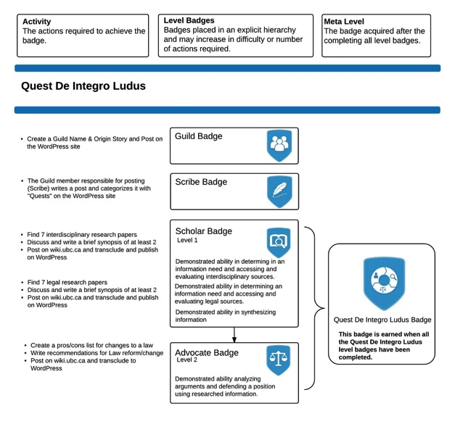

Slide 74
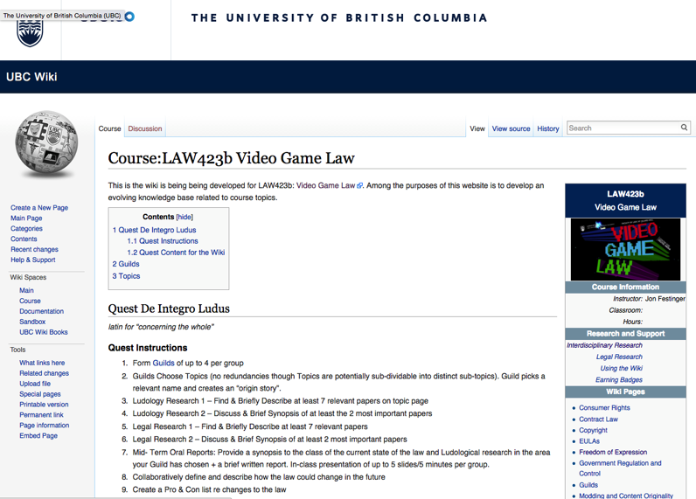

Slide 75
Topics (+Legal Aspects of + Video games)
Topic 1 (Class 2): Freedom of Expression
Topic 2 (Class 3): Copyright
Topic 3 (Classes 4 & 9): Modding & Content Originality
Topic 4 (Class 5): Consumer Rights
Topic 5 (Class 6): Contract Law
Topic 6 (Class 7): EULA’s - Good & Evil
Topic 7 (Class 8): Technology & Change
Topic 8 (Class 10): Violence, Misogyny & Social Issues
Topic 9 (Class 11): Privacy & Surveillance
Topic 10 (Class 11, 12 & 13): Government Regulation & Control

Slide 76
Class Activities
Class 1 Rules Explained: *Guilds of up to 4 per group; *All CC licensed and in Wiki.
Class 2 Guilds Formation Based on Topics (no redundancies though Topics are potentially sub-dividable into distinct sub-topics). Guild picks a relevant name and creates an “origin story”.
Class 3 Ludology Research 1 – Find & Briefly Describe at least 7 relevant papers
Class 4 Ludology Research 2 – Discuss & Brief Synopsis of at least the 2 most important papers
Class 5 Legal Research 1 – Find & Briefly Describe at least 7 relevant papers
Class 6 Legal Research 2 – Discuss & Brief Synopsis of at least 2 most important papers
Class 7 Mid- Term Oral Reports: Provide a synopsis to the class of the current state of the law and Ludological research in the area your Guild has chosen + a brief written report. In-class presentation of up to 5 slides/5 minutes per group.
Class 8 Collaboratively define and describe how the law could change in the future
Class 9 Create a Pro & Con list re changes to the law
Class 10 Recommendations for Law Reform/Change
Class 11 & 12 Oral Opinions/Presentation: 2 sub-groups of the same Guild present up to10 slides of alternating but responsible views on critical aspects of their legal quest in up to 10 minutes. This is not intended as a debate but rather as a technique to fairly illuminate different perspectives on a particular issue.

Slide 77
Our Academic Partners

