Slide 1


Mass Effect-s
Talk 10
Part C “Controlling”
Video Game Law 2015
UBC Law @ Allard Hall
Jon Festinger Q.C.
Centre for Digital Media
Festinger Law & Strategy
http://videogame.law.ubc.ca
@gamebizlaw
jon_festinger@thecdm.ca

Slide 2
Course Evaluations
Students will be able to access the online course evaluation website beginning at 1:00 a.m. on Saturday, November 21, and will be able to complete evaluations until 11:59 pm on Monday, December 7. The URL for the CoursEval website is:
https://eval.ctlt.ubc.ca/law

Slide 3
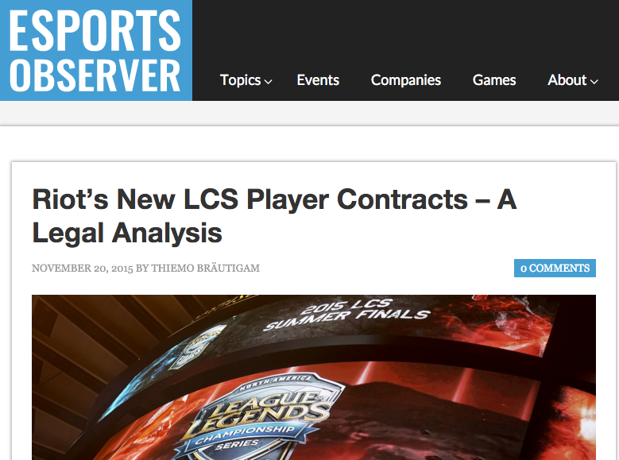
News of the Week

Slide 4
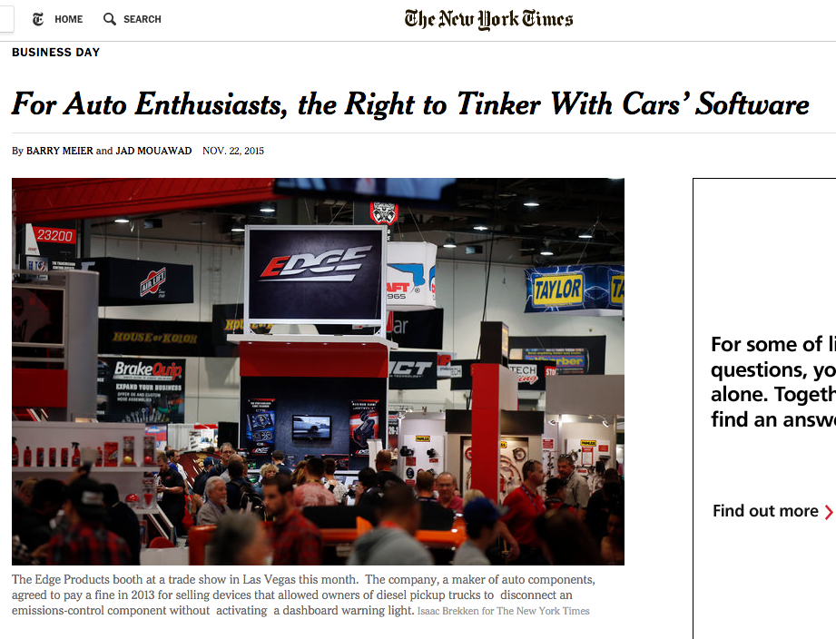
More kinds of “mods”

Slide 5
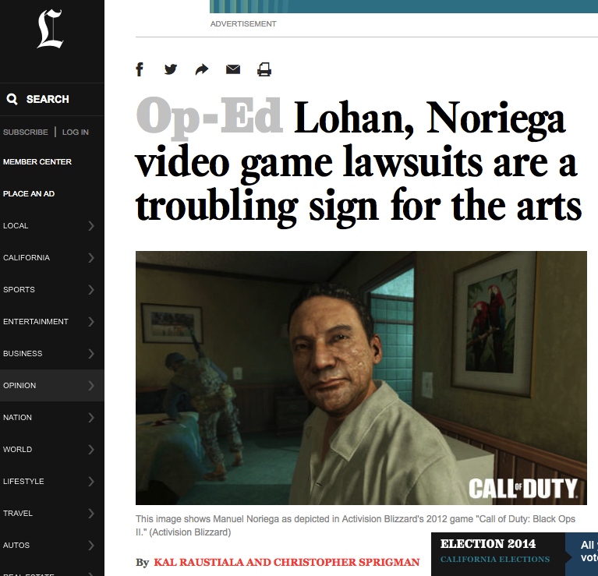
Additional Original-ism notes
http://www.latimes.com/opinion/op-ed/la-oe-raustiala-video-games-lohan-noriega-20141031-story.html

Slide 6
Personality Rights:
PRIVACY ACT [RSBC 1996]
Unauthorized use of name or portrait of another
3. (2) It is a tort, actionable without proof of damage, for a person to use the name or portrait of another for the purpose of advertising or promoting the sale of, or other trading in, property or services, unless that other, or a person entitled to consent on his or her behalf, consents to the use for that purpose.
Action does not survive death
5. An action or right of action for a violation of privacy or for the unauthorized use of the name or portrait of another for the purposes stated in this Act is extinguished by the death of the person whose privacy is alleged to have been violated or whose name or portrait is alleged to have been used without authority.

Slide 7

Karen Gravano & GTA V
PENDING???

Slide 8


Lady Miss Kier & Space Channel 5
SEGA (Space Channel) 5 WINS

Slide 9
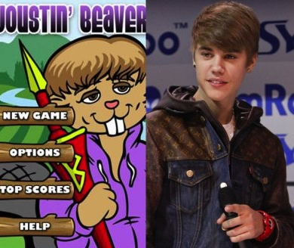

Justin Bieber v. ‘Joustin Beaver’
??? – Who cares

Slide 10
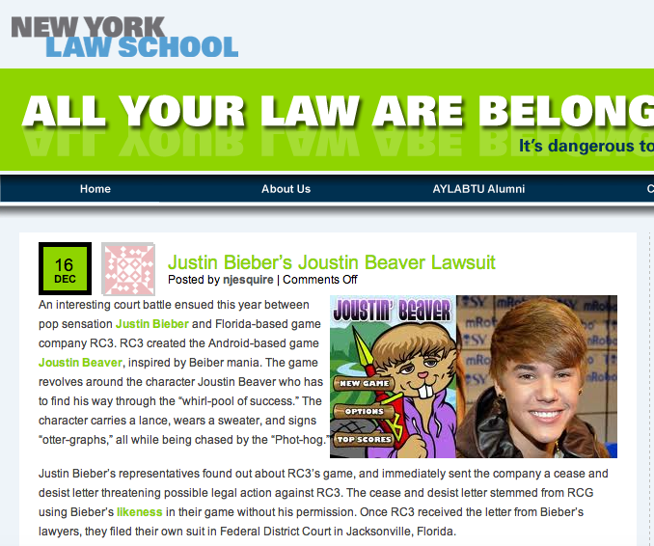
???
http://www.allyourlawarebelongtous.com/justin-biebers-joustin-beaver-lawsuit/

Slide 11

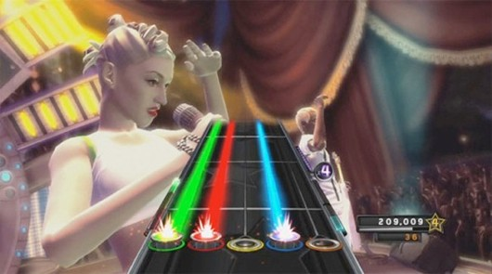
No Doubt v. Activision Publishing, Inc.
(No Doubt & Band Hero)
SETTLED

Slide 12


Dillinger v. Electronic Arts
John Dillinger & “Dillinger Tommy Gun”

Slide 13

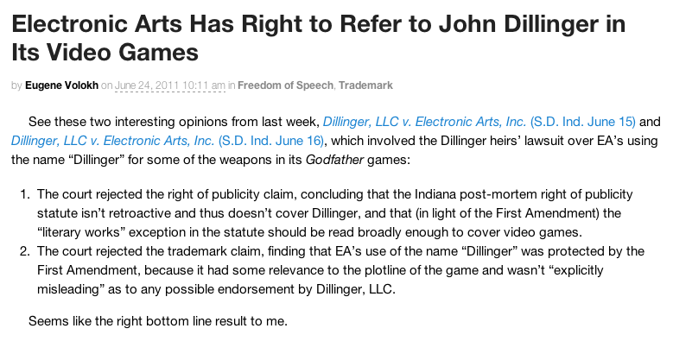
http://volokh.com/2011/06/24/electronic-arts-prevails-over-dillinger-heirs/

Slide 14

While we are at it: A Trademark Refresher

Slide 15







Blingville & Zynga
???

Slide 16


The Learning Co. & Zynga
Zynga renames its game “Pioneer Trail”

Slide 17

ESS Entertainment & Rock Star
The Play Pen & The Pig Pen
Defendant Rock Star (Pig Pen) WINS

Slide 18
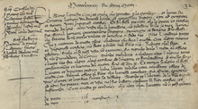
Finally
Patent Rights

Slide 19

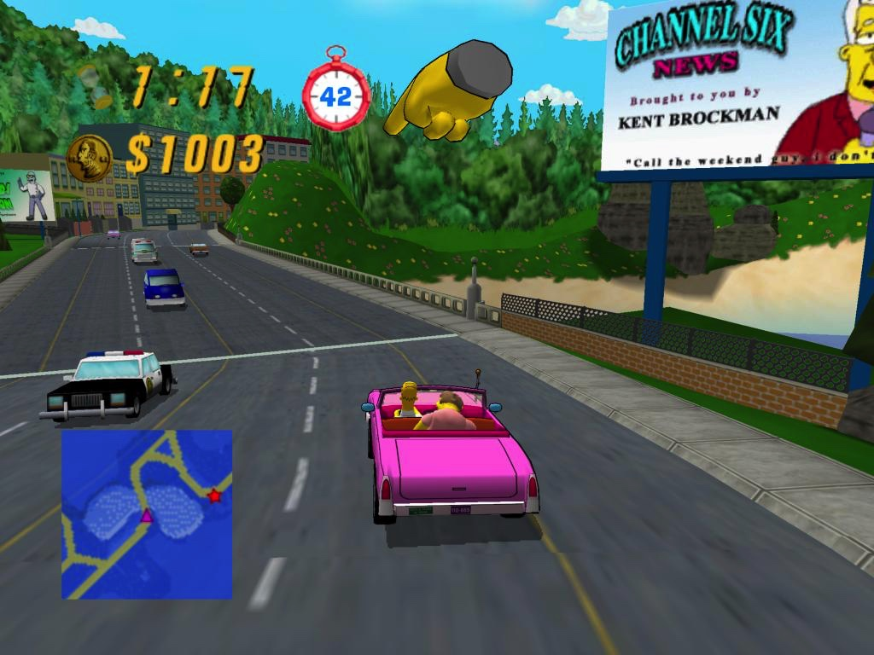
Crazy Taxi v. Simpsons Road Rage
SETTLED

Slide 20


Golden Tee v. PGA Tour Golf
Defendant PGA Tour Golf WINS

Slide 21
This Week..

Slide 22

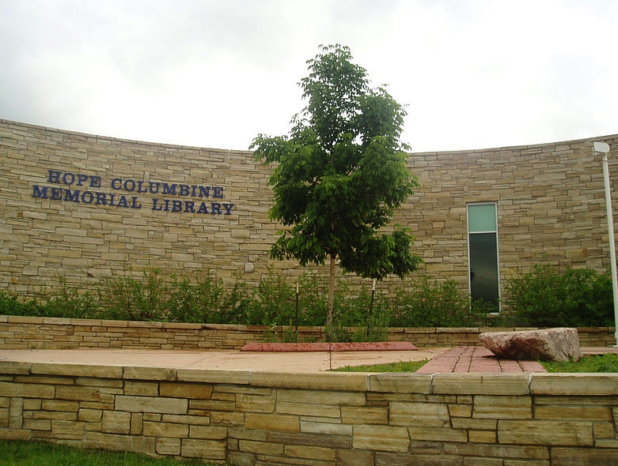
Assaults on Videogames
Assaults by Videogames
REMIXING VIOLENCE, MISOGYNY
& CIVIL SOCIETY

Slide 23
Intro: “Secrets” of contractual immunity
* Overall video game population is
about one third kids
ESA Game Player Data: “Sixty-eight percent of gamers are 18 years of age or older” http://www.theesa.com/facts/gameplayer.asp
See also “2012 Sales, Demographic and Usage Data”
http://www.theesa.com/facts/pdfs/ESA_EF_2012.pdf
“91 percent of kids are gamers, research says” (also kids responsible for 44% of physical software sales)http://news.cnet.com/8301-13506_3-20118481-17/91-percent-of-kids-are-gamers-research-says/

Slide 24
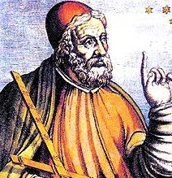
Industry Complicity? 1
EULA’s & ToS generally do not even mention
underage use
Avoiding the issue?
Not wanting to scare anyone off?
Confirming ineffectualness?
Looking the other way?
Confirming double standard?
"We consider it a good principle to explain the phenomena by the simplest hypothesis possible.” Ptolemy

Slide 25

Industry Complicity? 2
“And here's another dirty little truth that the media try their best to conceal: There exists in this country a callous, corrupt and corrupting shadow industry that sells, and sows, violence against its own people…Through vicious, violent video games with names like Bulletstorm, Grand Theft Auto, Mortal Kombat and Splatterhouse. And here’s one: it’s called Kindergarten Killers. It’s been online for 10 years…” --- Wayne LaPierre NRA --- http://home.nra.org/pdf/Transcript_PDF.pdf
(Bulletstorm=sci-fi; Grand Theft Auto=crime; Mortal Kombat=fantasy; Splatterhouse=horror; Kindergarten Killers=“flash”)
WHAT’S MISSING?... CALL of DUTY; BATTLEFIELD; America’s Army…
* “Shooters: How Video Games Fund Arms Manufacturers” - Simon Parkin http://www.eurogamer.net/articles/2013-02-01-shooters-how-video-games-fund-arms-manufacturers
* “EA removes links to gun sellers on ‘Medal of Honor’ page”
http://www.theverge.com/2012/12/27/3807900/ea-removes-links-to-gun-sellers-on-medal-of-honor-page
Double Standards Test?
-------------------------------------
See also: “Invading Your Hearts and Minds”:
Call of Duty and the (Re)Writing of Militarism
In U.S. Digital Games And Popular Culture” (2010)
http://ejas.revues.org/8831

Slide 26

Industry Complicity? 3
Industry maturity issue?
Actual maturity issue (young geeky
Males trying to be cool)?
Counter-culture roots become trendy
poseur rebellion ?
The “Grand Theft Auto San Andreas/Hot
Coffee” saga
* “Debate intensifies over Hot Coffee sex in GTA” (Gamespot June 2005) http://www.gamespot.com/news/debate-intensifies-over-hot-coffee-sex-in-gta-6128837
* “Hot Coffee controversy grows as Hilary Clinton weighs in” (Gamesindustry International July 14, 2005)http://www.gamesindustry.biz/articles/hot-coffee-controversy-grows-as-hilary-clinton-weighs-in
* “ESRB concludes investigation into Grand Theft Auto: San Andreas; Revokes M (Mature) Rating” http://www.esrb.org/about/news/7202005.jsp
* “BREAKING: RB Recalls San Andreas” (Kotaku July 2005) http://kotaku.com/113506/breaking-esrb-recalls-san-andreas

Slide 27

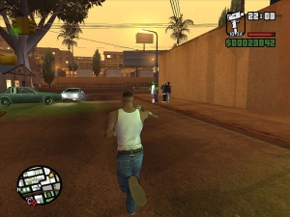
Industry Complicity? (3 – GTA continued)
“Who spilled Hot Coffee? The man who uncovered gaming's greatest sex scandal” http://www.eurogamer.net/articles/2012-11-30-who-spilled-hot-coffee
“Federal Trade Commission Complaint against Take-Two & Rockstar Games” (July 17, 2006) http://www.ftc.gov/os/caselist/0523158/0523158c4162TakeTwoInteractiveandRockstarComplaint.pdf
Settled June 8, 2006 http://www.ftc.gov/opa/2006/06/grandtheftauto.shtm
To “corporatize” - solution or greater problem?

Slide 28
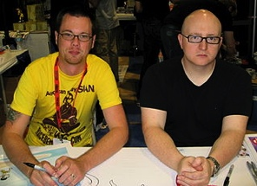
Industry Complicity? 4
Not a separate issue from industry misogyny…
Very much the same issue of immaturities & insecurities
* “Every Misogynistic Argument You’ve
Ever Heard About Video Games” http://groupthink.jezebel.com/every-misogynistic-argument-youve-ever-heard-about-vid-756662565
* “Quit – Going To PAX Already, What is
Wrong With You” (re Penny Arcade principal)
http://elizabethsampat.com/quit-fucking-going-to-pax-already-what-is-wrong-with-you/

Slide 29
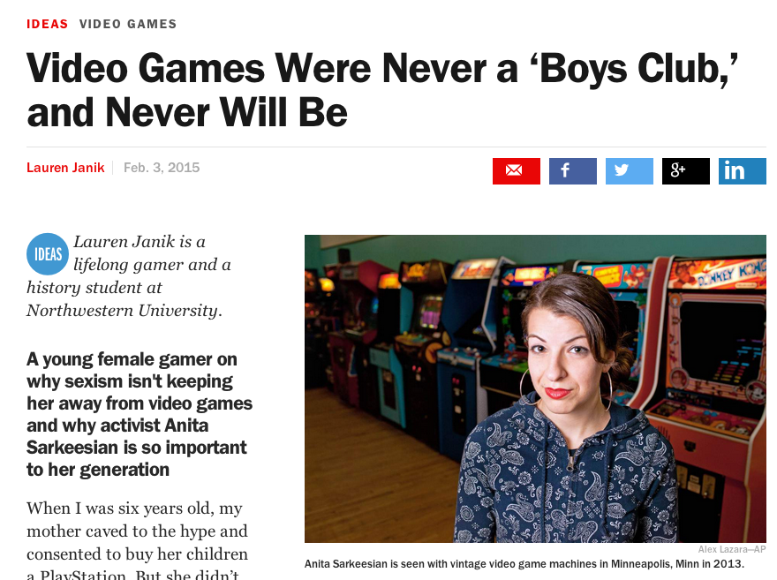
Who is a Gamer (part 1) ?

Slide 30
Consumers:
Console & Gamer Stats
“Guardians of the Galaxy”
opening Weekend = $161M
“Destiny” opening five days = $325M (GTA V launch day = $800M; Jurassic World $209M)
Current Gen consoles sales: 9.1M Wii U; 11.3M Xbox One; 19.1M PS 4
Last gen console sales = 267M worldwide
Over 1.2 Billion “gamers”: 700M on-line
http://bgr.com/2015/02/18/ps4-vs-xbox-one-vs-wii-u-lifetime-console-sales/

Slide 31

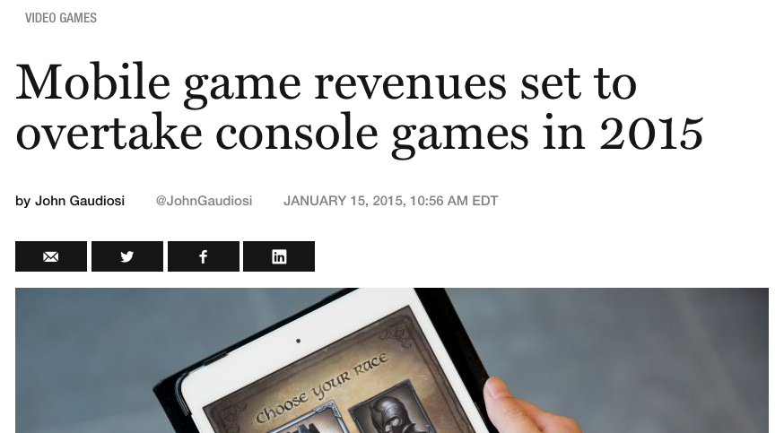
But…

Slide 32

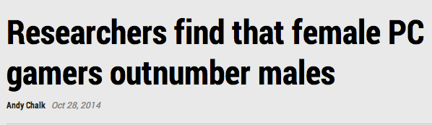
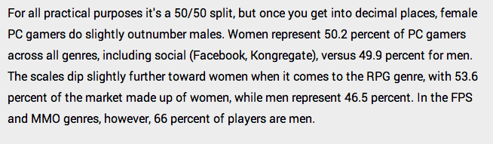
http://www.pcgamer.com/researchers-find-that-female-pc-gamers-outnumber-males/

Slide 33

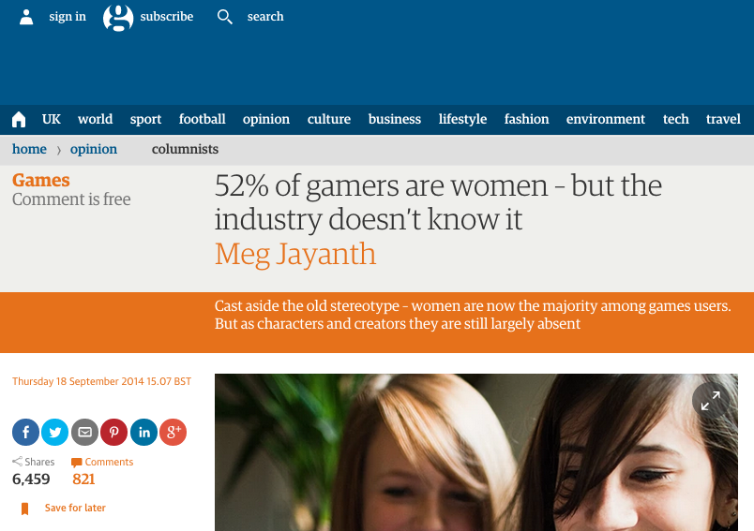
52% Women/48% Men

Slide 34
The question of gamer identity/gender appears as a “trigger” ?

Slide 35
You can think…
“Get over it/get over yourself, the world has changed.”
But maybe look at the research and think again…

Slide 36
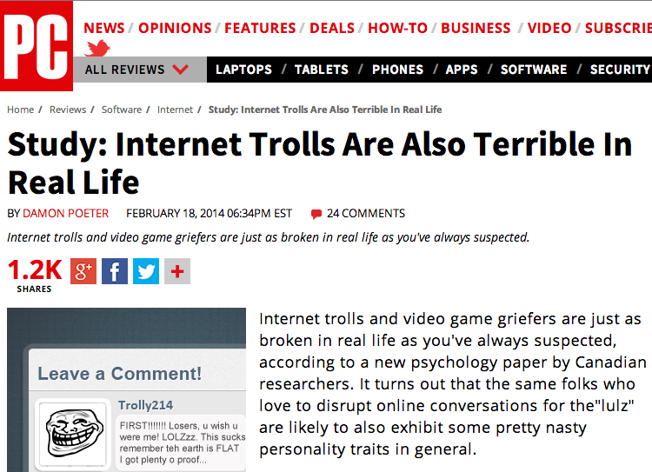
“Trolls” are likely vulnerable members of society

Slide 37
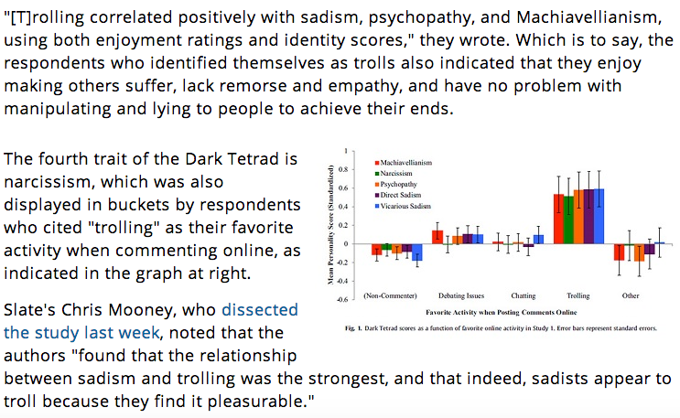

Slide 38
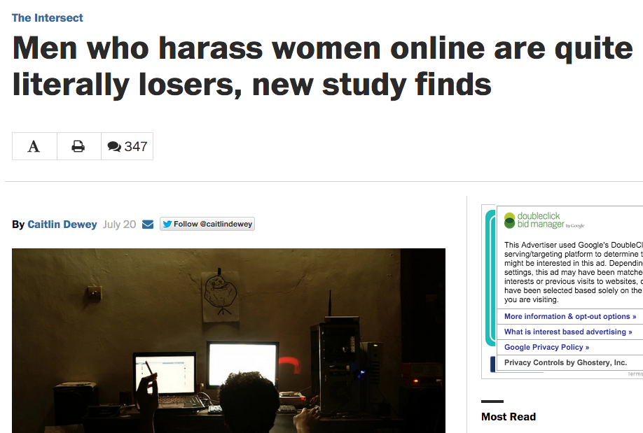
https://www.washingtonpost.com/news/the-intersect/wp/2015/07/20/men-who-harass-women-online-are-quite-literally-losers-new-study-finds/

Slide 39
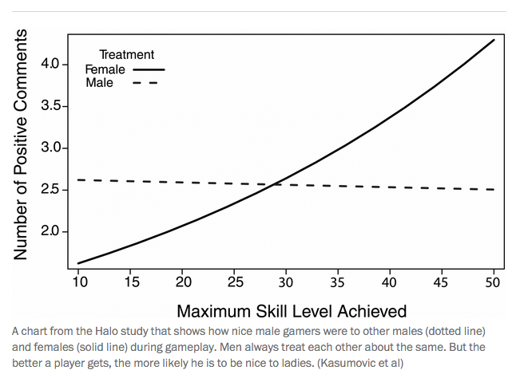

Slide 40
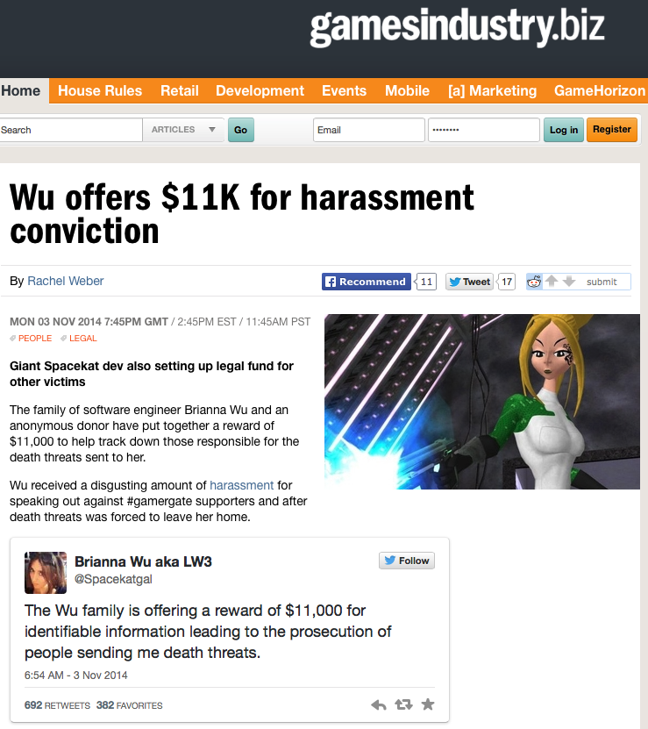
We have arrived…#gamergate
http://www.gamesindustry.biz/articles/2014-11-03-wu-offers-usd11k-for-harassment-conviction

Slide 41
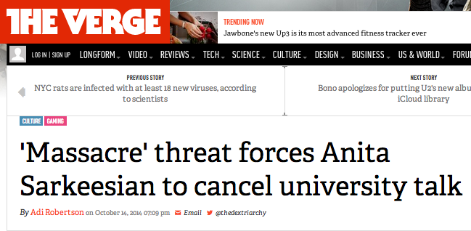
http://www.theverge.com/2014/10/14/6978809/utah-state-university-receives-shooting-threat-for-anita-sarkeesian-visit

Slide 42
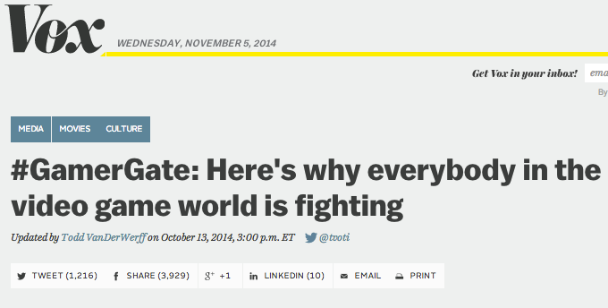
http://www.vox.com/2014/9/6/6111065/gamergate-explained-everybody-fighting

Slide 43

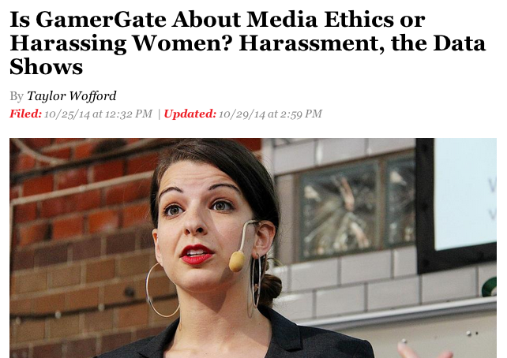
http://www.newsweek.com/gamergate-about-media-ethics-or-harassing-women-harassment-data-show-279736

Slide 44
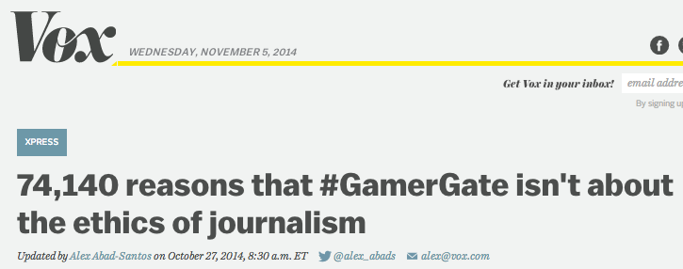
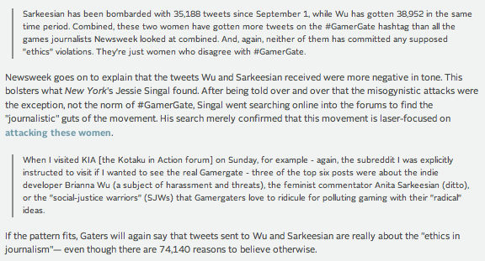
http://www.vox.com/xpress/2014/10/27/7070983/why-gamergate-isnt-about-the-ethics-of-journalism-in-35188-tweets

Slide 45
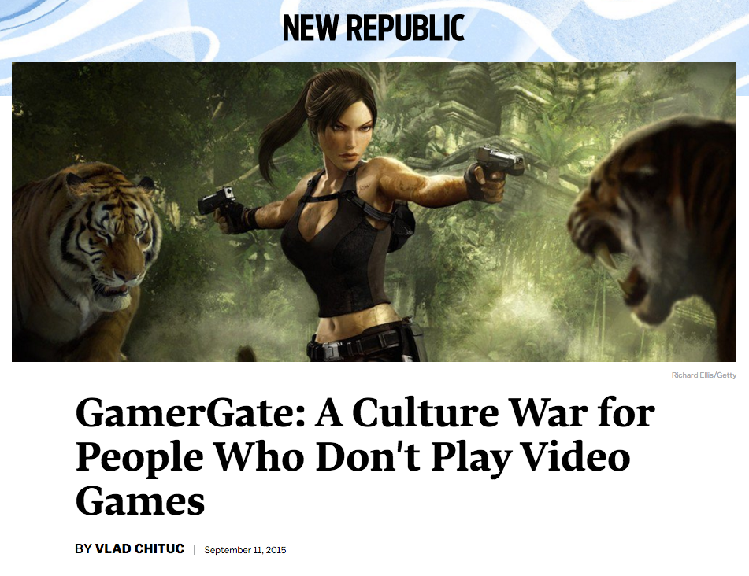
https://newrepublic.com/article/122785/gamergate-culture-war-people-who-dont-play-videogames

Slide 46
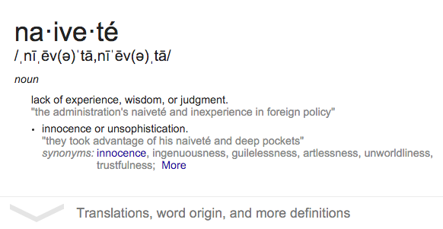
What about sports?
What about entertainment?

Slide 47

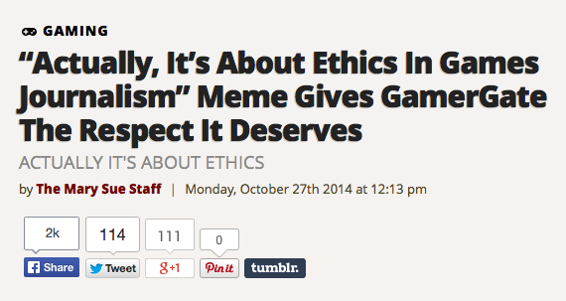
The answer to…#gamergate?
http://www.themarysue.com/actually-its-about-ethics/

Slide 48
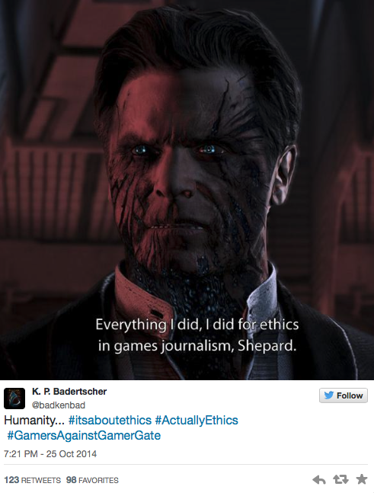

Slide 49
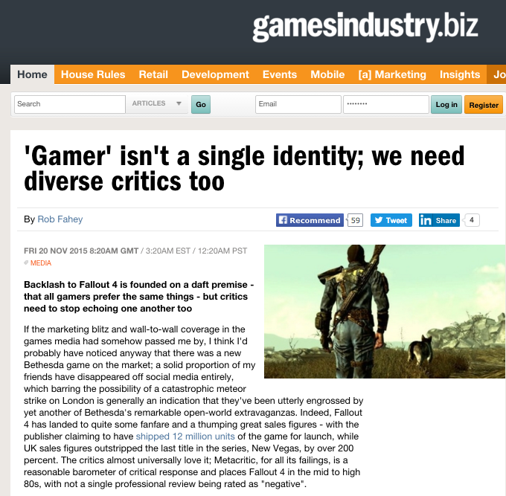
A reconciling perspective?

Slide 50
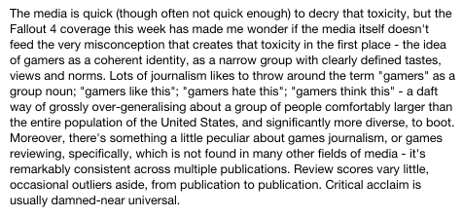



Slide 51

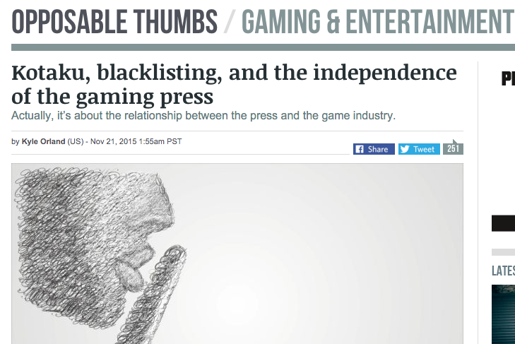

Slide 52

Education: The (further) answer to…#gamergate?
http://www.theesa.com/newsroom/release_detail.asp?releaseID=235

Slide 53
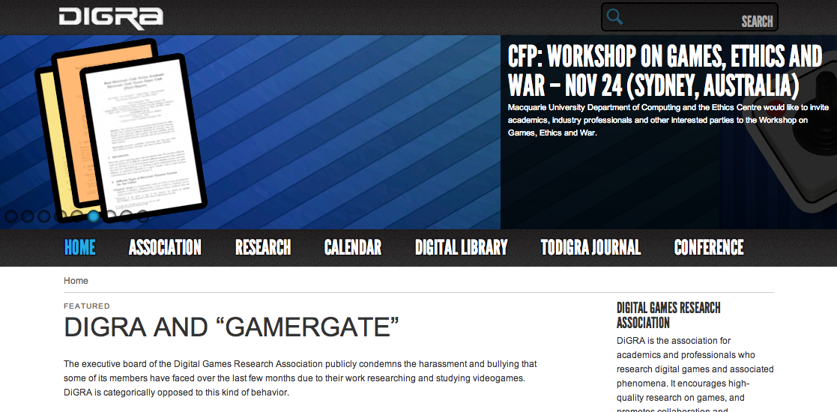
http://www.digra.org/

Slide 54

Self Identifying is a Right
– isn’t it?
* Many (most/all??) women playing hardcore (FPS) games pretend not to be.
* “The most desirable thing in the world is freedom to be true to oneself, i.e., Honesty”, Susan Sontag (at 14 years old)
*Lets not pretend this is a choice.

Slide 55
So why no legal actions?
Four possible roads (aside from provincial human rights complaints):
Might ISP’s (telco’s/cableco’s) be seen as performing a government function in transmitting information which contravenes S. 15(1) of the Charter (Equality rights)? (Hospital analogy)
Direct attack constitutionally through s. 7 or s. 36 of the Telecommunications Act (S.C. 1993, c. 38)
Civil action through s. 72 of the Telecommunications Act (S.C. 1993, c. 38)
Reinterpretation of the definition of “broadcasting” = Regulatory Process

Slide 56
General Charter & Telecom Act Provisions
CANADIAN CHARTER OF RIGHTS AND FREEDOMS
15. (1) Every individual is equal before and under the law and has the right to the equal protection and equal benefit of the law without discrimination and, in particular, without discrimination based on…sex…
TELECOMMUNICATIONS ACT
7. It is hereby affirmed that telecommunications performs an essential role in the maintenance of Canada’s identity and sovereignty and that the Canadian telecommunications policy has as its objectives
(a) to facilitate the orderly development throughout Canada of a telecommunications system that serves to safeguard, enrich and strengthen the social and economic fabric of Canada and its regions;
(h) to respond to the economic and social requirements of users of telecommunications services; and
(i) to contribute to the protection of the privacy of persons.

Slide 57
Specific Telecom Act Provisions
36. Except where the Commission approves otherwise, a Canadian carrier shall not control the content or influence the meaning or purpose of telecommunications carried by it for the public.
72. (1) Subject to any limitation of liability imposed in accordance with this or any other Act, a person who has sustained loss or damage as a result of any act or omission that is contrary to this Act or any special Act or a decision or regulation made under either of them may, in a court of competent jurisdiction, sue for and recover an amount equal to the loss or damage from any person who engaged in, directed, authorized, consented to or participated in the act or omission.

Slide 58
Is multiplayer gaming “broadcasting”?
Broadcasting Act:
“broadcasting” means any transmission of programs…by…means of telecommunication for reception by the public by means of broadcasting receiving apparatus…
“program” means sounds or visual images, or a combination of sounds and visual images, that are intended to inform, enlighten or entertain…
(Notes: 1. CRTC exemption order; & 2. SCC has held ISP’s are not broadcasting. Is W.O.W. an ISP or something else? See SCC in Rogers v. SOCAN – streaming on demand = communication to the public)

Slide 59
Conclusions
Several options under the Telecom Act & the Broadcast Act.
Argument that if at least "some" steps to prevent discriminatory abuse are not taken the Act is breached. Act has to be read in light of the Charter. Query if steps are being taken by the carriers?

Slide 60
Raising the question: Should the idea of the Magic Circle…
EVEN SURVIVE?

Slide 61

Remember
The “Magic Circle” acts (in theory) as a fence keeping out real world laws

Slide 62
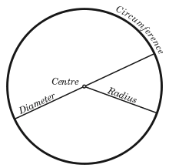
The “Magic Circle”
“All play moves and has its being within a play-ground marked off beforehand either materially or ideally, deliberately or as a matter of course. Just as there is no formal difference between play and ritual, so the ‘consecrated spot’ cannot be formally distinguished from the play-ground. The arena, the card-table, the magic circle, the temple, the stage, the screen, the tennis court, the court of justice, etc. are all in form and function play-grounds, i.e. forbidden spots, isolated, hedged round, hallowed, within which special rules obtain. All are temporary worlds within the ordinary world, dedicated to the performance of an act apart.”
Johan Huizinga (1872-1945) in “Homo Ludens: A Study of the Play-Element in Culture”. Applied to video games by Katie Salen & Eric Zimmerman in “Rules of Play: Game Design Fundamentals” (2003)

Slide 63
The “Magic Circle” exposed
“As stated previously, players never play a new game or fail to bring outside knowledge about games and gameplay into their gaming situations. The event is ‘‘tainted’’ perhaps by prior knowledge. There is no innocent gaming…Players also have real lives, with real commitments, expectations, hopes, and desires. That is also brought into the game world, here Azeroth. We can neither ignore such realities nor retreat to structuralist definitions of what makes or defines a game. Games are created through the act of gameplay, which is contingent on acts by players.”
“There is No Magic Circle” - Mia Consalvo (2009)http://www.academia.edu/654444/There_is_no_magic_circle

Slide 64
Violent Games, Liability & Regulation: Cases
Watters v. TSR (D&D) 1990 USCA
James v. Meow (Heath High, Kentucky) 2002 USCA
Sanders v. Acclaim (Columbine) 2002 US Dist.
Wilson v. Midway (Mortal Kombat) 2002 US Dist.
----------------------------------------------------------
American Amusement v. Kendrick 2001 USCA
(protecting minors)
IDSA v. St. Louis 2003 USCA (protecting minors)
VSDA v. Maleng 2004 US Dist. (regulate games
depicting violence against law enforcement)
ESA v. Blagojevich 2006 USCA (protecting minors)
EMA v. Henry 2007 US Dist. (protecting minors)
ESA v. Swanson 2008 USCA (purchase contrary to
“rating”)
ESA v. Chicago Transit 2010 US Dist. (restricted
“M” game ads on CTA vehicles)
ESA v. Schwarzenegger 2011 SCOTUS (prohibited violent
video games) - Class 12 upcoming

Slide 65
Violent Games, Liability & Regulation: Rationales
Proximate cause (civil) not demonstrated - not
foreseeable - studies ambiguous re “actual harm”
Products liability claims inapplicable
Duty to exercise ordinary care
-----------------------------------------------------
Link of violent games to violence unproven – causality not demonstrated; correlation not cause
Thought control = totalitarianism = family
responsibility
Drafting not narrowly tailored to objective
Vague & ambiguous definitions/provisions
Classic literature/film, Bible, fairy-tale
comparisons

Slide 66

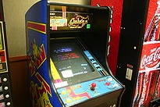

Canada - potentially quite different (if tested)
Montreal v. Arcade Amusements 1985 SCC – City By-Law 5156 (1977) cannot discriminate based on age (under 18) prohibiting entry to video arcade (narrowly construed decision)
Irwin Toy v. Quebec 1989 SCC - constitutionality of ban on commercial advertising directed at children under 13 upheld (no evidence or discussion of direct harm)
R. v. Sharpe 2001 SCC - reasoned apprehension of harm to children is sufficient (child pornography)

Slide 67
Start with…The Painful Truth
Watters v. TSR, Inc., 904 F. 2d 378 - Court of Appeals, 6th Circuit 1990 (Dungeons & Dragons):
“But if Johnny's suicide was not foreseeable to his own mother, there is no reason to suppose that it was foreseeable to defendant TSR…
…The fact is, unfortunately, that youth is not always proof against the strange waves of despair and hopelessness that sometimes sweep seemingly normal people to suicide, and we have no way of knowing that Johnny would not have committed suicide if he had not played Dungeons & Dragons…
…As far as the record discloses, no one had any reason to know that Johnny Burnett was going to take his own life. We cannot tell why he did so or what his mental state was at the time. His death surely was not the fault of his mother, or his school, or his friends, or the manufacturer of the game he and his friends so loved to play. Tragedies such as this simply defy rational explanation, and courts should not pretend otherwise.”

Slide 68
A Case For Absolutes (1)
Dealing with violent video games with a goal of preventing further New Town’s & Columbine’s mixes up CAUSALITY & CORRELATION
Seems likely that games don’t create killers but that
killers seek out killing games as an outlet (explains study results where violent games and sexual outlets appear to decrease “deviance”)
“Gun Control Debate: Violent Video Games Actually Decrease Violence, Study Finds” http://www.policymic.com/articles/28280/violent-video-games-actually-decrease-violence-study-finds
“Research: As Violent Video Game Sales Climb,
Violent Crime Among Youths Decreases” http://www.gamepolitics.com/2013/02/13/research-violent-video-game-sales-climb-crime-among-
youths-decreases#.UR9AI6XR0m0

Slide 69
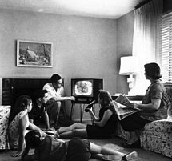
A Case For Absolutes (2)
2nd ABSOLUTE: historical truth (?) that we look back & laugh (and cry) at previous censorship
“What matters is not what Canadians think is right for themselves to see. What matters is what Canadians would not abide other Canadians seeing because it would be beyond the contemporary Canadian Standard of tolerance to allow them to see it.”
(1985 SCC Dickson CJ Towne Cinema)
THE “MRS. SMITH” PRINCIPLE
Human Instinct to Censor?
(non-dialectical- impedes progress)

Slide 70

A Case For Absolutes (3)
(but not the one you expect)
One good that appears absolute is…
(drumroll please)...
…dialectics on issues of
…violence, censorship & fear
(as well as protecting ourselves from ourselves)
Proof: INCREASE in debate over censorship/freedom issues appears to parallel DECREASE in violence & crime
Parallels: Steven Pinker “The Better Angels of Our
Nature: Why Violence Has Declined”
*to paraphrase - our ability to reason has allowed us
to curtail the appeals of violence

Slide 71
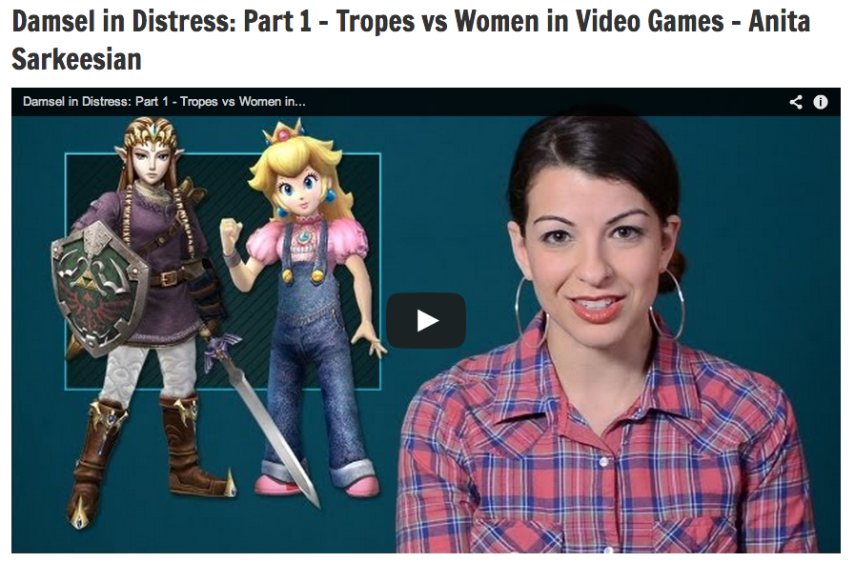
Increasing the debate!

Slide 72

Women Gamers – Women in Games
“Video Games and Aestheticising Sexual Violence” http://gamingbolt.com/video-games-and-aestheticising-sexual-violence
“A Feminist Reviews Tomb Raider's Lara Croft” http://www.forbes.com/sites/carolpinchefsky/2013/03/12/a-feminist-reviews-tomb-raiders-lara-croft/
“Hitman Absolution: Trailer causes outrage” http://www.pocket-lint.com/news/45874/hitman-absolution-trailer-causes-outrage-io-games-producer-talks-violence-and-content
“In Virtual Play, Sex Harassment Is All Too Real” http://www.nytimes.com/2012/08/02/us/sexual-harassment-in-online-gaming-stirs-anger.html
“Image Based Harassment and Visual Misogyny” http://www.feministfrequency.com/2012/07/image-based-harassment-and-visual-misogyny/
“Fear of a Woman Warrior” http://www.gamespot.com/features/fear-of-a-woman-warrior-6404142/
“On being a girl in computer science - a confession” by Dr. Kimberly Voll http://zanytomato.tumblr.com/post/44978912674/on-being-a-girl-in-computer-science-a-confession

Slide 73
Something(s) utopian to reflect on..
Razing the virtual glass ceiling: Gendered economic disparity in two massive online games – Ratan, Lehdonvirta, Kennedy, Williams (2012) http://vili.lehdonvirta.com/files/wmtr2821/Ratan-2012-gender-virtual-wealth-gap.pdf
Online dating study shows racial prejudices can be easily altered
http://www.boston.com/news/science/blogs/science-in-mind/2013/11/04/online-dating-study-shows-racial-prejudices-can-easily-altered/UsN6Rc6oOEIQQTsUQFLdxM/blog.html
Modifying player behavior in League of Legends using positive reinforcement
http://www.gamasutra.com/view/news/184806/
You and Your Videogame Avatar Are More Moral Than You Realize
http://www.forbes.com/sites/carolpinchefsky/2012/11/28/you-and-your-videogame-avatar-are-more-moral-than-you-realize/
Computer Games Save Norwegian Youth
http://www.tnp.no/norway/panorama/3904-computer-games-save-norwegian-youth
Strong-female protagonist game jam kicks off in Vancouver to fight industry sexism
http://business.financialpost.com/2013/07/12/strong-female-protagonist-game-jam-kicks-off-in-vancouver-to-fight-industry-sexism/?__lsa=9ee1-db35
And a concern: Sexualized avatars affect the real
world, Stanford researchers find
http://news.stanford.edu/news/2013/october/virtual-female-avatars-100913.html

Slide 74
Additional Sources…
* “The Agony and the Exidy: A History of Video Game Violence and the Legacy of Death Race” http://gamestudies.org/1201/articles/carly_kocurek
* “How 4 Microsoft engineers proved that the “darknet” would defeat DRM”
http://arstechnica.com/tech-policy/2012/11/how-four-microsoft-engineers-proved-copy-protection-would-fail/
* “Violence and videogames: we look at the studies cited in the aftermath of Sandy Hook”http://www.pcgamer.com/2012/12/20/violence-and-videogames-we-look-at-the-studies-cited-in-the-aftermath-of-sandy-hook/
* “Don't Trust the Research Saying Video Games Cause Real-World Aggression”http://www.slate.com/blogs/crime/2012/12/21/wayne_lapierre_don_t_listen_to_the_nra_the_research_saying_video_games_cause.html
* “All Games Are (In A Sense) Violent” http://techcrunch.com/2012/12/22/all-games-are-in-a-sense-violent/
* “Video games don't create violence in society, they reflect it http://www.polygon.com/2013/1/14/3875420/video-game-violence
* “Expert: Violent Video Games Should Be For Adults Only” http://hereandnow.wbur.org/2013/02/21/video-games-guns

Slide 75
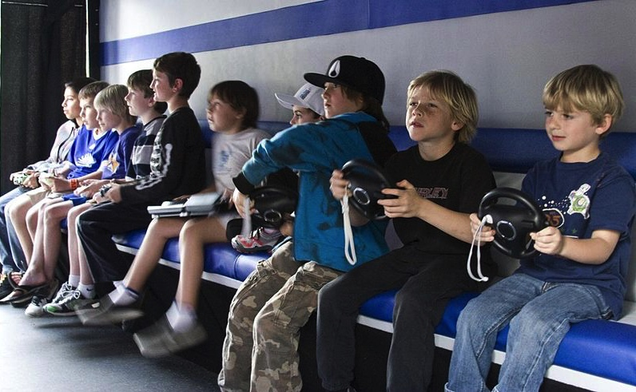
Kids & Video Games
Some Surprising
positives ??

Slide 76
…& adults too
9 Ways Video Games Can Actually Be Good For You
1. 'Mario' Is Like Steroids For Your Brain
2. 'Starcraft' May Make You Smarter
3. Video Games May Slow The Aging Process
4. They May Help Dyslexic Kids Read Better
5. Teen Gamers End Up Better At Virtual Surgery
Than Real Medical Residents
6. Video Games Can Be A Pain Reliever
7. 'Call Of Duty' Can Improve Your Eyesight
8. Video Games Can Be As Effective As One-On-One
Counseling
9. They Can Help Stroke Victims More Fully
Recover http://www.huffingtonpost.com/2013/11/07/video-games-good-for-us_n_4164723.html

Slide 77

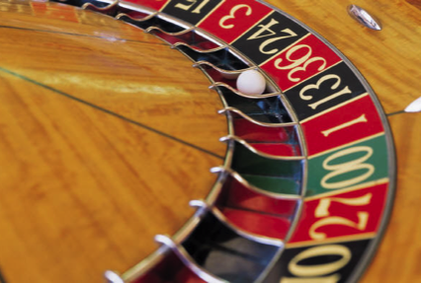
But..Game Addiction
Researchers: Game Developers Need
to Put Limits on MMORPG Players to
Avoid Pathological Addiction’
http://www.gamepolitics.com/2013/08/06/researchers-game-developers-need-put-limits-mmorpg-players-avoid-pathological-addiction#.UoGlM5Fa_zc
“Top 10 Cases of Extreme Game Addiction”http://listverse.com/2010/11/07/top-10-cases-of-extreme-game-addiction/
“Problems with the Concept of Video Game “Addiction”: Some Case Study Examples” - Richard T. A. Wood
http://laurier.communicationstudies.ca/files/wood_problems_game_addiction.pdf
“A case study of Internet Game Addiction - Eun Jin Lee"http://wpblog.uncfsu.edu/fsu_news/files/2012/01/Journal-of-Addictions-Nursing-Article-on-A-Case-Study-of-Internet-Game-Addiction.pdf
“Computer and Video Game Addiction—A Comparison between Game Users and Non-Game Users”https://www.sfu.ca/cmns/courses/2011/325/class/13zachary/3_final_project/Misc_files/Computer%20and%20Video%20Game%20Addiction%20%20Weinstein.pdf
Video Game Addiction.Orghttp://www.video-game-addiction.org/video-game-addiction-articles/study-documents-prevalence-of-pathological-behavior-among-young-video-gamers.htm

Slide 78

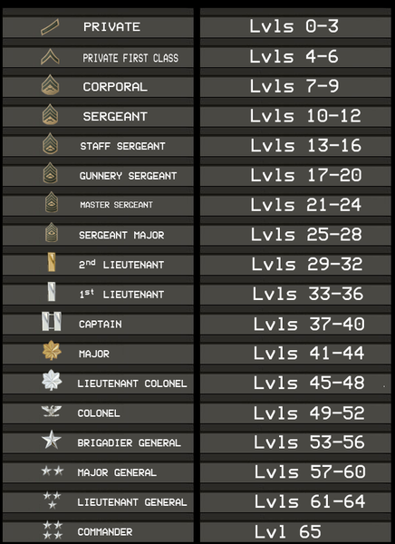

What’s Your Take?
“Gamers committing war crimes should suffer ‘virtual consequences,’ says Red Cross”
http://www.theverge.com/2013/10/8/4815090/gamers-committing-war-crimes-should-suffer-virtual-consequences-says

Slide 79

Next Class: Controlling the Controllers
The many meanings of “Privacy”
in/through Video Games
Contours of Video Game Regulation?

Slide 80

Just auditing the course…

Slide 81
Quest De Integro Ludus (latin for “concerning the whole” Game)

Slide 82
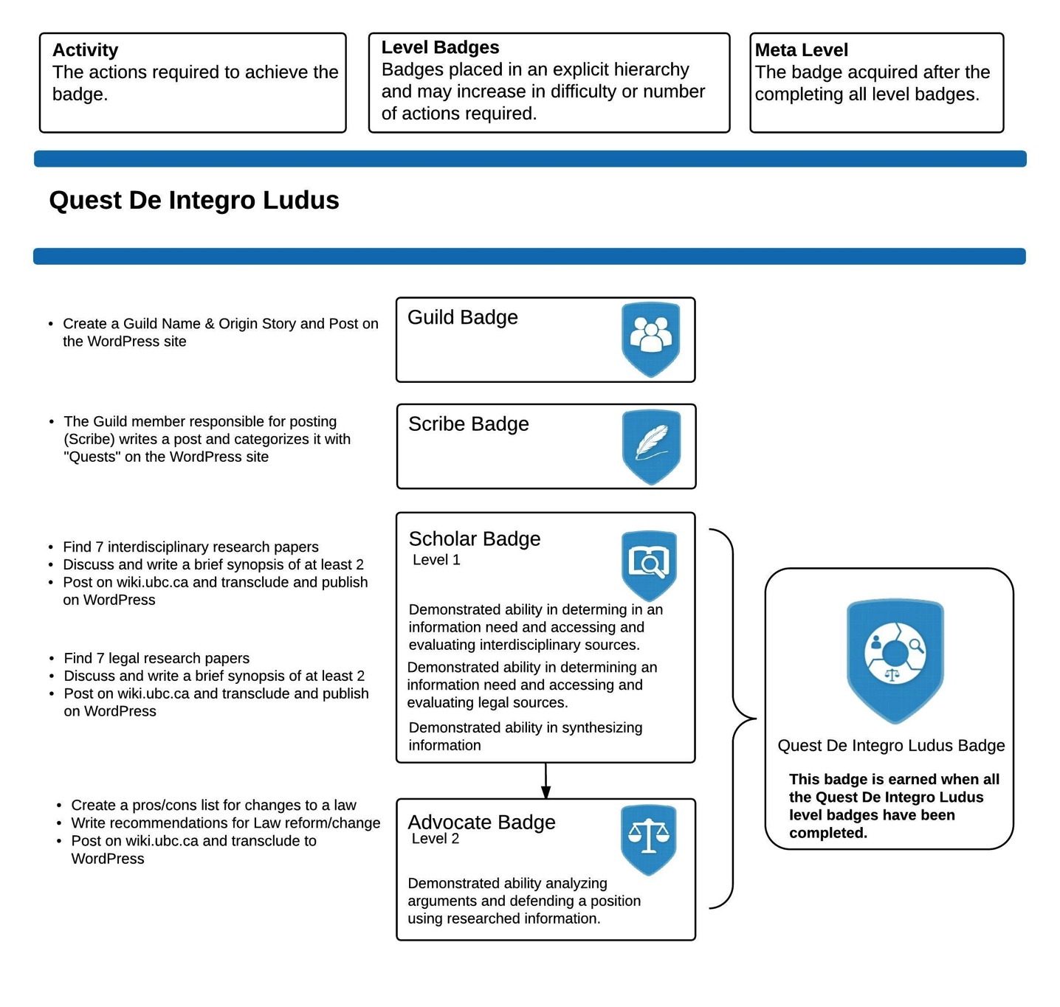

Slide 83
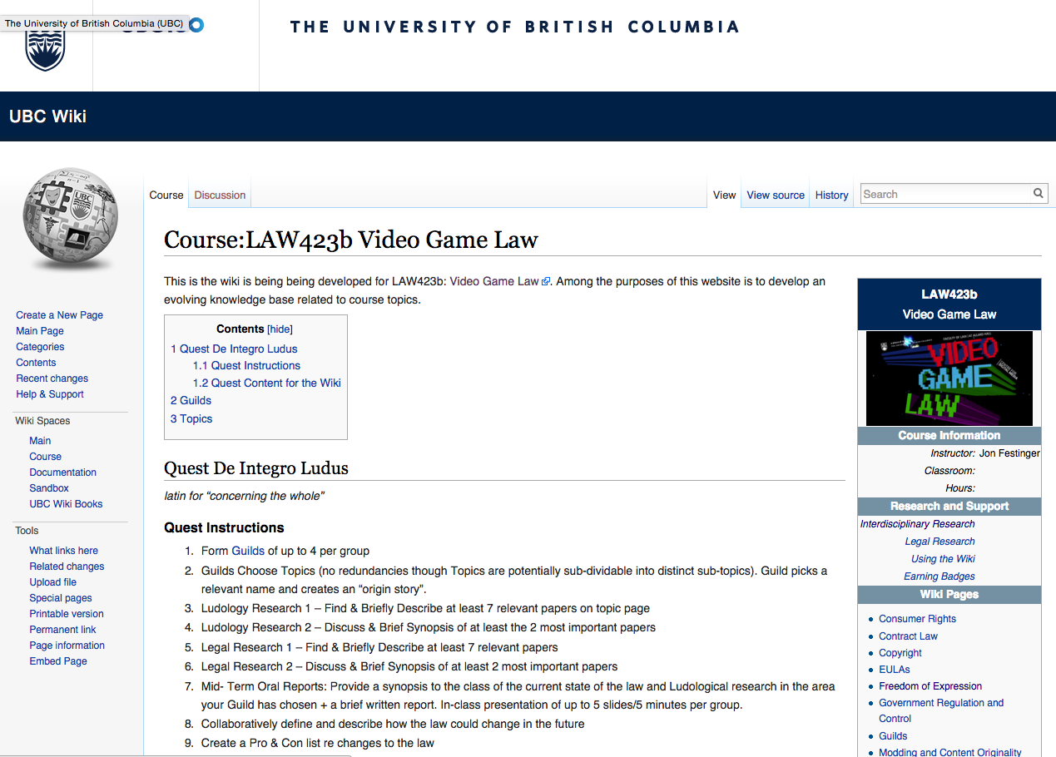

Slide 84
Topics (+Legal Aspects of + Video games)
Topic 1 (Class 2): Freedom of Expression
Topic 2 (Class 3): Copyright
Topic 3 (Classes 4 & 9): Modding & Content Originality
Topic 4 (Class 5): Consumer Rights
Topic 5 (Class 6): Contract Law
Topic 6 (Class 7): EULA’s - Good & Evil
Topic 7 (Class 8): Technology & Change
Topic 8 (Class 10): Violence, Misogyny & Social Issues
Topic 9 (Class 11): Privacy & Surveillance
Topic 10 (Class 11, 12 & 13): Government Regulation & Control

Slide 85
Class Activities
Class 1 Rules Explained: *Guilds of up to 4 per group; *All CC licensed and in Wiki.
Class 2 Guilds Formation Based on Topics (no redundancies though Topics are potentially sub-dividable into distinct sub-topics). Guild picks a relevant name and creates an “origin story”.
Class 3 Ludology Research 1 – Find & Briefly Describe at least 7 relevant papers
Class 4 Ludology Research 2 – Discuss & Brief Synopsis of at least the 2 most important papers
Class 5 Legal Research 1 – Find & Briefly Describe at least 7 relevant papers
Class 6 Legal Research 2 – Discuss & Brief Synopsis of at least 2 most important papers
Class 7 Mid- Term Oral Reports: Provide a synopsis to the class of the current state of the law and Ludological research in the area your Guild has chosen + a brief written report. In-class presentation of up to 5 slides/5 minutes per group.
Class 8 Collaboratively define and describe how the law could change in the future
Class 9 Create a Pro & Con list re changes to the law
Class 10 Recommendations for Law Reform/Change
Class 11 Oral Opinions/Presentation: Each Guild present up to 20 slides of alternating but responsible views on critical aspects of their legal quest in up to 15 minutes. This is not intended as a debate but rather as a technique to fairly illuminate different perspectives on a particular issue. A joint conclusion or perspective at the end is optional, but encouraged.

Slide 86
Our Academic Partners

