Slide 1


Controlling Originality
Talk 9
Part C “Controlling”
Video Game Law 2015
UBC Law @ Allard Hall
Jon Festinger Q.C.
Centre for Digital Media
Festinger Law & Strategy
http://videogame.law.ubc.ca
@gamebizlaw
jon_festinger@thecdm.ca

Slide 2
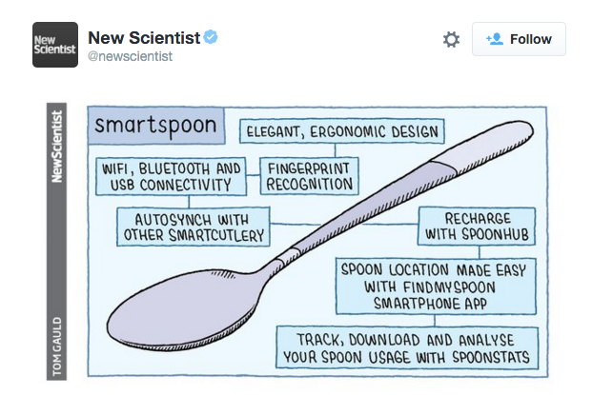
Follow up to last week on advancing tech...

Slide 3
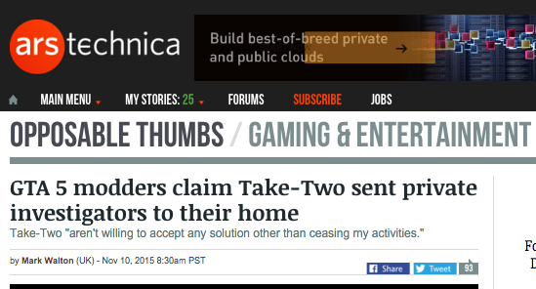
News of the Week

Slide 4
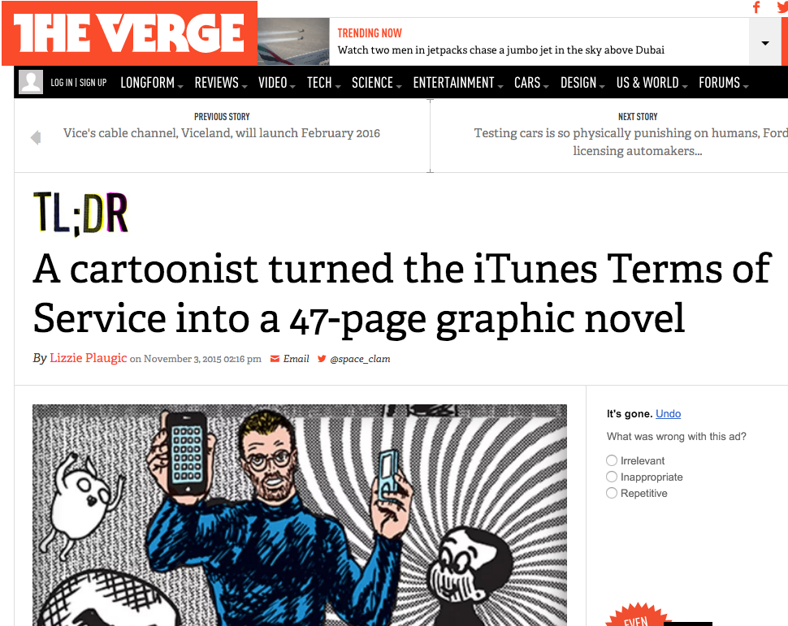
http://www.theverge.com/2015/11/3/9664956/itunes-terms-of-service-graphic-novel-r-sikoryak-tumblr

Slide 5
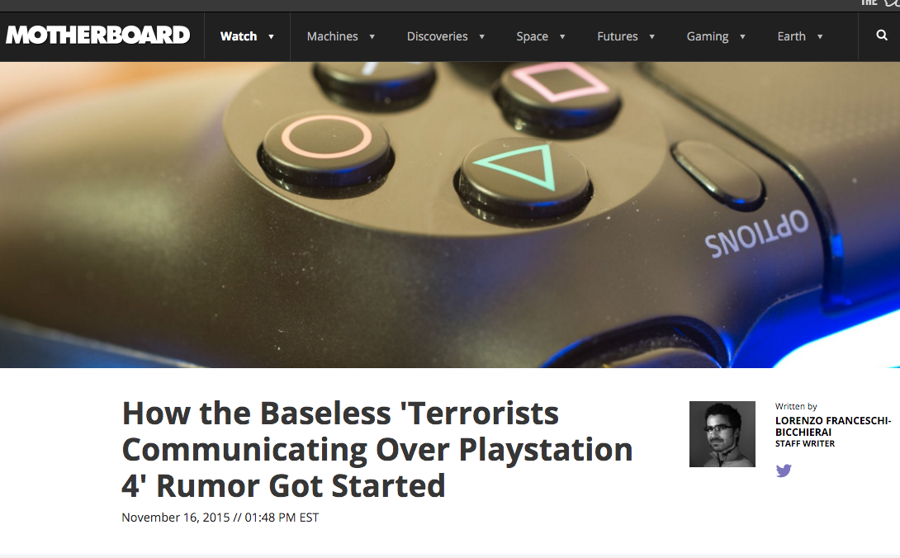
http://motherboard.vice.com/read/how-the-baseless-terrorists-communicating-over-playstation-4-rumor-got-started

Slide 6
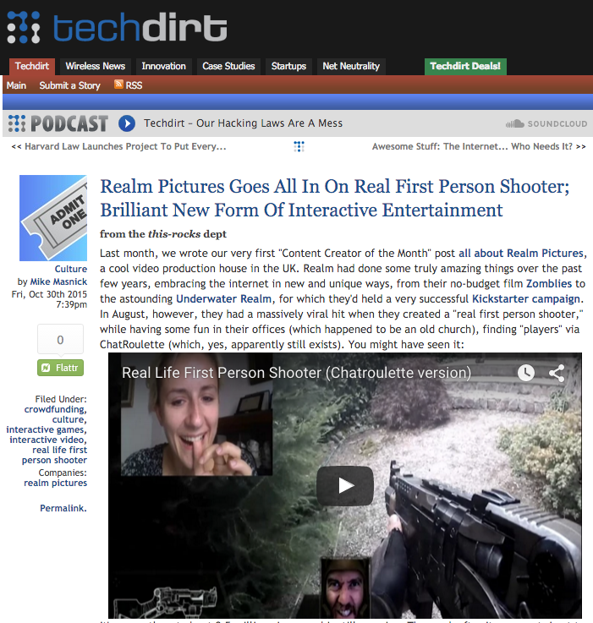

Slide 7
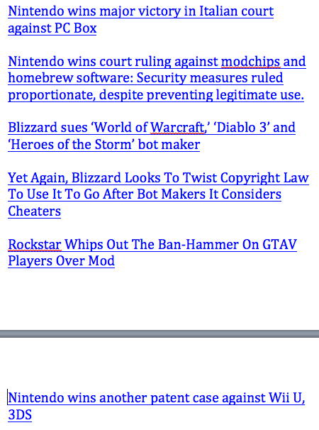
Most
Mod
Cases
EVER

Slide 8
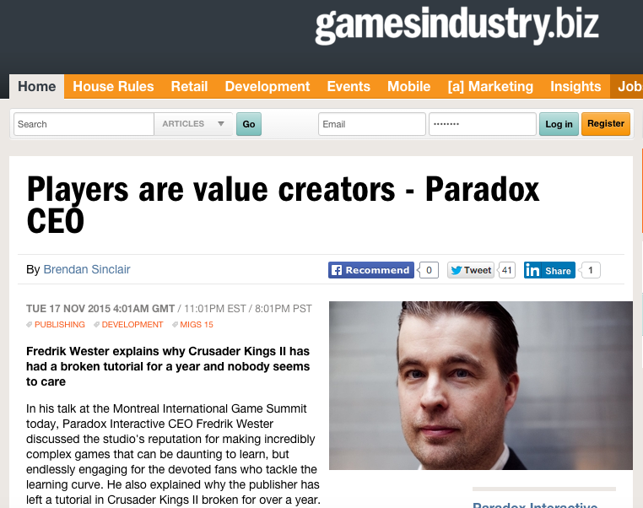
But…

Slide 9

Something is going on…

Slide 10
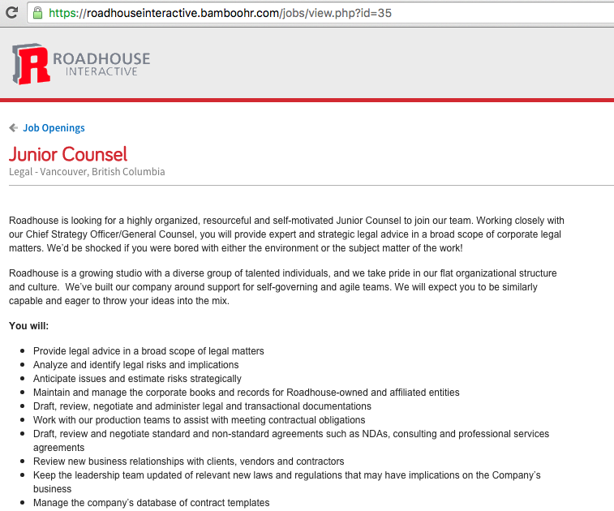
&

Slide 11
I.E.
=
Interactive
Entertainment

Slide 12
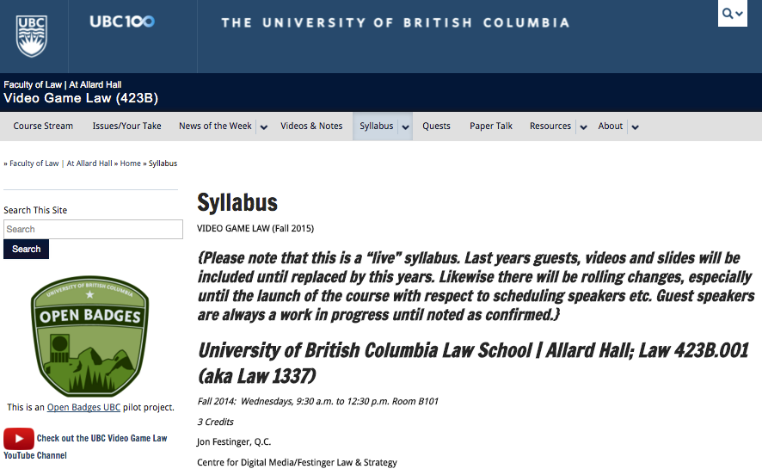
Revisions

Slide 13
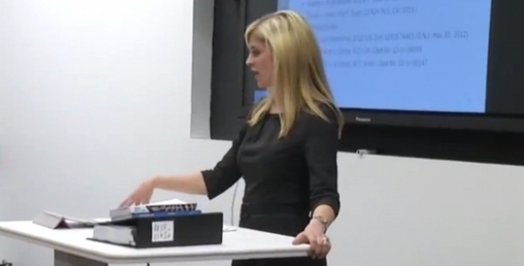
Today: Jennifer Kelly

Slide 14

Continuing: The Big Question
Something super weird…
Or totally obvious?

Slide 15

All the World is a Game
“ARE YOU LIVING IN A COMPUTER
SIMULATION?” Nick Bostrom – Faculty of
Philosophy, Oxford University. http://www.simulation-argument.com/simulation.html
“Physicists devise test to see if we're living in 'The Matrix” http://www.theverge.com/2012/10/11/3487710/computer-simulation-silas-beane-university-bonn
WE ARE ?

Slide 16
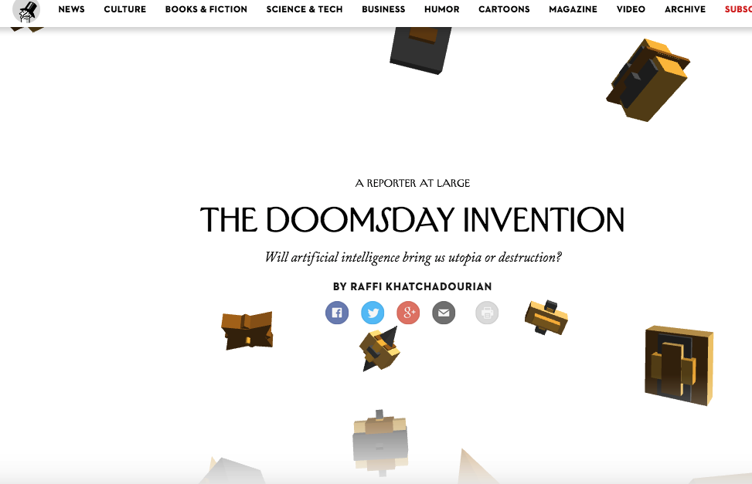
Bonus re Bostrom

Slide 17
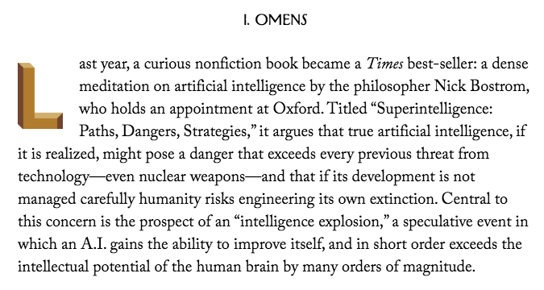

Slide 18
Is this a video game?
“…the process of creating a model of the world using multiple feedback loops in various parameters (e.g., in temperature, space, time, and in relation to others), in order to accomplish a goal (e.g., find mates, food, shelter).”

Slide 19
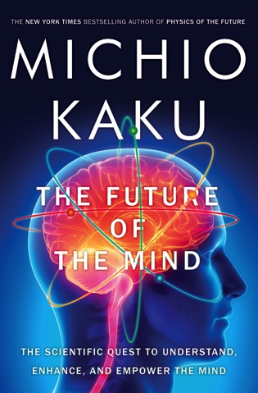
NO, IT IS YOU
“Consciousness is the process of creating a model of the world using multiple feedback loops in various parameters (e.g., in temperature, space, time, and in relation to others), in order to accomplish a goal (e.g., find mates, food, shelter).”

Slide 20
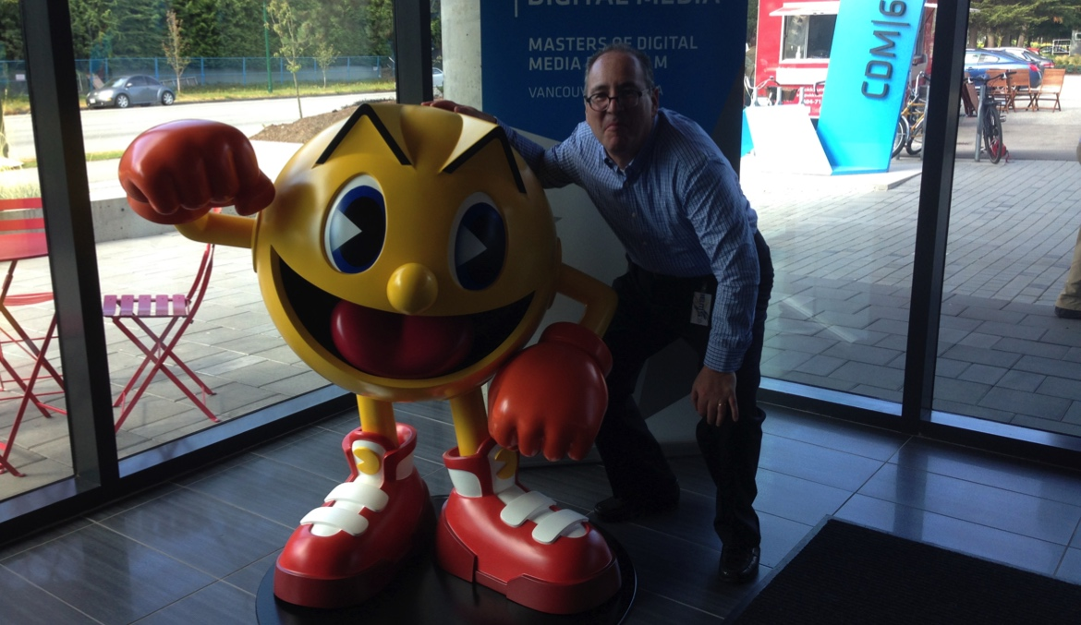
Could it be..?
…That Kaku’s definition of Consciousness aligns so well with video games, because Bostrom is right; we are in a video game.

Slide 21

https://medium.com/message/the-secret-of-minecraft-97dfacb05a3c
“A generative, networked system laced throughout with secrets.”

Slide 22

Is this why we are so obsessed with pursuing confusion between what is virtual and what is real?

Slide 23

The Game of Life
Have we turned life into a game(gamification)?
*ARG’s e.g. EA’s 2001game “Majestic”: tagline = “It Plays You”; by phone, email, instant messaging, fax, and dedicated websites.
* Film Meme: “Inside the Game”
Tron (1982) & Tron Legacy (2010);
Wargames (1983); eXistenZ (1999);
The Thirteenth Floor (1999);
The Matrix (1999); Avalon (2001);
Gamer (2009); Surrogates (2009);
Wreck-It-Ralph (2012).

Slide 24

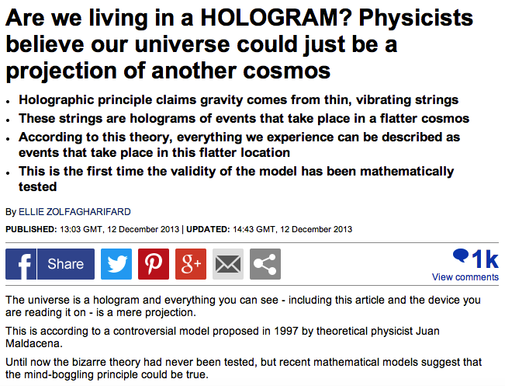
If you want to go all the way…
http://www.dailymail.co.uk/sciencetech/article-2522482/Is-universe-hologram-Physicists-believe-live-projection.html

Slide 25
Remember
Causation
or
Correlation?

Slide 26
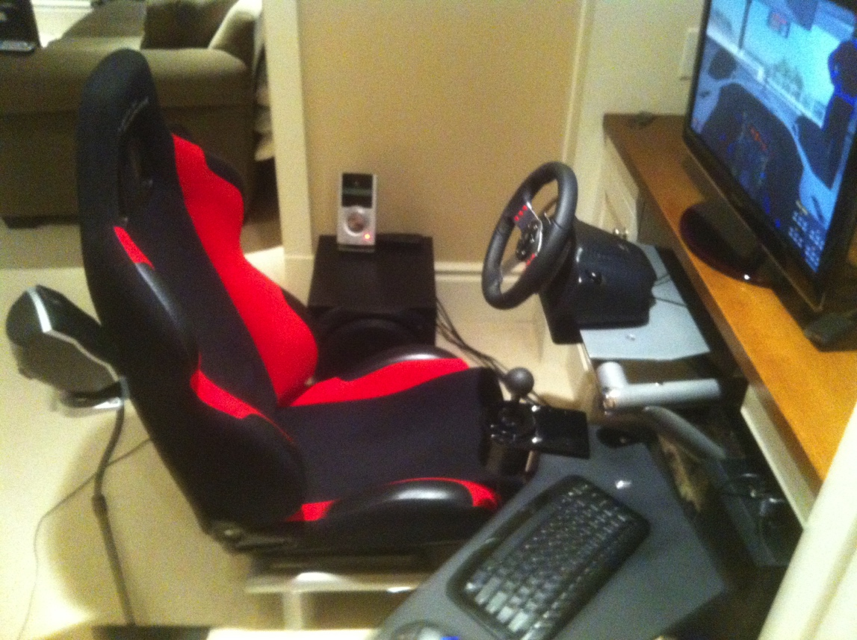
But even if not…
Even if conventional explanation…
Do you remember this question?

Slide 27

WHY?
“Equally strange is our general addiction to games, both physical and mental. The profusion of games is truly startling: card games, board games, word games, ball games, electronic games….We even assemble in huge crowds to watch others playing games. What does all this mean? Do we simply get easily bored and cannot tolerate inactivity? I can find nothing in the literature of scientific psychology that helps me to understand such bizarre behavior.”
The Human Legacy (1982)
Leon Festinger

Slide 28
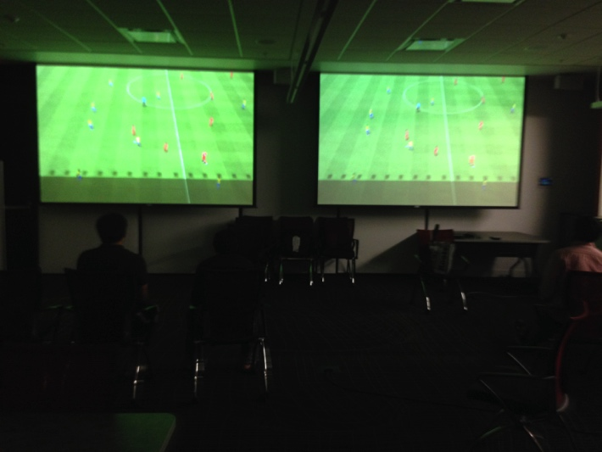
Perhaps we can answer that… at least
How we are conscious &
how we (video) game
appear to be
profoundly aligned.

Slide 29
Exhibit 1:
Jung on Games & Instinct
“One of the most difficult tasks men can perform, however much others may despise it, is the invention of good games and it cannot be done by men out of touch with their instinctive selves.”
Jung and the Story of Our Time, Laurens van der Post (1977)

Slide 30

Exhibit 2: Play as Evolution
Does Gaming have an evolutionary purpose in the Darwinian sense?
Dr. Kimberly Voll (CDM/UBC) – From “Game Design” – DMED 521:
1. “neurons that fire together, wire together” (Donald Hebb, aka “Hebbian Learning”)
2. “..so “fun” seems to be something our brains use to keep us doing something to the point of mastery…makes sense if it is something that will help us live better and get our genes out into the gene pool again…”

Slide 31
Exhibit 3: McLuhan, 1964
(Games as social reaction)
Games are popular art, collective, social reactions to the main drive or action of any culture. Games, like institutions, are extensions of social man and the body politic, as technologies are extensions of the animal organism. Both games and technologies are counter-irritants or ways of adjusting to the stress of the specialized actions that occur in any social group. As extensions of the popular response to the workaday stress, games become faithful models of a culture. They incorporate both the action and the reaction of whole populations in a single dynamic image.

Slide 32

Exhibit 4:
GAMING AS A DARWINIAN EVOLUTION
“The role of self image in video game play”
James Madigan (Gamasutra Feb. 3, 2012)
http://www.gamasutra.com/view/news/40093 The_role_of_self_image_in_video_game_play.php
“In the article, Andrew Przybylski...and his co-
authors hypothesize that we’re motivated to play video
games to the extent that they allow us to sample our
“ideal self characteristics,” especially when there’s
a large gap between our ideal selves and who we actually
think we are. This could help explain why people are
attracted to games in a way that’s unique to the medium.”
Przybylski, A. K., Weinstein, N., Murayama, K., Lynch, M. F., & Ryan, R. M. (2012). The ideal self at play: The appeal of videogames that let you be all you can be. Psychological Science, 23, 69-76.
http://pss.sagepub.com/content/23/1/69.full.pdf+html

Slide 33
Exhibit 5: Boyden
“In all of these situations, the owners of a copyright in a form, description, or set of instructions were attempting to extend their copyright to material for which the user of the work provided the essential content, not its author. That is what made them systems. They were, without that input, empty shells, waiting to be filled.”
“Games are systems in exactly the same way. A game, as sold, is only a game form; the content necessary for an instance of the game comes from the players. That is, the game form establishes the environment for play—the game space—and it defines permissible moves and the conditions for winning or drawing. But the game itself is supplied by the players.”
“Systems are shells into which users pour meaning. While they may contain expression themselves, that expression is there merely to facilitate the meaning added by the user.”

Slide 34
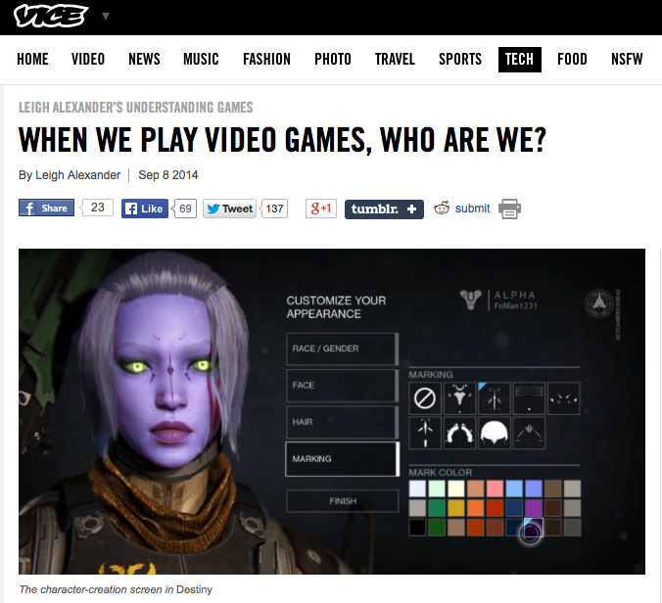
So Who Are We (in-game) A?
“But games, designed to let us act as some fantasy of ourselves, don’t often ask us to think about what someone else “would” do. That players have choices is considered one of the medium’s exciting traits, but I always struggled a little bit to connect to games that have that kind of openness—am I playing a character, or am I being me?”
http://www.vice.com/read/leigh-alexander-understanding-video-games-column-destiny-105

Slide 35
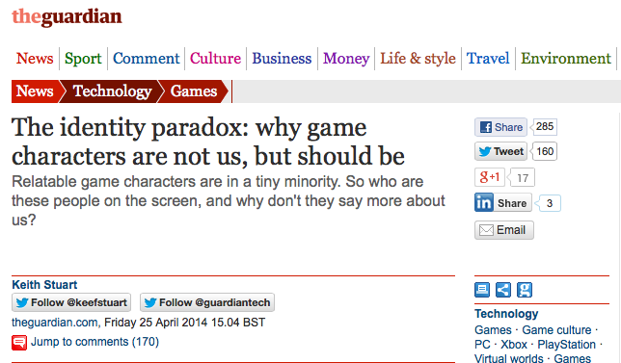
So Who Are We (in-game) B?
http://www.theguardian.com/technology/2014/apr/24/the-identity-paradox-why-game-characters-are-not-but-should-be

Slide 36
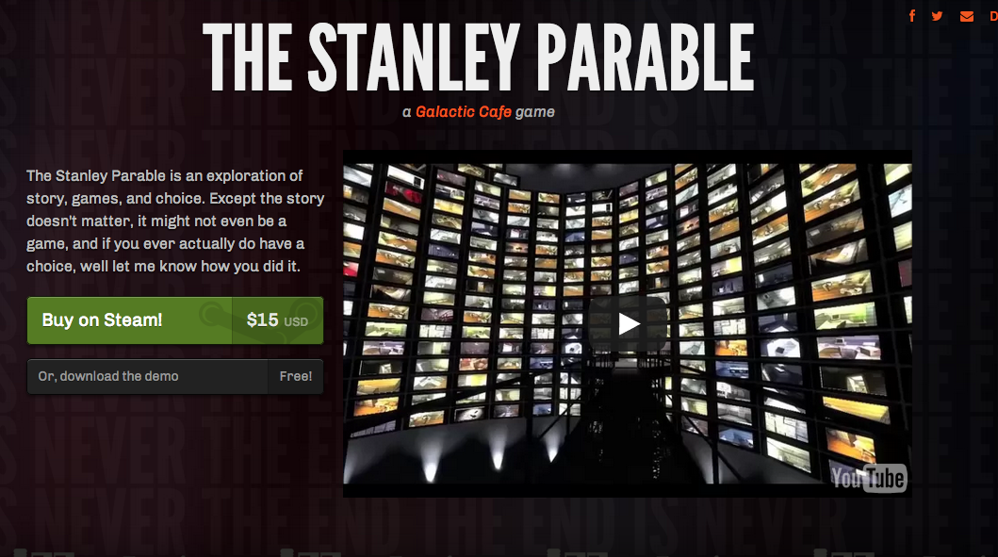
So Who Are We (in-game) C?

Slide 37


Slide 38

Two phenomena we have (fairly) observed?
Alignment of human consciousness & video-game modalities; &
Identity/Immersion Effect (who am I really?)

Slide 39
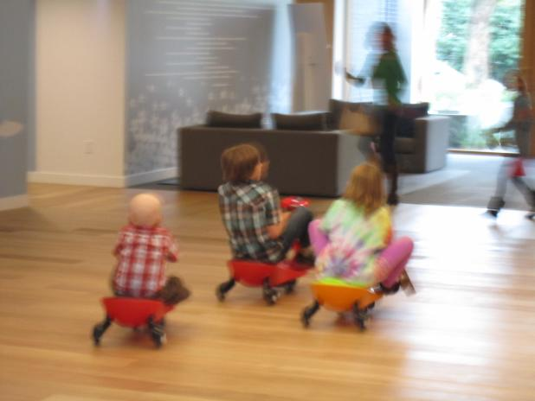
+ One More…
3. Connection (community)
All leading to (you guessed it)…

Slide 40
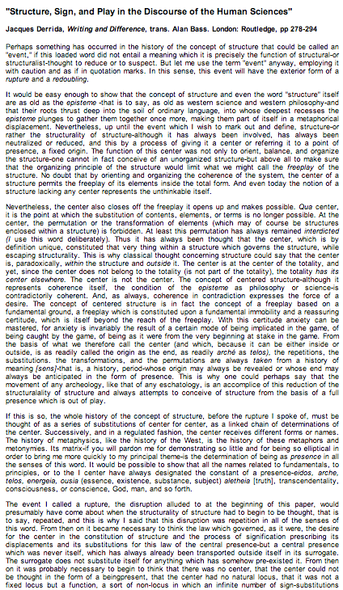
Exhibit 6: Video-Games as
Post-Structuralism
"Structure, Sign, and Play in the Discourse of the Human Sciences” Jacques Derrida
Structures as free-floating (or 'playing') sets of relationships. Structuralist discourses unfortunately hold on to a "center” which anchors the structure and “does not play”.
http://hydra.humanities.uci.edu/Derrida/sign-play.html

Slide 41
From “Post-Structuralism and Videogames
“Post-structuralism with respect to narratology can be said to focus on decentralization of the author and the replacement of them with the reader. What this means is that authorial intent is not the primary goal of a textual or narrative analysis of a work. Decentralizing the author allows the work to be open to new interpretations. The way a text is read by one person is not invalidated by another reading of it, but rather just another interpretation given a different situated perspective. So what does this mean for an individual reader and, more importantly, a videogame player?”

Slide 42
Some legal concepts to consider if video-games are post-structuralist?
Copyright (e.g. mods)
Copyright as an author’s right
Trademarks
Patents
RIGHT TO CREAtE ?
Moral rights
Contracts
Browsewrap contracts
Clickwrap contracts
Privacy (e.g. gamer not system dictates)

Slide 43
Accordingly…
Is it too much to ask that law also align with the already aligned realities of:
human consciousness;
(video) game design; &
community interactions

Slide 44
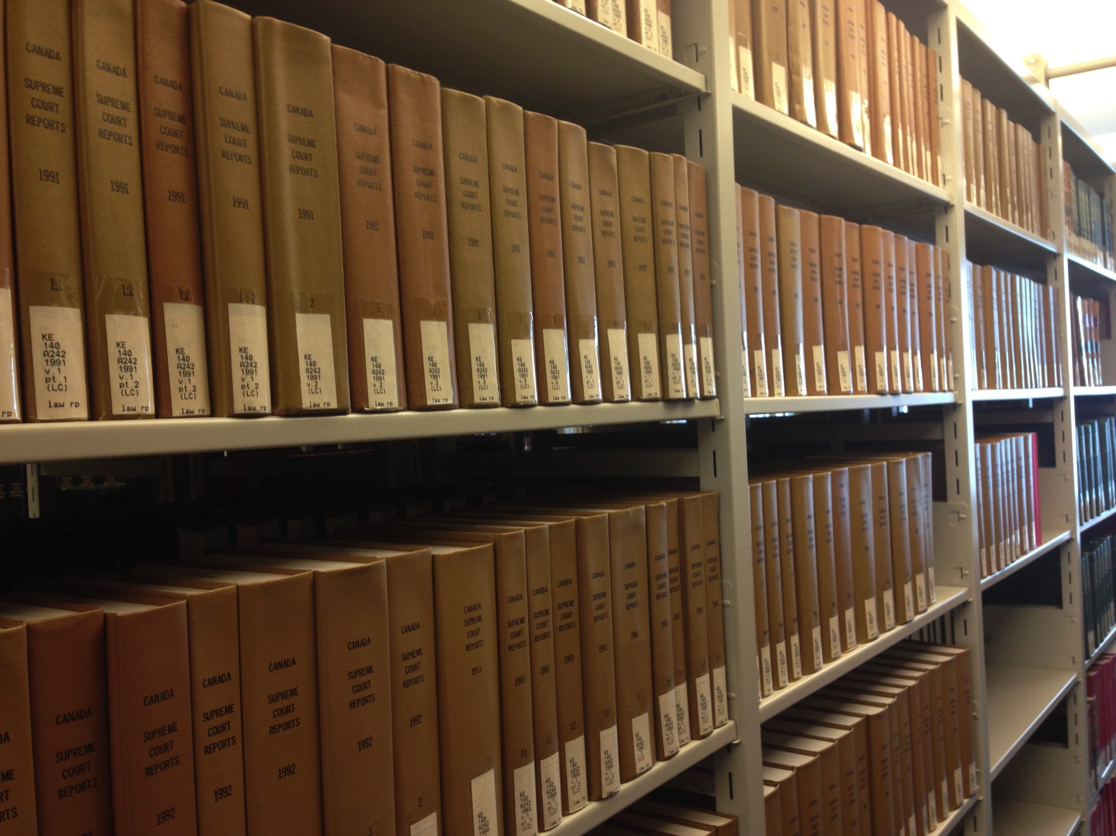
Preliminary Assessments If So
Copyright law does not seem to align.
Perhaps contract law (done properly) does align?

Slide 45

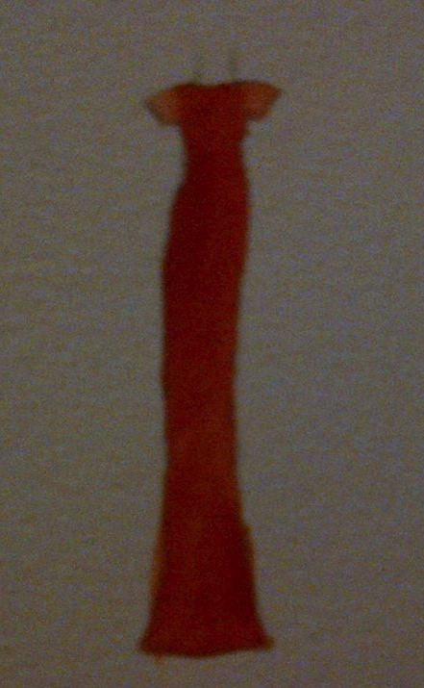

Creativity/Connection IS More Important than Property!

Slide 46

I Can Mod

Slide 47
That was the unconventional analysis of why video-game creativity should not be controlled.
Now on to the conventional analysis of how it is…

Slide 48
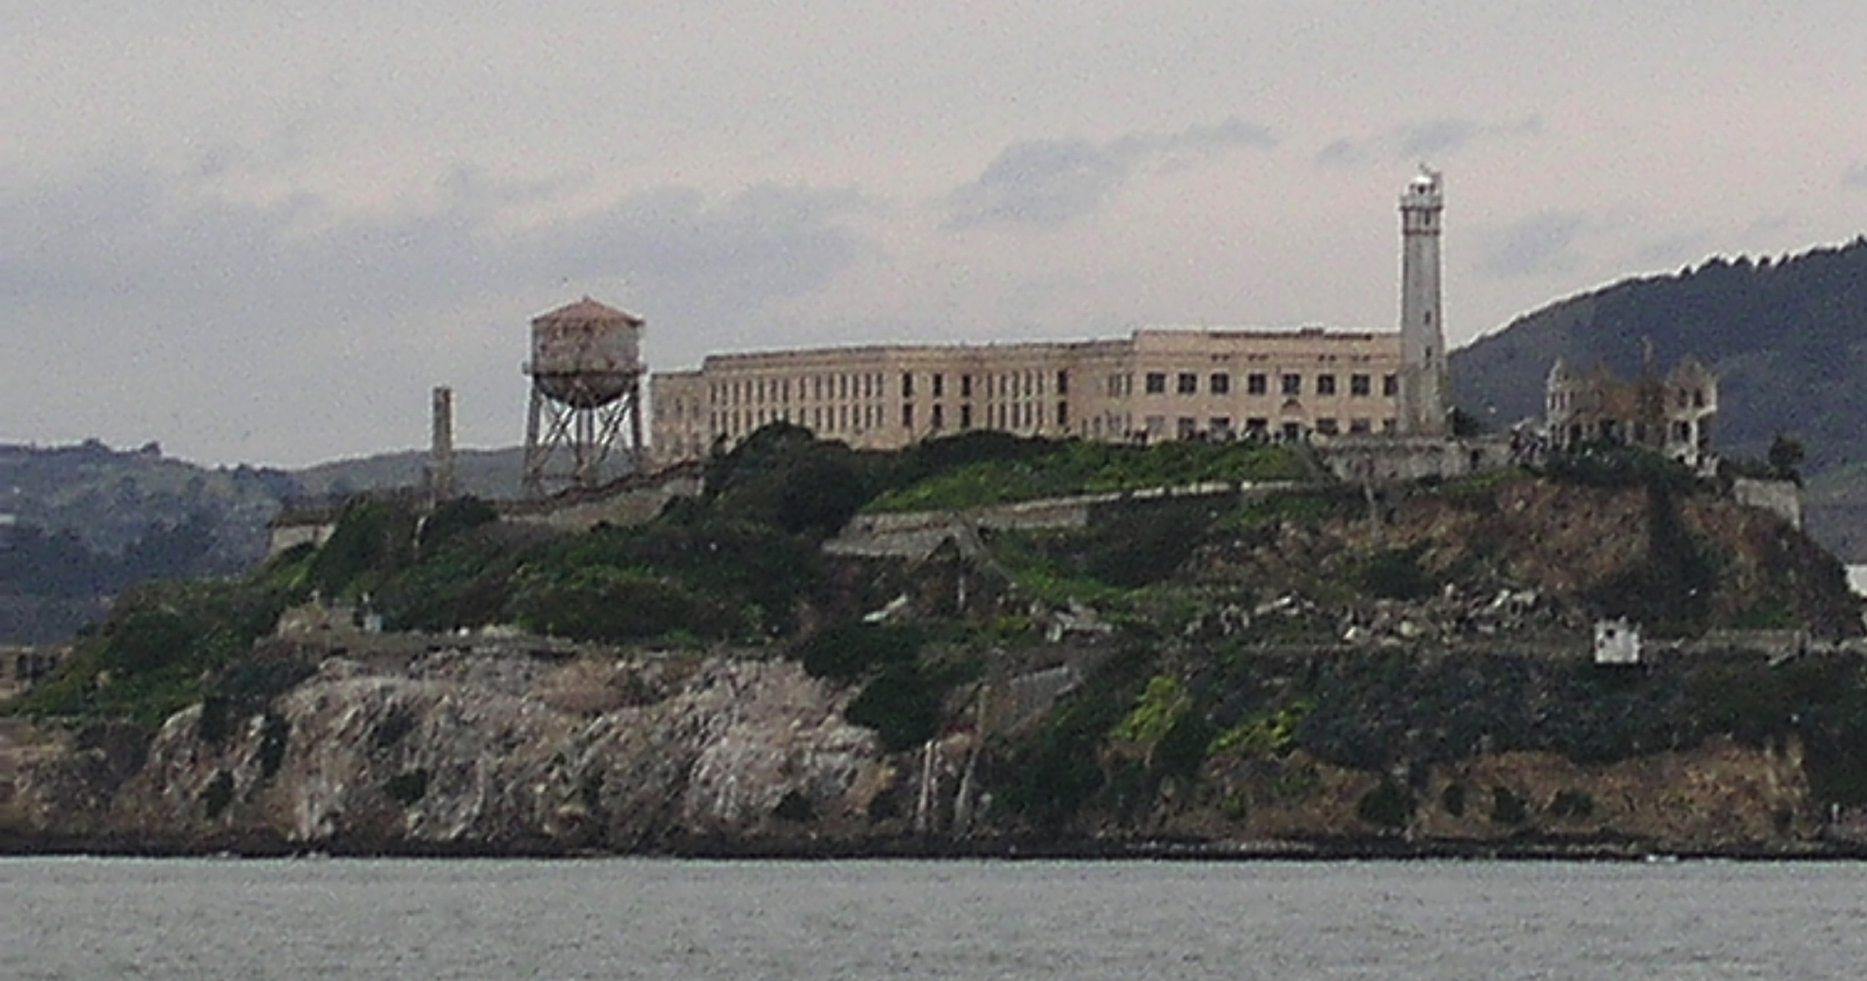
“Part C. Controlling” begins

Slide 49
Which Laws? Layers of Control
11. Internet Governance & Surveillance (International Law)
10. Criminal & Obscenity Laws.
9. Taxation/Currency/Gambling (regulatory; quasi-criminal law)
8. Misleading promises/advertising, physical or psychological harm,
unfair competition/anti-trust (consumer protection)
7. Industry self regulation (delegated authority) & medium specific
regulation (constitutional)
Out of the Creation Norms
------------------------------------------------------------------------------------------------
In the Creation (Magic Circle) Ethics (of Originality, Creativity & Expression)
6. Privacy, Defamation & Personality law (tort, IP)
5. EULA/ToS & Contracts (contractual, private)
4. Trademark, Patents & the IP Business
3. Copyright & Users Rights (statutory)
2. Technology (quasi extra-legal)
1. Community (extra-legal)

Slide 50

Legal Constraints on Digital Creativity:
Originalities & Behaviors
First 6 layers concern what is “original” in the game.
Final 5 concern limiting behaviors outside the game.

Slide 51

The Really New & Difficult: What is next…(& 2 b controlled?)
TELEPATHIC GAMING

Slide 52
Can the Magic Circle
EVEN SURVIVE?
NO QUESTION IT’S SHRINKINg

Slide 53

Remember
The “Magic Circle” acts (in theory) as a fence keeping out real world laws

Slide 54

The “Missing (Ironic) Link”?
Were EULA & ToS originally considered the way to create community laws insulated from real – world laws?
Reinforcing ‘the magic circle’…

Slide 55
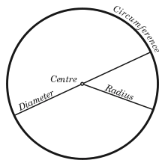
The “Magic Circle”
“All play moves and has its being within a play-ground marked off beforehand either materially or ideally, deliberately or as a matter of course. Just as there is no formal difference between play and ritual, so the ‘consecrated spot’ cannot be formally distinguished from the play-ground. The arena, the card-table, the magic circle, the temple, the stage, the screen, the tennis court, the court of justice, etc. are all in form and function play-grounds, i.e. forbidden spots, isolated, hedged round, hallowed, within which special rules obtain. All are temporary worlds within the ordinary world, dedicated to the performance of an act apart.”
Johan Huizinga (1872-1945) in “Homo Ludens: A Study of the Play-Element in Culture”. Applied to video games by Katie Salen & Eric Zimmerman in “Rules of Play: Game Design Fundamentals” (2003)

Slide 56
The legalities of the “Magic Circle” 1
1. “The Laws of the Virtual Worlds” - Greg Lastowka & Dan Hunter (2003)
http://papers.ssrn.com/sol3/papers.cfm?abstract_id=402860
“No doubt there will be time and litigation enough to soon make further observations. However there is one point
that is worth making in conclusion. It is not going to be a sufficient answer, either for property or avatar rights, to
say, “It’s just a game”. Nor can the company creating the world simply intone that the world is theirs to do with as
they wish. The issues are more complex than that, and the users and community will have a say in the outcome
of these questions…We will have to recognize that these are separate places, with a separate community, separate laws,
and separate rights. Sometimes the inhabitants of these worlds will come down to our world, to have
recourse to our law, and gain protections against their gods. But more and more they will live out their lives in a different
world, and they will eventually come to create their own laws, just as they are building their own community. In time perhaps they won’t care what we think or what our laws say. They will live and love and law for themselves.”
2. “Virtual Liberty: Freedom to Design and Freedom to Play in Virtual Worlds” Jack Balkin (2004) http://papers.ssrn.com/sol3/papers.cfm?abstract_id=555683
“In the future, virtual worlds are likely to become important spaces for innovation and free expression. Properly
drafted interration statutes can help promote these values. To this end, legislatures should prominently state the
public values these statutes are designed to serve in the statutes themselves as guides to interpretation by
courts, and courts, in turn, should interpret these statutes liberally to promote free speech values. We should view
interration statutes as applications and extensions of the central values of individual creativity and democratic
participation that we associate with the First Amendment.⁹⁶ That is to say, we should view them as “First
Amendment extension acts” appropriate for a digital world in which many of the most important spaces for
creative expression are held in private hands.”
3. “The Right to Play” - Edward Castronova (2005)
http://papers.ssrn.com/sol3/papers.cfm?abstract_id=733486
“A legal framework for make-believe places will not be very fun to create either. It will require numerous creditors,
theft victims, tax collectors, protestors, defeated warriors and impoverished wizards to simply go home empty
handed, unsatisfied, perhaps distraught. But it will allow everyone, all of us, to spend time in worlds where magic
is real. Goodness, we haven’t done anything like that in hundreds of years. We miss it.”

Slide 57
The legalities of the “Magic Circle” 2
4. “Virtual Property” - Joshua Fairfield (2005) http://papers.ssrn.com/sol3/papers.cfm?abstract_id=807966
“I propose a different answer: cyberspace is neither a bad analogy nor a metaphor. Cyberspace is a
descriptive term. It describes the degree to which some kinds of code act like spaces or objects…And
while the place and space language is routinely used by the courts and lawyers, again, legal academics
have either supported the place metaphor as merely psychologically useful, or have completely
rejected it as a bad analogy.”
5. “Virtual Borders: The Interdependence of Real and Virtual worlds” – James
Grimmelmann (2006) http://papers.ssrn.com/sol3/papers.cfm?abstract_id=868824
“In the end, talking about the real-money trade points out the deep interdependence of the virtual and the real. It is possible only because of their interrelationship. If avatars in virtual worlds were not so profoundly linked to people in the real one, there would be no real-money trade. To the extent that the real-money trade is a problem, its solution also must recognize the interdependence of the real and the virtual.”
6. “The Magic Circle” - Joshua Fairfield (2008)
http://papers.ssrn.com/sol3/papers.cfm?abstract_id=1304234
“The implications for the future of virtual worlds are complex. On one hand, denizens of virtual worlds
should hope that the law that ultimately govern virtual worlds will not only take their interests into account
in some sort of paternalistic fashion, but that courts will give the actual solutions worked out by online
communities the force of law. On the other hand, players in virtual worlds should understand that their
behavior online is not entirely free from real-world scrutiny. This is a bit saddening. It was wonderful to live
in the cyber Wild West. But every new frontier has its civilizing moments. And virtual worlds are an
enormous phenomenon, one that law cannot afford to ignore.”

Slide 58

The “Magic Circle” exposed
“As stated previously, players never play a new game or fail to bring outside knowledge about games and gameplay into their gaming situations. The event is ‘‘tainted’’ perhaps by prior knowledge. There is no innocent gaming…Players also have real lives, with real commitments, expectations, hopes, and desires. That is also brought into the game world, here Azeroth. We can neither ignore such realities nor retreat to structuralist definitions of what makes or defines a game. Games are created through the act of gameplay, which is contingent on acts by players.”
“There is No Magic Circle” - Mia Consalvo (2009)http://www.academia.edu/654444/There_is_no_magic_circle
“An activity that occurs in a virtual environment is subject to real-world law if the user undertaking the activity reasonably understood, or should have reasonably understood, at the time of acting, that the act would have real-world implications.”
“Virtual Law: Navigating the Legal Landscape of Virtual Worlds” – Benjamin Duranske (Paperback, ABA, 2008)
BACK TO:
Real-world “play” (“Ingress” – Capture the Flag mechanic)
+ Immersive control mechanism (Google Glass)
+ Anywhere/any device capability (the “cloud”)
+ “Open World” design (literally & Google Earth)
+ Tools/weapons (AR Drone Quadra Copter; Google Car)
IS THIS REALLY A GAME?

Slide 59
So now..
With the magic circle shrinking or shrunk
What is original (& therefore IP) in a Video Game?
(Hint: not as much as you think..)

Slide 60
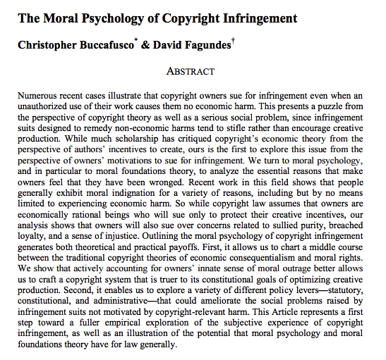
Psychological factors first…

Slide 61
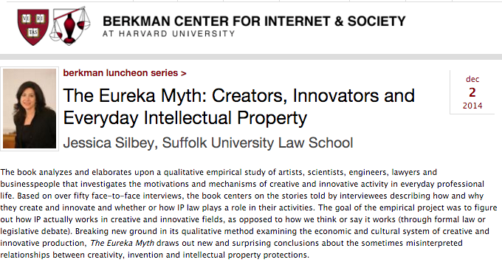
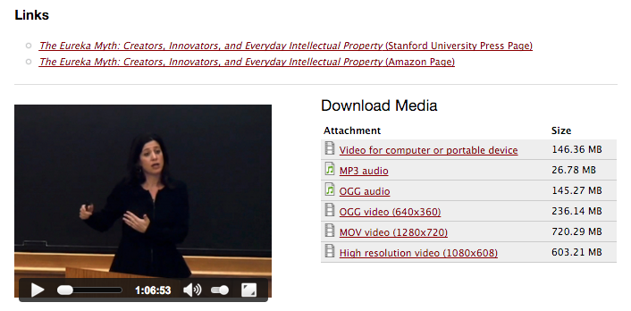

Slide 62
STEP 1 – not the “system”
“Games and Other Uncopyrightable Systems” Bruce Boyden (2011) http://www.georgemasonlawreview.org/doc/Boyden_18-2_2011.pdf
“Games are systems in exactly the same way. A game, as sold, is only a
game form; the content necessary for an instance of the game comes
from the players. That is, the game form establishes the environment for play
—the game space—and it defines permissible moves and the conditions for
winning or drawing. But the game itself is supplied by the players. Games
are systems in the same way that the excluded schemes in the cases above
were systems.”
“For systems, the rule against the copyrightability of games demonstrates why
systems are generally uncopyrightable and why that term has special
significance. The term is not merely a synonym for “idea,” or “process.”
Systems are shells into which users pour meaning. While they may contain
expression themselves, that expression is there merely to facilitate the meaning
added by the user. Copyright properly excludes them.”

Slide 63
Other Steps
*Not Ideas or General
Concepts
*Not Genres; scenes a faire
*Not Rules, play methods,
common moves
*Not stock characters

Slide 64
What’s left that is protectable?
ART - look & feel
& Atari v. Oman (Breakout) almost denied that
+
Underlying Code
+
Sound
+
Plagiarism (protected against)

Slide 65
Original-ism cases
* “IGT v. Alliance Gaming Corp” (wheel of Fortune http://www.bakerlaw.com/alerts/patent-watch-igt-v-alliance-gaming-corp-12-20-2012/
* “Washington v. Take-two Interactive Software, Inc., et al.” (misappropriation of likeness in GTA) http://www.loeb.com/news/CaseList.aspx?Type=ip&case=1907
* “GSC Game World Claims Ownership of S.T.A.L.K.E.R. Game Rights”http://gamepolitics.com/2012/12/13/gsc-game-world-claims-ownership-stalker-game-rights#.UTb246XR2kU
* “SEGA Takes Legal Action Against Level-5 Over Nintendo DS Patent Dispute”http://www.nintendolife.com/news/2012/12/sega_takes_legal_action_against_level_5_over_nintendo_ds_patent_dispute
* “Court Tackles Copyright Issue of "Throwback" NFL Uniforms in Video Games” http://www.manatt.com/SportsLaw/Court_Tackles_Copyright_Issue_of_Throwback_NFL_Uniforms_in_Video_Games.aspx
* “Tweeria Struggles With Copyright Problems”http://www.gamepolitics.com/2012/12/27/tweeria-struggles-copyright-problems#.UTb6UaXR2kU
* “Tetricide” http://uttresl.wordpress.com/2013/02/01/tetricide-2/
* “Wizards of the Coast Sued for Magic: The Gathering Online Patent Infringement Claims”http://gamepolitics.com/2012/11/02/wizards-coast-sued-magic-gathering-online-patent-infringement-claims#.UTb8KKXR2kU
* “Scrabble 3D tile held to be invalid by High Court - JW Spear & Sons Ltd and Mattel Inc v Zynga” http://www.lexology.com/library/detail.aspx?g=c918285f-f721-4a1a-8b70-80dce5b422ba
* “British games company says it owns the idea of space marines”http://www.theregister.co.uk/2013/02/07/games_workshop_in_spurious_space_marines_claim/
* “Infringing World of Warcraft theme park built in China”http://the1709blog.blogspot.ca/2013/01/infringing-world-of-warcraft-theme-park.html
* “Tolkien estate unleashes legal Uruk-hai on LoTR online slot machines”
http://arstechnica.com/tech-policy/2012/11/tolkien-estate-unleashes-legal-uruk-hai-on-lotr-online-slot-machines/
* “Keller v. EA: visual elements mean game isn’t protected by First Amendment”
http://tushnet.blogspot.ca/2013/08/keller-v-ea-visual-elements-mean-game.html
* ”The First Amendment in play: Brown v. EAhttp://tushnet.blogspot.ca/2013/08/the-first-amendment-in-play-brown-v-ea.html

Slide 66

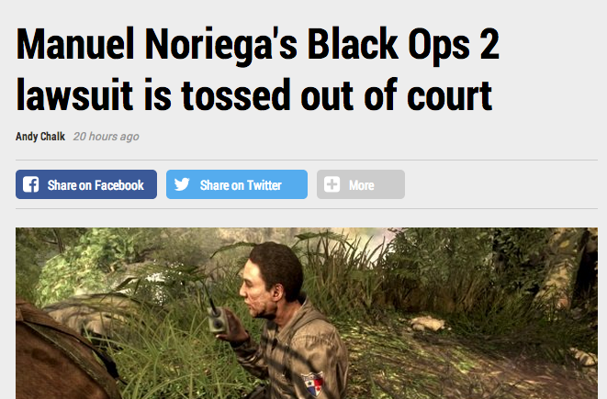
http://www.pcgamer.com/manuel-noriegas-black-ops-2-lawsuit-is-tossed-out-of-court/

Slide 67
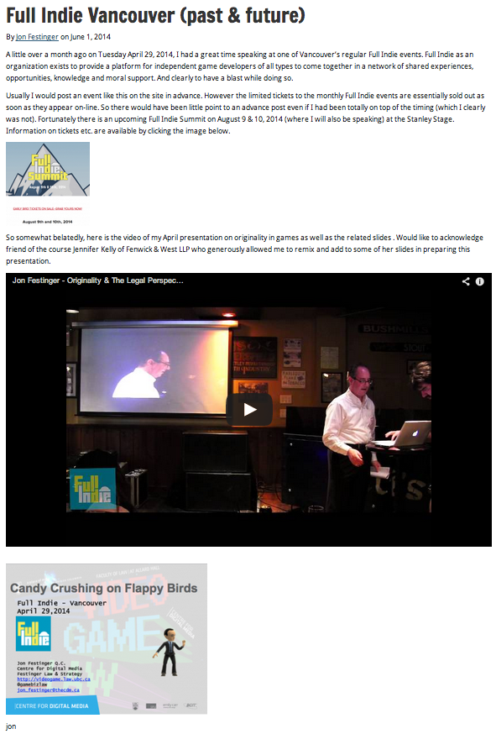
My Version…
http://videogame.law.ubc.ca/2014/06/01/full-indie-vancouver-past-future/

Slide 68
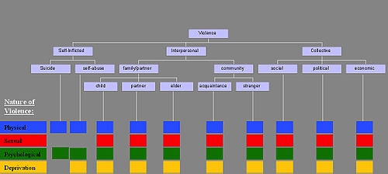
Next Class: “Mass Effect-s”
The Assault on Video gaming
The Assault by Video gaming
REMIXING VIOLENCE, MISOGYNY & CIVIL SOCIETY

Slide 69

Always include a cat picture

Slide 70
Quest De Integro Ludus (latin for “concerning the whole” Game)

Slide 71
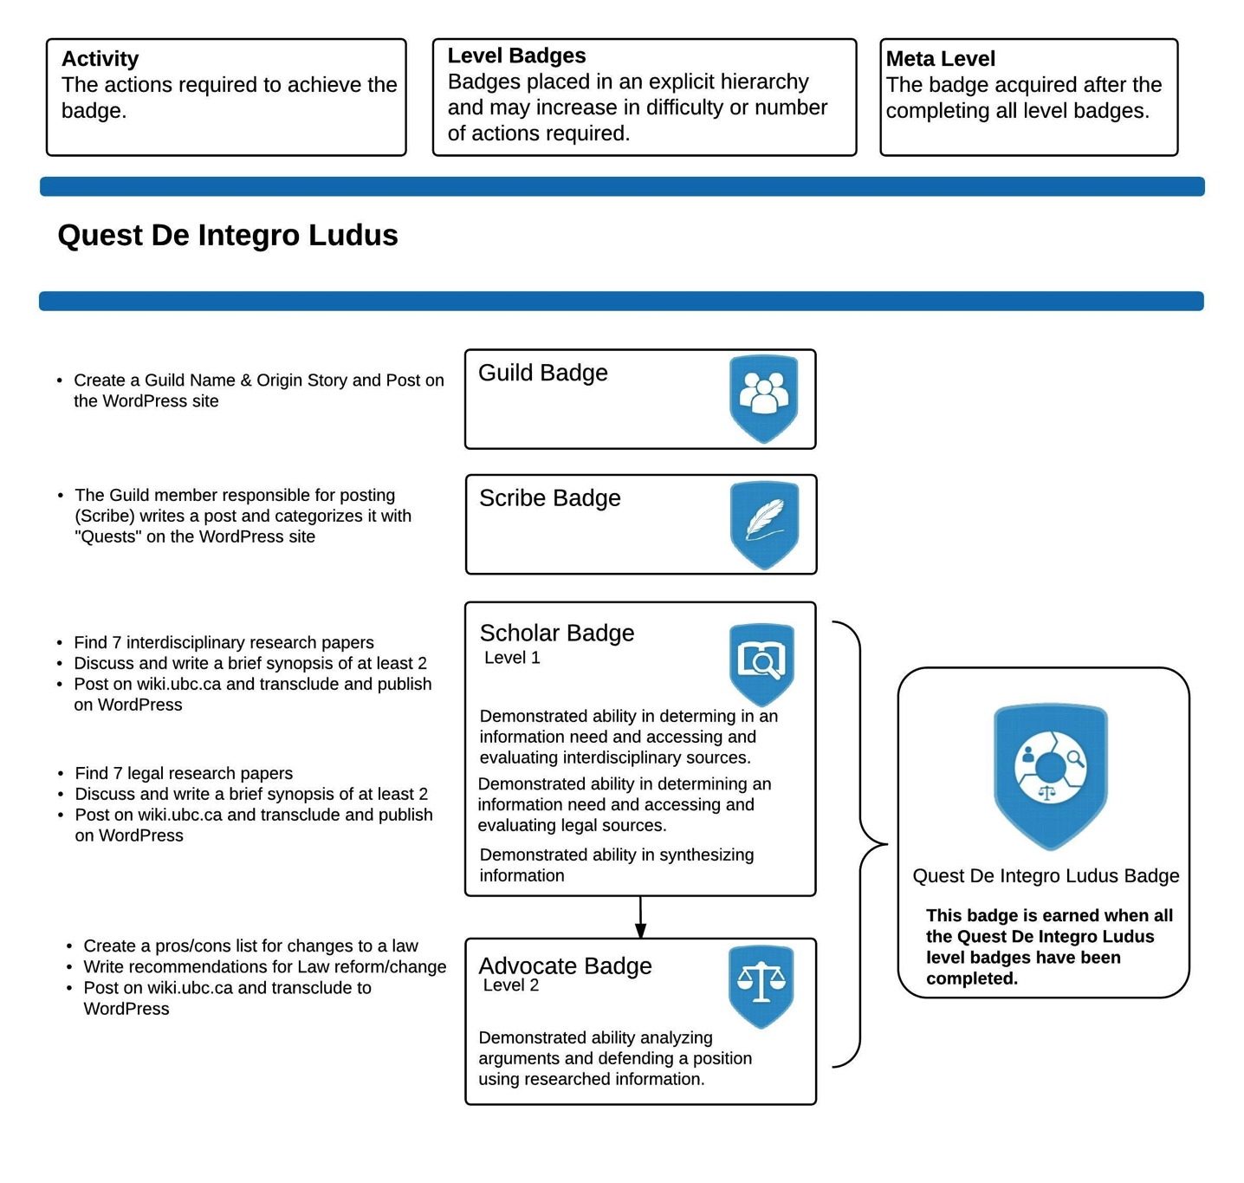

Slide 72
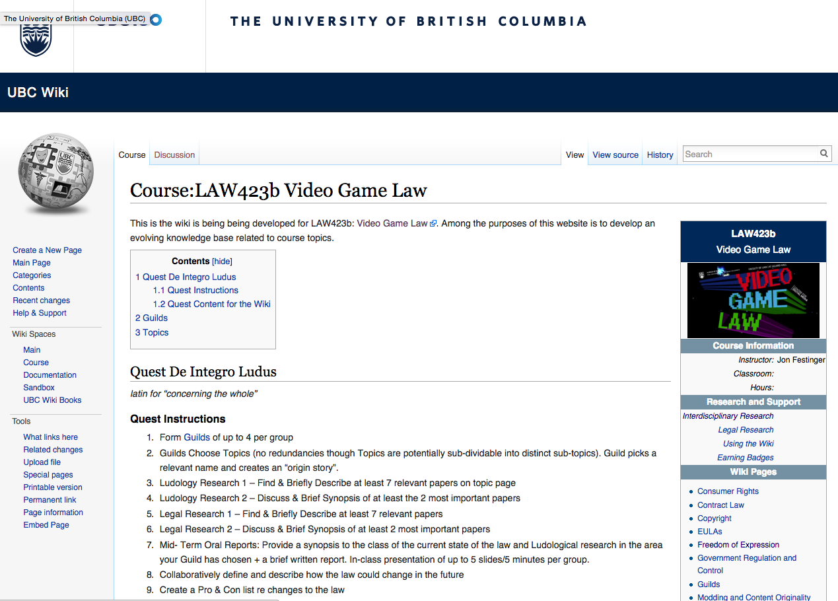

Slide 73
Topics (+Legal Aspects of + Video games)
Topic 1 (Class 2): Freedom of Expression
Topic 2 (Class 3): Copyright
Topic 3 (Classes 4 & 9): Modding & Content Originality
Topic 4 (Class 5): Consumer Rights
Topic 5 (Class 6): Contract Law
Topic 6 (Class 7): EULA’s - Good & Evil
Topic 7 (Class 8): Technology & Change
Topic 8 (Class 10): Violence, Misogyny & Social Issues
Topic 9 (Class 11): Privacy & Surveillance
Topic 10 (Class 11, 12 & 13): Government Regulation & Control

Slide 74
Class Activities
Class 1 Rules Explained: *Guilds of up to 4 per group; *All CC licensed and in Wiki.
Class 2 Guilds Formation Based on Topics (no redundancies though Topics are potentially sub-dividable into distinct sub-topics). Guild picks a relevant name and creates an “origin story”.
Class 3 Ludology Research 1 – Find & Briefly Describe at least 7 relevant papers
Class 4 Ludology Research 2 – Discuss & Brief Synopsis of at least the 2 most important papers
Class 5 Legal Research 1 – Find & Briefly Describe at least 7 relevant papers
Class 6 Legal Research 2 – Discuss & Brief Synopsis of at least 2 most important papers
Class 7 Mid- Term Oral Reports: Provide a synopsis to the class of the current state of the law and Ludological research in the area your Guild has chosen + a brief written report. In-class presentation of up to 5 slides/5 minutes per group.
Class 8 Collaboratively define and describe how the law could change in the future
Class 9 Create a Pro & Con list re changes to the law
Class 10 Recommendations for Law Reform/Change
Class 11 Oral Opinions/Presentation: Each Guild present up to 20 slides of alternating but responsible views on critical aspects of their legal quest in up to 15 minutes. This is not intended as a debate but rather as a technique to fairly illuminate different perspectives on a particular issue. A joint conclusion or perspective at the end is optional, but encouraged.

Slide 75
Our Academic Partners

