Slide 1


“If Picasso had painted a round object..”
Talk 2
Part A “Creating”
Video Game Law - Fall 2017
Allard School of Law, UBC
Jon Festinger Q.C.
Centre for Digital Media
Allard Law of Law, UBC
QMUL School of Law (CCLS)
Festinger Law & Strategy
http://videogamelaw.allard.ubc.ca/
Twitter: @jonfestinger
jon_festinger@thecdm.ca

Slide 2
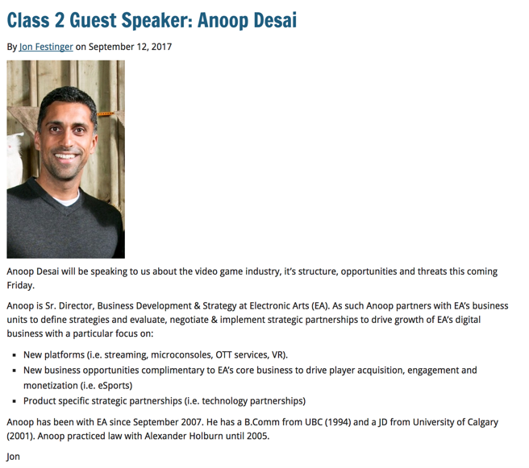

Slide 3
http://videogame.law.ubc.ca

Slide 4
For full privileges on the website
1. Please create an account at http://cms.ubc.ca/ using your CWL.
2. Once you create an account and sign in at http://cms.ubc.ca/ you can click your name in the top right. Half way down the following page will be your WordPress email address.
3. Send me your WordPress email address at jfestinger@telus.net or at jon@fblawstrategy.com
4. Then, I will invite you to participate with authoring privileges via your WordPress email address.

Slide 5

Website & Badge issues…

Slide 6
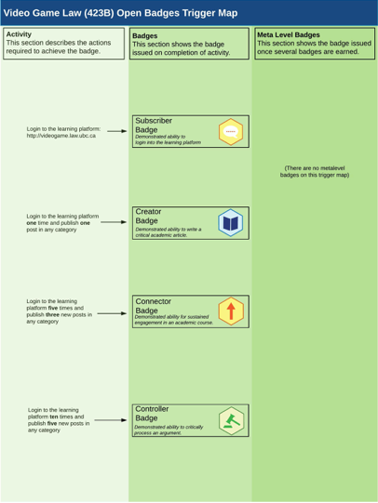

Slide 7
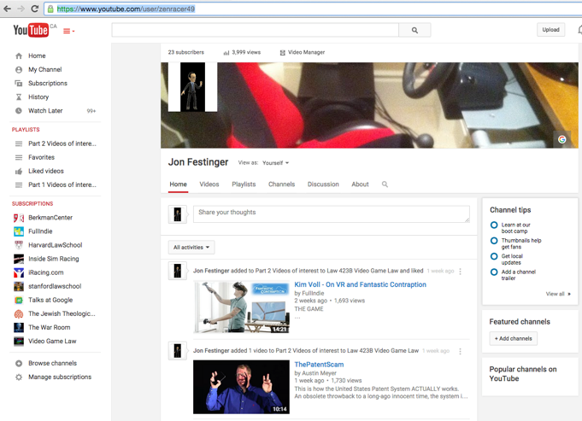
Two more things re sources…
https://www.youtube.com/user/zenracer49

Slide 8


Slide 9
Presentation Groups?

Slide 10

Now Back to Our Regularly Scheduled Programming…

Slide 11
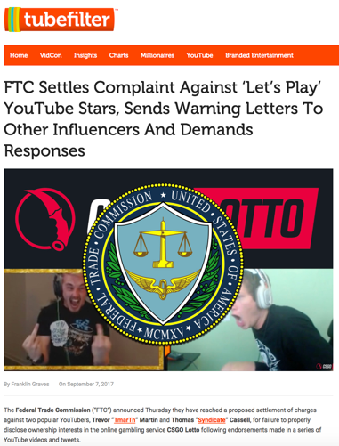
News of the Week 1

Slide 12
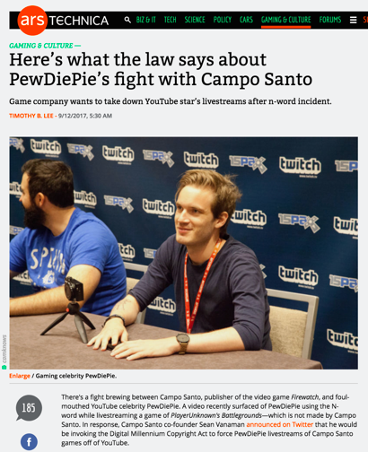
News of the Week 2

Slide 13

Follow Up 1
GAMING AS A DARWINIAN EVOLUTION
“The role of self image in video game play”
James Madigan (Gamasutra Feb. 3, 2012)
http://www.gamasutra.com/view/news/40093 The_role_of_self_image_in_video_game_play.php
“In the article, Andrew Przybylski...and his co-
authors hypothesize that we’re motivated to play video
games to the extent that they allow us to sample our
“ideal self characteristics,” especially when there’s
a large gap between our ideal selves and who we actually
think we are. This could help explain why people are
attracted to games in a way that’s unique to the medium.”
Przybylski, A. K., Weinstein, N., Murayama, K., Lynch, M. F., & Ryan, R. M. (2012). The ideal self at play: The appeal of videogames that let you be all you can be. Psychological Science, 23, 69-76.
http://pss.sagepub.com/content/23/1/69.full.pdf+html

Slide 14
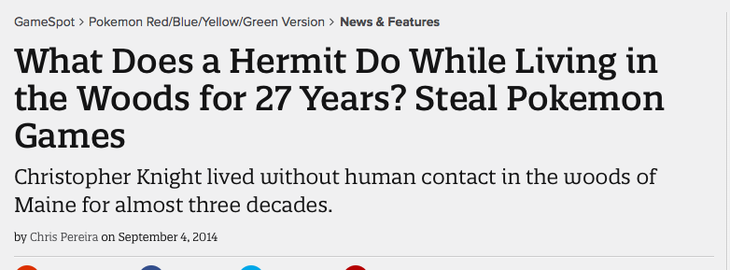
“To keep himself occupied--27 years or so is a long time to go without human contact--he stole things like books and games, including handheld Pokemon, Dig Dug and Tetris games”
http://www.gamespot.com/articles/what-does-a-hermit-do-while-living-in-the-woods-fo/1100-6422106/

Slide 15
Follow Up to Talk 1:
Why do we game?
A. Social reaction (McLuhan);
B. Social learning interaction (Panksepp);
C. To be in touch with our instinctive self (Jung);
D. As part of Evolution (Darwin, Voll).

Slide 16
Most significant legal implications are from which of the above?
NOTE BAIT & SWITCH
Not “Why do we game?”

Slide 17
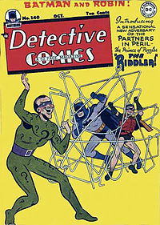
Answer:
A. Social reaction (McLuhan)
Why?
That is the rest of the course

Slide 18
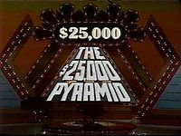
Think…Social Reaction +…
Violence in games
Misogyny in games and in the games industry
Privacy & Surveillance
Contract validity (End User License Agreement click-wrap)
AND YES…
EVEN COPYRIGHT
But how?…remember the riddle…

Slide 19

Last Weeks Riddle:
Games are not IP;
Video Games are IP;
Explain?:….
Last Week’s Question:
“Why Games?”
To answer the riddle (& perhaps more) we must ask
WHAT IS A GAME (in IP terms)?
“Games and Other Uncopyrightable Systems” Bruce Boyden (2011) http://www.georgemasonlawreview.org/doc/Boyden_18-2_2011.pdf

Slide 20
“Games and Other Uncopyrightable Systems”
Bruce Boyden (2011)
“Games therefore pose a number of challenges for copyright and patent law. Yet to date, intellectual property doctrine and scholarship has not really grappled with the slippery nature of games. Indeed, copyright has developed a very simple black-letter rule to handle them: games are not copyrightable. That rule begins to fall apart on close examination, however. It turns out that while games per se are not copyrightable, most of their constituent elements are: the board, pieces, cards, and even the particular expression of the rules. What could be the purpose of such a rule?” http://www.georgemasonlawreview.org/doc/Boyden_18-2_2011.pdf
Clue : ROLE OF THE GAMER

Slide 21
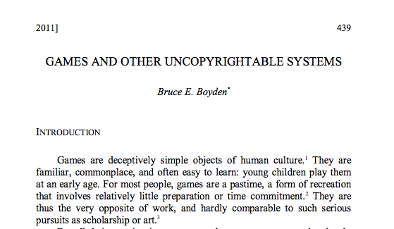

More on Boyden…
Next class…

Slide 22

Starting Point

Slide 23
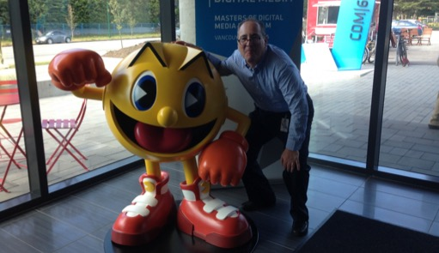
Let’s start with…not quite knowing what is real…

Slide 24

All the World is a Game
WE ARE
?

Slide 25
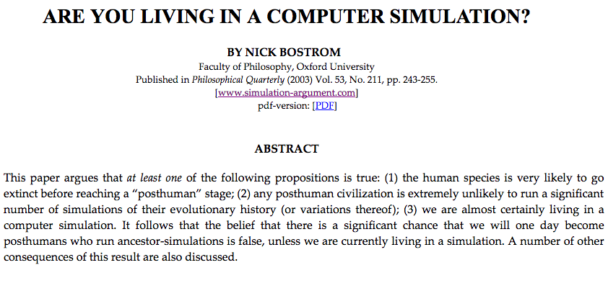

Slide 26
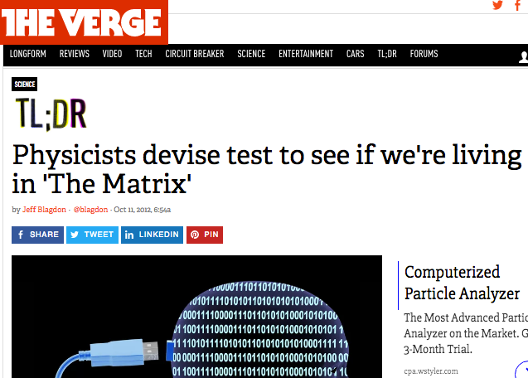

Slide 27
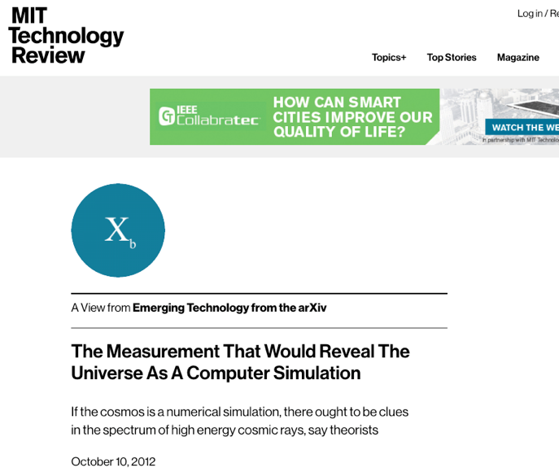

Slide 28
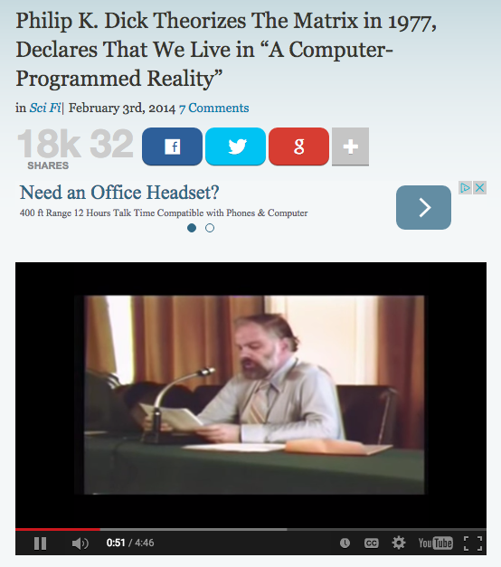
http://www.openculture.com/2014/02/philip-k-dick-theorizes-the-matrix-in-1977-declares-that-we-live-in-a-computer-programmed-reality.html

Slide 29
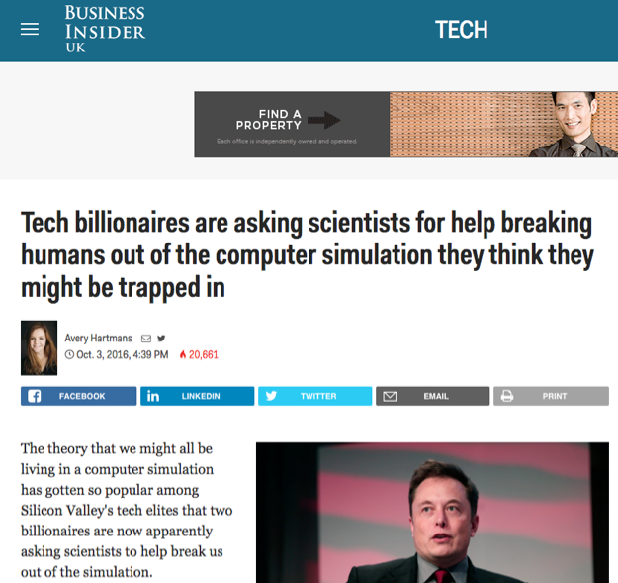

Slide 30

The Really Big Question
Something super weird…
Or totally obvious?

Slide 31
Is this a video game?
“…the process of creating a model of the world using multiple feedback loops in various parameters (e.g., in temperature, space, time, and in relation to others), in order to accomplish a goal (e.g., find mates, food, shelter).”

Slide 32

NO, IT IS YOU
“Consciousness is the process of creating a model of the world using multiple feedback loops in various parameters (e.g., in temperature, space, time, and in relation to others), in order to accomplish a goal (e.g., find mates, food, shelter).”

Slide 33

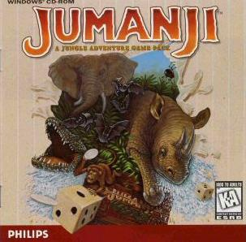
Could it be..?
…That Kaku’s definition of Consciousness aligns so well with video games, because Bostrom is right; we are in a video game.

Slide 34

Is this why we are so obsessed with pursuing confusion between what is virtual and what is real?

Slide 35

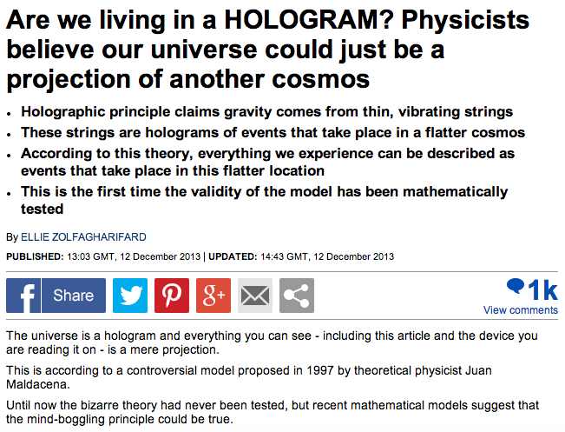
If you want to go all the way…
http://www.dailymail.co.uk/sciencetech/article-2522482/Is-universe-hologram-Physicists-believe-live-projection.html

Slide 36
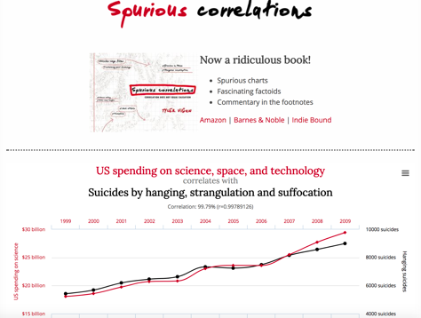
Remember:
Causation
or
Correlation?

Slide 37
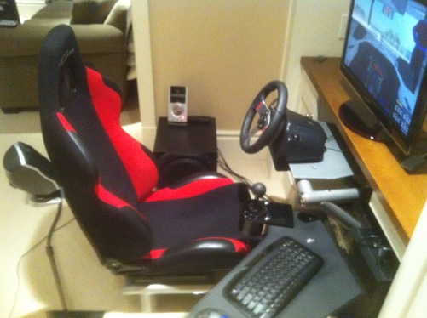
But even if not…
Even if conventional explanation…
Remember this question?

Slide 38

WHY?
“Equally strange is our general addiction to games, both physical and mental. The profusion of games is truly startling: card games, board games, word games, ball games, electronic games….We even assemble in huge crowds to watch others playing games. What does all this mean? Do we simply get easily bored and cannot tolerate inactivity? I can find nothing in the literature of scientific psychology that helps me to understand such bizarre behavior.”
The Human Legacy (1982)
Leon Festinger

Slide 39
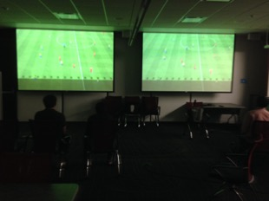
Perhaps we can answer that… at least
How we are conscious &
how we (video) game
appear to be
profoundly aligned.

Slide 40
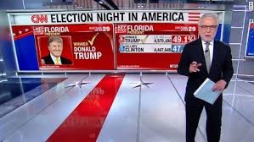
And does all this explain?

Slide 41

To be continued…
Batman Episode 66

Slide 42
All leading to…
→→

Slide 43

“What Are Video Games (today)?”
https://medium.com/message/the-secret-of-minecraft-97dfacb05a3c
“A generative, networked system laced throughout with secrets.”

Slide 44
Video games as Media
The return of the oral narrative?
“Mass Effect and Orality: Video Games as Transitional Literature” Conrad Leibel http://ualberta.academia.edu/ConradLeibel
“Ultimately, video games stand as the successor of the original oral culture; revitalizing itself through the use of written text in order to make itself relatable to the player/reader yet also giving new life to the written tradition through enabling a level of interactivity between the text and reader only seen in the oral tradition…”
“Games as Conversation” Rogelio E. Cardona-Rivera and R. Michael Young
“ We present a metaphor through which to study games: games as conversation, which casts gameplay as a communicative exchange between player and game.”
http://www.rogel.io/content/02-publications/cardona-rivera2014gamesasconversation.pdf

Slide 45

“Ulysses as an RPG” Alistair Brown (2012)
http://www.alluvium-journal.org/2012/10/01/ulysses-as-an-rpg/
“Whilst ludological game theorists…have made
us aware of the fundamental structural
differences between a game and a book, Joyce’s
novel may be said to be more ludic than most. As
Jay David Bolter and Michael Joyce have
suggested, modernist writers like Joyce “were
trying to set up new relationships between the
moment-by-moment experience of reading a text and
our perception of the organizing and controlling
structures of the text. In this sense,
hypertextual fiction is a natural extension of
their work, redefining the tradition of modernism
for a new medium”

Slide 46

Worth noting – the challenges to IP posed by oral storytelling cultures
http://www.goethe.de/ins/za/prj/wom/inw/enindex.htm

Slide 47
IP Dystopia?
* Donaldson v. Beckett (1774) 1Eng. Rep. 837 H.L. denied continued existence of perpetual common law copyright, upholding limitation on term per statute (see Statute of Anne, 8Anne c. 19 (1710)
* “How The Video Game Industry Was Launched 40 Years Ago... Thanks To Infringement” Techdirt Nov. 30, 2012 http://www.techdirt.com/blog/innovation/articles/20121129/17592021179/how-video-game-industry-was-launched-40-years-ago-thanks-to-infringement.shtml
* “Copyright Law and Video Games: A brief History of an Interactive Medium” Prof. Greg Lastowka http://papers.ssrn.com/sol3/papers.cfm?abstract_id=2321424

Slide 48
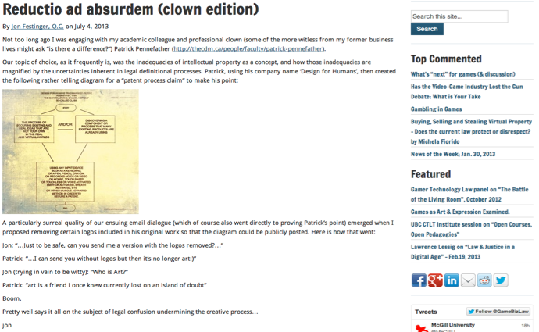
IP Dystopia
Dystopia = an imaginary place where people lead dehumanized and often fearful lives

Slide 49


Universal v. Sony (for the 1st time)
Sony Corporation of America et al. v. Universal City Studios, Inc., et al. 464 U.S. 417 (1984) Supreme Court of the United States
http://scholar.google.ca/scholar_case case=5876335373788447272&hl=en&as_sdt=2&as_vis=1&oi=scholarr&sa=X&ei=hGYvUsjELay7jALQ9YHYBg&ved=0CEAQgAMoATAA
* Time Shifting is Fair Use not Copyright infringement
(see also Fox v. Dish Network USCA 9th (July 24,2013) upholding “ad skipping” http://www.scribd.com/doc/155719747/Hopper)

Slide 50
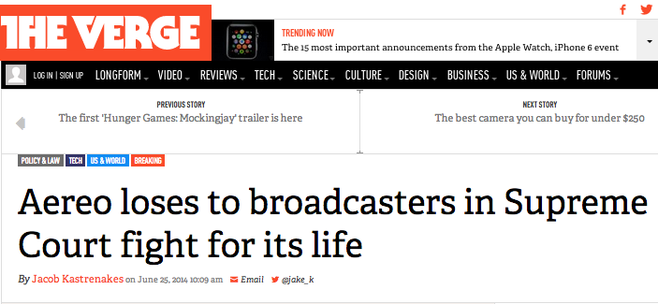
BUT…
http://www.theverge.com/2014/6/25/5801052/aereo-supreme-court-ruling

Slide 51


Slide 52
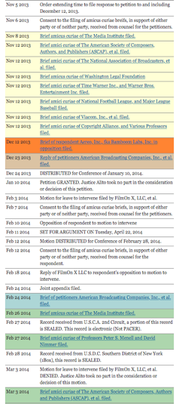
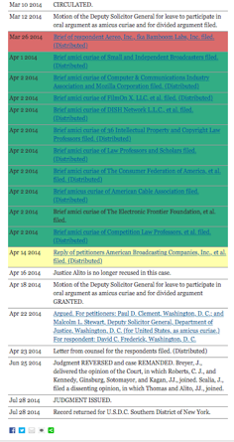
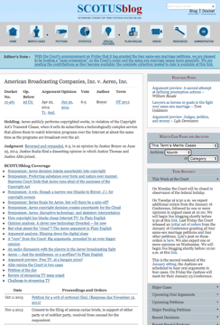
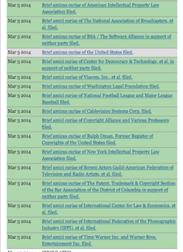
http://www.scotusblog.com/case-files/cases/american-broadcasting-companies-inc-v-aereo-inc/

Slide 53
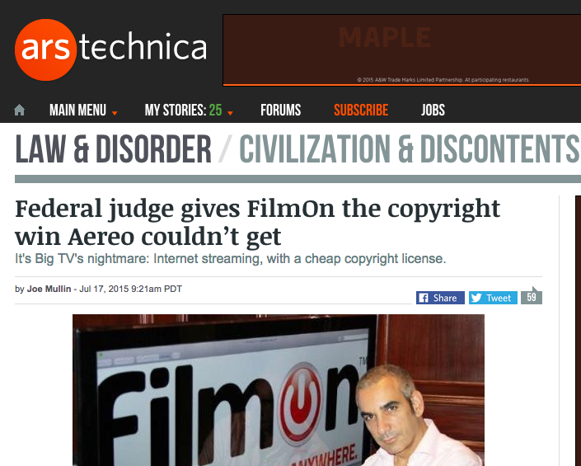
But, but…

Slide 54

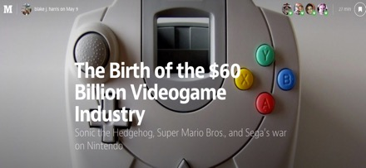
For Now #2. Are Video Games a
“Mass Media” (& does it matter)?
Certainly a “MASSIVE” media
https://medium.com/@blakejharrisNYC/the-birth-of-the-60-billion-videogame-industry-67a360dc4498
http://www.gamesindustry.biz/articles/2014-06-25-game-software-market-to-hit-usd100-billion-by-2018-dfc

Slide 55
D.L Shaw, “The Rise and Fall of American Mass
Media: Roles of Technology and Leadership”, April 1991 “Roy W. Howard Lecture” Indiana University.
“No medium, once it has lost it’s dominant position has ever returned to the top”
“Audience choice, made possible by modern technologies, has made the concept of “mass media” obsolete; and audiences are not necessarily loyal, exercising choices when available to obtain information and entertainment in the most efficient way possible.”
“Historically mass media seem to play the role of Trojan Horse to social change. That seems to be an effect of evolving communication technologies.”
Limitation – does not foresee audience as CREATOR

Slide 56
Which leads to: Application of real world laws to (massive)virtual environments
Is there a virtual world?
Is virtual Property “real”???
Ben Duranske “ Virtual Law” (2008): “This chapter will argue that the law needs to acknowledge and provide protection for virtual property, but that it must do so in a way that preserves virtual worlds and games as play spaces, at least to the extent that the developers desire their worlds to remain pure play spaces. On one hand, many game and virtual world providers seek to avoid real-life implications in their social and play spaces. Where providers take reasonable steps to draw a line between the real and the virtual, the world or game should be protected by the “magic circle” that protects other play spaces (from theme parks to family Monopoly games) from taking on inadvertent real-world implications. On the other hand, it is both inevitable and desirable that some game and virtual world designers will seek to include real money trade (RMT) and offer a real cash economy (RCE) in their platforms. Users of these platforms need the protection of virtual property law.”http://www.amazon.com/Benjamin-Tyson-Duranske/e/B001JP104A
EULA/ToS: The “real world law” is the law of contracts.

Slide 57
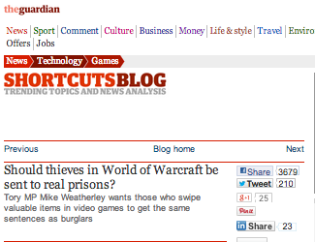
An issue that won’t go away…

Slide 58
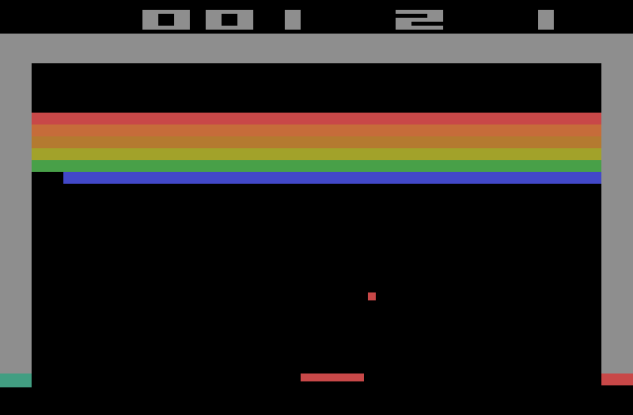
Back to why IP Dystopia?
BREAKOUT
Issue: The “creativity standard” in copyright.

Slide 59
Atari v. Oman - 1989/1992 USCA DC Cir.
* “BREAKOUT's audiovisual display features a wall formed by red, amber, green, and blue layers of rectangles representing bricks. A player maneuvers a control knob that causes a rectangular-shaped representation of a paddle to hit a square-shaped representation of a ball against the brick wall. When the ball hits a brick, that brick disappears from its row, the player scores points, and a brick on a higher row becomes exposed. A "breakout" occurs when the ball penetrates through all rows of bricks and moves into the space between the wall and the top of the screen; the ball then ricochets in a zig-zag pattern off the sides of the screen and the top layer of the wall, removing bricks upon contact and adding more points to the player's score. Various tones sound as the ball touches different objects or places on the screen. The size of the paddle diminishes and the motion of the ball accelerates as the game is played.”
District court judge asked counsel for the Register, "If Picasso had painted a round object on a canvas, would you say because it depicts a familiar subject--namely, something that's round--it can't be copyrighted?”
Atari Games Corp. v. Oman, 979 F. 2d 242 - 1992 - ‎Court of Appeals, Dist. of Columbia Circuit
Atari Games Corp. v. Oman, 888 F. 2d 878 - 1989 - ‎Court of Appeals, Dist. of Columbia Circuit
Atari Games Corp. v. Oman, 693 F. Supp. 1204 - 1988 - ‎Dist. Court, Dist. of Columbia

Slide 60

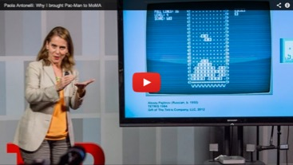
Games as arT
* “Are Video Games Art? MoMA Says Yes.” (Slate 11.29.12) http://www.slate.com/blogs/browbeat/2012/11/29/moma_s_new_video_game_collection_museum_of_modern_art_proclaims_video_games.html
“Video Games: 14 in the Collection, for Starters”http://www.moma.org/explore/inside_out/2012/11/29/video-games-14-in-the-collection-for-starters

Slide 61

Irony 1
While eligibility for copyright meant a certain
legal recognition…..
…it brought with it the limitations of IP law
Impact on mods, genre issues etc….
IP Dystopia:
…..Stern v. Kaufman (1982 USCA) – “Scramble” knockoff case – “kitchen sink” arguments included that “each play of the game is an original work because of the player’s participation.”
http://scholar.google.com/scholar_case?case=7204019639108685629&q=%22669+F.2d+852&hl=en&as_sdt=2002

Slide 62

Say again???
Stern v. Kaufman (1982 USCA) – “Scramble” knockoff case – “kitchen sink” arguments included that “each play of the game is an original work because of the player’s participation.”

Slide 63

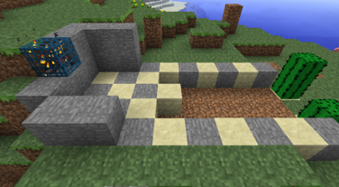
Irony 1(continued)
The Problem with Stern
Defendants point: that player participation meant no “fixation” = Scramble not protected.
Court rejected argument. Found “Someone first conceived what the audiovisual display would look like and sound like. Originality occurred at that point.” (huh?)
Consider since that time: 1. massively multiplayer; 2. open world; 3. (effectively) crowd sourced; 4……

Slide 64

Irony 2: Legal Recognition May Not
Equal Respect
Easier to target, censor & oppress the disrespected (symptoms):
Refrain of blame without causality?
Based on belief not data?
Related to being “different”?
Related to being “new” (technology)?
Virtual guns more to blame then real ones???
NRA says so “The NRA's Absolutely Unhinged Response to Newtown Condemns Video Games as a 'Shadow Industry' that 'Sows Violence Against Its Own People'” Kotaku (21 December 2012) http://kotaku.com/5970484/the-nras-absolutely-unhinged-response-to-newtown-blames-a-10+year-old-flash-game

Slide 65
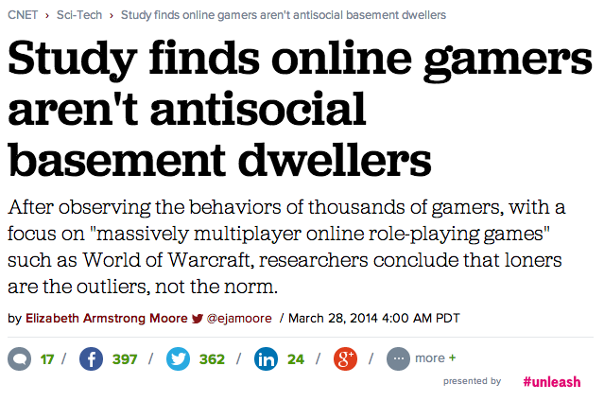
And who can ever forget…
http://www.cnet.com/news/study-finds-online-gamers-arent-anti-social-basement-dwellers/

Slide 66
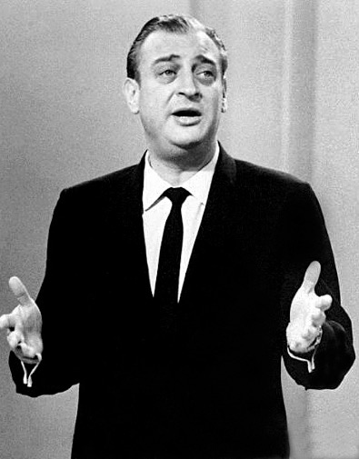
The Rodney Dangerfield “No Respect” Effect

Slide 67
Microstar v. Formgen (1998 USCA Ninth Circuit)
KOZINSKI, Circuit Judge:
“Duke Nukem routinely vanquishes Octabrain and the Protozoid Slimer. But what about the dreaded Micro Star?”
Nintendo of America Inc v King, 2017 FC 246
The Honourable Mr. Justice Campbell:
“[13] In the result, to fairly and appropriately acknowledge the precise, clear, well supported, and effectively uncontested final argument prepared by Counsel for the Applicant, with which I fully agree, I find that the Applicant is entitled to have the final argument, as stated below, as my reasons for decision in the present litigation.”

Slide 68
NO CLASS NEXT WEEK….

Slide 69
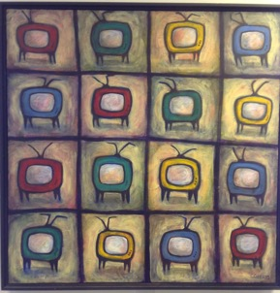
Next Class…
Why expression/speech are not paramount?
Are the real censors legal concepts we might not at all expect?…
Dichotomies
& Paradoxes

Slide 70

Always include a cat picture

Slide 71
Our Academic Partners

