Slide 1
Sex, violence & videogames

Slide 2
What is ‘real’?
Sexual and violent offences in reality are firmly within the ambit of the criminal law.
What do we mean by ‘real’?
Is technology thinning the line between virtual reality and actual reality?
How will the law adapt to address new virtual ‘crimes’?

Slide 3
Freedom of Expression & Paternalism
Age restrictions have, in most jurisdictions, been sufficient to balance concerns about violent and sexual content.
Other jurisdictions have banned content all together.
Is it right that traditional videogames are treated the same way as movies?
- Studies showing kids more aggressive thoughts if they play VR games rather than 2D
- There has been speculation that violent and sexual crimes in games may increase real life crime.
Technology is entering into unchartered territory…instances of the virtual world influencing real world crime is a very different thing to actually committing crime virtually…
Is virtual crime beyond the ambits of Freedom of Expression arguments?

Slide 4
Fifty Shades of Grey Banned in Indonesia, Kenya, parts of Russia, UAE, Papua New Guinea, Cambodia and India due to extreme violent and sexual scenes.
Manhunt 2
Refused classification in the UK and banned from sale in Germany, Ireland, New Zealand, Kuwait, Saudi Arabia and Korea.
Call of Duty: Black Ops
Notes:
-Influencing real world crime

Slide 5
Virtual and Augmented Reality
Smart phones + new headsets – Oculus Rift, Vive, Playstation VR, Hololens.
Player becomes the avatar.
Real time, visual communication very different to cyberspace
Sex and pornography has a significant part to play in the development for a wide user base

Slide 6
https://www.youtube.com/watch?v=hLqVxC6JWIM

Slide 7
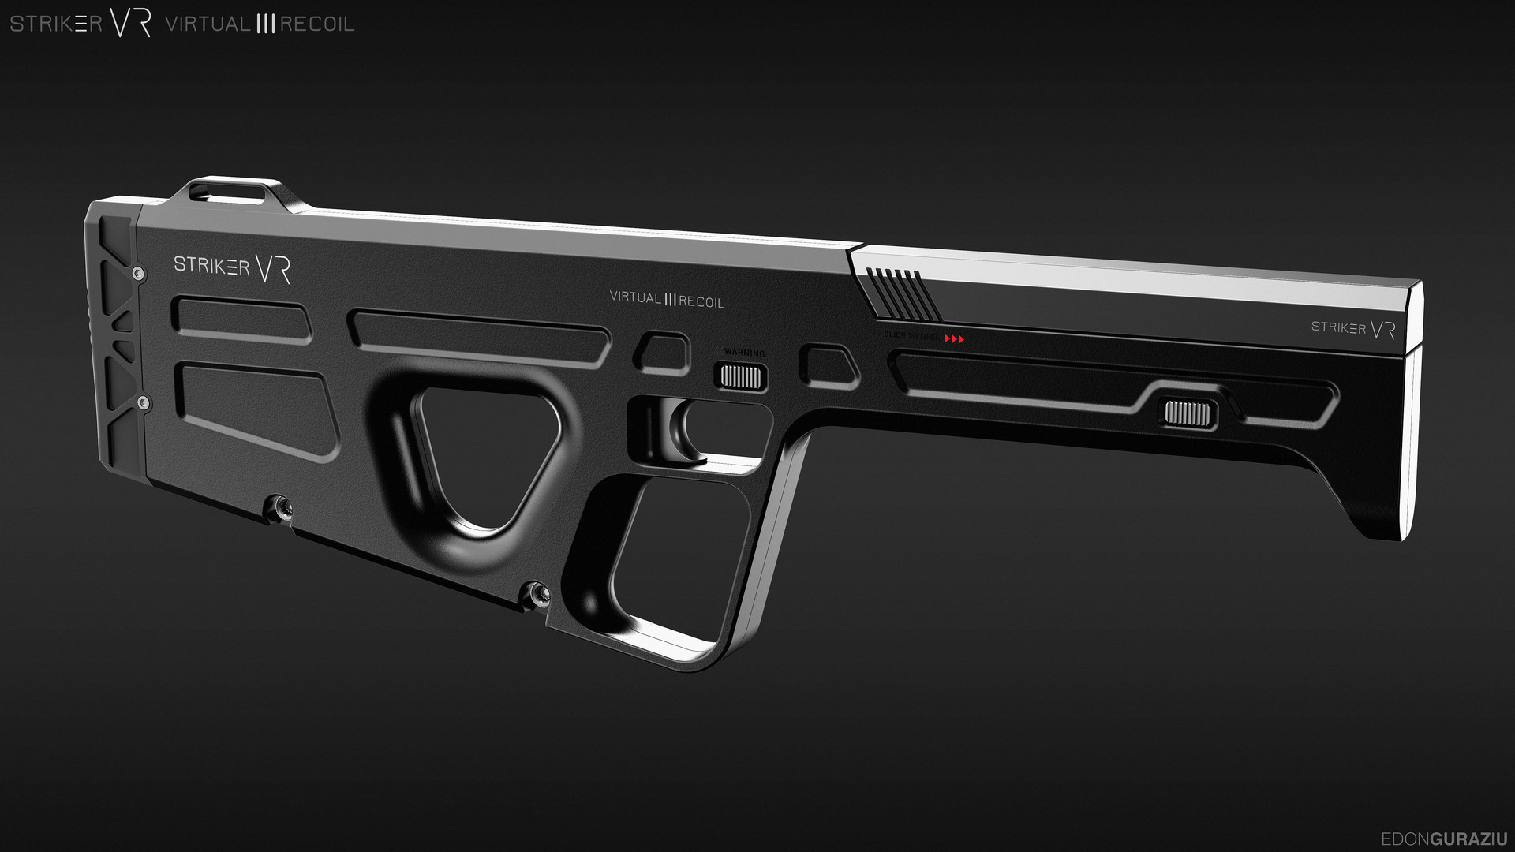
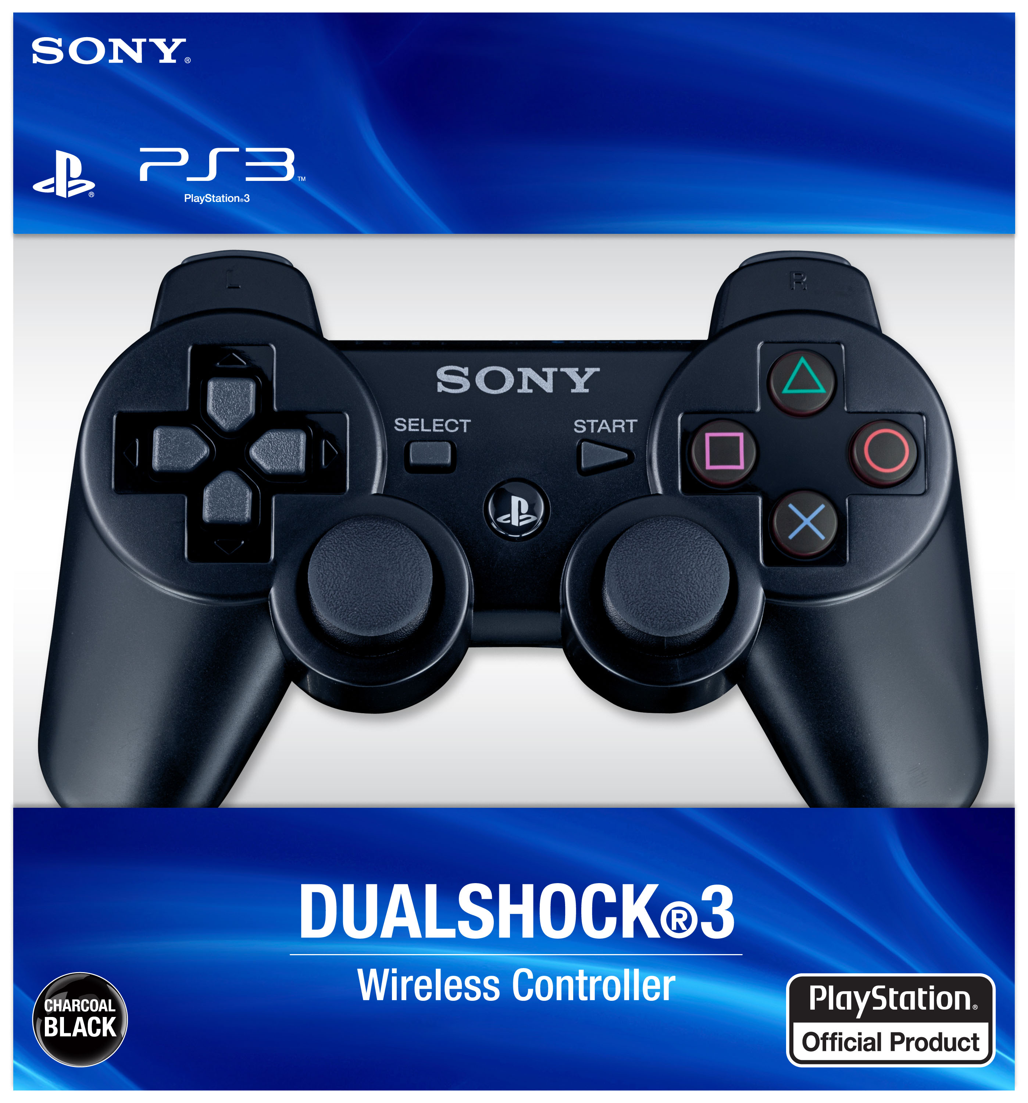
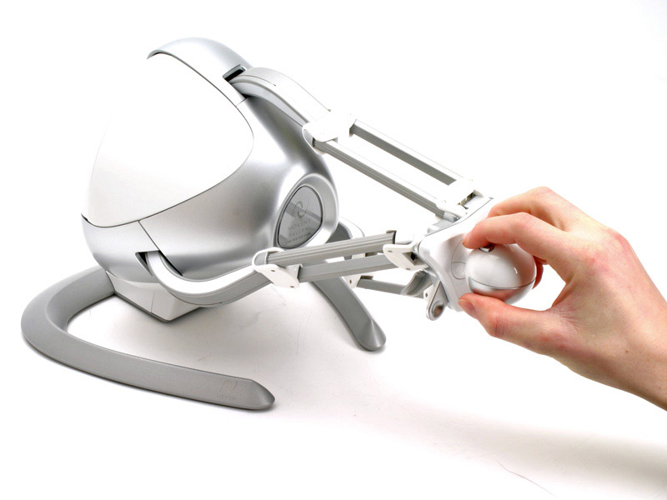
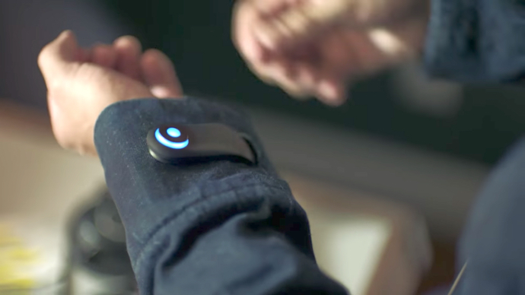
Haptics
Striker Virtual Recoil Rifle
Tactical Haptics Reactive Grip Device
Nintendo 64 Rumble Pak
The science of applying tactile sensation and control to interaction with computer screens.
Taking the experience from audiovisual to sensory – key in bridging
the gap between physical and virtual.
Psychological impact and question of what is ‘real’ becomes even more important.
The missing piece of the puzzle for VR and AR technology?
Vibrations produced by an actuator : phones, watches, video game controllers
Motion-tracked props with built-in haptic feedback – eg Sliding plates in the surface which mimic friction sensations of holding an object. Striker virtual Recoil Rifle. Tactical Haptics Reactive Grip Device.
Sex-tech & Teledildonics
Skinterface & wearables - Magnetic nodes stimulating a wide range of sensations
Novinct Falcon Haptic Joystick

Slide 8
https://www.youtube.com/watch?v=k1MMz3zomQo

Slide 9
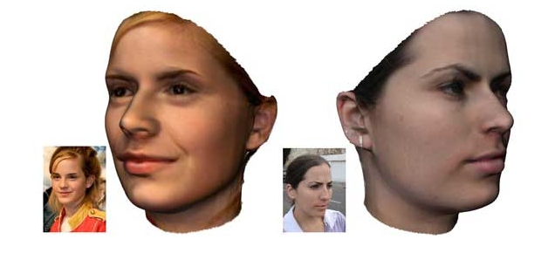
Realistic Avatars
Technology to build believable 3D digital characters – previously exclusive to hollywood.
Uses facial musculature rigs powered by robust image analysis.

Slide 10
Completing the puzzle: audiovisual + sensory + emotionally intelligent experience.
Multi-player and single player applications
Simulated human contact
Porn industry is a significant force in driving VR and haptic development because of the wide user base
Sex dolls and AI taking the human experience further than realistic haptics.

Slide 11
https://www.youtube.com/watch?v=WzV6mXIOVl4

Slide 12
Second Life
A relatively unsophisticated online virtual world, not technically a game.
What would a virtual world look like which fully utilized all of the audiovisual and sensory technology available?
Is it ‘real’ yet?

Slide 13
Can real-world crimes now be committed virtually? How should the law respond?
Extend existing laws?
-Some areas of law are easier and analogous to cyberspace e.g virtual threats
- Some crimes would need to be stretched – sexual and violent offences, personality rights, privacy, torts etc
2) New laws to cover new virtual crimes?
3) Self-regulation through code
– recognizing the capabilities of virtual
technology and code.

Slide 14
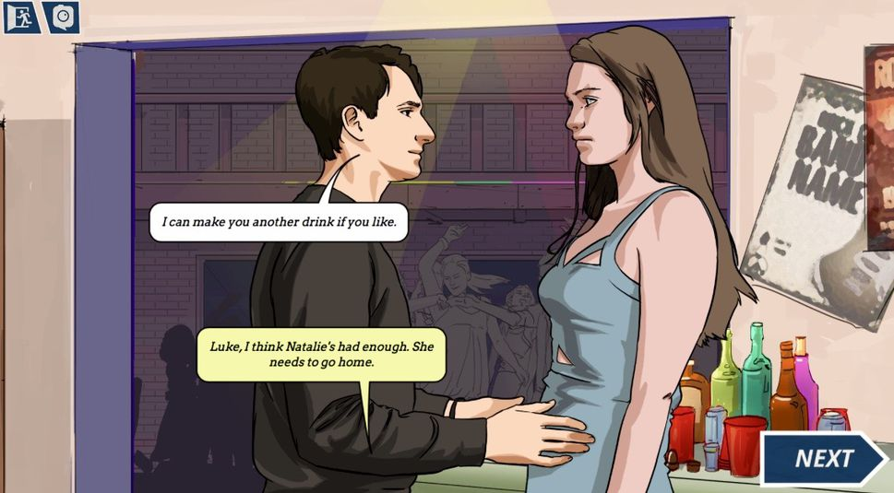
Assault
Haptic Assault:
Haptics devices enable temperature controls,
electric shocks, physical resistance and force
meaning that virtual attack can physically hurt a
player.
A virtual swordfight would wield realistic sensations.
Teledildonics allow for haptic sex crimes.
Another example:
Strobe lighting presents a non-trivial risk of injury to 3% of the population who are epileptic.
Not generally seen as significant enough to ban strobe lighting
An offence of deliberately creating strobe lighting in VR?
Psychological assault and impact

Slide 15
Virtual groping and sexual battery
There have been complaints of virtual groping in videogames – Jordan Belamire
An instance where the current law probably could not be simply extended
No imminent apprehension of physical contact.
Sexual threats are easier to extend current law – this is not new territory.
Is virtual groping less traumatizing
than actual groping?
But is it more traumatizing than mere
messages?

Slide 16
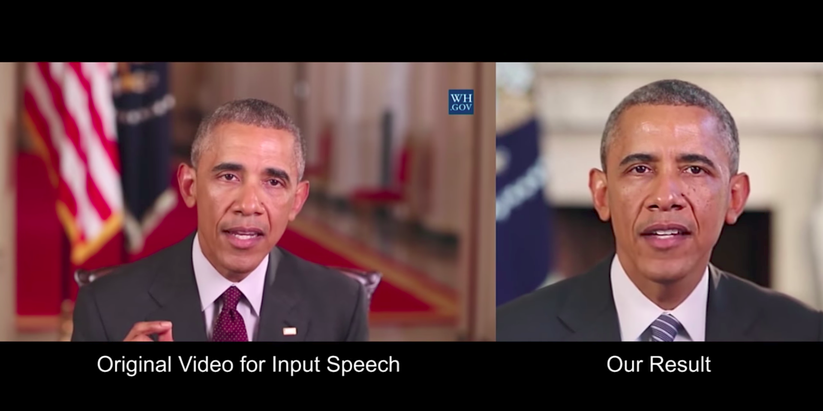
Impersonation & Video Recording
Technology like convincing avatars and voice recognition breakthrough teamed with intimate virtual relationships make virtual impersonation a very real possibility.
Should there be a criminal offence of virtual impersonation?
How is the best way to protect personality rights? IP? Human Rights? Contract?
Video games are inherently easy to record and it is a recognized and widely used part of video gaming.
Should ‘real-life’ laws surrounding voyeurism and privacy be extending to the virtual world?
Is sharing sexual audiovisual, sensory content between 2 life like avatars analogous to sharing real sex tapes and revenge porn?
Is sharing audiovisual and sensory information
in a video game more like sharing information
publically online or is it like sending a private
message?

Slide 17
https://www.youtube.com/watch?v=dkoi7sZvWiU

Slide 18
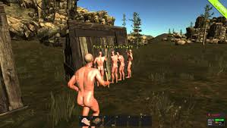
Indecent exposure and nudity
Naked, realistic, offensive, crude, obscene avatars and avatar interactions.
Public sexual acts in cyberspace.
Supreme court of US has said that 1st Amendment protects public film viewings showing nudity, even in drive-ins visible from the street. (Erznoznik v City of Jacksonville).
Obscene material has not been banned online.
Is nudity in VR different? Technically
viewing video but the whole point is
to emulate in-person presence…
Jurisdiction and the realities of the virtual
world make enforcement complicated.

Slide 19
Is it appropriate territory for criminal law?
What do we mean by ‘real’?
Studies have shown that the psychological perception of audiovisual, sensory experiences is the same as in the real world.
2013 experiment by Liat Clark – walking the plank with the Oculus Rift
Mel Slater’s Replica of the Milgram shock experiment
Even if Audiovisual crime is a long shot, is sensory crime easier to justify?
Can punishing the the mentality/culpability of crimes regardless of the physical effects be justified? E.g. haptic assault or even rape of a sex doll?
CONSENT:
Perhaps consent or contract within a virtual or video game environment makes criminal law inappropriate….
Is it the same as stealing in-game currency that can be brought for real world money?
Would the perception be different if the stealing was done by hacking?
What about audiovisual and sensory torts – is it a case of volenti non fit injuria?
Some players even want this risk because of the
reckless play that it prevents - ‘playing poker with
matchsticks’ argument.
The problem of enforcement and jurisdiction…

Slide 20
https://www.youtube.com/watch?v=RjUNg3pkEag

Slide 21
Regulating manufacturers
Is the law better aimed at manufacturers, prohibiting these technological advancements altogether?
Paternalism v freedom of expression
Just because you can doesn’t mean you should
Some thought into whether it should be regulated like drugs because it is effectively a drug.

Slide 22
Code as law
Larry Lessig argues that we code is capable of replacing the need for for hard law/social norms/natural law in the virtual world. For example, A user can press “Dress avatar” or choose options to convert
strobes through their VR headset.
Different experiences of same virtual landscape?
Is the choice a good thing or is it wrong that we should have to choose not have a crime committed against us and/or to correct that crime once committed?
Lessig says that although code could be a solution, it doesn’t mean that it should be.
Who would decide what code was desirable, optional or mandatory?
Code could be used as a way to help enforce the law of as an alternative to the law.
Some game designers have seen virtual abuse as a design fault, ready to be corrected via code.
What about single player interactions?
Code is a feasible solution to unwanted multi-player interactions but what about single player games and virtual experiences. Is there a place for paternalism or is the virtual world a place for unrestrained technology?

Slide 23
1) Criminal sanctions for players
2) Regulating production
3) Self-regulation: code as law (lessig)
- Look at haphazard development of cyberspace law.

