Slide 1


John Milton Plays Grand Prix Legends
Talk 3
Part A “Creating”
Video Game Law - Fall 2017
UBC Law @ Allard Hall
Jon Festinger Q.C.
Centre for Digital Media
Allard Law of Law, UBC
QMUL School of Law (CCLS)
Festinger Law & Strategy
http://videogamelaw.allard.ubc.ca/
Twitter: @jonfestinger
jon_festinger@thecdm.ca

Slide 2
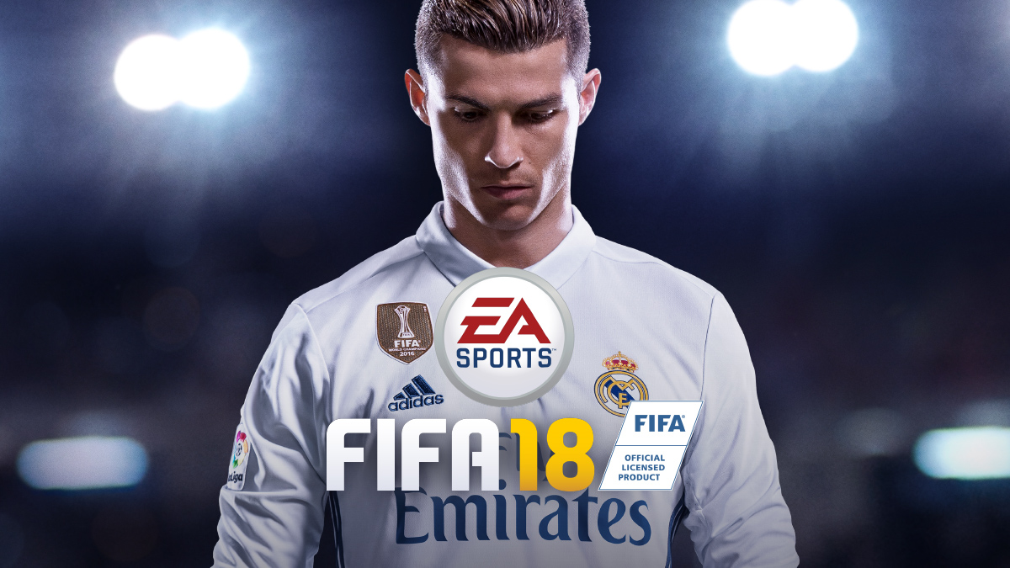
Happy FIFA 18 Release Day

Slide 3

Notifications

Slide 4
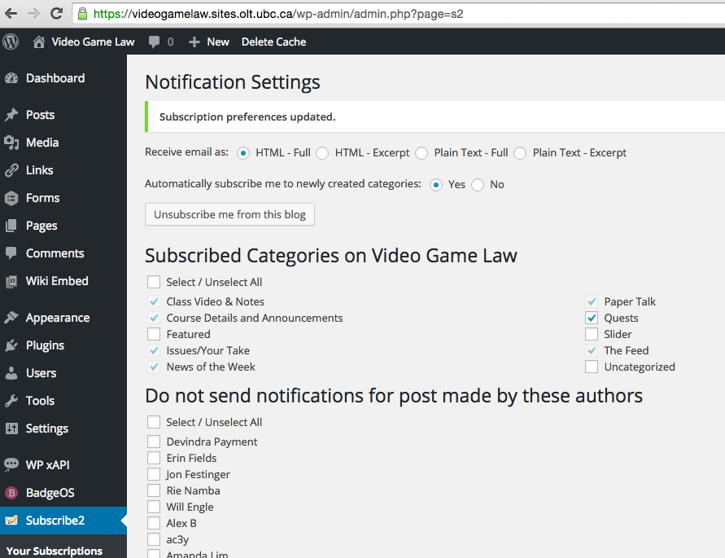
For NoW click-through emails..

Slide 5
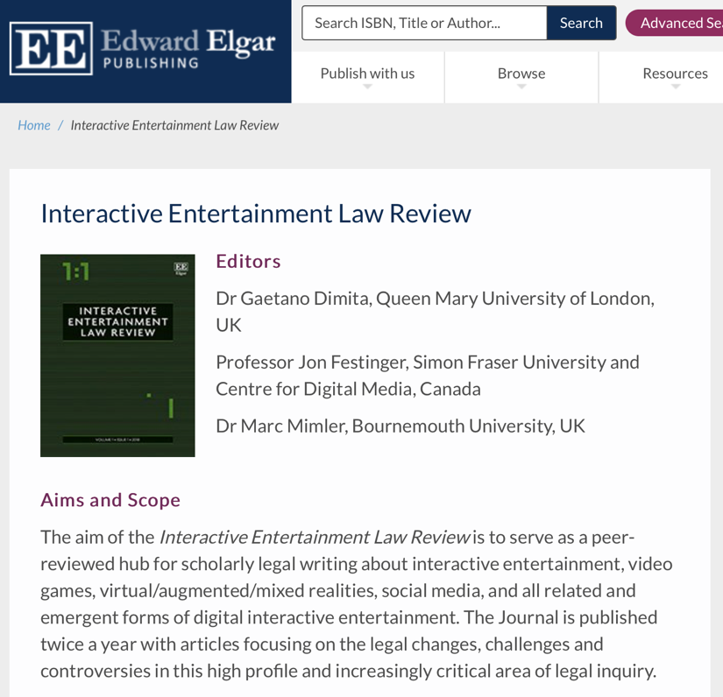
Great papers might be…

Slide 6
News of
the Week

Slide 7
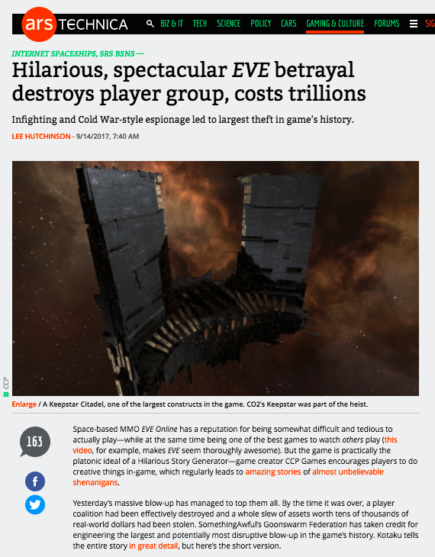

Slide 8
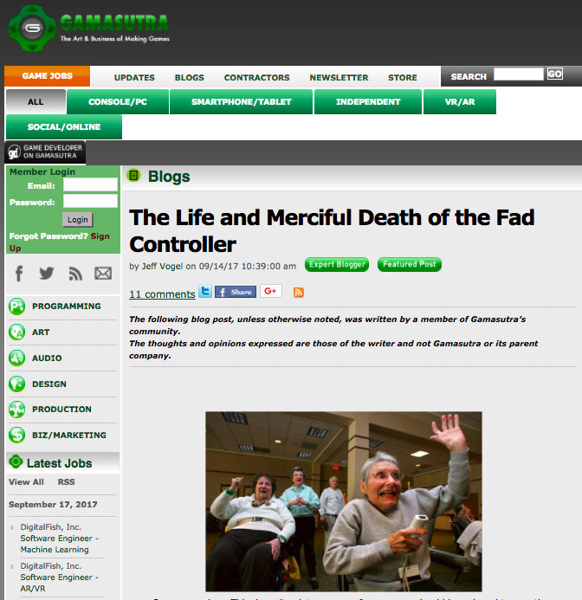

Slide 9
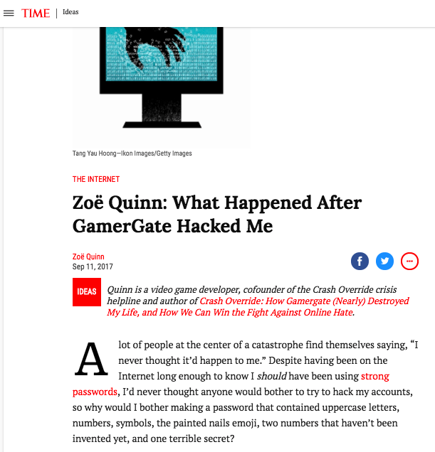

Slide 10
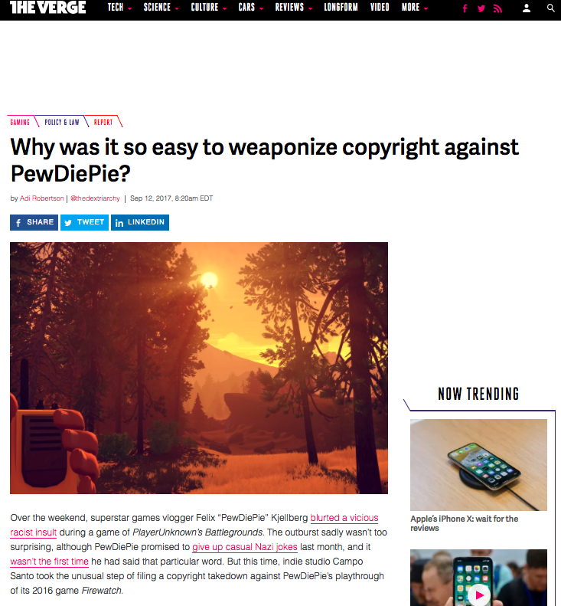

Slide 11
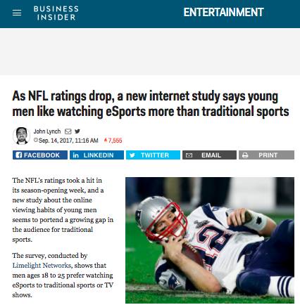

Slide 12
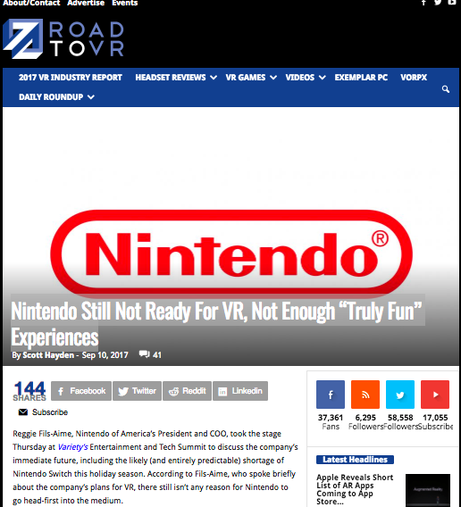

Slide 13
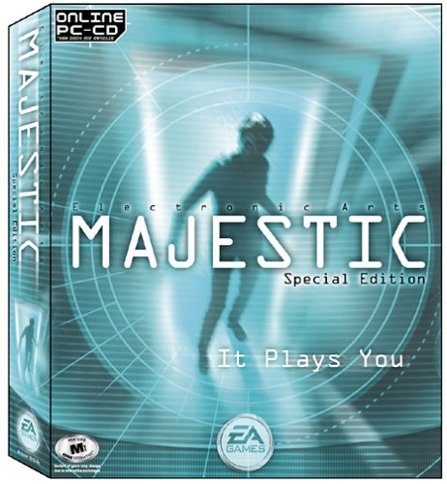



Following on…..
What is a game?

Slide 14
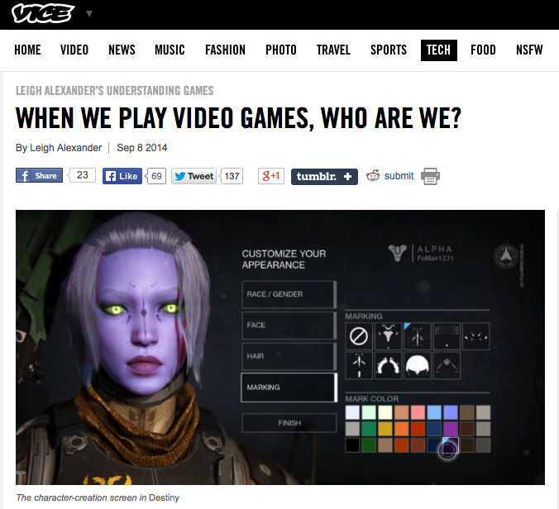
“But games, designed to let us act as some fantasy of ourselves, don’t often ask us to think about what someone else “would” do. That players have choices is considered one of the medium’s exciting traits, but I always struggled a little bit to connect to games that have that kind of openness—am I playing a character, or am I being me?”
http://www.vice.com/read/leigh-alexnder-
understanding-video-games-column-destiny-105

Slide 15
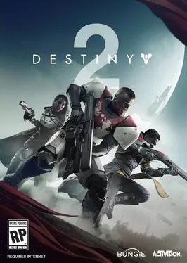
Relates to “social reaction”
(McLuhan-meme)?
Think of the “lens of identity” in relationship to:
Violence in games
Misogyny in games
Privacy & Surveillance in games
Who am I when I play “Destiny 2”? No idea.

Slide 16
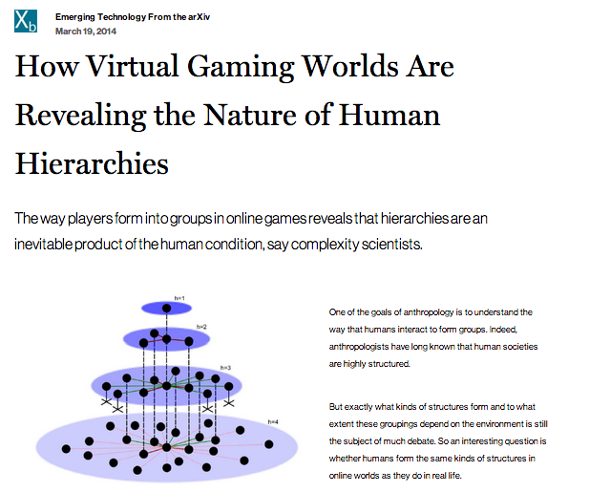

More Evidence
http://www.technologyreview.com/view/525696/how-virtual-gaming-worlds-are-revealing-the-nature-of-human-hierarchies/

Slide 17
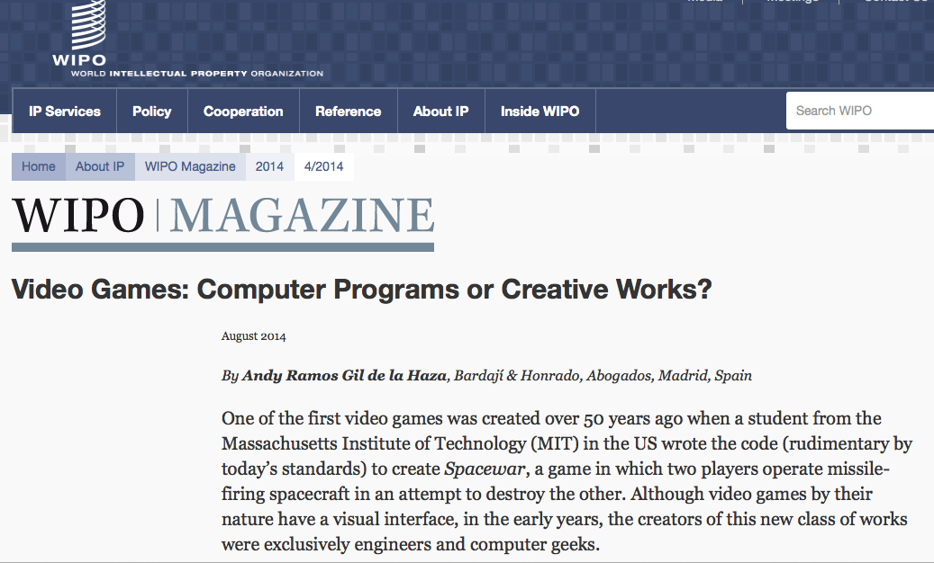
But does copyright law recognize the complexity of the relationships?
http://www.wipo.int/wipo_magazine/en/2014/04/article_0006.html

Slide 18
Computer Programs or Creative Works
“Are specific regulations for video games required?
…the time is ripe for an international discussion to evaluate the merits of adopting specific regulations for video games. Such a discussion might consider:
the legal nature of these modern and complex works;
the relationship between creators and producers;
how to determine who is the creator of a video game;
systems of presumption of transfer of rights to the producers;
fair and equitable compensation systems for creators;…”
However focus is primarily on: 1. “Audio elements”; 2.“Video elements”; 3. “Computer code”
NO MENTION OF ROLE OF THE GAMER – though
(carefully?) not excluded.

Slide 19
Which leads directly back to
“When is it a game (in IP terms)?”
“Games and Other Uncopyrightable Systems” Bruce Boyden (2011) http://www.georgemasonlawreview.org/doc/Boyden_18-2_2011.pdf
“Games therefore pose a number of challenges for copyright and patent law. Yet to date, intellectual property doctrine and scholarship has not really grappled with the slippery nature of games. Indeed, copyright has developed a very simple black-letter rule to handle them: games are not copyrightable. …What could be the purpose of such a rule?”
Two possibilities emerge from the cases. First, several cases describe games, and game rules, as unprotectable ideas… The other possible explanation that emerges from the case law is that games are uncopyrightable systems or processes.”

Slide 20
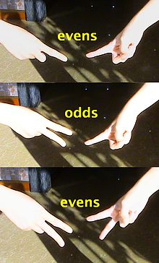
Game That Is Not IP?
Odds
&
Evens

Slide 21
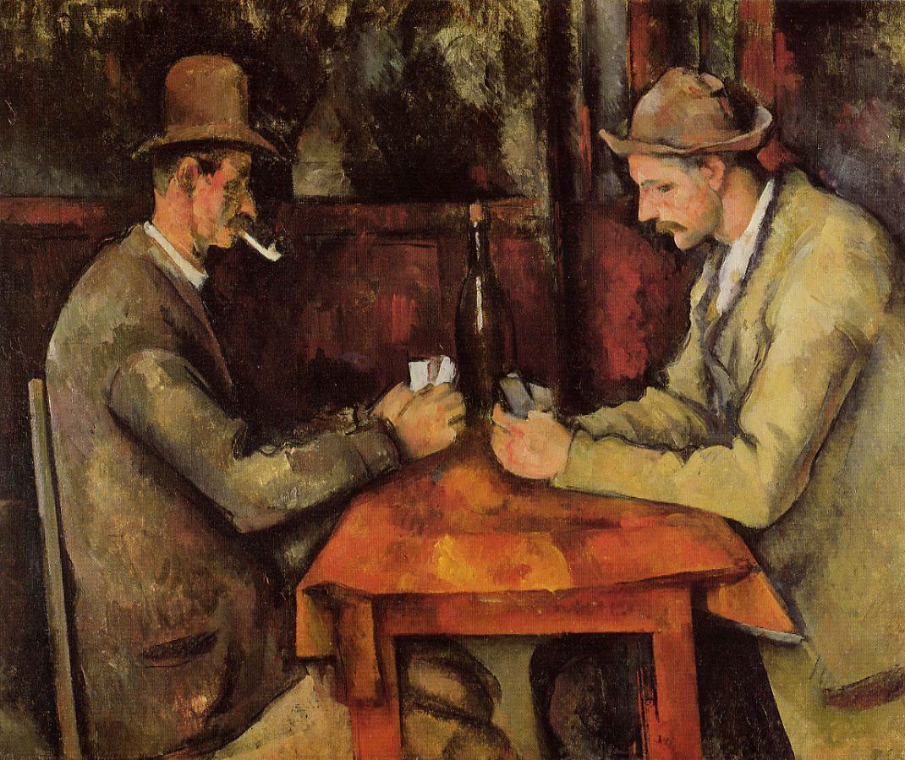
Paul Cézanne: The Card Players 1894–1895,
Musée d'Orsay, Paris

Slide 22
How important to the game is the game designer?
How important to the game are you?
How important to the game are the other people you are playing with?

Slide 23

Boyden – the key
Cases denied copyrights in:
(a) systems for the presentation of information;
(b) systems that are expressly designed to allow others to
organize information.
(c) systems of notation
(d) contests and betting systems.
“In all of these situations, the owners of a copyright in a form, description, or set of instructions were attempting to extend their copyright to material for which the user of the work provided the essential content, not its author. That is what made them systems. They were, without that input, empty shells, waiting to be filled.”

Slide 24
Boyden - Conclusion
“Games are systems in exactly the same way. A game, as sold, is only a game form; the content necessary for an instance of the game comes from the players. That is, the game form establishes the environment for play—the game space—and it defines permissible moves and the conditions for winning or drawing. But the game itself is supplied by the players. Games are systems in the same way that the excluded schemes in the cases above were systems.”
“For systems, the rule against the copyrightability of games demonstrates why systems are generally uncopyrightable and why that term has special significance. The term is not merely a synonym for “idea,” or “process.” Systems are shells into which users pour meaning. While they may contain expression themselves, that expression is there merely to facilitate the meaning added by the user. Copyright properly excludes them.”

Slide 25
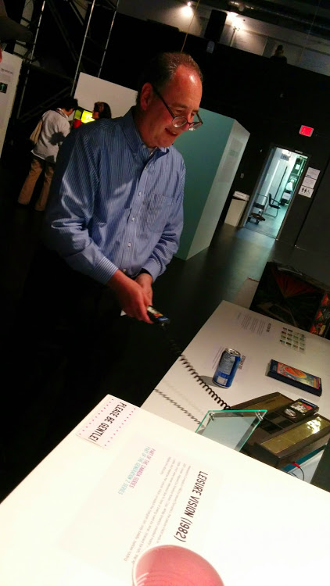
So the key is in the…
Creative Expression of Gamers

Slide 26

Pause…

Slide 27
Reflections?

Slide 28
Key is not in the…
IDEA/
EXPRESSION
DICHOTOMY

Slide 29
Key is not in the…
Holes/Overlaps/Definitions of IP
Copyright: literary, artistic, dramatic or musical works
(including computer programs)
Trade-mark: word, symbol, design (or combination) for wares
& services
Industrial Design: visual features of shape, pattern or ornament (or combination) applied to a finished manufactured article
Patents: new inventions (process, machine, manufacture, composition of matter) or new & useful improvements of an existing invention
“Software Patent”: controversies

Slide 30
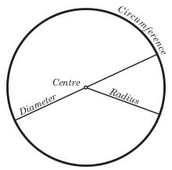
Key seems to be in the…
The “Magic Circle”
“All play moves and has its being within a play-ground marked off
beforehand either materially or ideally, deliberately or as a matter of course.
Just as there is no formal difference between play and ritual, so the
‘consecrated spot’ cannot be formally distinguished from the play-ground.
The arena, the card-table, the magic circle, the temple, the stage, the
screen, the tennis court, the court of justice, etc. are all in form and
function play-grounds, i.e. forbidden spots, isolated, hedged round,
hallowed, within which special rules obtain. All are temporary worlds
within the ordinary world, dedicated to the performance of an act apart.”
Johan Huizinga (1872-1945) in “Homo Ludens: A Study of the Play-Element in
Culture”. Applied to video games by Katie Salen & Eric Zimmerman in “Rules
of Play: Game Design Fundamentals” (2003)

Slide 31
But is Canadian IP Law…
..the same as Boyden’s
interpretations?
(WHAT AN AWESOME
PAPER IDEA)

Slide 32
+ Gamer creative involvement is growing…

Slide 33
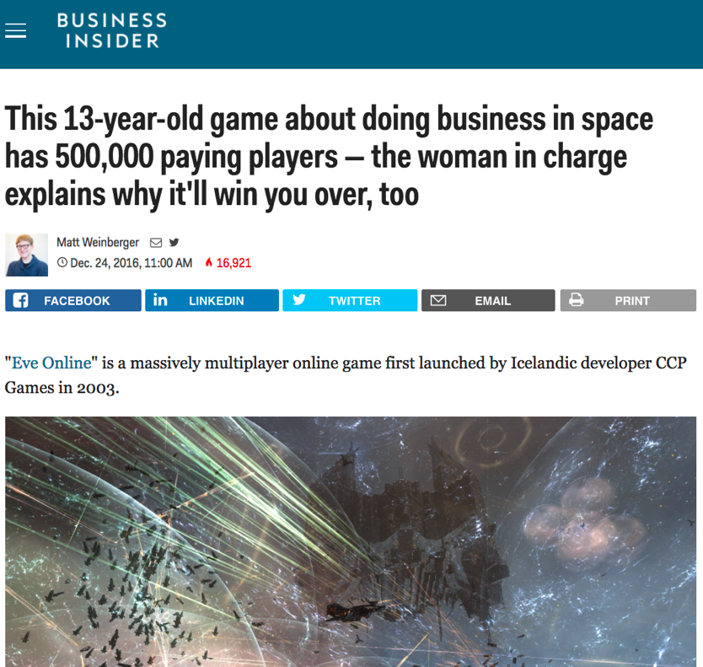
Massively Multiplayer

Slide 34
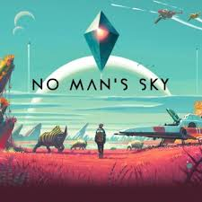
Open World

Slide 35
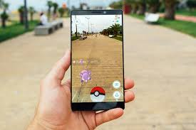
Augmented Reality

Slide 36


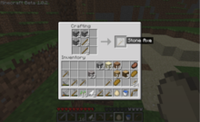

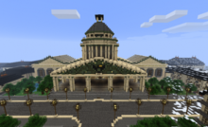

When you look at a video game it is not about what the developer intended…it’s about what the player does…

Slide 37
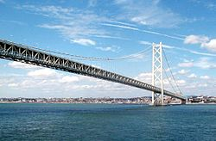
So Boyden is really about the role of creative expression
…creative speech/creative expression = the key
…including the player’s
Expression
…bridges to…

Slide 38
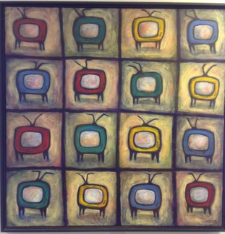
Dichotomies & Paradoxes of Free Expression
Why expression/speech might not be paramount?
Are the real censors legal concepts (or identities) we might not expect?…

Slide 39
Free Expression: The Usual Suspects
Winters v. New York 68 S. Ct. 665 (U.S. 1948) – magazine case “…we find the specification of publications, prohibited from distribution, too uncertain and indefinite to justify the conviction of this petitioner.”
Montreal v. Arcade Amusements Inc. [1985] 1 SCR 368
By-law of the City of Montréal prohibiting gamers under 18 from being in “amusement arcades” was invalid as being discriminatory.
Brown v. Entertainment Merchants Association 131 S. Ct. 2729 (2011) - California law banning the sale of violent videogames to anyone under 18: “Like the protected books, plays, and movies that preceded them, video games communicate ideas—and even social messages—through many familiar literary devices…That suffices to confer First Amendment protection.”

Slide 40
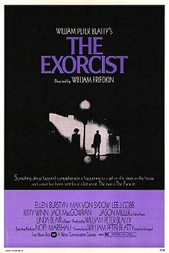
AN EXERCISE
(or an exorcis-m)

Slide 41
Please Self Identify
AUTHOR
or
CONNECTOR

Slide 42
Who is an AUTHOR?
“The creative is the place where no one else has ever been. You have to leave the city of your comfort and go into the wilderness of your intuition. What you’ll discover will be wonderful. What you’ll discover is yourself.”

Slide 43
Who is a CONNECTOR?
“Creativity is just connecting things. When you ask creative people how they did something, they feel a little guilty because they didn't really do it, they just saw something. It seemed obvious to them after a while. That's because they were able to connect experiences they've had and synthesize new things.”

Slide 44
Please Self Identify
AUTHOR
or
CONNECTOR

Slide 45

“Connecting”(remixing)
*“If you wish to make an apple pie from scratch, you must first invent the universe.” – Carl Sagan
* “Creativity is just connecting things. When you ask creative people how
they did something, they feel a little guilty because they didn't really do it, they
just saw something. It seemed obvious to them after a while. That's because
they were able to connect experiences they've had and synthesize new things.”
Steve Jobs in a Wired Magazine interview (Feb. 1996)
http://www.wired.com/wired/archive/4.02/jobs_pr.html
* “Creativity is contagious. Pass it on.” – Albert Einstein
* “All Creative Work is Derivative” – Nina Paley
http://blog.ninapaley.com/2010/02/09/all-creative-work-is-derivative/
* “The great driver of scientific and technological innovation [in the last 600 years has been] the increase in our ability to reach out and exchange ideas with other people, and to borrow other people’s hunches and combine them with our hunches and turn them into something new.” – Steven Johnson “Where Good Ideas Come From: The Natural History of Innovation”

Slide 46

The Romantic Author (The “Unique Gift”)
* “The creative is the place where no one else has ever been. You have to leave the city of your comfort and go into the wilderness of your intuition. What you’ll discover will be wonderful. What you’ll discover is yourself.”
* Personal creation mythology deeply rooted in our psyches’: “And G-d said: ‘Let us make man in our image, after our likeness;”(Genesis, Chap. 1 Verse 26)
* View of creativity as uniquely personal (or not) impacts beliefs about copyright & IP (e.g. film & music business – T.V. more flexible?) – consequences of “specialness”

Slide 47
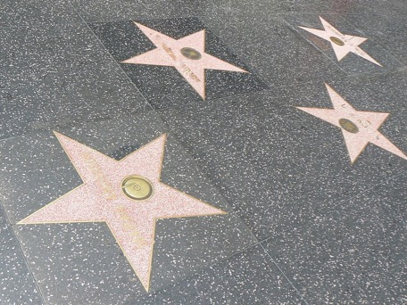
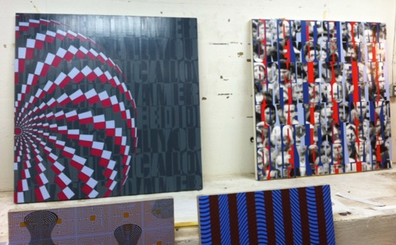
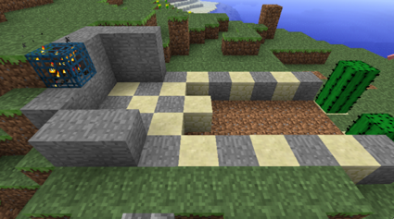
The Result?
* Role and consequences of IP law aligning along according to personal belief: Do Copyright literalists’ adopt “self” generated model of creativity? Do “Connection-ists” adopt open source model?
* the “Hollywood Model” v. the “Remix Model”

Slide 48
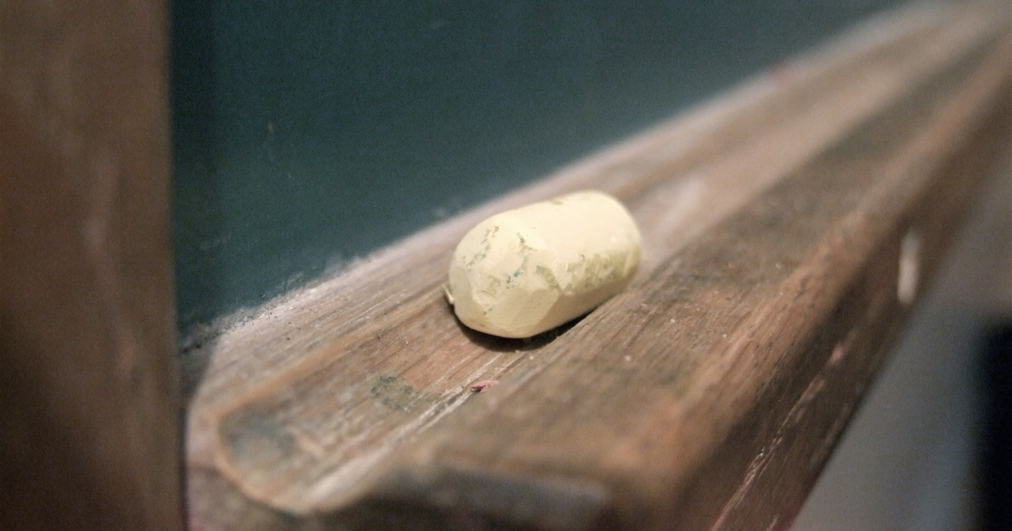
Education as remixing

Slide 49
Learning as Remix
“The Usefulness of Useless Knowledge” By Abraham Flexner, American educator (1939, Harpers)
http://library.ias.edu/files/UsefulnessHarpers.pdf
“…Marconi was inevitable. The real credit for everything that has been done in the field of wireless belongs, as far as such fundamental credit can be definitely assigned to anyone, to Professor Clerk Maxwell who in 1865 carried out certain abstruse and remote calculations in the field of magnetism and electricity…. Other discoveries supplemented Maxwell’s theoretical work during the next fifteen years. Finally in 1887 and 1888 the scientific problem still remaining — the detection and demonstration of the electromagnetic waves which are the carriers of wireless signals — was solved by Heinrich Hertz... The inventor in the legal sense was of course Marconi, but what did Marconi invent? Merely the last technical detail, mainly the now obsolete receiving device called coherer, almost universally discarded.”

Slide 50
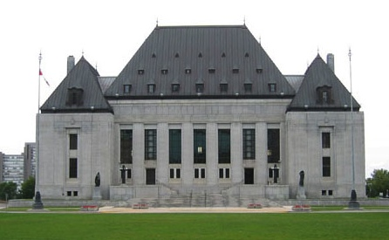
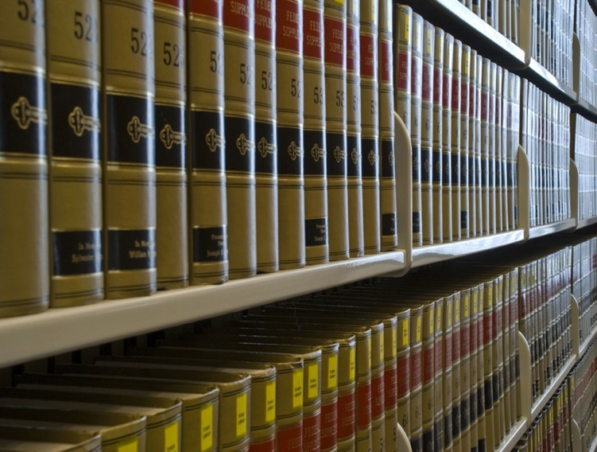
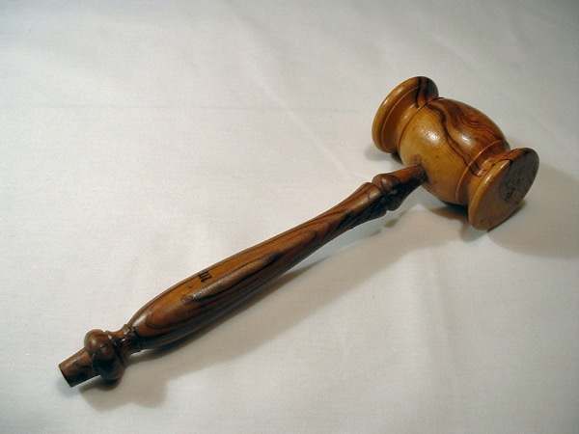
The Common Law as Remix

Slide 51
An Un-enumerated Right
Can we find a
FREEDOM
TO
CREAtE ?

Slide 52

Charter of Rights (Canada)
1. The Canadian Charter of Rights and Freedoms guarantees the rights and freedoms set out in it subject only to such reasonable limits prescribed by law as can be demonstrably justified in a free and democratic society.
2. Everyone has the following fundamental freedoms:
(a) freedom of conscience and religion;
(b) freedom of thought, belief, opinion and expression, including freedom of the press and other media of communication;

Slide 53

U.S. Constitution, 1st Amendment
“Congress shall make no law respecting an establishment of religion, or prohibiting the free exercise thereof; or abridging the freedom of speech, or of the press; or the right of the people peaceably to assemble, and to petition the Government for a redress of grievances.”

Slide 54

The Universal Declaration of Human Rights
Article 18. Everyone has the right to freedom of thought, conscience and religion; this right includes freedom to change his religion or belief, and freedom, either alone or in community with others and in public or private, to manifest his religion or belief in teaching, practice, worship and observance.
Article 19. Everyone has the right to freedom of opinion and expression; this right includes freedom to hold opinions without interference and to seek, receive and impart information and ideas through any media and regardless of frontiers.

Slide 55
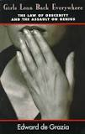
Closest to establishing a “Right to CREAtE”?
“Girls Lean Back Everywhere: The Law of Obscenity and the Assault on Genius” - Edward De Grazia
Query: Is all
Art political?

Slide 56
The point being…
We are back to:
Boyden – games are “systems” that need the creative acts of gamers (otherwise no copyright)
McLuhan – games as “social reaction”
“Connector” – creativity neither arises nor has its destiny in isolation

Slide 57
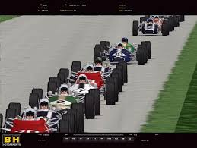
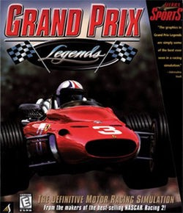
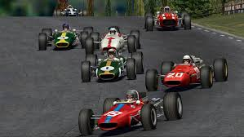
Let’s Talk About Mods. Really.

Slide 58
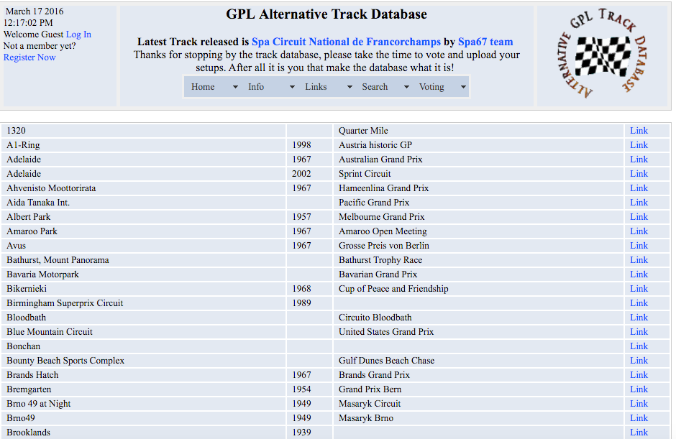
More hours of labour:
Developer or Modders?

Slide 59
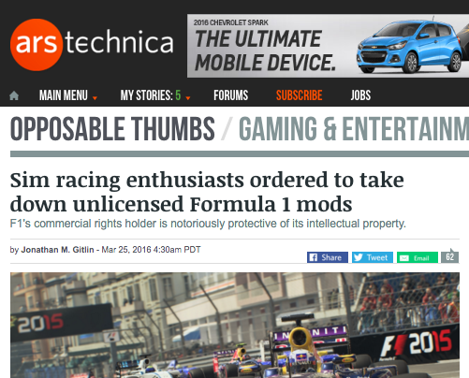

Slide 60
Revealing contradictions Manifest in Video Game Worlds
→←

Slide 61
Legal Contradictions Manifest in Video Game Worlds # 1
The characterization of the copyright in digital works as “property” often seems to be more about politics and patriarchy.
→←

Slide 62
“Copyright” as property can seem confusing and contradictory
Copyright Act (R.S.C., 1985, c. C-42)
3 (1) For the purposes of this Act, copyright, in relation to a work, means the sole right to produce or reproduce the work or any substantial part thereof in any material form whatever, to perform the work or any substantial part thereof in public or, if the work is unpublished, to publish the work or any substantial part thereof …

Slide 63
Perhaps more helpful if copyright thought of in terms of common or state property which returns to the public domain, but rarely contextualized that way.
Nor does it necessarily mean that the term “property” which already applies to a great diversity of things could not be “stretched to fit”.

Slide 64
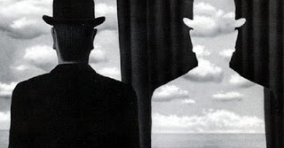
All of which is exacerbated by…a copyright dichtomy

Slide 65
Not Idea/Expression
But
Low Creative Threshold/Monopoly Consequences
( when it comes to derivative rights)

Slide 66
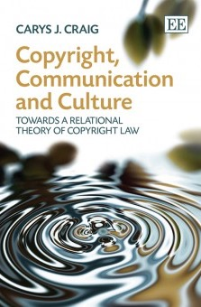
And further exacerbated by the Romantic Author Construct

Slide 67
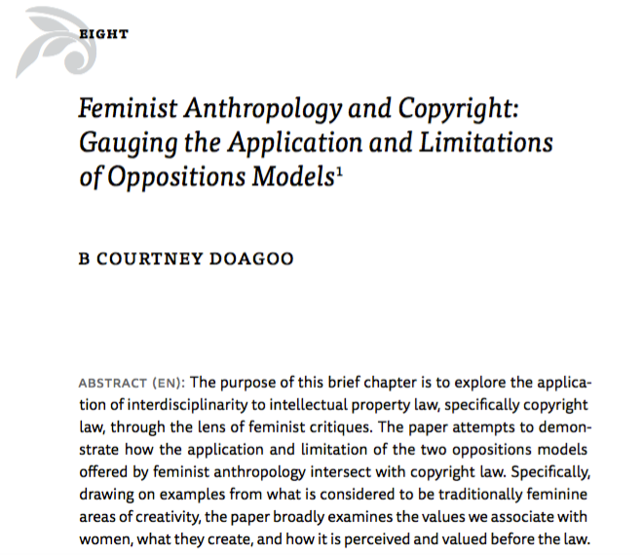
Consequences: Copyright as property can be misogynistic

Slide 68
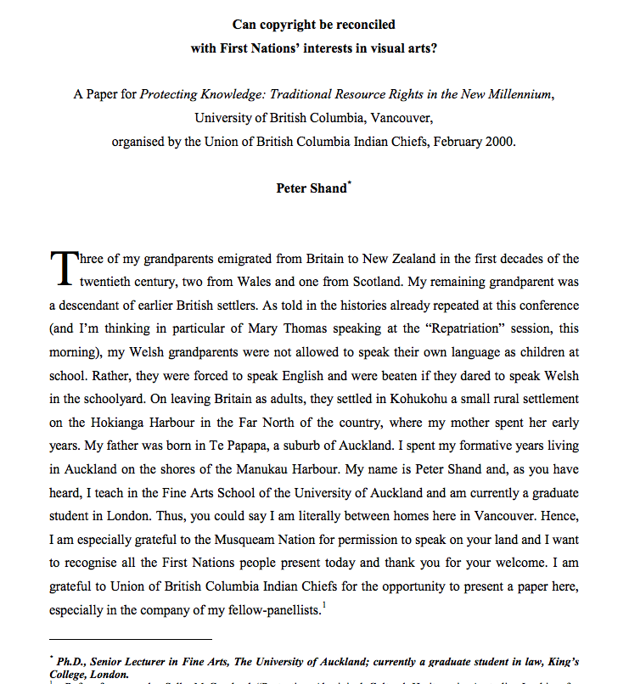
Not to mention racist & colonialist..

Slide 69
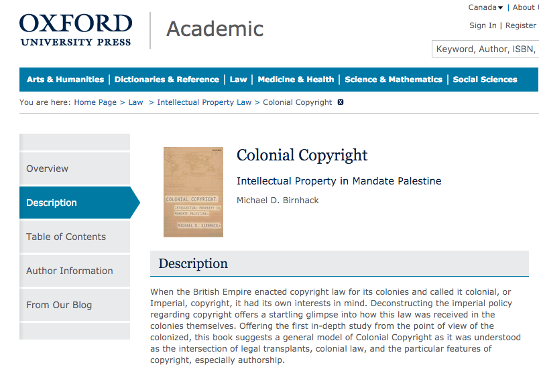

Slide 70
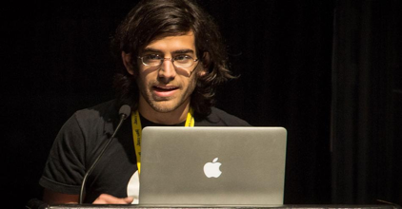
“Copyright as Property” can be irresponsible
“[s]tealing is stealing whether you use a computer command or a crowbar, and whether you take documents, data or dollars. It is equally harmful to the victim whether you sell what you have stolen or give it away.”*
*The United States Attorney’s Office, District of Massachusetts, Press Release, “Alleged Hacker Charged with Stealing over Four Million Documents from MIT Network” (19 July 2011), online: <http://www.justice.gov/usao/ma/news/2011/July/SwartzAaronPR.html>

Slide 71
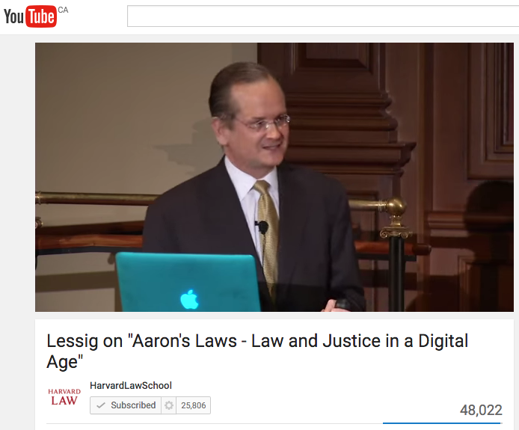
See…

Slide 72
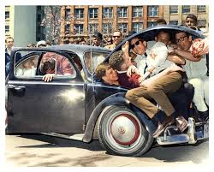
Legal Contradictions Manifest in Video Game Worlds # 2
Copyright concepts such as fair dealing/fair use fit uneasily, with the exclusionary rights schemes and memes core to notions of (private) property.
→←

Slide 73
Specifically…
Neither copyright nor contracts adequately accommodate the real world collaborations between “creators” and others (users/collaborators) in today’s digital world.
→←

Slide 74
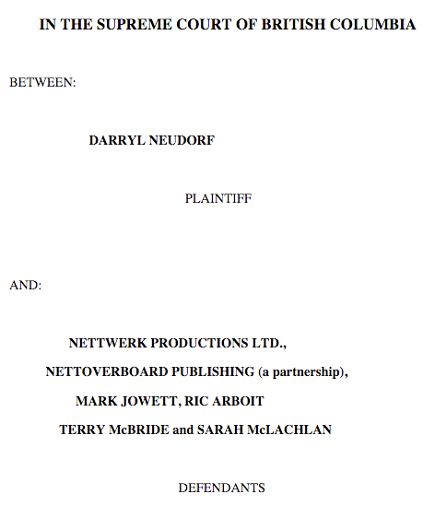
The Binary…Neudorf v. Nettwerk, McLachlan et al, BC Supreme Court (1999)

Slide 75
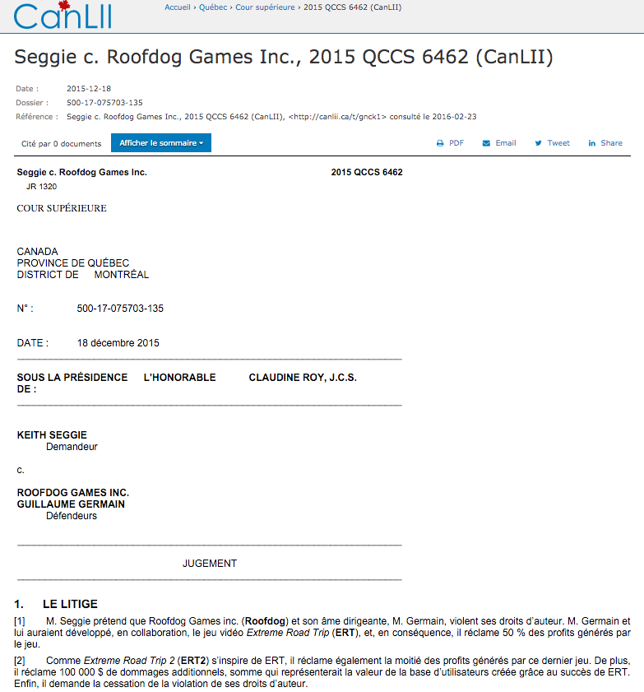
Also not joint authorship…

Slide 76
Courts determined that an album (in Neudorf v. McLachlan) and a video game (in Seggie v. Rooftop Games) were not works of joint authorship based on the work each party did, and there was no common intention to create a collaborative work.

Slide 77
“In dismissing the plaintiff's copyright claims, I found that while the plaintiff had proven that he made a contribution of original expression to the verse vocal melody in the song "Steaming", he had failed to satisfy the test for joint ownership because he did not prove a mutual intent to co-author this song with the defendant McLachlan.”

Slide 78
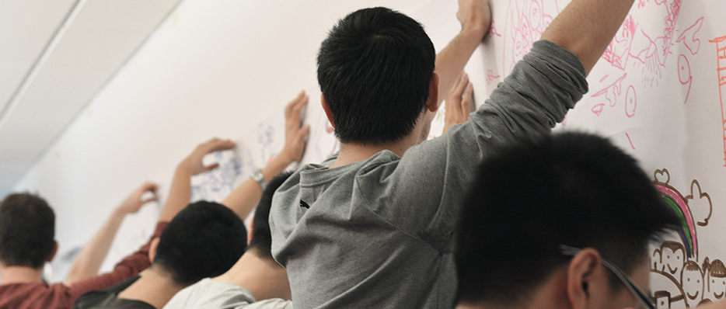
All in contrast to the real world,
where digital is collaborative.

Slide 79

Agile v. Scrum v. Waterfall

Slide 80

Another way to illustrate that creativity is collaborative ?…

Slide 81

Why so many music ©?
* Courtesy Jeff Young

Slide 82


Slide 83
Acknowledgement of the collaboration inherent in forms of creativity even beyond music?

Slide 84

Is “everyone gets a copyright” a practical or good solution in the digital age?

Slide 85
Legal Contradictions Manifest in Video Game Worlds # 3
An apparent double standard of behavioral freedoms favoring patents over copyright in analogous circumstances (e.g. “modding”) with no explanation?
→←

Slide 86

Is the game rigged?
Industry > Art

Slide 87


Significant that…
Creativity maps to Copyright Law
Innovation maps to Patent Law

Slide 88
Double standards ?
Innovation in a patent law context effectively allows “mods”….So why doesn’t creativity in a copyright law context similarly allow mods.
Patent law allows free riding on both ideas and expression (through designing around). Copyright law allows free riding on ideas only. If free riding on ideas is ok, why is free riding on expression not ok?… (Rebecca Tushnet)

Slide 89
Conclusions…
Today…the further democratization of tools for creativity through digital means…requires additional reforms:
The RIGHT TO CREAtE?

Slide 90
Moving Forward Through the Contradictions

Slide 91

Saving Copyright to
Save Creativity?
Was copyright really built on such a shaky foundation?
Is there a way to understand & interpret copyright’s purpose that is not confusing, racist, sexist or colonialist?

Slide 92
Perhaps the “property” was in fact a “freedom”…
“Once upon
a time…”

Slide 93

The Statute of Anne (1709) can be interpreted as the apotheosis in a trajectory of authorial freedom from censorship.

Slide 94
TRAJECTORY OF CREATIVE FREEDOMS
{KING..} Star Chamber (UK) abolished July 1641; {TO PARLIAMENT..} → Replacement of Royal censorship with Parliamentary censorship.
{TO REGULATOR..} “Licensing Order of 1643”: Parliament required authors to have a government license before a work could be published. Enforced by Stationers’ Company, a printers guild with the exclusive power to print literary works, and the responsibility to censor them, in return for monopoly on the printing trade.
{TO EXCLUSIVE GUILD..} “Licensing of the Press Act 1662” - "An Act for preventing the frequent Abuses in printing seditious treasonable and unlicensed Bookes and Pamphlets and for regulating of Printing and Printing Presses.”
{TO PUBLISHERS/AUTHORS..} “The Statute of Anne” 1710 moved control to publishers/authors…

Slide 95


But always good to get back to basics:
Areopagitica by John Milton (1644)

Slide 96
“For Books are not absolutely dead things, but doe contain a potencie of life in them to be as active as that soule was whose progeny they are; nay they do preserve as in a violl the purest efficacie and extraction of that living intellect that bred them…
And though all the windes of doctrin were let loose to play upon the earth, so Truth be in the field, we do injuriously, by licencing and prohibiting to misdoubt her strength. Let her and Falshood grapple; who ever knew Truth put to the wors, in a free and open encounter
Lords and Commons of England, consider what Nation it is whereof ye are, and whereof ye are the governours: a Nation not slow and dull, but of a quick, ingenious, and piercing spirit, acute to invent, suttle and sinewy to discours, not beneath the reach of any point the highest that human capacity can soar to.”

Slide 97
Common Denominator of
Contradictions 1, 2 & 3
They all point to the question: Have we got our values reversed?

Slide 98



Shouldn’t Creativity Be More Important Than Property ?

Slide 99
Pause for breath…

Slide 100

Perhaps “moral rights” as a model*
Snow v. The Eaton Centre Ltd.
(1982), 70 CPR (2d) 105.
Ont. High Ct of Justice
*Note: Aligns with “Recreating further conundrums as “Liberty” aligns with Right to be Forgotten” “Property”

Slide 101

Footnote: Moral Rights
14.1 (1) The author of a work has…the right to the integrity of the work and, in connection with an act mentioned in section 3, the right, where reasonable in the circumstances, to be associated with the work as its author by name or under a pseudonym and the right to remain anonymous.
(2) Moral rights may not be assigned but may be waived in whole or in part.
(3) An assignment of copyright in a work does not by that act alone constitute a waiver of any moral rights…

Slide 102
Reconciling creativity & IP
What is perhaps most interesting about “moral rights” is that it is the (only) legal concept that directly incorporates the process of Creativity?

Slide 103

Support for moral rights?…

Slide 104


Videogames as Metaphor
Video Games as proof of mutually reliant and merged creativity?
Player’s creative input is necessary to the game & game designer. Game designer’s creativity is (obviously) necessary for the game to exist.
Video-games: Either exception where all creativity is connected (by design) or more proof that all creativity is connected generally???

Slide 105



…Evolving a
single standard:
For CREATORS as USERS, &
For USERS as CREATORS

Slide 106

Right to Remix/Mod/CREAtE ?
“Right to CREAtE”
Not “Right in the
Creation”
Right to Remix-CREAtE-Mod as a creative/expressive right rather than an IP right/property protection.

Slide 107

Pause once again…

Slide 108
Reactions?

Slide 109

One more (wild & crazy) thing on freedoms
Economic growth & IP freedoms (freedom from IP) – Where would a data-crunch take us?
“It seems simple, really” (Kevin Smith @ Duke)
CORRELATES STRONG ECONOMIES & WEAK IP LAWS
(BRIC – Brazil, India, Russia and China)
http://blogs.library.duke.edu/scholcomm/2012/12/14/it-seems-simple-really/

Slide 110
My Version: attempt to correlate
Economic Success & Facilitating Creativity but add respect for Fundamental Rights
CAUTION: (entirely unscientific – gut and Google…)
1.The World Justice Project | Rule of Law Index 2012-2013 (241 pages): Highest Rankings in “Fundamental Rights” are Sweden, Denmark & Norway. Highest Rankings in “Open Government” are Sweden, Netherlands & Norway.
2. Worlds best economies in 2012 (World Economic Forum – Global Competitiveness Report): Finland (3rd), Sweden (4th) & the Netherlands (5th)
3. Global Creativity Index (Martin Prosperity Institute): Sweden (1st), Finland (3rd) & Denmark (4th)
WHAT LEVELS OF CREATIVE FREEDOMS ARE IN
THOSE COUNTRIES IP/COPYRIGHT REGIMES?

Slide 111

http://www.gamesindustry.biz/articles/2014-05-21-why-is-the-nordic-region-so-good-at-making-games

Slide 112

Connection
Between
Creativity &
Weak IP Laws?

Slide 113

Next Class: Creating (meme) Part 3
Now that we have creativity, content & contradictions (partially) accounted for, what is the next horizon?
Remixing in games…
Next week…

Slide 114

Always include a cat picture

Slide 115


Slide 116
Our Academic Partners

