Slide 1


Right to CreaTE or Rights to the Creation
Talk 4
Part A “Creating”
Video Game Law - Fall 2017
UBC Law @ Allard Hall
Jon Festinger Q.C.
Centre for Digital Media
Allard Law of Law, UBC
QMUL School of Law (CCLS)
Festinger Law & Strategy
http://videogamelaw.allard.ubc.ca/
Twitter: @jonfestinger
jon_festinger@thecdm.ca

Slide 2
Logistics?

Slide 3
News of the Week

Slide 4
Yours?

Slide 5
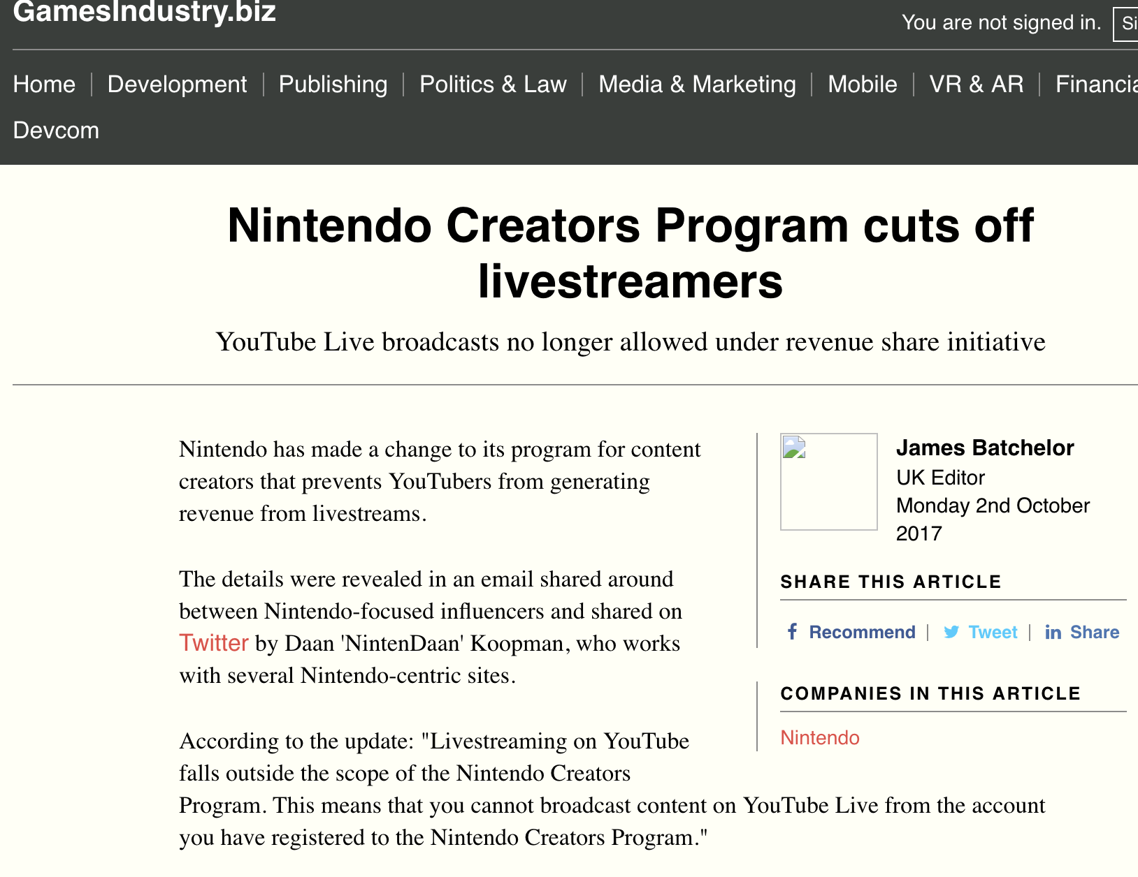

Slide 6
DISCUSSION?

Slide 7
Questions?

Slide 8
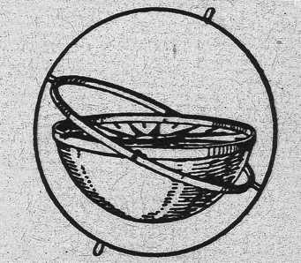
Where Are We?
*3rd and final Talk in Part A of the course under “Creating”
*Today:…(How) Can a Right to CREATe (Mod) be established?
*Next class – beginning of Part B: “Connecting”

Slide 9
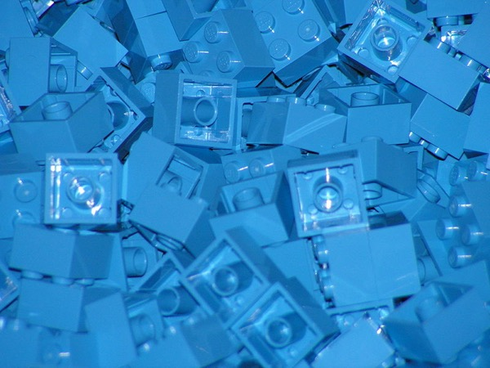
Today: Creating (meme) Part 3
Now that we have creativity, content & contradictions (partially) accounted for, what is the next horizon?
Remixing in games…
This week…

Slide 10
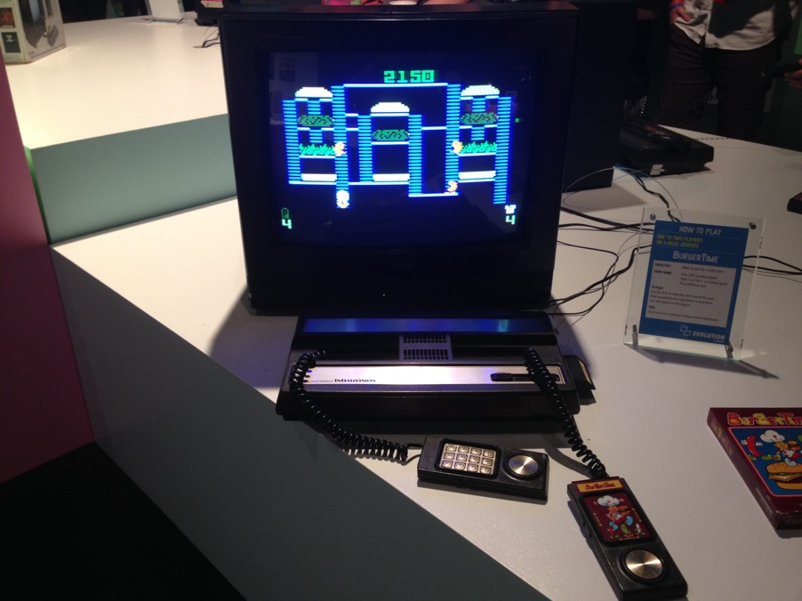
What Did You Learn From Your Homework?

Slide 11
Back to…
Where is the
FREEDOM
TO
CREAtE ?

Slide 12
Restating a concept:
“What is perhaps most interesting about “moral rights” is that it is the (only) legal concept thaT directly incorporates the process of Creativity.”

Slide 13

Pause…

Slide 14
Copyright Act R.S.C., 1985, c. C-42
S. 2: “artistic work” includes paintings, drawings, maps, charts, plans, photographs, engravings, sculptures, works of artistic craftsmanship, architectural works, and compilations of artistic works;
“dramatic work” includes (a) any piece for recitation, choreographic work or mime, the scenic arrangement or acting form of which is fixed in writing or otherwise (b) any cinematographic work, and (c) any compilation of dramatic works;
“every original literary, dramatic, musical and artistic work” includes every original production in the literary, scientific or artistic domain, whatever may be the mode or form of its expression, such as compilations, books, pamphlets and other writings, lectures, dramatic or dramatico-musical works, musical works, translations, illustrations, sketches and plastic works relative to geography, topography, architecture or science;

Slide 15
What’s wrong with this picture?
THE “MECHANIC” IS BASED ON THE COMMODITY NOT THE CREATIVITY
(OUTCOME NOT PROCESS)
Policy statements are about “…encouraging creativity” but the law is essentially related to its commercial liquidity.
The only assumption is that creativity must exist, and that is only ever implied (also remember how low the threshold for creativity is – Atari v. Oman)

Slide 16
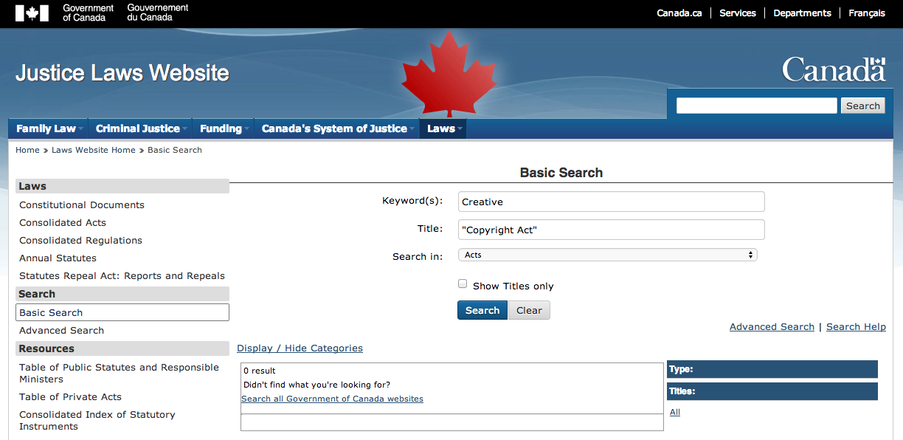
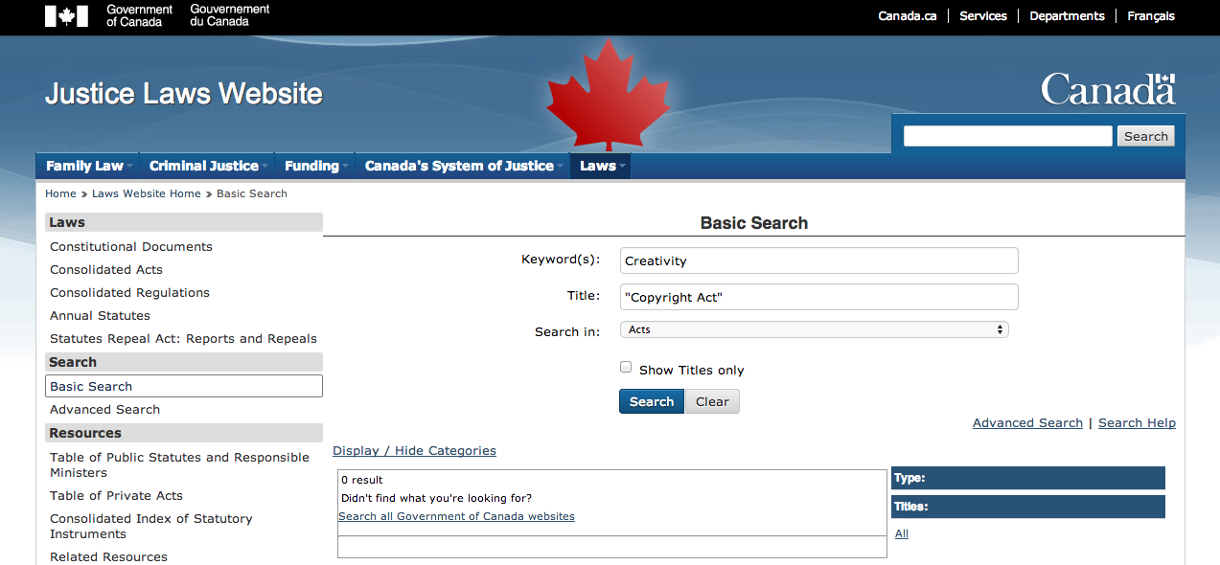

Slide 17

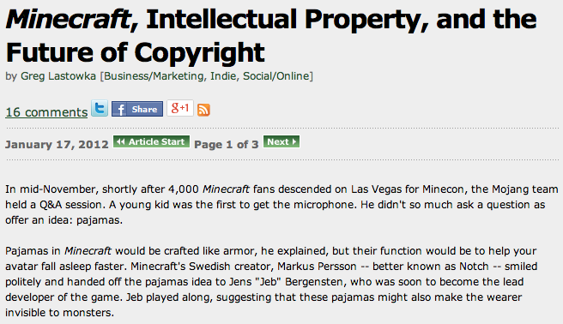
http://www.gamasutra.com/view/feature/134958/minecraft_intellectual_property_.php

Slide 18
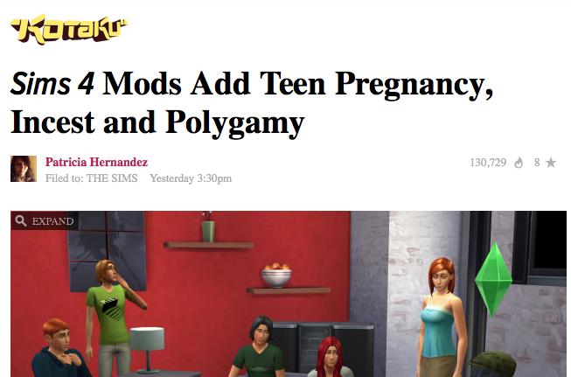
http://kotaku.com/preview/sims-4-mods-add-teen-pregnancy-incest-and-polygamy-1638223190

Slide 19
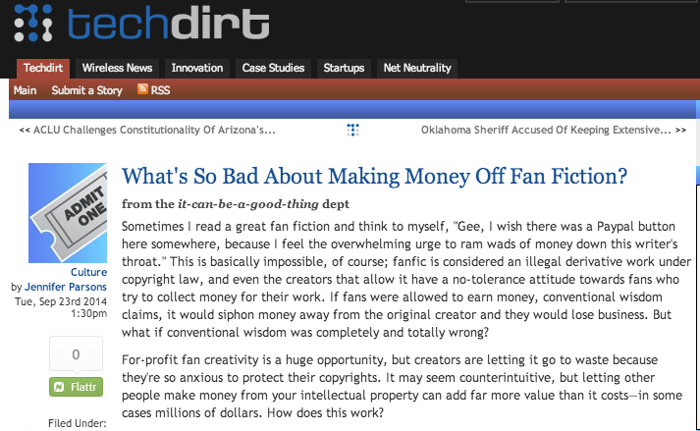
https://www.techdirt.com/articles/20140821/21532628289/whats-so-bad-about-making-money-off-fan-fiction.shtml

Slide 20
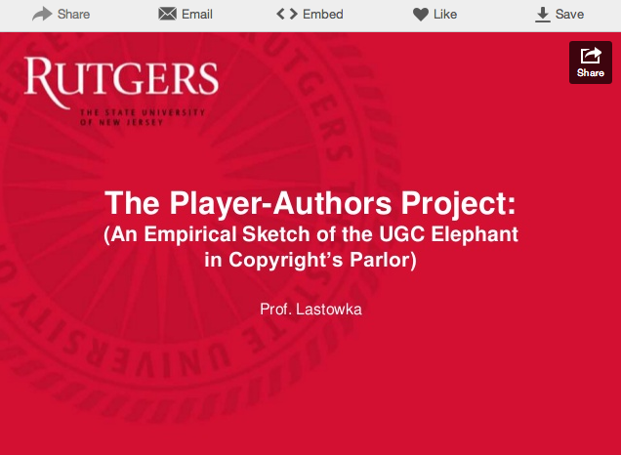
http://www.slideshare.net/greglas/the-player-authors-project

Slide 21
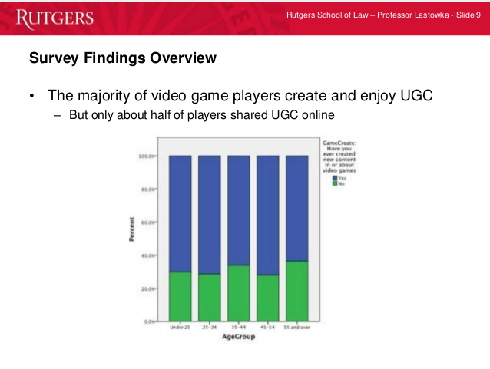

Slide 23
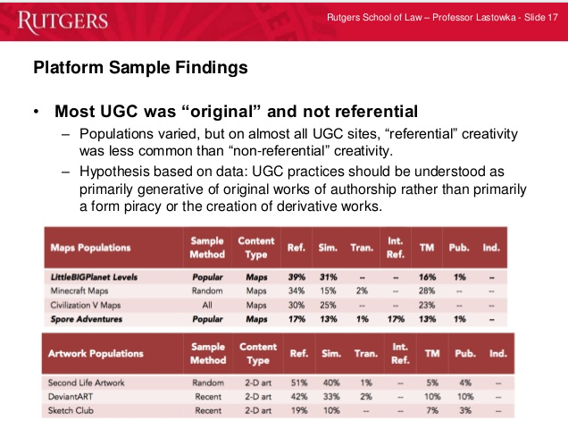

Slide 24
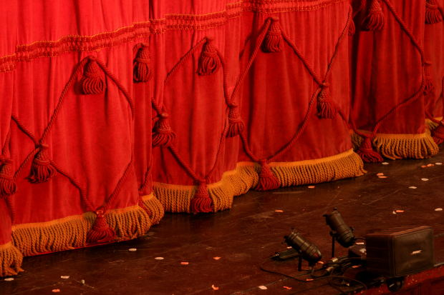
Follow Up to Talks 1, 2 & 3
Emergent Themes Evolve?

Slide 25
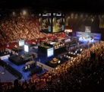
Evolving Theme 1?
What constitutes a “VIDEOGAME” & how is it to be differentiated?
Is Madden NFL a Sport?
“Examined, the Virtual Life Is Worth Living: Madden NFL 25 Portrays ‘Real’
Football” New York Times, August 26, 2013 http://www.nytimes.com/2013/08/27/arts/video-games/madden-nfl-25-portrays-real-football.html
& “Are Video Games a Sport?” (NYTimes video) http://nyti.ms/17cJXTO
2. “Game or be gamed: Douglas Rushkoff on prototyping democracy through play” (The Verge Dec. 12, 2012)
http://www.theverge.com/2012/12/12/3758576/douglas-rushkoff-gameplay-as-prototype
“By viewing our social, political, and economic structures through the lens of interactivity, Rushkoff says, we are beginning to "transition from the world of passively accepted narrative to one that invites our ongoing participation.”

Slide 26
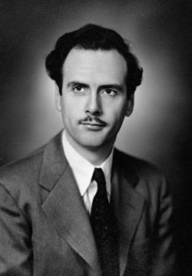
Evolving Theme 2?
“Why do we
(video) game?”
Answer:
A. Social reaction (McLuhan)

Slide 27
McLuhan, 1964
(Games as social reaction)
Games are popular art, collective, social reactions to the main drive or action of any culture. Games, like institutions, are extensions of social man and the body politic, as technologies are extensions of the animal organism. Both games and technologies are counter-irritants or ways of adjusting to the stress of the specialized actions that occur in any social group. As extensions of the popular response to the workaday stress, games become faithful models of a culture. They incorporate both the action and the reaction of whole populations in a single dynamic image.

Slide 28
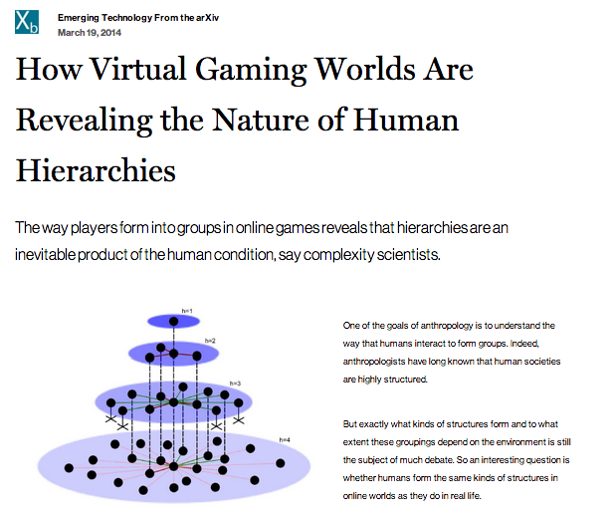

http://www.technologyreview.com/view/525696/how-virtual-gaming-worlds-are-revealing-the-nature-of-human-hierarchies/

Slide 29
Evolving Theme 3?
VIDEO - GAME
IP NOT IP
“Games and Other Uncopyrightable Systems” Bruce Boyden (2011) http://www.georgemasonlawreview.org/doc/Boyden_18-2_2011.pdf
“Games are systems in exactly the same way. A game, as sold, is only a game form; the content necessary for an instance of the game comes from the players. That is, the game form establishes the environment for play…”

Slide 30
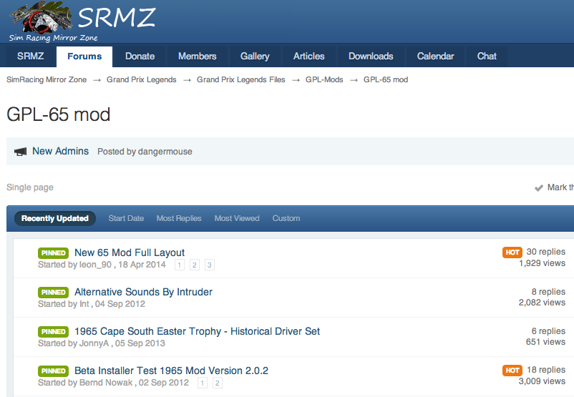
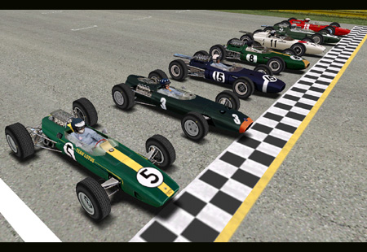
Mods (today’s topic)
Part of the evolution of
this Emergent Theme

Slide 31
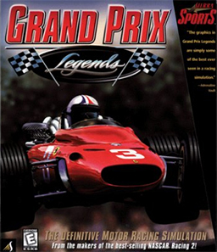

Slide 32
Starting Point Conundrum:
IDEA/EXPRESSION DICHOTOMY
Paradoxical Thesis: The problem with “the Law” may not have anything to do with the Law
IDEA/EXPRESSION DICHOTOMY:
No IP in an idea.
Becomes IP as (fixated - static) expression.

Slide 33
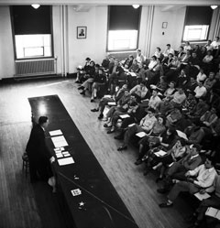
Contrast this “talk” to 70 years ago:

Slide 34
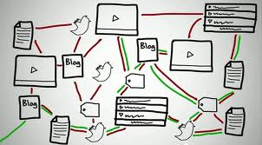
Now fixation happens @ digital speed..

Slide 35
...SO WHAT →????
Conundrum A (Literalist Dichotomy) =
What is Private v. What is Public
Conundrum B = Idea v. Expression
Once upon a time…a long time ago……
Private Public
Idea Expression

Slide 36

IN THE DIGITAL UNIVERSE
idea
private
EXPRESSION
PUBLIC

Slide 37
Not a Failure of Law:
A Failure of Balance
Some Ways to Rebalance???:
BY acknowledging the Right to CREaTe….
Mod
Use
Share
AS A PRIVATE RIGHT OF INDIVIDUALS
User Rights = S.C.C. “Pentalogy”
Right to Hyperlink = Crookes v. Newton (2011 SCC 47)

Slide 38
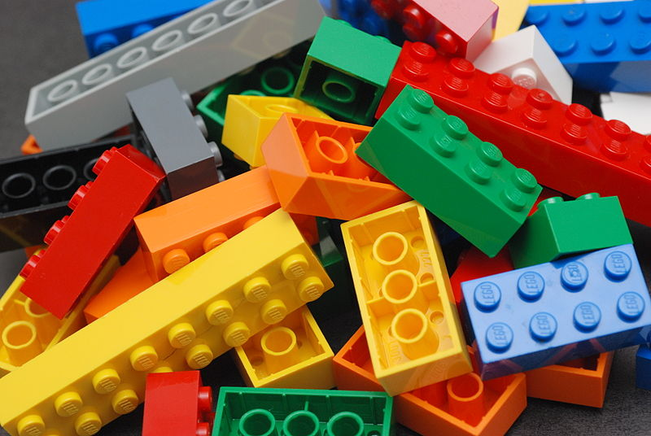
An Un-enumerated Right?
Where is the
FREEDOM TO
→MOD←/
CREAtE ?

Slide 39
Concept to Reflect On (for the next while)
PERSONAL CREATIVITY
as part of an
INTERACTIVE ENVIRONMENT
Same or different from books, TV, Film etc?
Same or different from sports, music etc?

Slide 40
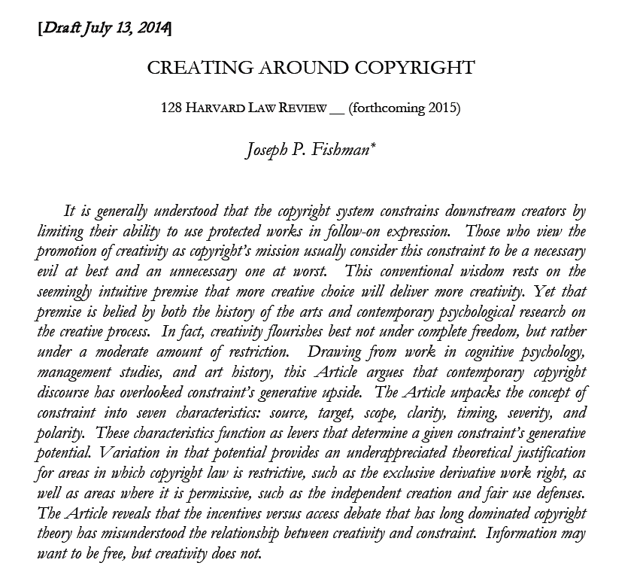
Problem to think about…
http://papers.ssrn.com/sol3/papers.cfm?abstract_id=2465590

Slide 41
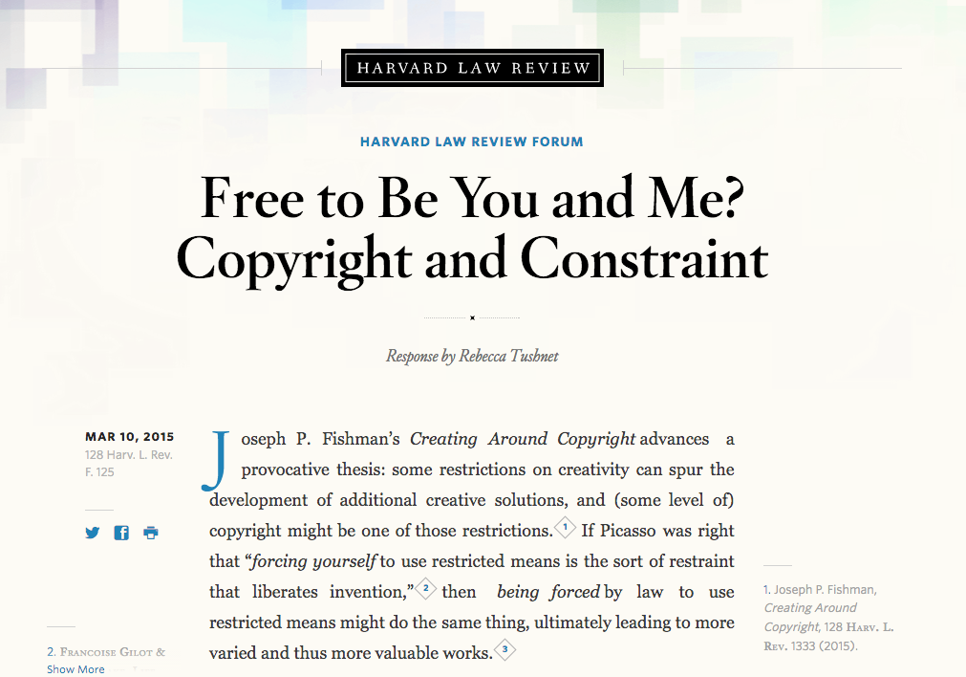
The formal answer…

Slide 42

Right to Mod/Right to CreaTe
Can these “right(s)” be established?
& if so through which legal pathways?
Core of anti-mod sentiment + attitude to overcome:
“[W]e believe it is our duty to uphold the integrity of our work.”
Statement by general manager of Tecmo Inc. re action against online forum members who released mod “skins” for (among other games) “Dead or Alive Xtreme Beach Volleyball”.

Slide 43
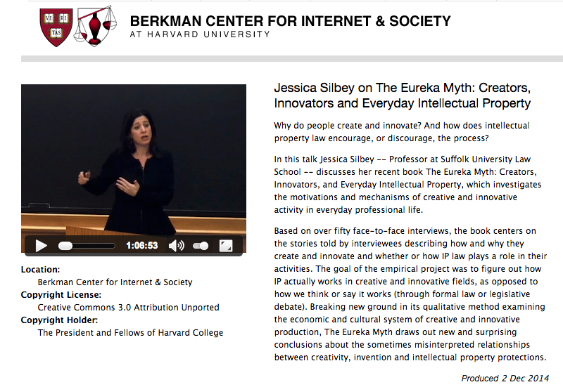
Creators do not need (nor want) additional constraints

Slide 44
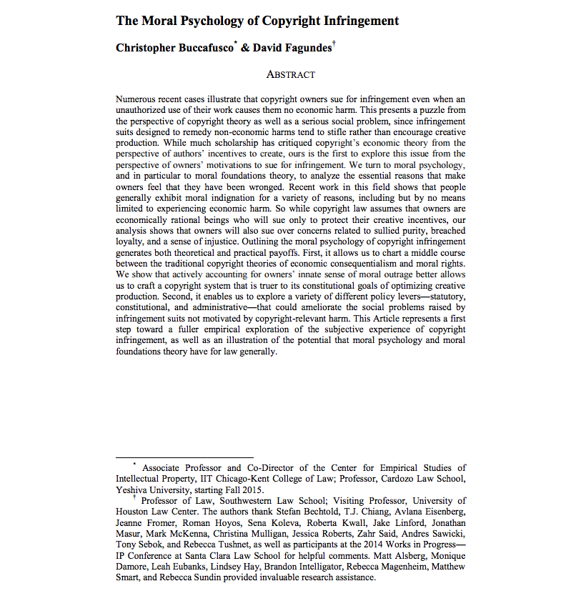
http://papers.ssrn.com/sol3/papers.cfm?abstract_id=2587339

Slide 45
“Numerous recent cases illustrate that copyright owners sue for infringement even when an unauthorized use of their work causes them no economic harm. This presents a puzzle from the perspective of copyright theory as well as a serious social problem, since infringement suits designed to remedy non-economic harms tend to stifle rather than encourage creative production…We turn to moral psychology…to analyze the essential reasons that make owners feel that they have been wronged. Recent work in this field shows that people generally exhibit moral indignation for a variety of reasons, including but by no means limited to experiencing economic harm. So while copyright law assumes that owners are economically rational beings who will sue only to protect their creative incentives, our analysis shows that owners will also sue over concerns related to sullied purity, breached loyalty, and a sense of injustice.”

Slide 46

Creator/designer v. User/Gamer/creator

Slide 47
“There is nothing more practical than a good theory…”
Karl Lewin (1951)

Slide 48
Is…
Post-Structuralism a “good theory” to apply to video-games?…
And therefore to Video Game (& all digital) Law?...

Slide 49
McLuhan, 1964:
Games as social creation
Games are popular art, collective, social reactions to the main drive or action of any culture. Games, like institutions, are extensions of social man and the body politic, as technologies are extensions of the animal organism. Both games and technologies are counter-irritants or ways of adjusting to the stress of the specialized actions that occur in any social group. As extensions of the popular response to the workaday stress, games become faithful models of a culture. They incorporate both the action and the reaction of whole populations in a single dynamic image.

Slide 50
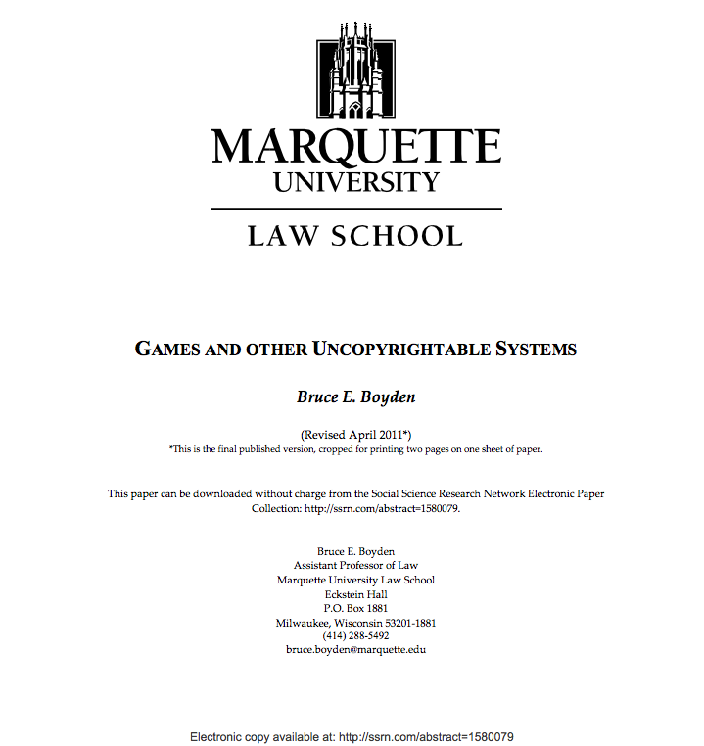
You as creator of meaning: Boyden

Slide 51
“In all of these situations, the owners of a copyright in a form, description, or set of instructions were attempting to extend their copyright to material for which the user of the work provided the essential content, not its author. That is what made them systems. They were, without that input, empty shells, waiting to be filled.”
“Games are systems in exactly the same way. A game, as sold, is only a game form; the content necessary for an instance of the game comes from the players. That is, the game form establishes the environment for play—the game space—and it defines permissible moves and the conditions for winning or drawing. But the game itself is supplied by the players.”
“Systems are shells into which users pour meaning. While they may contain expression themselves, that expression is there merely to facilitate the meaning added by the user.”

Slide 52
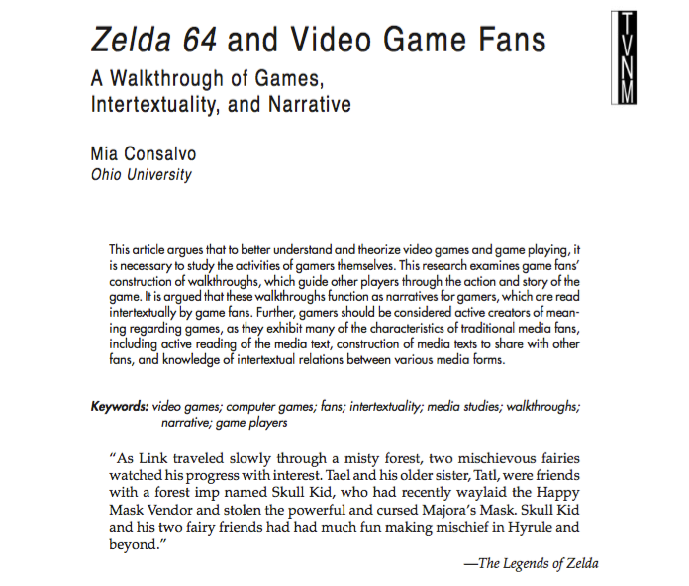
See also…

Slide 53
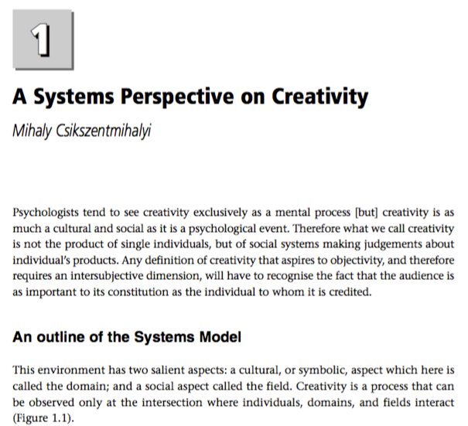
&…

Slide 54
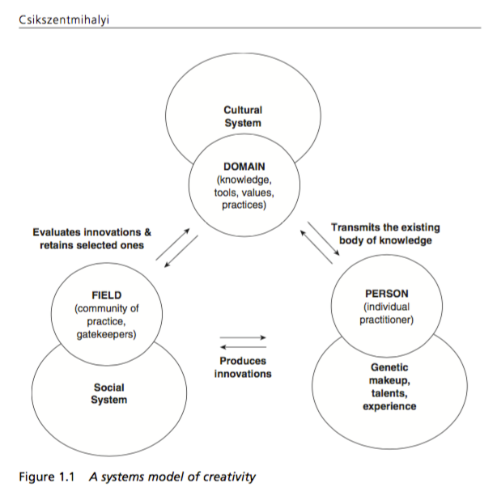

Slide 55

So here we are…
Jacques Derrida 1930-2004

Slide 56
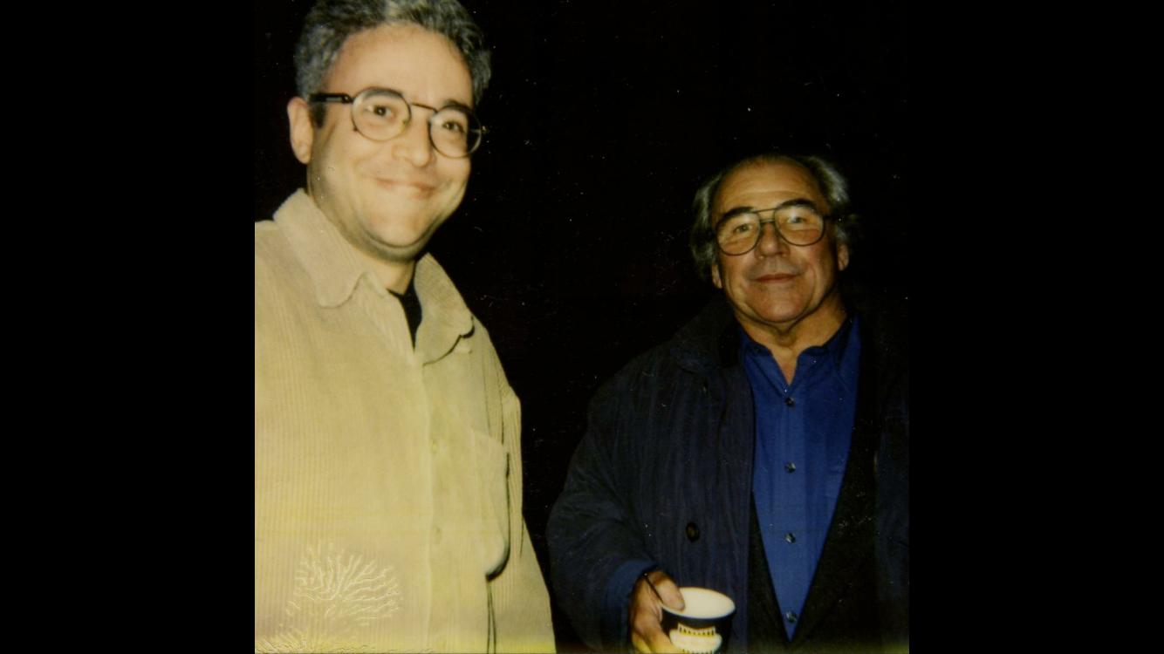

Slide 57
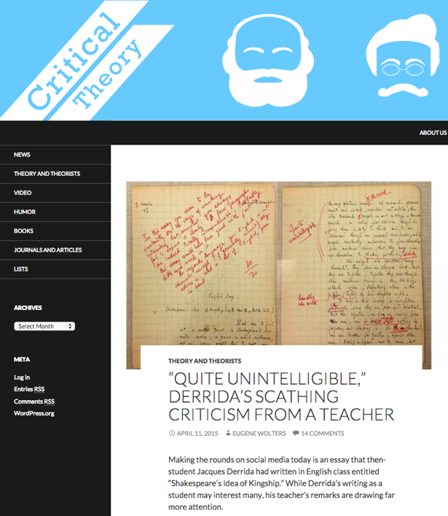
;)
http://www.critical-theory.com/quite-unintelligible-derridas-scathing-criticism-from-a-teacher/

Slide 58
Post Structuralism is…
Decentralizing Author & Replacing Them With Reader
=
Decentralizing Developer & Replacing Them With Gamer
=
CREAtIVe Acts (MODDING)

Slide 59
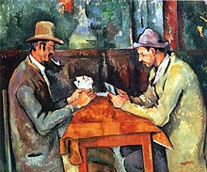
Think about playing a game
Cezanne – The Card Players

Slide 60
How important to the game is the game designer?
How important to the game are you?
How important to the game are the other people you are playing with?

Slide 61
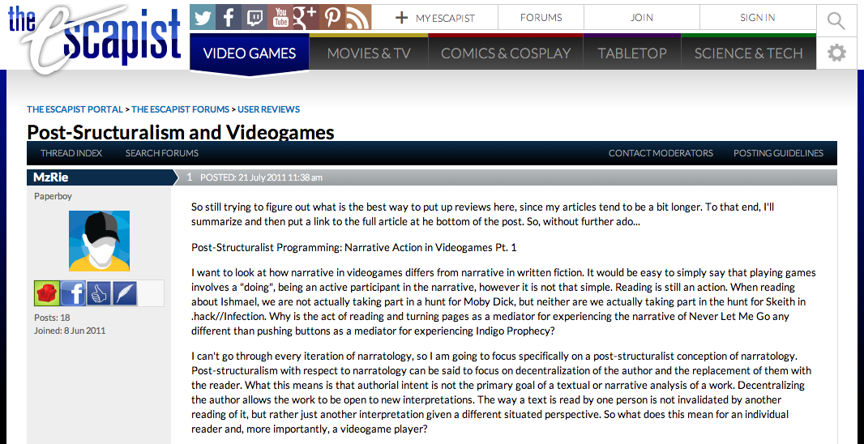
http://www.escapistmagazine.com/forums/read/326.302015-Post-Sructuralism-and-Videogames

Slide 62
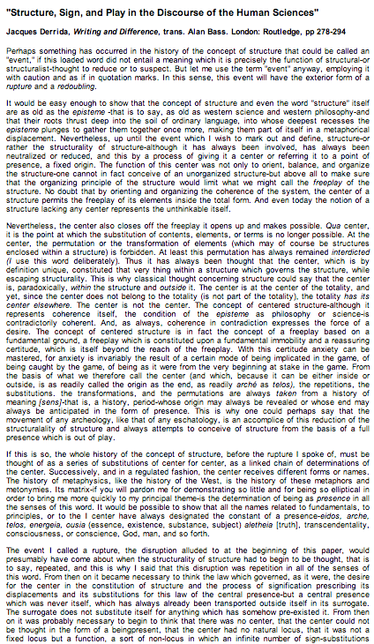
Gamer/modder as “author”:
Video Games as Post-Structural
"Structure, Sign, and Play in the Discourse of the Human Sciences” Jacques Derrida
Structures as free-floating (or 'playing') sets of relationships. Structuralist discourses unfortunately hold on to a "center” which anchors the structure and “does not play”.
http://hydra.humanities.uci.edu/Derrida/sign-play.html

Slide 63
“Freeplay is the disruption of presence. The presence of an element is always a signifying and substitutive reference inscribed in a system of differences and the movement of a chain. Freeplay is always an interplay of absence and presence, but if it is to be radically conceived, freeplay must be conceived before the alternative of presence and absence; being must be conceived of as presence or absence beginning with the possibility of freeplay and not the other way around.” Jacques Derrida

Slide 64
“And it's not enough to deconstruct to expose the way oppositions work and how meaning and values are produced in speech of all kinds and stop there in a nihilistic or cynical position regarding all meaning, "thereby preventing any means of intervening in the field effectively". To be effective, deconstruction needs to create new concepts, not to synthesize the terms in opposition, but to mark their difference and eternal interplay.”
Jacques Derrida "Interview with Jean-Louis Houdebine and Guy Scarpetta," in "Positions" p.43
http://inspirasi.co/ensiklopedia_inspirasi/post/1246

Slide 65
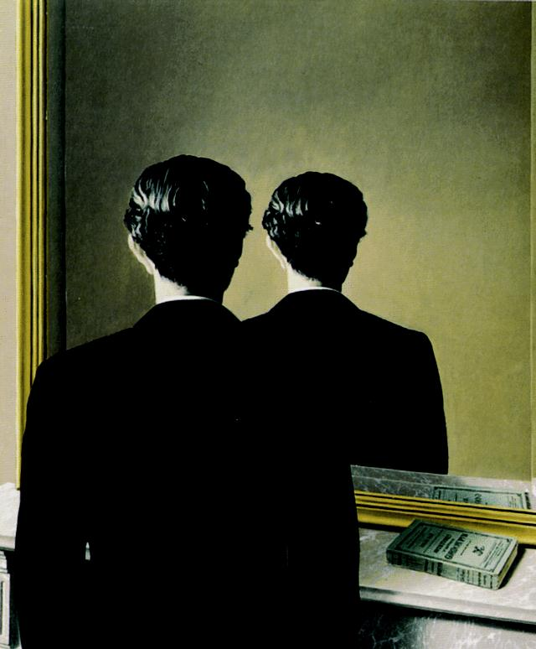
Magritte “Not to be Reproduced” 1937

Slide 66
From “Post-Structuralism and Videogames
“Post-structuralism with respect to narratology can be said to focus on decentralization of the author and the replacement of them with the reader. What this means is that authorial intent is not the primary goal of a textual or narrative analysis of a work. Decentralizing the author allows the work to be open to new interpretations. The way a text is read by one person is not invalidated by another reading of it, but rather just another interpretation given a different situated perspective. So what does this mean for an individual reader and, more importantly, a videogame player?”

Slide 67


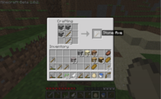

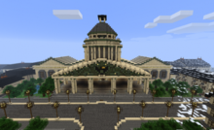

When you look at a video game it is not about what the developer intended…it’s about what the player does…

Slide 68
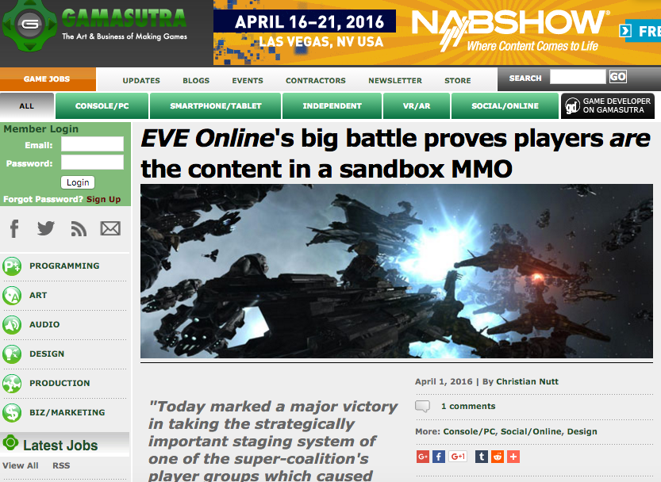
file:///Users/jfestinger/Desktop/Blizzard%20v.%20Lillith.pdf

Slide 69
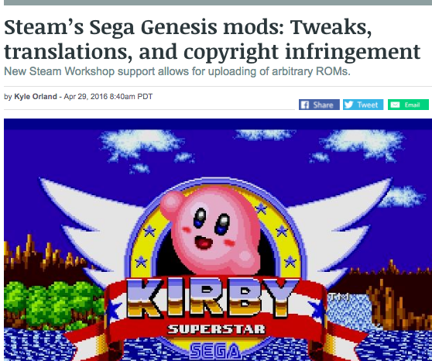
Some industry recognition…

Slide 70
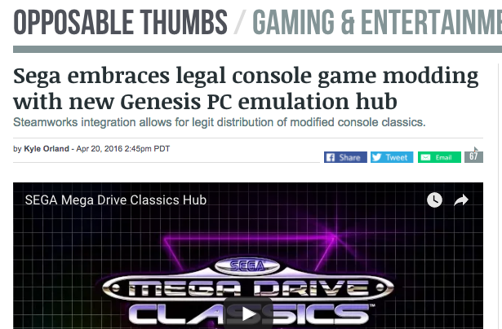

Slide 71
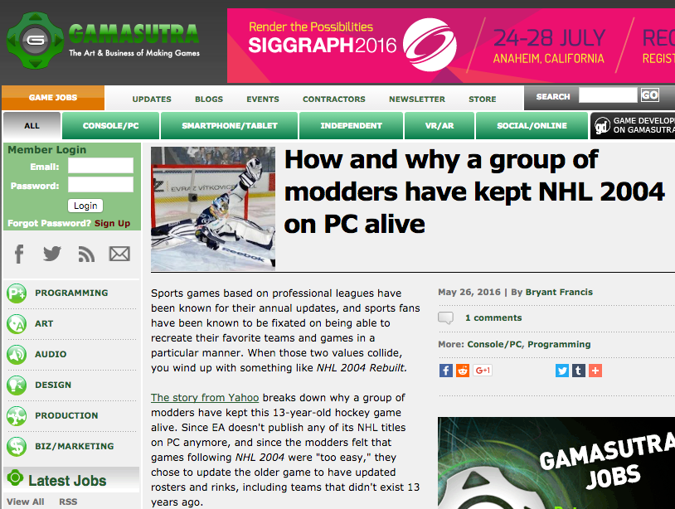

Slide 72
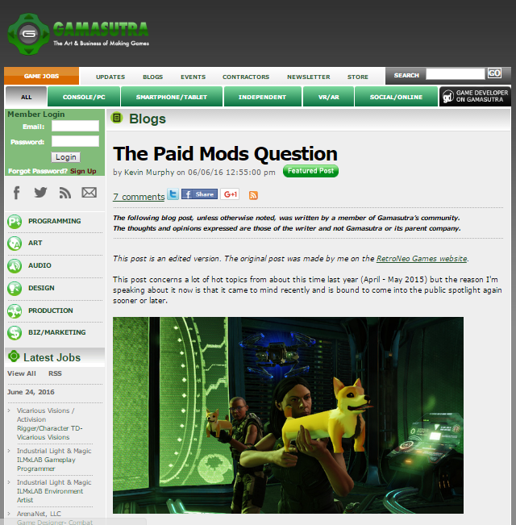
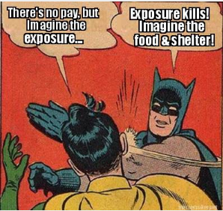

Slide 73
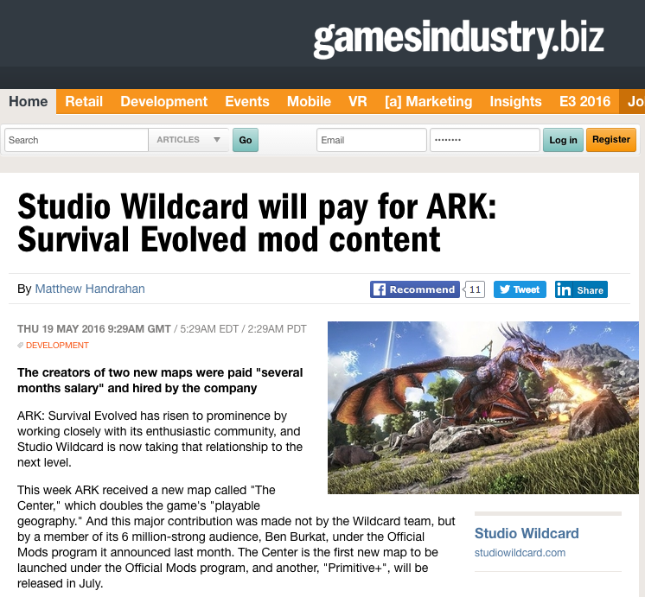

Slide 74
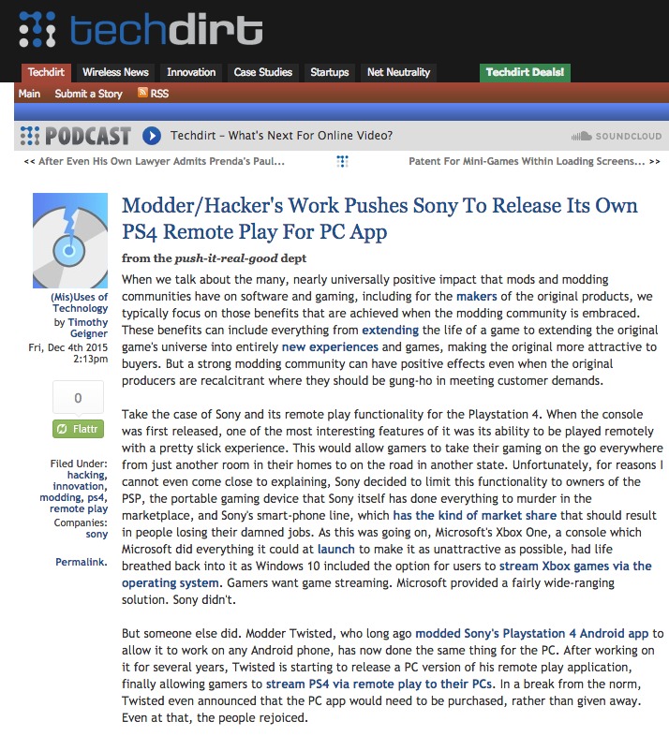

Slide 75
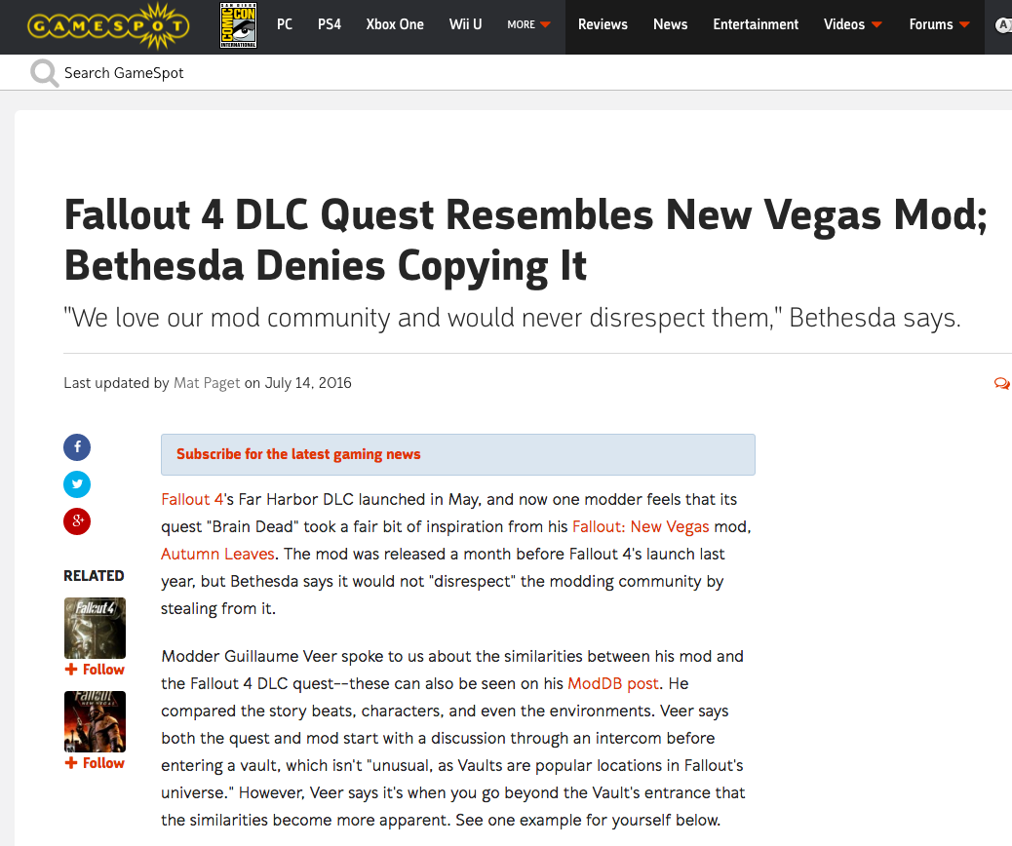
Shoe on other foot?

Slide 76
Post Structuralism is…
Decentralizing Author & Replacing Them With Reader
=
Decentralizing Developer & Replacing Them With Gamer
=
CREAtIVe Acts (MODDING)

Slide 77
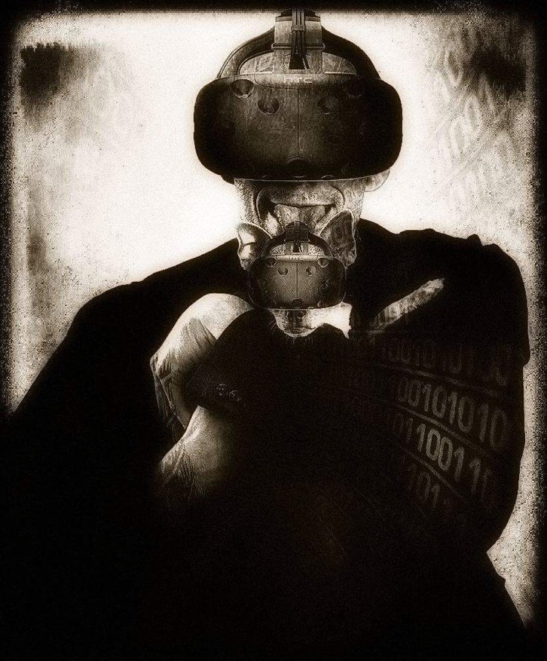

Slide 78
Post-Structuralist Concepts in Games:
All are about what players do/create.
Massively Multiplayer
Open World Playground
Content Creation Tools
Cooperative Mode
Public Gameplay Mode
Remote Play
Dynamic Gameplay Engine
WorldEditor (WED)
Scennery & Character Generators
A.I.

Slide 79
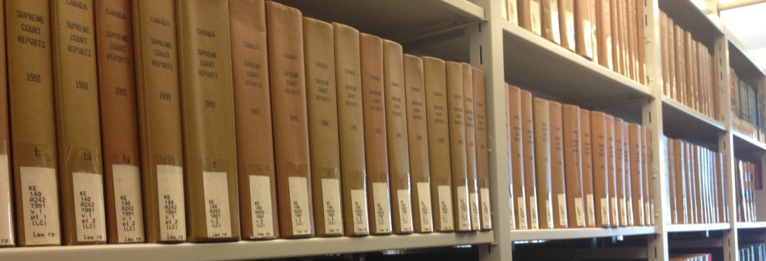
Video Games are Post-Structuralist
What are the legal implications?

Slide 80
Legal concepts to consider in a post-structuralist context:
Copyright (e.g. mods) = a FREEDOM TO CREAtE (MOD)
Contracts: Consumer protections
Privacy : Gamer not system dictates

Slide 81
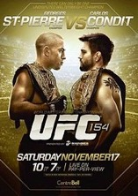

1. Copyright (e.g. mods):
Think about Tattoos as post- structuralist: Less of a problem?
Escobedo v. THQ, Inc.:
Tattoo artist sues THQ, makers of UFC video game for copyright infringement. Artist claims to have tattooed an originally created lion on Carlos Condit’s body. Escobedo and Condit had no written agreement.

Slide 82

LeBron…

Slide 83

Footnote: Moral Rights as Poststructuralist
14.1 (1) The author of a work has…the right to the integrity of the work and, in connection with an act mentioned in section 3, the right, where reasonable in the circumstances, to be associated with the work as its author by name or under a pseudonym and the right to remain anonymous.
(2) Moral rights may not be assigned but may be waived in whole or in part.
(3) An assignment of copyright in a work does not by that act alone constitute a waiver of any moral rights…

Slide 84
RIGHT TO CREAte
Aligns very well with post-structuralism while copyright law by (generally) anointing one author or limited authorship…is not well aligned with post- structuralism (or collaboration).

Slide 85

“RIGHT TO CREAtE”
Not…a
“Property Right in the Creation”

Slide 86
Take-away’s from last 2 classes
Misogyny and colonialism are not simply a product of video-games or tech culture. In fact it became baked into our understanding of copyright law through our tendency to property-ize copyright. Until we embrace collaborative digital work, biases toward property-ization (and the romantic sole author/genius myth) will tend to exclude principles of equality from the fruits of creative processes.

Slide 87
2. Copyright can more usefully be understood as the culmination of a process of moving away from Crown control over artistic works to finally allowing authors the full control to publish their own works. This was finally achieved by the Statute of Anne (otherwise known as the first Copyright Act) in 1708. However not a great deal of conceptual progress beyond the introduction of concepts of fair use have been made since then. For example there still is no clear “Right to Create” protecting and empowering creative processes as opposed to the wide-ranging affordances made for the products that result.

Slide 88
3. Copyright needs to evolve beyond its current state of being author/property centric to accommodate how people actually work in the digital world, which is iteratively, collaboratively and by using fragments (or more) of the pre-existing works of others.
= RIGHT TO CREAtE

Slide 89


Cases to overcome*…
Micro Star v. FormGen 1998 USCA:
Micro Star commercially sold “Nuke It” – CD Rom
collection of 300 user created levels for Duke Nukem 3D
Did so without permission of community creators who had
previously released those levels for free.
EULA allowing “non-commercial” mods existed between
FormGen & Duke Nukem 3D purchasers.
Micro Star’s fair use argument failed.
2. Davidson & Associates, Inc. v. Internet Gateway
2005 USCA (D&A = Blizzard):
Free Battle.net community created competitor “bnetd”
EULA & TOU prohibited “reverse engineering”
“Blizzard” succeeds
* & one not to: Lewis Galoob Toys v. Nintendo of America 1992 USCA: “Game Genie” device allowed gameplay features to be modified (e.g. # of lives) but did not change data in Nintendo cartridge. Court found “fair use”.

Slide 90
Cases to overcome (con’d)
3. iRacing v. Robinson (2007 Mass. Dist. Ct.):
“Nascar 2003” mod which modified the “.exe” source code file contrary to EULA.
“No CD” patch also made available by Robinson.
iRacing “wins” but Court found: “A defendant may successfully raise a fair use defense against a copyright infringement claim while still being found in breach of a contract not to copy.”
4. MDY Industries, LLC v. Blizzard Entertainment, Inc. (2010 USCA):
Blizzard used technological protection measure (“TPM” to prevent “bots” in “WoW” and effectively prohibited them by TOU.
MDY developed & sold “Glider” which circumvented the TPM and allowed bots into the game.
USCA affirmed Dist. Ct. finding that MDY violated DMCA’s copy control (anti-circumvention) provisions…

Slide 91
MDY (con’d): Contract not Copyright
Court in MDY reaffirmed copyright/contract distinction:
“…A Glider user violates the covenants with Blizzard, but does not thereby commit copyright infringement because Glider does not infringe any of Blizzard’s exclusive rights. For instance, the use does not alter or copy WoW software…
We conclude that for a licensee’s violation of a contract to constitute copyright infringement, there must be a nexus between the condition and the licensor’s exclusive rights of copyright. Here, WoW players do not commit copyright infringement by using Glider in violation of the ToU. MDY is thus not liable for secondary copyright infringement, which requires the existence of direct copyright infringement. Grokster, 545 U.S. at 930.”
* EFF: “A Mixed Ninth Circuit Ruling in MDY v. Blizzard: WoW Buyers Are Not Owners – But Glider Users Are Not Copyright Infringers” https://www.eff.org/deeplinks/2010/12/mixed-ninth-circuit-ruling-mdy-v-blizzard-wow

Slide 92
Notice any common denominators?
Creativity is never in issue in any of the cases
Copyright Law is only directly relevant in Microstar (& Galoob “Game Genie”) - no contractual nexus, so sole “copyright only” case.
“Fair Use” to create mods question avoided by:
Contract Law (Davidson, iRacing & MDY all decided on EULA, ToS or ToU terms & obligations).
Nothing creative in what Micro Star did – they did not create a mod – they usurped mod creators without permission
Conclusion: No current precedent that game mods are not “Fair Use” which is a copyright concept.

Slide 93

What’s at stake?
Mods
Machinima
Fan Fiction
Re-mix
Multi-source content
3D Printing
& (of course) Freedom to CREatE

Slide 94

“Right to CreaTE” v. “Rights in the Creation”
Right to CreaTe: Think Freedom of Speech/Expression. A PERSONAL RIGHT.
“CREATORS RIGHT” has come to mean a “right in the creation”, which attaches to content; a “benefit” post facto creation. Think IP/Copyright. Attaches to the product, not the person (contrast to “moral rights”).

Slide 95

Right to Remix/Mod/CREAtE ?
“Right to CREAtE”
Not “Right in the
Creation”
Right to Remix-CREAtE-Mod as a creative/expressive right rather than an IP right/property protection.

Slide 96



IS Creativity More
Important than Property?

Slide 97
“Intellectual Property” Paradoxes?
“Intellectual” + “Property”: Misnomer, contradiction, odd, oxymoronic?
Word “Intellectual” undermined by legal requirements of fixation/“actual-ness”/tangibility?
Word “Property” somewhat undermined by statutory limitations of impermanence: Property which expires????
Word “Property” undermined by statutory statements of “larger purpose.” Whose property is it if ultimately it belongs to us all in order to serve “progress”?
Is copyright “property” or “right”? Copyright Act: “property” appears only in ways unrelated to a “built in” right. Appears several times in true ownership context in Trade-marks Act and Patent Act.

Slide 98

SHOULD…
“Copy”
in“Copyright”
just mean
“copy”?

Slide 99
How do we update “Derivative Rights” for the Digital Age? (current provisions)
3. (1) For the purposes of this Act, “copyright”, in relation to a work, means the sole right to produce or reproduce the work or any substantial part thereof in any material form whatever, to perform the work or any substantial part thereof in public or, if the work is unpublished, to publish the work or any substantial part thereof, and includes the sole right
  (a) to produce, reproduce, perform or publish any translation of the work,
  (b) in the case of a dramatic work, to convert it into a novel or other non-dramatic work,
  (c) in the case of a novel or other non-dramatic work, or of an artistic work, to convert it into a dramatic work, by way of performance in public or otherwise,
  (d) in the case of a literary, dramatic or musical work, to make any sound recording, cinematograph film or other contrivance by means of which the work may be mechanically reproduced or performed,
  (e) in the case of any literary, dramatic, musical or artistic work, to reproduce, adapt and publicly present the work as a cinematographic work,
  (f) in the case of any literary, dramatic, musical or artistic work, to communicate the work to the public by telecommunication,
  (g) to present at a public exhibition, for a purpose other than sale or hire, an artistic work created after June 7, 1988, other than a map, chart or plan,
  (h) in the case of a computer program that can be reproduced in the ordinary course of its use, other than by a reproduction during its execution in conjunction with a machine, device or computer, to rent out the computer program,
  (i) in the case of a musical work, to rent out a sound recording in which the work is embodied, and
  (j) in the case of a work that is in the form of a tangible object, to sell or otherwise transfer ownership of the tangible object, as long as that ownership has never previously been transferred in or outside Canada with the authorization of the copyright owner,
and to authorize any such acts.

Slide 100
U.S. Copyright Act
A “derivative work” is a work based upon one or more preexisting works, such as a translation, musical arrangement, dramatization, fictionalization, motion picture version, sound recording, art reproduction, abridgment, condensation, or any other form in which a work may be recast, transformed, or adapted. A work consisting of editorial revisions, annotations, elaborations, or other modifications which, as a whole, represent an original work of authorship, is a “derivative work”.

Slide 101
IS LAW “AGILE”(enough)?
POSSIBLE
WAYS
FORWARD

Slide 102

POSSIBLE WAYS FORWARD
Right to Remix/Mod/CREATE ?
Right to Remix-CREATe-Mod as a creative/expressive right rather than an IP right/protection?
“Right to CreaTe” v. “Right in the Creation”
Can we...evolve a single standard:
For CREATORS as USERS, &
For USERS as CREATORS
…….to match reality…..
“Right to CREATe”
Not “Right in the Creation”

Slide 103


POSSIBLE WAYS FORWARD
“Context Shifting”
Imagine a world without Sony v. Universal SCOTUS
464 U.S. 417 (1984) (Betamax) time-shifting” fair use?
Why isn’t everything in digital world not a form
of tool enabled “time-shifting”
= “context shifting”
Key Factors in Sony:
a. enlarged audience;
b. did not impair copyright value.

Slide 104

Fair Dealing in Canada:
Enter User Rights…
Recent SCC “User” paradigm shifts
USERS ARE CREATORS TOO
August 2012 “Copyright Pentalogy” & previous cases
Moving from fair dealing as an exception to copyright infringement towards proactive “User Rights”
Right to Link (Crookes v. Newton)
Right to longer iTunes previews
Tech Neutrality
Fair dealing is to be assessed from the point of view of the purchaser/user
“Research” need not be associated with traditional intellectual pursuits

Slide 105

SCC Penatalogy...words
Abella J. for the majority in Alberta (Education) v. Canadian Copyright Licensing Agency (Access Copyright) 2012 SCC 37
“…fair dealing is a “user’s right”, and the relevant perspective when considering whether the dealing is for an allowable purpose…is that of the user…”
Abella J. for the Court in Society of composers, Authors and Music Publishers of Canada v. Bell Canada 2012 SCC 36
“Further, given the ease and magnitude with which digital works are disseminated over the Internet, focusing on the “aggregate” amount of the dealing in cases involving digital works could well lead to disproportionate findings of unfairness when compared with non-digital works.”
See also: “Copyright Fair Use Cases of the United States Supreme Court” http://www.ipwatchdog.com/2012/10/05/copyright-fair-use-cases-of-the-united-states-supreme-court/id=26225/

Slide 106

Non-commercial user-generated content
(Copyright Act, Canada)
29.21 (1) It is not an infringement of copyright for an individual to use an
existing work or other subject-matter or copy of one, which has been
published or otherwise made available to the public, in the creation of a
new work or other subject-matter in which copyright subsists and for the
individual — or, with the individual’s authorization, a member of their
household — to use the new work or other subject-matter or to authorize an
intermediary to disseminate it, if
(a) the use of, or the authorization to disseminate, the new work or other
subject-matter is done solely for non-commercial purposes;
(b) the source — and, if given in the source, the name of the author, performer,
maker or broadcaster — of the existing work or other subject-matter or copy of
it are mentioned, if it is reasonable in the circumstances to do so;
(c) the individual had reasonable grounds to believe that the existing work or
other subject-matter or copy of it, as the case may be, was not infringing
copyright; and
(d) the use of, or the authorization to disseminate, the new work or other
subject-matter does not have a substantial adverse effect, financial or
otherwise, on the exploitation or potential exploitation of the existing work or
other subject-matter — or copy of it — or on an existing or potential market for
it, including that the new work or other subject-matter is not a substitute for the
existing one.

Slide 107

PWF: Raise Thresholds for IP Protection
“The Innovation Dilemma: Intellectual Property and the Historical Legacy of Cumulative Creativity” Dutﬁeld & Suthersanen (U.K.)
http://www.academia.edu/860340/

Slide 108


POSSIBLE WAYS FORWARD
Isn’t it Barter Not Theft
(Piracy) IF We Are All
Creators?

Slide 109

POSSIBLE WAYS FORWARD
Double Standard Test yields answer?
ETHICAL SOLUTION?: Embedding a “Do Unto Others” algorithm rule-set which permits us to use the digital bits of others if we share ours to the same standard.
Barter not infringement.

Slide 110

Can I Mod
Yet?

Slide 111

Case of the Year?

Slide 112


Slide 113


Slide 114


Slide 115


Slide 116
Next Class
We now done Part A (meme # 1): “Creating”
Entering into (drumroll please…)
Part B (meme#2) of the course:
>>>>>>>>>>>>>>>“CONNECTING”>>>>>>>>>>>>>>>>>
Talk: Creators, Consumers & Users
(sub-nom: intro to contractual conundrums)

Slide 117

Always include a cat picture

Slide 118
Our Academic Partners

