Slide 1
Realism in Video Games & Digital Branded Integration
By Laura Courdi & Mina Khan
Notes:
LAURA

Slide 2
Realism in Video Games & Digital Branded Integration
Realistic effect
Why Make Games Realistic? Escapism
Digital Branded Integration
Concerns & Legal Issues
Notes:
MINA:
Introduction

Slide 3
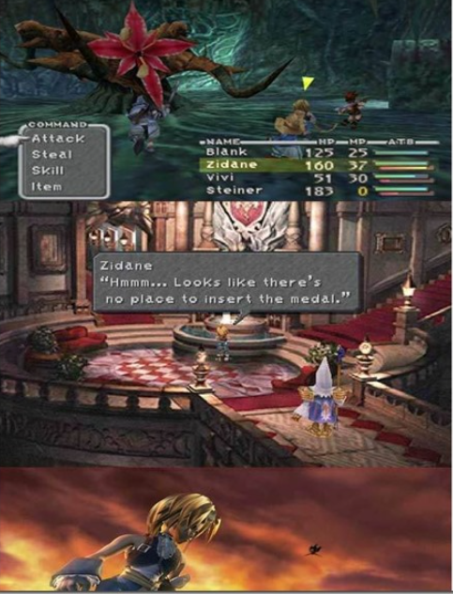
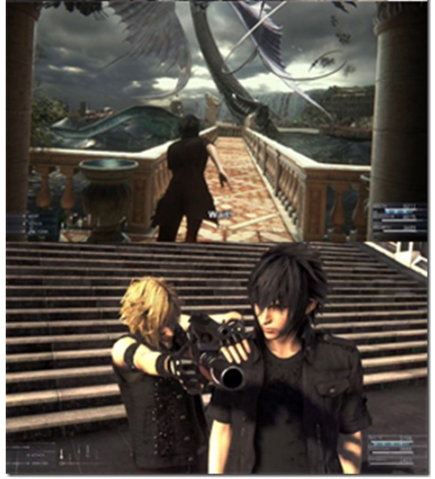
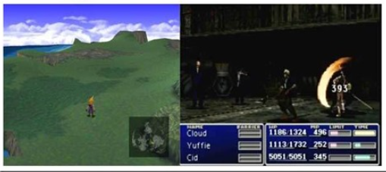
How Visuals Have Evolved
Realism: Def.: “representing things as they are in real life”
In a video game: Reproduction of the environment and goods
Video games then and now: FF → 1987 (2D), 1997 (3D), 2000, 2016
Notes:
MINA
This realism derives from a combination of factors, such as the lifelike appearance of characters and settings in some games, naturalistic movements of characters and tools, historical parallels in the stories of some, and logically consistent choices of game play.

Slide 4
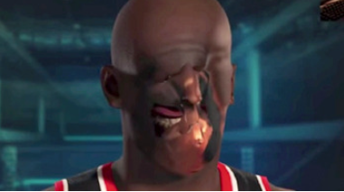
Visually Realistic
Failure:
Success:
Notes:
MINA
Bad: NBA 2K15 Facial Recognition
Good
Unknow
San Francisco / Watch Dogs 2 (Ubisoft)
Assassin’s Creed and other games that incorporate historical figures or wars and authentic-looking locales may have “ramifications that reach beyond art and into education”
https://www.tomsguide.com/us/pictures-story/552-visually-stunning-video-games.html#s5
http://www.cracked.com/article_23008_5-spectacular-failures-in-video-game-realism.html

Slide 5
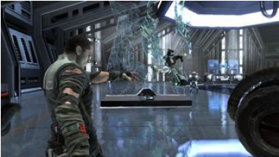
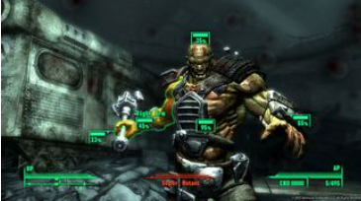
Realistic Games
Following the rules of reality: beyond graphics to lifelike physics, characters and controls
Benefits of including physics into game: Enemies are smart and unpredictable
Different every time you play
The Force Unleasched
Fallout 3
Tom Clanc’s Endwar
Cons:
Reality or departure from reality? Better?
Some games that we love are not based on reality
Notes:
MINA
Science: Developers have finally figured out how to write software that takes better advantage of the multiple processing cores in the Cell chip that runs the PS3 and the Xenon CPU that powers the Xbox 360. By performing several tasks at once, the chips can execute billions more instructions per second than their predecessors.
« a world that's lifelike down to the molecules and muscles.”
« obey the laws of physics as they smash into the computer-simulated skeletal systems of supermutants and irradiated ghouls.”
E.g:
If you are broken harm you can’t hold a gun;
broke leg won’t support the weight;
And the game's Euphoria artificial-intelligence system simulates the muscles and nervous systems of every Jedi or Wookiee you encounter.
not based on reality: E.g. supermario cart
https://www.popsci.com/entertainment-amp-gaming/article/2008-10/most-realistic-video-games-yet#page-2

Slide 6
Why Make Games Realistic? Escapism
Definition:
The avoidance of reality by absorption of the mind in entertainment or in an imaginative situation, activity, etc.
Wikipedia : Escapism is the avoidance of unpleasant, boring, arduous, scary, or banal aspects of daily life. It can also be used as a term to define the actions people take to help relieve persisting feelings of depression or general sadness.
Question:
Do you agree?
Notes:
MINA
LAURA → ASK THE QUESTION

Slide 7
Living the Dream!
NBA 2K18
https://www.youtube.com/watch?v=3EPHnjHu77g
Discussion
What do you think about products placement into the video game?
How is it affecting the gaming experience?
Are you inclined to those brands?
Notes:
MINA: Transition // Escapism and that section:
Play a video game is a great way to disconnect with reality; relax; entertaine yourself
Video games give you the opportunity to personify a talented person; like athlete in a sport game.
The game gives to the players the closest experience as possible to the reality.
LAURA: Introduction of the product placement as a factors of realism
To creat an immersive experience for the gamer, the depiction of an accurate environement is a tool.
We choose the trailer of a sport game
Because it illustrates how digital branded intergration could be one of the factors that help to create that envrionement
Watch video: 2:25 minute
Will watch a short trailer that was used to promote NBA 2K18 that was release a month ago.
MINA: Question/Discussion
We have been targetted by TM => we see: NBA / Nike / Nike tagline « just do it » / Jordan (nike) / Foot Locker / Gatorade / Mountain Dew
Those are all trade mark that we already associate with sport.
*stop there
NBA 2K18 is an example of Static “In-game advertising”.
NBA 2K18 est un jeu vidéo de simulation de basket-ball développé par Visual Concepts et édité par 2K Sports. C'est le 19ᵉ opus de la franchise NBA 2K et la suite de NBA 2K17. Il est sorti le 19 septembre 2017 sur Microsoft Windows, Nintendo Switch, PlayStation 4, PlayStation 3, Xbox One et Xbox 360. Kyrie Irving des Celtics de Boston apparaît sur la couverture de l'édition basique du jeu, tandis que Shaquille O'Neal apparaît sur la jaquette de l'édition spéciale.
when you go to a sport event or watch it on TV (superbowl, Stanley Cup Playoff) we used to see a lot of advertising and sponsor .
We associated sport events and athletes to strong brands, sponsorship and advertising;

Slide 8
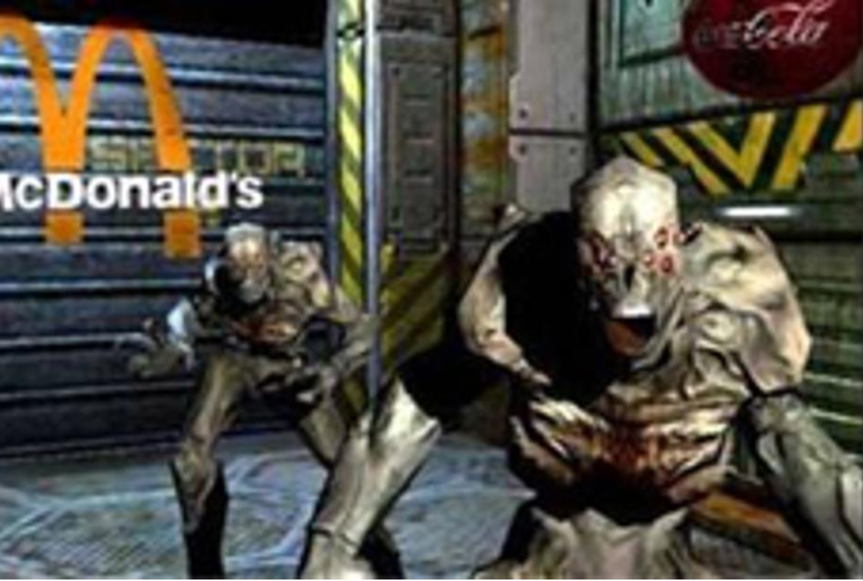
Digital Branded Integration
Before businesses did not pay for advertising; creators paid them
“Advergaming”
“Static In-game advertising”
New technologies
“Dynamic In-game advertising”
Mobile games
Benefits of brand owners
Benefits of gamers
Ads Worsen Gaming Experience
Notes:
LAURA → History
To give you a background about DBI
It is a practice that we has seen a lot on television...
Traditionally, brand companies did not pay for product placements in video games
Any placements were either a result of
a cross-promotional agreement or,
license under which the video game creators would have paid fees → idea was to use likenesses of existing branded products in the game to make it more realistic.
At one point, the brand companies realized potential of doing advertising and product placement in video game.
1st wanted to target Male customer 16-25. (now is least true – but it s a large audience end the technology alow )
There has been a turnaround where now brand owners pay for advertising and product placement in to video games.
There has been a significant rise in the spending on in-game product placement from 2004 and now. For what we have seen now it is around 7B$ for in-game ad spending.
There are different kind of advertising.
MINA → GIVE THE DEFINITION OF TYPE OF ADVERTISING
LAURA → GIVE SOME EXAMPLES + DISCUSS INFLUENCE OF NEW TECHOLOGIES
One form of digital brand interation is advergaming which refers to a game where its aim is to clearly advertise a specific product: like:
LAURA: Coke, Pepsi, Pizza hut, MacDonald & others; Chex Quest series (1996-2008) was designed to promote Chex cereal aimed at children 6 to 9 and up years old. The volume of their sales increased by almost 300%.
MINA: Static In-game advertising”: integrated advertising into the game, the advertising is programmed directly into the game and it cannot be change. Like in the film industry… the product is just there or mention because is logical
LAURA: In NBA2K18 (2017) : Nike, Foot Locker, Gatorade
MINA: New technology
Internet connectivity:
This ability has created the Dynamic in game advertising:
also inside the video game, is implemented in real-time, like billboard, in the game showing advertisement.
LAURA: Time-sensitive advertisement as movie release (Disney used it to promote the 2016 fil “Pete’s Dragon” or politic campaign. grant more flexibility then television… change of location within the game or advertise during a specific period of time or even choose to which audience type the ad is targeted.
LAURA: GPSbased technology. Eg: Mobile games: location-based mobile app example Pokemon Go
Booyah's MyTown (When players "check in" to a real-life location, such as a store or a restaurant, that place is recorded in their Town and they unlock rewards to buy or upgrade their shops and, eventually, to "own" the real-life place (within the context of the game)
FOR THE BENEFIT OF BRAND OWNERS
LAURA: Video game market
Rising of popularity of video games compare to a decline in television viewing
Demographic sector
15 years a go it was mostly a male demographic sectors,
The age and gender distinction between the gamers tend to reduce; female represents a large part of mobile games;
the aged of gamers is broader however, under 18 years old gamers still represent a significant number of the video gamers: 29% in 2017 in American
MINA : Control over when, where and how
Technologie → connectivity :
This ability allows for better product placement tracking
play against "live" players: This ability to make gaming a more "social" activity has broadened its scope of consumers
MINA : Impact
Results suggest that consumers recall familiar brands placed in the video game better than unfamiliar ones. Familiar brands also performed better in a brand recognition measure than unfamiliar brands.
FOR THE BENEFIT OF THE GAMER
MINA : Look more realistic
We discussed it;
LAURA: Monetization
additional revenue : for game studios to offset creation costs: & maintain the price low
Free-to-play: invite their friends to participate
Ads video alongside the game (free-to-play).
Branded Virtual Goods to sale : second-life game: On Gaia Online: a virtual Snoop Dogg hoodie was sold for $100 U.S. for clothing an avatars. His goods have become such a hot commodity in the virtual world that when supplies "run out," players bid to pay higher prices for their avatar to sport the rapper's brand. This marketing strategy has been successful in increasing awareness of the Snoop Dogg brand and has generated more than $200,000 in sales of virtual goods.
LAURA: interactive part of the gaming experience
The player connect with a brand by intertwining the goods with a near real-life situation.
Even brand release new clothes design in video game and with the reaction will decide if they will create and sell them in their physical store
Eg: American Apparel released a new line of jeans into their virtual "stores" in Second Life several months before making the product available in their "real world" stores.
E.g.: BMW introduced their new M5 prototype in a video game so consumers could experience the look, sound, and handling before a working prototype was available.
MINA: ADS WORSEN GAMING EXPERIENCE
There is also the opposite situation, where the gaming experience is not improved: that could create "ad-blindness,": when people see the same ad repeatedly, they can adapt to its presence and filter it out
This is a video of top 6 advertising fail for the gaming experience.
3:30 minutes
**stop here
Advergaming:
(15K$ to 100K$ fully fonctionny game)
Pepsiman” (1999) to promote Pepsi,
“Pepsi Invaders” (1983) to promote Coke,
“Yo!Noid!” (1990) to promote Domino’s pizza,
“Zool: Ninja of the Nth Dimension” (1992) to promote Chupa Chumps,
“M.C. Kids” (1992) to promote MacDonald,
“Chex Quest” series (1996-2008) promoting Chex Quest cereal.
“ Darkened Skye” (2002) promoting Skittles,
In-game
in Alan Wake (2010): Verizon, Energizer and Mustang);
in “Metal Gear Solid: Peace Walker” (2010) Axe, Doritos, Mountain Dew

Slide 9
Concerns & Legal Issues
Power of commercial advertising
Discussion
Should we protect children and teenagers?
Some of the Legal Issues
Canada:
Ads directed to children → not to exploit their credulity, lack of experience
Product placement within entertainment programming is acceptable
Quebec Consumer Protection Act → prohibits ads directed to children under 13 - Irwin
USA : FTC refused, in 2005, to impose a general rule for paid product placement
Freedom of expression
Notes:
MINA → INTRODUCTION OF SUBJECT
Various research show that a positive emotional response to advertisement has a correlation with brand recognition and positive attitude towards the brand as well as the consumers' buying intentions. The ultimate goal is to create that positive attitude by the game.
It has been well documented that children, especially those under thirteen, are vulnerable to the persuasive power of advertisements on television. Researchers have expressed apprehension of similar vulnerability of children to online advertisements and marketing practices.
MINA → DISCUSSION
LAURA → LEGAL ISSUES
In Canada,
Regulation on advertising:
Canadian Code of Advertising Standards provides
Code of Ethics and Standards of Practice
Quebec Consumer Protection Act : Irwin Toy Ltd. V. Quebec (Attorney) General [1989]
The advertising practices are regulated by acts and self-regulations.
The Competition Act prohibits false or misleading representation in commercial promotions at large.
The Canadian Code of Advertising Standards provides, pursuant section 12, that “advertising that is directed to children must not exploit their credulity, lack of experience or their sense of loyalty, and must not present information or illustrations that might result in their physical, emotional or moral harm. […]”. Similarly, in the Code of Ethics and Standards of Practice published by the Canadian Marketing Association has special consideration for children (under 13 year age) and teenager.
Commercial advertisements are not prohibited, but marketer “must not exploit children's credulity, lack of experience or sense of loyalty” or “exploit teenagers' impressionability, or susceptibility to peer or social pressures”.
It is explicitly note in that code under the section regarding broadcast as specific media that “product placement within entertainment programming is acceptable”.
In Quebec. The Quebec Consumer Protection Act prohibits the commercial advertising directed to children under 13 years of age subject to some exceptions (sections 248, 249 of the act and sections 87 to 91 of the Regulation respecting the application of the Consumer Protection Act). The SCC’s, in Irwin Toy Ltd. V. Quebec (Attorney) General [1989], the Court held that a Quebec law that restricted advertising directed to children was valid law which violated section freedom of expression but could be justified under section 1.
The Office de la protection du consommateur du Québec has published an application guide for commercial advertising directed at children published. In it, they used as an example of prohibited advertising the case of an advergaming by a cereal company aimed at children.
In the United Stated,
in 2005, the FTC answered to Commercial Alert is refusal refuse to impose a general rule (e.g. disclosure) for paid product placement and will act on a case-by-case basis. The FTC rational is that the product placement and brand integration is about the performance or attribute of the product and will unlikely give more credence to the product. And if the programming directed to children, the Commission will examine the deceptive ads from the standpoint of an ordinary child.
*Stop there
To create positive attitudes → A customer with a positive attitude toward a brand gradually moves toward commitment.
When a brand which has created a positive image in customers' mind is re-advertised or other products and services of the same brand are advertised, customers pay considerable attention to the advertisement of that brand. This is a great step in establishing a group of loyal customers
Attracting consumers and informing them of new products and services
Four-word manner to make the advertisement more efficient: notice, interest, desire, and attempt

Slide 10
Concerns & Legal Issues
Power of political, military, educational advertisement
Discussion
Do you think there is a problem?
Should there be a distinction between commercial & political/military /educational advertising
Worries about propaganda? Freedom of expression?
Some of the Legal Issues
Freedom of expression
Public interest
Notes:
MINA → INTRODUCTION OF THE SUBJECT
We mostly see commercial example of advertissing and product placement. But there is also Political/military/educational examples
It is not neutral… instead of promoting a product promote an idea, a culture…
LAURA → EXAMPLE OF AA & SF
Political/military examples of
America’s Army (2002/ AA3 2008), (ERSB Rated Teen - blood violence) first-person shooter video games developed and published by the U.S. Army. It was part of their communication strategic.. Players can explore the Army and see if he/she has an interest. A kind of recruitment tools… according to a research:
"30% of all Americans age 16 to 24 had a more positive impression of the AArmy because of the game and,
the game had more impact on recruits than all other forms of Army advertising combined."
Special Force (2003/2007) is a first-person shooter video game, developed and published by Hezbollah. The player takes the role of a Hezbollah combatant fighting the Israel Defense Forces.
Educational is directly related to culture and social environment
MINA → DISCUSSION
LAURA → Freedom of expression. Commercial < idea (Hated speech)
Freedom of expression. Commercial < idea (Hated speech)
Source of the study:
"Changing the Game: How Video games are Transforming the Future of Business October, 2008." David Edery, Microsoft Xbox executive and research affiliate of the MIT Comparative Media Studies Program, and Ethan Mollick, researcher at the MIT Sloan School of Management, investigate the future of video games. They cite the combat medic training received by Paxton Galvanek to save a life as "tangible evidence of the power of games to educate". (p. 97) Furthermore, the book praises America's Army by saying "Far-sighted companies are using games to recruit, train, motivate, and make employees more productive" (p. 97) and includes (p. 141)

Slide 11
Concerns & Legal Issues
Power of realism and legal responsibility of creators/producers
Discussion
Does the virtual word influence people behavior? (virtual violence, indecency)
What should be the creators/producers legal responsibility?
What about virtual reality?
Some of the Legal Issues
Protection of minors; Brown v . Entertainment Merchants Association
Liability
Freedom of expression
Public interest
Notes:
MINA → INTRODUCTION OF SUBJECT
Videogame are sold on assumptions about the immersivity of virtual environments. The game subjects its players to virtual violence and all the social, political, and ethical consequences that surround it.
If it looks more realistic then the gamer may not be able to differentiate between what is real and what is made up. This may lead to gamers to be highly influenced especially if they are young. Also it may led to gamers being more susceptible to being swayed by advertisements. When games are more realistic then perhaps it causes the gamer to immerse themselves into the game more readily and may find the game to be more authentic then real life. This may effect the gamer's behaviour and beliefs in real life. Since realistic games have such a strong effect there may be legal consequences that can be linked to the game. Therefore, game creators may be liable for the actions of gamers caused by their realistic games.
LAURA → DISCUSSION Does the virtual word influence people behavior?
MINA → + Grand theft auto + Super Columbine massacre RPG
Grand theft auto: action-adventure / fiction town / crime under world… making look cool illegal activities. There is lawsuits against that game for murder or people shootted say those cases was dismissed… but illustrated the power… the people can attribute their behavior to video game
Super Columbine massacre RPG (massacre 1999; 30 persons murdered; Colorado; Columbine High School) (free download online 2005) (no a FPS but an menu-driven role playing game) portray the tragedy at Columbine in an abstract, highly mediated fashion. Neither the graphic nor the gameplay approach realistic depiction and the second half of the game shifts abruptly into surrealism and parody.
LAURA → +The shooter at Dawson College + “House Party” sex game
The shooter at Dawson College: Gill admired the Columbine shooters and was an avid fan of Super Columbine Massacre RPG.
Some research proposes violent video game use correlates with a temporary increase in aggression and a decrease in caring about the welfare and rights of others, but these results have not been reproduced. Others theorise positive effects of playing video games including prosocial behavior in some contexts.
LAURA → DISCUSSION
What should be the creators/producers legal responsibility?
What about virtual reality?
LAURA → ESRB + Brown => freedom violence > indecency
ESRB (Entertainment software rating board) is video-game industry’s voluntary rating system
BROWN V . ENTERTAINMENT MERCHANTS ASSOCIATION Et Al. (Supreme Court Of The United States; 2011): Respondents, representing the video-game and software industries, filed a preenforcement challenge to a California law that restricts the sale or rental of violent video games to minors. The Federal District Court concluded that the Act violated the First Amendment
Video games qualify for First Amendment protection. Like protected books, plays, and movies, they communicate ideas
is subject to a few limited exceptions for historically unprotected speech, such as obscenity, incitement, and fighting words. But a legislature cannot create new categories of unprotected speech simply by weighing the value of a particular category against its social costs and then punishing it if it fails the test.
This country has no tradition of specially restricting children’s access to depictions of violence. And California’s claim that “interactive” video games present special problems, in that the player participates in the violent action on screen and determines its outcome, is unpersuasive.
Because the Act imposes a restriction on the content of protected speech, it is invalid unless California can demonstrate that it passes strict scrutiny,i.e., it is justified by a compelling government interest and is narrowly drawn to serve that interest. R. A. V. v. St. Paul , 505 U. S. 377 . California cannot meet that standard. Psychological studies purporting to show a connection between exposure to violent video games and harmful effects on children do not prove that such exposure causes minors to act aggressively.
OTHER Eg:
Newtown: Sandy Hook Elementary School: shot 20 children and 6 adults… Obama open debate about America’s relationship with guns. Once it was discovered that the shooter enjoyed Call of Duty: Modern Warfare 2 and Dynasty Wirrors, video game were immediately implicated in the tragedy. 2013 meet the entertainment software association discussed the “virtual guns”.
'House Party' sex game removed from Steam July 27, 2017 due to "pornographic content.“ August 1, it is back on Steam with censor bars, but the harassment scenes remain. (http://mashable.com/2017/07/28/house-party-pornography-steam/#VtyhE_Y2eiqn): moral choices: There's also the mere fact that aggressive acts of sexual assault are being presented in a game supposedly, "meant to setup absurd and humorous scenarios to allow for nudity and/or sex.“; You start the game walking in the door of a House Party already in progress, and your goal is to try to play out to a variety of endings by completing various puzzles and smooth-talking. The game is unique in the sense that your actions dictate the gameplay and story direction heavily. Making certain choices in the game can either cut off or open up more options. You are faced with moral choices that yield different outcomes that drive the way the story unfolds. In the game, you'll experience the usual debauchery found at these types of parties in the form of foul language, party games, nudity, fighting, sex, and more, and believe me, it doesn't pull any punches!
- This War of Mine: War isn't the grand adventure games usually make it out to be. Wartime is tough on the population caught in the conflict, causing normal citizens to scrape by as they try to avoid becoming a casualty of a battle. This War of Mine shows you war from the common people's perspective, forcing you to make some extremely tough, life and death decisions as you scrape by on scavenged resources. Should you risk starving yourself to feed hungry orphans? Is finding medicine for a sick companion worth killing someone over? This War of Mine isn't just a survival game, it deals with some seriously mature themes that might just end with you staring at your screen contemplating the atrocities you just committed in order to survive. Yeah, it gets pretty dark. -Lorenzo Veloria

Slide 12
Concerns & Legal Issues
Data protection issues regarding private gamer information
Discussion
Ethical point of view
Informed consent
Moral right issues with respect of the creator work
Discussion
Notes:
MINA → DATA
LAURA → MORAL RIGHT
Use of Gamer information
Data protection law.
Doubtful given that the collection and use of information about consumers often lacks the transparency required by law and fails to meet the relatively high standard of informed consent.
businesses can collect vast amounts of information about consumers given that their online activities can be easily tracked, stored and analysed in order to better understand the needs and wishes of every individual consumer. Second, electronic communication allows the tailoring of products and services as well as prices to every individual consumer based on previously collected information.
The monitoring of consumers’ online activity primarily aims at collecting consumer data in order to improve existing online processes, deliver better services and provide a better user experience.
Personalised Advertising
Intrusiveness is also important for both Web site designers and advertisers. Pop-ups and pop-unders seem to be more intrusive than in-line ads, implying that users should not be interrupted from their online tasks to close the extraneous windows.
Feelings of vulnerability vs trust
USA Children's Online Privacy Protection Act (The law took effect on April 21, 2000): COPPA requires online operators of commercial websites who collect personal information from children of twelve and under to place a link to their privacy policy on the homepage as well as on any page where personal information is collected. Online operators are also required to make reasonable efforts to ensure that parental permission is obtained before personal information is collected from children.
Privacy law in Canada:
The Personal Information Protection and Electronic Documents Act (PIPEDA): is the federal privacy law for private-sector organizations. It sets out the ground rules for how businesses must handle personal information in the course of commercial activity.:
Def:
organization includes an association, a partnership, a person and a trade union.
personal information means information about an identifiable individual.
commercial activity means any particular transaction, act or conduct or any regular course of conduct that is of a commercial character, including the selling, bartering or leasing of donor, membership or other fundraising lists.
Application
Marginal note:Application
4 (1) This Part applies to every organization in respect of personal information that
(a) the organization collects, uses or discloses in the course of commercial activities; or
(b) is about an employee of, or an applicant for employment with, the organization and that the organization collects, uses or discloses in connection with the operation of a federal work, undertaking or business.
Marginal note:Application
(1.1) This Part applies to an organization set out in column 1 of Schedule 4 in respect of personal information set out in column 2.
Marginal note:Limit
(2) This Part does not apply to
(a) any government institution to which the Privacy Act applies;
(b) any individual in respect of personal information that the individual collects, uses or discloses for personal or domestic purposes and does not collect, use or disclose for any other purpose; or
(c) any organization in respect of personal information that the organization collects, uses or discloses for journalistic, artistic or literary purposes and does not collect, use or disclose for any other purpose.
Provincial laws that have been deemed substantially similar are as follows: (other then health info protection)
British Columbia’s Personal Information Protection Act.
Alberta’s Personal Information Protection Act (printable version from the Alberta Queen’s Printer Web site.)
Québec’s An Act Respecting the Protection of Personal Information in the Private Sector.
PIPEDA does not apply to provincially-regulated organizations within the province of Quebec. It will not apply to provincially-regulated organizations in Alberta or British Columbia as the privacy laws in those provinces have received substantially similar status from the Governor in Council. However, FWUBs operating in these provinces continue to be subject to PIPEDA. PIPEDA also applies to inter-provincial and international transactions involving personal information in the course of commercial activities.
Trans-border personal information flows in a commercial context are covered by PIPEDA due to the federal government's constitutional power over inter-provincial and international trade and commerce.
If there is no commercial activity then PIPEDA does not apply.
Morality right
“Dynamic In-game advertising” allow digital insertions and changes to be made to a work long after production has wrapped
Canada offers a broader moral rights regime applicable to all works protected by the Canadian Copyright Act.
Section 14.1 grants the original author the right to attribution and the right to the integrity of the work.
integrity rights protect the work from distortion, alteration, and modification that results in prejudice to the honor or reputation of the artist.
Artists may have a claim resulting from the addition or alteration of product placements in their work through section 28.2(1)(b), generally known as the "right of association."
Section 28.2 states: "(1) The author's right to the integrity of a work is infringed only if the work is, to the prejudice of the honour or reputation of the author, (a) distorted, mutilated or otherwise modified; or (b) used in association with a product, service, cause or institution."
Within the context of a product placement in the ordinary commercial situation, the likelihood of success in a right of association claim is very low because protection will only be granted if the brand or product injures the reputation or honor of the artist.
Thus, this recourse may only be useful to an artist in egregious cases, or perhaps cases involving political, social, or religious causes.

Slide 13
Concerns & Legal Issues
Lifelike quality vs appropriation
Discussion
Freedom of expression
Trademark part of the reality… fair use
Publicity right
Notes:
LAURA & MINA
a tension between the speech rights of creators
mimicry is too much and thus loses speech protection for not being original
Trademark: landscape not a problem, but some buildings are now registered + goods : eg. Eiffel tower is trademarded at night if focus you need consent for VILLE DE PARIS

Slide 14
Notes:
LAURA/MINA CONCLUSION

