Slide 1


What’s it all about…EULA?
Talk 8
Part B “Connecting”
Video Game Law 2017
UBC Law @ Allard Hall
Jon Festinger Q.C.
Centre for Digital Media
Allard Law of Law, UBC
QMUL School of Law (CCLS)
Festinger Law & Strategy
http://videogamelaw.allard.ubc.ca/
Twitter: @jonfestinger
jon_festinger@thecdm.ca

Slide 2

Happy NFS Release Date

Slide 3
Logistics?

Slide 4
Questions on..
Papers ?
Participation ?
Class Presentations ?

Slide 5
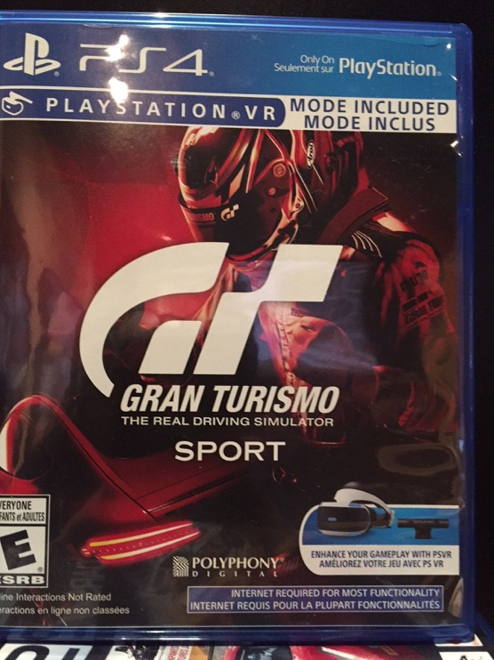

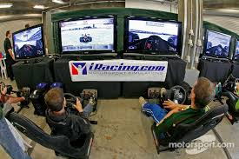
E-Sports Follow-Up

Slide 6
News of the Week

Slide 7
Yours?

Slide 8
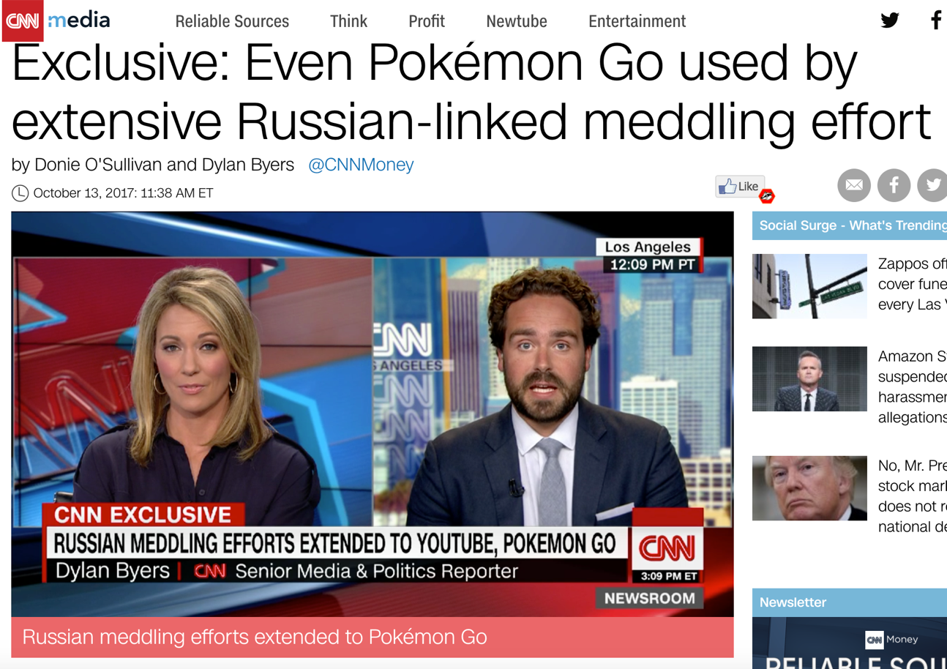

Slide 9
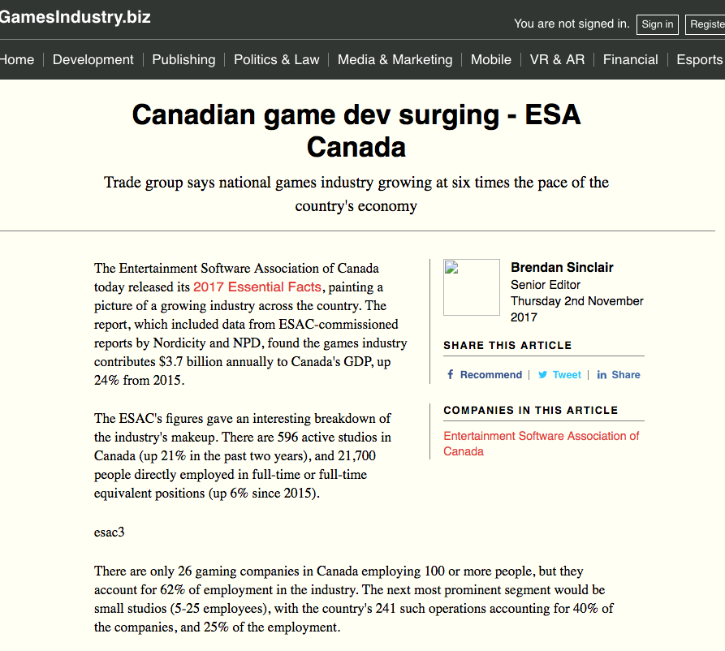

Slide 10
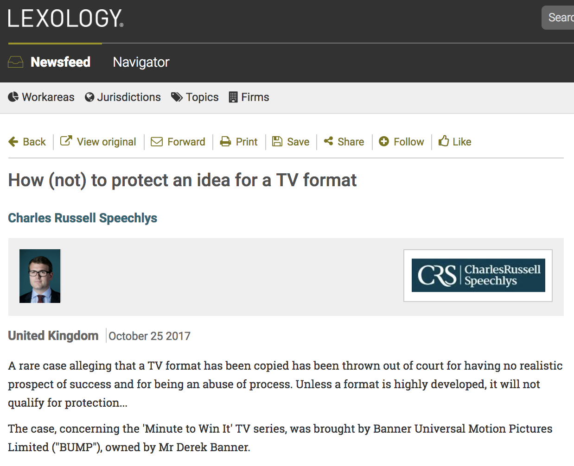

Slide 11
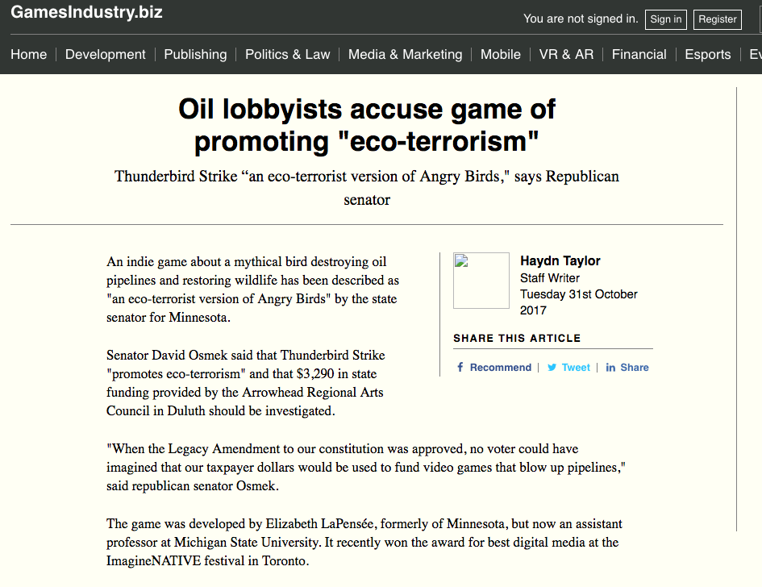

Slide 12
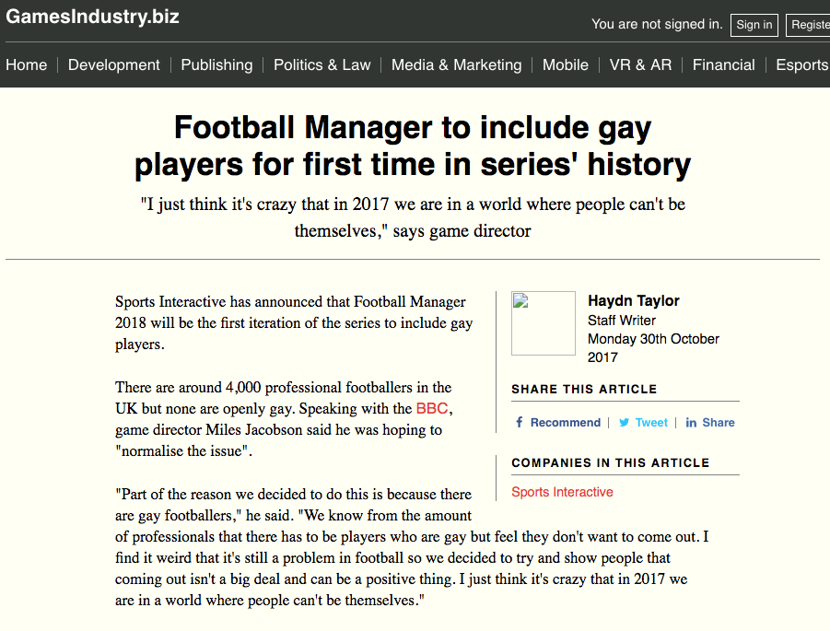

Slide 13
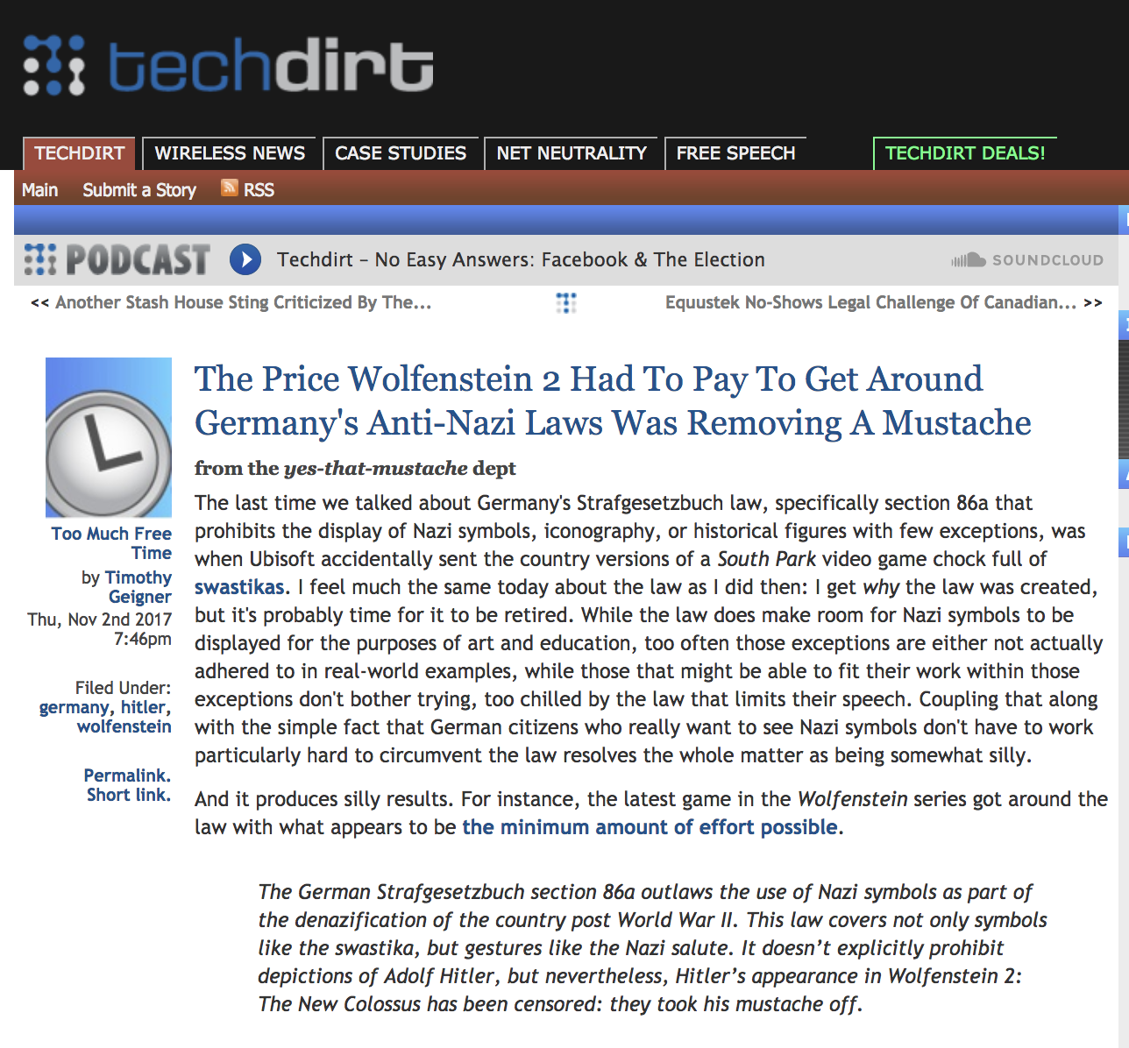

Slide 14
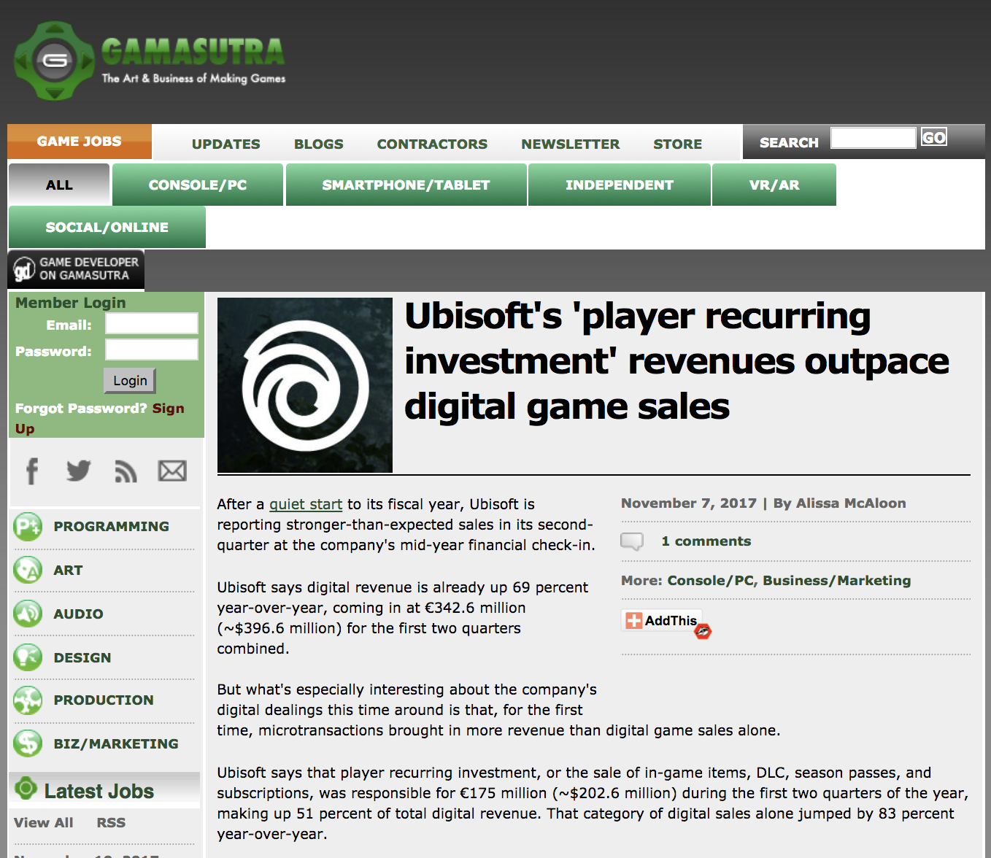

Slide 15
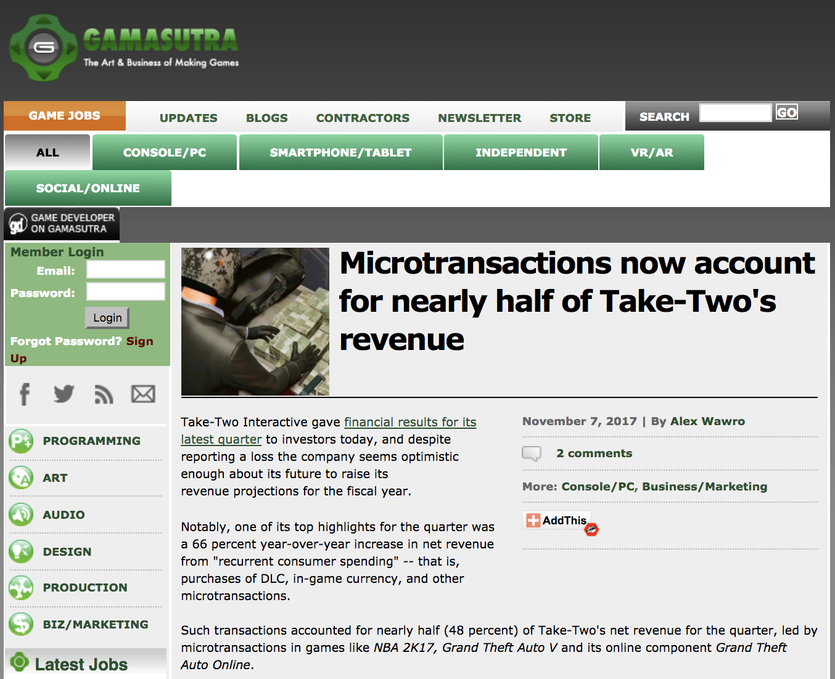

Slide 16


Slide 17
Taking Stock: Where Are We?
Part A: Memes of “Creating”
Meaning & purpose of creating (in a video game context)
Right to CREAte (mod)
Games as social reaction (McLuhan)
Games as empty vessels (Boyden)
Role of the “Magic Circle”?
Copyright as power & constraint

Slide 18
Taking Stock: Where Are We? (2)
Part B: Memes of “Connecting”
How connecting creativity transforms and restrains it
Creation as Connection: Connection as both the cause & the purpose of Creation = Games are post-structuralist
Video-games (like all creative works) as merger of Creativity & Connection of both Developer/Creator & Player/Creator
Connections→Creation→Greater Connections→Legal implications of post-structuralist nature of games

Slide 19
Leading to “THE POST IP WORLD”?
* Does the dominance of contracts mean we are already in a “The Post IP World”??
* Focus on contractual restraints (digital re-sale; transferability by will, contracting out of IP law permissions e.g. ToS prohibitions of reverse engineering)
CREATION goes with COPYRIGHT/IP LAW
CONNECTING goes with CONTRACT LAW

Slide 20
Nasty Questions:
Has the trajectory of copyright freedoms/uncertainties led to a contractual backlash?
Does copyright matter in a “Post IP World”?
Do freedoms exist outside of contract in a “Post IP World”?

Slide 21

Today
An assessment of the utility
of EULA’s (etc.)

Slide 22
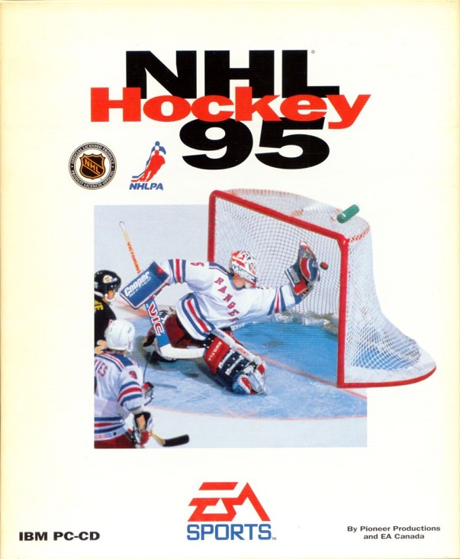
No EULA or ToS !

Slide 23
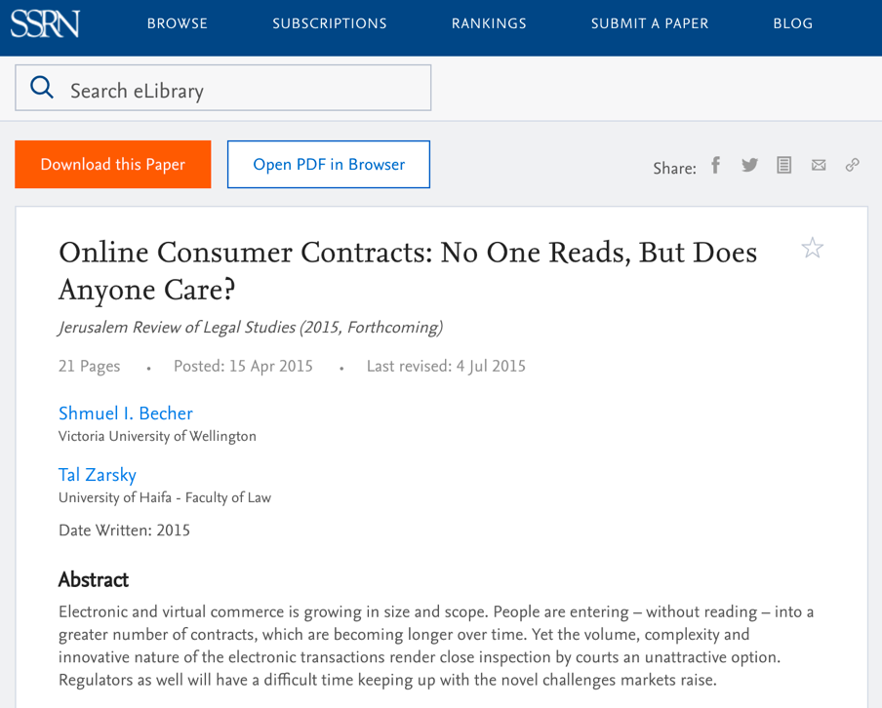
Threshold Issue:
No one reads these things

Slide 24
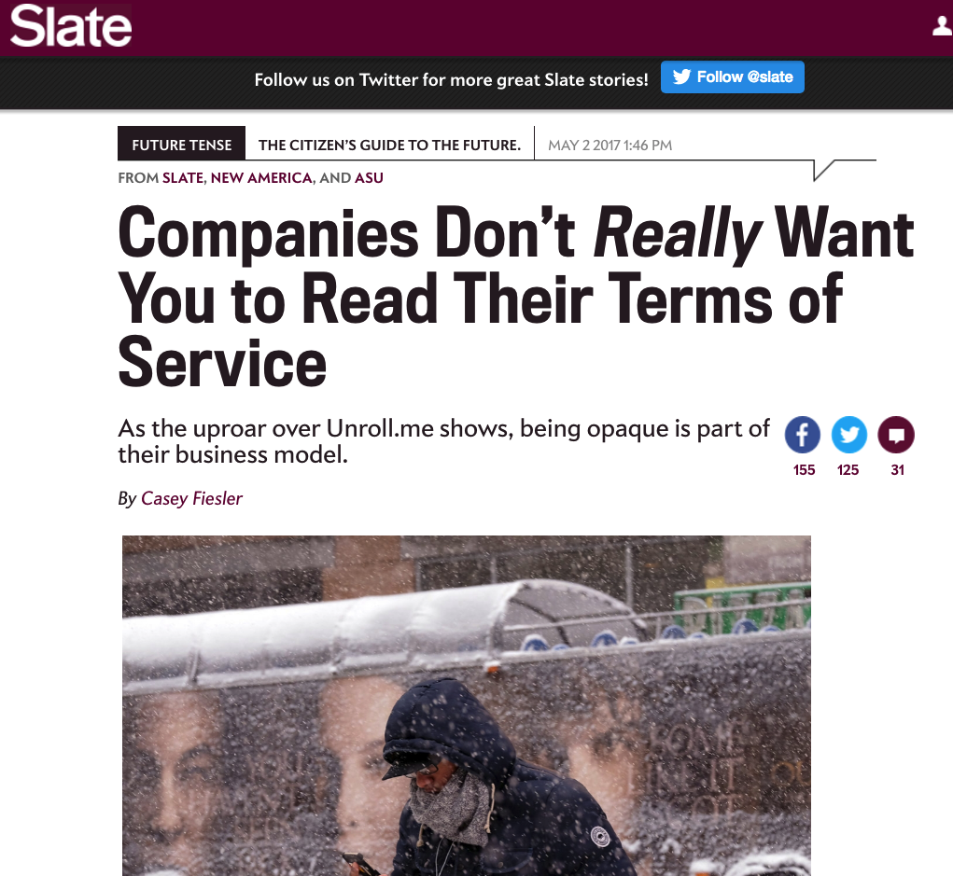

Slide 25
The Joy of Tech:
“Support group for writers of end-user
license agreements” by Nitrozac & Snaggy
http://www.geekculture.com/joyoftech/joyarchives/2210.html

Slide 26
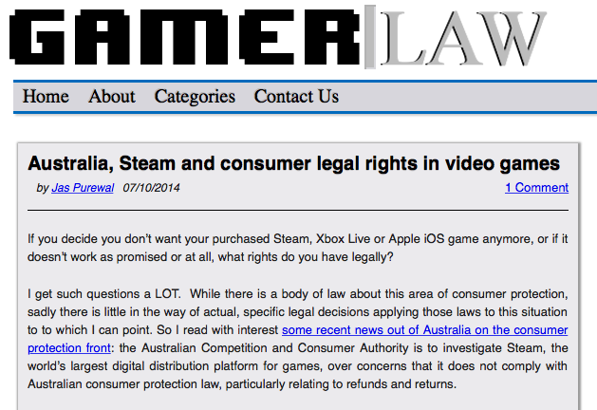
THINGS ARE CHANGING…
http://www.gamerlaw.co.uk/2014/australia-steam-and-consumer-legal-rights-in-video-games/

Slide 27
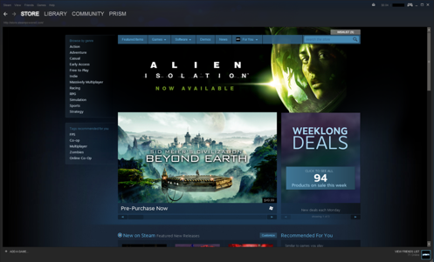
Jas Purewal: “This is a really interesting development to me for a few reasons: This is the first regulator to my knowledge which is specifically investigating the topic of digital distribution platforms’ compliance with consumer protection law, particularly regarding issues like refund rights and the extent to which platforms are bound by legal rules that products must always meet minimum quality standards (eg a requirement called called ‘satisfactory quality’ or ‘acceptable quality’ in the UK and Commonwealth countries or ‘merchantable quality’ in the US, among other requirements).”

Slide 28
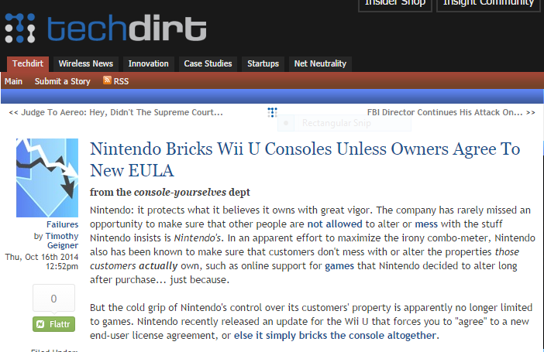
More EULA Unfairness
https://www.techdirt.com/articles/20141013/11010528810/nintendo-bricks-wii-u-consoles-unless-owners-agree-to-new-eula.shtml

Slide 29
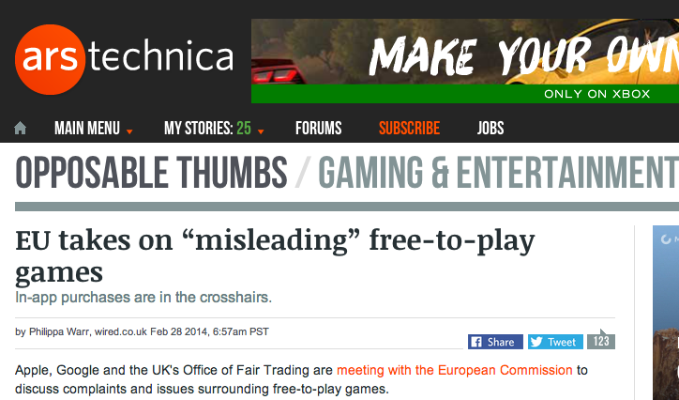
http://arstechnica.com/gaming/2014/02/eu-takes-on-misleading-free-to-play-games/

Slide 30
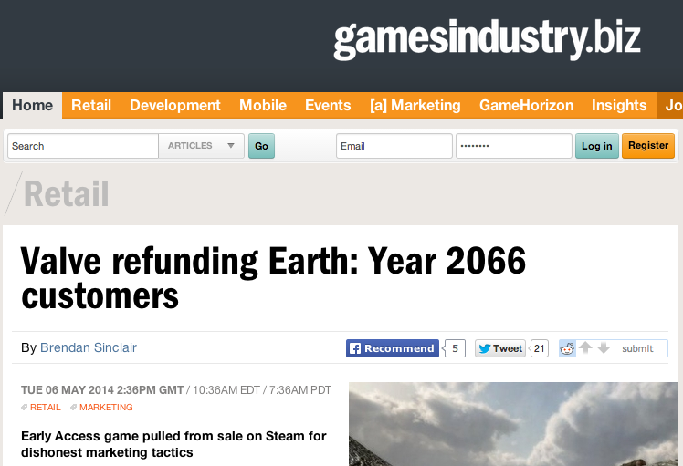
http://www.gamesindustry.biz/articles/2014-05-06-valve-refunding-earth-year-2066-customers

Slide 31
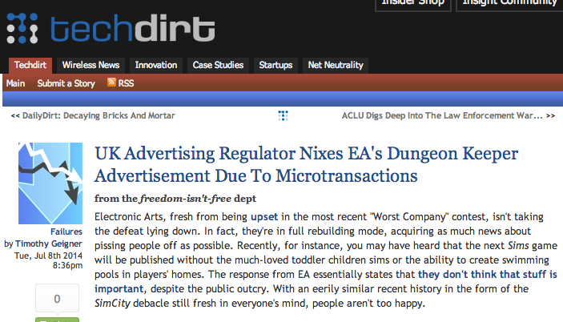
https://www.techdirt.com/articles/20140702/07443127757/uk-advertising-regulator-nixes-eas-dungeon-keeper-advertisement-due-to-microtransactions.shtml

Slide 32
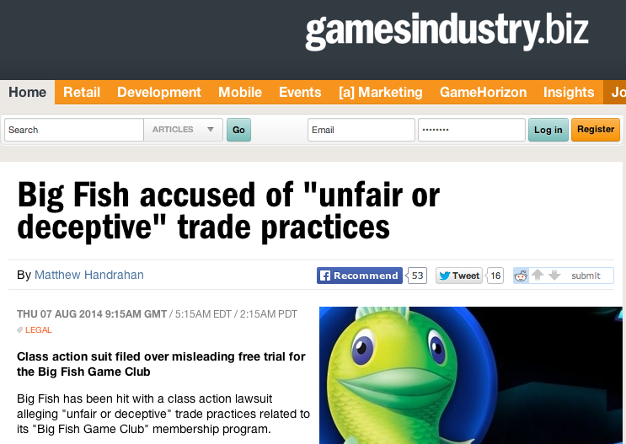
http://www.gamesindustry.biz/articles/2014-08-07-big-fish-accused-of-unfair-of-deceptive-trade-practices

Slide 33

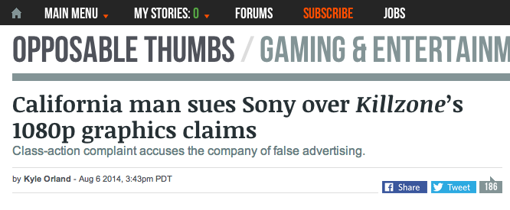
http://arstechnica.com/gaming/2014/08/california-man-sues-sony-over-killzones-1080p-graphics-claims/

Slide 34
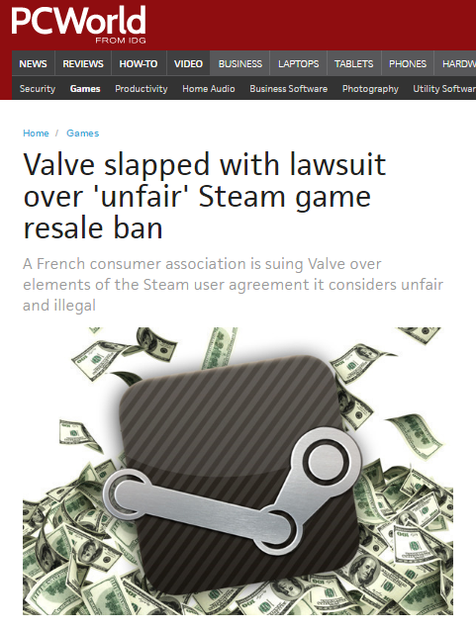

Slide 35
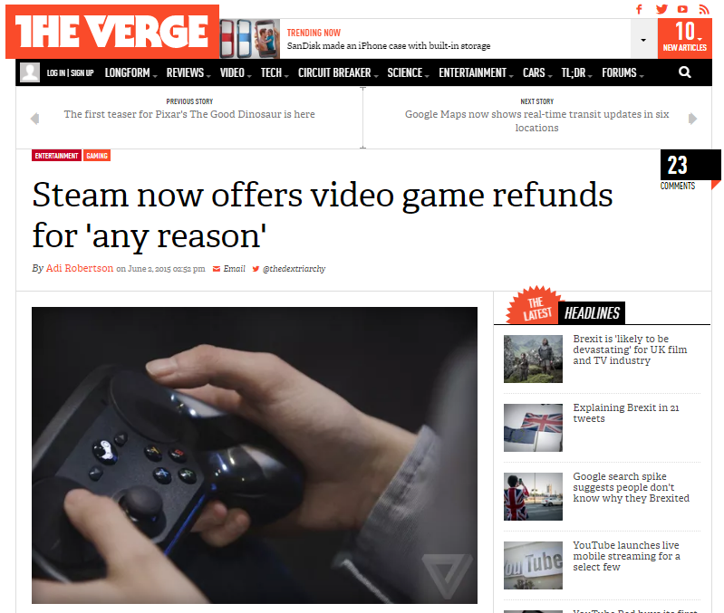

Slide 36
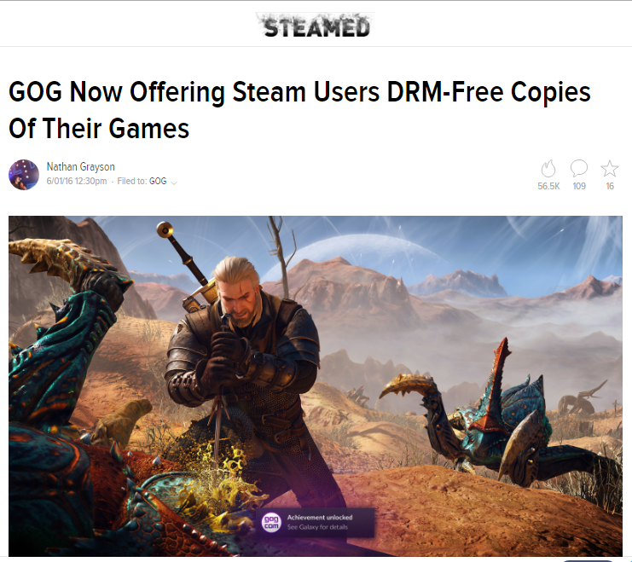

Slide 37
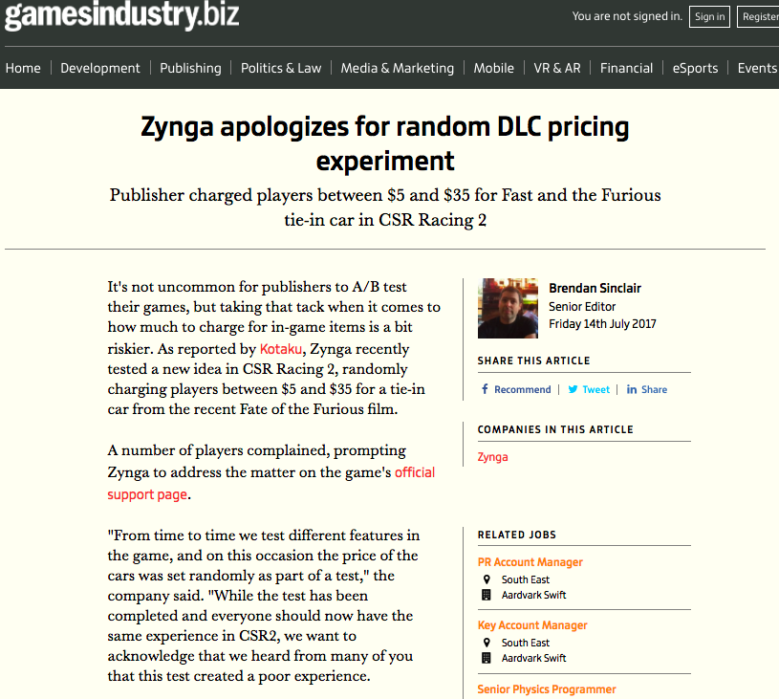

Slide 38
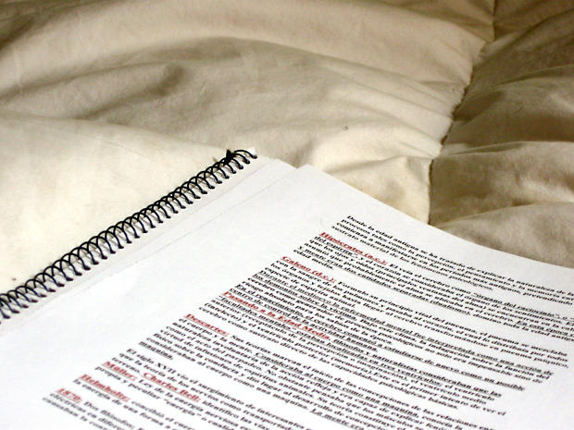
Weird contractual issues…

Slide 39
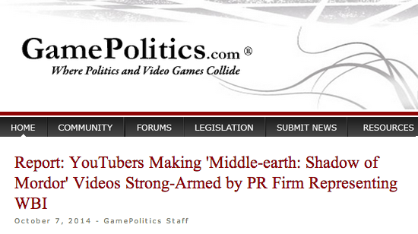
http://www.gamepolitics.com/2014/10/07/report-wb-strong-arms-shadow-mordor-reviewers#.VDxyXpRdX9Q

Slide 40
“YouTubers had to agree to do the following:
- Maximize awareness for the game during the ‘week of vengeance’
Persuade viewers to purchase game
Not show bugs or glitches that may exist
The agreement also notes that "videos will promote positive sentiment about the game.”
”…the company has final approval on the YouTube video at least 48 hours before any video goes live,”
Those who didn't sign the "branding agreement" and made their own found their videos taken down by a YouTube ContentID claim” (Abuse of copyright law?)

Slide 41
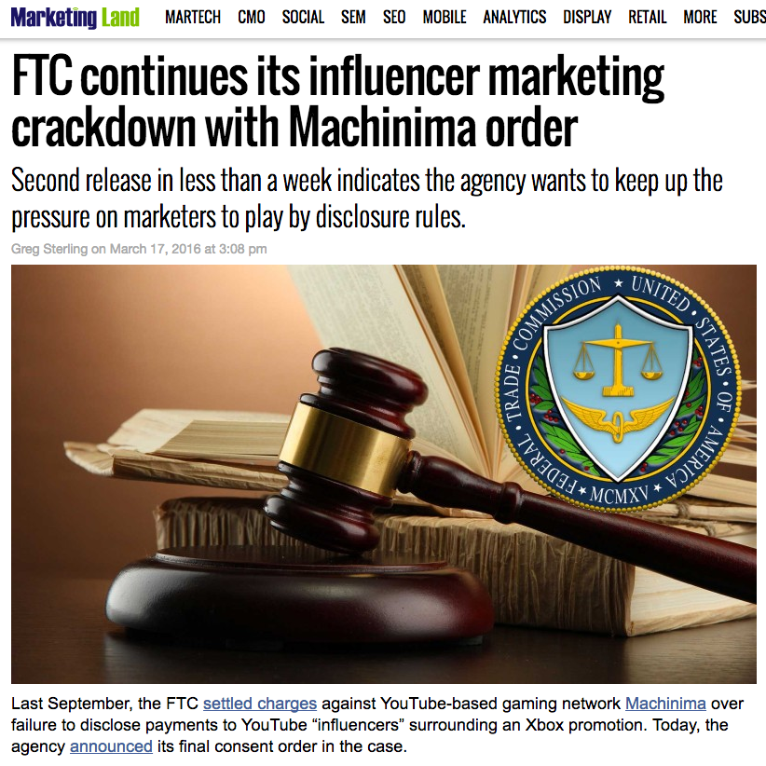
A Cautionary Tale

Slide 42
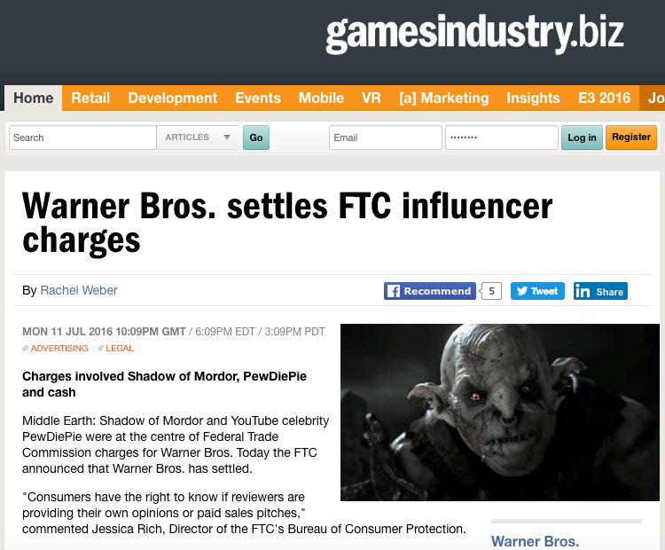

Slide 43
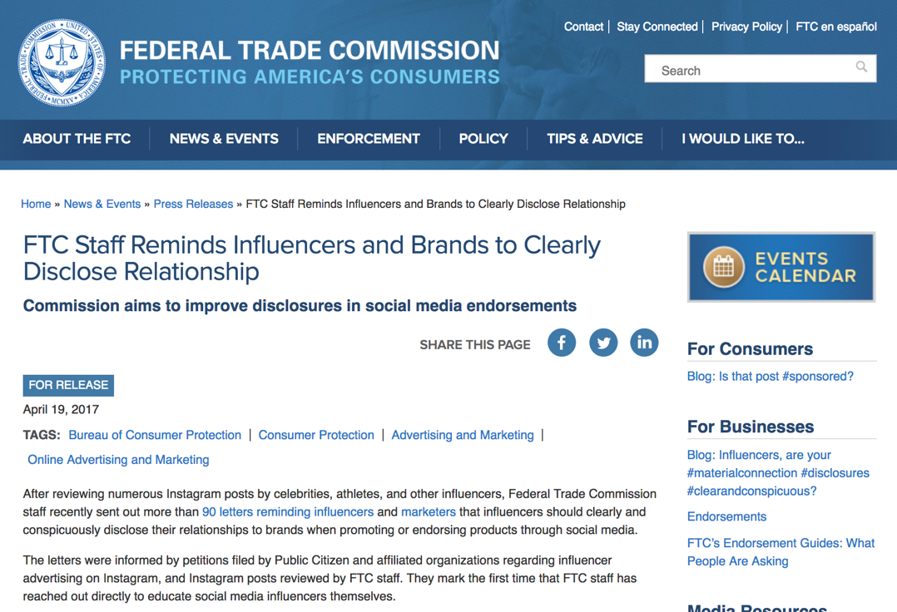
Led to…

Slide 44
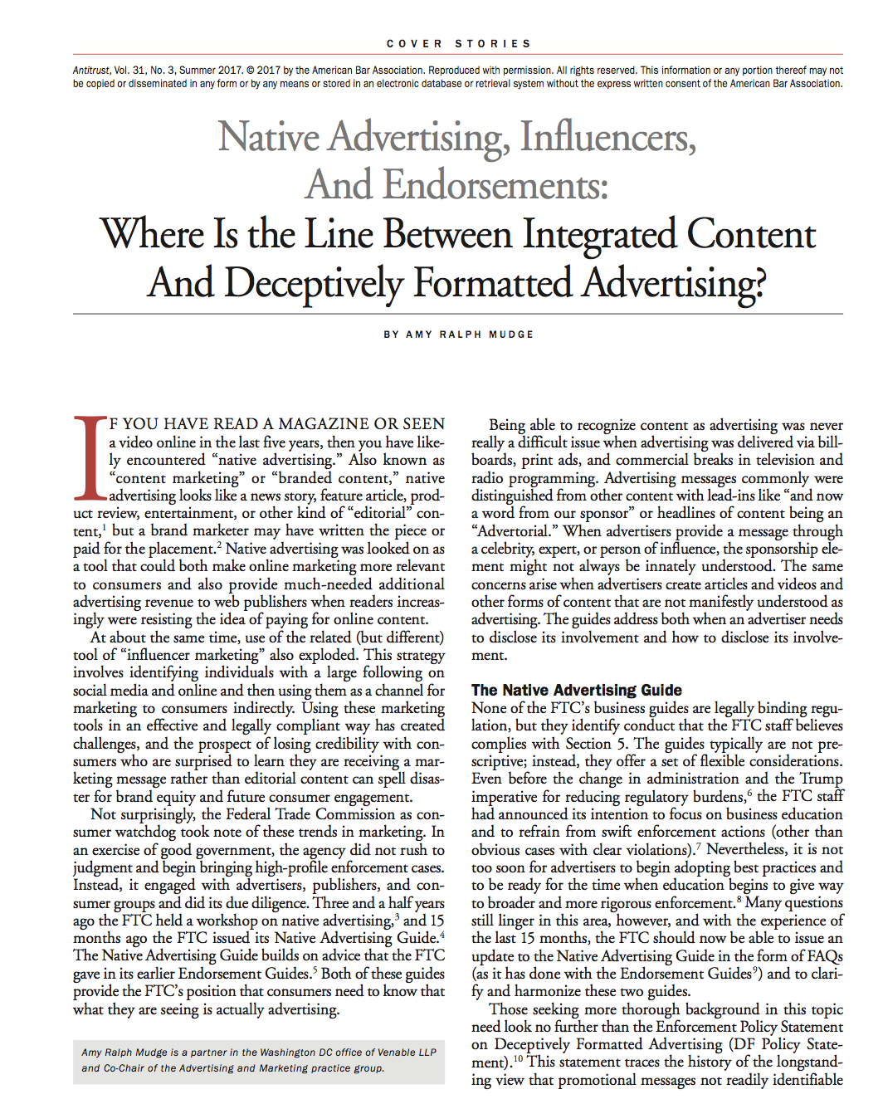

Slide 45
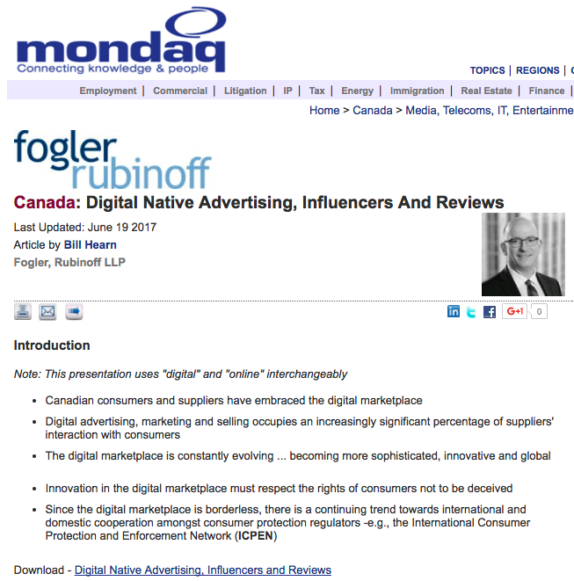
Canada

Slide 46


One Last Thing: We are all international lawyers!

Slide 47
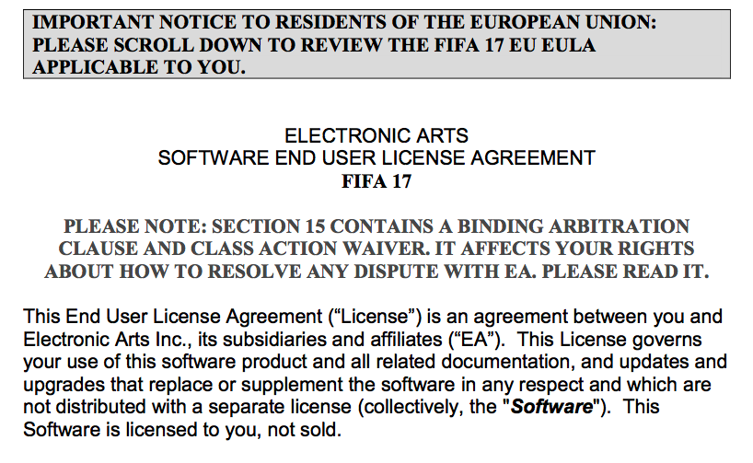

Slide 48
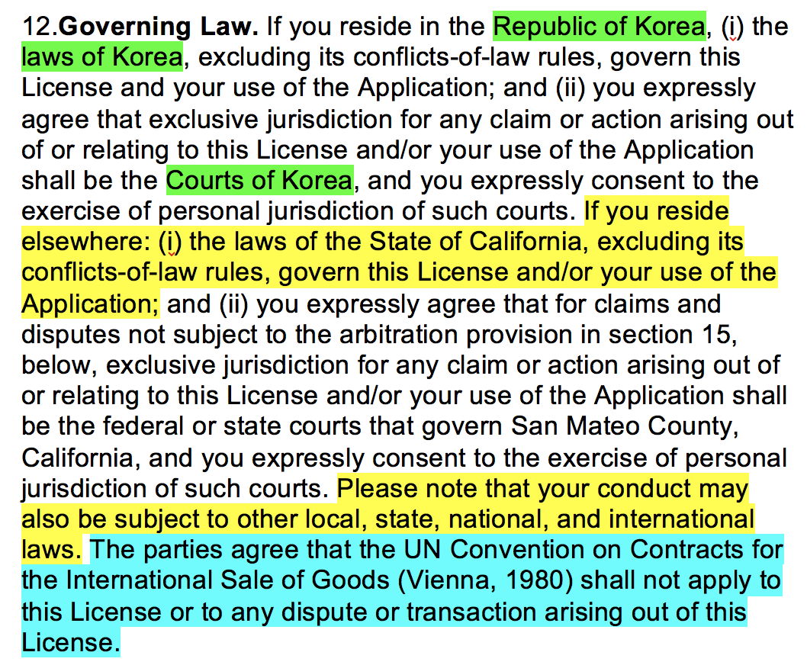

Slide 49
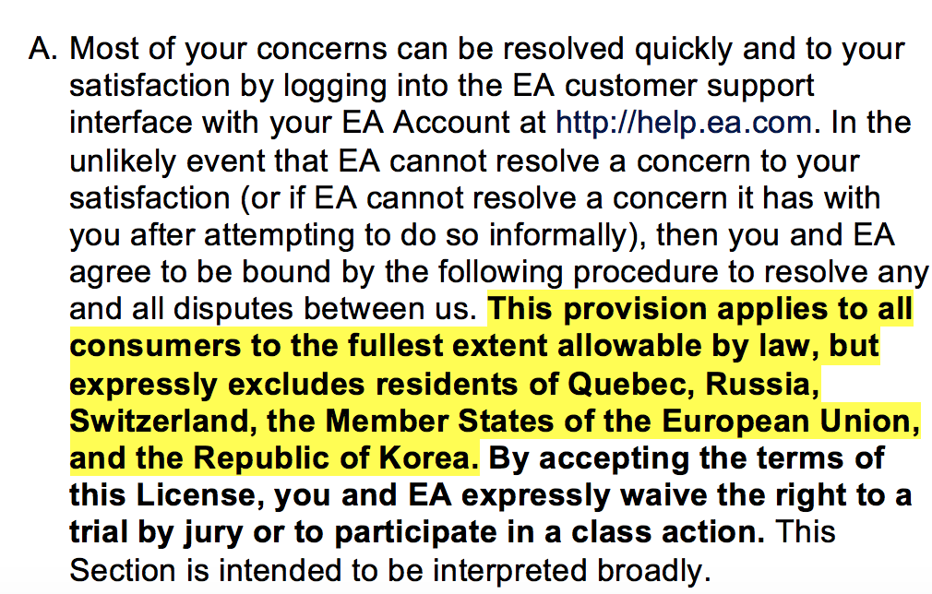

Slide 50
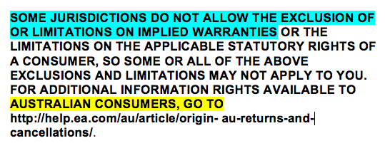


Slide 51
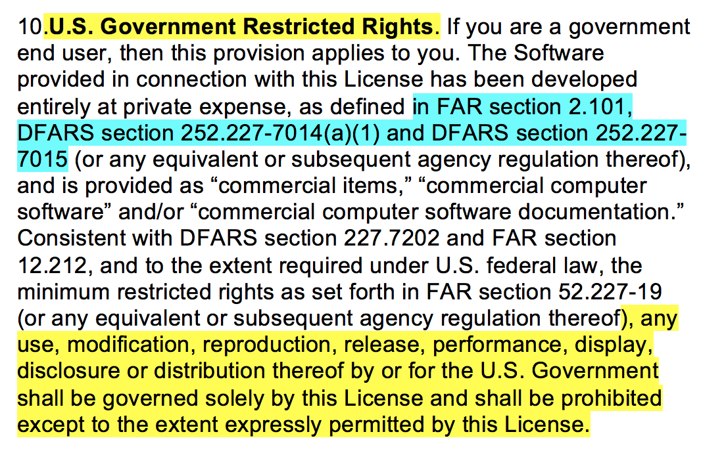

Slide 52
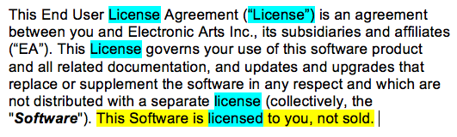
Do you think it’s (perhaps) a license?

Slide 53
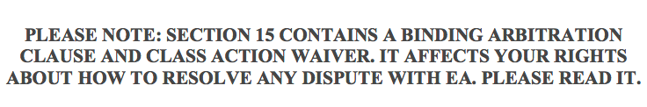
Click-Wrap
& Clauses

Slide 54
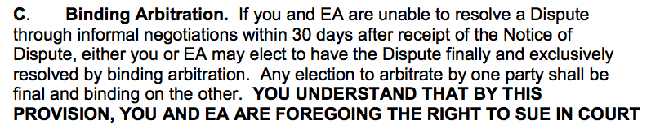
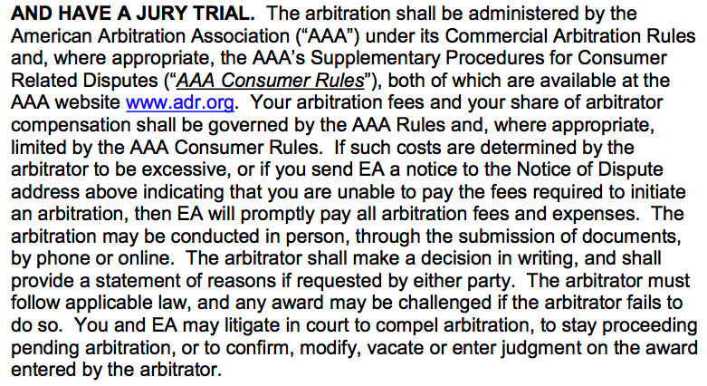

Slide 55
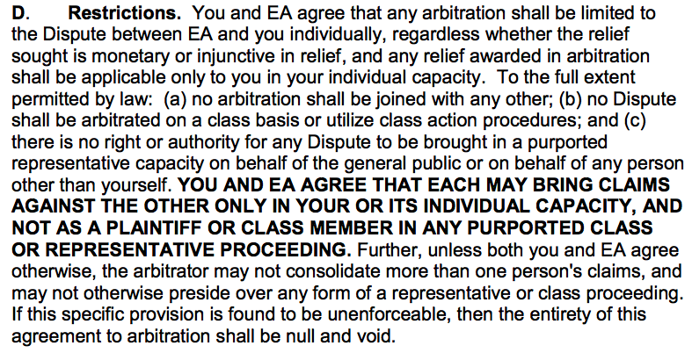

Slide 56
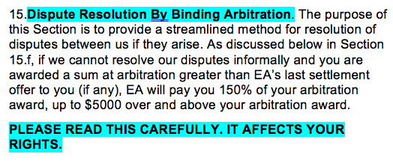
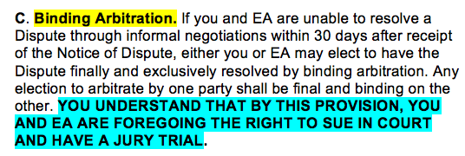

Slide 57
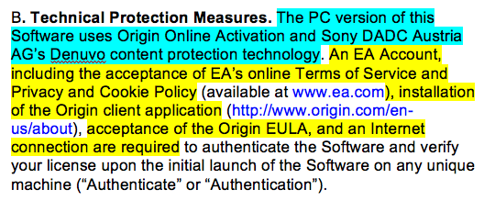
DRM consequences

Slide 58
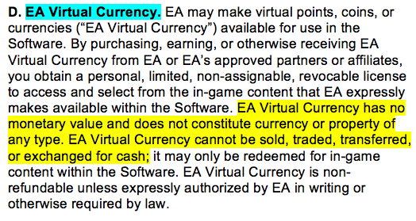
Virtual Currency & Digital Mining

Slide 59
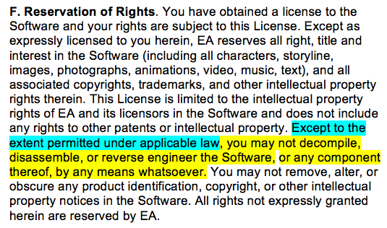
Reverse engineering & BNETD

Slide 60
MODS ?

Slide 61
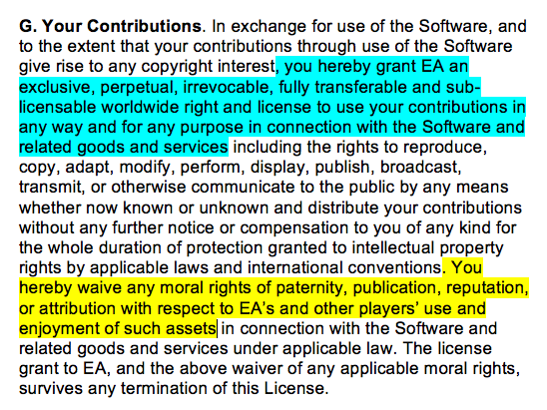

Slide 62
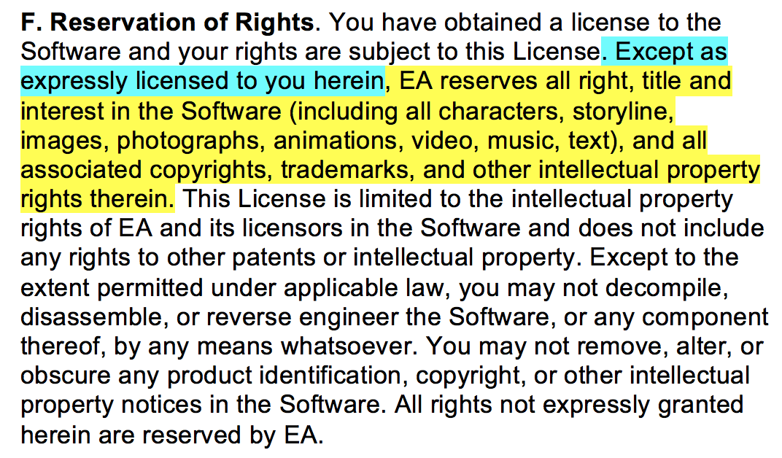
But para. F.

Slide 63
(NOT?)
PRIVACY

Slide 64
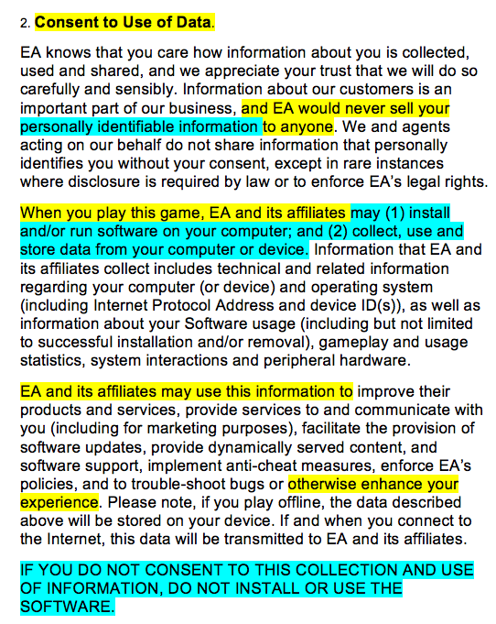

Slide 65



NEXT TIME….
FROM WHEELBARROWS TO HOLODECKS: “CONNECTING” LIVING ROOMS…THINGS…MOBILE DEVICES…EACH OTHER…AND WAY BEYOND…ON THE LEGAL IMPLICATIONS OF CONVERGEANCE…

Slide 66

Always include a cat picture

Slide 67
Our Academic Partners

