Slide 1

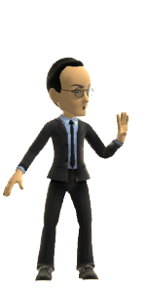
News of the Week:
EA & other stuff
Talk 9
Video Game Law 2017
UBC Law @ Allard Hall
Jon Festinger Q.C.
Centre for Digital Media
Allard Law of Law, UBC
QMUL School of Law (CCLS)
Festinger Law & Strategy
http://videogamelaw.allard.ubc.ca/
Twitter: @jonfestinger
jon_festinger@thecdm.ca

Slide 2
Logistics?

Slide 3
Questions on..
Papers ?
Participation ?
Class Presentations ?

Slide 4

Happy (?) Battlefront 2 Release Date

Slide 5
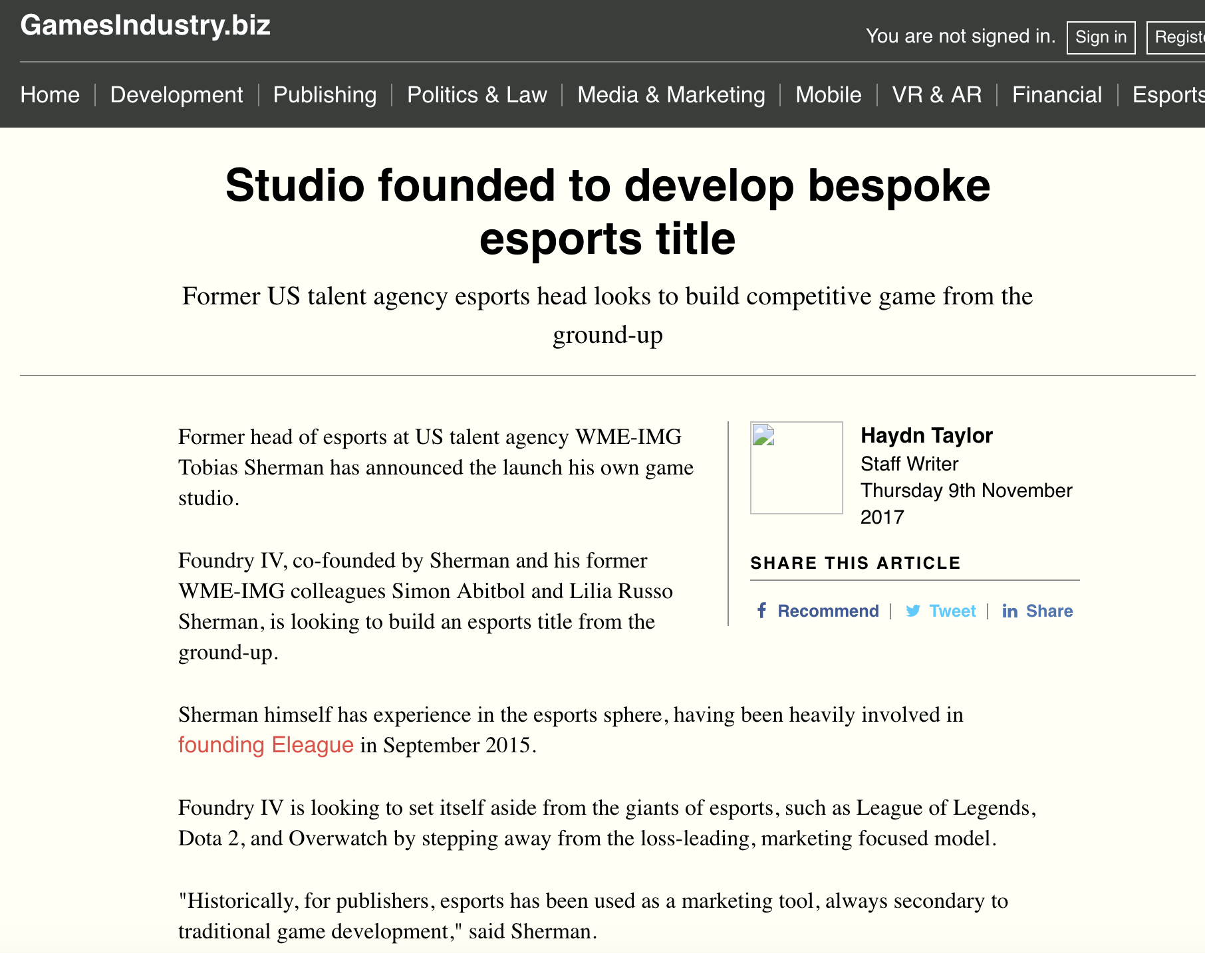
E-Sports (Olympics) Follow-Up

Slide 6
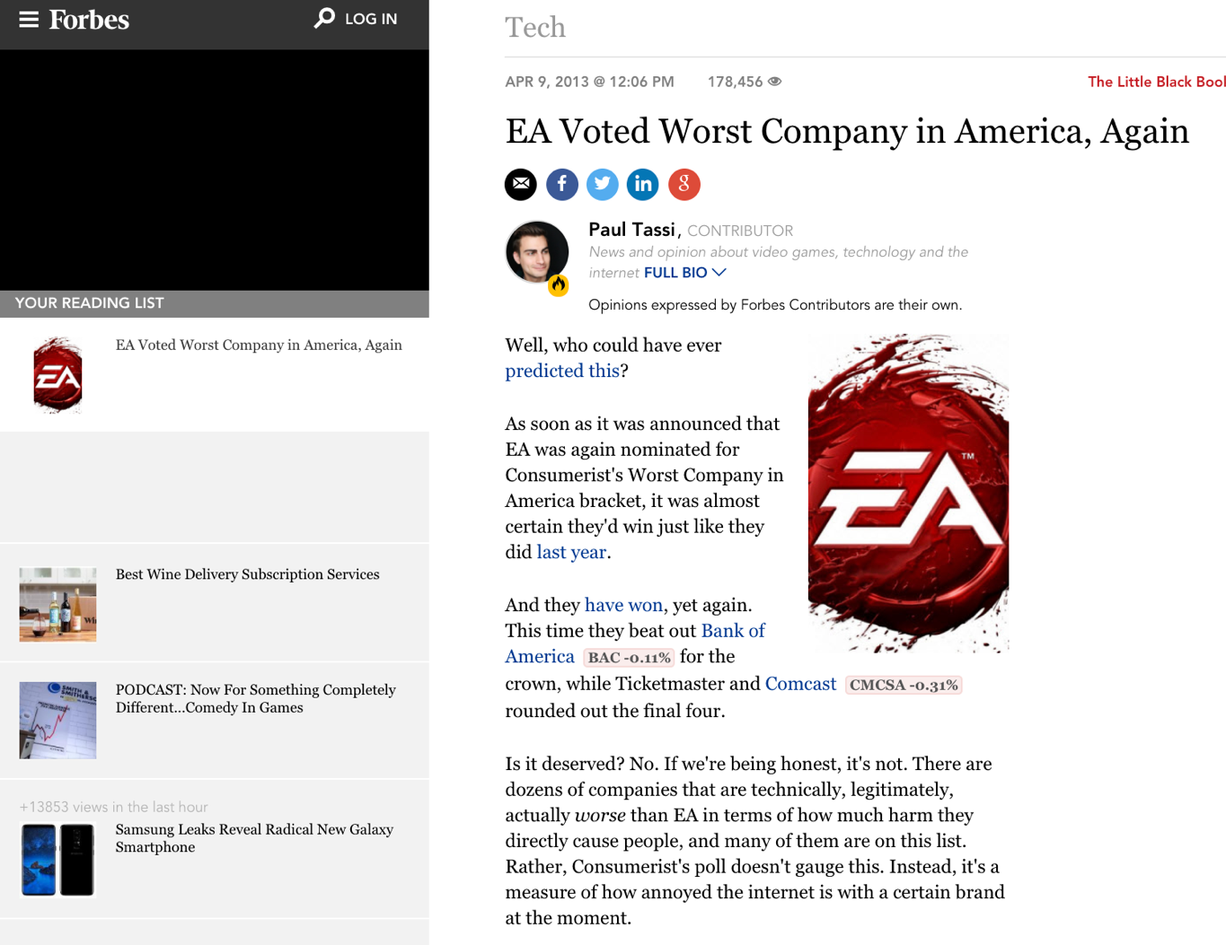
EA Follow-Up

Slide 7
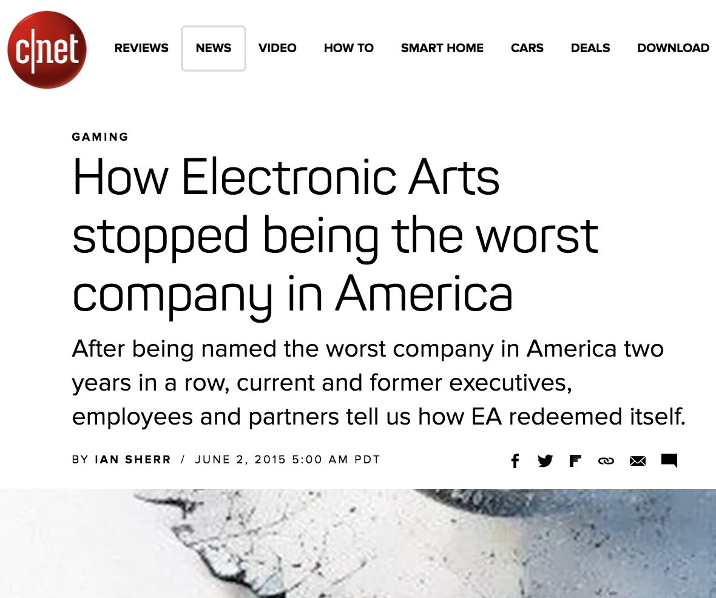

Slide 8
News of the Week

Slide 9
Yours?

Slide 10
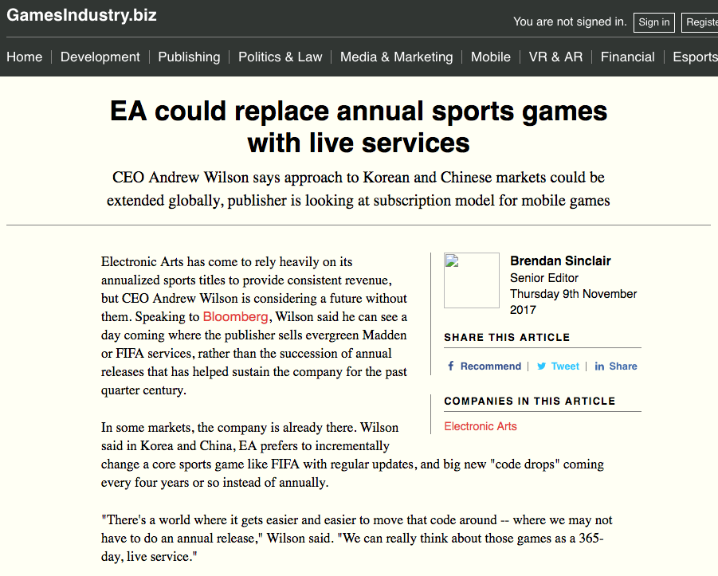

Slide 11
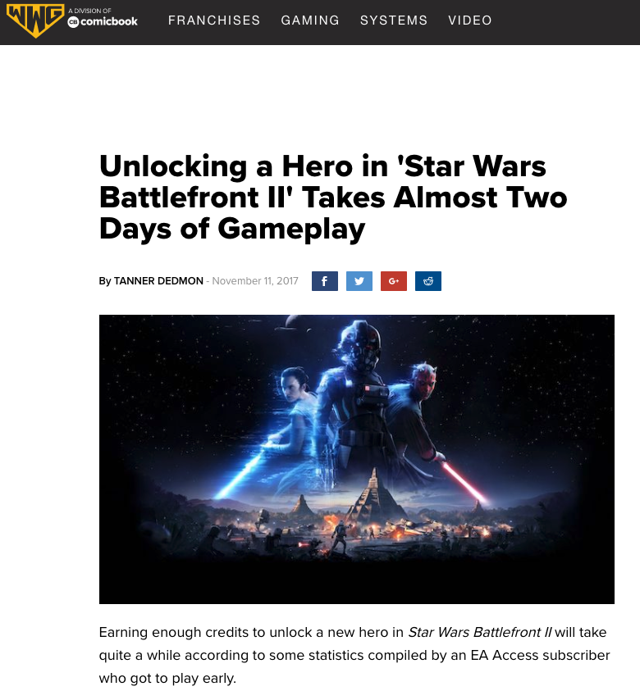

Slide 12
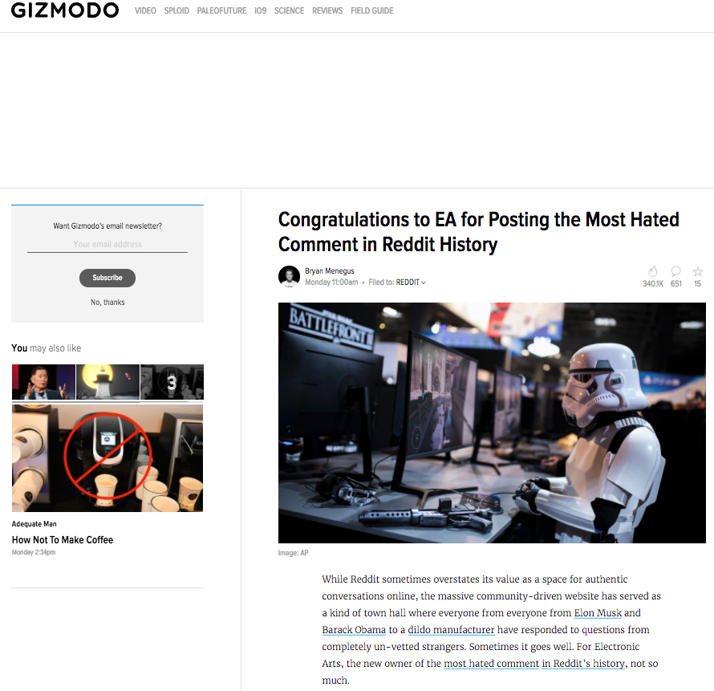

Slide 13
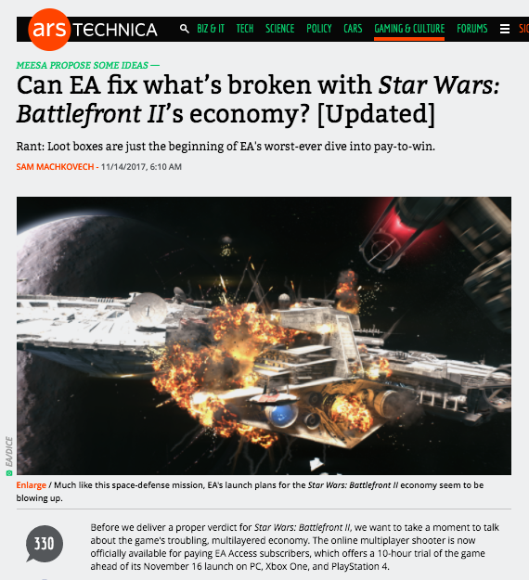

Slide 14
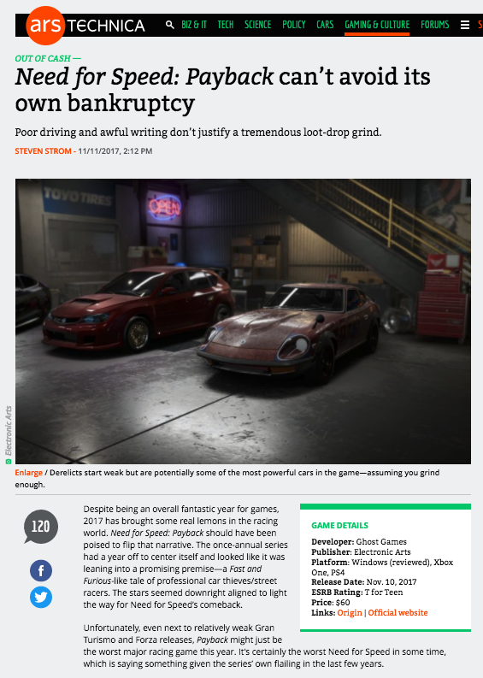

Slide 15
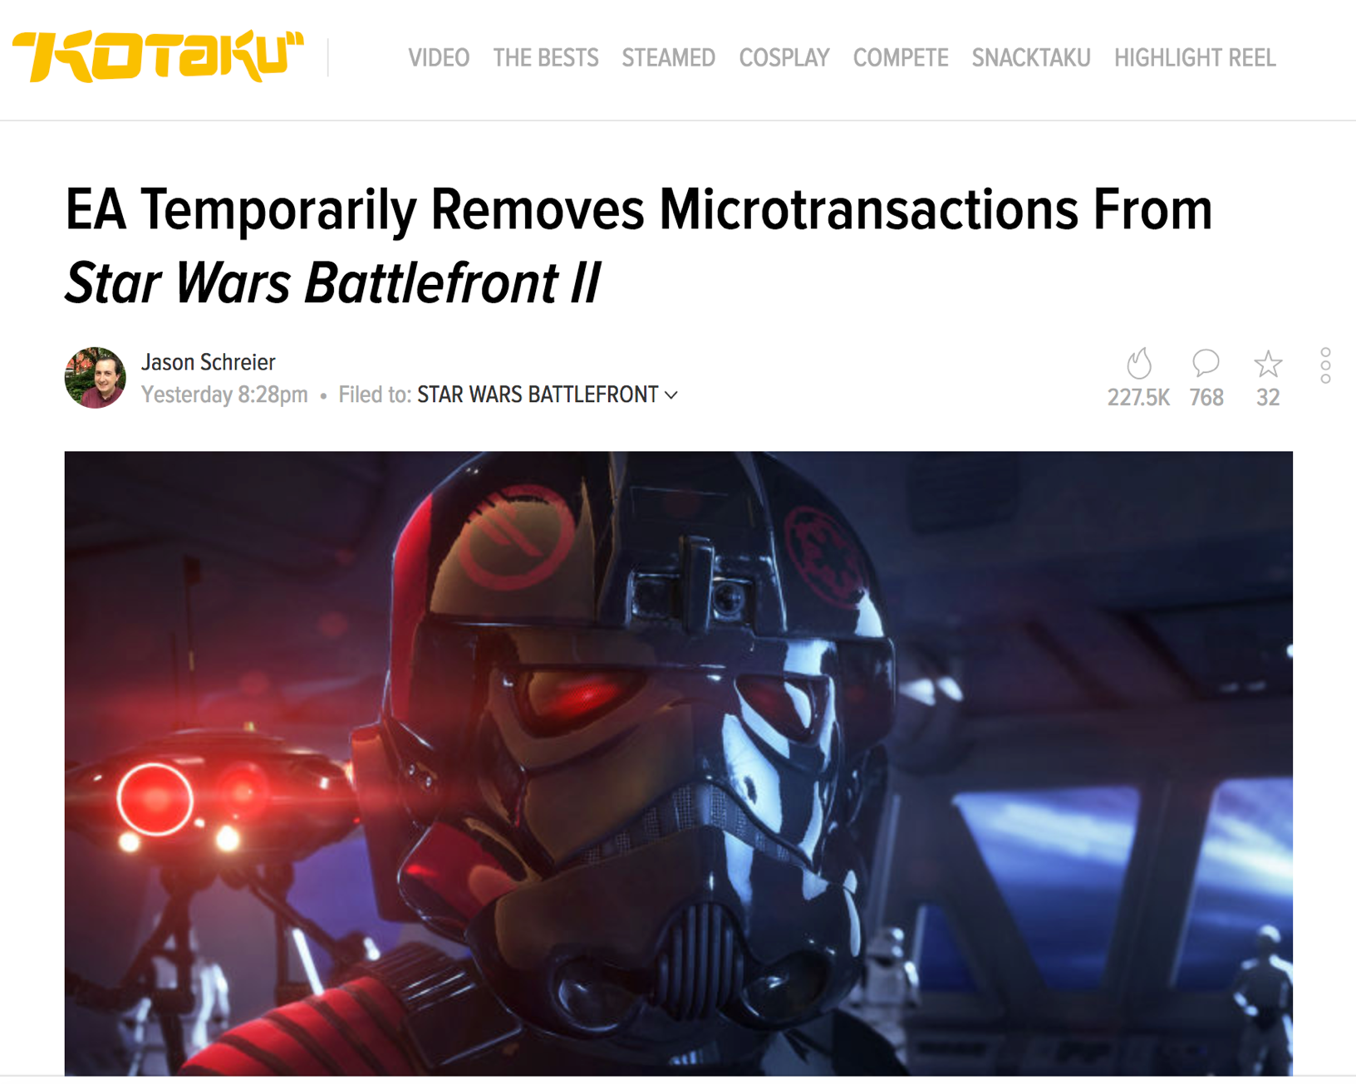

Slide 16
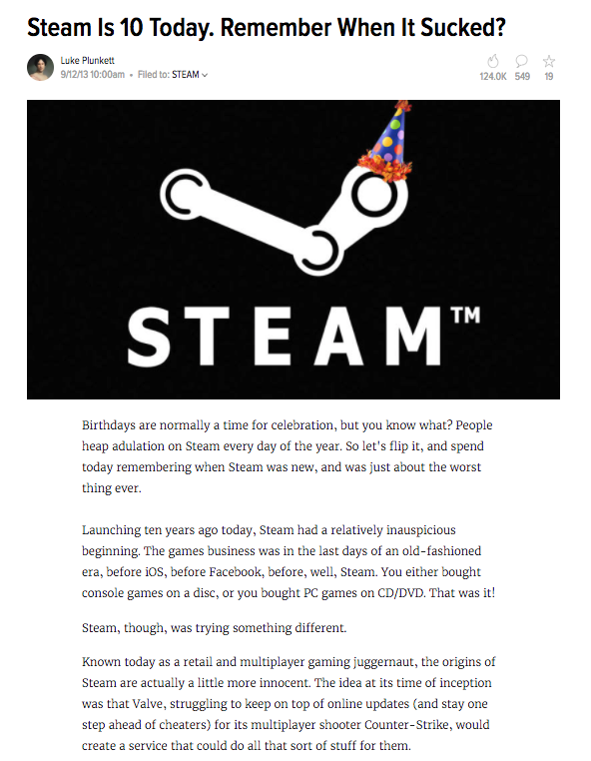
Remember…

Slide 17
And in other non-EA related news…

Slide 18
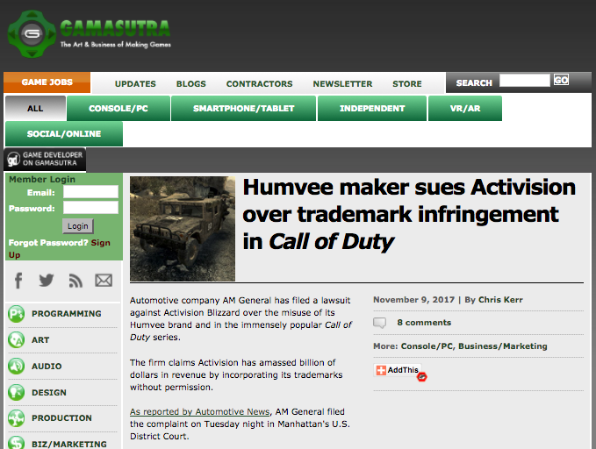

Slide 19
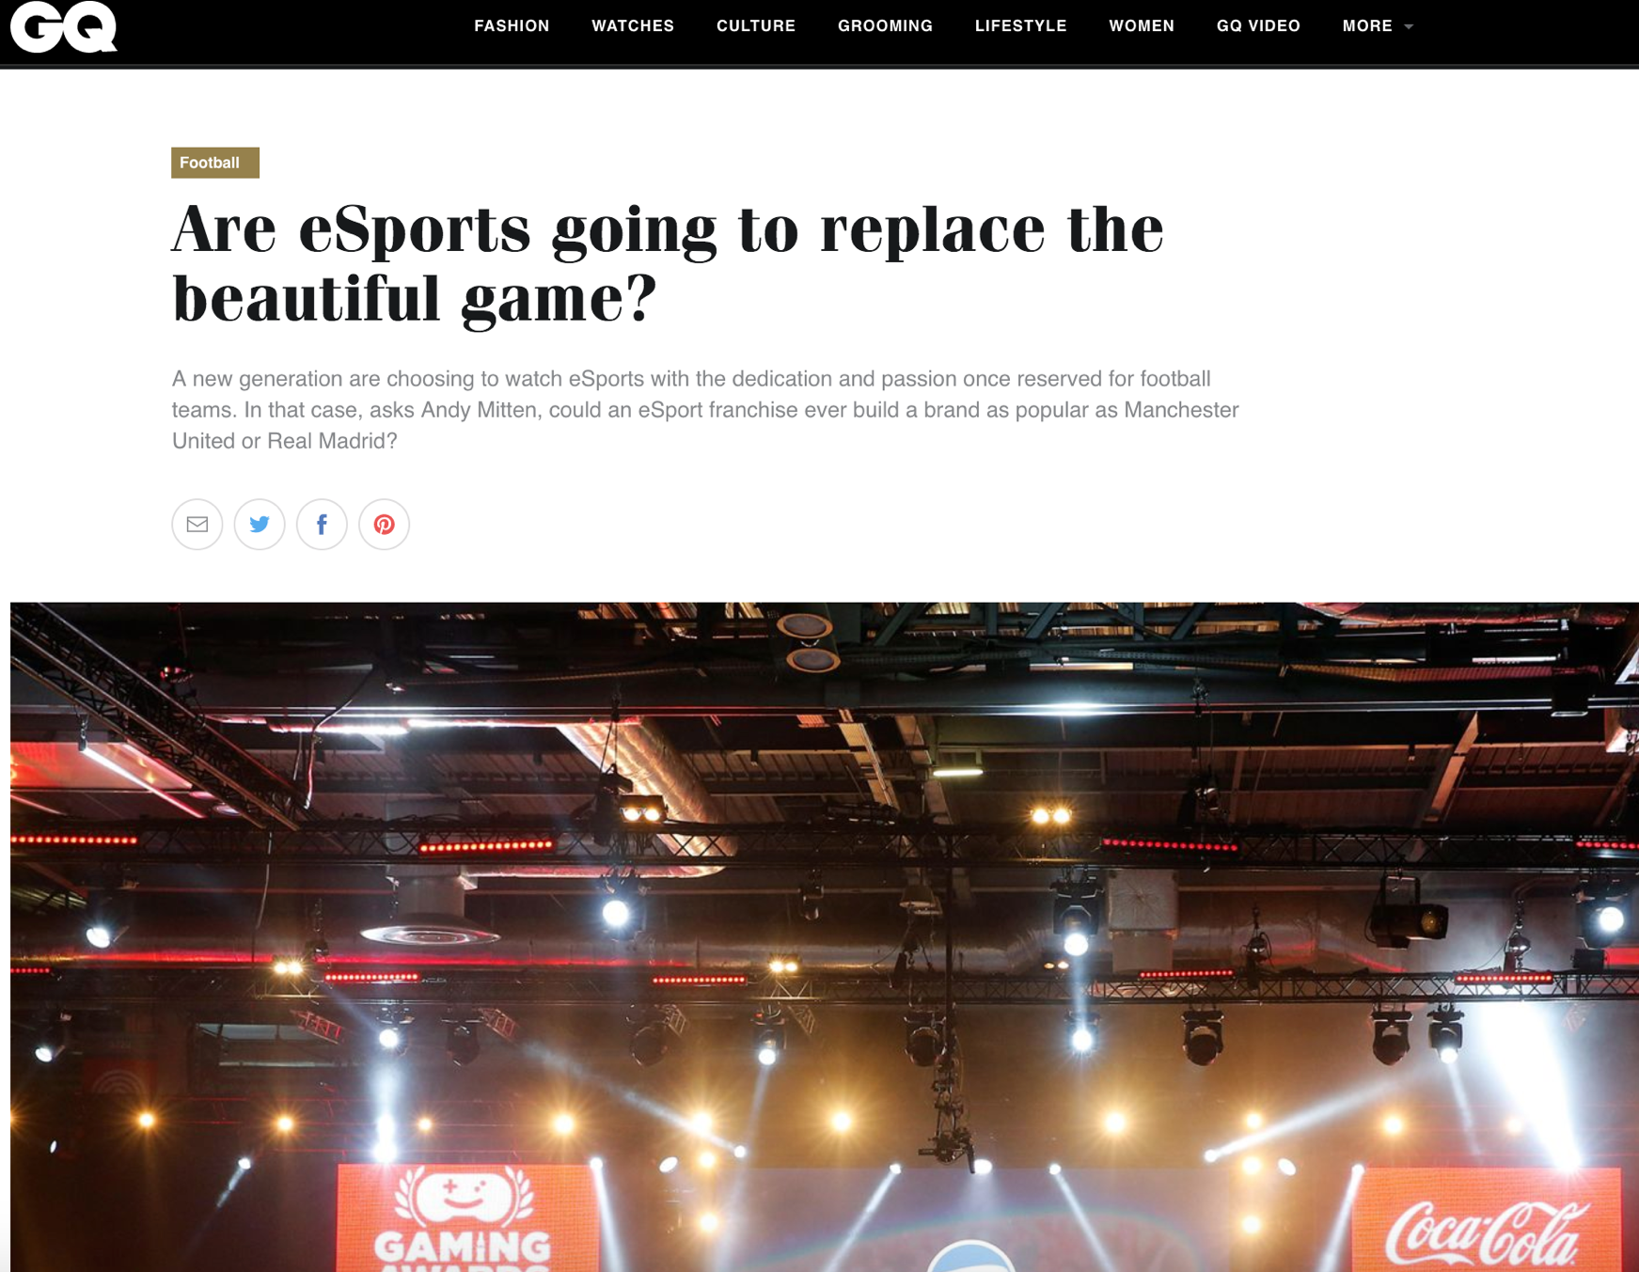

Slide 20
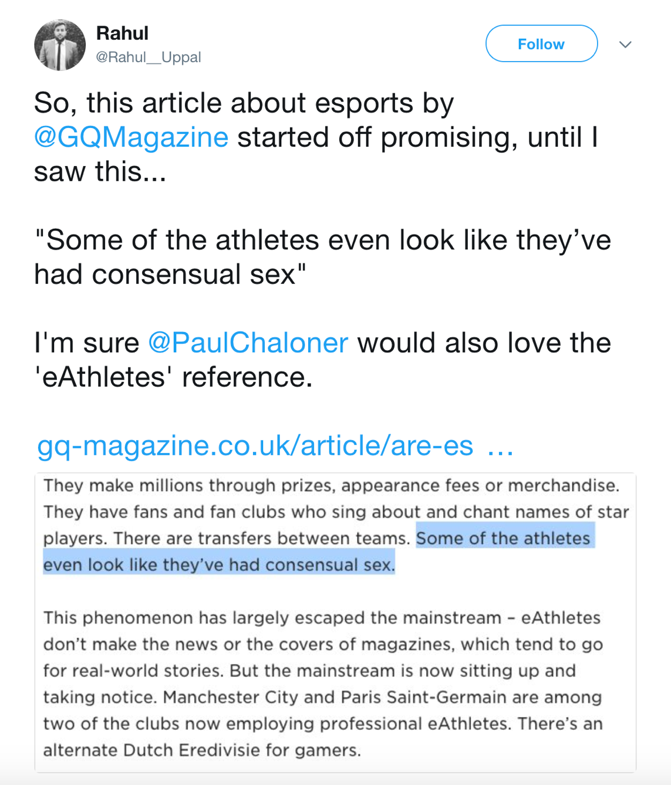

Slide 21
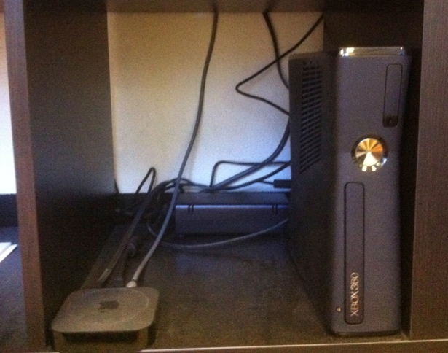

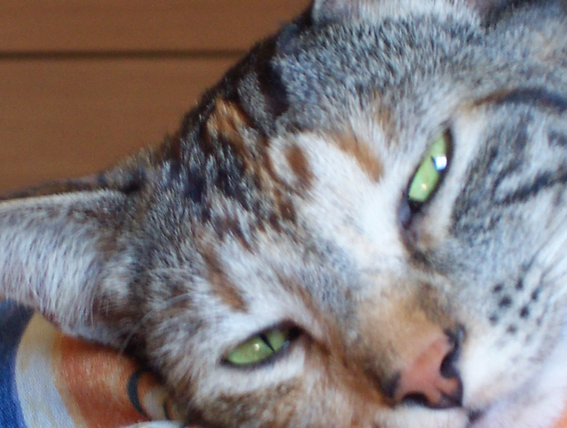
COMING SOON….
FROM WHEELBARROWS TO HOLODECKS: “CONNECTING” LIVING ROOMS…THINGS…MOBILE DEVICES…EACH OTHER…AND WAY BEYOND…ON THE LEGAL IMPLICATIONS OF CONVERGEANCE…

Slide 22

Always include a cat picture

Slide 23
Our Academic Partners

