Slide 1
Artificial Intelligence
Michael Wang, Yang Guo, Chris Lee

Slide 2
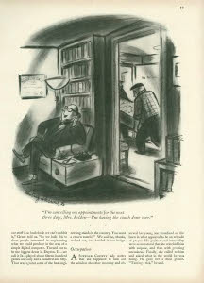
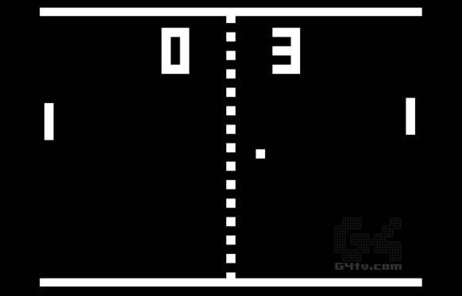
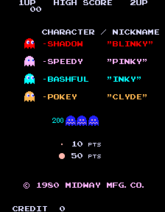
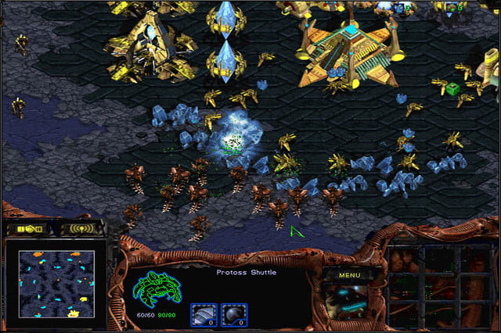
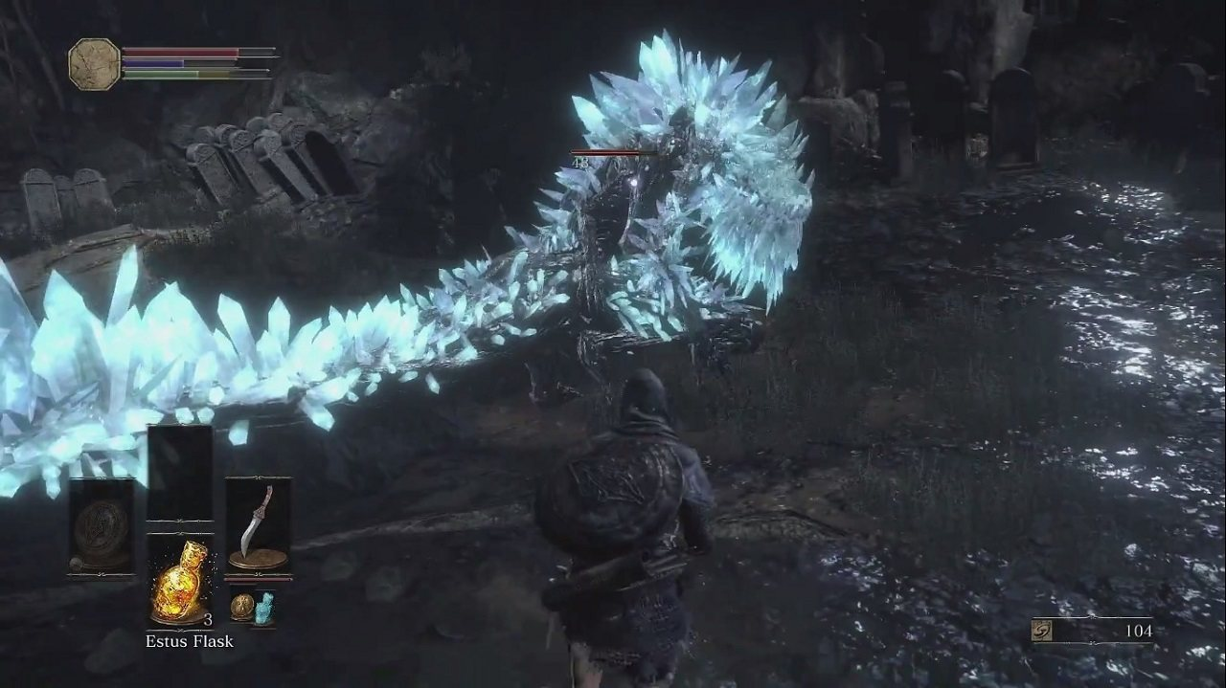
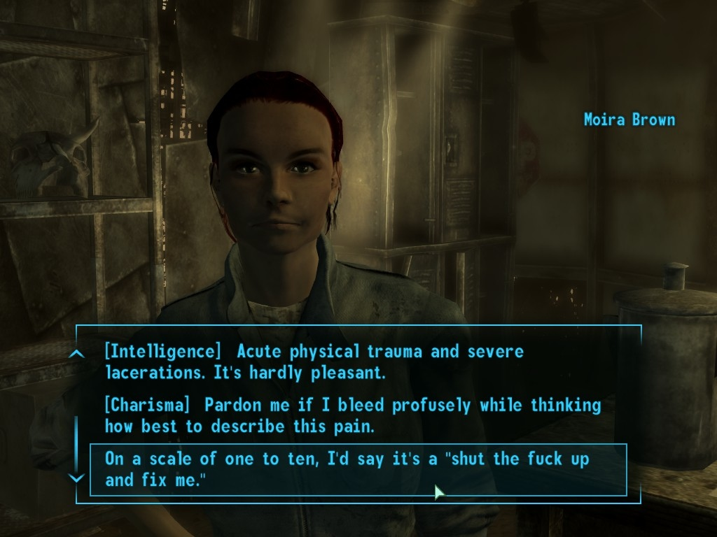
History & Development
Notes:
Artificial intelligence is the development of computer systems that attempts to simulate intelligent human behaviours, such as learning, language acquisition and problem solving. More specifically in computer science, artificial intelligence studies “intelligent agents” which observe their environment and act upon it to achieve some goal. The use of AI in videogames is a much more limited subset of the full capabilities of current state-of-the-art AI, and there is some debate about use of the term to describe algorithms in videogames which simulate the intelligent interaction through the use of pre-determined inputs & outputs, but as we will discuss, AI use in videogames are no longer limited to the backend. AI can now create and play videogames as well and are changing the way we interact and play with media.
Game playing has always been used in the study and development of AI. Whenever the player is playing against the computer, they are competing against a pre-programmed algorithm that moves blocks on the screen, changes responses from NPCs, and customizes the player experience to improve immersion. That is, the AI is part of the system and structure of the game. It takes the players’ input and outputs gameplay elements.
Examples: New Yorker article from 1952 about a computerized version of the game Nim, a simple 2-player strategy game, Pong (1972) where the computer moves the opposite paddle is an example of very simple computer logic, Pac-Man (1980) had path-finding in a maze and ghosts with “personalities”, Starcraft (1998) had pathfinding, real time resource management, Fallout 3 (2008) had changing dialogue options depending on the strengths & weaknesses of the player character, Dark Souls III (206) has a notoriously difficult computer that punishes you if your timing & reaction time aren’t perfect
https://www.computerworld.com/article/2906336/emerging-technology/what-is-artificial-intelligence.html
http://searchcio.techtarget.com/definition/AI
https://www.britannica.com/technology/artificial-intelligence

Slide 3
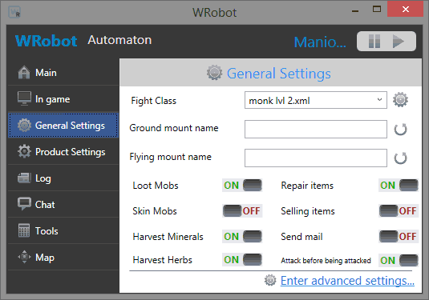
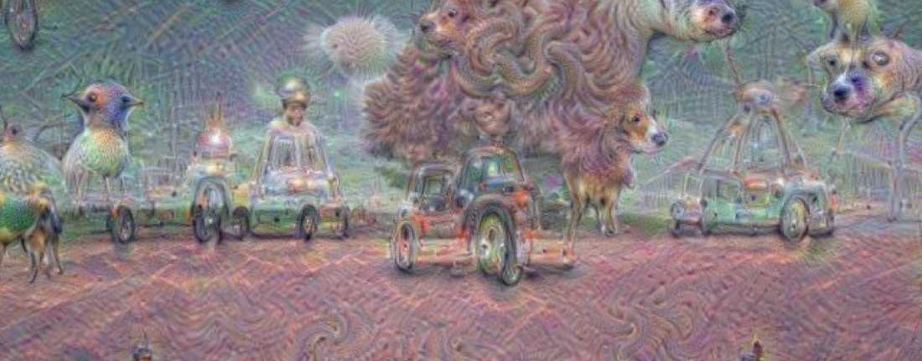
Uses of AI
Simulating real human interactions to improve immersion
Customizing gaming experience to improve immersion
Creation of games and assets
Playing and improving
Notes:
Although previous slide showed how videogame AI have increased in complexity and capacity historically, there are far more robust uses for AI now. We can divide AI use in videogames into 3 rough categories: AI as game mechanics (examples from previous slide) and non-player characters, AI as the player, and ultimately, AI as creator.
In the beginning games used simple logic and limited AI to compete against the player, simulating the experience of playing against a real person, often with different difficulty settings that were very simplistic. Over time the complexity of these programs increased as the number of in-game interactions that had to seem “real” increased. Games became story-driven and open-world (See previous slide from Pong to Fallout 3). Developers began creating worlds that would change dynamically based on player input and directions. For the most part this is still somewhat like reading a choose-your-own-adventure book. All the possible interactions have been preprogrammed by the developers, the game isn’t dynamically learning about the player and customizing the experience entirely, but the use of logic is becoming more sophisticated and immersion is improved by giving players the feeling of actually being able to impact the game world and interacting with real people who have a real reaction.
In 1997, the IBM computer Deep Blue defeated Gary Kasparov, Chess is not really a “solved game” in that the way the AI beats human players is by exhaustively searching all potential moves & outcomes at once and selecting the winning path but can’t always force a win or draw. Another old boardgame, Go, has also recently been subject to AI victory. Google’s DeepMind developed AlphaGo which in May of this year beat the world’s no. 1 ranked player. AlphaGo uses machine learning to improve upon its skill. “initially trained to mimic human play by attempting to match the moves of expert players from recorded historical games, using a database of around 30 million moves.^{[17]} Once it had reached a certain degree of proficiency, it was trained further by being set to play large numbers of games against other instances of itself, using reinforcement learning to improve its play”
Use of AI focuses a lot on learning from inputs, especially now that there is a vast amount of data on many subjects available on the internet, it’s easy to find a dataset to train your AI on. This is particularly useful for neural networks, which are computer systems that attempt to mimic the structure & function of human brain cells. These systems learn (progressively improve performance) to do tasks by considering examples, generally without task-specific programming. For example, in image recognition, they might learn to identify images that contain cats by analyzing example images that have been manually labeled as "cat" or "no cat" and using the analytic results to identify cats in other images. They have found most use in applications difficult to express in a traditional computer algorithm using rule-based programming. E.g. Google’s neural networks “recognizing” images, the result is when the process is reversed and the system is given an object & asked to generate images of it.
Use of AI in videogames isn’t limited to computers playing against the player. If the computer can simulate a player, then they could simulate the human player. Enter botting, which is the use of computer programs such as mods to substitute for the human player, usually for reducing some of the repetitiveness of games by gathering in-game resources or increasing the player’s skill level. Usually used in online multiplayer games. Takes many forms, e.g. bots in MMOs, aimbots in FPS. Like card-counting in Vegas, botting is generally forbidden by game service providers as it provides an unfair advantage. These are usually relatively simple, on the same order of magnitude as in-game character programming, but as we will see, they can be and are becoming more and more sophisticated, coming up with new and novel ways to beat the game.
But perhaps a more interesting use of AI is the use of AI to create videogame assets such as images, music and game mechanics.
http://geekologie.com/2017/11/an-anti-scamming-artificial-intelligence.php

Slide 4
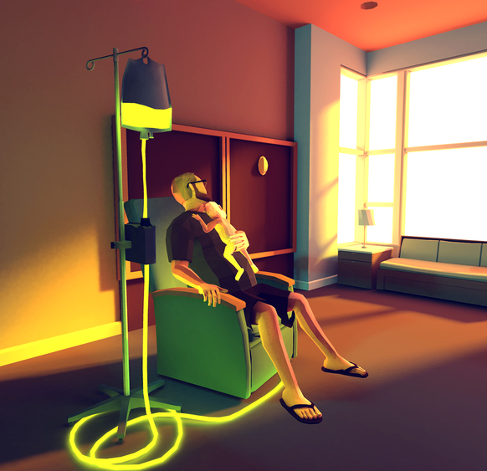
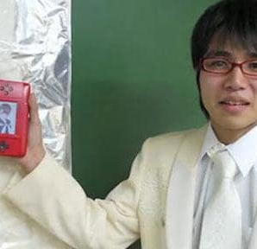
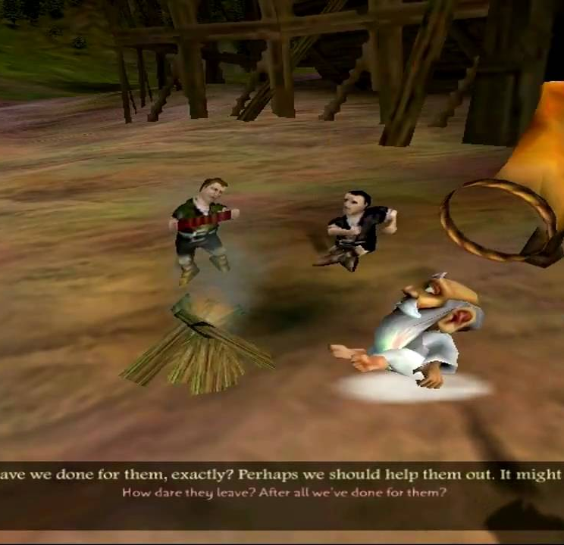
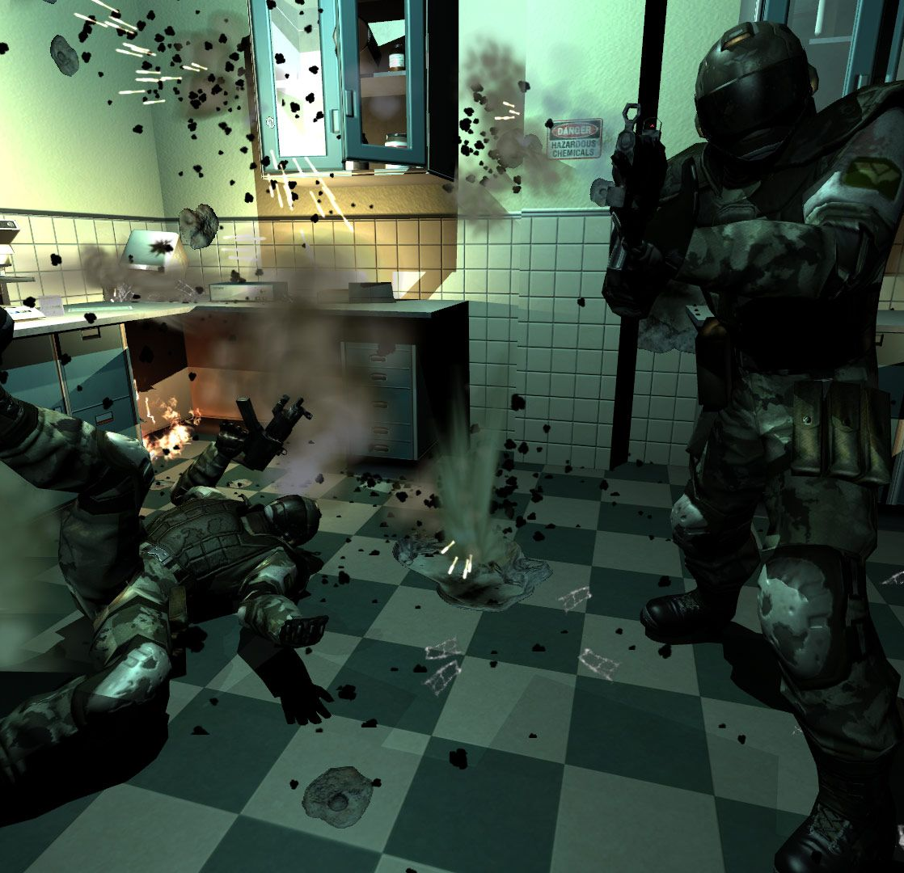
Consciousness and AI Creativity
Can AI be creative?
Can AI have emotions?
How much of a videogame is its underlying mechanics and how much is a result of creative input?
Is use of AI to find optimal strategies for games a creative outcome?
Notes:
Videogames are art, art requires creativity. If AI can create videogames, is there any difference between what they create and what humans do? Can they truly create art? It’s possible to imagine that through learning algorithms, AI could create a structure/system/rules for a game, i.e. gameplay elements and mechanics, but is there something more required in making a game? Is sufficiently advanced AI indistinguishable from humans? I.e. Turing test. If AI come up with a new way to solve puzzles, is that creativity (if creativity is coming up with novel ideas)?
http://www.telegraph.co.uk/technology/video-games/6651021/Japanese-gamer-marries-Nintendo-DS-character.html
A Japanese man married a character in a videogame, Love Plus.
That Dragon, Cancer = “video game created by Ryan and Amy Green, Josh Larson, and a small team under the name Numinous Games. The autobiographical game is based on the Greens' experience of raising their son Joel, who was diagnosed with terminal cancer at twelve months old, and though only given a short time to live, continued to survive for four more years before eventually succumbing to the cancer in March 2014. The game is designed to have the player experience the low and high moments of this period in the style of a point-and-click adventure game, using the medium's interactivity and immersion to relate the tale in ways that a film cannot”
Many experts complain that the "AI" in the term "game AI" overstates its worth, as game AI is not about intelligence, and shares few of the objectives of the academic field of AI. Whereas "real" AI addresses fields of machine learning, decision making based on arbitrary data input, and even the ultimate goal of strong AI that can reason, "game AI" often consists of a half-dozen rules of thumb, or heuristics, that are just enough to give a good gameplay experience. Historically, academic game-AI projects have been relatively separate from commercial products because the academic approaches tended to be simple and non-scalable. Commercial game AI has developed its own set of tools, which have been sufficient to give good performance in many cases
https://hbr.org/2017/04/there-will-always-be-limits-to-how-creative-a-computer-can-be
http://gvu.gatech.edu/index.php?q=ai-uses-less-two-minutes-videogame-footage-recreate-game-engine
We have AI that can create the individual assets of a game, the art and music (Google DeepMind, https://futurism.com/a-new-ai-can-write-music-as-well-as-a-human-composer/), and create game designs (http://bigthink.com/ideafeed/ai-creates-its-own-video-game, in which levels were created "by randomly selecting from a list, then scattering enemies and power-ups throughout the level." It then simulates a human playing the game to determine which designs produce the most fun and interesting results”), and we have AI that can put everything together (https://kotaku.com/a-computer-program-made-a-game-by-itself-well-thats-1494080189) eventually AI will develop to the point where it can create a complete game.
Black & White is a god game which includes elements of artificial life simulations and some strategy. The player rules over an island populated by various tribes, and can teach a large animal-like creature to do his/her bidding.
Innovations in Game AI
The gameplay is focused on the interaction with a large AI creature which can learn from examples, and takes reward and punishment.
The design integrates artificial life within the context of a strategy game.
The engine uses a solid AI architecture, rooted in cognitive science, known as belief-desire-intention (BDI).
Machine learning techniques such as decision trees and neural networks are used with great success.
F.E.A.R. First Encounter Assault Recon is a first-person shooter where the player helps contain supernatural phenomenon and, naturally, armies of cloned soldiers.
Innovations in Game AI
The AI uses a planner to generate context-sensitive behaviors, the first time in a mainstream game. This technology used as a reference for many studios still today.
The enemies are capable of using the environment very cleverly, finding cover behind tables, tipping bookshelves, opening doors, crashing through windows…
Squad tactics are used to great effect. The enemies perform flanking maneuvers, use suppression fire, etc.
https://medium.com/@DavidVandegrift/can-artificial-intelligence-be-creative-40e7eac56e71
https://www.ibm.com/watson/advantage-reports/future-of-artificial-intelligence/ai-creativity.html
http://www.abc.net.au/news/2017-08-11/artificial-intelligence-can-ai-be-creative/8793906
https://www.forbes.com/sites/forbescommunicationscouncil/2017/10/11/will-ai-replace-creative-jobs/#6dd7cbb596a2
http://www.escapistmagazine.com/news/view/130538-Horror-Game-Nevermind-Learns-Your-Fears-Knows-When-You-Are-Afraid

Slide 5
AI as Intellectual Property
Who owns the artificial intelligence?
Can you own a sentient machine?
Who owns the intellectual property created by sufficiently advanced artificial intelligence?
Who owns the data used to train and develop AI?
Where does the creative input come from?
Notes:
What if an AI manages to create a videogame, who owns the intellectual property rights of that videogame? Is it the creator of the AI? What if the AI is sufficiently advanced to be considered “sentient”?
No definition for “inventor” re. Patents in Canadian CA - “Where a person is directed to engage in a purely mechanical act for the purpose of testing whether an invention will work, in circumstances where "[t]he whole train of ideas put into motion . . . were those of others", the person is not to be treated as an inventor. If a person merely verifies another’s previous predictions, the person is not an inventor.”
Where an employee is hired to and does create an invention in the course of his employment, the employer will own the invention. However, this exception is not statutory, but developed by the courts
no actual requirement for human authorship in the US Copyright Act. Nevertheless, the “courts have always assumed that authorship is a human phenomenon,” she says.
Eran Kahana, an intellectual-property lawyer at Maslon LLP and a fellow at Stanford Law School, doesn’t believe we should award authorship to AIs. He explains that the reason IP laws exist is to “prevent others from using it and enabling the owner to generate a benefit. An AI doesn’t have any of those needs. AI is a tool to generate those kinds of content.” He likens the idea to a computer word processor using spell check. If you make a spelling mistake in something you’re writing and the computer corrects it, who owns the copyright to the final product? “Obviously not the computer”, Kahana quips. “The computer has no ownership of your writing.”
AI also raises some thorny issues by potentially impinging on the IP rights of others. This is especially true if a creative work is based on machine learning, a technique that allows an AI to learn for itself from data it is provided. If the input on which a creation is based—the data—is made by someone else, shouldn’t then be the owner of whatever work is created from it? And even if work is produced by an AI independently, can it really be classed as original?
AI also raises some thorny issues by potentially impinging on the IP rights of others. This is especially true if a creative work is based on machine learning, a technique that allows an AI to learn for itself from data it is provided. If the input on which a creation is based—the data—is made by someone else, shouldn’t then be the owner of whatever work is created from it? And even if work is produced by an AI independently, can it really be classed as original?
Seldom have we seen a document originating from a body of the European Union being introduced in the literary-romantic way as the Motion for a European Parliament Resolution A8-0005/2017 (of January 27th, 2017) by the Committee on Legal Affairs of the European Parliament.
This report on Civil Law Rules on Robotics constitutes an acknowledgement of the likely upcoming event that “ever more sophisticated robots, bots, androids and other manifestations of Artificial Intelligence (“AI”) unleash a new industrial revolution”, and that such an event will affect all spectra of society.
As human creators are increasingly assisted by AI systems or co-creating works with autonomous machines, whereas also the creative input can potentially also come from computer programs, we may indeed have to rethink the role of copyright law. In some cases the creative process is even left entirely up to such systems. Some issues that arise challenge the very foundations underlying IP laws. Questions such as how to provide incentives and protection of investment for artists and the industries that work with such systems[1], but also what kind of ownership results from works (partially) created by AI machines.[2] One of the issues with ownership is that these are not even new sources of creative works in some cases, but they depend highly on access to works created by others and require massive amounts of input-data (which can be subject to varying IP regimes). This input must remain at an economically affordable cost if we want to incentivise the AI revolution and ensure the interoperability of network-connected autonomous robots. But also the other way around needs important considerations, as the current legal framework is insufficient on “data protection and ownership due to the (expected massive) flow of data arising from the use of robotics and AI”.[3]
It leaves us to wonder what should happen to traditional IP law concepts as ‘inventiveness’, ‘original’, and ‘creator’ in this new evolving environment of machine creation. For example, currently, only the UK has “an explicit regulation for (some) computer generated works, though the strict equivalence with human works may give overly generous protection to works that can increasingly be produced with almost no effort and in quantities previously unimaginable.”[4]
http://blogs.findlaw.com/technologist/2016/08/who-owns-the-creation-of-an-artificial-intelligence.html
https://www.lexology.com/library/detail.aspx?g=cdad0111-2ba9-424e-bd10-76654cd02b4f
https://law.maastrichtuniversity.nl/ipkm/artificial-intelligence-ai-and-intellectual-property-ip-a-call-for-action/
https://qz.com/1054039/google-deepdream-art-if-an-ai-creates-a-work-of-art-who-owns-the-rights-to-it/
http://www.ipwatchdog.com/2017/06/18/artificial-intelligence-disrupt-legal-framework-intellectual-property-rights/id=84319/
https://www.google.ca/search?q=ownership+of+artificial+intelligence&rlz=1C5CHFA_enCA698CA699&oq=ownership+of+artificial+intelligence&aqs=chrome..69i57.4293j0j4&sourceid=chrome&ie=UTF-8

Slide 6
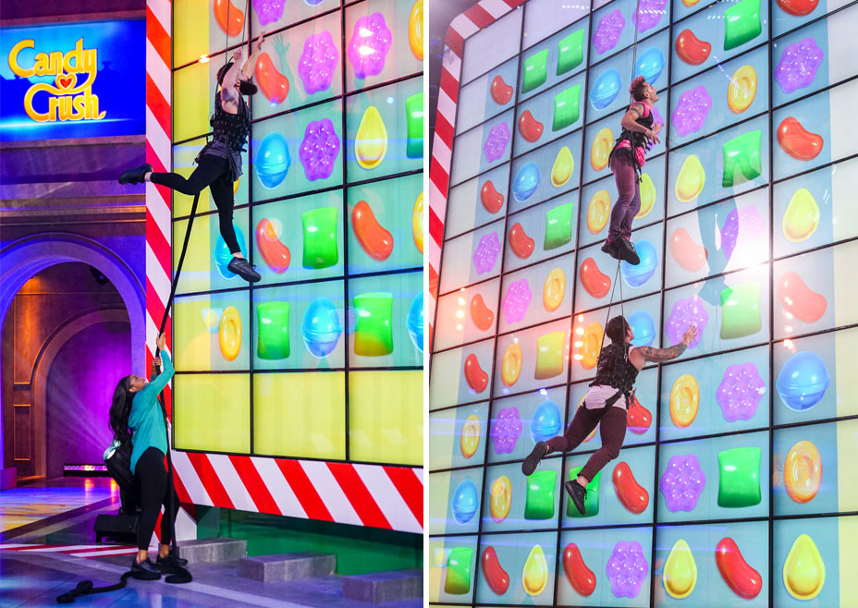

Slide 7
AI and eSports
OpenAI bot - https://youtu.be/5zaJ58q9vuI?t=4m08s
Legal issues with AI licensing
Mixed teams?
Notes:
Very mechanically complex game

Slide 8
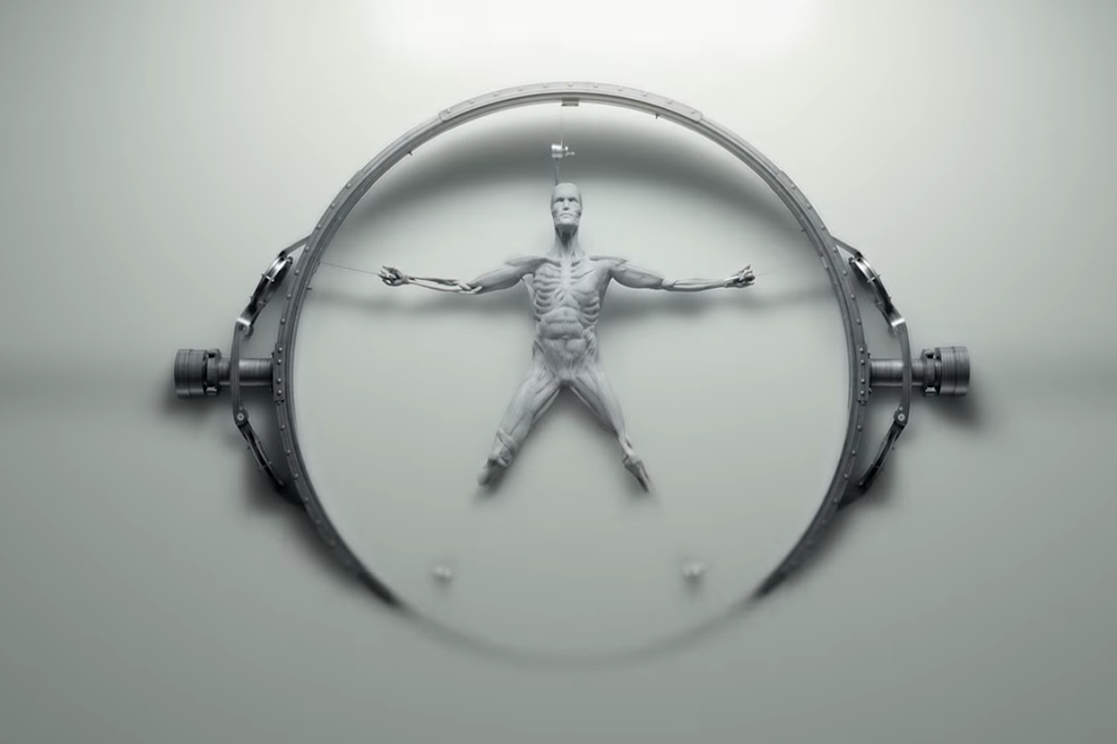
AI as NPC & Player
Westworld or matrix esque future?
Ownership of NPCs?
When bots become more advanced (hearthstone, runescape, league of legends)
Notes:
See any issues with westworld? Hint: abuse
Ownership issues because NPCs develop from your interactions with them so arguably you’re one of its ‘creators’

Slide 9
Machine Learning and Ethics
First and foremost issue - do we recognize them as human and if not, what do we label them?
Lots of constitutional questions/rights if we do recognize them as human
Certain rights won’t need to be afforded
Notes:
AI is becoming more and more ‘human’
If we combine AI with robotics then worker safety won’t be an issue
Xenophobia for sure

Slide 10
Some philosophical questions
What will the future look like?
Why develop AI using games/videogames? (Go, DOTA)
Limits we put on AI?
Notes:
- inherent humanness in gaming?
Future is not so far away

Slide 11
Notes:
Purpose of using games to develop AI?
o Games provide a complex platform for AIs to learn
o Indicative of more sophisticated AI systems of the future; AI capable of making complex decisions that could translate into real-world tasks (e.g. surgeries)
o Tom Murphy, computer scientist, created a program that ‘solves’ how to play Super Mario Bros or any other NES game
o This specific method fails at Tetris
o When AI is about to lose, it pauses the game indefinitely

Slide 12
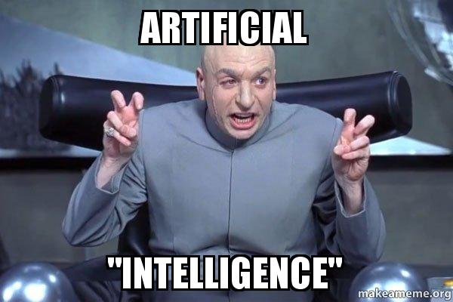
The Future of AI
The Singularity Hypothesis: A point in time when all the advances in technology, including artificial intelligence, will lead to machines being smarter than humans
Notes:
o Evolutionary growth is an exponential process due to positive feedback (feedback loop in which the effects of a small disturbance on a system results in an increase in the magnitude of the perturbation; A produces more of B which in turn makes more A)
Trigger unfathomable changes to human civilization

Slide 13
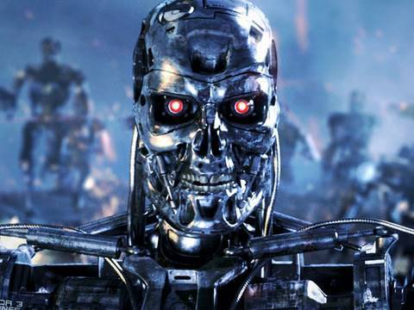

Slide 14
Should We Fear AI in the Future?
Notes:
Uncertain. Some experts predict that superhuman artificial intelligence will be detrimental to humans. Others believe that this post-apocalyptic scenario is purely science-fiction. They believe that AI can be used to amplify and augment human capabilities (perhaps even human-machine synthesis).

Slide 15
Regulating AI
Three Laws of Robotics, Isaac Asimov:
(1) A robot may not injure a human being or, through inaction, allow a human being to come to harm.
(2) A robot must obey orders given to it by human beings except where such orders would conflict with the First Law
(3) A robot must protect its own existence as long as such protection does not conflict with the First or Second Law
Problems?
Notes:
Set of rules devised by science fiction author Isaac Asimov. Very basic and general in nature. Presumes that AI have human intelligence and are capable of differentiating between right and wrong.

Slide 16
Regulating AI (cont.)
Modified Rules, Oren Etzioni:
(1) An AI system must be subject to the rule of law;
(2) An AI system must clearly disclose that it is not human; and
(3) An AI system cannot retain or disclose confidential information without explicit approval from the source of that information
Better, but not complete.

Slide 17
Notes:
It is clear that AI, like many technological advances before it, isn’t without risk. However, this does not mean that we should just assume the worst. Perhaps with careful regulation and legitimate practices, AI can usher in a new age for humanity like nothing we’ve seen before.

Slide 18
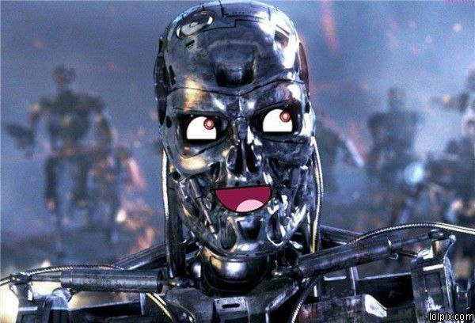
Notes:
:D

