Slide 1
YouTube ’Let’s Play’ videos and the Defense of Fair Comment
Columban Young-Smith

Slide 2
Forget Who Dares Wins, It’s Who Prepares Wins
What is a Let’s Play Video?
History of Copyright Takedowns
Overview and recap of Canadian Copyright Law
Limitations on Copyrights – Fair Dealing Defence
Specific Exception – The ‘YouTube’ clause
American Law
Looking to the Future

Slide 3
What are Let’s Play videos?
document the play-through of a video game
usually include commentary by the gamer
different from a video game walkthrough or strategy guide
focus on an individual's subjective experience with the game,
often with humorous, irreverent, or critical commentary from the gamer,
tend to be curated experiences that include editing and scripted narration
Wikipedia(!)

Slide 4
Some examples…
PewDiePie – 57 million subscribers; 14 billion total views: Let’s Play Montage
FrankieOnPCin1080P – 3.5 million subscribers: Prey Walkthrough
PewdiePie 2015 earnings - $12 million pre-tax (Forbes x The Independent)

Slide 5
A History of Copyright Takedowns
May 2013 – Nintendo starts enforcing its copyright by installing ads at the start of user-generated videos of its copyrighted material
Jan 2016 – Channel Awesome videos removed for My Neighbour Totoro infringement
Sep 2017 – Developer Campo Santos executes copyright takedown of PewDiePie’s Firewatch videos for racists slur
Oct 2017 – Nintendo cuts off associated live streamers from YouTube Live using copyright enforcement
Notes:
http://www.rollingstone.com/glixel/news/pewdiepie-streams-racist-slur-prompts-dmca-threat-w502231
https://kotaku.com/lets-play-copyright-threat-raises-questions-about-the-l-1803784376
http://www.gamesindustry.biz/articles/2017-10-02-nintendo-creators-program-cuts-off-livestreamers
https://arstechnica.com/gaming/2017/10/nintendo-cuts-off-ad-program-for-youtube-livestreamers/
http://www.tubefilter.com/2017/10/02/nintendo-youtube-creator-program-live-stream/

Slide 6
Canadian Copyright Law
Federal jurisdiction – consistent throughout the country
Current legislation – Copyright Act
Sole and exclusive right to reproduce, perform or publish a work
Rights subject to specific limitations under the Act
Automatically created
Lesley Ellen Harris, Canadian Copyright Law, Wiley (Toronto) 2013

Slide 7
Two key principles…
Two types of property right in one physical object – right in object itself, and in tangible property – less needed due to digital downloads
Ideas are not protected, but their expression is.

Slide 8
Reform of Copyright Law
2012 Copyright Modernization Act
Non-commercial User-Generated Content – the ‘Youtube’ provision
Distinction in damages between commercial and non-commercial infringement
Fair Dealing expanded to education, parody, and satire.

Slide 9
Fair Dealing
Copyright Act s.29
Not defined in the Act
Defense to a claim of unauthorized use of copyright materials.
Onus on User
No exact definition in cases
Case by case basis

Slide 10
‘Substantial’ – how much is too much?
No right to prevent use where less than a substantial part of the work is being used (Harris, 2013)
Not defined in law
Matter of degree
Frankie – Battlefield 1 Let’s Play
PewDiePie – Garry’s Mod Montage
Is this substantial re the rest of the game?

Slide 11
Fair Dealing – Judicial Interpretation
Théberge – author’s rights can be constrained
CCH – fair dealing as a user’s right.
SOCAN and CCLA – application of CCH and clarification of two-step test
Does the dealing in question fall within a legislated category?
Is the dealing fair, in light of CCH?
Myra Tawfik, The Supreme Court of Canada and the Fair Deal Trilogy

Slide 12
Fair Dealing – Judicial Interpretation (cont.)
SOCAN – threshold for the test:
“the Court in CCH created a relatively low threshold for the first step so that the analytical heavy-hitting is done in determining whether the dealing was fair.” (para 27)
BUT
Tawfik - “no matter how broadly one sets the boundaries of each category, they are nevertheless exhaustive. There will always be factual situations that will fall outside even the most generous interpretation of any given category, in which case the matter will end there.”
Contrast with US approach

Slide 13
Making a Fair Dealing determination…
Step 1 – Does it fall within a protected purpose?
Research; private study; education; parody; satire; criticism; review; news reporting
Angry Joe’s review of Star Wars BF Poo
Frankie playing BF1 – historically educational?
Some videos fall into the categories; but
Some are more difficult, even with a generous interpretation per SOCAN
What do you think?

Slide 14
Making a Fair Dealing determination…
Step 2 – is the use fair?
CCH; SOCAN:
Purpose of the dealing
Character of the dealing
Amount of the dealing
Alternatives to the dealing
Nature of the work
The effect of the dealing on the work
Not an exhaustive list
Intentionally ambiguous – applying the law to your facts
Hubbard v Vosper (1972) – long extracts and short comments vs short extracts and long comments
User’s Rights!
What do you think?

Slide 15
Specific Exceptions: Non-commercial User-Generated Content
S.29.21(1) Copyright Act - The ’Youtube’ or ‘mash-up’ provision
Not illegal for an individual to use an existing work or other subject-matter in order to create a new work or other subject matter and to share that new work.
Can be shared through intermediary – YouTube
Conditions:
Existing work is published
Non-commercial purposes
Source is included
Existing work doesn’t infringe copyright
Use of work has no financially adverse effect on original author

Slide 16
Looking over the border (because we have to, not because we want to)…
SOCAN – distancing from US Fair Use doctrine
Canadian two step process vs Jon’s ‘stew’:
Nature of the work
Amount of original work used
Purpose and character of the use
Effect of the use on the works value
Which is the better model?

Slide 17
Will the law change?
Law & technology – always playing catch-up?
Greater development of user rights principles?
What do you think?

Slide 18
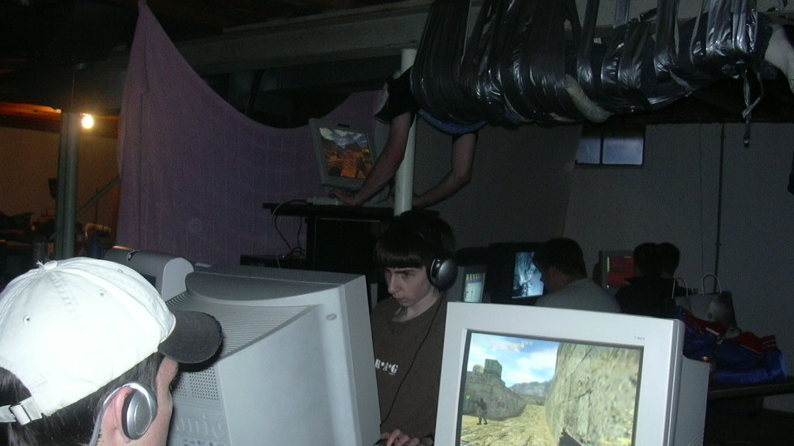
Thanks for a great semester!
Video Game Law Seminar – October 2017

