Slide 1


Relating Technology,
Originality & Identity
Talk 11
Part B “Connecting”
Video Game Law 2017
UBC Law @ Allard Hall
Jon Festinger Q.C.
Centre for Digital Media
Allard Law of Law, UBC
QMUL School of Law (CCLS)
Festinger Law & Strategy
http://videogamelaw.allard.ubc.ca/
Twitter: @jonfestinger
jon_festinger@thecdm.ca

Slide 2
Logistics?

Slide 3
Course Evaluations
https://eval.ctlt.ubc.ca/law

Slide 4
Questions on..
Papers ?
Participation ?
Class Presentations ?

Slide 5

Today’s Game Release

Slide 6
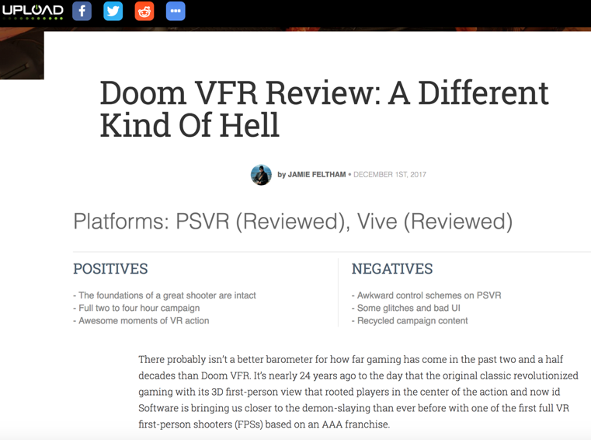

Slide 7
Loot Box Follow Ups…
COMPETION ACT R.S.C., 1985, c. C-34
53(1): “No person shall, for the purpose of promoting, directly or indirectly, any business interest or the supply or use of a product, send or cause to be sent by electronic or regular mail or by any other means a document or notice in any form, if the document or notice gives the general impression that the recipient has won, will win, or will on doing a particular act win, a prize or other benefit, and if the recipient is asked or given the option to pay money, incur a cost or do anything that will incur a cost.

Slide 8
53(2) Subsection (1) does not apply if the recipient actually wins the prize or other benefit and the person who sends or causes the notice or document to be sent
(a) makes adequate and fair disclosure of the number and approximate value of the prizes or benefits, of the area or areas to which they have been allocated and of any fact within the person’s knowledge that materially affects the chances of winning;
(b) distributes the prizes or benefits without unreasonable delay; and
(c) selects participants or distributes the prizes or benefits randomly, or on the basis of the participants’ skill, in any area to which the prizes or benefits have been allocated.

Slide 9
So what’s in the EULA…
?

Slide 10
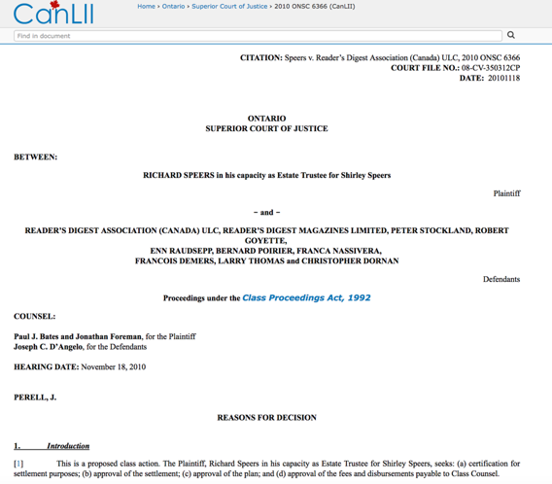
Class action…

Slide 11
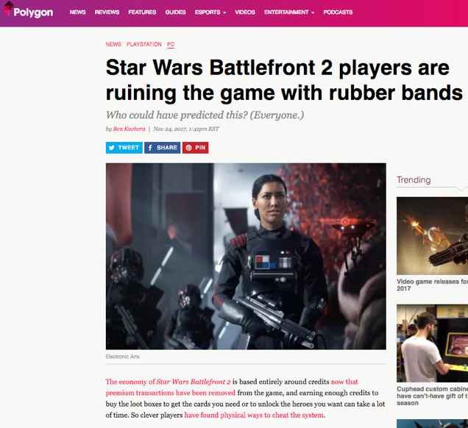

Slide 12
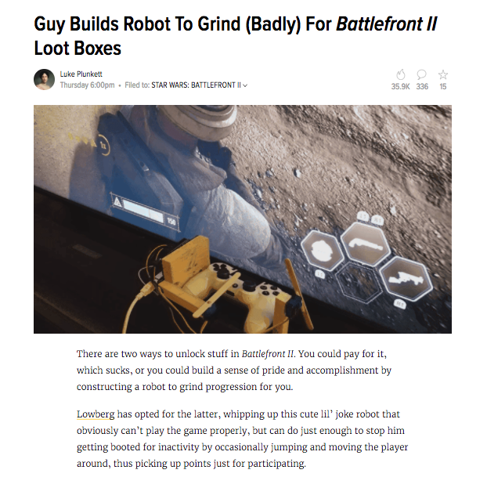

Slide 13
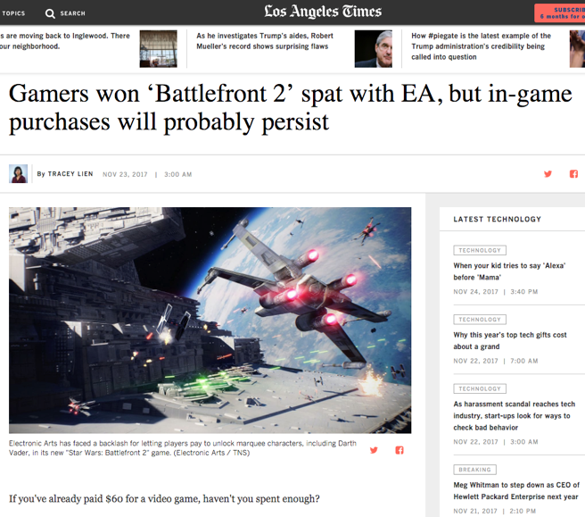

Slide 14
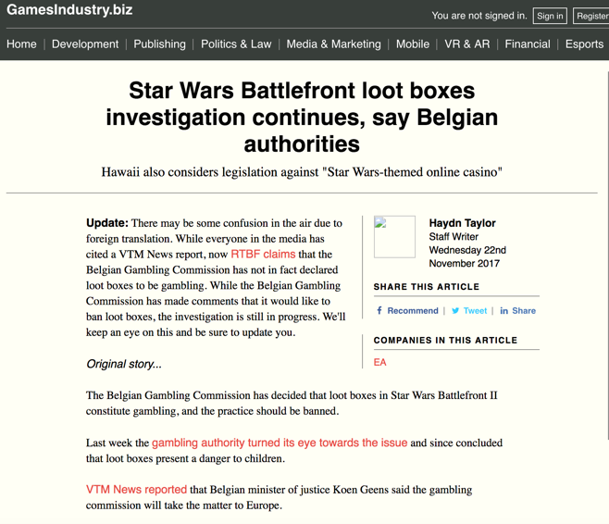

Slide 15
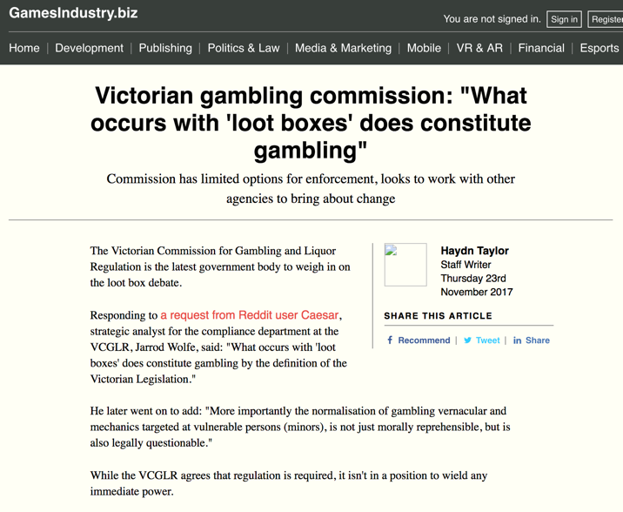

Slide 16
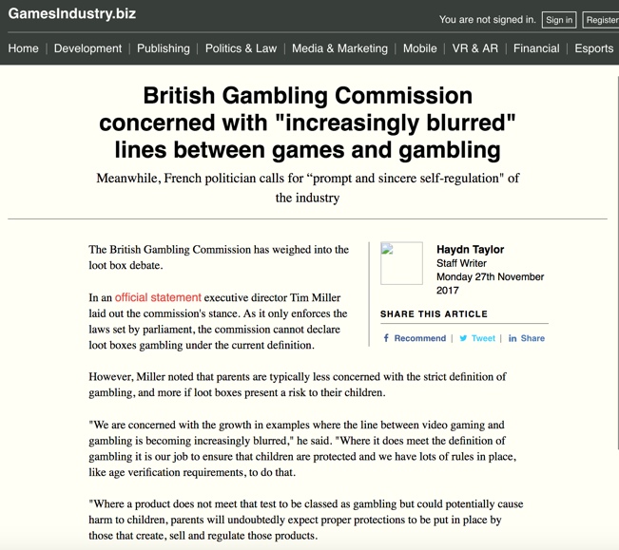

Slide 17
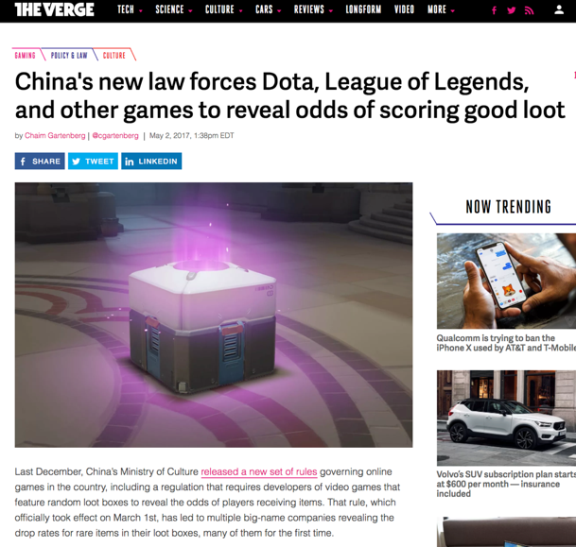

Slide 18
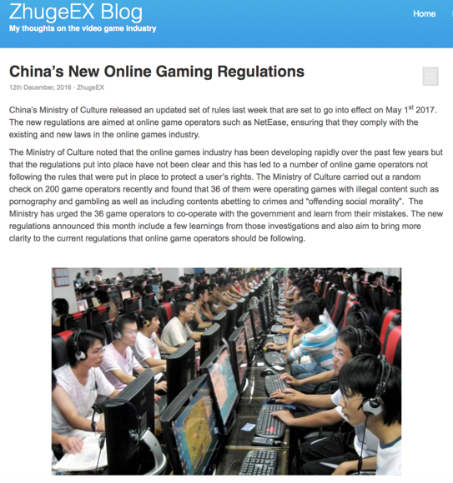

Slide 19
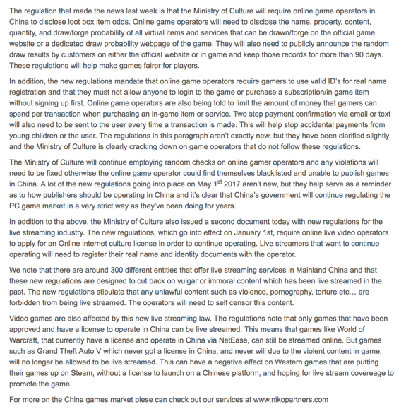

Slide 20
News of the Week

Slide 21
Yours?

Slide 22
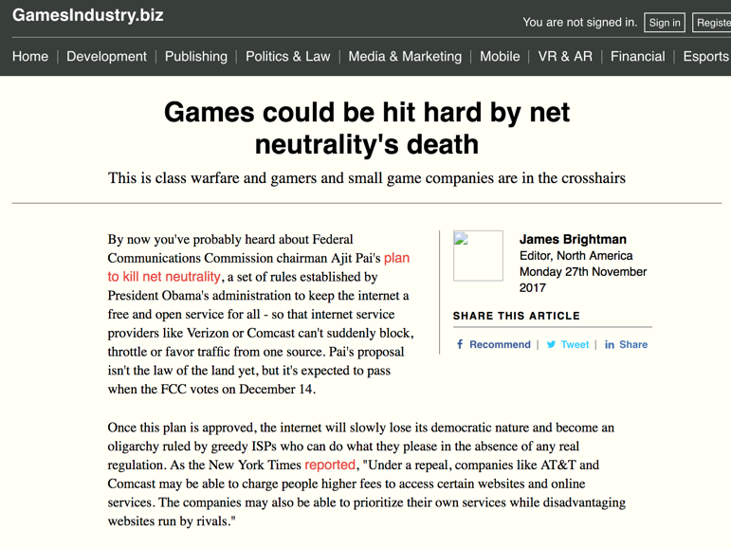

Slide 23
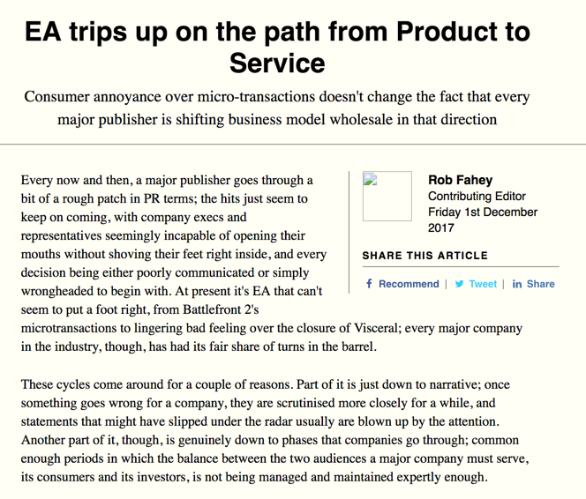

Slide 24
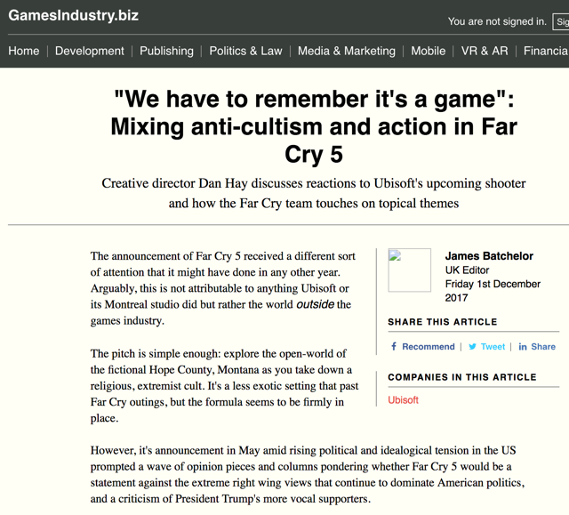

Slide 25

Today: Wrapping Up

Slide 26
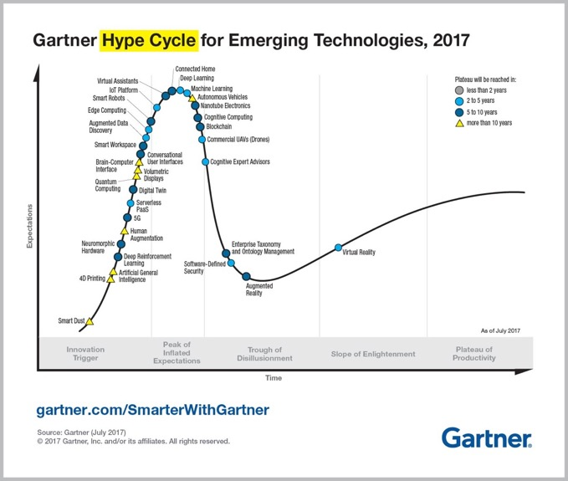

Slide 27
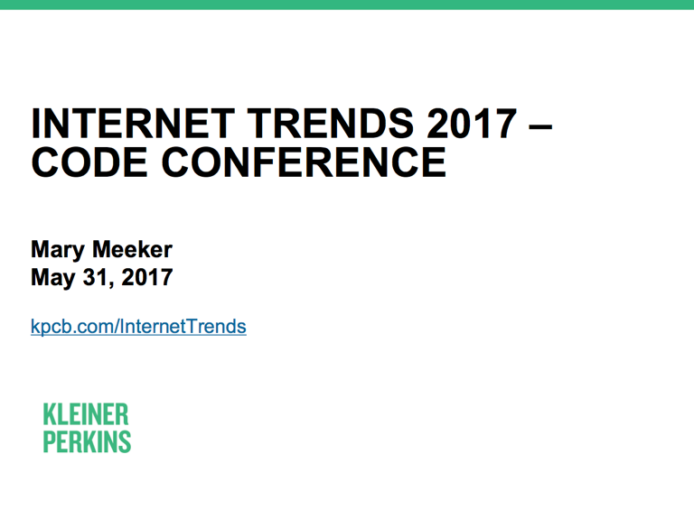

Slide 28
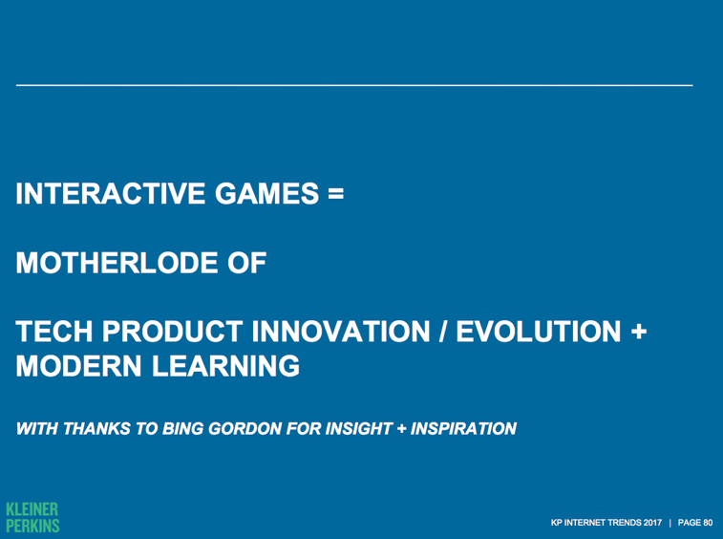

Slide 29
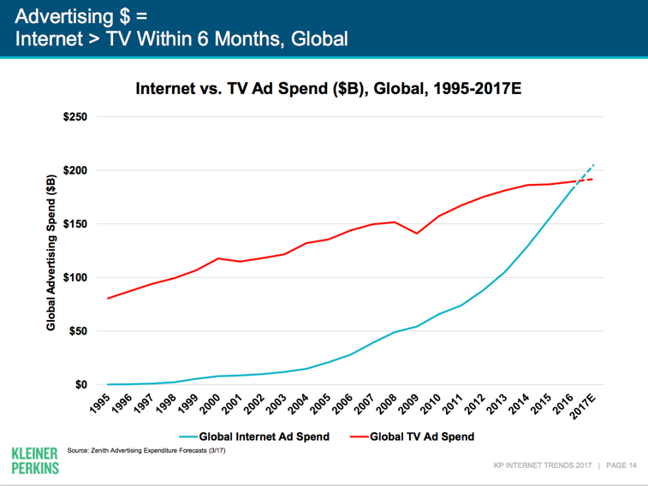

Slide 30
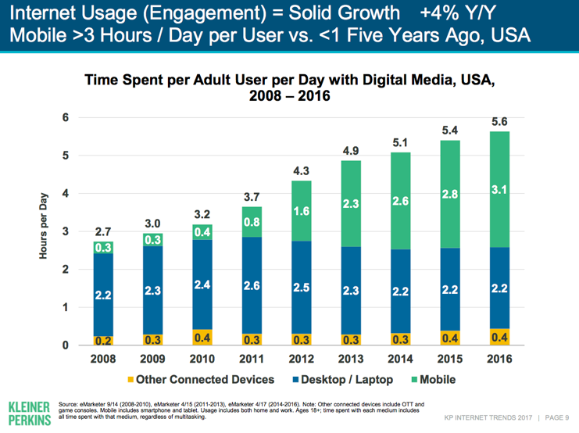

Slide 31
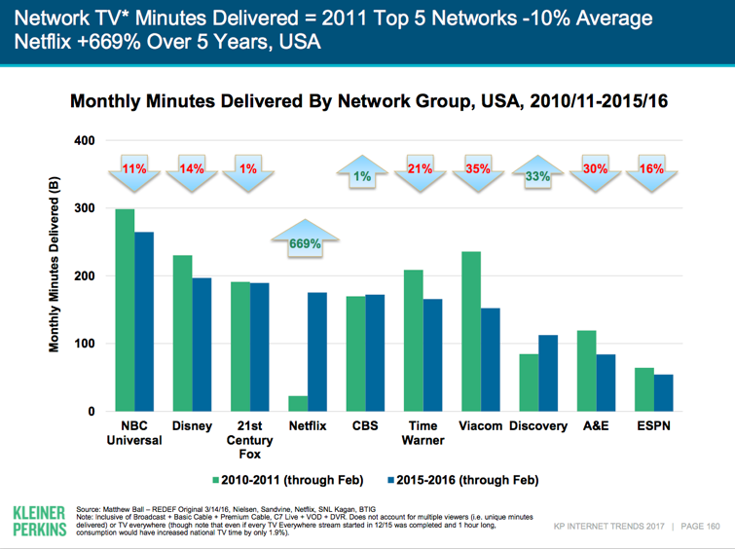

Slide 32
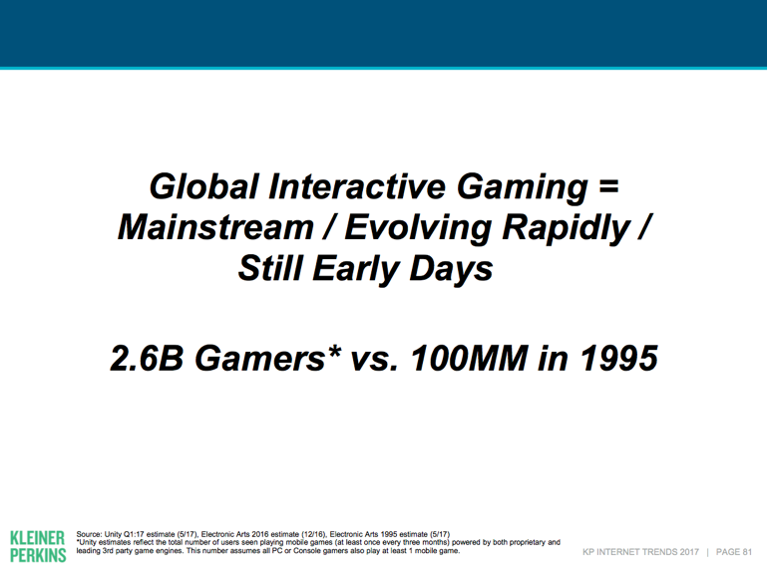

Slide 33
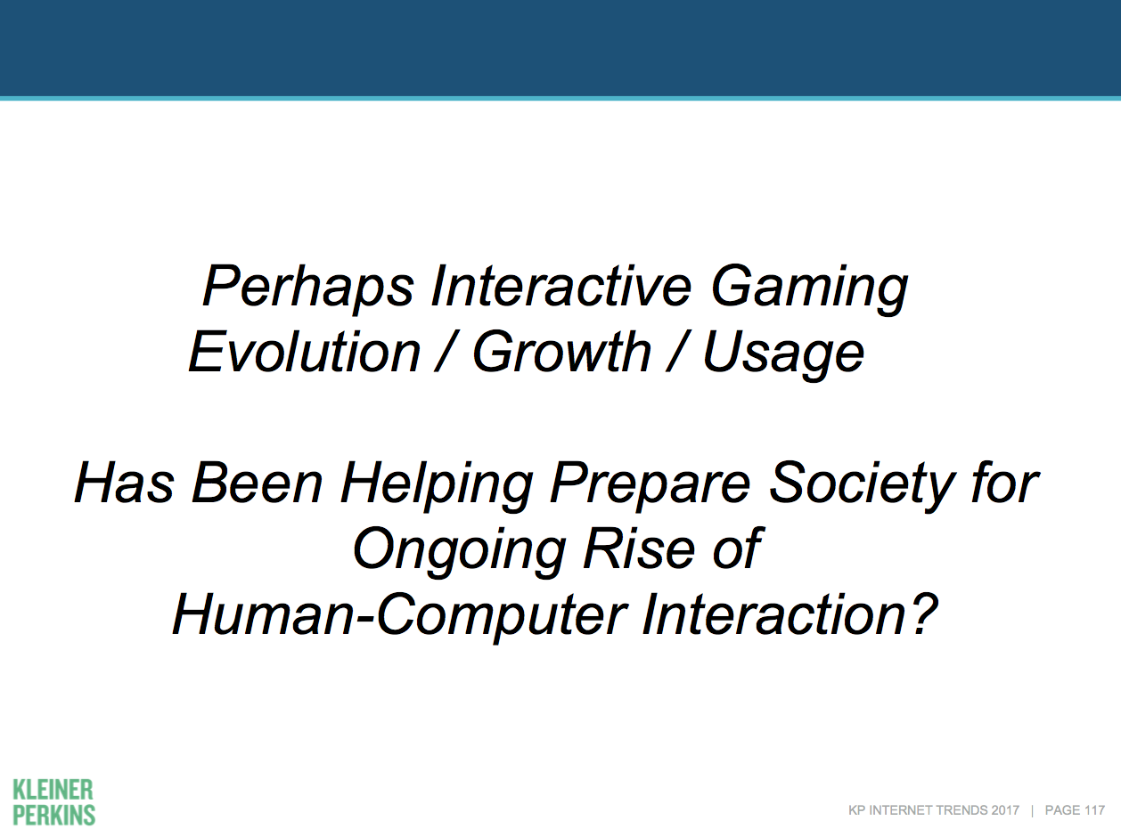

Slide 34
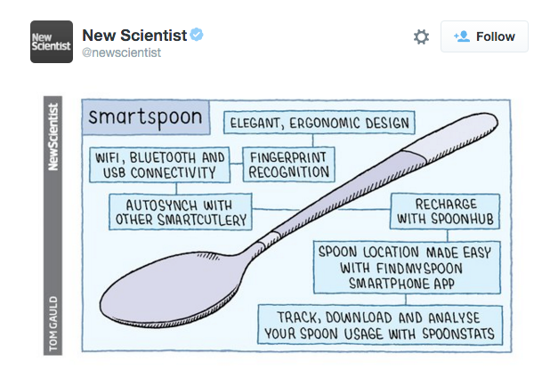

Slide 35
A.I. IS POST-STRUCTURAL

Slide 36
Replacing Author with Reader…
Except with Big Data enabled A.I. you are the book being read.

Slide 37
Enabling…
MEdia

Slide 38
So is anything original (& therefore IP) in a Video Game?
(Hint: not as much
as you think..)
+
Should anything be plagiarism?

Slide 39
STEP 1 – not the “system”
“Games and Other Uncopyrightable Systems” Bruce Boyden (2011) http://www.georgemasonlawreview.org/doc/Boyden_18-2_2011.pdf
“Games are systems in exactly the same way. A game, as sold, is only a
game form; the content necessary for an instance of the game comes
from the players. That is, the game form establishes the environment for play
—the game space—and it defines permissible moves and the conditions for
winning or drawing. But the game itself is supplied by the players. Games
are systems in the same way that the excluded schemes in the cases above
were systems.”
“For systems, the rule against the copyrightability of games demonstrates why
systems are generally uncopyrightable and why that term has special
significance. The term is not merely a synonym for “idea,” or “process.”
Systems are shells into which users pour meaning. While they may contain
expression themselves, that expression is there merely to facilitate the meaning
added by the user. Copyright properly excludes them.”

Slide 40
Other Steps
*Not Ideas or General
Concepts
*Not Genres; scenes a faire
*Not Rules, play methods,
common moves
*Not stock characters

Slide 41
What’s left that is protectable?
ART - look & feel
& Atari v. Oman (Breakout) almost denied that
+
Underlying Code
+
Sound
+
Plagiarism (protected against)

Slide 42
WHAT IS AN
“ORIGINAL”
GAME (IN
Law)?

Slide 43
STEP 1

Slide 44
First key is the…
IDEA/
EXPRESSION
DICHOTOMY

Slide 45
STEP 2

Slide 46
THE IP
THRESHOLD
FOR GAMES

Slide 47
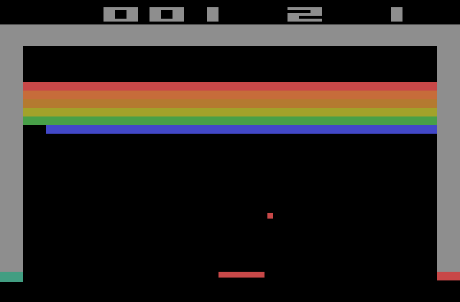
BREAKOUT
Issue: The “creativity standard” in copyright.

Slide 48
Atari v. Oman - 1989/1992 USCA DC Cir.
* “BREAKOUT's audiovisual display features a wall formed by red, amber, green, and blue layers of rectangles representing bricks. A player maneuvers a control knob that causes a rectangular-shaped representation of a paddle to hit a square-shaped representation of a ball against the brick wall. When the ball hits a brick, that brick disappears from its row, the player scores points, and a brick on a higher row becomes exposed. A "breakout" occurs when the ball penetrates through all rows of bricks and moves into the space between the wall and the top of the screen; the ball then ricochets in a zig-zag pattern off the sides of the screen and the top layer of the wall, removing bricks upon contact and adding more points to the player's score. Various tones sound as the ball touches different objects or places on the screen. The size of the paddle diminishes and the motion of the ball accelerates as the game is played.”
District court judge asked counsel for the Register, "If Picasso had painted a round object on a canvas, would you say because it depicts a familiar subject--namely, something that's round--it can't be copyrighted?”
Atari Games Corp. v. Oman, 979 F. 2d 242 - 1992 - ‎Court of Appeals, Dist. of Columbia Circuit
Atari Games Corp. v. Oman, 888 F. 2d 878 - 1989 - ‎Court of Appeals, Dist. of Columbia Circuit
Atari Games Corp. v. Oman, 693 F. Supp. 1204 - 1988 - ‎Dist. Court, Dist. of Columbia

Slide 49
STEP 3
Copyright

Slide 50
    No protection for:
    general concepts, plots,
    themes and genres;
    scenes a faire, ideas
    “merged” with
    expression; content not
    original to the author

Slide 51
Meaning no protection for:
    basic game concept, rules, method of play, stock characters, common sports moves, other aspects of games “driven by genre”

Slide 52
STEP 4
What is protectable…

Slide 53
      “look and feel”, game
      progression, graphics,
      instructions
      (verbatim), underlying
      Code, storyline,
      Sounds, can be protected

Slide 54
STEP 5
Defenses:
Copyright invalidity;
Independent creation;
Fair dealing/use.

Slide 55
Summary of Copyright Analysis
Step 1: Identify game’s genre and others that fall into it
Step 2: Identify un-protectable aspects of such games
Step 3: Compare the games

Slide 56
APPLYING THESE RULES:…

Slide 57
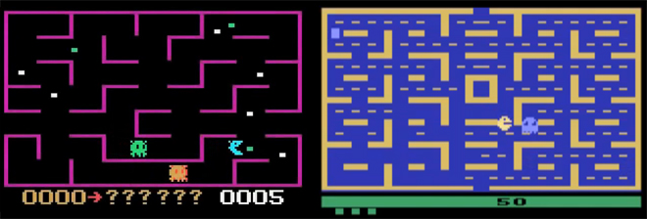
K.C. Munchkin & Pac-Man
Pac-Man won on appeal

Slide 58
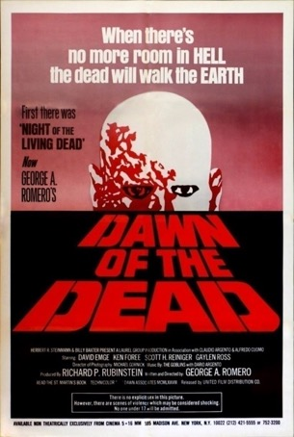

Dawn of the Dead & Dead Rising
Dead-rising wins declaratory judgment

Slide 59
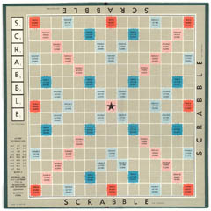
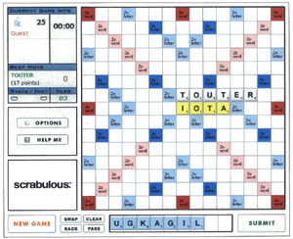
Scrabble & Scrabulous
Changed name to “Lexulous” as part of settlement .
Delhi High Court found “game” couldn’t be copyrighted

Slide 60
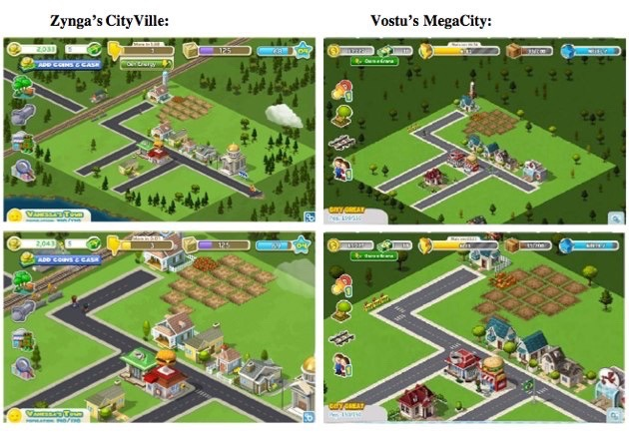
Cityville v. MegaCity
Settled with Vostu making changes to it’s
games and paying some $ to Zynga

Slide 61
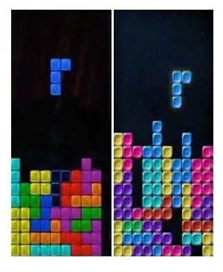
Tetris & Mino
Tetris wins case in Summary Judgment

Slide 62

Triple Town & Yeti Town
Court denied 6Waves (Yeti Town) motion to dismiss Spry Fox’s (Triple Town) infringement claim and case settled with transfer of Yeti Town’s copyright to Spry Fox.

Slide 63
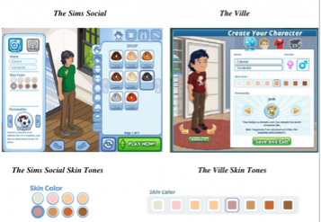
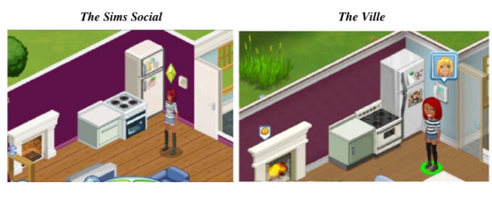
Sims Social & The Ville
EA sued Zynga. Settled. Both games
shut down almost simultaneously.

Slide 64
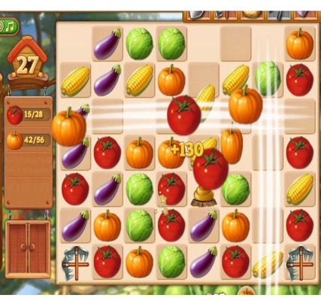
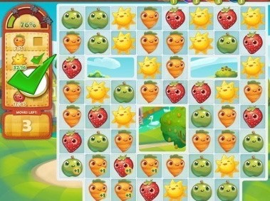
Farm Heroes Saga & Farm Epic
Farm Epic removed by 6Waves as part of settlement with King.

Slide 65
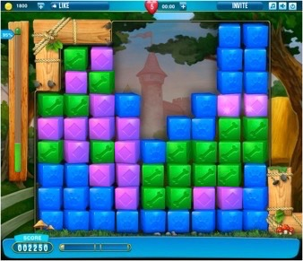
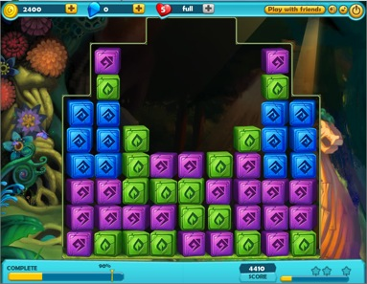
Pet Rescue Saga & Treasure Epic
Treasure Epic removed by 6Waves as part of same settlement with King.

Slide 66
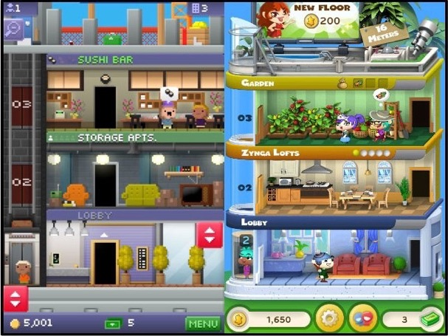
Tiny Tower & Dream Heights
Nimblebit (Tiny Tower) shames Zynga (Dream Heights)

Slide 67
STEP 6
Trademark

Slide 68







Blingville & Zynga
???

Slide 69

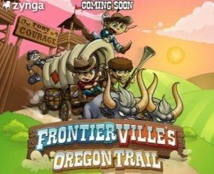
The Learning Co. & Zynga
Zynga renames its game “Pioneer Trail”

Slide 70
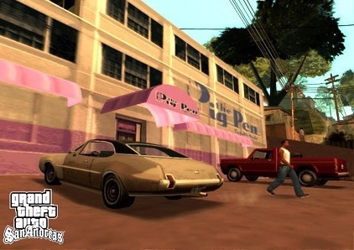
ESS Entertainment & Rock Star
The Play Pen & The Pig Pen
Defendant Rock Star (Pig Pen) WINS

Slide 71
STEP 7
Personality Rights

Slide 72
Personality Rights:
PRIVACY ACT [RSBC 1996]
Unauthorized use of name or portrait of another
3. (2) It is a tort, actionable without proof of damage, for a person to use the name or portrait of another for the purpose of advertising or promoting the sale of, or other trading in, property or services, unless that other, or a person entitled to consent on his or her behalf, consents to the use for that purpose.
Action does not survive death
5. An action or right of action for a violation of privacy or for the unauthorized use of the name or portrait of another for the purposes stated in this Act is extinguished by the death of the person whose privacy is alleged to have been violated or whose name or portrait is alleged to have been used without authority.

Slide 73
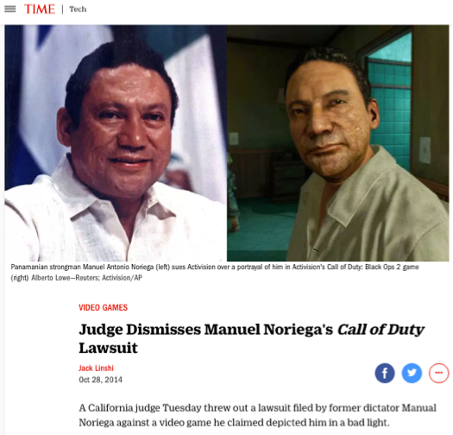
Noriega v. Call of Duty

Slide 74

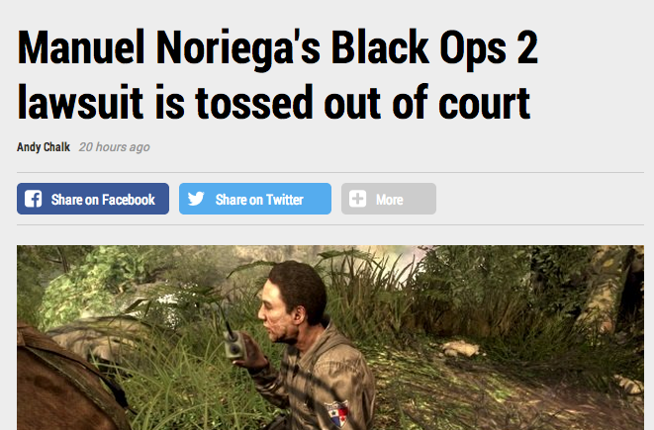

Slide 75
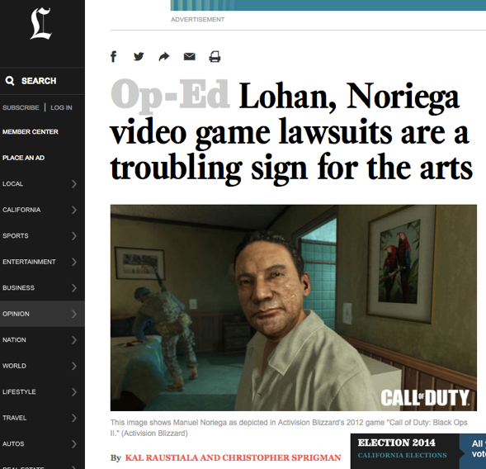
http://www.latimes.com/opinion/op-ed/la-oe-raustiala-video-games-lohan-noriega-20141031-story.html

Slide 76

Karen Gravano v. GTA V
Gravano loses 9.1.16

Slide 77

Lindsay Lohan v. GTA V
Lohan loses in same decision 9.1.16

Slide 78
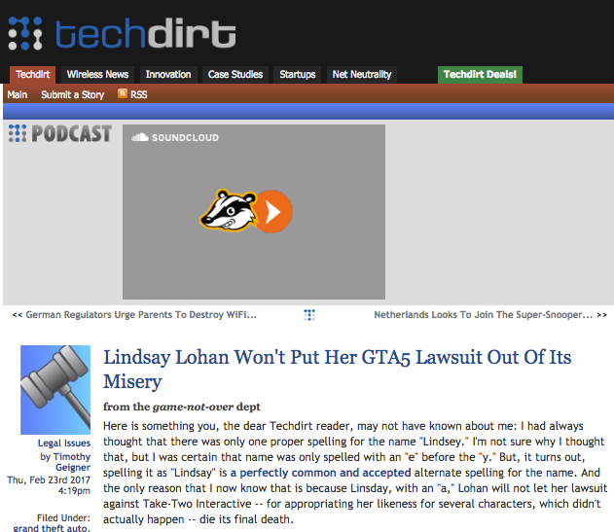
But…

Slide 79


Lady Miss Kier v. Space Channel 5
SEGA (Space Channel) 5 WINS

Slide 80
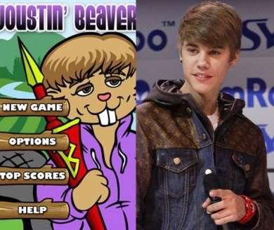
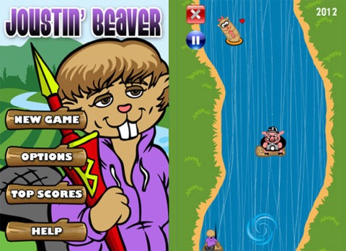
Justin Bieber v. ‘Joustin Beaver’
??? – Who cares

Slide 81
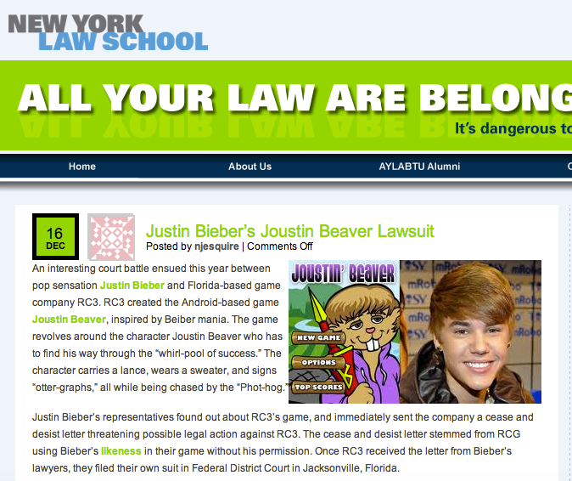
???
http://www.allyourlawarebelongtous.com/justin-biebers-joustin-beaver-lawsuit/

Slide 82

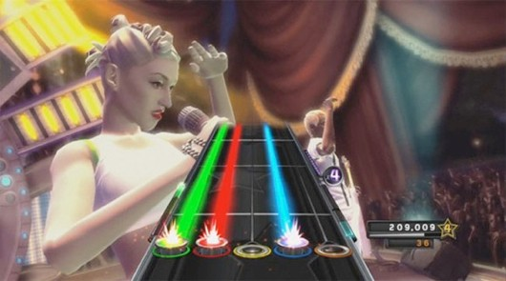
No Doubt v. Activision Publishing, Inc.
(No Doubt & Band Hero)
SETTLED

Slide 83
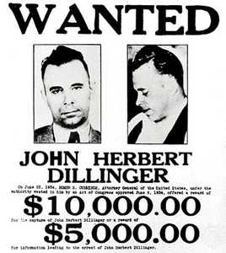

Dillinger v. Electronic Arts
John Dillinger & “Dillinger Tommy Gun”

Slide 84

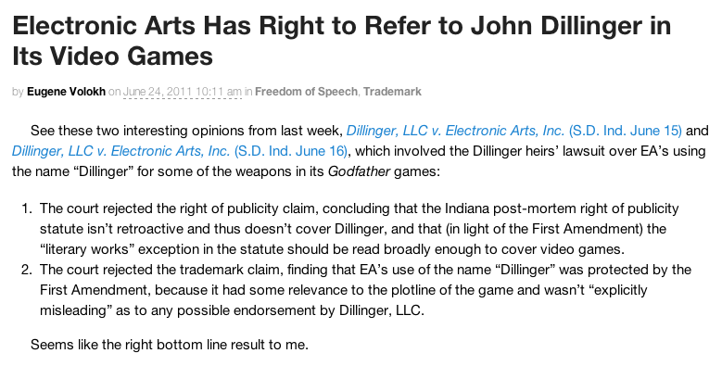
http://volokh.com/2011/06/24/electronic-arts-prevails-over-dillinger-heirs/

Slide 85
STEP 8
Patent Rights

Slide 86
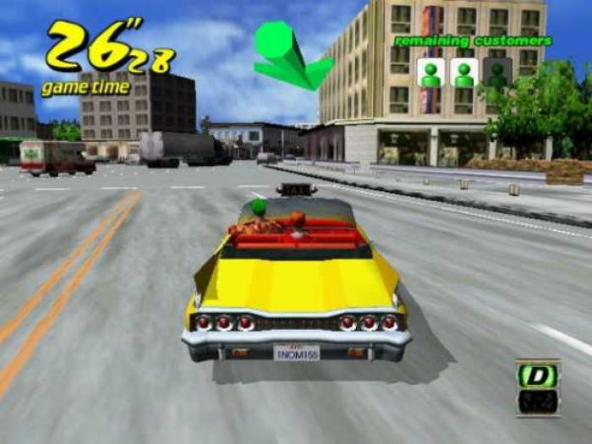

Crazy Taxi v. Simpsons Road Rage
SETTLED

Slide 87


Golden Tee v. PGA Tour Golf
Defendant PGA Tour Golf WINS

Slide 88
STEP 9
What do YOU think?

Slide 89
& just to confuse your
feelings...

Slide 90
don’t forget
FREEDOM TO
MOD/
CREAtE ?

Slide 91
Some Other Original-ism cases
* “IGT v. Alliance Gaming Corp” (wheel of Fortune http://www.bakerlaw.com/alerts/patent-watch-igt-v-alliance-gaming-corp-12-20-2012/
* “Washington v. Take-two Interactive Software, Inc., et al.” (misappropriation of likeness in GTA) http://www.loeb.com/news/CaseList.aspx?Type=ip&case=1907
* “GSC Game World Claims Ownership of S.T.A.L.K.E.R. Game Rights”http://gamepolitics.com/2012/12/13/gsc-game-world-claims-ownership-stalker-game-rights#.UTb246XR2kU
* “SEGA Takes Legal Action Against Level-5 Over Nintendo DS Patent Dispute”http://www.nintendolife.com/news/2012/12/sega_takes_legal_action_against_level_5_over_nintendo_ds_patent_dispute
* “Court Tackles Copyright Issue of "Throwback" NFL Uniforms in Video Games” http://www.manatt.com/SportsLaw/Court_Tackles_Copyright_Issue_of_Throwback_NFL_Uniforms_in_Video_Games.aspx
* “Tweeria Struggles With Copyright Problems”http://www.gamepolitics.com/2012/12/27/tweeria-struggles-copyright-problems#.UTb6UaXR2kU
* “Tetricide” http://uttresl.wordpress.com/2013/02/01/tetricide-2/
* “Wizards of the Coast Sued for Magic: The Gathering Online Patent Infringement Claims”http://gamepolitics.com/2012/11/02/wizards-coast-sued-magic-gathering-online-patent-infringement-claims#.UTb8KKXR2kU
* “Scrabble 3D tile held to be invalid by High Court - JW Spear & Sons Ltd and Mattel Inc v Zynga” http://www.lexology.com/library/detail.aspx?g=c918285f-f721-4a1a-8b70-80dce5b422ba
* “British games company says it owns the idea of space marines”http://www.theregister.co.uk/2013/02/07/games_workshop_in_spurious_space_marines_claim/
* “Infringing World of Warcraft theme park built in China”http://the1709blog.blogspot.ca/2013/01/infringing-world-of-warcraft-theme-park.html
* “Tolkien estate unleashes legal Uruk-hai on LoTR online slot machines”
http://arstechnica.com/tech-policy/2012/11/tolkien-estate-unleashes-legal-uruk-hai-on-lotr-online-slot-machines/
* “Keller v. EA: visual elements mean game isn’t protected by First Amendment”
http://tushnet.blogspot.ca/2013/08/keller-v-ea-visual-elements-mean-game.html
* ”The First Amendment in play: Brown v. EAhttp://tushnet.blogspot.ca/2013/08/the-first-amendment-in-play-brown-v-ea.html

Slide 92


Assaults on Videogames
Assaults by Videogames
REMIXING VIOLENCE, MISOGYNY
& CIVIL SOCIETY

Slide 93
Intro: “Secrets” of contractual immunity
* Overall video game population is
about one third kids
ESA Game Player Data: “Sixty-eight percent of gamers are 18 years of age or older” http://www.theesa.com/facts/gameplayer.asp
See also “2012 Sales, Demographic and Usage Data”
http://www.theesa.com/facts/pdfs/ESA_EF_2012.pdf
“91 percent of kids are gamers, research says” (also kids responsible for 44% of physical software sales)http://news.cnet.com/8301-13506_3-20118481-17/91-percent-of-kids-are-gamers-research-says/

Slide 94

Industry Complicity? 1
EULA’s & ToS generally do not even mention
underage use
Avoiding the issue?
Not wanting to scare anyone off?
Confirming ineffectualness?
Looking the other way?
Confirming double standard?
"We consider it a good principle to explain the phenomena by the simplest hypothesis possible.” Ptolemy

Slide 95

Industry Complicity? 2
“And here's another dirty little truth that the media try their best to conceal: There exists in this country a callous, corrupt and corrupting shadow industry that sells, and sows, violence against its own people…Through vicious, violent video games with names like Bulletstorm, Grand Theft Auto, Mortal Kombat and Splatterhouse. And here’s one: it’s called Kindergarten Killers. It’s been online for 10 years…” --- Wayne LaPierre NRA --- http://home.nra.org/pdf/Transcript_PDF.pdf
(Bulletstorm=sci-fi; Grand Theft Auto=crime; Mortal Kombat=fantasy; Splatterhouse=horror; Kindergarten Killers=“flash”)
WHAT’S MISSING?... CALL of DUTY; BATTLEFIELD; America’s Army…
* “Shooters: How Video Games Fund Arms Manufacturers” - Simon Parkin http://www.eurogamer.net/articles/2013-02-01-shooters-how-video-games-fund-arms-manufacturers
* “EA removes links to gun sellers on ‘Medal of Honor’ page”
http://www.theverge.com/2012/12/27/3807900/ea-removes-links-to-gun-sellers-on-medal-of-honor-page
Double Standards Test?
-------------------------------------
See also: “Invading Your Hearts and Minds”:
Call of Duty and the (Re)Writing of Militarism
In U.S. Digital Games And Popular Culture” (2010)
http://ejas.revues.org/8831

Slide 96

Industry Complicity? 3
Industry maturity issue?
Actual maturity issue (young geeky
Males trying to be cool)?
Counter-culture roots become trendy
poseur rebellion ?
The “Grand Theft Auto San Andreas/Hot
Coffee” saga
* “Debate intensifies over Hot Coffee sex in GTA” (Gamespot June 2005) http://www.gamespot.com/news/debate-intensifies-over-hot-coffee-sex-in-gta-6128837
* “Hot Coffee controversy grows as Hilary Clinton weighs in” (Gamesindustry International July 14, 2005)http://www.gamesindustry.biz/articles/hot-coffee-controversy-grows-as-hilary-clinton-weighs-in
* “ESRB concludes investigation into Grand Theft Auto: San Andreas; Revokes M (Mature) Rating” http://www.esrb.org/about/news/7202005.jsp
* “BREAKING: RB Recalls San Andreas” (Kotaku July 2005) http://kotaku.com/113506/breaking-esrb-recalls-san-andreas

Slide 97


Industry Complicity? (3 – GTA continued)
“Who spilled Hot Coffee? The man who uncovered gaming's greatest sex scandal” http://www.eurogamer.net/articles/2012-11-30-who-spilled-hot-coffee
“Federal Trade Commission Complaint against Take-Two & Rockstar Games” (July 17, 2006) http://www.ftc.gov/os/caselist/0523158/0523158c4162TakeTwoInteractiveandRockstarComplaint.pdf
Settled June 8, 2006 http://www.ftc.gov/opa/2006/06/grandtheftauto.shtm
To “corporatize” - solution or greater problem?

Slide 98

Industry Complicity? 4
Not a separate issue from industry misogyny…
Very much the same issue of immaturities & insecurities
* “Every Misogynistic Argument You’ve
Ever Heard About Video Games” http://groupthink.jezebel.com/every-misogynistic-argument-youve-ever-heard-about-vid-756662565
* “Quit – Going To PAX Already, What is
Wrong With You” (re Penny Arcade principal)
http://elizabethsampat.com/quit-fucking-going-to-pax-already-what-is-wrong-with-you/

Slide 99

Who is a Gamer (part 1) ?

Slide 100



http://www.pcgamer.com/researchers-find-that-female-pc-gamers-outnumber-males/

Slide 101


52% Women/48% Men

Slide 102
The question of gamer identity/gender appears as a “trigger” ?

Slide 103
You can think…
“Get over it/get over yourself, the world has changed.”
But maybe look at the research and think again…

Slide 104

“Trolls” are likely vulnerable members of society

Slide 105


Slide 106

https://www.washingtonpost.com/news/the-intersect/wp/2015/07/20/men-who-harass-women-online-are-quite-literally-losers-new-study-finds/

Slide 107


Slide 108

We have arrived…#gamergate
http://www.gamesindustry.biz/articles/2014-11-03-wu-offers-usd11k-for-harassment-conviction

Slide 109

http://www.theverge.com/2014/10/14/6978809/utah-state-university-receives-shooting-threat-for-anita-sarkeesian-visit

Slide 110

http://www.vox.com/2014/9/6/6111065/gamergate-explained-everybody-fighting

Slide 111


http://www.newsweek.com/gamergate-about-media-ethics-or-harassing-women-harassment-data-show-279736

Slide 112

https://newrepublic.com/article/122785/gamergate-culture-war-people-who-dont-play-videogames

Slide 113

Most disturbing of all?

Slide 114

http://arstechnica.com/gaming/2014/09/new-chat-logs-show-how-4chan-users-pushed-gamergate-into-the-national-spotlight/

Slide 115

Self Identifying is a Right
– isn’t it?
* Many (most/all??) women playing hardcore (FPS) games pretend not to be.
* “The most desirable thing in the world is freedom to be true to oneself, i.e., Honesty”, Susan Sontag (at 14 years old)
*Lets not pretend this is a choice.

Slide 116
So why no legal actions?
Four possible roads (aside from provincial human rights complaints):
Might ISP’s (telco’s/cableco’s) be seen as performing a government function in transmitting information which contravenes S. 15(1) of the Charter (Equality rights)? (Hospital analogy)
Direct attack constitutionally through s. 7 or s. 36 of the Telecommunications Act (S.C. 1993, c. 38)
Civil action through s. 72 of the Telecommunications Act (S.C. 1993, c. 38)
Reinterpretation of the definition of “broadcasting” = Regulatory Process

Slide 117
General Charter & Telecom Act Provisions
CANADIAN CHARTER OF RIGHTS AND FREEDOMS
15. (1) Every individual is equal before and under the law and has the right to the equal protection and equal benefit of the law without discrimination and, in particular, without discrimination based on…sex…
TELECOMMUNICATIONS ACT
7. It is hereby affirmed that telecommunications performs an essential role in the maintenance of Canada’s identity and sovereignty and that the Canadian telecommunications policy has as its objectives
(a) to facilitate the orderly development throughout Canada of a telecommunications system that serves to safeguard, enrich and strengthen the social and economic fabric of Canada and its regions;
(h) to respond to the economic and social requirements of users of telecommunications services; and
(i) to contribute to the protection of the privacy of persons.

Slide 118
Specific Telecom Act Provisions
36. Except where the Commission approves otherwise, a Canadian carrier shall not control the content or influence the meaning or purpose of telecommunications carried by it for the public.
72. (1) Subject to any limitation of liability imposed in accordance with this or any other Act, a person who has sustained loss or damage as a result of any act or omission that is contrary to this Act or any special Act or a decision or regulation made under either of them may, in a court of competent jurisdiction, sue for and recover an amount equal to the loss or damage from any person who engaged in, directed, authorized, consented to or participated in the act or omission.

Slide 119
Is multiplayer gaming “broadcasting”?
Broadcasting Act:
“broadcasting” means any transmission of programs…by…means of telecommunication for reception by the public by means of broadcasting receiving apparatus…
“program” means sounds or visual images, or a combination of sounds and visual images, that are intended to inform, enlighten or entertain…
(Notes: 1. CRTC exemption order; & 2. SCC has held ISP’s are not broadcasting. Is W.O.W. an ISP or something else? See SCC in Rogers v. SOCAN – streaming on demand = communication to the public)

Slide 120
Conclusions
Several options under the Telecom Act & the Broadcast Act.
Argument that if at least "some" steps to prevent discriminatory abuse are not taken the Act is breached. Act has to be read in light of the Charter. Query if steps are being taken by the carriers?

Slide 121
Raising the question: Should the idea of the Magic Circle…
EVEN SURVIVE?

Slide 122

Remember
The “Magic Circle” acts (in theory) as a fence keeping out real world laws

Slide 123

The “Magic Circle”
“All play moves and has its being within a play-ground marked off beforehand either materially or ideally, deliberately or as a matter of course. Just as there is no formal difference between play and ritual, so the ‘consecrated spot’ cannot be formally distinguished from the play-ground. The arena, the card-table, the magic circle, the temple, the stage, the screen, the tennis court, the court of justice, etc. are all in form and function play-grounds, i.e. forbidden spots, isolated, hedged round, hallowed, within which special rules obtain. All are temporary worlds within the ordinary world, dedicated to the performance of an act apart.”
Johan Huizinga (1872-1945) in “Homo Ludens: A Study of the Play-Element in Culture”. Applied to video games by Katie Salen & Eric Zimmerman in “Rules of Play: Game Design Fundamentals” (2003)

Slide 124
The “Magic Circle” exposed
“As stated previously, players never play a new game or fail to bring outside knowledge about games and gameplay into their gaming situations. The event is ‘‘tainted’’ perhaps by prior knowledge. There is no innocent gaming…Players also have real lives, with real commitments, expectations, hopes, and desires. That is also brought into the game world, here Azeroth. We can neither ignore such realities nor retreat to structuralist definitions of what makes or defines a game. Games are created through the act of gameplay, which is contingent on acts by players.”
“There is No Magic Circle” - Mia Consalvo (2009)http://www.academia.edu/654444/There_is_no_magic_circle

Slide 125
Violent Games, Liability & Regulation: Cases
Watters v. TSR (D&D) 1990 USCA
James v. Meow (Heath High, Kentucky) 2002 USCA
Sanders v. Acclaim (Columbine) 2002 US Dist.
Wilson v. Midway (Mortal Kombat) 2002 US Dist.
----------------------------------------------------------
American Amusement v. Kendrick 2001 USCA
(protecting minors)
IDSA v. St. Louis 2003 USCA (protecting minors)
VSDA v. Maleng 2004 US Dist. (regulate games
depicting violence against law enforcement)
ESA v. Blagojevich 2006 USCA (protecting minors)
EMA v. Henry 2007 US Dist. (protecting minors)
ESA v. Swanson 2008 USCA (purchase contrary to
“rating”)
ESA v. Chicago Transit 2010 US Dist. (restricted
“M” game ads on CTA vehicles)
ESA v. Schwarzenegger 2011 SCOTUS (prohibited violent
video games) - Class 12 upcoming

Slide 126
Violent Games, Liability & Regulation: Rationales
Proximate cause (civil) not demonstrated - not
foreseeable - studies ambiguous re “actual harm”
Products liability claims inapplicable
Duty to exercise ordinary care
-----------------------------------------------------
Link of violent games to violence unproven – causality not demonstrated; correlation not cause
Thought control = totalitarianism = family
responsibility
Drafting not narrowly tailored to objective
Vague & ambiguous definitions/provisions
Classic literature/film, Bible, fairy-tale
comparisons

Slide 127
Start with…The Painful Truth
Watters v. TSR, Inc., 904 F. 2d 378 - Court of Appeals, 6th Circuit 1990 (Dungeons & Dragons):
“But if Johnny's suicide was not foreseeable to his own mother, there is no reason to suppose that it was foreseeable to defendant TSR…
…The fact is, unfortunately, that youth is not always proof against the strange waves of despair and hopelessness that sometimes sweep seemingly normal people to suicide, and we have no way of knowing that Johnny would not have committed suicide if he had not played Dungeons & Dragons…
…As far as the record discloses, no one had any reason to know that Johnny Burnett was going to take his own life. We cannot tell why he did so or what his mental state was at the time. His death surely was not the fault of his mother, or his school, or his friends, or the manufacturer of the game he and his friends so loved to play. Tragedies such as this simply defy rational explanation, and courts should not pretend otherwise.”

Slide 128



What’s Your Take?
“Gamers committing war crimes should suffer ‘virtual consequences,’ says Red Cross”
http://www.theverge.com/2013/10/8/4815090/gamers-committing-war-crimes-should-suffer-virtual-consequences-says

Slide 129



Perspective when analyzing…
“Those who cannot remember history are doomed to repeat it”
- George Santayana
So start with the “507 patent”
No, not that 507…..
…“U.S. Reissue Patent No. 28507”
Our tale begins with Magnavox v. Mattel 1982 U.S. Dist. LEXIS 13773 (N.D. Ill.)

Slide 130

The Magnavox “apparatus”…
“The apparatus generated a display on the screen comprising a television picture including a symbol on the right side of the screen representing a first player, a symbol on the left side of the screen representing a second player, and a symbol which moved across the screen representing a ball. Player controls were provided so that each human player could move his corresponding player symbol on the face of the television screen. Each human player manipulated his corresponding player symbol to intercept the path of the ball as it moved across the screen. When the player symbol intercepted the ball symbol, i.e., two symbols appeared to be coincident on the screen, the motion of the ball was changed.”
Sounds like…??

Slide 131
Chronology
1962: Spacewar! released on DEC PDP-1 mainframe @ MIT
...’507 from experiments done by Rusch, employee of Sanders Associates in 1967/68
1971: Sanders & Magnavox enter into exclusive license
1972: Magnavox Odyssey introduced (analog circuitry)
1975: Atari introduces Pong game console for home use (analog)
1976 General Instruments introduces TV game microprocessor (digital circuitry)
Magnavox sues Atari for patent violation & infringing concept of electronic ping pong (settled by Atari becoming Magnavox exclusive licensee)
1978 Magnavox Odyssey 2 has a microprocessor (digital)
1979 Mattel introduces Intellivision with General Instruments microprocessor (digital). Magnavox sues Mattel.

Slide 132

Court decided…
* No distinction between analog and digital:
“I regard analog and digital circuitry as two means which are interchangeable largely, which are equivalent, and which are, therefore, essentially the same means for achieving substantially the same results in substantially the same way.”
So far, so good…

Slide 133

But…OOPS!

Slide 134
Creation of a meaningless
Computer Game/TV Console Divide
* Mattel argued its console was not based on ’507 but on computer prior art, Space War!
* Court noted PDP-1 was 6’ tall by 7’ wide, & cost approximately $120K. Court found for Magnavox: “…it is clear from the evidence that Mattel did not in fact follow the prior art but, instead, followed developments in the television game industry, an industry which was created because of the work done at Sanders in developing the first television games and an industry which expanded and developed and become economically viable largely because of television games which followed the teachings of the ’507 Patent.”

Slide 135
The Importance of Perspective
Consequences of legal bifurcation of
Computer Games & Console Games
“Those who cannot remember history
are doomed to repeat it”
Television Console Computer Mobile

Slide 136


Slide 137


Truth in ‘tone’…it’s about mod-maker & reader as creator
Audio of the June 20, 2005 oral argument in 8th Circuit Court of Appeal in Blizzard v. BnetD (Davidson) @ 32:40 – 33:05: “This case does not involve new creation. There may be a case that does. This isn’t it…”
ABOUT MOD_MAKER AS CREATOR
Audio of the November 2, 2010 oral argument in the U.S. Supreme Court in Brown v. Entertainment Merchants Association @ 1:13 - 7:20 + 11:25 - 14:04: “What’s a deviant violent video game?...Some of the Grimm’s Fairy Tales are quite grim…”
ABOUT THE READER AS CREATOR

Slide 138

CONCLUSION
EVERYTHING IS A VIDEO-GAME:
GAMES ARE AND REMAIN AT THE
CUTTING EDGE CROSS-ROADS OF
FREEDOM OF SPEECH/
EXPRESSION, COPYRIGHT/IP &
CONTRACTS. NO LENS FOR THE
LAW IS CLEARER OR LESS
FORGIVING BECAUSE VIDEO
GAMES IMPLICATE CREATIVITY,
INTERACTIVITY & CUTTING EDGE
TECHNOLOGY LIKE NOTHING ELSE
DOES.

Slide 139


How we are conscious &
how we (video) game
appear to be
profoundly aligned.

Slide 140
Accordingly…
It is not too much to ask that law also align with the already aligned realities of:
human consciousness;
(video) game design; &
community interactions

Slide 141

From the beginning of the course:
Pedagogic Goals
One word: ENGAGEMENT
Two words: CREATING PERSPECTIVE
Three words: APPRECIATING (LEGAL) COMPLEXITY
Eve Online

Slide 142

Finis
“I have learned much from my teachers, more from my peers, but from my students most of all” (Ta'anit 7a)
THANK YOU…

Slide 143

Always include a cat picture

Slide 144
Our Academic Partners

