Slide 1


“If Picasso had painted a round object..”
Talk 2
Part A “Creating”
Video Game Law - Fall 2018
Allard School of Law, UBC
Jon Festinger Q.C.
Centre for Digital Media
Allard Law of Law, UBC
QMUL School of Law (CCLS)
Festinger Law & Strategy
http://videogamelaw.allard.ubc.ca/
Twitter: @jonfestinger
jon_festinger@thecdm.ca

Slide 2

Another Wonderful Wednesday

Slide 3
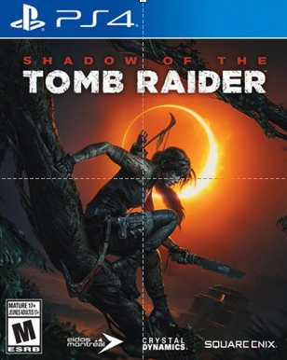
Shadow of the Tomb Raider Release

Slide 4
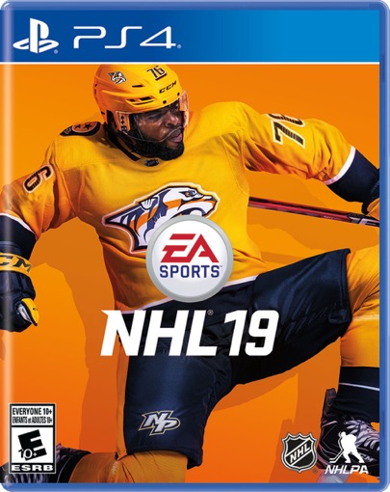
Bonus Release (also 9.14.18)

Slide 5


Slide 6
Logistics

Slide 7
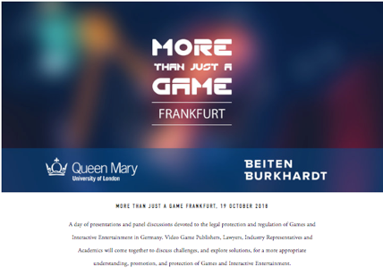
No class
NEXT Wednesday September 19
Wednesday October 17 should be OK

Slide 8
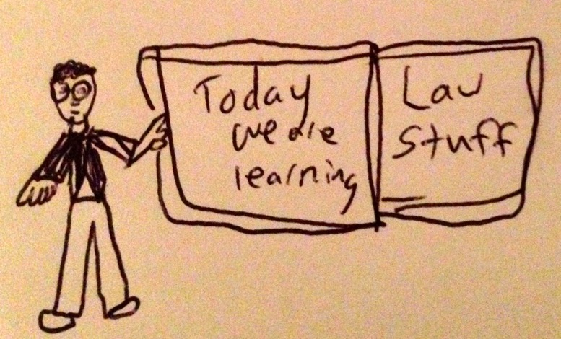

Slide 9
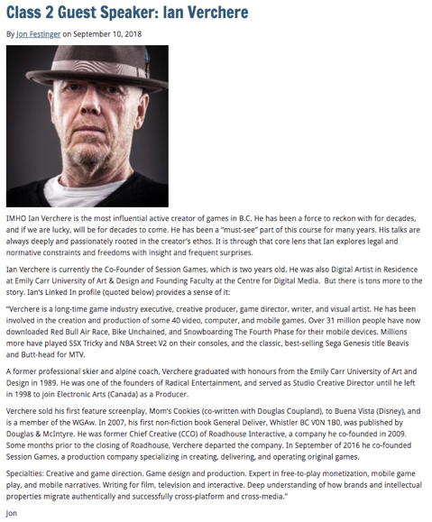

Slide 10
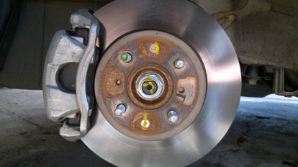
Breaks
15 minutes at 10:45 (hopefully)
End at 12:15 (hopefully)

Slide 11
http://videogame.law.ubc.ca

Slide 12
For full privileges on the website
1. Please create an account at http://cms.ubc.ca/ using your CWL.
2. Once you create an account and sign in at http://cms.ubc.ca/ you can click your name in the top right. Half way down the following page will be your WordPress email address.
3. Send me your WordPress email address at jfestinger@telus.net or at jon@fblawstrategy.com
4. Then, I will invite you to participate with authoring privileges via your WordPress email address.

Slide 13

How do you know if you are on?

Slide 14

Website & Badge issues…

Slide 15
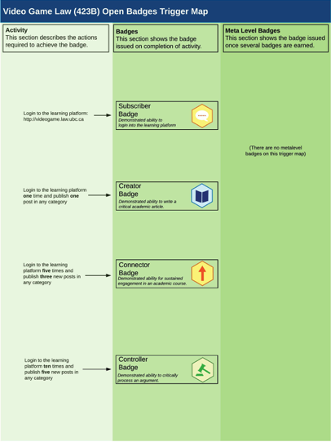

Slide 16
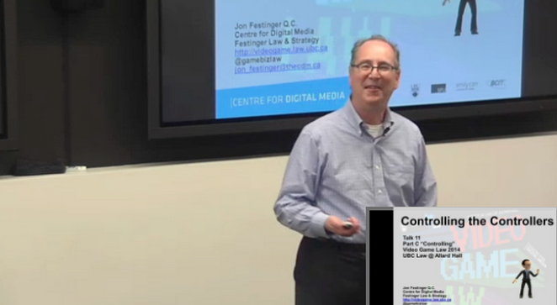
Lecture Capture
Because maybe CPD credits student images, names or voices will be edited out if possible.

Slide 17
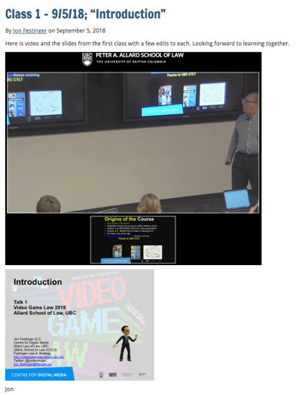
Video up

Slide 18
COMING
SOON

Slide 19
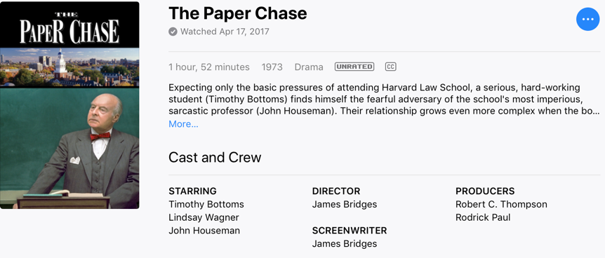
Embedded Self Socratic A.I.(ish)
Up next week we hope – will post

Slide 20
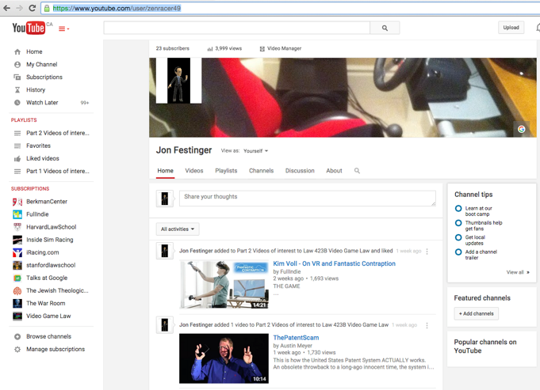
Two more things on resources…
https://www.youtube.com/user/zenracer49

Slide 21


Slide 22
Evaluation
A. Participation = 25% includes any or all of:
attendance;
class, website, forum contributions;
following “Journey” and/or “Self-Socratic” protocols.
B. Group presentation during “Discussion Hour” = 25%. This will be based on group preparation of a Discussion Outline that must be created and handed out to the class—preferably by posting on the course website—at least five days before your particular discussion takes place, and leading the discussion for that week.
C. Term Paper/Major Project (18 to 20 pages or equivalent – 5000 words – any font but comic sans) = 50%.

Slide 23
Evaluation Tips
Term paper topics need not be discussed with me, but often helpful to you if you do.
Term paper can be on your presentation topic.
Participation: In-class or other contributions, including attendance.
Group presentation need not be on that week’s topic (20 minute per student multiplier suggested 2-4 per group to 60 minute max).
You can bring in guests.

Slide 24
Paper Confessional
Legal/normative reasoning/argument including footnote/bibliography support & Contribution/Move forward → 60%
Presentation including layout, headings, grammar, language/writing skills, “tightness” → 25%
Topic/Originality/Degree of Difficultly → 15%
THIS IS NOT A RUBRIC. IT IS A SELF ASSESSMENT.

Slide 25
Grades (primarily)
Paper → Quality
Participation → Effort

Slide 26
Presentation Groups?

Slide 27
Group Presentations
2 - 4 (ideally) per group
Marked individually or as a group? Yes.
Sign-up at breaks or email me
Any topic – not constrained by what I’m talking about that week
Consult with me re the topic you want to take on
Post one thing you want us to read or watch

Slide 28
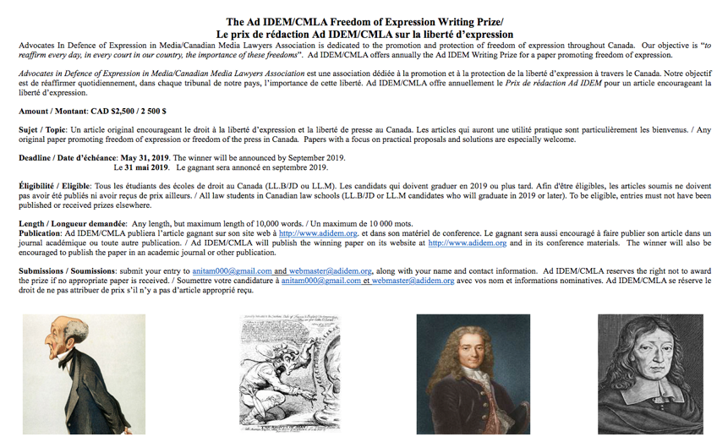

Slide 29


Slide 30
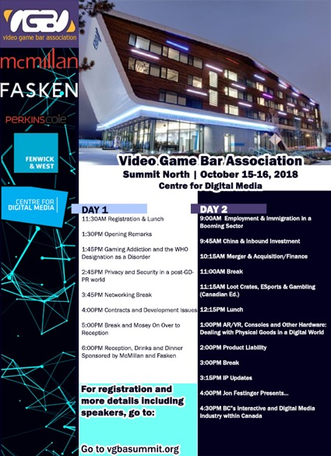
FREE
TICKETS

Slide 31
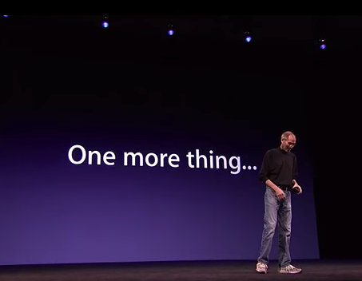

Slide 32
Don’t you think
you better
TELL THEM!!!!
So I forgot about
class size…

Slide 33
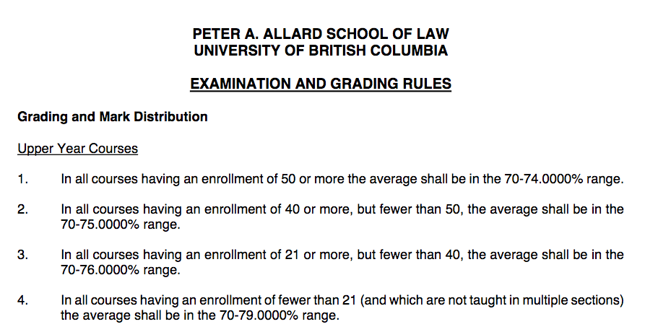

Slide 34


Surprise???
→

Slide 35

Now Back to Our Regularly Scheduled Programming…

Slide 36
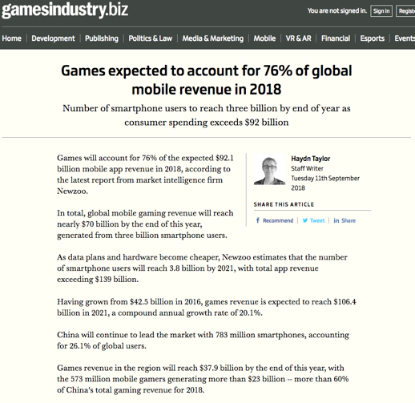
News of the Week

Slide 37


Slide 38
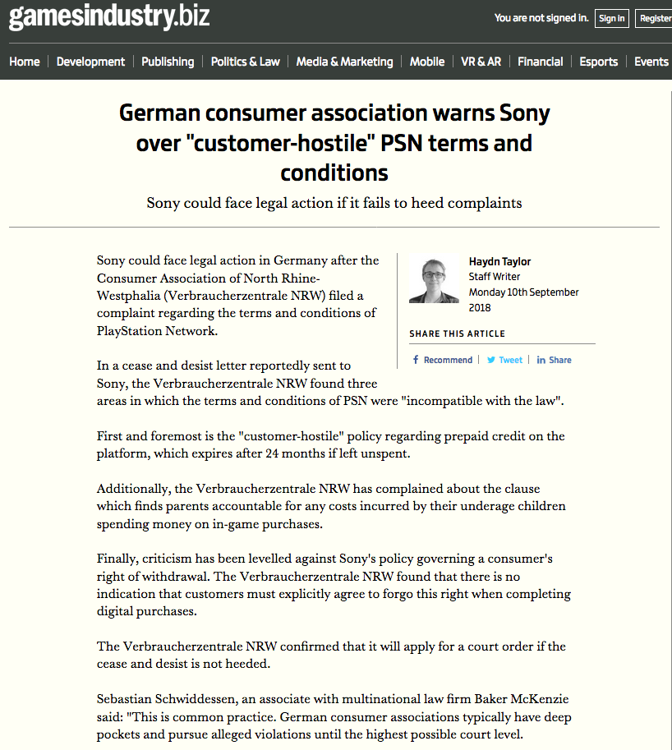

Slide 39
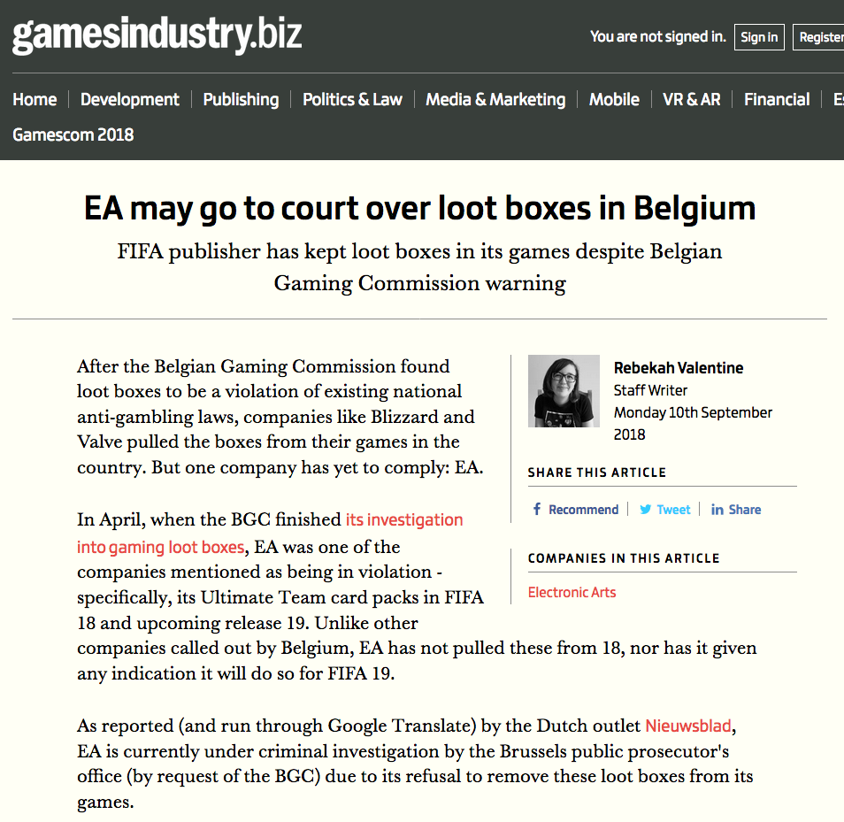

Slide 40
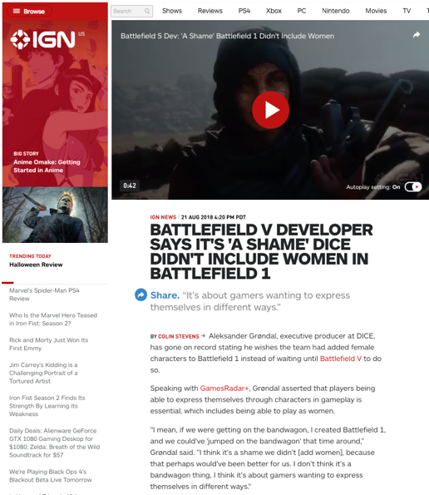

Slide 41
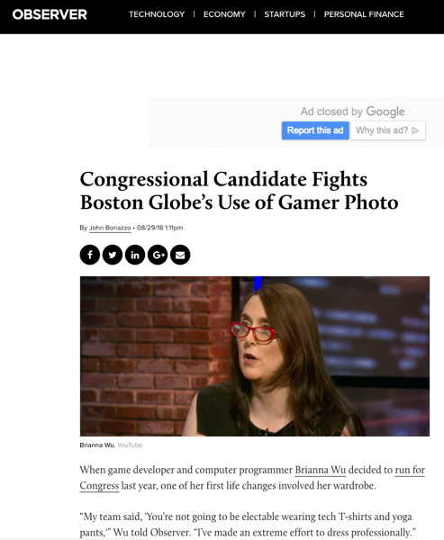

Slide 42
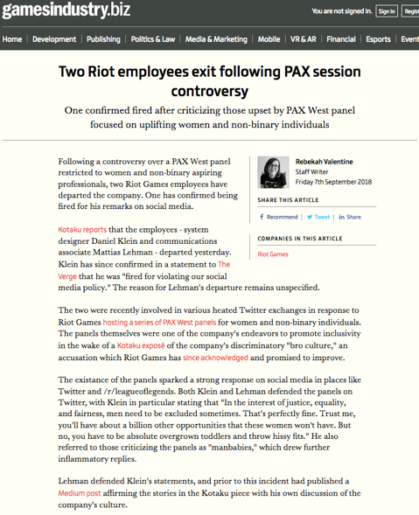

Slide 43
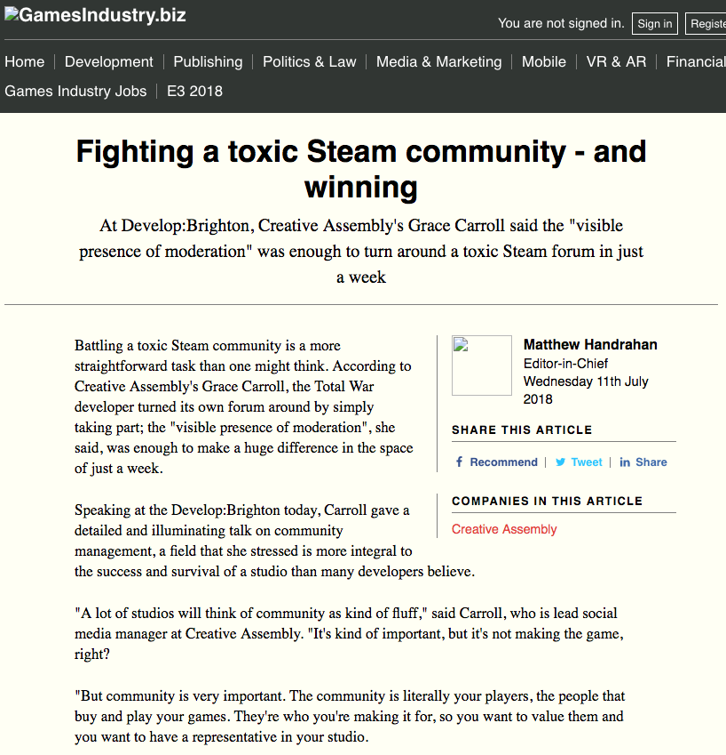

Slide 44
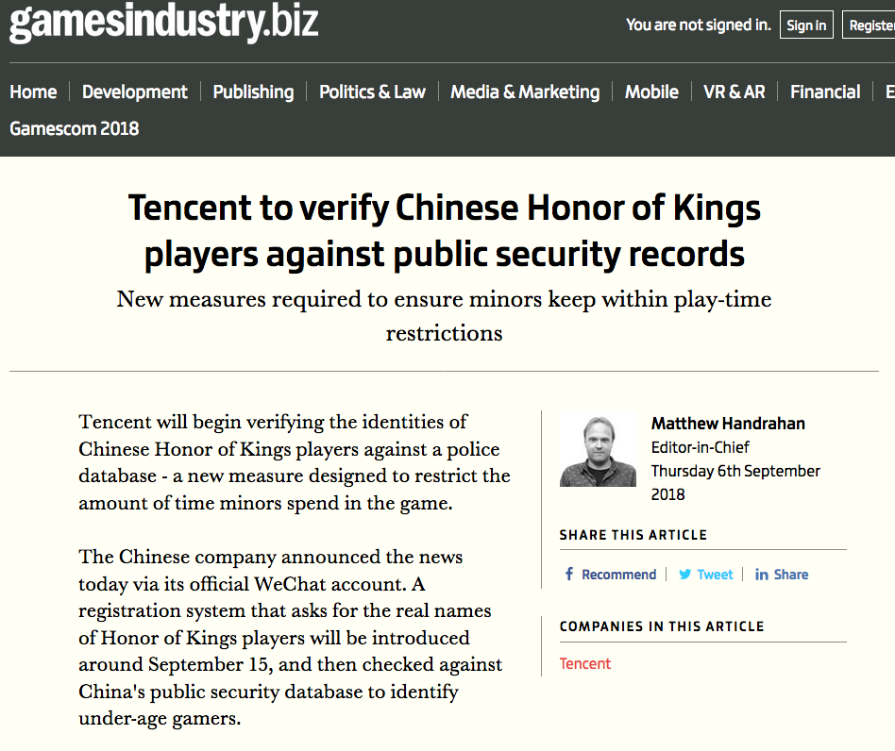

Slide 45
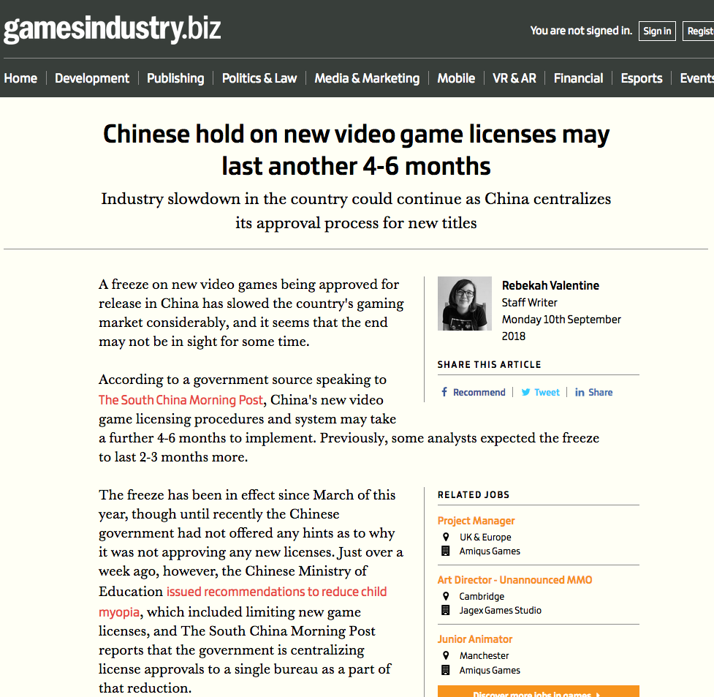

Slide 46
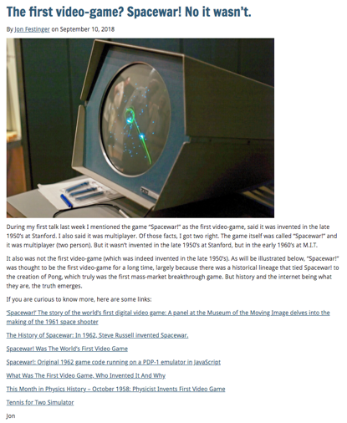
Follow-up to last week 1

Slide 47
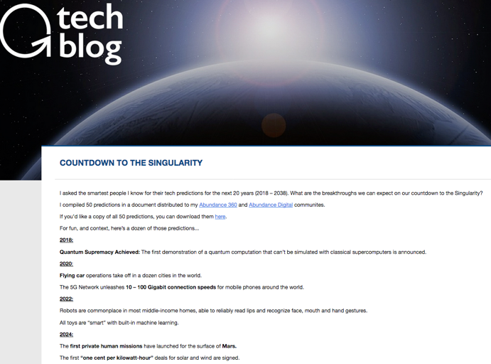
Follow-up to last week 2

Slide 48
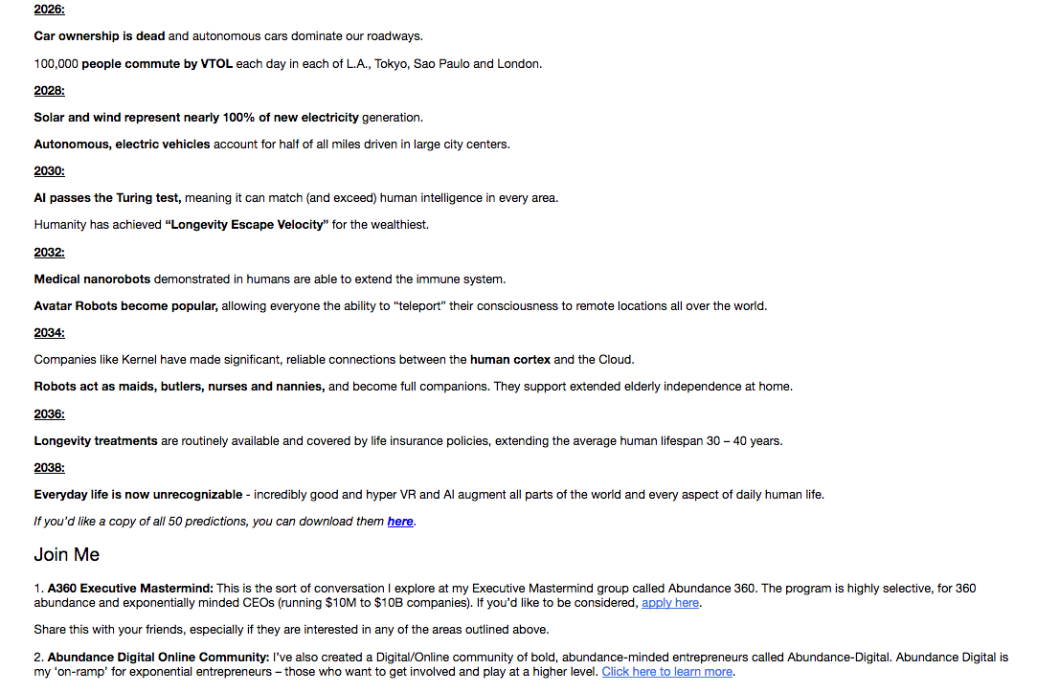

Slide 49
Follow-up to last week 3:
Why do we game?
A. Social reaction (McLuhan);
B. Social learning interaction (Panksepp);
C. To be in touch with our instinctive self (Jung);
D. As part of Evolution (Darwin, Voll).

Slide 50
Most significant legal implications are from which of the above?
NOTE BAIT & SWITCH
Not “Why do we game?”

Slide 51
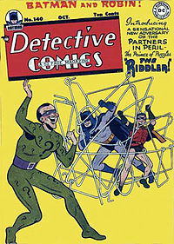
Answer:
A. Social reaction (McLuhan)
Why?
That is the rest of the course

Slide 52
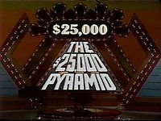
Think…Social Reaction +…
Violence in games
Misogyny in games and in the games industry
Privacy & Surveillance
Contract validity (End User License Agreement click-wrap)
AND YES…
EVEN COPYRIGHT
But how?…remember the riddle…

Slide 53

Last Weeks Riddle:
Games are not IP;
Video Games are IP;
Explain?:….
Last Week’s Question:
“Why Games?”
To answer the riddle (& perhaps more) we must ask
WHAT IS A GAME (in IP terms)?
“Games and Other Uncopyrightable Systems” Bruce Boyden (2011) http://www.georgemasonlawreview.org/doc/Boyden_18-2_2011.pdf

Slide 54
“Games and Other Uncopyrightable Systems”
Bruce Boyden (2011)
“Games therefore pose a number of challenges for copyright and patent law. Yet to date, intellectual property doctrine and scholarship has not really grappled with the slippery nature of games. Indeed, copyright has developed a very simple black-letter rule to handle them: games are not copyrightable. That rule begins to fall apart on close examination, however. It turns out that while games per se are not copyrightable, most of their constituent elements are: the board, pieces, cards, and even the particular expression of the rules. What could be the purpose of such a rule?” http://www.georgemasonlawreview.org/doc/Boyden_18-2_2011.pdf
Clue : ROLE OF THE GAMER

Slide 55
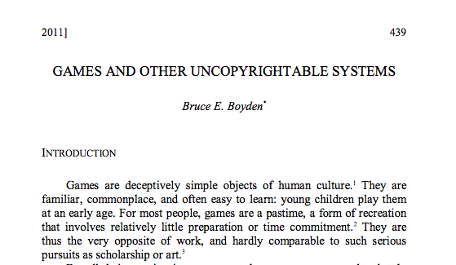

More on Boyden…
Next class…

Slide 56
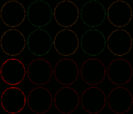
Starting Point

Slide 57
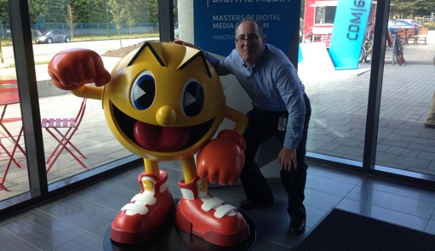
Let’s start with…not quite knowing what is real…

Slide 58

All the World is a Game
WE ARE
?

Slide 59
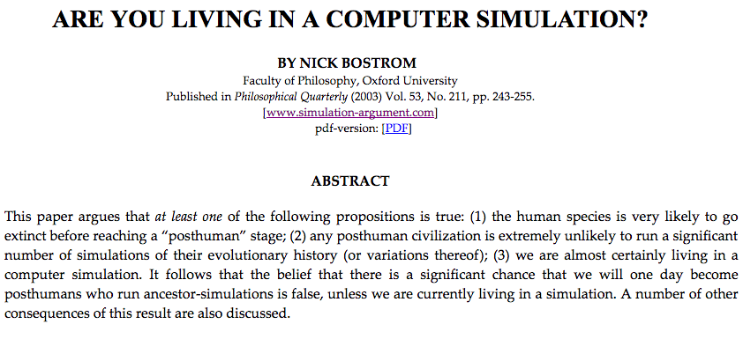

Slide 60
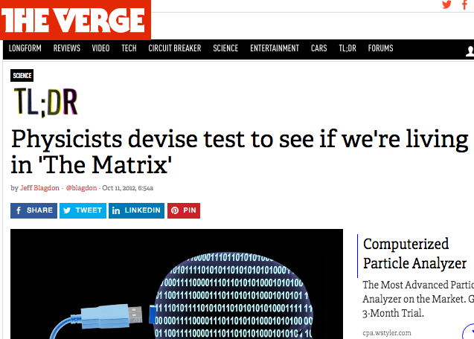

Slide 61
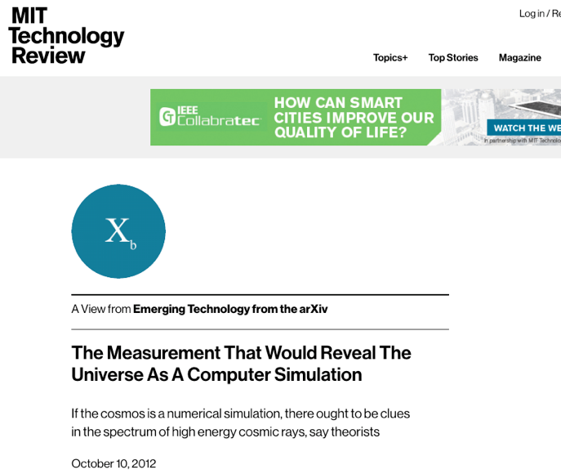

Slide 62
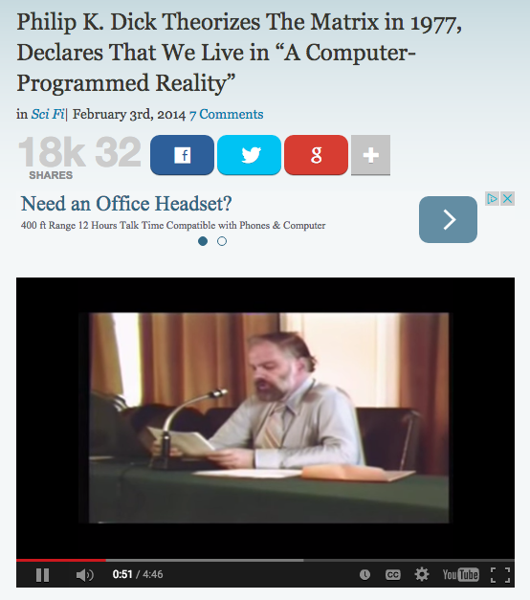
http://www.openculture.com/2014/02/philip-k-dick-theorizes-the-matrix-in-1977-declares-that-we-live-in-a-computer-programmed-reality.html

Slide 63
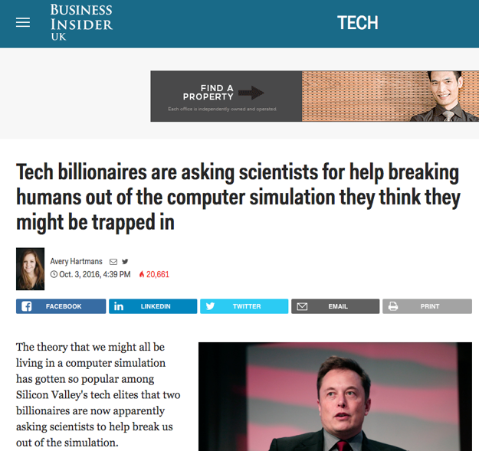

Slide 64
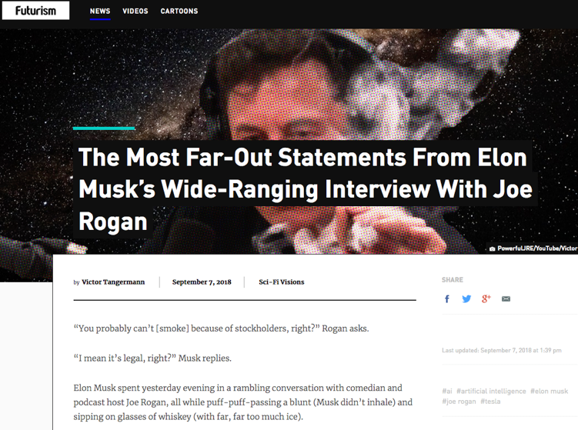

Slide 65
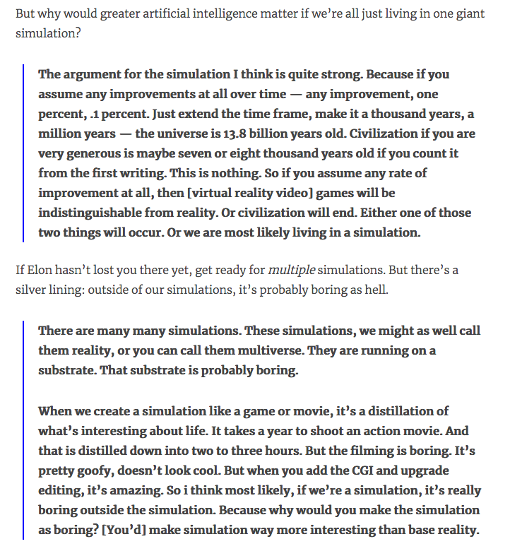

Slide 66
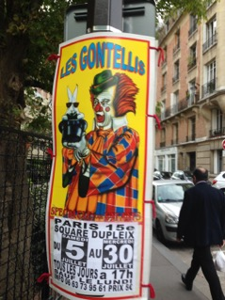
The Really Big Question
Something super weird…
Or totally obvious?

Slide 67
Is this a video game?
“…the process of creating a model of the world using multiple feedback loops in various parameters (e.g., in temperature, space, time, and in relation to others), in order to accomplish a goal...”

Slide 68

NO, IT IS YOU
“Consciousness is the process of creating a model of the world using multiple feedback loops in various parameters (e.g., in temperature, space, time, and in relation to others), in order to accomplish a goal (e.g., find mates, food, shelter).”

Slide 69

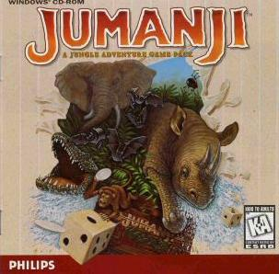
Could it be…?
…That Kaku’s definition of Consciousness aligns so well with video games, because Bostrom is right; we are in a video game.

Slide 70

Is this why we are so obsessed with pursuing confusion between what is virtual and what is real?

Slide 71
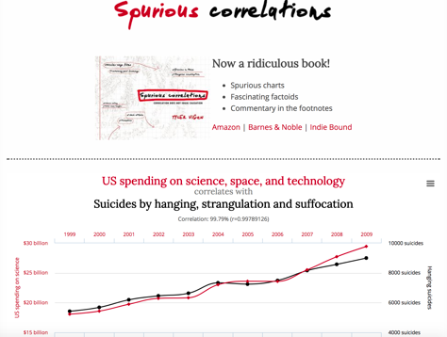
Remember:
Causation
or
Correlation?

Slide 72
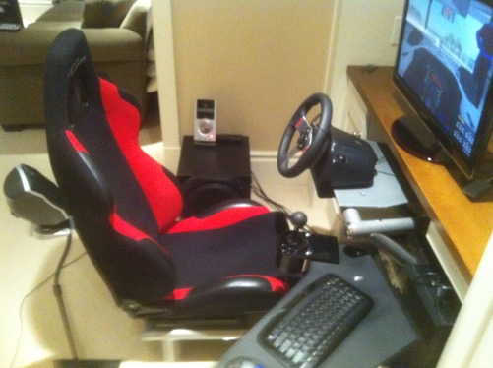
But even if not…
Even if conventional explanation…
Remember this question?

Slide 73

WHY?
“Equally strange is our general addiction to games, both physical and mental. The profusion of games is truly startling: card games, board games, word games, ball games, electronic games….We even assemble in huge crowds to watch others playing games. What does all this mean? Do we simply get easily bored and cannot tolerate inactivity? I can find nothing in the literature of scientific psychology that helps me to understand such bizarre behavior.”
The Human Legacy (1982)
Leon Festinger

Slide 74
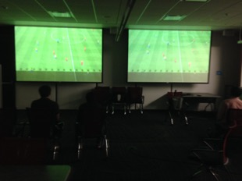
Perhaps we can answer that…
Perhaps the least we can say is…
How we are conscious &
how we (video) game
appear to be
profoundly aligned.

Slide 75
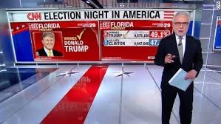
And does all this explain?

Slide 76
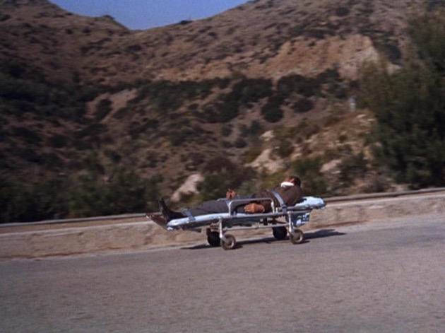
To be continued…
Batman Episode 66

Slide 77
All leading to…
→→

Slide 78
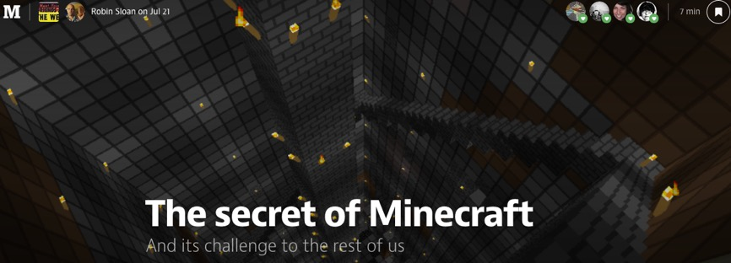
“What Are Video Games (today)?”
https://medium.com/message/the-secret-of-minecraft-97dfacb05a3c
“A generative, networked system laced throughout with secrets.”

Slide 79
Video games as Media
The return of the oral narrative?
“Mass Effect and Orality: Video Games as Transitional Literature” Conrad Leibel http://ualberta.academia.edu/ConradLeibel
“Ultimately, video games stand as the successor of the original oral culture; revitalizing itself through the use of written text in order to make itself relatable to the player/reader yet also giving new life to the written tradition through enabling a level of interactivity between the text and reader only seen in the oral tradition…”
“Games as Conversation” Rogelio E. Cardona-Rivera and R. Michael Young
“ We present a metaphor through which to study games: games as conversation, which casts gameplay as a communicative exchange between player and game.”
http://www.rogel.io/content/02-publications/cardona-rivera2014gamesasconversation.pdf

Slide 80

“Ulysses as an RPG” Alistair Brown (2012)
http://www.alluvium-journal.org/2012/10/01/ulysses-as-an-rpg/
“Whilst ludological game theorists…have made
us aware of the fundamental structural
differences between a game and a book, Joyce’s
novel may be said to be more ludic than most. As
Jay David Bolter and Michael Joyce have
suggested, modernist writers like Joyce “were
trying to set up new relationships between the
moment-by-moment experience of reading a text and
our perception of the organizing and controlling
structures of the text. In this sense,
hypertextual fiction is a natural extension of
their work, redefining the tradition of modernism
for a new medium”

Slide 81
IP Dystopia?
* Donaldson v. Beckett (1774) 1Eng. Rep. 837 H.L. denied continued existence of perpetual common law copyright, upholding limitation on term per statute (see Statute of Anne, 8Anne c. 19 (1710)
* “How The Video Game Industry Was Launched 40 Years Ago... Thanks To Infringement” Techdirt Nov. 30, 2012 http://www.techdirt.com/blog/innovation/articles/20121129/17592021179/how-video-game-industry-was-launched-40-years-ago-thanks-to-infringement.shtml
* “Copyright Law and Video Games: A brief History of an Interactive Medium” Prof. Greg Lastowka http://papers.ssrn.com/sol3/papers.cfm?abstract_id=2321424

Slide 82
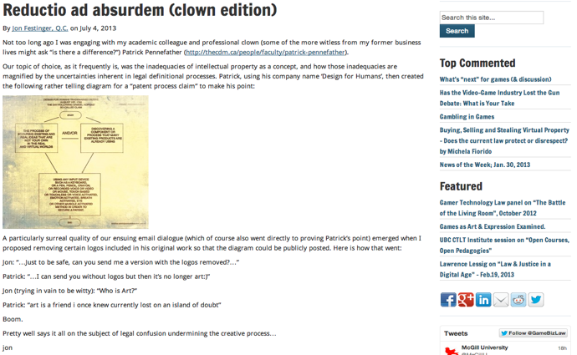
IP Dystopia
Dystopia = an imaginary place where people lead dehumanized and often fearful lives

Slide 83

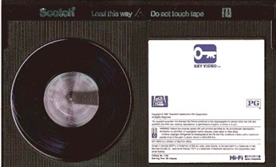
Universal v. Sony (for the 1st time)
Sony Corporation of America et al. v. Universal City Studios, Inc., et al. 464 U.S. 417 (1984) Supreme Court of the United States
http://scholar.google.ca/scholar_case case=5876335373788447272&hl=en&as_sdt=2&as_vis=1&oi=scholarr&sa=X&ei=hGYvUsjELay7jALQ9YHYBg&ved=0CEAQgAMoATAA
* Time Shifting is Fair Use not Copyright infringement
(see also Fox v. Dish Network USCA 9th (July 24,2013) upholding “ad skipping” http://www.scribd.com/doc/155719747/Hopper)

Slide 84
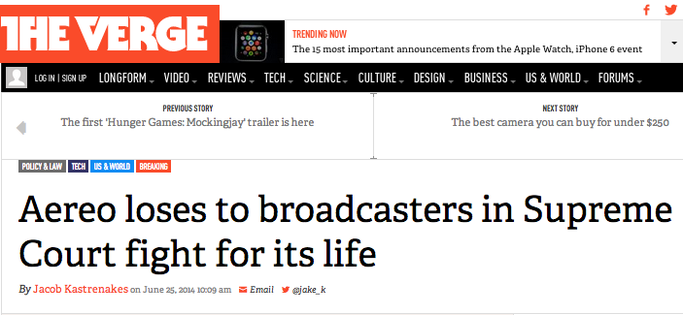
BUT…
http://www.theverge.com/2014/6/25/5801052/aereo-supreme-court-ruling

Slide 85


Slide 86




http://www.scotusblog.com/case-files/cases/american-broadcasting-companies-inc-v-aereo-inc/

Slide 87

But, but…

Slide 88

But, but, but…

Slide 89

But, but, but, but…

Slide 90
Which leads to: Application of real world laws to (massive)virtual environments
Is there a virtual world?
Is virtual Property “real”???
Ben Duranske “ Virtual Law” (2008): “This chapter will argue that the law needs to acknowledge and provide protection for virtual property, but that it must do so in a way that preserves virtual worlds and games as play spaces, at least to the extent that the developers desire their worlds to remain pure play spaces. On one hand, many game and virtual world providers seek to avoid real-life implications in their social and play spaces. Where providers take reasonable steps to draw a line between the real and the virtual, the world or game should be protected by the “magic circle” that protects other play spaces (from theme parks to family Monopoly games) from taking on inadvertent real-world implications. On the other hand, it is both inevitable and desirable that some game and virtual world designers will seek to include real money trade (RMT) and offer a real cash economy (RCE) in their platforms. Users of these platforms need the protection of virtual property law.”
http://www.amazon.com/Benjamin-Tyson-Duranske/e/B001JP104A

Slide 91

An issue that won’t go away…

Slide 92

Another reason for IP Dystopia?
BREAKOUT
Issue: The “creativity standard” in copyright.

Slide 93
Atari v. Oman - 1989/1992 USCA DC Cir.
* “BREAKOUT's audiovisual display features a wall formed by red, amber, green, and blue layers of rectangles representing bricks. A player maneuvers a control knob that causes a rectangular-shaped representation of a paddle to hit a square-shaped representation of a ball against the brick wall. When the ball hits a brick, that brick disappears from its row, the player scores points, and a brick on a higher row becomes exposed. A "breakout" occurs when the ball penetrates through all rows of bricks and moves into the space between the wall and the top of the screen; the ball then ricochets in a zig-zag pattern off the sides of the screen and the top layer of the wall, removing bricks upon contact and adding more points to the player's score. Various tones sound as the ball touches different objects or places on the screen. The size of the paddle diminishes and the motion of the ball accelerates as the game is played.”
District court judge asked counsel for the Register, "If Picasso had painted a round object on a canvas, would you say because it depicts a familiar subject--namely, something that's round--it can't be copyrighted?”
Atari Games Corp. v. Oman, 979 F. 2d 242 - 1992 - ‎Court of Appeals, Dist. of Columbia Circuit
Atari Games Corp. v. Oman, 888 F. 2d 878 - 1989 - ‎Court of Appeals, Dist. of Columbia Circuit
Atari Games Corp. v. Oman, 693 F. Supp. 1204 - 1988 - ‎Dist. Court, Dist. of Columbia

Slide 94


Games as arT
* “Are Video Games Art? MoMA Says Yes.” (Slate 11.29.12) http://www.slate.com/blogs/browbeat/2012/11/29/moma_s_new_video_game_collection_museum_of_modern_art_proclaims_video_games.html
“Video Games: 14 in the Collection, for Starters”http://www.moma.org/explore/inside_out/2012/11/29/video-games-14-in-the-collection-for-starters

Slide 95

Irony 1
While eligibility for copyright meant a certain
legal recognition…..
…it brought with it the limitations of IP law
Impact on mods, genre issues etc….
IP Dystopia:
…..Stern v. Kaufman (1982 USCA) – “Scramble” knockoff case – “kitchen sink” arguments included that “each play of the game is an original work because of the player’s participation.”
http://scholar.google.com/scholar_case?case=7204019639108685629&q=%22669+F.2d+852&hl=en&as_sdt=2002

Slide 96

Say again???
Stern v. Kaufman (1982 USCA) – “Scramble” knockoff case – “kitchen sink” arguments included that “each play of the game is an original work because of the player’s participation.”

Slide 97

Re-litigate in context of e-sports?

Slide 98


Irony 1(continued)
The Problem with Stern
Defendants point: that player participation meant no “fixation” = Scramble not protected.
Court rejected argument. Found “Someone first conceived what the audiovisual display would look like and sound like. Originality occurred at that point.” (huh?)
Consider since that time: 1. massively multiplayer; 2. open world; 3. (effectively) crowd sourced; 4……

Slide 99

Irony 2: Legal Recognition May Not
Equal Respect
Virtual guns more to blame then real ones???
NRA says so “The NRA's Absolutely Unhinged Response to Newtown Condemns Video Games as a 'Shadow Industry' that 'Sows Violence Against Its Own People'” Kotaku (21 December 2012)
http://kotaku.com/5970484/the-nras-absolutely-unhinged-response-to-newtown-blames-a-10+year-old-flash-game

Slide 100

And who can ever forget…
http://www.cnet.com/news/study-finds-online-gamers-arent-anti-social-basement-dwellers/

Slide 101

The Rodney Dangerfield “No Respect” Effect

Slide 102
Microstar v. Formgen (1998 USCA Ninth Circuit)
KOZINSKI, Circuit Judge:
“Duke Nukem routinely vanquishes Octabrain and the Protozoid Slimer. But what about the dreaded Micro Star?”
Nintendo of America Inc v King, 2017 FC 246
The Honourable Mr. Justice Campbell:
“[13] In the result, to fairly and appropriately acknowledge the precise, clear, well supported, and effectively uncontested final argument prepared by Counsel for the Applicant, with which I fully agree, I find that the Applicant is entitled to have the final argument, as stated below, as my reasons for decision in the present litigation.”

Slide 103
NO CLASS
NEXT WEDNESDAY
September 19, 2018

Slide 104

Next Class (9.26.18)…
Logistics: Syllabus & Readings
Talk: Why are expression/speech freedoms not paramount? Are the real censors legal concepts we might not at all expect?…
Dichotomies
& Paradoxes

Slide 105

+ Quiz Question Will Be Answered

Slide 106




The Mosque-Cathedral of Cordoba

Slide 107

Always include a cat picture

Slide 108
Our Academic Partners

