Slide 1
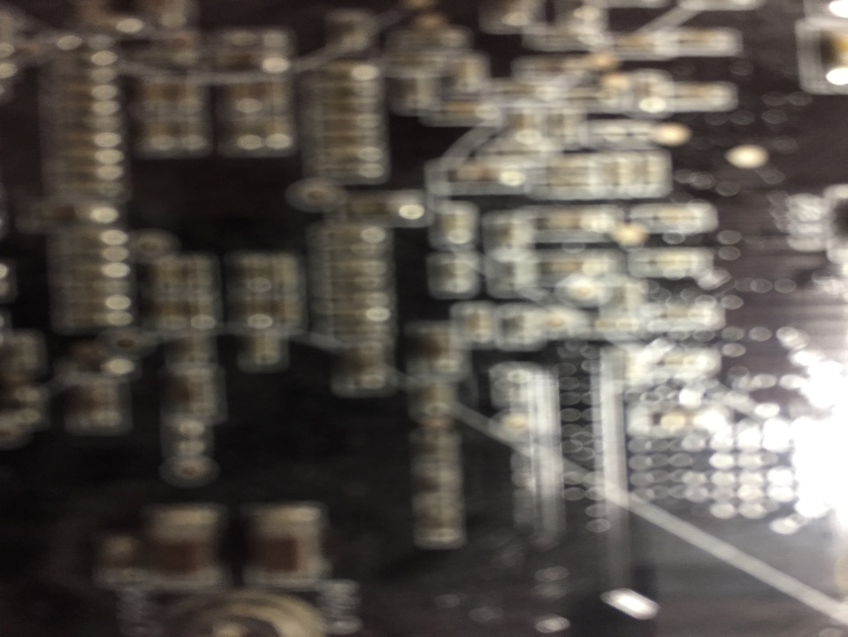
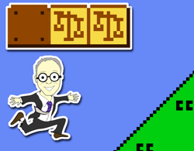
Freedom of Thought in A.I. Virtual Realities
& The Rule of Law Step 1
UBC Emerging Media Lab Lecture Series
9.25.18
Jon Festinger Q.C.
Faculty in Residence, EML;
Centre for Digital Media;
UBC Law; QMUL CCLS;
Festinger Law & Strategy
http://commlaw.allard.ubc
@jonfestinger
jon_festinger@thecdm.ca

Slide 2
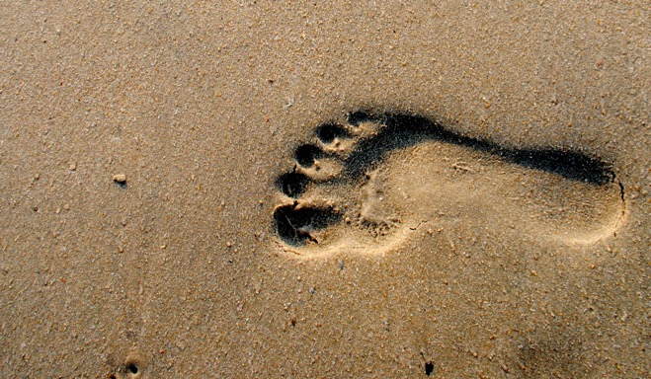
Step 1

Slide 3
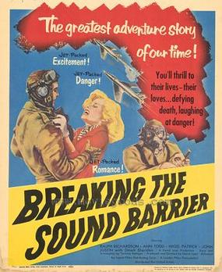
Outline of this talk overall…

Slide 4
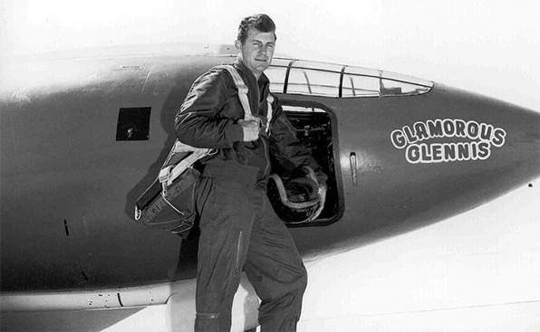
Be skeptical: what actually happened…

Slide 5
The Story so far… 2016
“Legal Contradictions Manifest in Video Game Worlds: Copyright through the Post-Structuralist Looking Glass”
Digital creativity is often collaborative. For that reason an appropriate post-structuralist view of Copyright would recognize user’s rights and even a Right to Create for mods, remixes and the like.

Slide 6
The Story so far… 2017
“Trusting Ourselves: Freedom of Thought in Virtual Realities”
How should we deal with the (narrow) possibility of being manipulated against our wills through a combination of ultra-realistic VR and misused personal data. The law should intervene when personal agency is lost and that media companies could be constructive trustees of our data.

Slide 7
The Story so far… 2018
“Life As A Game: Legal Consequences of A.I. Individuated MEdia”
Examines the possible consequences and necessary safeguards if current trends towards media custom made for each of us individually is taken to the logical end.

Slide 8
RIGHT TO CREAtE
to
FREEDOM OF THOUGHT
to
Copyright in our own data
to
???

Slide 9
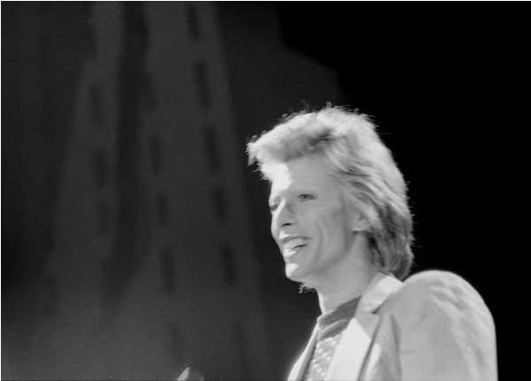
2016
David Bowie

Slide 10
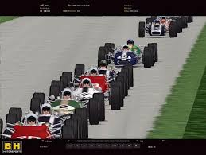
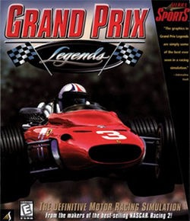
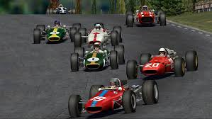
Started With Mods. Really?

Slide 11
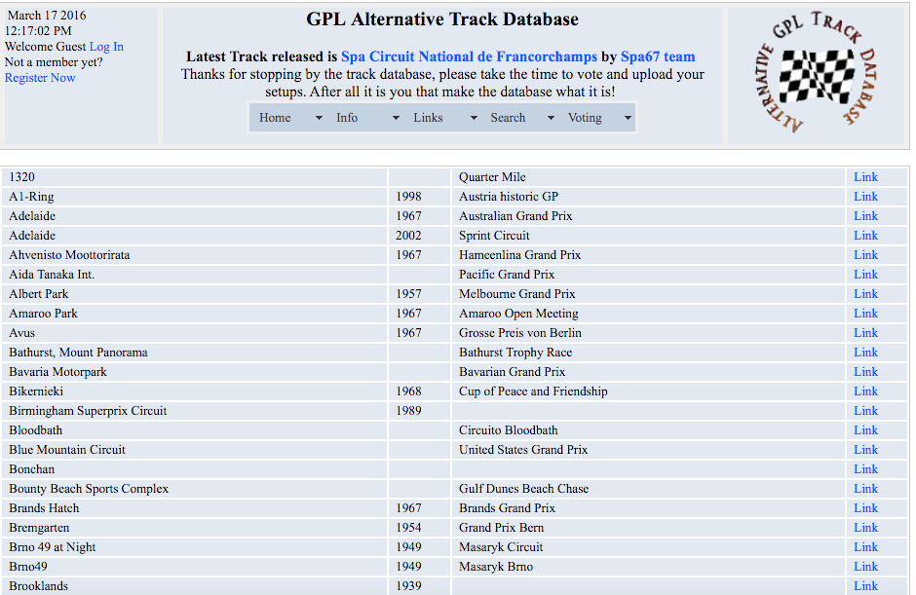
More hours of labour:
Developer or Modders?

Slide 12
Then…
Revealing
contradictions
→←

Slide 13
Specifically…
Copyright law does adequately accommodate the real world collaborations between “creators” and others (users/collaborators) in today’s digital world.
→←

Slide 14
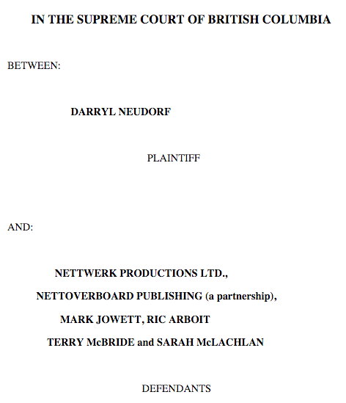
The Binary…Neudorf v. Nettwerk, McLachlan et al, BC Supreme Court (1999)

Slide 15

All in contrast to the real world,
where digital is collaborative.

Slide 16

“Copyright” can be irresponsible understood
“[s]tealing is stealing whether you use a computer command or a crowbar, and whether you take documents, data or dollars. It is equally harmful to the victim whether you sell what you have stolen or give it away.”*
*The United States Attorney’s Office, District of Massachusetts, Press Release, “Alleged Hacker Charged with Stealing over Four Million Documents from MIT Network” (19 July 2011), online: <http://www.justice.gov/usao/ma/news/2011/July/SwartzAaronPR.html>

Slide 17
Another Legal Contradiction Manifest in Video Game Worlds
An apparent double standard of behavioral freedoms favoring patents over copyright in analogous circumstances (e.g. “modding”) with no explanation?
→←

Slide 18
Double standards ?
Innovation in a patent law context effectively allows “mods”….So why doesn’t creativity in a copyright law context similarly allow mods.
Patent law allows free riding on both ideas and expression (through designing around). Copyright law allows free riding on ideas only. If free riding on ideas is ok, why is free riding on expression not ok?… (Rebecca Tushnet)

Slide 19
Conclusions…
Today…the further democratization of tools for creativity through digital means…requires additional reforms:
A RIGHT TO CREAtE?

Slide 20
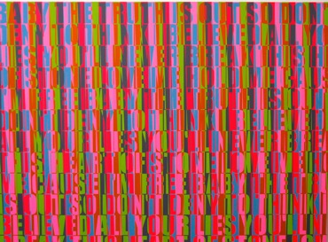
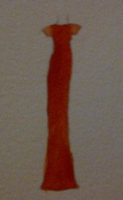
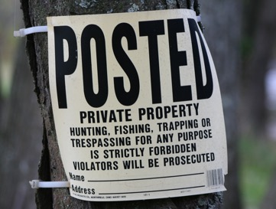
Shouldn’t Creativity Be More Important Than Property ?

Slide 21
Pause for breath…

Slide 22
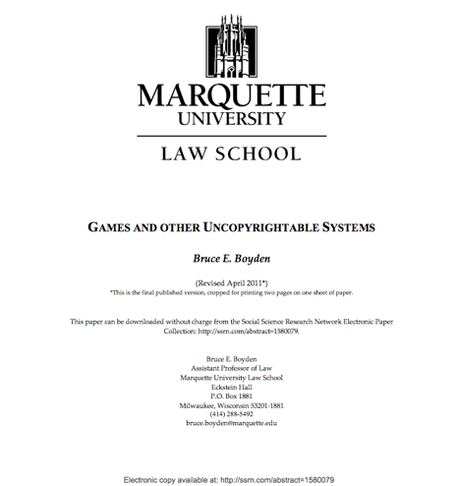
You as creator of meaning: Boyden

Slide 23
“In all of these situations, the owners of a copyright in a form, description, or set of instructions were attempting to extend their copyright to material for which the user of the work provided the essential content, not its author. That is what made them systems. They were, without that input, empty shells, waiting to be filled.”
“Games are systems in exactly the same way. A game, as sold, is only a game form; the content necessary for an instance of the game comes from the players. That is, the game form establishes the environment for play—the game space—and it defines permissible moves and the conditions for winning or drawing. But the game itself is supplied by the players.”
“Systems are shells into which users pour meaning. While they may contain expression themselves, that expression is there merely to facilitate the meaning added by the user.”

Slide 24

Furthering Empowering User as Creator…

Slide 25
Is…
Post-Structuralism a “good theory” to apply to video-games?…
And therefore to Video Game (& all digital) Law?...

Slide 26
Post Structuralism is…
Decentralizing Author & Replacing Them With Reader
=
Decentralizing Developer & Replacing Them With Gamer
=
CREAtIVe Acts (MODDING)

Slide 27

Breathe

Slide 28
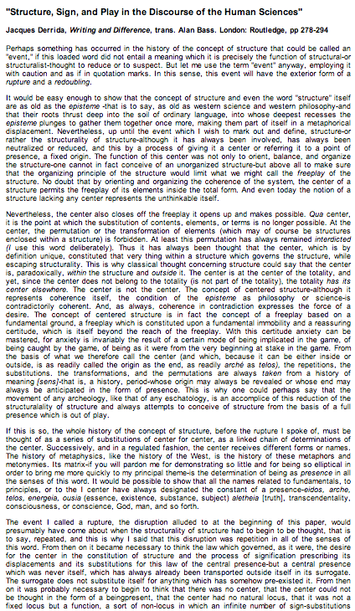
Gamer/modder as “author”:
Video Games as Post-Structural
"Structure, Sign, and Play in the Discourse of the Human Sciences” Jacques Derrida
Structures as free-floating (or 'playing') sets of relationships. Structuralist discourses unfortunately hold on to a "center” which anchors the structure and “does not play”.
http://hydra.humanities.uci.edu/Derrida/sign-play.html

Slide 29
“Freeplay is the disruption of presence. The presence of an element is always a signifying and substitutive reference inscribed in a system of differences and the movement of a chain. Freeplay is always an interplay of absence and presence, but if it is to be radically conceived, freeplay must be conceived before the alternative of presence and absence; being must be conceived of as presence or absence beginning with the possibility of freeplay and not the other way around.” Jacques Derrida

Slide 30
“And it's not enough to deconstruct to expose the way oppositions work and how meaning and values are produced in speech of all kinds and stop there in a nihilistic or cynical position regarding all meaning, "thereby preventing any means of intervening in the field effectively". To be effective, deconstruction needs to create new concepts, not to synthesize the terms in opposition, but to mark their difference and eternal interplay.”
Jacques Derrida "Interview with Jean-Louis Houdebine and Guy Scarpetta," in "Positions" p.43
http://inspirasi.co/ensiklopedia_inspirasi/post/1246

Slide 31
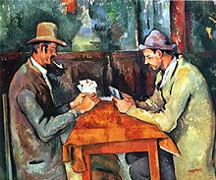
Think about playing a game
Cezanne – The Card Players

Slide 32
How important to the game is the game designer?
How important to the game are you?
How important to the game are the other people you are playing with?

Slide 33


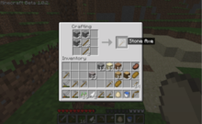

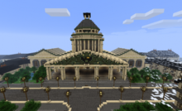

When you look at a video game it is not about what the developer intended…it’s about what the player does…

Slide 34
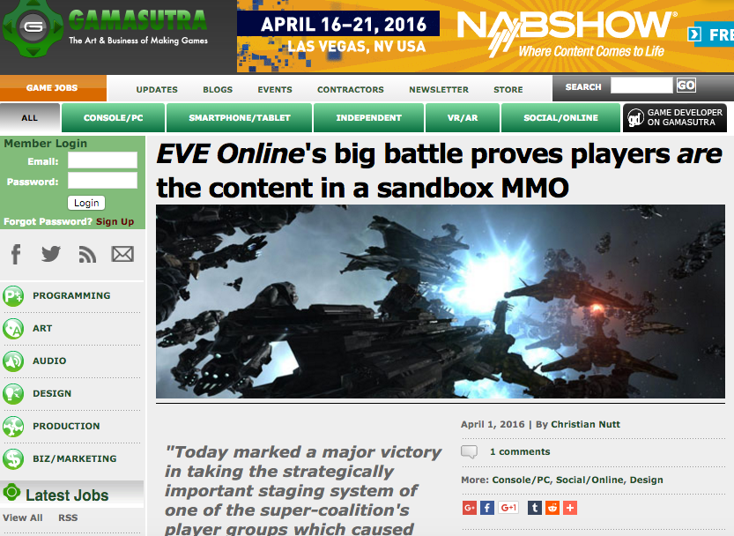

Slide 35
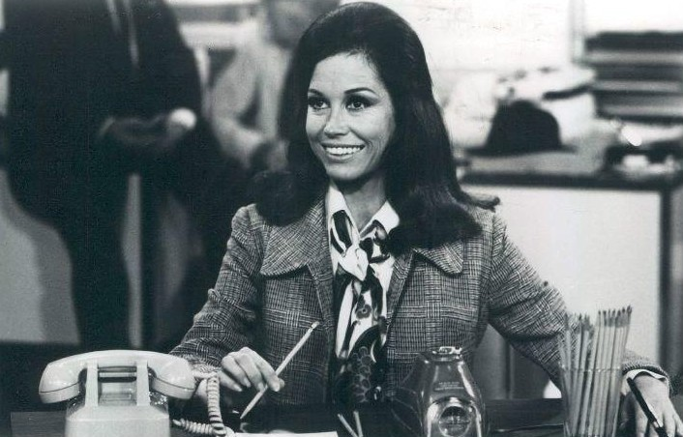
2017
Mary Tyler Moore

Slide 36
Virtual Reality 3.0

Slide 37
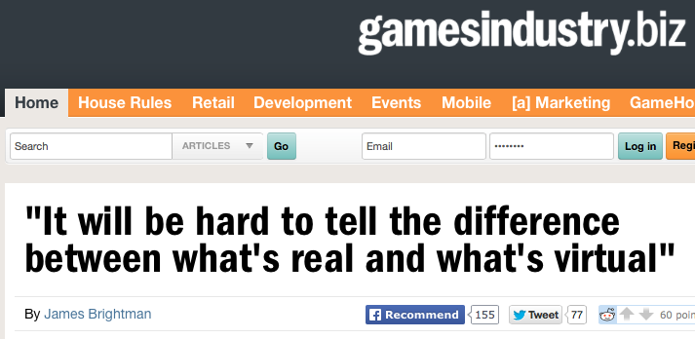
http://www.gamesindustry.biz/articles/2014-12-03-it-will-be-hard-to-tell-the-difference-between-whats-real-and-whats-virtual

Slide 38
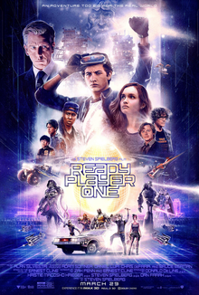

Slide 39
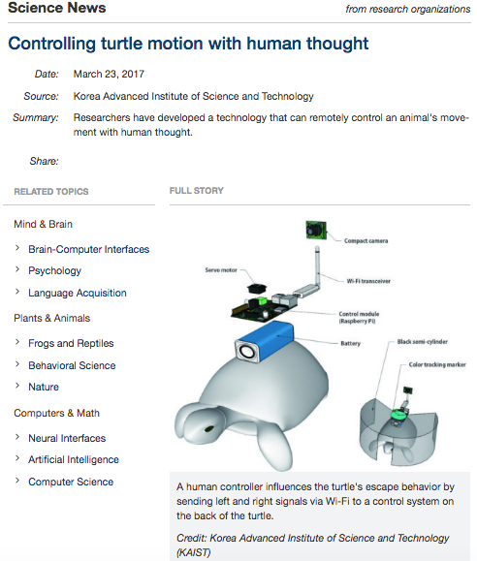

Slide 40
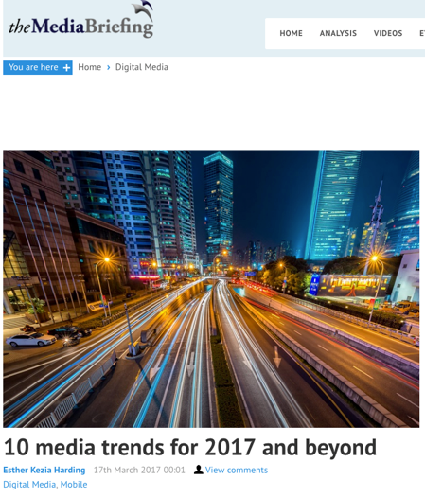
“What the new realities
represent is an entirely new
way to think about advertising.
We always assumed the
screens were the canvas, and
there’s a frame around what
we are doing. But AR and VR
transform all that.”
Tom Goodwin.
EVP Zenith USA

Slide 41
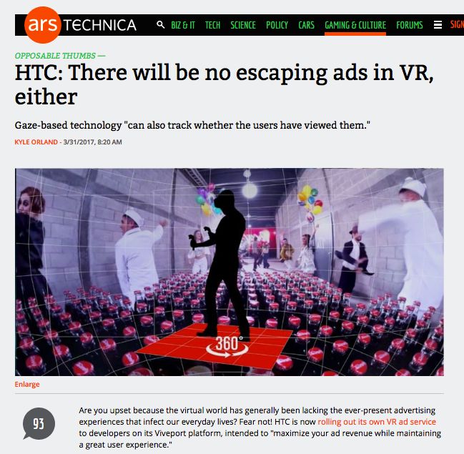

Slide 42
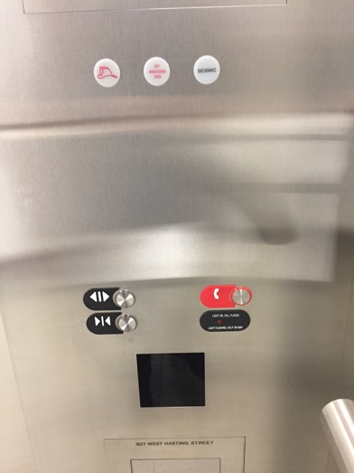

Slide 43
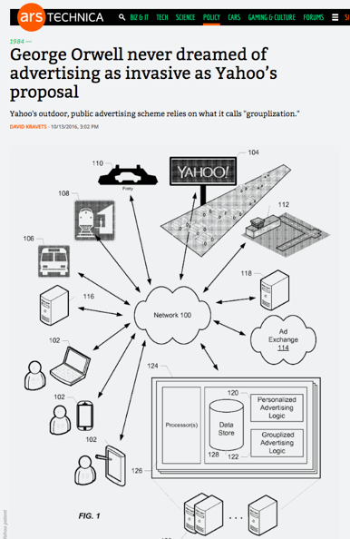

Slide 44
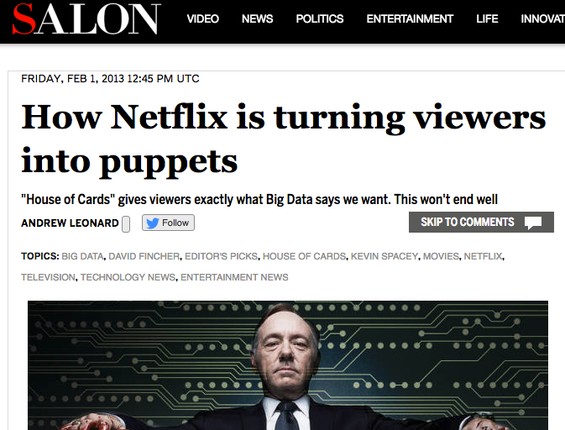

Slide 45
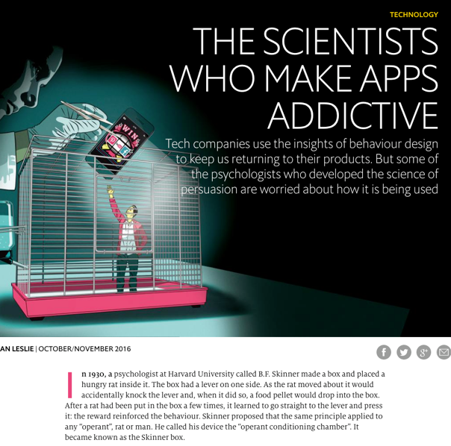


Slide 46
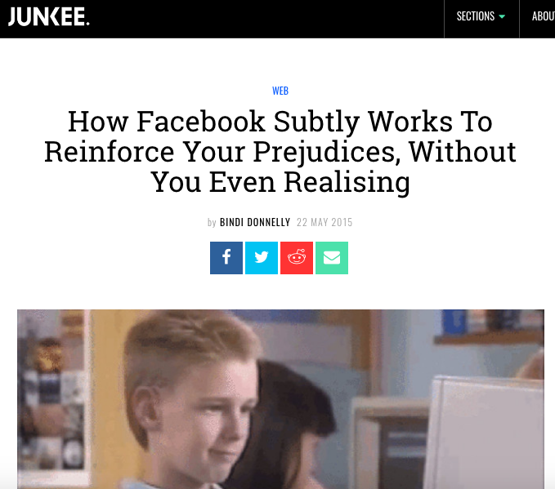

Slide 47
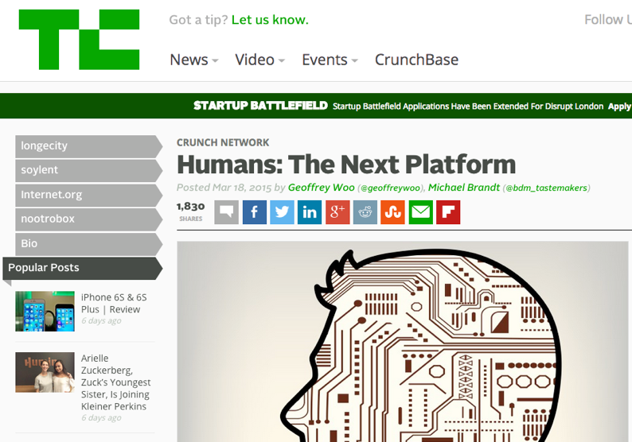

Slide 48
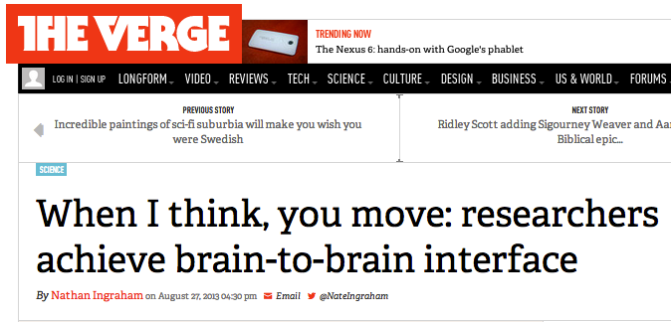
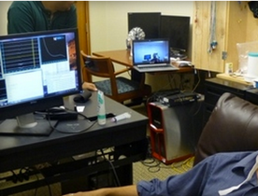
http://www.theverge.com/2013/8/27/4664722/researchers-control-a-subjects-body-with-another-persons-brain

Slide 49

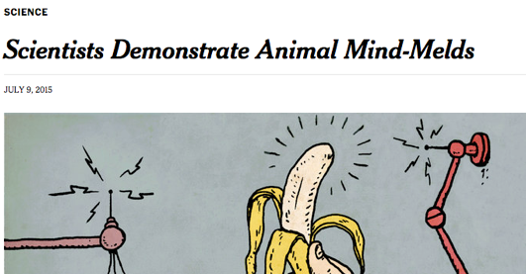
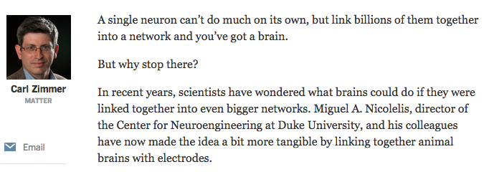

Slide 50
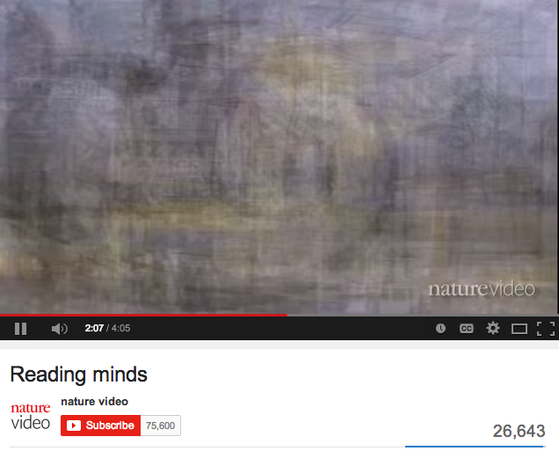
http://youtu.be/z8iEogscUl8

Slide 51
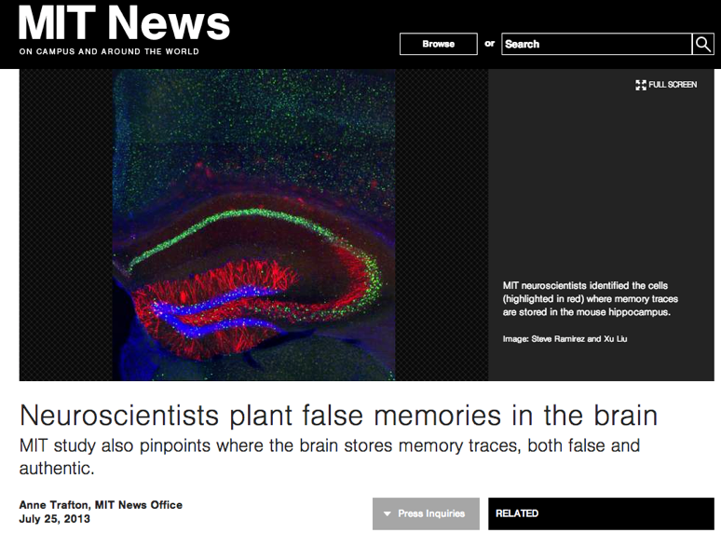
http://newsoffice.mit.edu/2013/neuroscientists-plant-false-memories-in-the-brain-0725

Slide 52
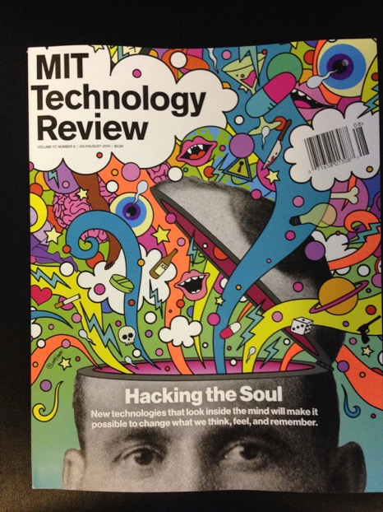

Slide 53
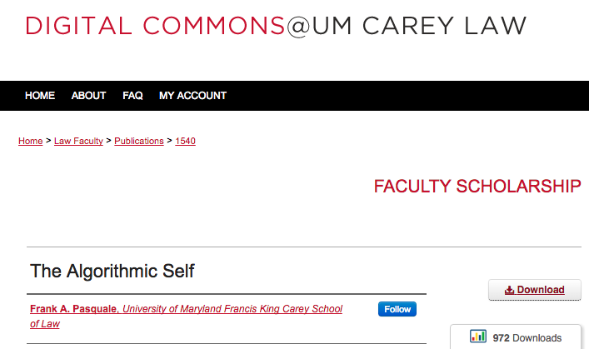
“…there is a delicate balance between appropriating new technologies and being appropriated by them.”

Slide 54
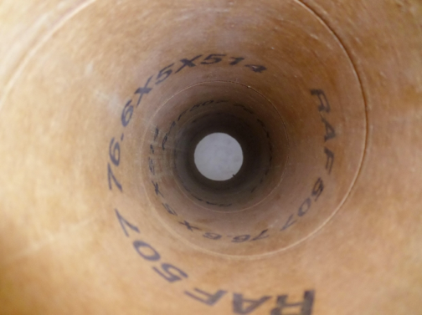
THE PROBLEM:
INFO-GATHERING
THERE IS NO ONE WAY TUBE

Slide 55

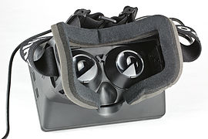


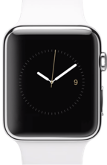
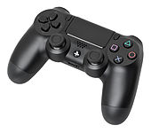
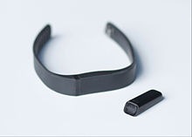
Devices read you.

Slide 56
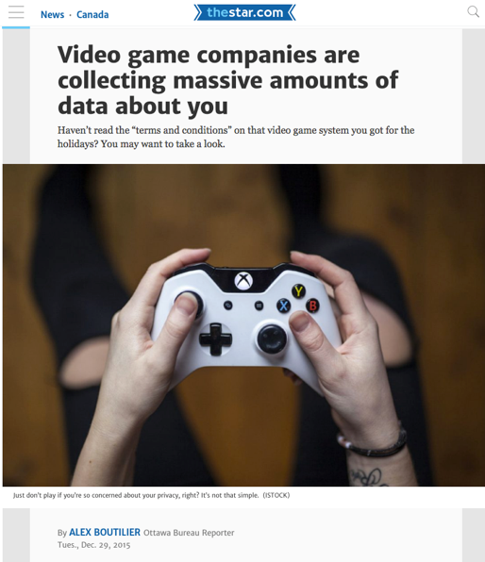

Slide 57

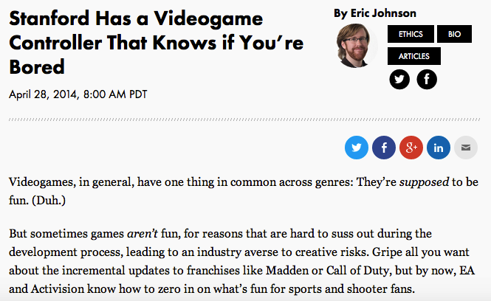
http://recode.net/2014/04/28/stanford-has-a-videogame-controller-that-knows-if-youre-bored/

Slide 58
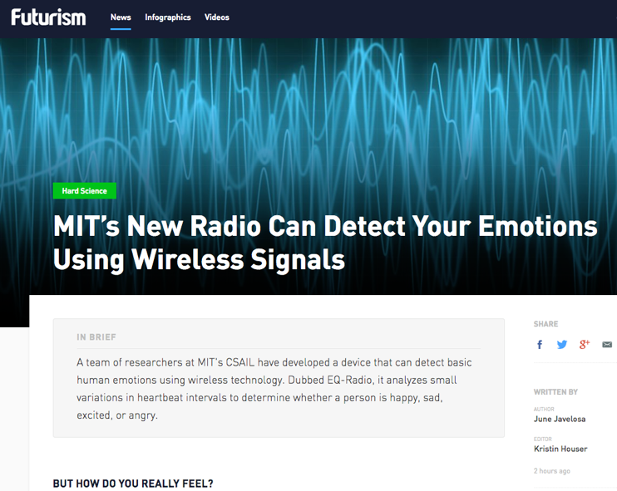

Slide 59
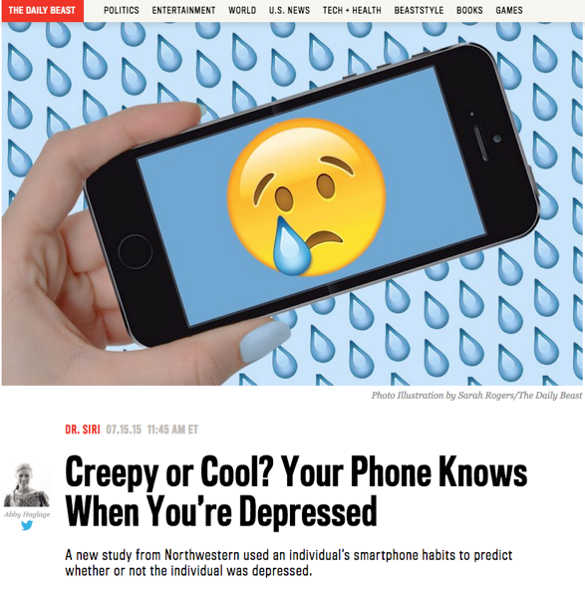

Slide 60

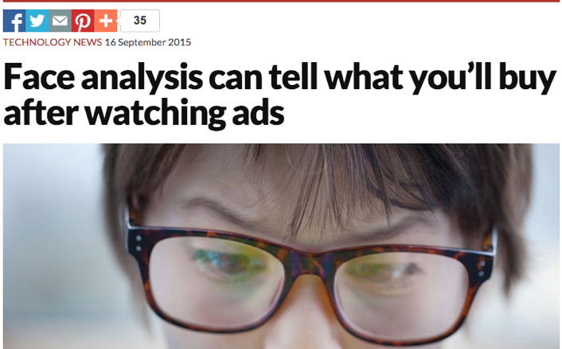
https://www.newscientist.com/article/mg22730392-700-face-analysis-can-tell-what-youll-buy-after-watching-ads-2/

Slide 61

Humans are particularly susceptible to VR

Slide 62

1. Is reality already “Virtual”?
“All the World is a Game”
WE ARE ?

Slide 63


Slide 64

2. A Really Strange Question
Something super weird…
Or totally obvious?

Slide 65
Is this a video game?
“…the process of creating a model of the world using multiple feedback loops in various parameters (e.g., in temperature, space, time, and in relation to others), in order to accomplish a goal (e.g., find mates, food, shelter).”

Slide 66

NO, IT IS YOU
“Consciousness is the process of creating a model of the world using multiple feedback loops in various parameters (e.g., in temperature, space, time, and in relation to others), in order to accomplish a goal (e.g., find mates, food, shelter).”

Slide 67

Perhaps we can at least say this…
How we are conscious &
how we (video) game
appear to be
profoundly aligned.

Slide 68

THE ISSUE: LOSS OF HUMAN AGENCY?

Slide 69

Post-Structuralism encourages/reinforces/represents the value of human agency, choice & creativity.
Rene Magritte
“Not to be
Reproduced”
1937

Slide 70

Technology is (very) Structuralist

Slide 71

Virtual Reality is Structuralist (For now? – For always?)

Slide 72

The law should intervene when we substantially lose our
human agency?

Slide 73

The Law

Slide 74

Subliminal Advertising

Slide 75
IS PRIVACY A ROBUST ENOUGH LEGAL CONCEPT FOR THESE DEVELOPMENTS?

Slide 76

Consumer Protection Regulation

Slide 77

Could VR be considered a drug?
Do we really want to go there?

Slide 78

Mandatory right to be forgotten for brain data?

Slide 79

Duties of contractual good faith and honest performance

Slide 80

Related legal question:
Might a Platform be a Trustee of certain of your (brain) data with commensurate fiduciary responsibilities given the implied terms of the contract and various assurances given?

Slide 81

“Information Fiduciaries”

Slide 82
Constructive Trust?
Might a court determine that the Platform is a Constructive Trustee of your sensitive data with commensurate fiduciary responsibilities towards you?

Slide 83
Enter “Freedom of Thought” as an interpretive aid
The Canadian Charter of Rights and Freedoms guarantees…
Everyone has the following fundamental freedoms:
(a) freedom of conscience and religion;
(b) freedom of thought, belief, opinion and expression, including freedom of the press and other media of communication;…
7. Everyone has the right to life, liberty and security of the person and the right not to be deprived thereof except in accordance with the principles of fundamental justice.

Slide 84
Universal Declaration of Human Rights
Article 3.
Everyone has the right to life, liberty and security of person.
Article 18.
Everyone has the right to freedom of thought, conscience and religion; this right includes freedom to change his religion or belief, and freedom, either alone or in community with others and in public or private, to manifest his religion or belief in teaching, practice, worship and observance.

Slide 85

When do we lose our human agency in Virtual Reality/Alternate Reality?
When is the player controlled, not in control?

Slide 86

Is Criminal Law mens rea the appropriate standard for non-criminal cases?

Slide 87
Human Agency as Freedom of Thought
The law should intervene where data was obtained from an individual without fully informed consent, and that individual’s freedom of thought is impacted causing a substantial risk of harm.
Freedom of thought to be defined in terms of personal autonomy and human dignity, not just to make choices, but to make creative choices on ones own terms creating one’s own meanings [very post-structural].

Slide 88


Slide 89

2018
Stephen Hawking

Slide 90

Place to Begin Exploration:
“Freedom of Thought” =
Content has Personal Meanings

Slide 91

Memory as personal knowledge not personal awareness…
Mind, Volume 65, Issue 1, 1 January 1956, Pages 312–331

Slide 92

Where personal content is created…

Slide 93
What if an algorithm knew…
My favorite type of movie (romantic comedy)
My favorite stars (Anna Kendrick + “young” John Cusack)
My favorite screen writer (Adam Sorkin)
My favorite plot trope (time travel that teaches life lessons)
Plot points & dialogue that I laugh at
Plot points & dialogue that I cry at
Favorite music (Springsteen, The Clash)
My personality profile (in detail)
My personal history & biographical details (Dad passed of cancer; mom of Alzheimer’s; Parents both Holocaust survivors from Poland)
& pretty well everything else about me.

Slide 94
Fictional Storytelling uniquely tailored to me: At the extreme an algorithmically directed “The Truman Show”

Slide 95



Slide 96

Been done?

Slide 97

We are simultaneously both AUDIENCE & CO-CREATOR

Slide 98

Dystopic Examples?

Slide 99

The Deeper Constitutional Problem?

Slide 100

Fantasy based on standard trope of corporations replacing government and becoming oppressive to all in their way.
However the trope does have substantive legal roots in constitutional rights being available to moderate the relationship between persons and government; and not being available to persons against corporate persons.

Slide 101



Digital world relationships between persons and media are controlled contractually where constitutional rights & protections generally don’t apply.

Slide 102

All of Us
Media
Companies
Constitutional
Rights & Protections

Slide 103

Theory please?…

Slide 104

The Deepest Problem (& partial solution?):
Algorithmic you is not YOU

Slide 105

The wisdom of 16 year olds…
“Basically I just think the ‘person’ we show to be ourselves on social media is only a part of who we are - it is our best, and sometimes most superficial parts. Therefore the algorithmic thing won't actually show us what we truly want to see.”

Slide 106
“Algorithms are at best a snapshot of today and maybe even more dangerous, a look through the rear view mirror of what is familiar. Algorithms can’t predict future trends.”
Ivan Fecan (Former CEO, Bell Globemedia)

Slide 107

The “paradox” of algorithmically filtered big data influencing each of us is that it tends to demonstrate our individuality and complexity rather than disproving it.

Slide 108
Put another way…
A.I., being based on algorithms, can’t account for extraneous inputs, what’s interesting, meaningful, or magical. They are the opposite of human agency and have virtually no hope of emulating it, much less improving on it.

Slide 109
=
Good news: We can’t be replaced by non-us.
Bad News: We can only manipulated by others.

Slide 110

So…WE are indeed “co-creators”…

Slide 111
“When these ghosts of the past stand in the path of justice clanking their medieval chains, the proper course for the Judge is to pass through them undeterred.”
Lord Atkin in United Australia Ltd. v. Barclays Bank
1941 A.C. 1 at 29

Slide 112

A Possible Conclusion
CO-AUTHORSHIP
RIGHTS WHEN OUR
PERSONAL DATA
IS USED*.
*Seemingly compatible with the various theories
of copyright: Utilitarianism; Labor Theory;
Personality Theory; and Social Planning Theory

Slide 113
Step 2…

Slide 114


A MATTER OF PERSPECTIVE

Slide 115


Slide 116
In learning you will teach
And in teaching you will learn
Phil Collins' Son of Man (1999)

Slide 117


Slide 118

Always include a cat picture

Slide 119
Our Academic Partners

