Slide 1

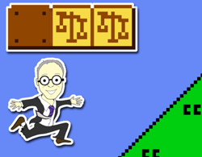
A.I. & Video-Games
VGBA North 2018
October 16, 2018
Vancouver, B.C.
Jon Festinger Q.C.
Centre for Digital Media
Allard Law of Law, UBC
Faculty in Residence, UBC EML
QMUL School of Law (CCLS)
Festinger Law & Strategy
http://videogamelaw.allard.ubc.ca/
Twitter: @jonfestinger
jon_festinger@thecdm.ca

Slide 2
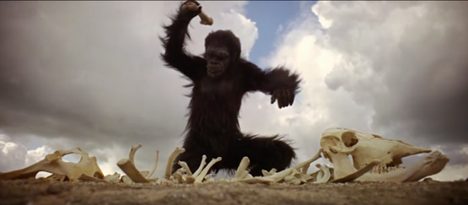
Prelude

Slide 3
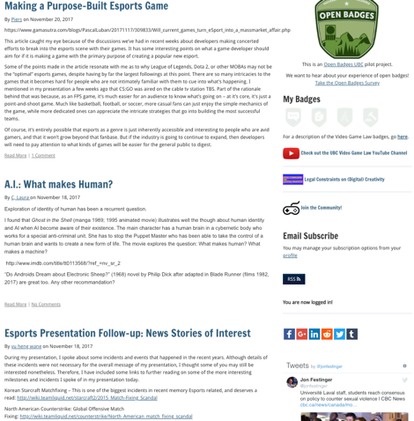
A simple question?

Slide 4


Slide 5
The importance of HORIZONTAL LAYERS
______________________

Slide 6
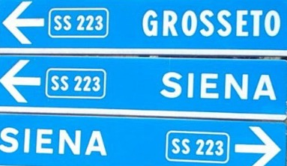
Abbreviated but NO short-cuts

Slide 7
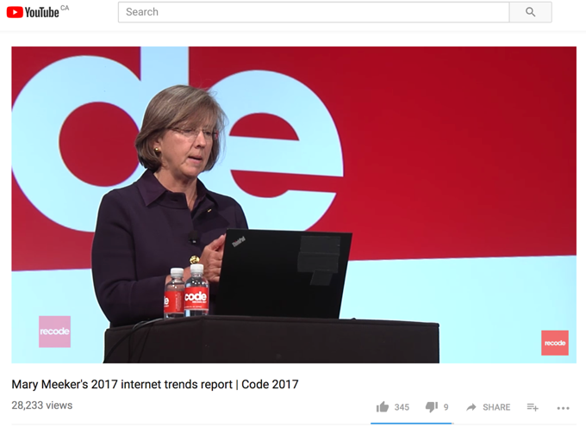
Video-Gaming Tech. Leadership

Slide 8
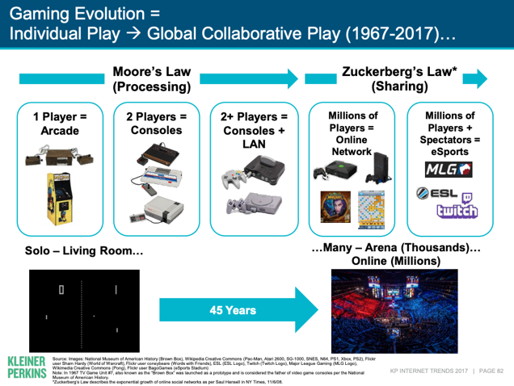

Slide 9
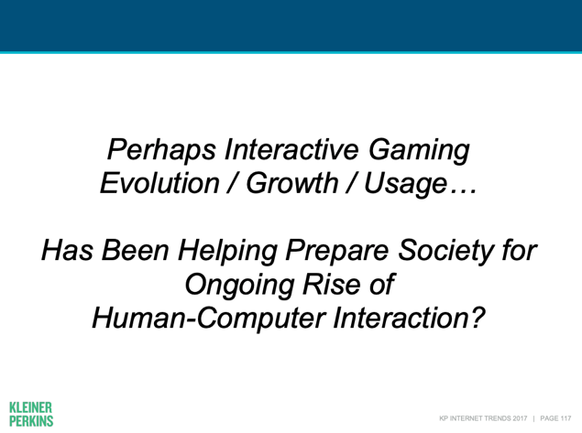

Slide 10
Video Game Leadership
Firsts & furthers, as well as barriers broken:
Interactivity (multiplayer “Spacewar”)
“Control”: mouse, controller, voice-command, Kinect, Google Glass
Augmented Reality
On-line “community”
Social (Media)
Voice Over IP
Open Worlds

Slide 11
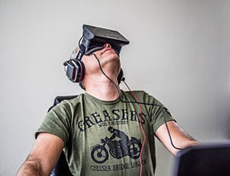
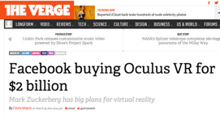
As well as…
Avatars (zeitgeist, memes, identity & equality)
3D
Portability (handhelds)
Micro-transactions
Game-Jams, now _____ Jams
AND VIRTUAL REALITY…

Slide 12
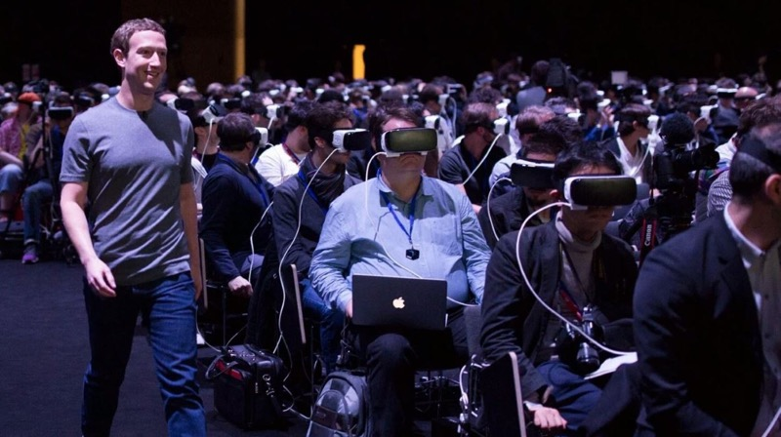
Technology is Structuralist
(For now? – For always?)

Slide 13
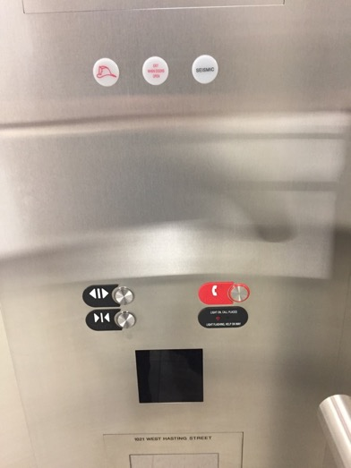

Slide 14
Post Structuralism is…
Decentralizing Author & Replacing Them With Reader
=
Decentralizing Developer & Replacing Them With Gamer

Slide 15

Breathe

Slide 16
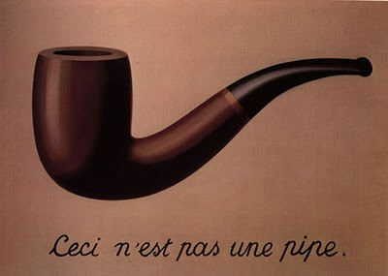
Rene Magritte

Slide 17
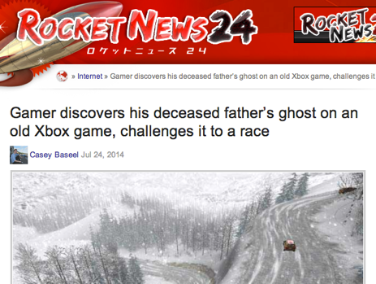
Narratives are post-Structuralist =
Content has Personal Meanings

Slide 18
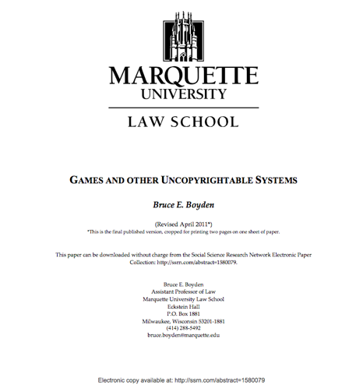
Gamer as creator of meaning: Boyden

Slide 19
“In all of these situations, the owners of a copyright in a form, description, or set of instructions were attempting to extend their copyright to material for which the user of the work provided the essential content, not its author. That is what made them systems. They were, without that input, empty shells, waiting to be filled.”
“Games are systems in exactly the same way. A game, as sold, is only a game form; the content necessary for an instance of the game comes from the players. That is, the game form establishes the environment for play—the game space—and it defines permissible moves and the conditions for winning or drawing. But the game itself is supplied by the players.”
“Systems are shells into which users pour meaning. While they may contain expression themselves, that expression is there merely to facilitate the meaning added by the user.”

Slide 20
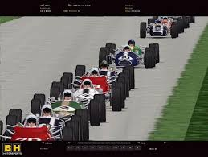
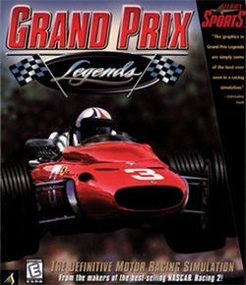
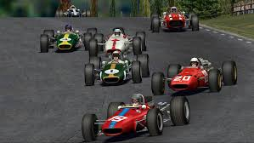
Mods are similer...

Slide 21






When you look at a video game it is not
about what the developer intended…
it’s about what the player does…

Slide 22
The point…
Copyright law does adequately accommodate the real world collaborations between “creators” and others (users/collaborators) in today’s digital world.
→←

Slide 23
Virtual Reality 3.0
(Actual or Metaphoric)

Slide 24
What if a gaming algorithm knew…
My favorite type of game (racing)
My favorite mediums, shows, movies
My Netflix & social media history
My decision-making patterns (through video-games)
Everything I’ve ever done or said on the web
My favorite stars (Anna Kendrick + “young” John Cusack)
My favorite plot trope (time travel that teaches life lessons)
Plot points, dialogue, and other things that I laugh at
Plot points, dialogue and other things that I cry at
Favorite music (Springsteen, The Clash)
My personality profile (in detail)
My personal history & biographical details (Dad passed of cancer; mom of Alzheimer’s; Parents both Holocaust survivors from Poland)
& pretty well everything else about me.

Slide 25
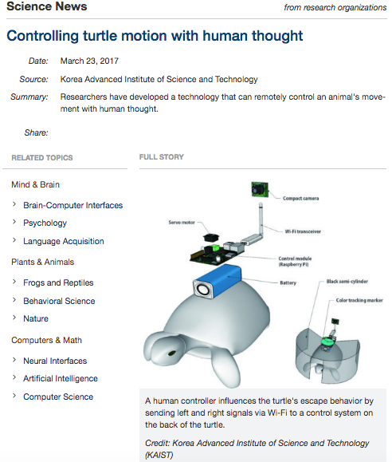

Slide 26

Video-Game Storytelling uniquely tailored to me: At the extreme an algorithmically directed “Jumanji”

Slide 27
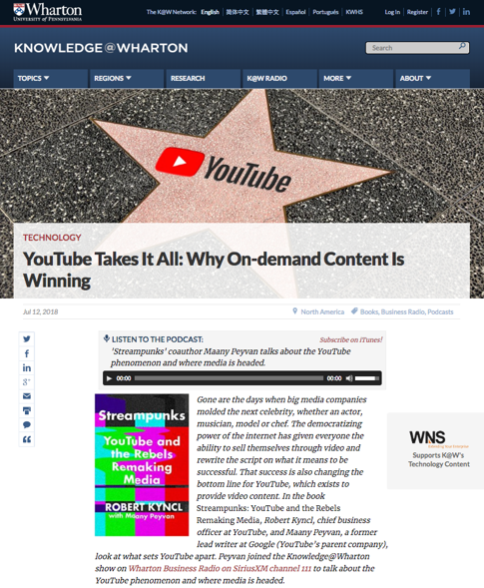

Slide 28
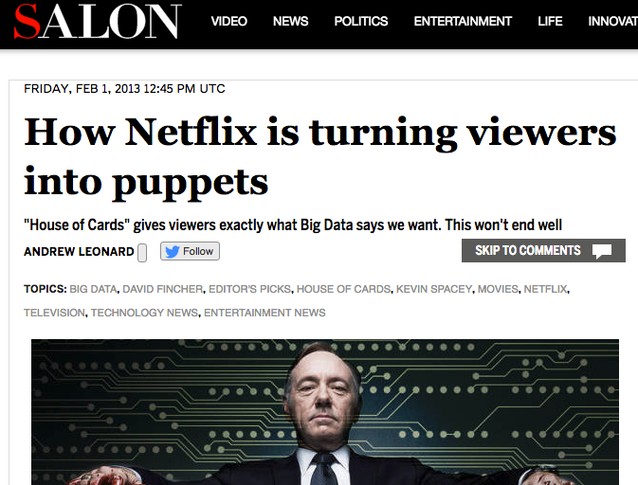

Slide 29
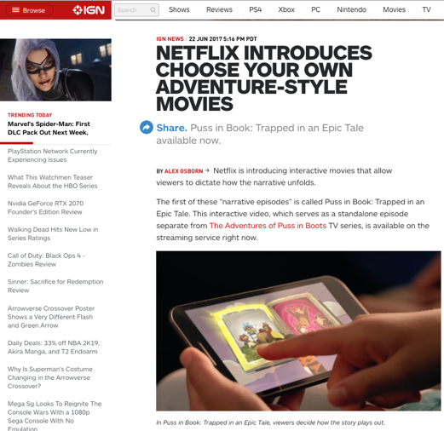

Slide 30
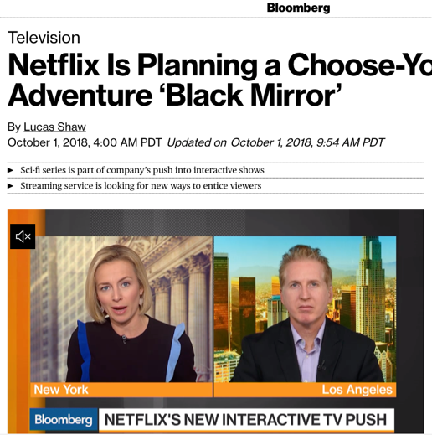

Slide 31
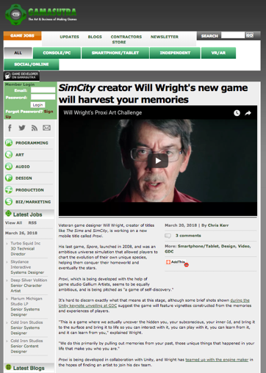
Where personal content is created…

Slide 32
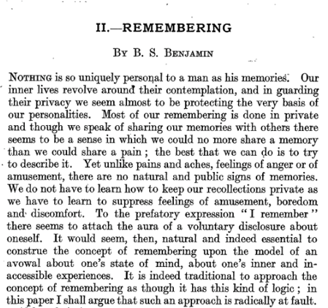
Memory as personal knowledge not personal awareness…
Mind, Volume 65, Issue 1, 1 January 1956, Pages 312–331

Slide 33
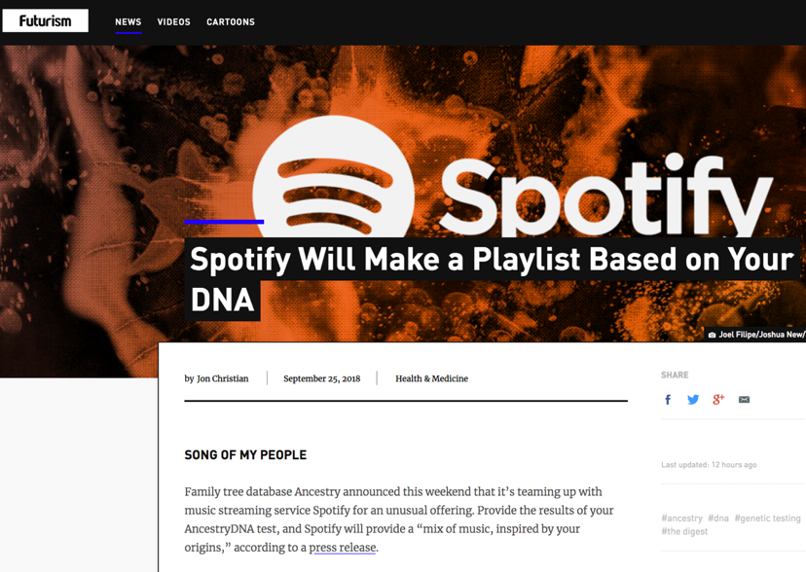

Slide 34
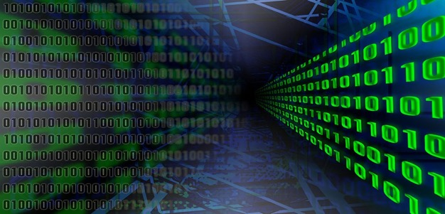
More than ever we (through our data) are simultaneously both AUDIENCE & CO-CREATOR

Slide 35
Dystopic Dystopic
Dystopic
When human respect is disintegrating,
This is whole crazy world is too frustrating.
And you tell me over and over and over again my friend,
Ah, You don’t believe we’re on the eve of destruction.
Barry McGuire – “Eve of Destruction”

Slide 36
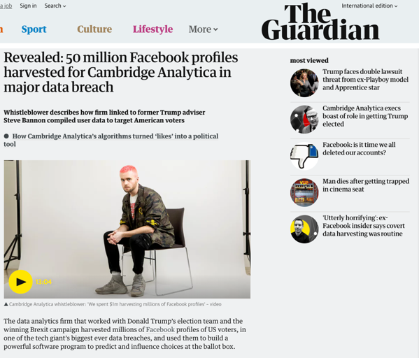

Slide 37
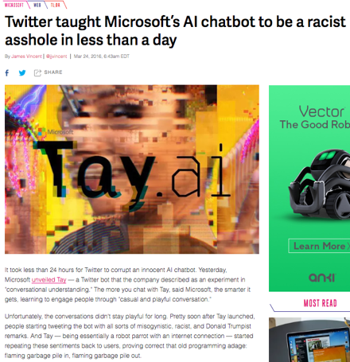
Intelligence that truly is artificial…

Slide 38
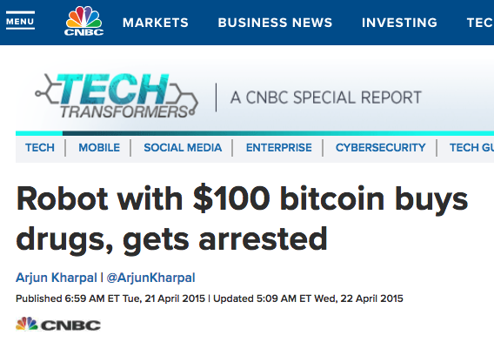

Slide 39
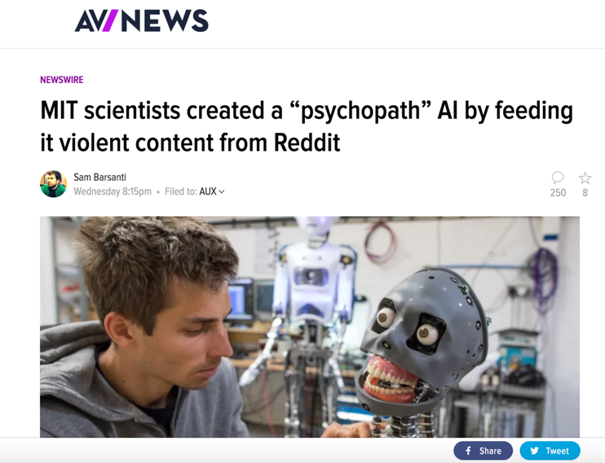

Slide 40
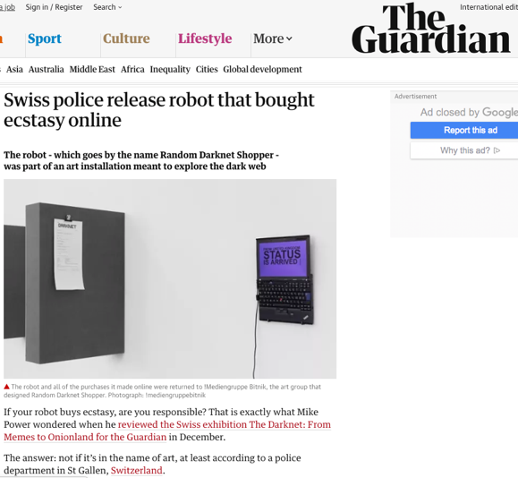

Slide 41
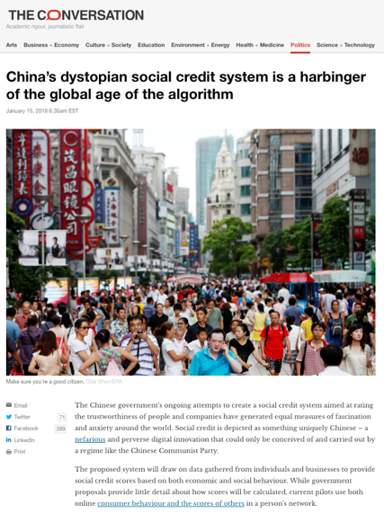

Slide 42
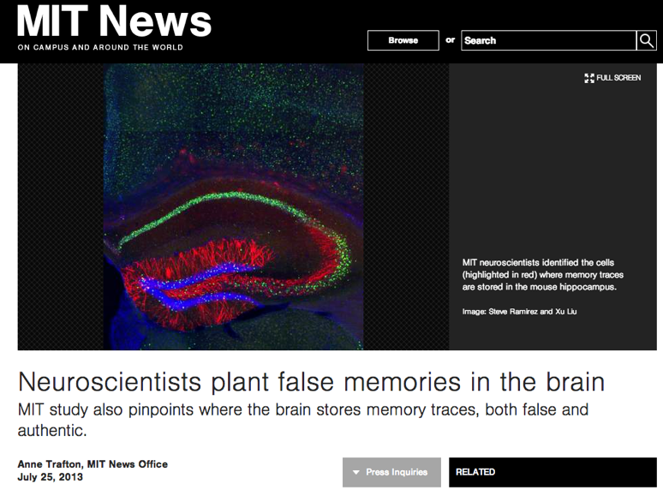
http://newsoffice.mit.edu/2013/neuroscientists-plant-false-memories-in-the-brain-0725

Slide 43
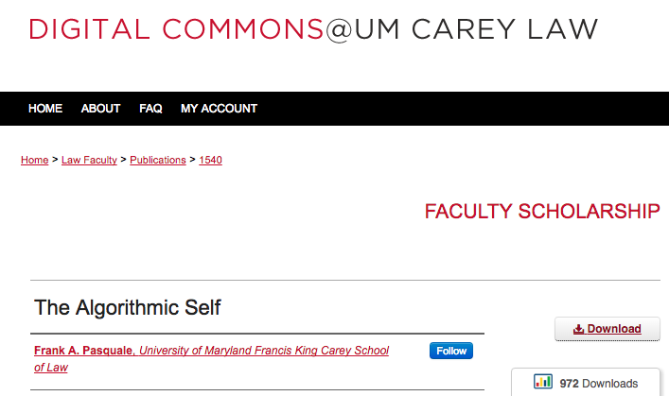
“…there is a delicate balance between appropriating new technologies and being appropriated by them.”

Slide 44
Human Agency as Freedom of Thought
The law should intervene where data was obtained from an individual without fully informed consent, and that individual’s freedom of thought is impacted causing a substantial risk of harm.
Freedom of thought to be defined in terms of personal autonomy and human dignity, not just to make choices, but to make creative choices on ones own terms creating one’s own meanings [very post-structural].

Slide 45
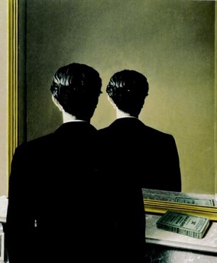
Post-Structuralism encourages/reinforces/represents the value of human agency, choice & creativity.
Rene Magritte
“Not to be
Reproduced”
1937

Slide 46
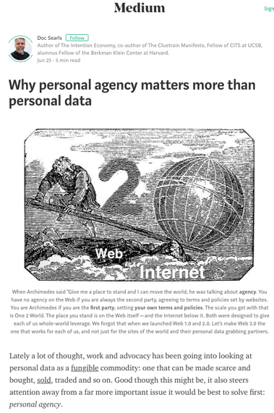

Slide 47
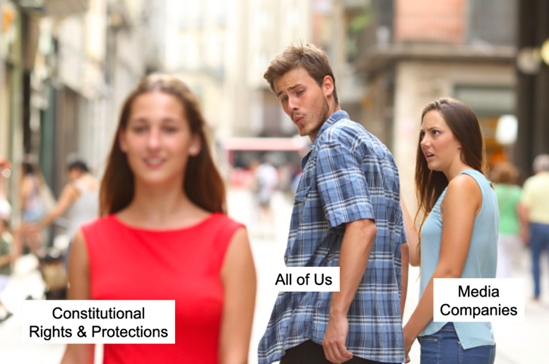
Lots of problems, not least of which…

Slide 48
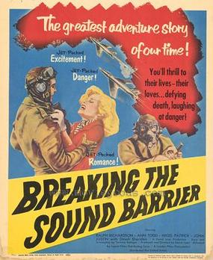
Now the surprise…

Slide 49
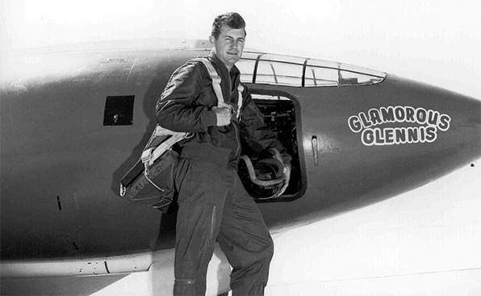
Be skeptical: what actually happened…

Slide 50
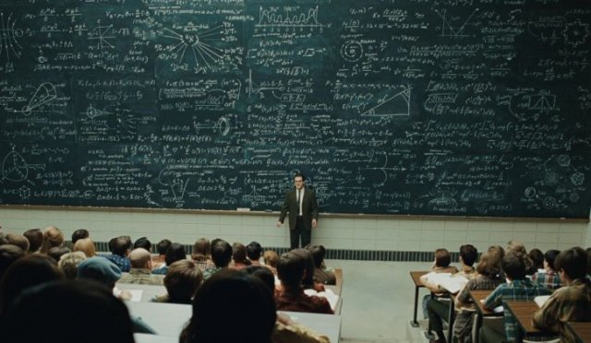
Theory please?…

Slide 51
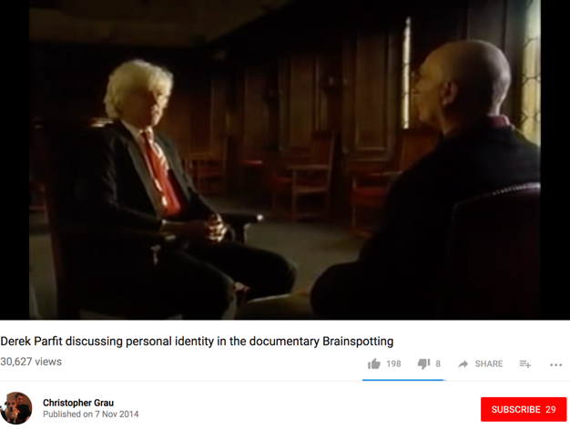
The Deepest Problem (& partial solution?):
Algorithmic you is not YOU

Slide 52
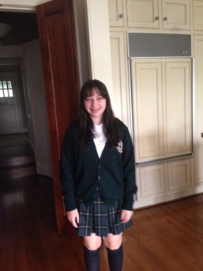
The wisdom of 16 year olds…
“Basically I just think the ‘person’ we show to be ourselves on social media is only a part of who we are - it is our best, and sometimes most superficial parts. Therefore the algorithmic thing won't actually show us what we truly want to see.”

Slide 53
“Algorithms are at best a snapshot of today and maybe even more dangerous, a look through the rear view mirror of what is familiar. Algorithms can’t predict future trends.”
Ivan Fecan (Former CEO, Bell Globemedia)

Slide 54
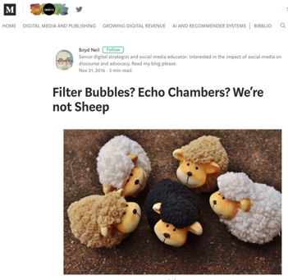
The “paradox” of algorithmically filtered big data influencing each of us is that it tends to demonstrate our individuality and complexity rather than disproving it.

Slide 55
Put another way…
A.I., being based on algorithms, can’t account for extraneous inputs, what’s interesting, meaningful, or magical. They are the opposite of human agency and have virtually no hope of emulating it, much less improving on it.

Slide 56
=
Good news: We can’t be replaced by non-us.
Bad News: We can only manipulated by others.

Slide 57

So again…WE are indeed “co-creators”…

Slide 58

A Possible Conclusion
CO-AUTHORSHIP
RIGHTS WHEN OUR
PERSONAL DATA
IS USED*.
*Seemingly compatible with the various theories
of copyright: Utilitarianism; Labor Theory;
Personality Theory; and Social Planning Theory

Slide 59

Because BIG DATA

Slide 60
Because Artificial Intelligence (A.I.)

Slide 61
Because Machine Learning

Slide 62
Because Virtual/Augmented Reality

Slide 63
“Perhaps interactive gaming evolution/growth/usage with related data collection/analytics/real-time simulations and engagement has been helping prepare society for the ongoing rise of human - computer interaction?”
Mary Meeker - 2017 Kleiner Perkins Internet Trends report
Answers (?):
“Equally strange is our general addiction to games, both physical and mental. The profusion of games is truly startling: card games, board games, word games, ball games, electronic games….We even assemble in huge crowds to watch others playing games. What does all this mean? Do we simply get easily bored and cannot tolerate inactivity? I can find nothing in the literature of scientific psychology that helps me to understand such bizarre behavior.”
Leon Festinger in the Introduction to his final book “The Human Legacy”, Columbia University Press, 1983.

Slide 64
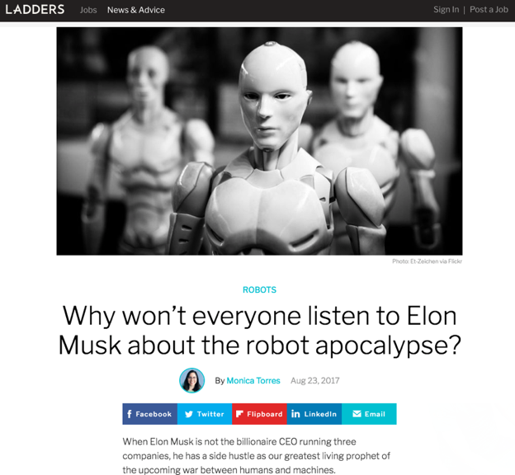

Slide 65
Rather could it be that…
A.I. technology can increasingly individuate us and the rights we individuals have or should have, especially to protect and enhance our human agency, including privacy, freedom of thought, copyright including Fair Use & “user’s rights”, freedom of expression, as well as contract law considerations including consumer protections.

Slide 66
Could A.I. actually be a
post-structuralist technology?
one that
encourages/reinforces/represents
the value of
human agency, individualism,
choice, & creativity?????

Slide 67
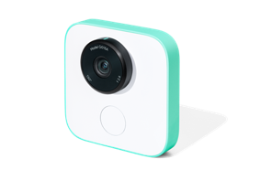
From A.I. as oppressor
To A.I. as tool of individuated liberation*
*Note both states can co-exist at the same time

Slide 68
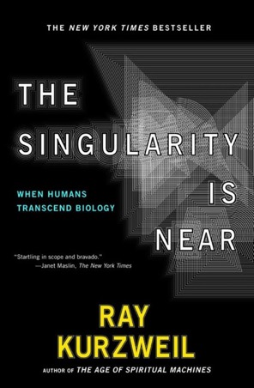
Not…

Slide 69

It’s the narrative that will evolve through the tools – & we will grow with the narrative

Slide 70
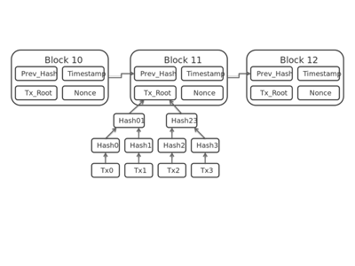
Still…
We likely must emphasize & empower more, better, and increasingly authentic modalities of human communication (peer to peer).
Less so the vertical ones (network to peer).
Blockchain as a solution?

Slide 71
The importance of HORIZONTAL LAYERS
______________________

Slide 72

Tailored to individual wants, needs, and circumstances → all about personal choices & personal control

Slide 73
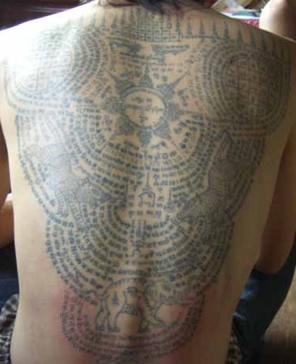
Tattoos

Slide 74

Pause

Slide 75
A.I. →
Everything is Personal

Slide 76
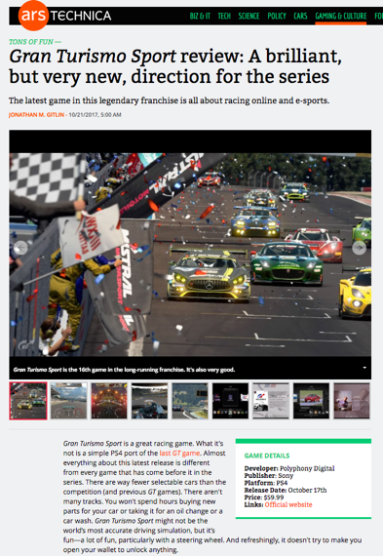
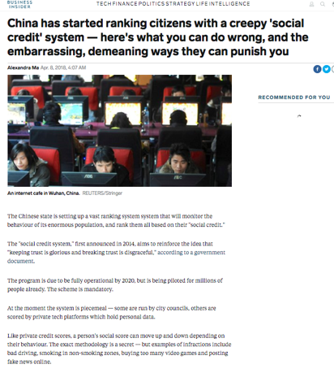

Slide 77
Pause

Slide 78




Questions to Think About:
1. How can A.I. serve
the uniquely personal?

Slide 79


Slide 80

Beware:
Diminishing Equality Before the Law
Article 7. All are equal before the law and are entitled
without any discrimination to equal protection of the law.
All are entitled to equal protection against any discrimination in violation of this Declaration and
against any incitement to such discrimination.

Slide 81




Questions to Think About:
2. How can A.I. help build horizontal layers of contact, communication, & compassion?

Slide 82
The importance of HORIZONTAL LAYERS
______________________

Slide 83

From Dr. Tyler R. Black’s slides yesterday

Slide 84




Slide 85

Final point about A.I. & video-games

Slide 86


A MATTER OF PERSPECTIVE

Slide 87


Slide 88
In learning you will teach
And in teaching you will learn
Phil Collins' Son of Man (1999)

Slide 89


Slide 90

Always include a cat picture

Slide 91
Our Academic Partners

